Slide 1
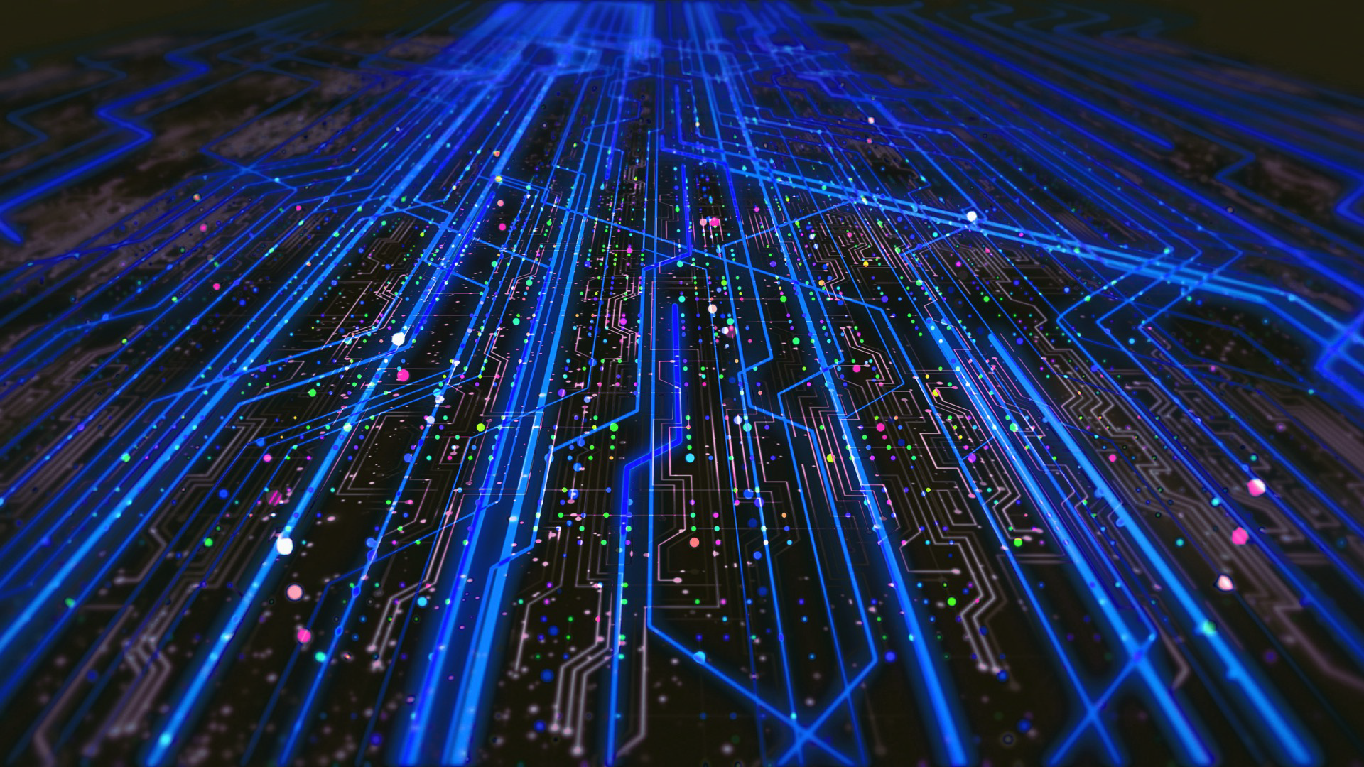

The Spoke 2 - FUNDAMENTAL RESEARCH & SPACE ECONOMY
Daniele Bonacorsi (UNIBO)
Tommaso Boccali (INFN – PI)
ISGC 2024

Slide 2
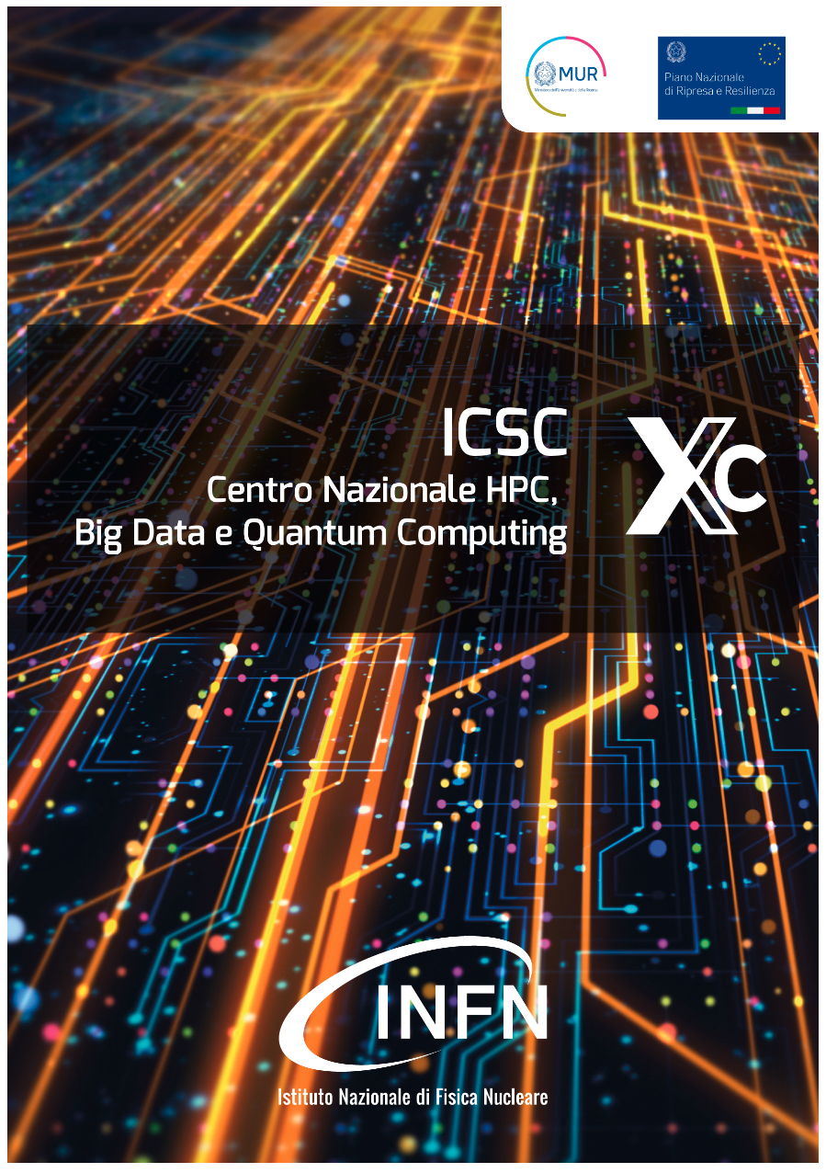
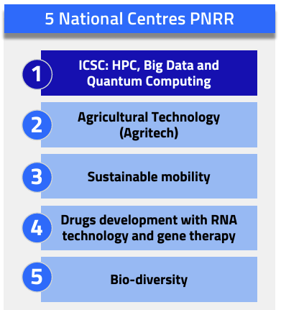
The National Center for HPC, Big Data and Quantum Computing
Italy has funded, with NRRP (pandemic recovery) funds, 5 large National Centers, for a total of 1.6 Beur over 3 years
One of them, coordinated by INFN, focuses on modern IT technologies, with the final goal to deploy a long-term (>>3 years) distributed infrastructure available to the reseach and the industrial ecosystems in Italy
Sept 2022 to Aug 2025

Slide 3
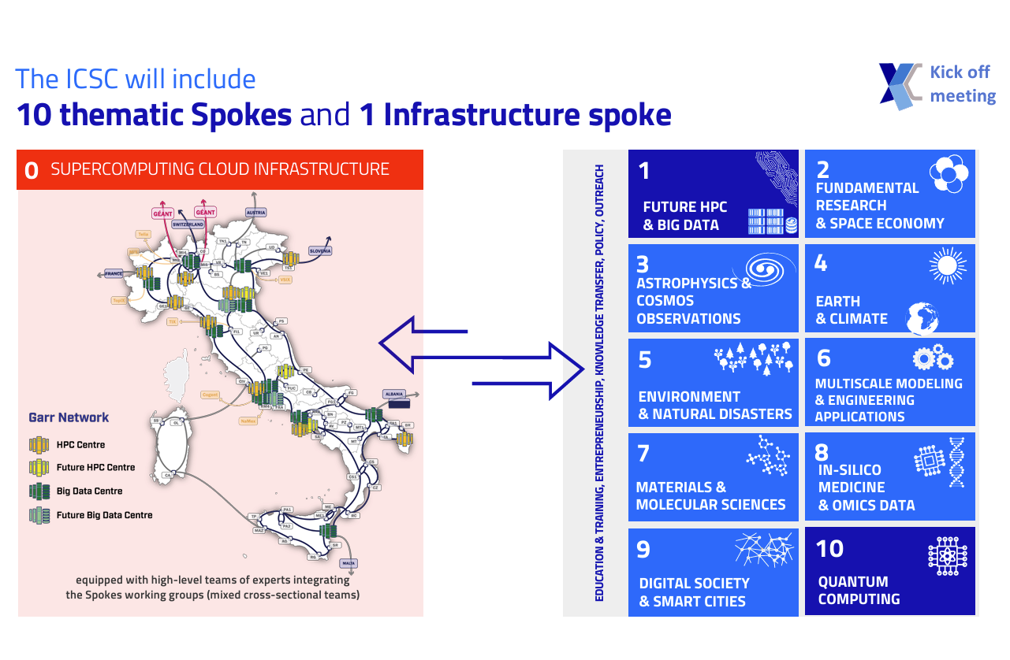
One “Spoke” dedicated to building the infrastructure (hw+middleware) (Spoke 0)
Ten thematic Spokes, one dedicated to the High Energy Physics and Astroparticle research domains

Slide 4
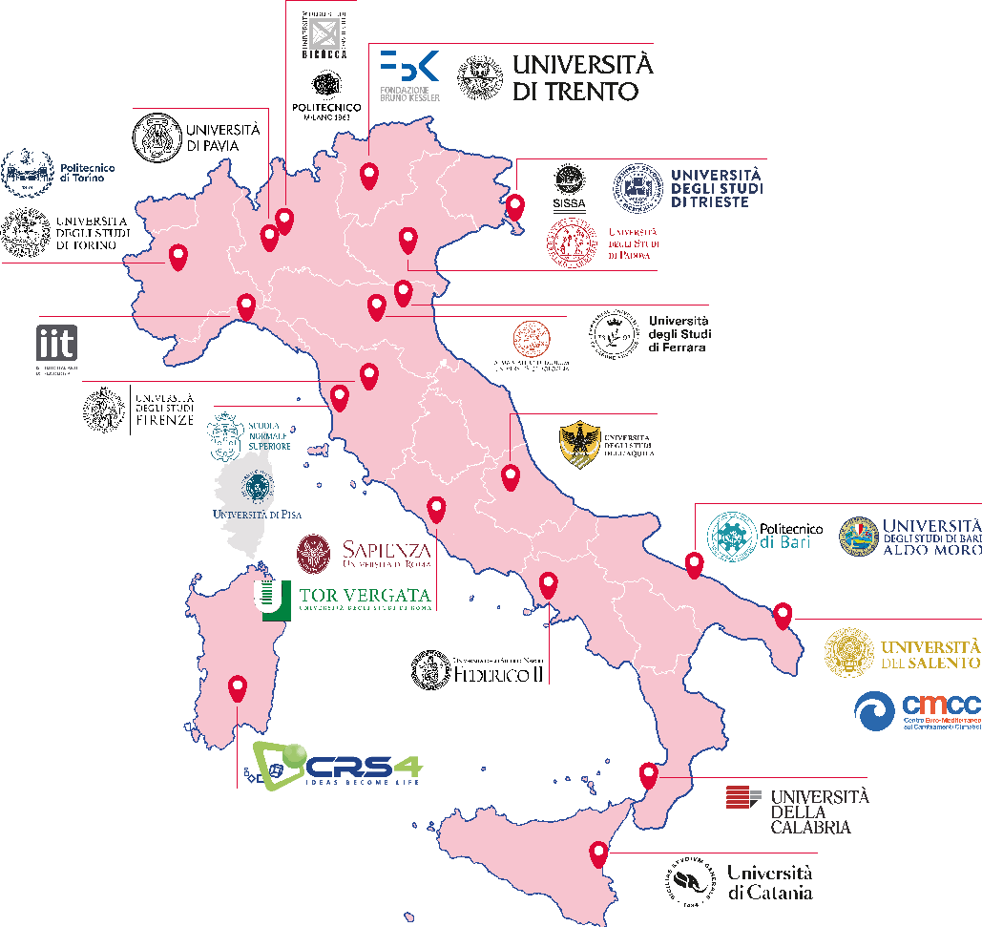

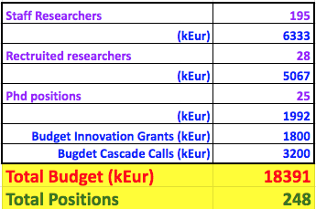

Slide 5
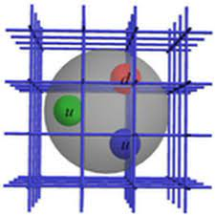
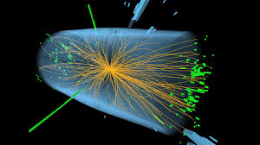
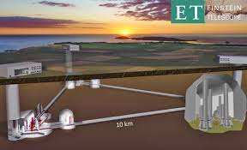
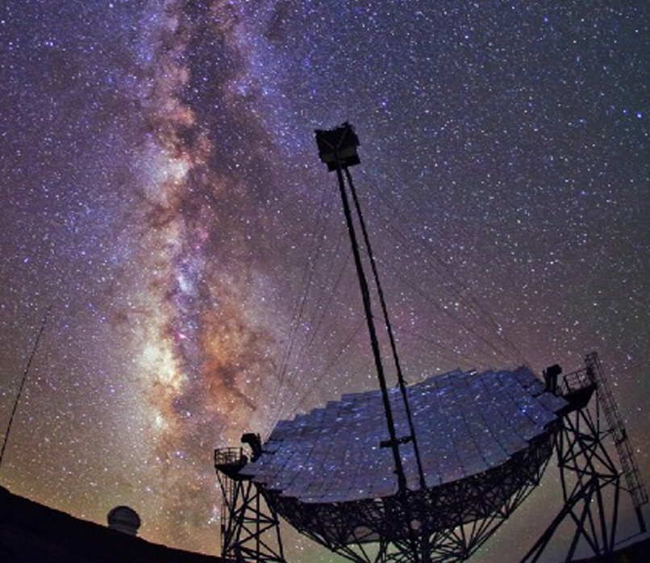
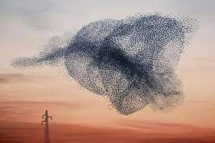
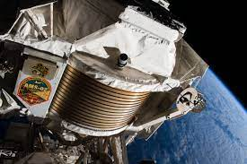
Who are “we”?
5

Slide 6
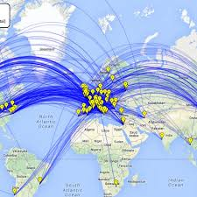
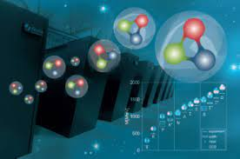
Why our communities need an ICSC
The Worldwide LHC Computing GRID
Since at least 2 decades, research at the fundamental frontier is heavily “computing bound”
Latest (and next) generation experiments collect data at the Exabyte and beyond
Simulation efforts in theoretical and experimental physics are at the Exascale
We have been forced to develop in-house solutions when nothing was available, with a good success. But it is now due time to evolve to a shared infrastructure model
The Web, the GRID, …
Examples:
LHC has has already surpassed the global scale of several Exabytes of Data, and more than 1 Million CPU cores
Lattice QCD simulations are, with Meteo, the main driver and benchmark for HPC systems
Lattice QCD on HPC

Slide 7
Why our communities need an ICSC #2
Access to world class facilities (up to know possible in INFN only for TH physics)
Leonardo, LISA, Galileo
Links with entities we normally do no collaborate with
Industries, different scientific domanins, …
Funds for systems beyond those we are generally allowed to acquire (the famous “pledges”):
GPU equipped machines
FPGAs and in gemneral specia architectures
”large machines” with lots of cores and fast disks
Small HPC systems (~10 nodes with fast interconenction)

Slide 8
Work Packages – the structure
“technological” WPs: they harvest / investigate technical solutions in computing, on the infrastructure of the ICSC and beyond, and provide support / training for these; at the same time propose these to a larger audience, including industries
We structured the work via 2 types of Work Packages:
“scientific” WPs: they analyze the needs of the (sub-)domain, and pose open problems for which advanced computing solutions are needed
Has a need; searches for a solution
WP1/2/3
WP4/5/6
Has a technology; searches for a test use case

Slide 9

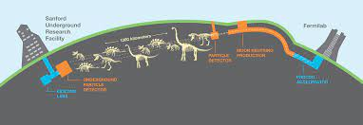
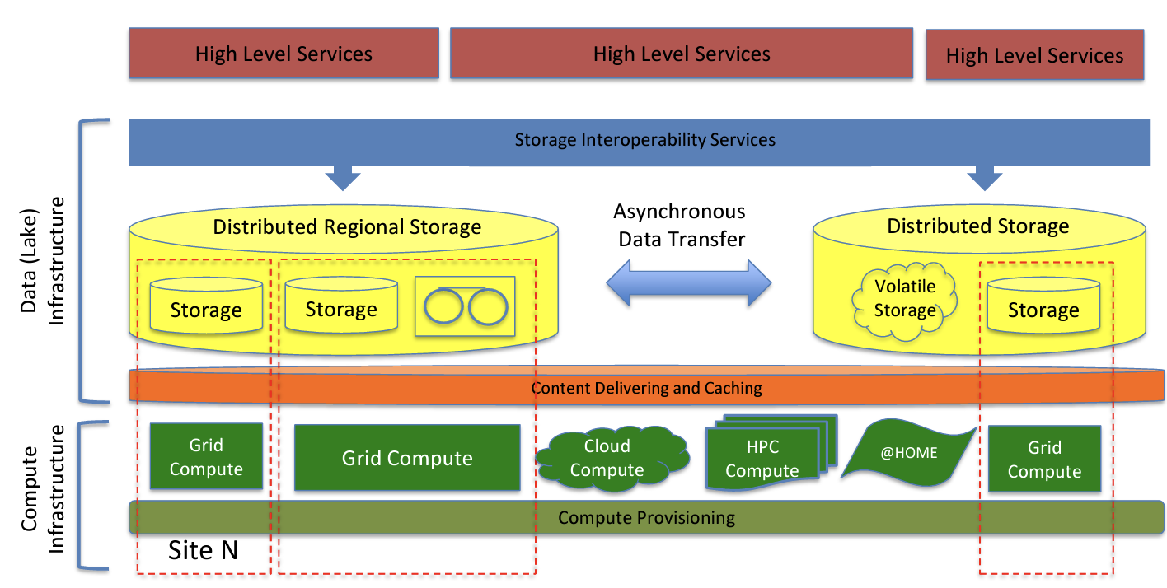

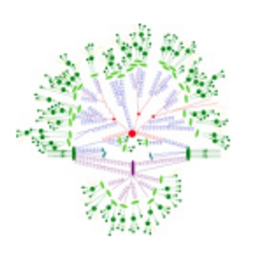
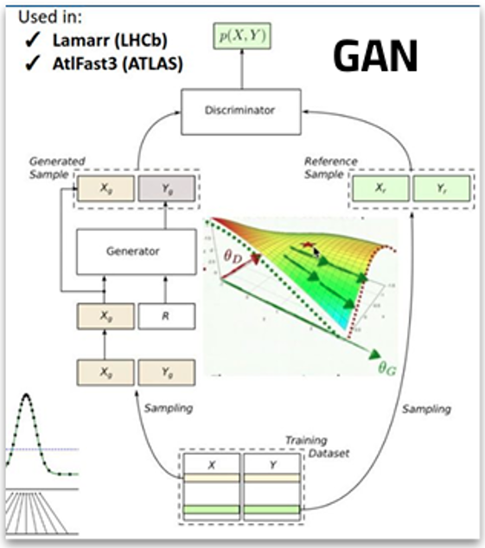
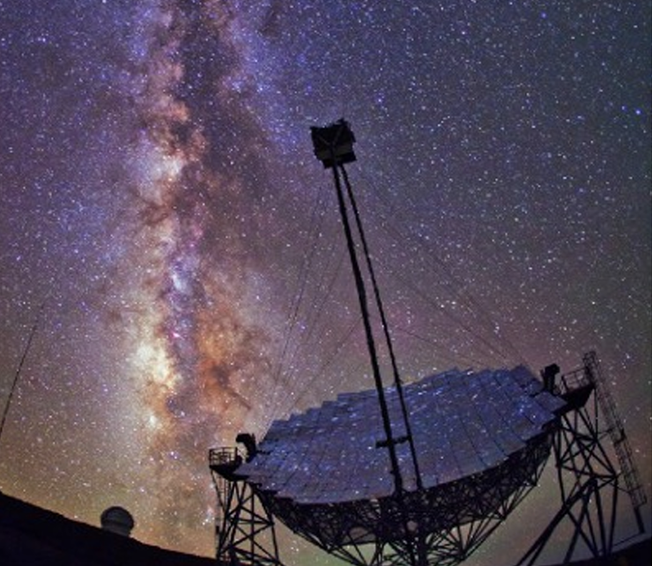

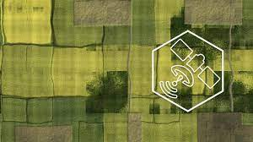
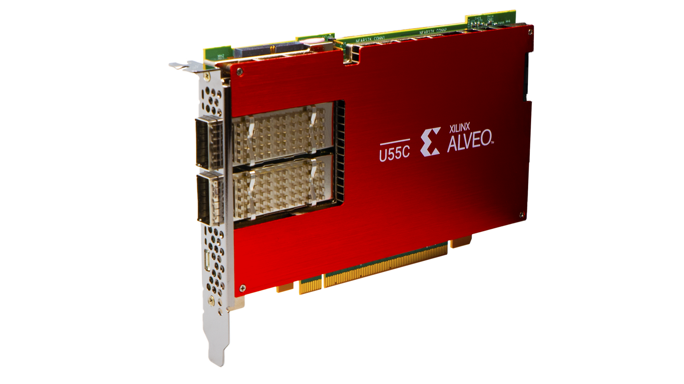
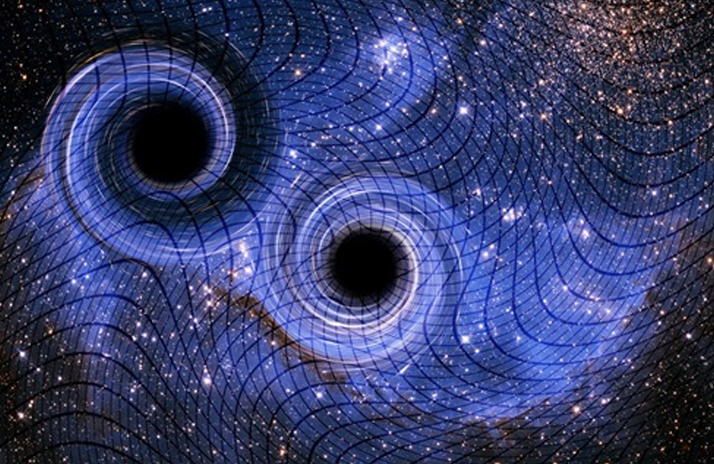


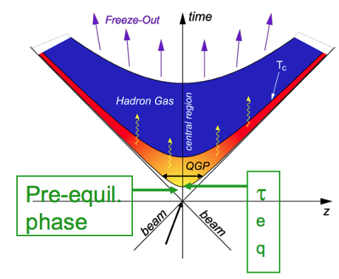

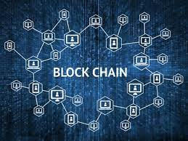
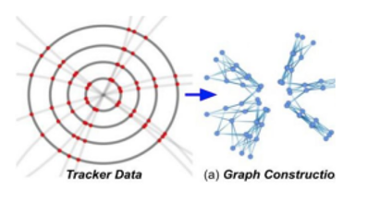
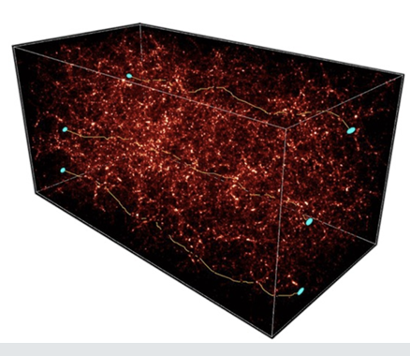

Work Package Structure
WP1: tools and algorithms for Theoretical Physics
WP2: tools and algorithms for Experimental Collider Physics
WP3: tools and algorithms for Experimental Astroparticle Physics and Gravitational waves
WP4: tools for porting / optimization on new architectures (low power, GPU, FPGA, …)
WP5: data management on the distributed CN infrastructure
WP6: cross domain initiatives, + space economy

Slide 10
The technologies in place (a 1 km view) …
Software:
Machine Learning as a substitute for hand-written algorithms
Porting of codes to
GPU systems, with heterogeneous frameworks
FPGA systems, with HLS or direct programming
Low power Architectures (ARM today, possibly RISC-V)
Adapting codes to
Distributed computing (”datalake compatible”)
Generic data management, data access
Conteinerization, …
Single node to Multinode (MPI, …)
Hardware
deploy generally accessible pilots with FPGA
Deploy generally accessible pilots with ARM and RISC-V
Deploys clusters accessible via cloud technologies, and managed via central data management systems

Slide 11
How do we operate?
Scientific use cases: research that is impossible today, due to the scarcity / absence of resources (human, but more importantly technological)
Among these, 19 “Flagship Projects” are especially selected as represetatives of categories of use cases
Innovation Funds:
12 projects industry / academia to “test” our solutions with ICSC industries
Open Calls:
14 objectives to involve more universities / SME
13 MEur
2 MEur 3 MEur

Slide 12
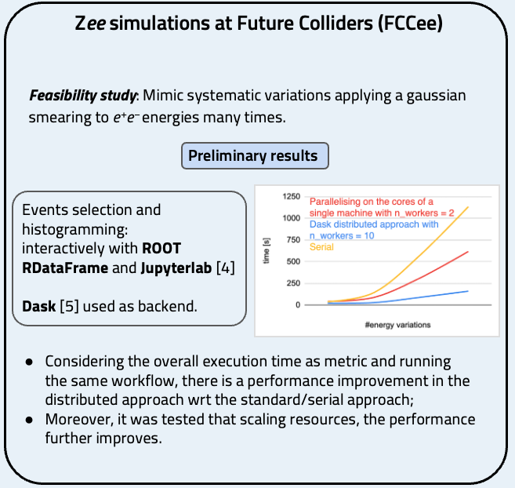
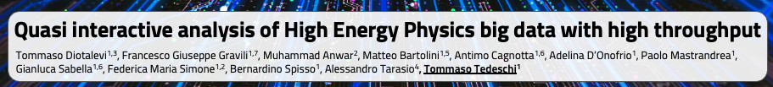
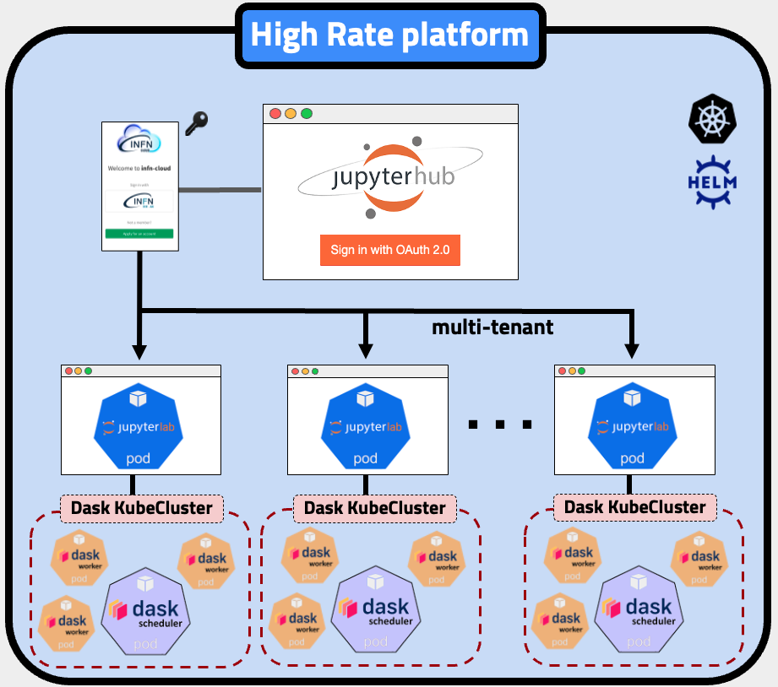

Flagship use cases: a few examples
Demonstrate the capability to process large amounts of data (GB-TB-PB) via a Cloud infrastructure extendable to 1-100-10000s nodes.
Tested on High Energy Physics Samples, but data-agnostic – even for sensitive data (using an industry-grade Authorization and Authentication Infrastructure)
Will be eventually provided as a service in the ICSC Datalake.

Slide 13
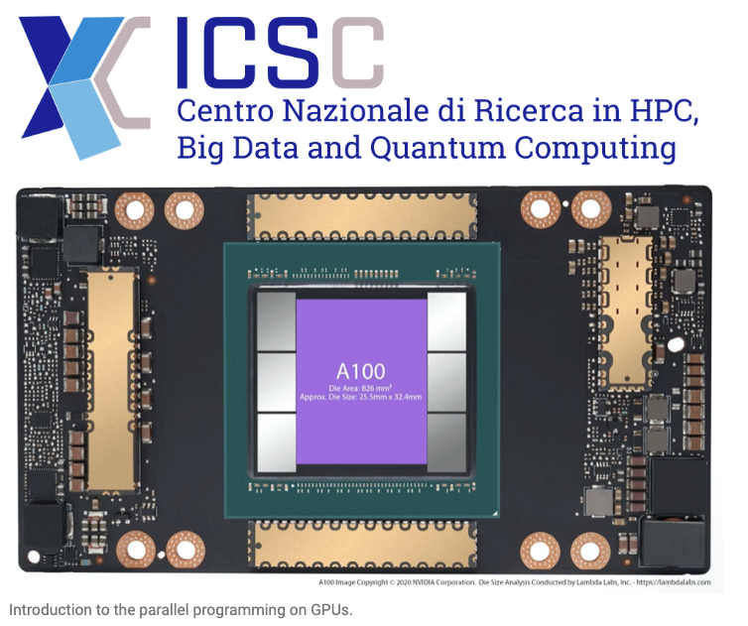
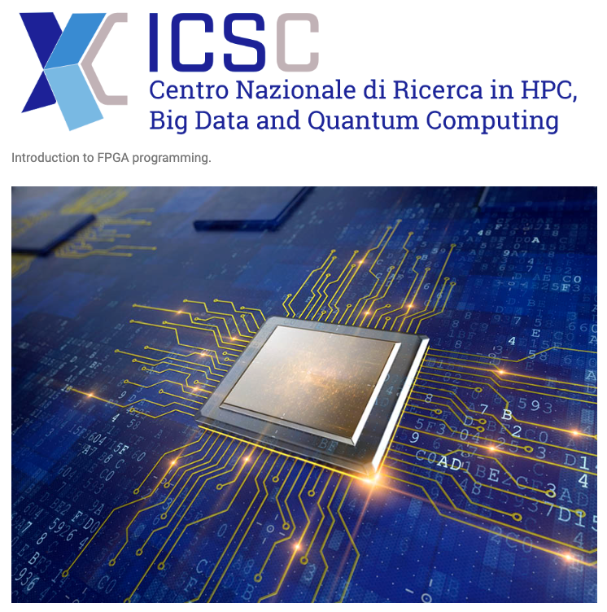
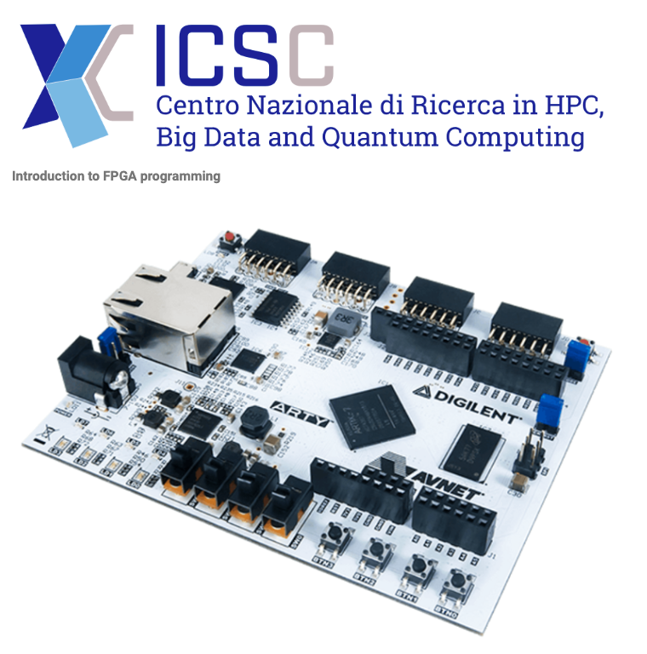
Boosting the Computational performance
High processing capabilities from single nodes: providing ICSC users with resources and training to use
GPU Programming (explicit / via programming frameworks)
FPGA Programming (direct / via ML tools)
Aiming at Spoke 2 use cases, but easily extended to other use cases from industry and research (click on the pictures to access full course information)
Now planning a Spoke2 + Spoke 3 FPGA initiative. Resources made available from INFN/CNAF, CINECA; later also by TeRABIT and ICSC

Slide 14
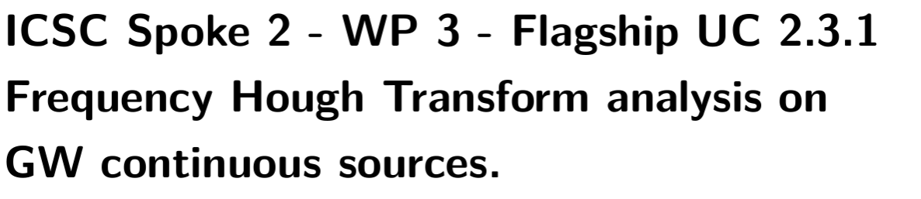
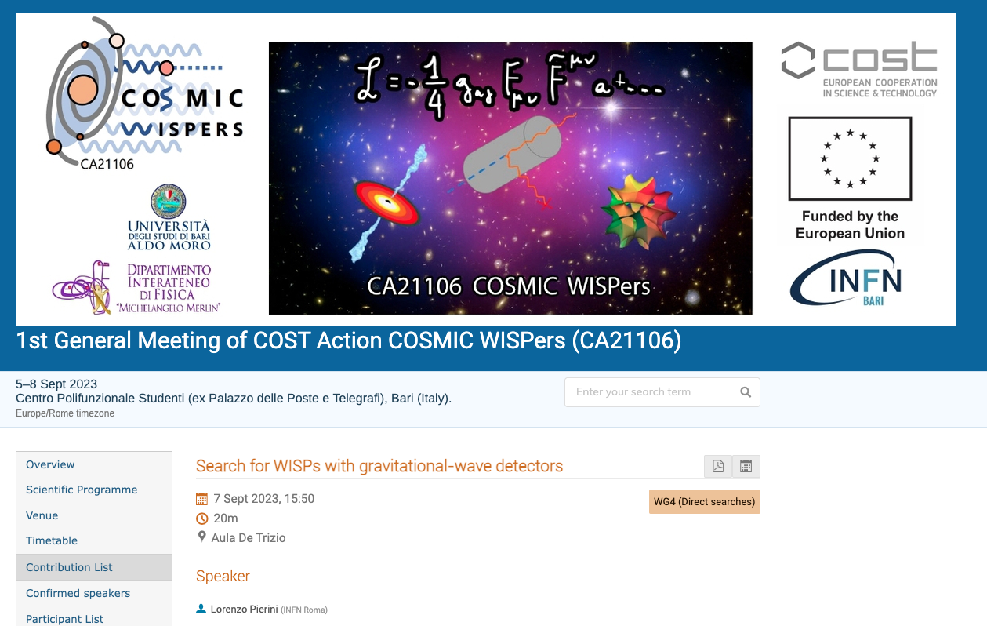
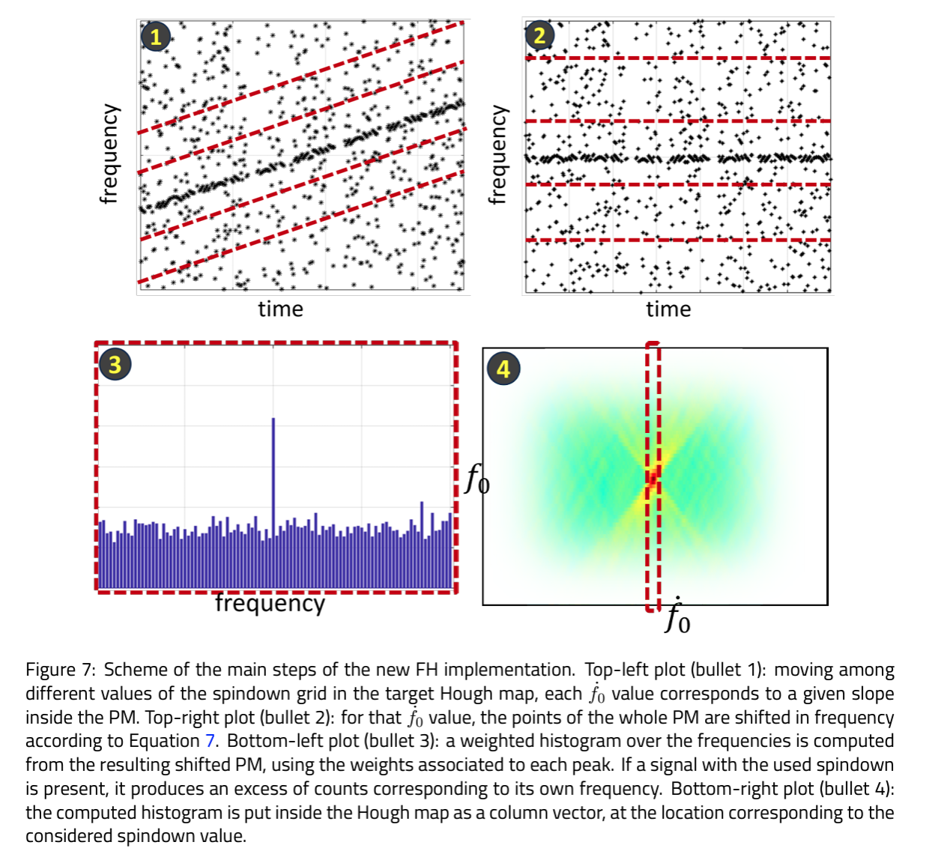
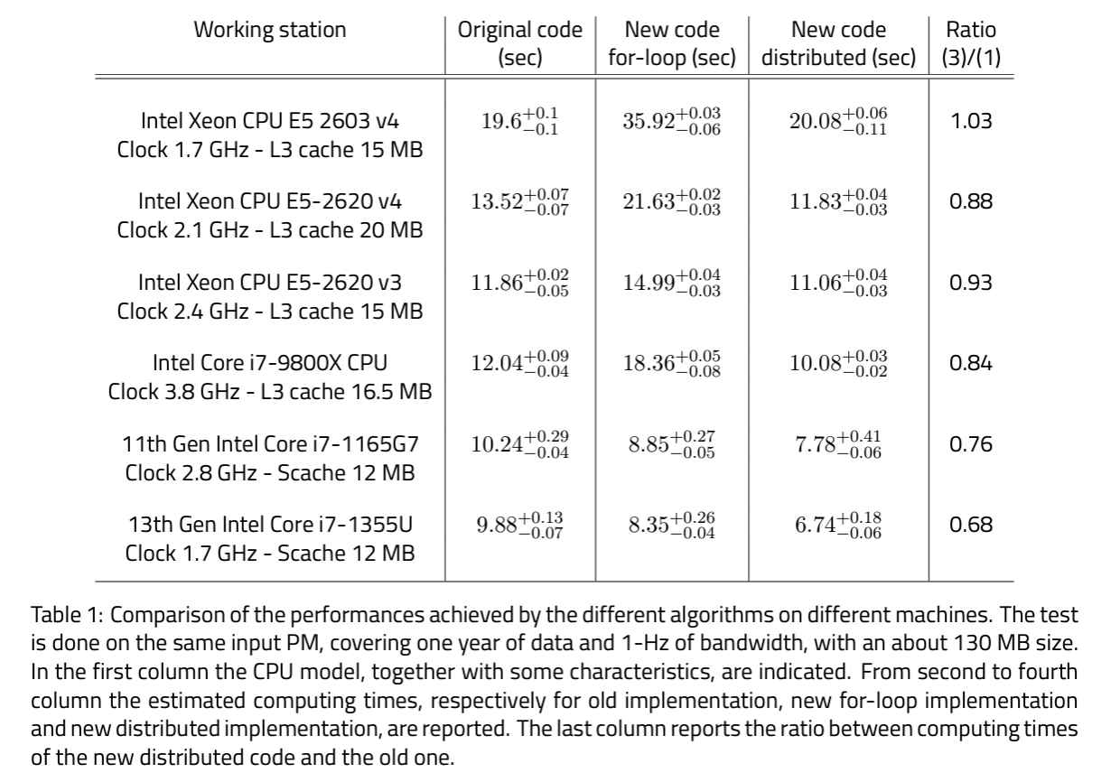
As Gravitational Waves datasets grow in size, the use of datacenter-sized resources become inevitable. A Spoke 2 flagship use case is devoted to a specific search of continuous GWs (CWs), which are expected to be emitted typically by rotating neutron stars, but they could also be the signature of the existence of weakly interacting sub-eV darkmatter.
The Hough Transform can be used to spot the predicted patterns from the spin-down in the (frequency, time) plane.
The new approach has been tested on various architectures, and is ready for mass deployment.

Slide 15
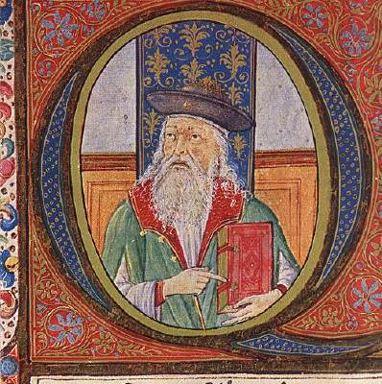
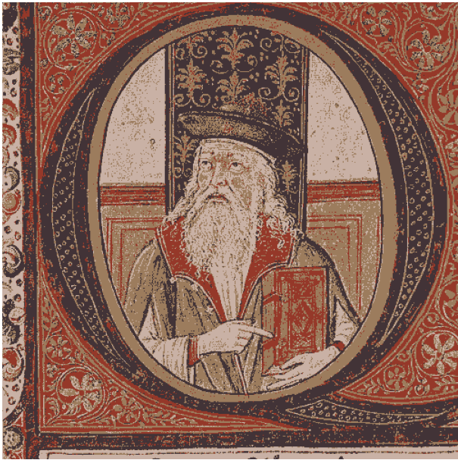
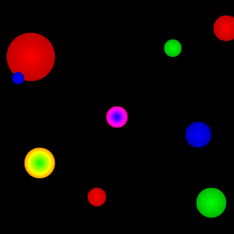
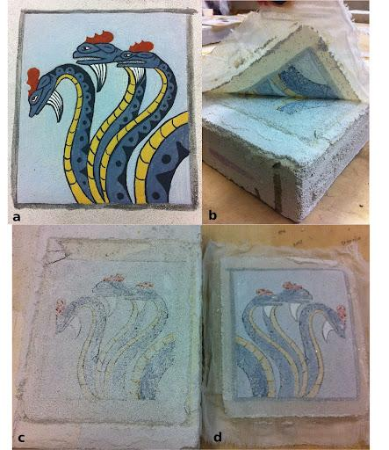
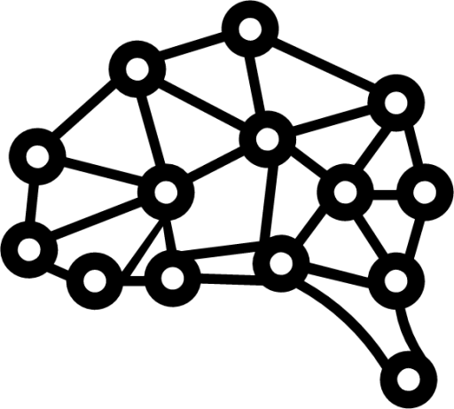
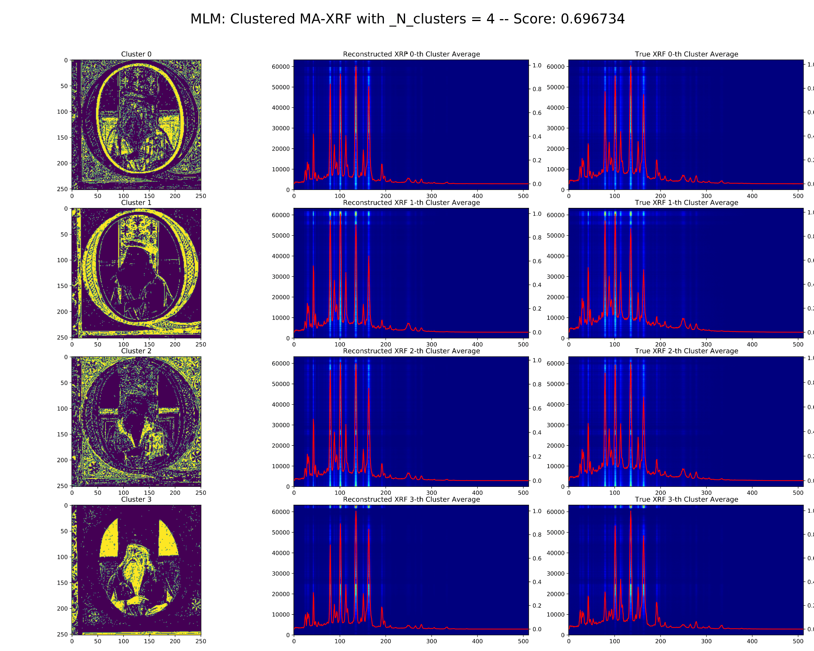
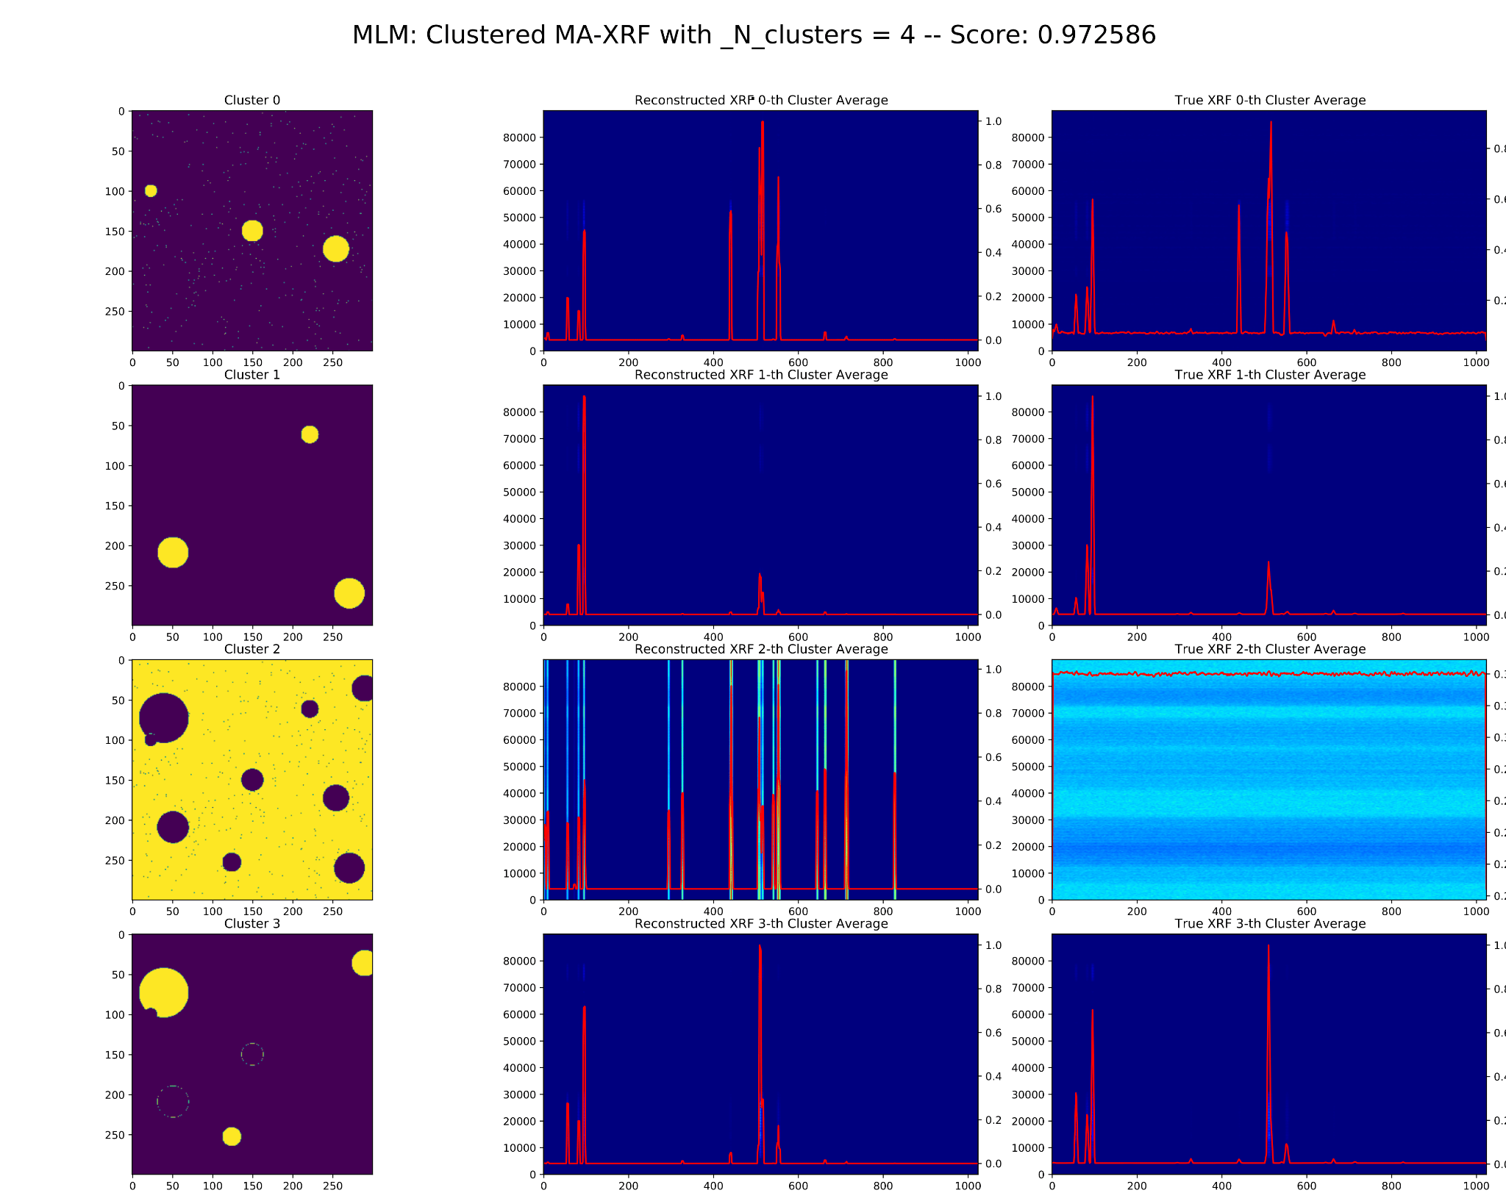
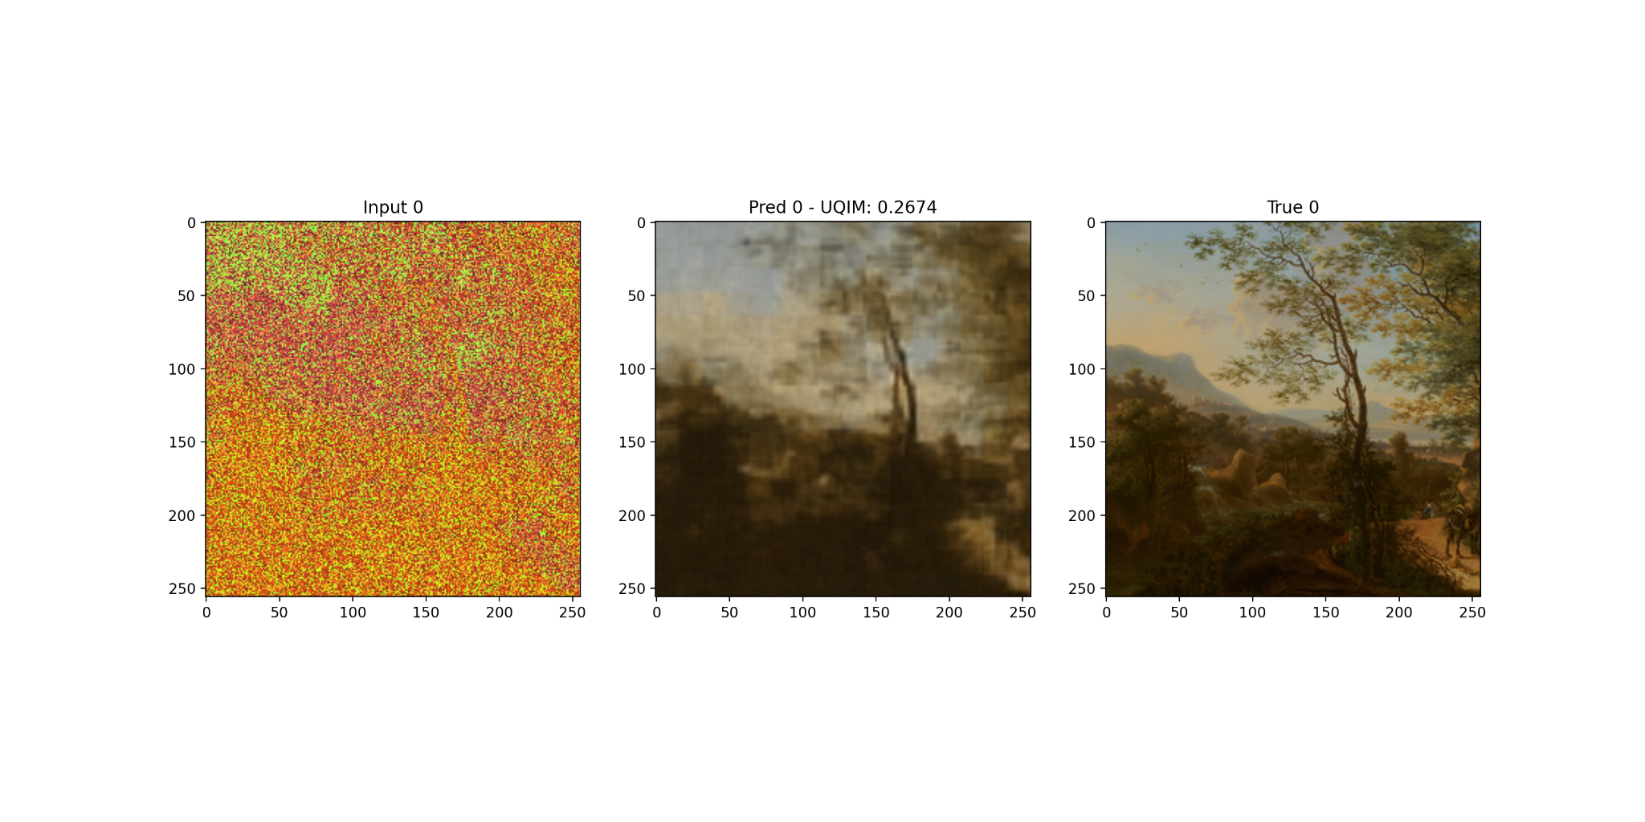
From stars to frescos: extended spectral computer vision
Datacube segmentation via Deep Spectral Clustering: adding a 3rd dimension to images.
First application to Synthetic Astrophysical Datacubes, obtained from images with HII, planetary nebulae and Shock regions, including synthetical nebular optical spectra.
Extended to pairings and frescos with embedded spectral measurements
Synthetic Astronomical Image
Original
Decoded
Digital restoration of frescos and paintings (in progress)
Miniature contained in the Codex Heroica by Phoilostratus, illuminated by the Florentine painter Attavante degli Attavanti
HII
planetary nebulae
shock regions
residual
detachment
Clustering through embedded spectra
Test on several DNN Train on multiple synthetic dataset.
architectures
Input
Predicted
Original

Slide 16
Innovation Grants
Fraud detection on financial data streams (for example, the flux of credit card requests)
Use anomaly detection techniques a-la LHC implemented on classical or quantum systems
Compare classical and quantum colutions
ENI Physics Inspired Machine Learning: test ML solutions which by design respect some physics law
Example: Maxwell or Navier stokes; experience gained on Nvidia Modulus
Interest also from Fincantieri

Slide 17
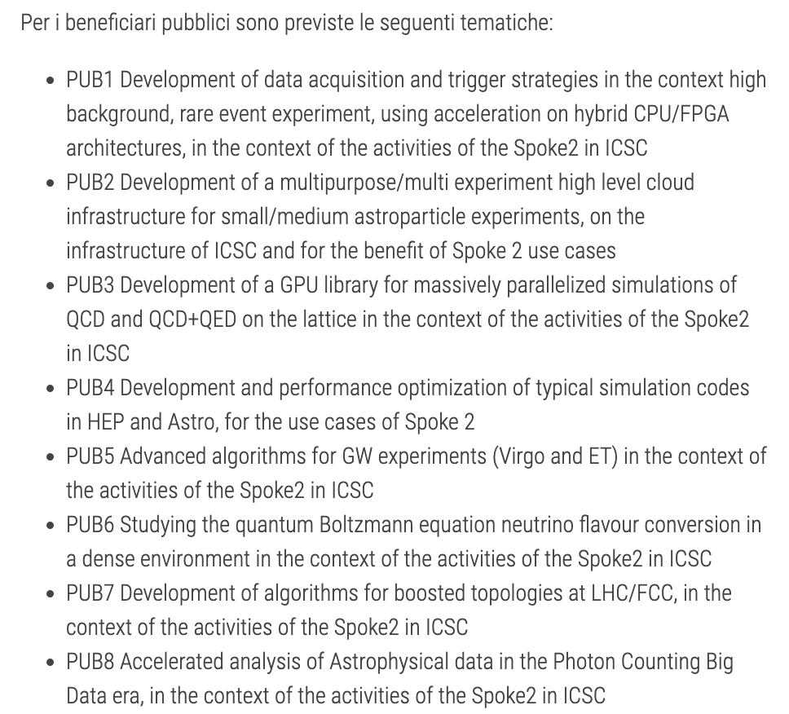
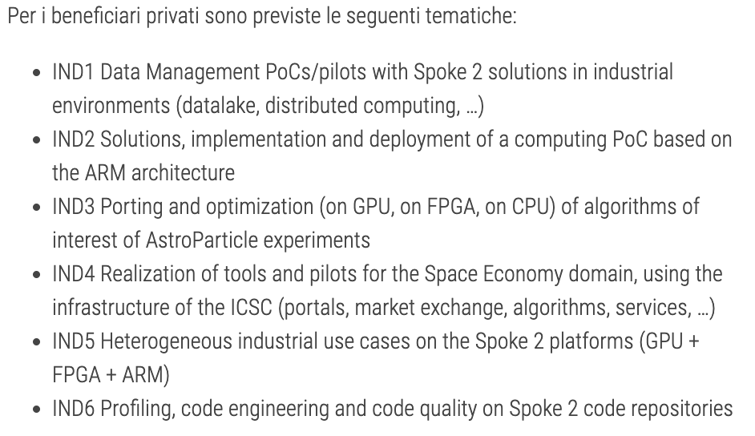
Open calls
Directed to universtities and industried not part of the ICSC
We identified 14 Objectives beyond the standard Spoke 2 program, and asked for participation
We received a number of bids, under evaluation

Slide 18

The computing resources
> 30 requests for (in some cases sizeable) resources:
Largest is for for 32 McoreHours of CPU (~ 1/5 of the standard allocation INFN has on Leonardo)
Requests for FPGA (from TeRABIT)
Requests for large GPU runs (up to the full Leonardo partition)
The ICSC allows access to high-quality resources
Either already existing (a fraction of Leonardo, Galileo and INFN Cloud)
Or are procured via ICSC and the «sister project» TeRABIT
All Granted!

Slide 19
Conclusions
The Spoke 2 activities are in the 2nd year, the “realization phase”
Many papers and talks flowing
Apart from the standard papers from the Spoke2 participants, all the 4 LHC Experiments have accepted to include ICSC in the standard “Acknowledgements”, more are coming …
We have created a very active community, with > 250 collaborators; with >50 hired by the project
ICSC will continue after the 36 months funding period; the whole center needs to focus on the sustainability, which means the links to industry are of paramount importance
What will happen after Sept 1st 2025 is honestly not clear yet

Slide 20
BACKUP SLIDES

Slide 21
How do we operate?
WP2 (5): «Advanced Machine Learning - Flash Simulation and bleeding edge applications», «Porting Algorithms on GPU», «Ultra-fast algorithms running on FPGA», «Validation of HEP reconstruction code on ARM», «Quasi interactive analysis of big data with high throughput»
WP1 (4): «Multilevel Hybrid Monte Carlo for lattice QCD», «QCD under extreme conditions», «Advanced Calculus for Precision Physics (ACPP)», «Large Scale Simulations of Complex Systems»
We identified “Flagship Projects”, 19 of them, which will demonstrate a technology / a new approach in a scientific domain
WP3 (7): «Frequency Hough (FH) Transform analysis on GW continuous sources», «Efficient use of machine learning and GPUs in cosmological data analysis: from theory to likelihood to statistical inference», «Inference of cosmological and astrophysical population properties from GW observations with and without electromagnetic counterparts», «Development of innovative analysis techniques using realistic simulations of the upgraded Auger Observatory within the context of a machine learning environment», «Detection and classification of SSO in Euclid Simulated data», «Pipeline optimization for space and ground based experiments (PSGE)», «Hydrodynamical simulations to test the nature of dark matter»
WP4 and WP5 do not have specific Flagship, but participate to most of the other flagships, with themes like GPU / FPGA utilization; Low power computing with ARM; High rate analysis solutions on the Data Lake; Machine learning at large scale; Fast simulations via generative networks, ; …
WP6 (3): «Enhancing Geant4 Monte Carlo Simulations through Machine Learning Integration», «Fast Extended Computer Vision», «AI algorithms for (satellite) imaging reconstruction»

Slide 22
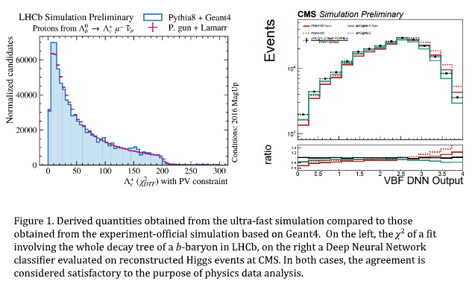
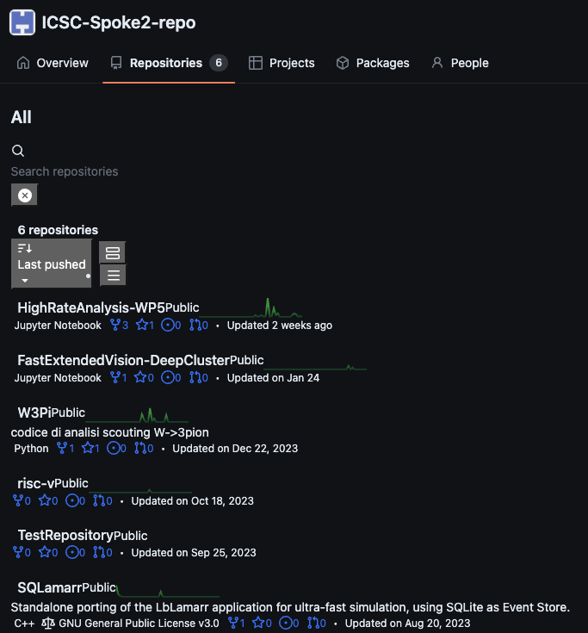
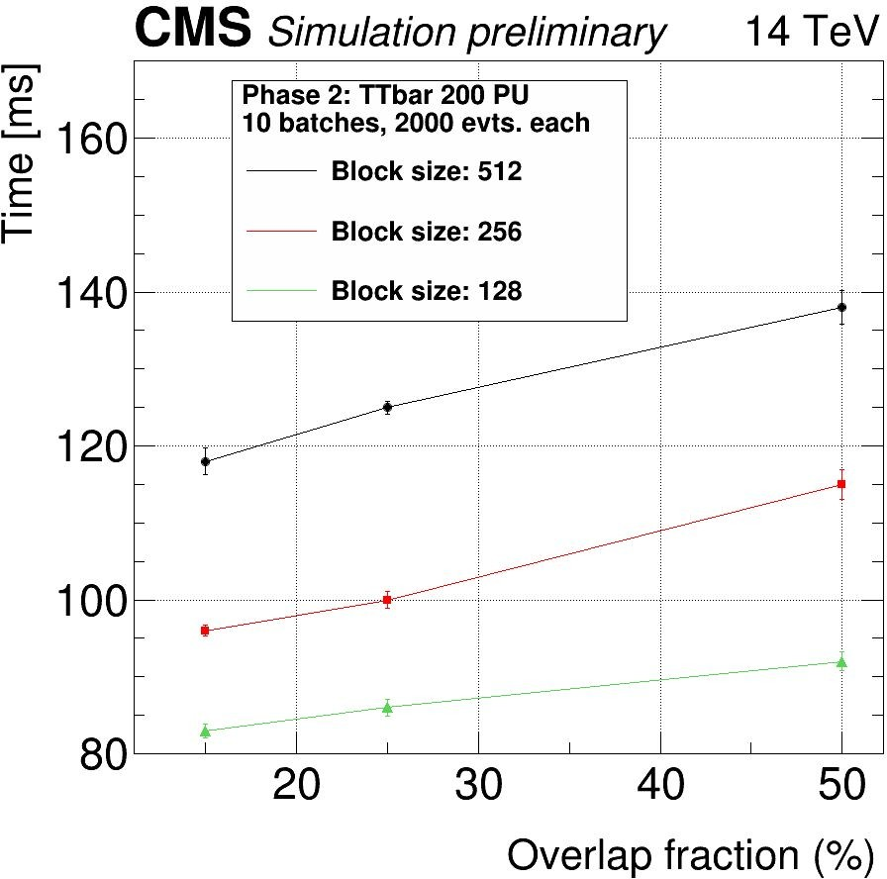
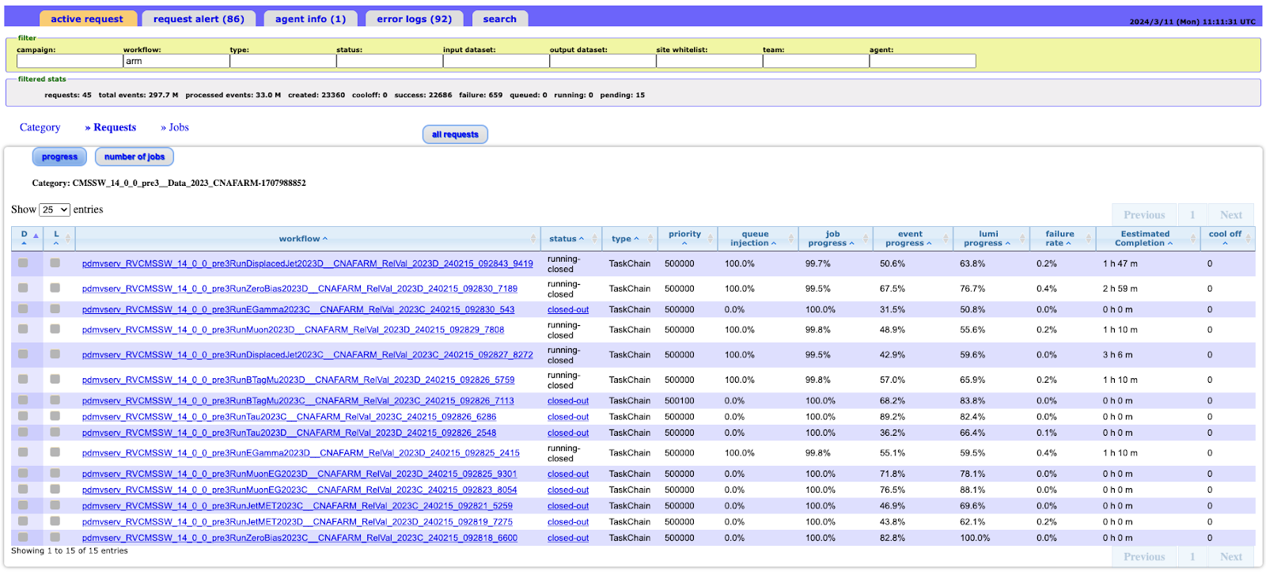




Results are already flowing

Slide 23
A further step: “From Research to Industry”
Why should industry be interested in what we do (”finding the Higgs boson?”)
Clearly they don’t, but on the technological side we can share the platforms, the solutions, the expertise
Spoke 2 has funded
2+ Meur on “Innovation Funds”: projects between Spoke 2 and Large Enterprises
3.2 Meur on “Cascade Calls”: projects between research groups and SME

Slide 24
An example of collaborations – Innovation Funds
ENI:
Testing HEP workflows on a industrial data center
Predictive maintenance on ENI’s industrial plants
Physics Inspired ML for the exploitation of natural resources
Leonardo + TASI:
Interoperable Datalake: Data management + Block Chain pilot per dati da space economy
Unipol:
Merging data and AI for improving Seismic Risk assessment and Management in populated areas
UnipolSAI + SOGEI:
Monitoring of alert and vulnerability hurban for fast response and assurance evaluation
Intesa Sanpaolo:
Correlations between satellite images and budget in agricoltural enterprises
Fraud detection as anomaly search on financial streams
IFAB, SECO, Coldiretti, …
Digital Twins for Precision Agricolture
IFAB, Bonfiglioli, Tampieri, SECO, …
Edge AI Anomaly Detection System for Critical Environments

Slide 25
Conclusions
The National Center for HPC, Big Data and Quantum Computing is a unique opportunity for research in Italy: build a modern infrastructure for research initially, and industry later, and make sustainable beyond the initial fundings
Spoke 2 Activities are aligned with the needs from High Energy and Astroparticle Physics
We are trying to form the next generatoin of scientists, versed in modern technologies
While doing that, we want to strenghten the links with italian industries

Slide 26






A single slide on the infrasctructure, before all 3 major pillars
GARR: Tbps-level connectivity between all public data centers
CINECA: expansion of Leonardo (HPC#6 on top500.org) with Lisa, and deployment of a production level Quantum Computer
INFN: strengthening of the WLCG infrastructure (1 Tier1 – 9 Tier-2s); acquisition of Cloud resources; implementation of the datalake middleware, based on INFN-Cloud
26

