Slide 1
Virtual Diagnostics ?!
Dr. Jan Grünert
X-ray Photon Diagnostics Group
Frascati, Italy 08 November 2024
Enlightening Science

Slide 2
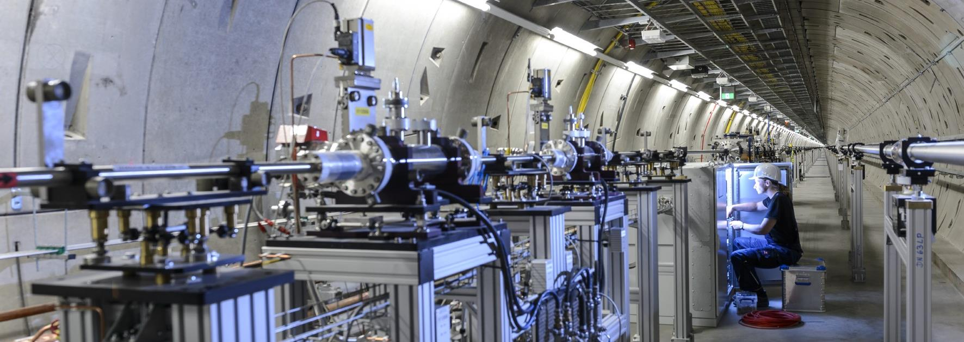
Photon Beamlines (photon tunnels)
** very real, not so virtual **

Slide 3
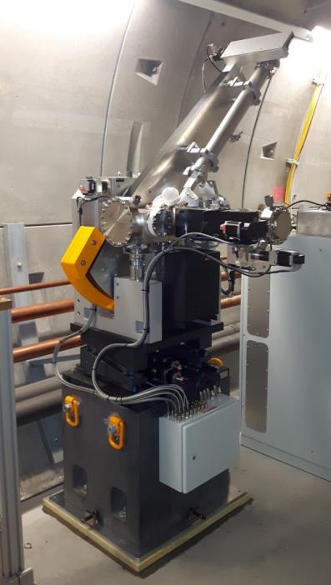
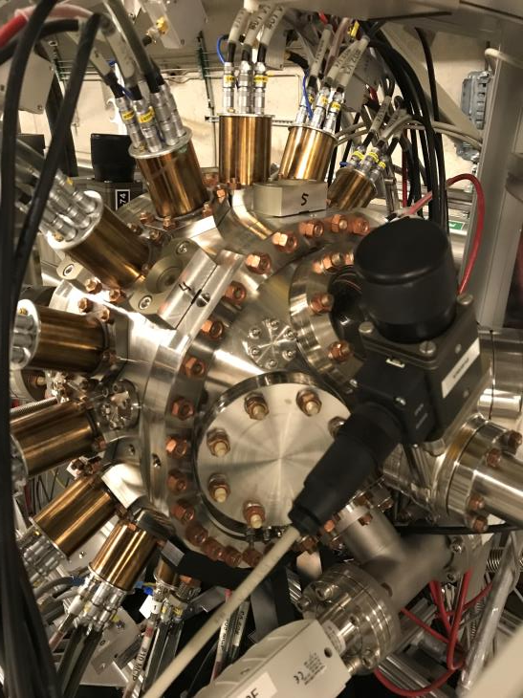
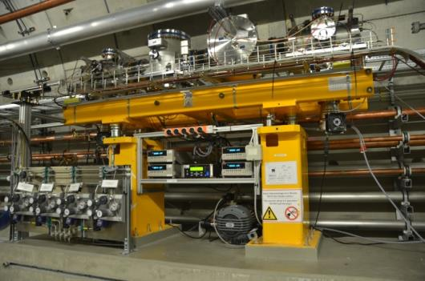
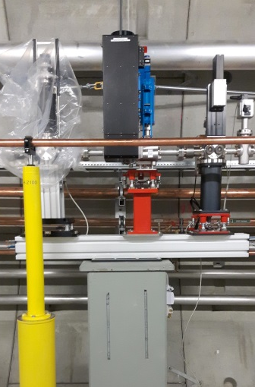
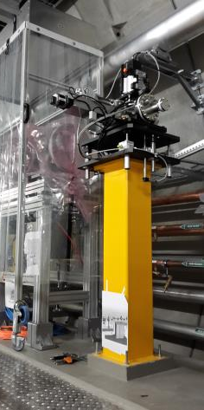
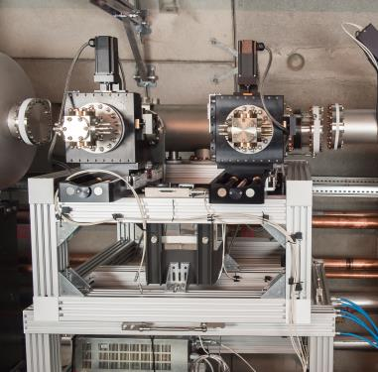
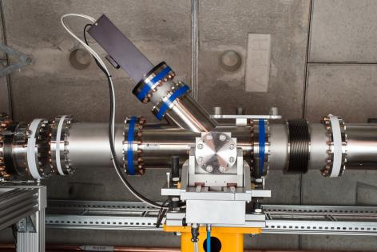
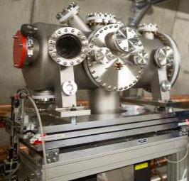
EuXFEL photon beam diagnostics hardware (real, physical)
** very real, not so virtual **
~ 50 distinct diagnostic hardware installations in 3 undulator beamlines
~ 15 to 20 of these are continuous online diagnostics
Beam parameters of interest:
pulse energy
beam position / shape
wavelength / spectrum
polarization
arrival time
pulse duration
wavefront
HIREX
single shot spectrometer
PES
X-ray Gas Monitor (XGM)
Filter Ch. & IMGTR
Pop-in Monitor
K-mono
SR-imager
MCP-detector
Overview Reference : J.Grünert et al., J. Synchrotron Rad. 26 (5), 1422–1431 (2019)

Slide 4
What‘s virtual beam diagnostics?
In a strict sense: a software-based beam-diagnostic monitor without physical hardware embodiment
In a wider sense, it could also be: data mining that creates additional information about the properties of the beam
Or maybe: access to beam property B via a monitor originally deployed for property A
And also: new insights about the beam by combinations of monitors

Slide 5
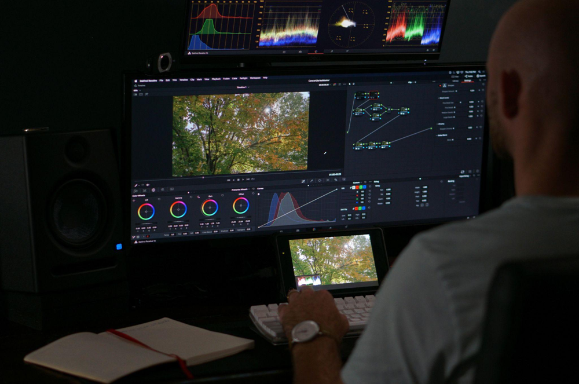
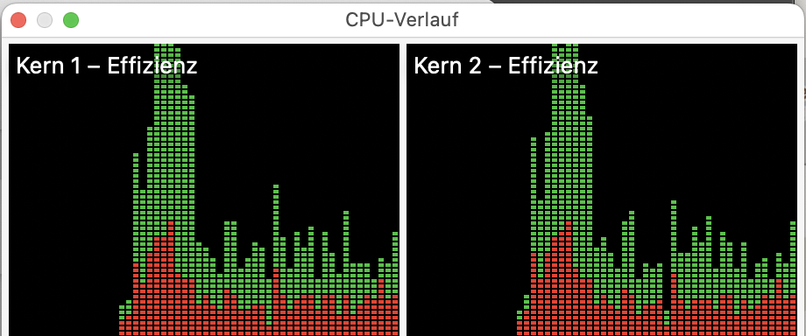
What‘s NOT virtual beam diagnostics?
Lengthly offline post-processing of (e.g.) user experiment data
Software monitors that don’t increase the knowledge about photon beam properties

Slide 6
What can we gain by introducing virtual diagnostics?
Improve the measurement resolution for a specific beam property the measurement accuracy, fidelity
Simplify the measurements (decrease the need for human experts) the calibrations and the data analysis
Become non-invasive online monitoring of beam properties which previously were only accessible invasively → increase information availability
....

Slide 7
What are practical foundations to obtain these benefits?
Existance of online diagnostics hardware - implemented and well characterized - must exist in the locations of interest
Availability of online diagnostics - in operation - tuned to actual current beam conditions - must produce reliable data
Automation of online diagnostics
The virtual diagnostics software itself

Slide 8
How can we create virtual diagnostics?
Aggregate data from several existing (hardware) monitors e.g. beam pointing from several transmissive imagers
Find deterministic correlations between data of several monitors
Beyond deterministic, use machine learning to create maps between several monitors which then allow to stop one of them (because it‘s invasive, costly, difficult, ...)

Slide 9
Let’s go virtual !
XPD group
Tunnel flight April 2016

