Slide 1



EURISOL and the European roadmap for radioactive beams
Yorick Blumenfeld
CERN and IPN Orsay

Slide 2
The science
Spectroscopy of superheavy elements
The different shapes of the nucleus: collectivity versus individuality
p-drip line
Testing the Standard Model
r-process path
Isospin dependence of the nuclear force
N=Z
n-drip line
Neutron-proton pairing
Doubly-magic nuclei
and shell structure far from stability
The origin of the chemical elements
Applications in materials and life sciences
Burning cycles in stars
The limits of nuclear stability: measuring and predicting masses
The size of the nucleus: halos and skins
Explaining complex nuclei from basic constituents
18 May 2009
New opportunities in the physics landscape at CERN
2
Notes:
2

Slide 3
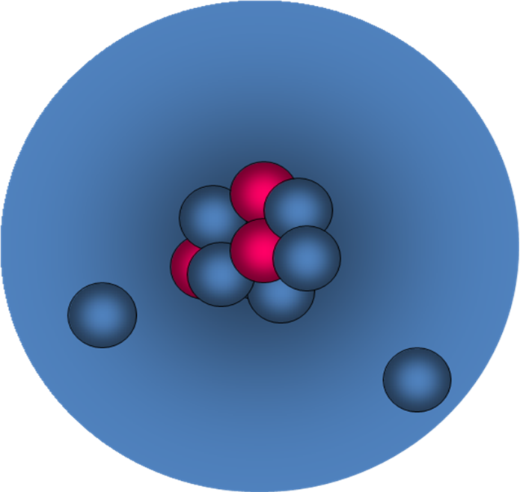
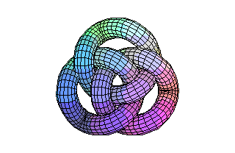
Halo Nuclei
Extended neutron wave functions make ¹¹Li the size of ²⁰⁸Pb
Heavier Halo Nuclei are predicted : ¹⁴Be; ¹⁹C; ²²C; ²³O and could be studied at EURISOL.

Slide 4
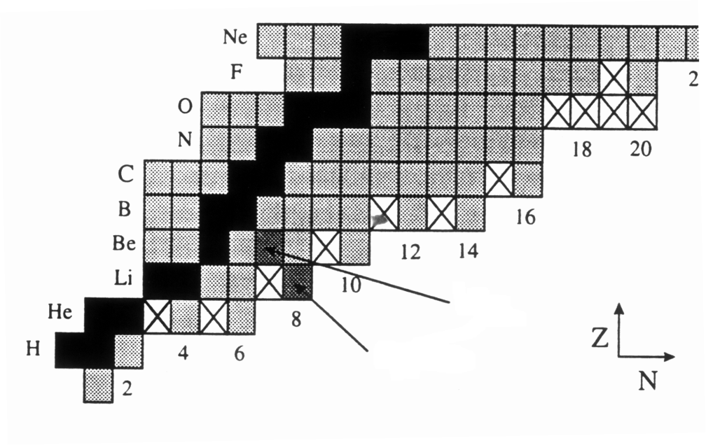
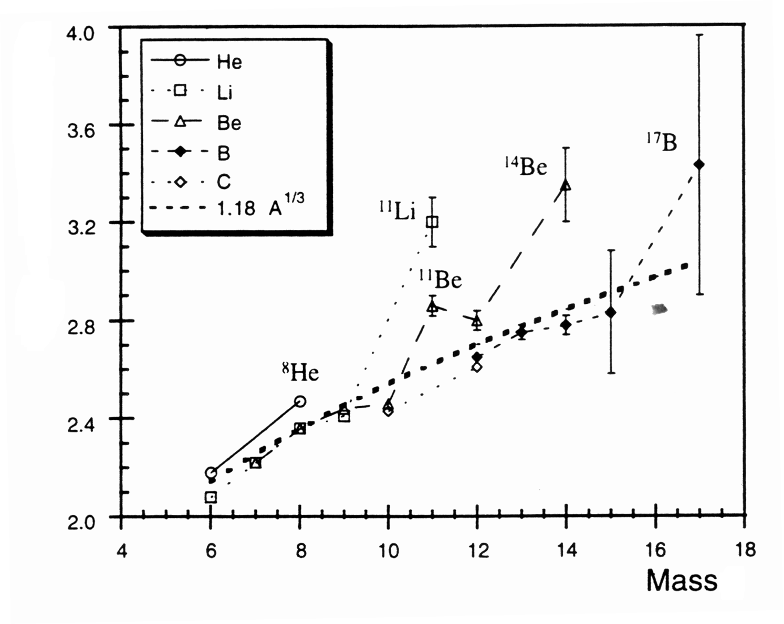
Halo Nuclei through reaction cross sections
R(fm)
¹¹Be
¹¹Li
R₁
R₁+R₂
R₂
s_{R}=p(R₁+R₂)²

Slide 5
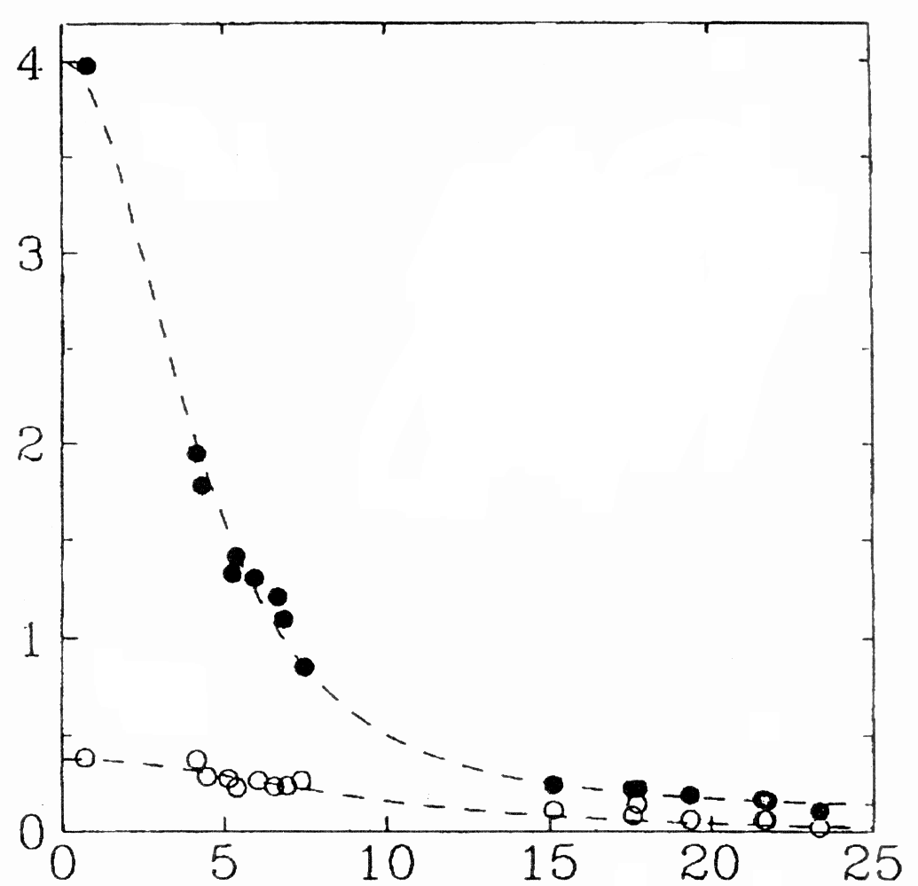
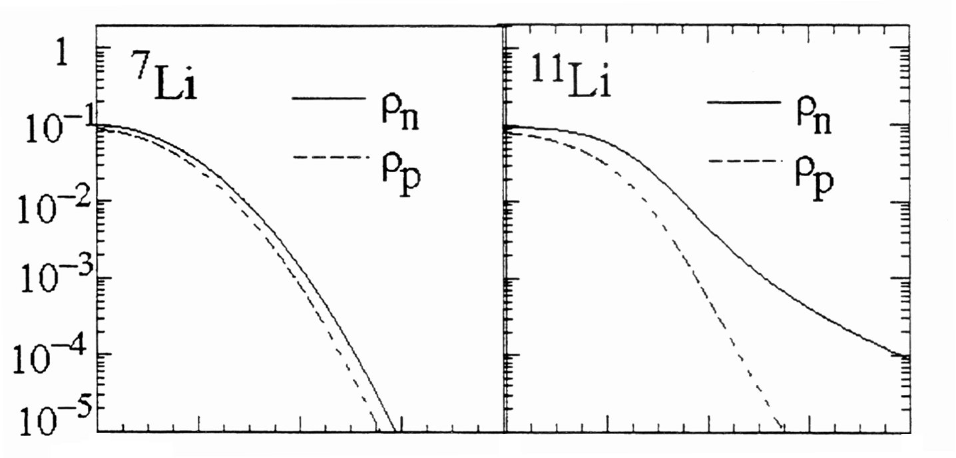
Halo Nuclei through break-up reactions
Thanks to Olivier Sorlin
Au
n
S_{2n} = 12910 keV
S_{2n} = 310 keV
^{9,11}Li
(50MeV/A)
q
n
⁷Li
¹¹Li
Dx.Dp > h
p
~
q
p_{n}
n
¹¹Li
Neutron counts (X 10³)
r(r) (fm⁻³)
⁹Li
2 4 2 4 6
angle (degrees)
radius(fm)

Slide 6
Halo Nuclei
Extended neutron wave functions make ¹¹Li the size of ²⁰⁸Pb
Heavier Halo Nuclei are predicted : ¹⁴Be; ¹⁹C; ²²C; ²³O and could be studied at EURISOL.

Slide 7
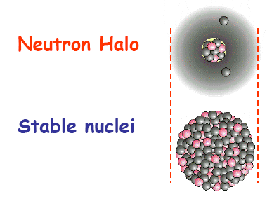
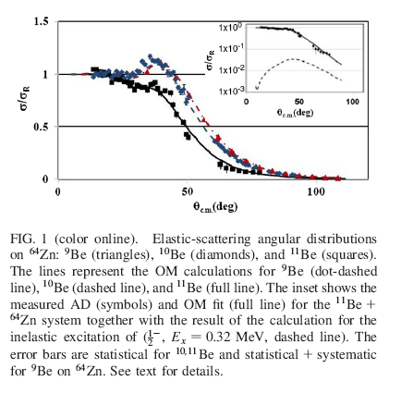
Disappearance of the rainbow in ¹¹Be
^{9,10,11}Be + ⁶⁴Zn
¹¹Be
²⁰⁸Pb
A. Di Pietro et al.; PRL 105, 022701 (2010)

Slide 8
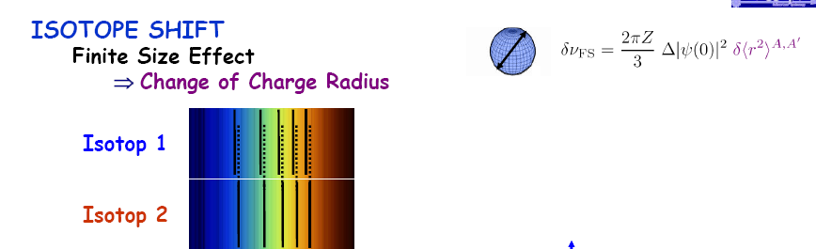
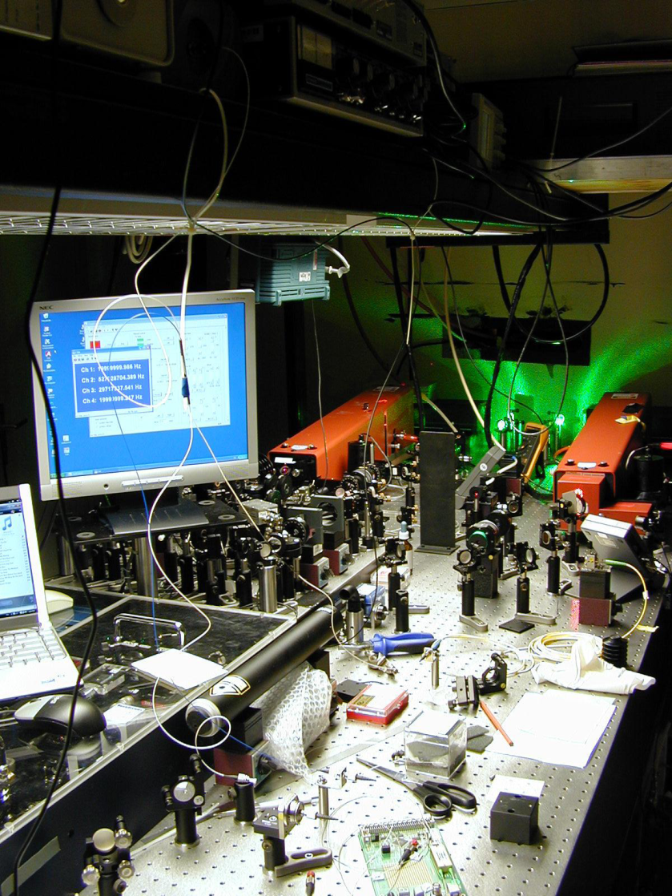
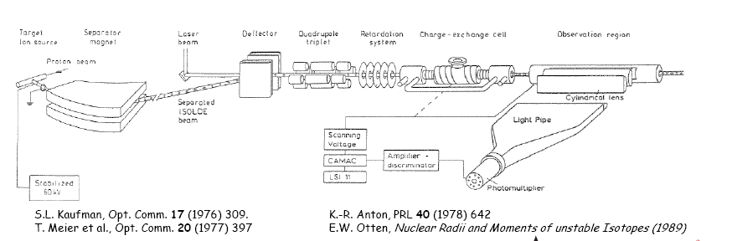
Isotope shifts and charge radii

Slide 9
Clustering in Nuclei

Slide 10

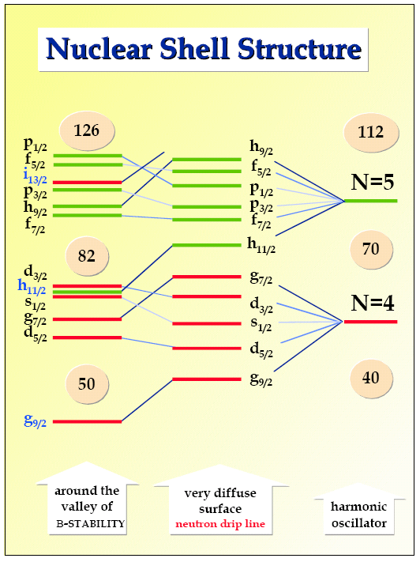
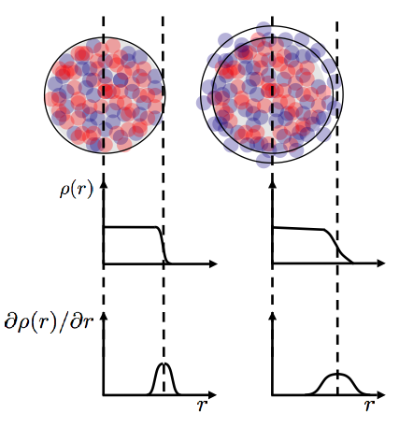
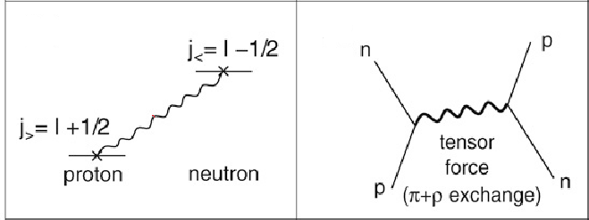
2. Evolution of Shell Structure
Dobaczewski et al.
Phys Rev Lett 72 (1994) 981
Otsuka et al.
Phys Rev Lett 95 (2005) 232502

Slide 11
³²Mg: The island of inversion
p_{1/2}
f_{5/2}
4
fp
p_{3/2}
400
N=20
28
3
sd+fp
f_{7/2}
E(2⁺) [MeV]
B(E2) [e²fm⁴]
20
2
200
sd
d_{3/2}
₂₀Ca
s_{1/2}
d_{5/2}
14
1
₁₂Mg
₁₆S
8
0
⁴⁰Ca
³⁸Ar
³⁶S
³⁴Si
³²Mg
³⁰Ne
p_{1/2}
12
16
20
24
N
Motobayashi et al. Phys. Lett. B 346 (95)9, Pritychenko et al., Phys. Lett. B 461(99)322
Ibbostson et al. PRL80(98)2081, V Chisté et al.

Slide 12
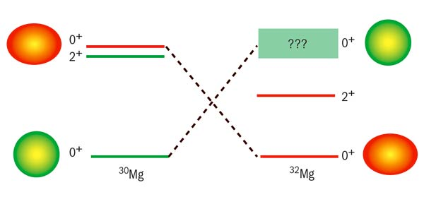
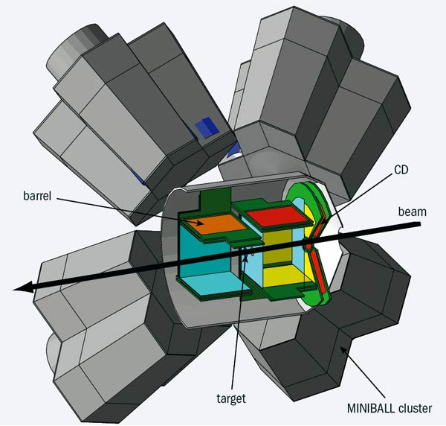
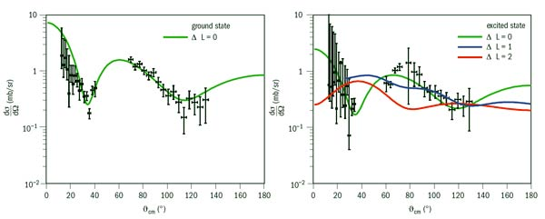
Shape changes
³⁰Mg(t,p)³²Mg
³⁰Mg
³²Mg
Cross section
Miniball + T-REX
Scattering angle

Slide 13
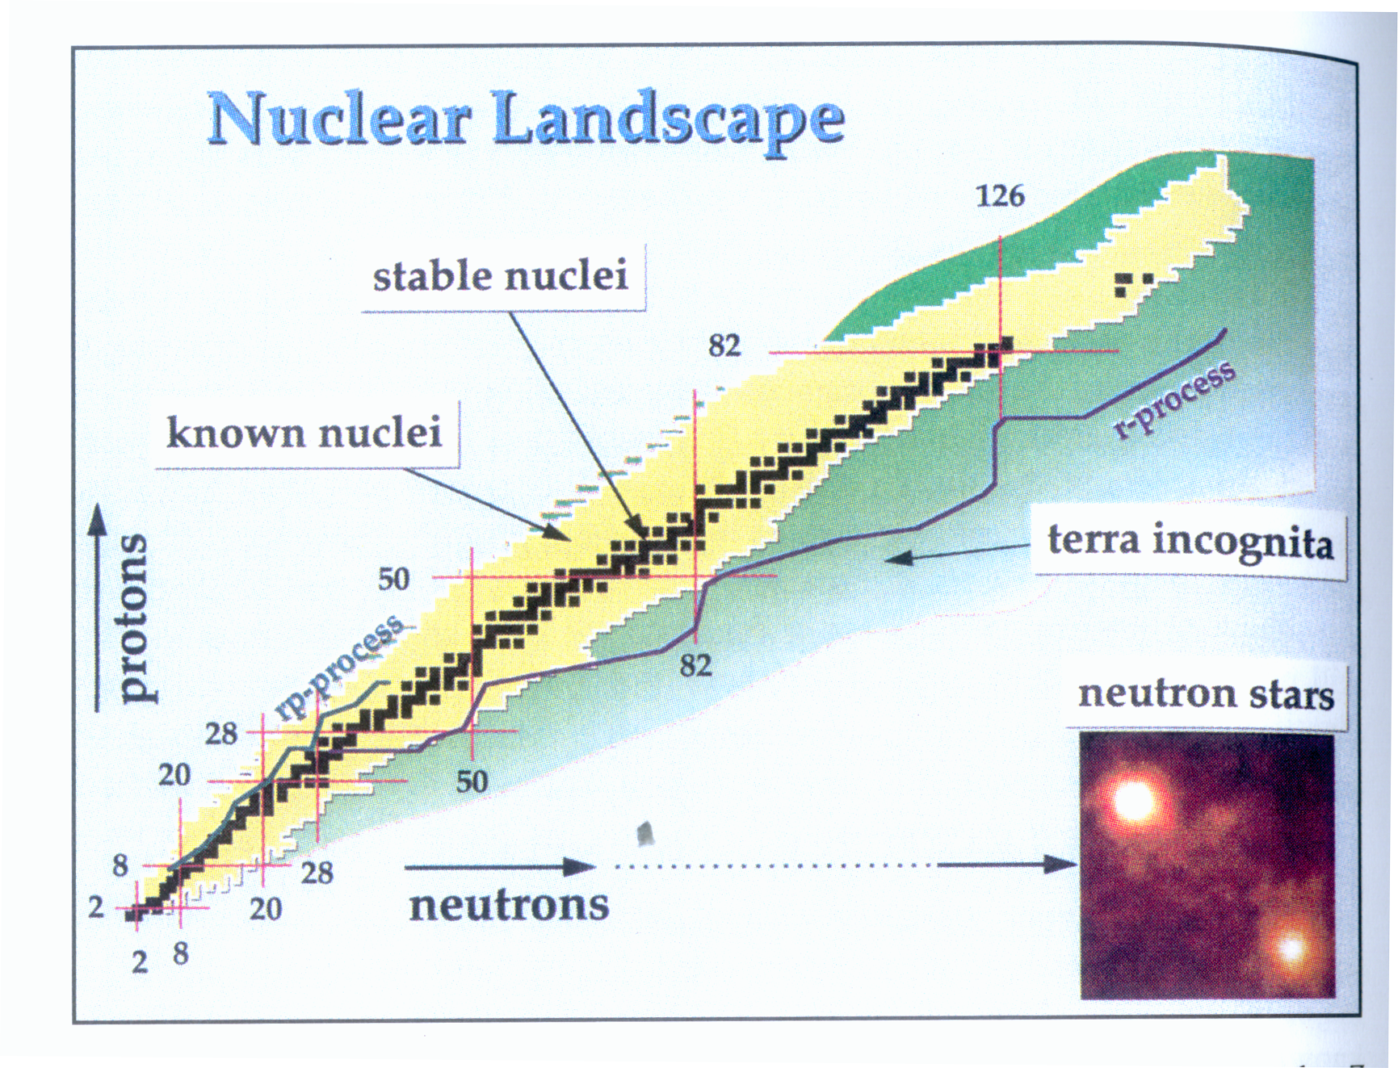
r and rp Processes in explosive stellar environments

Slide 14
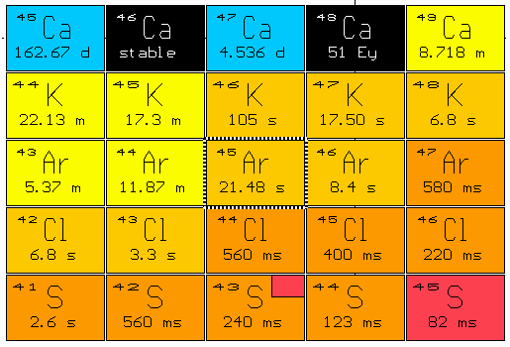
A zoom on the r-process
We need masses, lifetimes and capture cross sections for unstable nuclei
: Capture n
: β ⁻

Slide 15
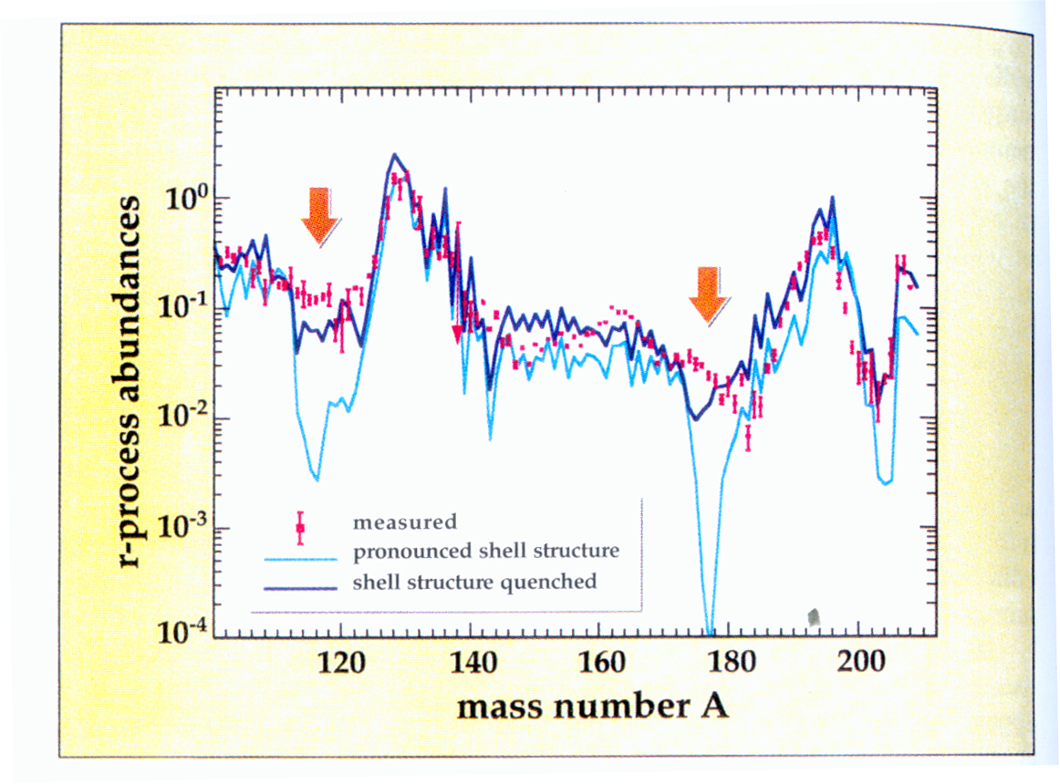
Effect of shell closures on element abundances

Slide 16
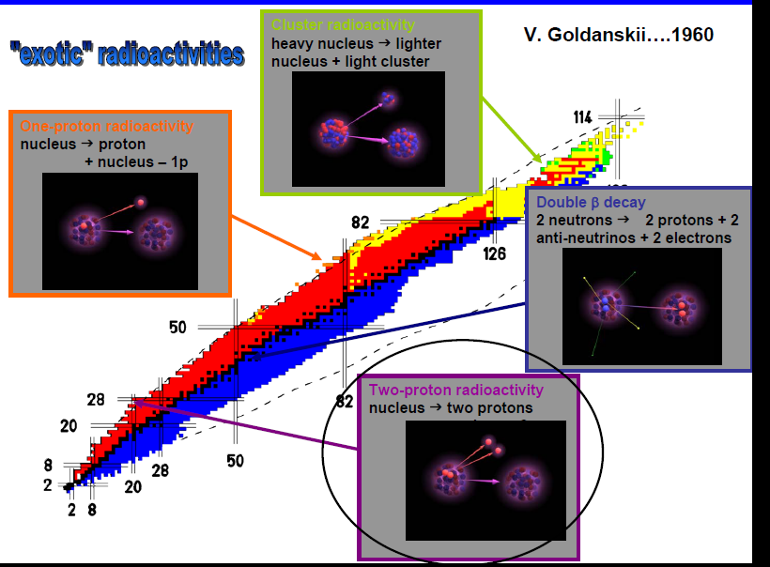
Exotic radioactivity

Slide 17
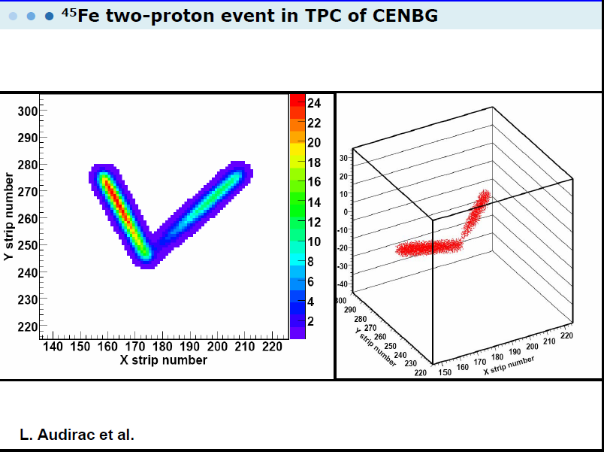

Slide 18
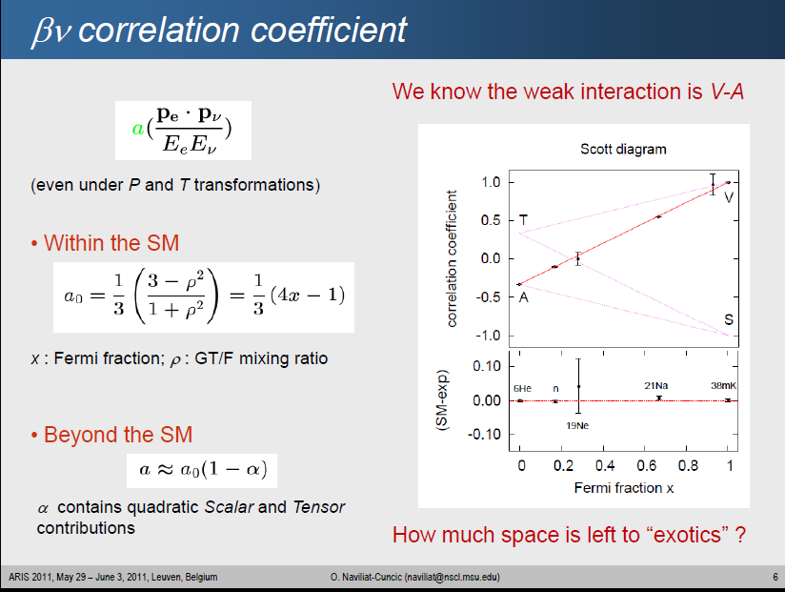

Slide 19
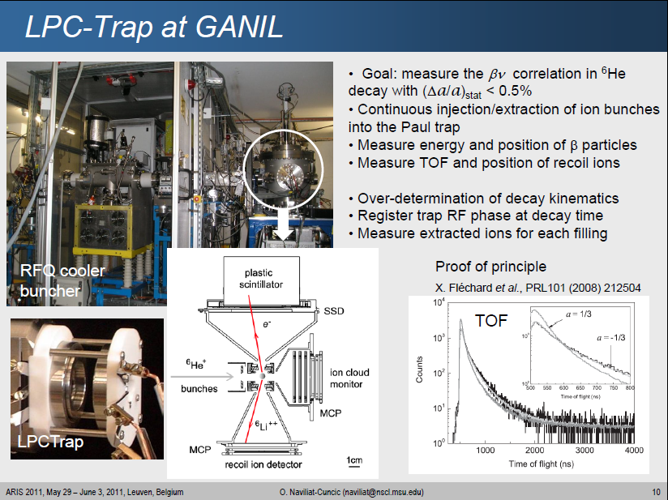

Slide 20
A new generation of RIB facilities: more exotic; more intensity(X10³)
Beta-decay, mass measurements: A few counts per minute
COULEX : 10 pps
Knock out :10² pps
Direct Reactions :10⁴ pps
Fusion :10⁵ pps
Z
N

Slide 21
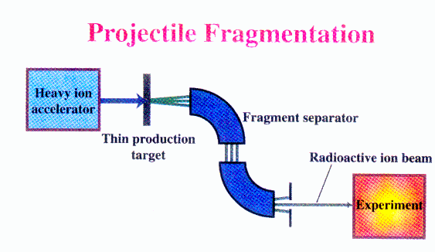
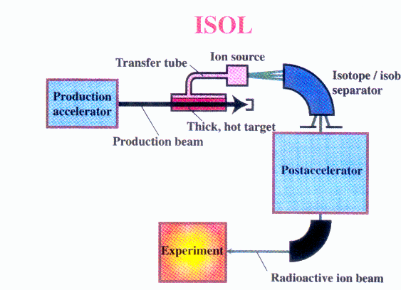

Radioactive beam production: Two complementary methods
GANIL/SISSI, GSI,
RIKEN, NSCL/MSU
FAIR
High energy, large variety of species,
Poor optical qualities
GANIL/SPIRAL, REX/ISOLDE,
ISAAC/TRIUMF
Low energy, chemistry is difficult, good beam qualities

Slide 22


Current Fragmentation Facilities
Facility | Location | Driver | Primary Energy | Typical intensity | Fragment separator
 | Caen, France | 2 separated sector cyclotrons | Up to 100A MeV | ³⁶S 10¹³ pps ⁴⁸Ca 2 10¹² pps | LISE
 | Darmstadt, Germany | Linac + Synchrotron | Up to 2A GeV | 10¹⁰ ppspill | FRS
 | East Lansing, USA | 2 coupled superconducting cyclotrons | Up to 200A MeV | ⁴⁰Ar 5 10¹¹ pps | A1900
RIBF RIKEN | Tokyo, Japan | Ring cyclotron | Up to 400A MeV | ⁴⁰Ar 5 10¹¹ pps 48Ca, 238U | BIG RIPS

Slide 23
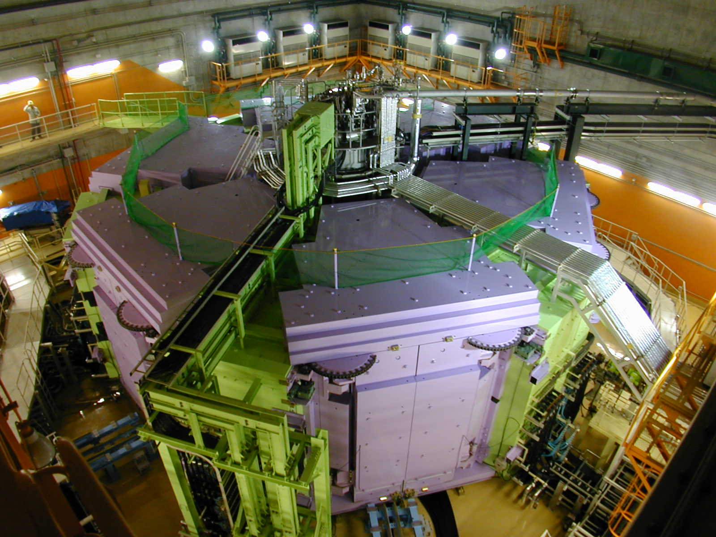
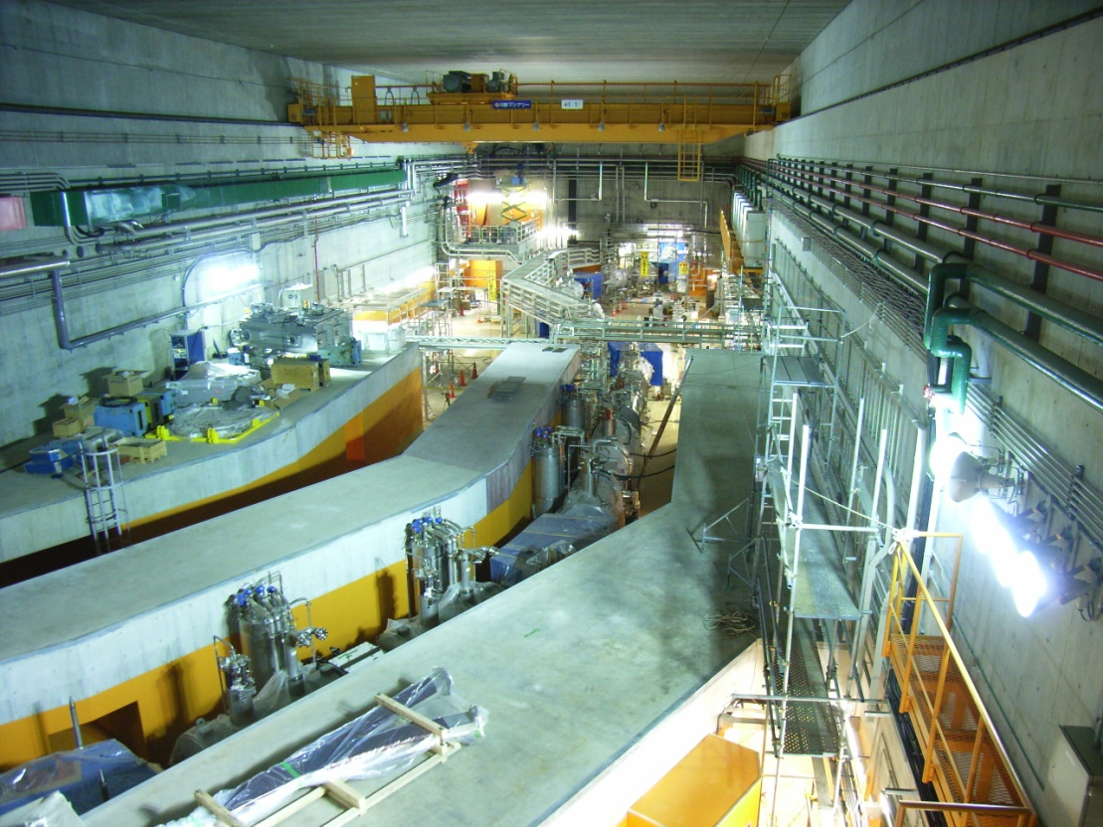
World’s First and Strongest
K2600MeV
Superconducting Ring Cyclotron
SRC
400 MeV/u Light-ion beam
345 MeV/u Uranium beam
BigRIPS
World’s Largest Acceptance
9 Tm
Superconducting RI beam Separator
~250-300 MeV/nucleon RIB
K980-MeV
Intermediate stage Ring Cyclotron (IRC)

Slide 24
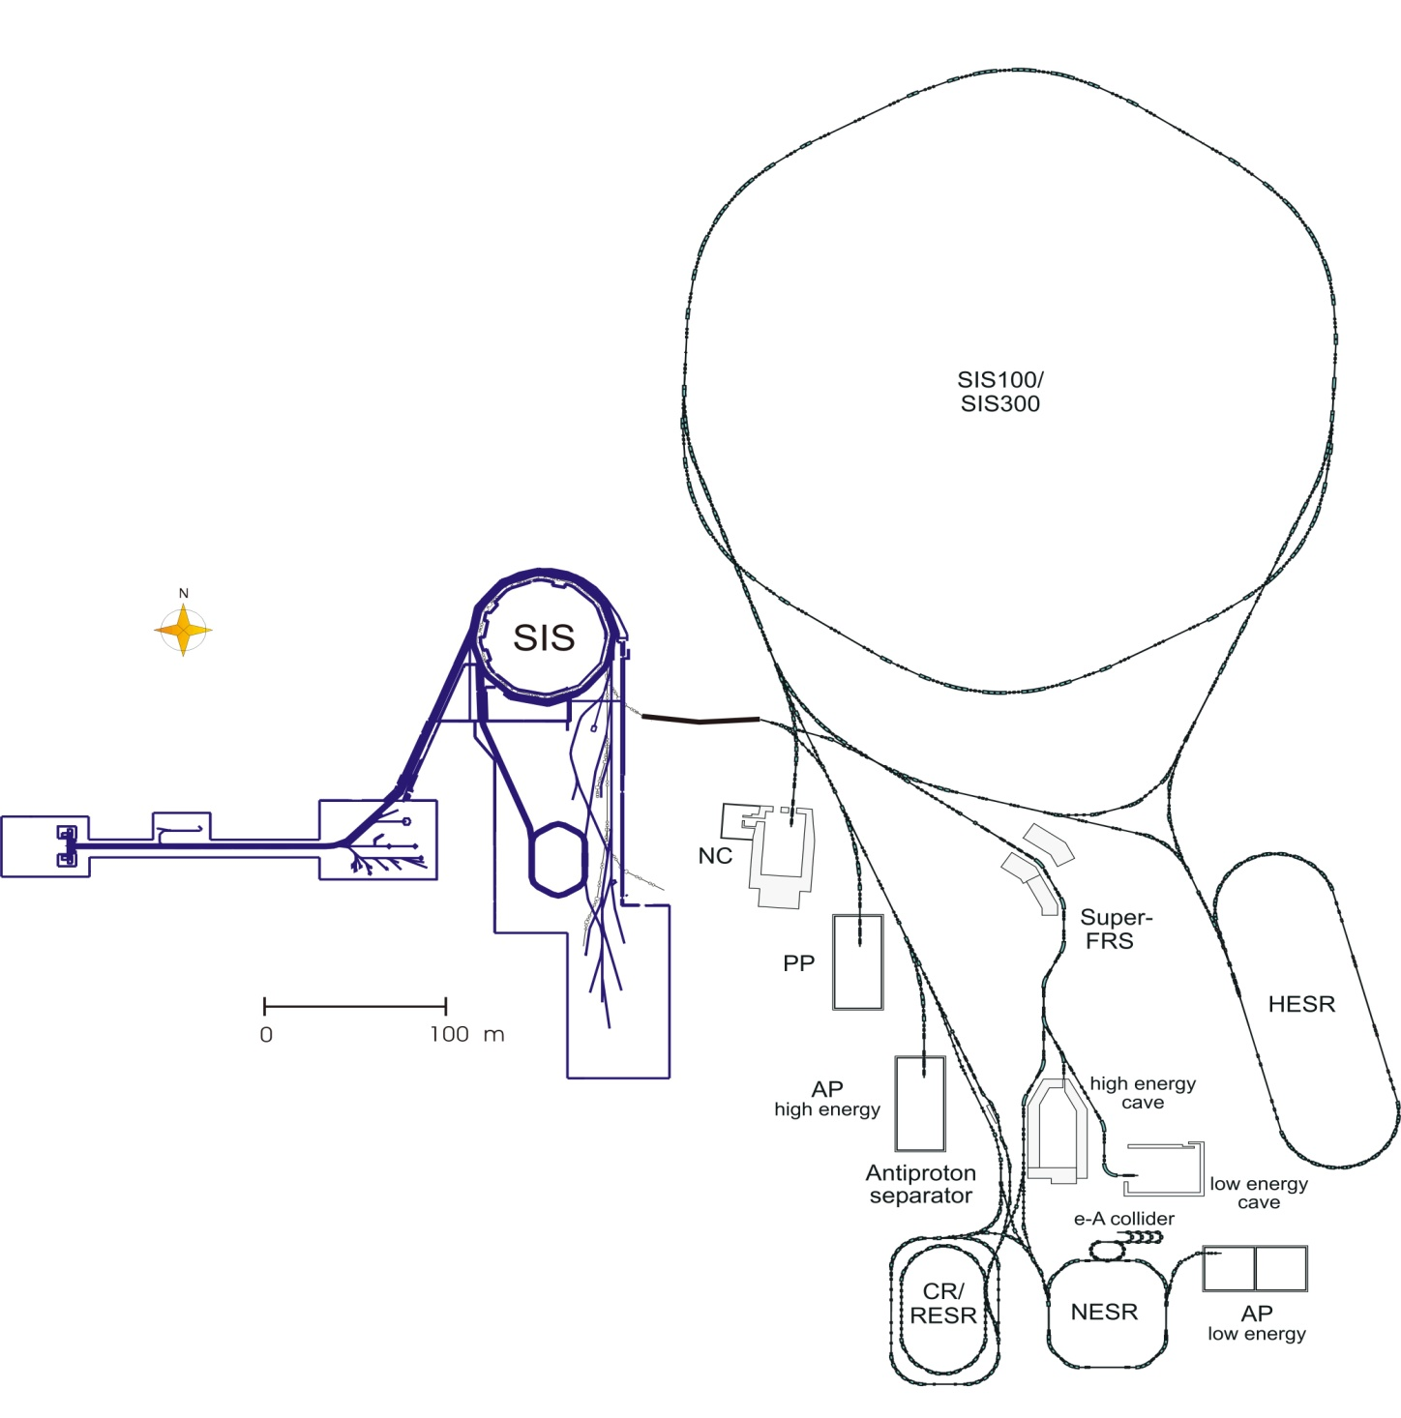
Next Generation Facility: FAIR at GSI
Primary Beams
Secondary Beams
10¹²/s; 1.5-2 GeV/u; ²³⁸U²⁸⁺
Factor 100-1000
over present in intensity
2(4)x10¹³/s 30 GeV protons
10¹⁰/s ²³⁸U⁷³⁺ up to 25 (- 35) GeV/u
Broad range of
radioactive beams up to
1.5 - 2 GeV/u;
up to factor 10 000 in
intensity over present
Antiprotons 3 - 30 GeV
Storage and Cooler Rings
Radioactive beams
e – A collider
10¹¹ antiprotons
stored and cooled
at 0.8 - 14.5 GeV
Key Technical Features
Cooled beams
Rapidly cycling superconducting magnets

Slide 25
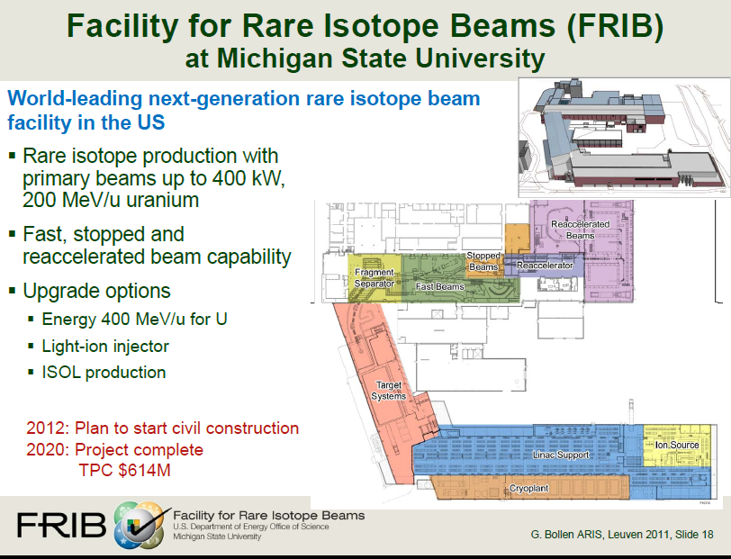

Slide 26

Future European ISOL Facilities
Facility | Driver | Beam Power | Number of fissions | Post-accelerator | Energy
SPIRAL-II GANIL | LINAC Deuterons 40 MeV HI 15A MeV | 200 kW | >5 10¹³ | Cyclotron CIME | 2A-25A MeV
HIE-ISOLDE CERN | PS booster Protons 1.4 GeV | 10 kW | 10¹³ + spallation | Linac REX | 0.8A–10A MeV
SPES Legnaro | Commercial cyclotron p 40 MeV | 8kW | 10¹³ | Linac ALPI | 10A MeV
EURISOL | Superconducting CW LINAC p 1GeV | 5 MW | >10¹⁵ + spallation | Superconducting LINAC | 150A MeV

Slide 27



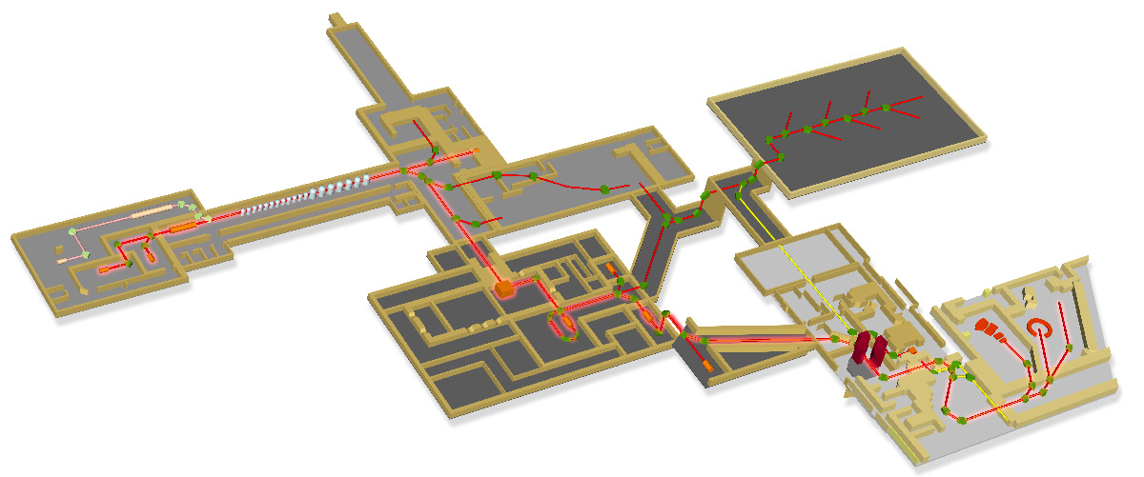






GANIL/SPIRAL1/SPIRAL2 facility
GANIL Beam time: 35 weeks/y (600 users)
SP2 Beam time: 44 weeks/y
ISOL RIB Beams: up to 53 weeks/y
Up to 50 % more users: 800-900
First experiments 2013
Caen, France
Neutrons For Science
LINAC:
33MeV p
40 MeV d
14.5 AMeV HI
S3 separator-spectrometer
DESIR Facility
low energy RIB
A/q=6 Injector option
GANIL/SPIRAL 1
today
A/q=2 source
p, d, ^{3,4}He 5mA
A/q=3 HI source
Up to 1mA
HRS+RFQ Cooler
RIB Production Cave
Up to 10¹⁴ fiss./sec.
CIME cyclotron RIB at 1-20 AMeV (up to 10 AMeV for fiss.fragments)
Cost: 200M€ Funded +
Detectors: Min. 8M€ – Max. 30 M€ (2011-2016)
2 RIB + 3 Stable-ion beams -> 5 experiments in parallel
Notes:
Cost of baseline project (without detectors) about 260M$ or a half of FRIB shared by France founding agencies and state of Basse Normandie authorities, EU partners

Slide 28
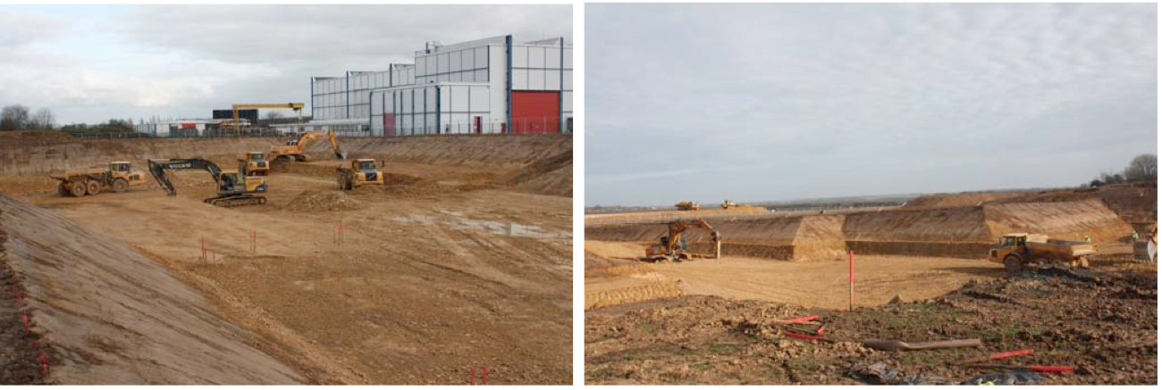
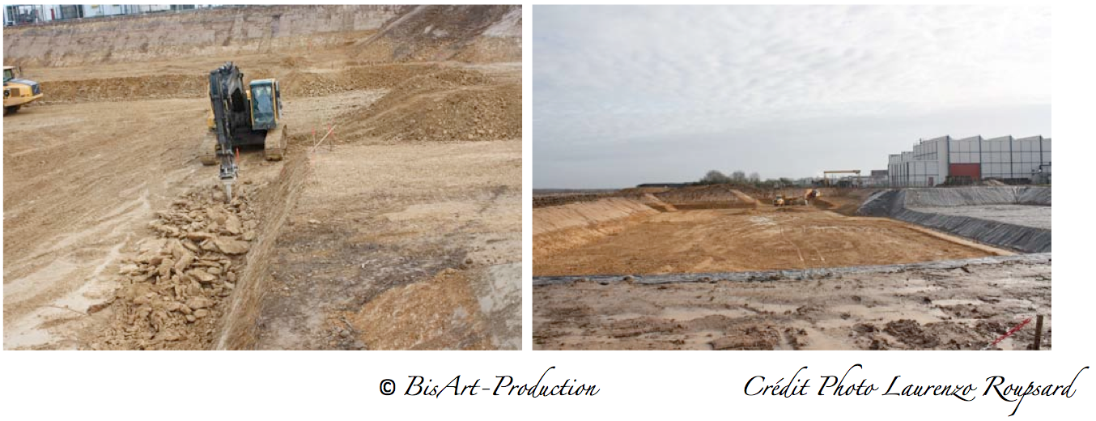
Civil construction SPIRAL2 Phase 1
March 1st, 2011
Beginning of ground breaking: December 2010
End of excavation phase: May 2011
Beginning of construction of buildings : July 2011
Notes:
Limestone level

Slide 29
ISOLDE today offers the largest range of available isotopes of
any ISOL facility worldwide.
HIE-ISOLDE aims at increasing the energy of these RIB up to 10A MeV and their intensity by a factor 10
http://isolde.web.cern.ch/ISOLDE/
So far >600 radioactive isotopes of >60 elements

Slide 30

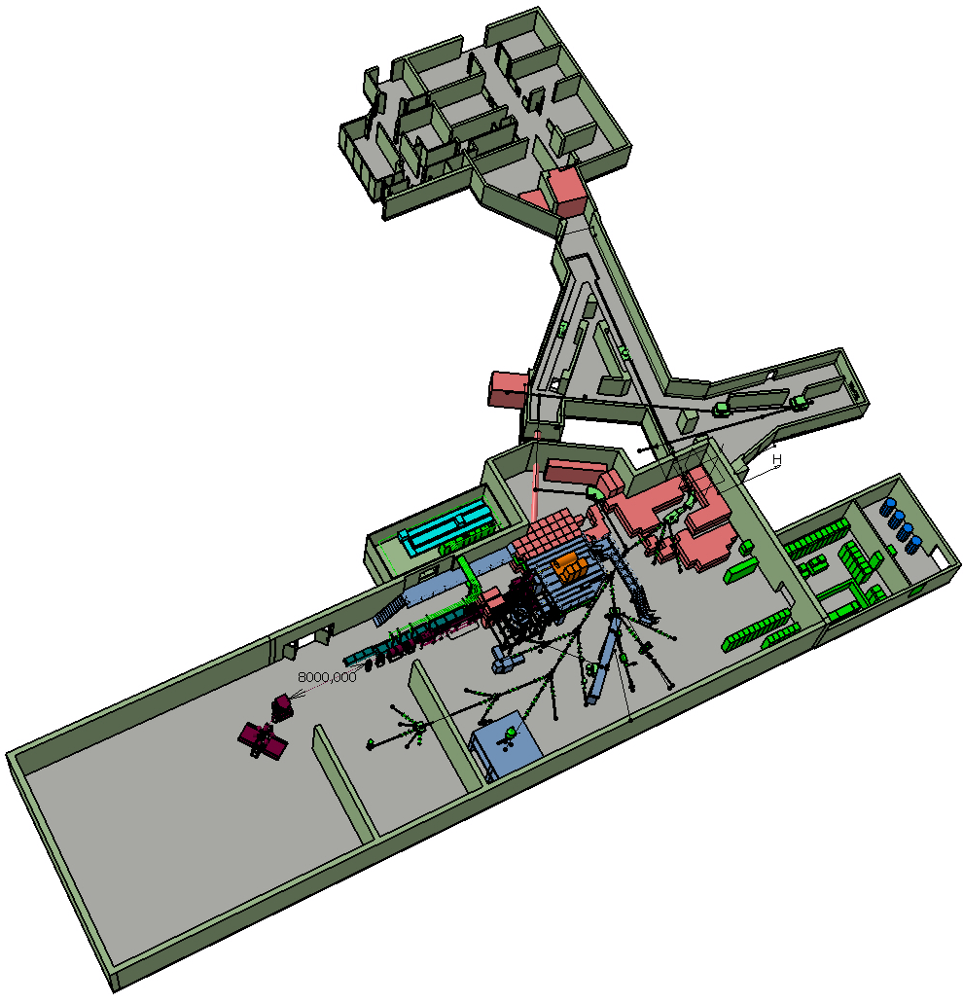
Scope of HIE-ISOLDE
HIE-ISOLDE aims at increasing the energy of these RIB up to 10A MeV and their intensity by a factor 10
Energy Upgrade:
The HIE-ISOLDE project concentrates on the construction of the SC LINAC and associated infrastructure in order to upgrade the energy of the post-accelerated radioactive ion beams to 5.5 MeV/u in 2014 and 10 MeV/u by 2016
Intensity Upgrade:
The design study for the intensity upgrade, also part of HIE-ISOLDE, starts in 2011, and addresses the technical feasibility and cost estimate for operating the facility at 10 kW once LINAC4 and PS Booster are online.

Slide 31
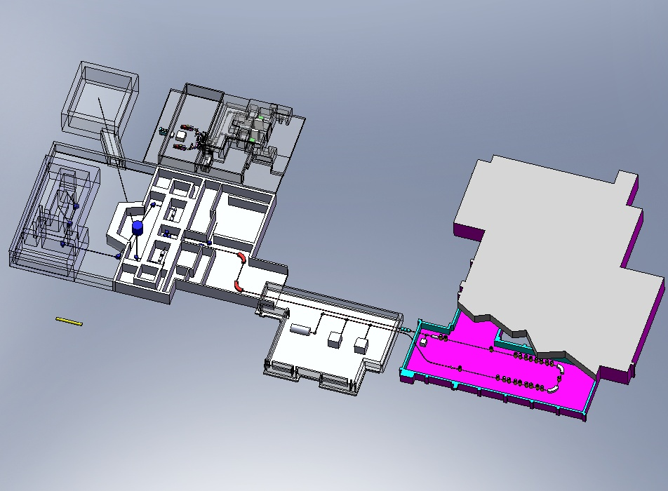


The SPES Project @ LNL
a multi-user project
ISOL BEAM FACILITY
8kW Direct Target: UCx 10¹³ fission s⁻¹
Primary Beam: 200 μA, 70 MeV protons from a 2 exit ports Cyclotron
Re-accelerator: ALPI Superconductive Linac E>10 AMeV for A=130
Applied Physics with proton and neutron beams
70 MeV 450 μA
Approved for construction by INFN
First beams in 2016
High intensity proton linac:
TRIPS source - TRASCO RFQ 30 mA, 5MeV
Neutron facility for Medical, Astrophysics and Material science.
Neutron source up to 10¹⁴ n s⁻¹
Thermal neutrons: 10⁹ n s⁻¹ cm⁻²
Notes:
31
11/12/2011
31

Slide 32
Specificities of SPES
Expertise of Italian community in nuclear reactions
Excellent instrumentation: magnetic spectrometers, gamma-ray arrays, multi-detectors…
Will exploit reaction mechanisms such as deep inelastic and fusion with “high intensity” radioactive beams in order to reach more exotic nuclei
Physics program very complementary to SPIRAL2 and HIE-ISOLDE

Slide 33

H-
HWRs
176MHz
1 GeV/q
H-, H+,
³He++
n-generator
UC_{x} target
RFQ
176 MHz
3-spoke ISCL
325 MHz
Elliptical ISCL
704 MHz
Elliptical ISCL
704 MHz
4-MW
target
station
100
keV
β = 0.09, β = 0.15
β = 0.03
β = 0.047
β = 0.65
β = 0.78
1+ ion
source
1.5 MeV/u
60 MeV/q
140 MeV/q
H+, D+,
³He++
>200 MeV/q
D+, A/q=2
Ion
sources
A possible schematic layout
for a EURISOL facility
One of several
100-kW direct
target stations
Secondary
fragmentation
target
Low-resolution
mass-selector
Spoke
ISCL
264 MHz
8 HWRs
ISCL
176 MHz
3 QWRs
ISCL
88 MHz
QWR
ISCL
88 MHz
Bunching
RFQ
Charge
selector
RFQs
High-resolution
mass-selector
Charge
breeder
β = 0.385
β = 0.27
β = 0.14
β = 0.065
20-150 MeV/u
(for ¹³²Sn)
9.3- 62.5 MeV/u
2.1-19.9 MeV/u
To high-energy
experimental areas
To low-energy areas
To medium-energy experimental areas

Slide 34
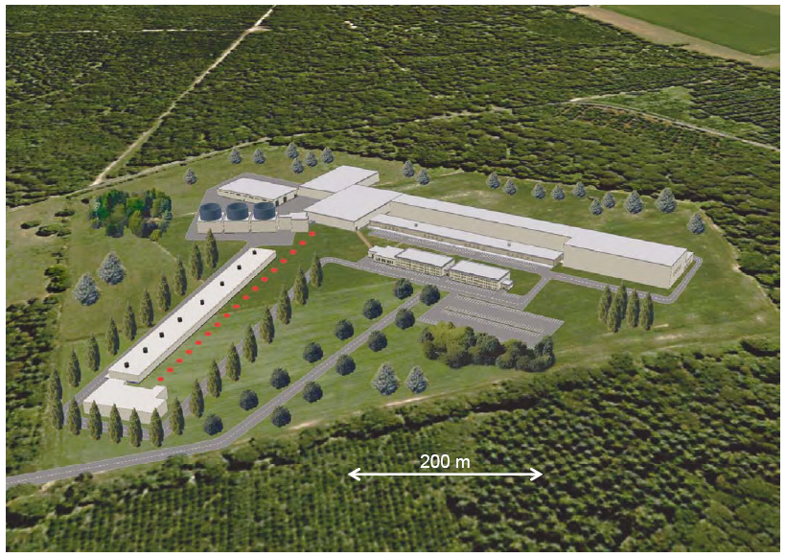
What is EURISOL?

Slide 35
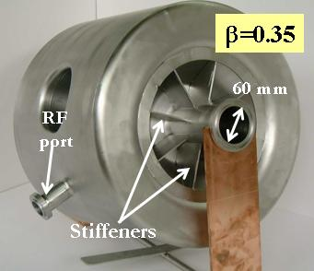
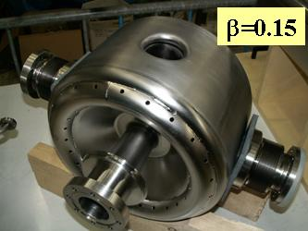
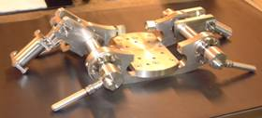
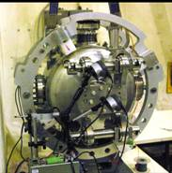
SOME OUTPUT FROM DESIGN STUDY
2005-2009 (~400 person-yrs, 20 Particpating labs, ~ 33M€)
Driver linac cavity development @ IPN Orsay
Driver requires half-wave resonators and spoke resonators
2 prototypes of 3-spoke cavity at β=0.15 and β=0.35 fabricated and successfully tested at 4.2 K
Spoke cavity tuner
Notes:
35

Slide 36
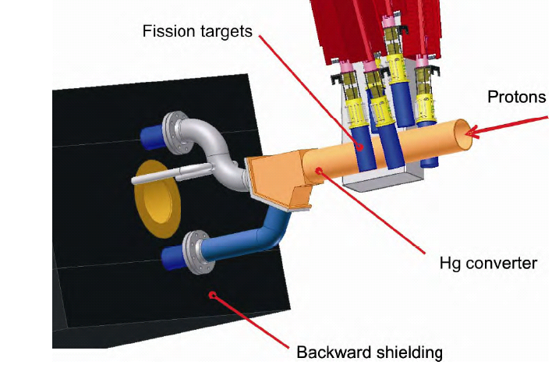
Multi Mega Watt Target Layout
DESIGN STUDY
6 x “MAFF”-type individual UC target-and-moderator units
new type of high-density UC compound tested on-line at PNPI, Gatchina

Slide 37
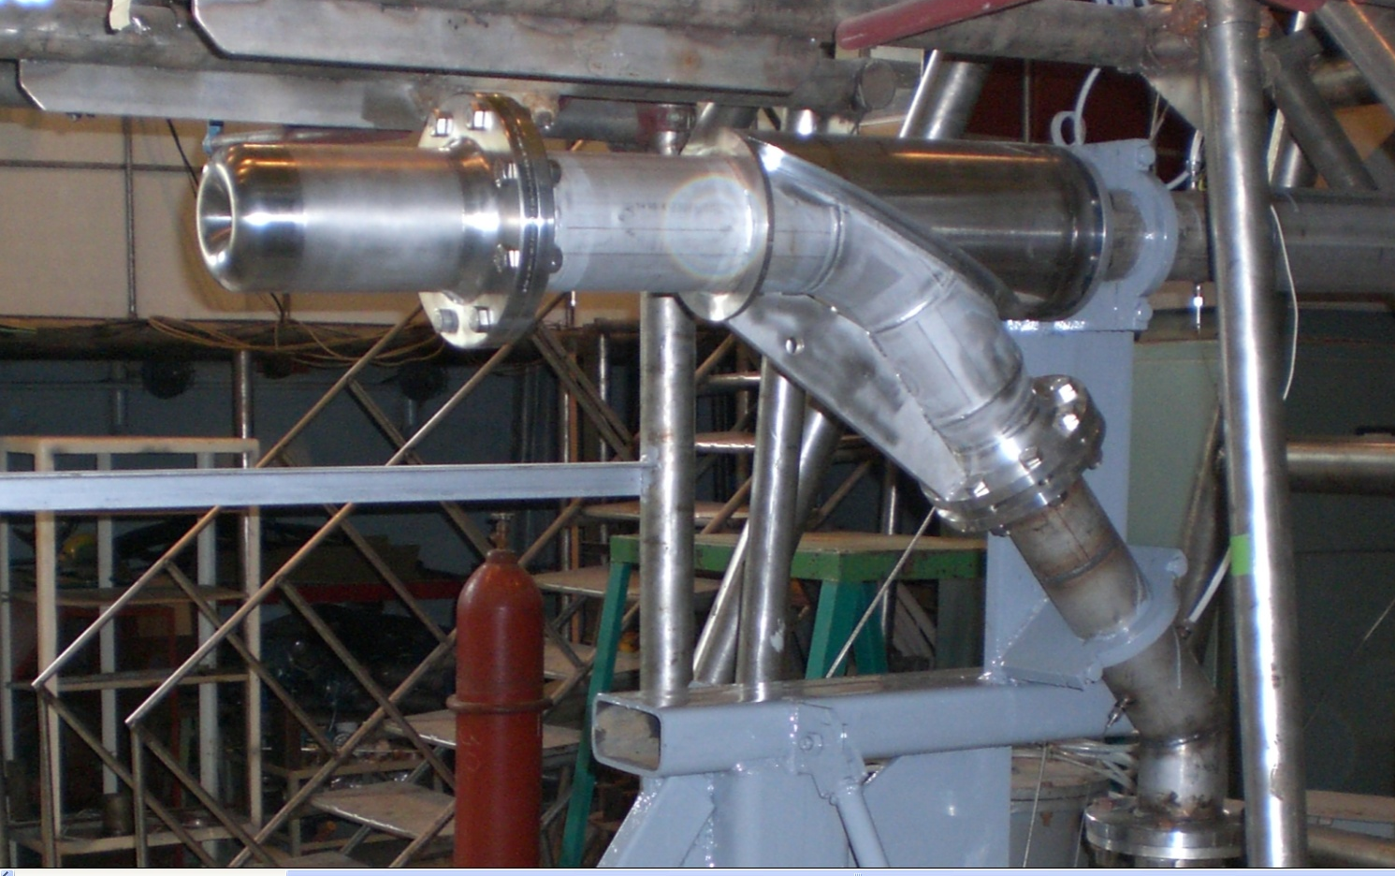
Off-line test in Hg loop at IPUL

Slide 38
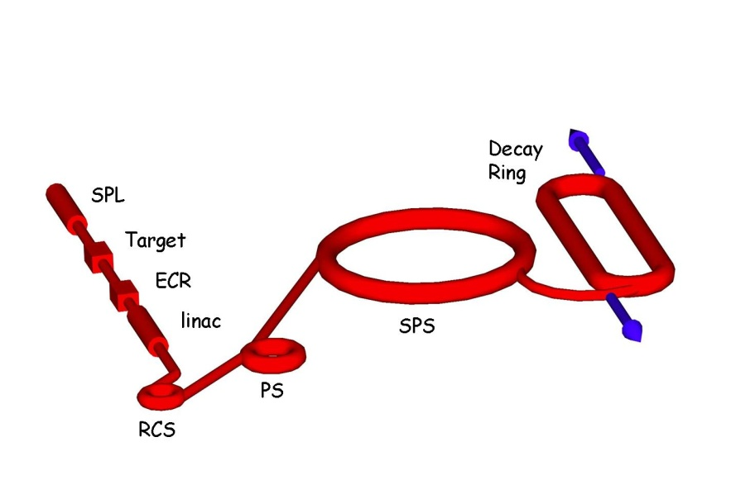
Beta Beam Study
EURISOL beta-beam scenario
Ion choice: ⁶He and ¹⁸Ne
Based on existing technology and machines
Study of a beta-beam implementation at CERN
Once we have thoroughly studied the EURISOL scenario, we can “easily” extrapolate to other cases. EURISOL study could serve as a reference.
EURISOL task 12 : Michael Benedikt - CERN

Slide 39
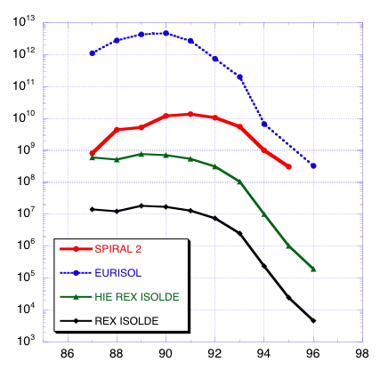
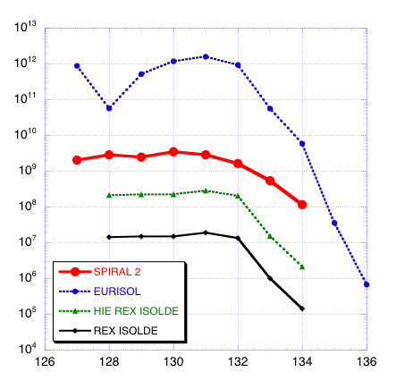
Yields of fission fragment after acceleration
(best numbers for all)
Kr
Sn
Yield, pps
Yield, pps
Today
Today
A
A
Thanks to Marek Lewitowicz
Notes:
Comparison of the expected yields for ISOL facilities.
SP2 and HIE-ISOLDE truly intermediate state ISOL facilities allowing for a very important increase (more than factor of 100) in the beam intensity with respect to the presently available intensities.

Slide 40
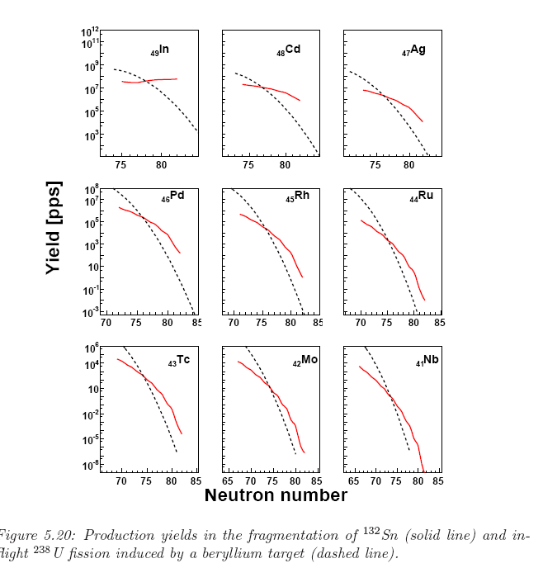
EURISOL vs. FAIR
D. Loureiro, PhD thesis, Santiago

Slide 41
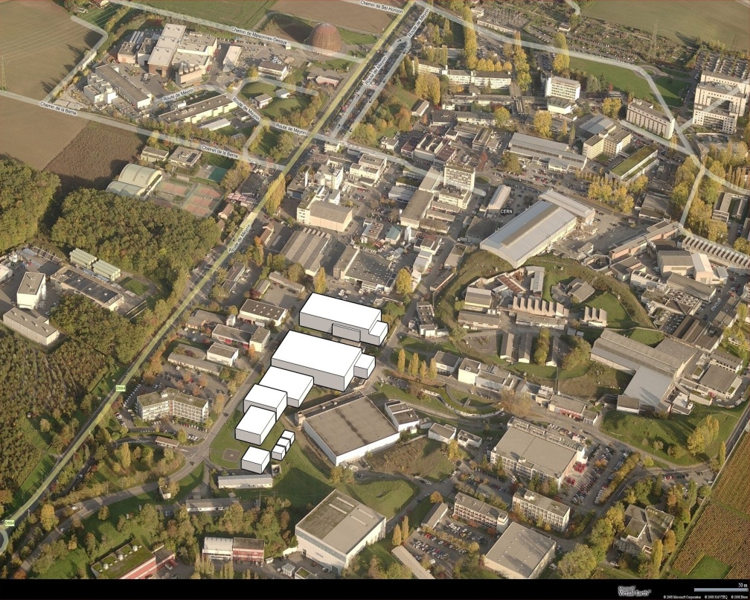
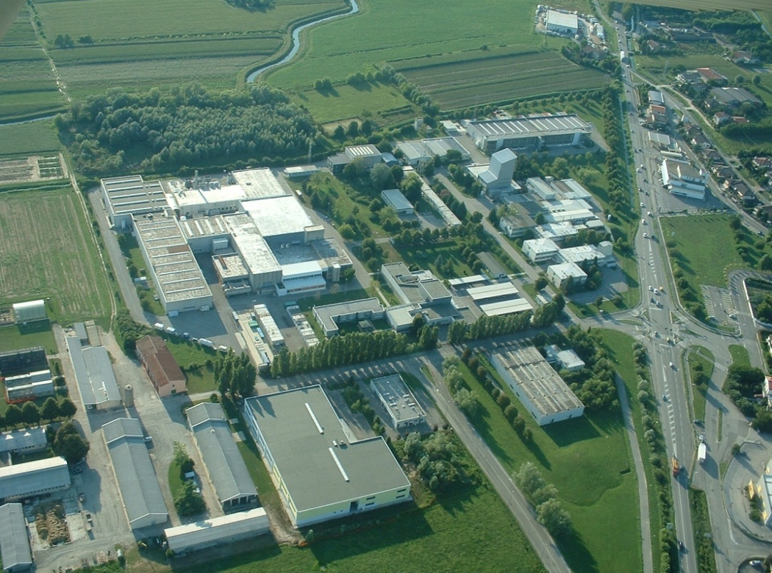
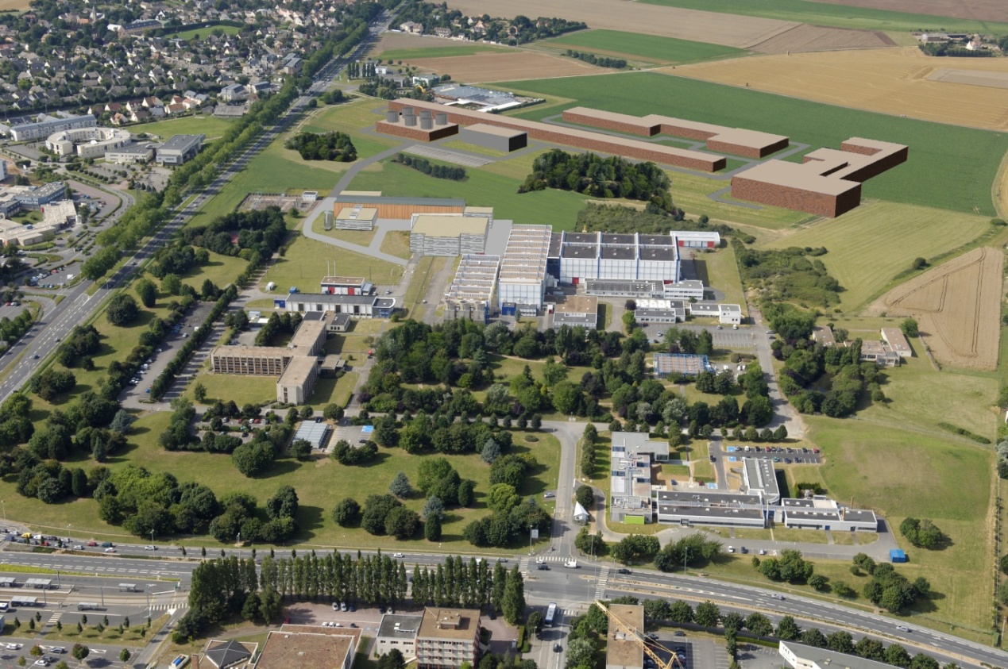
CERN
LNL Legnaro
1. LINAC4 – 2014
10 kW direct target
2. Decision on SPL
Potential candidates to host
EURISOL
GANIL
+ other sites?
1. Post-accelerator for SPIRAL-2
150 MeV/u
2. Phased approach to full EURISOL

Slide 42
NuPECC Long Range Plan 2010 Timeline
RIB Facilities
 |  | 2010 |  |  |  |  | 2015 |  |  |  |  | 2020 |  |  |  |  | 2025
 | NuSTAR@ FAIR |  | Preparatory Phase |  |  |  |  | SuperFRS experiments |  |  |  | NESR
 | SPIRAL2 |  | Preparatory Phase |  |  | RIB experiments |  |  |  |  |  |  | 150 MeV/u post-acceleration |  |  |  | EURISOL experiments
 |  | HIE-ISOLDE |  |  |  | RIB experiments |  |  |  |  |  |  |  | CERN injector upgrade
 |  |  | SPES |  |  |  | RIB experiments
EURISOL Design study |  |  | further R&D |  |  | preparatory phase & site decision |  |  |  | engineering study |  |  |  | construction

