Slide 1
WP3: rules and regulations
Second site
A.Speka, A.Ghigo and P.Campana
1st Cost & Schedule Review Meeting A.Ghigo Frascati 11 Dicembre 2023

Slide 2
WP3 Report (1)
We prepared the report for the milestone WP3-MLS3.1: April 2024
Benchmark of comparable RI organisational models
We make the comparison between the following EU distributed RI:
- EMFL European magnetic field
- The Extreme Light Infrastructure: ELI
- KM3 - NET
- ELIXIR -EMBL
EuPRAXIA Preparatory Phase La Biodola 22-28 September , 2024

Slide 3
EMFL European magnetic field
Four main labs distributed in three european countries
the Dresden High Magnetic Field Laboratory (HLD, Germany),
the Laboratoires National des Champs Magnétiques Intenses (LNCMI) in Grenoble and Toulouse (France),
High Magnetic Field Laboratory in Nijmegen (HFML, The Netherlands) –
Each of the laboratories has a specialization in the measurement of magnetic fields from different types of magnets such as pulsed magnets, superconducting magnets, high field magnets etc.
These laboratories are associated with other laboratories that are users of these infrastructures and use them continuously.
The legal framework is an AISBL.
EuPRAXIA Preparatory Phase La Biodola 22-28 September , 2024

Slide 4
The Extreme Light Infrastructure: ELI
Three main labs distributed in three european countries
ELI Beam lines located in Prague Czech Republic;
ELI Alps in Budapest Hungary;
ELI-NP in Magurele close to Bucarest Romania
and a certain number of laboratories which are users who also contribute to the development of equipment and research lines. The three pillars host very high powerful lasers made available for experiments to external users.
Czech and Hungarian laboratories joined forces in an ERIC, European Research Infrastructure Consortium together with other member countries, Italy and Lithuania.
The legal framework is an ERIC.
EuPRAXIA Preparatory Phase La Biodola 22-28 September , 2024

Slide 5
KM3-NET
Two main infrastructure located in two European countries:
ARCA telescope located in Italy
ORCA located in France
KM3NeT is a research infrastructure housing the next generation neutrino telescopes. Once completed, the telescopes will have detector volumes between megaton and several cubic kilometres of clear sea water.
The governance and management of the implementation, the commissioning and the first operation period of KM3NeT-phase 2 is defined in a Memorandum of Understanding signed by the funding authorities.
After the completion of the infrastructure the legal framework chosen is an AISBL.
EuPRAXIA Preparatory Phase La Biodola 22-28 September , 2024

Slide 6
ELIXIR -EMBL
ELIXIR is an European intergovernmental organisation that is made up of life scientists, computer scientists and support staff. The ELIXIR goal is to help researchers take advantage of the huge amounts of data produced in life science, so that we can gain new insights into how living organisms work in health and disease.
ELIXIR is part of the European Molecular Biology Laboratory that is an organization with the commitment to making biological data and information accessible to life scientists in all disciplines.
In ELIXIR there are 23 countries that work together using a ‘Hub and Nodes’ model.
ELIXIR makes use of the legal structure of European Molecular Biology Laboratory (IGO)
EuPRAXIA Preparatory Phase La Biodola 22-28 September , 2024

Slide 7
WP3 reports
We prepared the report of the Deliverable
WP3-DVL3.1: April 2024
Criteria and methodology for 2nd site selection
aimed at sites that propose themselves as a second site:
CLPU - Salamanca (ES)
CNR - Pisa (IT)
ELI-ERIC - Prague (CZ)
EPAC - Oxford (UK)
EuPRAXIA Preparatory Phase La Biodola 22-28 September , 2024

Slide 8
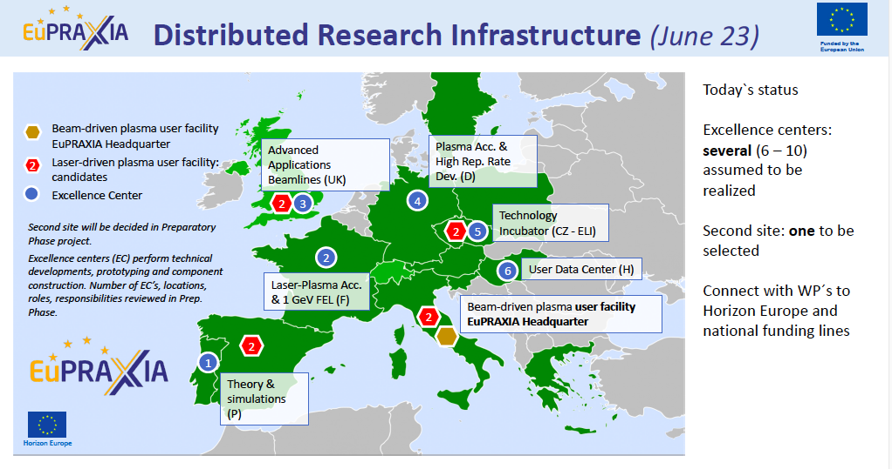
EuPRAXIA Preparatory Phase La Biodola 22-28 September , 2024

Slide 9
Criteria and methodology for 2nd site selection
The report describes the main elements that will be used to prepare the path toward a decision for the choice of the second site, i.e. the one that will host the Laser Driven Plasma Accelerator of the ESFRI EuPRAXIA infrastructure.
the report contains :
General Assessment Criteria for Research Infrastructure
Assessment Criteria Specific to Laser Plasma Acceleration
These criteria are the the framework of the “bid-book” that laboratories that want to host the second site can present at the Collaboration Board
EuPRAXIA Preparatory Phase La Biodola 22-28 September , 2024

Slide 10
Bid-book
We prepared a short document titled :
EuPRAXIA Laser based infrastructure bid-book request
in which we ask to the lab that proposed themselve to be EuPRAXIA laser site to describe the characteristics and conditions proposed to meet the requirements of the second site
In the next presentation Arnd will describe the bid-book
EuPRAXIA Preparatory Phase La Biodola 22-28 September , 2024

Slide 11
Visits to possible second site
We visited the proposed second sites:
CNR - Pisa (IT) → 13-14 June 2023
CLPU - Salamanca (ES)→ 3-4 December 2023
ELI-ERIC - Prague (CZ) → 1-2 October 2023
EPAC - Oxford (UK) → 13-14 February 2024
Following the agenda:
Overview of the structure (Ongoing/planned researches and infrastructure)
Facility tour
Round table discussion
EuPRAXIA Preparatory Phase La Biodola 22-28 September , 2024

Slide 12
Thanks for the attention
1st Cost & Schedule Review Meeting A.Ghigo Frascati 11 Dicembre 2023

