Slide 1






















Incorporating
EuPRAXIA into EPAC
PWASC
Rajeev Pattathil

Slide 2
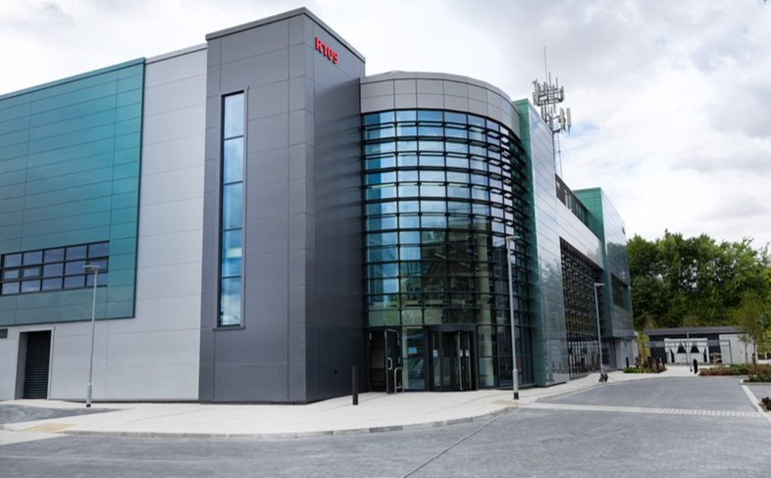

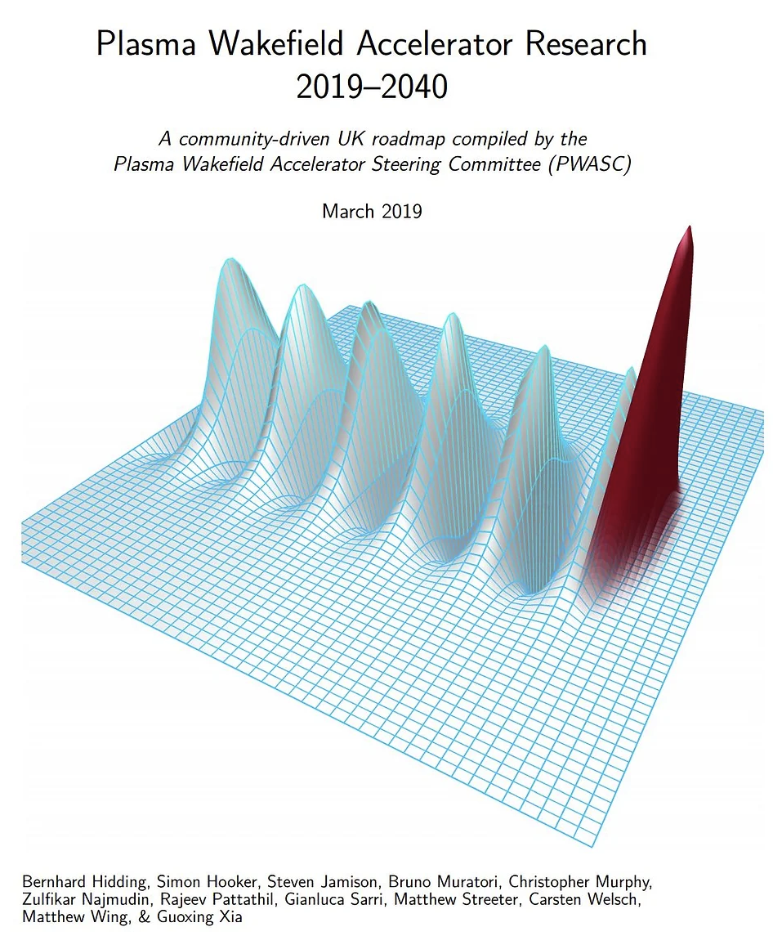
@ EPAC?
10Hz PW laser driving plasma accelerators
Built for 10GeV beams at 10Hz
Propose to start with 10Hz PW beam with 100Hz upgrade option (under development)
Strong expertise within STFC (lasers, accelerators, detectors, targetry, data…) and the academic community (plasma accelerators)
Applications-oriented program and industry links
STFC has long history and all the infrastructures required to run a successful user programme
Joining EuPRAXIA is in PWASC Roadmap
EPAC’s operations to start in 2026/27 – EuPRAXIA can be built on this – EPAC will be a plasma accelerator facility (not just a laser facility)
PWASC

Slide 3
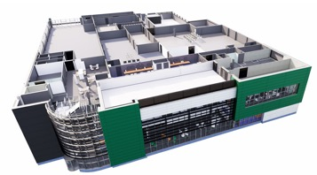
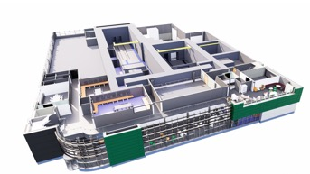
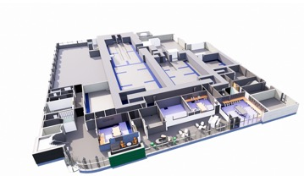
EPAC Facility Schematics
Pump
Front End
Ti:S Amp
Switchyard
Top floor houses
1 PW@ 10Hz Laser areas and laser control room.
Space for the addition of new laser systems: 2nd and 3rd synched beamlines
Office space on 2nd and 1st floors
Ground Floor houses three double height radiologically shielded experimental areas
Experimental area 1 (EA1) ~38 m x 9 m,
Experimental area 2 (EA2) ~18 m x 10 m
Future experimental area (EA3)
Control rooms and auxiliary labs and future cleanroom space and development laser labs
Compressor
2nd Floor
Beam
Transport
1st Floor
EA1
EA2
Ground Floor

Slide 4
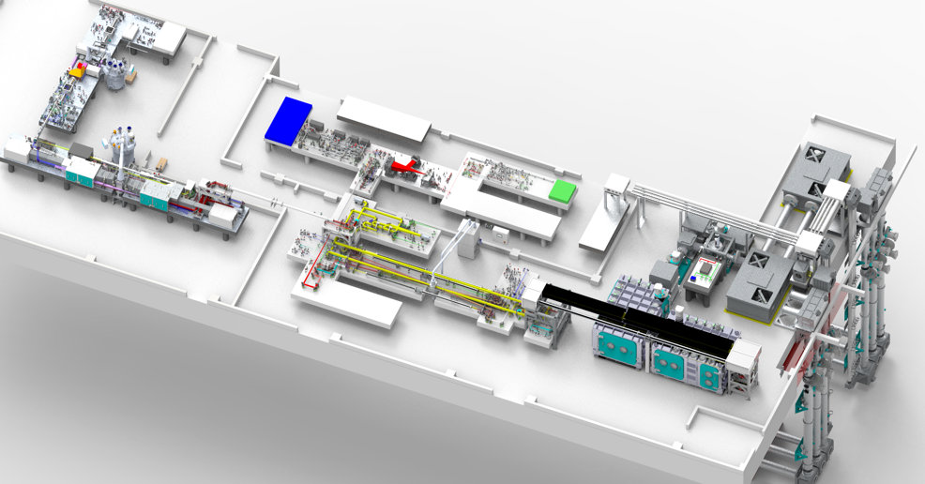
EPAC Laser system
EPAC specification
1PW@10Hz
Output Energy 30 J
Pulse duration ≤ 30 fs Repetition rate 10 Hz, 1 Hz, Shot on Demand
Beam transport
EPAC Front End
DPPLS Pump
Pump for Ti:S is CLF developed 100J DiPOLE system.
Additional space for future laser and experimental areas (eg. a 100Hz system under development)
Green conversion
Ti:Sa High Energy Amplifier
Compressor & diagnostics
EPAC Front End
10 Hz TiSa Amplifier
Compressor
Beam propagation
EPAC pump
2w Conversion
Experimental Areas

Slide 5
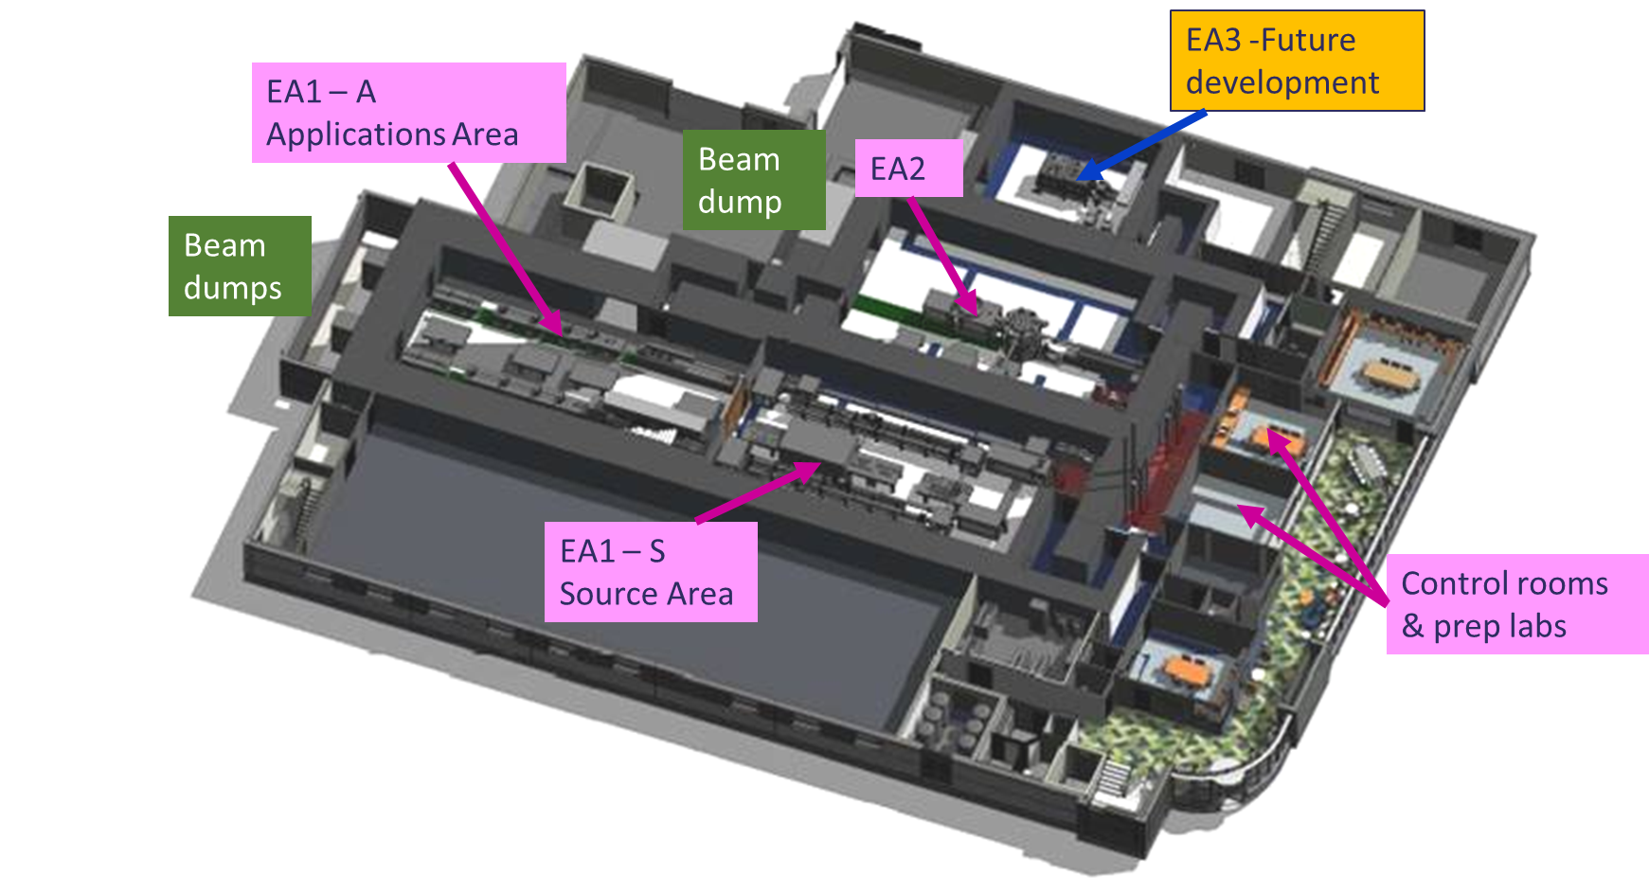
Experimental areas on the ground floor
EA2:
Electrons. Ions. Protons & x-rays
Multimodal imaging
EA1:
Secondary source beamline
Fixed laser configuration LWFA
Flexible applications area
Electrons, x-rays, positrons, muons
Notes:
Replace this guidance text with your own bullet pointed content.
For further guidance please see https://www.bdadyslexia.org.uk/advice/employers/creating-a-dyslexia-friendly-workplace/dyslexia-friendly-style-guide

Slide 6
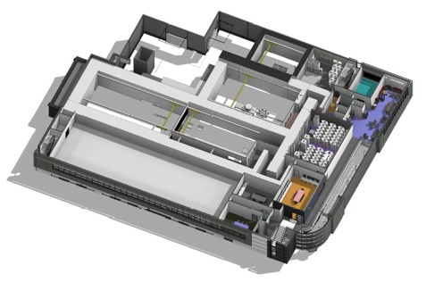
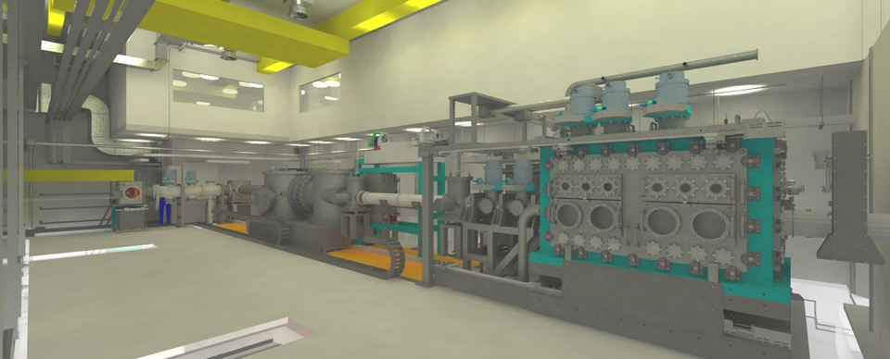
EA1 Configured for plasma accelerator research
First Floor
EPAC 1 PW drives a laser plasma accelerator
Focused to relativistic intensity (above 10¹⁸ Wcm⁻²)
Target is a few cm of gas
Creates a plasma with extremely high accelerating fields
Generates multi-GeV electron beams and x-rays
Timeline:
2023: Chambers and large equipment delivered
2024: Commissioning with internal laser
2025: Pulsed beam commissioning
2026: LWFA commissioning
2027: Operational user facility
Beam enters from the pit
Beam focusing
Electrons
Interaction chamber
X-rays

Slide 7
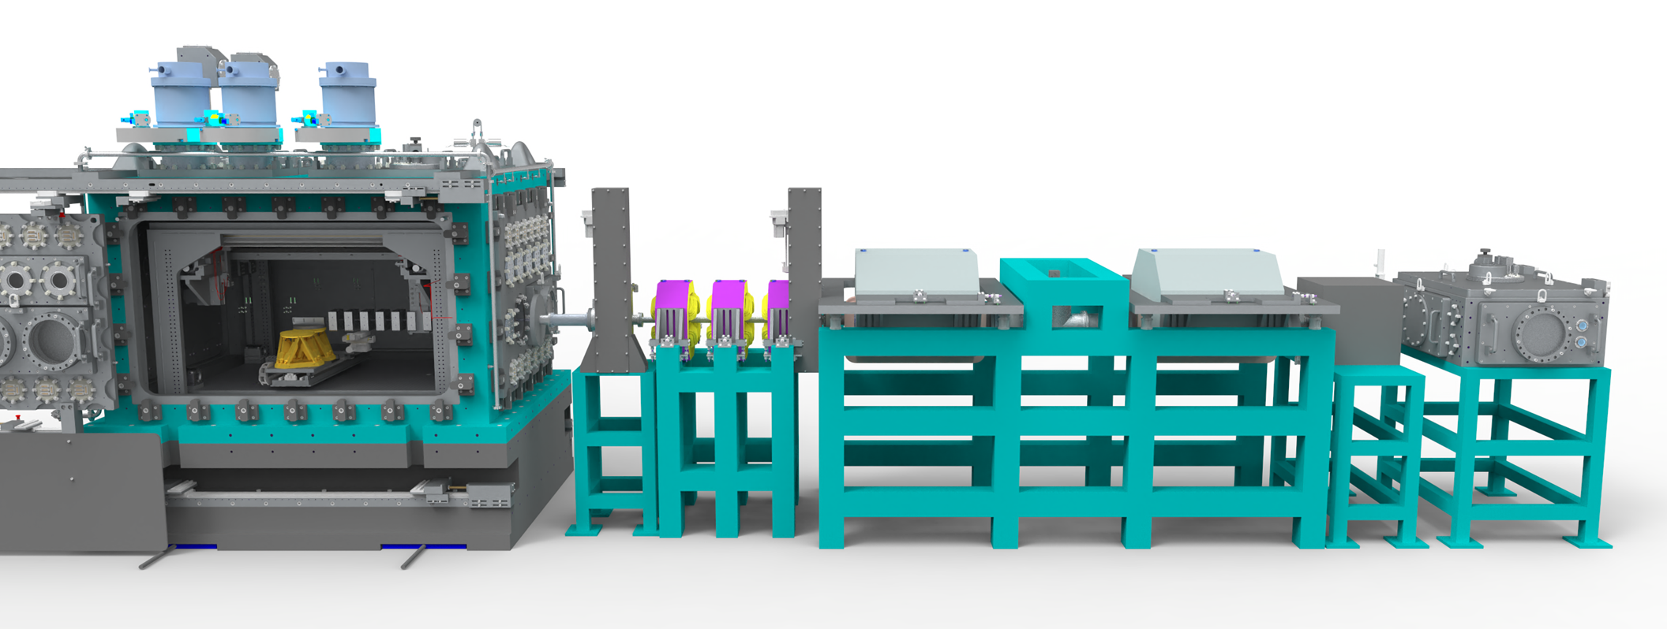
EA1 sources and applications
Impact (positrons / muons / bremsstrahlung)
Collisions (Inverse Compton Scattering & QED)
X-ray Diffraction and Spectroscopy
X-FEL
Bimodal imaging (x-ray + neutron)
Very similar to what EuPRAXIA user-base would need
Notes:
Delete boxes as required

Slide 8
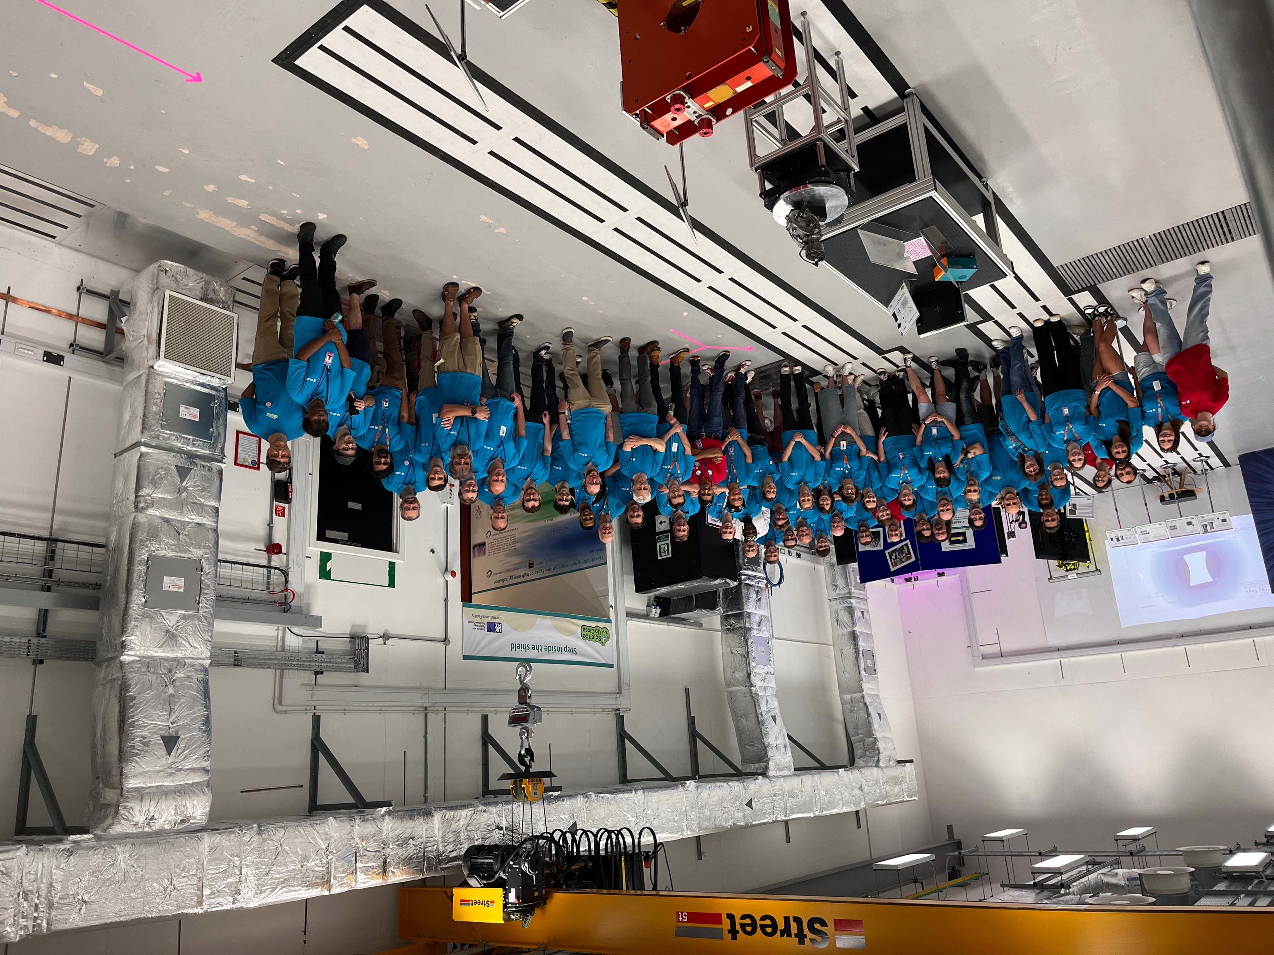
“Outreach” in EPAC
Harwell open weeks
~18000 visitors
  Students
  Strategic partners
  Public

Slide 9
@EPAC: requirements from community
  Prototypes of amplifier head, solutions for heat management
  Test compressors with gratings with appropriate damage thresholds and heat management solutions
  Solutions for wavefront and pointing corrections
  Diagnostics, Targets, Gas flow control, feedback systems, ML control, plasma lens
  Inputs to end-to-end FEL simulations with laser-driven electrons, undulator design, electron beam transport, photon beamline, diagnostics
  Input to design of user stations, rigs, diagnostics
  Physics simulations of LWFA and optimisation of secondary sources for various applications, diagnostics
  Advanced Accelerator schemes (eg. Trojan Horse)
France, Germany, Italy..
Internally developed/coordinated key components
Building design and construction with radiological modeling (CLF)
EPAC 10Hz, 30J system, 100Hz – few 100TW system (CLF)
Laser beam transport (CLF)
Plasma accelerator (UK CoE)
FEL beamline, undulators (ASTeC)
User areas (UK CoE)
Betatron beamline (UK CoE)
Positron beamline (UK CoE)
France Germany, …
France, Germany, Italy
France, Germany, Switzerland
Germany, Italy, Switzerland
Germany, Portugal
Germany

Slide 10
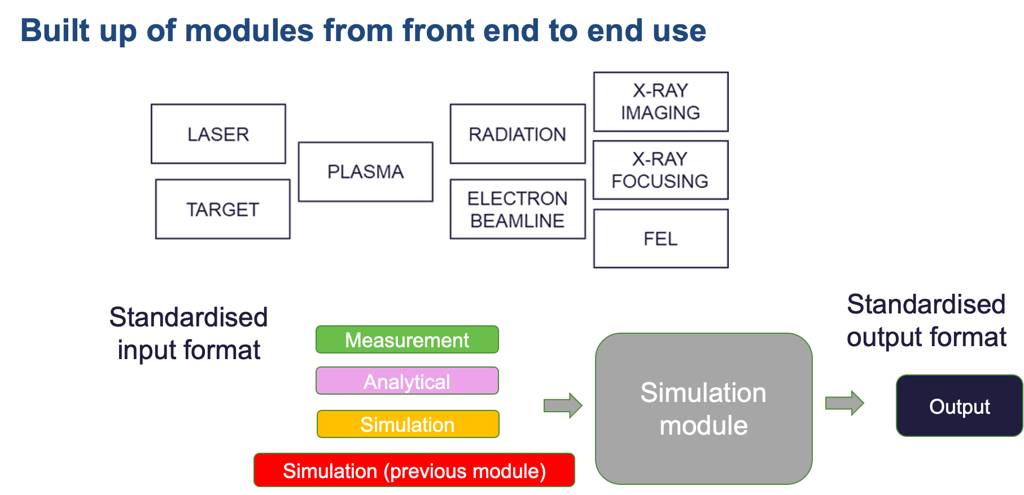
@EPAC: collaboration opportunities
This will benefit EuPRAXIA regardless of the site

Slide 11
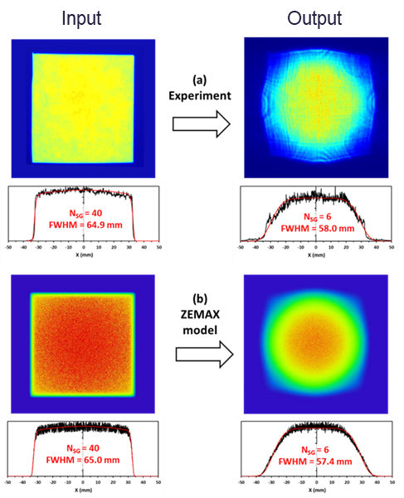
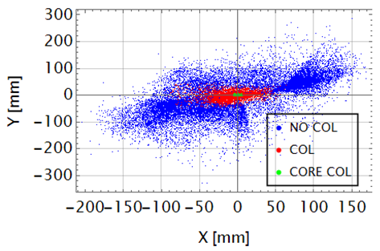
@EPAC: collaboration opportunities
© DESY

Slide 12
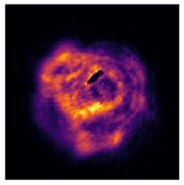
@EPAC: collaboration opportunities
Laser damage is a big issue
Development of high damage threshold optics
Studies on laser damage: dependence on
  Coatings
  Vacuum levels
  Cleanliness
  Humidity and environment control
  Memory effects
Integrated machine safety systems

Slide 13
