Slide 1
Attractivity for users in the inertial fusion field
Leonida A. GIZZI
Istituto Nazionale di Ottica, CNR, Pisa, Italy

Slide 2
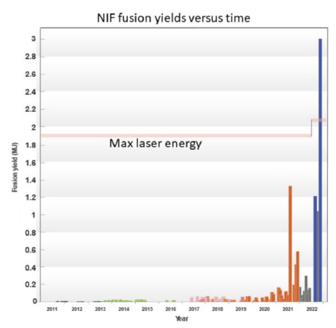
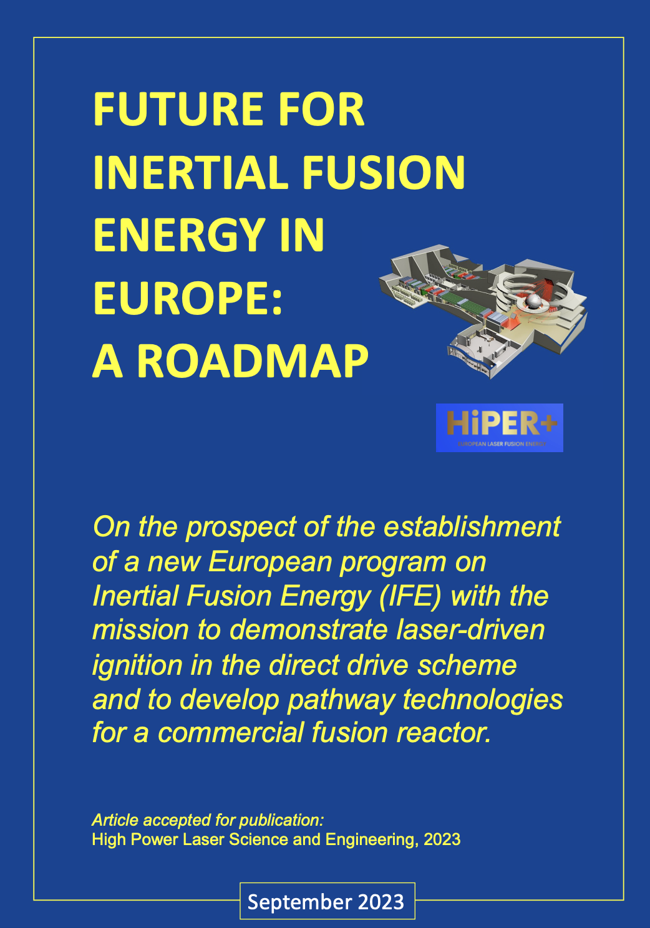
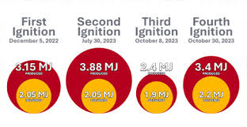

Inertial Fusion Ignition
In December 2022, experiments performed at the National Ignition Facility (NIF) in the U.S. have demonstrated a “net energy gain” from an inertial confinement fusion (ICF) experiment
Gain = 3.15MJ / 2.05 MJ = 1.54
Long and difficult way to success
Major impact of NIF Ignition demonstration
National Ignition Campaign (2011-2013) Max fusion output $≈$ 3 kJ
Broad research programmes on IFE being engaged worldwide

Slide 3




Inertial Fusion Case
Investigating Underlying Physics of Direct-Drive Inertial Fusion Energy
  Physics issues to be understood:
Plasma production and characterization
Parametric instabilities in implosion-like and shock-ignition-like Laser-Plasma interaction;
      Stimulated Brillouin Scattering (SBS)
      Stimulated Raman Scattering (SRS), side SRS
      Two Plasmon Decay
      Cross-beam Energy Transfer (CBET)
      Filamentation
      Speckles from smoothing
      Hot electrons generation and their impact
      Acceptable degree of non uniformity in irradiation during compression / ignition phases
      Multiple beam irradiation
      Broadband and Chirped pulse irradiation
      Polar Direct Drive
      Hydrodynamics and Shock generation vs. Laser pulse profile
      Optimization of ablators for IFE targets
      Use of foam targets
      Diagnostics development including laser-driven secondary sources
      Comparison with advanced simulations tools (Hydro, PIC)
Phase 1: laser irradiation
Phase 2: Compression
Phase 3: Ignition
Phase 4: Burn
Needed platform for investigating matter under extreme conditions and High Energy Density plasmas

Slide 4
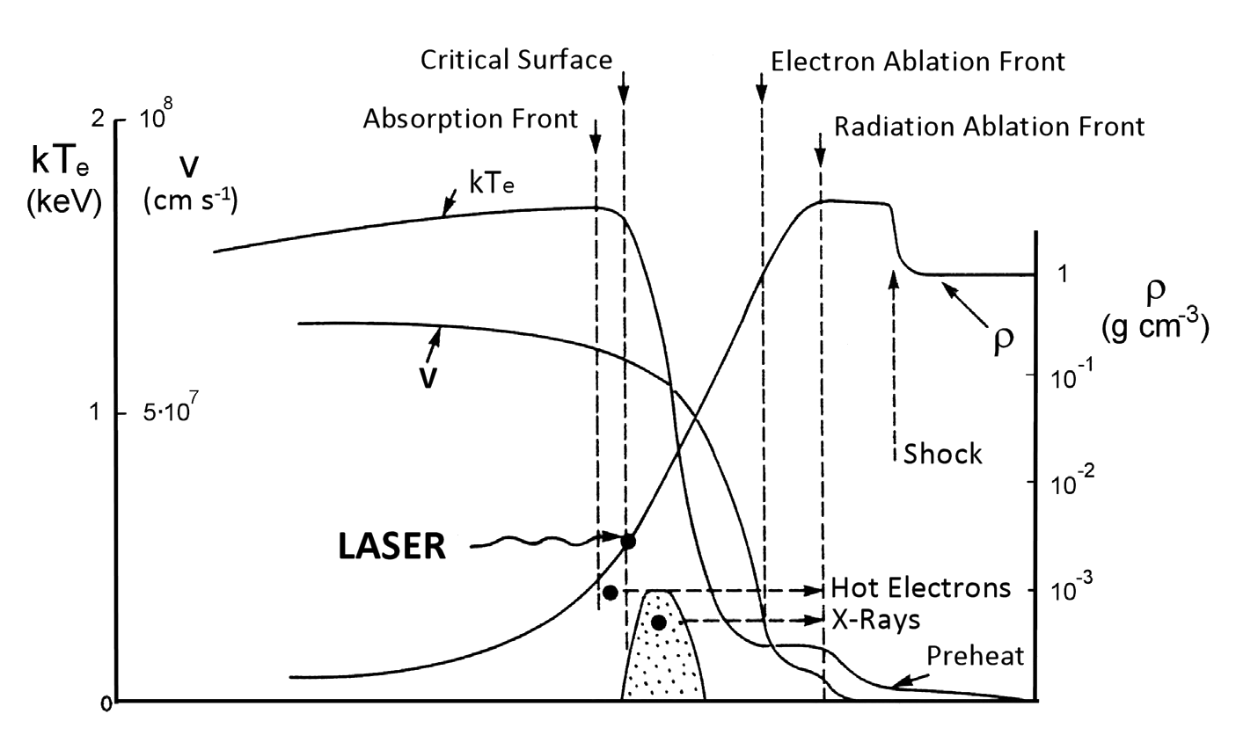

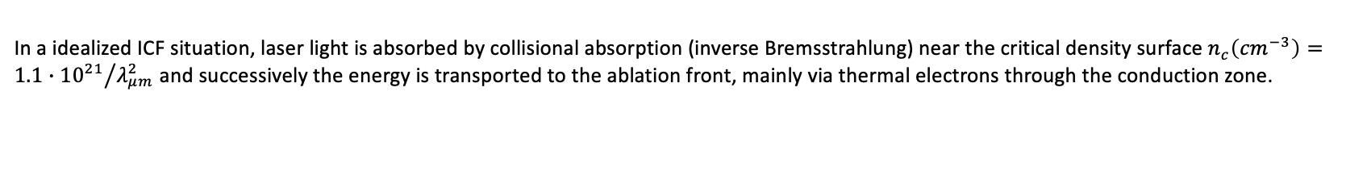

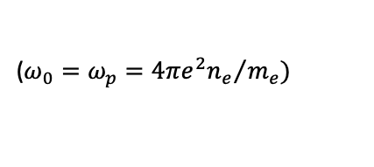
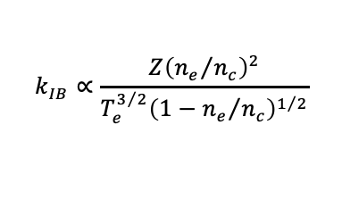



Mimicking ICF interaction
Conduction Zone
$\sim 1022$ (cm⁻³)
$\sim 1024$ (cm⁻³)
PLANAR GEOMETRY
Interaction
Laser
$$\frac{}{}dI$$
In a idealized ICF situation, laser light is absorbed by collisional absorption (inverse Bremsstrahlung) near the critical density surface $n_{c}\left({cm}^{−3}\right)={1.1∙{10}^{21}}/{λ_{μm}^{2}}$ and successively the energy is transported to the ablation front, mainly via thermal electrons through the conduction zone.
$$n_{c}=\frac{m_{e}ω^{2}}{4πe^{2}}$$
$$\frac{dI_{L}}{dz}=−k_{IB}I_{L}$$
$$k_{IB}∝\frac{Z{\left({n_{e}}/{n_{c}}\right)}^{2}}{T_{e}^{3/2}{\left(1−{n_{e}}/{n_{c}}\right)}^{1/2}}$$
($ω_{0}=ω_{p}={4πe^{2}n_{e}}/{m_{e})}$

Slide 5
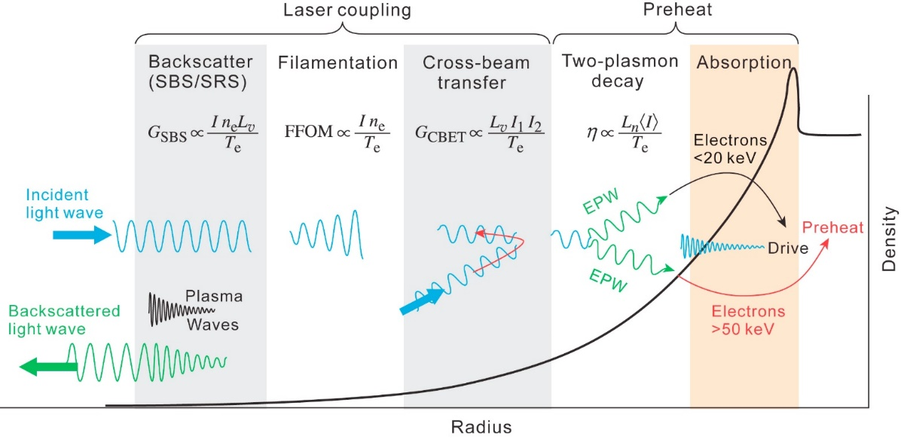
Mimicking ICF interaction
Several open physics issues at different densities
Plasma density mapping and scalelength is crucial for investigating LPI
A wide range of plasma conditions exists in ICF
Higher densities not accessible in the optical range
Shock driving is relevant for studies of material under extreme conditions
Froula et al., Plasma Phys. Control. Fusion 54 (2012) 124016
Density characterization needed including scalelength, density fluctuations, temporal evolution

Slide 6
Probing full range of plasma conditions
Investigating Underlying Physics of Direct-Drive Inertial Fusion Energy
PLANAR GEOMETRY
PLANAR GEOMETRY
Interaction
Laser
Interaction
Laser
Probe
Laser
Needed platform for investigating matter under extreme conditions and High Energy Density plasmas

Slide 7
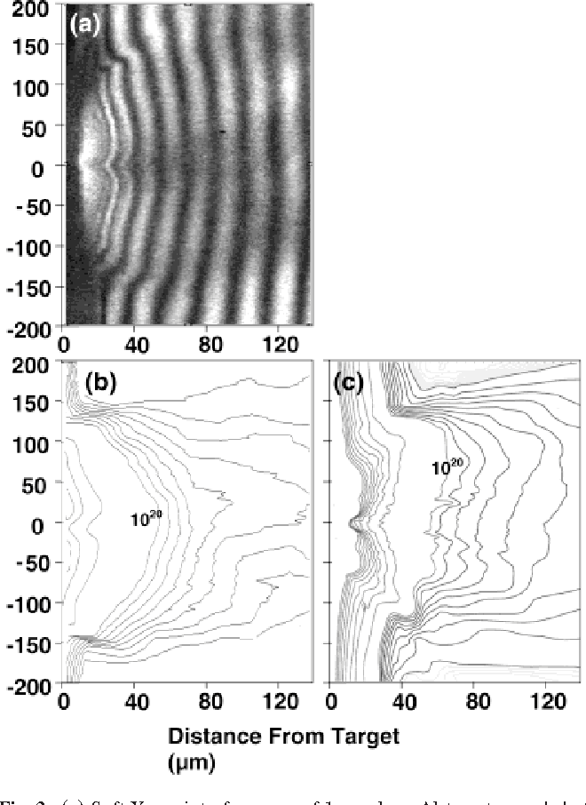
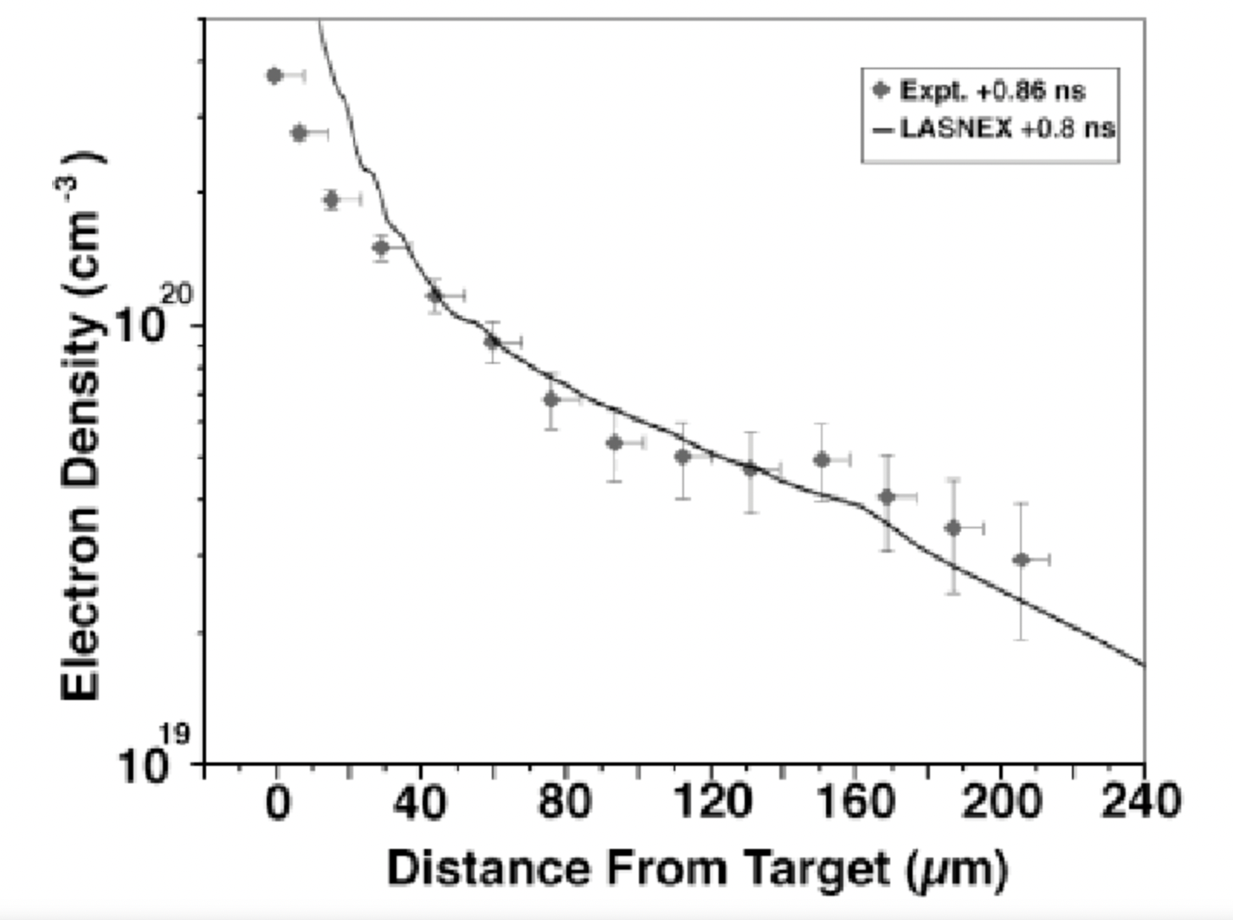
Probing Wavelength vs Density in Plasmas
Plasma density characterization and mapping has been developed strongly using interferometry with optical or X-ray probe
Optical probing can address densities << n_{c} = 1.1 × 10²¹ λ_{L}⁻²cm⁻³
Higher densities require shorter wavelengths
Plasma-based X-ray laser
Dunn, James et al. “Picosecond 14.7 nm interferometry of high intensity laser-produced plasmas.” Laser and Particle Beams 23 (2005): 9-13.
Critical Density (cm-3) | Wavelength (nm)
1,00E+19 | 10000
1,00E+20 | 3162
1,00E+21 | 1000
1,00E+22 | 316
1,00E+23 | 100
1,00E+24 | 32
1,00E+25 | 10
1,00E+26 | 3
Scattering and refraction lead to much shorter optimum wavelength
Fully laser-plasma based platform can be developed, but has limitations in X-ray laser performance

Slide 8
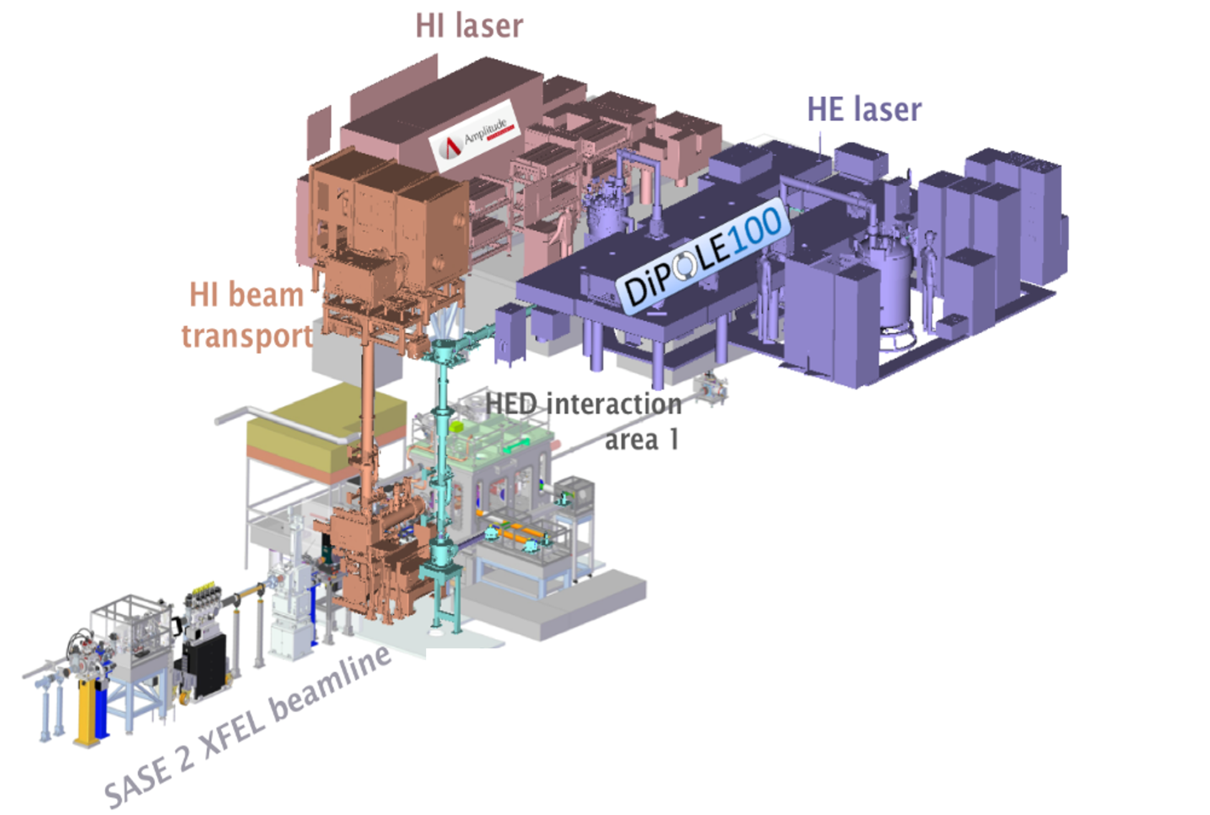
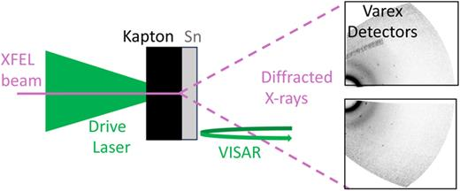
HED studies of X-ray laser FEL: XFEL
Coupling high energy lasers with XFEL beamline to investigate extreme states of matter with X-ray probing
DIPOLE@XFEL
First experiment on X-ray diffraction of laser shocked material: large community
λ=0.68 Å
DIPOLE:
70J pulses, ns duration, to drive shock
M. G. Gorman et al., Shock compression experiments using the DiPOLE 100-X laser on the high energy density instrument at the European x-ray free electron laser: Quantitative structural analysis of liquid Sn. J. Appl. Phys. 28 April 2024; 135 (16): 165902. https://doi.org/10.1063/5.0201702
A new paradigm to study Extreme Matter States and HED/ICF relevant

Slide 9

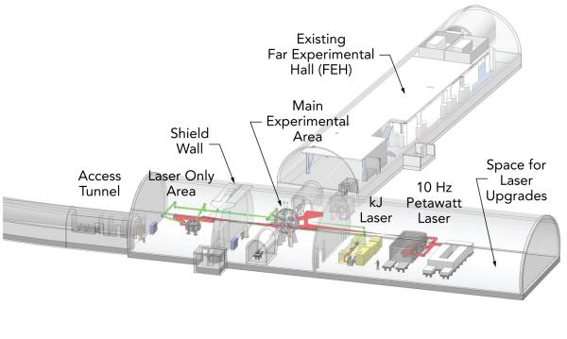
HED studies with X-ray laser FEL: LCLS
MEC Upgrade (MEC-U) @ LCLS
“The capabilities and research goals of MEC-U are driven by several DOE-FES strategic goals and will provide a world-leading facility to attract and retain a new generation of plasma and fusion science leaders.”
https://www.osti.gov/servlets/purl/1866100

Slide 10
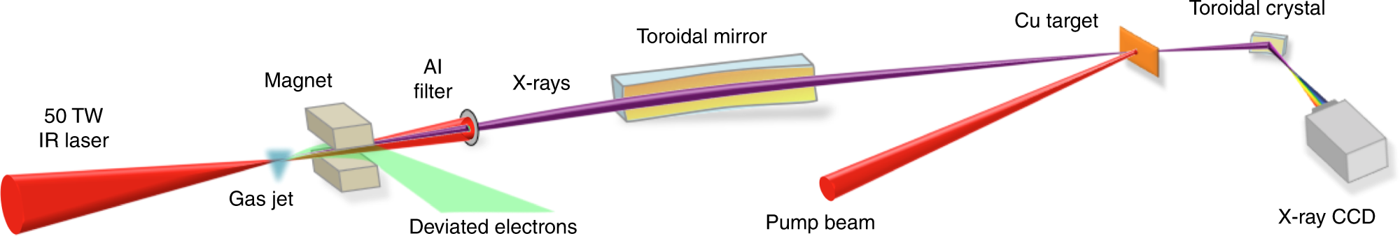
HED and fusion studies @EUPRAXIA
First stage: probing HED plasmas with betatron source
Betatron source can be used for
  X-ray absorption spectroscopy
  X-ray phase contrast imaging
  Investigate ionization dynamics
  Map density fluctuations
  ….
Mahieu, B., Jourdain, N., Ta Phuoc, K. et al. Probing warm dense matter using femtosecond X-ray absorption spectroscopy with a laser-produced betatron source. Nat Commun 9, 3276 (2018). https://doi.org/10.1038/s41467-018-05791-4
Accessible with moderate beam parameters, but boosted by high repetition rate
Pump beam available from unused Ti:Sa pump lasers

Slide 11
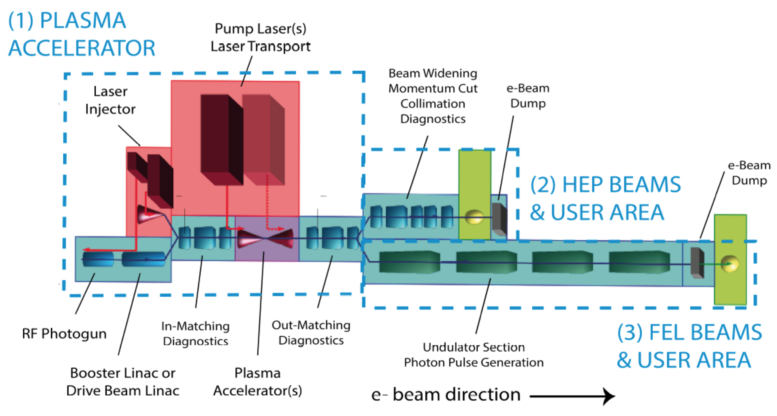
HED and fusion studies @EUPRAXIA
Full case: X-ray FEL to probe HED and Fusion relevant plasmas
Need of a high energy laser co-located with the X-ray FEL to produce ICF-relevant plasma: specifications of a PUMP laser
Extra, high-energy pump laser

Slide 12
Conclusions
Fusion energy is a strong case with major socio-economic impact and Inertial Fusion Energy is attracting increasing attention
High Energy Density research is a main topic in the portfolio of many physics research infrastructures
X-ray FEL sources are establishing instruments and capabilities for HED and Inertial Fusion research
EuPRAXIA can attract the users of this community with a modest effort and enter this highly developing field.

Slide 13

Acknowledgements
EuPRAXIA Preparatory Phase
This project has received funding from the European Union’s Horizon Europe research and innovation programme under Grant Agreement No. 101079773. It is supported by in-kind contributions by its partners and by additional funding from UK and Switzerland.
EuPRAXIA Doctoral Network
This project has received funding from the European Union´s Horizon Europe research and innovation programme under grant agreement no. 101073480 and the UKRI guarantee funds.
EuAPS
This publication has been made with the co-funding of European Union Next Generation EU.

