Slide 1
Hosting and outreach at INFN
Massimo Ferrario (INFN-LNF)
on behalf of the EuPRAXIA@SPRAC-LAB Collaboration
EuPRAXIA_PP Annual Meeting, September 22

Slide 2
EuPRAXIA Mission
EuPRAXIA is the first European project that develops a dedicated particle accelerator research infrastructure based on novel plasma acceleration concepts driven by innovative laser and linac technologies.
High Acc. Tech. available => not limited to FEL applications on a longer term view
Undulators
1 GeV LINAC
Plasma module
RF power modules
FEL user area @4nm
Secondary
Sources
Beam user areas
0.5 PW Laser

Slide 3
Possible Extensions
High Brigthness X-band Linacs => CLIC Community, Coll. with CERN
High Brightness Laser Systems => Inertial Fusion Community
High rep rate modules => Plasma Collider => Alegro and Muon Collider
Medical Applications =>VHEE, FLASH
Positron Source
Laboratory Astrophysics
High Acc. Tech. available => not limited to Plasma Acceleration
Undulators
1 GeV LINAC
Plasma module
RF power modules
FEL user area @4nm
Secondary
Sources
Beam user areas
0.5 PW Laser

Slide 4
EuCOLL: EuPRAXIA R&D for Plasma Collider
EuPRAXIA, if properly supported, will be able to shading light among some still open issues relevant for a LC design:
WP1 Plasma accelerator theory and simulations (LNF, Mi, RM1,RM2, Pisa, ITS, QUB)
WP2 - High repetition rate plasma module (LNF, LNS)
WP3 High efficiency plasma acceleration, high transformer ratio mode (LNF, RM1, Mi)
WP4 Positron source and acceleration (QUB, LNF, RM2)
WP5 – Scalable laser driver technology (Pisa, LNF)
In addition it may provide fundamental information about long term machine operation and its reliability and, also very important, training of the next generation Accelerator Scientist.

Slide 5
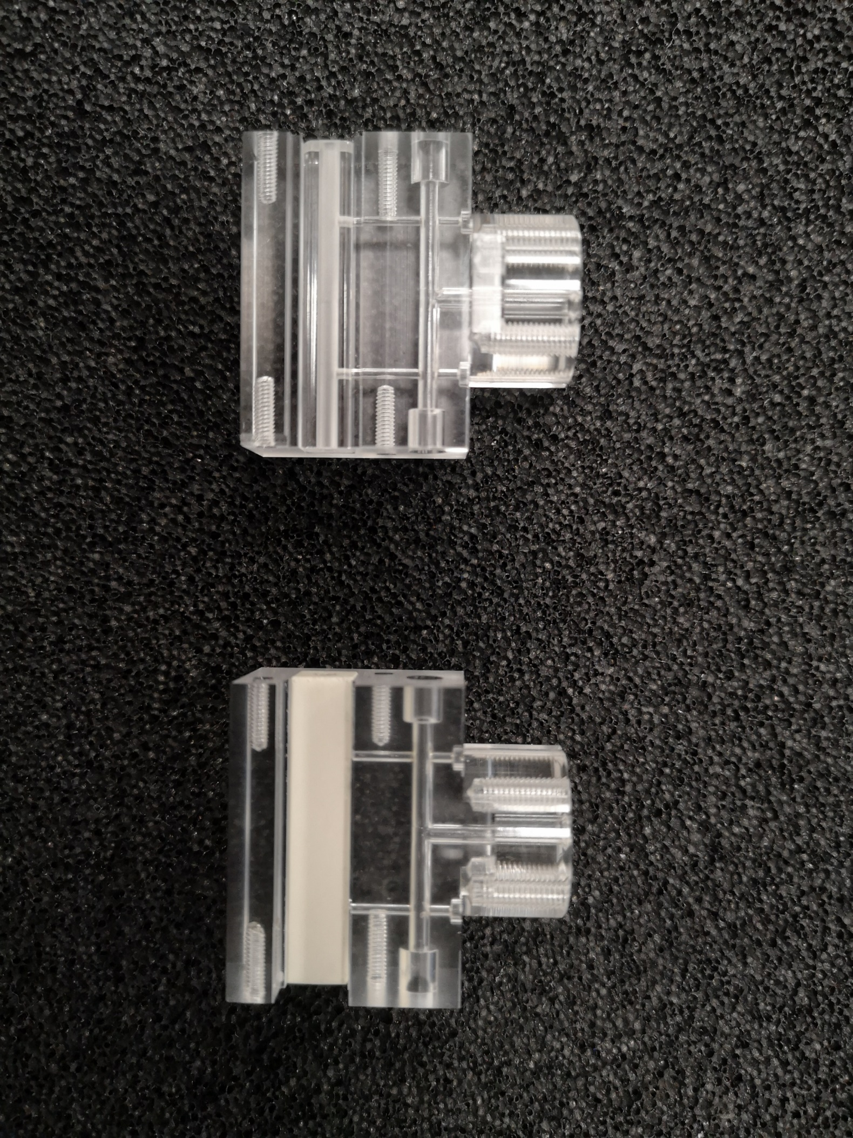
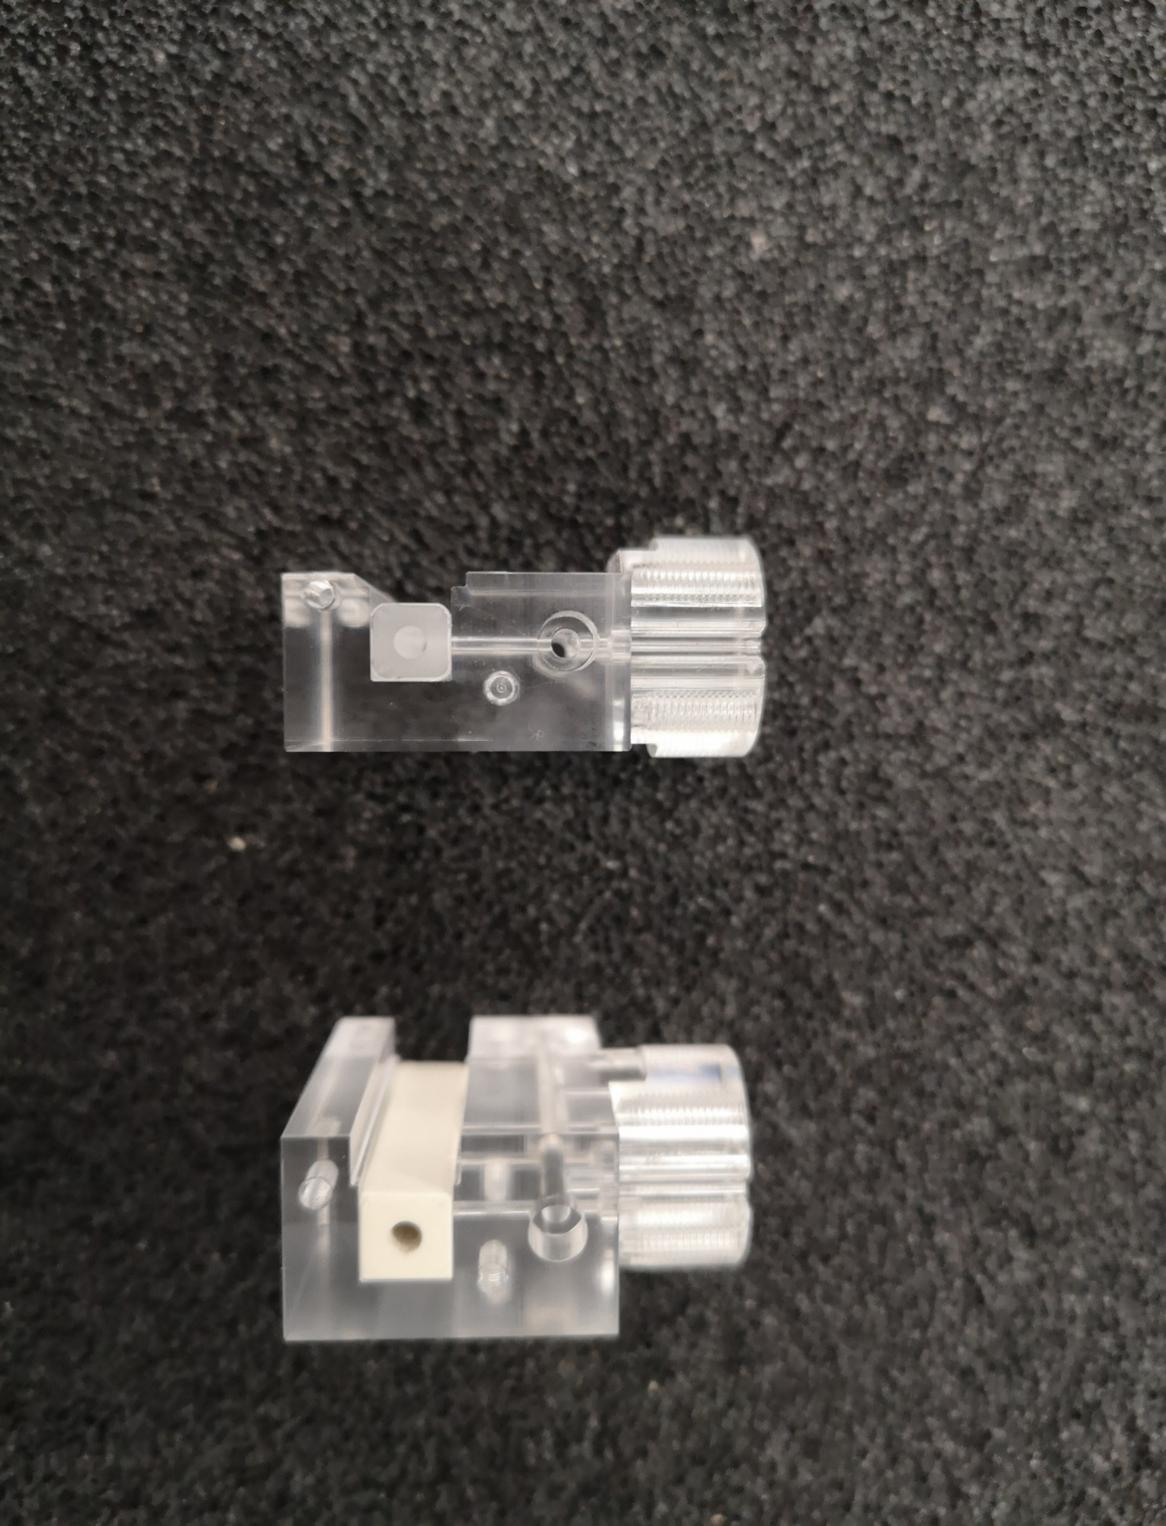
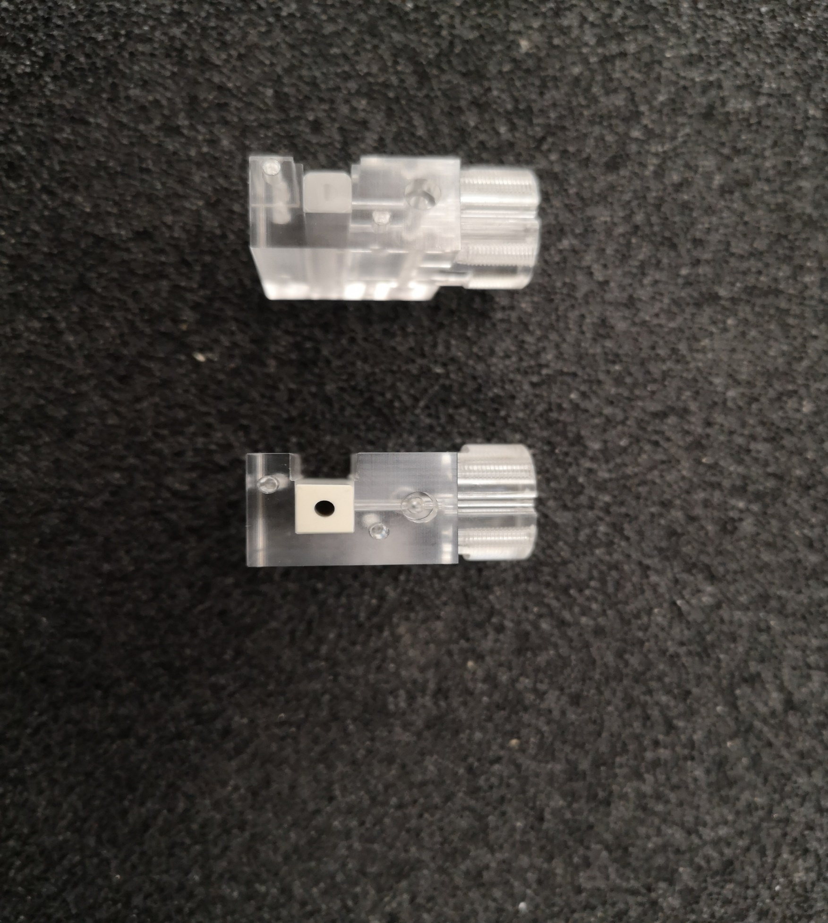
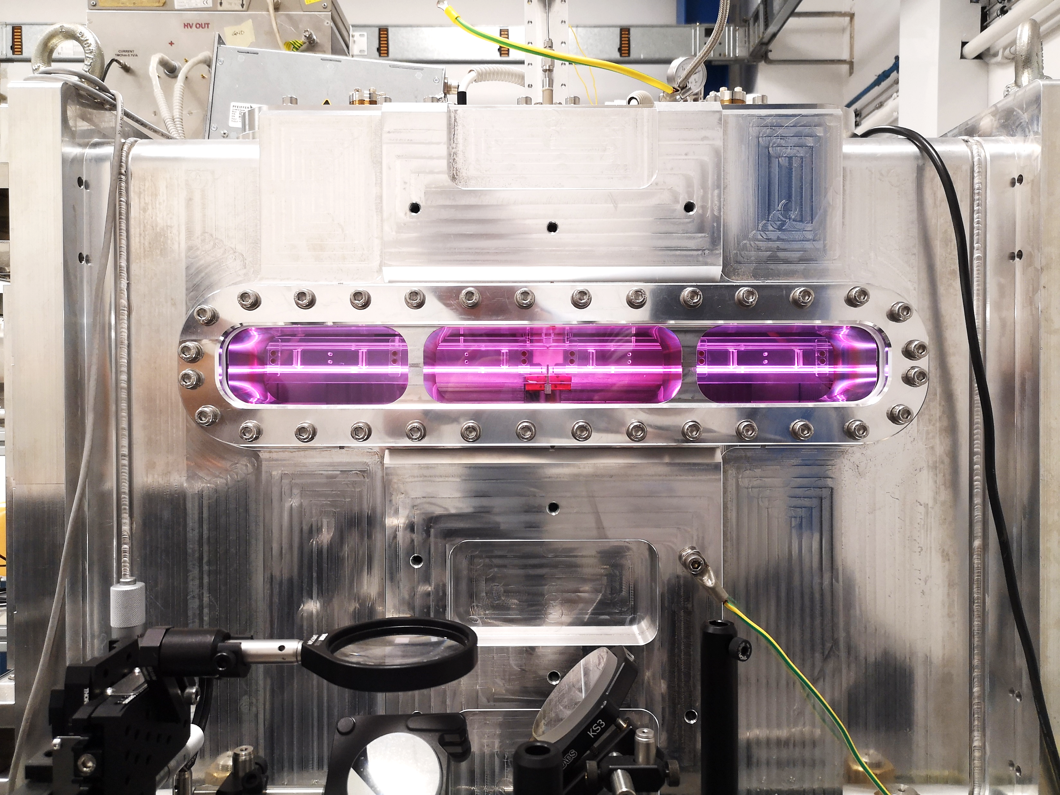
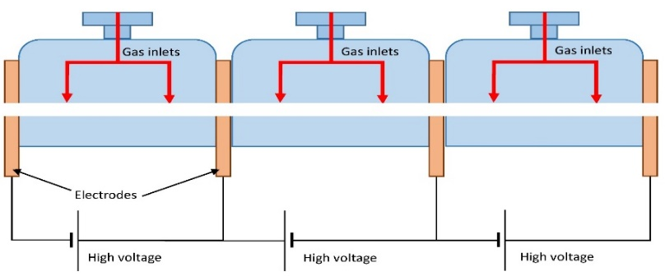
WP2 - High repetition rate plasma module
(LNF, LNS)
Sapphire
Ceramics
Task 2.1 - Study of a new generation of materials capable of withstanding the high temperatures produced during the plasma formation, which at the same time are machinable to produce long but very thin structures. This includes the use of 3D-printing techniques.
Task 2.2 - Study of plasma source segmentation techniques for making devices having lengths of several meters, where plasmas with controllable densities can be produced. A crucial part of this study is the development of high-voltage source systems for plasma formation.
Task 2.3 - Optimization of the capillary discharge technique for high-power lasers, focusing on enhancing the density profile and mechanical resistance of the capillary. The objective is to increase the total electron charge and energy.
Task 2.4 - Investigate new approaches to capillary electron acceleration by incorporating oriented nanotube structures. This involves coupling capillary discharge with aligned capillary designs to improve beam emittance.
60 cm long Plasma module (1 GV/m), tested
Courtesy Biagioni and Crincoli

Slide 6
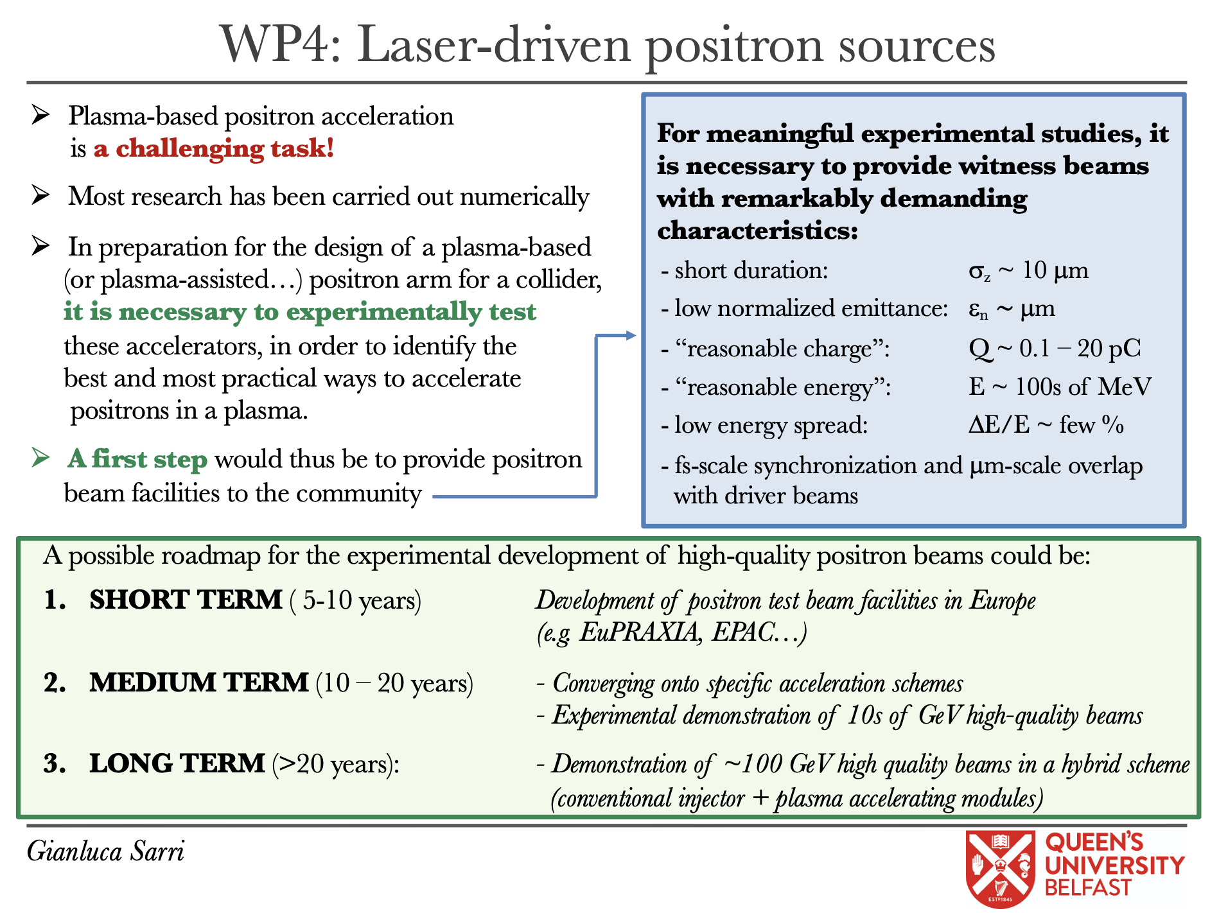
WP4 Positron source and acceleration
(QUB, LNF, RM2)
Task 4.1 Positron beam production at EuAPS facility
Once the electron beam and x-ray characteristics have been optimised in terms of peak brightness and energy, the electron beam will also be used to generate high-energy positron beams during their interaction with mm-scale high-Z solid targets.
Task 4.2 Positron beam characterisation
The generated positron beams will be characterised by measuring, simultaneously, energy spectrum, total charge and energy-dependent divergence and source size, using a diagnostic method pioneered by the group of Prof. Sarri (see, e.g., Refs. [4]).
Task 4.3: selection and guiding of narrowband, low emittance positron beams.
Following the first proof-of-principle experimental demonstration [9] and numerical modelling [11], we aim to produce pC-scale positron beams with a 5% bandwidth at 1 GeV, micron-scale normalised emittance and femtosecond-scale duration. These are characteristics required for efficient injection in following plasma accelerator modules
Task 4.4: feasibility study of positron Wakefield acceleration .
A first design of a plasma module for the post-acceleration of the positron beam will be prepared towards the first demonstration of an all-optical staged acceleration beamline

Slide 7
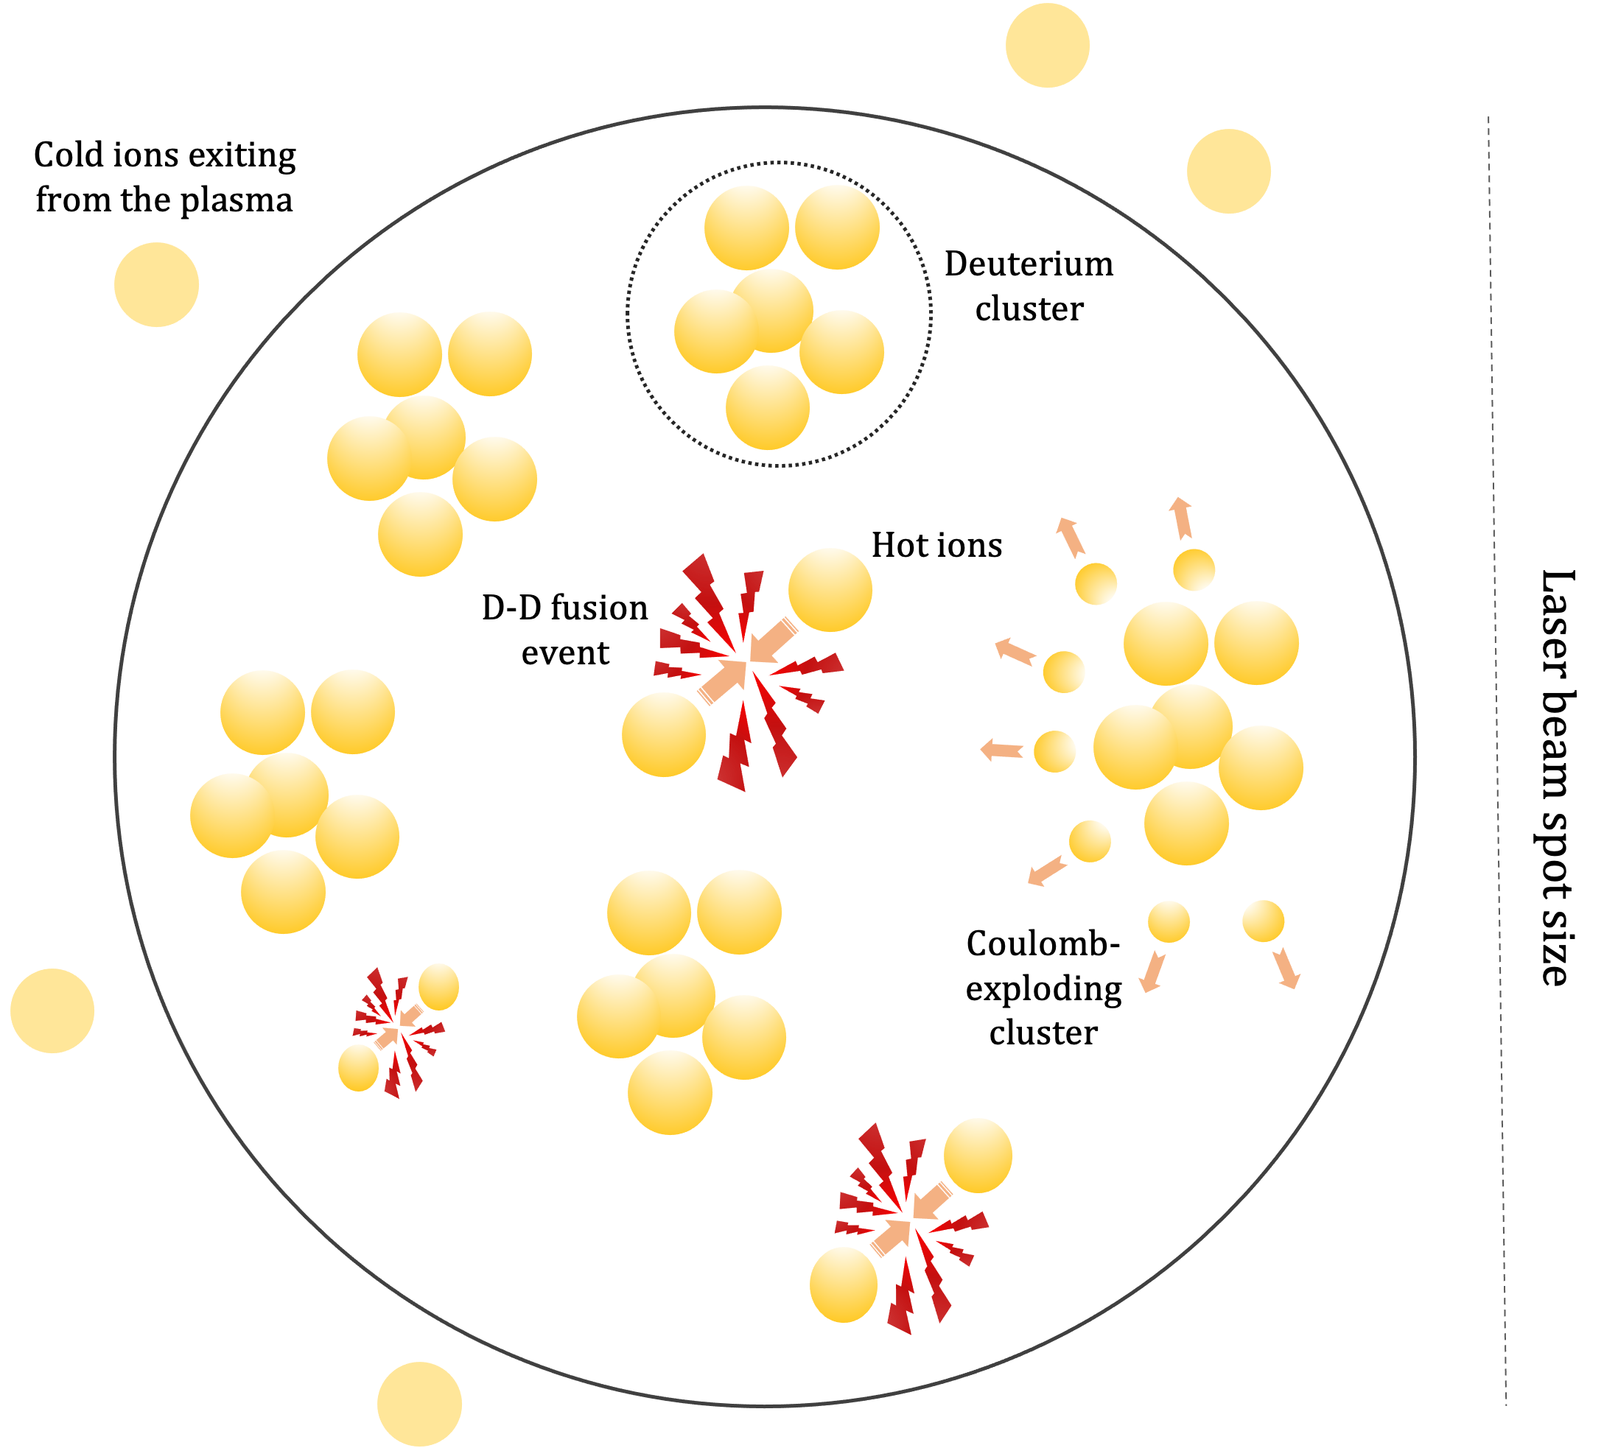
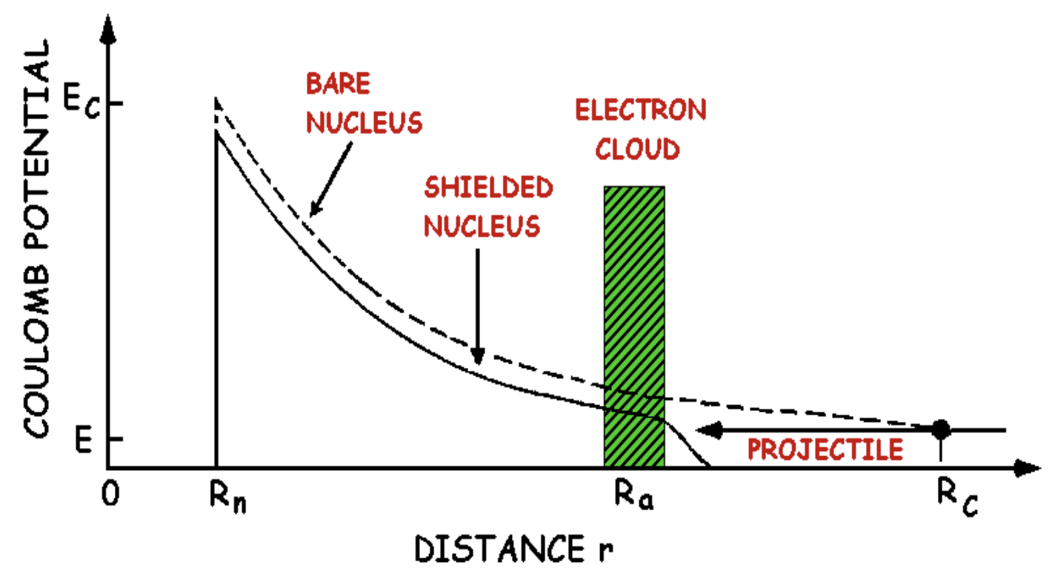
EuPRAXIA sources
In the measurements of fusion processes, the understanding of the impact of the electron screening is crucial to properly extrapolate cross-sections in the kinematic region relevant for nuclear astrophysics. By performing these measurements in a laser-induced plasma one can estimate the electron screening contribution.
Example measurement: deuterium fusion
High-power laser is used to ionize deuterium
A Coulomb explosion takes places, due to the strong electric field produced by the ionized deuterium nuclei
Deuterium ions are accelerated, gaining enough kinetic energy to overcome the electrostatic barrier and undergo a fusion process
The laser can be used to produce plasma and will allow to perform measurements as
Fusion processes of astrophysical interest in plasma
Nuclear decays in plasma
Courtesy Silvia Pisano

Slide 9
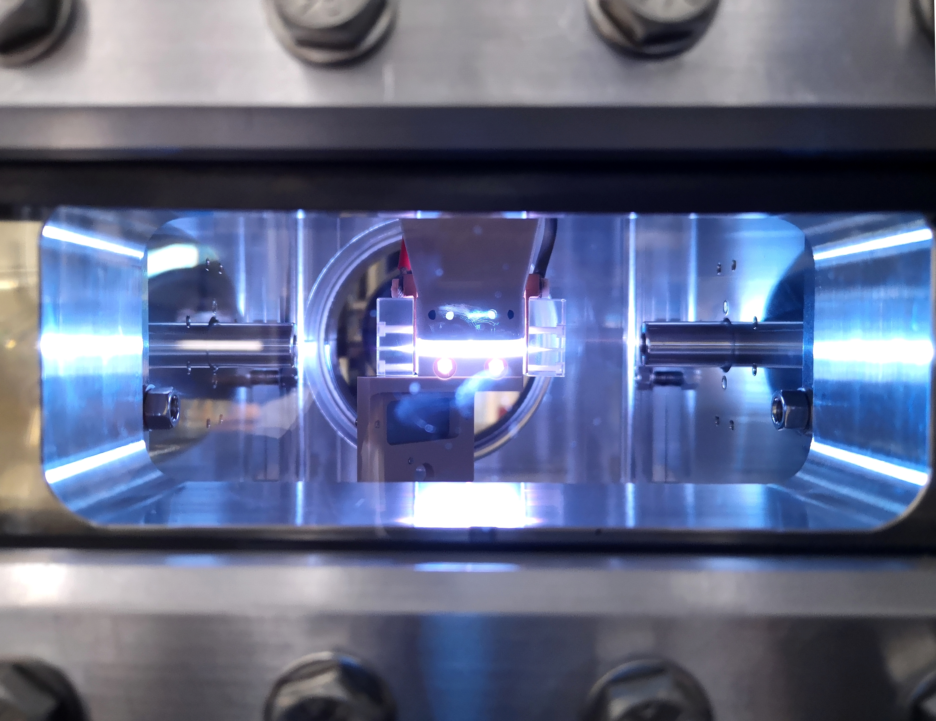
Thank for your attention

