Slide 1
Membership Extension Strategy WP6
B. Cros (CNRS), A. Mostacci (Sapienza)
EuPRAXIA-PP Annual Meeting 2024, 22-28 September 2024

Slide 2


WP6 - Membership Extension Strategy
Mandate
Propose a strategy to increase EuPRAXIA community
For example, in the context of European Strategy for Particle Physics (ESPP), EuPRAXIA should be involved in the scientific discussion as an example of a plasma-based facility (see Pierluigi’s presentation).
EU explicit recommendation (see Antonio's presentation).
Identify potential members, e.g. communities, interested in either contributing to the development of EuPRAXIA accelerator technology or the use of particle beams delivered by EuPRAXIA facilities.
Next Milestone
Organise a workshop to imagine the role of Eupraxia outside the current partnership.
Involved institutes
Brigitte Cros (leader)
Andrea Mostacci (co-leader)
Notes:
Underline that the mandate of this WP is towards the institutional partners. Other (technical) WPs are taking care of interaction with industries

Slide 4
Outreach Workshop – Friday 27/09
Presentation of EuPRAXIA
Potential links in countries not yet represented in EuPRAXIA
EuPRAXIA framework for R&D
Training and young researcher education

Slide 5
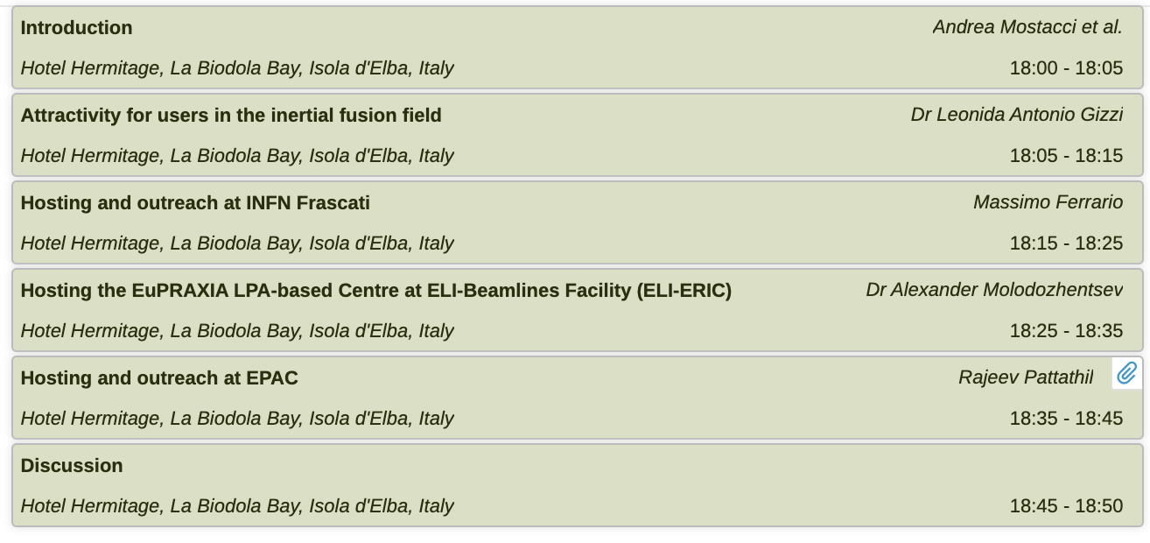

Today program
We asked candidates to host EuPRAXIA sites to present their vision on the linking of EuPRAXIA outside the current partnership, to suggest possible directions and interesting topics.

