Slide 1
WP12 – Laser Technology and Liaison to Industry
Leonida Antonio GIZZI/ CNR-INO, Pisa, Italy
Paul CRUMP/ FBH Berlin, Germany
September 24th, 2024

Slide 2
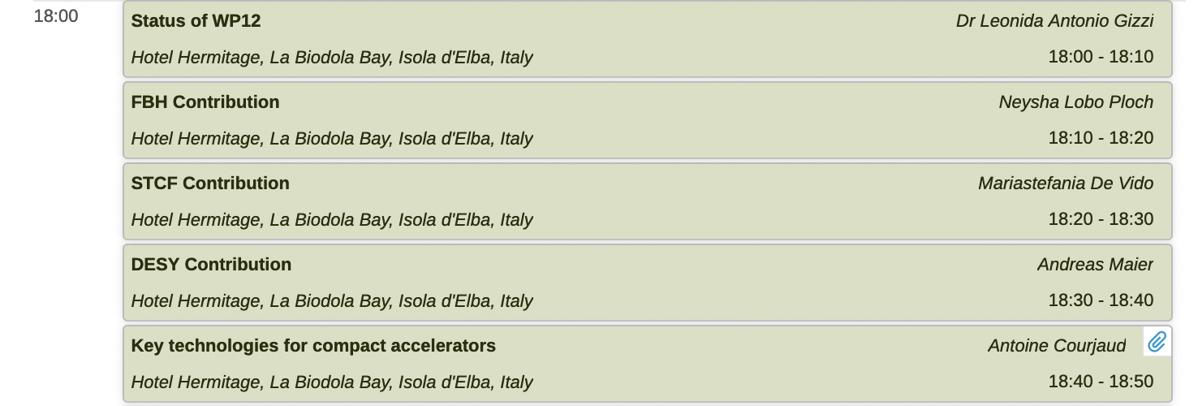
WP12 presentations today

Slide 3
Preparatory Phase - WP12
Main Objective of WP12 / duration 48m :
This is the Laser Technology R&D WP, dealing with all aspects required to target and address laser needs for EuPRAXIA
Technical WP‘s Main Goals
Update of CDR concepts and parameters, towards technical design (full technical design requires more funding)
Specify in detail Excellence Centers and their required funding: TDR related R&D, prototyping, contributions to construction
Help in defining funding applications for various agencies
As one of the TECHNICAL WPs of PP, WP12 should:
- Make progress towards the technical design of the laser-driver for the 2nd laser-driven site;
- strengthen the role of industry to enable the delivery of a robust laser-driver to enable reliable and affordable operation;
Effort
Amplitude (F) – New partner (Contact A. Curjaud)
Université Côte d'Azur, Nice (F) – New observer (Contact G. Cheriaux)

Slide 4
Preparatory Phase - WP12
Deliverables
Del. No
Del no.
Deliverable Name
WP no.
Beneficiary
Type
Diss. level
Due month

Slide 5
Preparatory Phase - WP12
Milestones

Slide 6
Design study path for EuPRAXIA Laser-driver
Baseline: proven technology based on Ti:Sa technology, pumped by diode-pumped lasers
Strong R&D effort in place (e.g HAPLS@ELI now entering into USER operation)
≈ 3-5 years to go to first industrial LWFA demonstrator [1]
Fully diode pumped with Direct Chirped Pulse Amplification with lasing media pumped directly by diodes is ideal for higher efficiency and higher rep-rate;
several materials under consideration, Yb:CaF2, Tm:YLF, Tm:Lu2O3 (Pisa) …
Available ps kW thin disk lasers using plasma modulation (Oxford [2]) spectral broadening &post compression [3]
OPCPA optical parametric amplification within large-aperture (LBO) crystals;
ELI-Beamlines facility, L2 DUHA (100 TW, 2 to 5 J between 20, 50, 100 Hz)
L.A Gizzi, F. Mathieu, P. Mason, P P Rajeev, Laser drivers for Plasma Accelerators, in Félicie Albert et al, 2020 roadmap on plasma accelerators, 2021 New J. Phys. 23 031101, https://doi.org/10.1088/1367-2630/abcc62;
O. Jakobsson, S. M. Hooker and R. Walczak, PRL, 2021
A.L. Viotti et al., Optica 9, 197-216 (2022).

Slide 7
EuPRAXIA Laser: Ti:SA modular architecture
Foreseen I/O energy and pump requirements
LPI 150 MeV
From the
front end
LASER1
E_{out} 8.8 J (P0) / 12.5 J (P1)
To the
compressor
E_{pump}: 19.2J (P0)/ 25.7 J (P1)
From the
front end
LPI 1GeV
LASER1
E_{out} 8.8 J (P0) / 12.5 J (P1
LASER2
E_{out} 18.8 J (P0) / 37.5 J (P1)
To the
compressor
E_{pump}: 37.2J (P0)/ 65.2 J (P1)
LPA 5GeV
From the
front end
LASER1
E_{out} 8.8 J (P0) / 12.5 J (P1)
LASER2
E_{out} 18.8 J (P0) / 37.5 J (P1)
LASER3
E_{out} 62.5 J (P0) / 125 J (P1)
To the
compressor
E_{pump}: 105J (P0)/ 197 J (P1)
Three main modules: LASER1, LASER2, LASER3
LASER1: stand-alone for LPI 150 MeV
LASER2: output stage for LPI 1 GeV, second stage for LPA 5GeV
LASER3: high energy stage for LPA 5GeV
Two levels of performance : P0 and P1

Slide 8
Underpinning EuPRAXIA Laser TDR
Key development areas identified for the baseline EuPRAXIA laser driver configuration
Partially funded by ongoing (EUAPS, IPHOQS) and new (PACRI) projects.

Slide 9
TDR: EuPRAXIA Ti:Sa front-end development funded
100 Hz operation at Joule level pulse energy is outstanding and a unique opportunity to address HAP issues
XPW
front-end
Laser driver stability
control
HRR Data collection
High repetition rate target
Stretcher
High averge power
transport to target
Preamplifier
Ti:SA mutipass
DPSSL pump
High average power Compressor
DISK amplifiers
Joule scale / 100 Hz / > 100 W
Procurement and preparation in progress

Slide 10
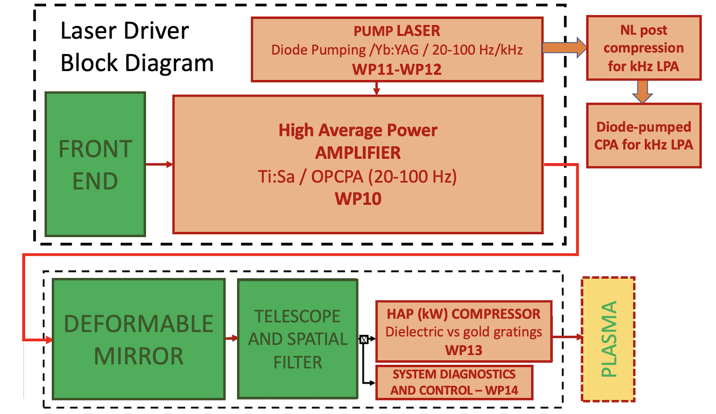
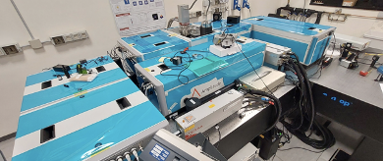
Funded Laser development in PACRI
Scaleup of collaborative TDR development of EuPRAXIA Laser
EuPRAXIA laser driver (100 Hz) and longer term options (1 kHz)
High repetition rate High power Ti:Sa amplifier module
PACRI WP10
High repetition rate pump sources for laser drivers
PACRI WP12
Prototype of High average power optical compressor
PACRI WP13
Laser driver System Architecture, transport and engineering
PACRI WP14
Efficient kHz laser driver modules for plasma acceleration
PACRI WP11
Project PACRI to start on March 1st, 2025
PACRI Overview tomorrow by Gerardo D’Auria

Slide 11
Deliverables of WP12
D12.1 Report on structures to be funded from national/bilateral/european level for laser technology (M12) √
D12.2 Report on technical results achieved in the field of Lasers (M24)
PACRI/EUAPS/IPHOQS preparation serving as knowledge base for this report
D12.3 TRL Report and maturity assessment on the development of Lasers (M42)
Based on technical development -> PACRI + other initiatives

Slide 12
Milestones of WP12
M25 Definition of criteria for down-selection of core industrial tech for the laser design (M12) √
M26 Update of concepts for EuPRAXIA, systems status report (M24)
Included in PACRI – cooperation with 2nd Site candidates and dedicated technical work
M27 Design and project of transport beamlines focusing on the preservation of beam parameters (M30)
Included in PACRI – cooperation with 2nd Site candidates and dedicated technical work

