Slide 1
EuPRAXIA status (II)
Massimo Ferrario (INFN-LNF)
on behalf of the EuPRAXIA Collaboration
EuPRAXIA_PP Annual Meeting, September 22

Slide 2
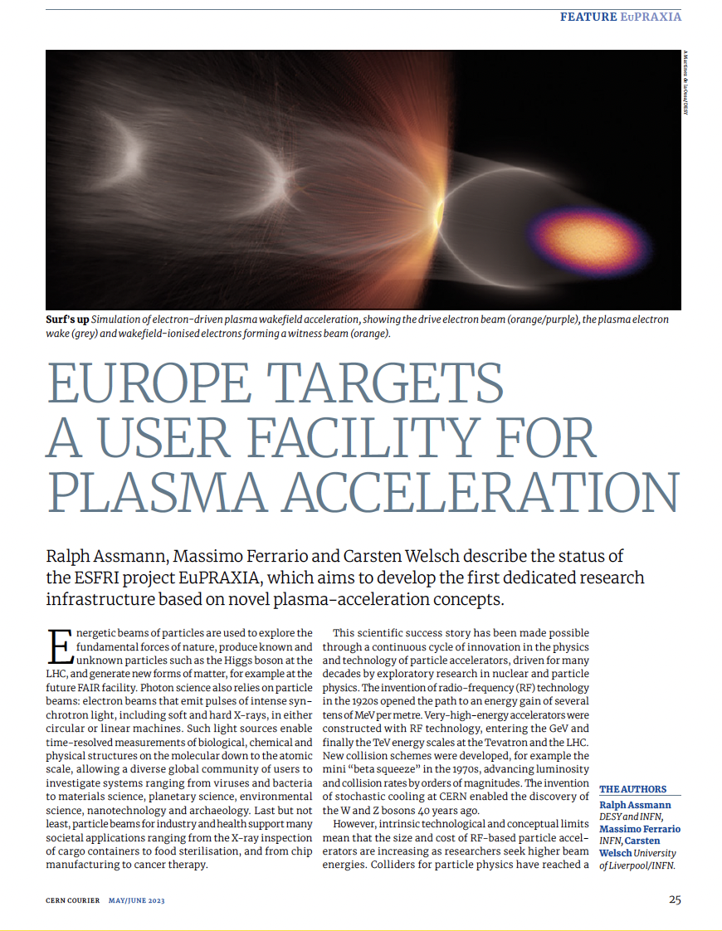
A New European High-Tech User Facility
Building a facility with very high field plasma accelerators, driven by lasers or beams
1 – 100 GV/m accelerating field
Shrink down the facility size
Improve Sustainability
1
Producing particles and photons to support several urgent and timely science cases
Drive short wavelength FEL
Pave the way for future Linear Colliders
2
https://www.eupraxia-facility.org/

Slide 3
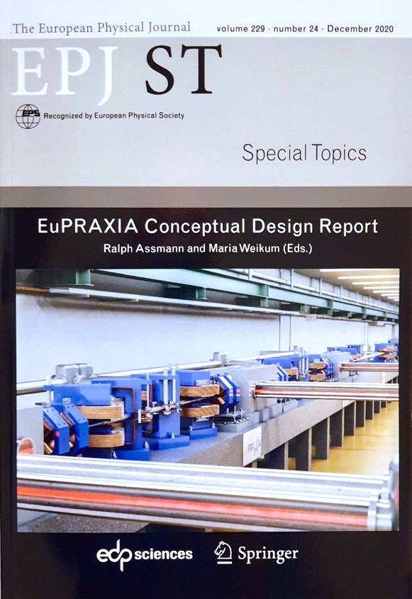
The EuPRAXIA CDR
First ever design of a plasma accelerator facility.
Conceptual Design Report for a distributed research infrastructure funded by EU Horizon2020 program. Completed by 16+25 institutes.
Challenges addressed by EuPRAXIA since 2015:
  Can plasma accelerators produce usable electron beams?
  For what can we use those beams while we increase the beam energy towards HEP and collider usages?
Next phase consortium: > 50 institutes
Preparatory Phase project: 2022 – 2026 (approved)
Start of 1st operation: 2029
http://www.eupraxia-project.eu
600+ page CDR, 240 scientists contributed

Slide 4
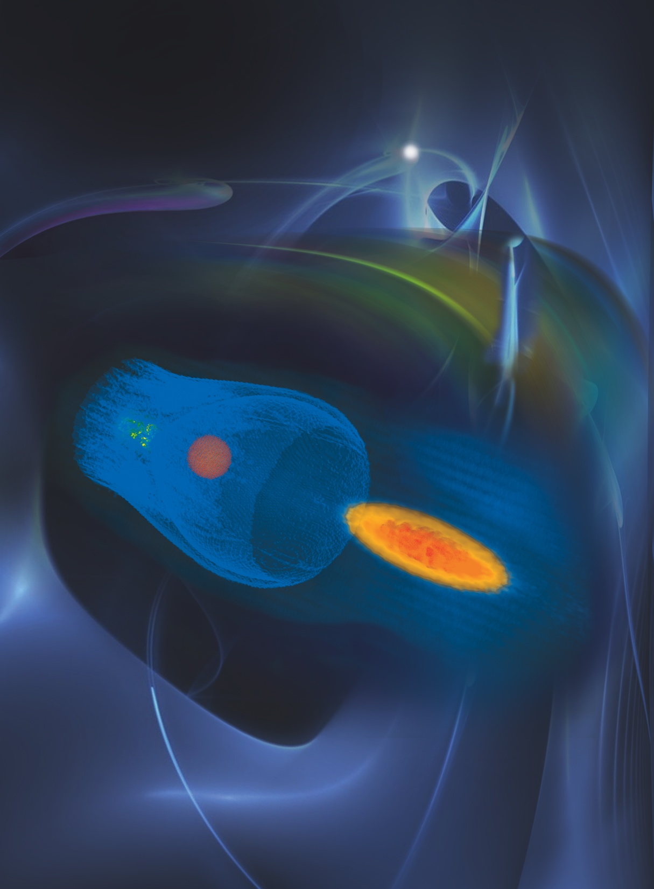
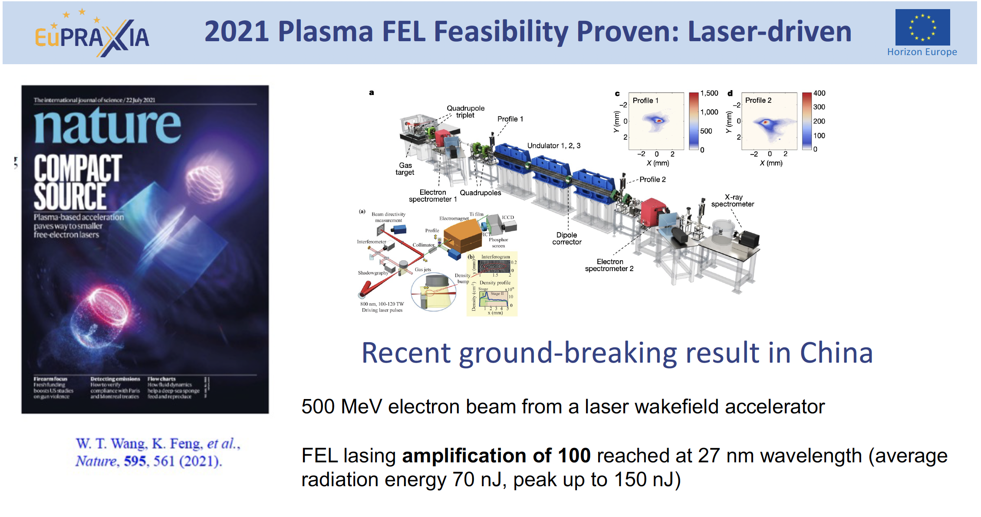
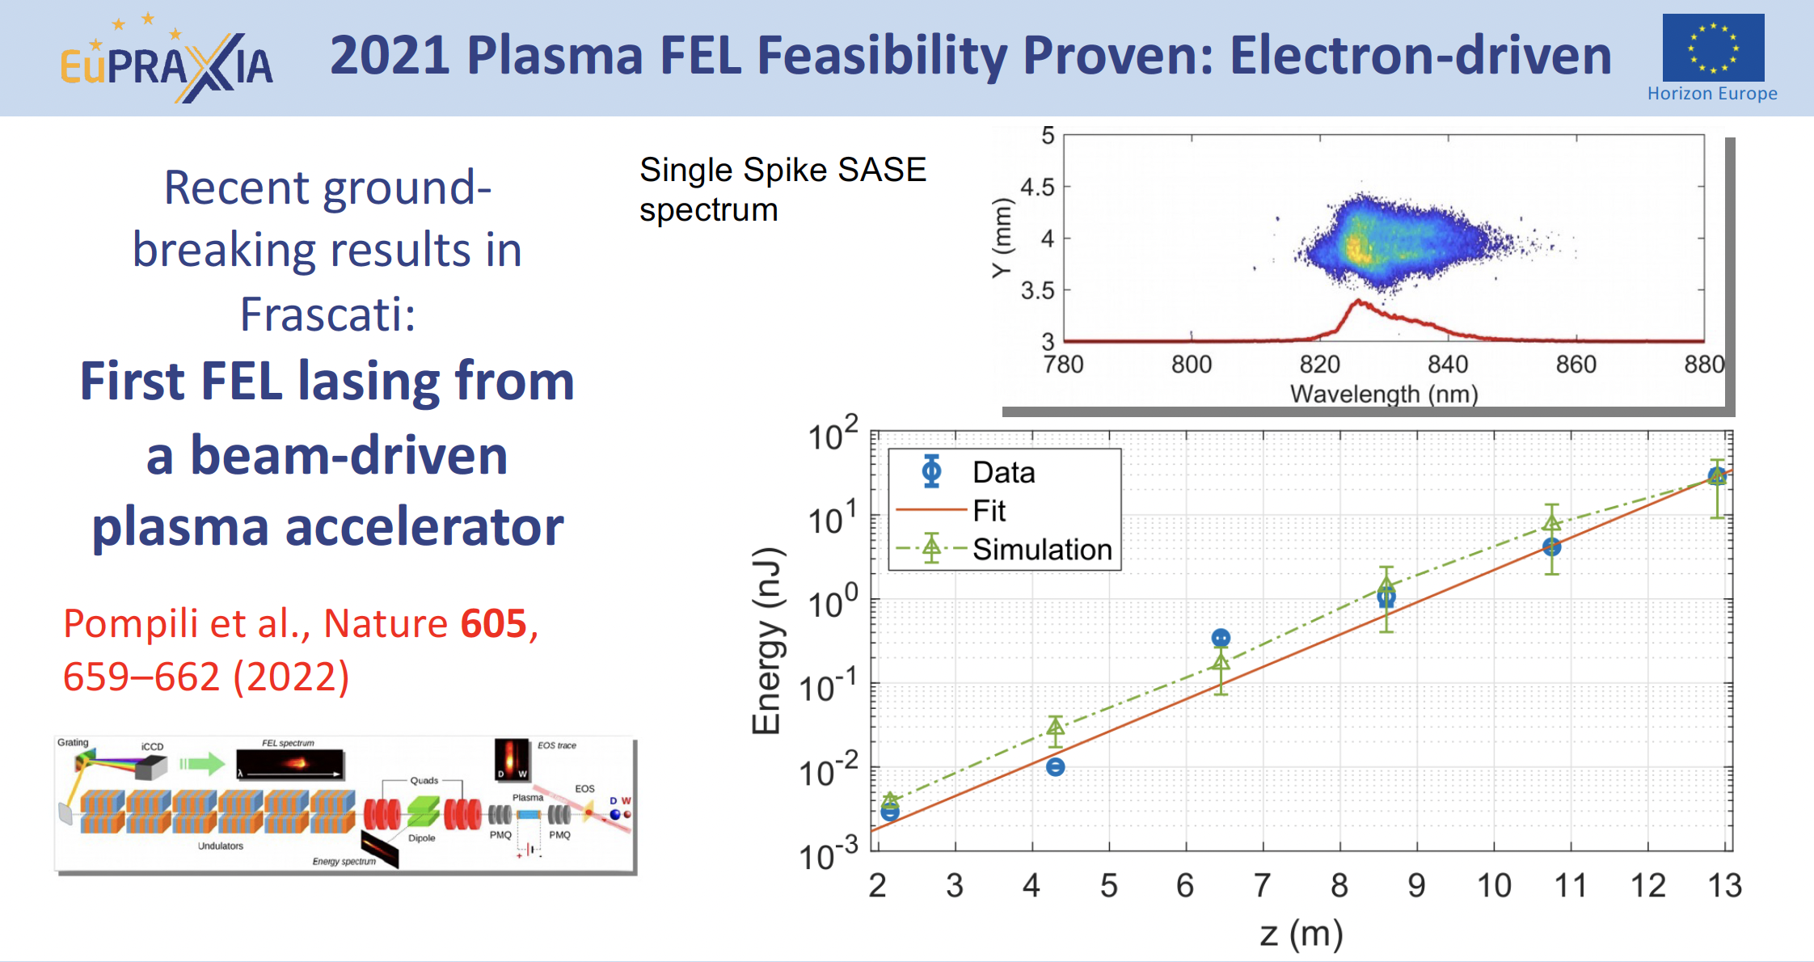
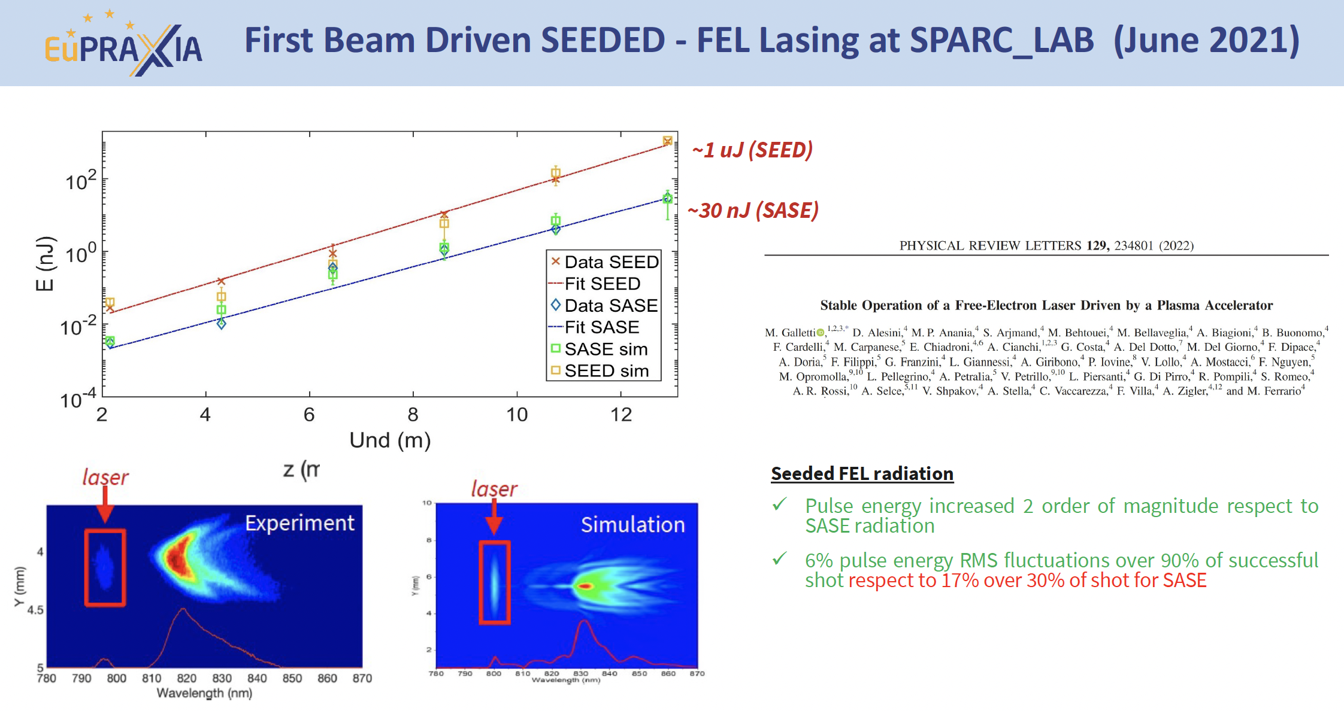
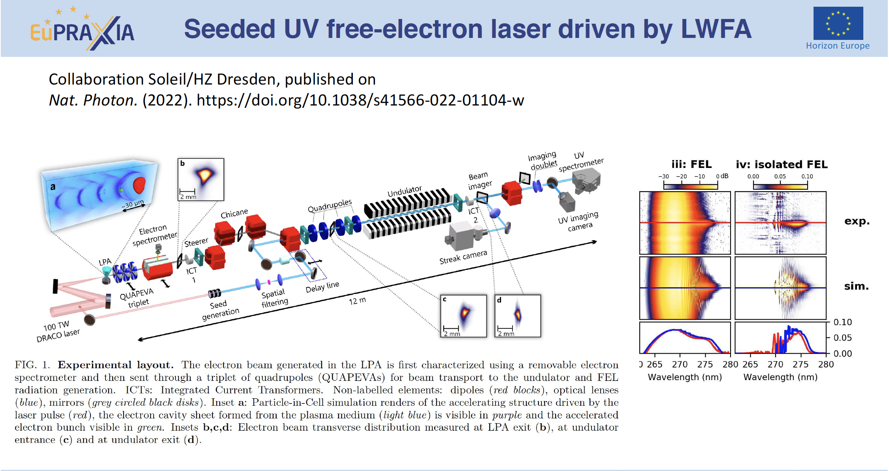
Basic beam quality achieved in pilot FEL experiments

Slide 5
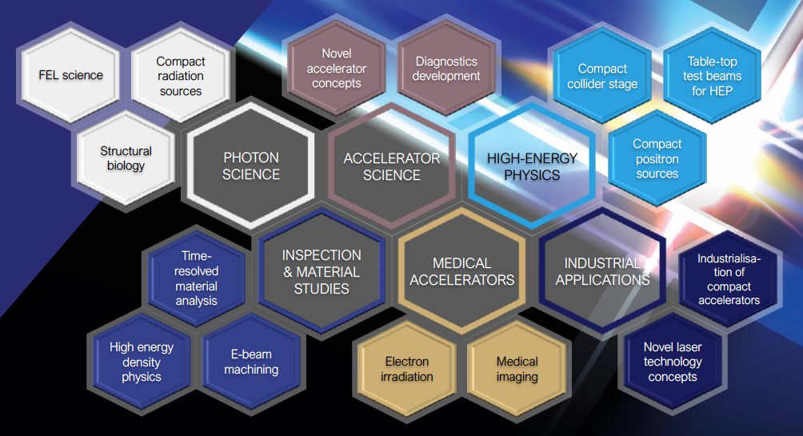
Intense R&D Program on critical components
Electrons
(0.1-5 GeV, 30 pC)
Positrons
(0.5-10 MeV, 10⁶)
Positrons (GeV source)
Lasers
(100 J, 50 fs, 10-100 Hz)
X-band RF Linac
(60 MV/m , up to 400 Hz)
Plasma Targets
Betatron X rays
(1-10 keV, 10¹⁰)
FEL light
(0.2-36 nm, 10⁹-10¹³)

Slide 6
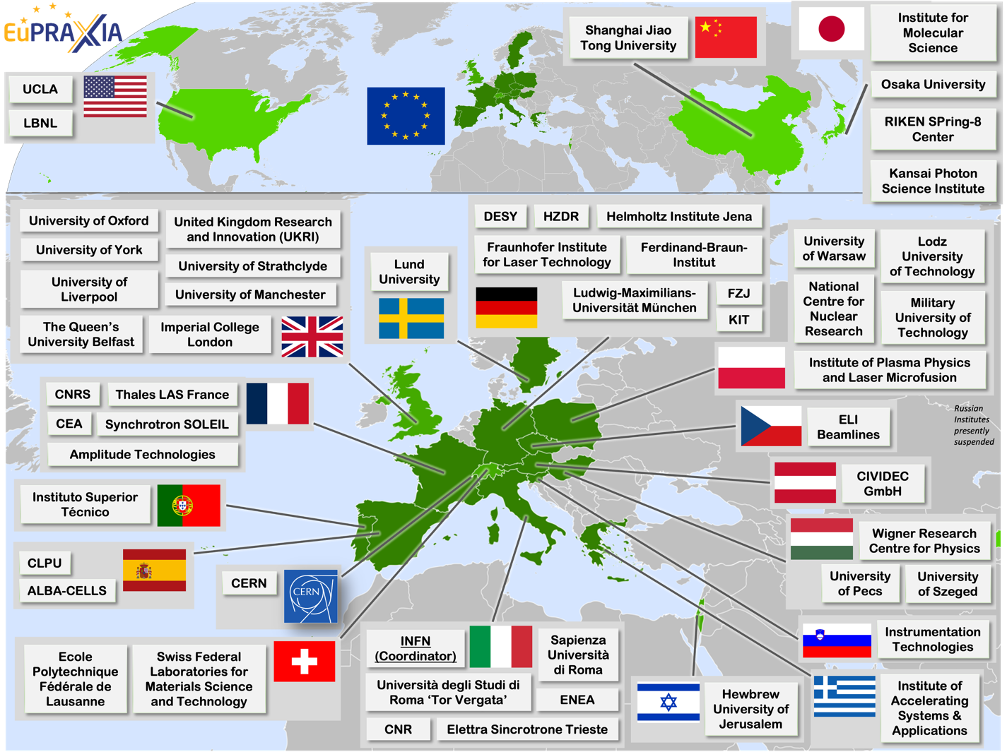
Wide International Collaboration
The EuPRAXIA Consortium today: 54 institutes from 18 countries plus CERN
Included in the ESFRI Road Map
Efficient fund raising:
  Preparatory Phase consortium (funding EU, UK, Switzerland, in-kind)
  Doctoral Network (funding EU, UK, in-kind)
  EuPRAXIA@SPARC_LAB (Italy, in-kind)
  EuAPS Project (Next Generation EU)
  What Next? => PACRI !

Slide 7
Phased Implementation of Construction Sites
 | Laser-driven | Beam-driven
Phase 1 | FEL beamline to 1 GeV + user area 1 Ultracompact positron source beamline + positron user area | FEL beamline to 1 GeV + user area 1 GeV-class positrons beamline + positron user area
Phase 2 | X-ray imaging beamline + user area Table-top test beams user area FEL user area 2 FEL to 5 GeV | ICS source beamline + user area HEP detector tests user area FEL user area 2 FEL to 5 GeV
Phase 3 | High-field physics beamline / user area Other future developments | Medical imaging beamline / user area Other future developments
INFN (Italy):
Facility for beam-driven plasma accelerators
Beamline BB-A: Radiation sources
FEL user area 1
Undulator
Undulator
Plasma Accelerator
FEL user area 2
RF Injector
RF Accelerator
ICS X-ray source user area (BU3)
HEP detector test user area
laser
Plasma Accelerator
Conversion & conditioning
electrons
GeV-class positron user area
positrons
Beamline BB-B: GeV-class positrons & HEP detector test stand
Beamline LB-C: X-ray imaging – life sciences & materials
Facility for laser-driven plasma accelerators
Plasma Injector
Life-science & materials X-ray imaging user area
Beamline LB-B: Positron beam source & table-top test beam
Table-top test beam user area
Plasma Injector
Plasma Accelerator
Conversion & conditioning
Ultracompact positron source user area
Laser
FEL user area 1
Plasma Accelerator
Undulator
Undulator
RF Injector
Beamline LB-A: FEL
FEL user area 2

Slide 8
Preparatory Phase Main Goals
Managerial WP`s
  Outreach to public, users, EU decision makers and industry
  Define legal model (how is EuPRAXIA governed?), financial model, rules, user services and membership extension for full implementation
  Works with project bodies and funding agencies → Board of Financial Sponsors
Technical WP‘s :
  Update of CDR concepts and parameters, towards technical design (full technical design requires more funding)
  Specify in detail Excellence Centers and their required funding: TDR related R&D, prototyping, contributions to construction
  Help in defining funding applications for various agencies
Output defined in milestones & deliverables with dates

Slide 9
EuPRAXIA_PP Project Coordinator: Pierluigi Campana (INFN)
Coll. Board
M. Ferrario
WP1 - Coordination & Project Management
P. Campana, INFN
M. Ferrario, INFN
WP2 - Dissemination and Public Relations
C. Welsch, U Liverpool
S. Bertellii, INFN
WP3 - Organization and Rules
A. Specka, CNRS
A. Ghigo, INFN
WP4 - Financial & Legal Model. Economic Impact
A. Falone, INFN
WP5 - User Strategy and Services
F. Stellato, U Tor Vergata
E. Principi, ELETTRA
WP6 - Membership Extension Strategy
B. Cros, CNRS
A. Mostacci, U Sapienza
WP7 - E-Needs and Data Policy
R. Fonseca, IST
S. Pioli, INFN
WP8 - Theory & Simulation
J. Vieria, IST
H. Vincenti, CEA
WP9 - RF, Magnets & Beamline
Components
S. Antipov, DESY
F. Nguyen, ENEA
WP10 - Plasma Components & Systems
K. Cassou, CNRS
R. Shalloo, DESY
WP11 - Applications
G. Sarri, U Belfast
E. Chiadroni,U Sapienza
WP12 - Laser Technology, Liaison to Industry
L. Gizzi, CNR
P. Crump, FBH
WP13 - Diagnostics
A. Cianchi, U Tor Vergata
R. Ischebeck, EPFL
WP14 - Transformative Innovation Paths
B. Hidding, U Dusseldorf
S. Karsch, LMU
WP15 - TDR EuPRAXIA @SPARC-lab
C. Vaccarezza, INFN
R. Pompili, INFN
WP16 - TDR EuPRAXIA Site 2
A. Molodozhentsev, ELI-Beamlines
R. Pattahil, STFC
Steering
Committee
Scientific and Technical Advisory Board
Board of Financial Sponsors
WP’s on coordination & implementation as ESFRI RI (organization, legal model, financing, users)
WPs on technical implementation and sites

Slide 10
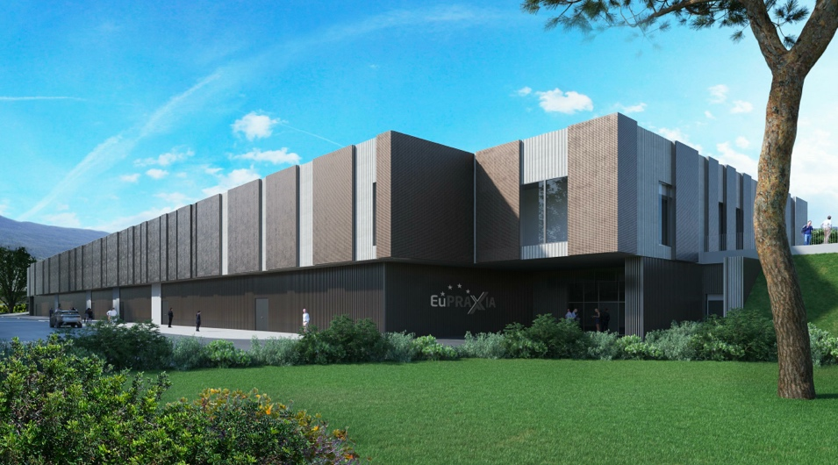
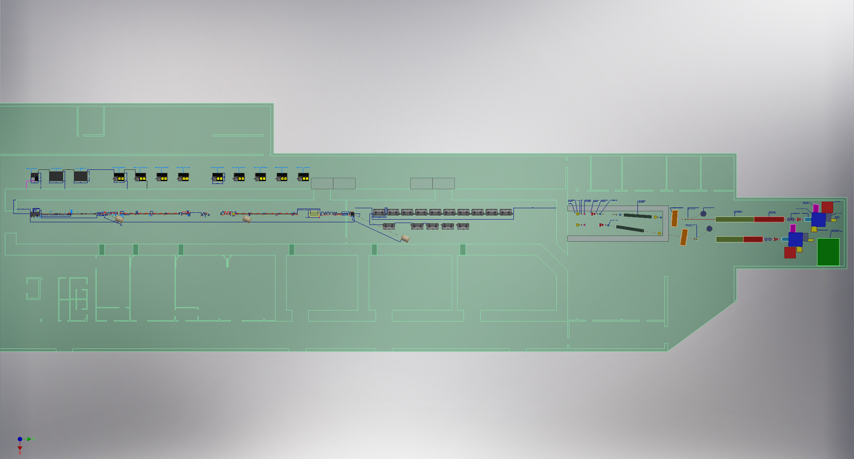
Headquarter and Site 1: EuPRAXIA@SPARC_LAB
Frascati`s future facility
> 130 M€ invest funding
Beam-driven plasma accelerator
Europe`s most compact and most southern FEL
The world`s most compact RF accelerator (X band with CERN)

Slide 11
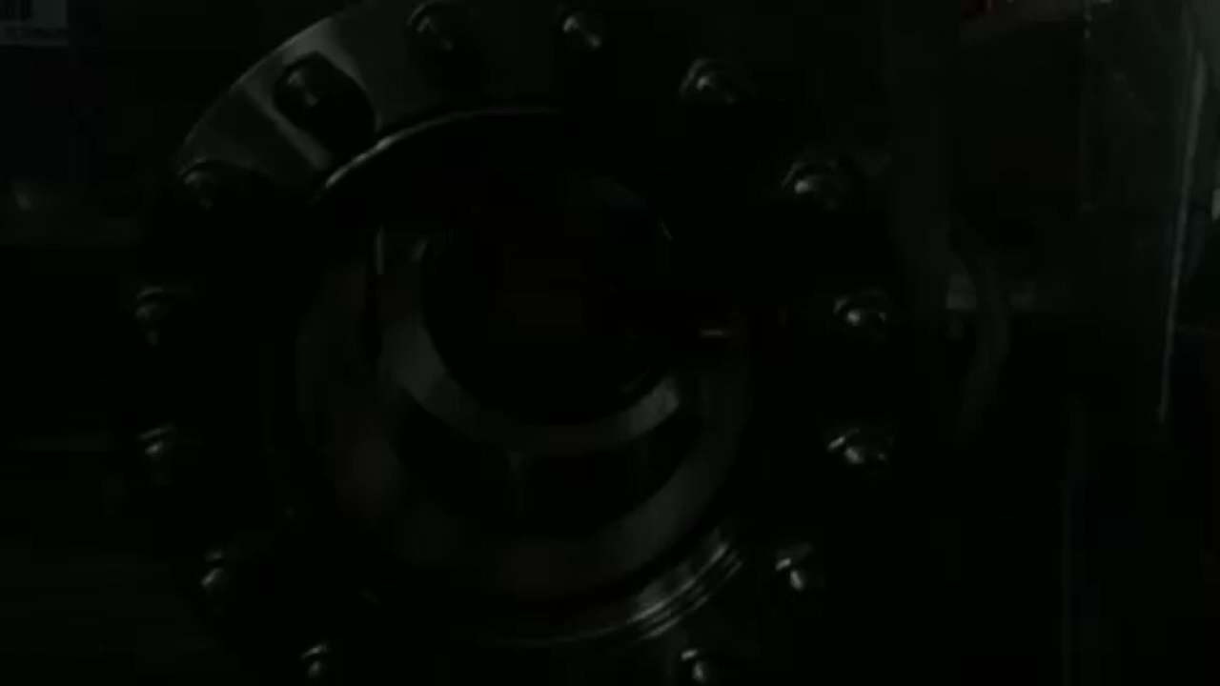
EuPRAXIA@SPARC_LAB
Undulators
1 GeV LINAC
Plasma module
RF power modules
FEL user area @4nm
Secondary
Sources
Beam user areas
0.5 PW Laser

Slide 12
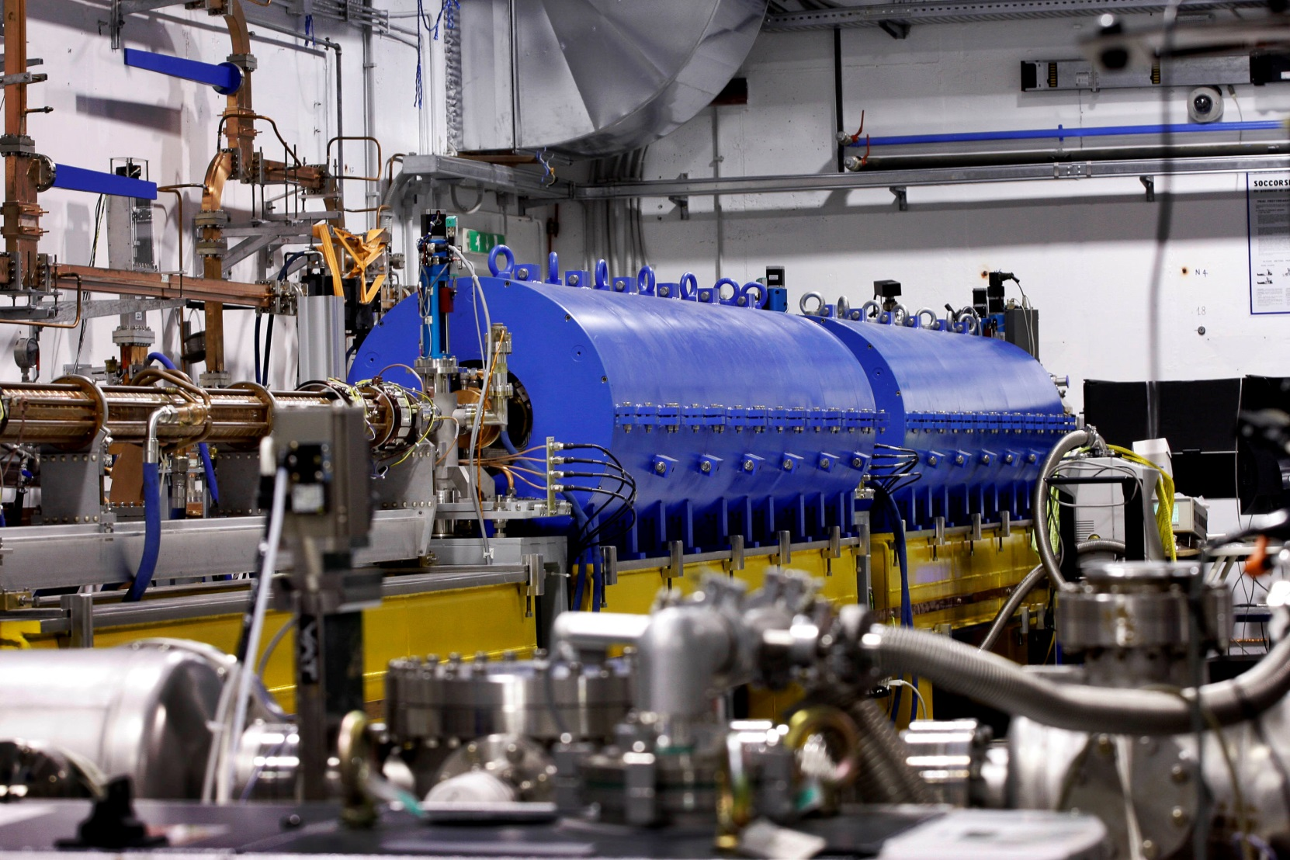
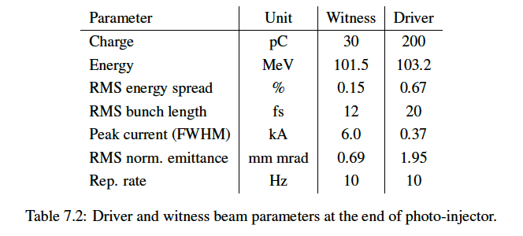
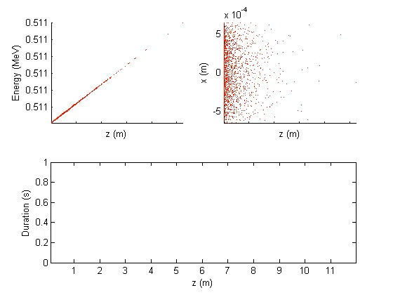
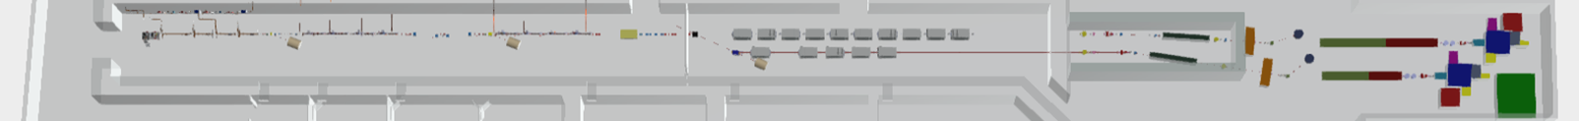
High Quality Electron Beams
10 m
Courtesy E. Chiadroni

Slide 13
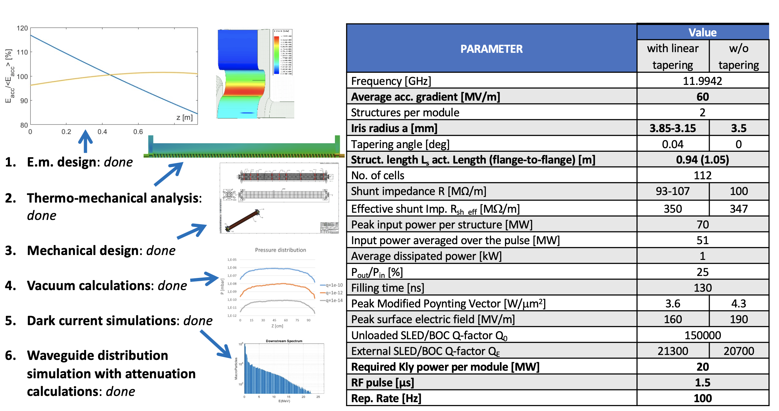
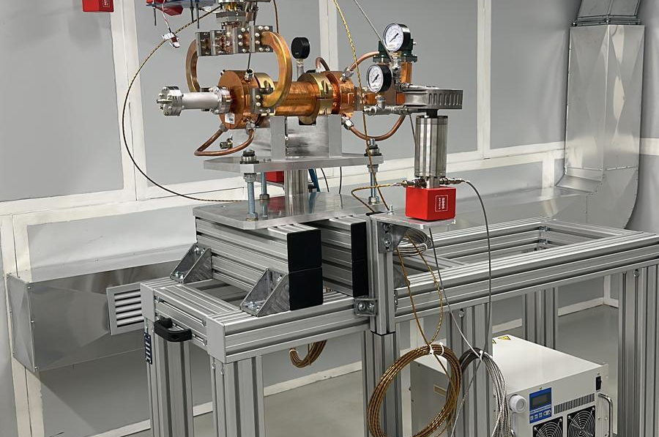
World`s Most Compact RF Linac: X Band
55 m
Courtesy D. Alesini

Slide 14
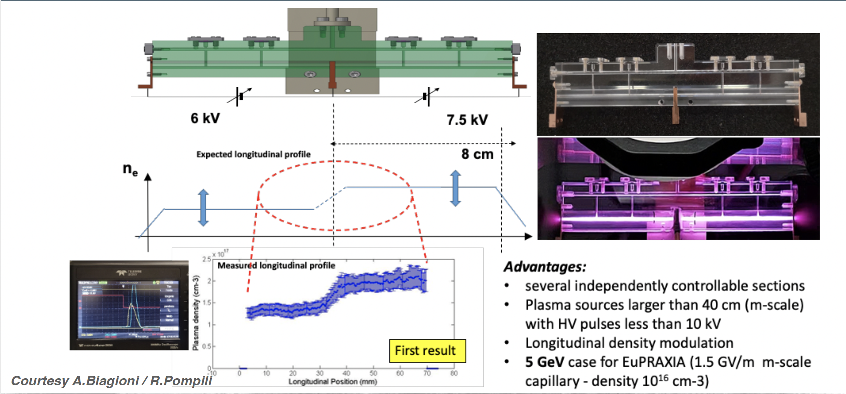
Plasma Module
3.5 m
Courtesy A. Biagioni, R. Pompili

Slide 15
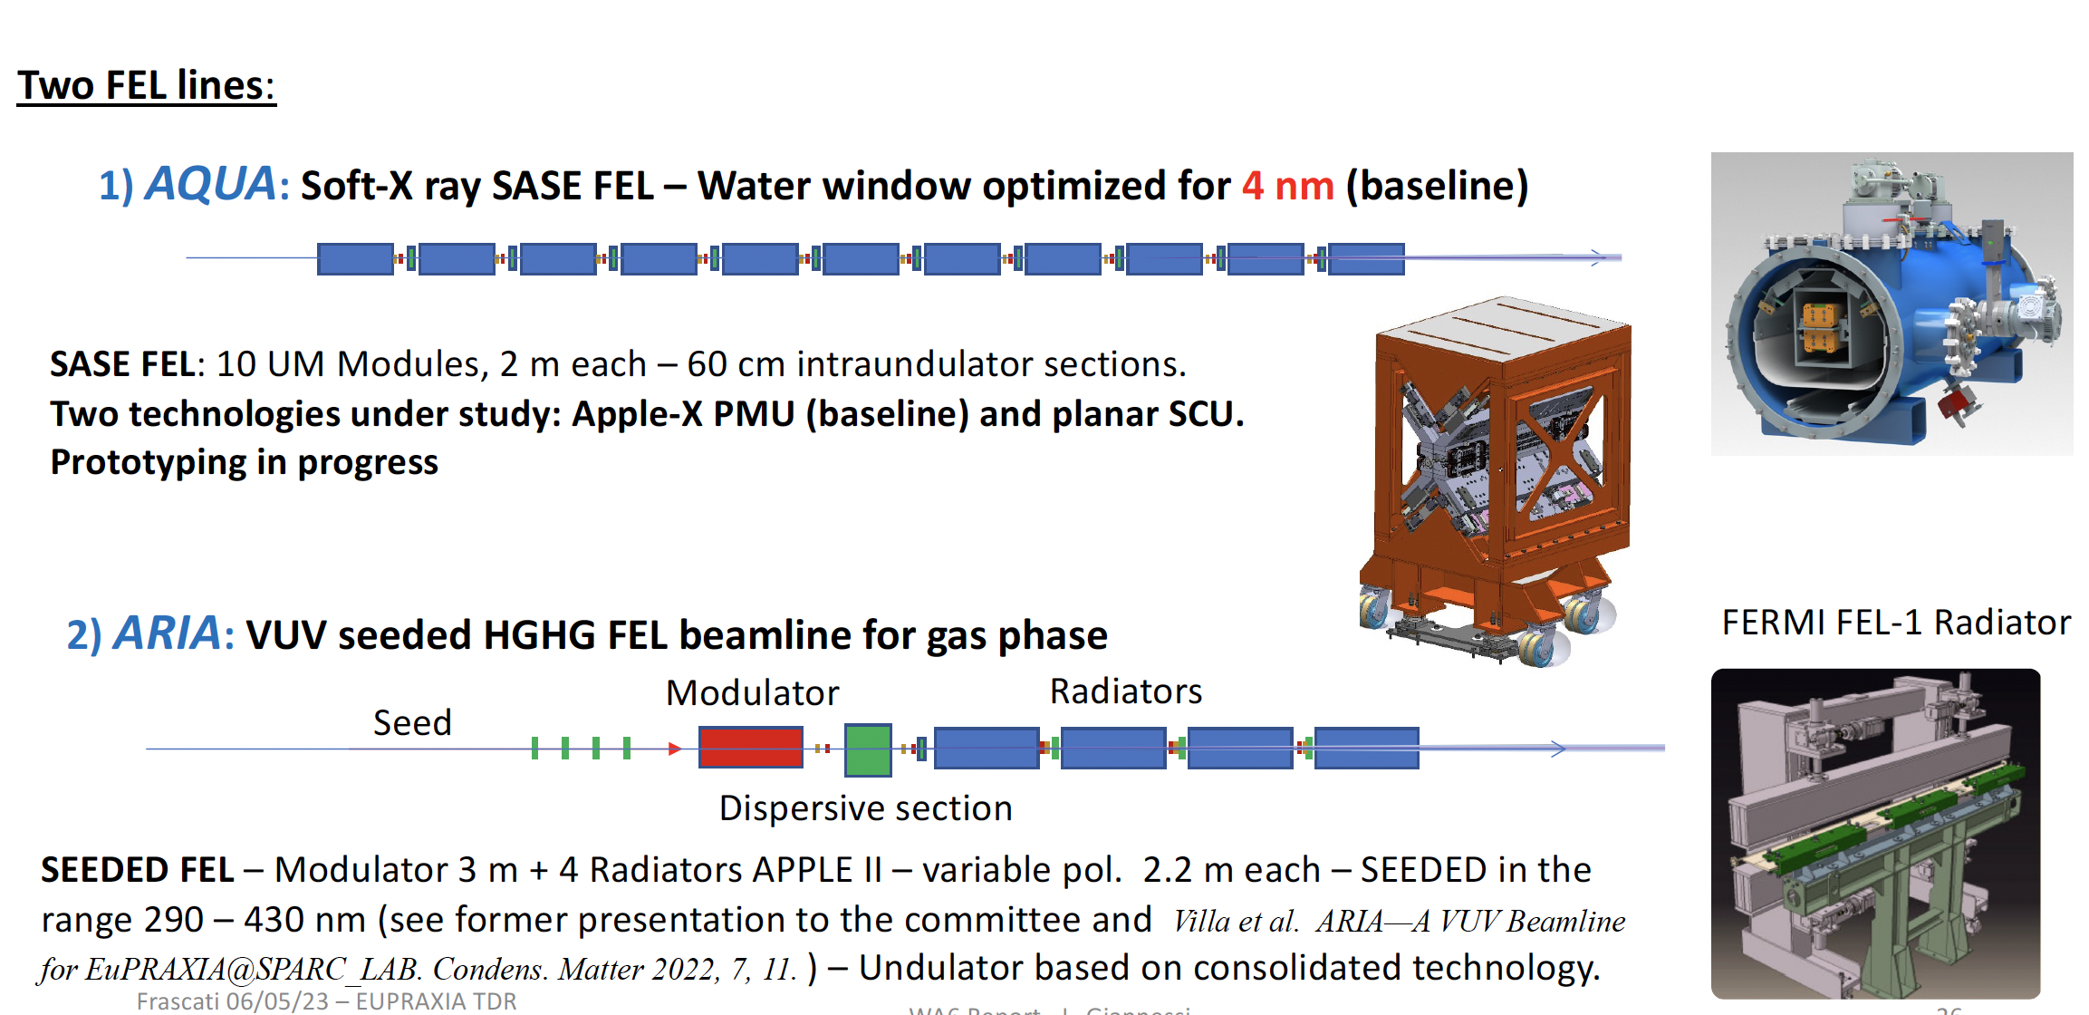
Radiation Generation: FEL
50-100
40 m
Courtesy L. Giannessi

Slide 16
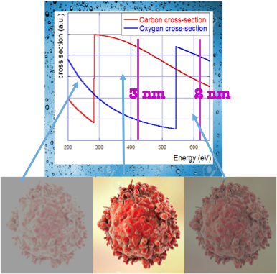
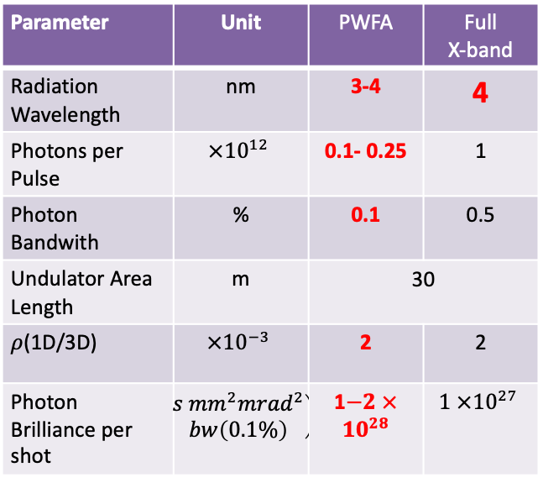
Expected SASE FEL performances
Parameter | Unit | PWFA | Full X-band
Electron Energy | GeV | 1-1.2 | 1
Bunch Charge | pC | 30-50 | 200-500
Peak Current | kA | 1-2 | 1-2
RMS Energy Spread | % | 0.1 | 0.1
RMS Bunch Length | 𝜇m | 6-3 | 24-20
RMS norm. Emittance | 𝜇m | 1 | 1
Slice Energy Spread | % | ≤0.05 | ≤0.05
Slice norm Emittance | mm-mrad | 0.5 | 0.5
In the Energy region between Oxygen and Carbon K-edge 2.34 nm – 4.4 nm (530 eV -280 eV) water is almost transparent to radiation while nitrogen and carbon are absorbing (and scattering)
Parameter | Unit | PWFA | Full X-band
Radiation Wavelength | nm | 3-4 | 4
Photons per Pulse | $$×{10}^{12}$$ | 0.1- 0.25 | 1
Photon Bandwith | % | 0.1 | 0.5
Undulator Area Length | m | 30 | 30
𝜌(1D/3D) | $$×{10}^{−3}$$ | 2 | 2
Photon Brilliance per shot | $$\left(\begin{aligned}s {mm}^{2}{mrad}^{2} \\ bw\left(0.1\%\right)\end{aligned}\right)$$ | 1$−2 ×{10}^{28}$ | $$1 ×{10}^{27}$$
Coherent Imaging of biological samples
protein clusters, VIRUSES and cells
living in their native state
Possibility to study dynamics
~10 ¹¹ photons/pulse needed
Courtesy C. Vaccarezza/L. Giannessi

Slide 17
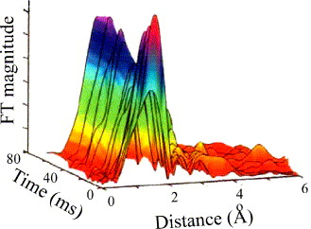
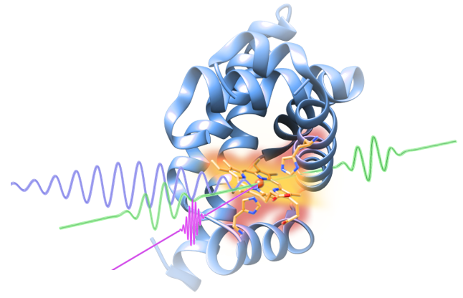
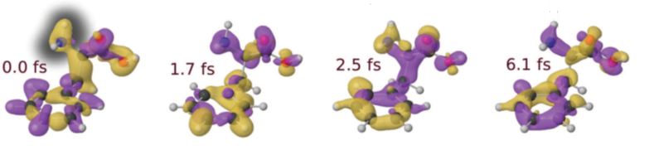
AQUA beamline scientific case
Experimental techniques and typology of samples
(Large) Viruses
Organelles
Bacteria/Cells
Metals
Semiconductors
Superconductors
Magnetic materials
Organic molecules
Coherent imaging
X-ray spectroscopy
Raman spectroscopy
Photo-fragmentation of molecules
Courtesy F. Stellato

Slide 18
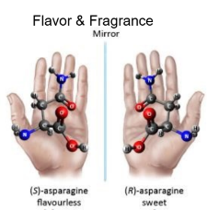
ARIA beamline scientific case
Defining experimental techniques and typology of samples (and applications)
Gas phase & Atmosphere
(Earth & Planets)
Aerosols
(Pollution, nanoparticles)
Molecules & gases
(spectroscopies, time-of-flight)
Proteins
(spectroscopies)
Surfaces
(ablation & deposition)
Photoemission
Spectroscopy
Photoelectron Circular
Dichroism
Raman spectroscopy
Photo-fragmentation of molecules
Time of Flight Spectroscopy
Courtesy F. Stellato

Slide 19
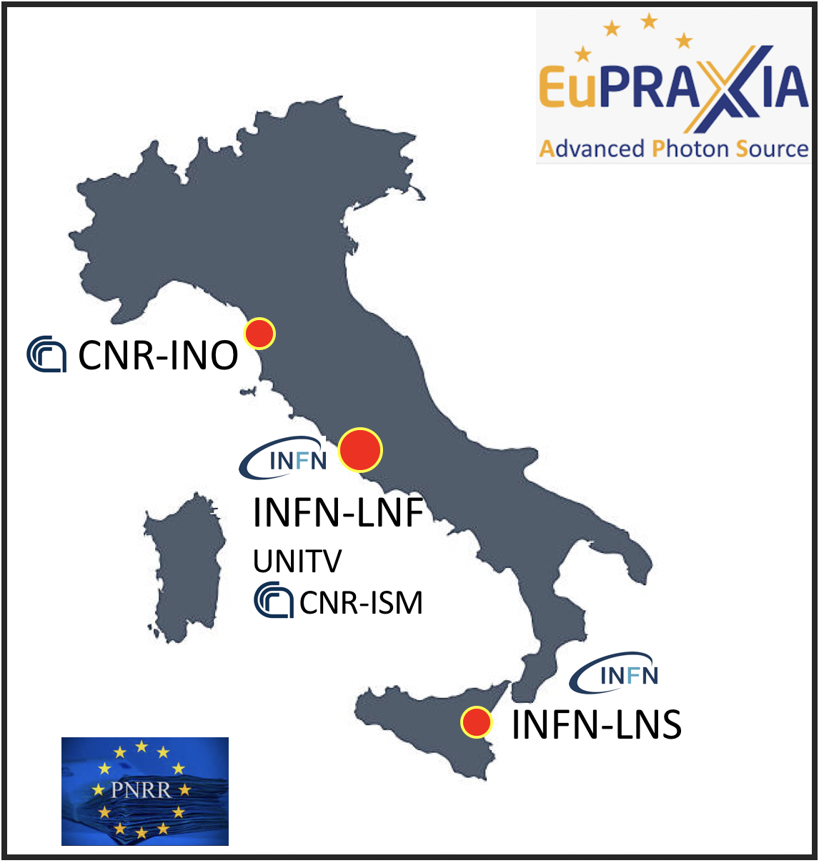
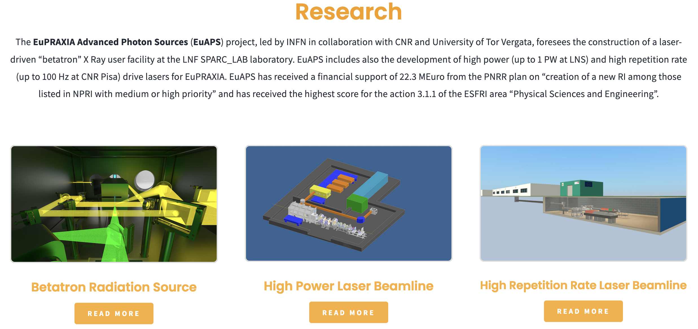
EuAPS: EuPRAXIA Advance Photon Sources - Principal Investigator: M. Ferrario,
- Infrastructure Manager: C. Bortolin,
- Management and Dissemination: A. Falone
Milano
A. Cianchi (Uni ToV)
P. Cirrone (INFN-LNS)
L. Labate (CNR-INO)
Potenza
M. Ferrario et al. INFN-23-12-LNF (2023)

Slide 20
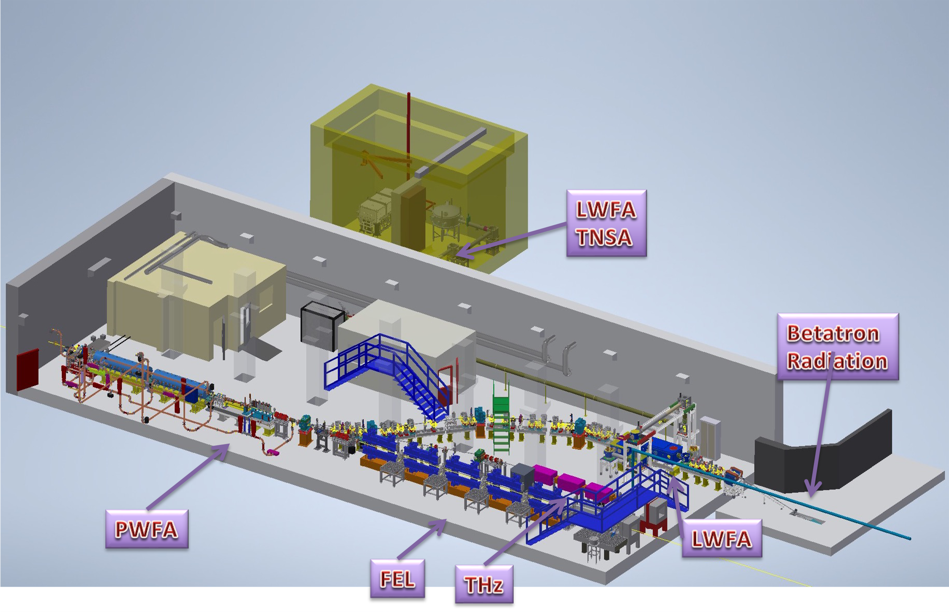
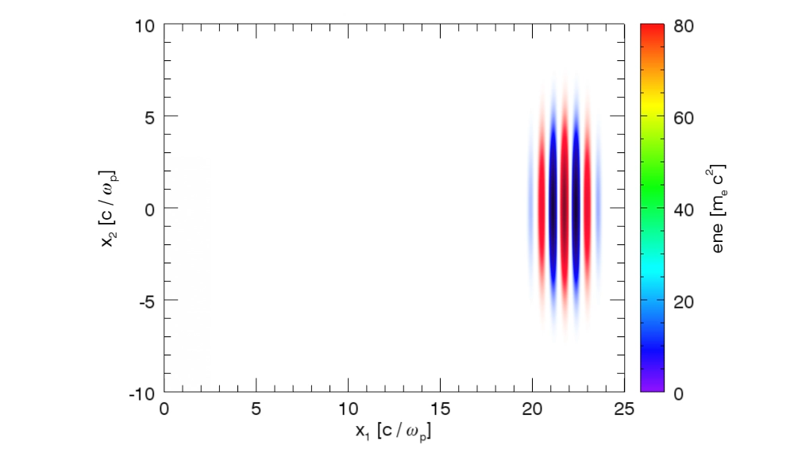
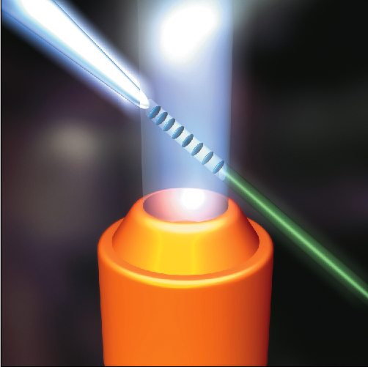
Electron beam Energy [MeV] | 50-800
Plasma Density [cm⁻³] | 10¹⁷ - 10¹⁹
Photon Critical Energy [keV] | 1 - 10
Nuber of Photons/pulse | 10⁶ – 10⁹
Courtesy J. Vieira, R. Fonseca/GoLP/IST Lisbon

Slide 21





Towards EuPRAXIA Laser Specs
EuPRAXIA
PW class,
100 Hz repetition rate,
multi kW average power,
diode pumped
Full thermal load transport
Eupraxia laser development is aimed at delivering more efficient, kW class PW laser driver for plasma acceleration at >100 Hz rate
EuAPS
50 TW peak power
100 Hz repetition rate
100 W average power
Diode pumped
Thermal load effects
s
CURRENT
PW class,
Hz repetition rate,
≈10 W average power
flashlamp pumped
No thermal load transport

Slide 22
NEXT STEP: PACRI
HORIZON-INFRA-2024-TECH-01-01: R&D for the next generation of scientific instrumentation, tools, methods, solutions for RI upgrade
Dead line 12 March 2024
Target Budget ~10 MEuro
# | Partner | Acronym
1 | Elettra - Sincrotrone Trieste SCpA (Coordinator) | ST
2 | European Organization for Nuclear Research | CERN
3 | Istituto Nazionale Fisica Nucleare | INFN
4 | University of Liverpool | ULIV
5 | Thales-MIS | Th-MIS
6 | Scandinova Systems AB | SCND
7 | VDL ETG Technology & Development BV | VDL
8 | COMEB | COMEB
9 | United Kingdom Research and Innovation | UKRI
10 | Consiglio Nazionale delle Ricerche | CNR
11 | Extreme Light Infrastructure ERIC | ELI-ERIC
12 | Centre National de la Recherche Scientifique CNRS | CNRS
13 | Thales LAS France SAS | Th-LAS
14 | Amplitude | Amplitude
15 | Centro de LÁSERES Pulsados | CLPU
16 | Ferdinand-Braun-Institut gGmbH, Leibniz-Institut für Hoechstfrequenztechnik | FBH
17 | Associacao do instituto superior Tecnico para a Investigacao e Desenvolvimento | IST
18 | Università degli Studi di Roma La Sapienza | USAP
19 | Heinrich-Heine-Universitaet Duesseldorf | UDUS
20 | Deutsches Elektronen-Synchrotron DESY | DESY
21 | The Chancellor, Masters and Scholars of the Univ. of Oxford | UOX
22 | Ludwig-Maximilians-Universitaet Muenchen | LMU
23 | GSI Helmholtz Centre for Heavy Ion Research | GSI
24 | Università degli Studi di Roma Tor Vergata | UTOR
25 | SourceLAB | SourceLAB
26 | Paul Scherrer Institut (Associated partner) | PSI
WP No. | Work Package Title | Lead Partic. Short Name
1 | Coordination and project management | ELETTRA
2 | Scientific and industrial exploitation | ULIV
3 | Plasma accelerator theory and simulations | IST
4 | High repetition rate plasma structures | INFN
5 | Plasma acceleration diagnostics and instrumentation | CNRS
6 | High efficiency RF generator | Thales-MIS
7 | High repetition rate modulator | Scandinova
8 | X-band RF Pulse Compressor (BOC) | INFN
9 | RF tests and validation | CERN
10 | High repetition rate high power Ti:Sa amplifier module | UKRI
11 | Efficient kHz laser driver modules for plasma acceleration | CNR
12 | High-rep rate pump sources for laser drivers | ELI-ERIC
13 | Prototype of high average power optical compressor | Thales-LAS
14 | Laser Driver System Architecture,transport and engineering | CNRS
25 Members
+
1 Associated partner
19 Universities and Scientific Labs.
+
7 Industries

Slide 23
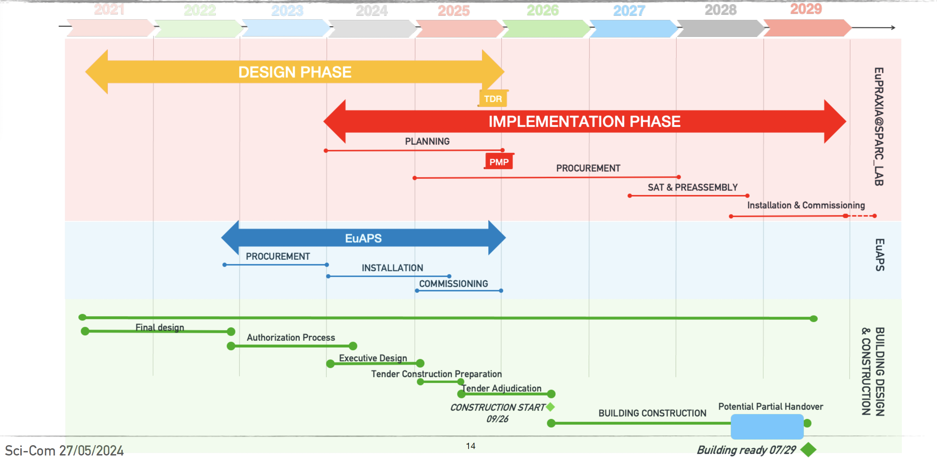
EuPRAXIA@SPARC_LAB baseline updating

Slide 24
ESPP Roadmap Update – Plasma Accelerators

Slide 25
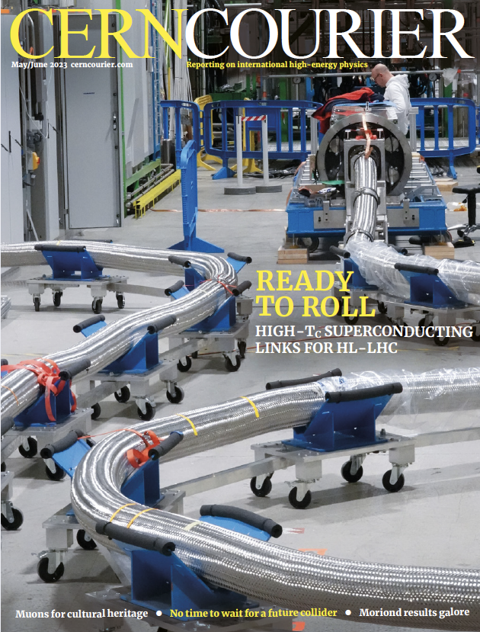
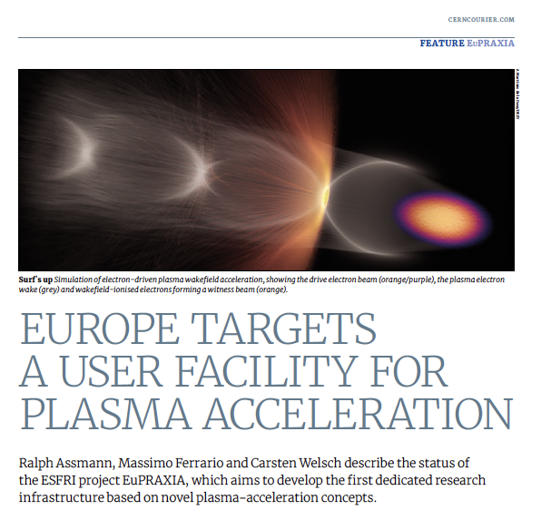
Conclusions
Plasma accelerators have advanced considerably in beam quality, achieving FEL lasing.
EuPRAXIA is a design and an ESFRI project for a distributed European Research Infrastructure, building two plasma-driven FEL´s in Europe.
EuPRAXIA FEL site in Frascati LNF-INFN is sufficiently funded for first FEL user operation in 2029.
Second EuPRAXIA FEL site will be selected in next months, among 4 excellent candidate sites.
Concept today works in design and in reality. Expect (solvable) problems in stability for 24/7 user operation. Facility needed to demonstrate!
Additional fund raising is continuosly going on

Slide 26
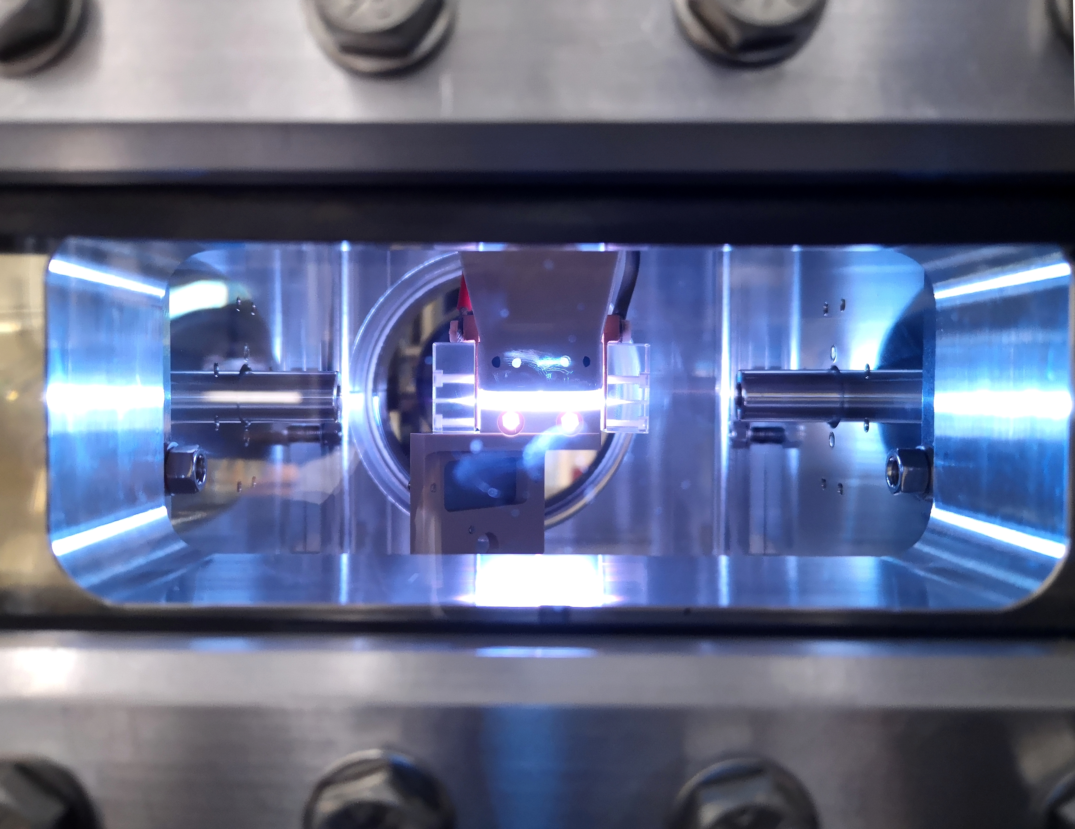
Thank for your attention

Slide 27
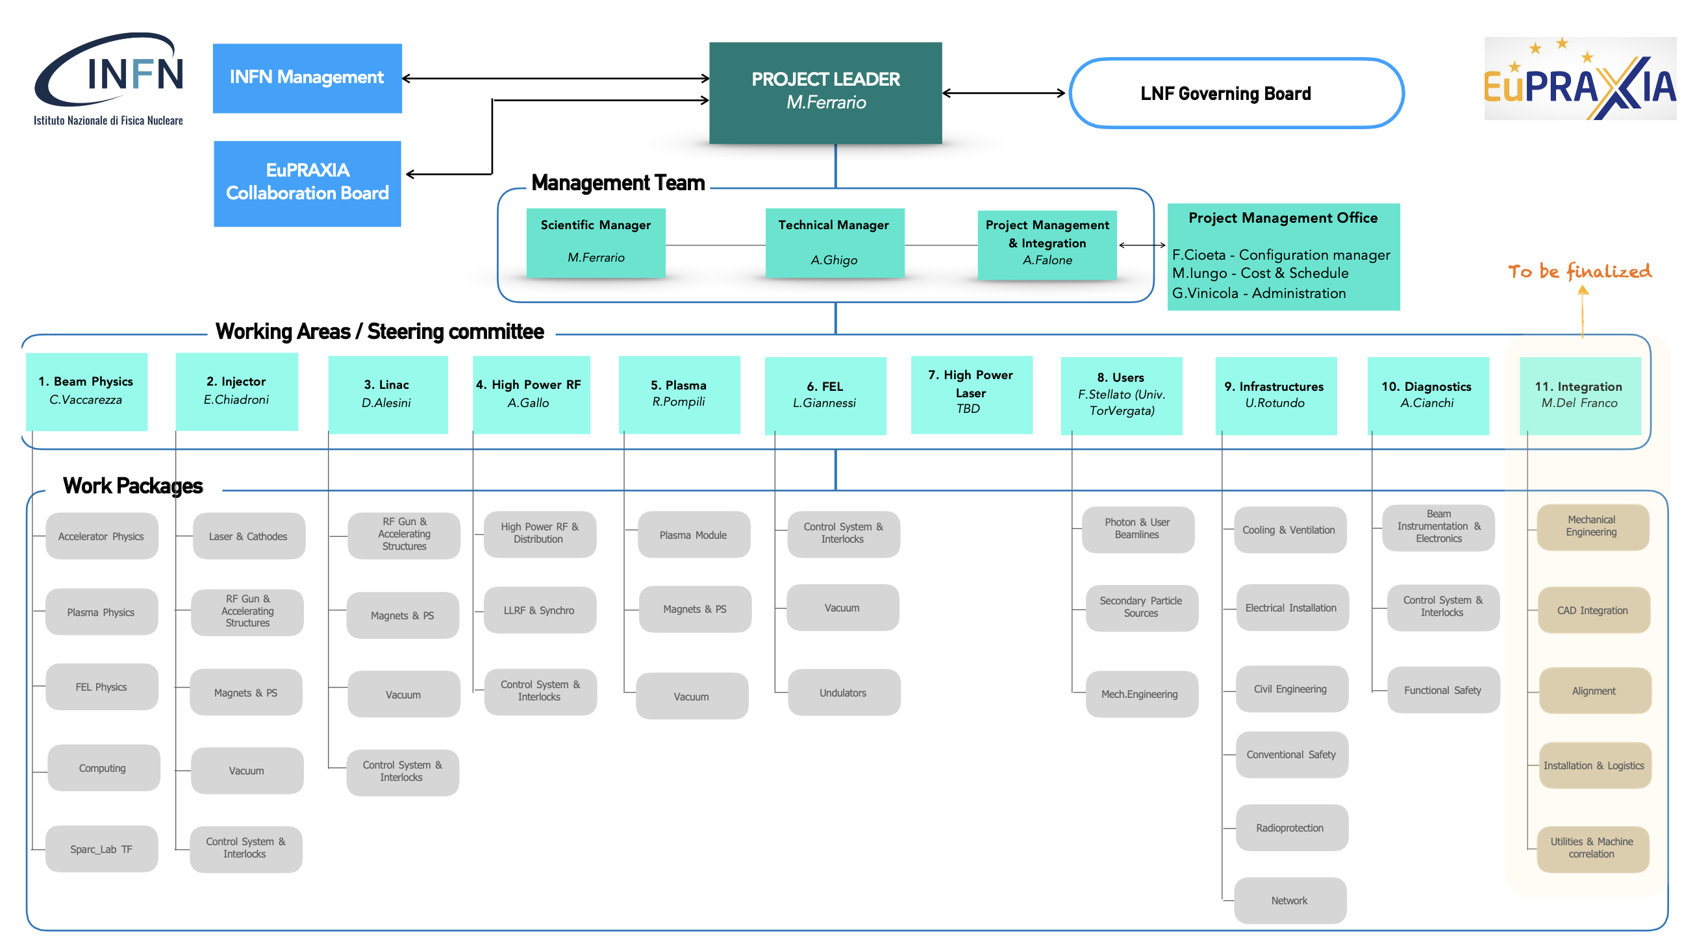
EuPRAXIA@SPARC_LAB Organization

Slide 28
WP12 Design study path for EuPRAXIA Laser-driver
Baseline: proven technology based on Ti:Sa technology, pumped by diode-pumped lasers
  Strong R&D effort in place (e.g HAPLS@ELI now entering into USER operation)
  ≈ 3-5 years to go to first industrial LWFA demonstrator [1]
Fully diode pumped with Direct Chirped Pulse Amplification with lasing media pumped directly by diodes is ideal for higher efficiency and higher rep-rate;
  several materials under consideration, Yb:CaF2, Tm:YLF, Tm:Lu2O3 (Pisa) …
  PENELOPE (Jena) 150 J, 1 Hz, at 1030 nm
  Available ps kW thin disk lasers using plasma modulation (Oxford [2])
OPCPA optical parametric amplification within large-aperture (LBO) crystals;
  ELI-Beamlines facility, L2 DUHA (100 TW, 2 to 5 J between 20, 50, 100 Hz)
Partially addressed by new/pending proposal
L.A Gizzi, F. Mathieu, P. Mason, P P Rajeev, Laser drivers for Plasma Accelerators, in Félicie Albert et al, 2020 roadmap on plasma accelerators, 2021 New J. Phys. 23 031101, https://doi.org/10.1088/1367-2630/abcc62;
O. Jakobsson, S. M. Hooker and R. Walczak, PRL, 2021

Slide 29
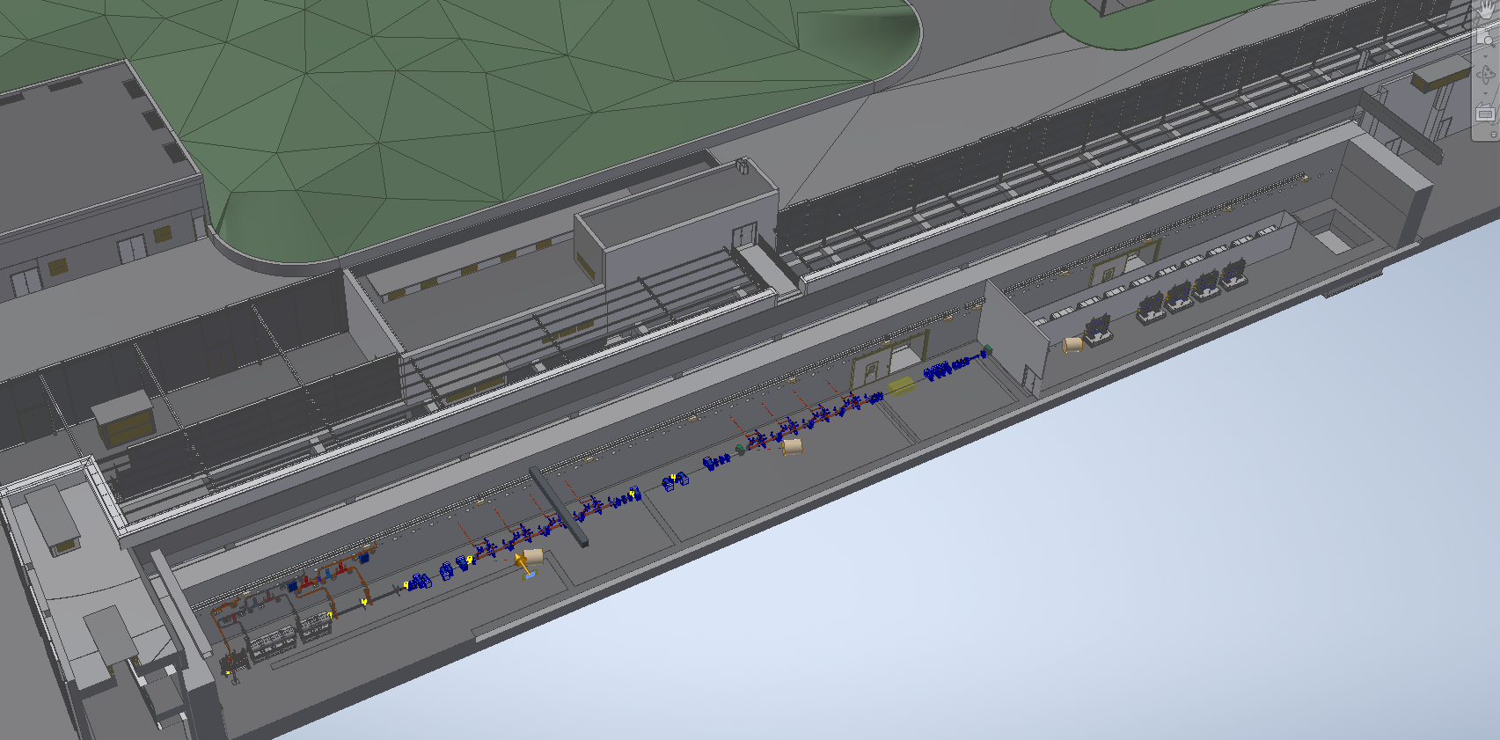
EuPRAXIA@SPARC_LAB

Slide 30
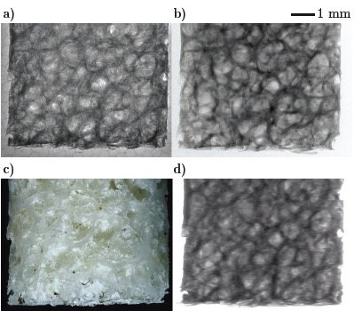
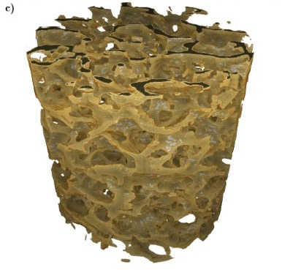
Betatron X Rays: Compact Medical Imaging
J.M. Cole et al, “Laser-wakefield accelerators as hard x-ray sources for 3D medical imaging of human bone”. Nature Scientific Reports 5, 13244 (2015)
Physics & Technology Background:
Small EuPRAXIA accelerator → small emission volume for betatron X rays.
Quasi-pointlike emission of X rays.
Sharper image from base optical principle.
Quality demonstrated and published, but takes a few hours for one image.
Advancing flux rate with EuPRAXIA laser by factor > 1,000!
EuPRAXIA technology
μCT Scanner
Added value
Sharper images with outstanding contrast
Identify smaller features (e.g. early detection of cancer at micron-scale – calcification)
Laser advance in EuPRAXIA → fast imaging (e.g. following moving organs during surgery)
3D tomography of human bone
EuPRAXIA laser advance (industry)
will push rate from 1/min to 100 Hz.
Ultra-compact source of hard X rays → exposing from various directions simultaneously is possible in upgrades
Macro-photography
Radioactive source
Notes:
Massimo

Slide 31
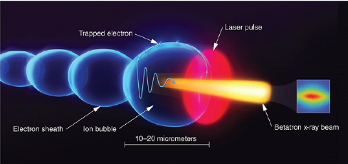
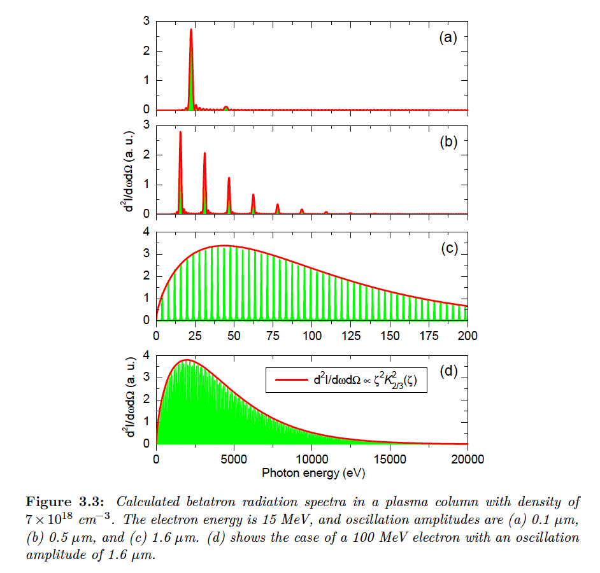
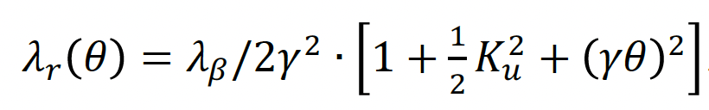
K_{u}<1
$$λ_{β}=\sqrt{2γ}λ_{p}$$
K_{u}>1
$$ω_{c}=3K_{u}γ^{2}ω_{β}$$
K_{u}>>1
$$N_{ph}∝N_{e}N_{β}K_{u}$$
$$K_{u}=γk_{β}r_{β}$$
$$r_{β}^{}=\frac{2\sqrt{a_{0}}c}{ω_{p}}$$
EuAPS Kick-off Meeting Roma , 28 February 2023, INFN Head quarter

Slide 32
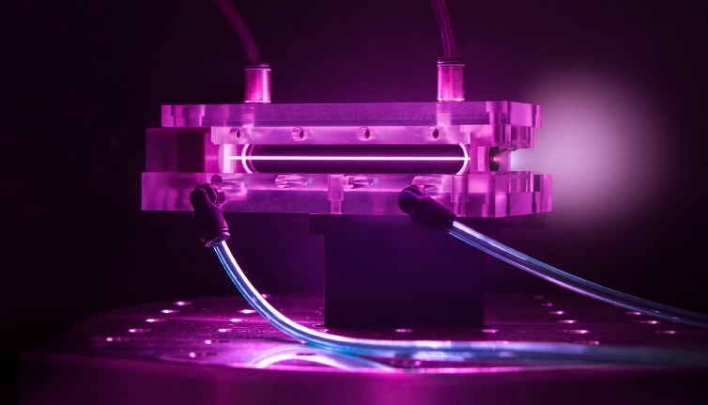
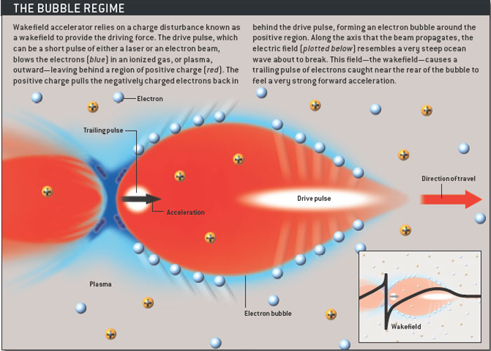
Principle of plasma acceleration
Laser Wakefield Accelerator (LWFA):
Drive beam = laser beam
Plasma WakeField Accelerator (PWFA):
Drive beam = high energy electron or proton beam
Break-Down Limit?
Wave-Breaking field:
Courtesy Sci. Am
Courtesy of BELLA

Slide 33
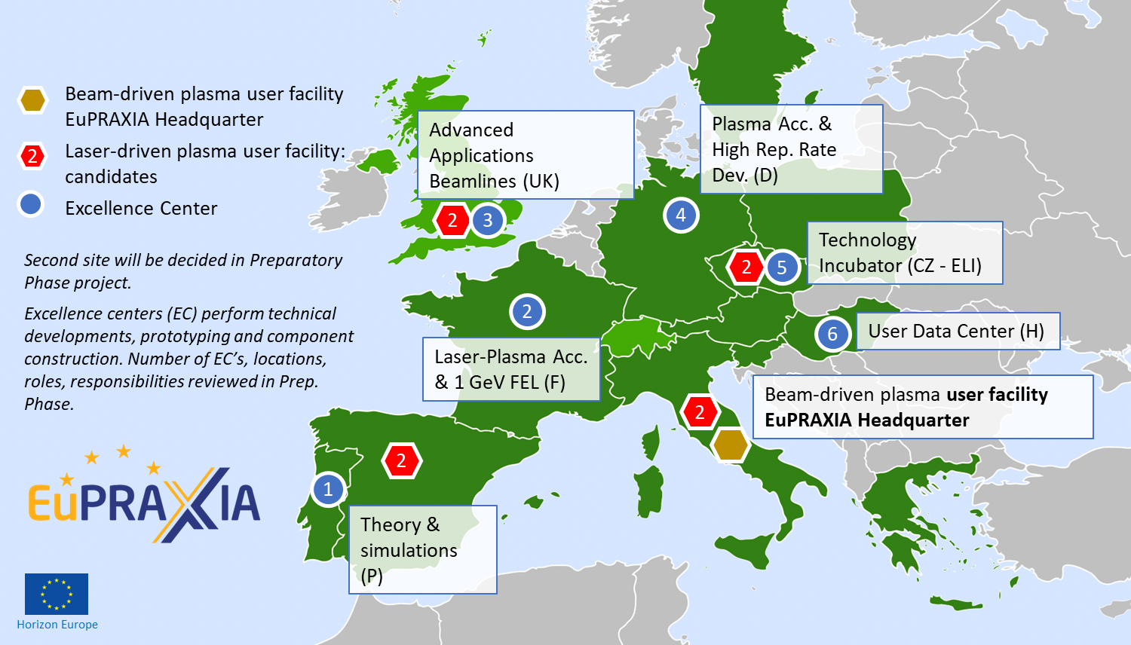
Distributed Research Infrastructure

