Slide 1






















Incorporating
EuPRAXIA into EPAC
Preparatory Phase
PWASC
Rajeev Pattathil

Slide 2
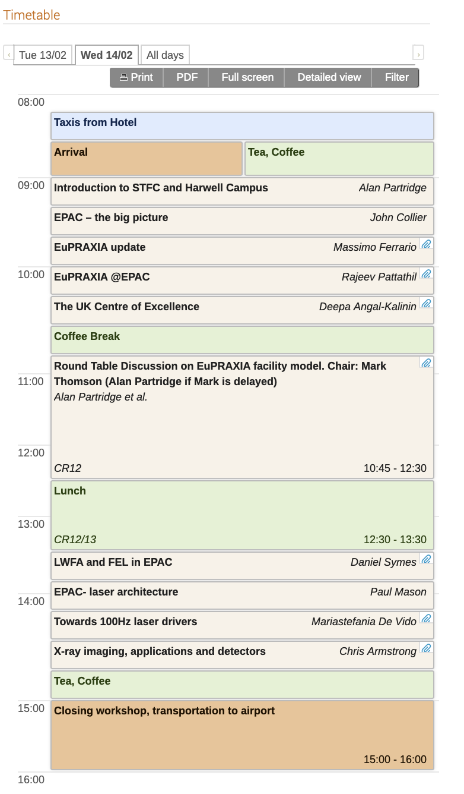
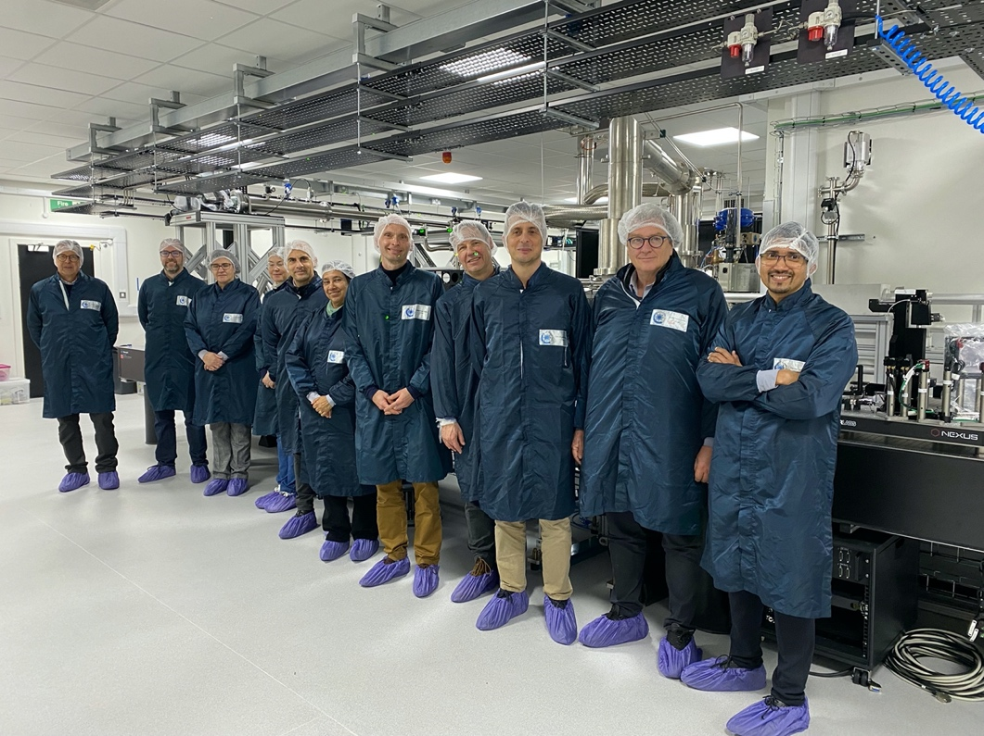
@ EPAC – site visit: February 2024
Discussions on both technical aspects and funding/governance models

Slide 3
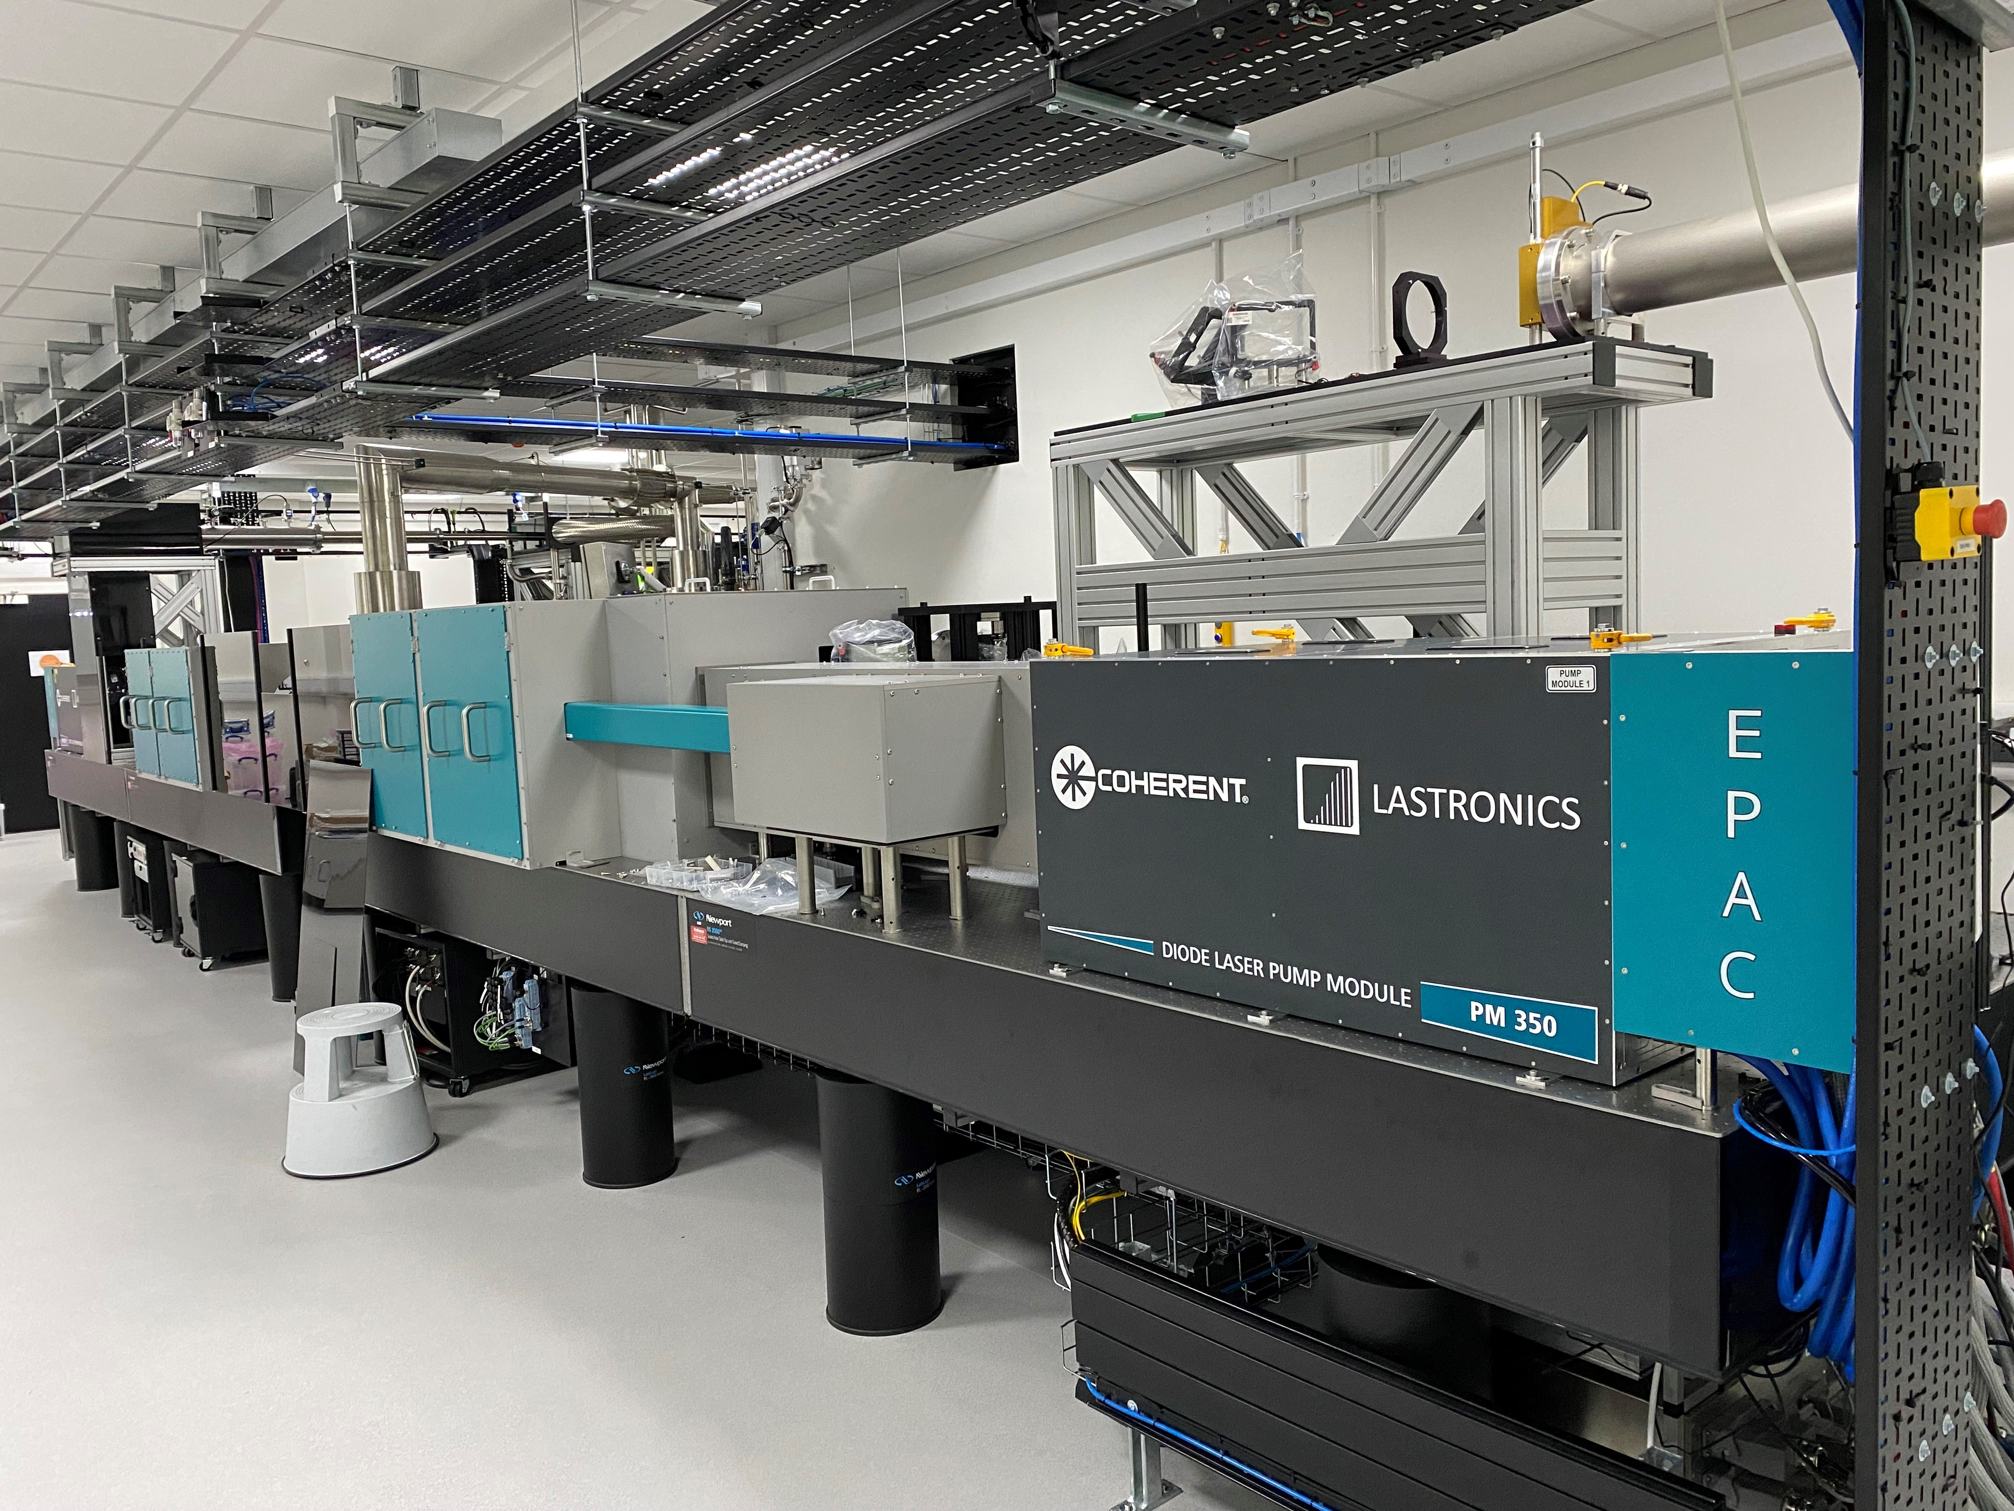
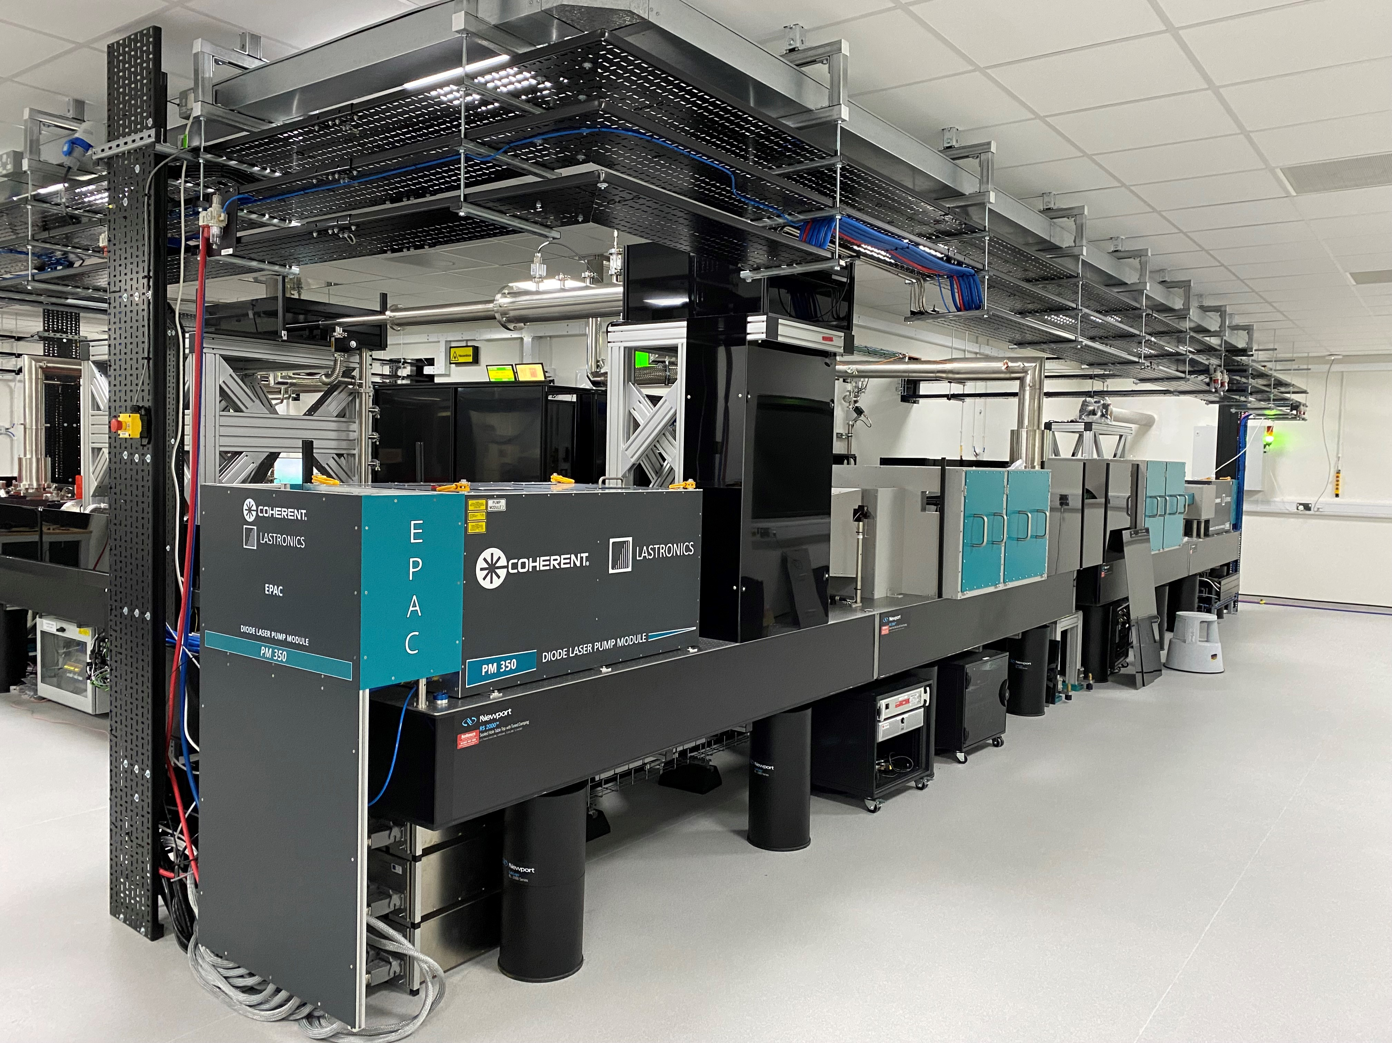
100J pump laser system being commissioned
Progress has been good across all subsystems : Front End , 10J amplifier and Hundred Joule (HJ) Amplifier
Highlight is the ‘completion’ of the Site Acceptance test for the 100J amplifier Diodes
Front End beam (both CW and pulsed) has been aligned
The 10J and 100J amplifiers are aligned, the debris shields have been installed and passed safety inspections
The beam transport line between the 10J and 100J has been aligned
EPAC 100 J amplifier

Slide 4
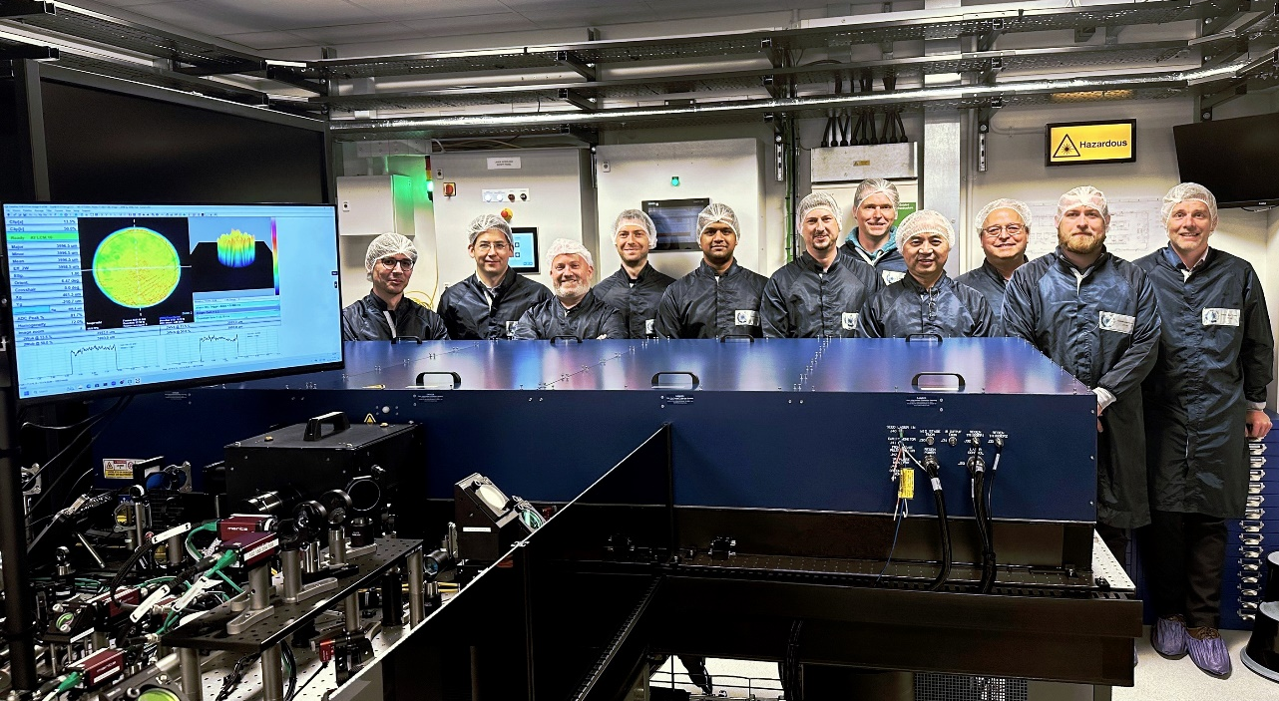
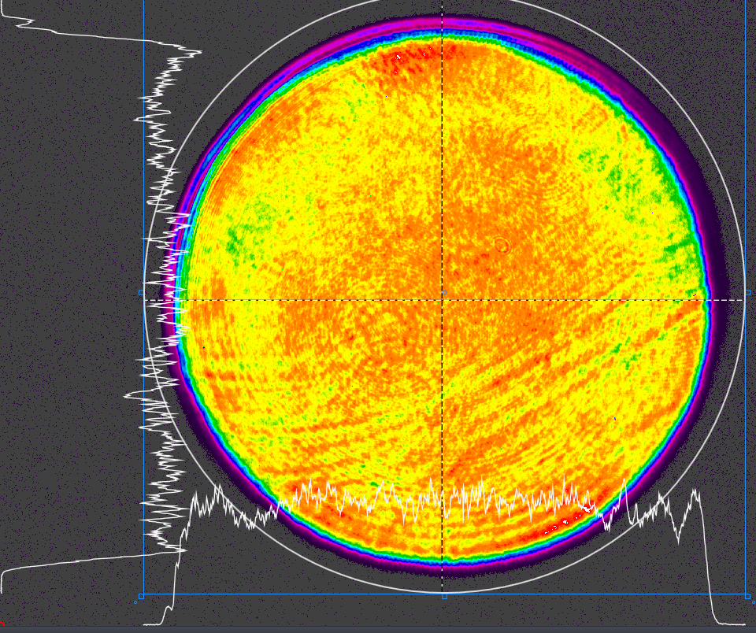
OPCPA front-end being commissioned
Progress has been good across all subsystems: picosecond preamplifier, nanosecond amplifier and temporary stretcher
Highlight is the ‘completion’ of the Site Acceptance Test for the ns amplifier pump laser
We have amplified pulses from the ps amplifier, and started to get gain in the ns amplifier
CLF & NG-CEO ns-pump installation team (June 2024)

Slide 5
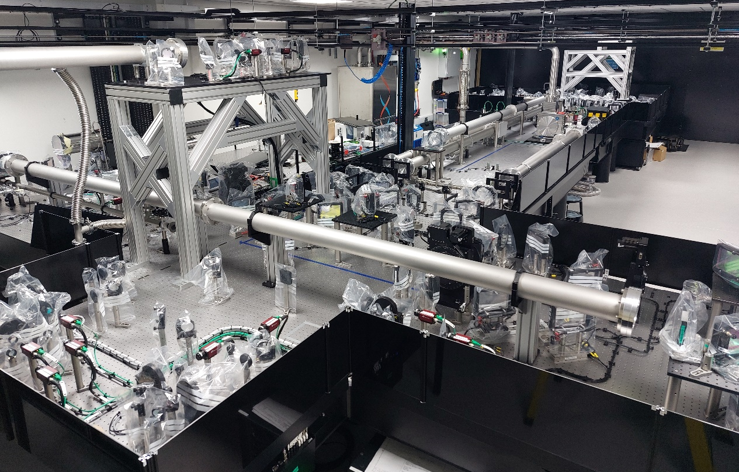
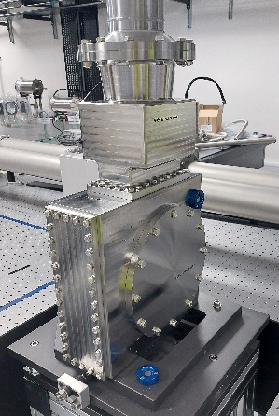

Main Ti:Sapphire Amplifier being installed
Highlight –Commissioning started in June and majority of opto-mechanics & optics installed
Laboratory configured for laser operations (interlock & controlled access)
Beam alignment commenced with low power CW lasers
EPAC crystal #3
Amplifier head
Ti:Sa amplifier

Slide 6
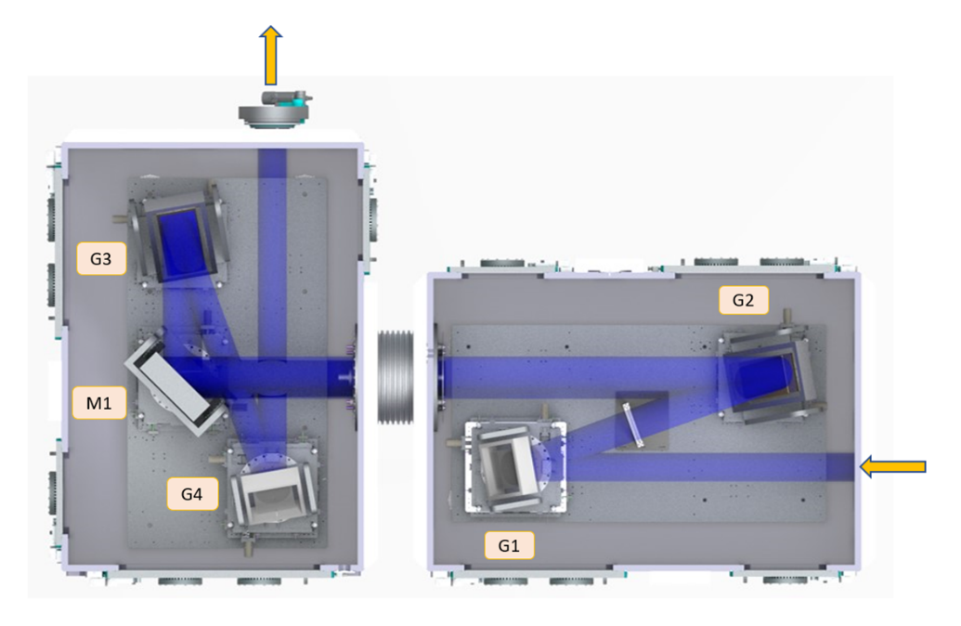
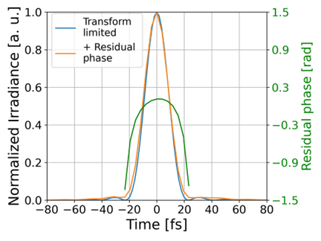
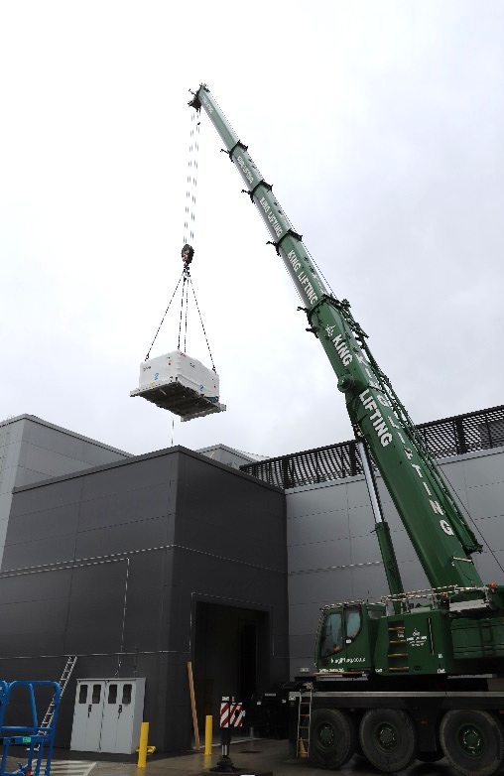
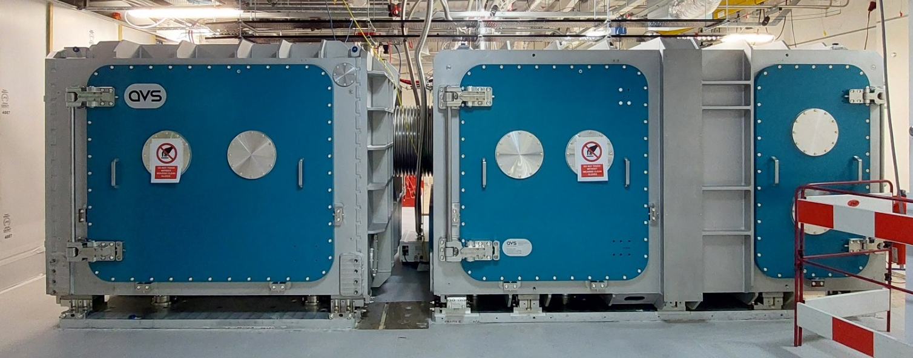
Compressor chambers installed
Aim: Compression to 30fs, 30J @ 10Hz.
4-grating design @ Littrow (10° out-of-plane angle).
300x300 mm² (G1&G4), 760x300 mm² (G2&G3)
Peak fluence @ 1 PW = 80 mJ/cm² (30 fs)
Phase #1 use gold gratings @ 1480 line/mm for 1 Hz.
Phase #2 use multi-layer dielectric gratings for 10 Hz.
30 J Out
G3
G2
M1
Modelled Optimum Compression
G4
50 J In
G1
¹ V. Aleksandrov et al., CLEO/Europe-EQEC 2023
Chambers installed April 2024
Grating installation scheduled Spring 2025.

Slide 7
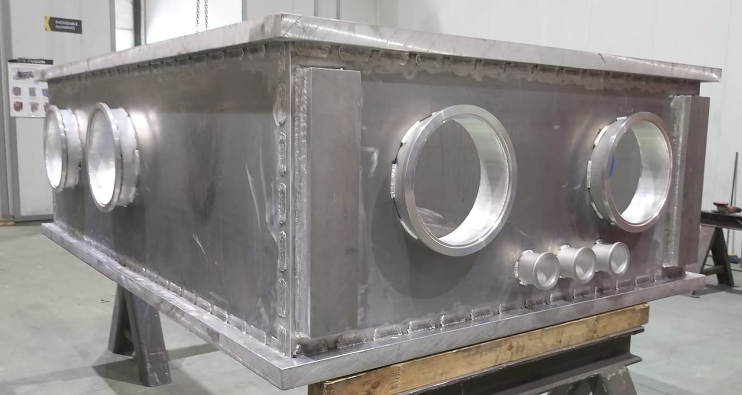
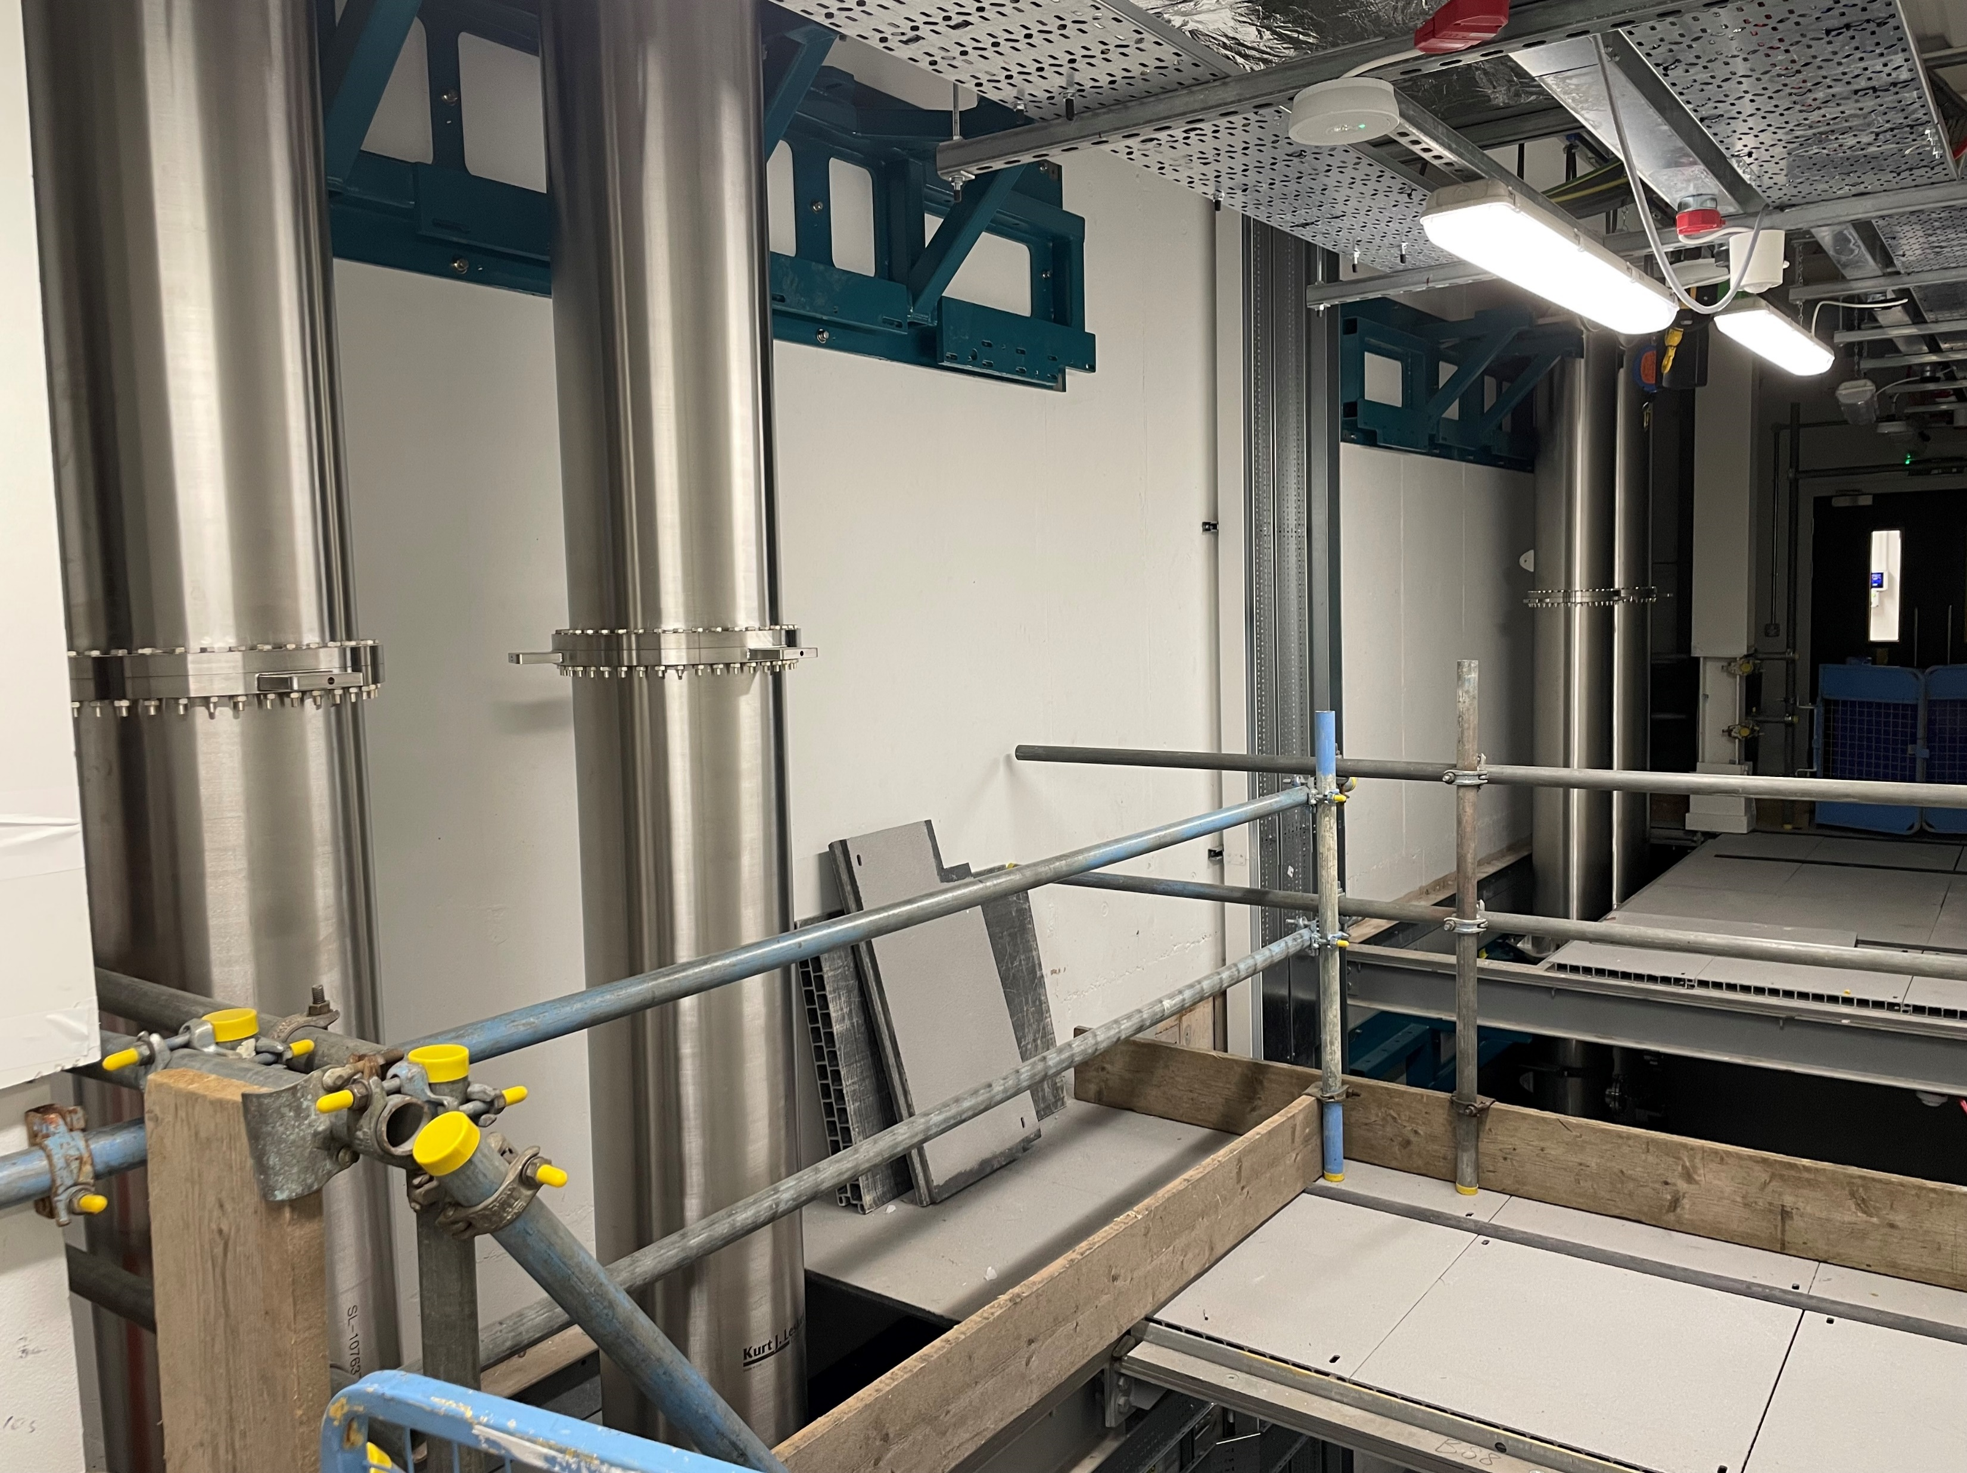
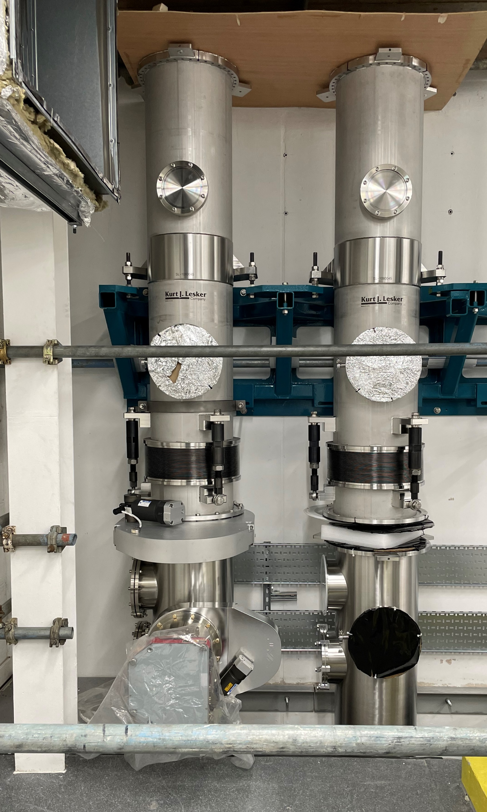
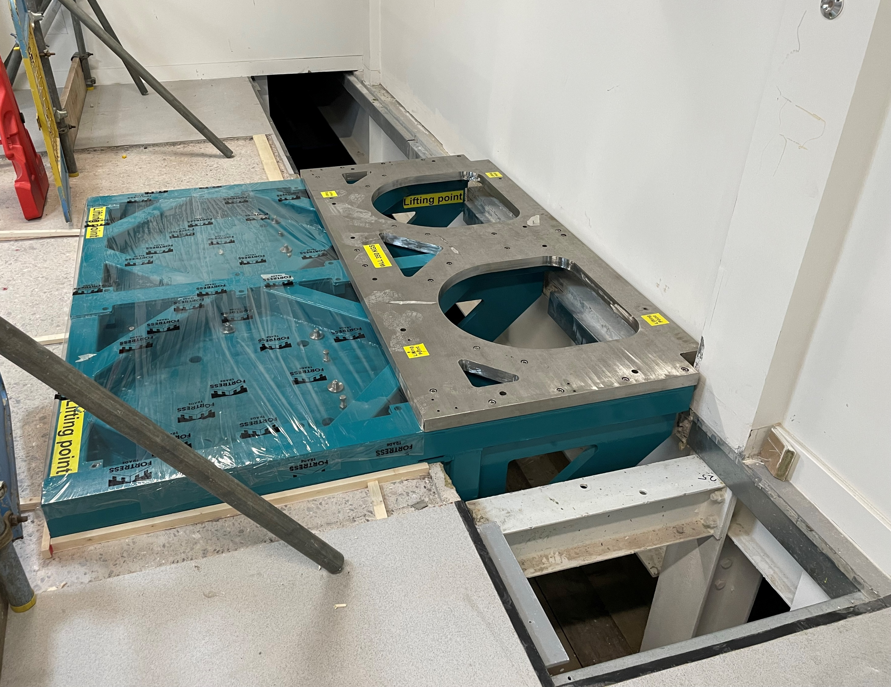
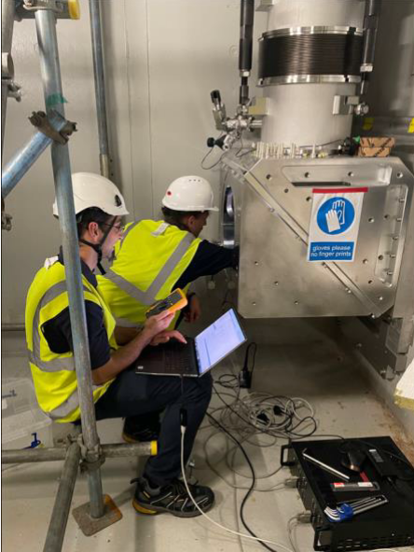
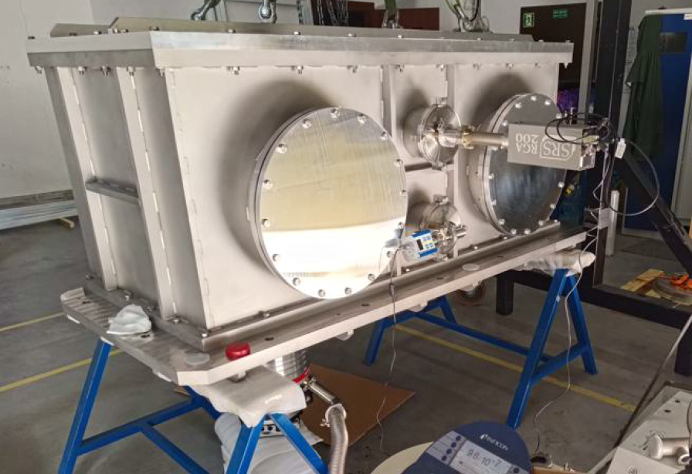
Beam transport installation underway
Highlight -good progress being made on the beam transport. It is complex - spans across 3 floors with multiple chambers
Double mirror chambers (EA1 & EA2) – In manufacture – expected delivery in October 2024. Support frames installed in August.
Beam line mirrors – Orders placed for final polishing and coating of 16 380 x 270 mm mirrors. Expected by April 2025.
EA1 Switchyard Chamber – In manufacture – expected delivery in November 2024
EA1 Switchyard Chamber
Riser pipework – Ground floor corridor
Riser pipework – Plant room 9
Support frame in position
Riser layout – Highlighted sections installed
Active beam pointing stabilisation schemes being developed
EA1 BL1 Riser turning chamber – Pit
EA1 Double Turning Chamber nearing completion
Double mirror chambers

Slide 8
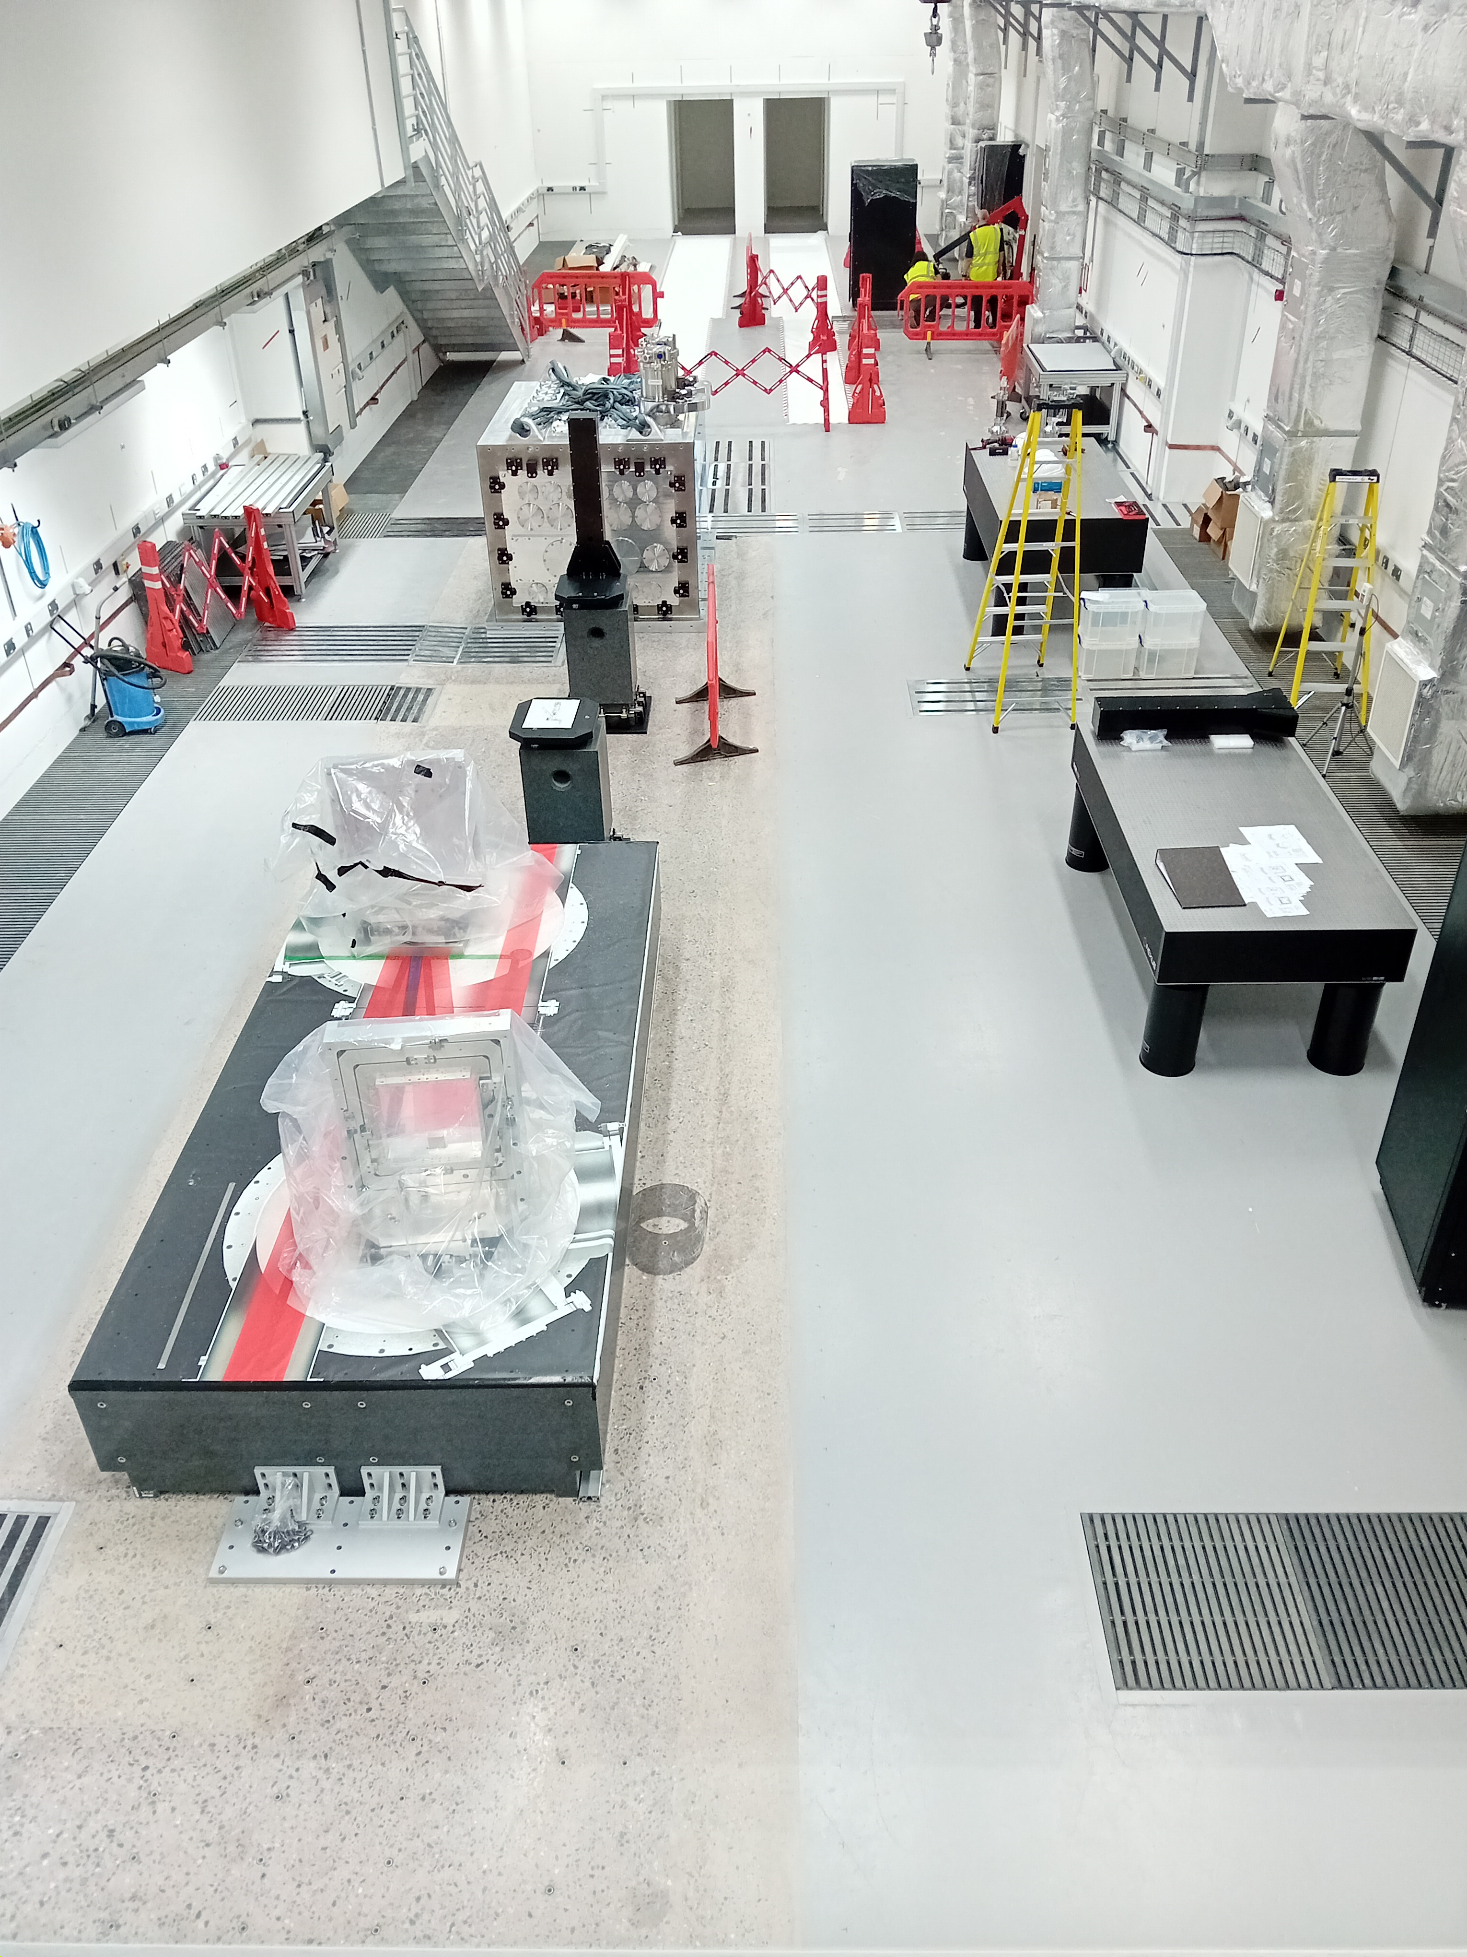
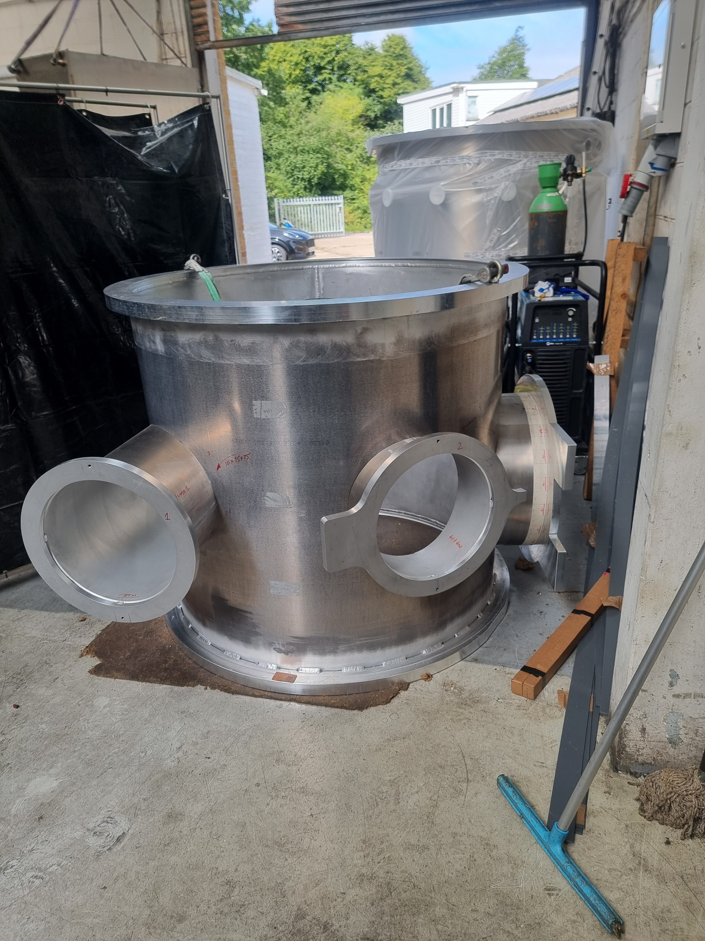
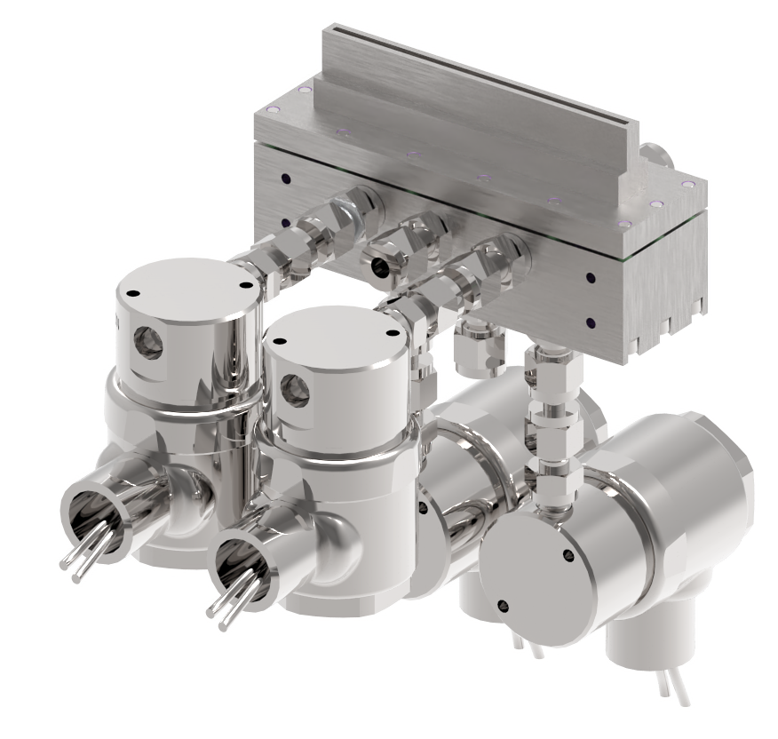
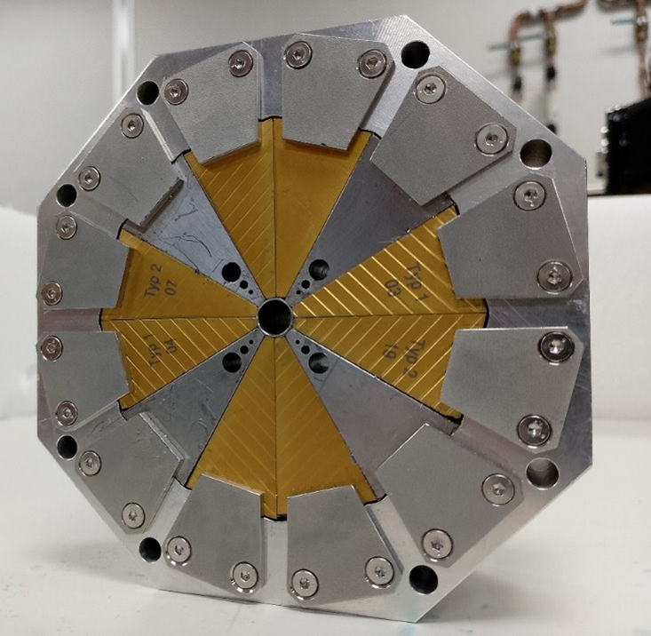
LWFA area progressing
All granite blocks in place apart from that of Target chamber
Focusing chamber close to completion
Area now prepared for granite delivery next week
Most optics on order – parabola expected Dec 2024
4 x quadrupole magnets being assembled at DL
Gas jet slot nozzles are being tested – initial applications
Will move to HOFI later
100 mm gas jet nozzle
PMQ
Focusing chamber
EA1 – two weeks ago
Double mirror chambers

Slide 9
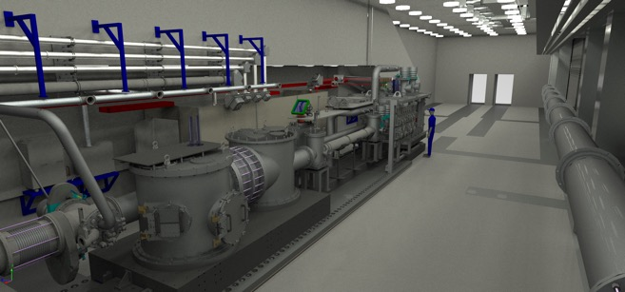
@ EPAC: Options
Option 0 – Existing EA1
Get the few-100TW @100Hz beam into the second beamline in EA1 (internal + PACRI)
1GeV beam in the first 5 – 8 m of the area (by middle of the source area)
~5m gain length - > 20m to get saturation for 1GeV beam (XUV wavelengths – not x-ray) - ASTeC
The last 8-10m can be the FEL user area
Pros:
Capital investment needed might be minimal
Cons
Will interfere with EA1 operations
Limited to 1GeV (phase 1)
Space for a second beamline
1GeV FEL with user area: >100m (EuPRAXIA CDR)
Upgradable to 5GeV in Phase 2

Slide 10
@ EPAC: Options
Option 1 – Extending EA1
EA1 is 40m long – but only ~ 20 m after the plasma source for FEL
~5m gain length - > 20m to get saturation for 1GeV beam (XUV wavelengths – not x-ray). This doesn’t leave any room for FEL user area
Need extension for 5GeV cases as well as user area
Pros:
Can use EPAC PW laser for higher energies
Can host multiple phases – good for future-proofing;
Cons
Capital investment (for building) can be high ~ 20-30M
Construction can be disruptive
Space for a second beamline. Building extended further
1GeV FEL with user area: >100m (EuPRAXIA CDR)
Upgradable to 5GeV in Phase 2

Slide 11
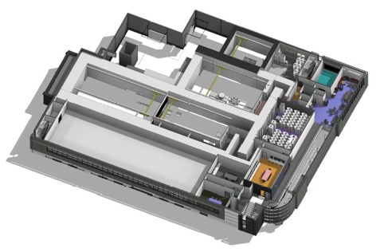
@ EPAC: Options
>200m
Option 2 – Building an Annex
Surrounding areas are green/brown fields
Earmarked for “large science” – so extendable
More expensive but gives flexibility for future-proofing
Building works and beamline construction can go in parallel with operation of EPAC
Pros:
Multiple beamlines, full flexibility, futureproofing
Cons
Significant capital investment required
(~60M - 80M)
150m-200m
1GeV FEL with user area: >100m (EuPRAXIA CDR)
Upgradable to 5GeV in Phase 2

Slide 12
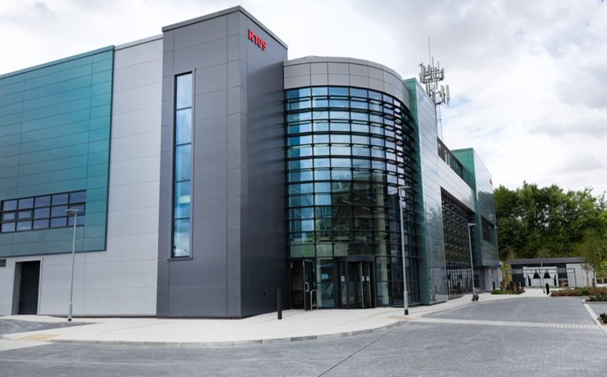

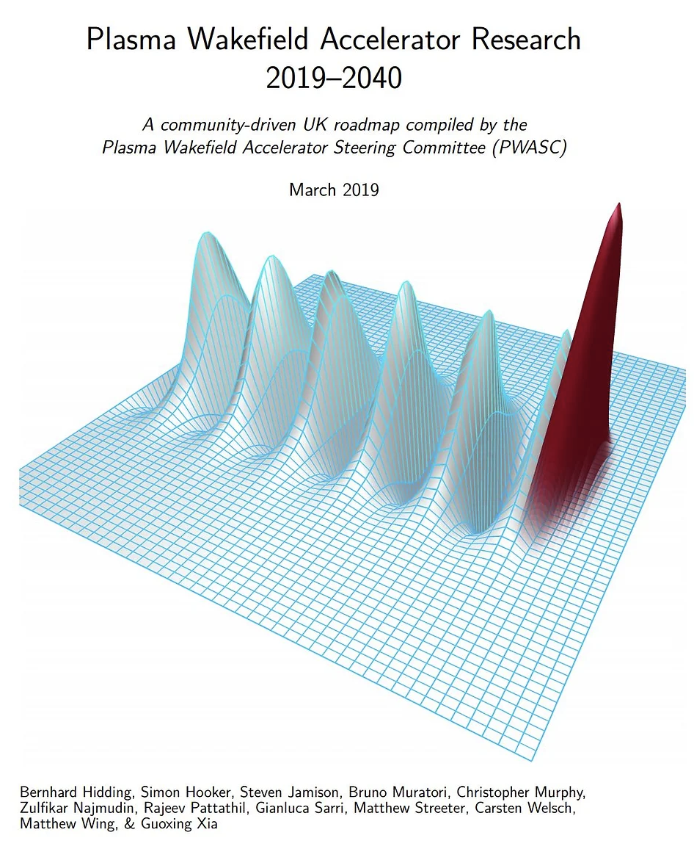
@ EPAC?
EPAC’s strategy and timescales align with EuPRAXIA well
Additional space for future laser and experimental areas (eg. a 100Hz system under development, which can be the main driver for 1GeV FEL beamline)
Has the capacity to expand the EPAC building to house the additional beamlines
Has an upgrade path to 5GeV and 10GeV with the EPAC PW laser
Strong expertise within STFC (lasers, accelerators, detectors, targetry, data…) and the academic community (plasma accelerators)
Applications-oriented program and industry links
STFC has long history and all the infrastructures required to run a successful user programme
STFC’s Accelerator Strategy now includes development of plasma accelerators
PWASC

Slide 13
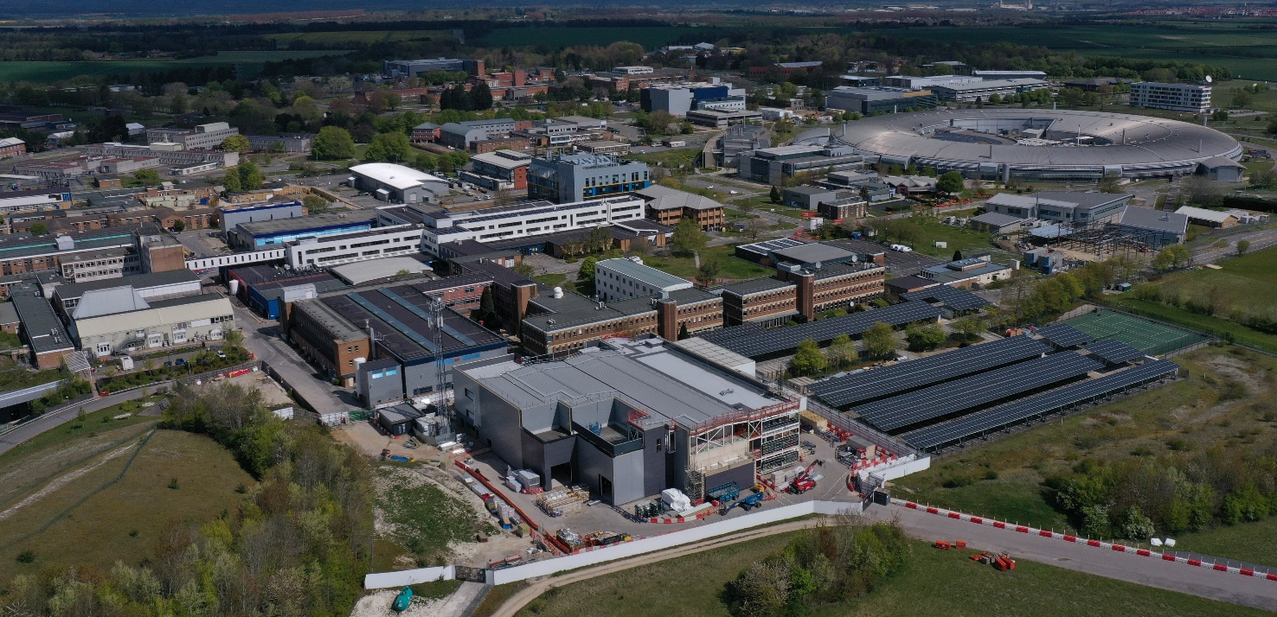
@ EPAC: synergies of the campus
DIAMOND synchrotron
Scientific Computing
RAL Space
MRC Harwell
RFI-bioimaging
Technology
CLF – Vulcan and Gemini
ISIS neutron & muon source
Campus-wide solutions for common developments
Access to cutting-edge technology:
accelerator, detectors, imaging, ML
Solutions for Data management and Infrastructure
EPAC building during construction

Slide 14



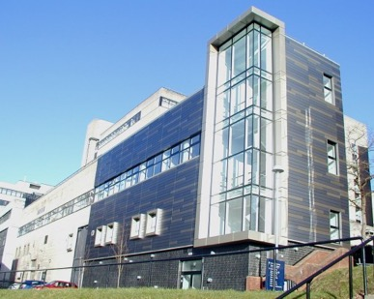
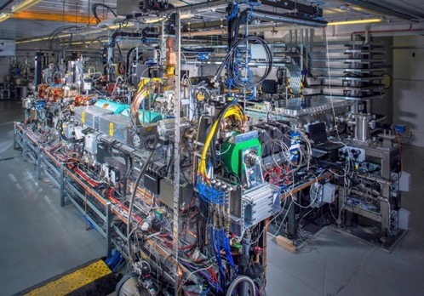





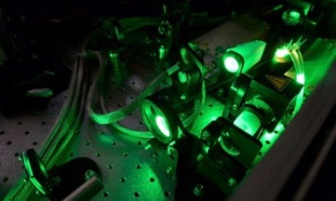
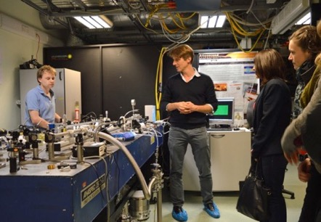
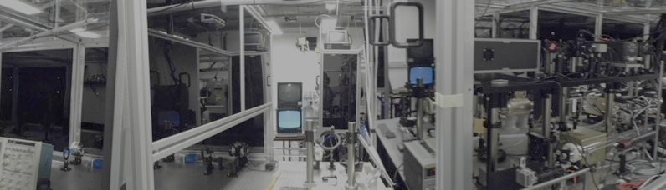
The UK Centre of Excellence
UK CoE will focus of the design and delivery of Applications Beamlines in Sites 1 & 2
The UK University Centers, Accelerator Institutes and the CLF are leaders in the underpinning science and technology
The UK PWASC coordinates activities in this area in the UK
SCAPA
CLARA- FEL prototype
PWASC
Oxford
Oxford
Imperial College
Given the level of management required PWASC recommended that this done via STFC
Since supply to Site 1 is also needed, ASTeC is chosen as the nodal point for the UK Excellence Centre
100Hz, 10TW system, Taranis and Taranis-X @ QUB

Slide 15
@EPAC: community contributions and collaborations
  Prototypes of amplifier head, solutions for heat management
  Test compressors with gratings with appropriate damage thresholds and heat management solutions
  Solutions for wavefront and pointing corrections
  Plasma accelerator components, Diagnostics, Gas flow control, feedback systems, plasma lens
  Inputs to end-to-end FEL simulations with laser-driven electrons, undulator design, electron beam transport, photon beamline, diagnostics
  Input to design of user stations, rigs, diagnostics
  Physics simulations of LWFA and optimisation of secondary sources for various applications, diagnostics
  Advanced Accelerator schemes (eg. Trojan Horse)
France, Germany, Italy..
Internally developed/coordinated key components
Building design and construction with radiological modeling (CLF)
EPAC 10Hz, 30J system, 100Hz – few 100TW system (CLF)
Laser beam transport (CLF)
Plasma accelerator (UK CoE)
FEL beamline, undulators (UKCoE/ASTeC)
User areas (UK CoE)
Betatron beamline (UK CoE)
Positron beamline (UK CoE)
France Germany, …
France, Germany, Italy
France, Germany, Switzerland
Germany, Italy, Switzerland
Germany,France/ Portugal
Germany

Slide 16
@ EPAC: our perspective
A very strong interest in the community to contribute to/host EuPRAXIA
STFC, UK Accelerator Institutes and the academic community possess a significant expertise critical for EuPRAXIA’s success: UK CoE
Possible to have access slots in EPAC/University centers via existing channels/additional grant funding
Some key questions/concerns
  Capital costs and source(s) (host + consortium?)
  Operational funding and source(s) (host + consortium?)
Long history of running world-class facilities
Very strong expertise on HPL and plasma accelerator technology
Strong user community and University facilities
Campus expertise on detectors/targetry/data management
Strong links with industrial community
Governance and funding arrangements need discussions
Initial funding requirements (for optimised options) are high
*Requires* external funding
Lower cost options would involve sharing of ”beam time”
External funding (capital and/or operational) would be necessary for the business case for hosting a European Infrastructure in the UK

