Slide 1
Update on 2nd SITE Preparation for CLPU
G. Gatti/Centro de Láseres Pulsados - CLPU

Slide 2
Outline
Building Construction Progress
EMP monitor for HRR Operations
Progress on VEGA Laser
New Lasers Development (2 𝜇m)
ggatti@clpu.es

Slide 3
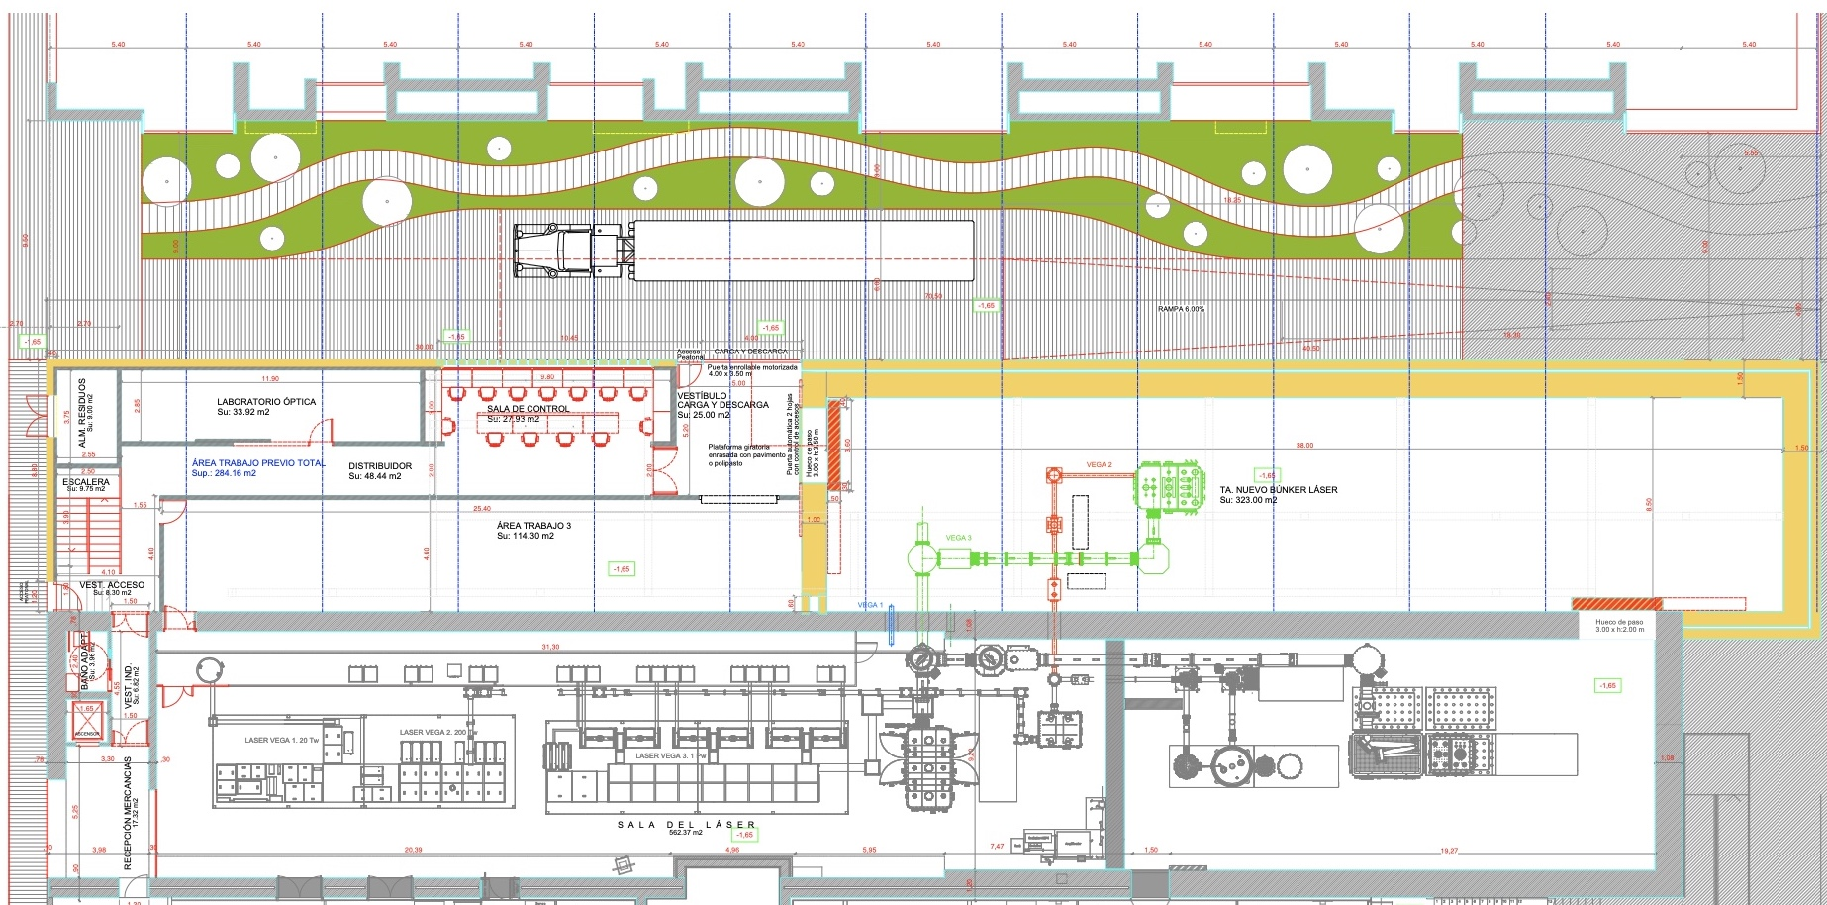
Building Construction Progress
NEW AREA
ggatti@clpu.es

Slide 4
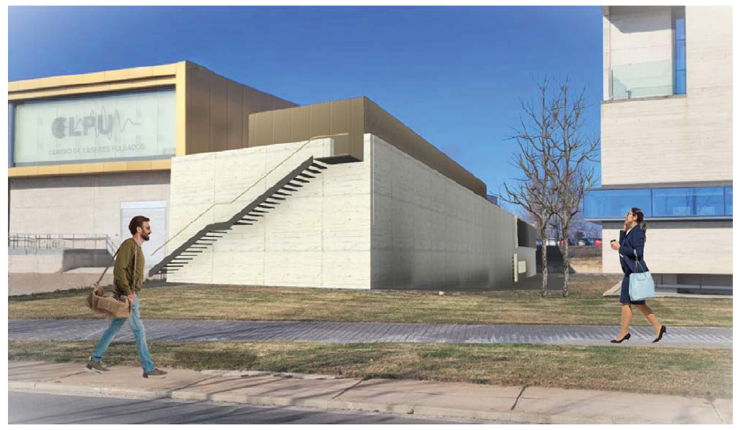
Building Construction Progress
Laser Transport Lines Defined
(launching tender)
Excavation Starting
(in a few weeks)
Safe Equipment Storage
ggatti@clpu.es

Slide 5
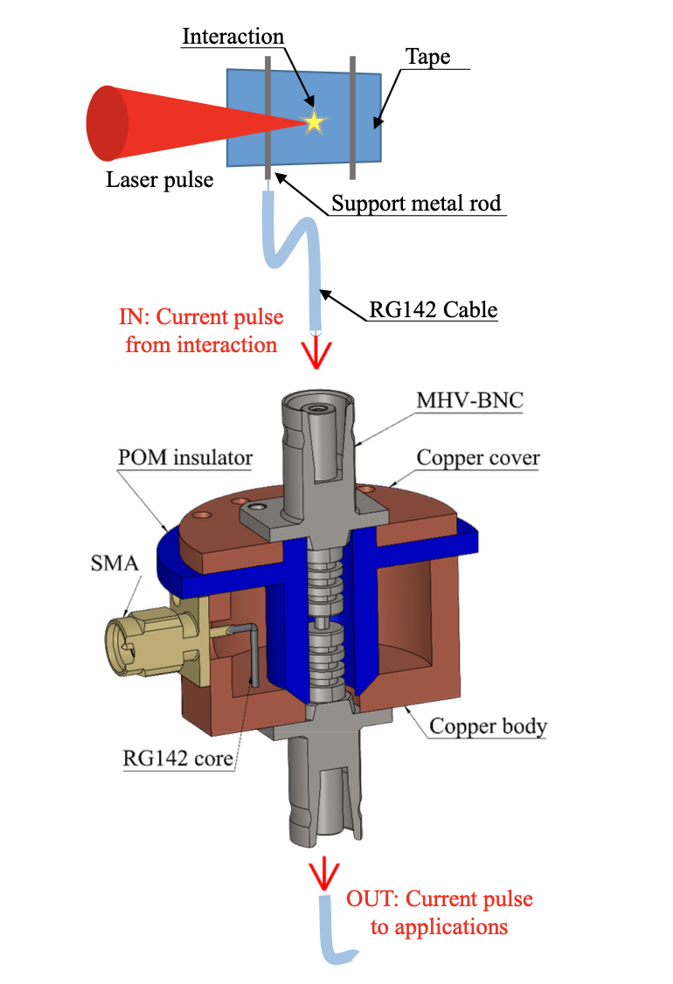
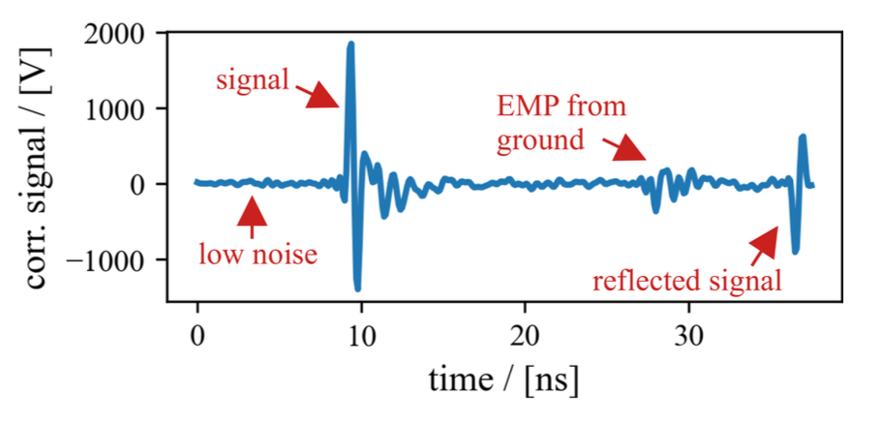
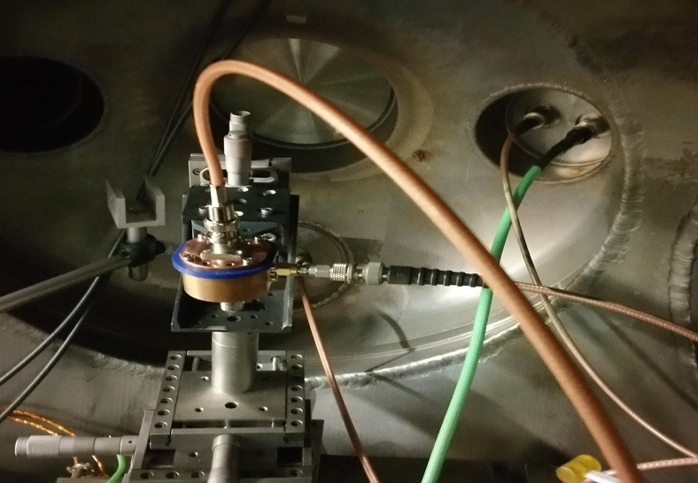
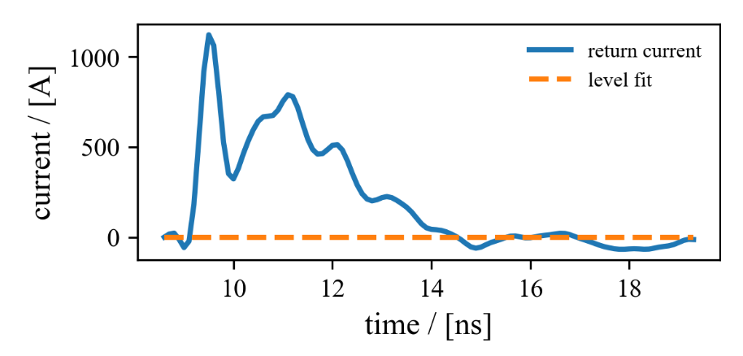
EMP Monitor for HRR Operations
Target
Inductive Coupled
Current Monitor
Measures induced current
Associated with plasma source
Beam generation
Solid Target
Testing in vacuum chamber
-Modelling & simulations (not shown here)
ggatti@clpu.es

Slide 6
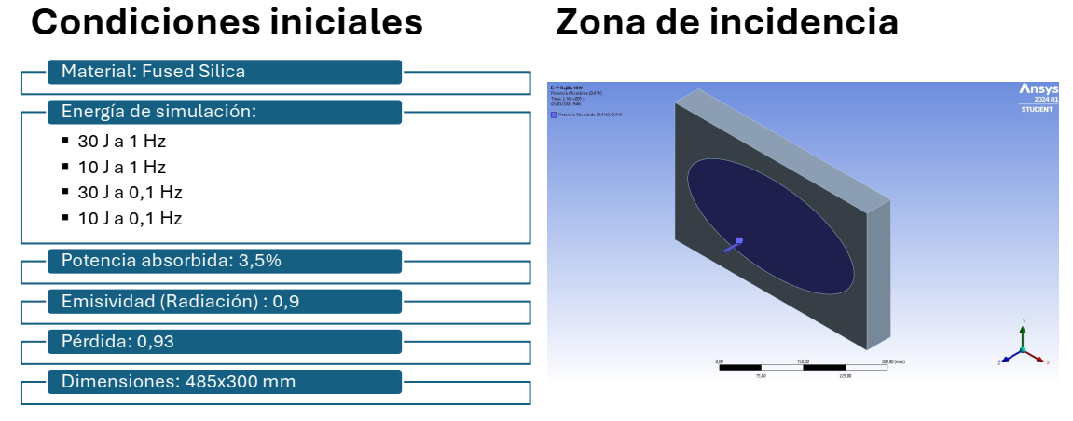
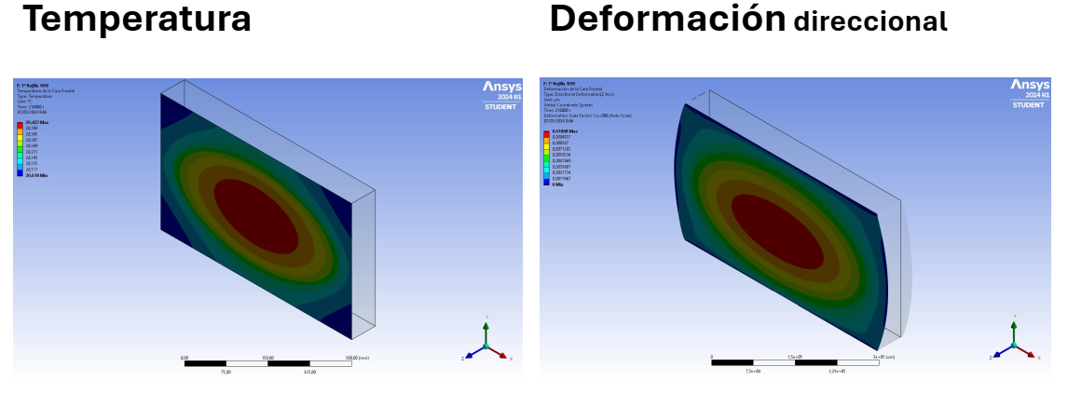
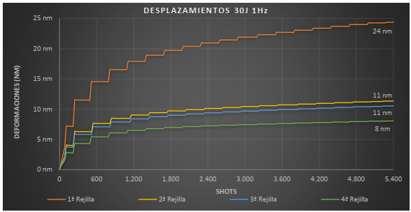
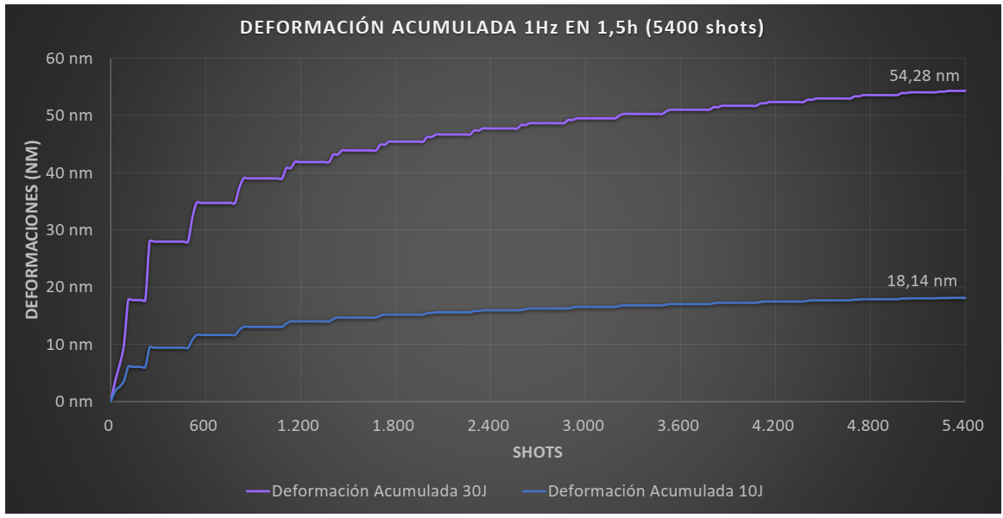
Optical Compressor Thermal Analysis
Assessing matching with present working points to scale to Higher Repetition Rates
First simulations ANSYS ongoing, trying to check with real experimental data (HRR)
Initial conditions
Incident laser footprint
Temperature distribution
Directional deformation
MAXIMUM DISPLACEMENT AT EVERY GRATING: 30 J @ 1 Hz
ACUMULATED MAXIMUM DISPLACEMENT: 1.5 h 30 J @ 1 Hz
ggatti@clpu.es

Slide 7
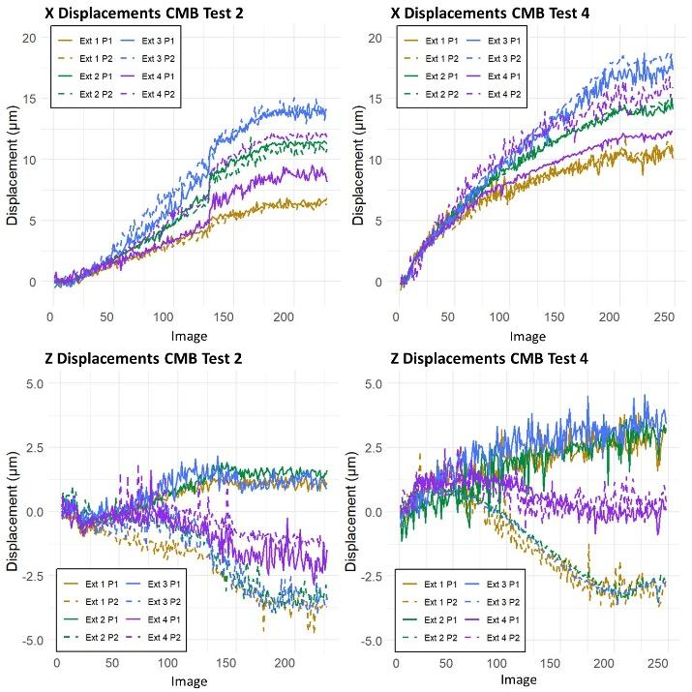
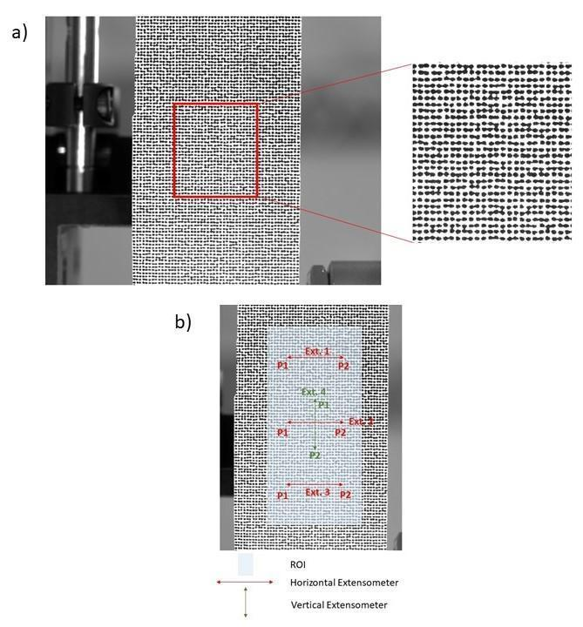
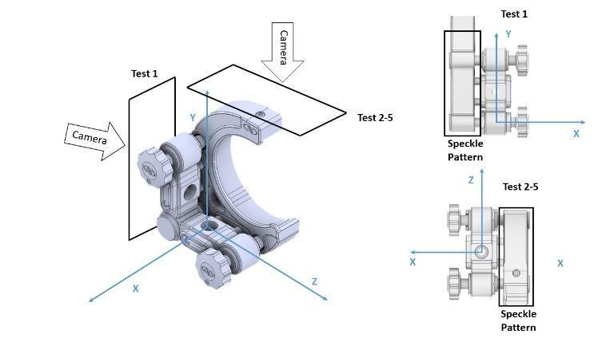
Amplifiers Thermo/Mechanical Analysis
Digital Image Correlation Technique for the kinematics assessment of laser sytems optomechanical mounts. Preliminary study for amplifier thermal checking
ROI and elastomers definition
Optical mount directions definition
Checking real movement
ggatti@clpu.es

Slide 8
Post-Compression and Characterization VEGA-2
Post-compression using spectral broadening
From an idea of
G. Moreau
Self phase modulation (SPM)
+
Dispersion management System (DMS)
SPM
DMS
SPM successfully used in H. Fibers
Main issue is to have a 2D
and not a 1D problem!
ggatti@clpu.es

Slide 9
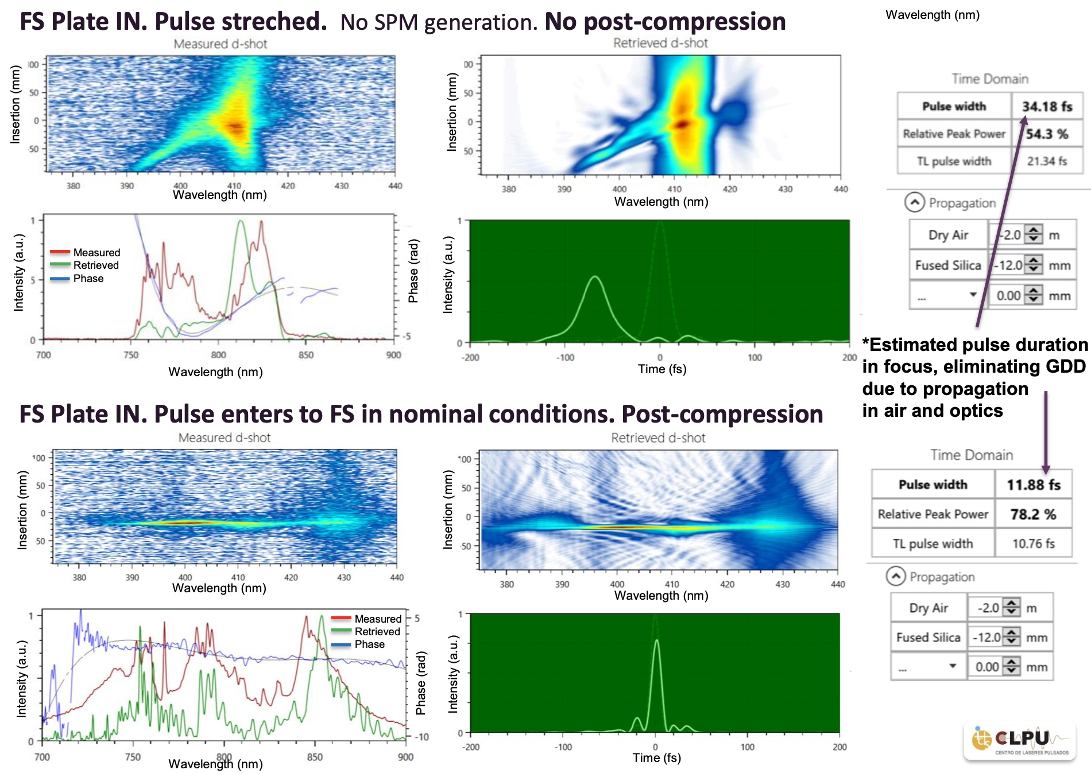
Time-Spectral Analysis (3 J level)
ggatti@clpu.es

Slide 10
Development of 2 𝜇m lasers
Hybrid system of parametric + conventional amplification
If possible skip regenerative amplification stage
All-diode pumped
Scheme for 100 mJ, 100 fs, 100 Hz @ 2 𝜇m (10 W)
Oscilllator (1 um)
Stretcher 1
2 um upconversion
OPA
Stretcher 2
CPA
Compressor
Pump (Yb:YAG)
Pump (diodes)
In progress
PARTE B
Conversion + OP(C)PA
Conventional CPA
ggatti@clpu.es

Slide 11
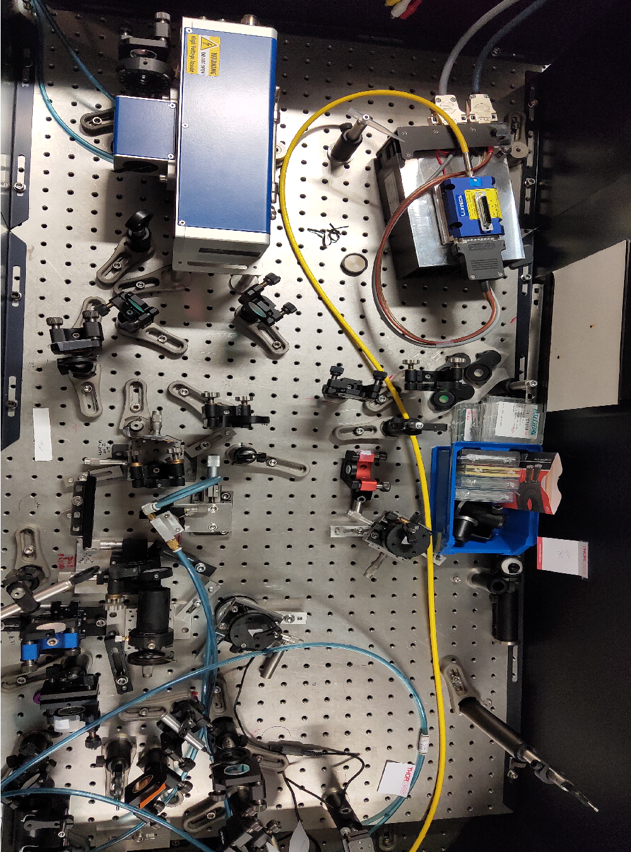
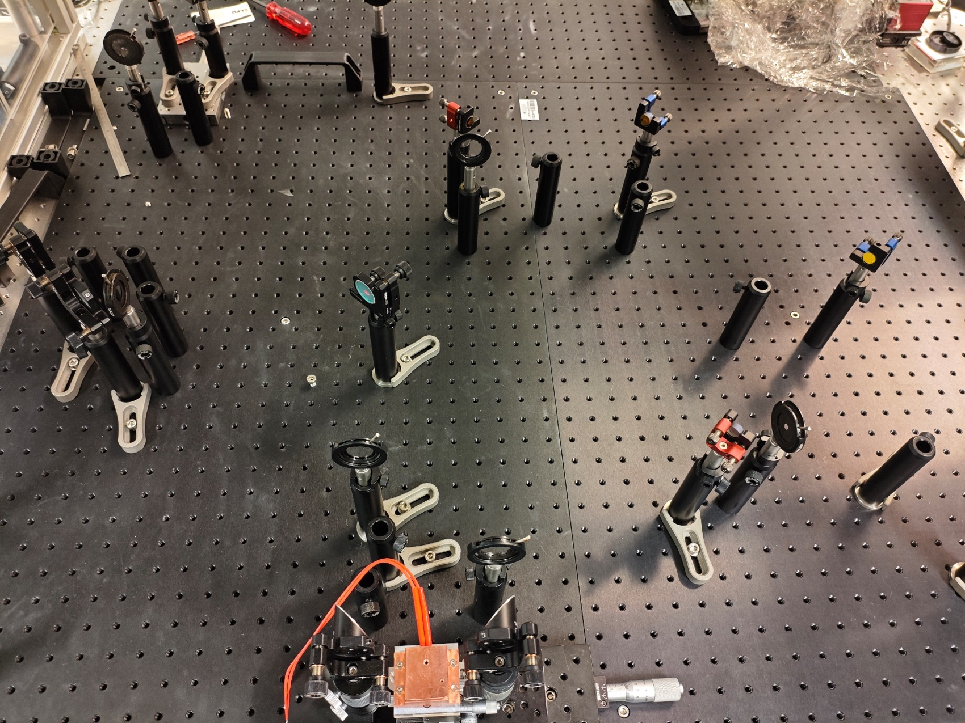
Development of 2 𝜇m lasers
Progress of the OPO cavity
Current Oscillator 1030 nm
(Test Bench)
PPLN for degenerate OPO
(Test Bench)
ggatti@clpu.es

Slide 12
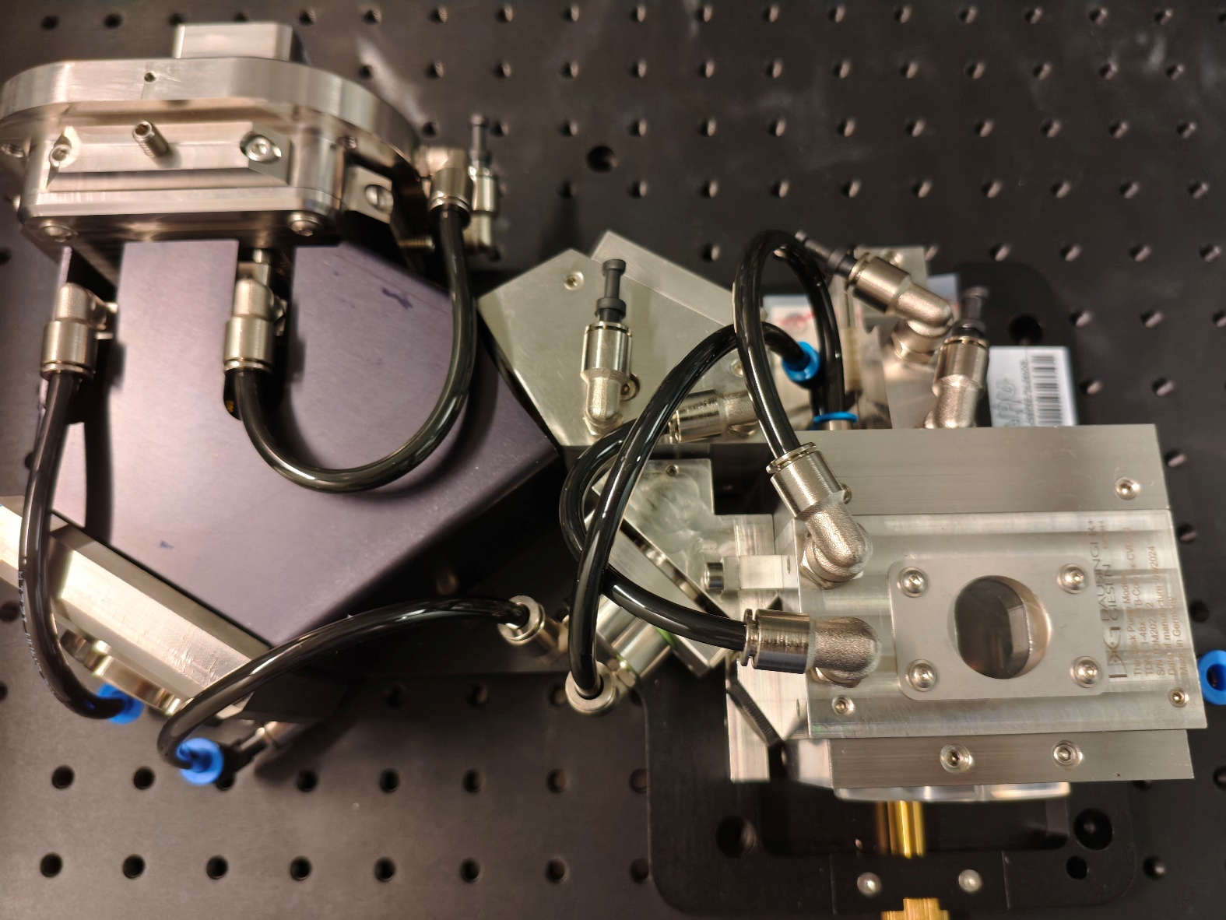
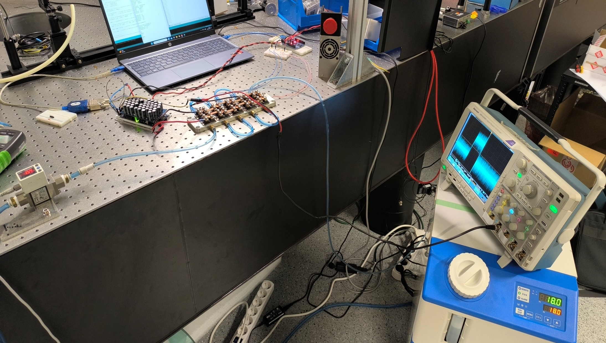
Development of 2 𝜇m lasers
Testing of new diode drivers
Yb:YAG thin disk (1030 nm) as OPA pump
ggatti@clpu.es

Slide 13
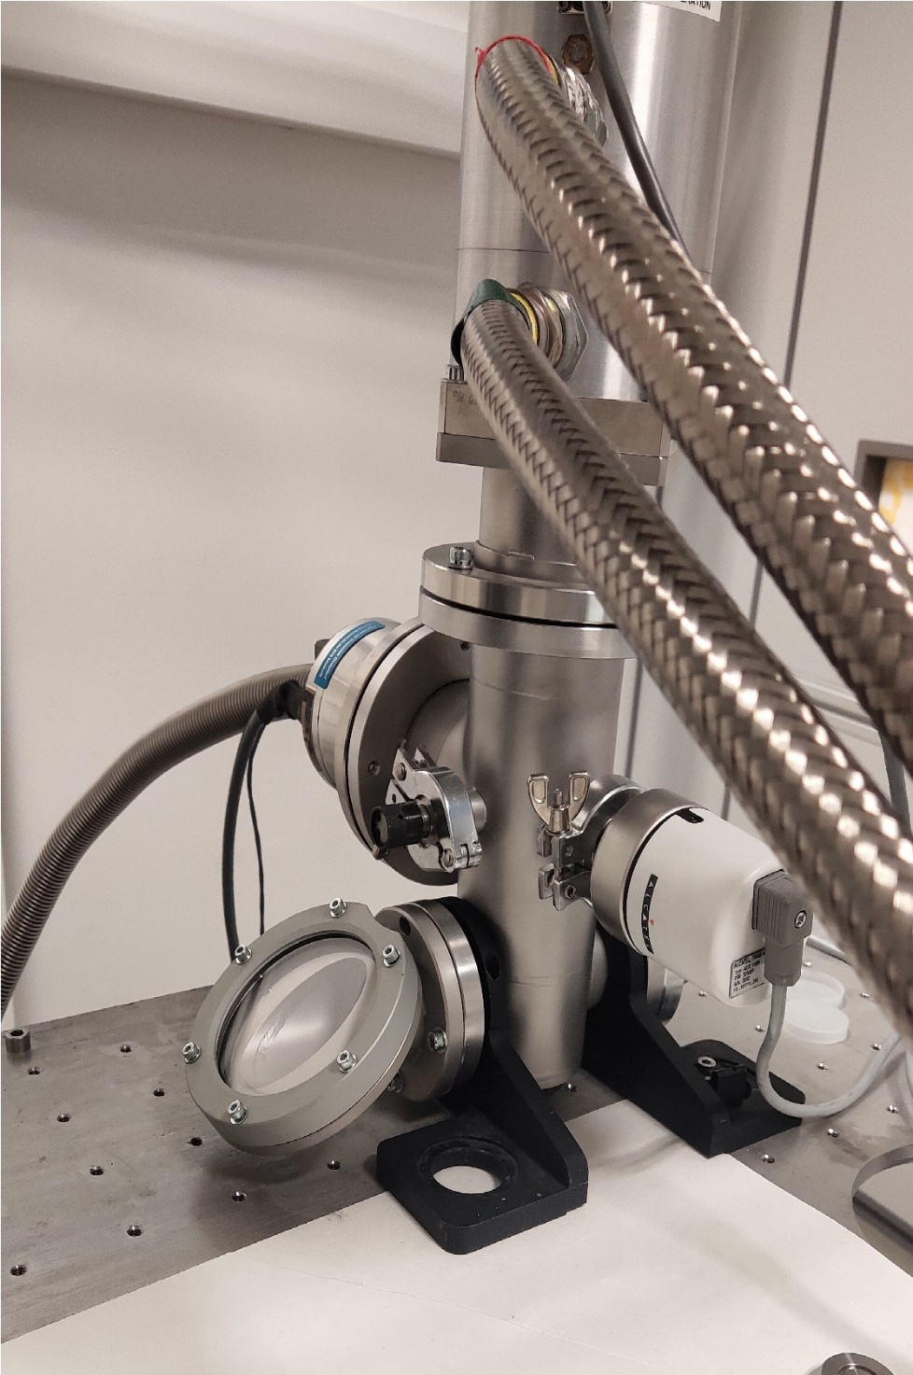
Development of 2 𝜇m lasers
Cryo Cooling
Module
In progress:
Workbench for the characterization of laser materials:
Optical characterization
Emission absorption spectrum
Upper state transition lifetime
Transmittance
Dopant distribution
Thermal characterization
Thermal conductivity
Thermal expansion coefficient
dn/dT
Depolarization
ggatti@clpu.es

Slide 14
Conclusions
Building Construction Starting
HRR Operations
VEGA Optimization
New Lasers Development
Bid Book Preparation (starting)
ggatti@clpu.es

