Slide 1
Arbitrary laser-pulse injection in PIC codes
Jorge Vieira, Rafael Almeida, Ricardo Fonseca/IST

Slide 2
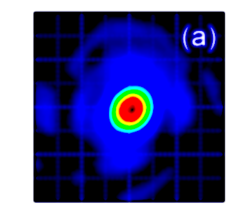
High power laser pulses in the laboratory
Lasers are non-ideal
Non-standard wave-fronts
Spectral phase variations
Experimental measurements can fully characterise e.m. fields
Fluence
Spectral-phase
Full 3D reconstructions
Spectrograms
We developed a new tool that allows to inject arbitrary laser pulses in PIC codes that strictly satisfy Maxwell’s equations
Measurements

Slide 3
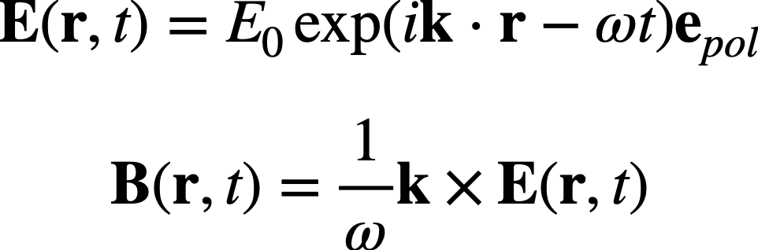
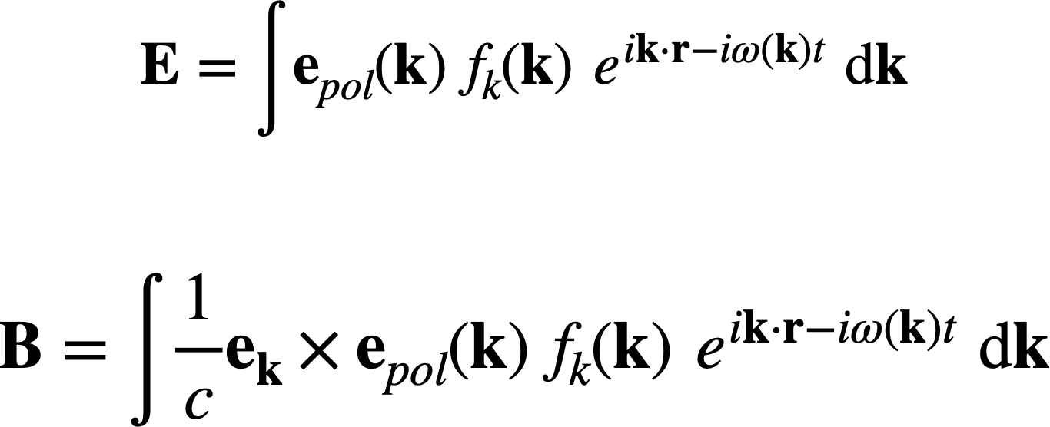
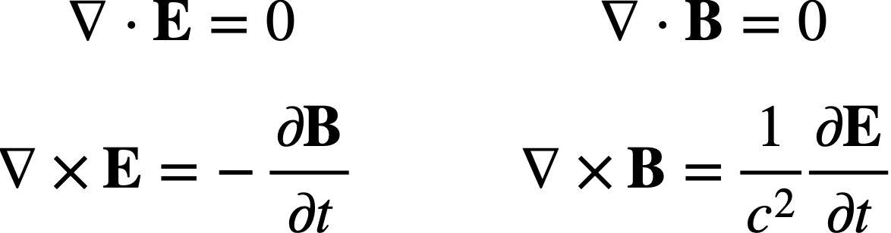
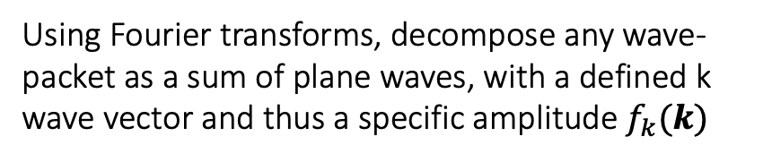
General laser injection method
Plane waves: exact solutions of Maxwell’s equations
New algorithm
Using Fourier transforms, decompose any wave-packet as a sum of plane waves, with a defined k wave vector and thus a specific amplitude $f_{k}(k)$
Exact solution
Maxwell’s equations in free space
Linearity
Sum of solutions is still a solution!

Slide 4
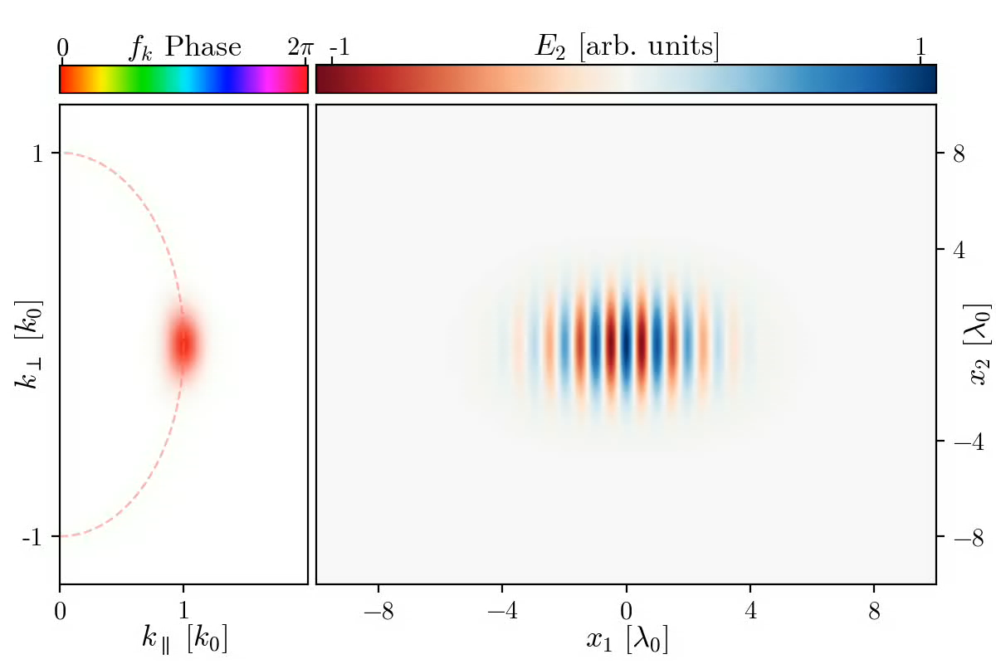

Controlling pulse properties with $f_{k}(k)$ function
We can control:
Main Frequency
Transverse Size
Longitudinal Size
Focus Position
Relative Injection Position
Transverse Profile
Basically Arbitrary Control over Pulse Shape

Slide 5
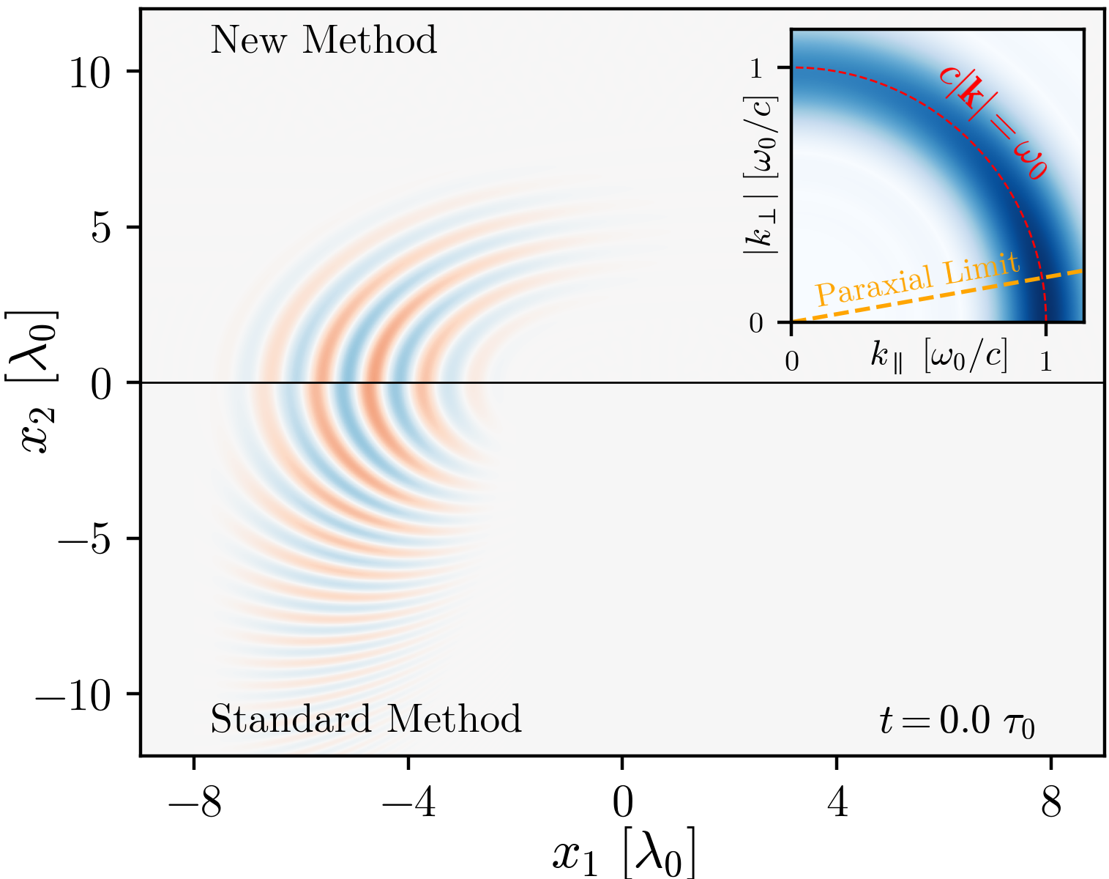
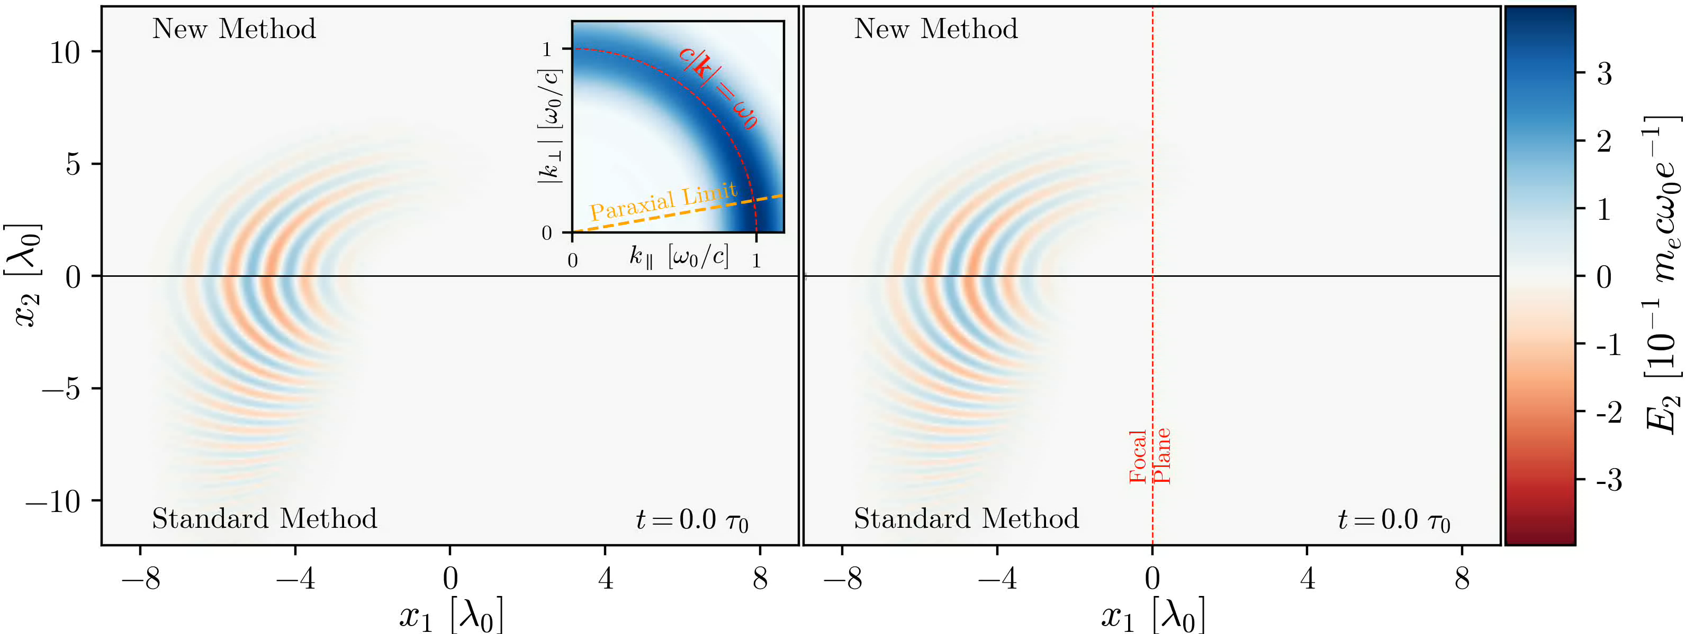
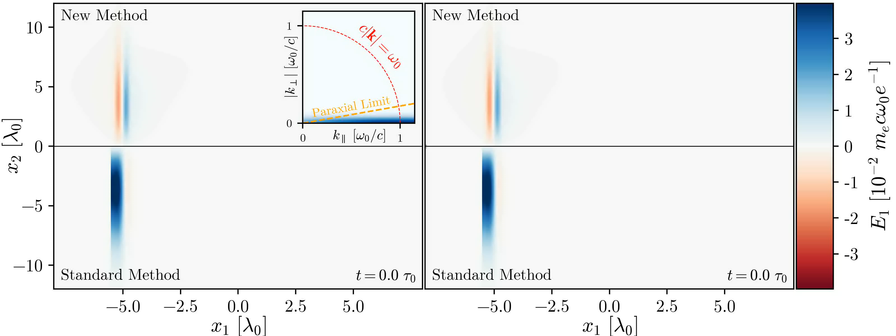
Arbitrary pulse injection in Osiris
Transverse electric field of a non-paraxial laser pulse
Beyond paraxial and envelope approximation:
Precise description of tight-focus and ultra-short e.m. fields
Transverse electric field of a single cycle laser pulse

Slide 6
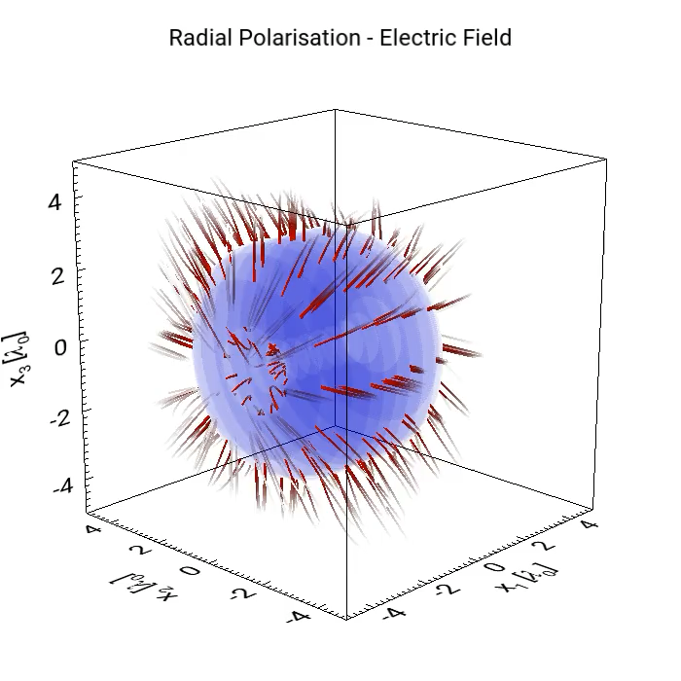
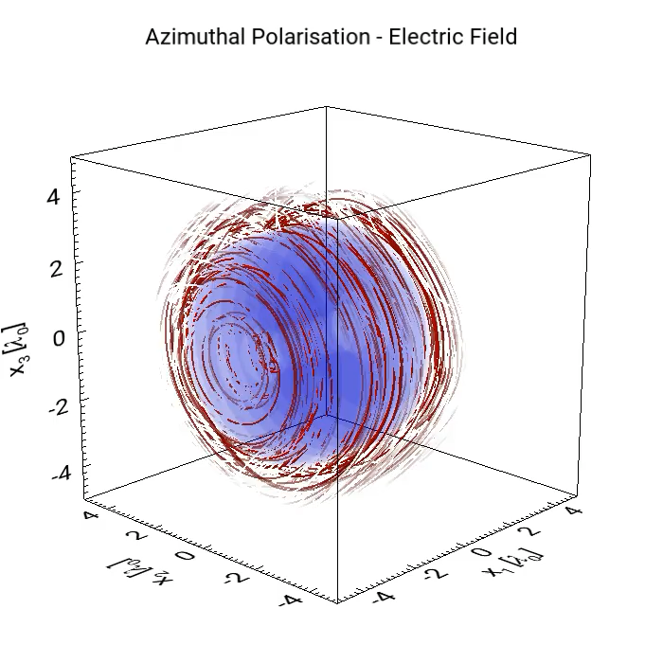
Arbitrary pulse injection in Osiris
Beyond paraxial and envelope approximation:
Precise description of tight-focus and ultra-short e.m. fields
Elliptical, radial and azimutal polasation build in
Direct injection of new polarisation states
Electric field intensity
Electric field lines

Slide 7
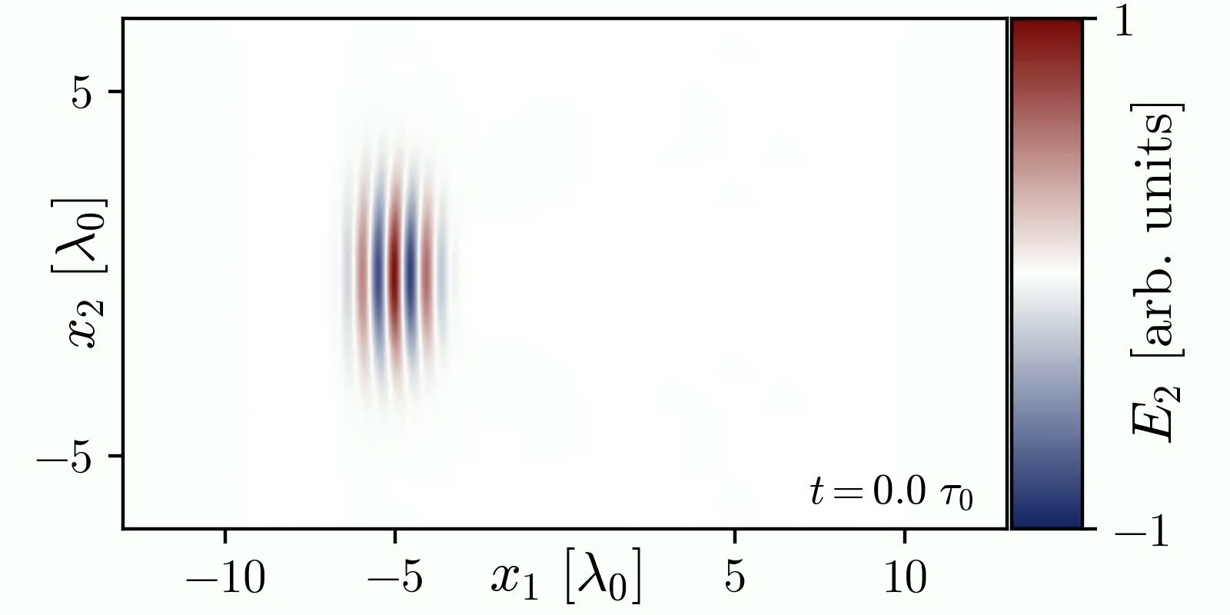
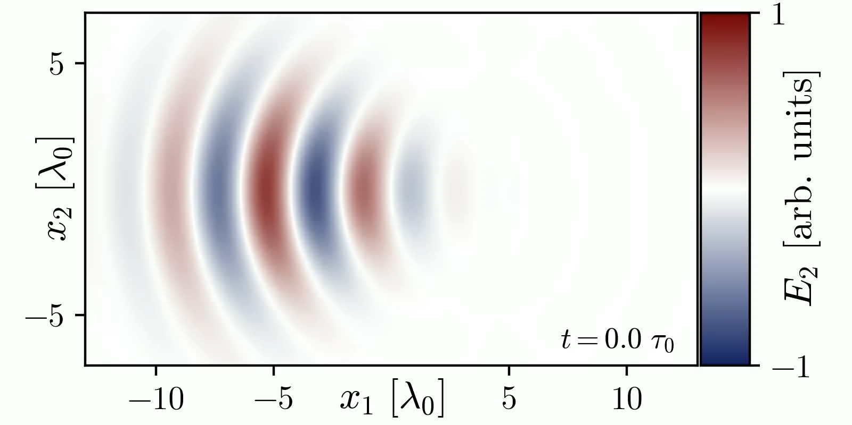
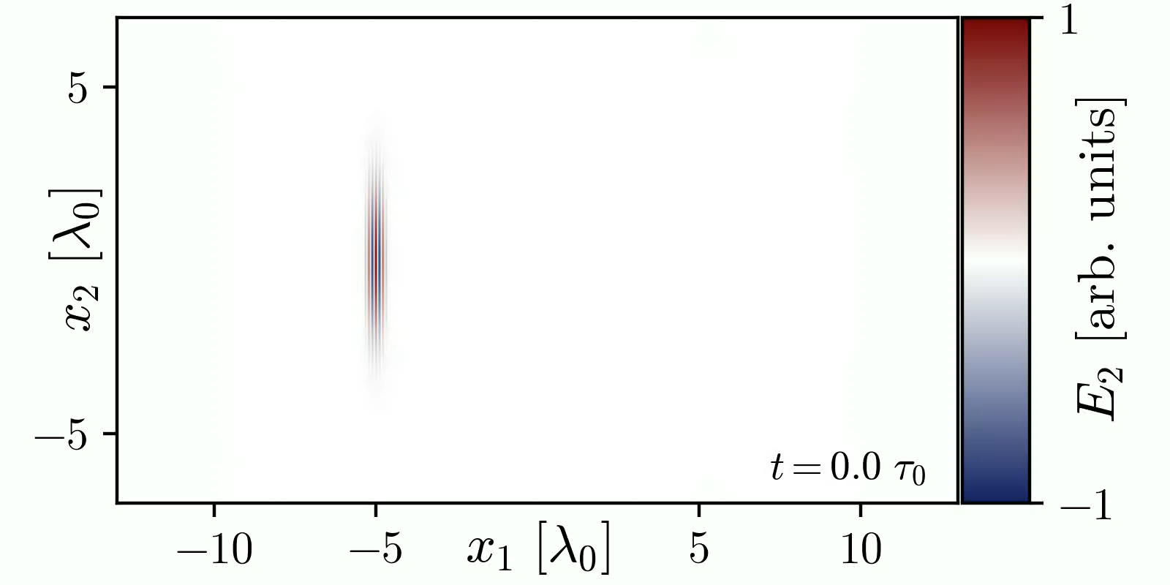
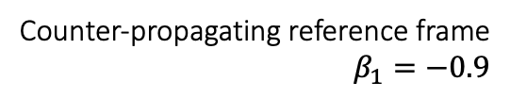
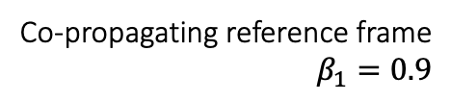
Arbitrary pulse injection in Osiris
Transverse electric field of a pulse in different frames
Beyond paraxial and envelope approximation:
Precise description of tight-focus and ultra-short e.m. fields
Laboratory
Elliptical, radial and azimutal polasation build in
Direct injection of new polarisation states
Arbitrary Lorentz boosts
Pulses can be injected in any inertial reference frame
Co-propagating reference frame
$$β_{1}=0.9$$
Counter-propagating reference frame
$$β_{1}=−0.9$$

Slide 8
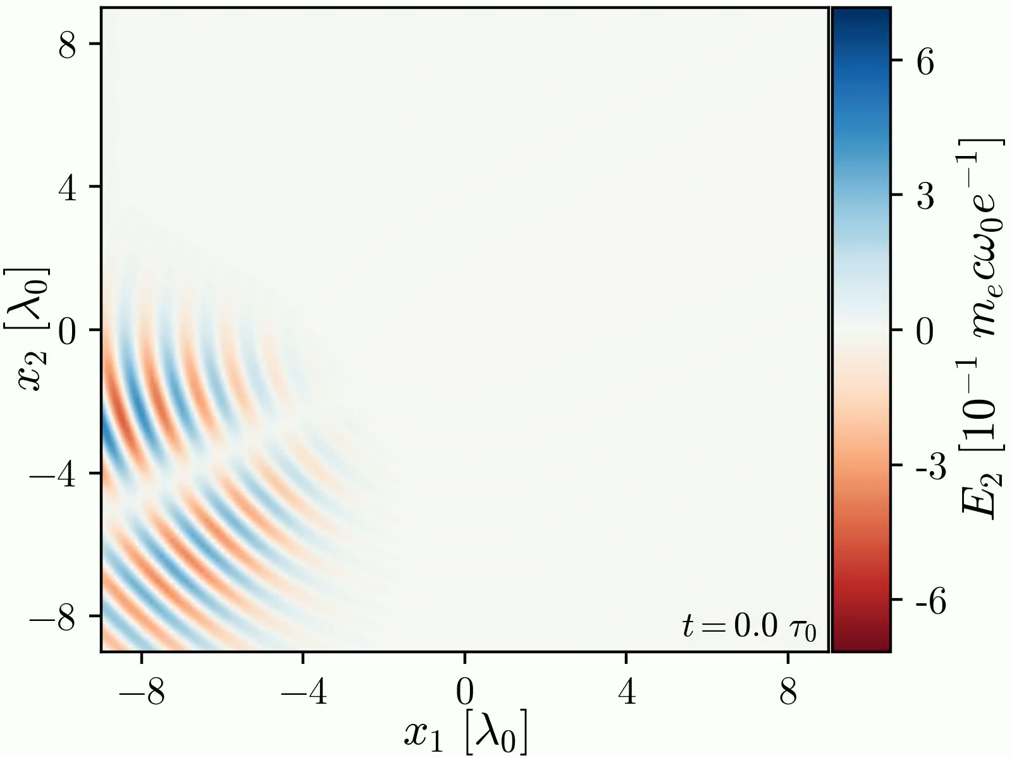
Arbitrary pulse injection in Osiris
Beyond paraxial and envelope approximation:
Precise description of tight-focus and ultra-short e.m. fields
Transverse electric field of a 1st order Hermite Pulse injected at 30º
Elliptical, radial and azimutal polasation build in
Direct injection of new polarisation states
Arbitrary Lorentz boosts
Pulses can be injected in any inertial reference frame
Angled injection
Pulses can be injected travelling in any direction

Slide 9
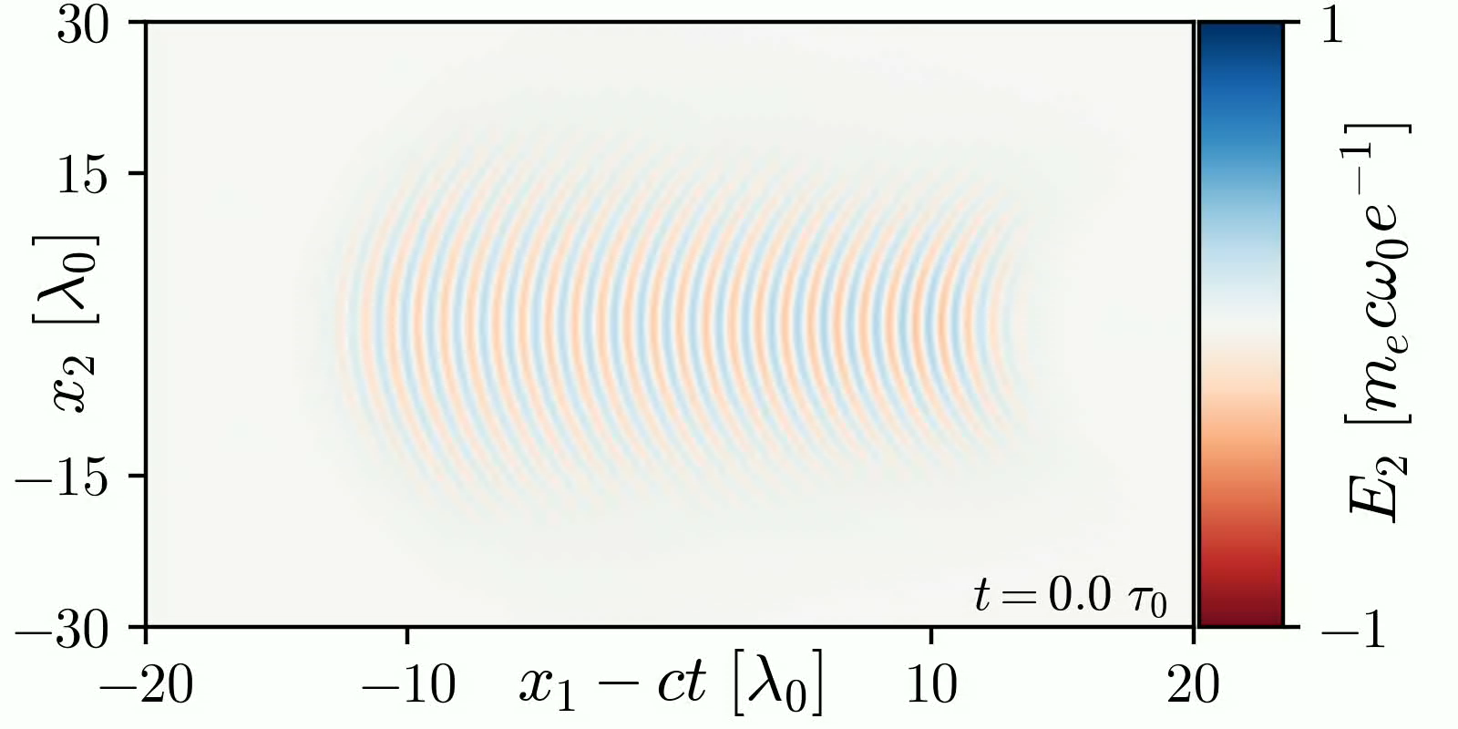
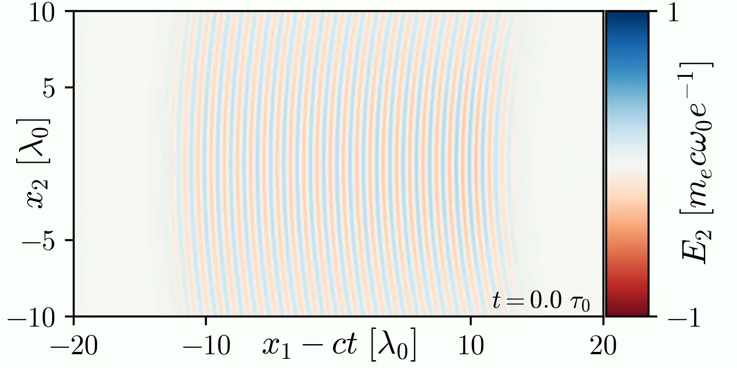
Arbitrary pulse injection in Osiris
Beyond paraxial and envelope approximation:
Precise description of tight-focus and ultra-short e.m. fields
Wide box
Elliptical, radial and azimutal polasation build in
Direct injection of new polarisation states
Narrow box without additional Wall-injection
Arbitrary Lorentz boosts
Pulses can be injected in any inertial reference frame
Angled injection
Pulses can be injected travelling in any direction
Narrow box with Wall-injection from top/bottom walls
Wall injection from side walls
Allows for transversely smaller simulation domains

Slide 10
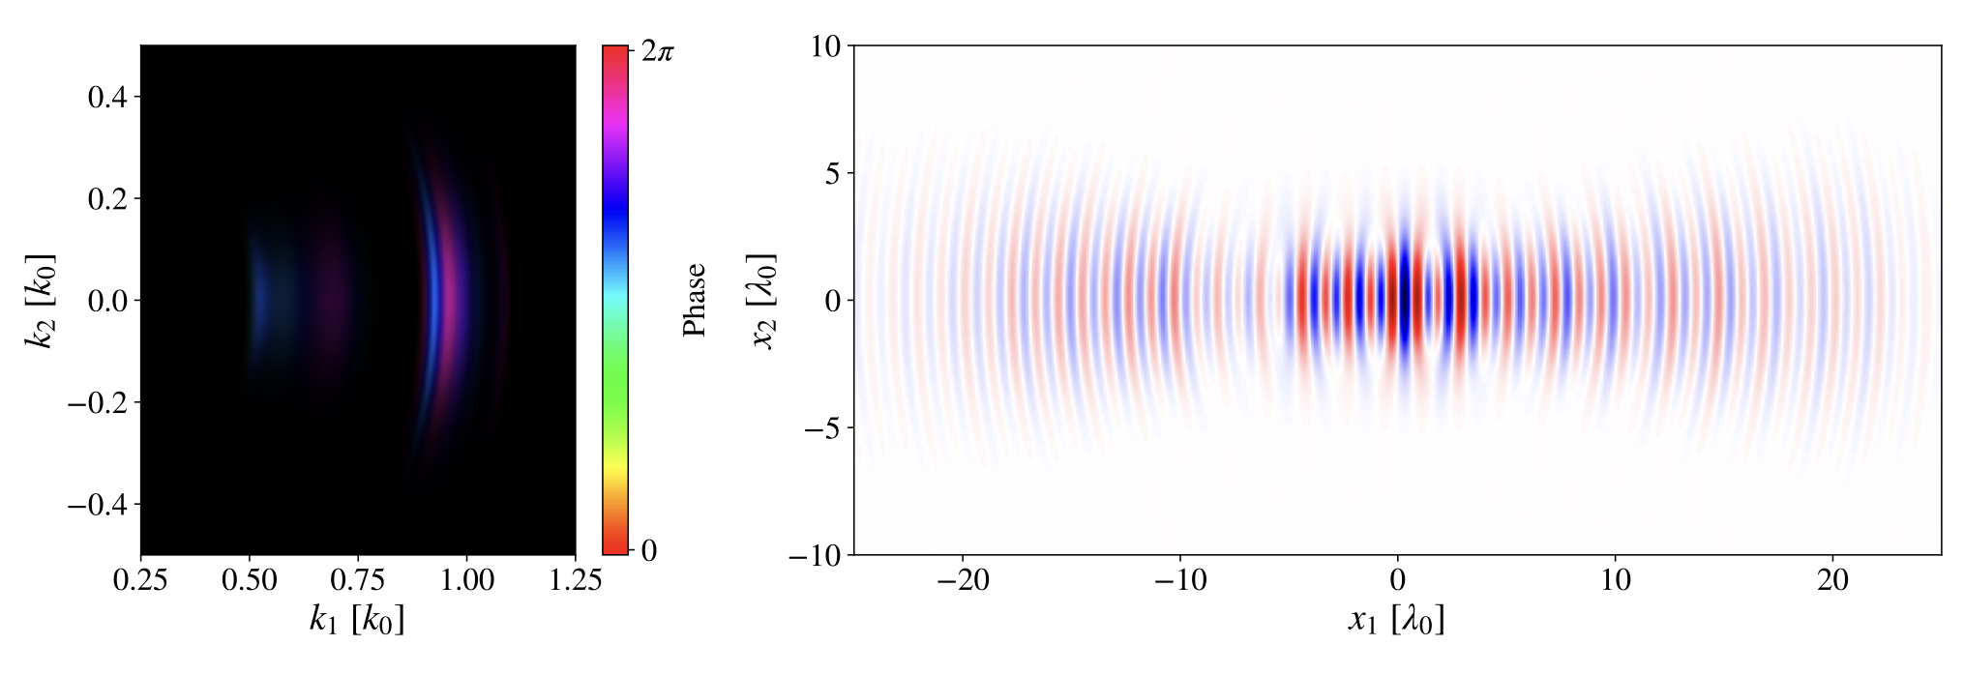
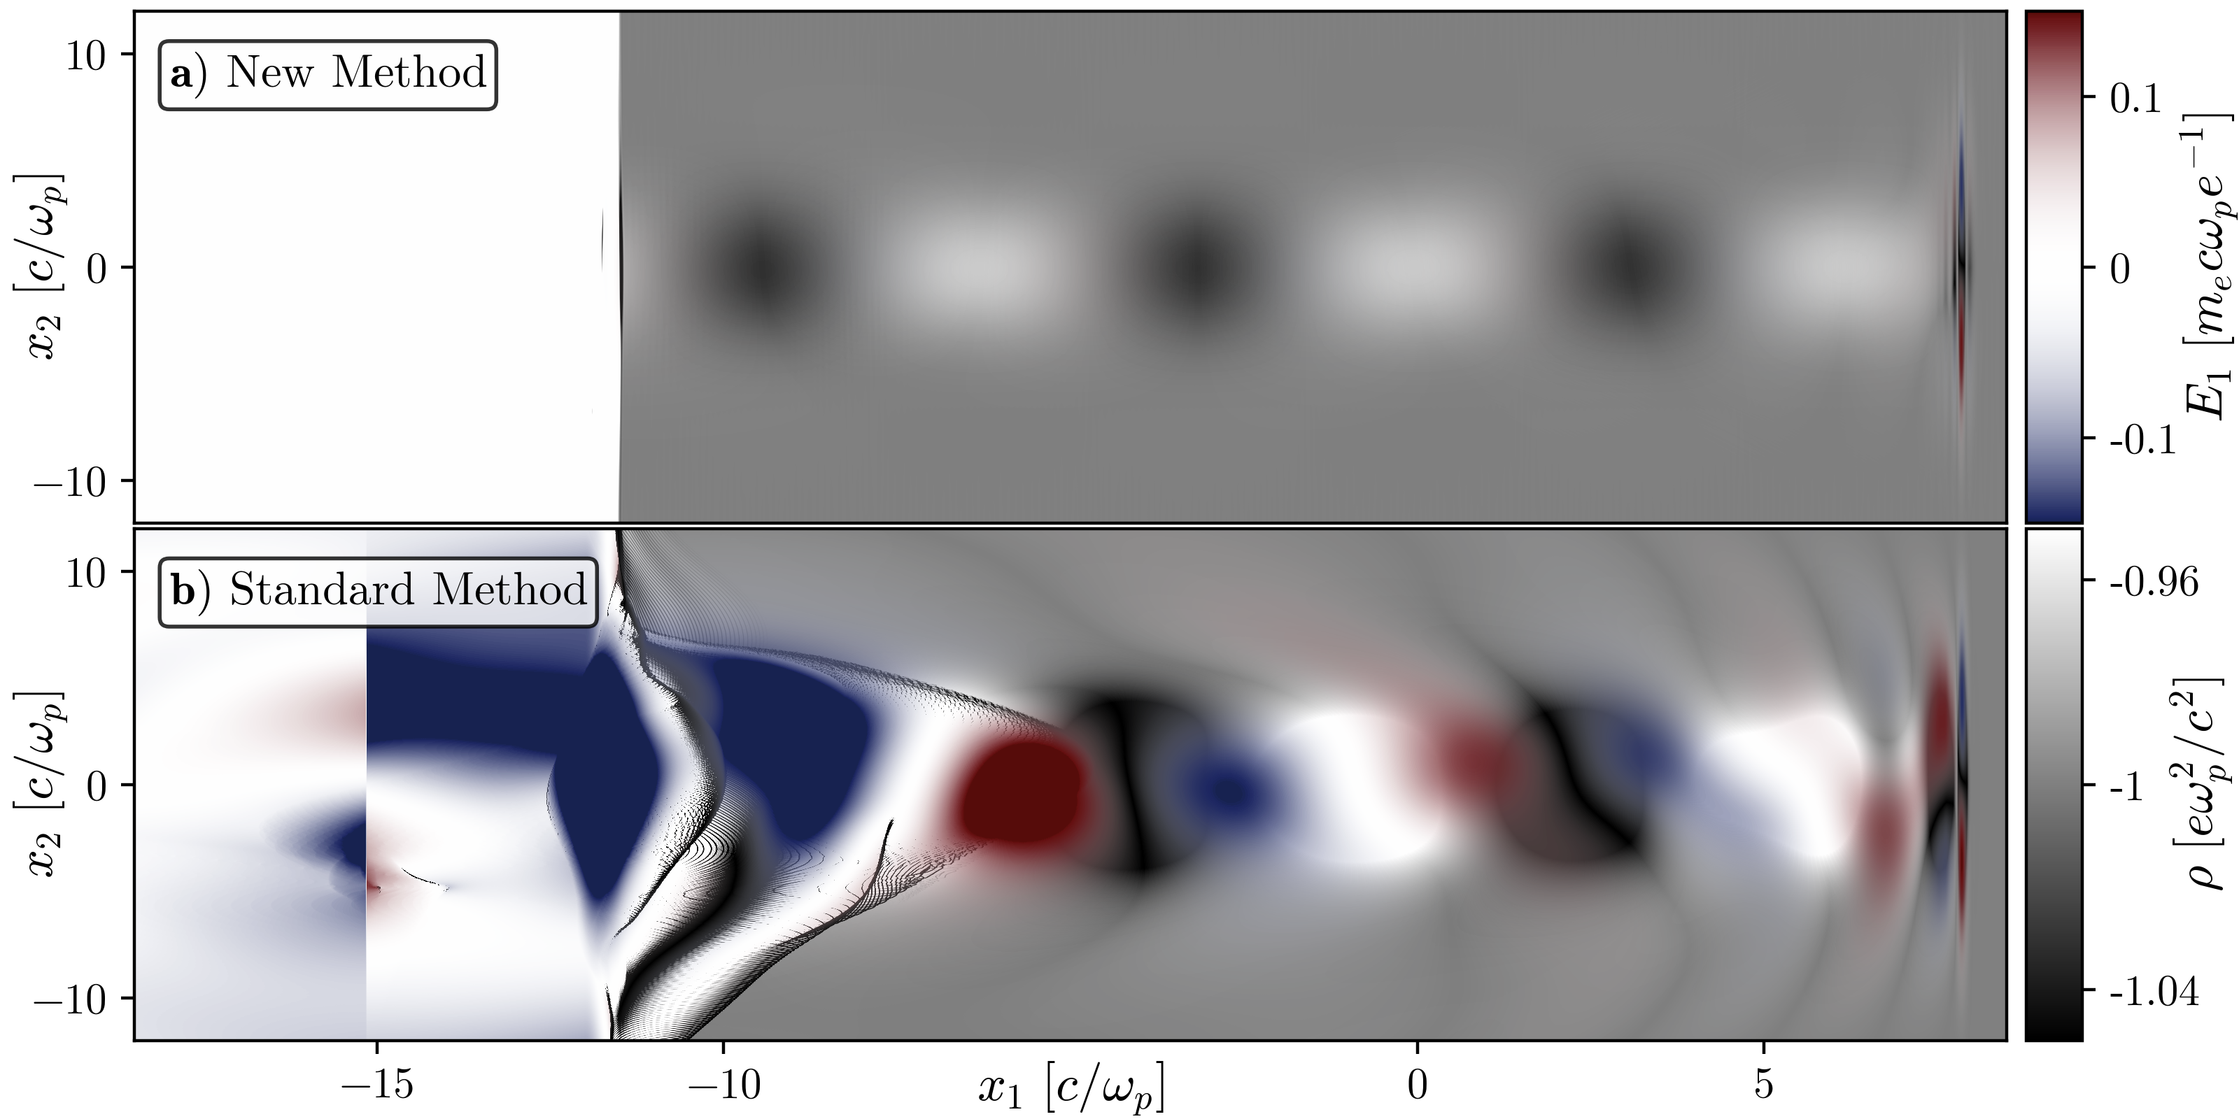
Conclusions
New numerical tool ready to inject any pulse:
Pulse injection from spectrum and spectral phase
Arbitrary injection (single cycle/ultra-tight focus, structured, any polarisation...)
Div B = 0 (up to precision of numerical scheme)
Injected pulse satisfies Faraday’s and Ampere’s law simultaneously
Near absence of backward propagating ghost pulses
Future work: complementary Zernike polynomial description (new post-doc coming in November)
Pulse injection from spectrum and spectral phase
Krauss, G. et al. Nature Photon 4, 33–36 (2010)
Single cycle pulse injection

