Slide 1
Survey of the Scientific Community: Key Findings and Insights
Emiliano Principi – Elettra-Sincrotrone Trieste S.C.p.A.
Francesco Stellato – Università Tor Vergata

Slide 2
The survey
https://surveys.infn.it/index.php/718177

Slide 3
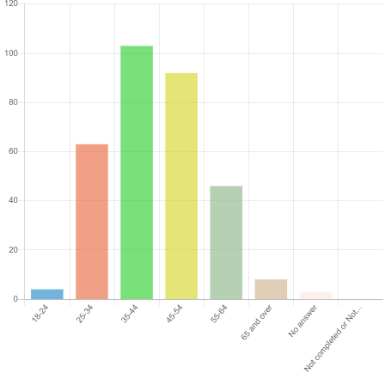
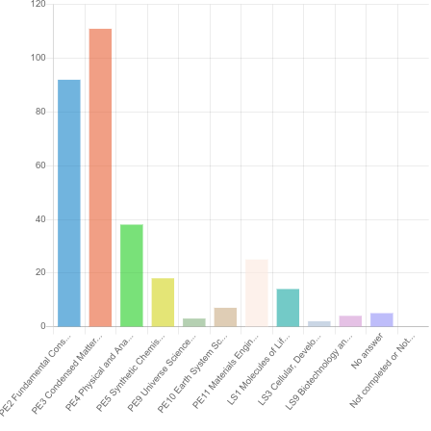
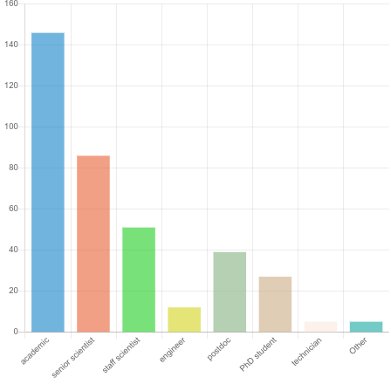
Analysis of the statistical sample
Over 500 people accessed the survey
319 participants submitted responses
156 completed the survey in full
163 submitted partial responses
Job position:
majority of academics and scientists
Age:
the majority are in the 35-54 range
Research area (ERC field classification):
PE2 Fundamental Constituents of Matter. Particle, nuclear, plasma, atomic, molecular, gas, and optical physics
PE3 Condensed Matter Physics. Structure, electronic properties, fluids, nanosciences, biological physics
Age
Job position
Research area

Slide 4
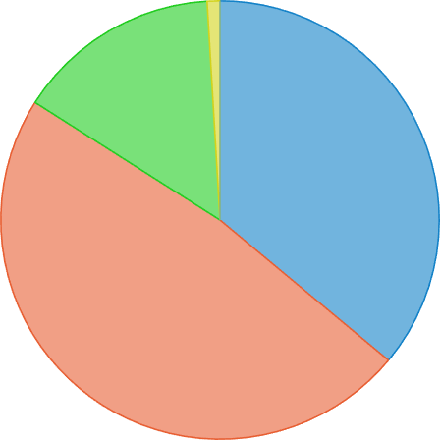
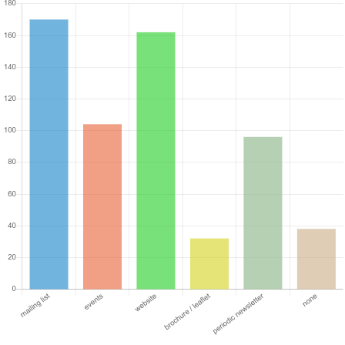
Participants’ knowledge of EuPRAXIA
EuPRAXIA project knowledge
48% report partial knowledge
36% have no knowledge
15% report full knowledge
Respondents would appreciate being informed and updated through these channels: mailing list, website
Events and newsletters are also appreciated, though with less preference.
Full knowledge
NO knowledge
Partial knowledge

Slide 5
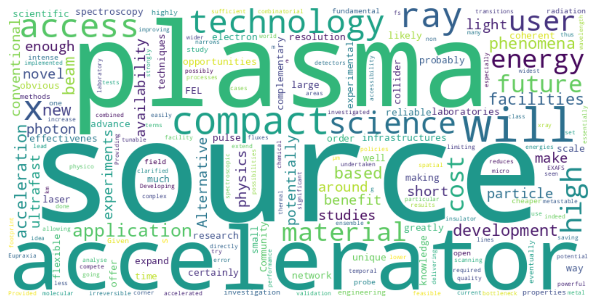
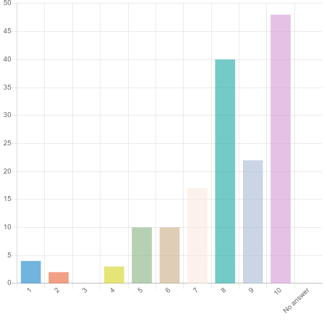
General opinion about EuPRAXIA
Respondents generally view the impact of plasma acceleration on science and engineering as positive.
“Science and engineering will benefit from plasma acceleration technology”
Rate from 1 (not at all) to 10 (completely agree)

Slide 6
Profile of the respondent
?
Directly involved in scientific research
At an advanced stage of scientific career
Has a correct understanding of EuPRAXIA’s aims
Holds a positive opinion of the EuPRAXIA project, though not fully informed about it
Likely to become a user of EuPRAXIA facilities within the next 10 years
It is important to carefully consider the expectations of this statistical sample

Slide 7
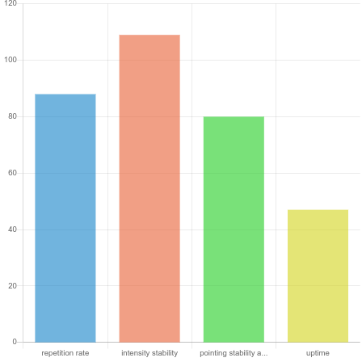
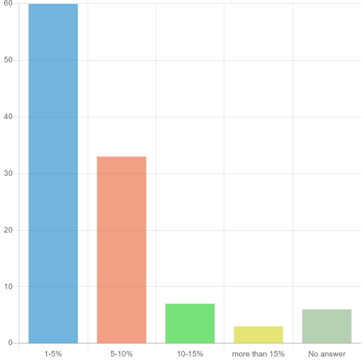
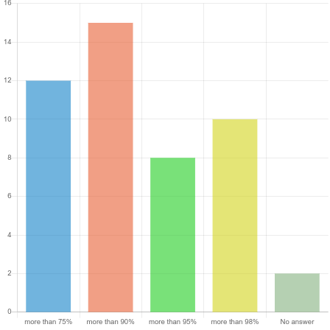
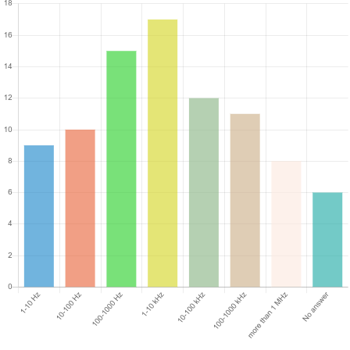
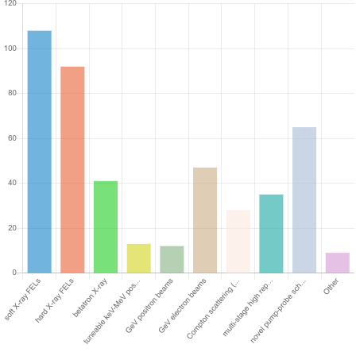
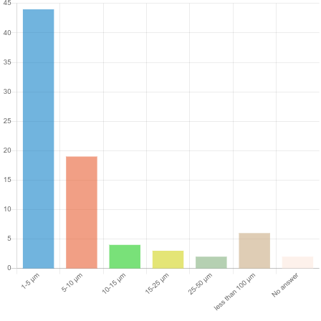
Types of EuPRAXIA sources of interest
X-ray sources
X-rays sources attract greater interest
Notably, there is interest in exploring combinations of different sources for novel pump-probe schemes
Required sources parameters:
Rep rate: 100-10000 Hz (36%)
Intensity fluctuations: 1-5% (55%)
Pointing stability at sample: 1-5 um (55%)
Uptime: it seems to be not critical
Source parameters
Uptime
Novel combinations
of sources
Repetition rate
Intensity stability
Pointing stability at sample
Particle sources

Slide 8
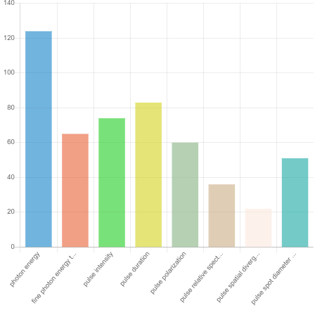
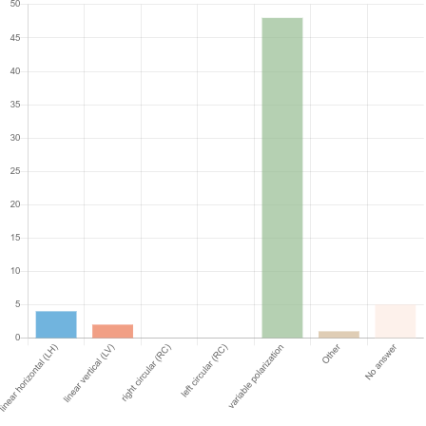
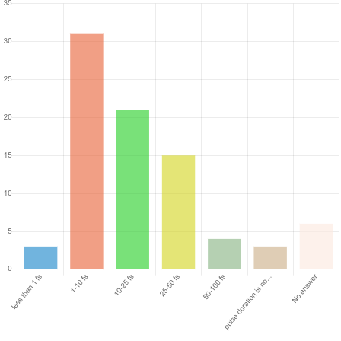
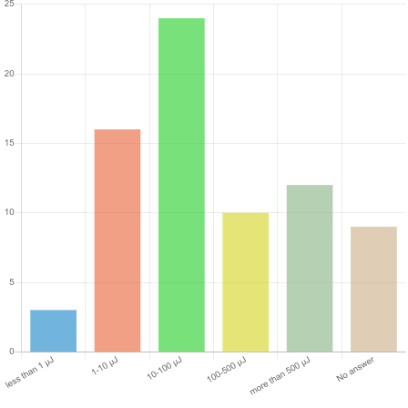
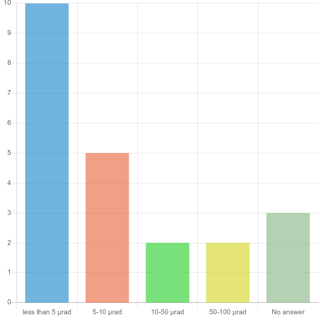
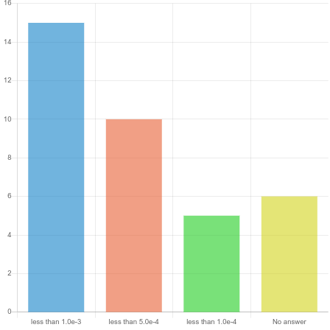
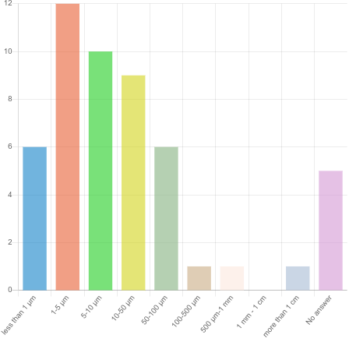
Photon parameters for experiments
Photon energy is the most important parameter:
33% prefer EUV (< 300 eV)
47% prefer soft x-ray
20% prefer hard x-ray (> 7 keV)
Fine photon energy tunability:
40% request fast photon energy changes (< 1 minute); 30% can wait up to 10 minutes
60% require energy mesh smaller than 0.5 eV; 27% between 0.5 and 1 eV
35% ask for more than 50 photon energies values; 35% ask for 10-50 photon energies values
Pulse intensity: 10-100 μJ is preferred by 32%
Pulse duration: 1-10 fs
Pulse polarization: variable
Relative bandwidth: < 1e-3
Beam divergence: < 5 μrad
Spot diameter: 1-5 μm
Pulse polarization
Relative bandwidth
Pulse duration
Beam divergence
Pulse intensity
Spot diameter

Slide 9
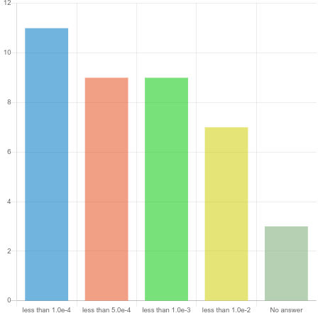
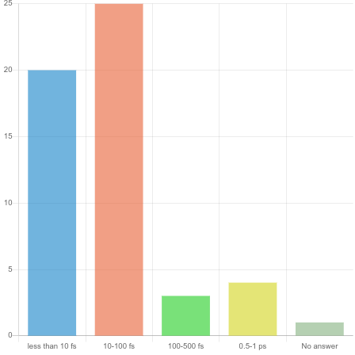
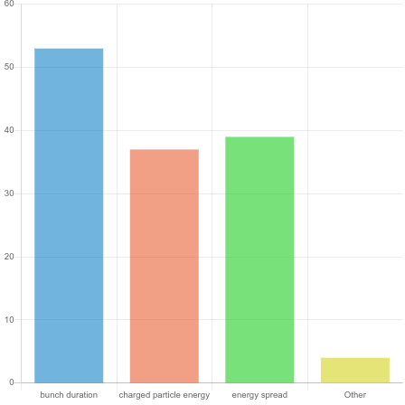
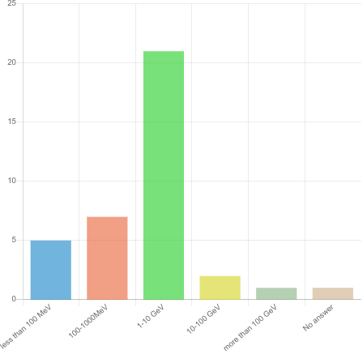
Particles parameters for experiments
Parameters of particle sources:
Bunch durations longer than 100 fs are not of interest to users
Particles energy should be in the range 1-10 GeV
A small energy spread is preferable, however it is not a critical parameter
Bunch duration
Energy spread
Particle energy

Slide 10
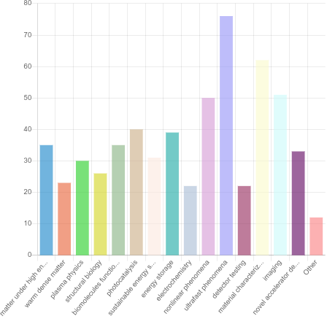
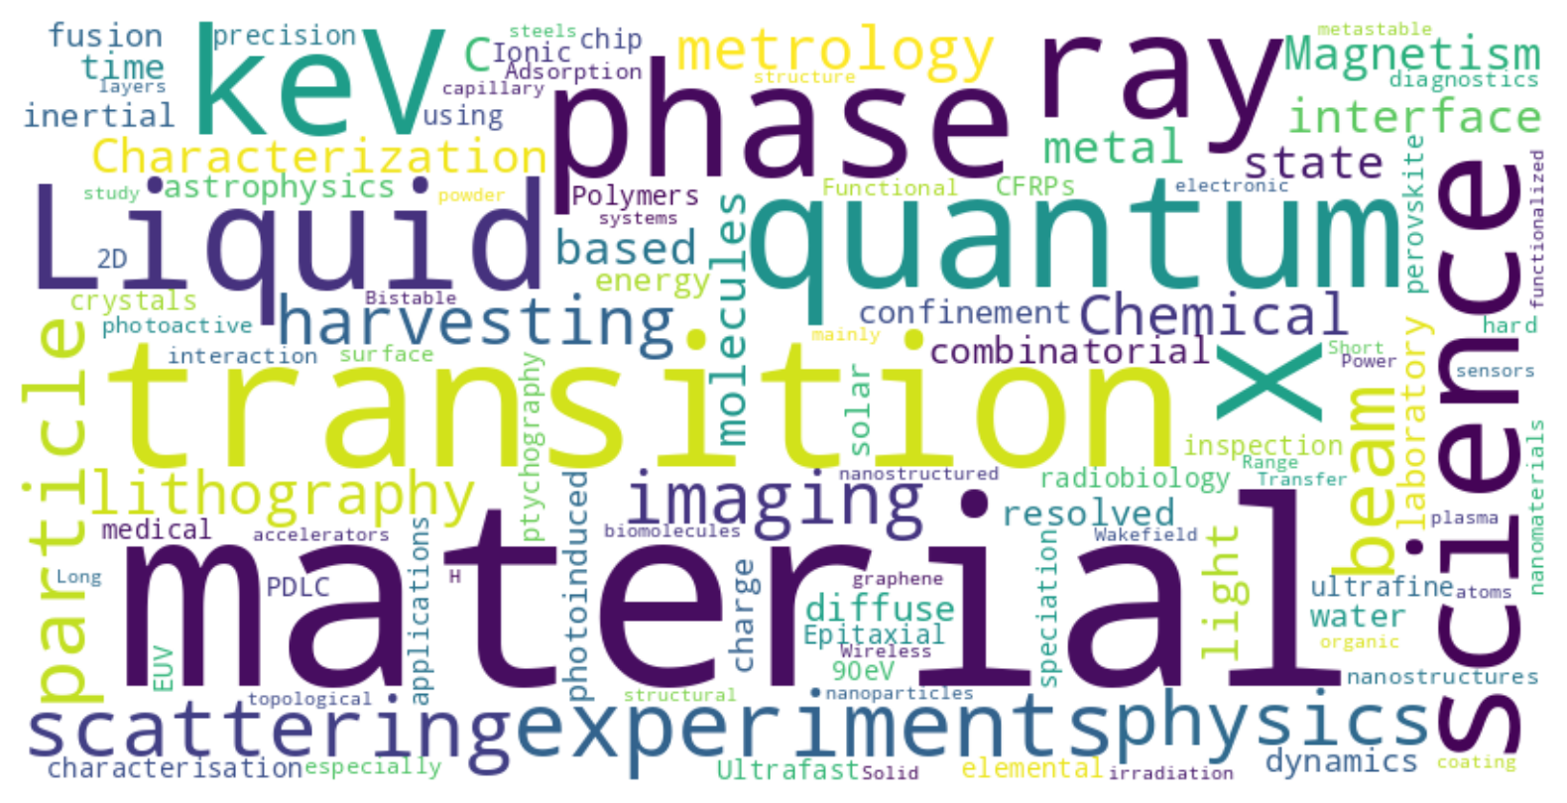
What science with EuPRAXIA?
Most preferred science:
Ultrafast phenomena (49%)
Material characterization (40%)
Imaging (33%)
Nonlinear phenomena (32%)

Slide 11
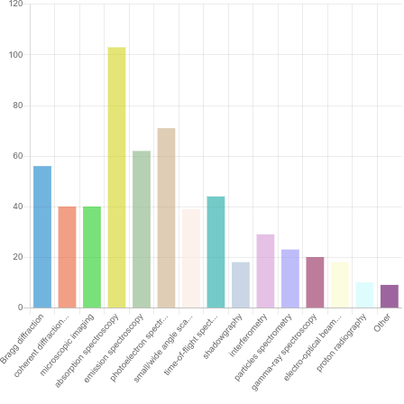
Experimental techniques
Most preferred techniques:
Absorption spectroscopy (66%)
Photoelectron spectroscopy (45%)
Emission spectroscopy (40%)
Bragg diffraction (36%)

Slide 12
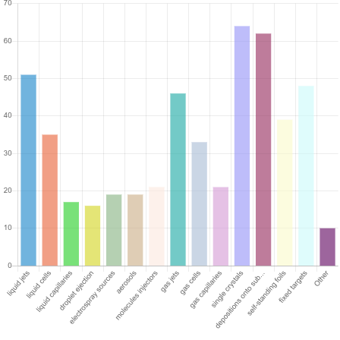
Sample delivery
Most preferred sample delivery approach:
Single crystal (41%)
Depositions onto substrates (40%)
Liquid jets (33%)
Fixed targets (31%)
Gas jets (30%)
Self-standing foils (25%)

Slide 13
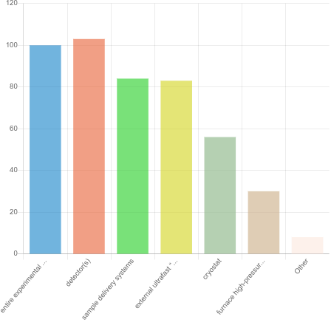
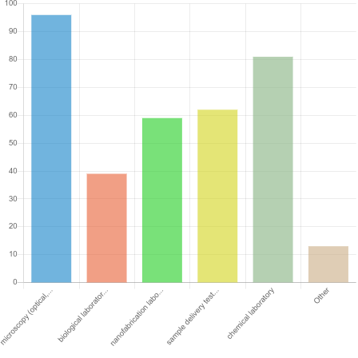
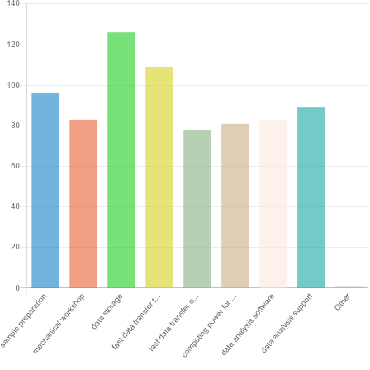
Experimental support
Equipment to be provided by the beamline:
Detectors (66%)
Entire experimental setup (64%)
Services
Support laboratories: microscopy (optical, SEM, AFM) and chemical lab are demanded
Additional infrastructural services: data storage and fast data transfer are particularly requested
Support laboratories
Equipment
Additional services

Slide 14
Conclusions
The results of this survey can serve as guidance for the steering committee and WP leaders. Future strategic choices might take into account the key findings from this survey. For more detailed insights, please contact the WP5 coordinators
Expectations of the respondents:
Photon science in the soft x-ray range is more appealing, followed by the EUV range
A repetition rate of 100 Hz is considered adequate (realistically achievable)
Excellent beam pointing and intensity stability are highly demanded (more challenging)
Significant experimental support is expected
Data storage, analysis, and fast transfer capabilities are seen as essential services
Although knowledge of EuPRAXIA remains limited, the scientific community seems to understand and agree with the project’s aims. This represents a positive starting point for building a user community around the EuPRAXIA facilities
EuPRAXIA should actively reach out to young scientists. The EuPRAXIA Doctoral Network is an excellent initiative to support this goal.

Slide 15
Acknowledgements
Francesco Stellato
Gianluca Sarri
Zeinab Ebrahimpour
Emiliano De Santis
Alexandra Welsch
Ricardo Torres
Davide Bleiner
Claudia Pelliccione

Slide 16
Participate in the survey!
https://surveys.infn.it/index.php/718177

