Slide 1
WP5: user strategy and services
Emiliano Principi – Elettra-Sincrotrone Trieste S.C.p.A.
Francesco Stellato – Università Tor Vergata & INFN

Slide 2
People
WP leaders
Emiliano Principi (Elettra)
Francesco Stellato (Uni ToV)
WP members
Davide Bleiner (EMPA)
Gianluca Sarri (Queen’s University Belfast)
EuPRAXIA-PP post-doctoral fellows
Emiliano De Santis (Uni ToV – from May 1st, 2024)
Zeinab Ebrahimpour (Elettra – starting November 1st, 2024)
Active role in preparing these slides.
Thanks!

Slide 3
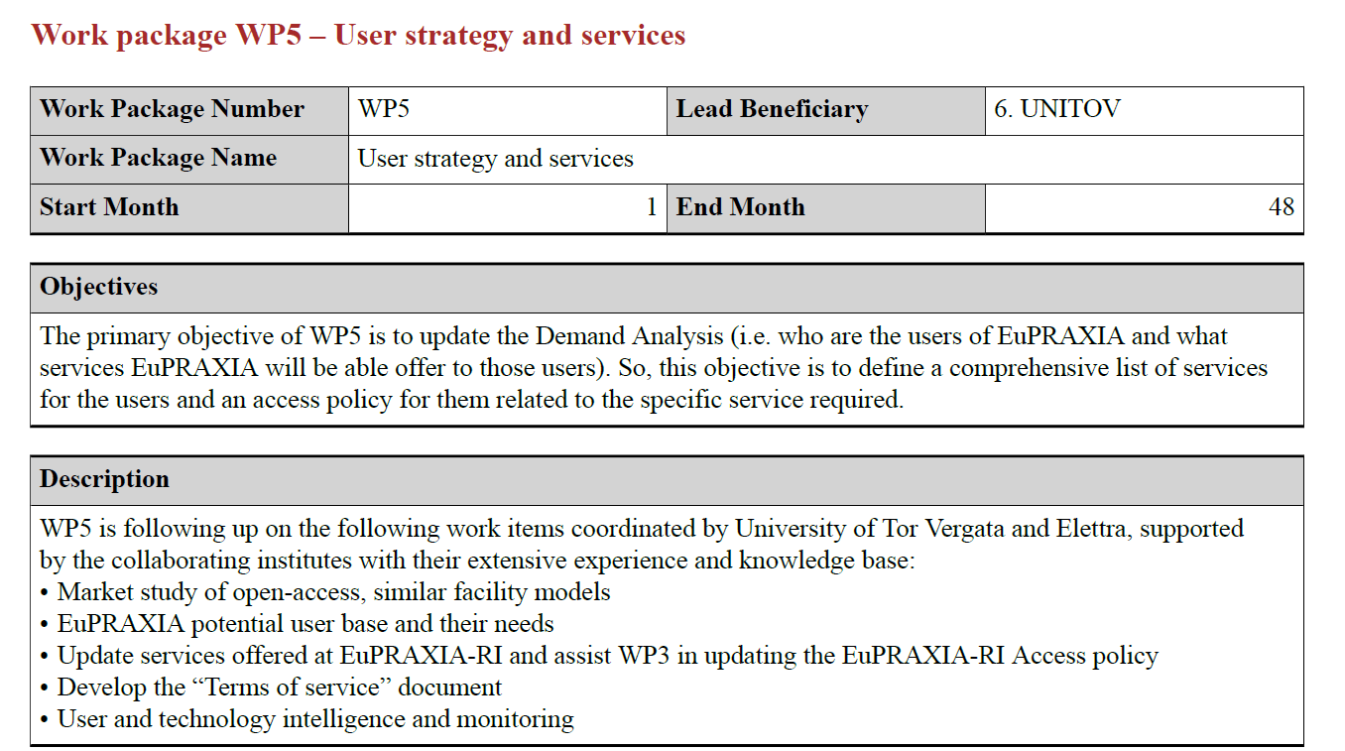
Grant agreement

Slide 4
Milestones & Deliverables

Slide 5
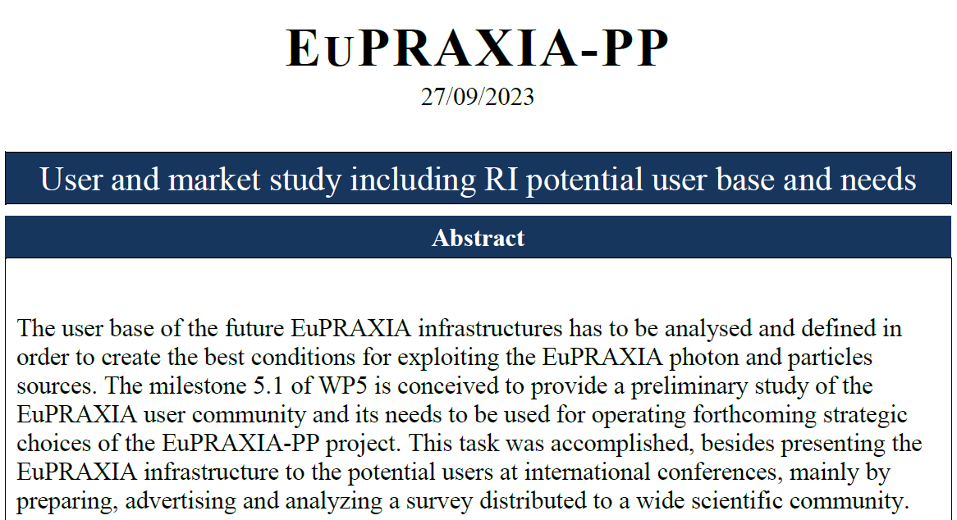
Milestones & Deliverables
In its first year, WP5 focused on identifying the potential EuPRAXIA user base and their needs through the design, implementation, and promotion of a survey (details by Emiliano Principi)
Outreach efforts at international meetings and conferences helped raise awareness of EuPRAXIA and foster dialogue with prospective users to better understand their requirements and expectations.
WP5 is complementing the survey analysis by examining user policies from similar European research infrastructures, allowing for the refinement of strategies and alignment with international best practices.

Slide 6
M15
Roadmap
Regular discussions in WP5 internal meetings, on average one/month, allowed WP5 to get a preliminary overview of access models
Broad spectrum internet searches on similar research infrastructures
Focused on-site discussion with user offices and/or users communities at similar facilities

Slide 7
What do we want to know?
Access policy
- Is there any official documentation about the "Access policy"
- How to get access to beamtime? - Scientific proposals selection: procedure, critical aspects, acceptance rate, calls per year - How many proposals received/accepted every year?
- Do users complain about limited access to the facility?
- Proposals review panels: composition, duration of the panel, budget for travels, in person sessions or ZOOM sessions
- Industrial users: how many, access policies, evaluation of industrial experimental proposals, access costs for industrial users

Slide 8
What do we want to know?
User services
- Is there any official documentation about the offered "User services"
- What is needed to operate a user office?
- Support offered to users: Guest House, Canteen, affiliated hotels, travel organization and/or reimbursement - What services can be improved, what are already excellent?
- What are the most required services?
- Monitoring users' satisfaction (post-beamtime surveys, …)
- Annual budget for users services

Slide 9
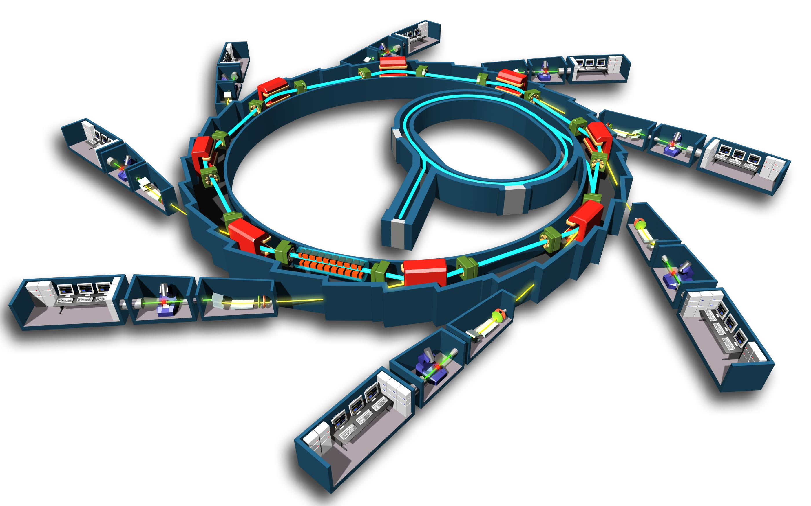
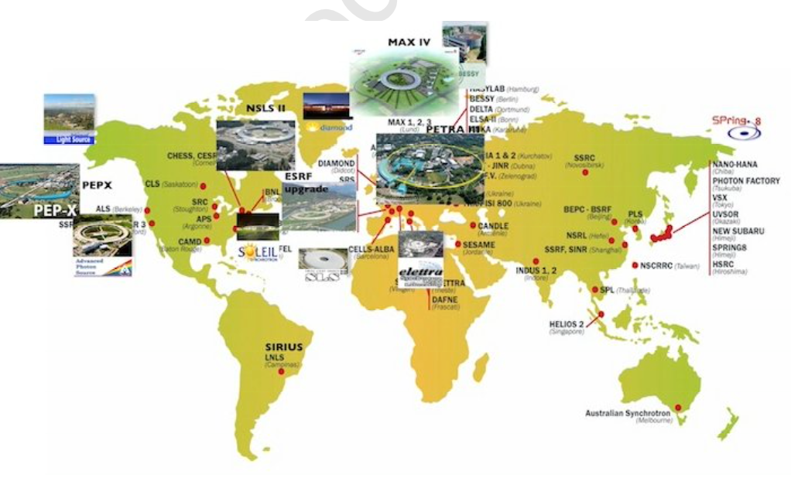
‘Similar’ facilities - Synchrotrons
🇫🇷
🇺🇸
🇬🇧
🇯🇵
🇦🇺
🇹🇭
🇮🇹
🇩🇪
European Synchrotron Radiation Facility (ESRF, France)
Located in Grenoble, ESRF is one of the most powerful synchrotrons, providing high-energy X-rays for a broad range of scientific fields.
Advanced Photon Source (APS, USA)
Located at Argonne National Laboratory in Illinois, APS is a leading source of high-brightness X-rays for research in materials science, chemistry, and biology.
Diamond Light Source (UK)
Located in Oxfordshire, Diamond is the UK's national synchrotron facility and supports a wide range of scientific research with its versatile X-ray beamlines.
SPring-8 (Japan)
Located in Hyogo, SPring-8 is one of the world's largest synchrotron radiation facilities, providing
high-energy X-rays for advanced research.
Australian Synchrotron (Australia)
Located in Melbourne, this facility provides a variety of X-ray techniques for research in materials
science, biology, and medicine.
Synchrotron Light Research Institute (SLRI, Thailand)
Based in Nakhon Ratchasima, this facility offers synchrotron radiation for research and industrial applications.
Elettra Sincrotrone Trieste (Italy)
Located in Trieste, Elettra is a cutting-edge research facility offering a range of synchrotron radiation techniques for studies in materials science, environmental science, and life sciences. It plays a key role in advancing scientific knowledge and industrial applications in Europe.
PETRA III (Germany) Located at DESY in Hamburg, PETRA III is one of the most brilliant X-ray sources worldwide. It supports a wide array of scientific disciplines, including physics, chemistry, biology, and nanotechnology, offering high-resolution imaging and structural analysis capabilities.

Slide 10
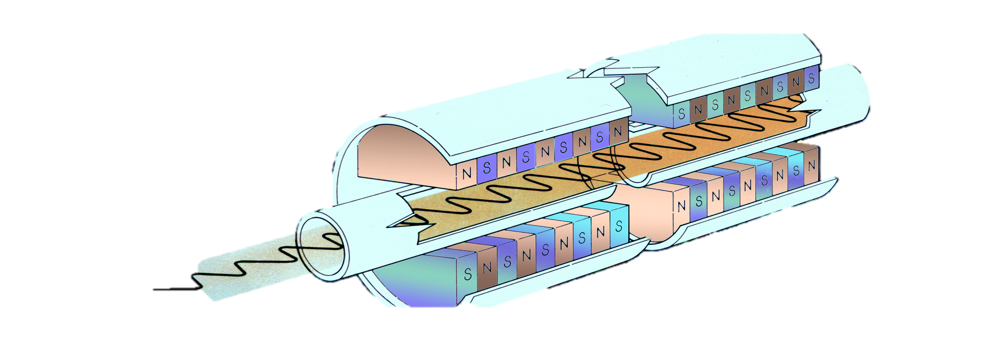
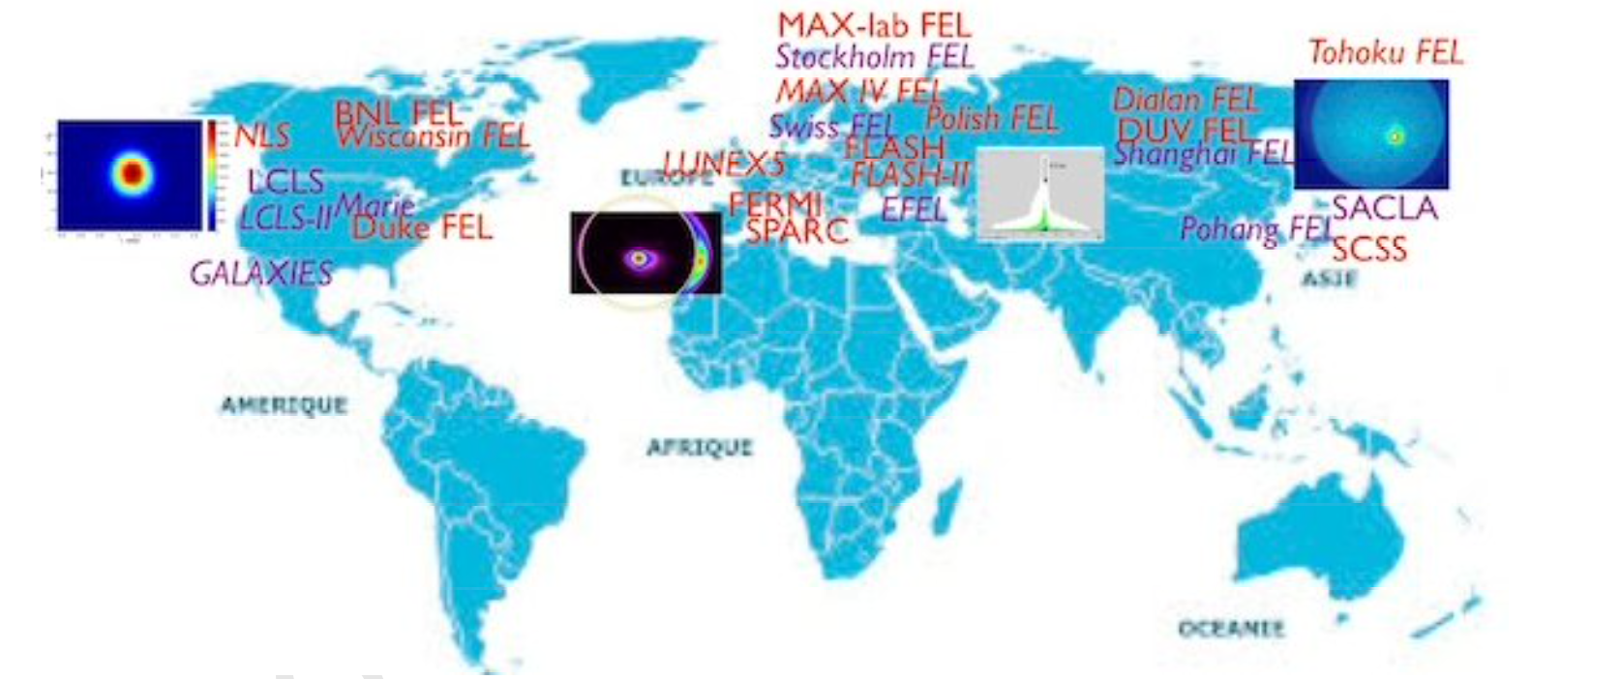
‘Similar’ facilities - Free Electron Lasers
🇩🇪
🇺🇸
🇨🇭
🇯🇵
🇩🇪
🇮🇹
🇰🇷
🇨🇳
European XFEL (Germany)
Located in Hamburg, the European XFEL is one of the most powerful X-ray lasers in the world, capable of generating extremely short and intense X-ray pulses.
Linac Coherent Light Source (LCLS, USA)
Located at SLAC National Accelerator Laboratory in California, LCLS was the first FEL to produce hard X-rays and is widely used for research in molecular and atomic physics.
SwissFEL (Switzerland)
Located at the Paul Scherrer Institute, SwissFEL is a cutting-edge facility that provides ultra-short X-ray pulses for a wide range of experiments.
SACLA (Japan)
Located in Harima, SACLA is one of the most compact XFELs in the world, producing
intense X-ray beams for high-resolution imaging and other applications.
FLASH (Germany)
Operated by DESY in Hamburg, FLASH is primarily used for soft X-ray and ultraviolet experiments.
FERMI (Italy)
Located in Trieste, FERMI is a state-of-the-art free electron laser facility specializing in soft X-rays and extreme ultraviolet light, offering advanced capabilities for ultrafast spectroscopy and imaging
Pohang Accelerator Laboratory X-ray Free Electron Laser (PAL-XFEL, South Korea) Located in Pohang, PAL-XFEL is a state-of-the-art facility providing hard and soft X-ray laser pulses for various scientific applications. It supports research in biology, chemistry, and materials science by offering ultrafast imaging capabilities.
Shanghai Coherent Light Facility (SCLF, China) Located in Shanghai, SCLF is a major free electron laser facility designed to produce high-brilliance X-rays for cutting-edge research. It aims to advance studies in physics, chemistry, and life sciences with its powerful and versatile X-ray beams.

Slide 11
‘Similar’ facilities - Free Electron Lasers
EU initiatives related to light sources
(https://lightsources.org/lightsources-of-the-world/europe/)
LEAPS – the League of European Accelerator-based Photon Sources – is a strategic consortium initiated by the Directors of the Synchrotron Radiation and Free Electron Laser (FEL) user facilities in Europe For more information visit: https://www.leaps-initiative.eu/
FELs Of EUROPE – is a collaboration of all free electron laser (FEL) facilities in Europe, with the goal to meet the technological and scientific challenges of these novel and rapidly developing technologies For more information visit: https://www.fels-of-europe.eu/
Wayforlight – is a portal for users of European Light sources; wayforlight is an initiative of the European H2020 projects CALIPSOplus and EUCALL For more information visit: http://www.wayforlight.eu
CALIPSOplus – The aim of the CALIPSOplus project is to remove barriers for access to world-class accelerator-based light sources in Europe and in the Middle East. For more information visit: http://www.calipsoplus.eu/
EUCALL – is a network between leading large-scale user facilities for free-electron laser, synchrotron and optical laser radiation working together on common methodologies and research opportunities, as well as developing tools to sustain this interaction in the future. For more information visit: https://www.eucall.eu/
ExPaNDS – ExPaNDS is the European Open Science Cloud (EOSC) Photon and Neutron Data Service. The ambitious ExPaNDS project is a collaboration between 10 national Photon and Neutron Research Infrastructures (PaN RIs) as well as EGI. The project aims to deliver standardised, interoperable, and integrated data sources and data analysis services for Photon and Neutron facilities. For more information visit: https://expands.eu/
PaNOSC – The Photon and Neutron Open Science Cloud (PaNOSC) is a European project for making FAIR data a reality in 6 European Research Infrastructures (RIs), developing and providing services for scientific data and connecting these to the European Open Science Cloud (EOSC). For more information visit: https://panosc.eu/

Slide 12
Where do we start?
From ESRF & Eu-XFEL policies
Why ESRF & Eu-XFEL ?
Both are multinational projects involving European countries that commit themselves in an intergovernmental convention.
Their collaboration and funding mechanisms involve a broad international community.
Other research infrastructures to look at: Fermi/Elettra , …

Slide 13
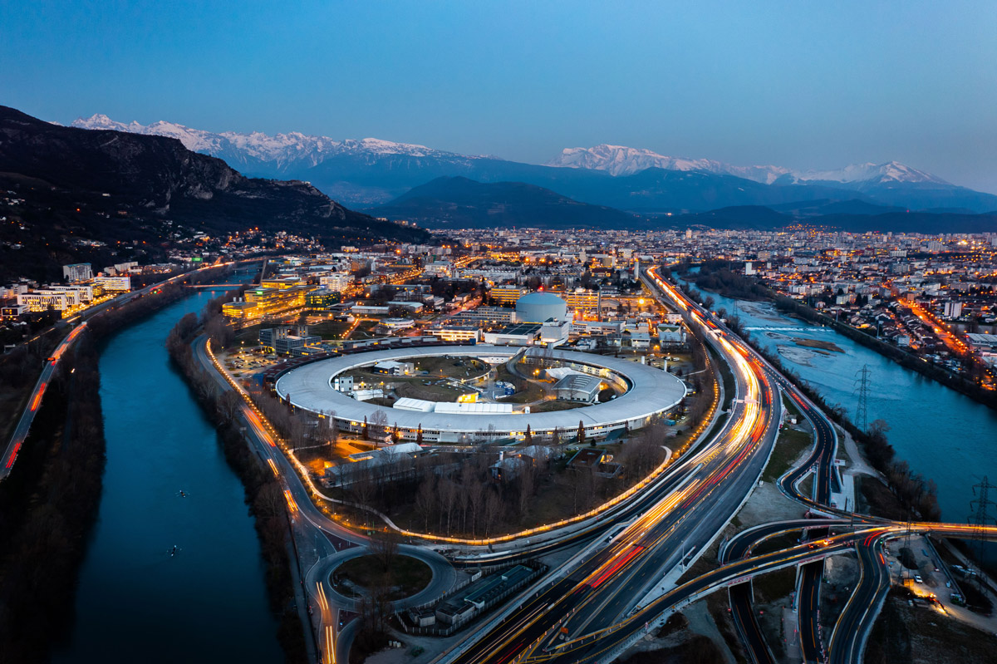
ESRF

Slide 14
User policy @ ESRF
Proposals are evaluated based on scientific impact and feasibility, with two calls per year and an acceptance rate of around 50%. Each proposal can request up to six days of beam time. Special agreements exist for specific beamlines funded by certain countries, reserving time for proposals including a principal investigator or team member from the respective country.
Beamline scientists/managers may offer extra shifts for feasibility tests or to complete experiments required by journal referees.
The review panel, divided into 12 areas of expertise, meets twice a year (one online and one on-site meeting) and each reviewer serves a 2 (+1) year term. The ESRF covers all related expenses

Slide 15
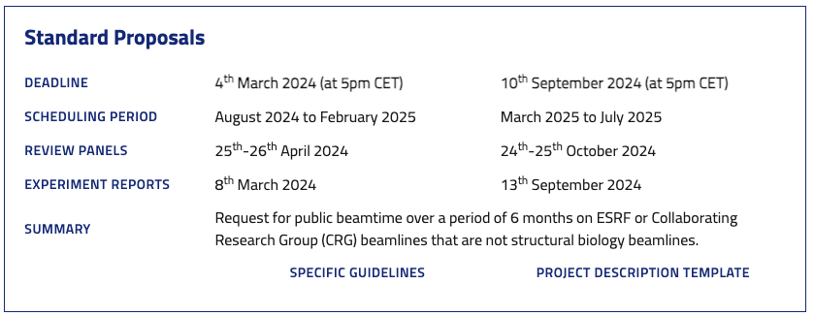
User policy @ ESRF
ESRF upcoming proposal call

Slide 16
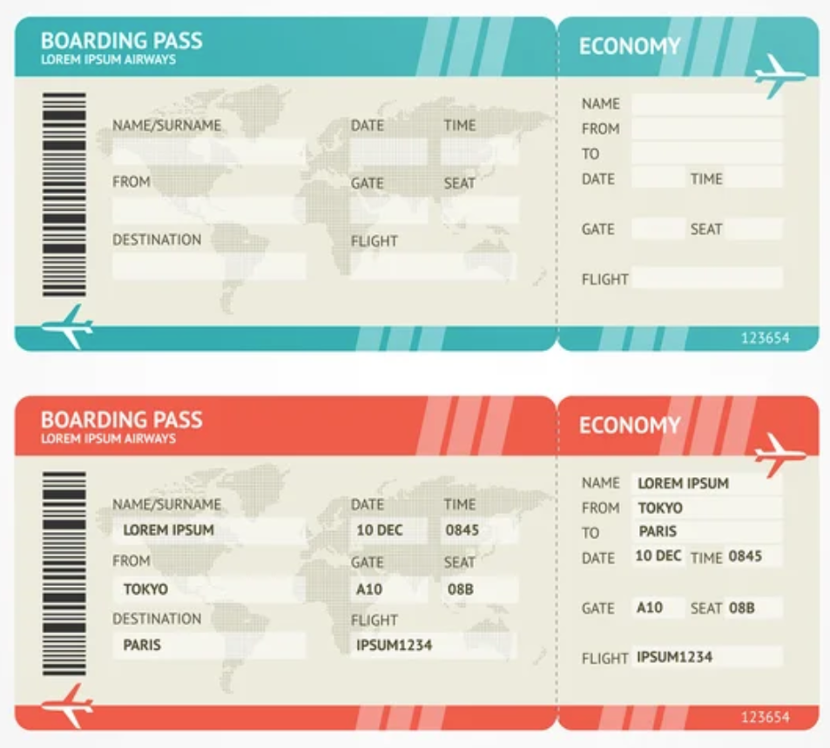
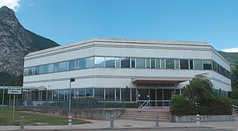
User policy @ ESRF
The ESRF offers comprehensive user services, including documentation on available resources and the user office. To better operate the user office, improvements in resources and support are continuously considered.
Support for users includes accommodation at the Guest House and meals at the Canteen (including dinner and weekends). Travel organization and reimbursement cover up to three users, adhering to policies that minimize costs (e.g., no first-class travel, preference for public transportation over taxi).

Slide 17
User policy @ ESRF
For industrial users, the access cost varies depending on the experiment and beamline, as there is no standardized policy.
https://www.esrf.fr/Industry
Programs to enhancing SME access to European research and technology infrastructures are being developed
https://www.esrf.fr/home/Industry/industry-news/content-news/esrf-news-list/enhancing-sme-access-to-european-research-and-technology-infrastructures.html
A potential broad range of industrial applications

Slide 18
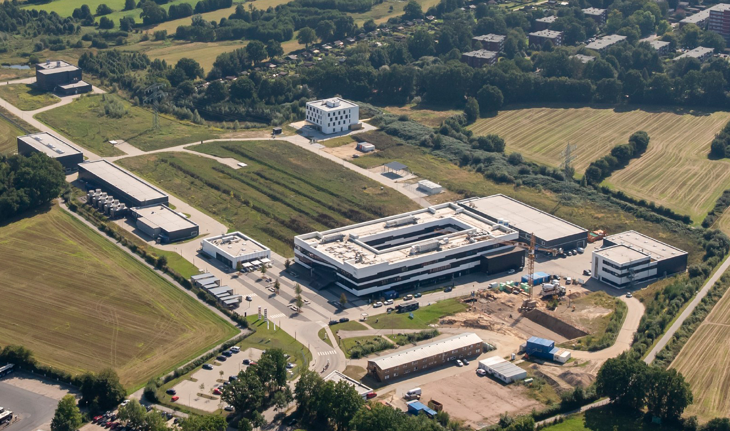
EuXFEL

Slide 19
User policy @ euXFEL
The European XFEL (EuXFEL) is a research facility open to scientists worldwide. Beamtime is free of charge, but experiment proposals must go through a review process. Proposal must be submitted through the User Portal to the European XFEL (UPEX).
Proposals are evaluated based on scientific impact, originality/new scientific applications,
maturity of experiment plan, need for European XFEL and specific instrument, scientific/methodological
risk for successful conduct and, prior results. Feasibility information provided by the instrument staff is made available prior to the meetings. Proposal evaluation is made by at least 3 review panel members and the total evaluation process takes 14.5 weeks after the proposal call (once per year) deadline.
Submission of the experiment report for standard experiments is required between 3 to 6 months after end of last shift of the experiment at the latest.
The review panel divided into 6 areas of expertise, each with 9-12 members
Two-day review meeting meetings in person, with costs for travel and living subsistence covered by European XFEL. Generally, members appointed for a 2+2-year period.

Slide 20
User policy @ EuXFEL
EuXFEL last call for proposal
13th Call for Proposals for User Experiments: Regular, Screening and Molecular Water Research Proposals
Allocation period | Call opening | Call deadline | Experiment report deadline
run 2025-I (first half of 2025) | 28 March 2024 | 30 April 2024 at 16:00 CEST (Hamburg/Schenefeld time/Central European Summer Time) | 6 May 2024

Slide 21
User policy @ EuXFEL
Various kinds of proposal:
Regular
Few days of beamtime allocated on a by-yearly basis
Screening
Combines sample characterization and injection tests in the laboratories, followed by screening beamtime at the SPB/SFX instrument
Special Topic
Beamtime allocated on particular topics (e.g. Molecular Water Research)
Cross-instrument
If specific parts of a project should be conducted by using different European XFEL instruments, the selection of two instruments is allowed
Community Proposal
Proposals with leading scientist, but open to the community → cooperative science

Slide 22
User policy @ EuXFEL
User consortia
European XFEL accepts contributions by User Consortia to the construction of scientific instruments, to the ancillary instrumentation, and to the technical infrastructure.
Contributions by User Consortia are regulated by a clear set of guidelines.
In a first evaluation round seven User Consortia proposals have been approved.
In 2011 a Call for Expressions of Interest in contributing to the European XFEL in the form of User Consortia was published.
This call was published with an initial deadline, in order to start a first evaluation, but is open, allowing new proposals to be submitted at any time.

Slide 23
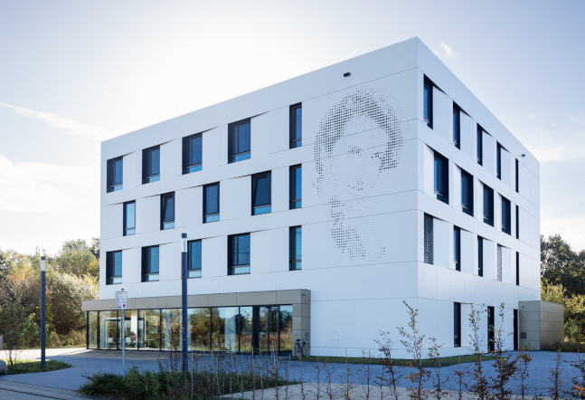
User policy @ EuXFEL
The EuXFEL also offers comprehensive user services, including documentation on available resources and the user office.
The user office are available to communicate with the users and to get updates by emails.
Support for users includes accommodation at the Guest House and meals at the Canteen.
Travel organization and reimbursement cover up to six users, and sample shipping can be reimbursed as well.
Online or on-site trainings is available for users before experiment upon request.
Users can have access to their data up to 3 years.
Funding from a third party is accepted too.

Slide 24
Ongoing Actions
Dissemination
Presentation of EuPRAXIA-PP at National and International conferences in various fields
EBSA 2023 (Biophysics)
EEAC2023 (Accelerators)
CMD-Fismat 2023 (Condensed matter physics)
Italian-Swedish workshop sponsored by the Italian Ministry of Foreign Affairs and International Cooperation (Bilateral cooperation → engagement of the Swedish community)
SILS 2023 & 2024 (Synchrotron radiation)
Big Science Business Forum 2024 (Industry)
XFEL users meeting 2023 & 2024 (FELs)
SIBPA 2024 (Biophysics)
Science@FELs 2024 (FELs)

Slide 25
Ongoing Actions
EuPRAXIA potential user community survey
WP5 twofold aim:
Report on demand analysis
Report on term of services
Web-survey to collect expectations and requirements of
the potential user community
→ Talk by Emiliano Principi

