Slide 1
M1.3 Decision on ranking of legal model for RI
Antonio Falone, INFN-LNF / EuPRAXIA Annual Meeting
Collaboration Board
25/09/2024

Slide 2
Introduction
An upcoming milestones concerning WP.1 (management) is approaching, deadline October 2024. This has a strong connection with WP.4 and it deserves to be presented and discussed within the collaboration board.
M1.3 Decision on ranking of legal model for RI
Many topics regarding the Legal Framework have been discussed on Monday during WP.4 presentation (see slides in the agenda). Here a short recap on this topic.

Slide 3
Legal Framework
WP.4 deals with three crucial aspects of any nascent research infrastructure. The 3 main pillars are:
Legal Framework
Financial Model
Socio-economic Impact
How we want to organize ourselves.
What kind of RI we want to be.
Governance and rules (with WP.3)
Voting mechanisms
Liabilities
Assess the resources needed for the implementation and operation of the RI.
Evaluate funding strategies
Ensure long term sustainability
Assess the impact of our RI.
Identify clear KPI and relevant indicators.
Draft a strategy to monitor the impact over the RI lifecycle

Slide 4

WP.4 proposal description
Deliverables Expected
D4.1 – Report on benchmark of financial and legal model of comparable RI - M12
DONE
D4.2 – Cost implementation and service preliminary assessment - M24 (postponed at M28)
D4.3– EuPRAXIA socio-economic impact assessment – M40
D4.4– Report on final EuPRAXIA financial and legal model, including RI governance and management – M48

Slide 5
WP.4 Deliverables & Milestones
Milestones to be accomplished
M4.1 – Report on legal requirements from partner – M18
DONE
M4.2 – Approval by the collaboration board of drafts of legal and financial packages – M36
M4.3 – Approval by the Board of Financial Sponsors of the legal and financial packages – M40

Slide 6
Strategy for the identification of a legal framework
At the moment the most reasonable scenario is to adopt a phasing approach that follows the maturity level of the implementation and the funding scheme associated.
The choice of a new legal entity provided with legal personality seems to be a bit immature at this stage, especially considering a funding model of the implementation phase largely based on National Funding.
Also assets ownership (and related operational costs) will remain under host institutions responsibility.
A new legal entity will rule a set of topics that are mostly related to the operational phase:
- User access
- Upgrading
- Training
- Industrial collaboration
On the other hand this CA will end with the preparatory phase (2026) it is therefore mandatory to have a new CA properly designed for the implementation phase that would pave the way for further development.

Slide 7
Phasing approach
2022
2024
2026
2028
2030
2032
Preparatory Phase
Implementation Phase
Operational Phase
Legal Personality – AISBL or other
CA – DESCA model
Currently used
Ad-hoc Long Term CA
To be drafted
No Legal Personality – Update CA
Rules the implementation phase.
Members Committment
In-Kind Contribution
Governance and steering
Hubs / National Nodes / Project Clusters
Asyncronims between legal model adopted and lifecycle phase due to funding availability.

Slide 8
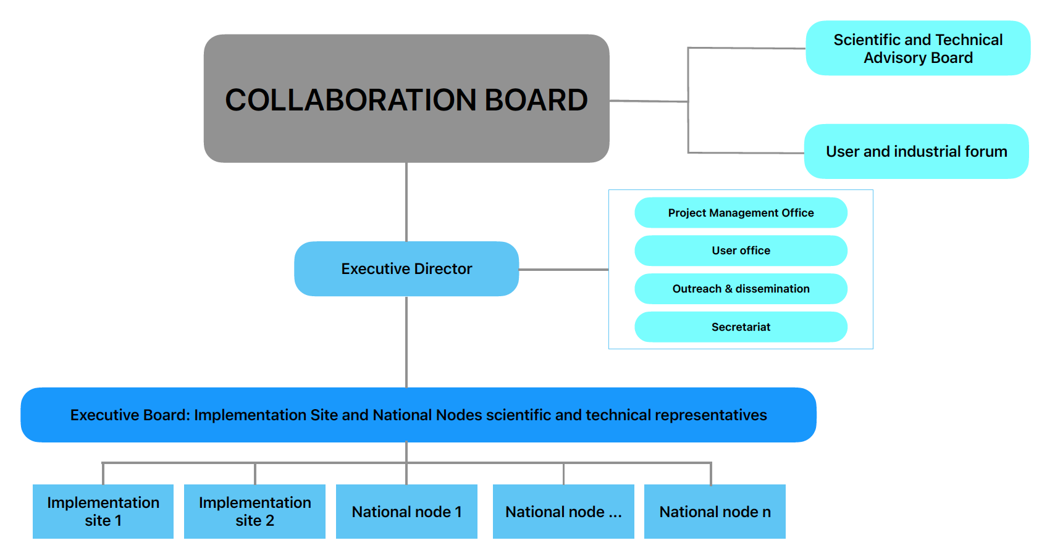
Update CA Requirements and proposed governance
Reinforce the commitment from collaboration members
Possible In Kind Contribution (regulated by ad-hoc MoU)
Open to joint Eu-Grant application
Common Project Management Practice and coordination for the two sites.
Common funds (modest amount) for general purposes (e.g. centralized Project Office for EU grants, training, outreach).
Support Office
Open access approach
Based on the agreed architecture (Hubs, National Nodes, Project Clusters).
Open – end (or very long term) to have sufficient time for a possible development into a new legal entity.
Board of sponsor - Council

Slide 9
Post-Implementation Phase
Why a new legal entity and its requirements
It is the most appropriate way (if done correctly) to guarantee a long term sustainability.
Some advantages in terms of procurement and hiring (depending on the model).
Provide a common strategy and vision
Needs to be agreed by all the institutions and backed up at political level → Increase commitment
Since the operations will be covered by host institutions and asset will remain in their property, the legal entity should act as an umbrella on the overall organization, coordinating user access, scientific strategy, upgrade and training.
Pre-invested assets will remain in the host institution property but at disposal of the collaboration.
ERIC
AISBL
LLC / GmbH / Societe Civil
And many more.
Several models are available:

Slide 10
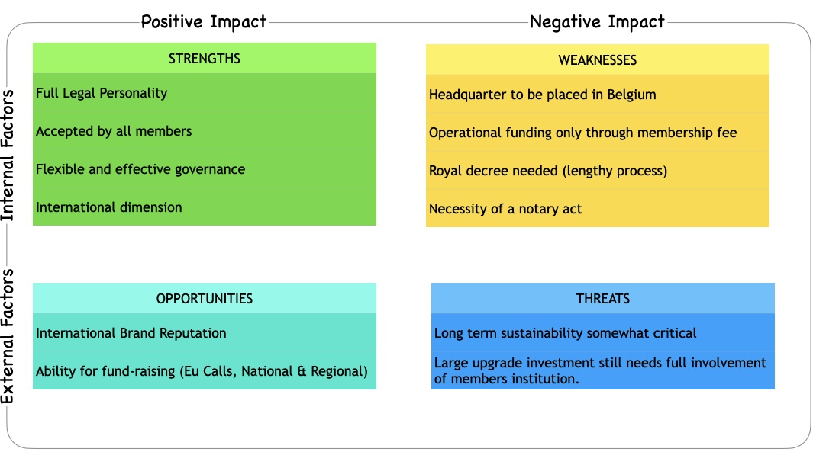
Post-Implementation Phase
New Legal Entity Options – SWOT analysis
European Research Infrastructure Consortium - ERIC
Association International sans but lucrative - AISBL

Slide 11
Post-Implementation Phase
New Legal Entity Options – SWOT analysis outcome
ERIC seems to be out of question. It does not seem adequate for the size and cost of EuPRAXIA plus some skepticism on the long term at political and institution level and additional membership problem (can an ERIC be member of another ERIC? Maybe not).
AISBL seems to be more attractive: less constraints in terms of governance and membership, apparently relatively easier to implement. The real implementation tricks have to be further investigated. Other similar facilities have adopted this framework (e.g. KM3NET).
Back up: if there’s no agreement on the legal personality model a stronger Consortium agreement will be set up to govern the operational phase.

Slide 12
Conclusions
The proposed ranking is the following:
A new CA for the implementation phase.
A strategy for its further evolution into a legal personality model (preferred AISBL).
A lot of discussions are ongoing at political level to update the legal tools for RI (e.g. ERIC Forum et al.). Maybe newer and more appropriate legal frameworks might appear in the future.
Meetings with KM3NET (AISBL to be very soon) to understand the process, pro&cons and tricks, are ongoing.

Slide 13


















































EuPRAXIA-PP Consortium
Coordinator

Slide 14

Acknowledgements
EuPRAXIA Preparatory Phase
This project has received funding from the European Union’s Horizon Europe research and innovation programme under Grant Agreement No. 101079773. It is supported by in-kind contributions by its partners and by additional funding from UK and Switzerland.
EuPRAXIA Doctoral Network
This project has received funding from the European Union´s Horizon Europe research and innovation programme under grant agreement no. 101073480 and the UKRI guarantee funds.
EuAPS
This publication has been made with the co-funding of European Union Next Generation EU.

