Slide 1
Reduction of Projected Energy Spread with a Dielectric Wake Field Structure
Evan Ericson

Slide 2
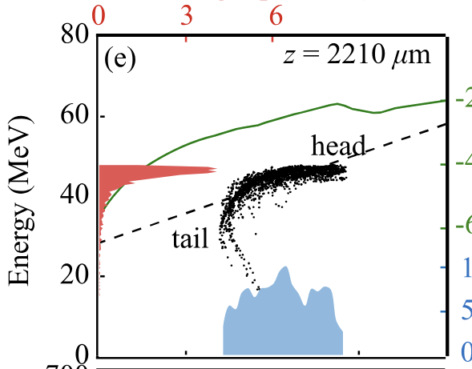
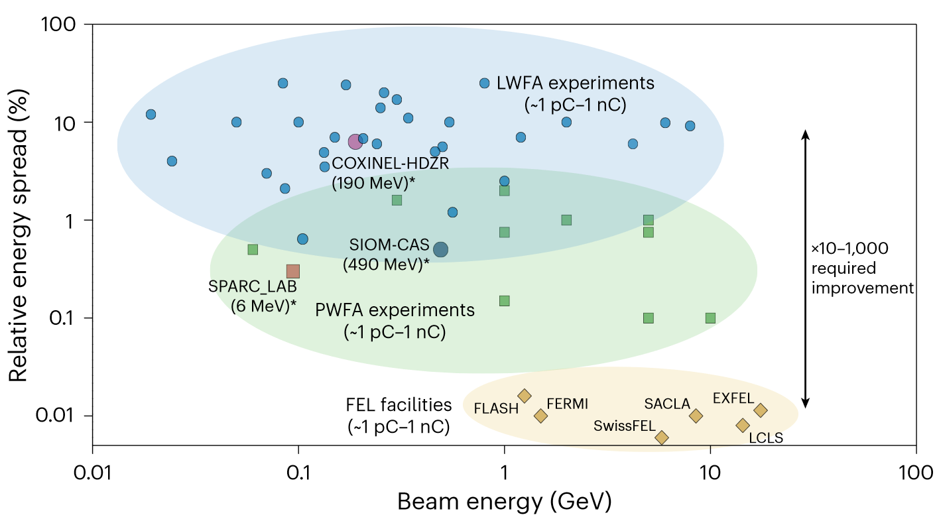
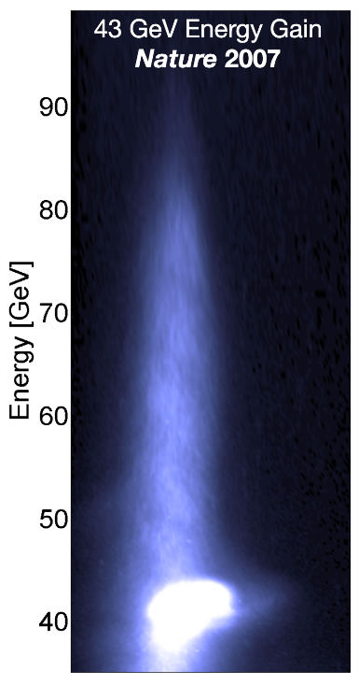
Near-GeV Electron Beams at a Few Per-Mille Level from a Laser Wakefield Accelerator via Density-Tailored Plasma, Ke, et al.
Prospects for free-electron lasers powered by plasma-wakefield-accelerated beams, Galetti, et al.
Demonstration of Large Bandwidth Hard X-Ray Free-Electron Laser Pulses at SwissFEL, Prat, et al.
Energy doubling of 42 GeV electrons in a meter-scale
plasma wakefield accelerator, Blumenfeld, at al.
Notes:
A recent review article detailing the progress of plasma accelerators includes this plot. The x-axis is the beam energy produced by the accelerator. The y-axis shows the relative energy spread of the beam produced. The plot is populated with results from different accelerators. The blue bubble shows data from LWFA, the green cloud is PWFA and the yellow points are FELs based on conventional RF accelerators. This plot shows the gap in performance between plasma and RF accelerators in terms of energy spread. The authors were in fact quite kind to us who are proud of the advances in plasma technology because they used a logarithmic y-axis. The gap between the energy spread of beams produced by plasma and RF accelerators is large. As an extreme example, consider this experiment conducted at FACET. Using a plasma accelerator, they were able to double the energy of a 42 GeV beam. However, the beam had energies ranging from 42 GeV to above 80 GeV meaning the beam had a 100% energy spread. This is, of course, a sensational example and since 2007, the field has progressed. This example from 2021 produced a beam from a LWA with less than a 1% energy spread. At the very bottom of the plot from the review article we have SwissFEL. There the energy spread is so small that they have had to look for ways to increase the energy spread for some user experiments. While RF and plasma accelerator technologies are different, they both have the challenge of controlling the energy spreads of the beams they produce. I think we should apply wakefield structures to control the energy spread of plasma particle accelerators.

Slide 3
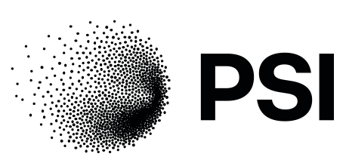
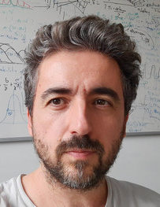
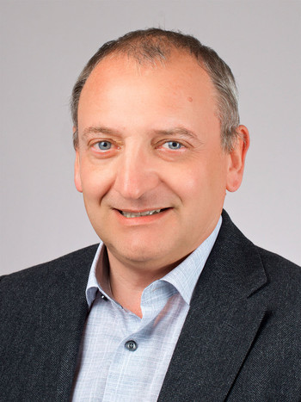
Rasmus
Ischebeck
Paolo
Craievich
Fabio
Marcellini
Sven
Reiche
Eduard
Prat
Mike
Seidel
Diagnostics & Instrumentation
Radio Frequency Systems
Beam Dynamics
Large Research Facilities
Notes:
My name is Evan Ericson. I am a PhD student at EPFL based at the Paul Scherrer Institute. I have been doing simulations for particle accelerators since 2018 and I have done the analysis and prepared the simulations I will show you today. I work at PSI because that is where the Swiss Free Electron Laser is located. I have worked with the people shown here because they are free electron laser experts. I study methods of manipulating the longitudinal phase space of particle beams because the correlated energy spread determines the bandwidth of free electron lasers.

Slide 4
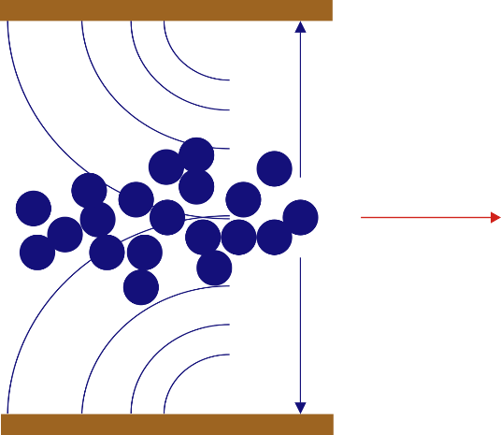
VACUUM
GAP
BEAM
DIELECTRIC
Inherently synchronized with witness beam
Notes:
At SwissFEL we use a wakefield structure to increase the energy spread of the beam. This photo shows it installed in a vacuum chamber in the accelerator. Inside the structure is simple: Two parallel dielectric plates are attached to two metal jaws whose separation can be varied. When a beam passes between the plates, wakefields are excited. The fields produced by the head of a bunch can affect the particles in the tail. The amplitude of the fields depends on the material properties and gap of the device. The wakefields are inherently synchronized with the beam since the beam is affecting itself. The wakefields also do not require an external power source.

Slide 5
Chirping for RF accelerator
E
E
tail
head
t
t
Dechirping for plasma accelerator
E
E
tail
head
t
t
Notes:
The wakefield structure can work in two ways. For RF accelerators that produce bunches with small energy spread, when a bunch passes through the wakefield structure, the wakefields generated by the head cause particles in the tail of the bunch to lose energy and the output beam has an increased energy spread. In the case of plasma accelerators with a large energy spread, the wakefields produced by the head cause the tail to lose energy and the energy spread of the beam is reduced. This effect is either called chirping of dechirping and it depends on the input beam. At SwissFEL we have an RF accelerator and we performed the Chirping experiment. We

Slide 6
E
Screen
C-band Transverse deflecting structure
Passive dielectric structure
Dipole
t
Measurement procedure:
Passive structure gap is fully opened to limit its effect
TDS is used to get the longitudinal phase space of the beam sent into passive structure
TDS is turned off
Passive structure gap is gradually closed
Dipole & screen measure energy of beam coming out of the passive structure
Process is repeated for three bunch lengths (76 fs, 38 fs, 16 fs), 300 images total

Slide 7
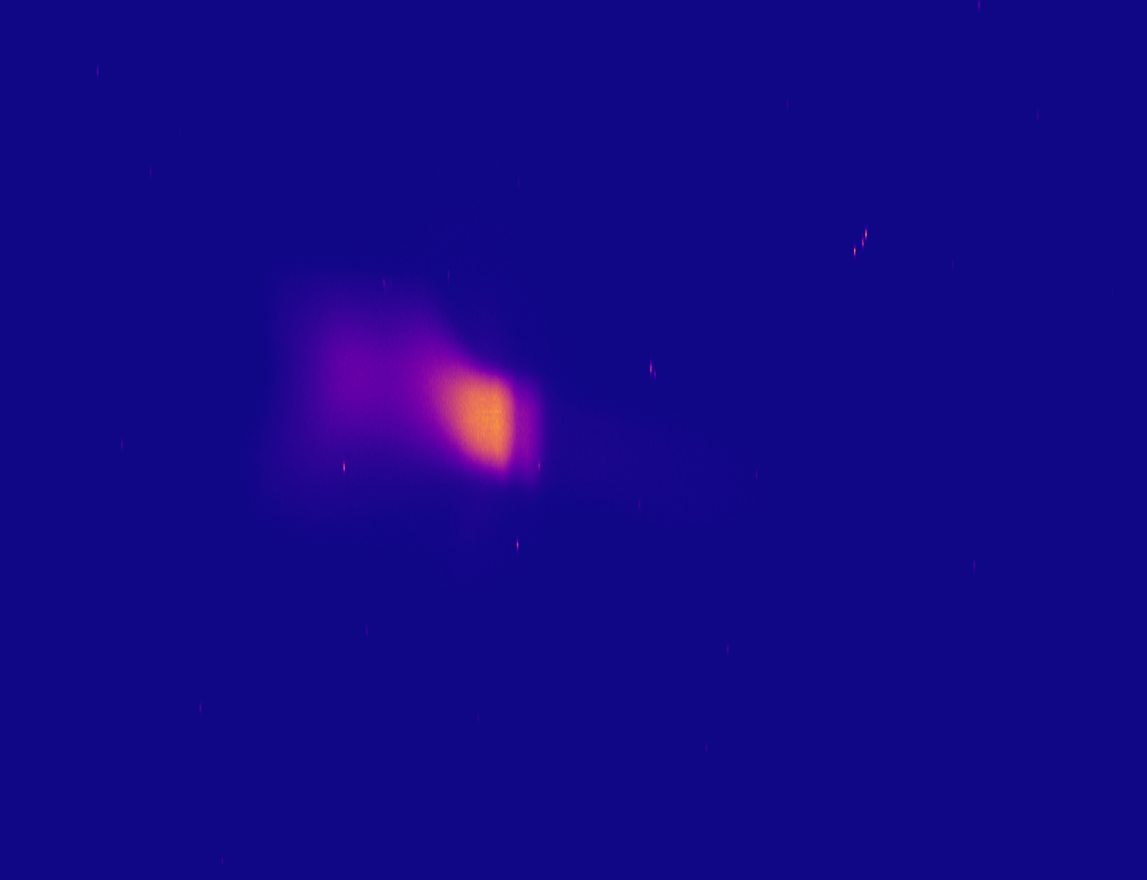
Pixel #
Screen
C-band Transverse deflecting structure
Passive dielectric structure
Dipole
E
Measurement procedure:
Passive structure gap is fully opened to limit its effect
TDS is used to get the longitudinal phase space of the beam sent into passive structure
TDS is turned off
Passive structure gap is gradually closed
Dipole & screen measure energy of beam coming out of the passive structure
Process is repeated for three bunch lengths (76 fs, 38 fs, 16 fs), 300 images total

Slide 8
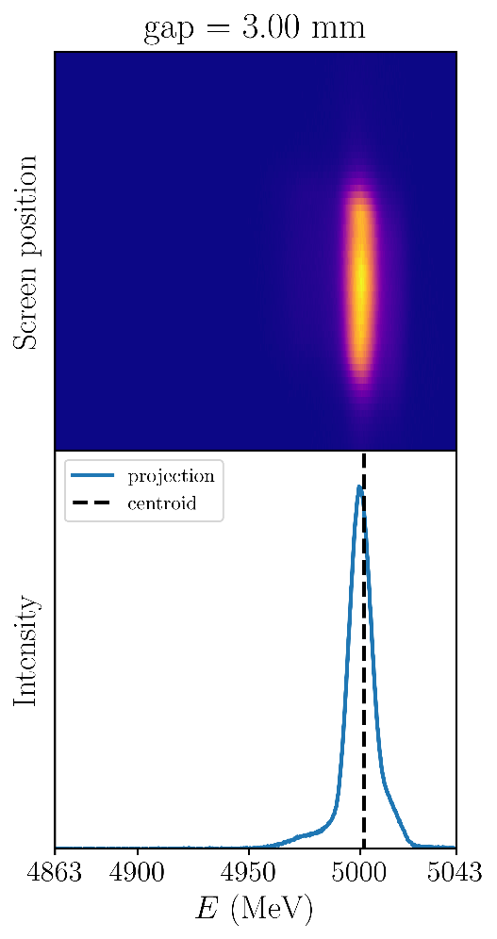
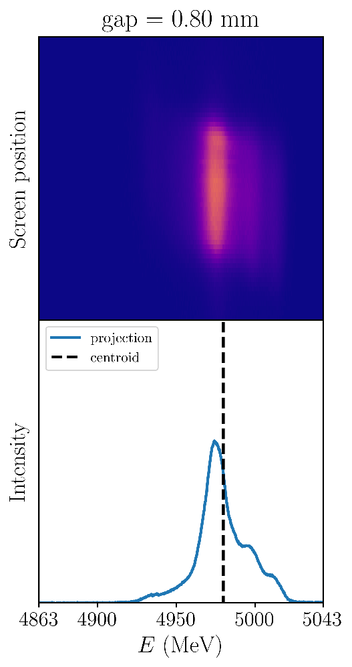
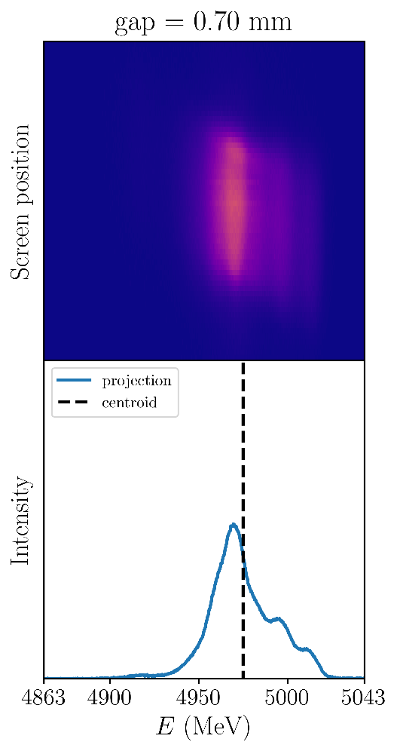
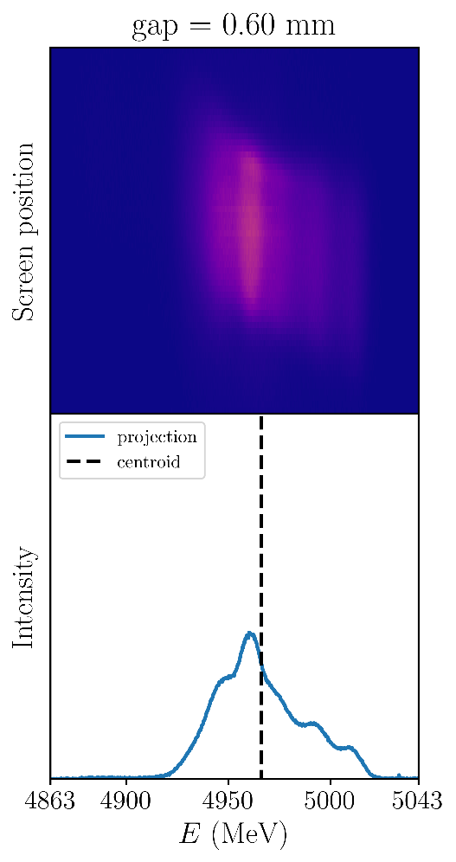
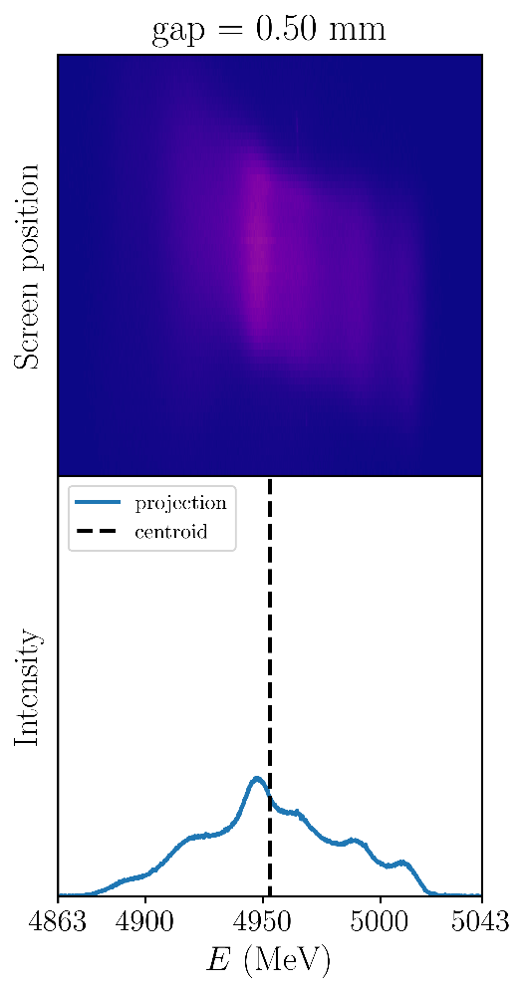
The wakefields change both the energy spread and centroid energy
…
Notes:
This is some data taken during the experiment. When the structure has a large gap, the energy distribution is narrow with a peak centered at 5 GeV. As the gap is decreased, the energy spread increases and the centroid of the distribution decreases. We did this measurement for three different bunch lengths. When operating the gap of the structure is adjusted until the desired bandwidth is obtained. A model of the structure did not exist and how the wakefields changes with gap was not well understood. I made a model of the wakefield structure by simulating the interaction of the beam with the structure in finite element software.

Slide 9
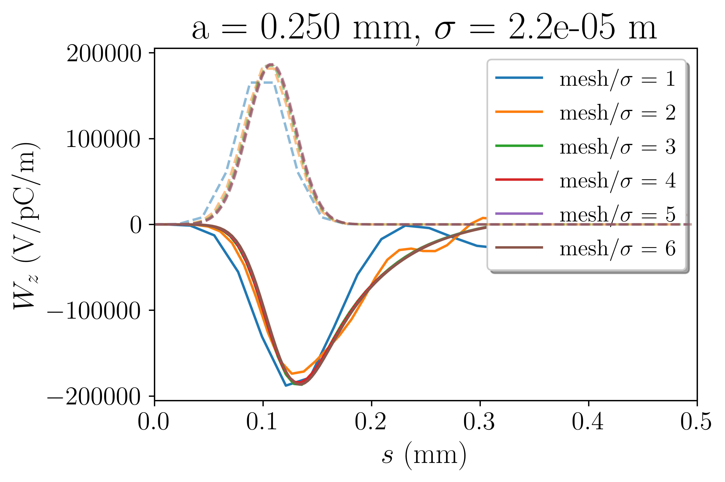
5 mesh elements per σ produces accurate wake potentials
Mesh setting determines how accurately the
Source
Boundaries
Electromagnetic fields
are represented in the simulation
Notes:
Simulating this interaction accurately was not straightforward. I needed to find the solver settings that were the least demanding as possible while still giving accurate predictions. I did mesh convergence checks which is a parameter that determines how finely the geometry and fields were discretized. I then found the minimum structure length that could be simulated while still giving accurate results. The wakefields are calculated as a finite sum of modal wake potentials. The number of terms to include in the sum was not immediately obvious to me. I found that after mode number 45 the wake potential does not change. Now that I had determined the settings, I could simulate the interaction.

Slide 10
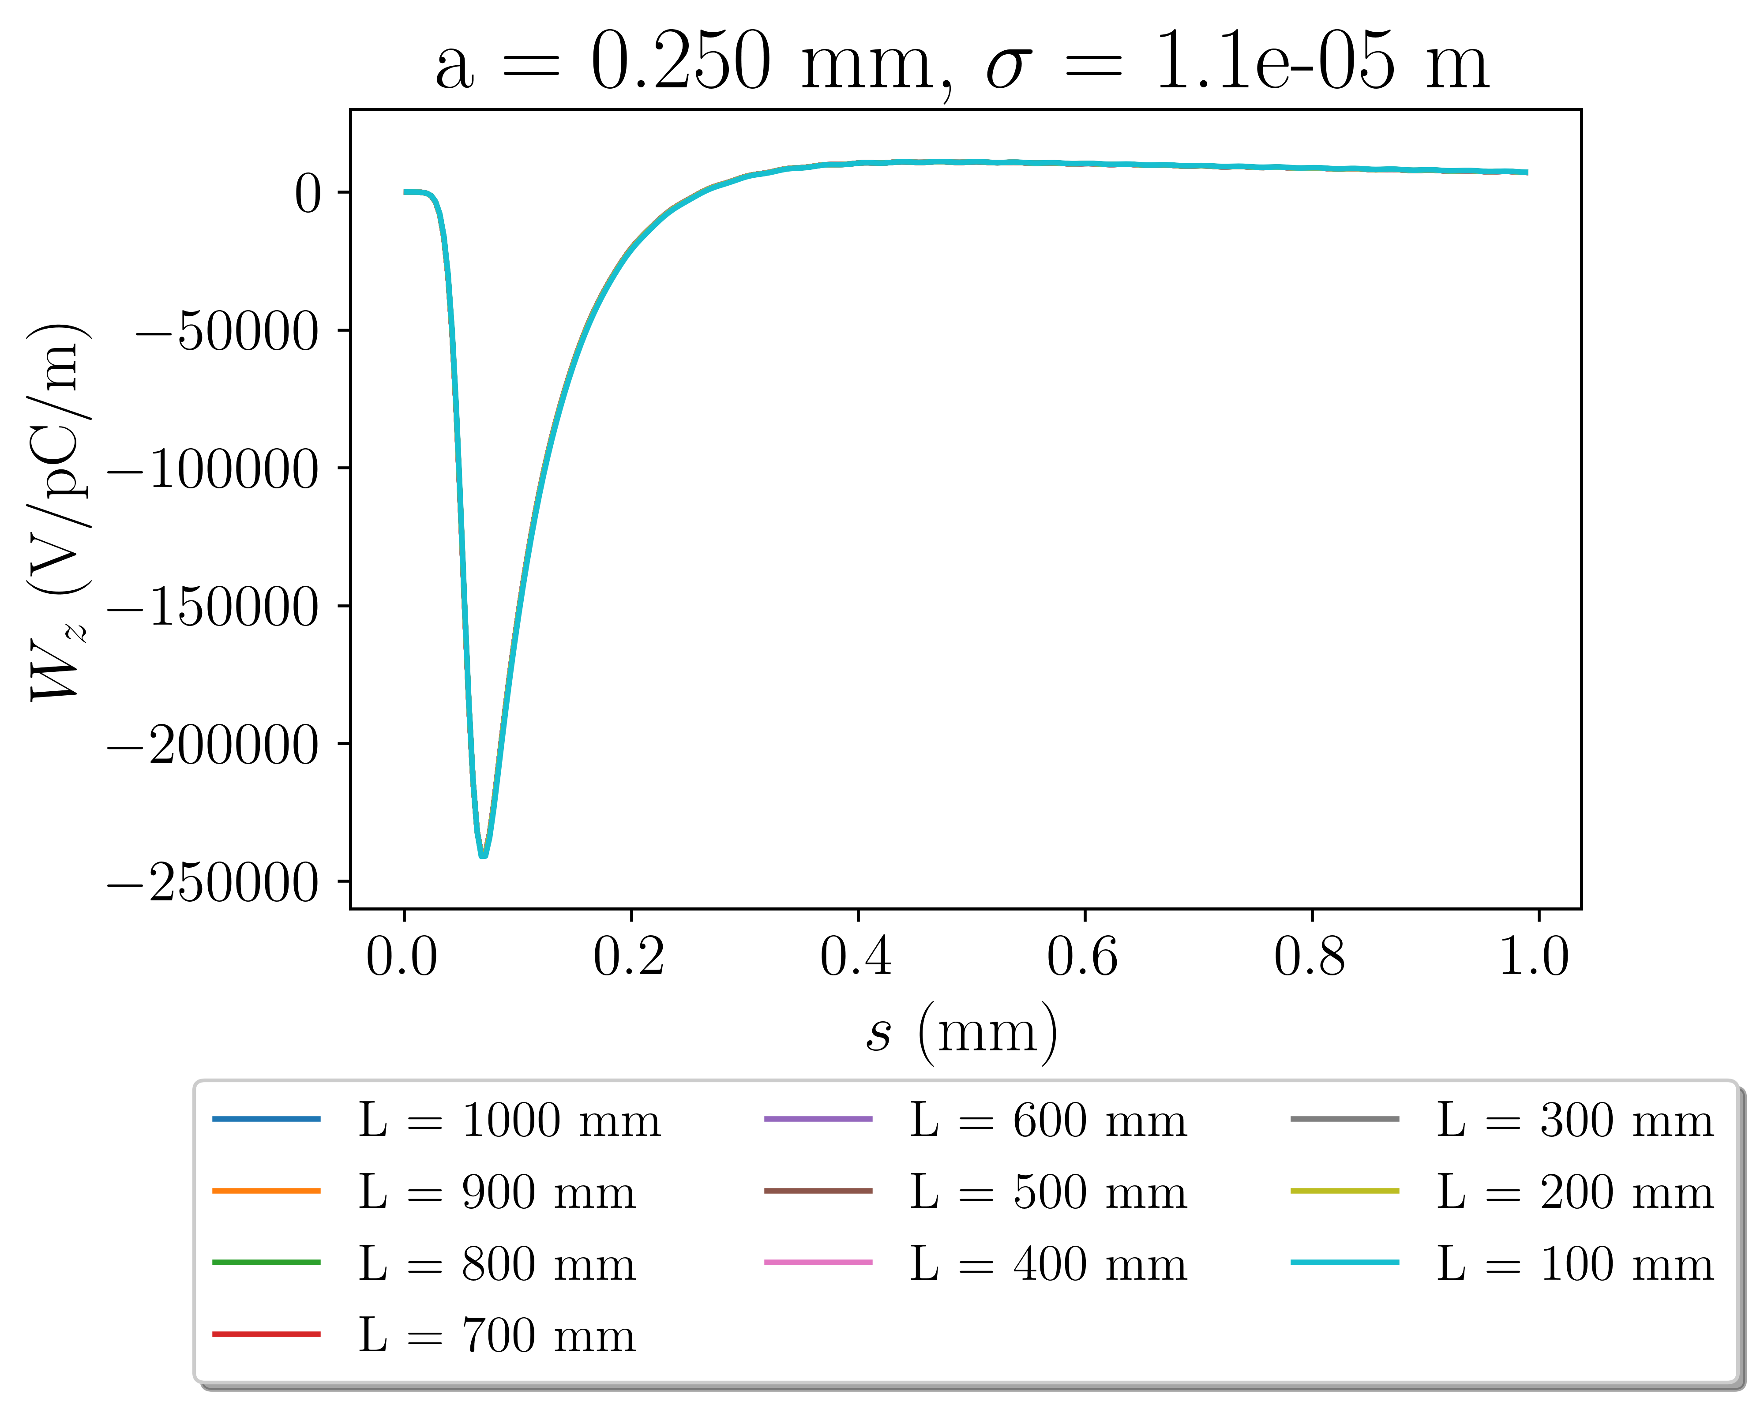
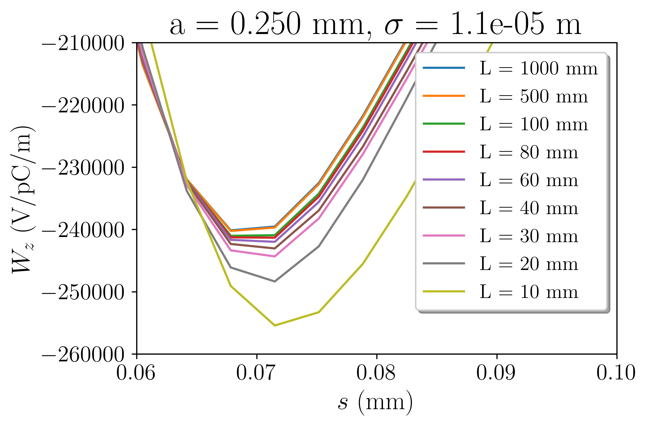
Less than a tenth of the structure needs to be simulated to obtain accurate wake potentials

Slide 11
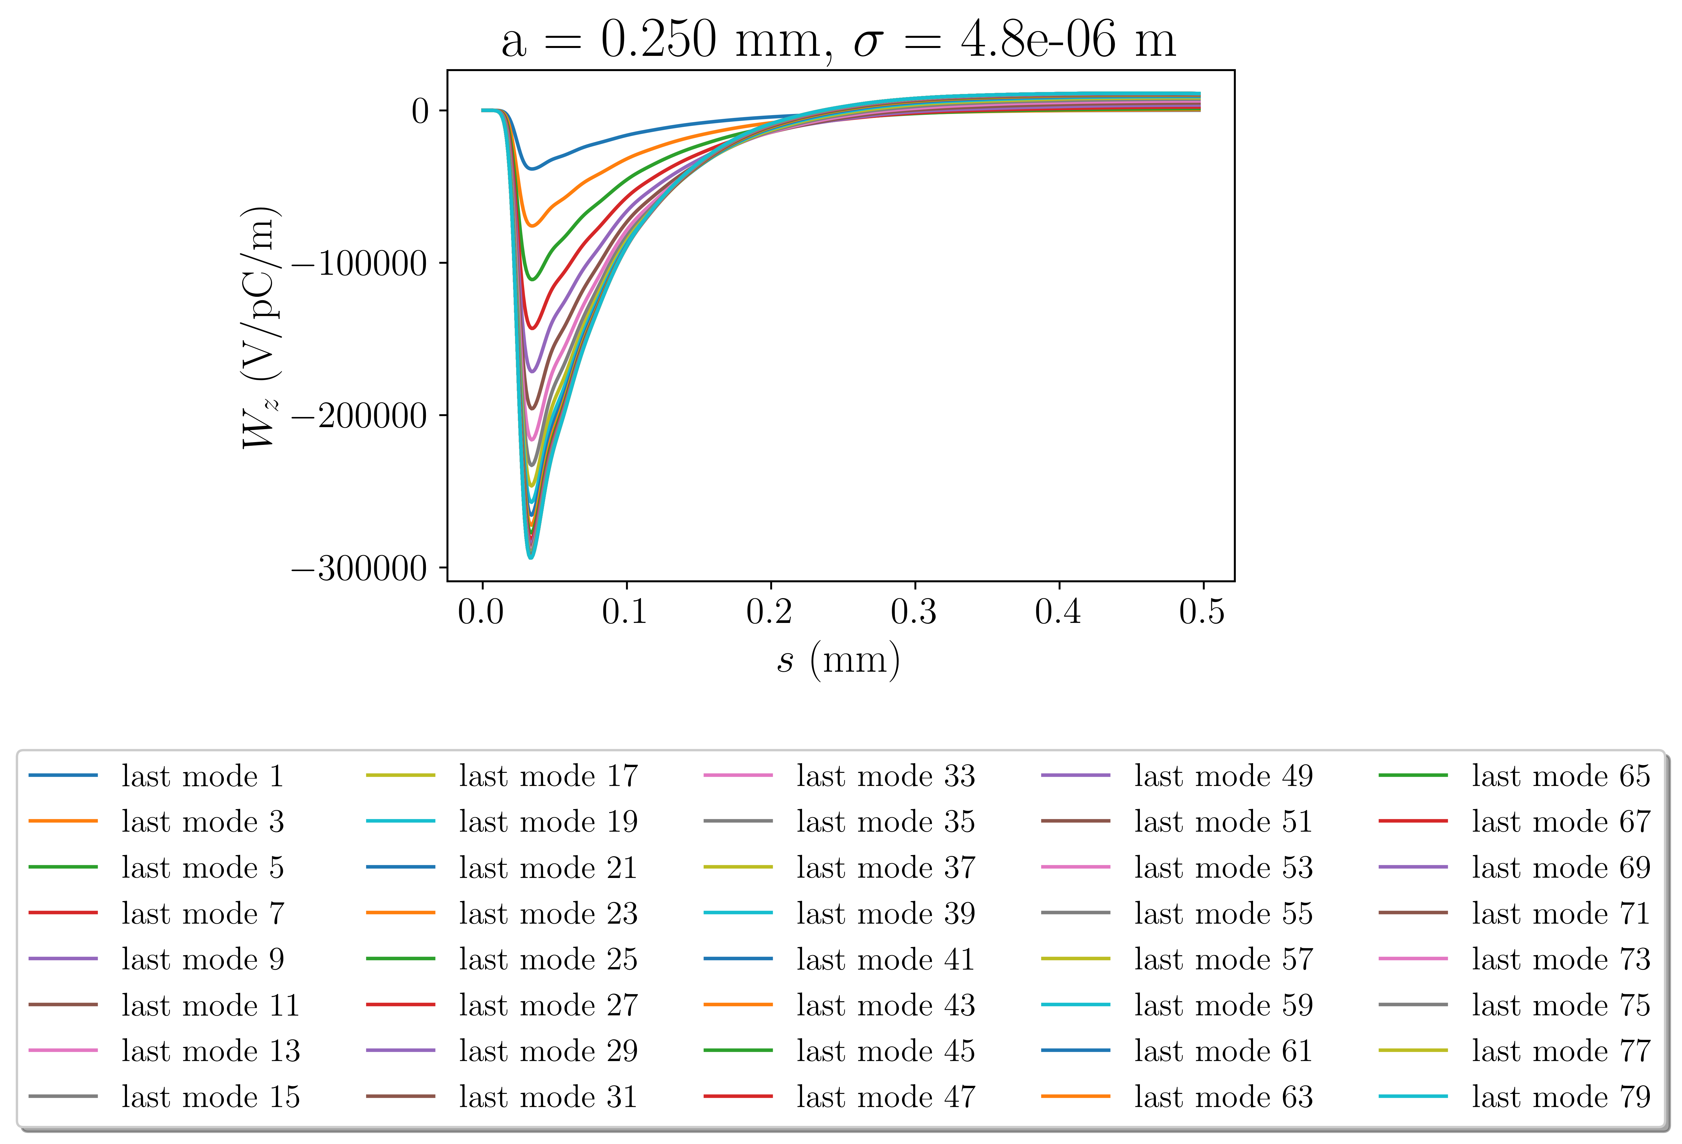
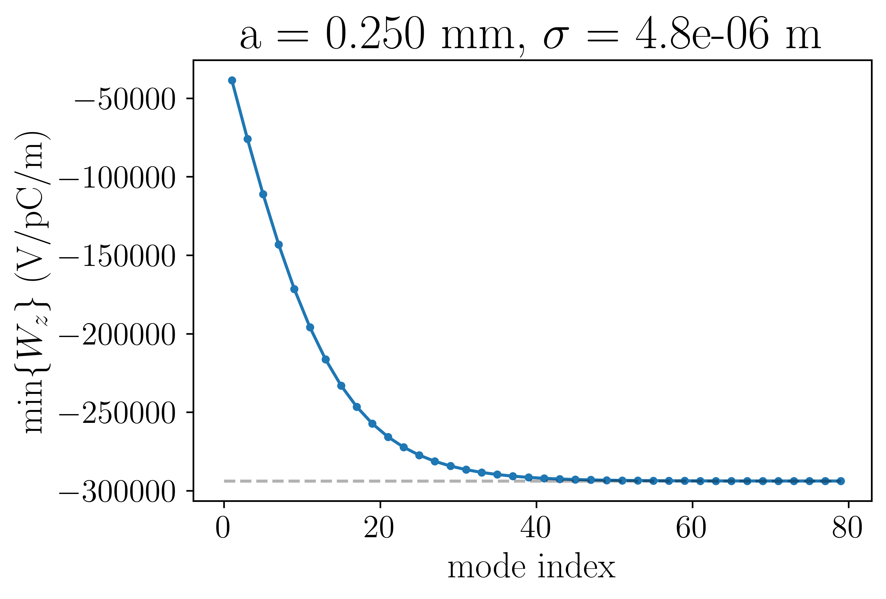
Wake potential does not change when including terms above index 45
$$W= \sum_{i= 1}^{?}{w_{m, i}}$$

Slide 12
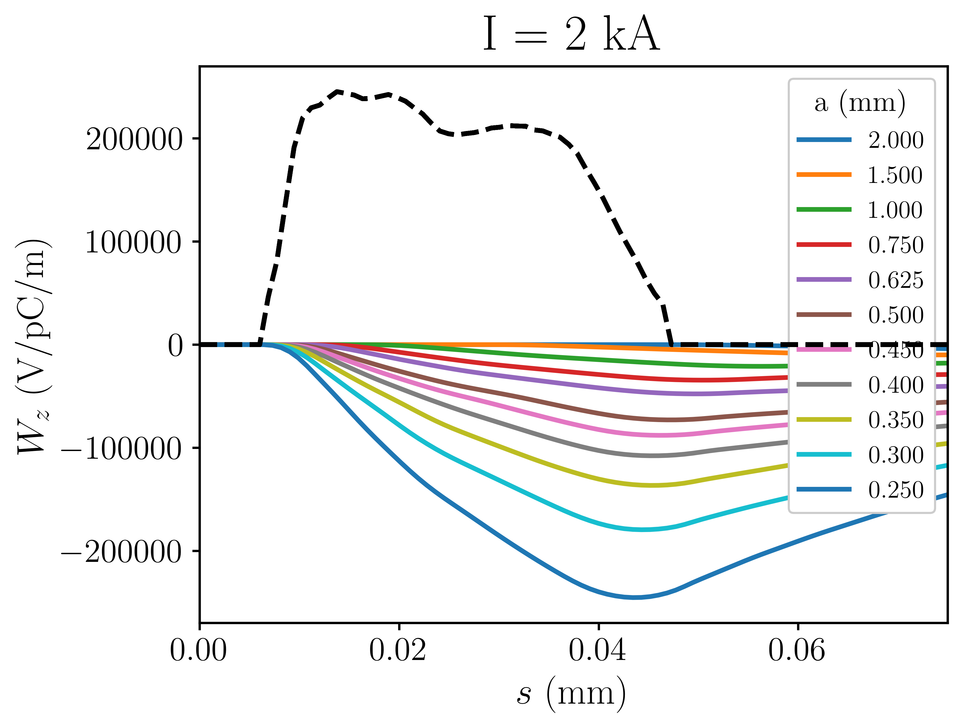
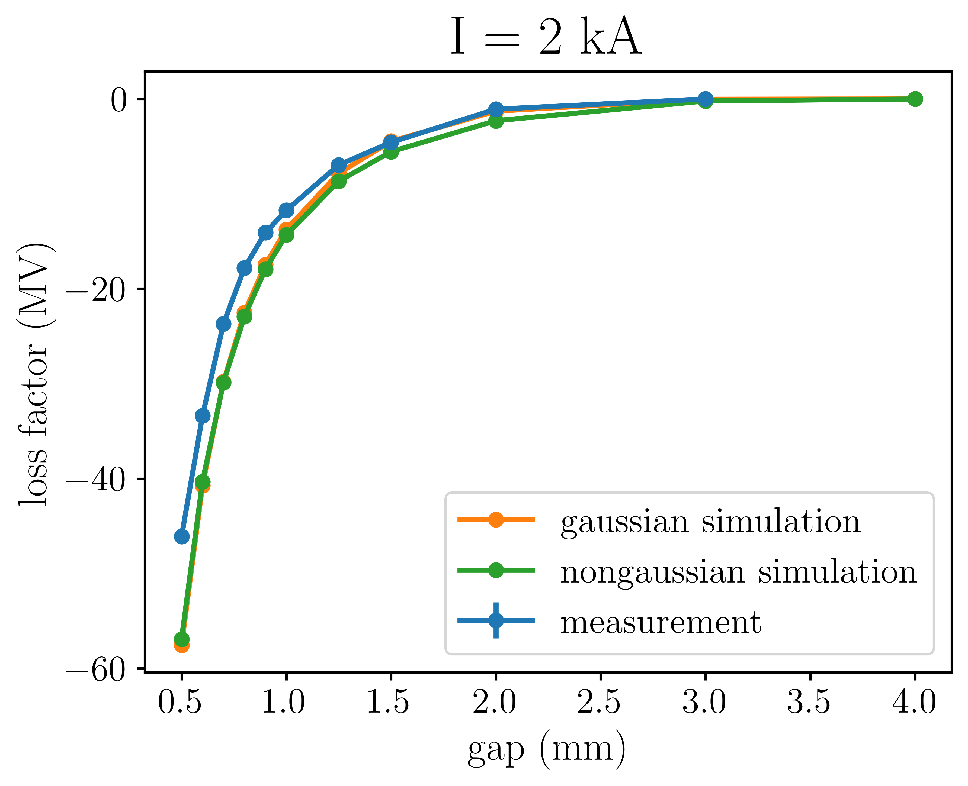
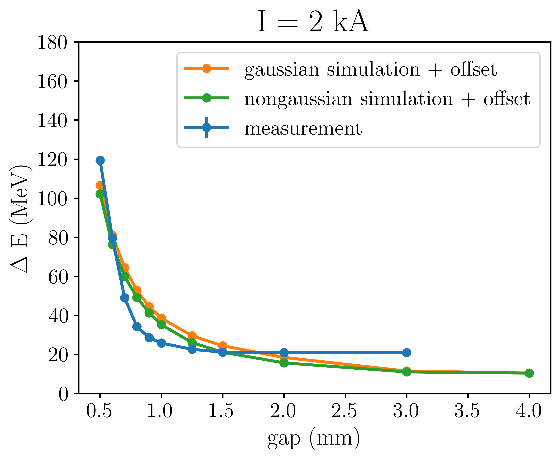

Slide 13
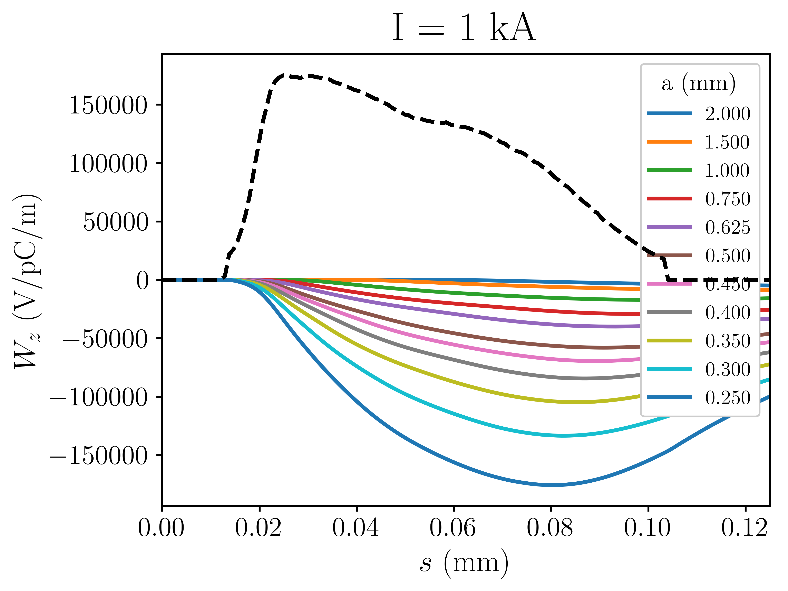
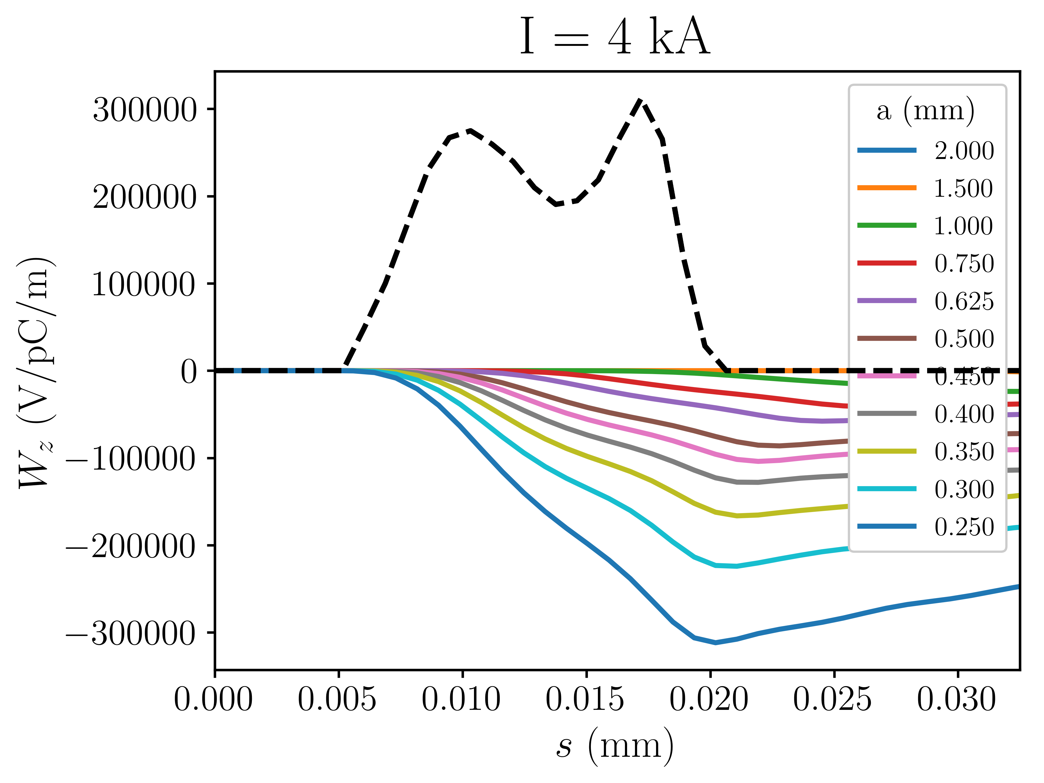
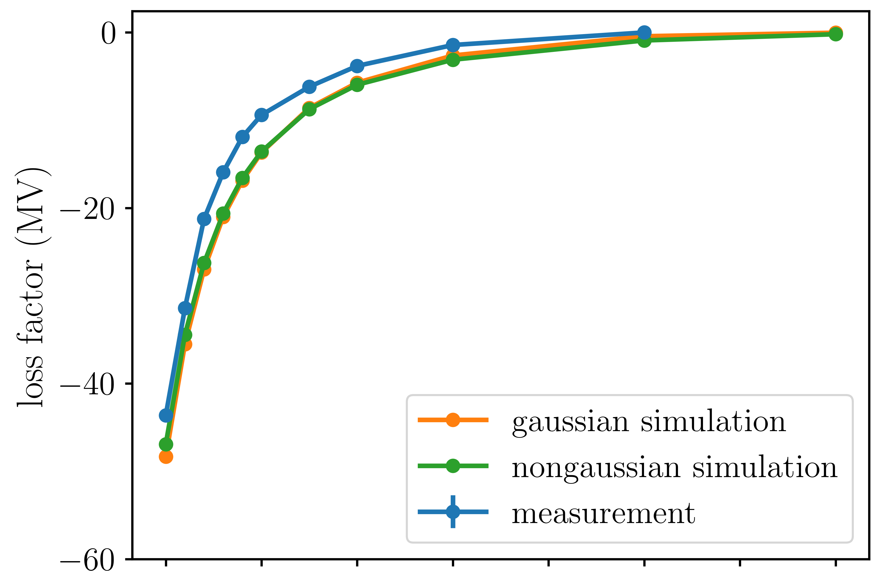
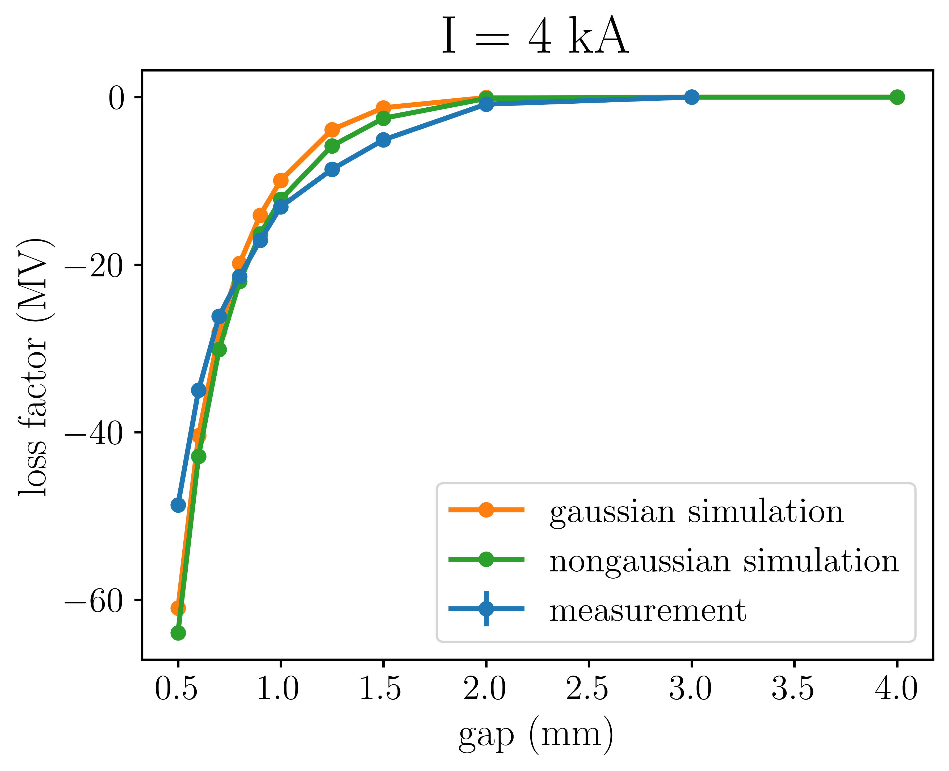
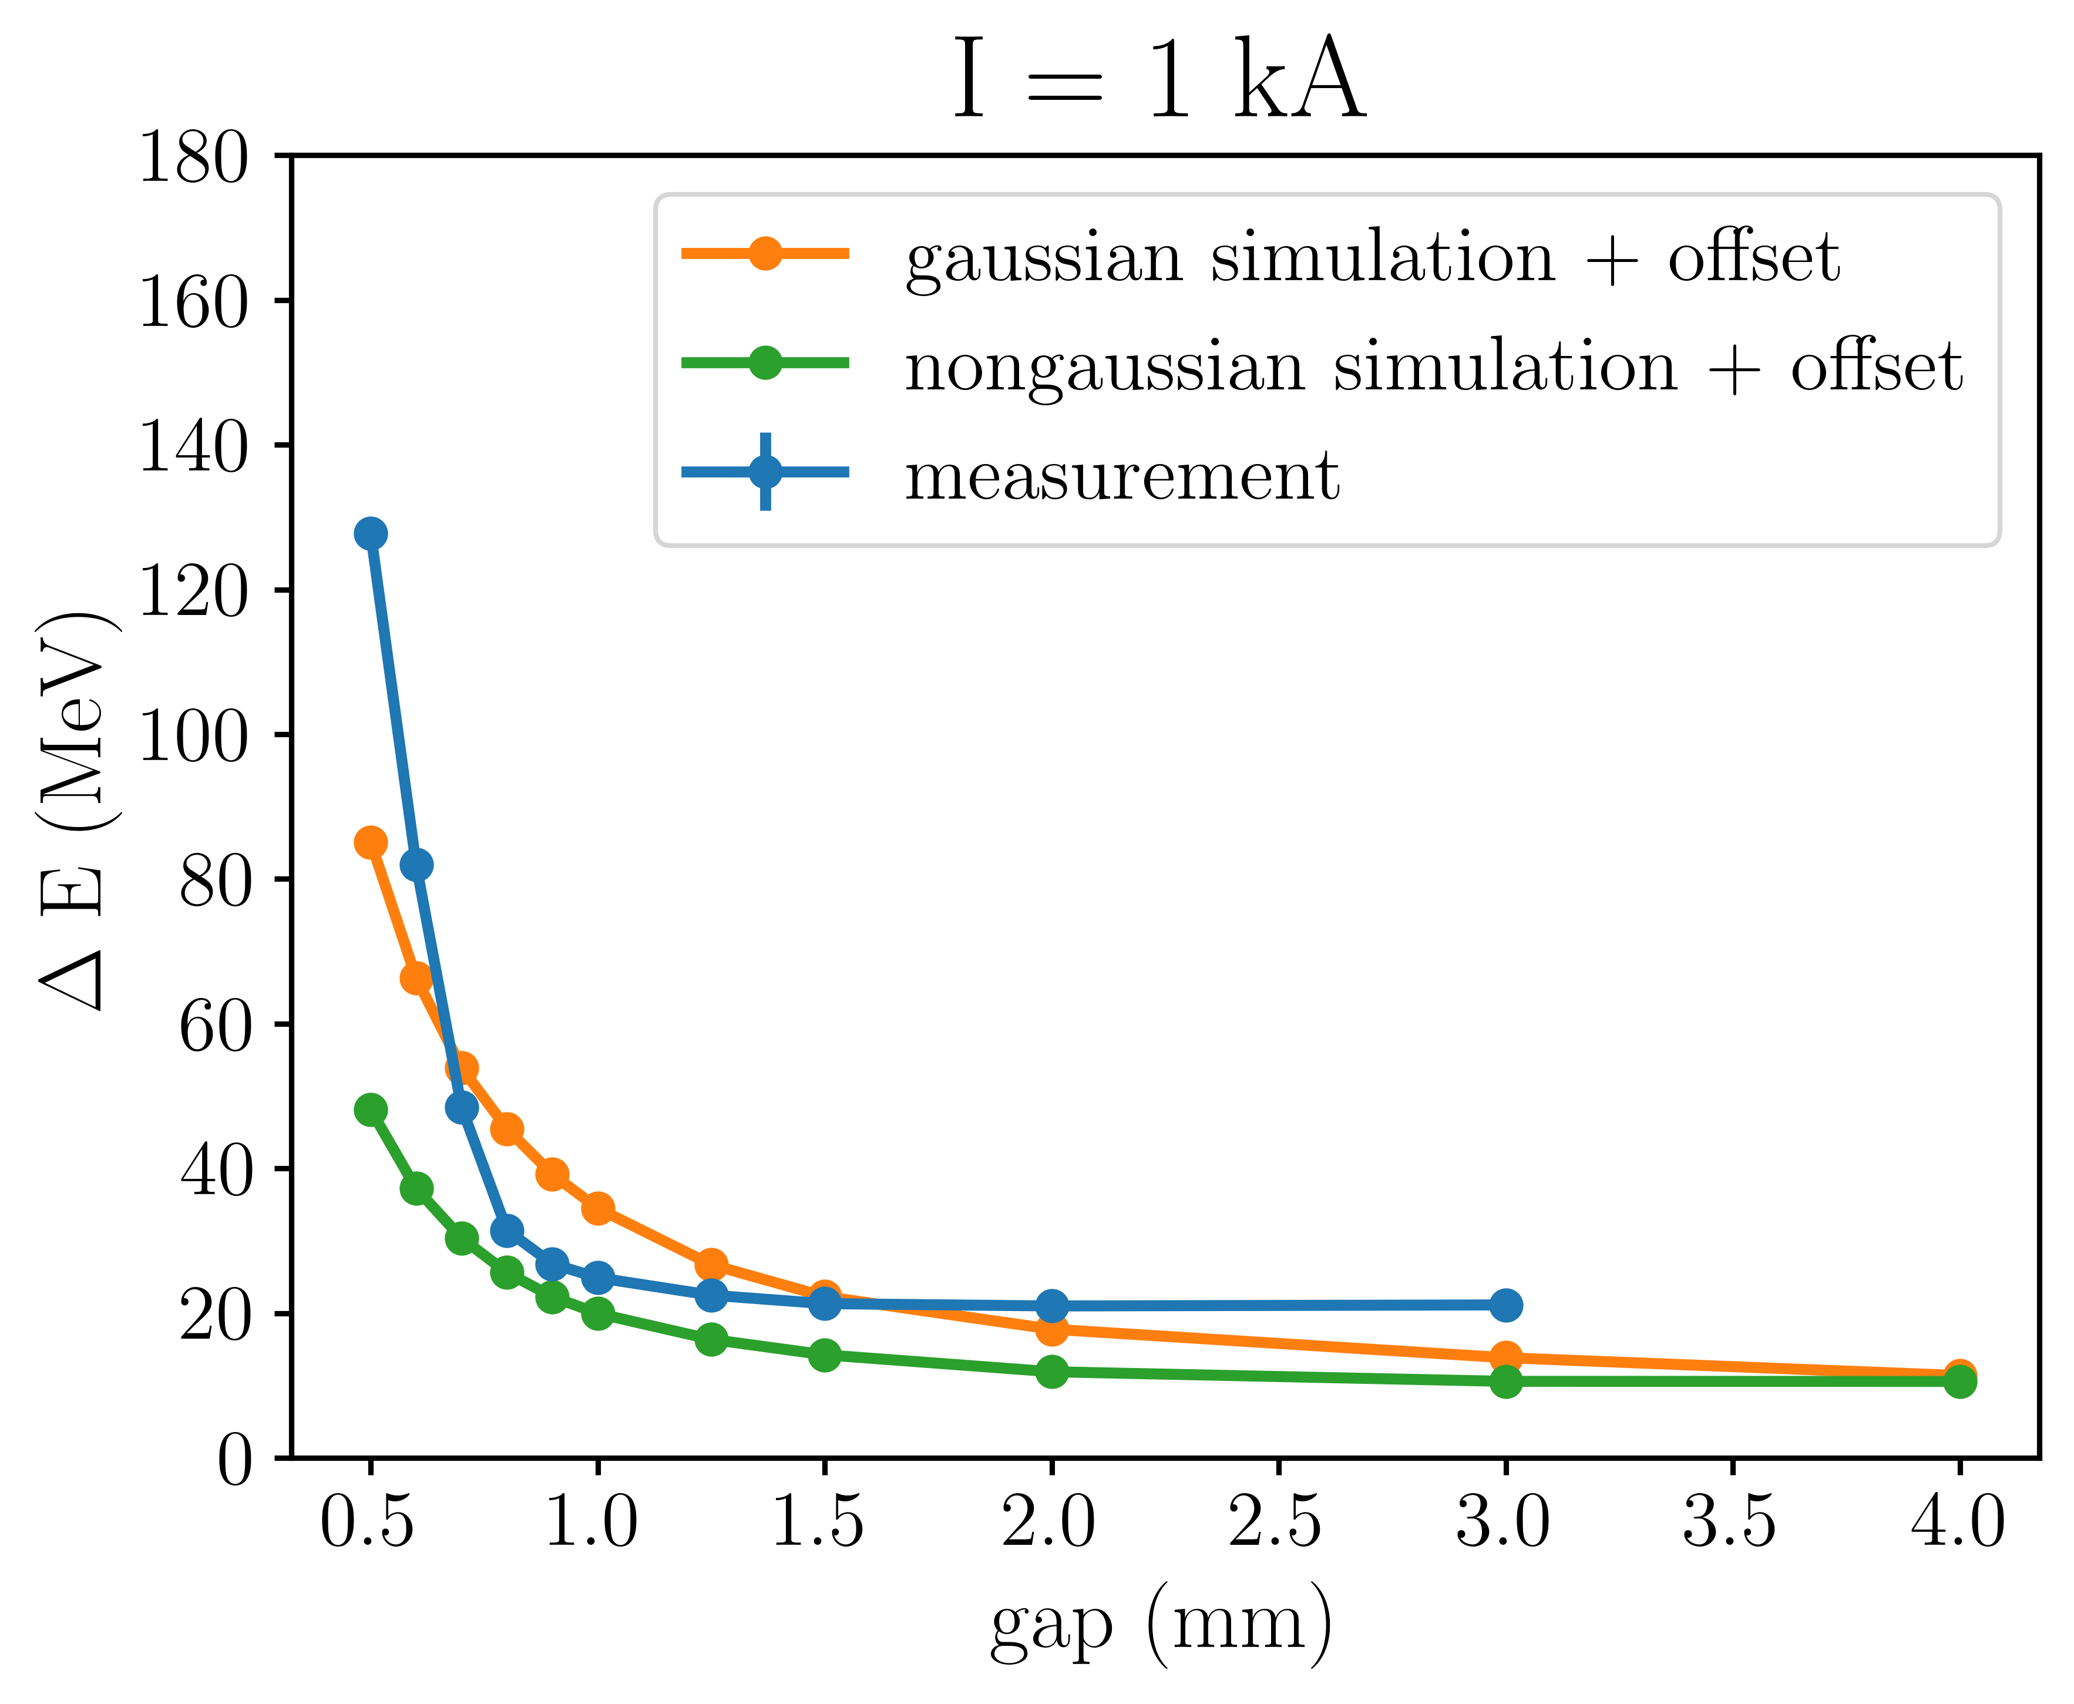
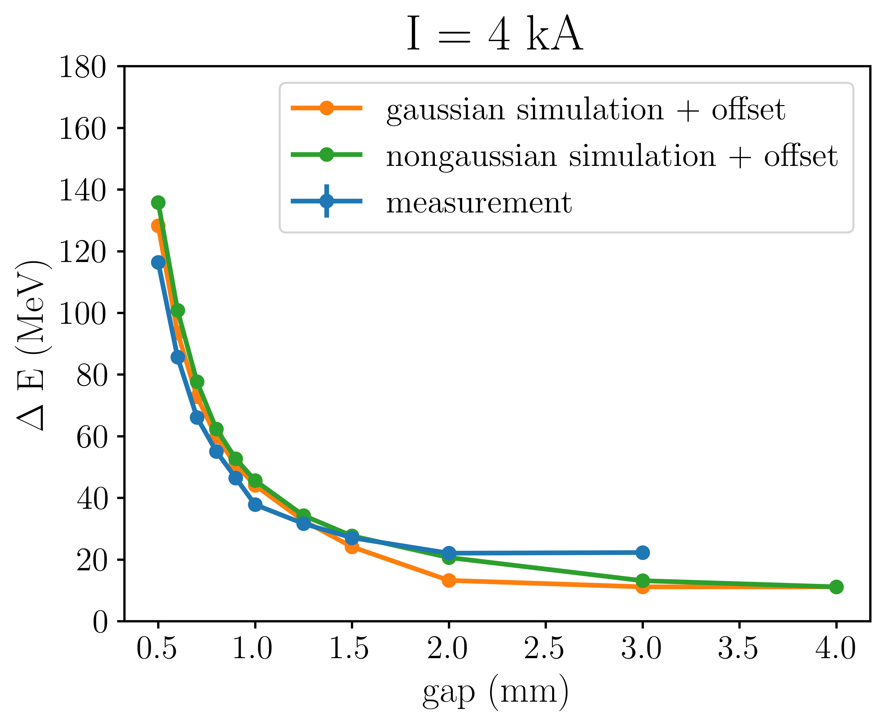
Notes:
The black dashed line represents the current distribution and each colored curved represents the resulting wake potential for a given structure gap. From these wake potentials I calculated the loss factor which is a measure of the change of the centroid energy of the beam and the energy spread of the beam. The blue curve show the values derived from the measurements. The orange and green show the values derived from simulations with gaussian and non-gaussian beams. The simulations follow the trend from the measurements. As the structure gap is closed, the centroid energy decreases and the energy spread increases. The data from the other bunch lengths are shown here.

Slide 14
Conclusion
We have demonstrated the manipulation of the longitudinal phase space of beams from an RF accelerator using a wakefield structure
I think we should use wakefield structures to control the energy spread of plasma particle accelerators

Slide 15
EXTRA SLIDES

Slide 16
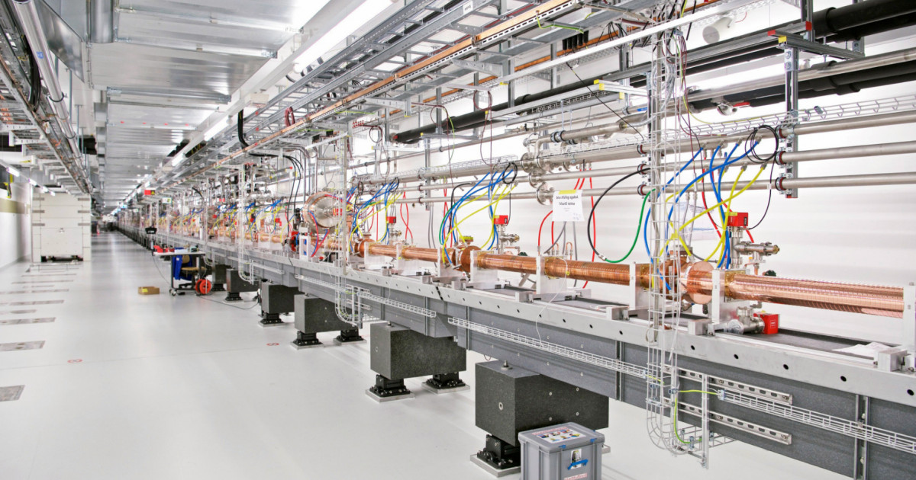
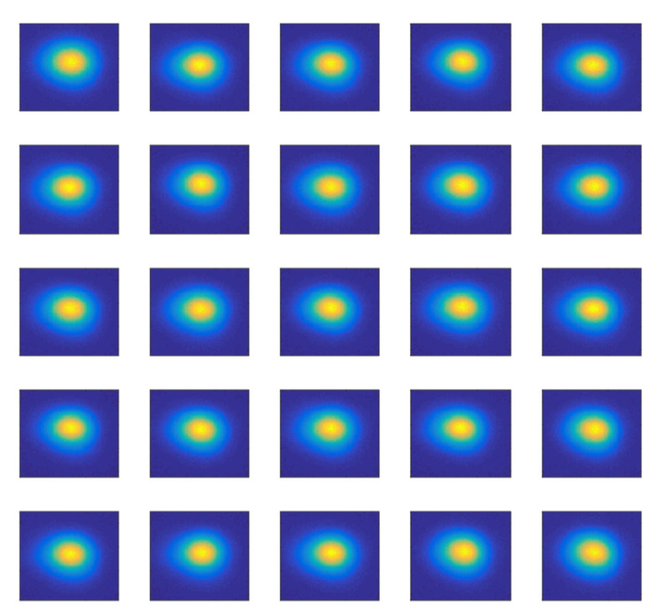
SwissFEL & EuPRAXIA
Parameter | SwissFEL
Length | 740 m
LINAC frequency | 5.7 GHz (C-band)
Repetition rate | 100 Hz
Energy | up to 6.1 GeV
Bunch charge | 10 – 200 pC
Trajectory jitter | < 10% of beam size
Relative energy jitter | ~ 10⁻⁴
Arrival time jitter | < 10 fs
Slice emittance | 200 nm (for 200 pC)
Bunch length | < 1 fs – 50 fs
Courtesy: Eduard Prat

Slide 17
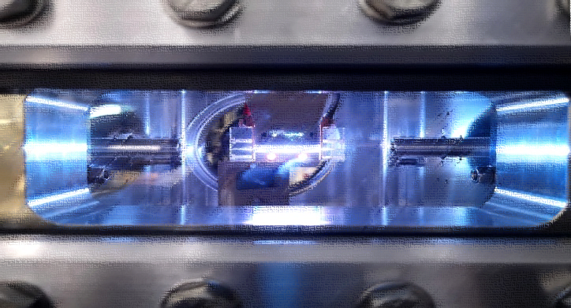
SwissFEL & EuPRAXIA
Parameter | SwissFEL | EuPRAXIA [*]
Length | 740 m | 150 m
LINAC frequency | 5.7 GHz (C-band) | 11.9942 GHz (X-band)
Repetition rate | 100 Hz | ~ 50 Hz
Energy | up to 6.1 GeV | 1 – 1.2 GeV
Bunch charge | 10 – 200 pC | 30 – 50 pC
Trajectory jitter | < 10% of beam size | –
Relative energy jitter | ~ 10⁻⁴ | –
Arrival time jitter | < 10 fs | –
Slice emittance | 200 nm (for 200 pC) | 500 nm
Bunch length | < 1 fs – 50 fs | 10 fs
Presented by A Biagioni at EuPRAXIA-DN School April 2024
EuPRAXIA Conceptual Design Report, Assmann, et al.
[*] Presented by C Welch at EuPRAXIA-DN School April 2024

Slide 18
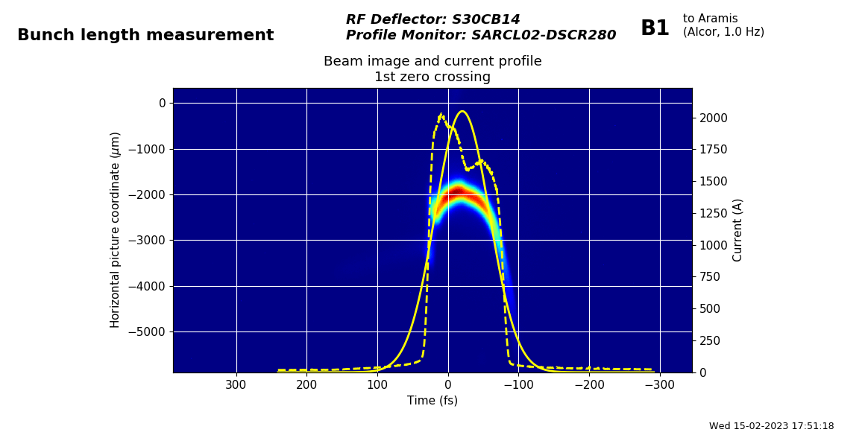
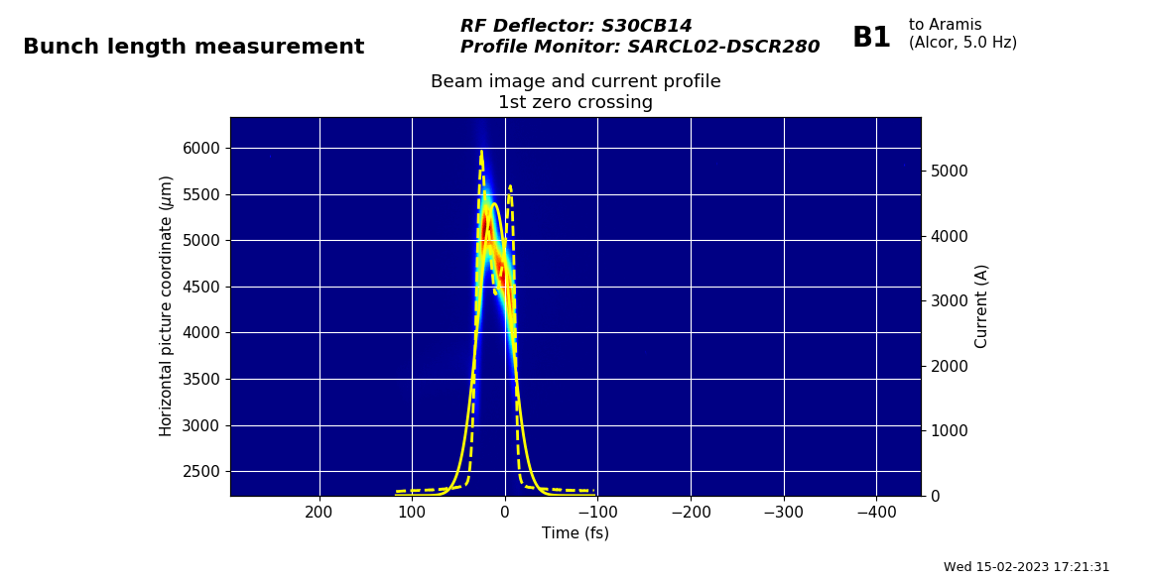
1 kA
2 kA
4 kA

Slide 19
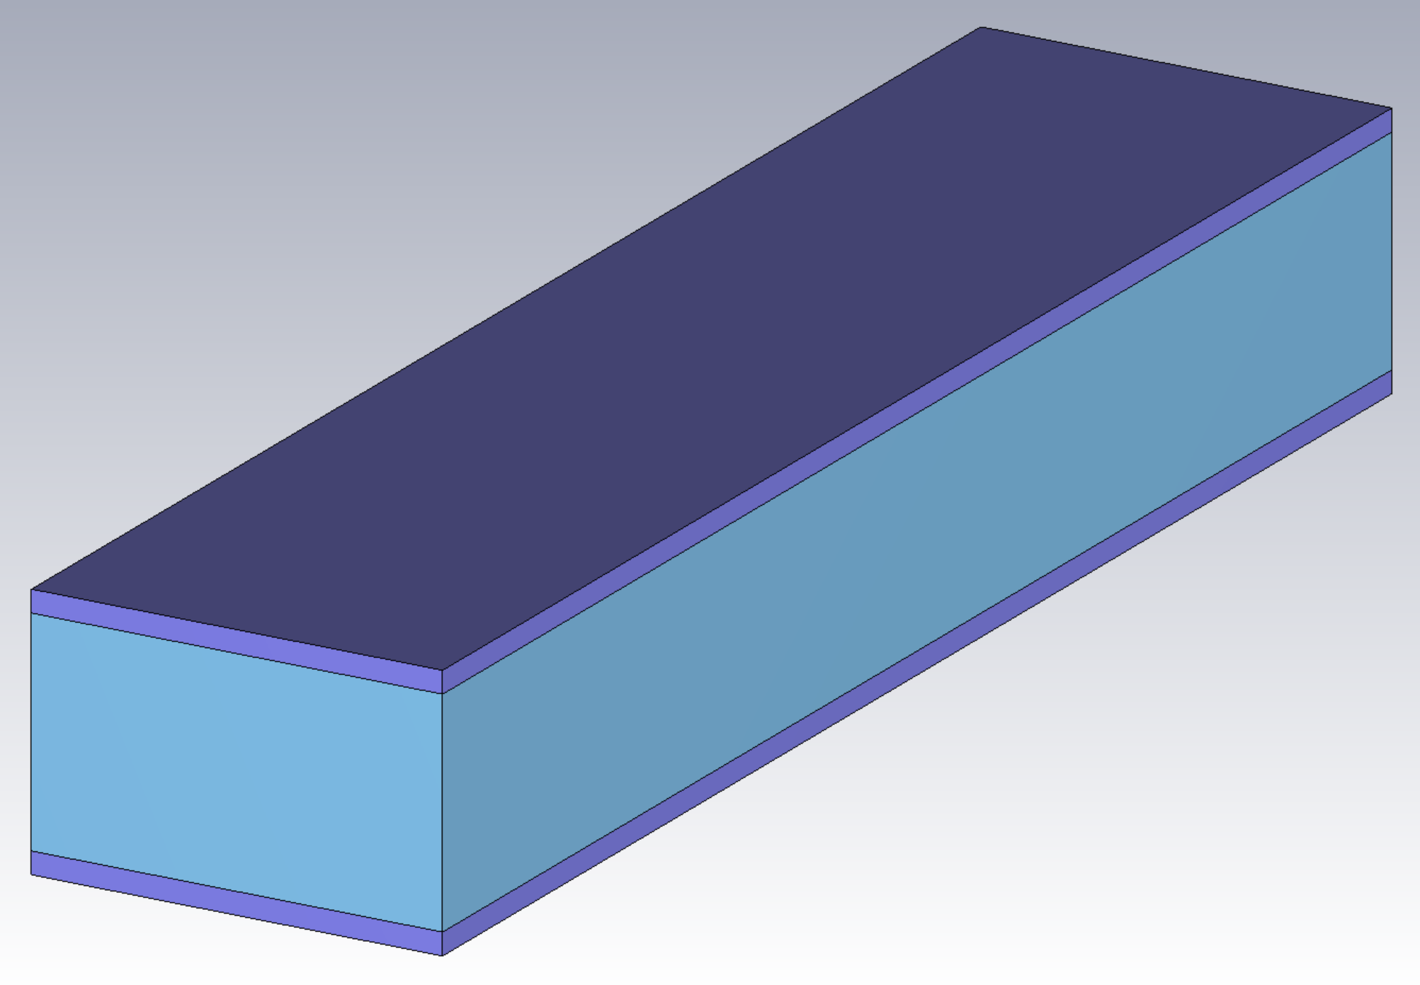
Parameter | Value
half-gap, a | 0.25 mm – 1.5 mm
Length, L | 1 m
Width, w | 15 mm
Dielectric thickness, d | 0.4 mm
Alumina Permittivity, ε_{r} | ~ 10
w
beam
d
L
a

Slide 20
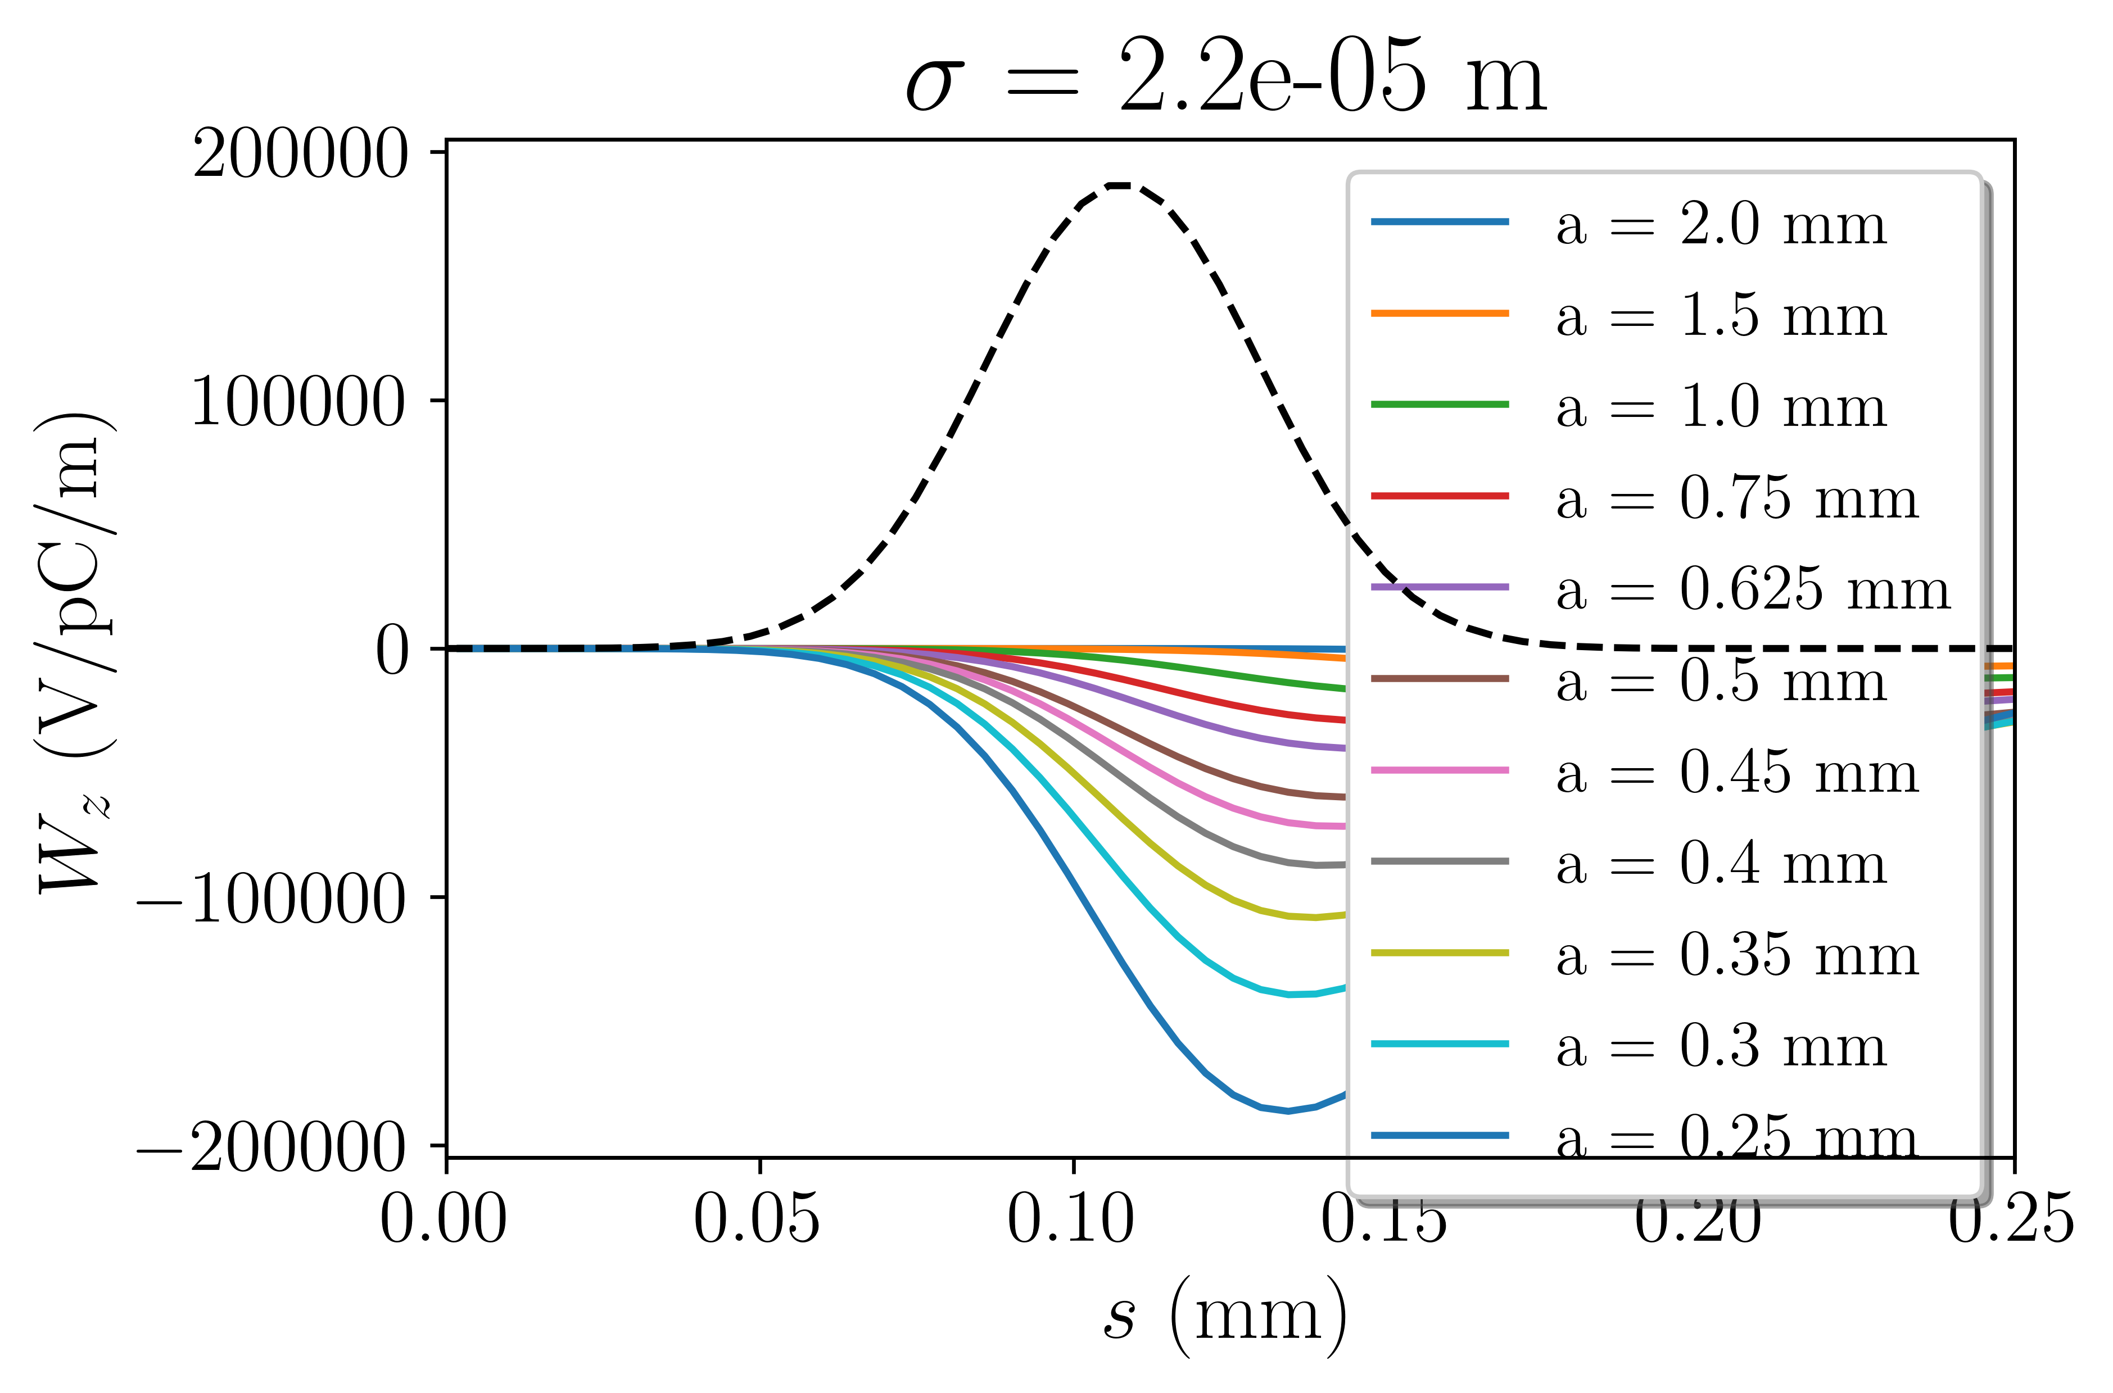
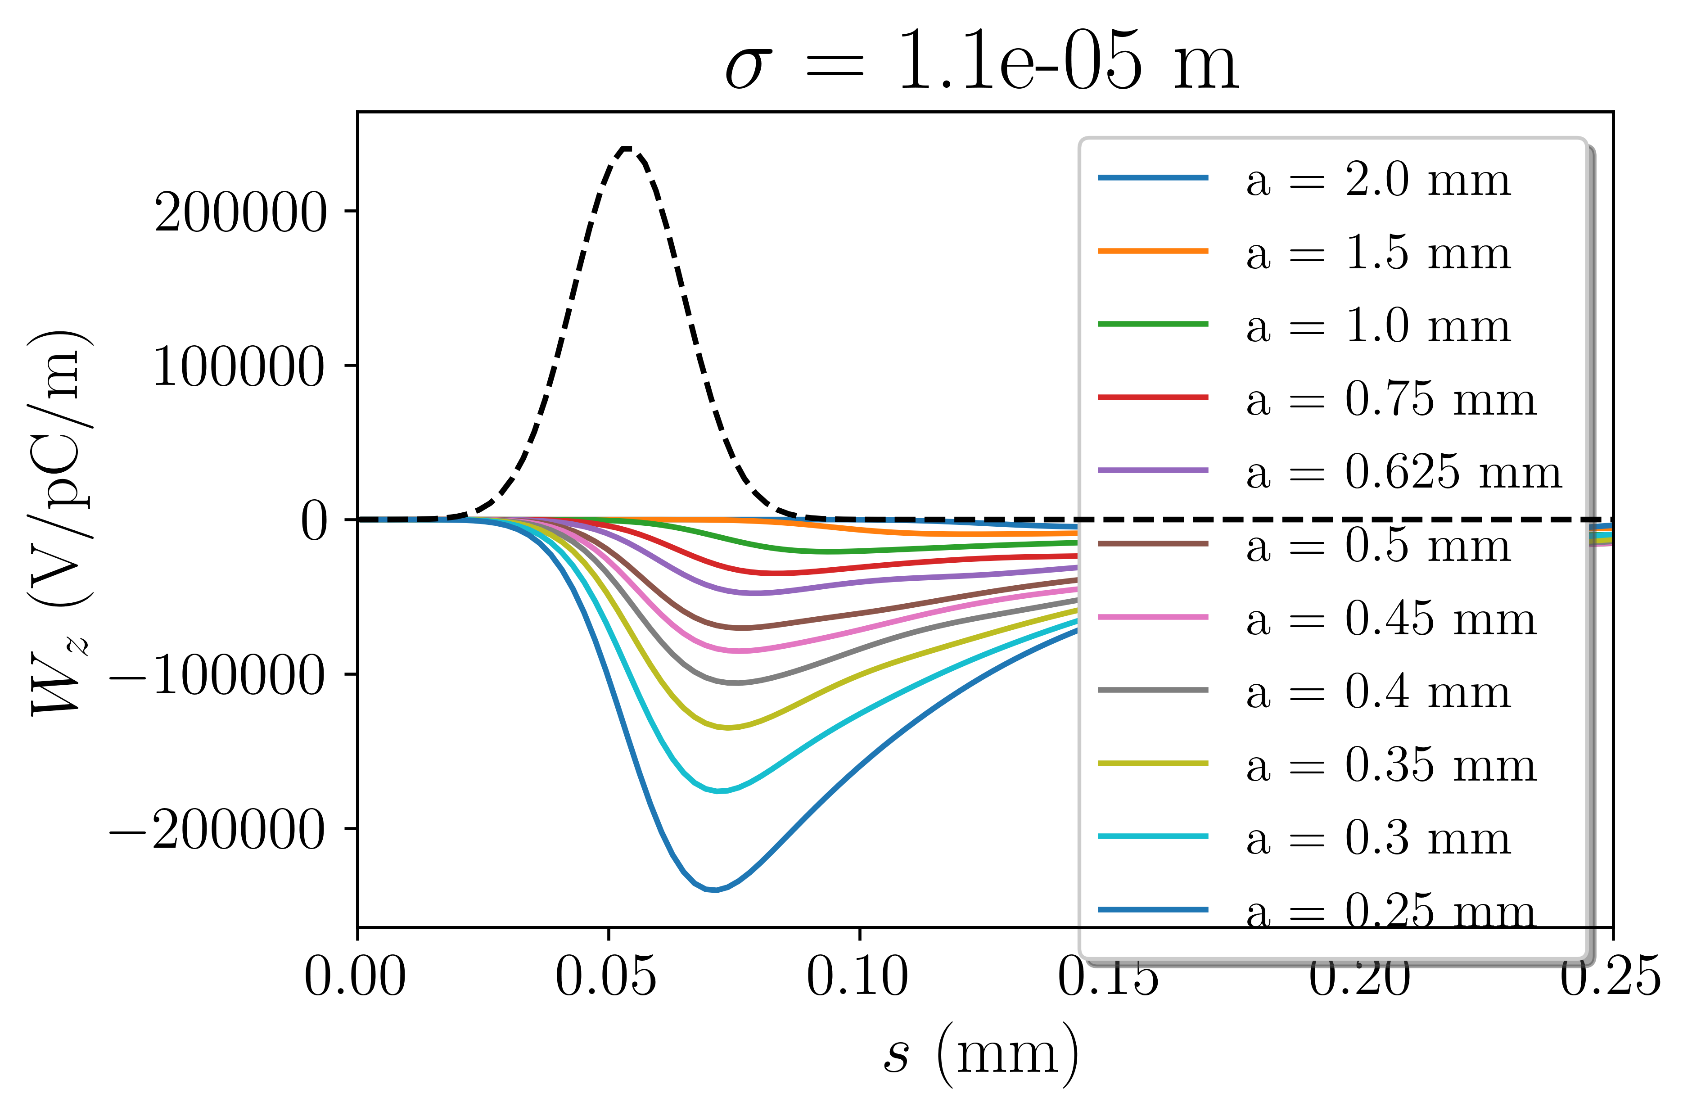
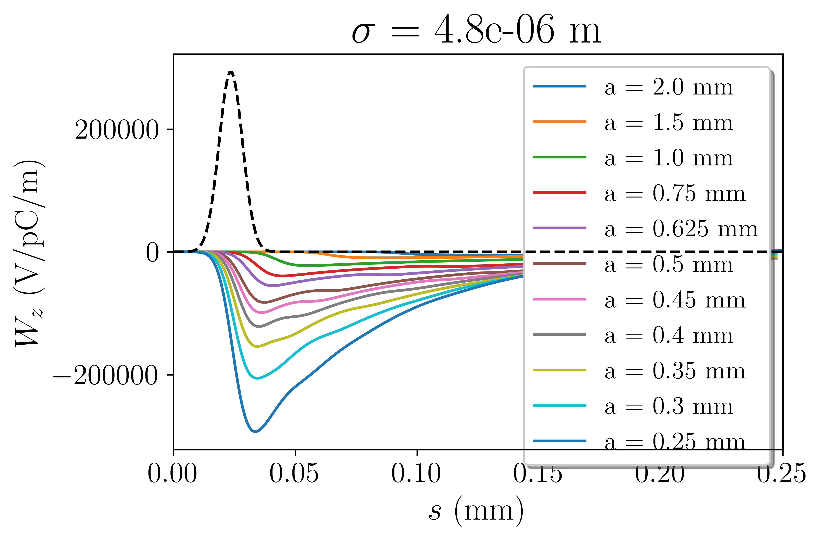

Slide 21
E
E
head
tail
t
t
For gap = 0.5 mm, structure produces wake with slope of -26 MV/pC/m/mm
For 2*1 m structure, 200 pC bunch:
Bunches with -10.4 MV/um chirp can be dechirped

Slide 22
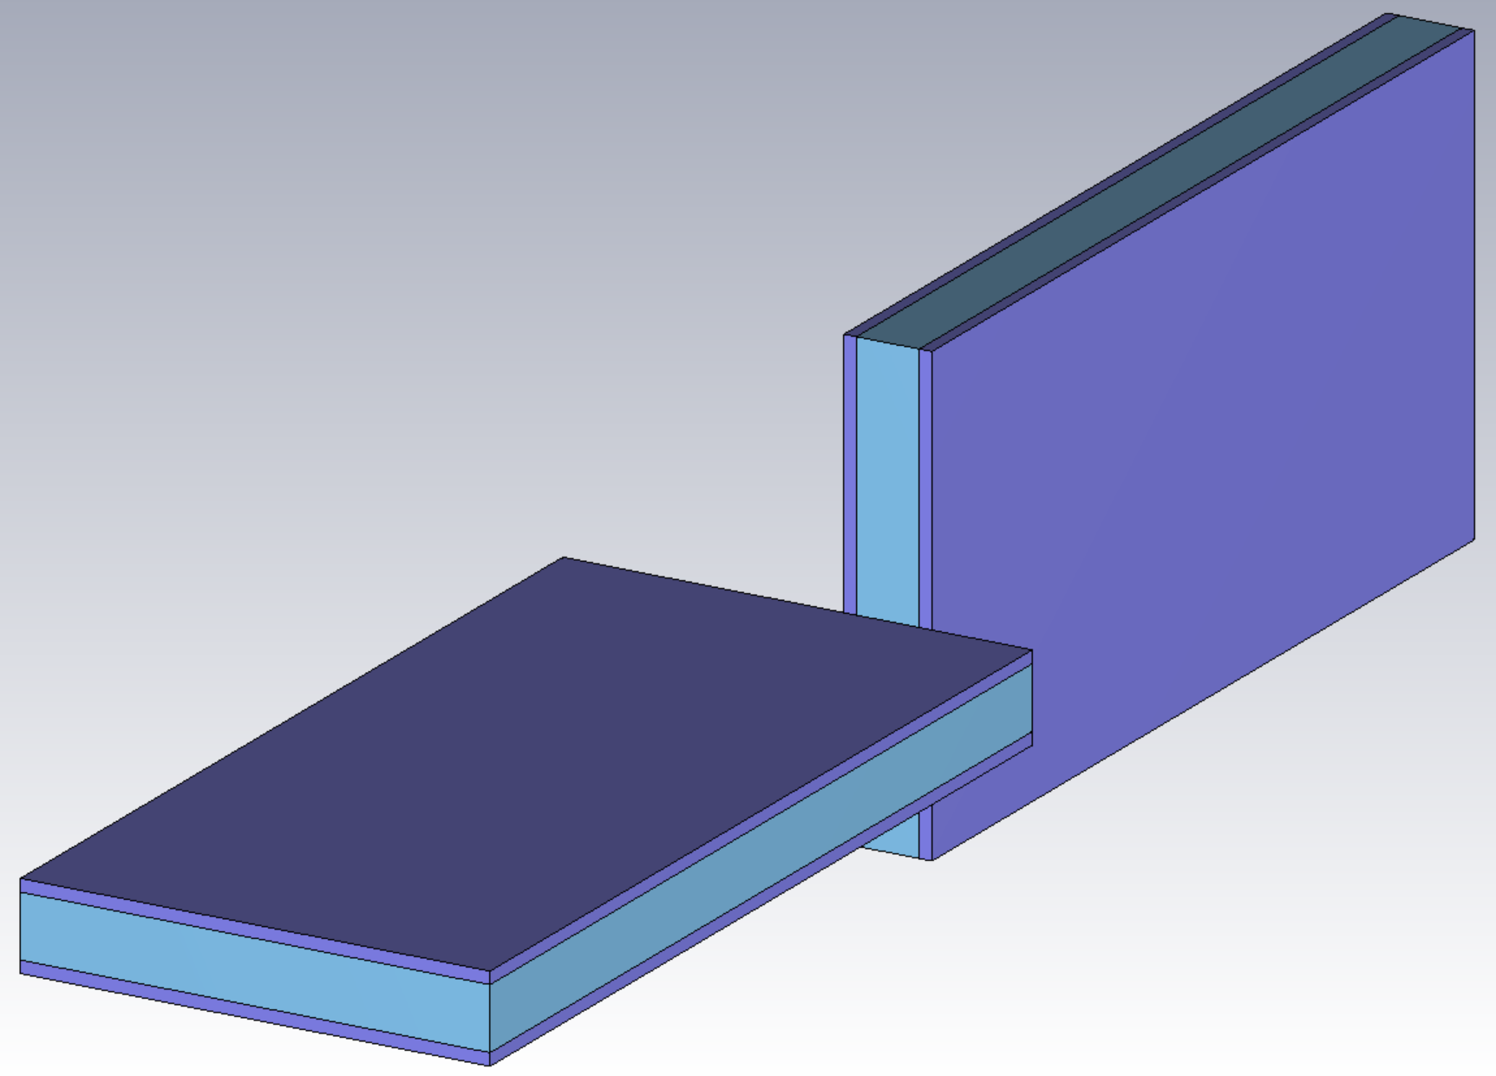

Slide 23
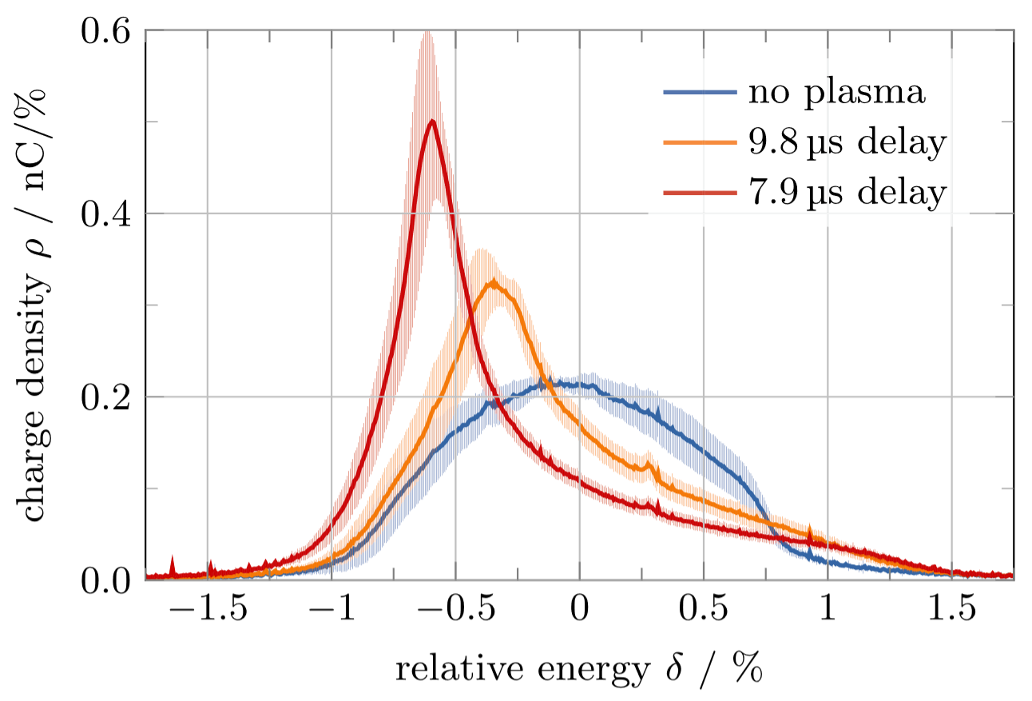
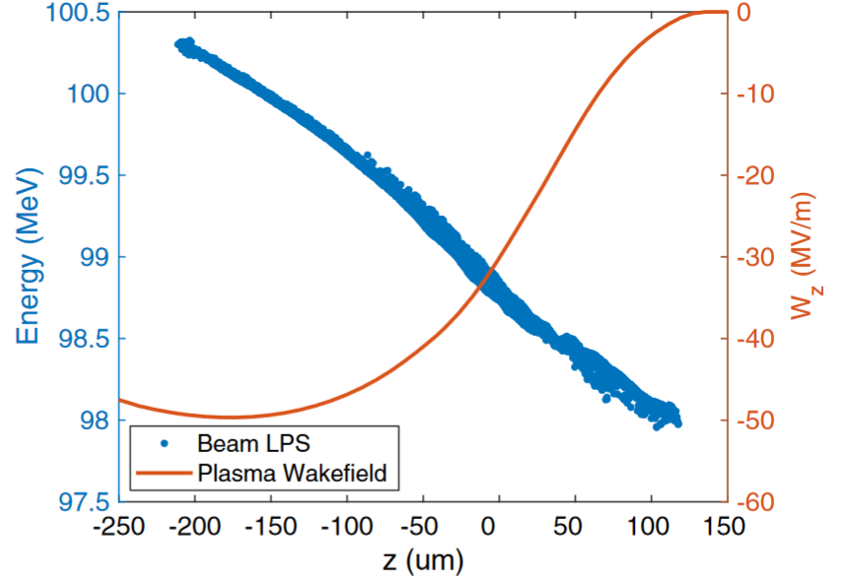
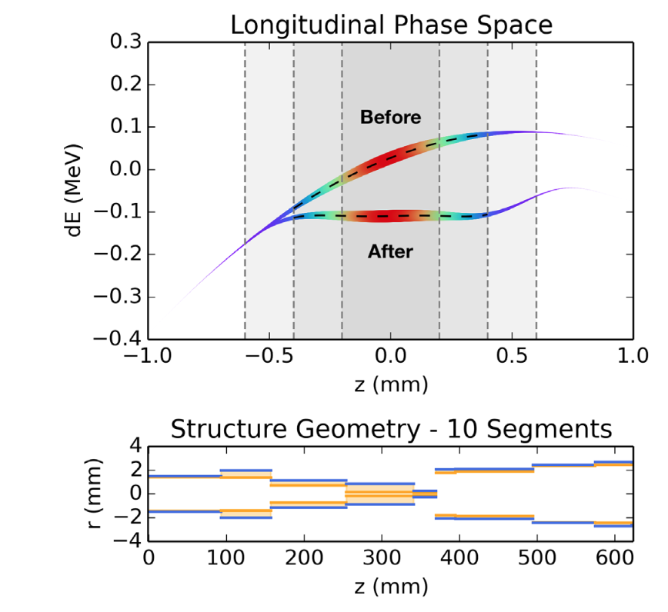
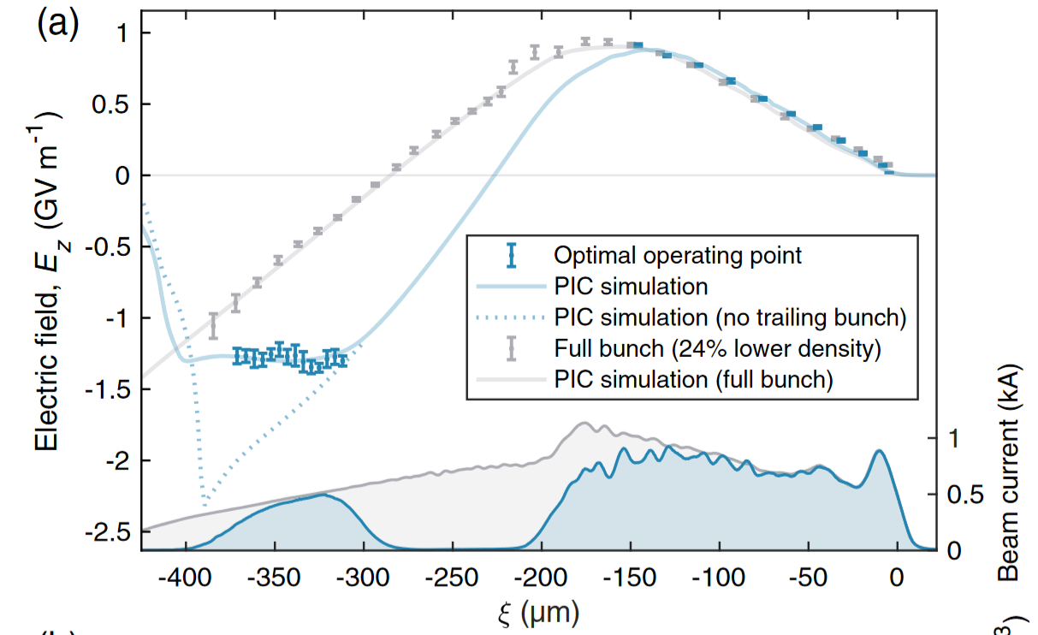
Possible solutions
Longitudinal Phase-Space Manipulation with Beam-Driven Plasma Wakefields, Shpakov, et al.
Tunable Plasma-Based Energy Dechirper, D’Arcy, et al.
Longitudinal phase space synthesis with tailored 3D-printable dielectric-lined waveguides, Mayet, et al.
Energy spread minimization in a beam-driven plasma wakefield accelerator, Pompili, et al.
Energy-Spread Preservation and High Efficiency in a Plasma-Wakefield Accelerator, Lindstrøm, et al.

