Slide 1
WP13: Diagnostics
Alessandro Cianchi*, Rasmus Ischebeck**,
on behalf of EuPRAXIA Diagnostic group
*University Rome Tor Vergata, Instituto Nazionale di Fisica Nucleare
** Paul Scherrer Institute, Ecole Polytechnique Federale de Lausanne

Slide 2
WP13: Diagnostics
Tasks
  Define a diagnostics suite for EuPRAXIA
  Assess the suitability of existing designs for a plasma wakefield accelerator

Slide 3
Main Challenges
A compact accelerator needs compact diagnostics
Conventional solution can be used even if:
  Small beam size at plasma entrance (µm scale) sets a problem for transverse diagnostics
  Short bunch length (fs scale)
  Since transporting the beam after the plasma cell is the first priority, the design of the diagnostics needs to accommodate the optics of the machine

Slide 4
Beam and photon diagnostics
Beam diagnostics
Photon diagnostics
PWFA & LWFA have similar problems:
  Driver removal
  Difficulties in capture optics
  High divergence
  Shot to shot instability
Less critical because we can use most of the usual FEL solution.
Once the beam is lasing the tools for X rays diagnostics are state of the art....

Slide 5
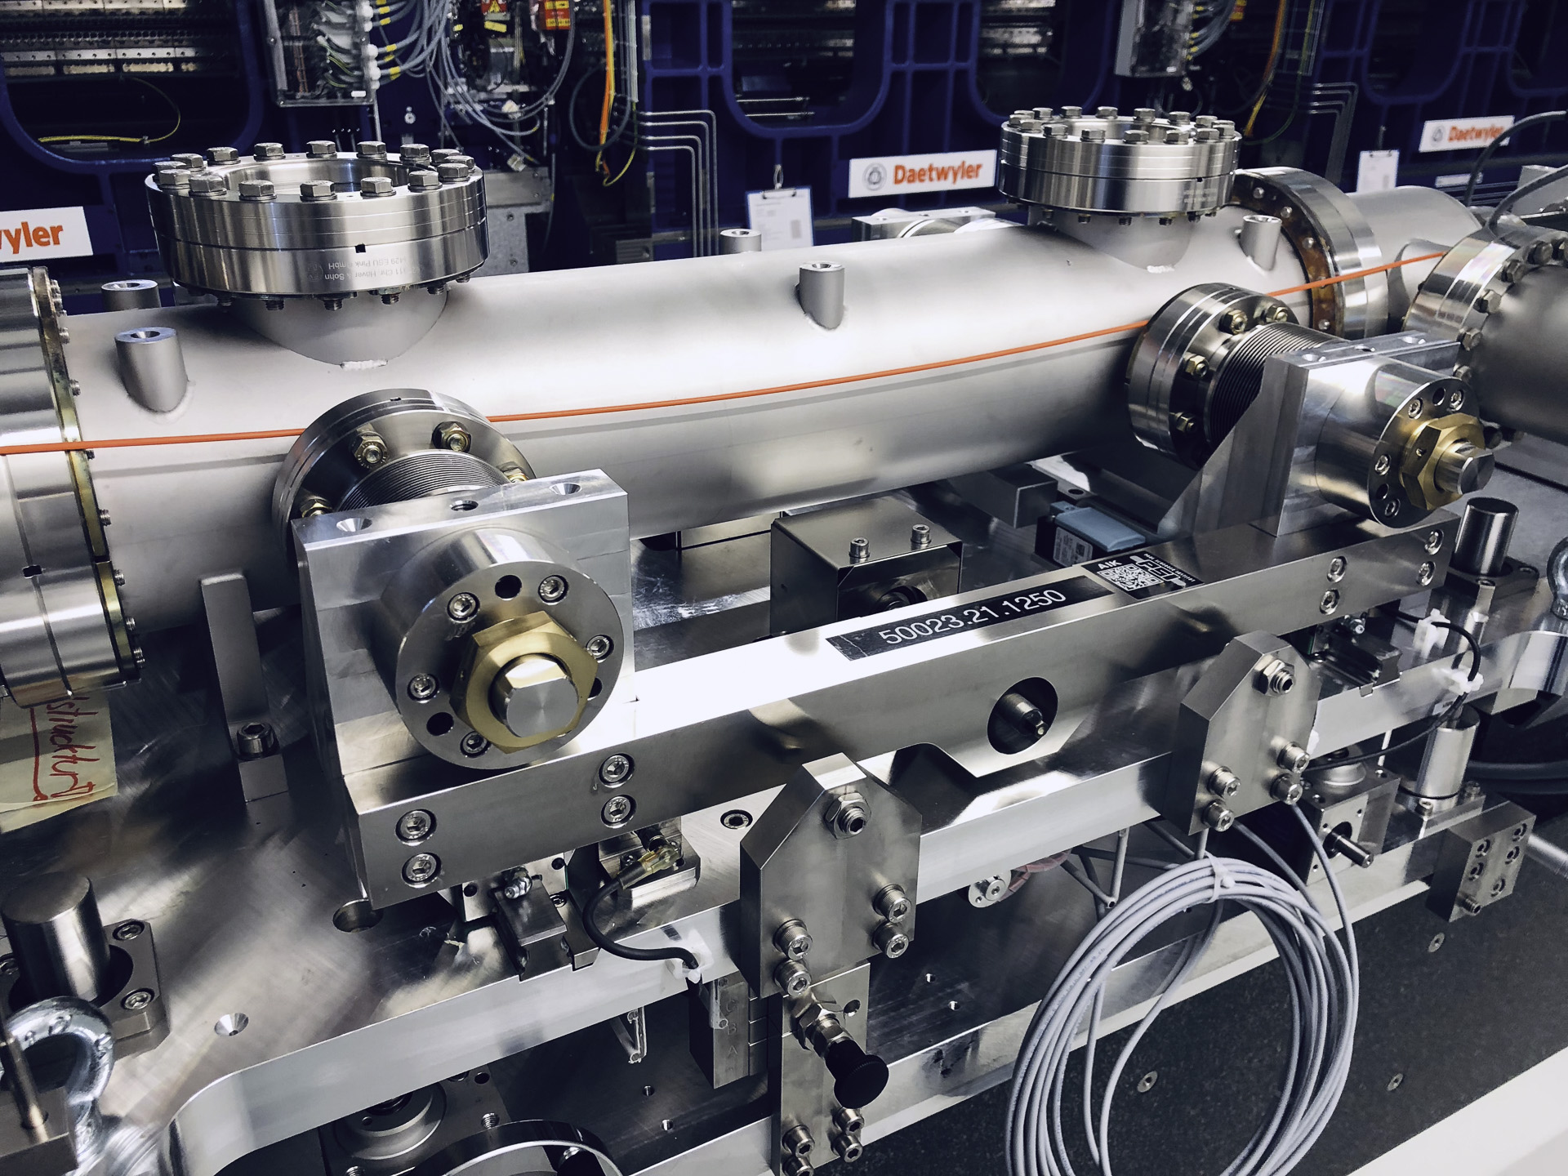
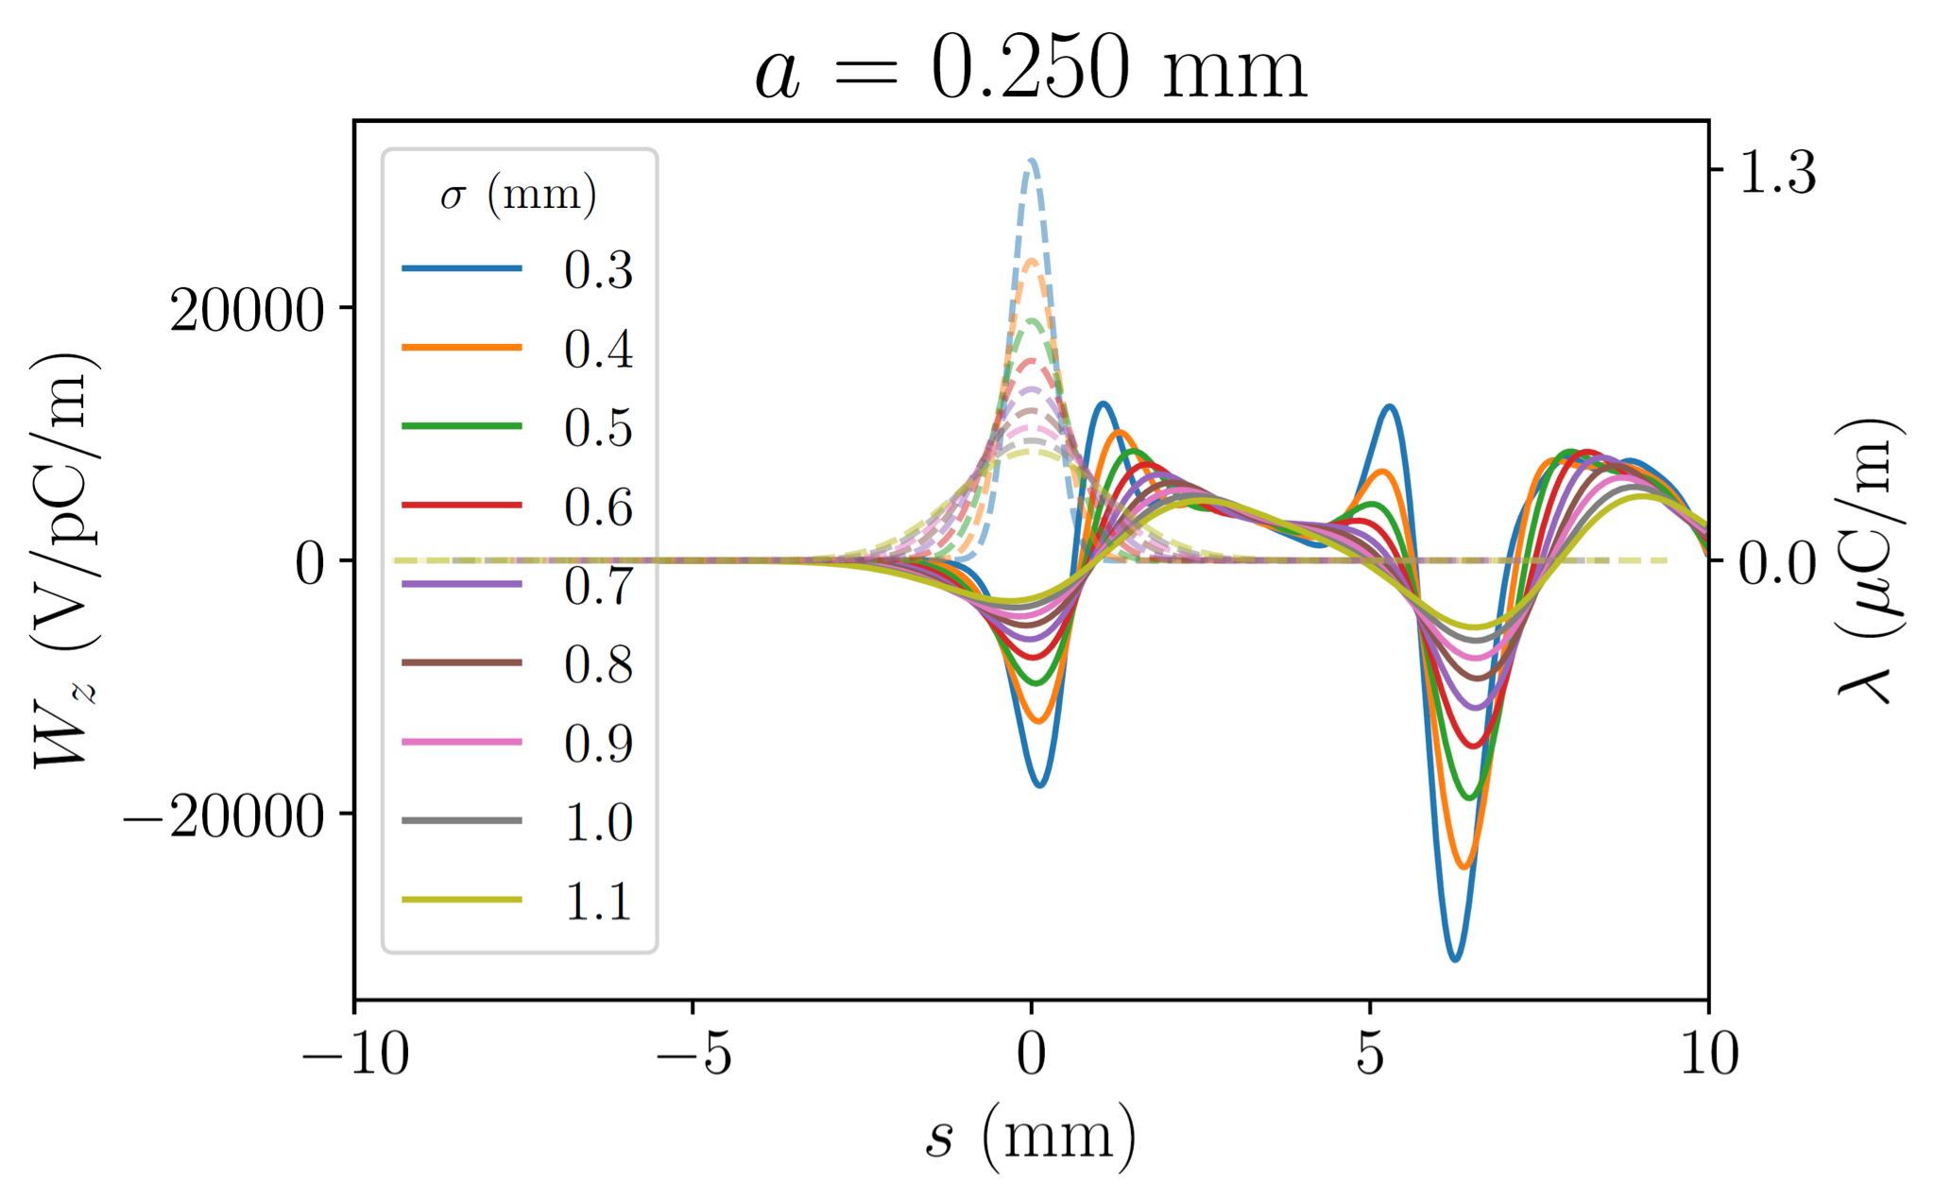
Longitudinal Phase Space
Challenge: control the longitudinal phase space
distribution
Many FELs have adjustable wake field structures
Modeling of these structures
  Different length scales make modeling difficult
  Exact material properties unknown
  Cross-check with other systems
Alternative to RF deflecting structures
Evan Ericson

Slide 6
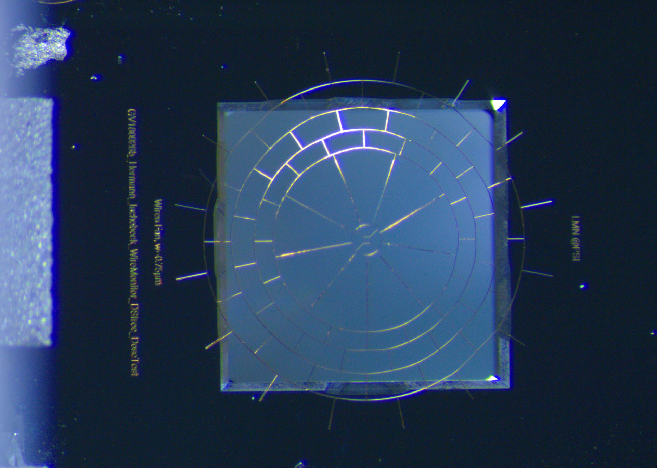
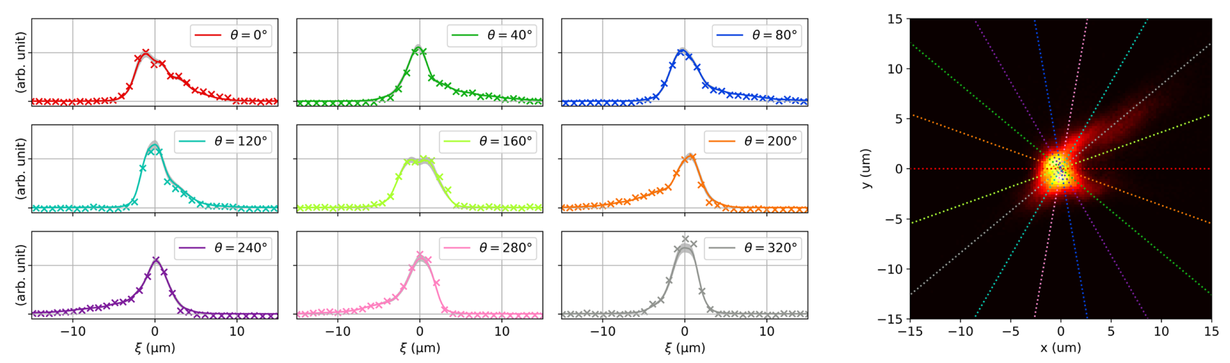
Photolithographic Wire Scanners
Spider web wire scanner, made from gold using electron beam lithography
Movement by in-vacuum piezo actuators
Manufacturing of silicon nitride
structures
Made by low-pressure chemical vapor deposition, and photo-lithography, using direct laser writing of the photoresist
Melting point: 2170K
Tomography is used to reconstruct the 2-dimensional image
Challenge: integration into the
plasma chamber
Detection of scattered particles over the background
Possible synergy with PACRI
Simona Borrelli, Benedikt Hermann, Francesca Addesa, Alessandro Cianchi, Rasmus Ischebeck

Slide 7
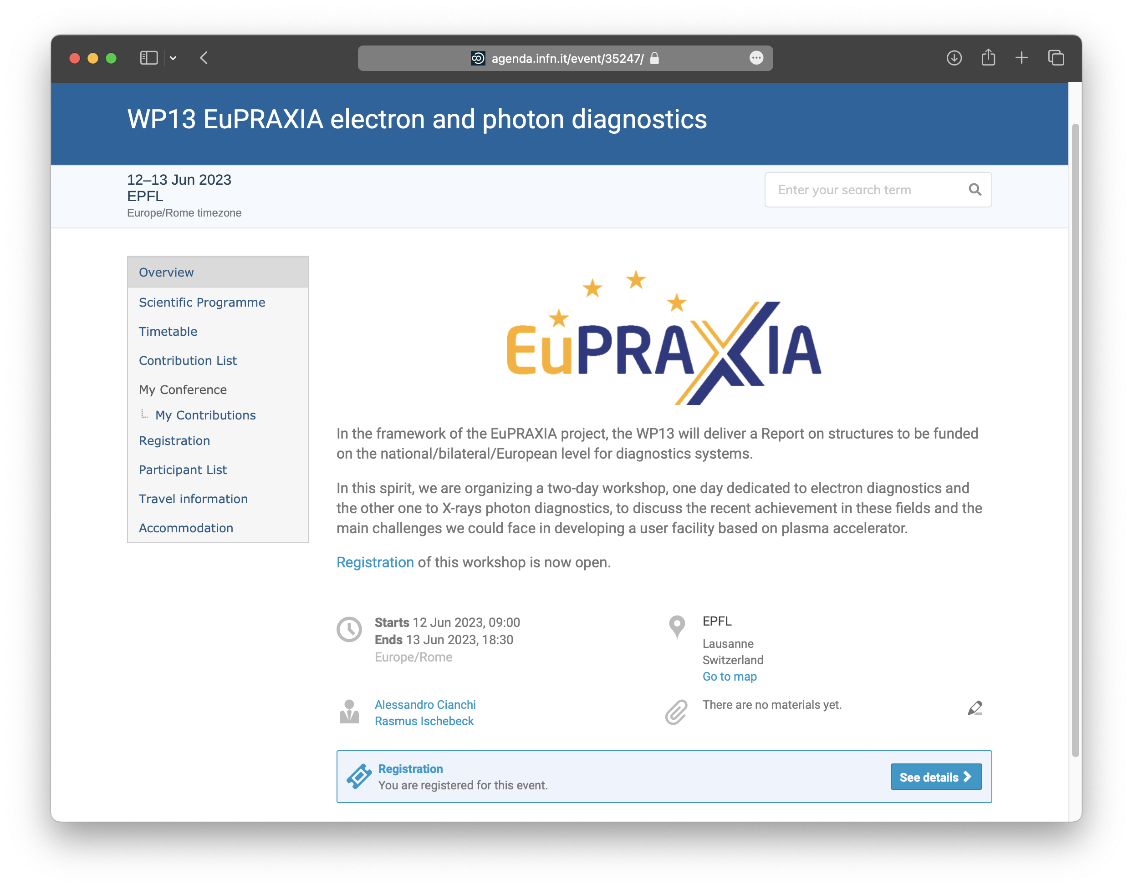
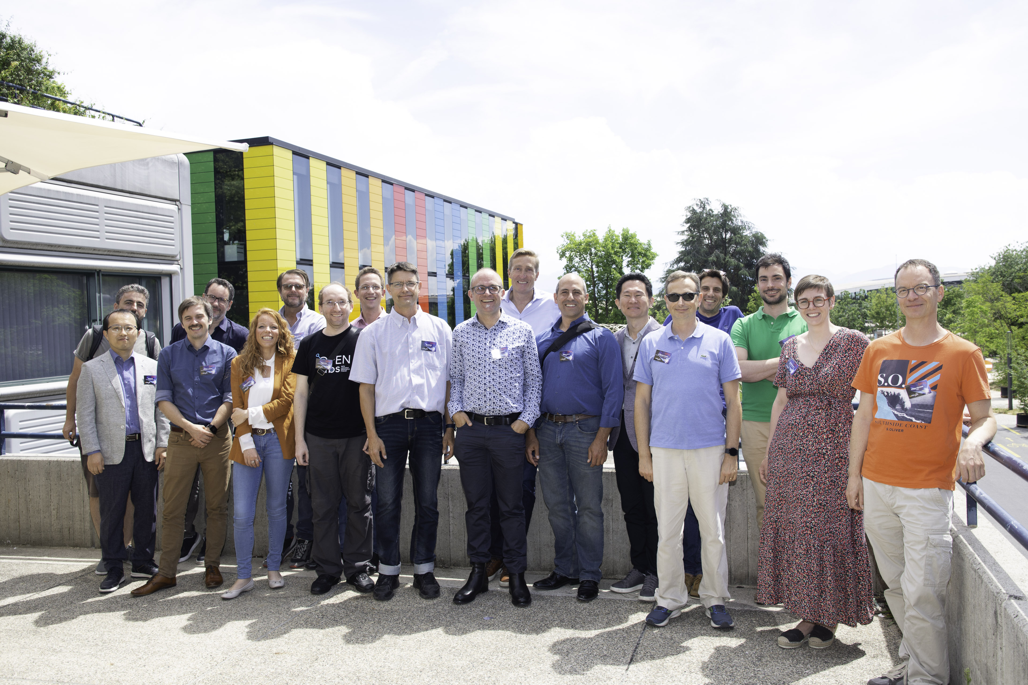

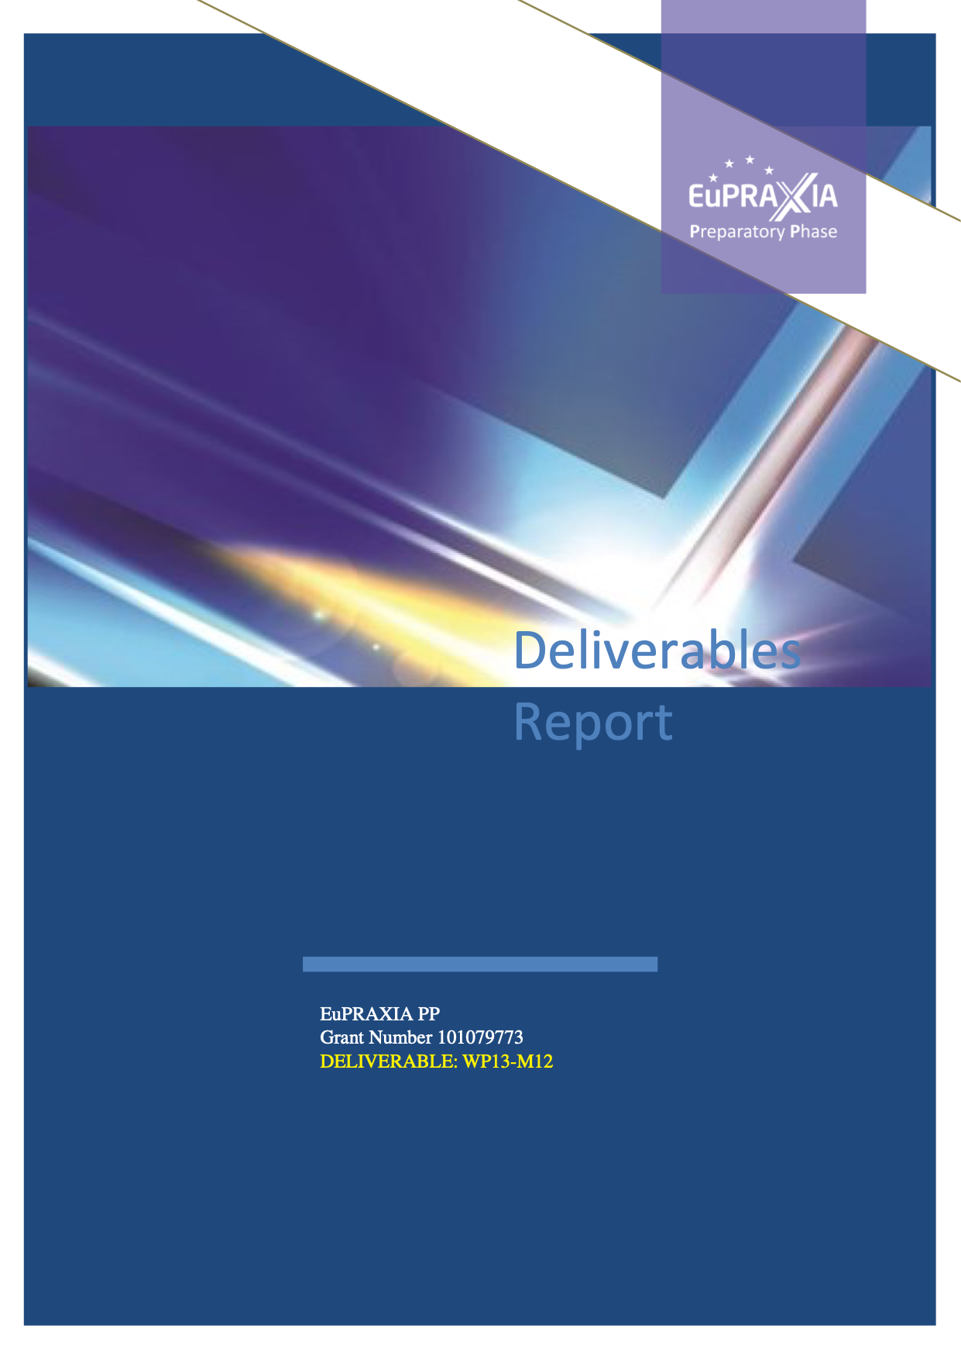
Workshop
Workshop on EuPRAXIA Electron and Photon Diagnostics
June 12–13, 2023
https://agenda.infn.it/event/35247/

Slide 8
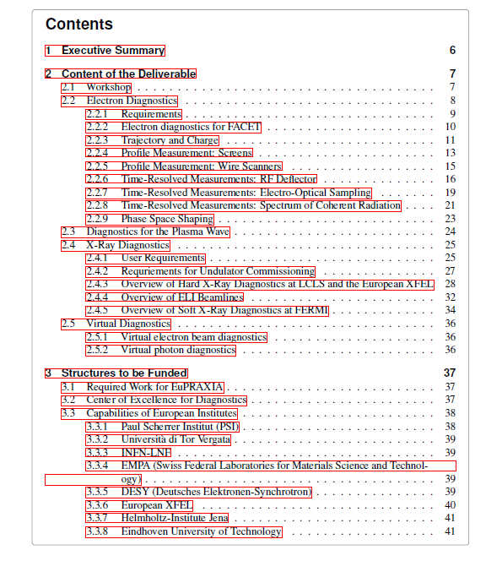

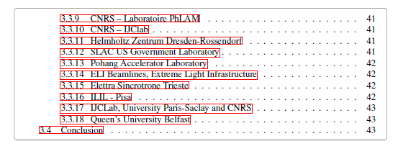
Deliverables WP13
Report on state of the art and structures to be funded
  Delivered: October 2023
Report on technical results achieved
  To be delivered: October 2024
Report on the technical readiness level and
maturity of diagnostics
  To be delivered: April 2026

Slide 9
Synergy with EuPRAXIA@SparcLab
EuPRAXIA@SPARC_LAB will be the first FEL for users driven by plasma acceleration
All the EuPRAXIA developments can be tested and used at EuPRAXIA@SPARC_LAB.
Diagnostics integration in the machine layout, especially in the plasma chamber will be the most difficult challenges

Slide 10
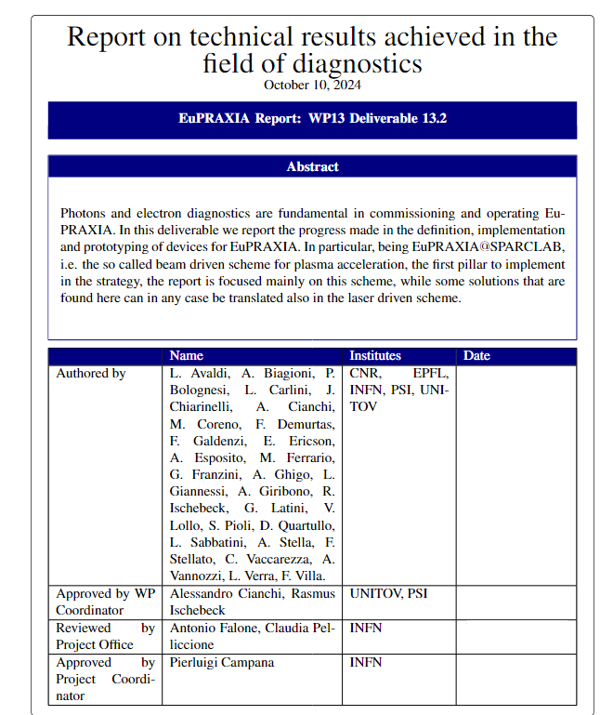
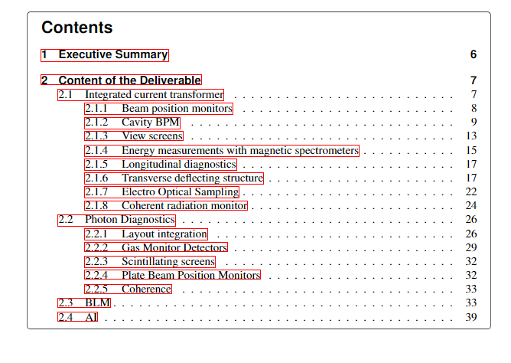
Second deliverable WP13
This second deliverable is mainly the status of the diagnostics in EuPRAXIA@SPARC_LAB TDR
We did not address all the problems, but we wrote the solutions for the ones we solved.

Slide 11
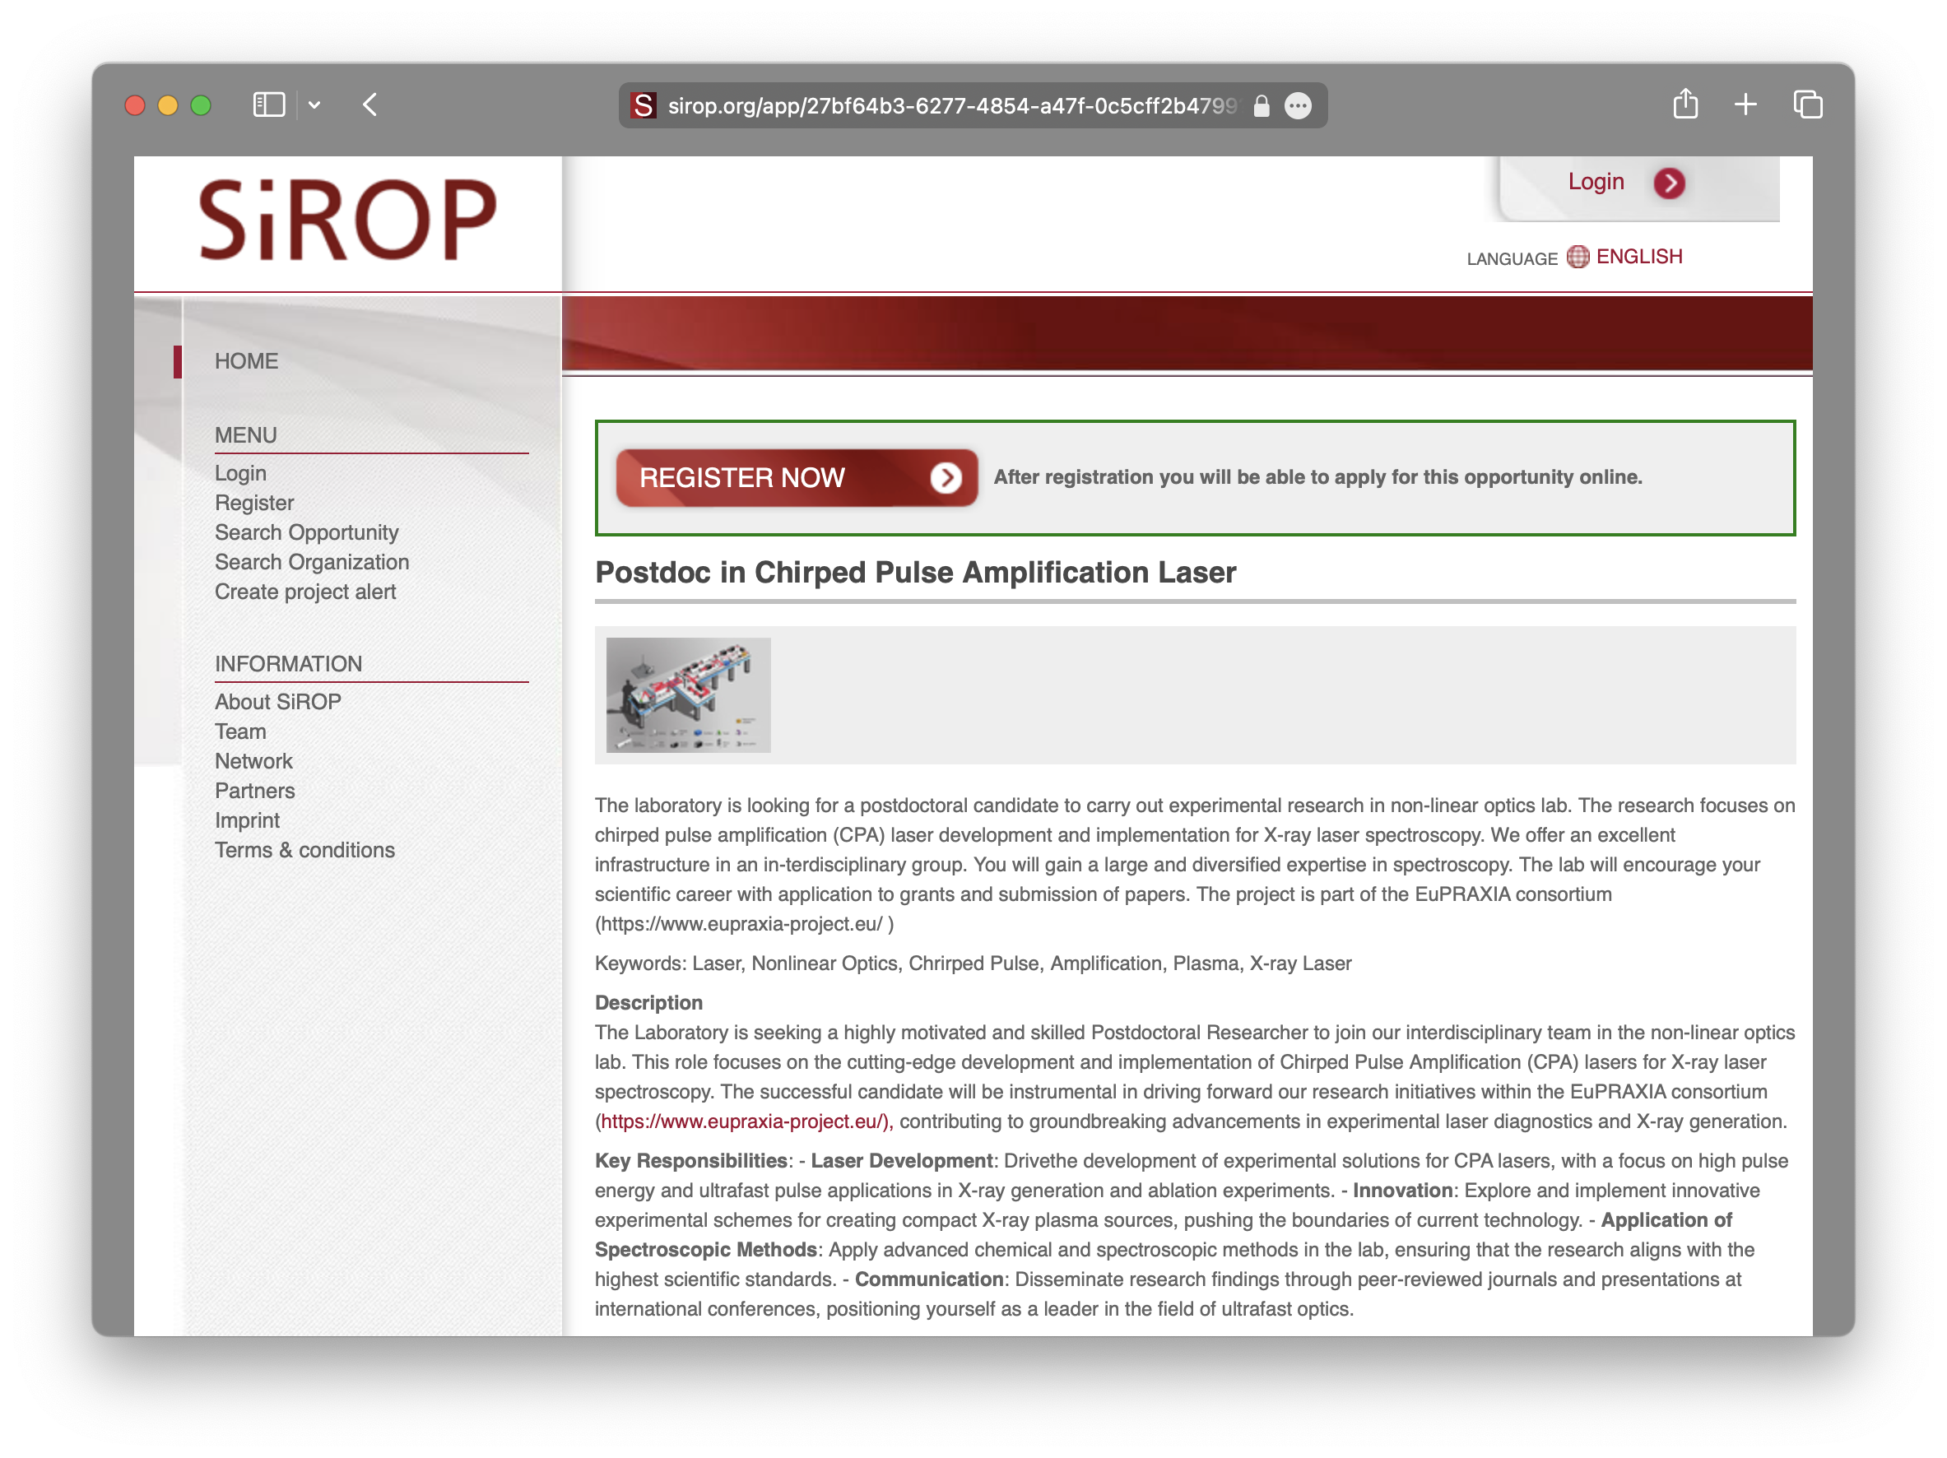
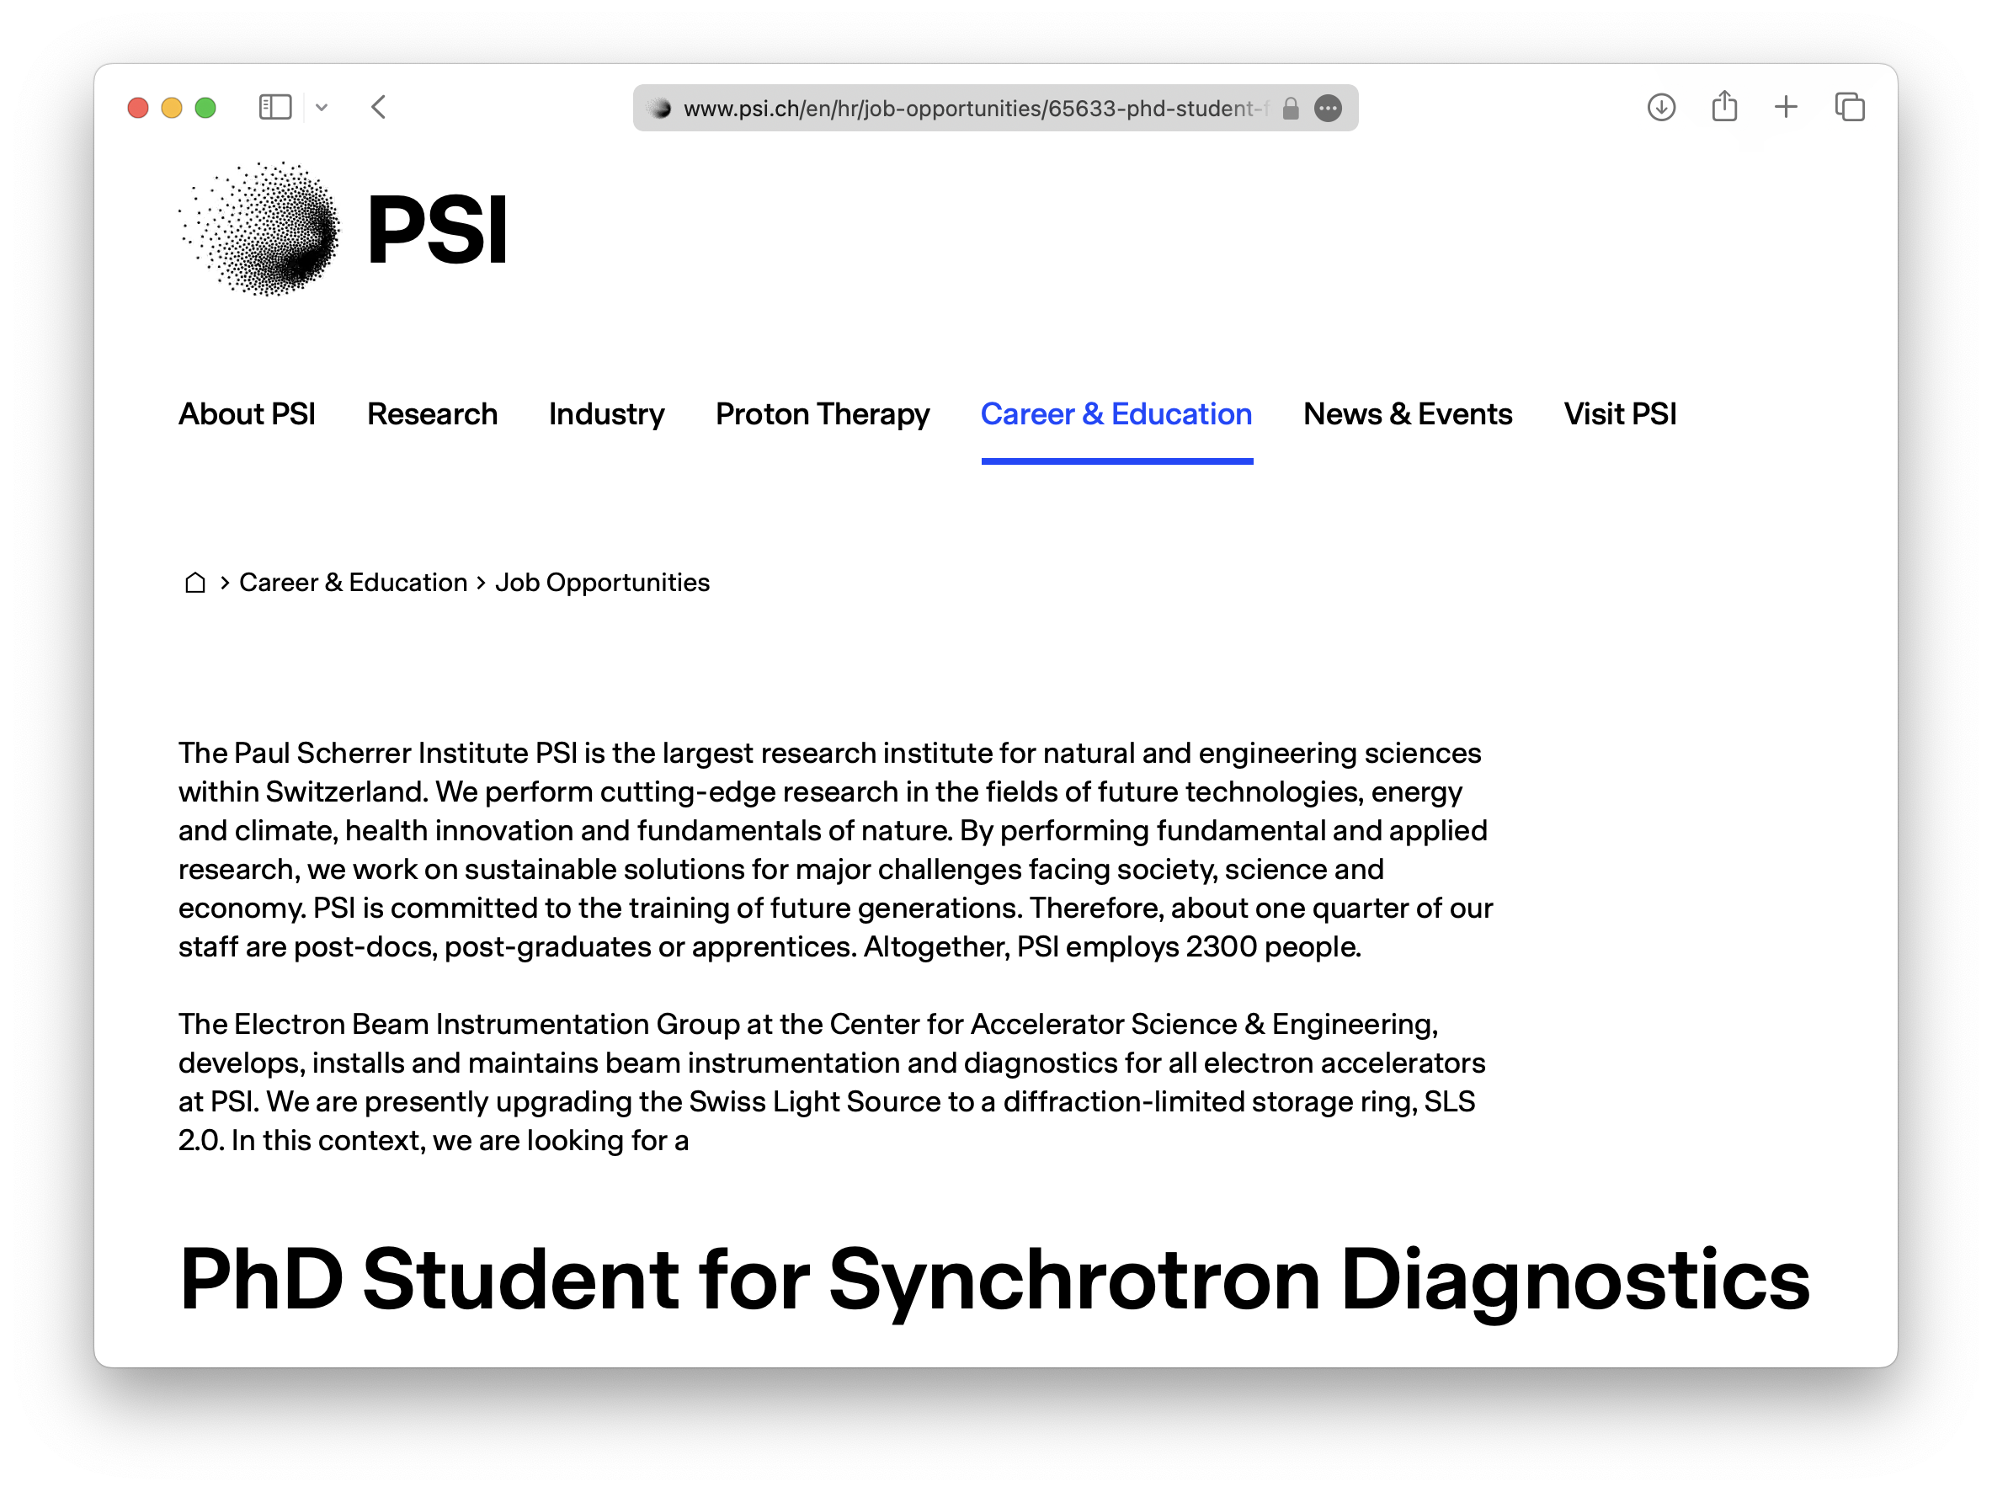

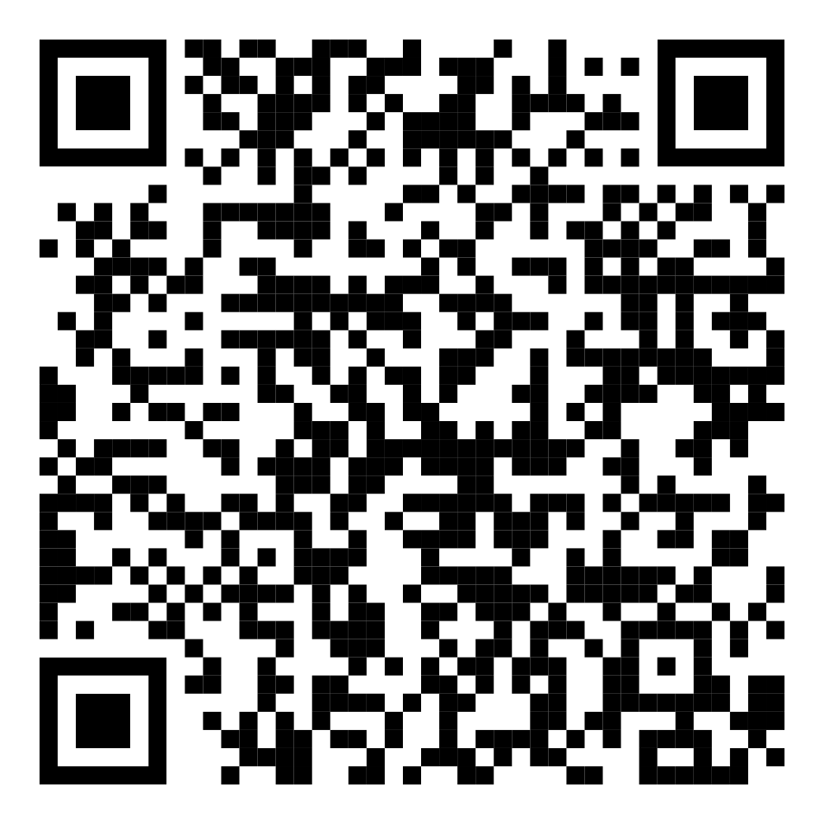
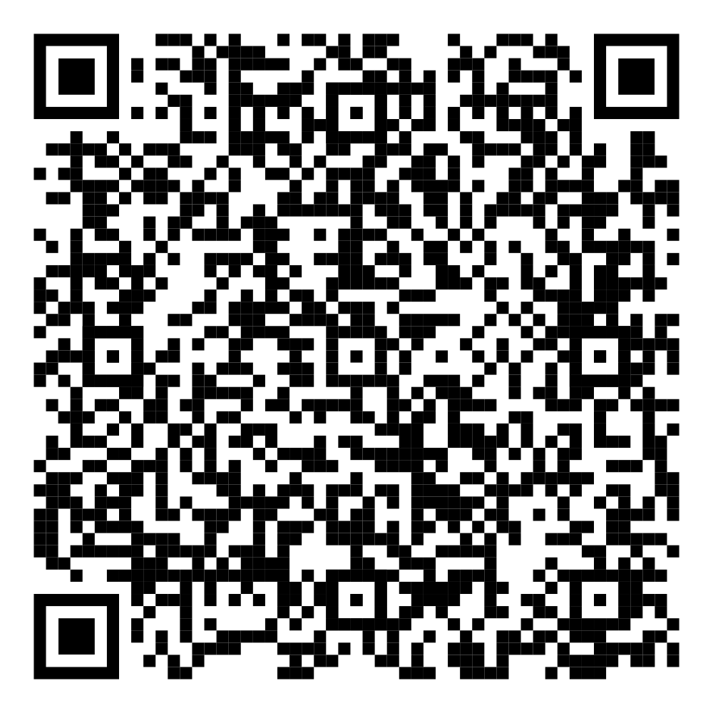
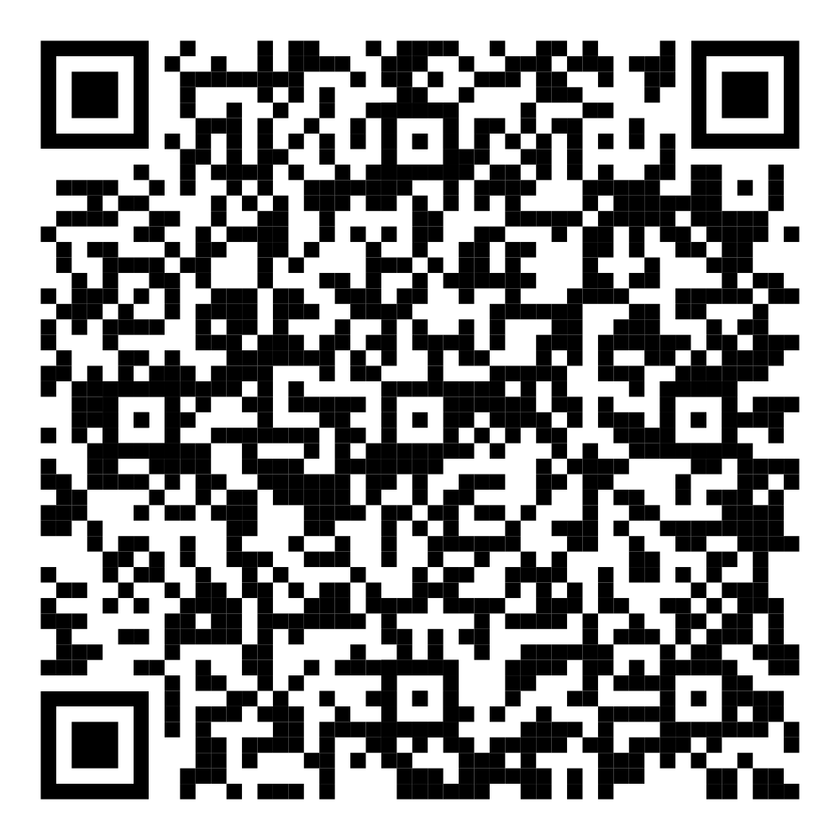
Announcements
Workshop
Open Positions

Slide 12
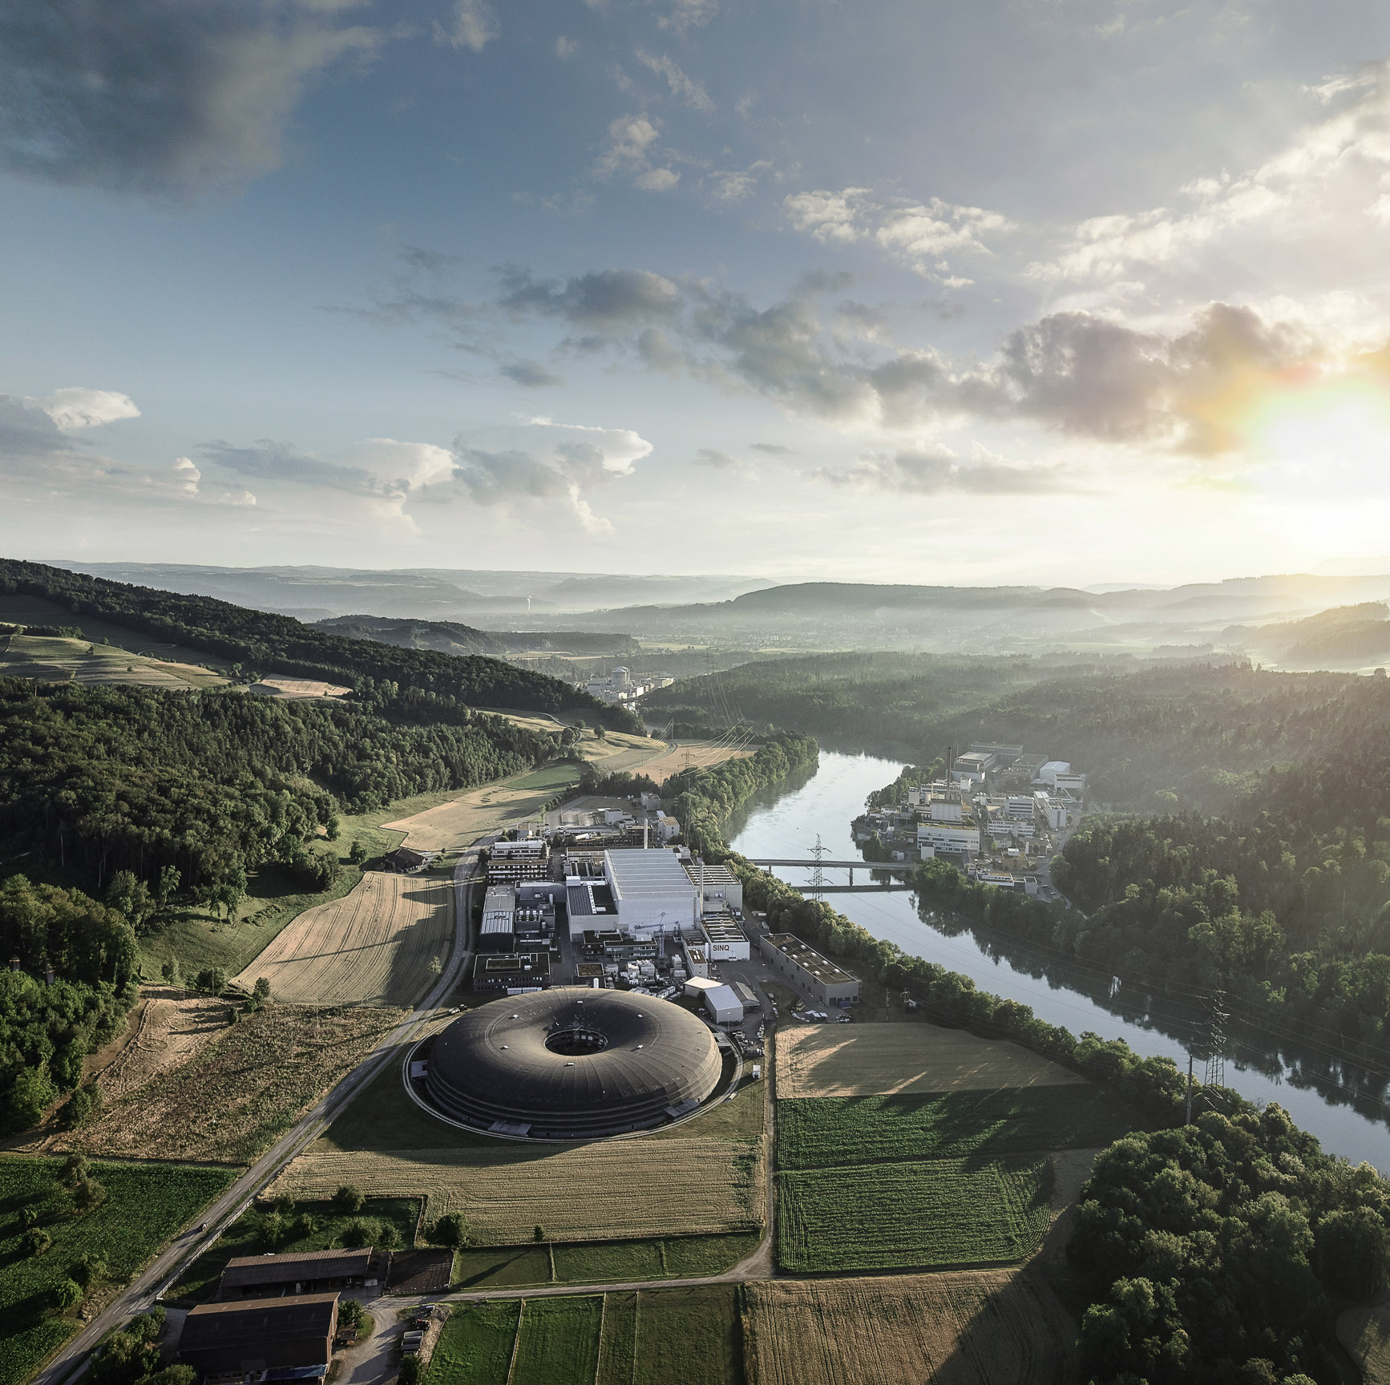
Center of Excellence for Diagnostics
Scope:
  Electron beam instrumentation
  X-ray instrumentation
  Controls, data acquisition
  Virtual diagnostics
Proposal: locate at PSI

Slide 13
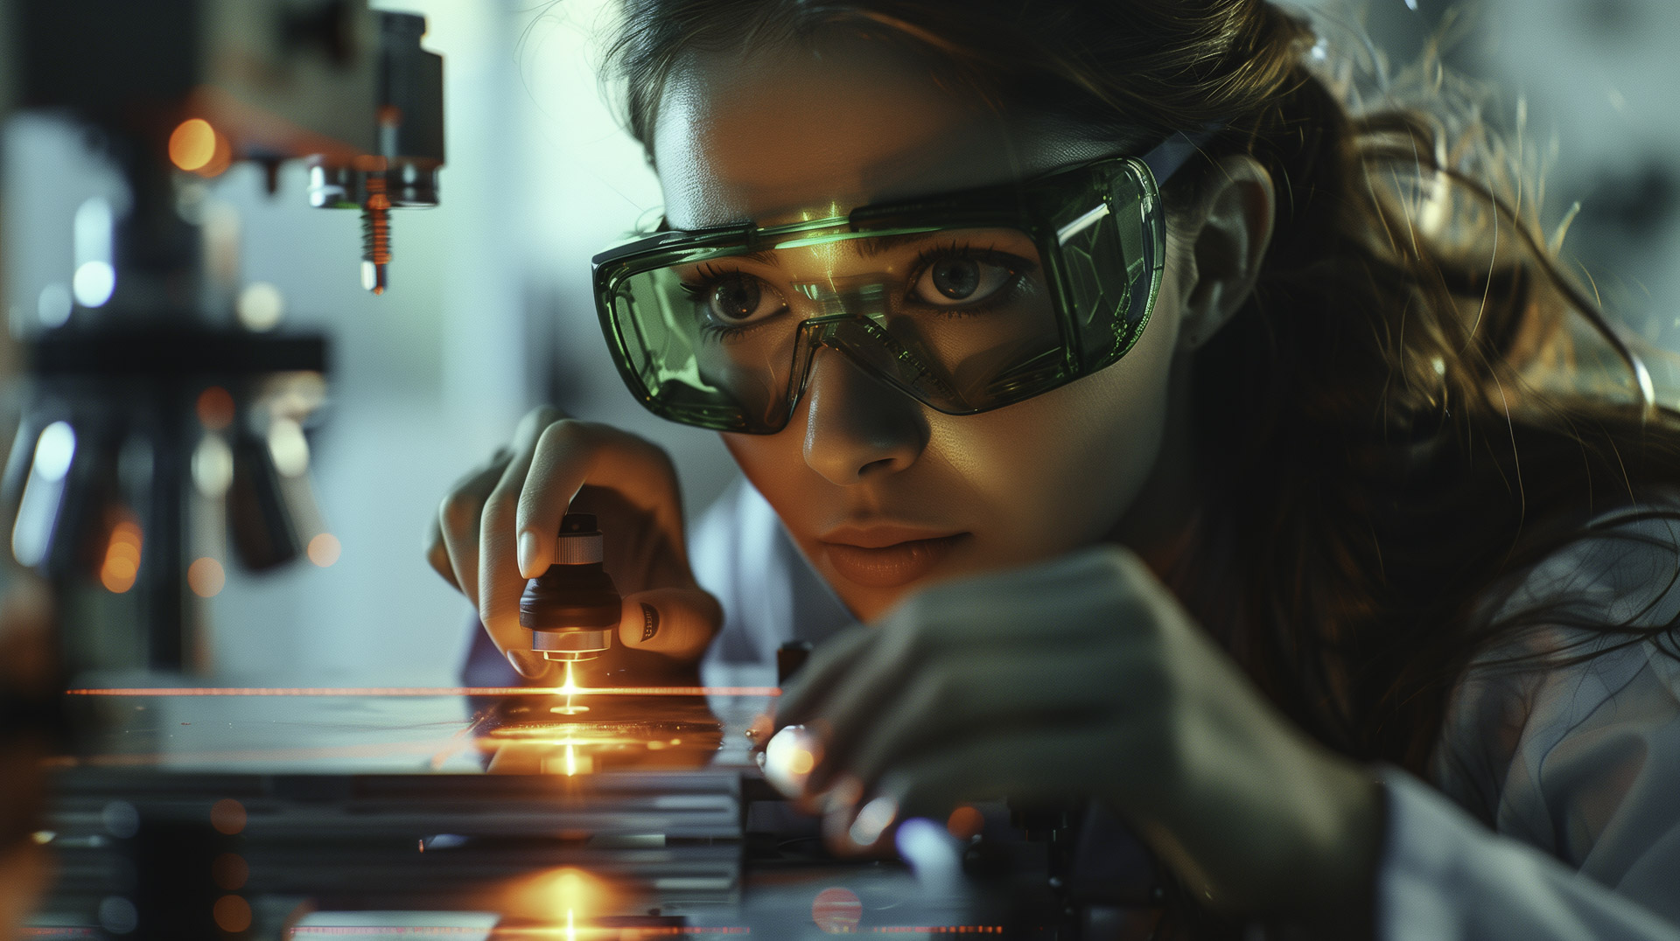
Develop
Rasmus + Midjourney

Slide 14

Design
Rasmus + Midjourney

Slide 15
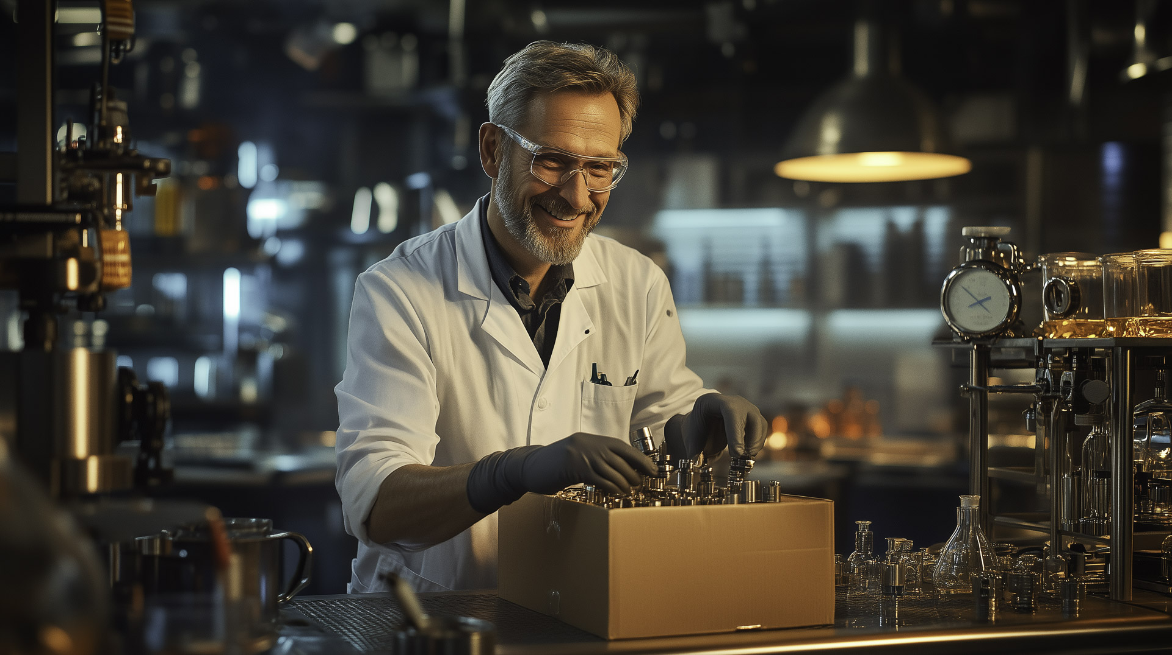
Deliver
Rasmus + Midjourney

Slide 16
Center of Excellence for Diagnostics
Develop
Design
Deliver
Rasmus + Midjourney

