Slide 1
WP9 – Considerations on Undulators
WP9 – RF, Magnets & Beamline Components
F. Nguyen (ENEA)
Elba Annual Meeting on September 24th, 2024

Slide 2
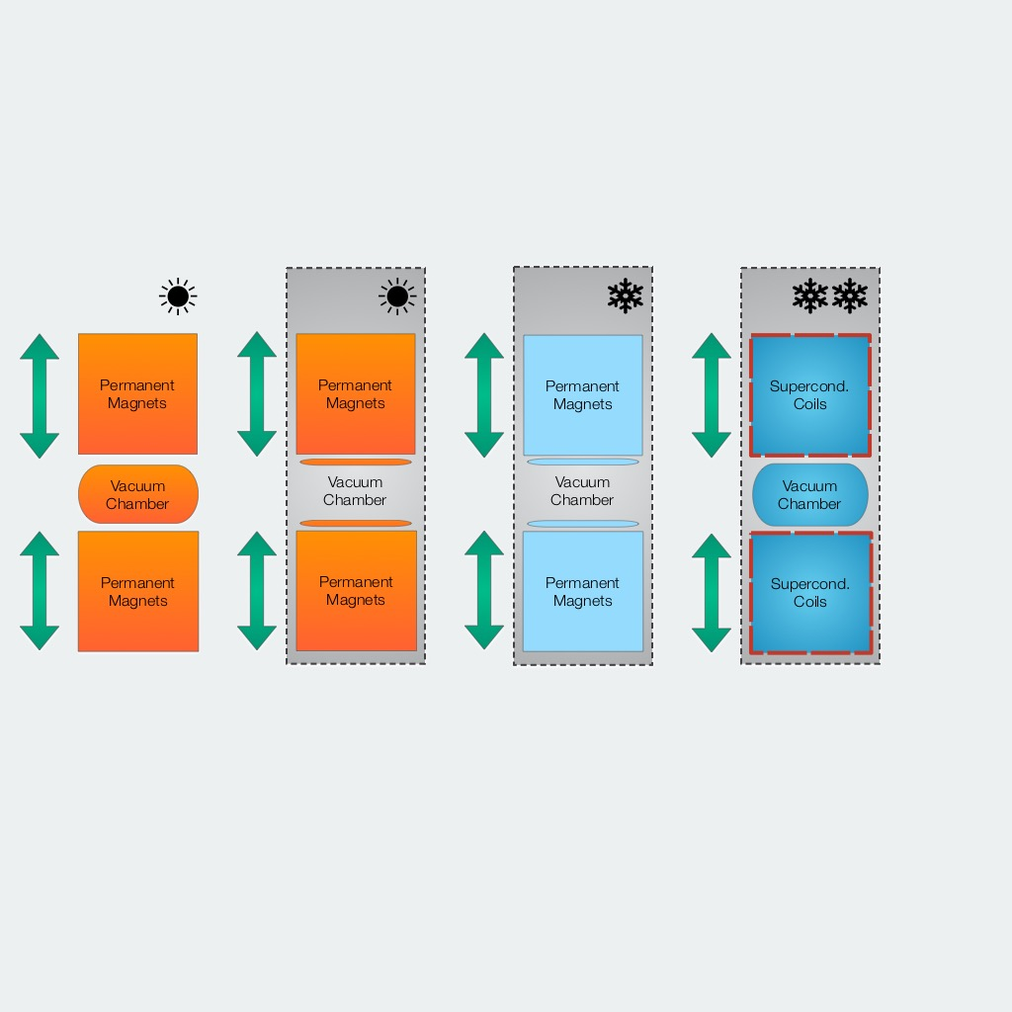
Undulators: technology ranking
Out of vacuum PMU
In vacuum PMU
Cryogenic PMU
Superconducting
Variable polarization & cheapest design
Good performance
Magnets inside VC → no polarization
Optimal performance
Improved B but increased complexity
Better performance
Highest B and SC electromagn. coils
Best performance

Slide 3
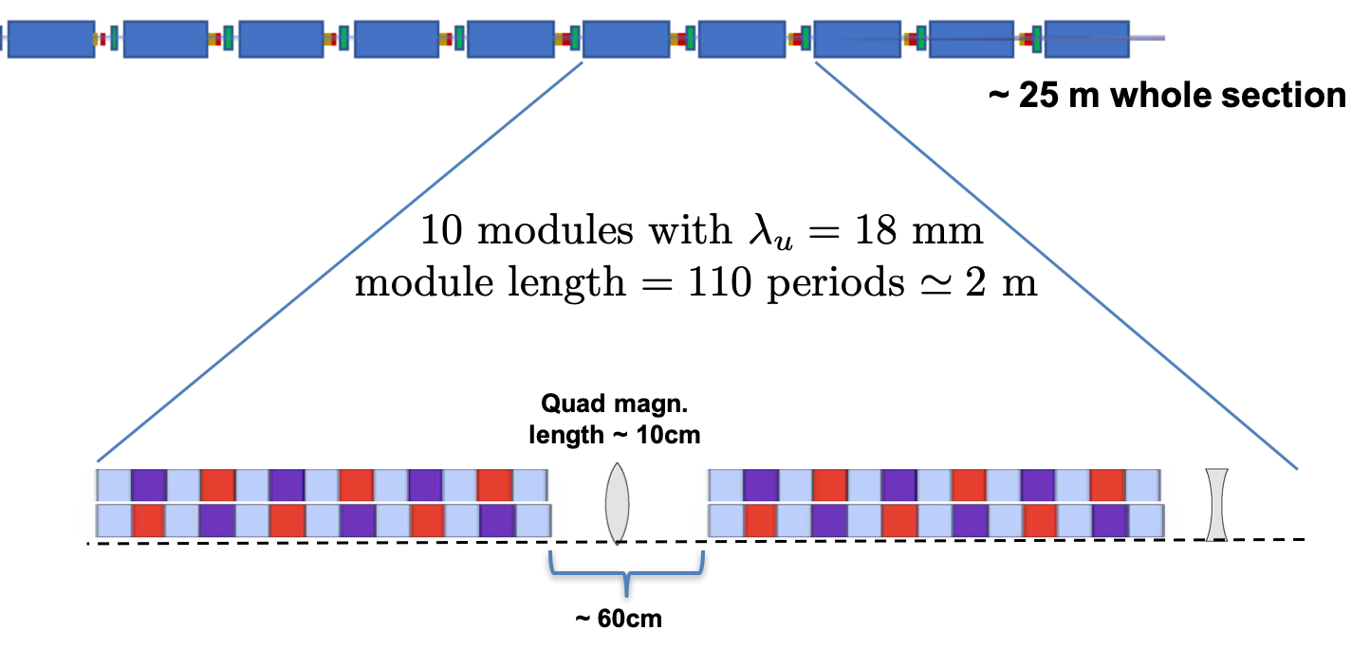
The AQUA beamline – EuPRAXIA@SPARC_LAB
Target wavelength 3-4 nm @ 1 GeV: relatively short period required (12-20 mm)
Total available length ∼ 25-30 m ← → linac floor constraints: matching section, beam diagnostics and beam dump
Hypotheses:
    Optimize magnetic length/available length filling factor
    Make sure gain length shorter than 1 undulator module length
    60-80 cm intra-undulator sections: Quads, BPMs, correctors, phase shifters, alignment diagnostics
APPLE-X undulator: increased PM field through “geometry”, selectable polarization
SCU: collaboration agreement with FNAL for the NbTi planar prototype
DELAYED 1 YEAR

Slide 4
Variable polarization undulator for AQUA
Advanced Planar Polarized Light Emitter-X
Field Integrals
from RADIA
Model parameters:
Remanent field Br = 1.35 T
Undulator period λ_{u} = 18 mm
4 blocks / period, NdFeB
# of periods (eff.) N = 110 (L_{u}=1990mm)

Slide 5
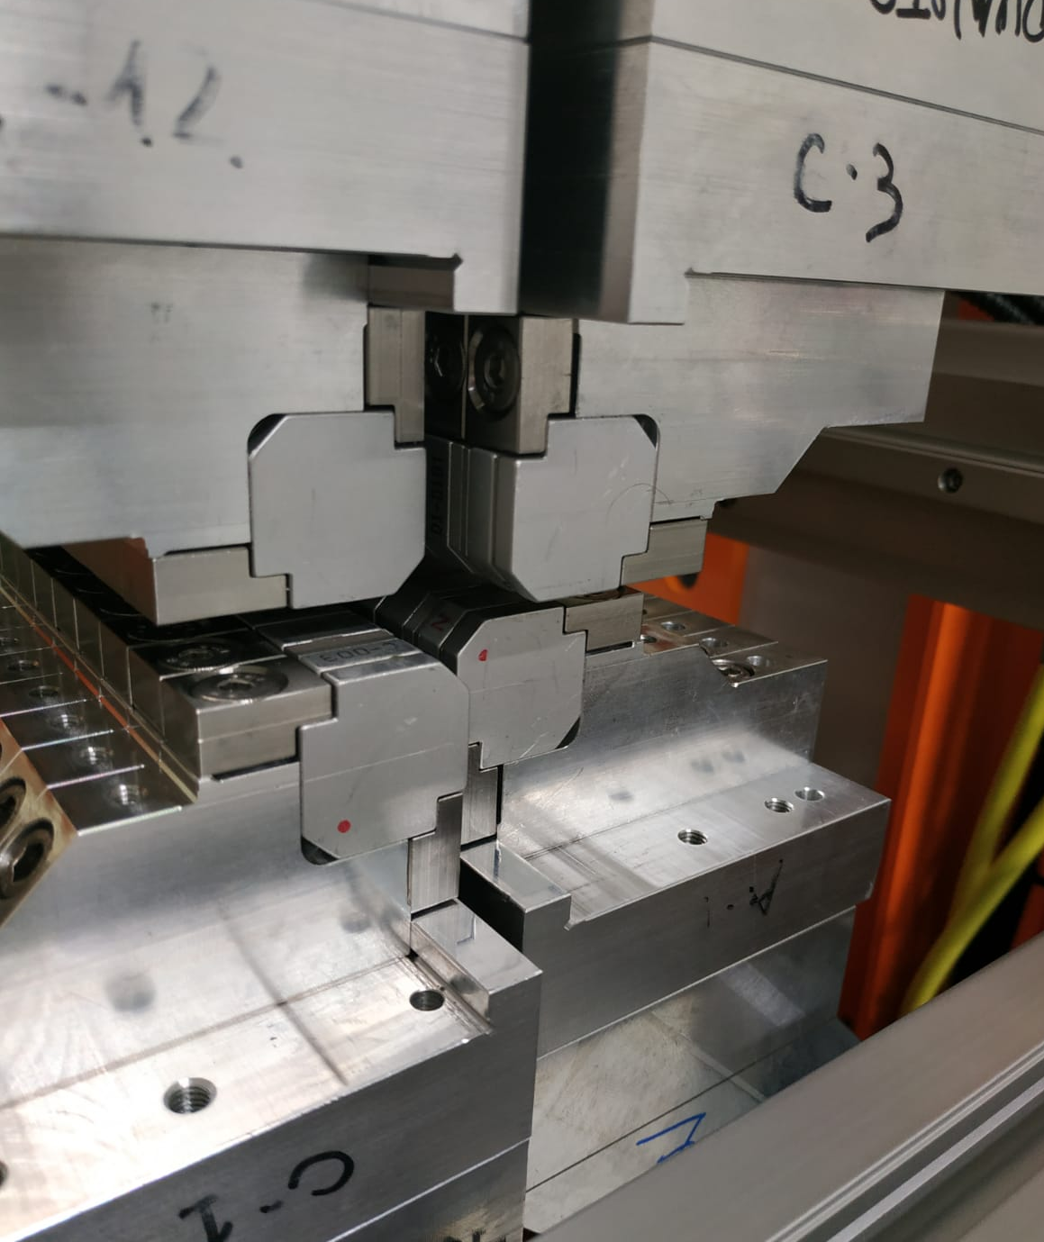
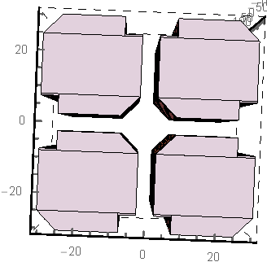
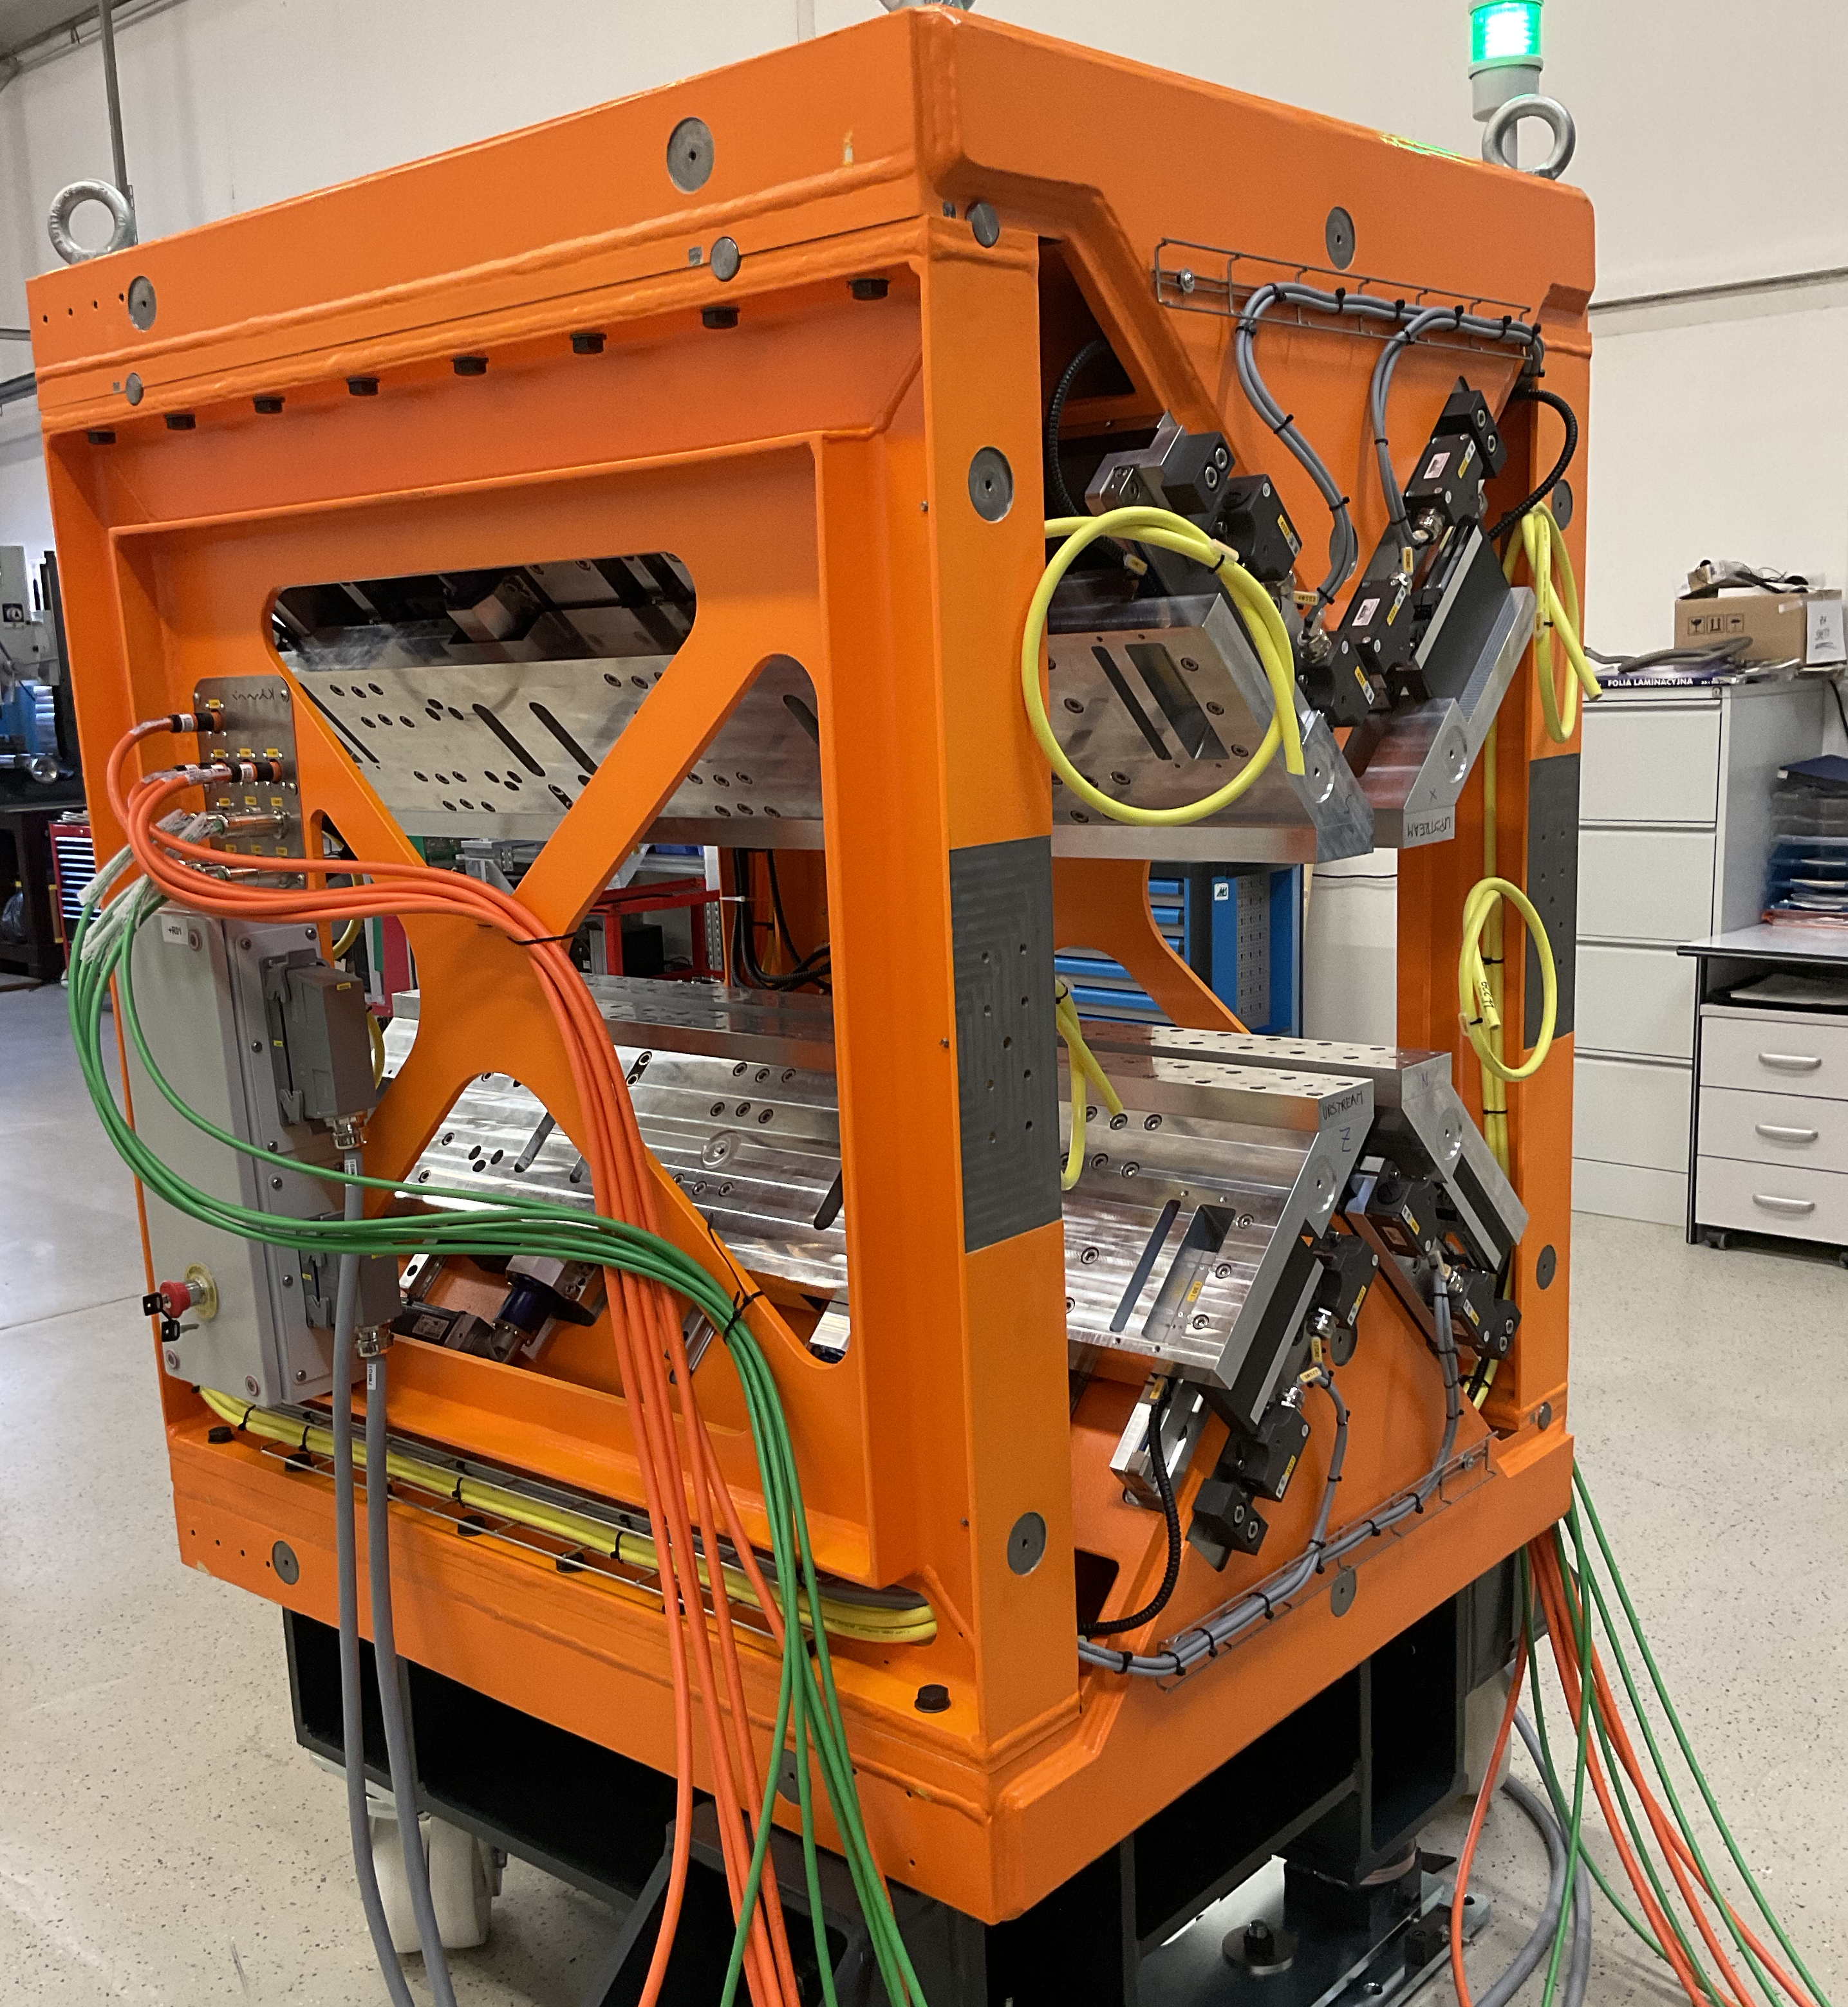
SABINA APPLE-X Undulator
Source of Advanced Beam Imaging for Novel Applications
Italian Regional Call (PI: Lucia Sabbatini)
THz user facility @ λ ∼ 10-100 μm – INFN-LNF
Operating at low energy e-beam - 30-100 MeV
pipe
φ 10 mm
- NdFeB
- Circ./Linear pol.
- λ_{u} 55 mm
- Br 1.22 T
- Min gap 5 mm
- 22 periods
- Kmax 3.4 (CP), 4.8 (LP)
- Length 1.35 m
- 3 modules
B
gap
5 mm
Purchased from KYMA after the tender:
Three APPLE-X modules ←→ 1.8 M€
Each module 1.3 m long, 55mm period
—> 650 k€/module —> 500 k€/meter

Slide 6
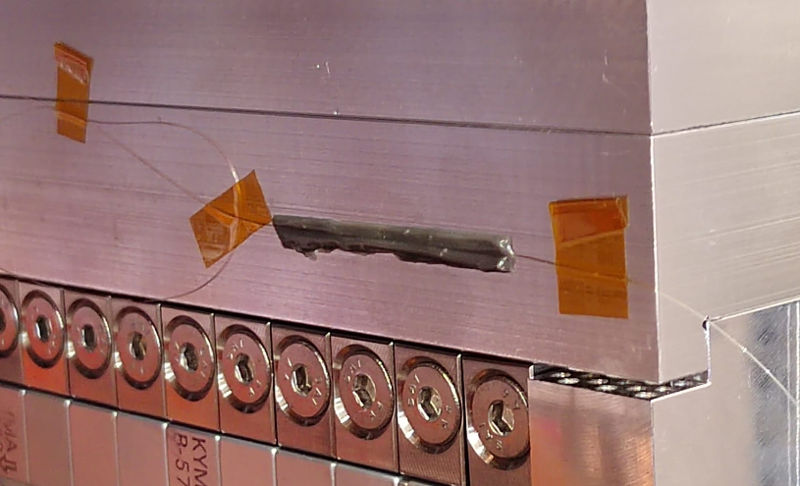
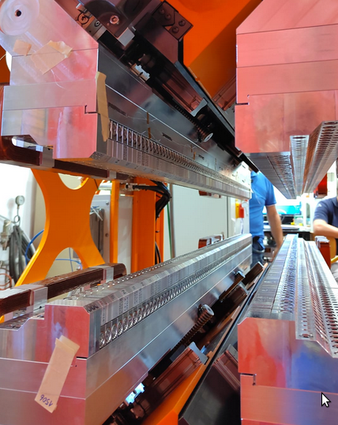
Lessons learned from the SABINA APPLE-X
Thanks to the Holographic Interferometry & Fibre Optic Sensors (HIFOS) Laboratory at ENEA we measured the APPLE-X mechanical structure deformations → negligible B field impact!
A diffraction grating is produced by the refraction index variation of the fiber core (FBG Sensors) → any movement generates wavelength spectrum modification
APPLE-X module tested for
Temperature dependence over a dynamic range of 3 °C
Magnetic forces: gap – phase variations opening. Sensors were used in two different ways:
  as strain measurement, by gluing the fiber fully adhered to the surface of the magnet holder-plates;
  as gap measurement devices, by placing the sensors between adjacent plates.
1
2
3
Sensors
No hysteresis or distortions independent of a gap macroscopic movement were observed → max wavelength shift of 0.2nm observed by gap sensor;
Max wavelength shift of 0.12nm over 2.7°C/15 hours
I. Balossino, A. Selce, A. Polimadei, M. Del Franco, A. Petralia
M. Caponero, L. Giannessi, A. Vannozzi, L. Sabbatini & Nguyen
TUP220-THB @ FEL2024
THPS21 @ IPAC2024

Slide 7
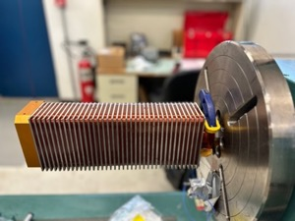
Planar SCU prototype from FNAL
One year delay wrt the schedule:
Prototype completed → tested during 2024
Vacuum vessel in final stages of manufacturing
Thermal shield in procurement
Assembly to be completed not before September 2024
Courtesy of Cristian Boffo
NbTi prototype to be deployed upstream of the APPLE-X modules
To be delivered from FNAL to INFN as a result of equipment exchange

Slide 8
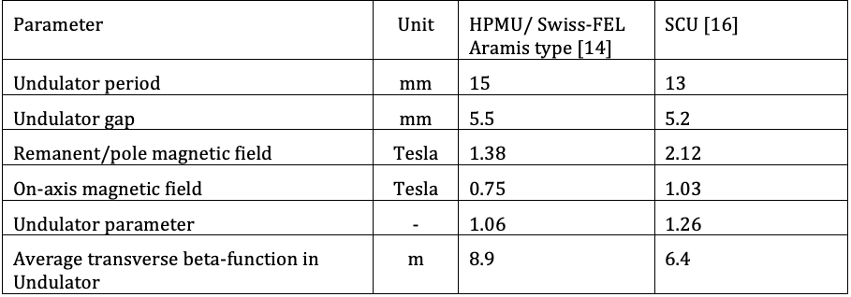
Undulator activities at ELI-ERIC
Courtesy of Alexander Molodozhentsev
Plans based on the novel L2-DUHA laser system (200TW/20-100 Hz):
Demonstration of an LPA driven SASE-FEL at beam energy = 350 MeV, within an undulator module 4m long, next in line → seeded FEL
Compact FEL operation in the “water window” at beam energy = 1.2 GeV

Slide 9
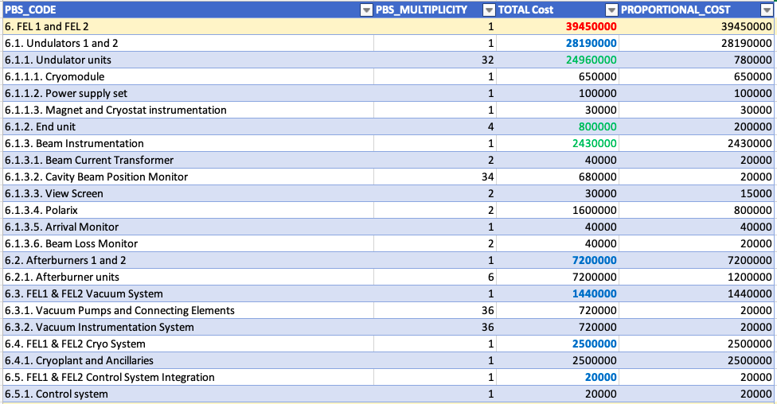
XLS FEL beamlines cost breakdown
2×16 helical 13mm
NbTi undulators
2×3 APPLE-X
19mm undulators
Courtesy of Carlo Rossi (CERN) – beginning of 2020
D’Auria, G., Adli, E.,… Nguyen, F. et al. The CompactLight Design Study
Eur. Phys. J. Spec. Top. 233, 1–208 (2024).
https://doi.org/10.1140/epjs/s11734-023-01076-0

Slide 10

Conclusions
Undulator decisions on the 1st site: APPLE type technologies for variable and selectable polarization FEL experiments
One planar NbTi SCU prototype module to be deployed in collaboration with Fermilab
LPA 2nd site example case: ELI-ERIC plans to operate a water-window FEL, driven by 1.2 GeV beam energy, with SCU modules
Undulators drive the facility cost → the final choice of the undulator technology shall depend on the particular application → specific facility budget, timeframe and wishlist
Thank you for your attention!

Slide 11


















































EuPRAXIA-PP Consortium
Coordinator

Slide 12
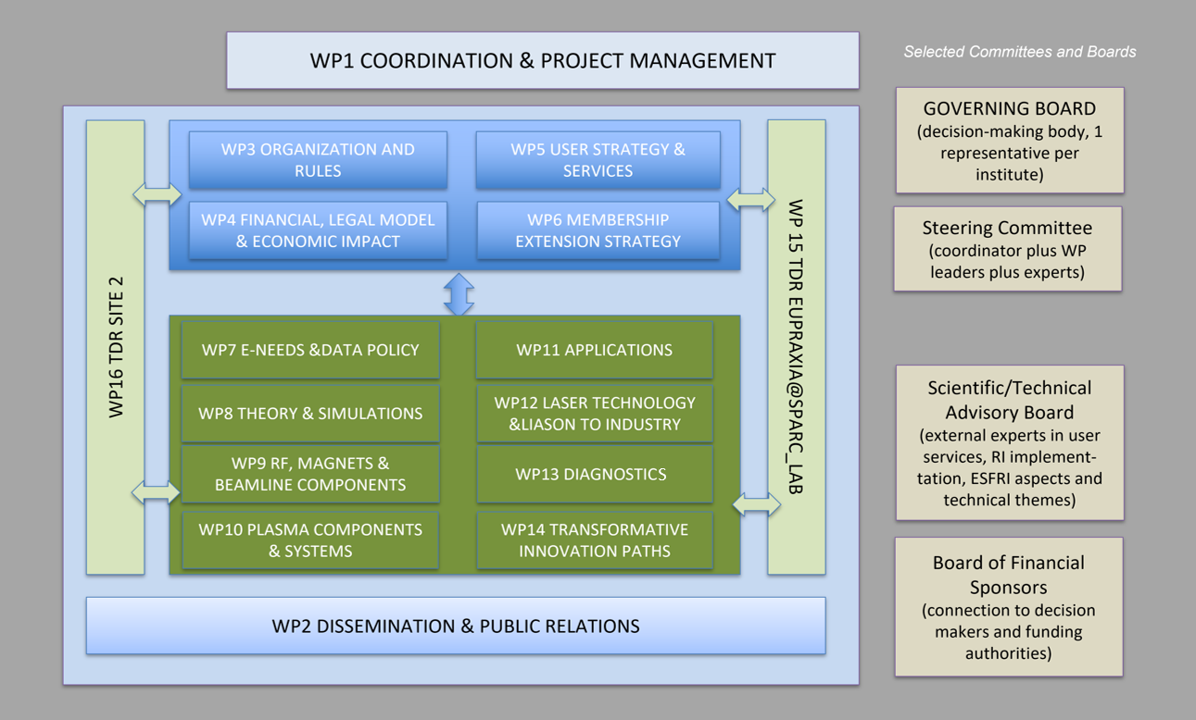
EuPRAXIA-PP Structure

Slide 13

Acknowledgements
EuPRAXIA Preparatory Phase
This project has received funding from the European Union’s Horizon Europe research and innovation programme under Grant Agreement No. 101079773. It is supported by in-kind contributions by its partners and by additional funding from UK and Switzerland.
EuPRAXIA Doctoral Network
This project has received funding from the European Union´s Horizon Europe research and innovation programme under grant agreement no. 101073480 and the UKRI guarantee funds.
EuAPS
This publication has been made with the co-funding of European Union Next Generation EU.

Slide 14
FEL Beamlines for EuPRAXIA@SPARC_LAB

Slide 15
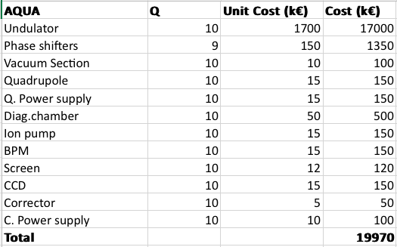
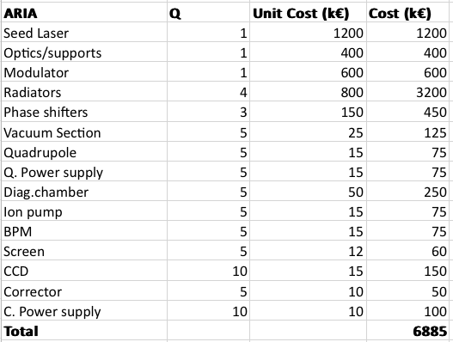
EuPRAXIA@SPARC_LAB: undulator costs
Courtesy of Luca Giannessi
Disclaimer: very preliminary cost values,
subject to significant variations
ARIA has no granted funds yet

Slide 16
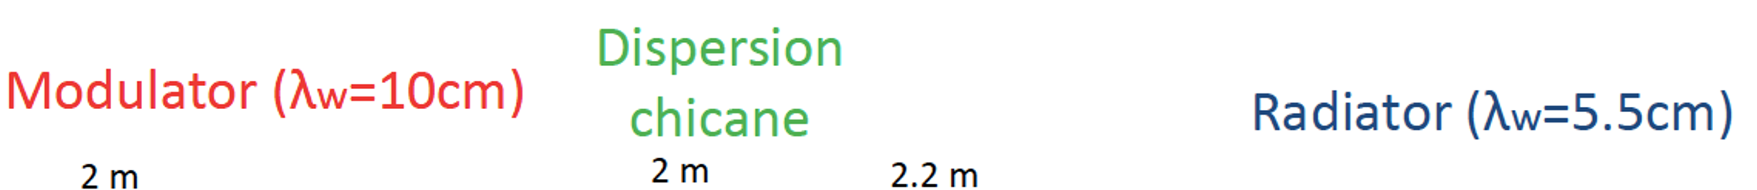
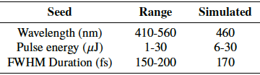
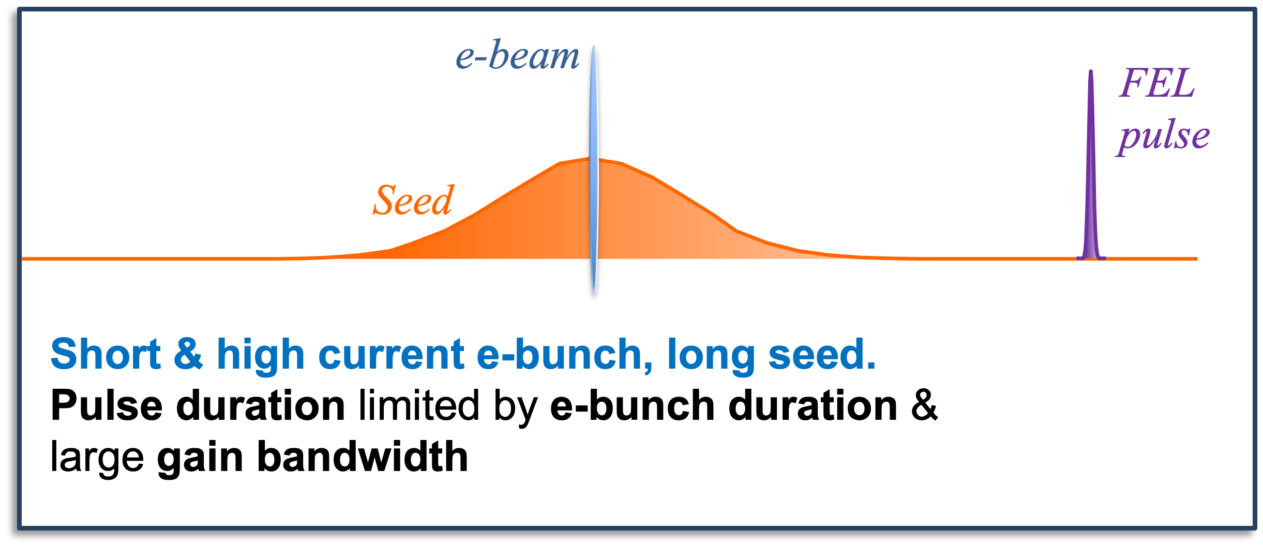
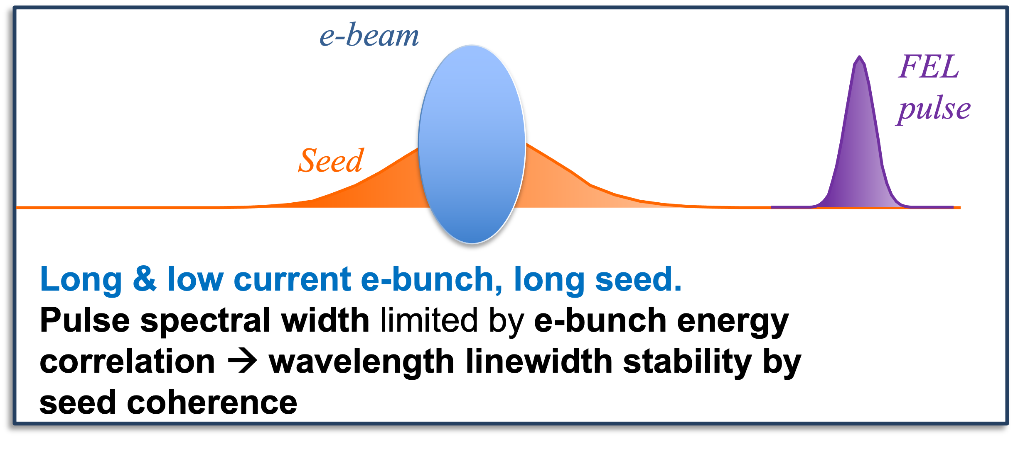
ARIA baseline layout
M. Opromolla et al., FEL2022 TUP75 Proceedings
Different and complementary to long-e bunch, low current and short seed (FERMI style)

Slide 17
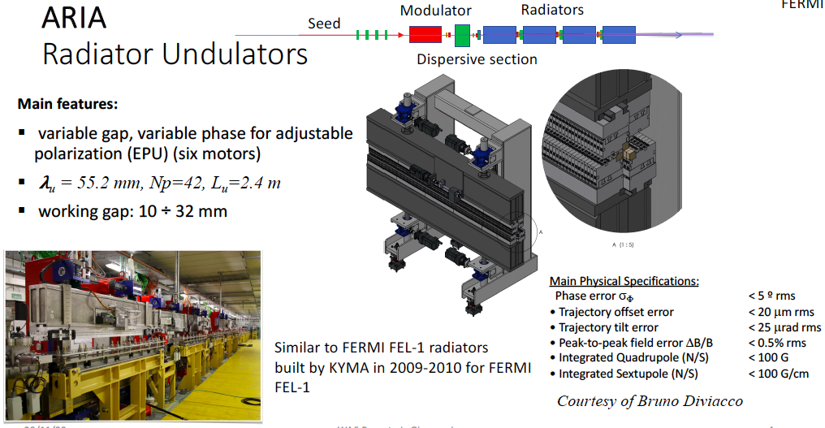
Undulators for ARIA

