Slide 1
WP9 Status Report: an introduction
WP9 – RF, Magnets & Beamline Components
WP leaders: S. Antipov (DESY) & F. Nguyen (ENEA)
Elba Annual Meeting on September 24th, 2024

Slide 2
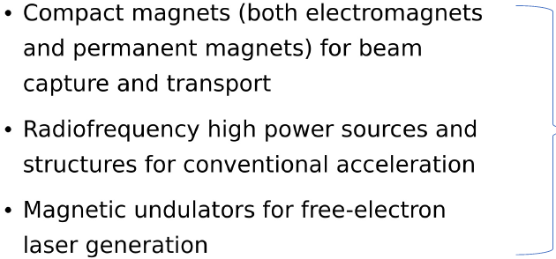

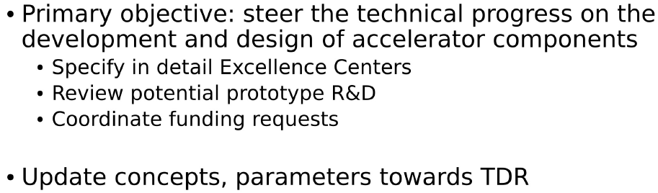
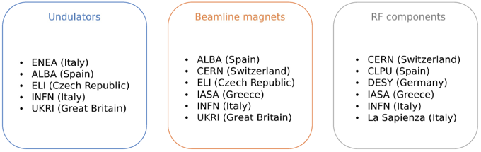
WP9: what is all about?

Slide 3
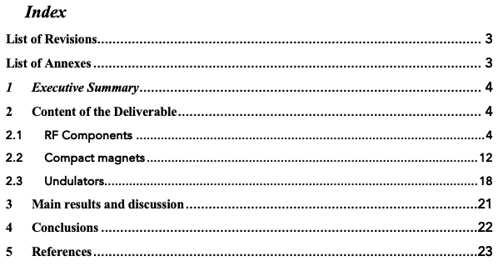
Deliverables/Milestones of this WP
D9.1 Report on structures to be funded from national/bilateral/european level for RF, Magnets and beamlines components (M12)*
D9.2 Report on technical results achieved in the field of RF, Magnets and beamlines components (M24)**
M.20 Update of concepts for EuPRAXIA, systems status report (M24)**
D9.3 TRL Report and maturity assessment on the development of RF, Magnets and beamlines components (M42)
* Done
** Final Version submitted to the management

Slide 4
Some highlights to take home
Recent progress on permanent magnet quadrupoles suggests that 30% stronger magnets can be used for the capture triplet, approaches are under development for tuning the quadrupole triplets without changing the magnet positions → variable aperture PMQ
To allow laser propagation and maintain good quality normalized emittance, it might be beneficial to use an active plasma lens → more flexible a setup also in terms of energy tuning → see WP10
Undulator technologies are driving the facility cost → permanent magnet and superconducting undulators identified as performant and sustainable
Today schedule:
Introduction – 5’
RF – 10’ + 5’
Magnets – 10’ + 5’
Undulators – 10’ + 5’

Slide 5

WP9-WP16 cooperation initiative
In a recent WP9 meeting, N. Gazis (IASA & ESS) offered CAD & FEA studies of the machine layout
A. Molodozhentsev (ELI-ERIC) showed interests in the CAD design of the FEL photon beamlines → collaboration WP9-WP16 just started
IASA is available to provide their CAD expertise to any interested site or institution
In case, please contact:
Evangelos Gazis, egazis@central.ntua.gr
Nick Gazis, nick.gazis@ess.eu
2024-09-23
N.Gazis

Slide 6
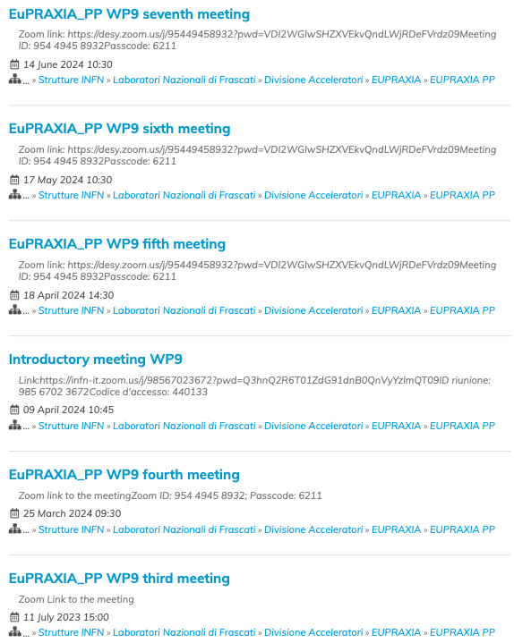
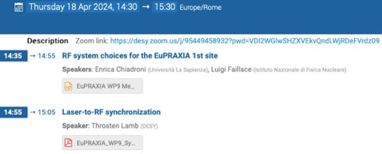

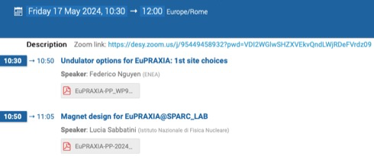
Indico WP9 meetings page
Thank you to the whole WP9 crew for
contributions, attendance & motivations

Slide 7


















































EuPRAXIA-PP Consortium
Coordinator

Slide 8
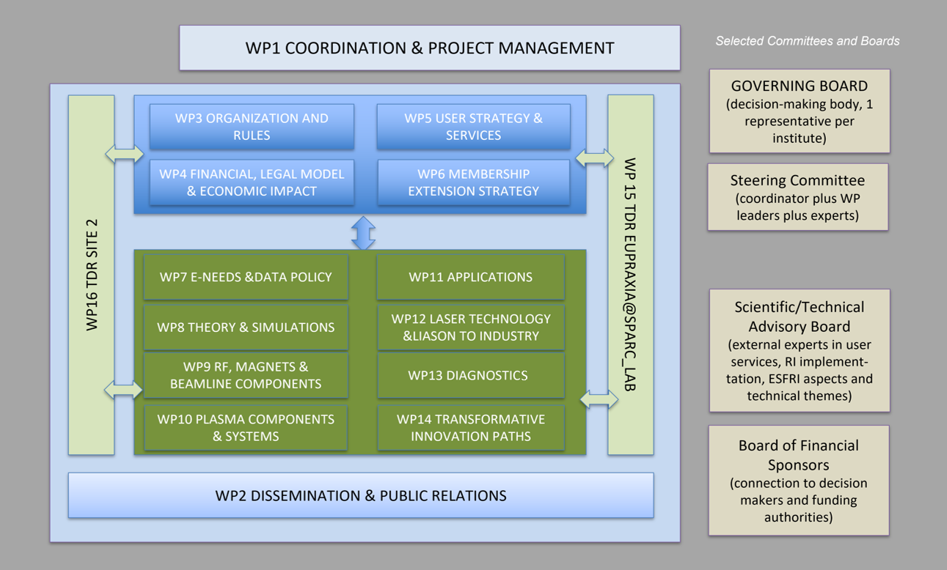
EuPRAXIA-PP Structure

Slide 9

Acknowledgements
EuPRAXIA Preparatory Phase
This project has received funding from the European Union’s Horizon Europe research and innovation programme under Grant Agreement No. 101079773. It is supported by in-kind contributions by its partners and by additional funding from UK and Switzerland.
EuPRAXIA Doctoral Network
This project has received funding from the European Union´s Horizon Europe research and innovation programme under grant agreement no. 101073480 and the UKRI guarantee funds.
EuAPS
This publication has been made with the co-funding of European Union Next Generation EU.

