Slide 1
EuPRAXIA@SPARC_LAB machine upgrade & additional beamlines
Francesco Stellato – Università Tor Vergata & INFN
On behalf of EuPRAXIA@SPARC_LAB WA8

Slide 2
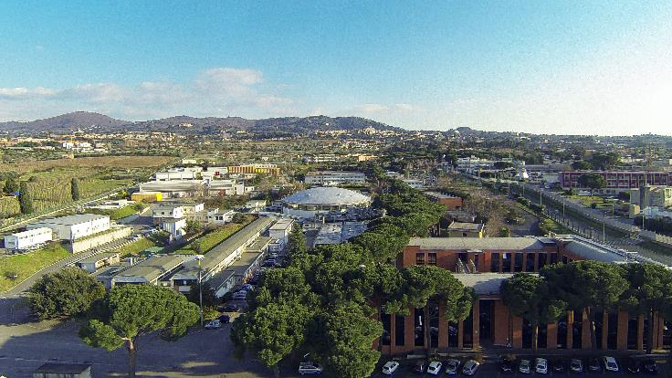
Outline
What is ARIA?
Wavelength, brilliance & Co.
What are the similar sources around the world?
Synchrotron, FEL and HHG sources
What is the photon science that can benefit from ARIA?
  Experimental techniques & sample classes
What will ARIA look like?
Overview of the experimental endstation

Slide 3
What is ARIA?
ARIA is a VUV-seeded FEL beamline that will be part of the EuPRAXIA@SPARC_LAB user facility
ARIA will deliver ultra-bright,
ultra-short photon pulses
in the 50 to 180 nm wavelength range (7-25 eV),
with tunable linear and circular polarization.
Parameter | Value
Wavelength | 50-180 nm
Photons/pulse | 10 ¹³ - 10 ¹⁴
Pulse duration | 20/200 fs
Repetition rate | 100 Hz

Slide 4
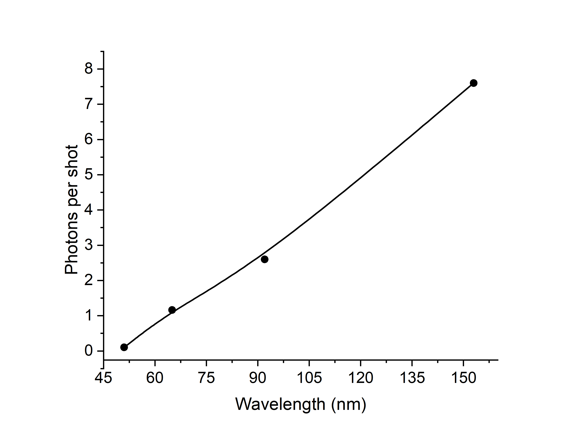
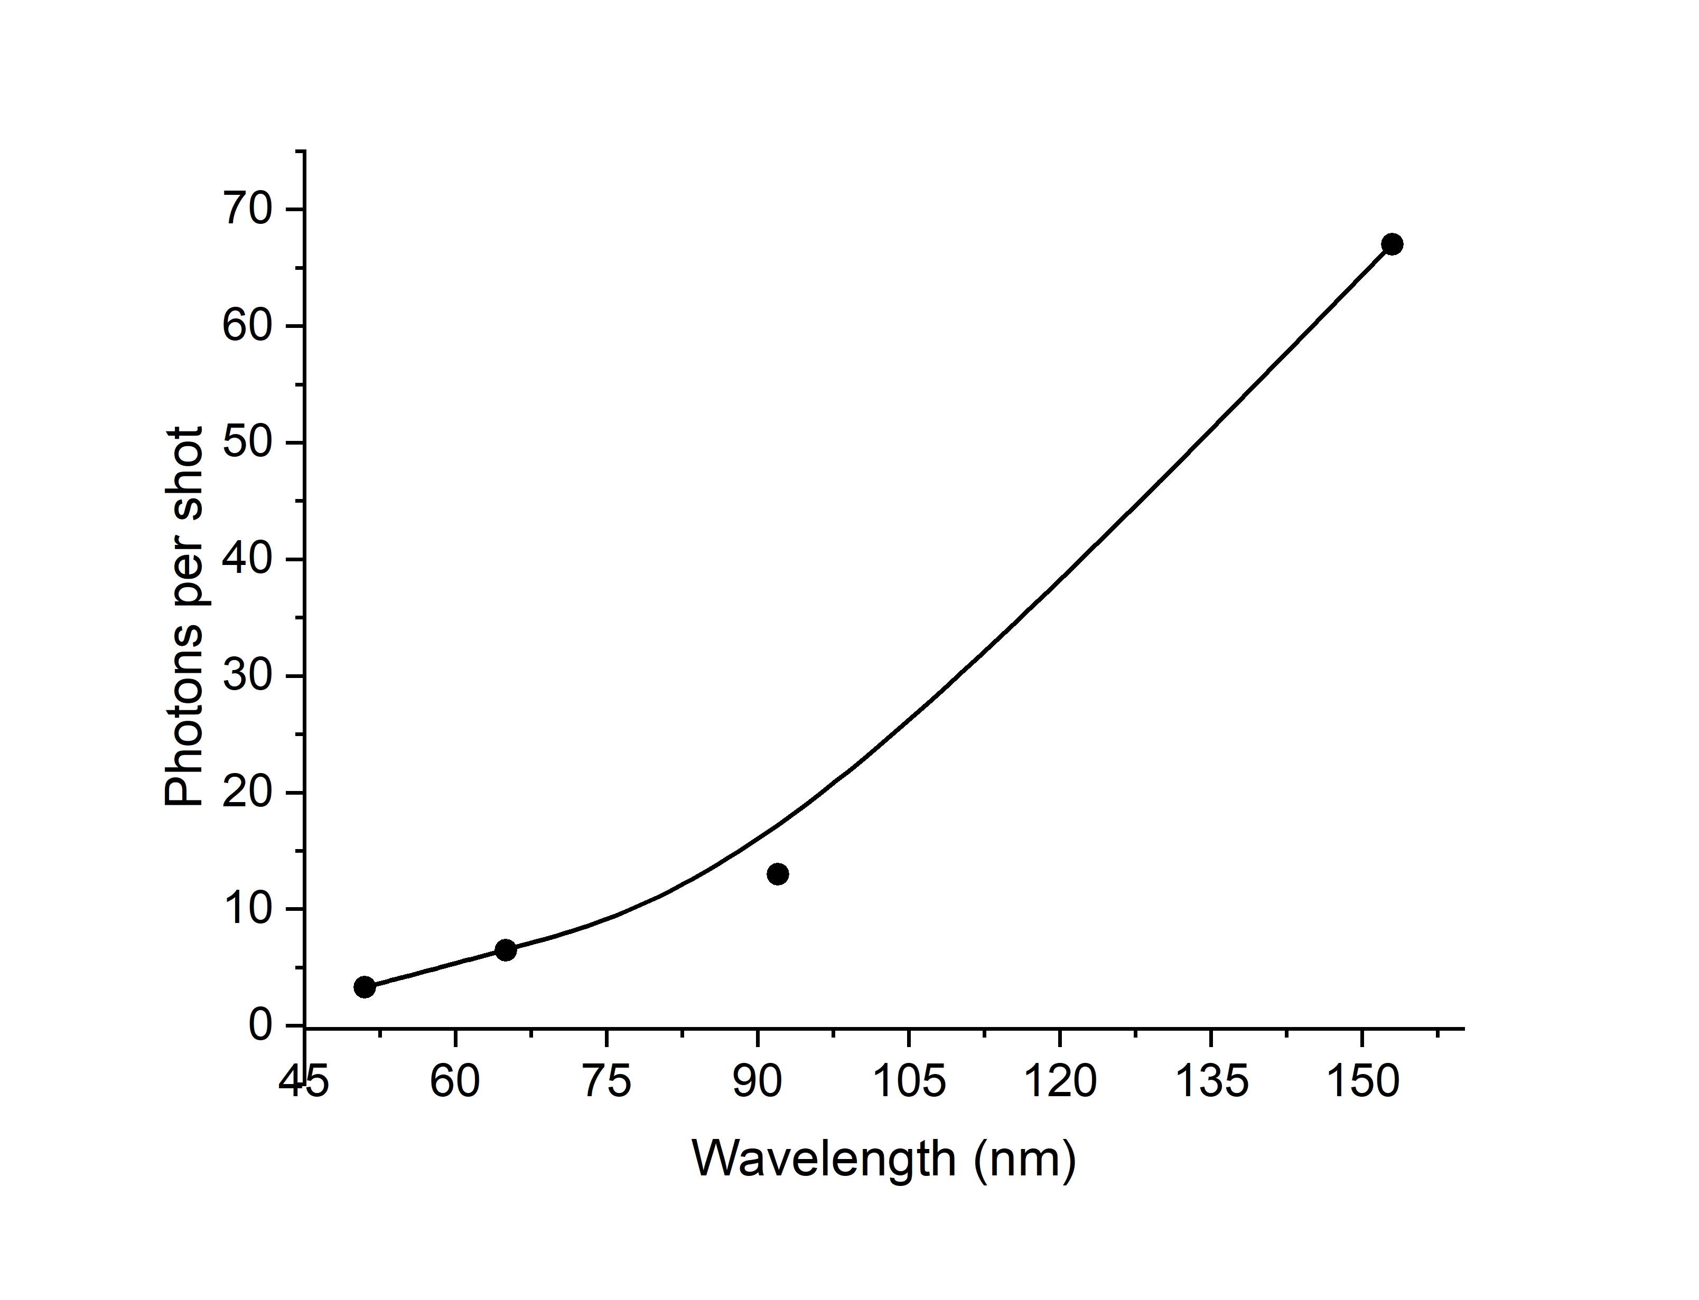
What is ARIA?
Short pulses – 20 fs – 10¹³ #/shot Long pulses – 200 fs - 10¹⁴ #/shot
Courtesy of M. Opromolla

Slide 5
What is ARIA?
ARIA will be complementary to the other EuPRAXIA@SPARC_LAB FEL beamline, AQUA
AQUA is a soft-X-ray SASE FEL beamline that will deliver photons in the region between 4 and 10 nm
Parameter | Value
Wavelength | 4-10 nm
Photons/pulse | 10 ¹⁰ - 10 ¹¹
Pulse duration | < 50 fs
Repetition rate | 100 Hz

Slide 6
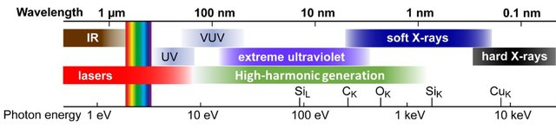
What is ARIA?
ARIA AQUA

Slide 7
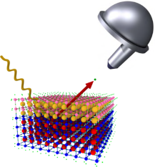
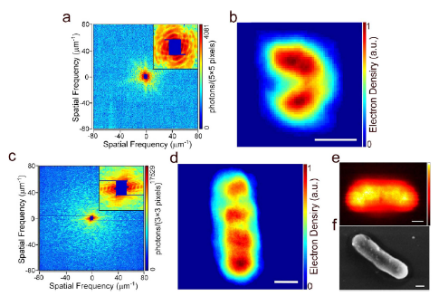
Science @ AQUA in a nutshell
X-ray & Photoemission pump-probe spectroscopy
Ultrafast studies on hydrocarbons, aminoacids, alloys, warm-dense matter, cuprates, catalysts, batteries
Coherent imaging in the water window, including stereoimaging schemes
Hydrated environment measurements on bacteria, viruses, nanoparticles, ashes…
Ultrafast
Raman spectroscopy
on metalloproteins
and organometallic molecules

Slide 8
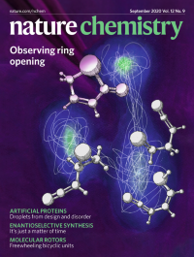
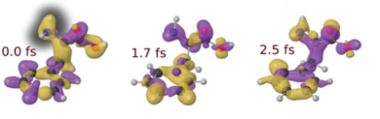
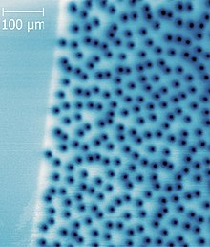
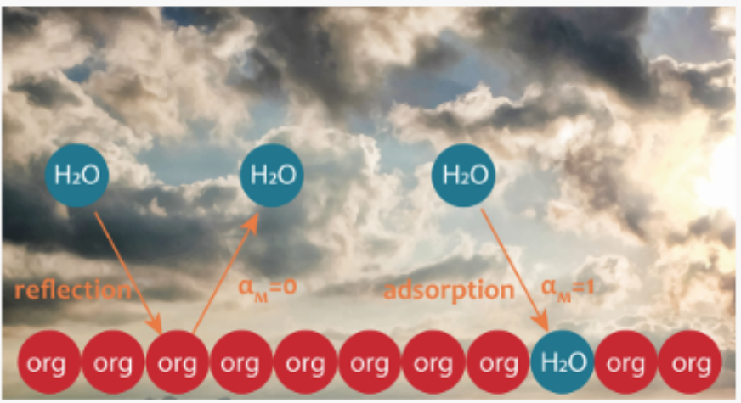
Science @ ARIA in a nutshell
Pump-probe studies of molecules photofragmentation
VUV, ion & Photoemission spectroscopy
Studies on molecules in gas phase, including astrochemistry
Aerosol, Liquids and solution chemistry
Solids phase: superconductors and magnetic materials, hydrodynamics of lattices.

Slide 9
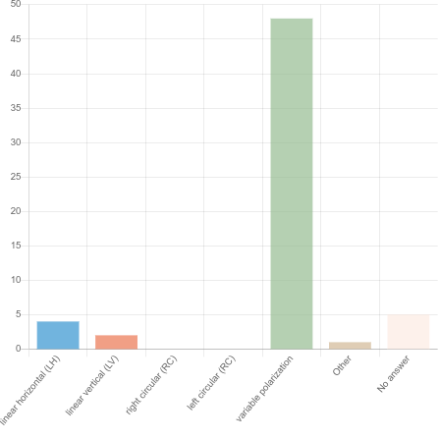
Requests from the EuPRAXIA-PP users’ survey
Photon wavelength is a crucial parameter:
  33% prefer EUV (< 300 eV)
  47% prefer soft x-rays
  20% prefer hard x-rays (> 7 keV)
  The long-wavelength tail of the EUV falls within the ARIA region

Slide 10
VUV sources around the world

Slide 11


Key Source Characteristics High Harmonic Generation sources:
Photon Flux: Typically between 10⁶−10¹⁰ photons/s, lower than synchrotrons and FELs but with high coherence.
Energy Tunability: Limited tunability, with discrete harmonics based on the driving laser frequency.
Pulse Length: Attosecond to femtosecond pulses, significantly shorter than synchrotrons and comparable to FELs.
Repetition Rate: High repetition rate, from kHz to MHz
Compactness: Tabletop-sized, making it more accessible for laboratory use.
These sources are ideal for ultrafast time-resolved spectroscopy, attosecond science, and nanoscale imaging in the VUV range.
  Ultrashort Pulses: Attosecond to femtosecond pulses are ideal for capturing electron dynamics.
  Coherent Light: High spatial and temporal coherence for techniques like coherent diffractive imaging (CDI).
  Compact & Accessible: Tabletop-sized, making them accessible in small-scale labs and university settings.
  Attosecond Science: Unique capability for studying electron dynamics on attosecond timescales, outperforming synchrotrons/FELs in this regard.
  Lower Photon Flux: Significantly lower photon flux (10⁶−10¹⁰ photons/s), limiting use in applications requiring high signal strength.
  Limited Tunability: Tuning is more discrete (based on harmonic orders), which may limit element-specific or resonant studies.
  Specialized Applications: While excellent for ultrafast and coherent imaging, HHG sources may not be suitable for broader applications that require high photon flux and tunability, such as X-ray scattering or high-resolution X-ray absorption.

Slide 12
Key Source Characteristics Large Scale Facilities (Synchrotrons & FELs):
Photon Flux: Typically between 10¹²−10¹⁴ photons/s (synchrotrons) and 10¹⁴−10¹⁶ photons/pulse (FELs).
Energy Tunability: Wide tunability in both VUV and soft X-ray regions, allowing for resonant and element-specific studies.
Pulse Length: Synchrotrons offer ps-range pulses, while FELs provide fs-range pulses, ideal for ultrafast time-resolved experiments.
These facilities are crucial for conducting high-resolution, high-flux, and tunable experiments in the VUV range, often required for advanced material science, surface science, molecular dynamics, and time-resolved studies.
  High Photon Flux: Orders of magnitude higher photon flux (10¹²−10¹⁶ photons/s or per pulse), suitable for high-sensitivity and high-resolution experiments.
  Wide Energy Tunability: Allows for resonant, element-specific studies across a broad energy range.
  Femtosecond Pulse Duration: FELs offer ultrafast pulses in the fs range for time-resolved experiments.
  Established Infrastructure: Access to advanced instruments for diverse techniques like spectroscopy, scattering, and imaging.
  Limited Accessibility: Large, centralized facilities often require competitive proposals for beam time, limiting frequent use.
  Size & Complexity: Large-scale, requiring significant infrastructure and operation costs.
  Pulse Duration Limitation: Synchrotrons are limited to the tens of ps timescale, FELs can reach the fs timescale, but (so far) cannot reach the attosecond timescales achievable by HHG sources.

Slide 13
Synchrotron beamlines in the VUV
Some examples

Slide 14
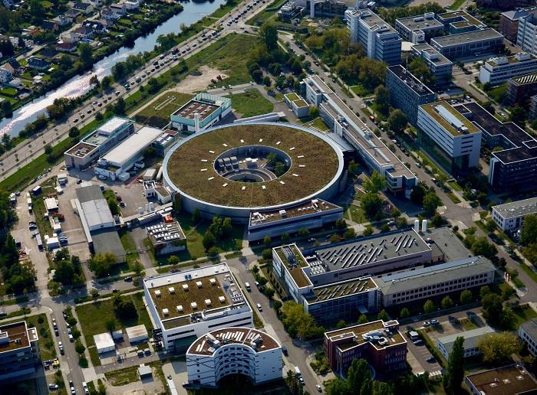
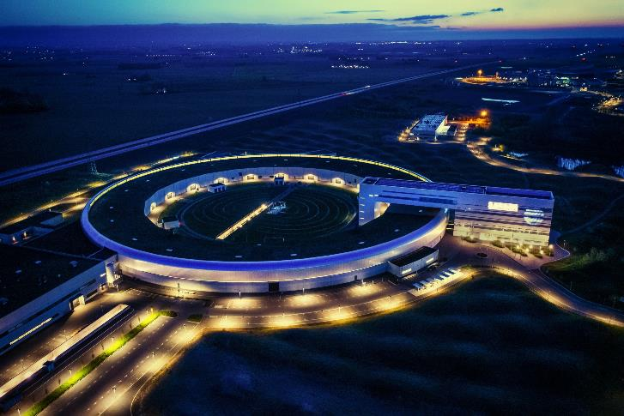
🇩🇪
BESSY II - Helmholtz-Zentrum Berlin (Germany)
Source Type: Synchrotron Radiation Facility
Photon Energy Range: 2 eV to 10 keV (VUV to soft X-rays)
Photon Flux: 10¹³ – 10¹⁵ photons/s
Energy Tunability: Wide range tunability, optimized for VUV and soft X-rays
Pulse Length: 50 ps
Specific Beamlines:
  UE52-PGM Beamline: Focuses on VUV and soft X-ray absorption spectroscopy.
  UE112 Beamline: For high-resolution PES and ARPES in the VUV energy range.
Applications: Photoemission, ARPES, surface science, catalysis research, material science.
Samples: Solids (surfaces and thin films), liquids (under certain conditions), and gas phase (with appropriate sample preparation).
🇸🇪
MAX IV Laboratory (Sweden)
Source Type: Synchrotron Radiation Facility
Photon Energy Range: 10 eV to 40 keV (VUV to hard X-rays)
Photon Flux: 10¹³ – 10¹⁴ photons/s
Energy Tunability: Fully tunable across the VUV range
Pulse Length: Sub-100 fs in single-bunch mode, or 100 ps in multi-bunch mode
Specific Beamlines:
  FinEstBeAMS Beamline: Specializes in VUV and soft X-ray studies of gas-phase molecules and surfaces.
Applications: VUV absorption spectroscopy, PES, time-resolved experiments, molecular dynamics, Rydberg state studies.
Samples: Solids (surfaces, thin films, and bulk), liquids (often in combination with in situ cells), and gas phase.

Slide 15
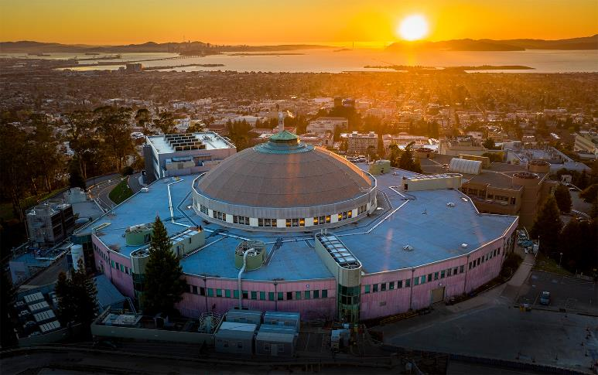
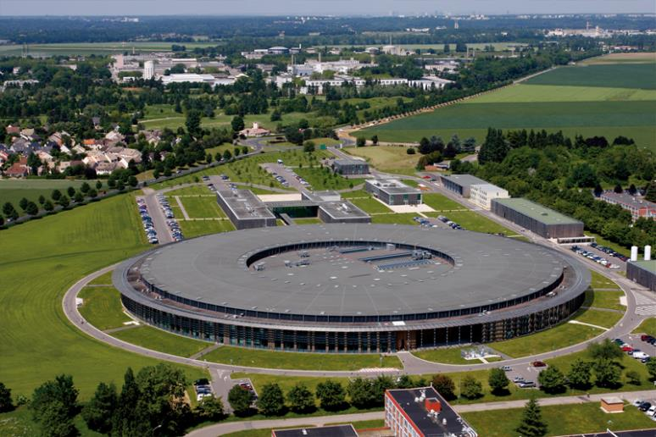
🇺🇸
Advanced Light Source (ALS) - Lawrence Berkeley National Laboratory (USA)
Source Type: Synchrotron Radiation Facility
Photon Energy Range: 10 eV to 2000 eV (covers VUV to soft X-rays)
Photon Flux: 10¹² – 10¹⁴ photons/s
Energy Tunability: Tunable over a wide range using various beamlines
Pulse Length: 70 ps
Specific Beamlines:
  Beamline 6.3.2 specializes in VUV absorption and surface science.
  High-resolution PES and ARPES are available at multiple beamlines.
Applications: PES, ARPES, VUV spectroscopy, surface science, material characterization.
Samples: Solids (surfaces, thin films), liquids (under special conditions), and gas phase.
🇫🇷
Synchrotron SOLEIL (France)
Source Type: Synchrotron Radiation Facility
Photon Energy Range: 5 eV to 40 keV (covers VUV, soft X-rays, and hard X-rays)
Photon Flux: 10¹³ – 10¹⁵ photons/s
Energy Tunability: Full energy tunability with undulators and monochromators
Pulse Length: 50–100 ps
Specific Beamlines:
  DESIRS Beamline: Dedicated to VUV spectroscopy (5–40 eV), providing high photon flux and energy resolution.
  PLEIADE PES Beamline: Offers angle-resolved and resonant PES experiments.
  DISCO Beamline: Offers angle-resolved and resonant PES experiments.
Applications: VUV photoemission, ARPES, molecular physics, astrophysics, surface chemistry.
Samples: Solids (surfaces, thin films, bulk), liquids (special setups), and gas phase.

Slide 16
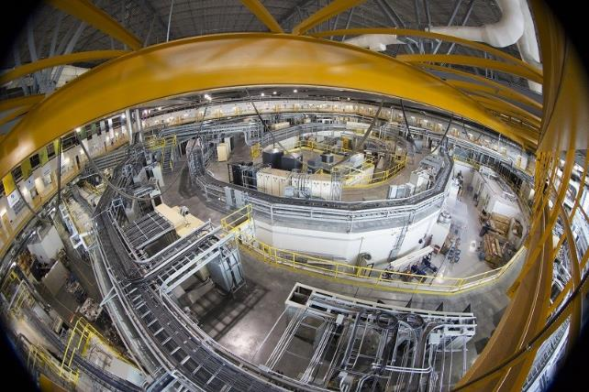
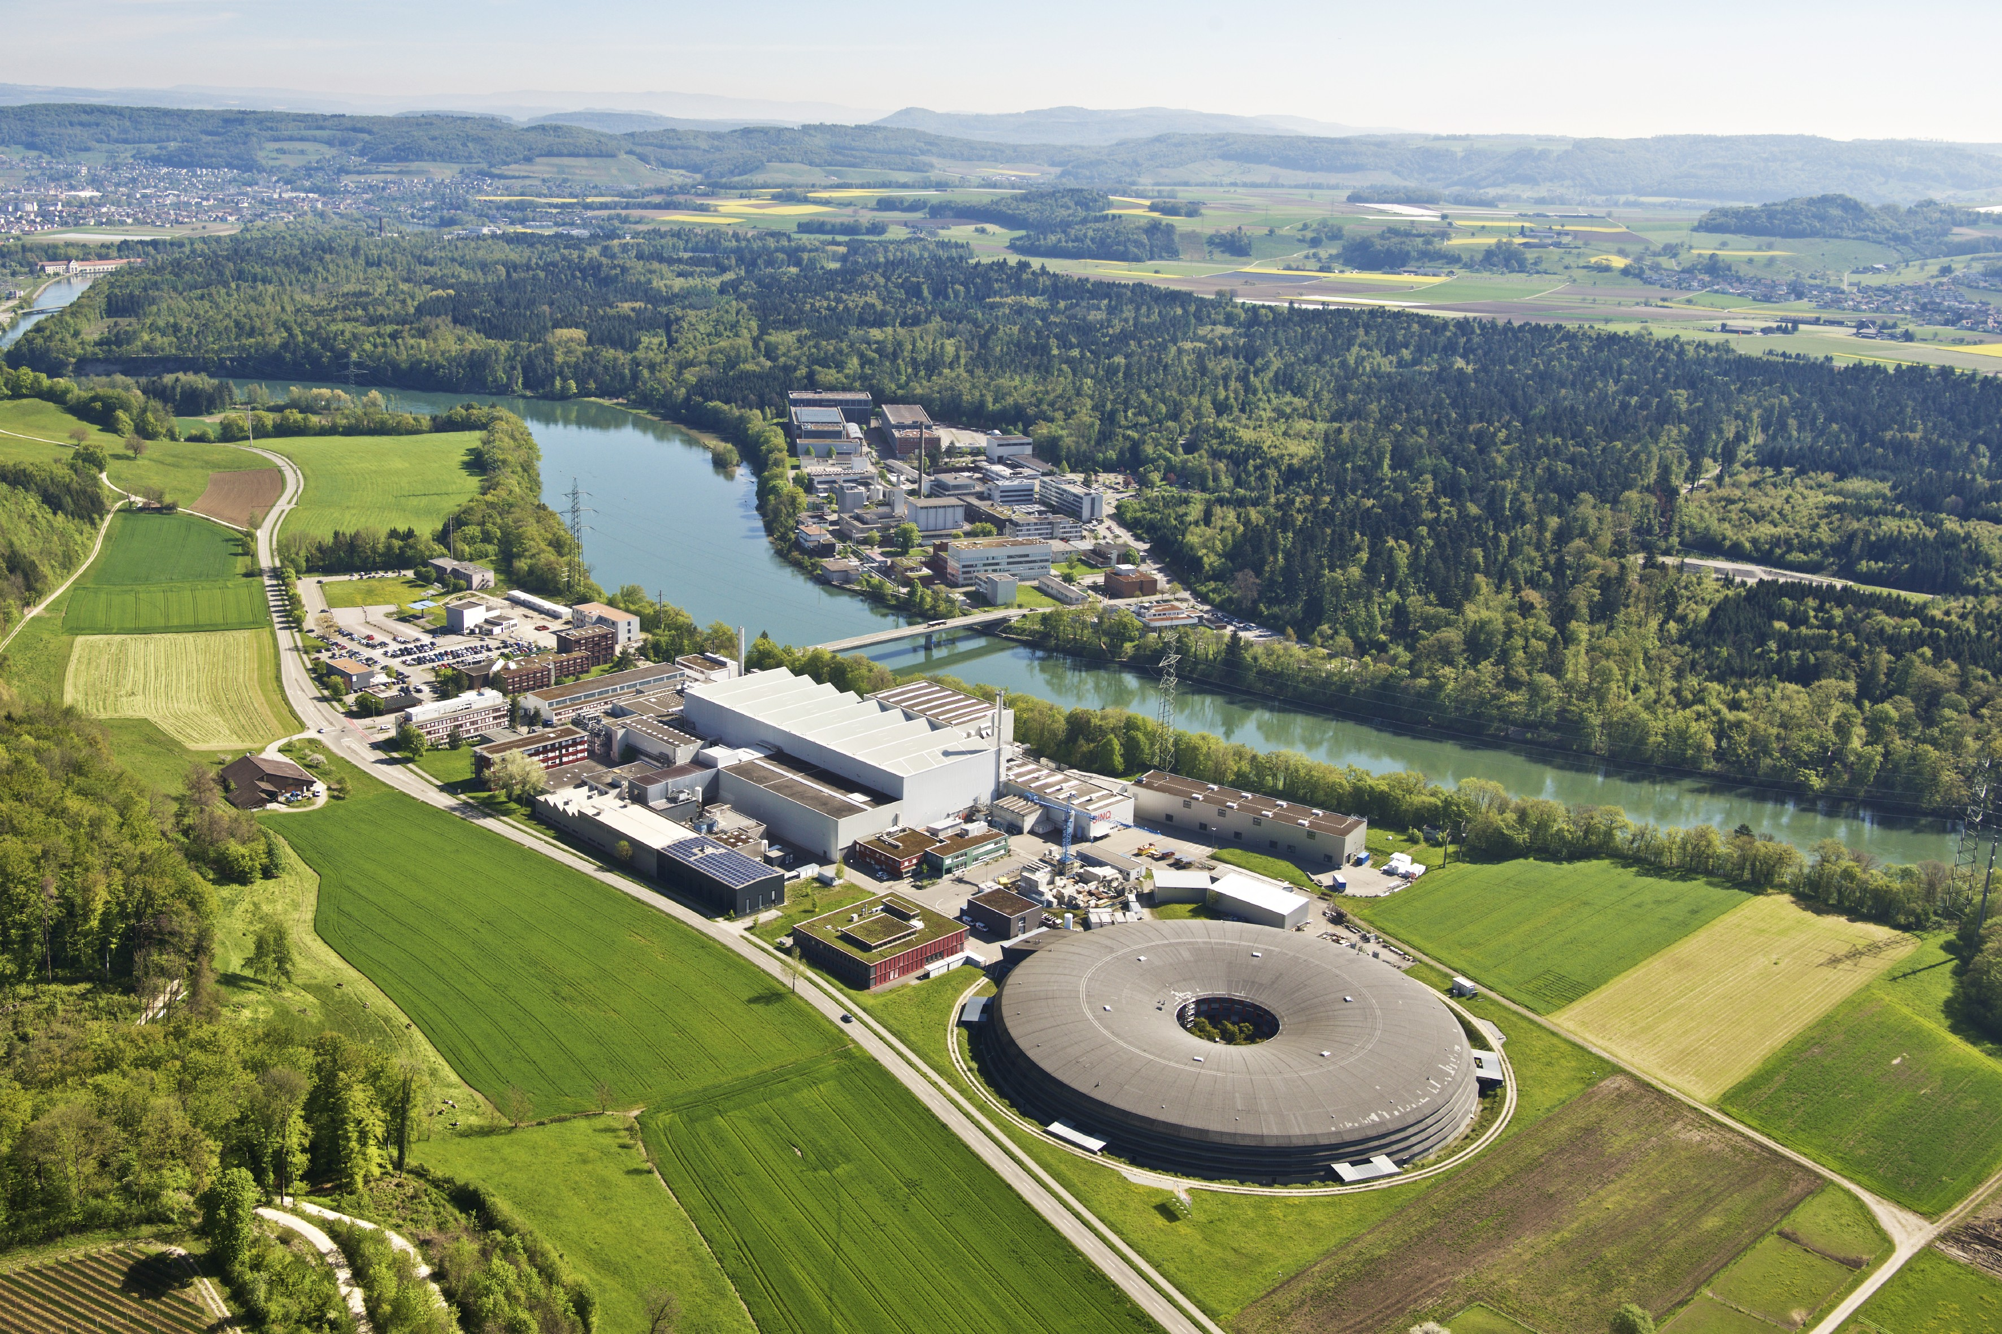
🇨🇦
Canadian Light Source (CLS) - VUV Beamlines (Canada)
Source Type: Synchrotron Radiation Facility
Photon Energy Range: 10 eV to 2500 eV (VUV to soft X-rays)
Photon Flux: 10¹³ – 10¹⁴ photons/s
Energy Tunability: Wide energy tunability with various beamlines
Pulse Length: 80 ps
Specific Beamlines:
  VLS-PGM Beamline: Specialized in high-resolution VUV spectroscopy and PES studies.
Applications: VUV absorption, PES, surface science, biomolecular structure studies.
Samples: Solids (surfaces, thin films, and bulk), liquids (with appropriate setups), and gas phase.
CH
PSI - Swiss Light Source (Switzerland)
Source Type: Synchrotron Radiation Facility
Photon Energy Range: 5 eV to 1500 eV (VUV to soft X-rays)
Photon Flux: 10¹² – 10¹⁴ photons/s
Energy Tunability: Tunable over a wide range using insertion devices (undulators)
Pulse Length: 80 ps
Specific Beamlines:
• X07MA and X04DB Beamlines : Specialize in VUV and soft X-ray spectroscopy, with a focus on spectromicroscopy and imaging.
Applications: VUV absorption, PES, surface science, biological studies, nanomaterials.
Samples: Solids (surfaces, thin films, and bulk), biological materials, and gas phase.

Slide 17
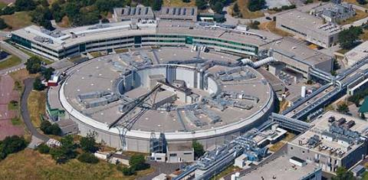
Elettra Sincrotrone Trieste (Italy)
Source Type: Synchrotron Radiation Facility
Photon Energy Range: 8 eV to 15 keV (VUV to soft and hard X-rays)
Photon Flux: 10¹³ – 10¹⁵ photons/s
Energy Tunability: Tunable over a wide range using insertion devices (undulators, wigglers)
Pulse Length: 100 ps
Specific Beamlines:
  APE Beamline: Focuses on VUV and soft X-ray ARPES and PES studies.
  SuperESCA Beamline: Dedicated to high-resolution PES and surface science.
  MOST@Elettra 2.0 (GasPhase +Circular Polarization )
Applications: PES, ARPES, VUV absorption, surface chemistry, material science, thin-film studies.
Samples: Solids (surfaces, thin films, and bulk), liquids (in specialized environments), and gas phase.

Slide 18
FEL beamlines in the VUV
Some examples

Slide 19
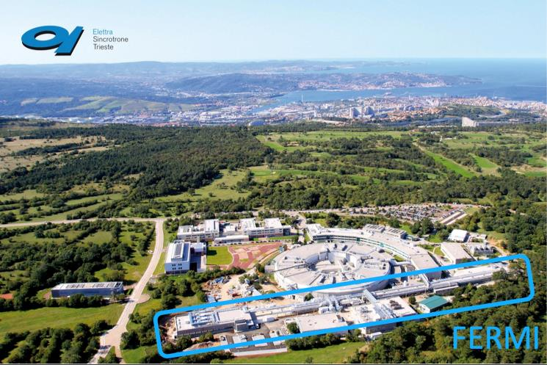
FERMI Free-Electron Laser (Italy)
Source Type: Free-Electron Laser (FEL)
Photon Energy Range: 12 eV to 310 eV (covers VUV and soft X-rays)
Photon Flux: 10¹¹ – 10¹⁴ photons/pulse
Energy Tunability: Tunable across a wide energy range using FEL amplification
Pulse Length: Sub-100 fs (femtoseconds), ideal for time-resolved studies
Specific Beamlines:
  EIS-TIMEX Beamline: For time-resolved spectroscopy and coherent VUV studies.
  LDM Beamline: For laser-driven dynamic experiments in the VUV range.
Applications: Time-resolved spectroscopy, ultrafast dynamics, pump-probe experiments, photoionization studies, VUV spectroscopy.
ARIA : 7-25 eV

Slide 20
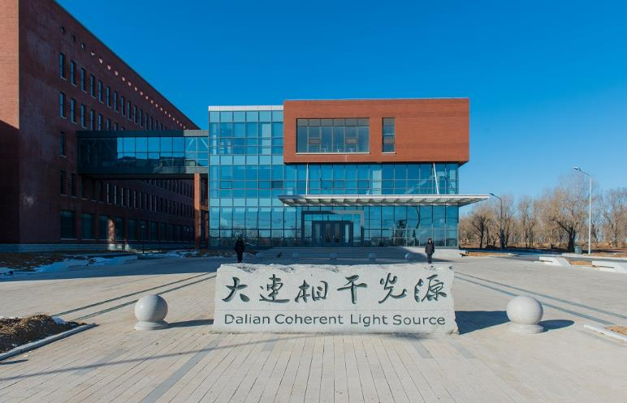
Dalian Coherent Light Source (DCLS) (China)
Source Type: Free-Electron Laser (FEL)
Photon Energy Range: 8 eV to 24 eV (covers VUV range)
Photon Flux: 10¹¹ – 10¹³ photons/pulse
Energy Tunability: Tunable across a limited VUV energy range, particularly for molecular and material studies
Pulse Length: Sub-femtosecond, ideal for ultrafast dynamics and spectroscopy.
Specific Beamlines:
  VUV Beamline: Primarily used for studying valence electronic structures, surface chemistry, and molecular dynamics.
  Applications: Time-resolved spectroscopy, photoemission, surface science, ultrafast dynamics, and VUV spectroscopy​.
  Samples: Solids (surfaces, thin films), liquids (with special sample environments), and gas phase.
ARIA : 7-25 eV

Slide 21
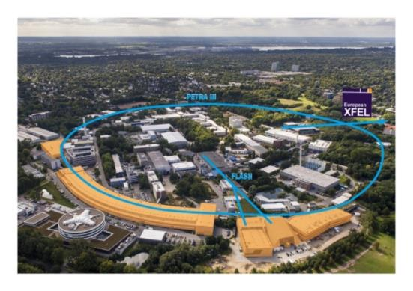
FLASH Free-Electron Laser (Germany)
Source Type: Free-Electron Laser (FEL)
Photon Energy Range: 10 eV to 250 eV (VUV and soft X-rays)
Photon Flux: 10¹¹−10¹⁴ photons/pulse
Energy Tunability: Wide tunability across the VUV and soft X-ray regions
Pulse Length: Sub-100 fs (femtoseconds), ideal for time-resolved experiments
Specific Beamlines:
  FLASH1 and FLASH2 Beamlines: Offer VUV and soft X-ray light for pump-probe and time-resolved spectroscopy experiments.
Applications: Ultrafast dynamics, photoemission spectroscopy, molecular dissociation, surface studies, Rydberg state research.
Samples: Gas phase (often used for isolated molecules), solids (with advanced techniques), and liquids (under specific conditions).
ARIA : 7-25 eV

Slide 22
Science in the ARIA range

Slide 23
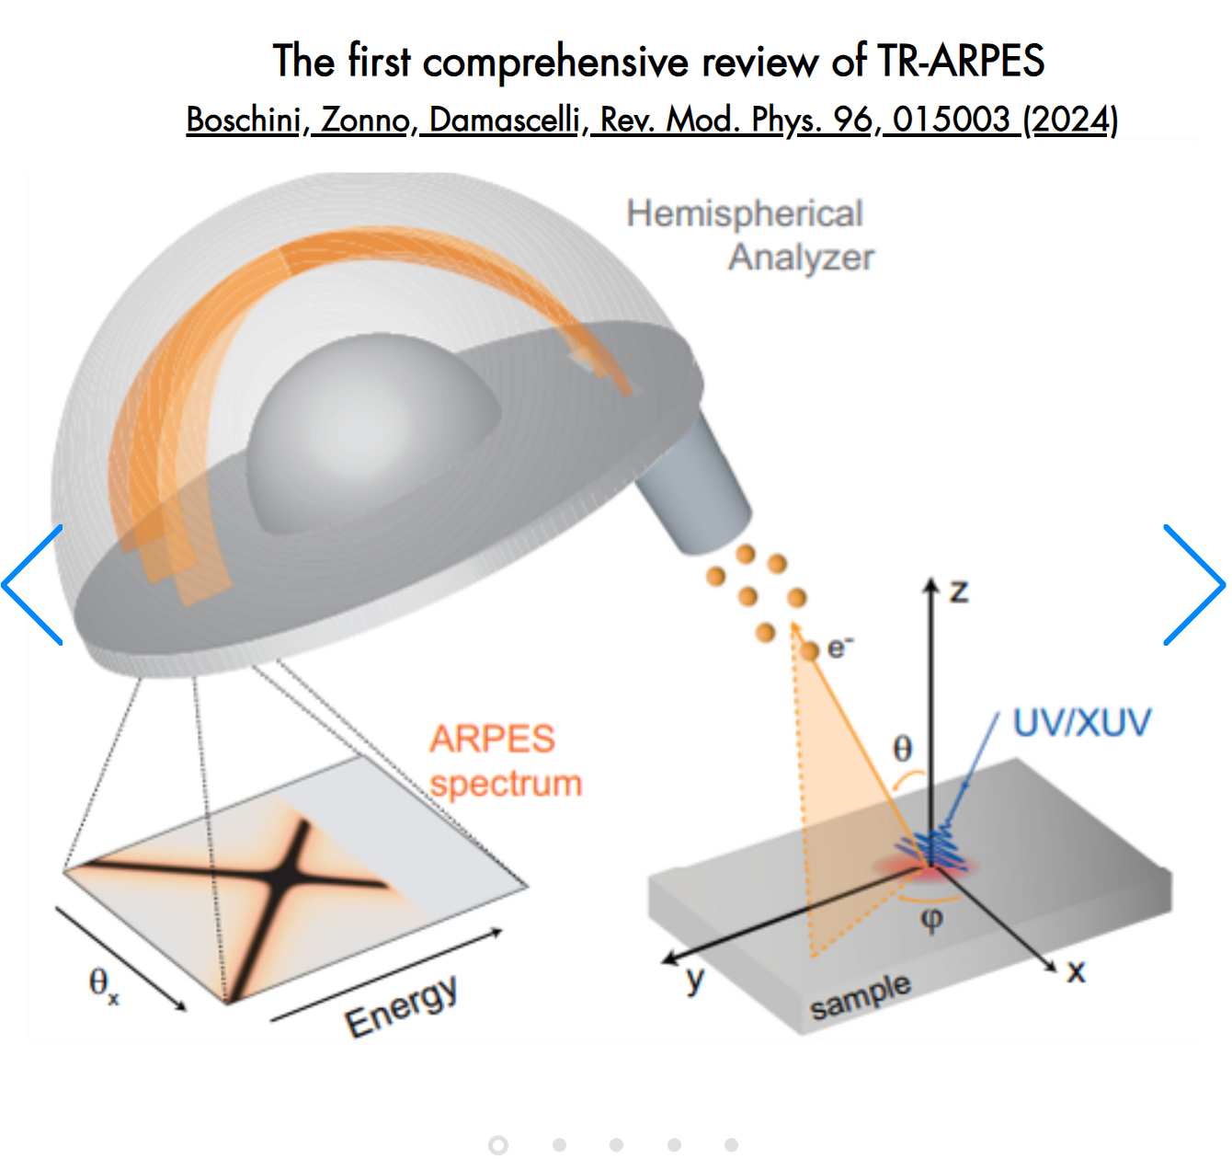
Photon Science Applications in the ARIA energy range
Atomic, Molecular, and Cluster Physics:
Experiments on atomic, molecular, and cluster systems, covering gas adsorbates, interfaces, and the evolution of properties from isolated particles to condensed phases.
Photo-Ionization and Atmospheric Science:
Access to ionization thresholds and ionic states allows the study of atmospheric species (from the troposphere to ionosphere) and combustion species.
Electronic Structure and Excited States is solids:
Electronic transitions in materials like nano-carbons, metal oxides. Excitons, polarons → spintronics & solar cells.
Chirality and Molecular Dynamics:
Exploring chirality and natural dichroism in biological systems
Techniques
- Photoemission Spectroscopy
(also Angle-Resolved)
- Time-of-Flight ion spectroscopy (ToF) /
Velocity Map Imaging (VMI)
- …
ARIA : 7-25 eV

Slide 24
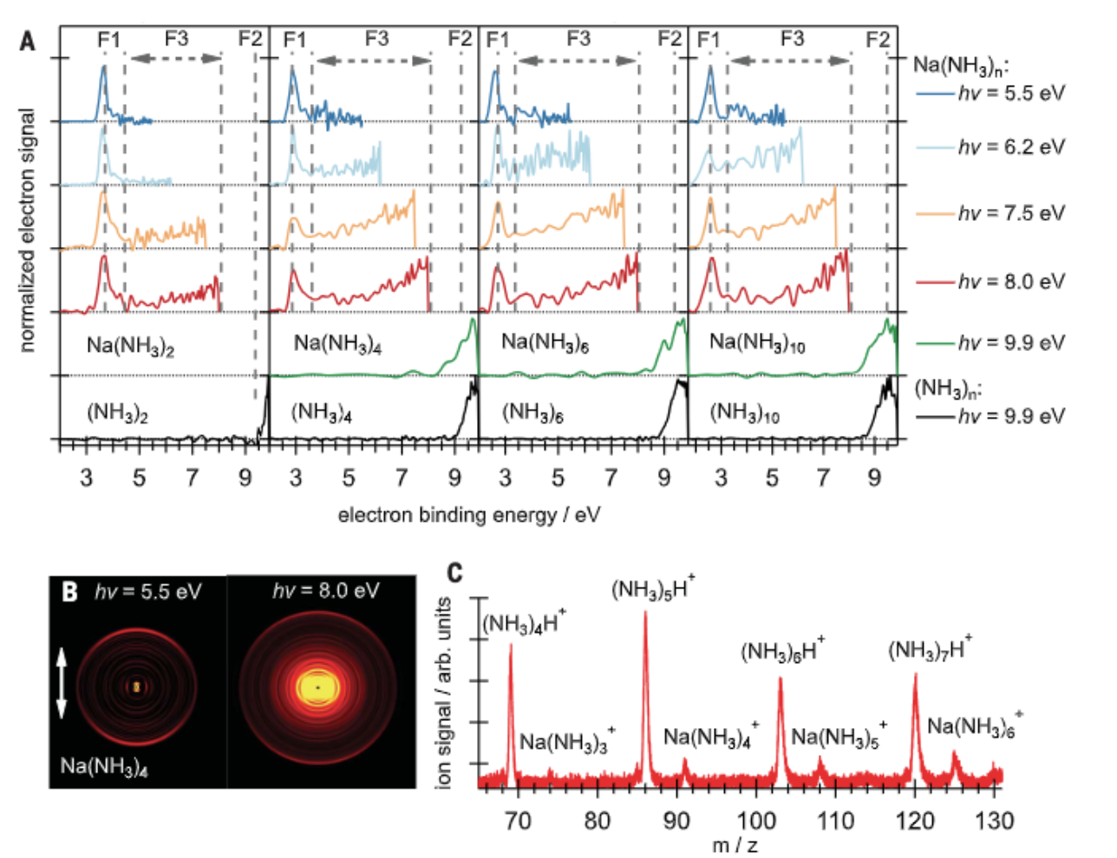
Photon Science Applications in the ARIA energy range
Atomic, Molecular, and Cluster Physics
ARIA will enable advanced experiments on atomic, molecular, and cluster systems, covering gas adsorbates, interfaces, and the evolution of properties from isolated particles to condensed phases. Studies range from rare gases to elements with high vaporization temperatures.
  [1] Hartweg, Sebastian, et al. "Solvated dielectrons from optical excitation: An effective source of low-energy electrons." Science 380.6650 (2023): 1161-1165.
  [2] Daniely, Amit, et al. "A Vacuum Ultraviolet Photoionization Mass Spectrometry and Density Functional Calculation Study of Formic Acid–Water Clusters." The Journal of Physical Chemistry A 128.31 (2024): 6392-6401.
  [3] Rupp, Daniela, et al. "Recombination-enhanced surface expansion of clusters in intense soft x-ray laser pulses." Physical review letters 117.15 (2016): 153401.
Low-energy electrons dissolved in liquid ammonia or aqueous media promote challenging reduction reactions, but can also cause radiation damage to biological tissue. Ultraviolet photoexcitation (5.5 – 10 eV) of metal-ammonia clusters could be used to generate tunable low-energy electrons in situ. [1]
ARIA : 7-25 eV

Slide 25
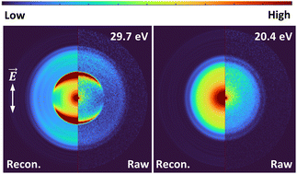
Photon Science Applications in the ARIA energy range
Molecules in the gas phase
ARIA will allow for the study of gas phase molecules to probe electronic transitions and gain insights into molecular structure and dynamics. This facilitates the investigation of ionization processes and fragmentation pathways, providing a deeper understanding of chemical reactions in the gas phase
ARIA : 7-25 eV
Oxybenzone in the gas phase can be characterized by mass spectrometry and angle-resolved photoelectron spectroscopy, using both single and multiphoton ionization schemes.
A tabletop high harmonic generation source with a monochromator was used for single-photon ionization of oxybenzone with photon energies of up to 35.7 eV.
Tsizin, S., Ban, L., Chasovskikh, E., Yoder, B. L., & Signorell, R. (2024). Valence photoelectron imaging of molecular oxybenzone. Physical Chemistry Chemical Physics, 26(28), 19236-19246.

Slide 26
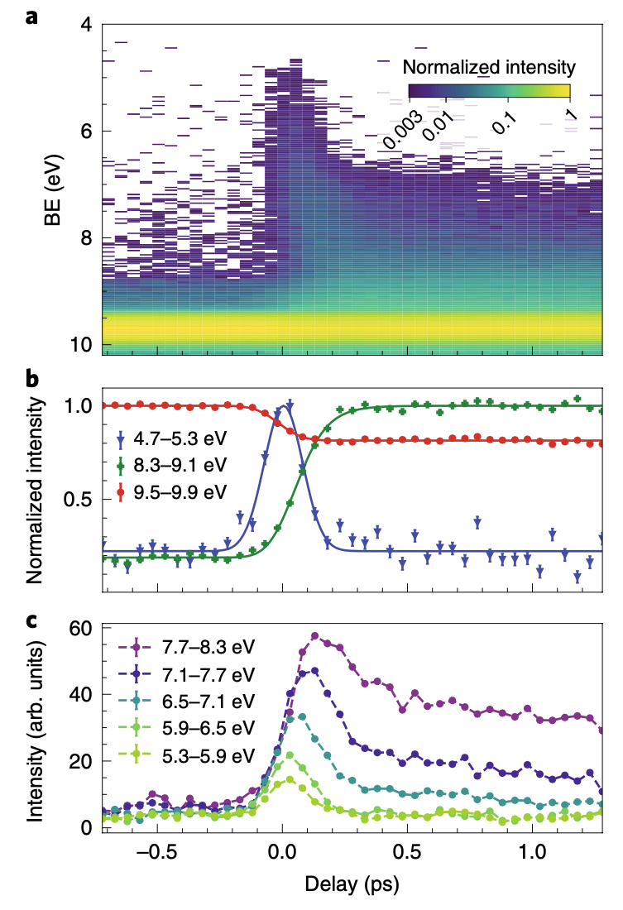
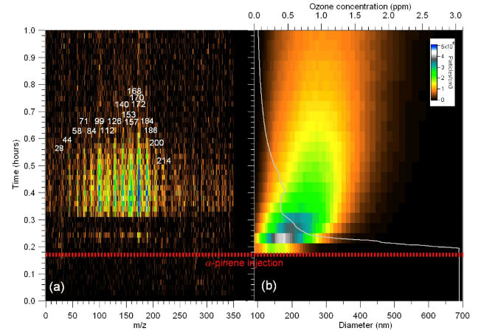
Photon Science Applications in the ARIA energy range
Photo-Ionization and Atmospheric Science:
Access to ionization thresholds and ionic states allows for the study of atmospheric species (from the troposphere to ionosphere), poorly understood combustion species, and biological materials.
Techniques like mass spectrometry and photo-emission are employed.
Studies range from rare gases to elements with high vaporization temperatures, gas adsorbates, interfaces, and the evolution of properties from isolated particles to condensed phases,
Time-resolved photoelectron spectroscopy with a seeded extreme ultraviolet free-electron laser (19.2 eV) to trace the ultrafast ring opening of gas-phase thiophenone molecules following ultraviolet photoexcitation. [2]
A reaction chamber coupled with a photoionization aerosol time-of-flight mass spectrometer was used for real-time analysis of organic and mixed aerosols, leveraging synchrotron vacuum ultraviolet photons (8 eV) for ionization. The 3D mass spectrum over time is obtained by sampling an aerosol [1]
  [1] Baeza-Romero, María Teresa, et al. "A smog chamber study coupling a photoionization aerosol electron/ion spectrometer to VUV synchrotron radiation: organic and inorganic-organic mixed aerosol analysis." The European Physical Journal D 70 (2016): 1-11.
  [2] Pathak, Shashank, et al. "Tracking the ultraviolet-induced photochemistry of thiophenone during and after ultrafast ring opening." Nature chemistry 12.9 (2020): 795-800.
  [3] Mason, N. J., et al. "Atmospheric chemistry with synchrotron radiation." Journal of Physics B: Atomic, Molecular and Optical Physics 38.9 (2005): S893.
ARIA : 7-25 eV

Slide 27
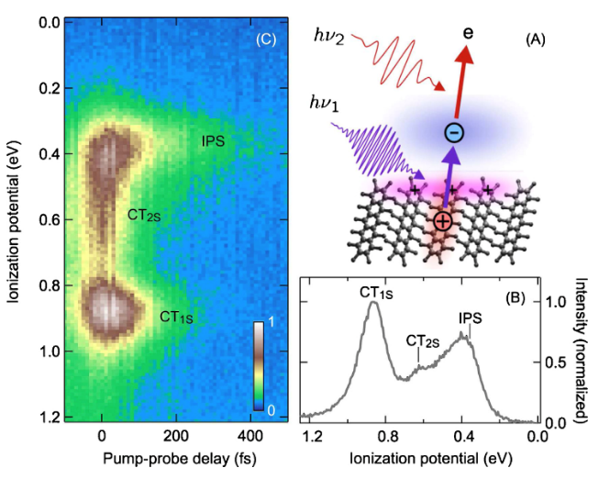
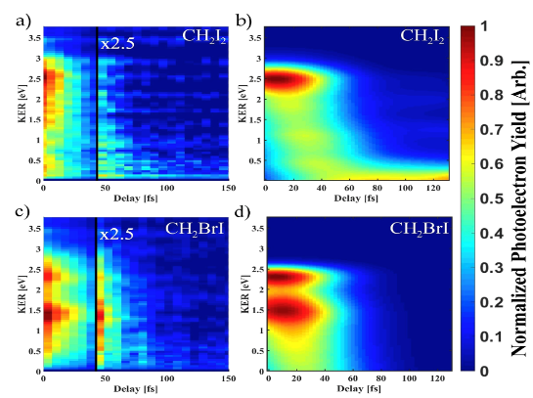
Photon Science Applications in the ARIA energy range
Electronic Structure and Excited States:
Resonant techniques in the VUV range provide insights into electronic transitions in materials like nano-carbons and metal oxides. ARIA would also support two-photon photoemission (2PPE) for studying excitons, polarons, and states relevant to spintronics batteries and solar cells.
Excited state dynamics of diiodomethane and bromoiodomethane are studied using time resolved PES. A 4.65 eV UV pump pulse excites both molecules and the dynamics are probed via photoionization using a 7.75 eV probe pulse. [1]
PES can be a powerful tool in providing a unique view on the energetics and dynamics of excitons in semiconductor materials. The experiment relies on time-resolved two-photon photoemission (TR-2PPE) spectroscopy in which the first laser pulse creates excitons in a semiconduttive material and the second laser pulse ionizes the excitons for detection. The pump is in the range of 2.15 – 4.65 eV [3]
  [1] Horton, Spencer L., et al. "Excited state dynamics of CH2I2 and CH2BrI studied with UV pump VUV probe photoelectron spectroscopy." The Journal of chemical physics 150.17 (2019).
  [2] Chen, Jiao-Jiao, et al. "A VUV photoionization time-of-flight mass spectrometer for the formation, distribution, and reaction of nano-sized neutral metal oxide clusters." International Journal of Mass Spectrometry 422 (2017): 98-104.
  [3] Zhu, X-Y. "Photoemission from excitons in organic semiconductors." Journal of Electron Spectroscopy and Related Phenomena 204 (2015): 75-79.
ARIA : 7-25 eV

Slide 28
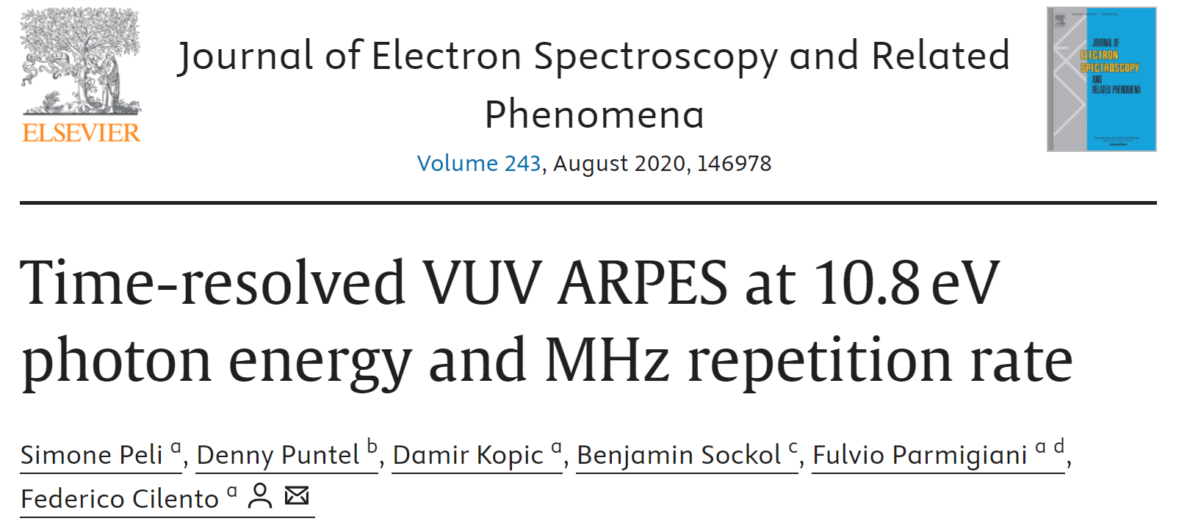
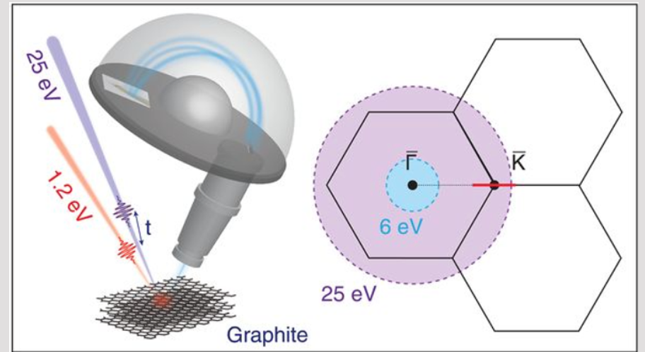
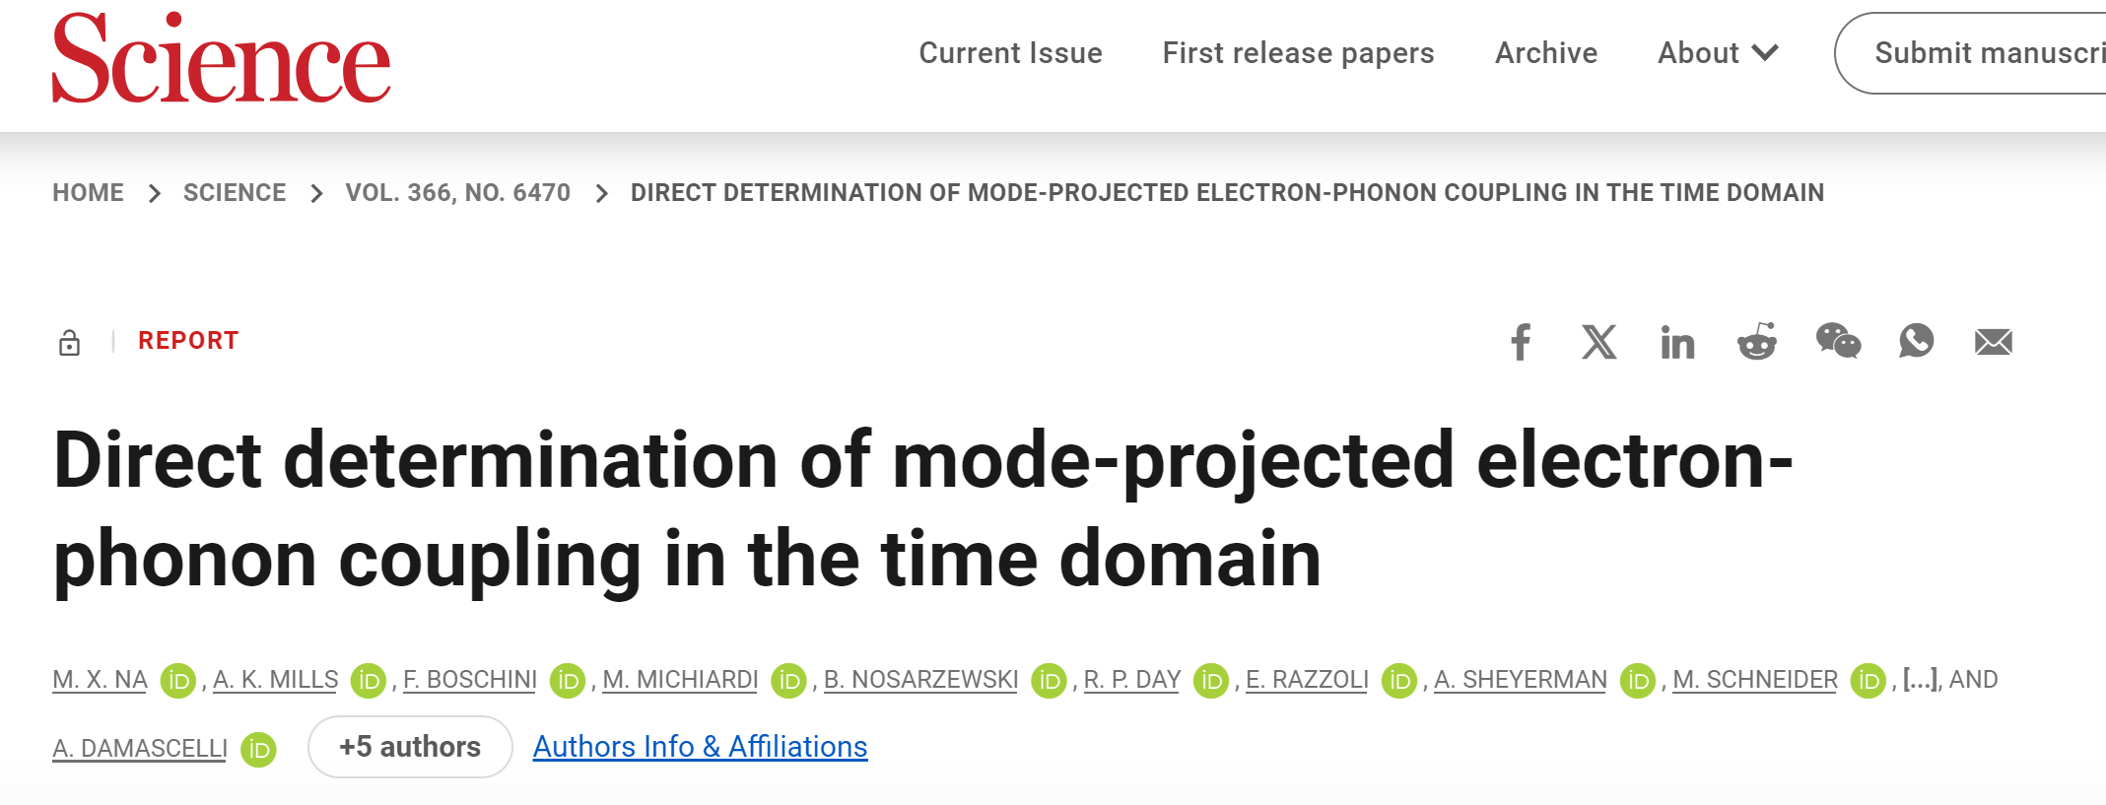
Photon Science Applications in the ARIA energy range
Electron dynamics in solids
Angle-Resolved Photo Emission Spectroscopy (ARPES) experiments can provide detailed information about the electronic dynamics and the underlying properties of materials.
Exploration of ultrafast electronic dynamics, orbital symmetries, surface vs. bulk states, and spin-dependent phenomena. ARIA will enable the access to multiphoton processes and non-linear optics.
Time- and angle-resolved photoemission spectroscopy (TR-ARPES) is applied to graphite, focusing on the dynamics of photoinjected electrons at the K point.
ARIA : 7-25 eV

Slide 29
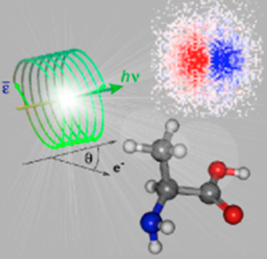
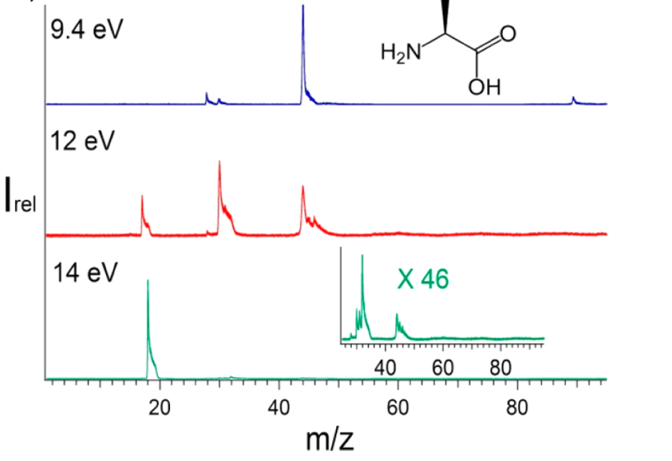
Photon Science Applications in the ARIA energy range
Chirality and Molecular Dynamics:
ARIA’s capabilities will extend to exploring chirality and natural dichroism in biological systems, aiding in the understanding of molecular structures.
  [1]Nahon, Laurent, et al. "Determination of accurate electron chiral asymmetries in fenchone and camphor in the VUV range: sensitivity to isomerism and enantiomeric purity." Physical Chemistry Chemical Physics 18.18 (2016): 12696-12706.
  [2] Tia, Maurice, et al. "VUV photodynamics and chiral asymmetry in the photoionization of gas phase alanine enantiomers." The Journal of Physical Chemistry A 118.15 (2014): 2765-2779.
  [3] Mason, N. J., et al. "Atmospheric chemistry with synchrotron radiation." Journal of Physics B: Atomic, Molecular and Optical Physics 38.9 (2005): S893.
  [4] Nahon, Laurent, et al. "DESIRS: a state-of-the-art VUV beamline featuring high resolution and variable polarization for spectroscopy and dichroism at SOLEIL." Journal of synchrotron radiation 19.4 (2012): 508-520.
The valence shell photoionization of the simplest chiral amino acid, alanine, is investigated over the vacuum ultraviolet region from its ionization threshold. Tunable and variable polarization synchrotron radiation was coupled to a double imaging photoelectron/photoion coincidence (i 2 PEPICO) spectrometer to produce mass-selected threshold photoelectron spectra and derive thestate-selected fragmentation channels. Photon energy is in the range in 9-15 eV [2].
ARIA : 7-25 eV

Slide 30
The ARIA beamline

Slide 31
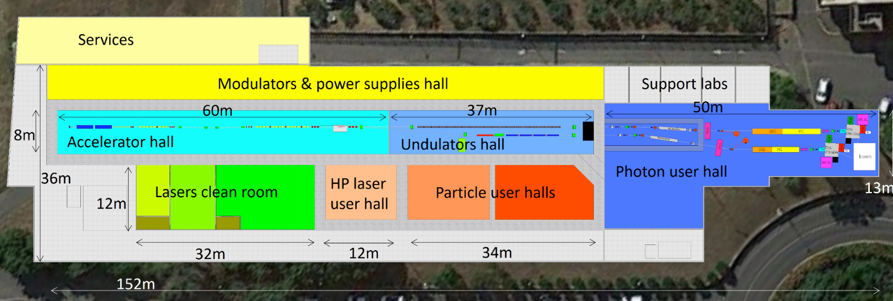
The ARIA beamline
Layout of the EuPRAXIA@SPARC_LAB facility

Slide 32
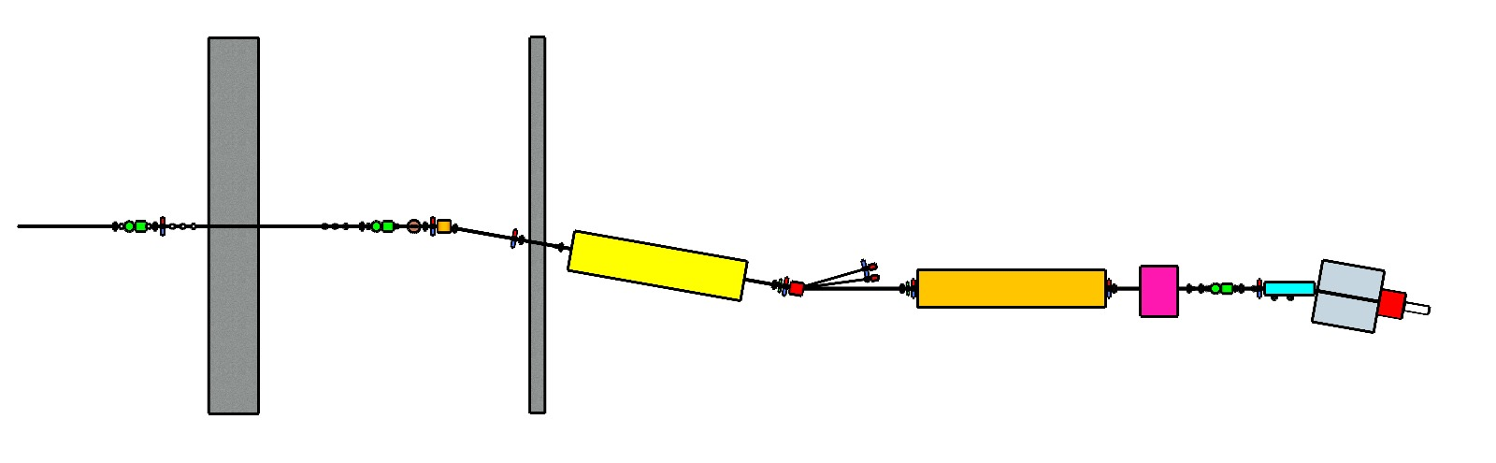
The ARIA beamline
After the undulator, approximately 50 m of the beamline will deliver the photon beam to an experimental chamber.
All of its elements can be divided into two different conceptual groups: beam transport and beam diagnostics.
Monochromator area
Split-and-delay area
GDM KB
Spectrometer Polarization/time
area Experimental chamber
Courtesy of F. Villa

Slide 33
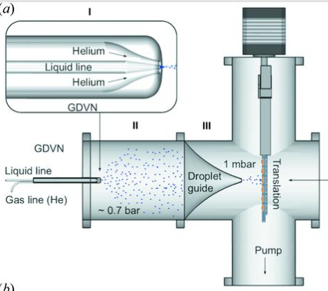
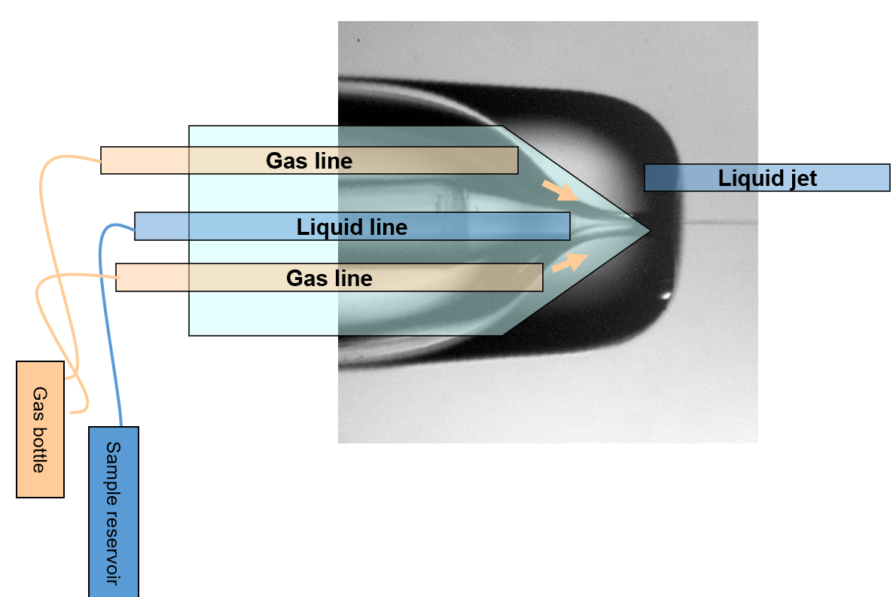
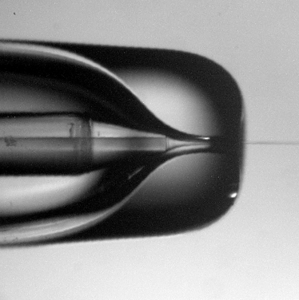
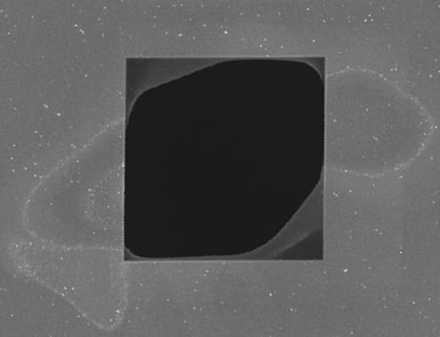
The ARIA beamline
Sample delivery systems (to be shared with AQUA)
Liquid jets (micro-jets, based on the gas dynamic virtual nozzle technology, including those developed for sample mixing and for a lower sample consumption at pulsed sources)
- Aerosols sources for gas-phase measurements
Solid samples mounted on motorized micro-precision stages and/or hexapod-like devices. Grids for single-shot expose-and-destroy measurements.
10 μm

Slide 34
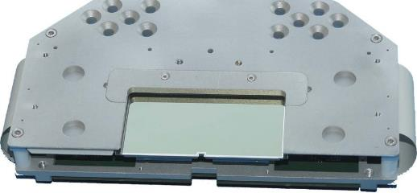
The ARIA beamline
Detectors
(some to be shared with AQUA)
Photons
2D, small pixel, fast-readout,
high dynamic range detector
0D & 2D energy-resolved detector for spectroscopy
Electron & Ions
High position sensitivity, large detection area, fine gridding to allow reconstruction of three-dimensional arrangement and motion of atoms within a molecule and distinguish between ions of different masses and charge states

Slide 35
The ARIA beamline
An inlet for an external laser will allow for the performing of laser pump/FEL– probe time-resolved experiments.
Two external laser sources (to be shared with AQUA) are foreseen – but open for discussion!
1- Ti:sapphire fixed wavelength (800nm) femtosecond laser, with also the possibility of exploiting second (400 nm) and third (267nm) harmonics.
2- Optical Parametric Amplifier (OPA), with tens of femtosecond pulses in the 700-900 nm range. Options to go from UV to MIR.

Slide 36
For this starting point, thanks to
(for discussions, ideas and inputs for this presentation)
Marcello Coreno
Emiliano De Santis
Luca Giannessi
Augusto Marcelli
Michele Opromolla
Emiliano Principi
Fabio Villa
All people in WA8
You all for the kind attention

