Slide 1
High repetition rate C-band photoinjector
Gilles Jacopo Silvi* (Sapienza University of Rome & INFN-LNF)
EuPRAXIA_PP Annual Meeting 2024
On behalf of the EuPRAXIA@SPARC_LAB collaboration
*gillesjacopo.silvi@uniroma1.it

Slide 2


OUTLINE
EuPRAXIA@SPARC_LAB injector base-line
Motivation for the upgrade to a full C-band Injector
Preliminary layout and beam dynamics studies
C-band injector proposal for future upgrade
Improvement in beam dynamics
Conclusions and future prospectives

Slide 3
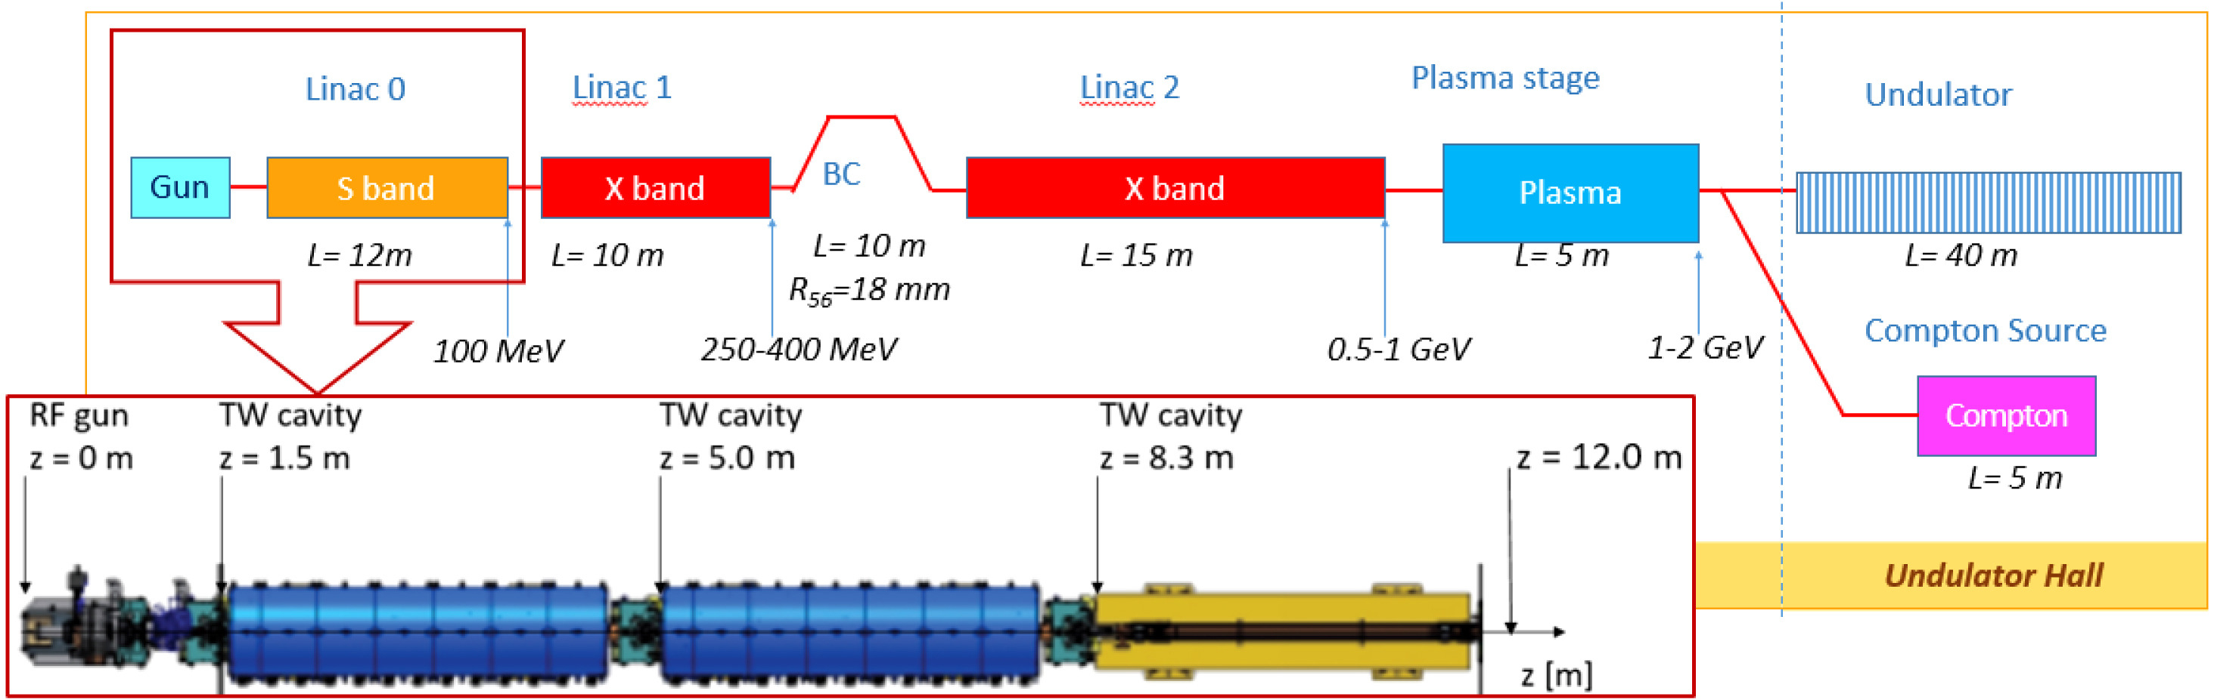
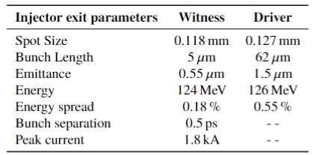
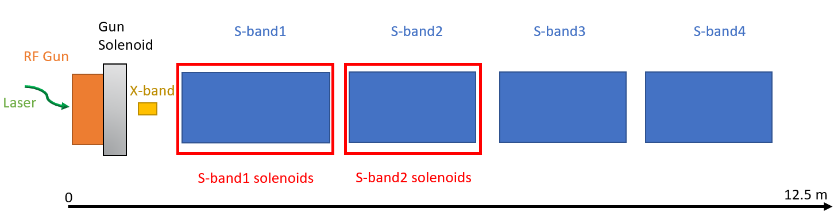
EuPRAXIA@SPARC_LAB base-line RF injector
1,6 cells S-band RF Gun equipped with a solenoid
4 TW S-band accelerating structures, the first one 3 m long while the other 2 m
2 emittance compensation solenoids around the VB sections
Overall length of ≈ 13 m
[1] A. Giribono et al. EuPRAXIA@SPARC_LAB, The high brightness RF photo injector layout proposal, NIMA (2018)

Slide 4
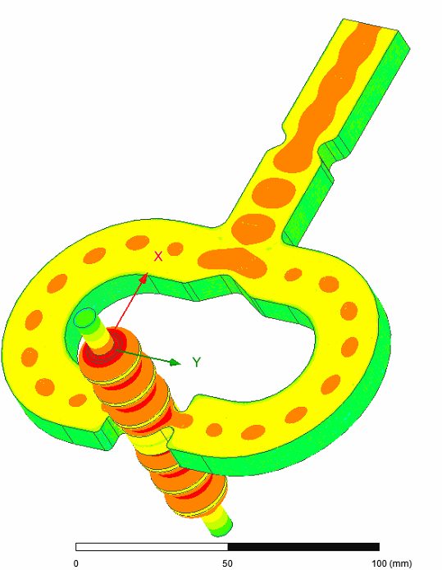
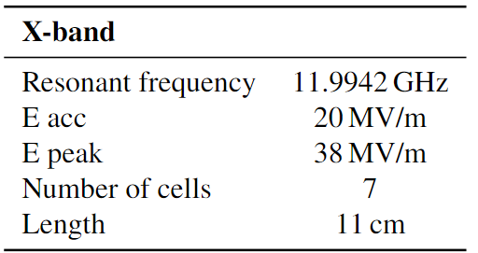
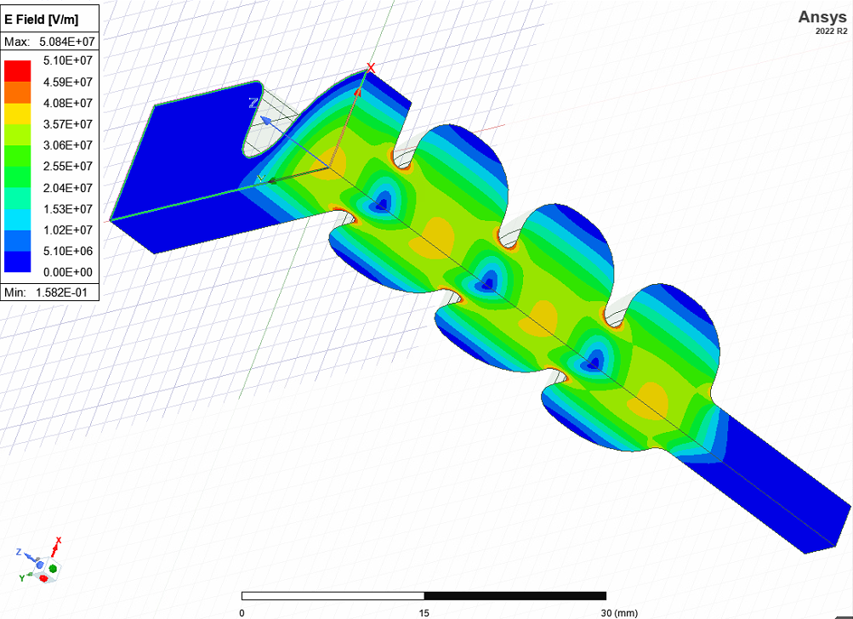
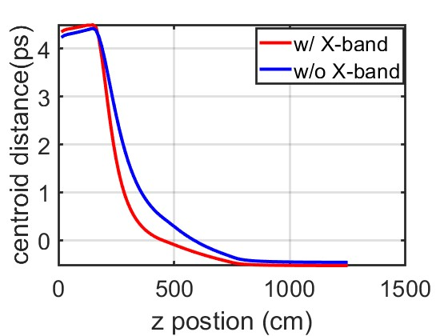
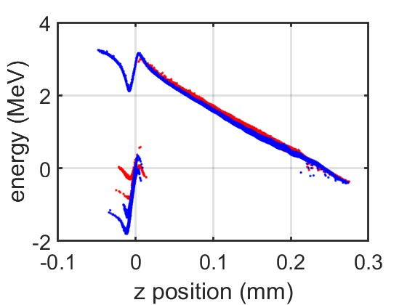
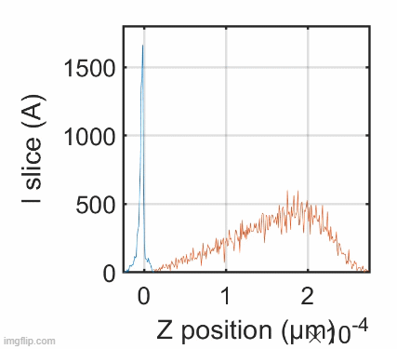

Working point optimization
Courtesy of L. Faillace
[2] Bacci A, Faillace L and Rossetti Conti M 2018 Extreme high brightness electron beam generation in a space charge regime.
[3] Alesini D et al., 2015 Study of a C-band harmonic RF system to optimize the RF bunch compression process of the SPARC beam 6th International Particle Accelerator Conference p TUPWA058
[4] Emma P., 2001 X-Band RF harmonic compensation for linear bunch compression in the LCLS SLAC Nation Accelerator Laboratory Technical Note SLAC-TN-05-004, LCLS-TN-01-1
[5] G.J Silvi et al., Optimizing beam dynamics in the EuPRAXIA@SPARC_LAB RF injector, SIF Congress 2023, 10.1393/ncc/i2024-24323-5
Notes:
Improving VB stability with HHC. The beam's stability can be improved by adding a High Harmonic Cavity (HHC) to pre-correct the bunch Longitudinal Phase Space to shorten and flatter the charge distribution and manipulate the beams to reach proper transverse and longitudinal parameters. The current profile is stabilized, and velocity bunching moves peak current while the X-band centers it.
In the S-band case, it has been noticed that a High Harmonic Cavity (HHC) could be used to improve beam stability, the X-band shapes the current distribution and pre-corrects the longitudinal phase space.
Downstream the drift the bunch enters Into a short, high frequency (x-band) accelerating cavity, that decelerates the bunch of 1,27 MeV. This deceleration that brings the bunch at low energy has many important effects: 1) it strengthens the long. space charge effects, also if the long. laminarity decreases, favoring a faster compression; 2) moves the bunch spike current on the bunch tail pre-compensating the symmetric VB effects, resulting in a much more uniform charge distribution at the compression end; 3) provides a pre-compression; 4) it enlarges the envelope relaxing transversal space charge effects; 5) applies a pre-correction of the radio rf curvature; 6) the energy decreasing results in a larger bunch vs. rf-phase slippage, a key effect for the VB technique.

Slide 5
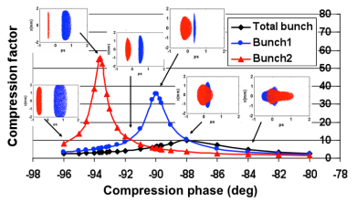
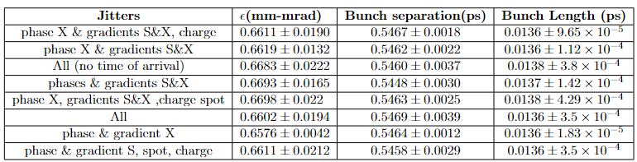
Stability studies
For a working point with the characteristics of the EuPRAXIA setup, the temporal jitter between the driver and witness beams of approximately δt ≈ few fs for an energy jitter of 0.1%.
[13] A Mostacci et al. Proceedings of IPAC2011, San Sebastián, Spain
Charge | Spot Size | RF phases (S/X) | Acc field amplitude
2 % | 1 % | 0,02/0,08 deg | 0.02% rms

Slide 6
Motivation for a C-band RF injector
The C-band technology allows for:
Higher efficiency suitable for applications requiring repetition rates in the 100 Hz ÷ 400 Hz range.
Reduce injector footprint by maintaining high-quality high-brightness beams.
Easier transition to the X-band booster.
Peak field Higher than S-band.
Gun 160-180 MV/m
TW structures 60 MV/m (35 MV/m S-band) [6]
[6] W. Fang et al., “Design, fabrication and first beam tests ofthe c-band rf acceleration unit at sinap,” Nuclear Instru-ments and Methods in Physics Research Section A: Acceler-ators, Spectrometers, Detectors and Associated Equipment,vol. 823, pp. 91–97, 2016, issn: 0168-9002. doi: https ://doi.org/10.1016/j.nima.2016.03.101. https://www.sciencedirect.com/science/article/pii/S0168900216301474
[7] D.Alesini,A.Bacci,M.Bellaveglia.,BeamenergyupgradeofthefrascatiFEL LINACwithaC-bandRFsystem,in:ProceedingsoftheIPAC10,Kyoto,Japan, 2010,pp.3682–3684.
Notes:
The S-band technology has been chosen being the current state of the art with stable and reliable performances in terms of beam brightness. The upgrade of the S-band photoinjector with a C-band one is actually in order to compact the machine and increase the beam brightness. The C-band technology has been chosen being a good compromise between the S and the X-band technology. It enables a higher available peak field in the gun region, which results in beam brightness, and higher accelerating gradient in the TW accelerating structures if compared to the S-band technology; in the meanwhile, it allows larger flexibility as regards the electron beam charge and length if compared to the X-band solution. In addition, it should ensure a reliable operation at up to 1 kHz repetition rate.

Slide 7


Preliminary layout and beam dynamics studies
The beam dynamics has been studied to generate a single bunch with a variable length in the range 55–280 μm and different charges.
[8] Giribono et al. - Dynamics studies of high brightness electron beams in a normal conducting, high repetition rate C-band injector, PHYSICAL REVIEW ACCELERATORS AND BEAMS 26, 083402 (2023)
[9] G. D’Auria et al, Compact-Light Design Study, doi:10.18429/JACoWIPAC2019-TUPRB032
driver for PWFA
280 μm
100 μm
55 μm
Notes:
The beam dynamics has been studied to generate a 200-pC beam with a variable length of 55–280 μm. In detail, three beam lengths have been investigated, 55, 100, and 280 μm, the first one of interest as a driver of a particle Wakefield acceleration accelerator and the following ones representing the maximum lengths to avoid distortions of the longitudinal phase space in a downstream X or C-band booster linac, respectively. XLS, IFAST and EuPRAXIA collaboration. One of the working point studied foresees a driver-like beam
Aggiungere Singolo bunch

Slide 8
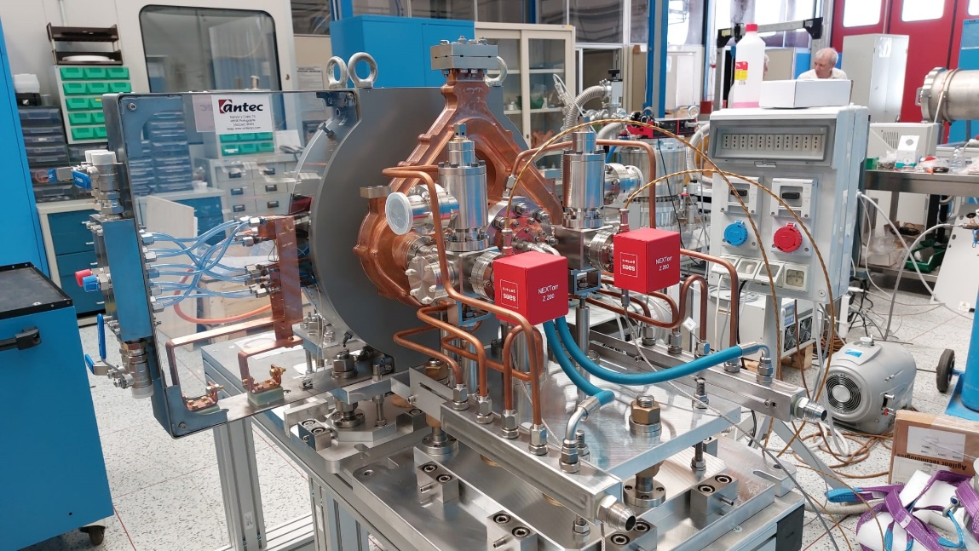
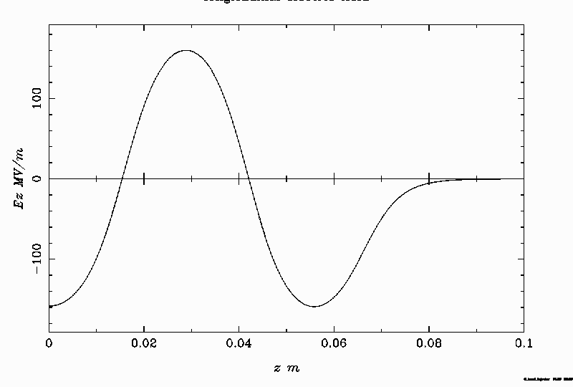
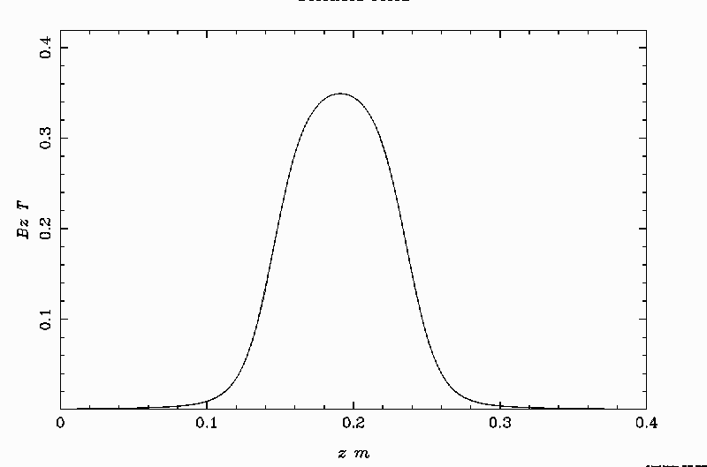
The C-band Gun layout
The Gun peak field is set to 160 MV/m, the limitation over the higher peak field for the high rep rate operation has been overcome by elongating the gun up 2,6 [10] cells so the beam energy after the Gun is 5,7 MeV
Gun Field
Solenoid Field
[10] M. Croia, D. Alesini, F. Cardelli, M. Diomede, M. Ferrario, A. Giribono, S. Romeo, C. Vaccarezza, and A. Vannozzi, High gradient ultra-high brightness C-band photoinjector optimization, J. Phys. Conf. Ser. 1596, 012031 (2020)
Notes:
The photoinjector presented in this presentation partially breaks with the scaling laws and faces also with technological issues related to the rf components in case of high repetition rate operation, i.e., maximum available peak fields, and operational and mechanical needs related to minimum free space between elements for diagnostics, vacuum or others. A huge effort has concerned the design of a new C-band gun with its own power distribution system and solenoid. Indeed, the injector described in [10] relies on a 1.6 cell C-band gun operating at least at 240 MV/m peak field, higher than the available one in case of high repetition rate operation—160 MV/m at 1 kHz repetition rate operation. The limitation on the peak field at the cathode forced by the high repetition rate has been overcame by elongating the gun with one more cell so the beam enters the downstream accelerating section with at least 5.5 MeV energy Also, the introduction of a mode launcher opens to an increased flexibility in positioning the input waveguide relative to the gun body that turns in more powerful cooling capability of the accelerating cells especially useful for the high repetition rate operation. The gun design, with the mode launcher, and the on-axis electromagnetic field are reported in Fig. . This layout also presents two main disadvantages: the continuation of the electromagnetic field in the mode launcher region, that can affect the beam dynamics, and a more challenging design for the gun solenoid requiring a bigger bore and the introduction of a bucking coil to zero the field at the cathode in order to reduce the magnetic field contribution to the emittance of the emitted beam.

Slide 9
C-band Gun specs
2.6 cells Standing wave RF Gun
Coupling coefficient β = 3
  Short RF Pulses
  Reducing BDR, pulsed heating,
  Reducing power dissipation
Elliptical iris profile with large aperture
  Reduce surface peak field
  Increase frequency separation,
  Increase pumping efficiency
4 port mode launcher on-axis coupling [*]
  Low pulsed heating
  compensation of the dipole and quadrupole field components
  Integrate 2 pumping units
Parameter | Unit | Value
Frequency | GHz | 5.712
Number of cells |  | 2.6
E_{cath}/√P_{diss} | MV/(m⋅MW^{0.5}) | 51.4
Peak input power | MW | 18
Cathode field | MV/m | 160 (180)
Cathode type |  | OFHC copper
Rep. rate | Hz | 100 (400)
Quality factor |  | 11900
Filling time | ns | 166
Coupling coefficient |  | 3
RF pulse length | ns | 300
Mode sep. π-π/2 | MHz | 47
E_{surf}/E_{cath} |  | 0.96
Mod. Poy. Vect. | W/μm² | 2.5
Pulsed heating | °C | <16
Av.diss. Power | W | 250 (1000)
Courtesy of F. Cardelli
* [11] Design based on G Castorina et al 2018 J. Phys.: Conf. Ser. 1067 082025
[12] D. Alesini et al., Design, realization and high-power RF test of the new brazed free C band photo-gun, Proc. IPAC'24, 2024
[13] F. Cardelli et al., Design and realization of high-gradient C-band standing wave RF gun, SIF Congress 2023, 10.1393/ncc/i2024-24272-y
Notes:
It has been designed to set the coupling coefficient equal to 3 so to allow the operation with short rf pulses (τrf < 300 ns) to reduce the breakdown rate (BDR), the pulsed heating, and the power dissipation.

Slide 10
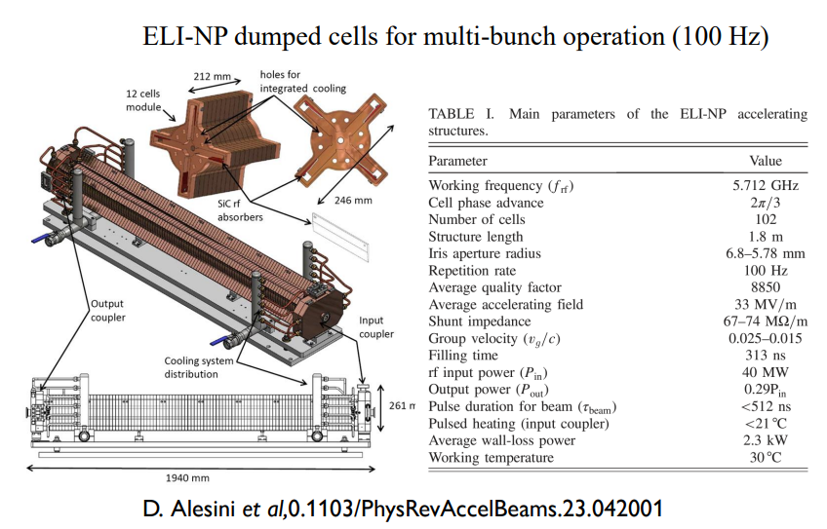
C-band TW structures, the INFN-LNF expertise
[14] D. Alesini et al,0.1103/PhysRevAccelBeams.23.042001

Slide 11
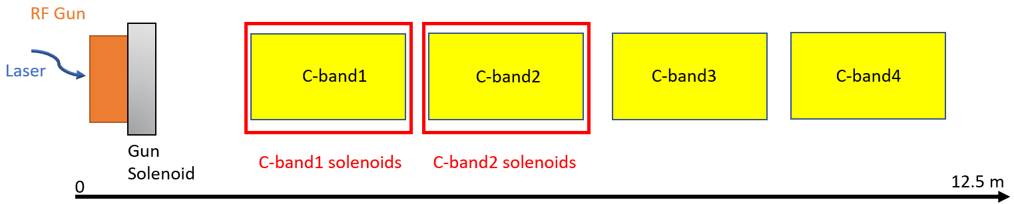
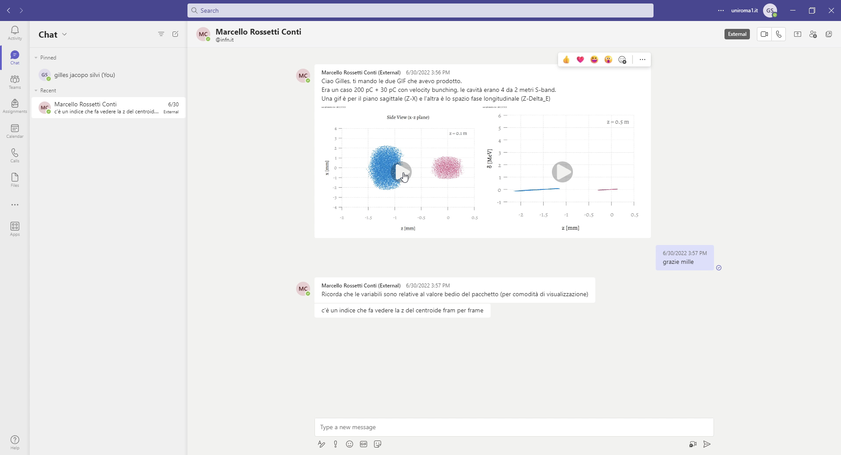
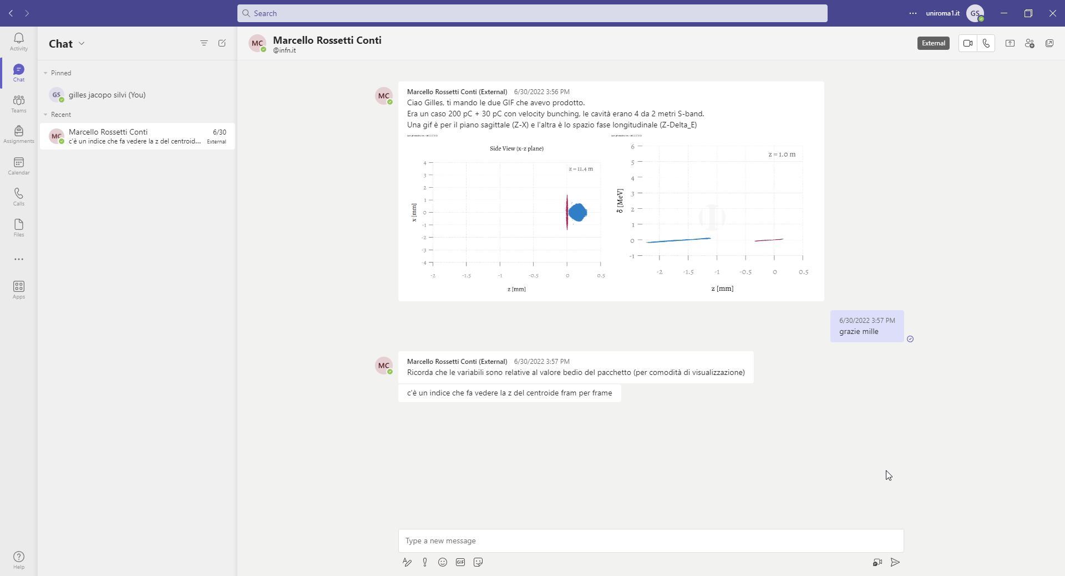
Comb working point
Velocity bunching
Emittance compensation solenoids
Courtesy of M. Rossetti Conti

Slide 12
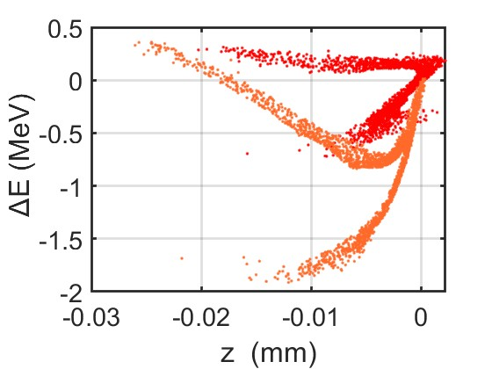
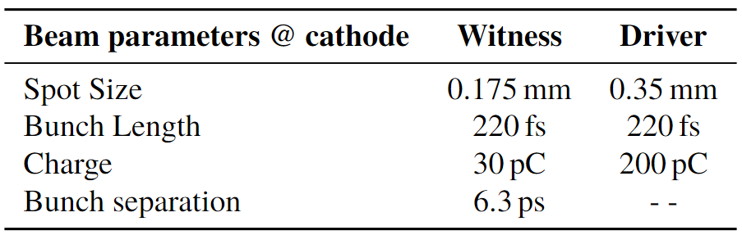
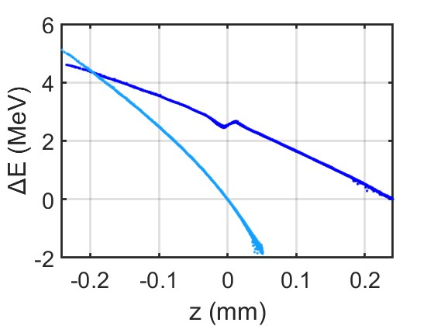
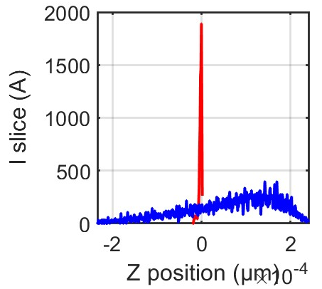

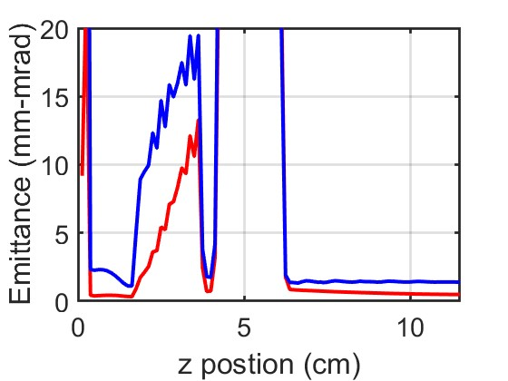
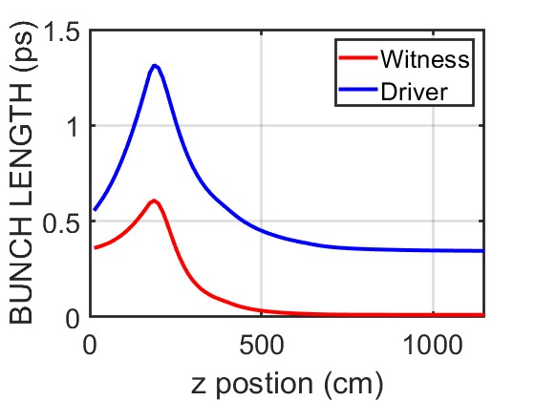


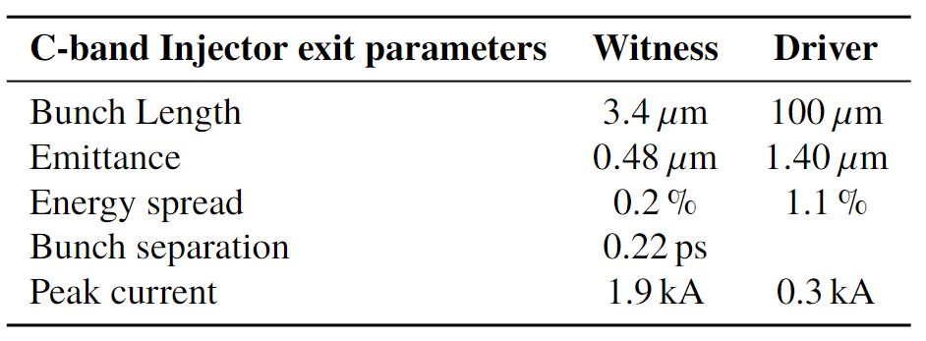
Comb beam dynamics results
Driver comb
Driver
Witness comb
Witness
Z (mm)
Z (m)
Z (cm)
Notes:
This layout was initially taken as a reference and subsequently optimized for Plasma Wakefield Acceleration (PWFA) applications. The primary goal was to adapt the injector configuration to effectively serve the requirements of these advanced applications. The first step in this optimization process involved implementing a second velocity bunching (VB) section in the injector layout. This addition complemented the existing VB section, allowing the system to achieve both single and comb beam lengths at the end of the injector. By introducing this second VB section, the researcher aims to enhance the flexibility and performance of the photoinjector, enabling it to produce beams with the desired properties for PWFA experiments. This enhancement was crucial for tailoring the beam characteristics to meet the stringent requirements of PWFA applications, where precise control over beam length and quality is essential for successful acceleration.

Slide 13
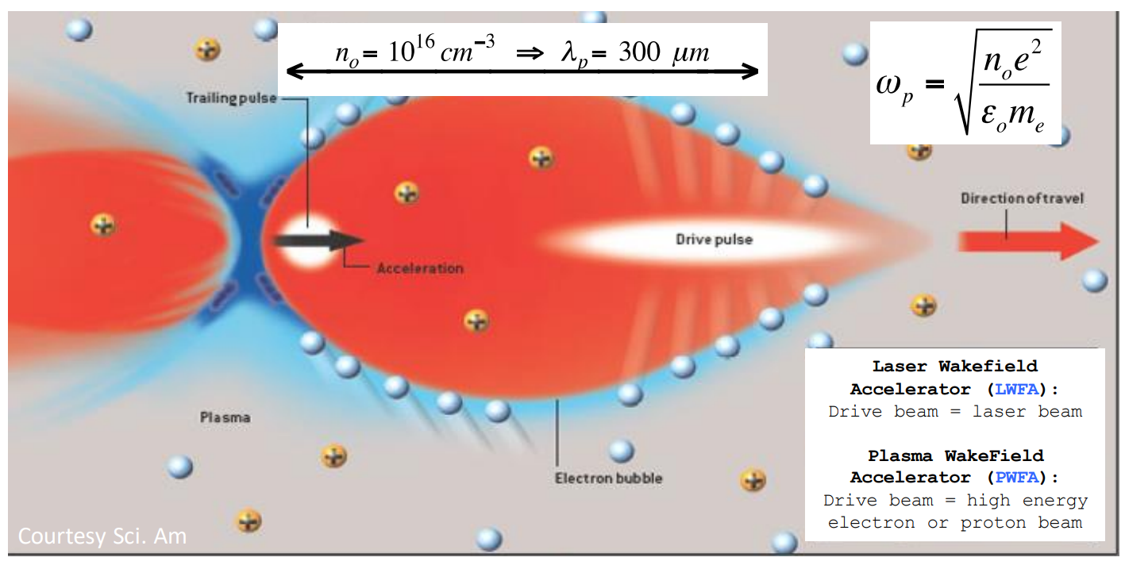
Matching condition in plasma

Slide 14
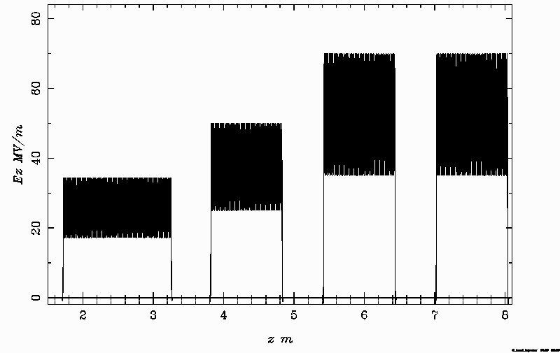
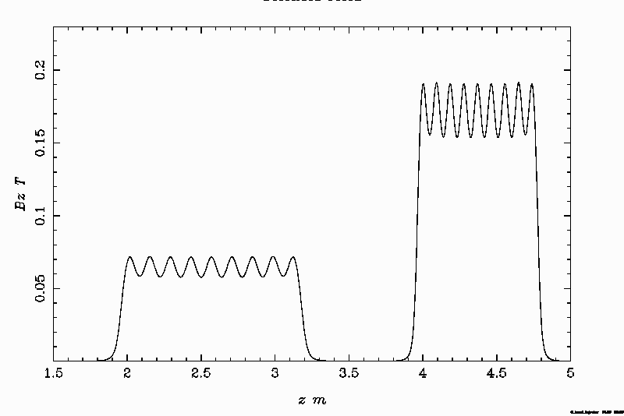
C-band injector layout proposal
The C-band injector, scaled [15] from the S-band design, features an initial cavity length of 1.5 meters, with subsequent cavities measuring 1 meter each. The electric fields within the cavities are doubled compared to the S-band configuration. The first cavity operates with a peak electric field of 34 MV/m to support VB operations. Additionally, the magnetic field in the solenoid cavities is also doubled in accordance with the scaling laws.
1,7 m
0,6 m
0,6 m
0,6 m
8 m
2,6 cells RF Gun
Emittance compensation solenoids
Beam@cathode | Witness | Driver
charge | 30 pC | 200 pC
Spot size | 0,2 mm rms | 0,32 mm rms
Bunch length | 100 fs | 100 fs
Bunch separation | 11,5 ps
Velocity bunching
Ez (MV/m)
Bz (T)
[15] J. Rosenzweig and E. Colby, Charge and wavelength scaling of RF photoinjector designs, AIP Conf. Proc. 335, 724 (1995).
Z (m)
Z (m)
Notes:
After this first benchmark of the working point, the C-band photoinjector has been scaled from the S-band layout, maintaining the 2.6 cell RF gun, shrinking by factor 2 the longitudinal lengths, while doubling the electric and magnetic fields. Also, the drift between the cathode and the first section will be properly scaled and then re-optimized. Considering the higher peak field and properly reducing the laser spot size and the duration using the well-known scaling laws. Using the ASTRA code, I optimized the positions of the sections and the integrated magnetic fields. The RF phase of the first two sections was adjusted to achieve RF compression through velocity bunching. The C-band injector, scaled from the S-band design, features an initial cavity length of 1.5 meters, with subsequent cavities each measuring 1 meter. The electric fields within the cavities are doubled compared to the S-band configuration. The first cavity operates with a peak electric field of 34.4~MV/m to support velocity bunching operations. Additionally, the magnetic field in the solenoid cavities is also doubled in accordance with the scaling laws. The final layout of the injector is shown in the following figures. The distribution at the cathode was also optimized to achieve the desired injector output parameters. The lengths of the beams at the cathode were halved as expected. However, the separation between the beams was increased to 11.5~ps to allow them to achieve the final separation required for injection into the plasma section.

Slide 15
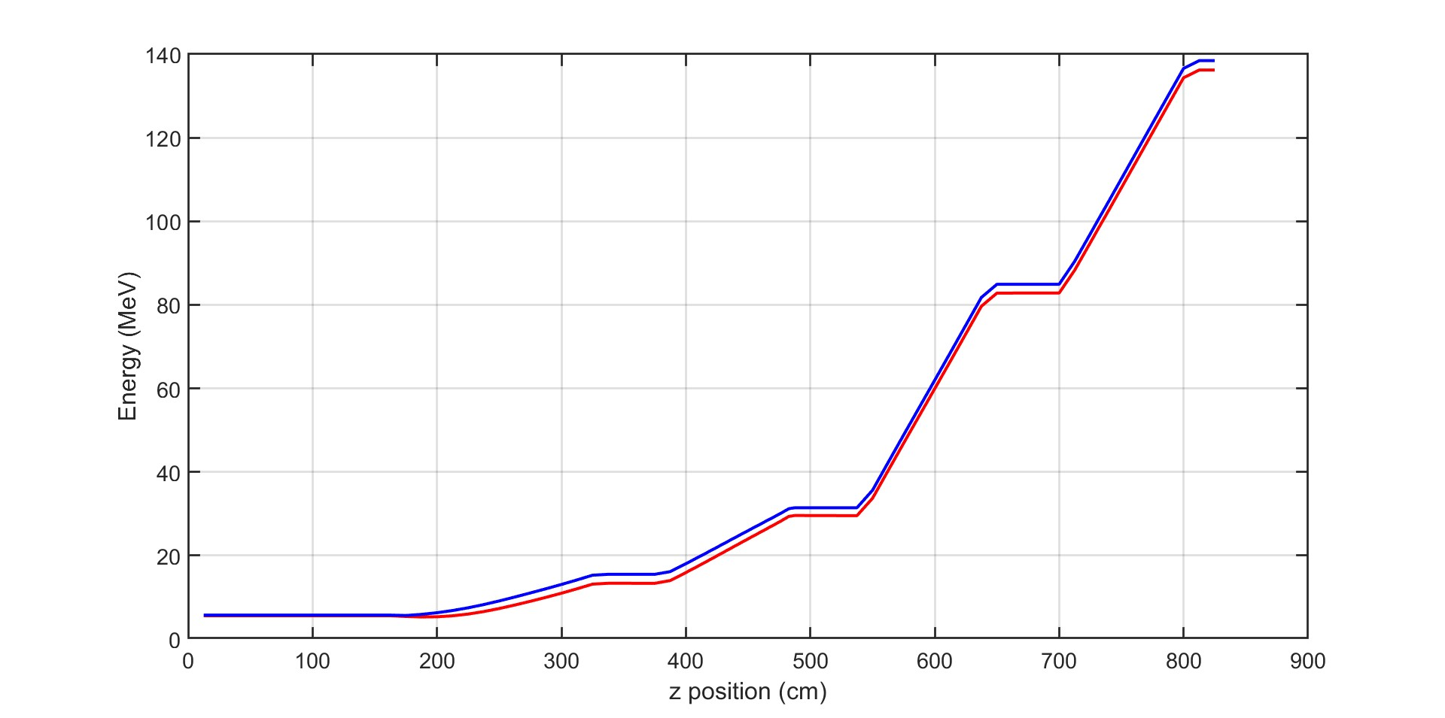
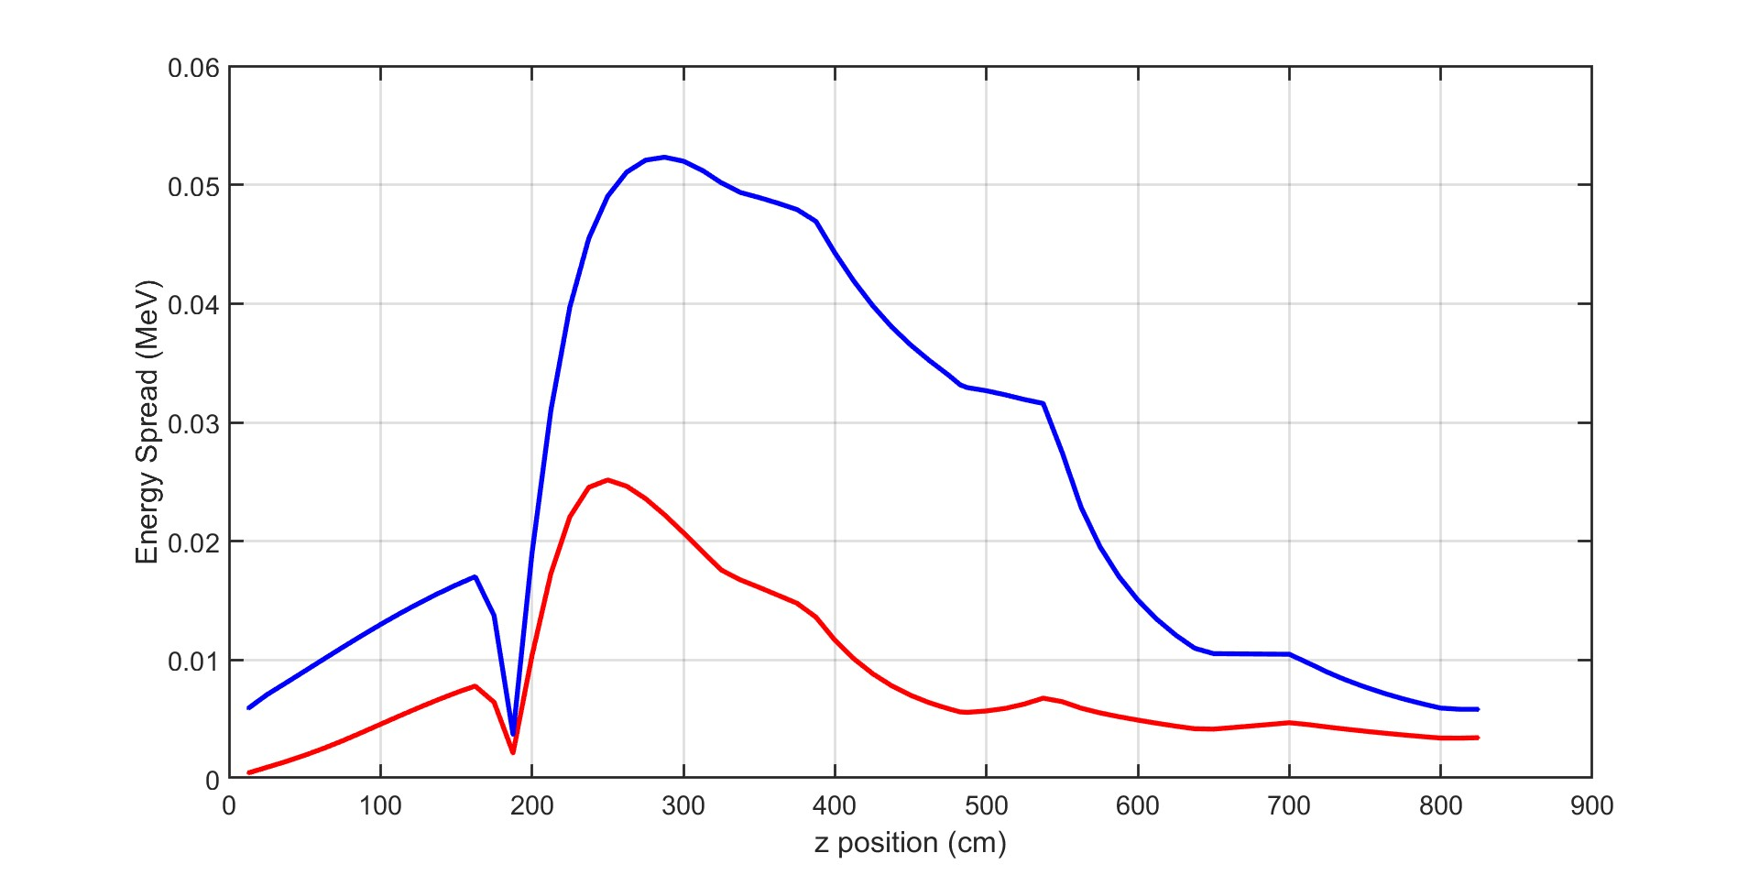
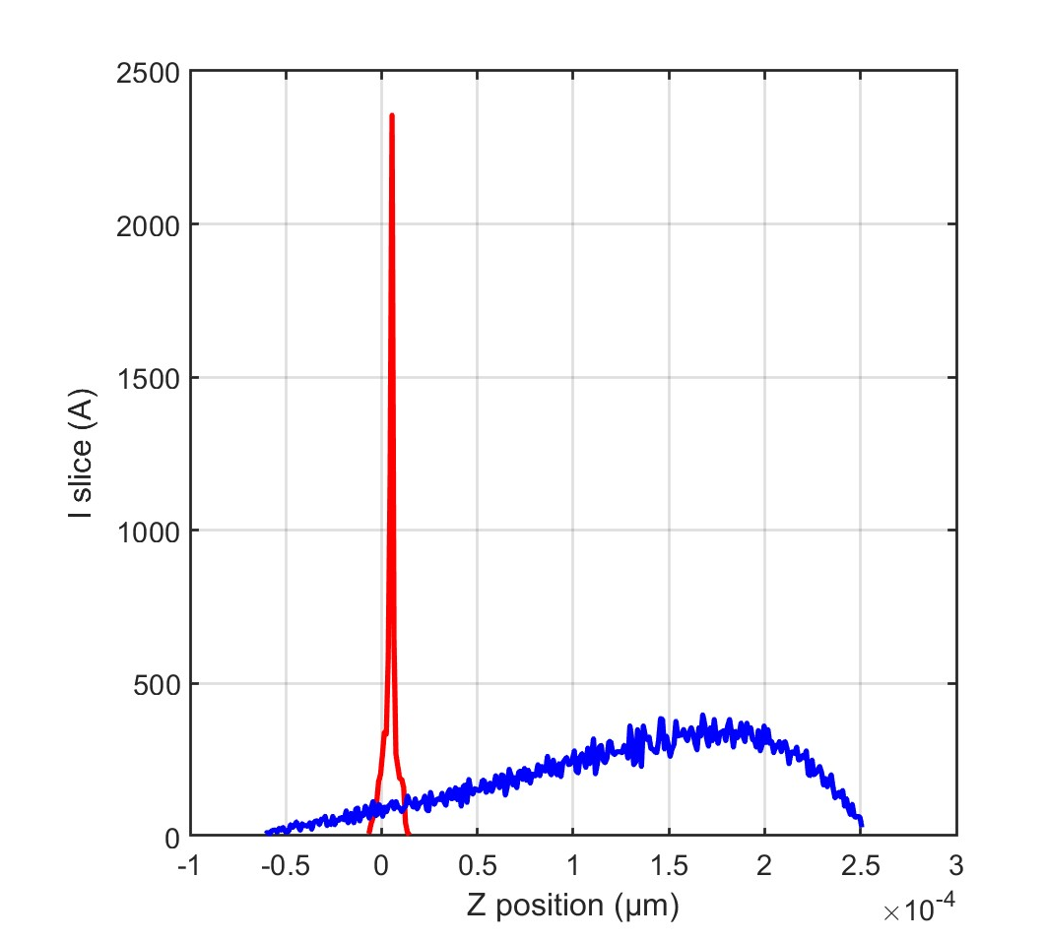
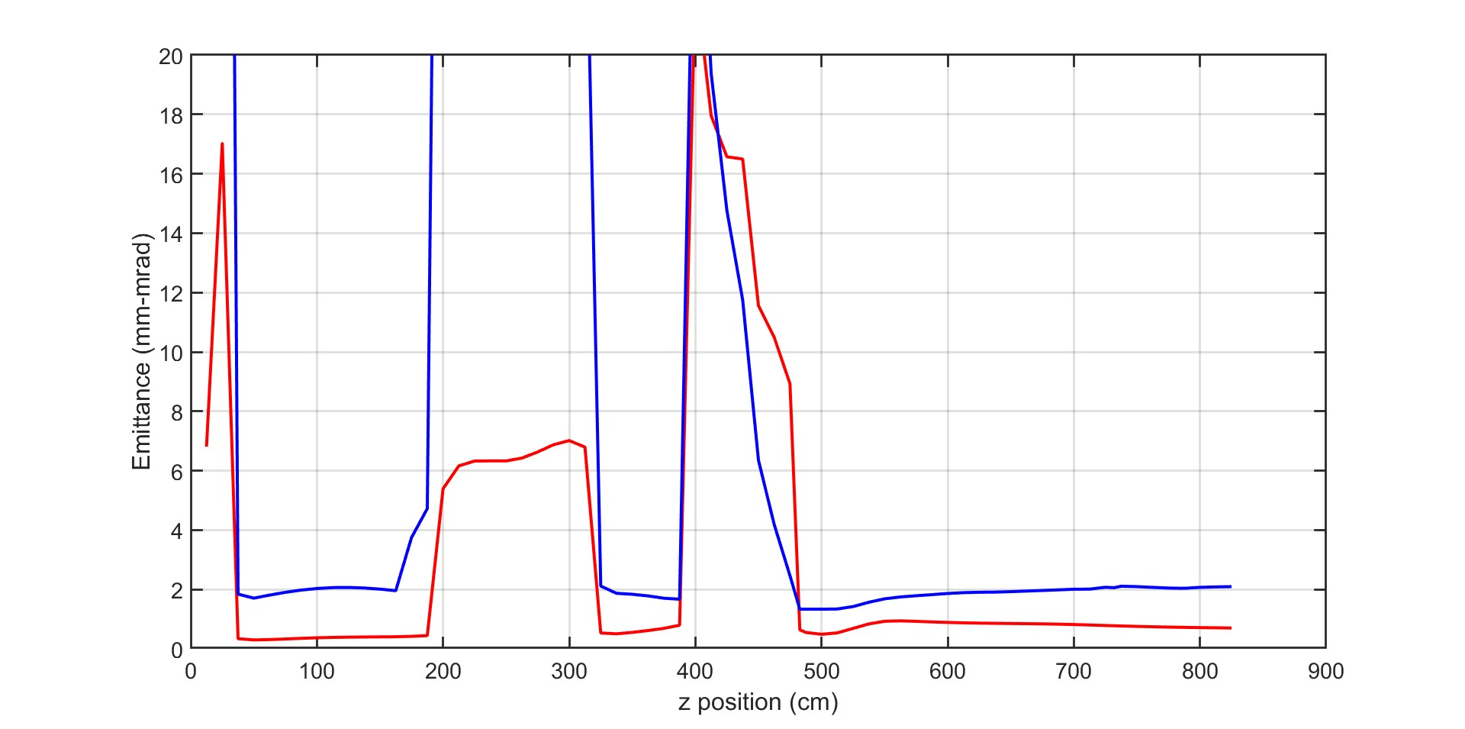
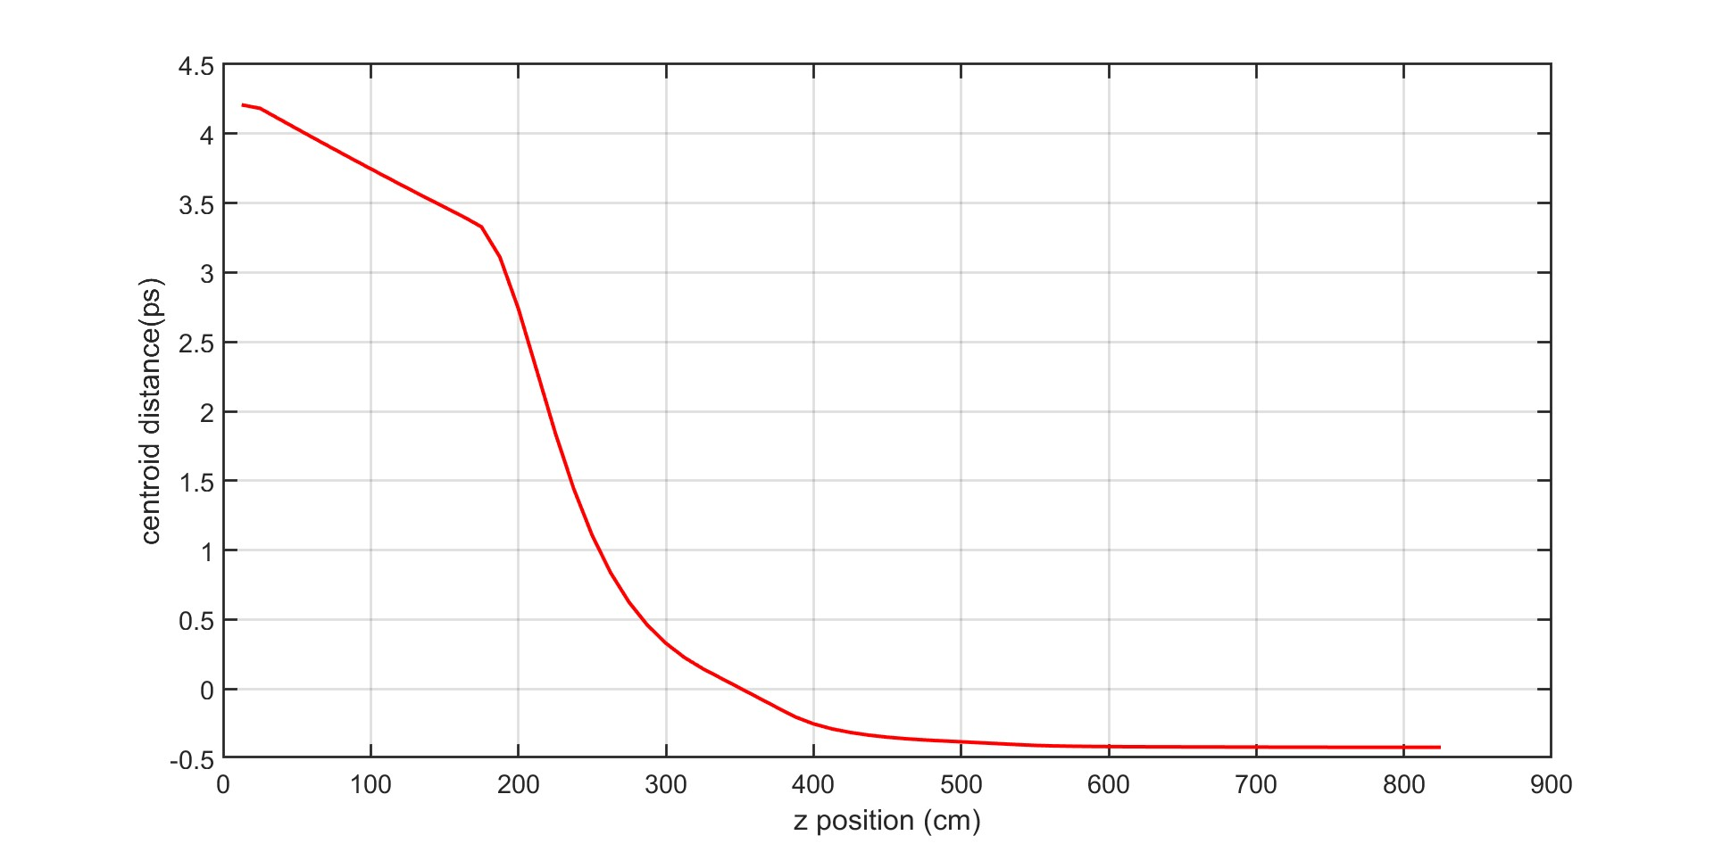
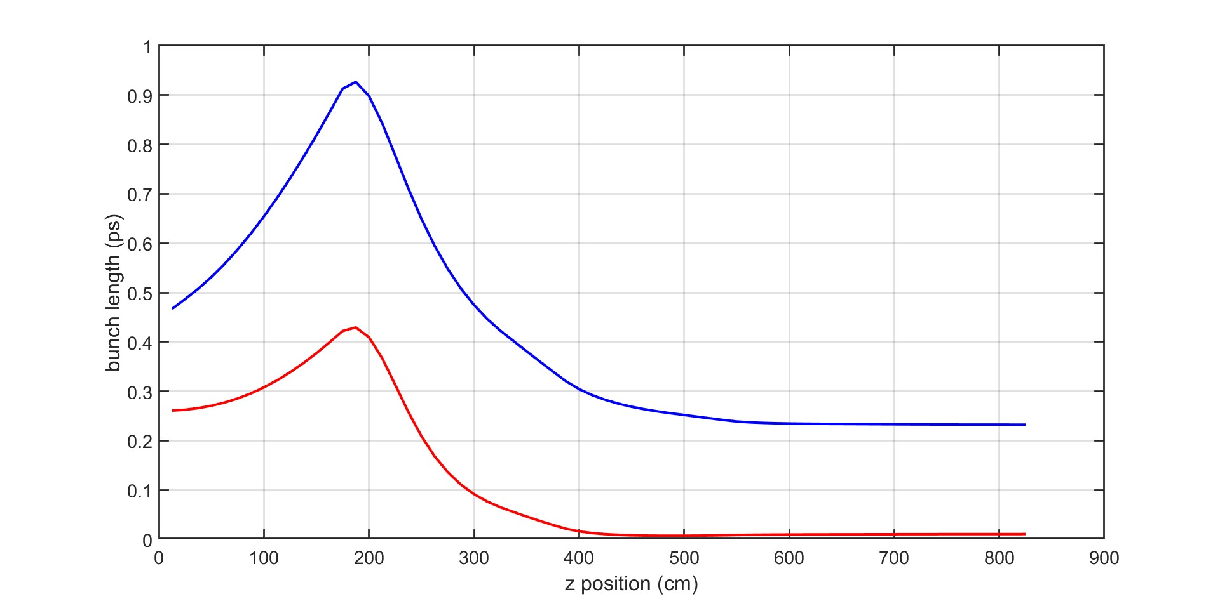
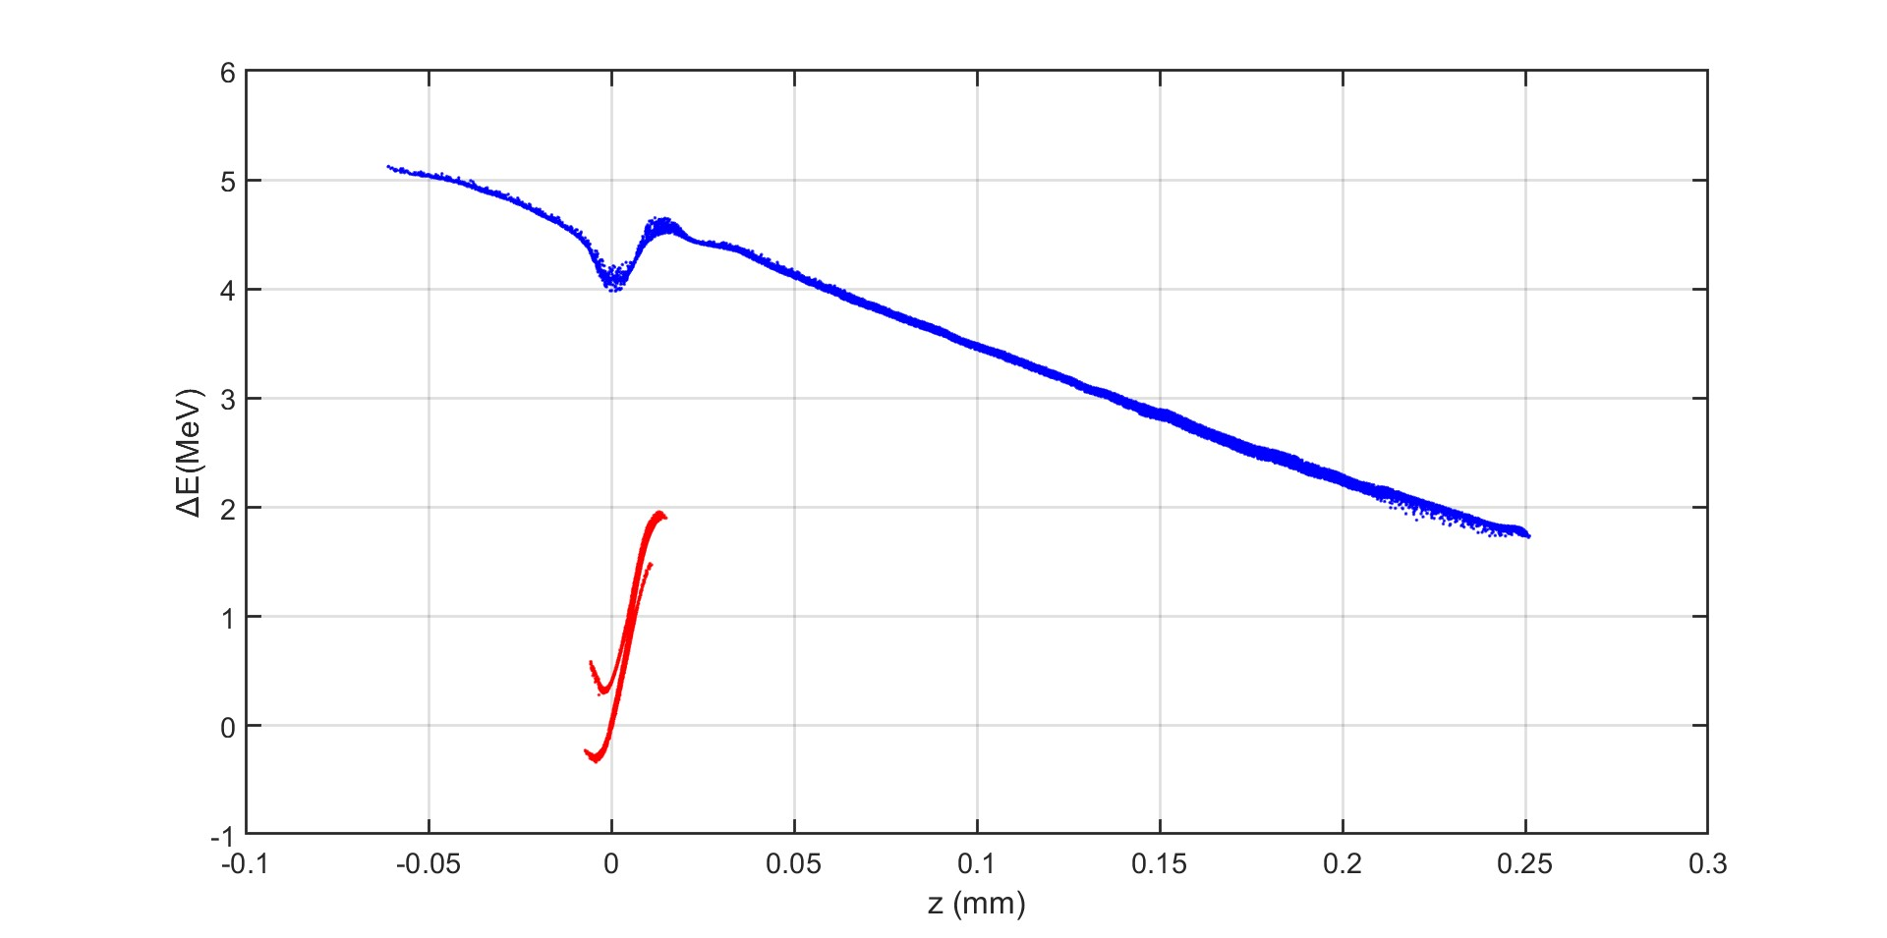
Beam dynamics simulations
Driver
Witness
Driver
Witness
Energy (MeV)
Driver
Witness
Energy spread (MeV)
I slice (A)
Z (cm)
Z (cm)
Driver
Witness
Driver
Witness
Bunch separation (ps)
Z (μm)
Emittance (mm-mrad)
Injector exit parameters | Witness / Driver
Emittance (mm-mrad) | 0,65 / 2
Energy (MeV) | 136 / 138
Energy spread (KeV) | 3,5 / 5,8
Bunch separation (ps) | 0,45
Bunch length (um) | 3,2 / 70
Z (cm)
Z (cm)
Driver
Witness
Driver
Witness
Bunch length (ps)
ΔE (MeV)
Z (cm)
Z (mm)

Slide 16

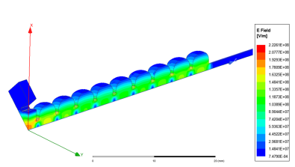
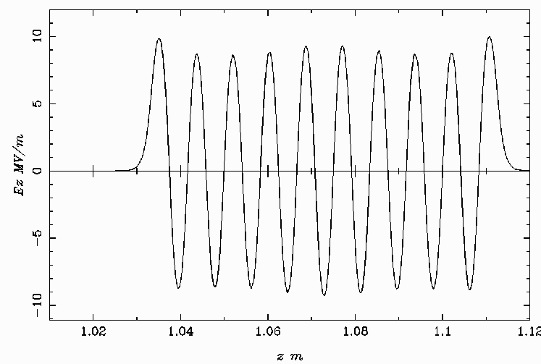
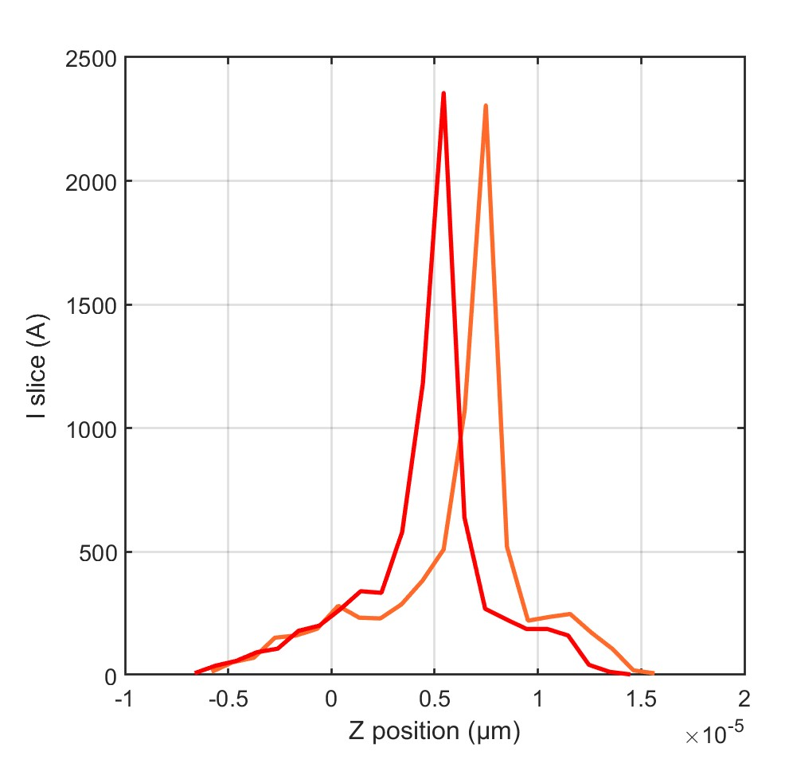
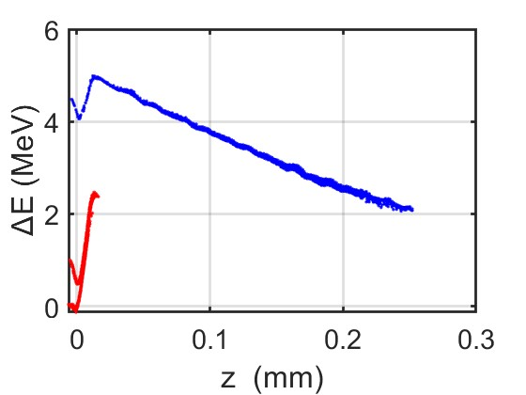
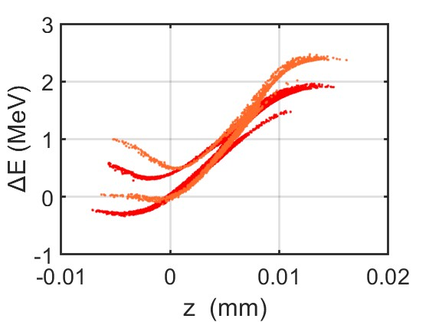
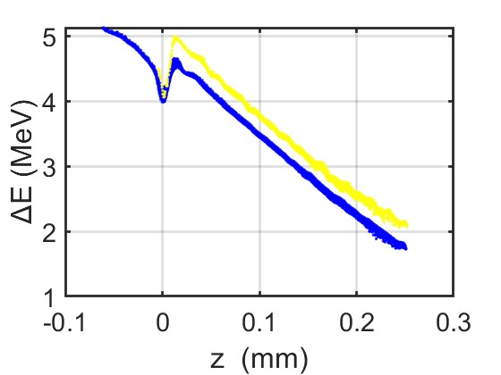
Phase space manipulation with a SW Ka-band cavity
SW Ka-band
Resonant Frequency | 36 GHz
E acc | 10 MV/m
Number of cells | 19
Length | 8 cm
Radius | 3,5 mm
Ka-band
Injector exit parameters | Witness / Driver
Emittance (mm-mrad) | 0,45 / 2,46
Energy (MeV) | 136 / 138
Energy spread (KeV) | 4,6 / 4,8
Bunch separation (ps) | 0,5
Bunch length (um) | 3,7 / 56
8 m
[17]
[16] M. Behtouei et al. ‘A SW Ka-Band linearizer structure with minimum surface electric
field for the compact light XLS project, NIMA vol 894 (2020) https://doi.org/10.1016/j.nima.2 020.164653
[17] J. Scifo et al. ‘BEAM DYNAMICS STUDIES IN A
STANDING WAVE Ka-BAND LINEARIZERIPAC2021, Campinas, SP, Brazil, doi:10.18429/JACoW-IPAC2021-MOPAB270
[18] A. Castilla, R. Apsimon, G. Burt, X. Wu, A. Latina, X. Liu, I. Syratchev, W. Wuensch, B. Spataro, and A. W. Cross
Phys. Rev. Accel. Beams 25, 112001 – Published 9 November 2022
Witness peak current
W/ Ka-band
W/o Ka-bank
Driver
Witness
W/ Ka-band
W/o Ka-bank
W/ Ka-band
W/o Ka-bank
I slice (A)
Witness
Driver
Z (μm)
Notes:
Because the side effect of the velocity bunching is to accumulate the charge in the bunch head, a correction of this effect was performed by the introduction of Ka-band before the first C-band structure. It operates at 180°respect to the crest and decelerates the beam of about 0,3 MeV.

Slide 17
Conclusions and future prospectives
This study demonstrates that operating a plasma stage with a complete C-band injector is feasible. This machine is expected to enhance the repetition rate and reduce the injector's footprint while maintaining high-quality beams through a more compact system.
Further optimizations of the new C-band injector are ongoing. Additional focus will be placed on beam dynamics simulations to address the time separation required for PWFA application.
  Further investigation into the layout, including the Ka-band cavity, is needed to assess its impact on the bunch separation and stability.
    technological feasibility must be demonstrated.
Jitter studies must be performed to assess the working point stability.

Slide 18
Thank you for your attention
Gilles Jacopo Silvi* (Sapienza University of Rome & INFN-LNF)
EuPRAXIA_PP Annual Meeting 2024
On behalf of the EuPRAXIA@SPARC_LAB collaboration
*gillesjacopo.silvi@uniroma1.it
Special acknowledgment to A. Giribono, E. Chiadroni, C. Vaccarezza, A. Mostacci, B. Spataro F. Cardelli, and the EuPRAXIA@SPARC_LAB WP1 for materials and discussions

Slide 19






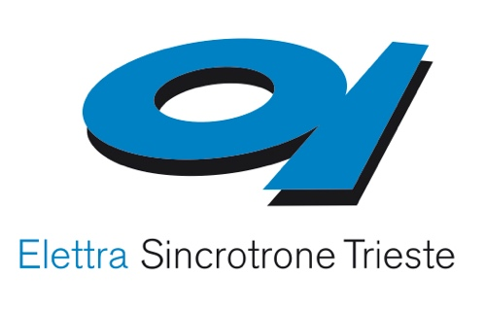









EuPRAXIA-PP Consortium I
Coordinator

Slide 20















EuPRAXIA-PP Consortium II

Slide 21









EuPRAXIA-PP Consortium III

Slide 22










EuPRAXIA-PP Consortium IV
Complemented by institutes in EuPRAXIA ESFRI consortium: additional 17 institutes from France, Germany, Poland, Sweden, United Kingdom, China, Japan, United States

Slide 23
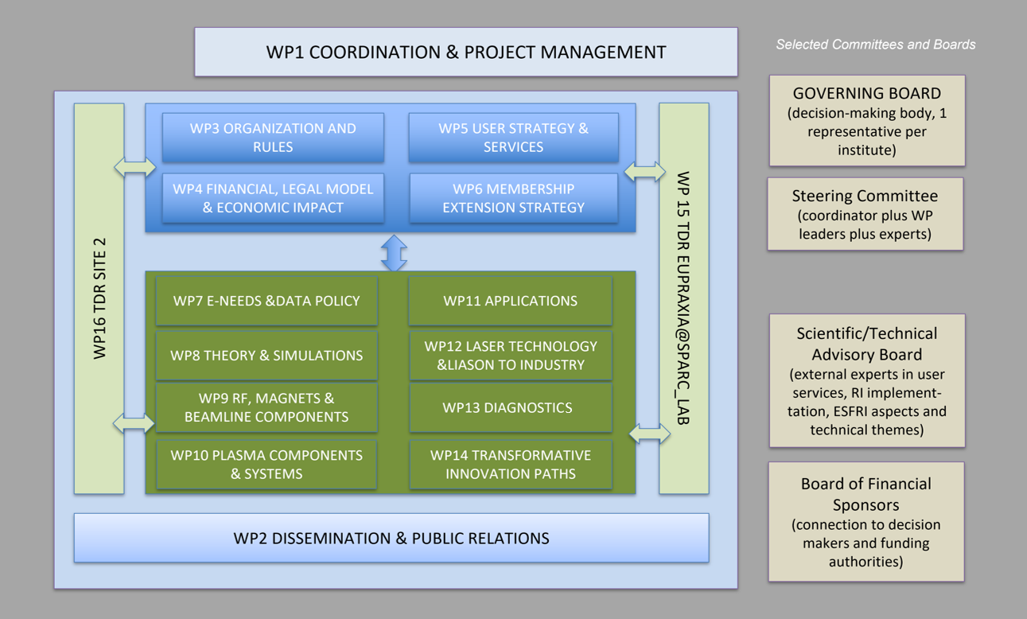
EuPRAXIA-PP Structure

Slide 24

Acknowledgements
EuPRAXIA Preparatory Phase
This project has received funding from the European Union’s Horizon Europe research and innovation programme under Grant Agreement No. 101079773. It is supported by in-kind contributions by its partners and by additional funding from UK and Switzerland.
EuPRAXIA Doctoral Network
This project has received funding from the European Union´s Horizon Europe research and innovation programme under grant agreement no. 101073480 and the UKRI guarantee funds.
EuAPS
This publication has been made with the co-funding of European Union Next Generation EU.

