Slide 1
Researcher Training in EU and Funding Opportunities
Prof Dr Carsten P Welsch

Slide 2
Overview
Interdisciplinary R&D – driving cutting-edge science and innovation
Researcher training – boosting skills and maximizing employability
Communication – maximizing reach and impact

Slide 3
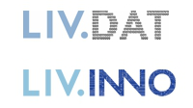
Own Background
Beam Diagnostics 2008 - 2012
21 Fellows, 32 partners www.liv.ac.uk/ditanet
Laser Applications 2011 - 2015
19 Fellows, 38 Partners www.la3net.nu
Accelerator Optimization 2011 - 2015
23 Fellows, 35 Partners www.opac-project.eu
Medical Applications 2016 - 2020
15 Fellows, 33 Partners www.oma-project.eu
Antimatter R&D 2017 - 2021
16 Fellows, 35 Partners www.ava-project.eu
EuPRAXIA-DN since 2023
12 Fellows, 23 Partners www.eupraxia-dn.org
MSCA Networks
Centre for Doctoral Training
Data Intensive Science 2017 - present
~80 PhD students, 2 universities + industry
www.livdat.org and www.livinno.org

Slide 4
Personal background
Coordinator of six MSCA research networks across life sciences, physics and engineering, overseeing training of ~100 Marie Curie Fellows
Director of two Centers for Doctoral Training in Data Intensive Science with ~40 PhD students per center
Head of Physics Department (2016 – 2023), responsible for training of +150 PhD students, plus all undergraduates and numerous fixed-term staff
Chair of STFC’s Education Training and Careers Committee and member of UKRI’s Skills Advisory Group (2021 – 2023), shaping researcher development in UK
Member of STFC Council (since 2023), contributing to strategic research and skills planning across all areas of STFC research.

Slide 5
Interdisciplinary R&D
MSCA networks are often part of something much bigger.
For example, the EuPRAXIA MSCA Doctoral Network is closely connected with:
EuPRAXIA Design Study (Horizon 2020)
EuPRAXIA Preparatory Phase (Horizon Europe Infra)
EuPRAXIA facility (ESFRI roadmap, national and international funding)
EuAPS (Nationally funded, Italy)
PACRI project (Horizon Europe)
and more…
Doctoral Networks are stimulating collaboration and ideal to pave the way for follow-on projects.

Slide 6
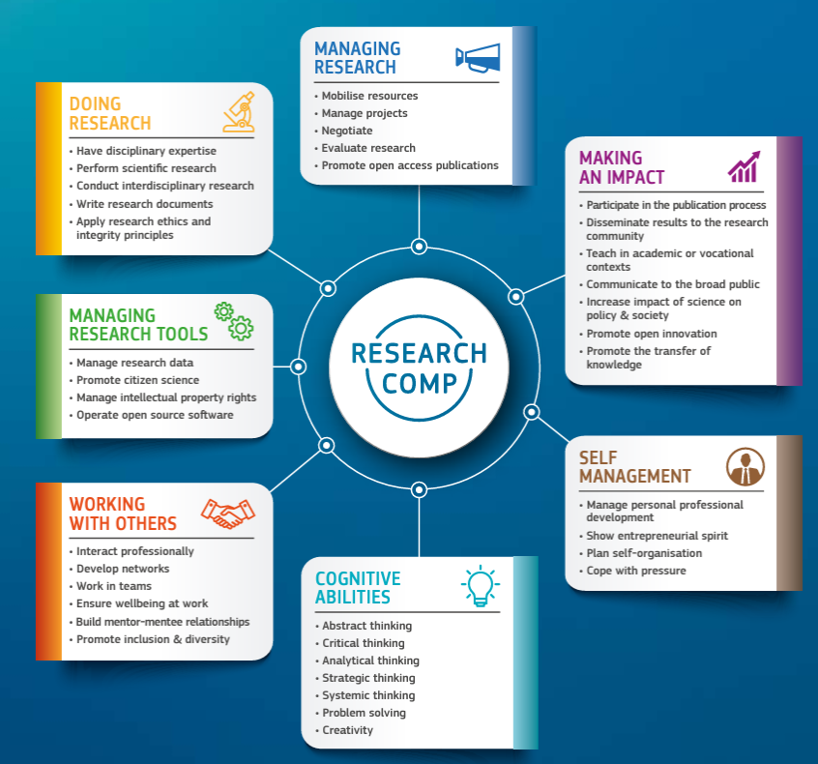
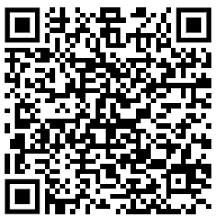
European Competence Framework

Slide 7
Researcher Training
Major issue: We live in one of the most dynamic times where the required skills for researchers are changing at record speed.
Key skills now required are not even mentioned in any of the major competence frameworks, e.g. digital literacy, prompt engineering, opportunities and challenges related to tools such as ChatGPT, looking after each other.
Consortia are powerful way to go beyond framework and define future best practice.
Role of industry? We need to re-think researcher training…in particular the opportunities from placements, see LIV.INNO.

Slide 8
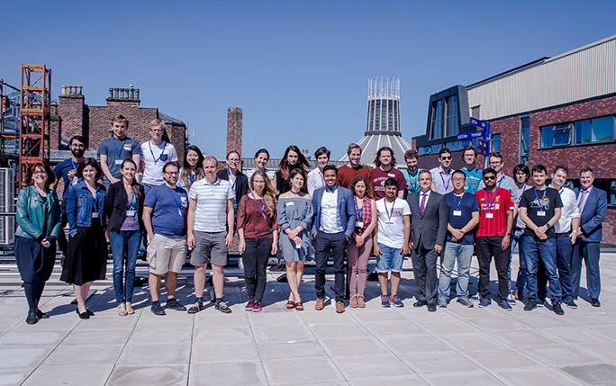
Researcher Training
Joint organization leads to improved efficiency and better experience.
Employability aspects are more attractive for businesses as they get access to larger pool of Fellows – and vice versa.
Close links allow to identify best practice and share experiences.

Slide 9
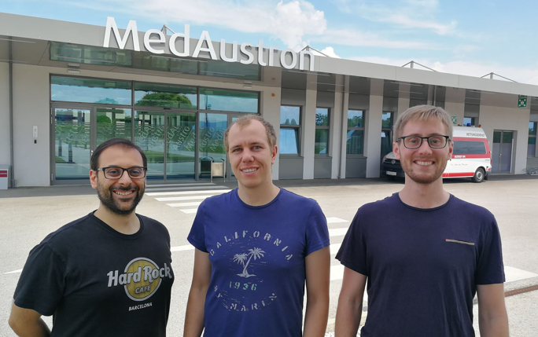
Researcher Training
Fellows get insight into other cutting-edge research areas; this is an excellent opportunity for them to make contacts – and identify future job opportunities
Case study: Miha Cerv (center) held Fellowship in AVA, now working on medical accelerators (OMA); links were created through joint events.

Slide 10
Outreach & Communication
Press releases, Newsletters, Symposia, Open Days, etc – all have more and wider impact if organized between several projects.
Enhanced visibility and better use of (always limited) resources are immediate benefits.
Examples:
https://marie-curie-day-2017.org/
https://indi.to/AccSciSoc
https://tinyurl.com/PhysicsofStarWars

Slide 11
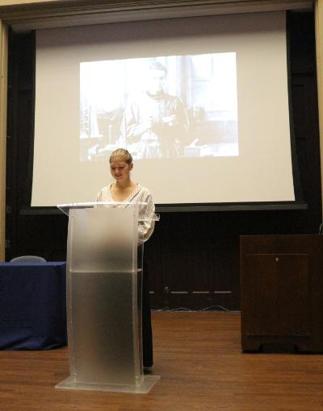
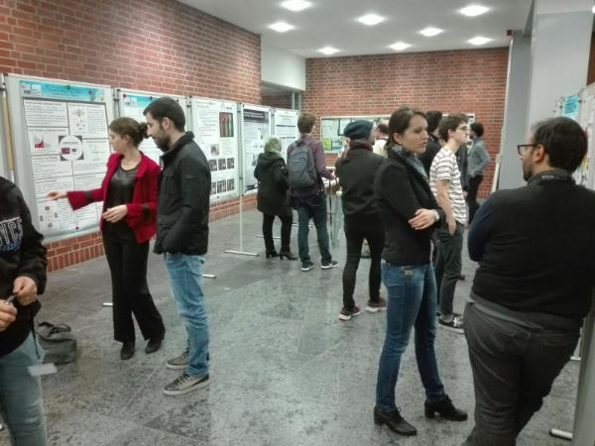
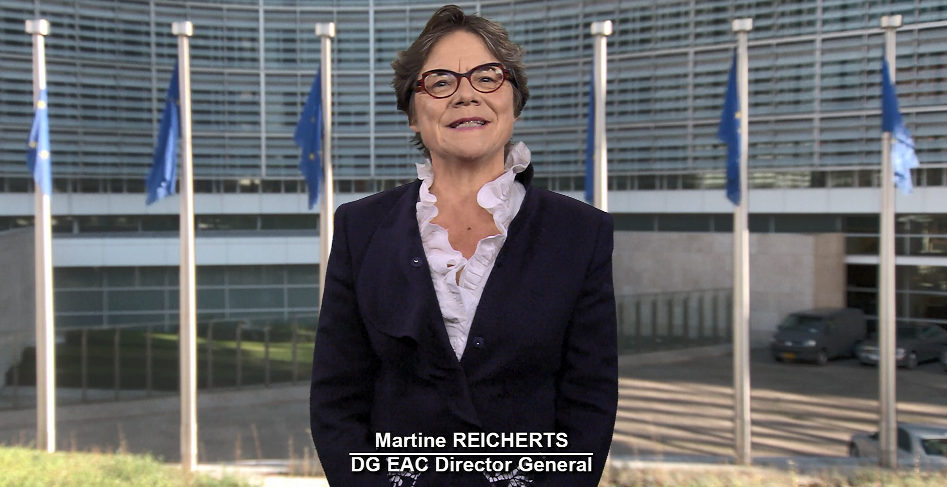
Marie Curie Day 2017
Introduction by Marie Curie (actor);
Talks by research leaders, online connection across three sites with other partners connected;
Hands-on activities for Schools;
Poster sessions for the general public.

Slide 12
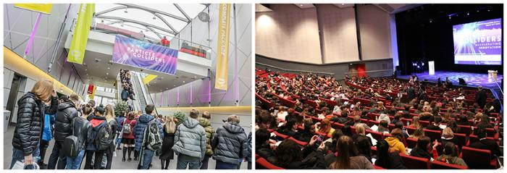
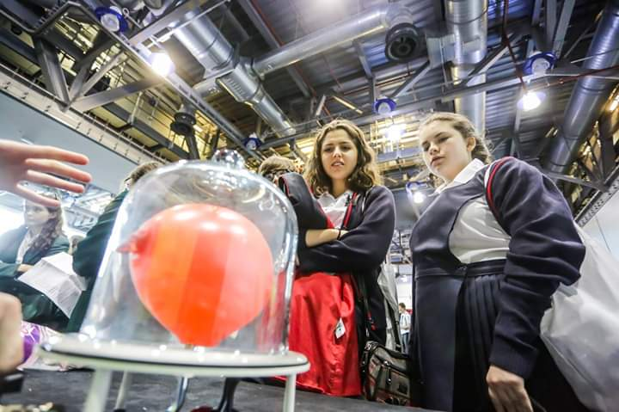
Accelerators for Science and Society
https://indi.to/AccSciSoc

Slide 13
Funding Opportunities
MSCA: Doctoral Networks and Individual Fellowships
Erasmus Mundus
COST Action for workshops and meetings, knowledge transfer
National and bi/multi-literal graduate schools and centers for doctoral training
EuPRAXIA is a great platform for this – and we need to do more to train the next generation of experts!

Slide 14
Summary
Successful researcher training programs are based on cohorts and connect universities, research centers and industry.
Cross-sector experience broadens skills, drives innovation and improves employability.
Interdisciplinary training events support knowledge transfer and pave the way for collaborative R&D.
Successful training model has been promoted through international workshops and L&T conferences.
Significant impact generated in our research community and engaged Millions around the world with our research.
More needs to be done! What are we waiting for?

