Slide 1
The Latin American Synchrotron in the Greater Caribbean
Galileo Violini
International Center of Physics, CIF, Bogota
EuPRAXIA_PP ANNUAL MEETING
La Biobola Bay, Elba Island, Italy, September 27, 2024

Slide 2
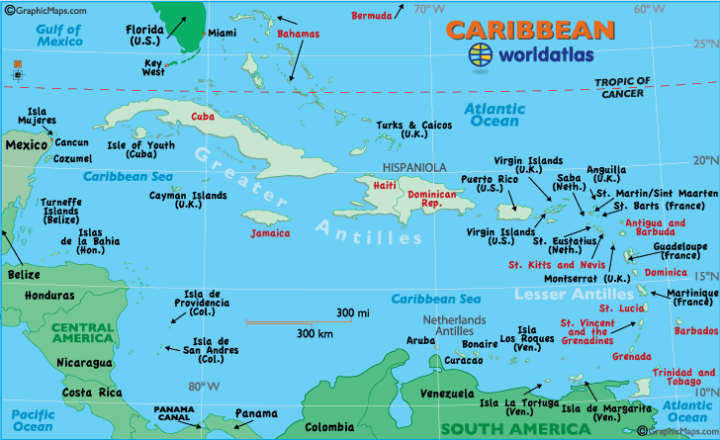
Greater Caribbean
Our project: Mexico, SICA countries (Continental Central America and Dominican Republic), Colombia, Caribbean islands.
Geographically: also Venezuela, Cuba, Puerto Rico
GC + Gulf of Mexico: add South Eastern US, namely Southern Texas, Louisiana, Alabama, Mississippi, and Florida

Slide 3
South Science - Priorities and Needs
Strengthen national and regional advanced education (Ph D programs)
ADEQUATE AND STABLE FUNDING
Strengthen Infrastructure (Research Centers, Megaprojects)
Strengthen research groups New research lines
International Networking
Notes:
Comentario sobre la Governance (Argentina ?)

Slide 4
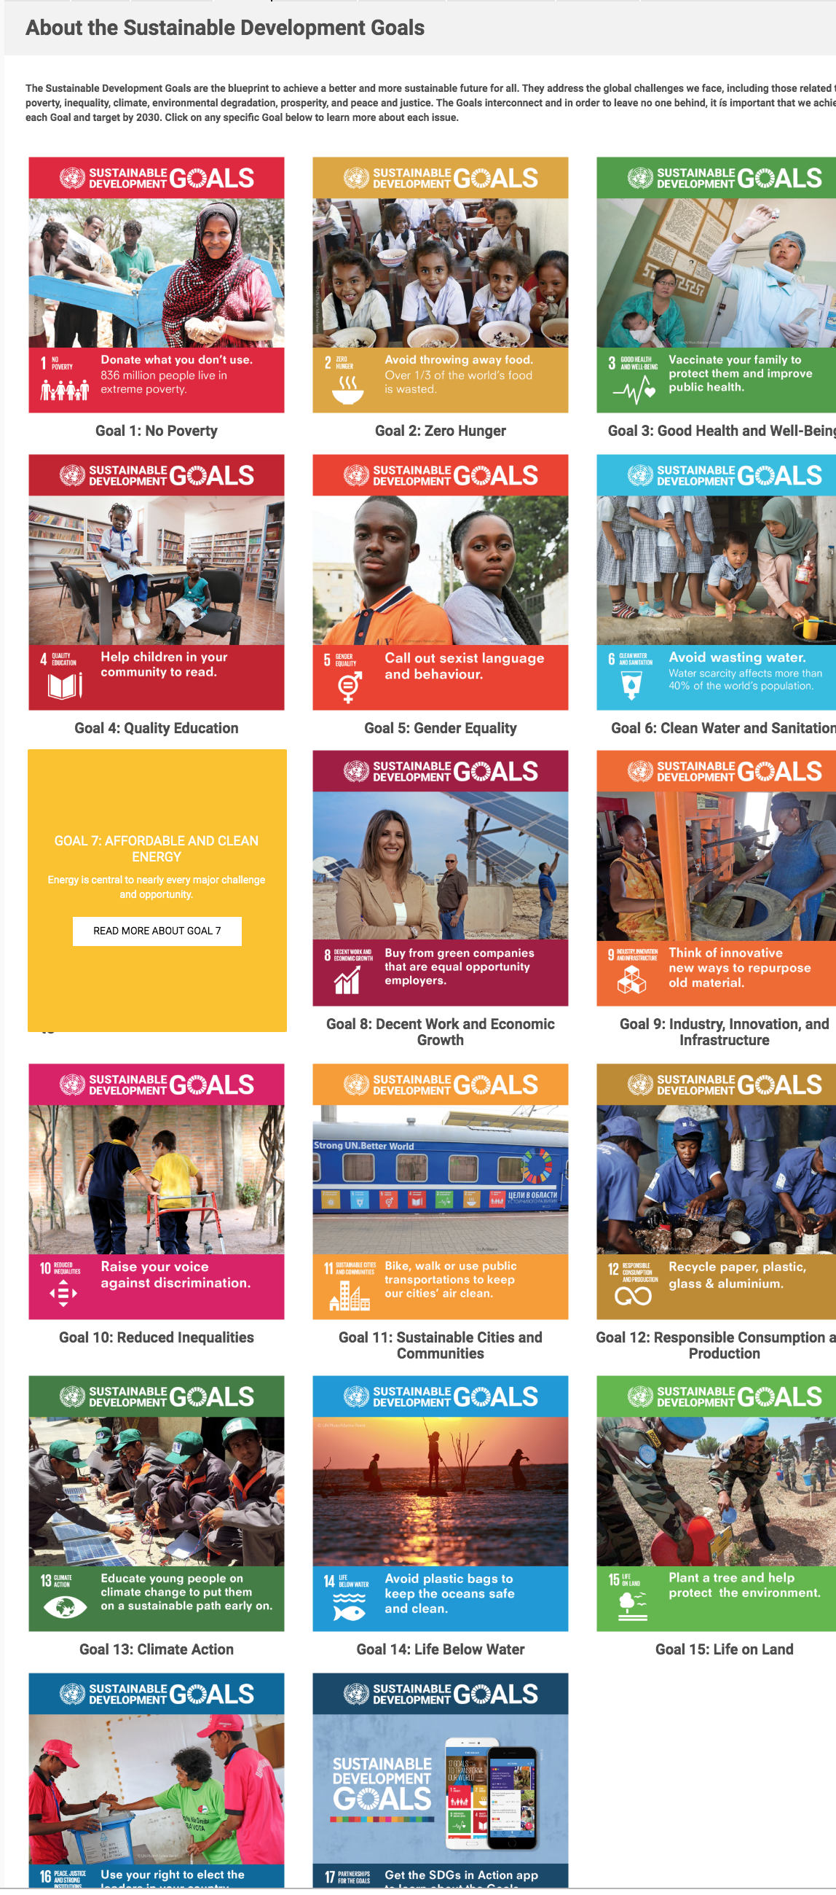
The Case for Synchrotrons - SDG
Synchrotron research relevant for
13 out of the 17 UN Sustainable
Development Goals
Among the 13 goals, Poverty, Health, Water,
Energy, four Is, Climate, especially relevant
for GC.
Notes:
Industry Innovation Infrastructure Inequality

Slide 5
Synchrotrons in the South
In Africa: No synchrotrons. AfLS proposal (1990-2015): AfLS may offer guidelines for GC project, and is a potential partner for international lobbying and training programs
In Latin America: LNLS, Campinas: first proposal 1981, VUV (1997), Sirius (2018) - Great impact on scientific and industrial development. Direct (SIRIUS built, 86%, by Brazilian enterprises). Indirect, e.g. pharmaceutical industries, production of radioisotopes.
SESAME, a successful case:
Promoted by international organizations: UNESCO, CERN
Political and diplomatic differences overcome through Science
Notes:
Through

Slide 6
Big scientific Infrastructure in Latin America: Astronomy and Astrophysics
Chacaltaya Lab in Bolivia, 1947 (pion discovery)
Arecibo (1963) closed August 2023
La Silla (ESO) and Cerro Tololo (Interamerican) Observatories, 1969
Pierre Augier Observatory (Mendoza, Cronin) 1999

Slide 7
Our Proposal
https://arxiv.org/abs/2109.11979
Independent, although not new. REGIONAL
Colombia: Bernardo Gómez (2015)
Mexico: first in Morelos (Brenda Valderrama, Víctor del Rio, 2015), then Hidalgo
Cuba: After Obama’s visit (2016), Jeremy Rothstein and Fidel Castro Smirnov
Currently: Puerto Rico PULS

Slide 8
Background and Milestones
2021- XVI Week of Dominican Science, Symposium on postpandemic science in LA - Arxiv article- Working group
2022- XVII Week of Dominican Science- Symposium on Scientific Megastructures
- LAAAMP, SESAME. First contact with Sirius, ICTP support, World Science Forum- Alliance with AfLS
2023- SLAC and LNBL visit. Result: Joining with the national Mexican Project. Formalization of the working group
- XVIII Week of Dominican Science- Six-country Symposium LAMISTAD
2024- Nature, https://www.nature.com/articles/d41586-024-005198-4
Some dozens International Presentations (Conferences, Workshops, Symposia, Seminars, Schools, Science Academy Meetings)

Slide 9
Which Kind of Synchrotron?
1- GCS: foreseen operating in the thirties, should be a 4th generation one. (Currently, only MaxIV, ESRF and Sirius are 4th generation, although many 3rd generation facilities are being upgraded and a new one is under construction in China).
2- Energy: complementary to 3 GeV Sirius synchrotron
3- Higher energy? Lower energy? 1.5 GeV interesting for several areas of application relevant for the region (e.g., bio - health), although mining and soil study are also important (case for 6 GeV)
4- MAX IV Example?

Slide 10
Where?
Probably NOT URGENT DECISION – Political and Financial considerations are to be taken into account
Several possibilities
- Mexico – Plans exist. Hidalgo offered land for the Mexican project. Largest GNP in the region. Political complexity (federal structure allows local decisions, but eventual decision by Federal government)
- Colombia – Royalties Law 2056 (Sept.30, 2020). Regional development of Atlantic Coast
- Dominican Republic – Project of a City of Knowledge
Central America? Jointly El Salvador - Guatemala - Honduras? Jamaica?

Slide 11
What else elsewhere?
Wherever established, it must be a Latin American Synchrotron, located WITHIN the Great Caribbean
Possible additional facilities. Compact Light Sources and small accelerators may be more than an intermediate-time option
Regional system of small accelerators? Potential Political NECESSITY
Belonging to a unique institution? If (and probably only if) part of a regional lab., independence of possible national political changes ensured

Slide 12
Feasibility Conditions
Exixtence of scientific demand and technical capacity
Availability of economic interest and financial resources
Social acceptance
Favourable national, regional and international context

Slide 13
Scientific Demand and technical Capacity
Scientific demand and potential users (basin of several thousands needed)
Expected also users from outside the Region
Potentially high availability, especially in sectors where Region’s non-scientific demand is high, such as health, food safety, biodiversity, all of socioeconomic importance. Estimated size of this community: tens of thousands potential users.
Little experience. Existing synchrotrons far located. Other research techniques are used. Training necessary, Possible support from e.g. Elettra, Sirius, SESAME, US.
A GC (South?) beamline? Joining a research group at some beamline?
Technical capacity - Engineers, staff and technicians
Vigogorus training program necessary. SESAME experience: It is possible to carry on such a program during the building of the facility

Slide 14
Economic Context - LA Matrix
- Explotation of Natural Resources
- Agriculture
- Tourism
- Trade – Internal economies
- Import of technological goods
- Services
- Migrant Remittances
Limited and unequal Industrial development
Options: National High Tech vs. Offshore foreign Medium Tech

Slide 15
Science in the Greater Caribbean
Country Res/1000 labor force HEExp/GNP Ph D students Publications R & D/GNP
(%) 2018 (year) (2018) (%) (2018) (2018)
Mexico 0.71 1.02 43774 (2018) 23508 0.27- 0.31
Colombia 0.17 1.05 6225 (2018) 11193 0.29-0.24
SICA countries
Guatemala 0.03 0.41 881 (2017) 269 0.06- 0.03
Belize*
El Salvador 0.15 0.33 63 (2018) 69 0.16-0.16
Honduras 0.08 0.88 492 (2017) 181 0.06-0.04
Costa Rica 0.79 1.36 2805 (2019) 1053 0.28-0.39
Nicaragua 118 0.11
Panama 0.08 1.1 107 (2016) 727 0.18-0.15
Dominican Rep. 232 0,24
* not considered by UNESCO Science Report becase included in the Caricom section.
Sources: UNESCO Science Report 2021 (Gabriela Dutrénit, Carlos Aguirre, Martín Puchet Mónica Salazar) and Carlos Aguirre, private communiation. CEPAL 2023 Report, Estimate

Slide 16
Structure of S & T Funding
Low investment: Average 0.6% of GNP, Big asymmetries, two extreme cases: Brasil (1.4%) Guatemala 0.04%)
GNP Percentage poor indicator for small under 10-15 million population), and/or low per capita income countries.
Big national scientific programs impossible
Funding sources:
- National public (very little, if any, private)
- International – Development Banks, (often earmarked, not allowing structural actions)
- Cooperation, often considered as a primary source and not as a complementary one. External-policy priorities may limit and constrain the eligibility of research programs.

Slide 17
Cost – Financing - Governance
Rough estimate: Initial investment: 300 MUS$ spread over 5-6 years. International support possible (Development Banks, International Cooperation ?)
Operational cost: 35 MUS$/year, (although SESAME, until now: 90 MUS$ (full solar-energy electric power) with financing from participating countries
Governance: Intergovernmental (CERN-like), Private-semipublic (Consortium of participants, ESFR-like)

Slide 18
Yearly Cost per Country
No external contribution for operation (35M$/y), Contributions: proportional to GNP, with a 25 % cap for individual countries .
Impact on the choice of host country (Mexico? Colombia?) Compatibility with countries policies

Slide 19
Social Acceptance
Problem: Cost of opportunity, vis à vis social and educational problems of the region. Usueally Science is not real governmental priority
However:
Insufficient scientific education and development cause indirect costs
Natural risk, Environment, Food security, Contamination), Agriculture, Health are socially relevant issues
Regional integration, industrial development, Biodiversity are part of political speech
Right of people to develop their capacities (RIGHT TO SCIENCE, not limited to access and use) Ethical, but politically weak argument
Necessary to present the benefit of the project, targeting both the society in general, and the private productive sector
Scientific world support (universities, academies, scientific societies) necessary, but not granted. Personal and sectorial interests may reflect in negative positions
Role of scientific journalism (weak in the region)

Slide 20
Cost of Opportunity?
Education: Argument rarely used to deny financing in this sector (Average LA: 4.6% GNP, against 0.6% Science)
Health: During the pandemic the BCIE (Central American Bank for Economic integration) gave $400 million to the 8 SICA countries
GC Military expenditure (40% of LA one): in 2021: $21.2 Billion, mostly by Mexico and Colombia ($18.9 Billion), but still remaining countries expenditure is $2.3 Billion.
(Sources: Stockholm International Peace Research Institute, D. Lopes Da Silva et al., https://www.macrotrends.net/countries/LCN/latin-america-caribbean-/military-spending-defense-Budget)

Slide 21
A must: Regional Financing
Interesting Proposal: FORCyT
First suggestion: GV, June 2015, CSUCA meeting in Cartagena, presented to Guatemala Government by J.A. Fuentes Soria, then CSUCA ‘s SG .
Endorsement by Guatemala Government (again J. A. Fuentes Soria, as Vicepresident) at a SICA Meeting, El Salvador, December 2015, 25M$/year during 5 years
CTCAP Meeting in Guatemala (September 28, 2016)
Still waiting for the decision of the Heads of State
Fuentes Soria, J. A. (2017), “Fondo Regional de Ciencia y Tecnología del Sistema de la Integración Centroamericana, FORCYT-SICA” in Lemarchand G., Relevamiento de la investigación y la innovación en la República de Guatemala, Paris, UNESCO

Slide 22
Possibilities of Cooperation: 1- US
House Resolution for SESAME: Funding is intended to promote scientific excellence in the Middle East region and prevent the loss of scientific expertise that is holding back science education and research in the region.
Science Diplomacy, Latin America strategically important for US, in particular after the pandemic (Vaccines issue)
A Latin American focused program? A Marshall Plan for Central America? Two years ago, Hispanic Law-makers advocated one - Main motivation: social problems. What about the role of Science for that?
USAID ? DOE ? NSF ? Puerto Rico?
Consortium of institutions having important LA programs?, of synchrotrons? First contacts: SLAC, LBNL, UPR, Cornell
Political opportunities – July 2023, US rejoined UNESCO, key
promoter of SESAME
– August 2023, US lifted Venezuela sanctions
Possible technical difficulty: Multilaterality of the project
Notes:
Alianza para el Progreso

Slide 23
Possibilities of Cooperation: 2- EU
European Union Association Agreement with Central America.
European Union Program for CELAC Infrastructure
7-year European Union Programs, current one, the ninth: Horizon Europe
Bilateral cooperation. In Italy, intergovernmental: Istituto Italo-Latino-Americano. Spain, leading European country. France, Agence Francophonie
Possible form: Matching Funds
Notes:
Alianza para el Progreso

Slide 24
Possibilities of Cooperation: 3- Others
Development Funds. Nominally stable (2000—2020) about 1 billion US$, 35% decrease in real terms
Direct Foreign Investiment: About 15 billion US$,
For both: rethinking goals?
IDB Regional Public Goods Program, WB, BCIE. CAF
Commonwealth programs

Slide 25
When?
LNLS, SESAME, AfLS: 10-15 yrs for first idea to decision
LNLS, SESAME: 10 yrs for decision to operation
AfLS: First idea nineties, Interim Steering Committee 2015, First governmental formal declaration of support: 2019 (Ghana’s president Akufo Addo), triggering Benin, South Africa, Nigeria and Ivory Coast
Optimistic: This project develops faster than similar projects. Mid thirties
More realistic: End thirties

Slide 26
Expected Results - 1
Scientific development, advanced research, increase of publication number (case of SESAME) integration of groups from different disciplines and sectors, strengthening of internationalization, increased access to international facilities,
Technological and industrial development, Challenges of the construction and maintenance of the facility, and its beamlines, of the data analisis, Sirius example of CERN patents use.
Academic development. Doctorates, broadening of the actual range of advanced teaching, with less scientific inbreeding

Slide 27
Expected Results - 2
Social and economical development Progress in sensible areas, food safety, circular economy, pharmaceutical, health (Cardiology, Neuronal degeneration, production of radioisotopes, medicine from natural products, tomography), biodiversity and molecular structure of plants, nanomaterials for energy, soil analisis, biosensors for agriculture
High-tech industrialization, Possible fostering of new industries, even during and for the construction.
Political development. Regional Integration, in particular between Spanish-speaking and English-speaking Caribbean
Return (Massimo Florio: Cost- Benefit of Big scientific Infrastructure): Tangible, estimate from existing facilities. Intangible, Indirect (industrial development, scientific growth)
Articular )

Slide 28
Interregional and intercontinental Dimension
AfLS Partnership – link through LAAAMP – Joint presentation at the 2022 World Science Forum in Cape Town, GCLS participation in the AfLS Conference.
Short term - Joint lobbying to get international support. – A case for UNESCO, US and Commonwealth? Role of Brazil for a SESAME-like resolution jointly supporting GCLS, AfLS and SESAME
Yesterday ADG/SC UNESCO speaker in our Workshop at UNGA Science Summit
Interregional coordination group with other South projects (AfLS, ILSF, Uzbekistan, SESAME). Possible goal: coordianted representation, availability of some South dedicated beamline
Long term prospective: South research collaborations.

Slide 29
GCLSI/LAMISTAD Organization
About 60 scientists, 20 countries with 3 national chapters: Colombia, Dominican Republic, Ecuador
Executive Committee: chair GV, deputy chair Abel Moreno, Mexico, members: chairs of 5 committees:
Communications (Carlos Rudamas, El Salvador)
Capacity building (Marvadeen Wilmoth-Singh, Jamaica)
International Relations (Víctor Castaño, Mexico)
Financial Committee (chair to be elected)
Scientific-Technical (Mayra Cuéllar, Mexico)
r

Slide 30
Conclusion: Where we are
Positive feedback from scientific community (SESAME, Sirius, several US and European synchrotrons)
Synergy with the AfLS project
International interest:
- Unique experience of a six – country (Colombia, Spain, Jamaica, Mexico, El Salvador, Dominican Republic), multi-venue Symposium
- Support from Brazil, Kenya and Australia
- Progress on diffusion. Impact of the article on Nature: Russian TV News, Latin American Post

Slide 31
Conclusion: Short & Medium-term Road Map
Creation of an Association (or Foundation) to promote the project, possibly in connection with RCN
Technical detailed article, and feasibility study (with PULS?)
Further diffusion of the project (Civil Society, Press, Private Sector, Politicians)
Strengthen contact with International Organizations (UNESCO, CARICOM, ISC, FAO, OMS)
Immediate short term goal: UNESCO resolution jointly supporting a big program of development of Synchrotrons in the South of the World, including the establishment of GCSL, AfLS, possibly the Uzbekistan synchrotron, and the strengthening of SESAME

Slide 32
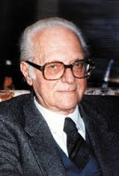
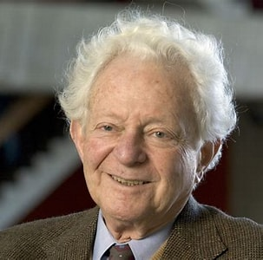
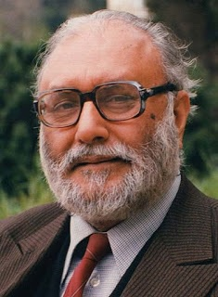
Acknowledgments
My deepest thanks to my colleagues of the ArXiv paper, the working group and the GCLS Executive Committee,in particular its previous cochairs, Carolina Santacruz, Victor Castaño, Victor Del Rio and Sekazi Mtingwa and the current Vicechair Abel Moreno
However, without the advice and support of my Science policy mentors, Edoardo Amaldi, Leon Lederman and Abdus Salam, my contribution to this proposal and my half-century activity in Latin America would have never been possible.

