Slide 1
EuPRAXIA outreach workshop
Presentation of EuPRAXIA
Chair: A. Mostacci
Potential links in countries not yet represented in EuPRAXIA
Chair: L. Serafini
EuPRAXIA framework for R&D
Chair: E. Principi
Mounia Laasiri
Training and young researcher education
Chair: E. Chiadroni

Slide 2
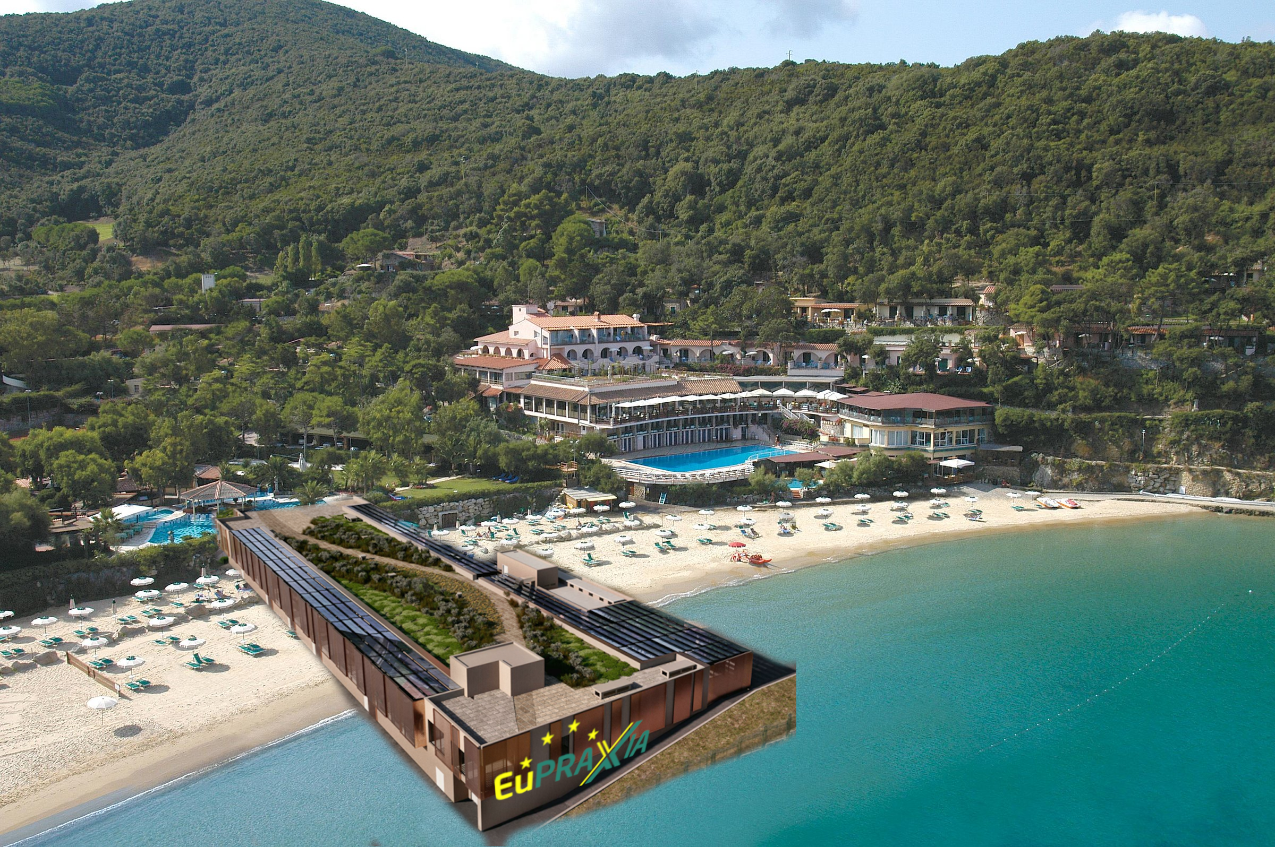
EuPRAXIA’s 2nd site

Slide 3
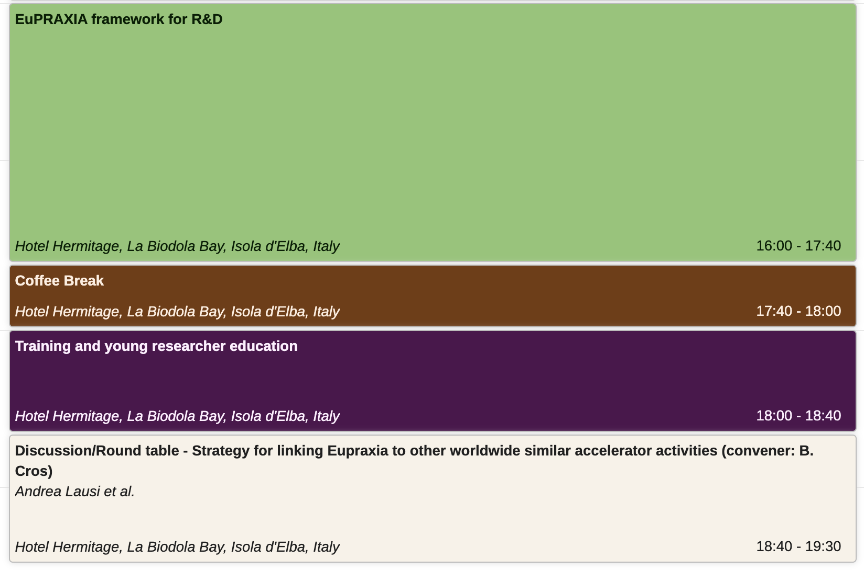
Afternoon Schedule
16:00 – 17:40

Slide 4
Round table
Strategy for linking EuPRAXIA to other worldwide similar accelerator activities
Discussion
How do you see the role of EuPRAXIA in the interaction with facilities/activities outside the present EuPRAXIA consortium?
How can EuPRAXIA be beneficial for the communities that you represent?
After today's presentations/discussion, do you see any specific topic/issue that EuPRAXIA could try to address?
Speakers
Ketevi Adikle Assamagan, Christine Darve, Massimo Ferrario, Andrea Lausi, Rajeev Pattathil, Galileo Violini
Notes:
Underline that the mandate of this WP is towards the institutional partners. Other (technical) WPs are taking care of interaction with industries

