Slide 1
EuPRXIA@SPARC_LAB energy boosting to 5 GeV by LWFA and external injection
Andrea R. Rossi

Slide 2
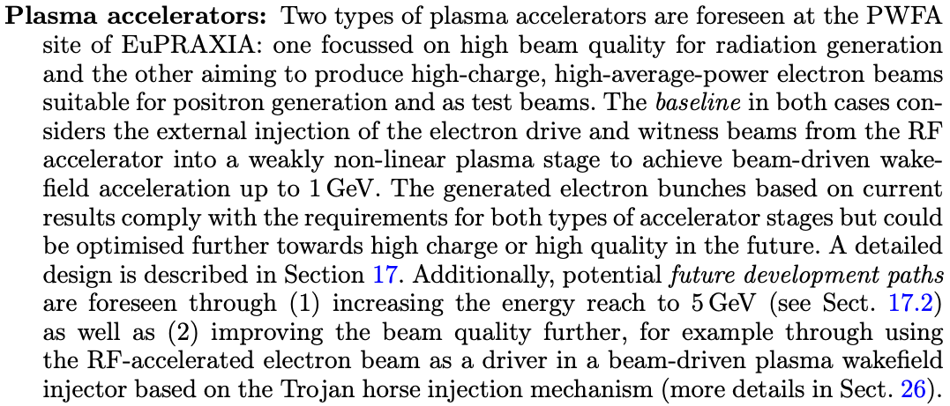
From EuPRAXIA CDR

Slide 3
Boundary conditions
Wall
Injector
Plasma
But also an operating user facility!

Slide 4
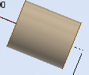
The interaction chamber, transfer line and diagnostic dipole
DUMP:
Only a placeholder!
TRANSFER LINE:
A chicane for separating driver(s) from witness.
Quadrupoles for transport and matching to the dipole.
Diagnostics.
INTERACTION CHAMBER:
Contains plasma target and optics for matching and capture of the electron bunch(es)
DIPOLE:
A bending magnet that opens dispersion and allows energy measurement.
We assume 22 deg bending angle.

Slide 5
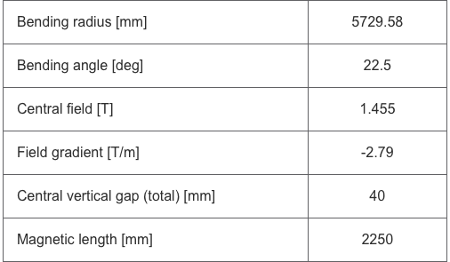
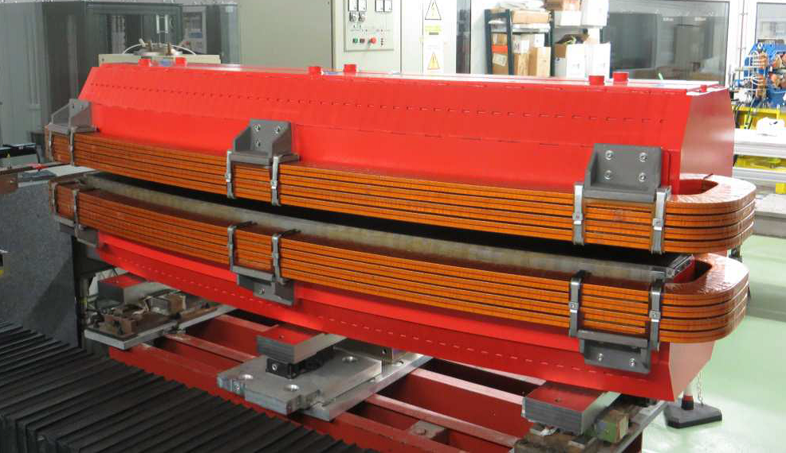
The spectrometer dipole @ 5 GeV
SESAME bending dipole @ 2.5 GeV
EuPRAXIA@SPARC_LAB bending dipole @ 5.0 GeV
SC option?
Possible, but expensive.
$$≈10000$$
$$≈1.7$$
Assuming a bending angle as the 1 GeV spectrometers (same resolution)
$$≈4000$$
https://www.sesame.org.jo/accelerators/technology/magnets-and-ids

Slide 6
Transfer line
Driver - Witness separation chicane:
most probably not needed.
Transfer - matching line (3125 mm).
Very rough approximation: $×3≈10\text{m}$
Again, SC magnets could be a viable but expensive alternative.

Slide 7
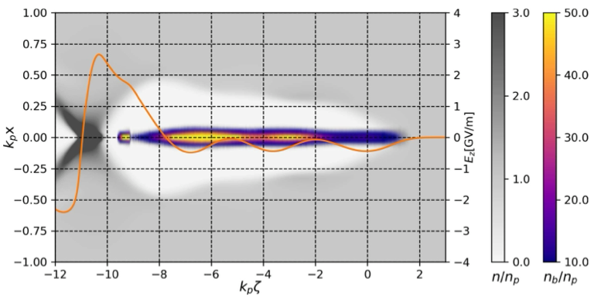
The PWFA option: high transformer ratio
…
…
Train of 4 bunches (3D+1W) with tuned, increasing charge and tailored current profile

Slide 8
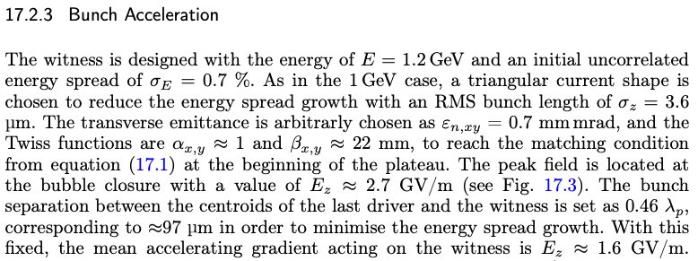
Plasma chamber: the PWFA option
1 GeV plasma target: $≈40-60\text{cm}$, int chamber $≈3\text{m}$ (contains PMQs)
ASSUME:
$$E_{in}=1.2\text{GeV}$$
$$⟨E_{z}⟩≈2.0\text{GeV}$$
The only way to reduce size is improving WP average field.
5 GeV plasma target: $≈250\text{cm}$, int chamber $5\text{m -}7\text{m}$ (?)

Slide 9
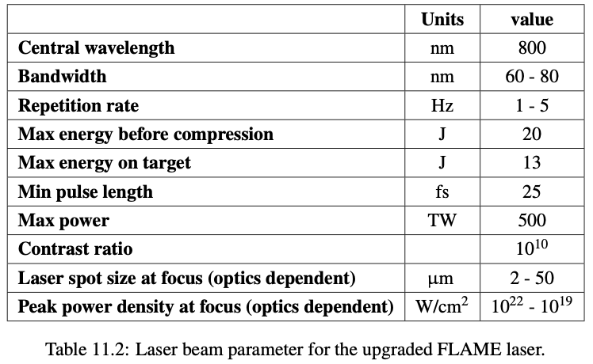
LWFA: external injection
I assume discharge capillaries. The high power laser pulse needs to be guided for the whole capillary length.
I am NOT considering the laser transport system!

Slide 10
Plasma chamber: the LWFA option
ASSUME:
$$E_{in}∼0.5-1.0\text{GeV}$$
$$⟨E_{z}⟩≳7.0\text{GeV}$$
5 GeV plasma target: $∼50\text{cm}$, int chamber $3\text{m -}5\text{m}$

Slide 11
Straight PWFA
4 m
5 m
10 m
The most trivial solution is “invasive”!
It’s implementation prevents facility operation for a long time and requires significant intervention and careful planning

Slide 12
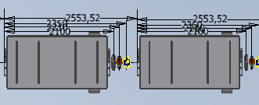
Dogleg PWFA
5 m
10 m
4 m
PROS:
Compatible with facility current layout
All PWFA
CONS:
Large bending angle (22 deg)
Highly risky: dogleg + COMB structure

Slide 13
Dogleg PWFA: building constraints

Slide 14
Dogleg LWFA: injection @ 500 - 600 MeV
3 m
10 m
4 m
PROS:
Compatible with facility current layout
Dogleg with smaller angle (10 deg)
Works with 12J laser on target
Undulator room downstream
CONS:
No PWFA at all
Risky: long laser guiding
Low rep rate
Laser should be removed

Slide 15
Dogleg LWFA @ 500 MeV: building constraints
3 m
10 m
4 m

Slide 16
Dogleg LWFA: injection @ 100 MeV
3 m
10 m
4 m
PROS:
Compatible with facility current layout
Dogleg with smaller angle (10 deg)
Lot of space downstream
CONS:
No PWFA at all
Lower injection energy, requires 1 PW laser
Risky: long laser guiding
Low rep rate

Slide 17
Dogleg LWFA @ 100 MeV: building constraints

Slide 18
Hybrid PWFA + dogleg LWFA, option 1
From PWFA:
Eout = 1.0 - 1.7 GeV
3 m
10 m
4 m
PROS:
Compatible with facility current layout
PWFA + LWFA!
CONS:
Large angle dogleg
Risky: long laser guiding
Staging
LWFA:
Ein = 1.0 - 1.7 GeV
Eout = 5.0 GeV

Slide 19
Hybrid PWFA + LWFA 1: building constraints

Slide 20
Hybrid PWFA + dogleg LWFA, option 2
LWFA:
Ein = 1.0 GeV
Eout = 5.0 GeV
2m
2m
3 m
10 m
4 m
PWFA:
Ein = 500 MeV
Eout = 1.0 GeV
PROS:
Compatible with facility current layout
Small dogleg angle (10 deg)
Only 1D + 1W in dogleg
PWFA + LWFA!
CONS:
Comb structure in dogleg
Risky: long laser guiding
Staging

Slide 21
Hybrid PWFA + LWFA 2: building constraints
2m
2m
3 m
10 m
4 m

Slide 22
Risk mitigation
Hose instability/dispersion related problems: Dumper bunch, arXiv:2409.12041v1
Long guiding channel: filament, HOFI
Laser removal: plasma mirror

Slide 23
Thanks for your attention

Slide 24
Backup slides

Slide 25
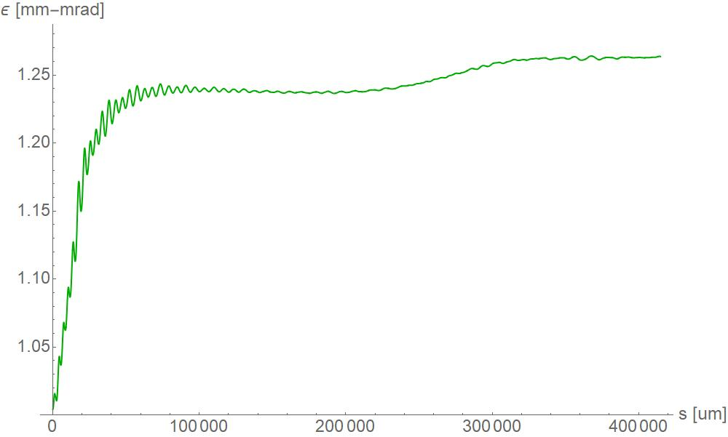
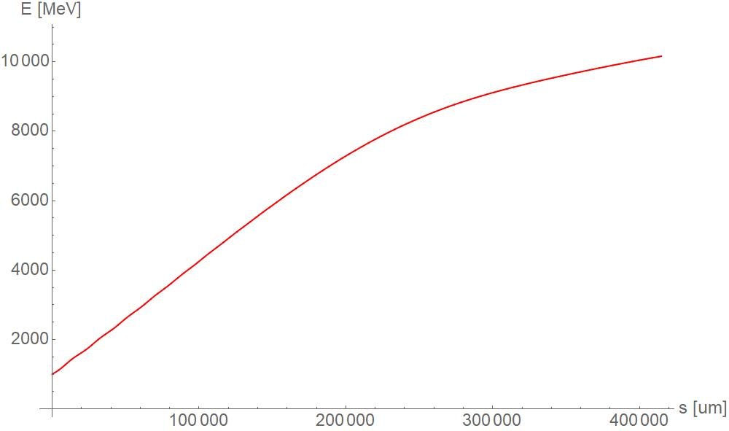
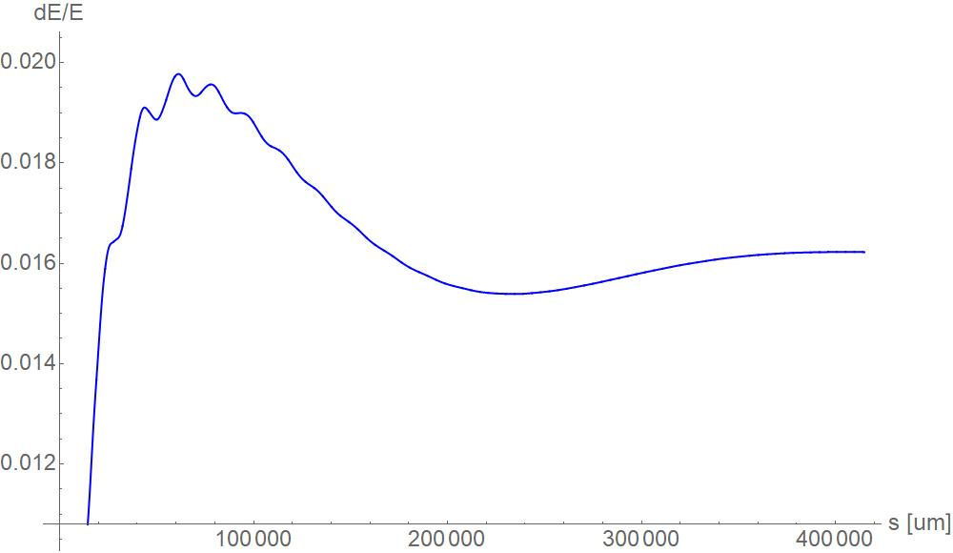
Dogleg LWFA: injection @ 500 - 600 MeV
Laser parameters:
σtr = 40 μm
El = 12 J
στ = 30 fs
Bunch parameters:
q = 30 pC
Ein = 500 MeV
στ = 13 fs
n0 = $5×{10}^{16}{\text{cm}}^{-3}$

