Slide 1
Check list for
July 2024 CERN Beam Test
F. Grancagnolo
24.04.2024

Slide 2
The following slides are modified from
2022 beam test preparation

Slide 3
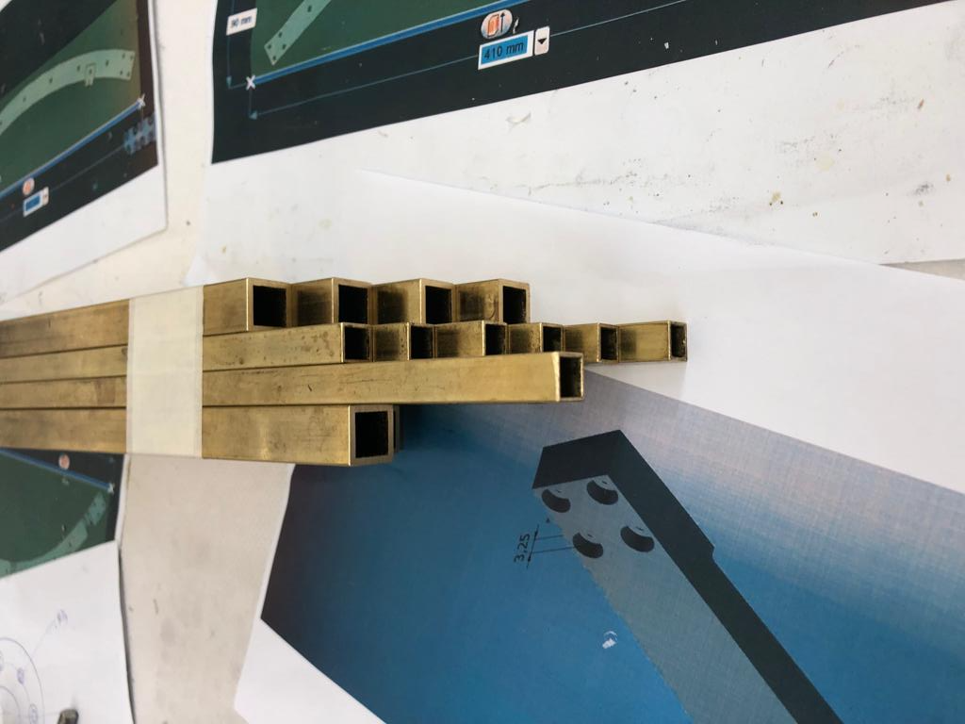
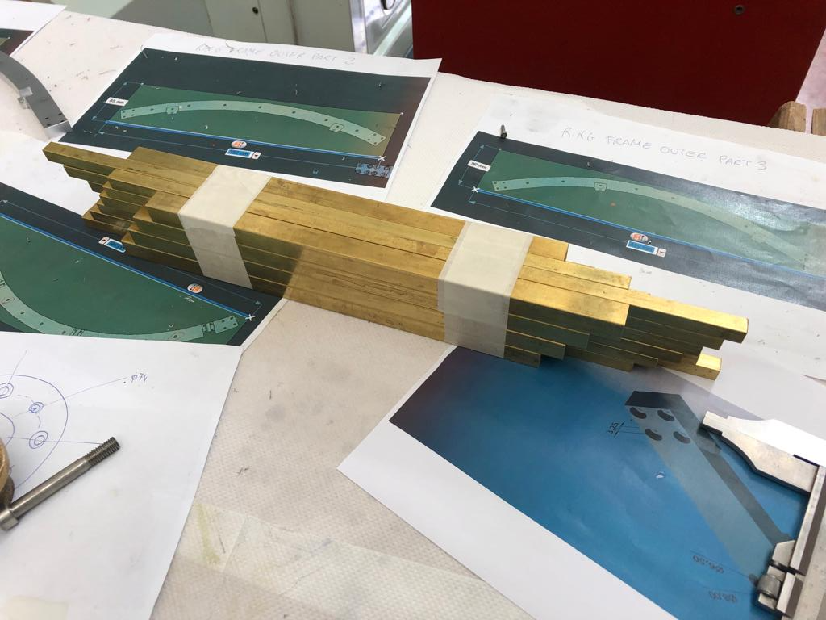
Optimal setup
12 drift tubes 1.0 cm
8 drift tubes 1.5 cm
20 μm
20 μm
20 μm
20 μm
20 μm
20 μm
20 μm
20 μm
20 μm
20 μm
beam
spacer
6.0
cm
20 μm
20 μm
20 μm
20 μm
20 μm
20 μm
20 μm
20 μm
20 μm
20 μm
6.0
cm

Slide 4
Alternative setup (2023 )
20 μm
20 μm
20 μm
20 μm
20 μm
20 μm
20 μm
20 μm
20 μm
20 μm
beam
spacer
6.0
cm
20 μm
20 μm
20 μm
20 μm
20 μm
20 μm
20 μm
20 μm
20 μm
20 μm
6.0
cm

Slide 5
Tube staggering for gas inlet interferences

Slide 6
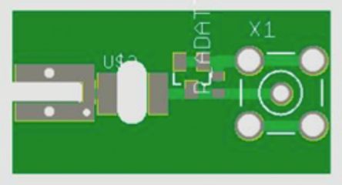
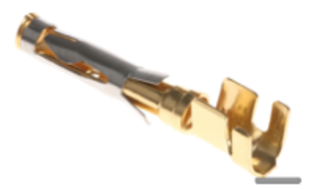

Tube staggering
50 mm
45 mm
25.3 mm
13 mm
40 mm

Slide 7
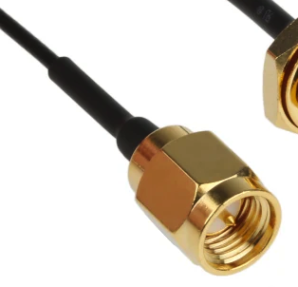
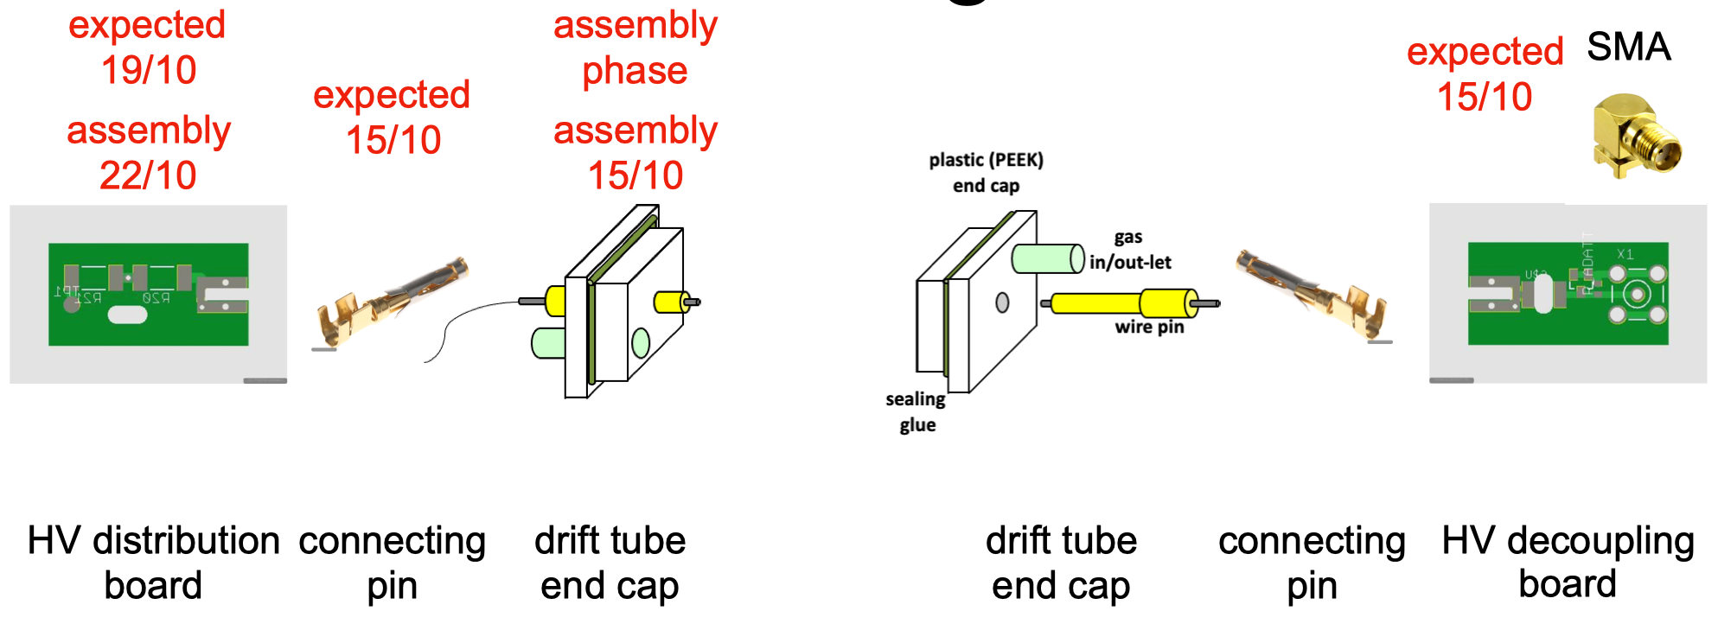
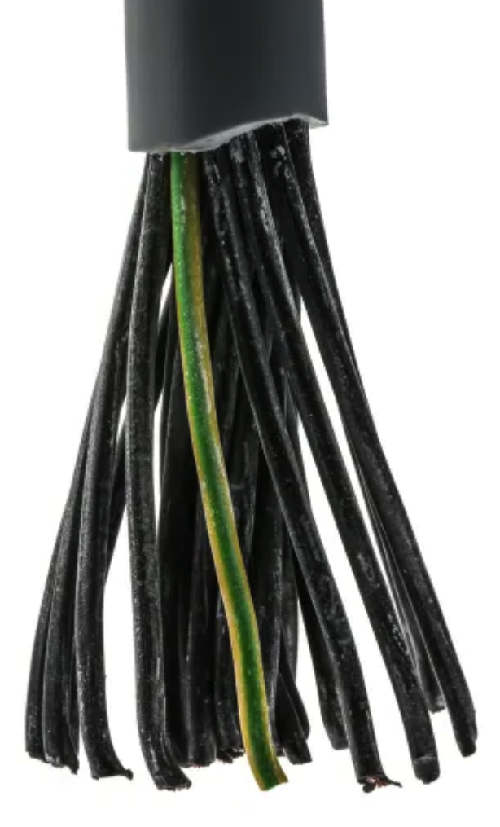
Pin connecting scheme
HV multipolar
CAEN cable (24)
soldered
SMA cable
soldered
NEW
NEW

Slide 8
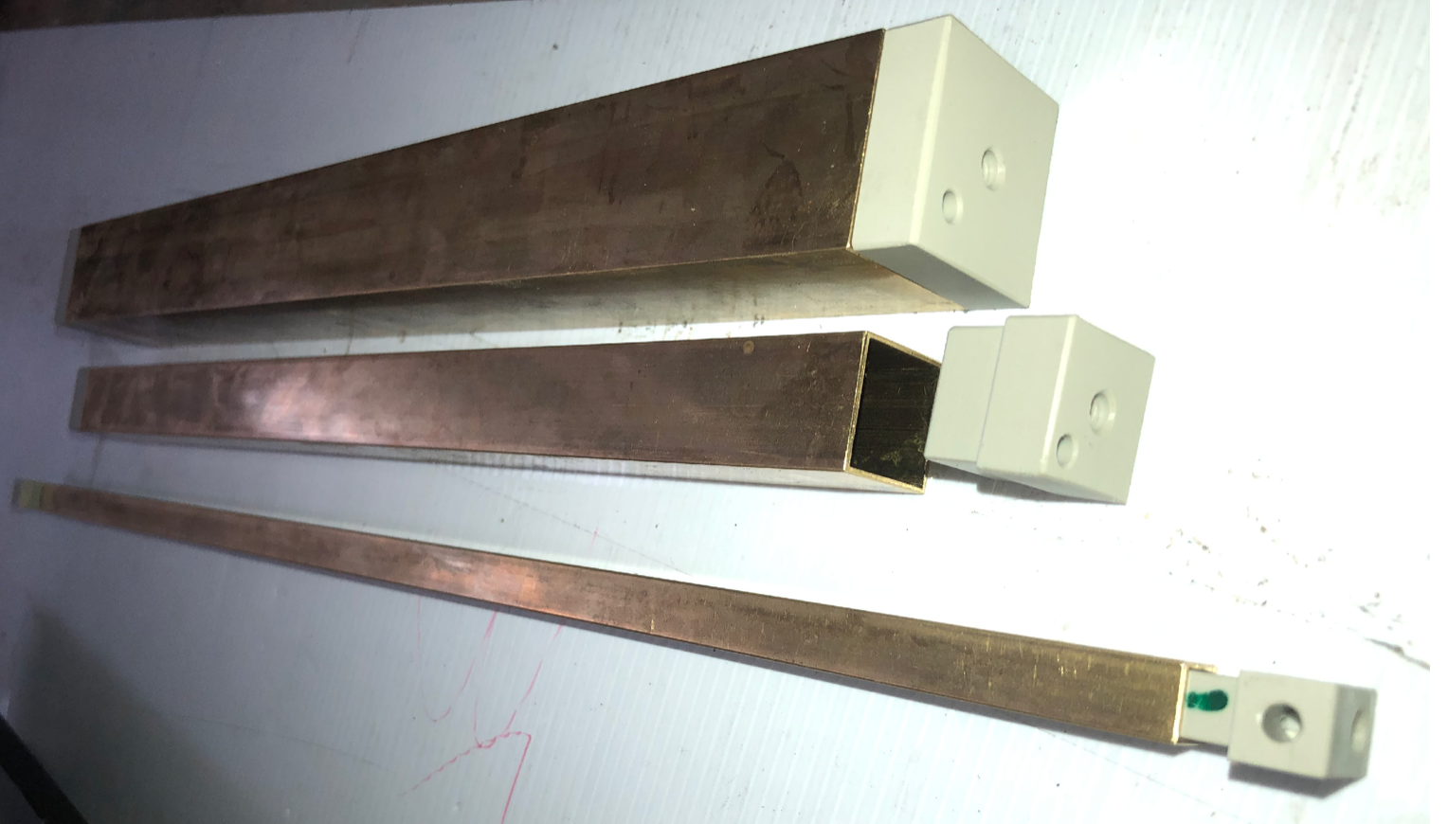
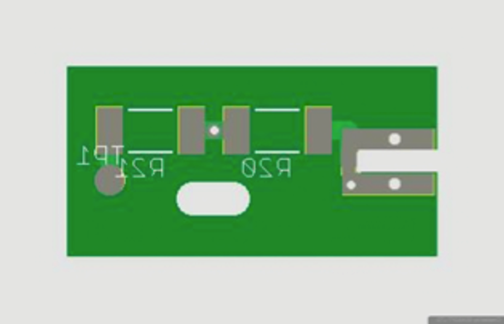
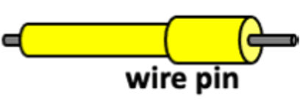
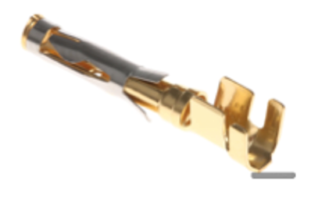
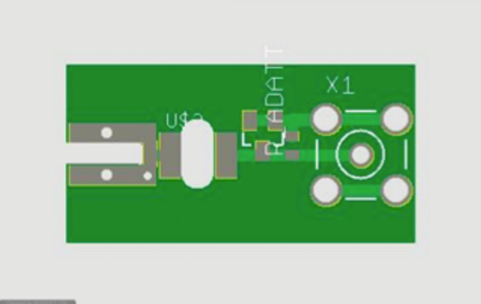
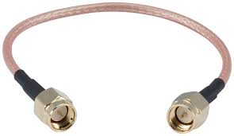
Material list
New PCB: check list of components
Old PCB
✓
8 brass tubes 1.5 cm x 30 cm cut to size
12 brass tubes 1.9 cm x 40 cm cut to size
all (ultrasound) cleaned
16 peek end caps 1.5 cm
24 peek end caps 1.0 cm
32 wire pins
32 connecting pins
10 SMA cables 100 cm long cut in half
1 MΩ
10 MΩ
✓
HV
+
1 nF
✓
✓
HV distribution boards
10 x (1MΩ + 10 MΩ resistors)
10 x 1nF capacitor
✓
✓
✓
✓
1 nF
✓
330 Ω
50 Ω
✓
✓
10 x 330 Ω resistors)
10 x 1nF capacitor
10 x diode bridge
✓
✓

Slide 9
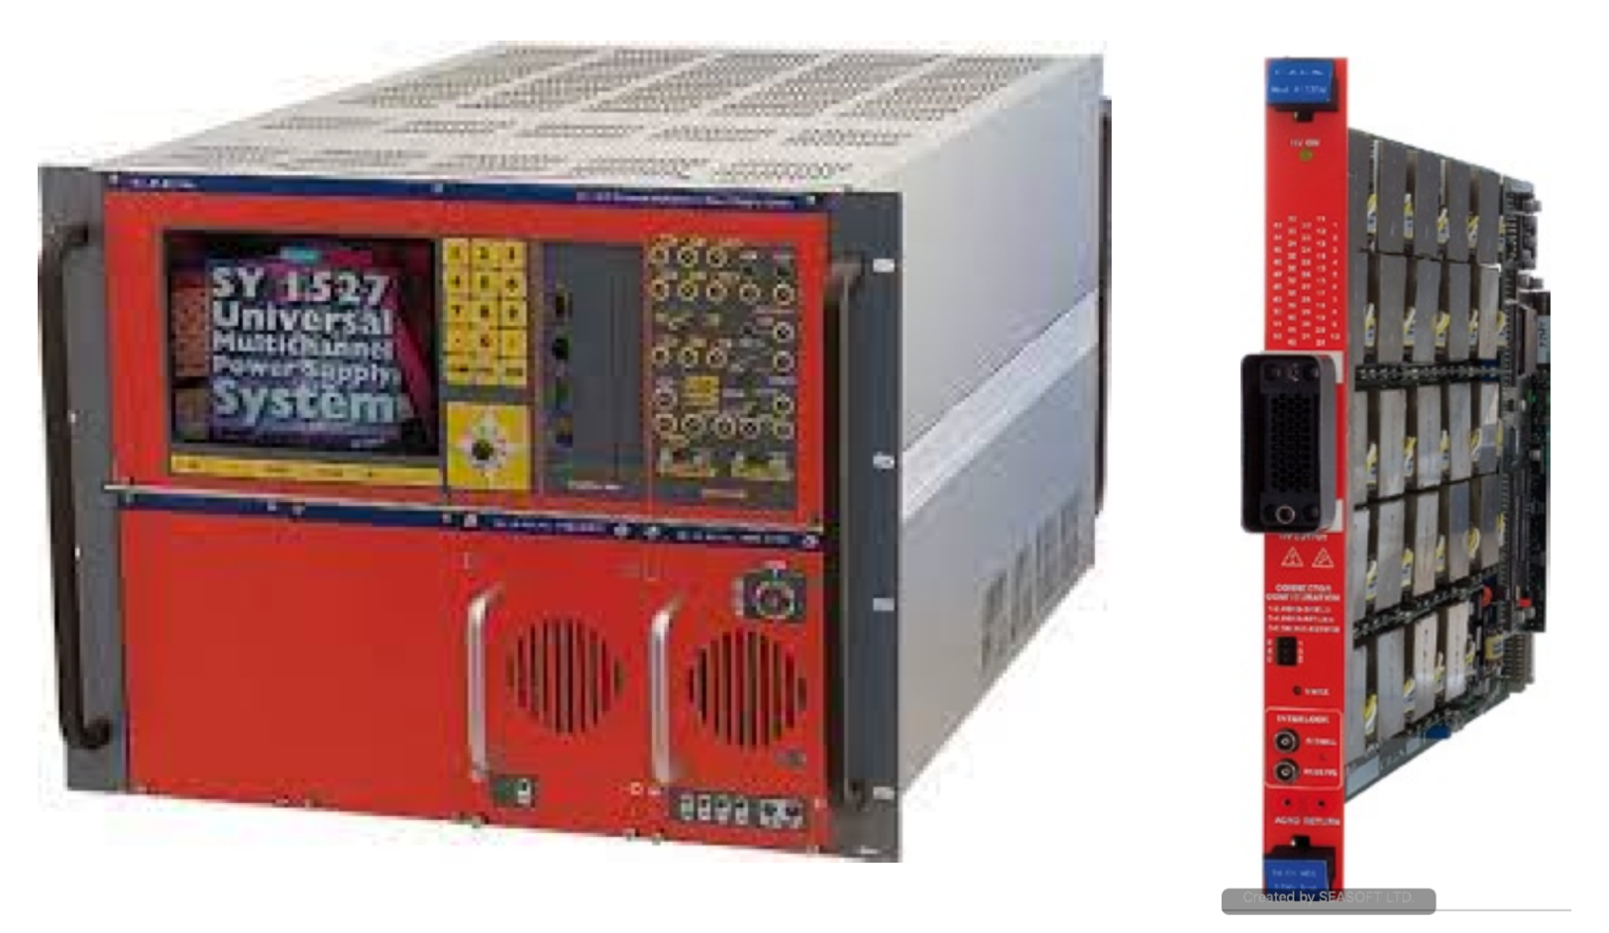
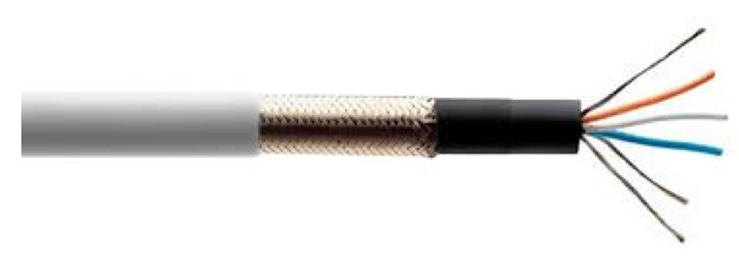
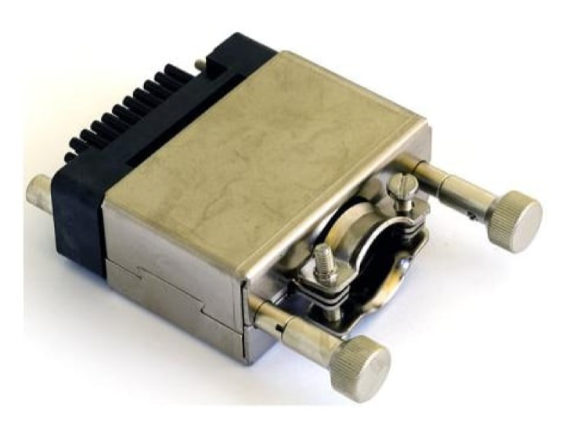
HV
24 poles HV cable crimped
to the Radiall connector.
SY 1527 Mainframe
1535P 24ch
✓
✓
HV mainframe fully functional.
Must resume HV setting and monitoring program.
Macro to be checked

Slide 10
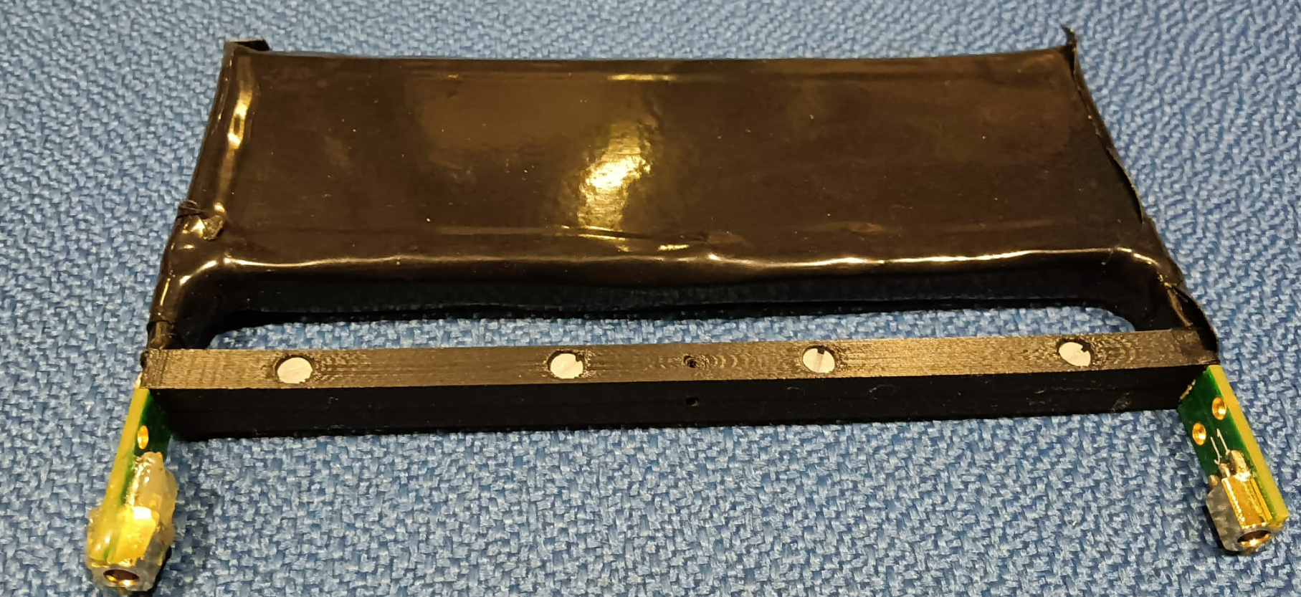
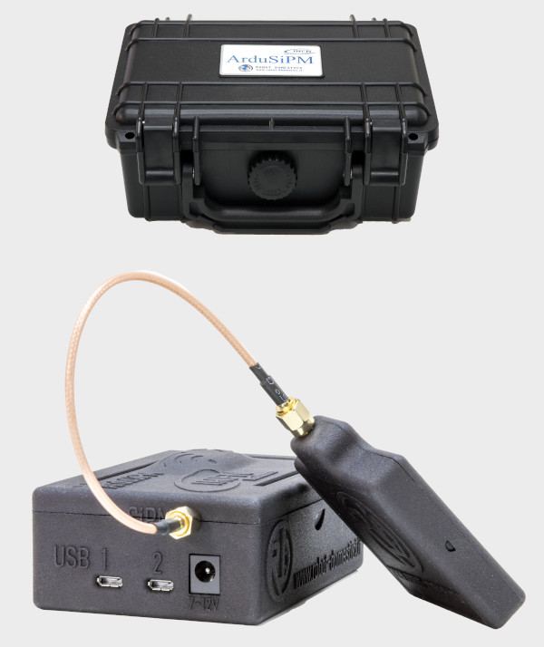
Trigger to the 16-ch DRS board
Select and test two good pairs of scintillators
6 cm x 12 cm
Need 4 MCX long cables for DRS trigger
Alternative trigger made with
ArduSiPM 5 cm x 5 cm
Check compatibility with DRS

Slide 11
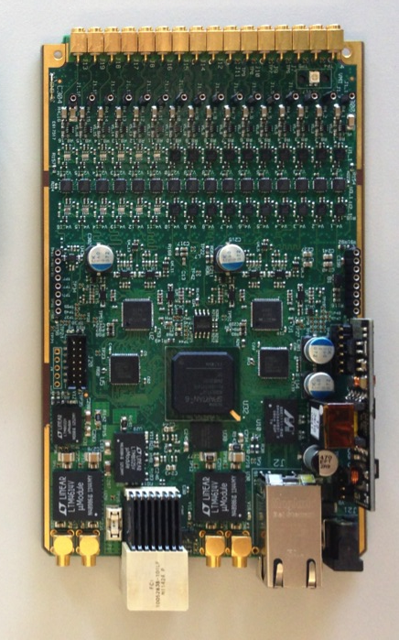
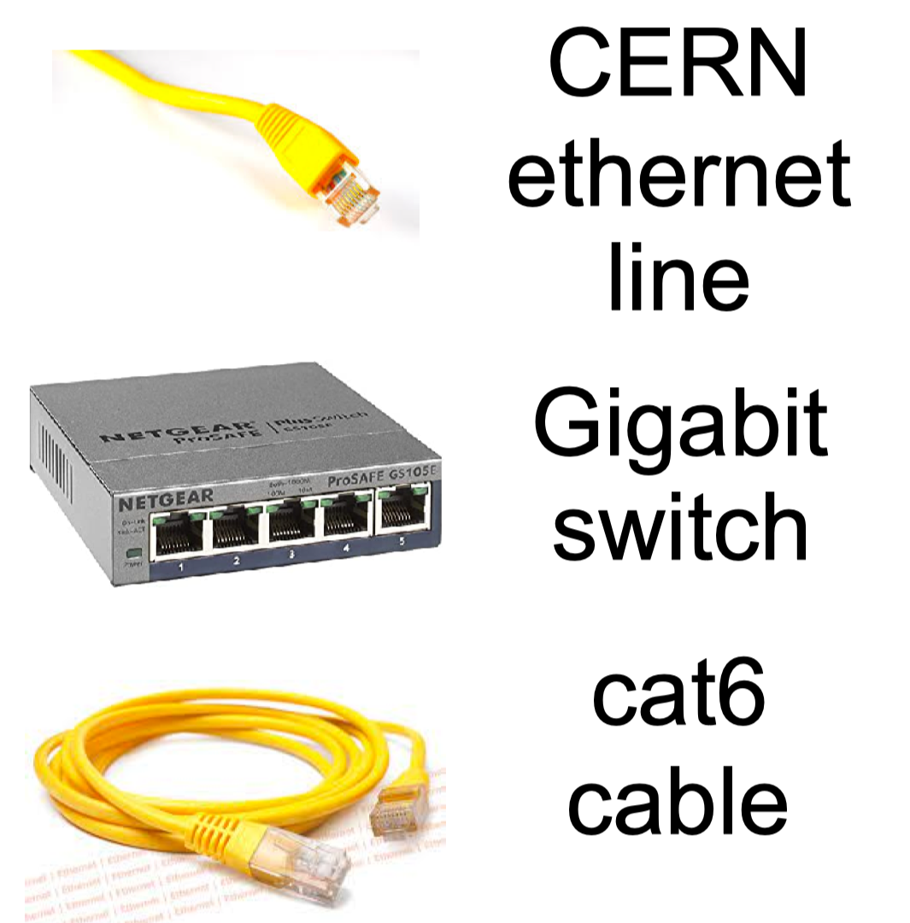

16-ch DRS board
16 channels board
✓
✓
✓
cat8
✓
✓
MacBook for DAQ

Slide 12
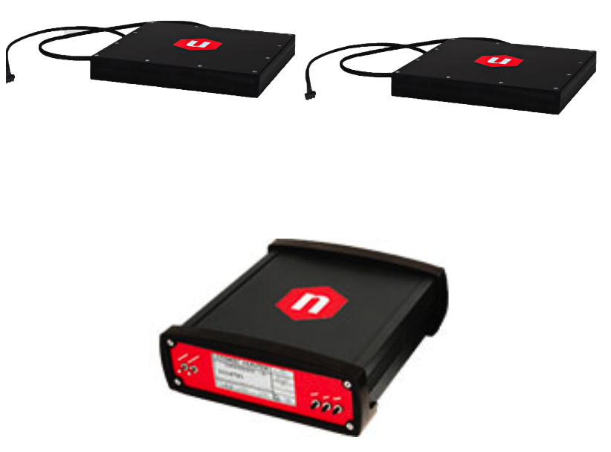
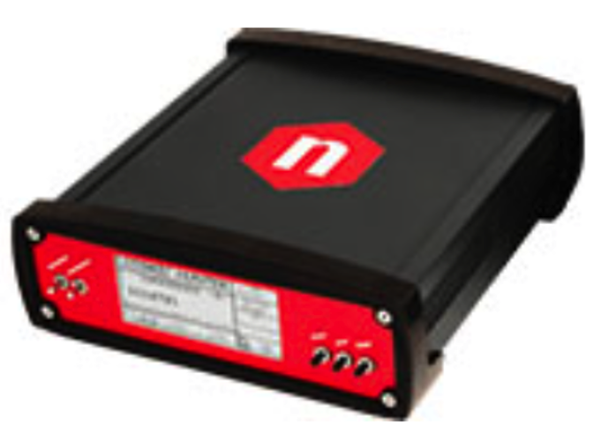
Trigger to the Teledyne-Lecroy oscilloscope
Trigger need to be anticipated by 800 ns appoximately
Check timing with drift tubes
Need very long cables from the SP5622 scintillator tiles to the coincidence module unit
to keep the very noisy coincidence unit far from the drift tubes
Check the ouput of the coincidence unit (if TTL need to translate to NIM for o-scope trigger)

Slide 13
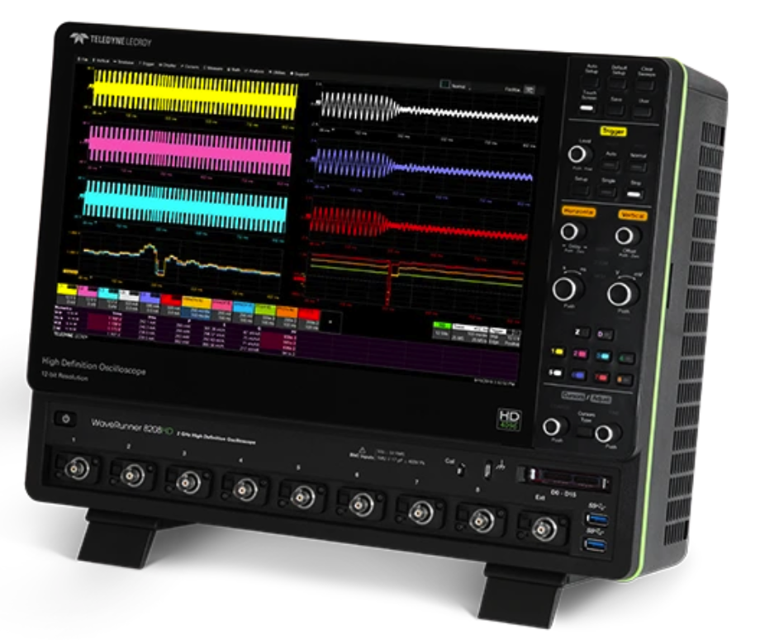
8-ch Teledyne Lecroy Trigger setup
15 cm x 15 cm
CAEN
5 cm x 5 cm
ArduSiPM
6 cm x 12 cm
MEG2 scintillator
side view
beam
10 cm x 10 cm
Allow for 45° rotation of
Tube pack
Tube pack
6 cm x 30 cm
top view
beam
10 cm x 10 cm

Slide 14
Summary of to-be-done operations
Mechanics:
Tubes refurbishing
Tubes: check HV and signal connections
Check length of ground spider (2x10 leads) HV side
10 mm compensation plates for tubes pack
Assemble the drift tube pack
Gas inlet and outlet manifold assembly
20x6mm x 2 rilsan inlet/outlet tubes (soft!)
Prepare bubbler at the output of the outlet manifold
Check the entire system for gas leaks
Trigger scintillators for DRS + bosch support
Trigger scintillators for oscilloscope + bosch support
Common support for upstream and downstream ?
Electronics:
HV and signal new PCB cards (20 + 20 +spares)
Signal boards component loading
SMA signal cable soldering
HV ground spider checking
HV boards component loading
HV leads soldering (CAEN 24-leads cable)
Connect HV and signal cards to drift tubes, check for continuity
Resume HV setting and monitoring program and check for shorts
Selection of 2 scintillators for trigger and testing for noise for the DRS
Test trigger chain for oscilloscope with the CAEN SP5620CH system
Check DAQ chain both for DRS and oscilloscope
Prepare data duplicating and storage system

Slide 15
Propedeutic checks in lab
Check reliability of DAQ with MacBook and DRS’s
Check reliability of DAQ with Teledyne-LeCroy scope
Define sampling rates (1.25 for DRS, 2.5 for o-scope)
Define a cosmic ray trigger
Check trigger delays and waveform windows (400 ns for 1.0 cm and 600 ns for 1.5 cm)
Check reliability of the existing portable gas system
Confirm reliability of HV system
Define details of the beam test work plan
Define transport logistic

Slide 16
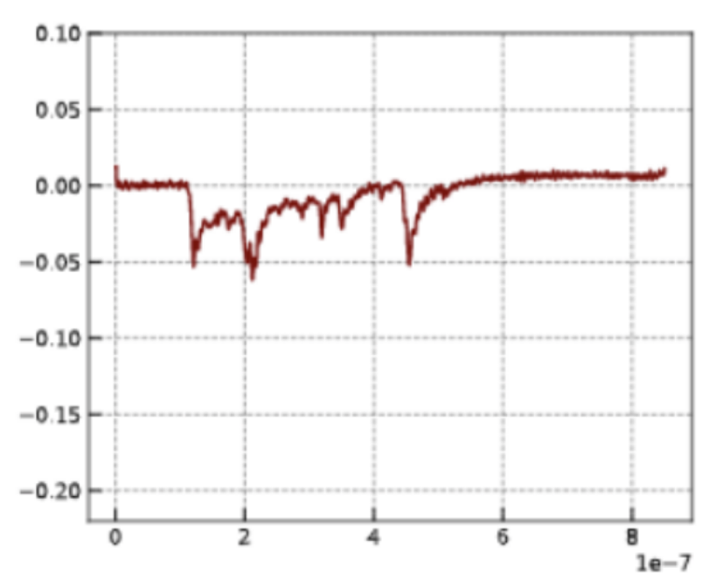
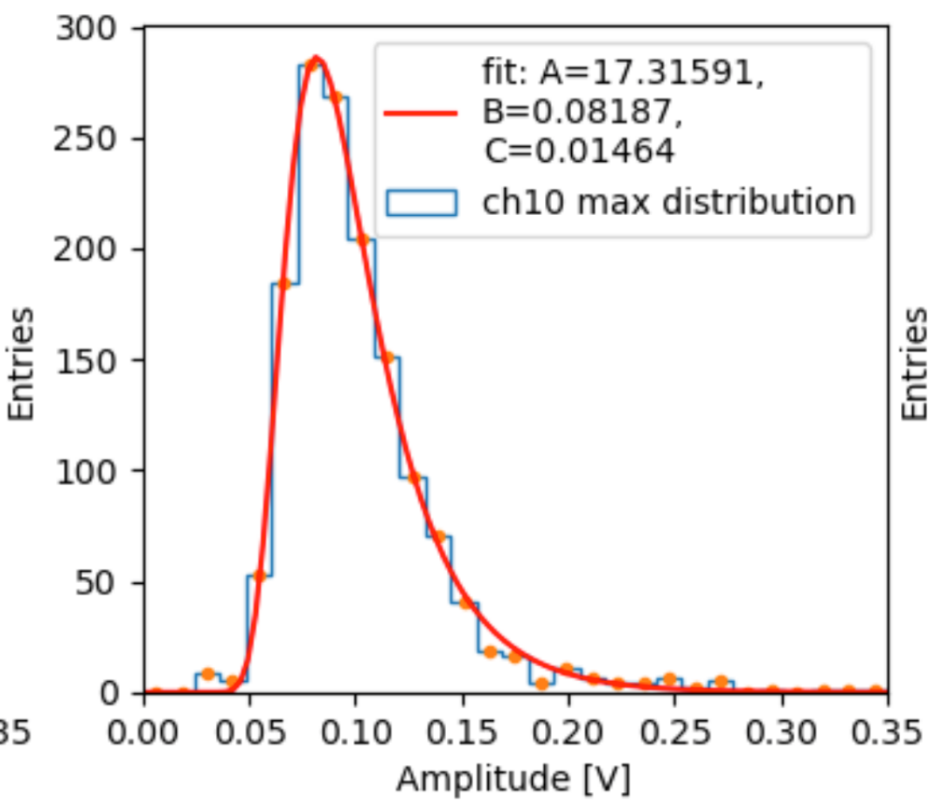
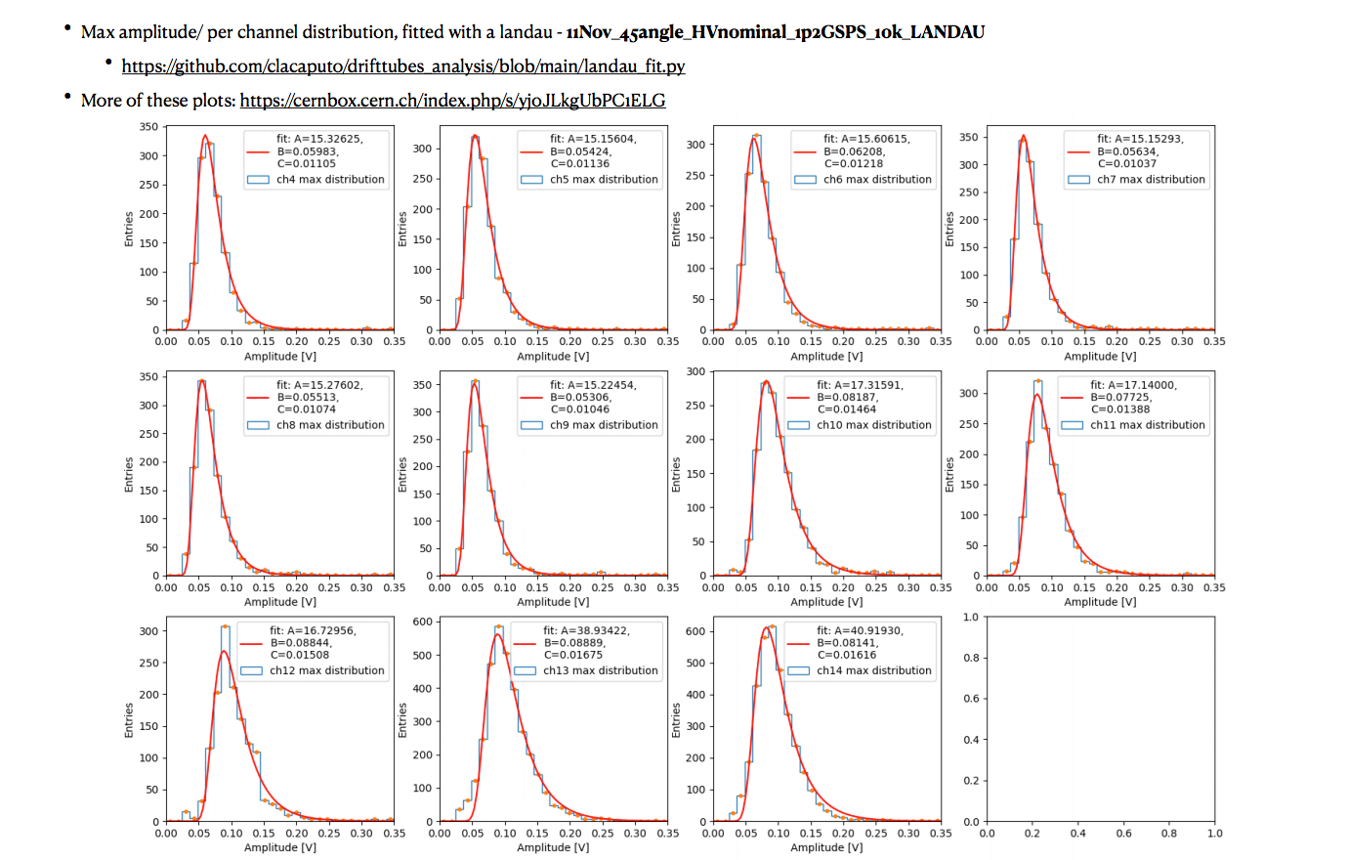
HV settings
Educated guess – to be checked
Define HV0 working point:
plot maximum pulse height
fit the distribution with a Landau
adjust HV to get a MPV ≈ 60 mV with 𝝘 ≈ 10 mV
HV vs gas gain for 90%He/10%iC₄H₁₀ – 760 torr
 | 2x10⁵ | 3x10⁵ | 4x10⁵
1.0 cm – 20 μm | 1480 | 1500 | 1520
1.5 cm – 20 μm | 1580 | 1600 | 1620
maximum pulse height
HV vs gas gain for 85%He/15%iC₄H₁₀ – 760 torr
 | 2x10⁵ | 3x10⁵ | 4x10⁵
1.0 cm – 20 μm
1.5 cm – 20 μm
HV vs gas gain for 80%He/20%iC₄H₁₀ – 760 torr
 | 2x10⁵ | 3x10⁵ | 4x10⁵
1.0 cm – 20 μm
1.5 cm – 20 μm

Slide 17
Work plan
Participating people:
M. Abbrescia
A. Corvaglia
B. D’Anzi
N. De Filippis
W. Elmetenawee
E. Gorini
F. Grancagnolo
S. Grancagnolo
F. Gravili
A. Miccoli
M. Panareo
M. Primavera
A. Ventura
(others from Bari ?, ATLAS-Lecce ?)
China (?)
USA (?)
Logistics:
Define list of participating people (now!)
Assign tasks (for needed and preparatory work)
Prepare list of materials and tools to be shipped to CERN
Decide how to ship:
  use a shipping agent (both ways)
  rent a truck (need to find drivers for both ways)
Freeze beam test program
Define a data taking program
Define shifts
On-line checks and data pre-analysis

Slide 18
Work plan
Tasks to be accomplished during test (beam test program):
Initial setup (IS):
  beam momentum 10 GeV/c (BM = 10)
  gas mixture 90%He - 10%iC₄H₁₀ (GM = 90/10),
  gas pressure at 760 torr, gas flow rate at 20 Nl/h (1 volume (5 Nl) exchange every 15 minutes)
  sampling rate (SR) at 1.25 GSa/s (DRS) and 2.5 GSa/s (o-scope)
  gas gain (GG) at 3x10⁵ (HV=HV0) - Define HV0 working point
  beam angle (BA) 45°
Run at IS and HV = HV0 (30000 triggers: sum of DRS + o-scope triggers), HV0 + 20V (GG = 4x10⁵)(10000 triggers), HV0 – 20V (GG = 2x10⁵) (10000 triggers) (1 long run + 2 medium runs)
Repeat 2. with BA = 0° (1 long run + 2 medium runs)
Repeat 2. and 3. with BM = 8, 6, 4, 2 GeV/c (total of 10 long runs + 20 medium runs)
Repeat 2., 3., 4. with GM = 85/15 and GM = 80/20 (total of 30 long runs (900000 triggers) + 60 medium runs (600000 triggers) for 1.5 million triggers)

Slide 20
Work plan
Estimated run time:
Last November: DAQ → ∼80 events/spill (5 s), ∼2 spills/minute
  beam rate ∼1500 μ /spill/100 cm² x 36 cm² (trigger coverage) = 540 expected μ/spill ➔ DAQ efficiency = 15%! → 2.7 μ/s (average) ≅ 30 min/run (5000 events)
Next June: improve DAQ efficiency! Improve trigger coverage to > 50 cm². Goal is reaching 15 min/run (10.000 events) (1 event ≅ 4 or 6 tubes hit)
Tasks 2. and 3. (28 runs 10.000 each) will take 1 shift (7 hours)
Task 4. (8 runs 20.000 each) will take 4 hours
Task 5. (10 runs 20.000 each) will take 5 hours
Total per GM = 16 hours → allow for 2 days (> 50% contingency)
3 x GM → 6 days

