Slide 1
Jets and Jet-like Correlations in STAR
Alice Ohlson (Yale University)
For the STAR Collaboration

Slide 2
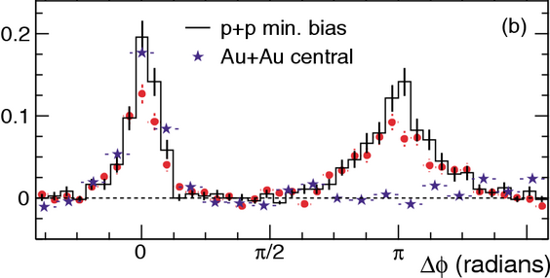
STAR Jet-like Correlations Analyses*
We have learned a lot from dihadron correlations…
Where do we go from here?
Extending the Kinematic Reach
→ Parton Energy Loss
Jet-hadron Correlations
Dijet Coincidence Rate
PRL 91 (2003) 072304
Fragmentation Biases
→ Pathlength dependence
2+1 Correlations
Jet and Ridge Composition
→ Modified Jet Fragmentation
PID-triggered Correlations
Particle Ratios In and Out of Jets
* Only high p_{T}, triggered correlations at mid-rapidity will be discussed here.

Slide 3
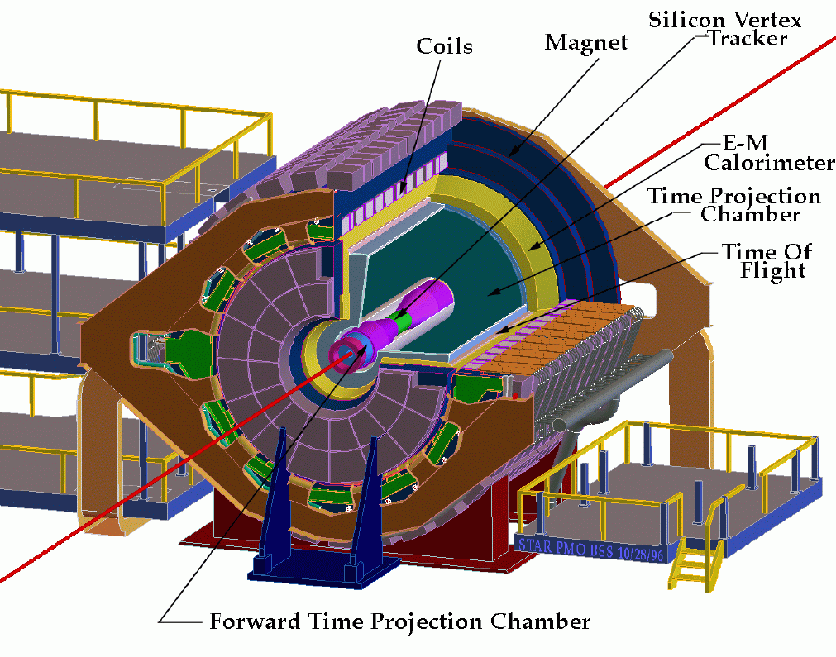
STAR (Solenoidal Tracker at RHIC)
neutral energy detection
Barrel
charged particle tracking & PID
PID
0 < φ < 2π
|η| < 1
Zero Degree Calorimeter

Slide 4
Dihadron Correlations
associates
trigger hadron
Investigate correlations of all “associated” particles with a “trigger”

Slide 5
Jet-hadron Correlations
associates
reconstructed
trigger jet
Jet-hadron correlations have increased kinematic reach compared to dihadron correlations

Slide 6
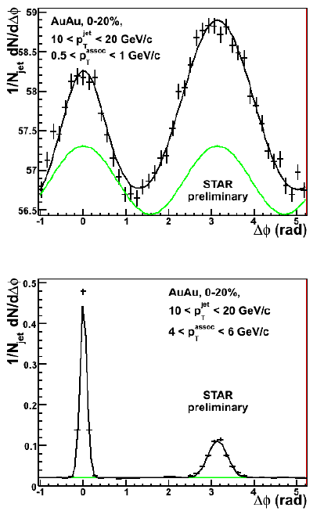
Jet-hadron Correlations
Jet Reconstruction: Anti-k_{T}, R = 0.4
High tower trigger
→ E_{T} > 6 GeV in a single BEMC tower (Δφ x Δη = 0.05 x 0.05)
Use tracks (towers) with p_{T} (E_{T}) > 2 GeV
Reduce effects of background fluctuations
Comparison to p+p is more straightforward
Trigger (nearside) jet population is highly-biased
Used to assign conservative uncertainties to shape of combinatoric background (v₂ and v₃) and trigger jet energy scale
Recoil (awayside) jet fragmentation is unbiased

Slide 7
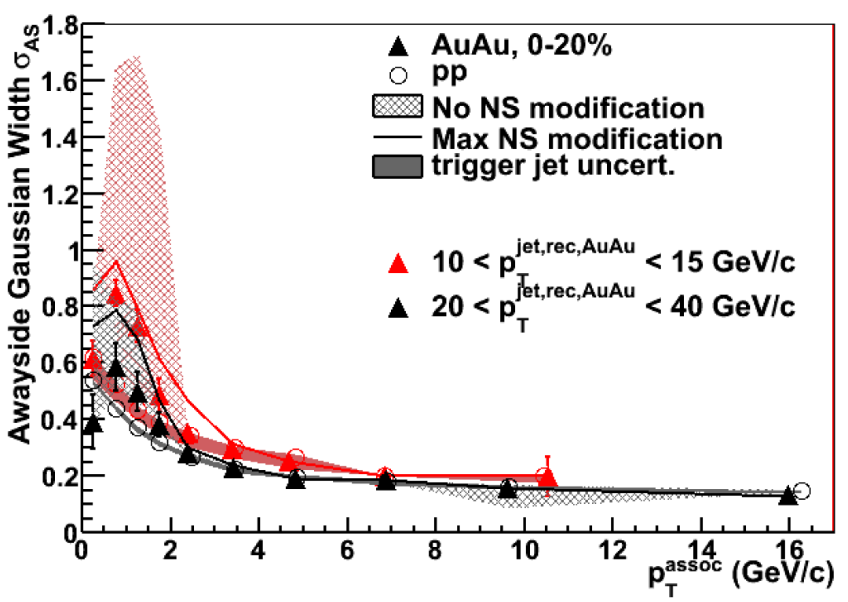
Awayside Gaussian Widths
STAR Preliminary
Awayside widths are highly-dependent on v₃ modulation.
Further information is needed about v₂^{jet}, v₃^{jet} (possible correlation of jets with reaction plane / participant planes)…

Slide 8
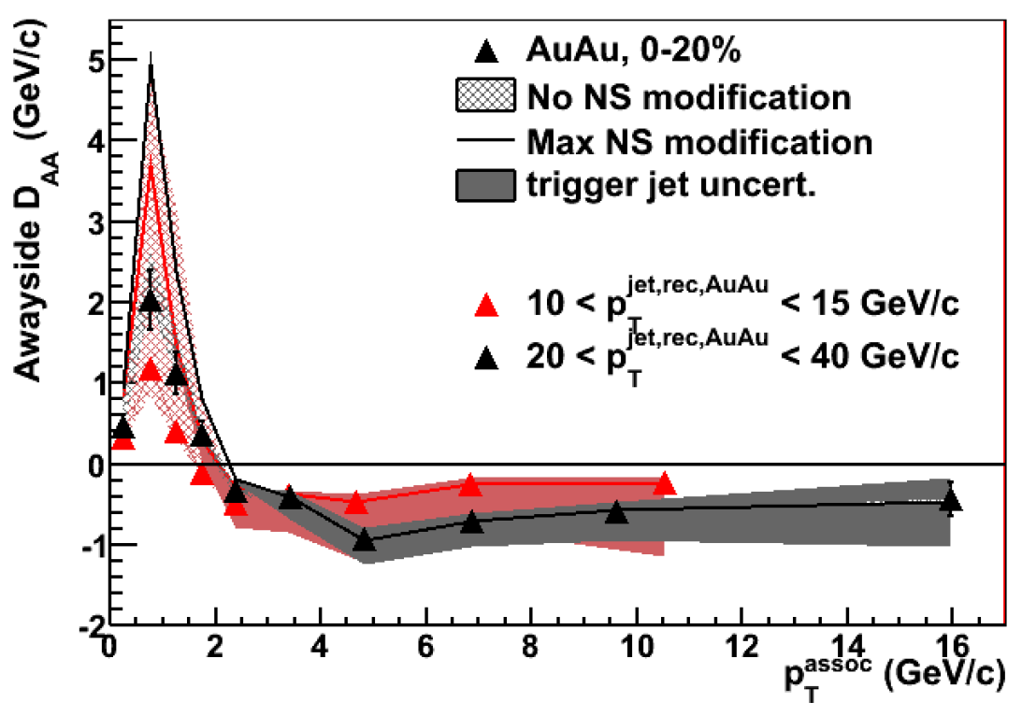
Awayside Energy Balance
p_{T}^{jet,rec} (GeV/c) | ΔB (GeV/c)
10-15
20-40
STAR Preliminary
Uncertainties due to:
detector effects
v₂ and v₃
jet energy scale
Suppression of high-p_{T} associated hadron yield is in large part balanced by low-p_{T} enhancement.

Slide 9
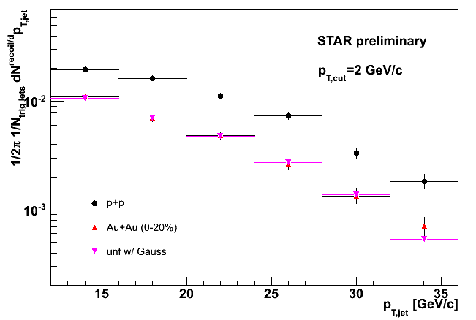
Dijet Coincidence Rate
STAR, QM 2009
Similar trigger jet population in Au+Au and p+p due to p_{T} cut and HT trigger requirements
Compare recoil jet spectrum in Au+Au and p+p
Suppression of recoil jet in Au+Au
Due to softening and/or broadening outside of jet cone
Trigger Jet:
R = 0.4
p_{T,cut} = 2 GeV/c
p_{T}^{jet} > 20 GeV/c
Recoil Jet:
R = 0.4
p_{T,cut} = 2 GeV/c
p+p
Au+Au (0-20%)
Au+Au (0-20%) unfolded

Slide 10
2+1 Correlations
Require high-p_{T} “dijet trigger” hadron opposite trigger
Investigate distributions of associated hadrons with respect to both trigger hadrons
associates
primary trigger
(trig1)
dijet trigger
(trig2)

Slide 11
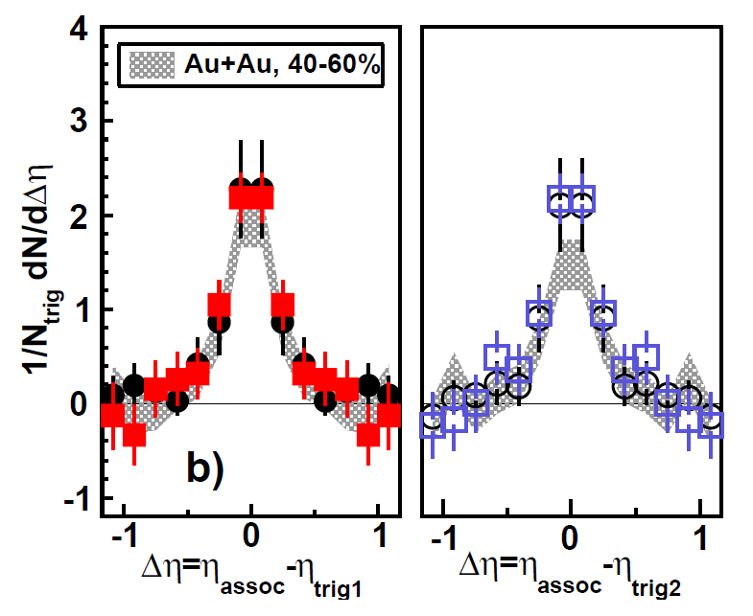
“Symmetric” Triggers
PRC 83 (2011) 061901
Near-side
Near-side
5 < p_{T}^{trig1} < 10 GeV/c
4 < p_{T}^{trig2} < p_{T}^{trig1}
1.5 GeV/c < p_{T}^{assoc} < p_{T}^{trig1}
No significant difference between Au+Au and d+Au
No significant difference between near-side and away-side.
Are we sampling surface-biased/unmodified dijets? Or dijets in which both jets lose similar amounts of energy?

Slide 12
Asymmetric Triggers
STAR, WWND 2011
E_{T}^{trig1} > 10 GeV (in BEMC)
p_{T}^{trig2} > 4 GeV/c
p_{T}^{assoc} > 1.5 GeV/c
AuAu near-side dAu near-side
AuAu away-side dAu away-side
STAR Preliminary
STAR Preliminary
Δφ (|Δη| < 1) Δη (|Δφ| < 0.7)
Still no significant shape difference between near- and away-sides, or between Au+Au and d+Au.
Apparently sampling tangential jets with these trigger p_{T} cuts…
Contrast to dihadron and jet-hadron results.

Slide 13
Jet-Hadron and 2+1 Correlations
STAR, WWND 2011
10 < p_{T}^{jet} < 20 GeV/c
|φ_{jet} – φ_{dijet trig}| > π – 0.2
p_{T}^{dijet trig} > 4 GeV/c p_{T}^{dijet trig} > 2 GeV/c no dijet trigger
1.5 < p_{T}^{assoc} < 2 GeV/c 6 < p_{T}^{assoc} < 8 GeV/c
Select unmodified jets with p_{T}^{dijet trig} > 4 GeV/c requirement.

Slide 14
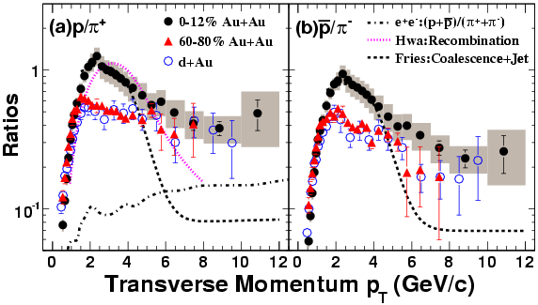
Why do PID in correlations?
Enhanced relative yield of baryons to mesons, compared to d+Au, well captured by recombination
PRL 97 (2006) 152301
Simplistic picture of recombination predicts stronger trigger dilution for baryons → Lower associated yield per trigger
→ Test by identifying trigger hadron
Is enhancement in p/π ratio correlated with jet production?
→ Test by identifying associated hadrons

Slide 15
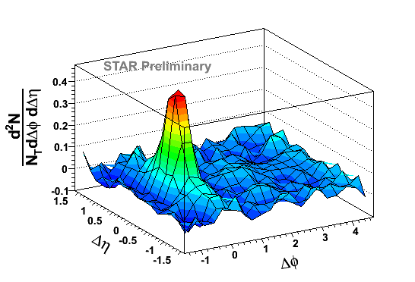
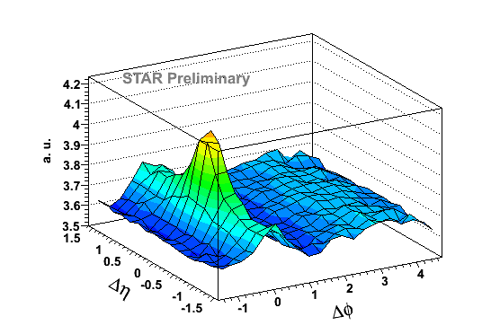
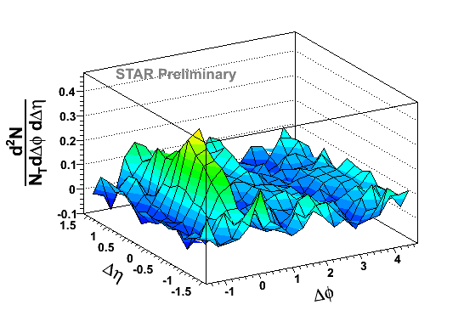
PID-triggered dihadron correlations
STAR, QM 2011
Trigger hadron identified via dE/dx in TPC
v₂ is subtracted (background level from ZYAM)
4 < p_{T,trigger} < 6 GeV/c
p_{t,assoc.} > 1.5 GeV/c
π± trigger
Inclusive hadrons
(p±+K±) trigger

Slide 16
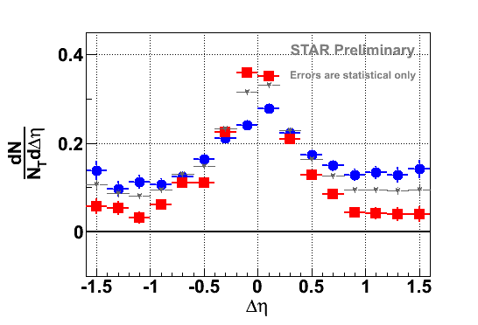
Δη Correlations – Au+Au
STAR, QM 2011
4 < p_{T}^{trigger} < 6 GeV/c
p_{T}^{assoc}. > 1.5 GeV/c
|Δφ|<0.73
Trigger:
■ π± ● (p±+K±)
▼ Charged h
Higher jet-like amplitude for pions
Ridge/v₃ predominantly contributed by non-pion-triggered events

Slide 17
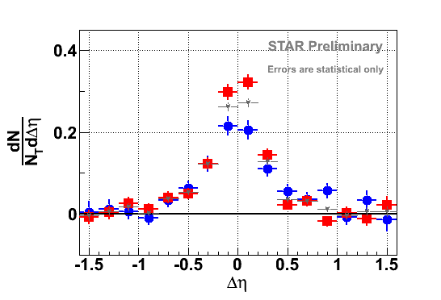
Δη Correlations – d+Au
STAR, QM 2011
4 < p_{T}^{trigger} < 6 GeV/c
p_{T}^{assoc}. > 1.5 GeV/c
Jet-like Cone Yield
|Δφ|<0.73
 | Au+Au | d+Au
π± trigger | 0.22 ± 0.01 | 0.19 ± 0.01
(p±+K±) trigger | 0.12 ± 0.01 | 0.14 ± 0.02
Trigger:
■ π± ● (p±+K±)
▼ Charged h
(stat. errors only)
Difference in jet-like amplitude persists in d+Au
Similarity of nearside associated yield in d+Au and Au+Au
→ no trigger dilution observed

Slide 18
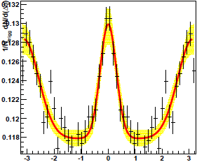
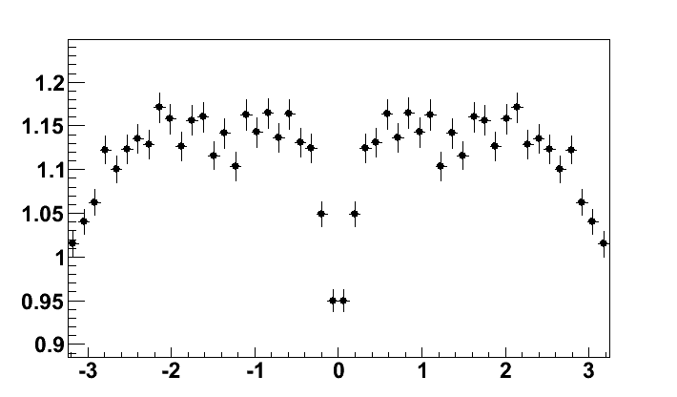
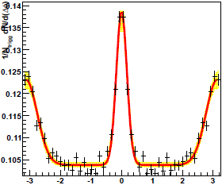
Jet-hadron Correlations w/PID
A. Dávila, Session IIB
p+p
STAR Preliminary
2 < p_{T}^{assoc} < 2.8 GeV/c
Ratio
(p+p)/(π⁺+π⁻)
 
Δφ
π⁺+π⁻
STAR Preliminary
STAR Preliminary
Δφ
Δφ

Slide 19
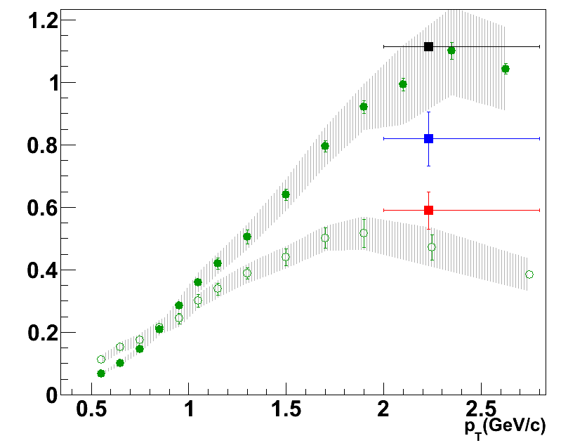
p/π Ratio
A. Dávila, Session IIB
Calculate p/π ratio of hadrons associated with trigger and recoil jet peaks
Ratio is ordered: inclusive > awayside > sameside
Inclusive:
Au+Au Central (0-12%)
d+Au Minbias
(p+p)/(π⁺+π⁻)
All Azimuth (0-20%)
Nearside
Awayside
STAR Preliminary

Slide 20
STAR Jet-like Correlations Analyses*
We have learned a lot from dihadron correlations…
Where do we go from here?
Extending the Kinematic Reach
→ Parton Energy Loss
Jet-hadron Correlations
Dijet Coincidence Rate
PRL 91 (2003) 072304
Fragmentation Biases
→ Pathlength dependence
2+1 Correlations
Jet and Ridge Composition
→ Modified Jet Fragmentation
PID-triggered Correlations
Particle Ratios In and Out of Jets

Slide 21
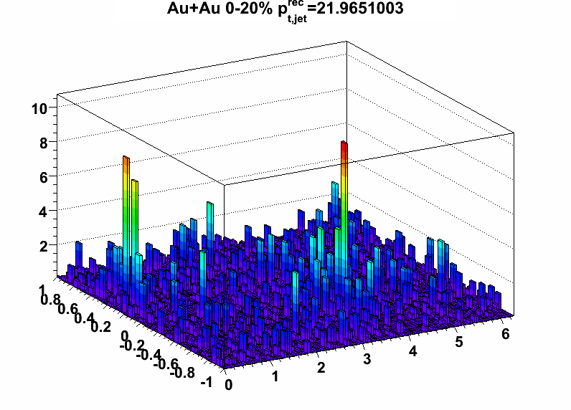
Conclusions
Parton Energy Loss
Softening of recoil jets which traverse the medium
Consistency between coincidence and correlation measurements
Qualitatively consistent with radiative energy loss
What have we learned?
STAR Preliminary
p_{T} per unit grid cell (GeV/c)
η
21
φ
Fragmentation Biases
High-p_{T} hadron (> 4 GeV/c) selects unmodified jets
Modified Jet Fragmentation
Higher jet cone yield in π-triggered events
Higher ridge/v₃ yield in K/p-triggered events
p/π ratio smaller in jets than in inclusive studies

Slide 22
Still to come…. (QM and beyond!)
Correlation Structures
y_{T}-y_{T} Correlations
Modeling 2D Correlation Functions
The Initial State
π⁰-π⁰ Correlations at Forward and Mid-Rapidity
Jet Peak Shapes & Energy Distribution
More on Asymmetric 2+1 Correlations
The Nearside in Dihadron Correlations
Flow & Nonflow
v_{n} Studies
Jet v₂
Collision Energy and System Dependence
R_{CP} at low √s_{NN}
Dihadron Correlations at low √s_{NN}
Correlations in U+U and Cu+Au

Slide 23
Backup

Slide 24
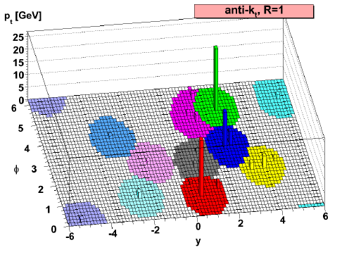
Jet Reconstruction
Anti-k_{T} algorithm – sequential recombination [PLB 641 (2006) 57]
Start with high-p_{T} particles
For each pair of particles (i,j), calculate
d_{ij} = min(1/p_{Ti}², 1/p_{Tj}²)((Δy)_{ij}²+(Δφ)_{ij}²)/R²
If d_{ij} < 1/p_{Ti}², merge the particles, else call particle i a jet
Repeat until all particles are clustered
R is resolution parameter
→ characteristic jet radius
M. Cacciari, G. P. Salam, G.Soyez, JHEP 04 063 (2008)

Slide 25
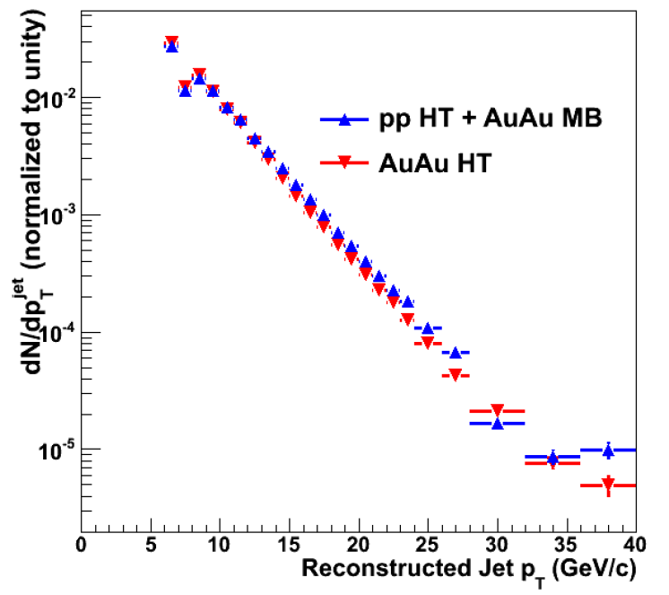
Comparing Trigger Jets
How can we select similar trigger (nearside) jets in both systems?
Assumption
Embed pp HT events in AuAu
MB events
→ Even after accounting for
detector effects, the shapes of the
pp HT + AuAu MB and AuAu
HT spectra do not quite match
AuAu HT event
pp HT event
fluctuations (AuAu MB event)
= ×
STAR Preliminary

Slide 26
Trigger Jet Energy Scale Uncertainties
Two extreme and opposite scenarios:
The nearside jet undergoes no modification in AuAu compared to pp.
A ΔE = -1 GeV/c in the pp jet p_{T} encompasses the differences between the AuAu HT and pp HT + AuAu MB spectra
The nearside jet undergoes maximal modification in AuAu compared to pp.
ΔB = 0 when parton energies are correctly matched; the shift in the pp trigger jet energy necessary to force the nearside ΔB to zero defines another systematic uncertainty limit.

Slide 27
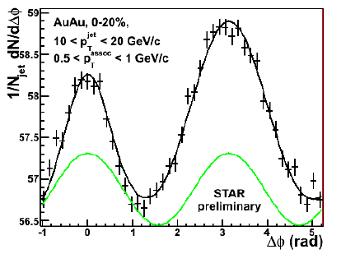
Background Subtraction
Background levels estimated by fitting
2 Gaus + B*(1+2v₂^{assoc}v₂^{jet}cos(2Δφ) + 2v₃^{assoc}v₃^{jet}cos(3Δφ))
v₂^{jet} and v₃^{jet} are unknown a priori
Systematic uncertainties assigned according to the same two extreme scenarios:
No nearside modification.
→ AuAu nearside yields and widths constrained to match pp, v₂^{assoc}v₂^{jet} is fixed to a mean value and v₃^{assoc}v₃^{jet} is free.
→ uncertainties: fix v₂^{assoc}v₂^{jet} to minimum and maximum values, let v₃^{assoc}v₃^{jet} float.
Maximal nearside modification.
→ largest nearside yields and widths correspond to
v₂^{assoc}v₂^{jet} = 0 and v₃^{assoc}v₃^{jet} = 0

Slide 28
Min and Max v₂ values
Maximum
v₂^{assoc}*v₂^{jet} = 1.5*v₂{FTPC}(p_{T}^{assoc})*v₂{FTPC}(6 GeV/c)
Minimum
v₂^{assoc}*v₂^{jet} = 0.5*v₂{4}(p_{T}^{assoc})*v₂{4}(6 GeV/c)
Mean
v₂^{assoc}*v₂^{jet} = 0.5*(v₂{FTPC}(p_{T}^{assoc})+v₂{4}(p_{T}^{assoc}))*v₂{FTPC}(6 GeV/c)

Slide 29
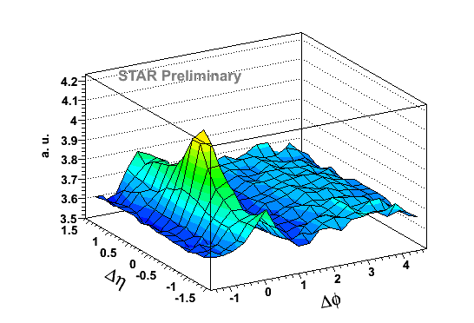
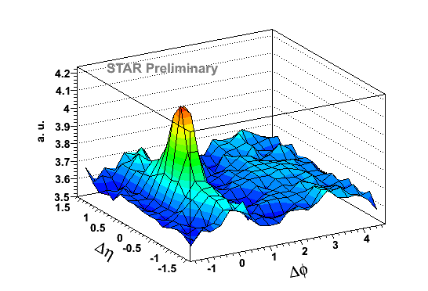
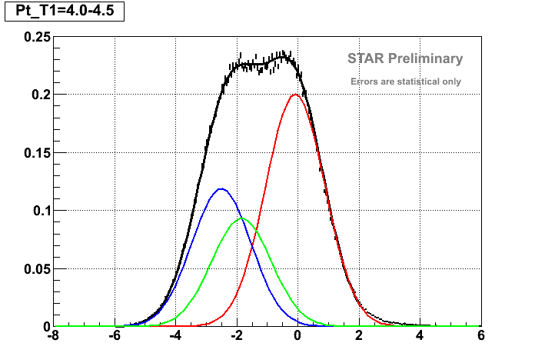
PID – statistical separation
pion-depleted sample
95% pure pion sample
a. u.
π
K
P

Slide 30
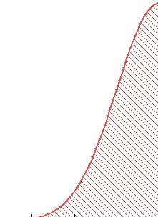
PID – statistical separation
pion-depleted sample
–
95% pure pion sample
a. u.
π
K
P
=
proton + kaon sample

Slide 31
Hadron-Jet Correlations
Trigger: 6 GeV cluster in BEMC
Reconstructed recoil jet:
Anti-k_{T}, R = 0.4
p_{T,cut} = 0.2 GeV
|Δφ - π| < 0.4
Compare jet yields in p+p and Au+Au
Vary p_{T} of leading particle in recoil jet → use fragmentation bias to vary in-medium pathlength
reconstructed
recoil jet
trigger

Slide 32
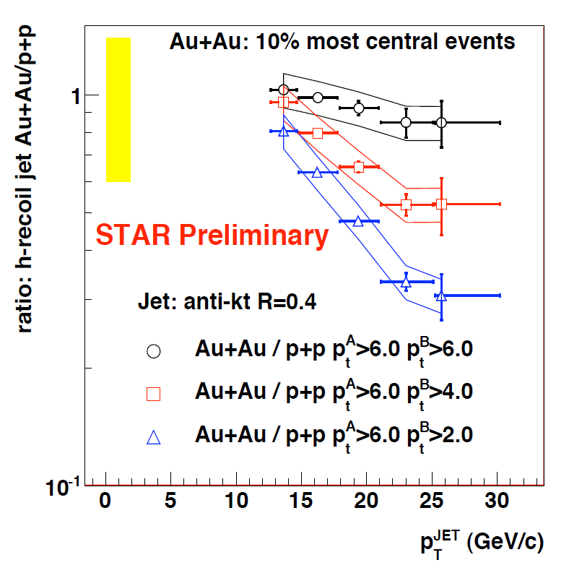
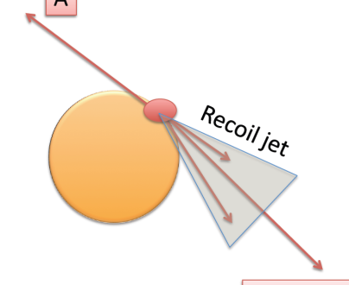
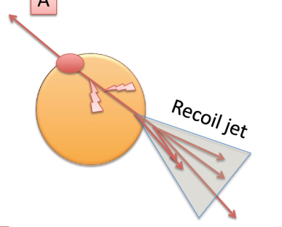
Hadron-Jet Correlations
STAR, QM 2009
High p_{T} leading particle in recoil jet
Selects same jet population in p+p and Au+Au
Little jet-medium interaction
A
B, p_{T}^{B} > 6 GeV/c
Lower p_{T} leading particle in recoil jet
More interaction
Significant redistribution of energy in jet
A
B, p_{T}^{B} > 2 GeV/c

