Slide 1
sPHENIX The Future Program of the PHENIX collaboration (central and forward rapidity)
Richard Seto
Hard Probes
May 31, 2012

Slide 2
sPHENIX and QCD
saturated state
of QCD
Color Glass Condensate
TMD PDFs at low-x
p(d)+A
QCD
Heavy Ions
Polarized
pp
The sQGP
Excited state
of QCD
Spin and the
Ground State
of QCD
TMD
Spin PDFs
“Understanding” QCD means more than knowing the Lagrangian
It means understanding how it manifests itself in different regimes.

Slide 3
A+A and the sQGP
?
Our understanding of the sQGP is limited
Mechanism of phase transition, quasiparticles
Transport coefficients
Jet medium interactions
Our understanding of the QGP would not be complete without a fundamental explanation for how the perfect fluid arises at strong coupling near T_{C} from an asymptotically free theory of quarks and gluons.
Jet observables at RHIC, enabled by the sPHENIX upgrade, are critical to providing this explanation by probing the QGP near T_{c}
We have two handles: T and Q²
Lever arm: LHC to RHIC to RHIC at lower energy (e.g. √s=100, 62)
Evolution of signals from RHIC to LHC is not trivial (e.g. J/ψ , hadron R_{AA})
Geometric Control at RHIC (Corona)– e.g. central Cu+Au

Slide 4
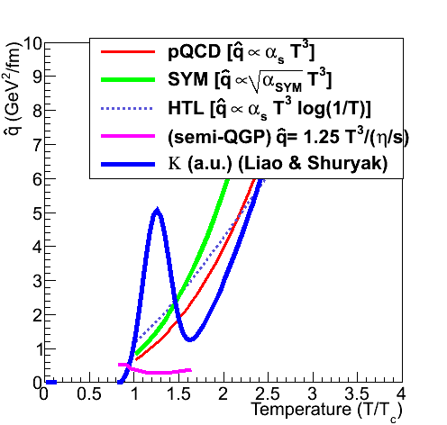
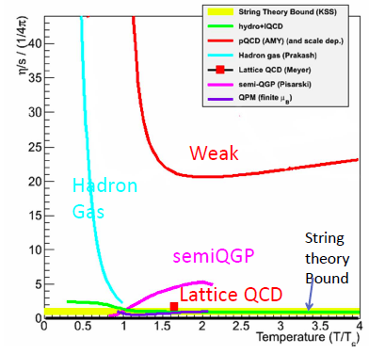
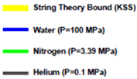
Temperature dependence of the sQGP?
additional
Information: jets
“Jet Quenching is a
few times stronger
near T_{c}
Liao and Shuryak, PRL 102,
202302 (2009), PRC 75 054907
η/s
$$\hat{q}$$
The weak coupling value for
η/s is > order of magnitude
too large
Yet we know at high T, the theory must be asymptotically free
Little is known about what happens on a microscopic level.
Strongly Coupled Scenario – electric and magnetically charged quasiparticles
RHIC creates a system is close to T_{C}
Such information together with data from
the LHC needed for clear understanding

Slide 5
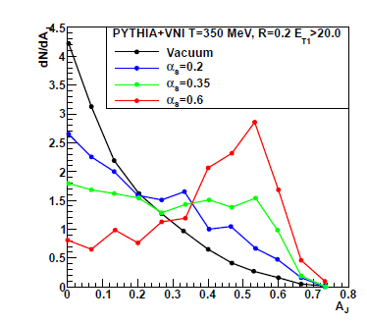
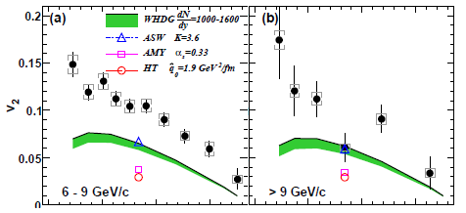
Would we be sensitive to the strength of the coupling α_{S?} ?
E₁ > 20 GeV
α_{S}=0.6
0.35
π⁰
0.2
vacuum
pQCD
PRL 105, 14230
Dijet (E₁-E₂)/(E₁+E₂)
RHIC dijets very sensitive to
effective coupling
Incorporating strong coupling
via AdS/CFT like path
dependence gives better
agreement
Embed parton showers into partonic medium,
where α_{S} can be varied
Chris Coleman-Smith (Duke)

Slide 6
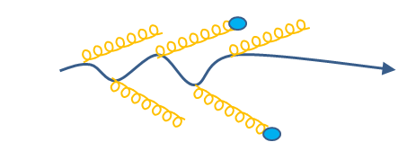
Q² Dependence: Heavy Quark Parton Virtuality
“RHIC” Scenario
T₀=300 MeV
Parton E_{T} = 30 GeV
“LHC” Scenario
T₀=390 MeV
Parton E_{T} = 200 GeV
pQCD
ΔQ²
LHC Scenario
“This means that the very energetic parton hardly notices the medium
for the first 3-4 fm of its path length”
B. Muller. Nucl.Phys., A855:74–82, 2011, RHIC/AGS Users Meeting 2011
This meeting

Slide 7
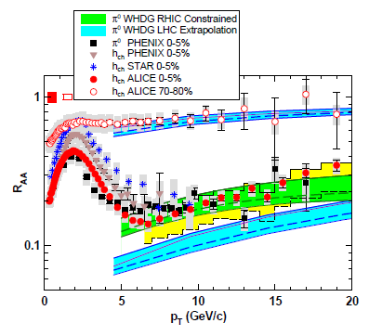
Q: Are RHIC and LHC the same of different?
Energy Loss Constrained
by RHIC data
Over-prediction of
quenching at LHC

Slide 8
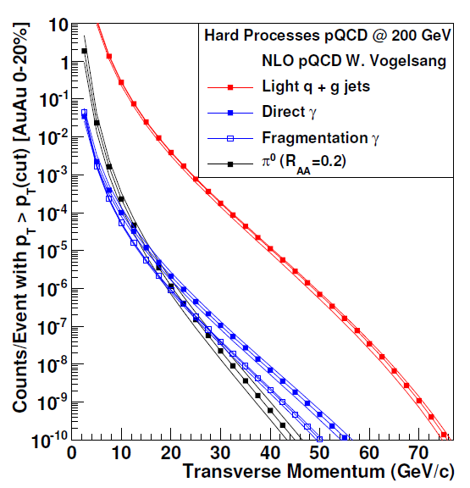
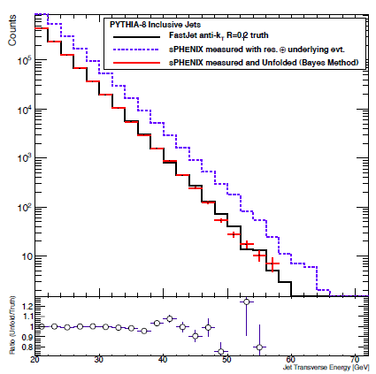
Can we to measure jets?
w/stochastic cooling
“raw” measured
with det resolution
and underlying event
Unfolding the
Energy spectrum
“Truth”
Measured and unfolded
Au+Au 10% Central
10⁵ Jets E>40 GeV (80% dijets)
10⁴ prompt photons E> 20 GeV
Rate together with the flexibility of RHIC will allow geometric control over measurements (A+A, A+B, p+A & p+p,), and allow us to vary T and Q²
Jet Transverse Energy (GeV)

Slide 9
Detector concept
Requirements
Jets (dijets): uniform, large solid angle coverage; reasonable jet resolution to 60 GeV; contain 97% of 50 GeV hadron
γ+Jet: Good photon coverage/resolution
Contain Cost: Compact, uniform electronics
Choices (Stage I – a jet detector) |η|<1.1
Solenoid 2T, R=70 cm, leaving room for tracking + “low granularity” PID for eRHIC
Compact EMCAL➔Small Molierre Radius (1.2cm)➔Tungsten
Outside magnet
Readout: SiMPT
ΔφΔη= 0.02x0.02
HCAL
Jets with R=0.2 -> Segmentation ΔφΔη=0.1x0.1
Upgradeable
π⁰ →γγ to 50 GeV (preshower)
Resolve Upsilon states: high resolution tracking
Retain capability to become an eRHIC detector (10x100 GeV²)
Leave room in forward direction for CNM, spin studies

Slide 10
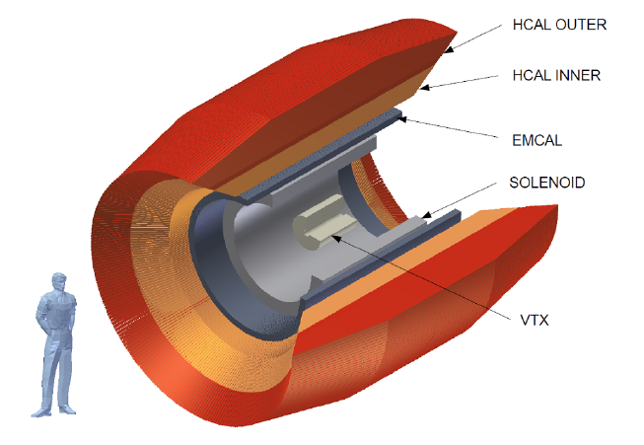
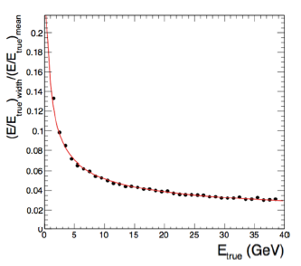
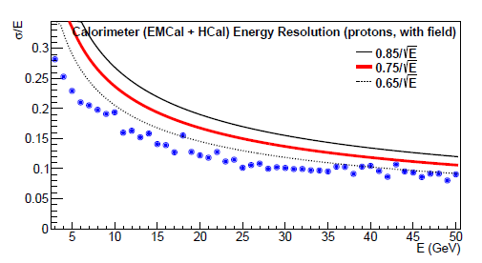
The central barrel Detector : Stage I
Solenoidal Magnet
B=2T R=0.7m
EMCAL
Tungsten-Fiber
ΔηΔφ =0.02*0.02
~17X₀
Geant-4
Hcal Resolution
~75%/√E
Geant-4
EMCal Resolution
~14%/√E
HCAL
Iron-Scintillator
ΔηΔφ =0.1*0.1
5λ (w/ EM=6 λ)
stage I – 25K Channels
|η|<1.1

Slide 11
p+A: cold Nuclear Matter

Slide 12
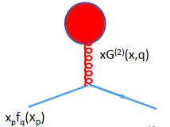
Three views of (saturated) gluons in nuclei
Shadowing and nPDFs
Color Glass Condensate
TMD Factorized gluon distributions: distributions dependent on k_{T}
Problem: TMD factorization violated for dijet production in hadron+hadron collisions
Solution: Get back effective TMD factorization in case of small x partons at high density (“CGC regime”) – probed by quark, or photon
Problem: TMD parton distributions not universal
Solution: they can be constructed for building blocks which ARE universal.
e.g. Gluon PDF ⇨G⁽¹⁾(x,q⊥), G⁽²⁾(x, q⊥)
quantities derived via CGC and via TMD identical
Equivalence between TMD and CGC
approach at low-x
Domingues, Marquet, Xiao, Yuan arXiv:1101.07152v2, PRL 106, 022301
Spin: TMD PDF (Sivers )↔ Twist 3 †
CNM: CGC ↔ TMD PDF←?→ Higher twist Shadowing?
† Ji, Qiu, Volgesang, Yuan PRL 97, 082002

Slide 13
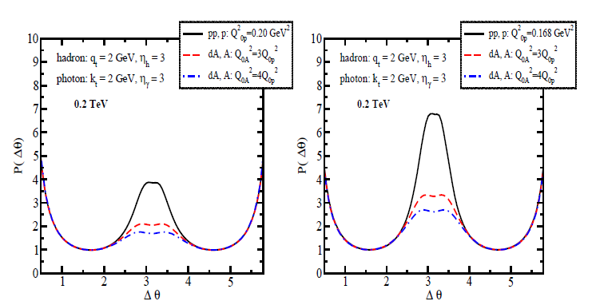
sPHENIX: Measuring G⁽¹⁾, G⁽²⁾
PRD 49, 2233, 3352
NPB 529, 451
xG(x,q⊥) now comes in two flavors G⁽¹⁾ and G⁽²⁾ in CGC limit
Cross sections are exactly same as calculated in the CGC framework
saturation scale should be extracted from the small-x evolution equation which gives the saturation momentum energy dependence
Will need both central barrel and forward arm
p+p
γ-jet
correlation
d+A
Various
Saturation
scales
13

Slide 14
Polarized p+p: spin Physics

Slide 15
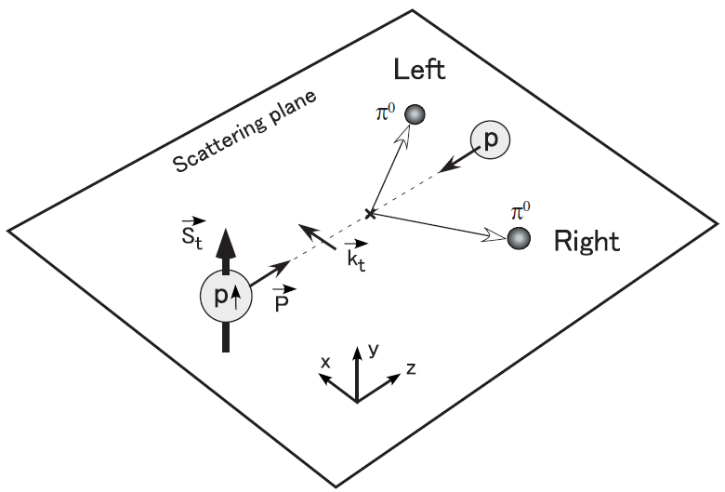
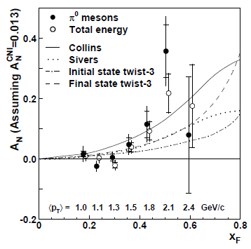
Transverse Spin Asymmetries
Asymmetries were expected
to be small at RHIC
BUT IT’S
LARGE
$$A_{N}=\frac{dσ_{L}−dσ_{R}}{dσ_{L}+dσ_{R}}$$
Result has spawned an enormous amount of theoretical progress
May give access to quark angular momentum in protons

Slide 16
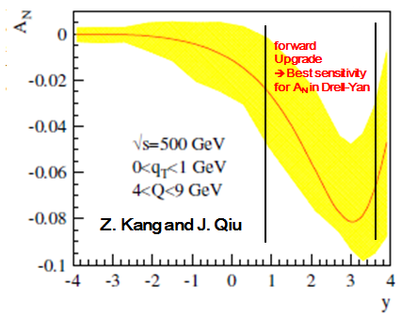
Forward sPHENIX : Transverse Spin
Measure Drell Yan in polarized pp
Estimated DY A_{N} from global Sivers fit
A possible solution:
Sivers quark-distribution
Correlation between proton-spin
and intrinsic quark transverse momentum
DY➔ Accurate
measurement of Sivers
TMD parton distribution
Function
Important check of our
Understanding of QCD
Z. Kang and J. Qiu. Phys. Rev., D81:054020, 2010

Slide 17
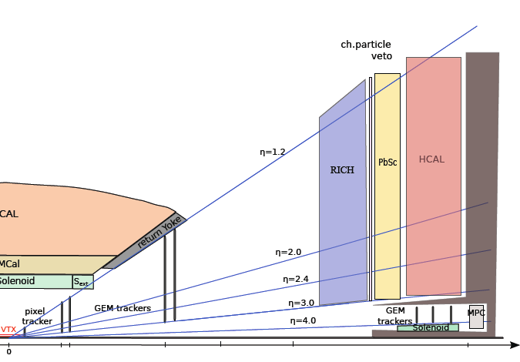
sPHENIX Forward Detector (conceptual)
1.2<η<4
3<eta<4 (forward lampshade magnet)
EMCal
PbSc 18 X0, 5.5x5.5*38 cm³
Restacked PHENIX EMCal
HCAL
High resolution Tracking
PID (RICH)

Slide 18
A staged approach
Stage I
Barrel Magnet+ EMCal+HCal:
Jets, high pT photons
Room for eRHIC PID sufficient for first stage of eRHIC
Later stages
MidRapidity
Tracking : charged hadrons, electrons
Preshower detector: lower p_{T} photons, π⁰s
Forward Rapidity
EMCAL (restacked PHENIX calorimeters)
HCAL
High rapidity magnet
Tracking
PID
Goal (Stage I)
Construction Start: 2014
Operation:2017

Slide 19
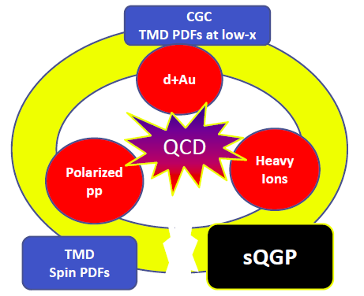
Conclusion: sPHENIX – the scope
Heavy ions – the excited state of QCD
Q: what is the nature of the sQGP and the QCD phase transition
RHIC data on jets together with LHC necessary to map out dependence on T, Q², length scale, DOF
sPHENIX is a detector which can, in the first stage deliver many of the answers
Parton distributions in large nuclei – saturated state of QCD
TMD and saturation
Measure G⁽¹⁾, G⁽²⁾, e.g. saturation scale
Initial state of heavy ions
Spin structure of nucleon – Ground state of QCD
TMD and transverse spin measurements
e.g. Sivers
Theoretical development and support for experimentalists will be crucial to interpreting the data in terms of interesting and physically meaning full quantities.

Slide 20
backups

Slide 21
Timeline for Stage I (magnet+calorimeters)
MIE – July 1
Critical Decision | Quarter and FY
CD-0 | 1QFY13
CD-1 | 4QFY13
CD-2 | 2QFY14
CD-3 | 2QFY14
CD-4 | 4QFY17
Start of Construction
Start of Operations

Slide 22
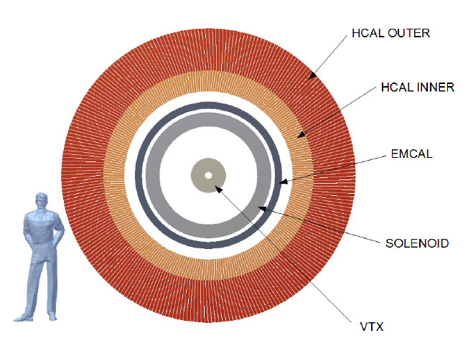

Slide 24
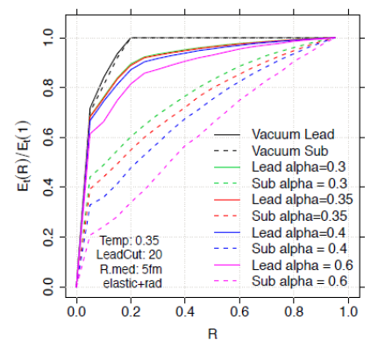
Detailed shower profile modification
reveals medium coupling and key sensitivity to
what you are scattering from in the medium!
Stronger α_{S}
Broader jet

