Slide 1
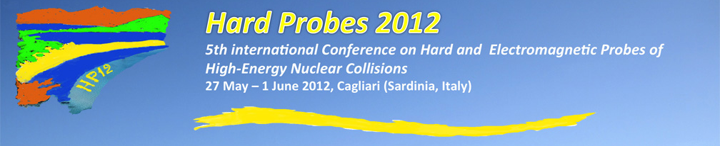
Heavy Quarkonia in the QGP
from effective field theories and potentials
Alexander Rothkopf
Albert Einstein Center for Fundamental Physics
Institute for Theoretical Physics
University of Bern
Hard Probes 2012, Cagliari, Italy May 30th 2012, 11:30 a.m.

Slide 2
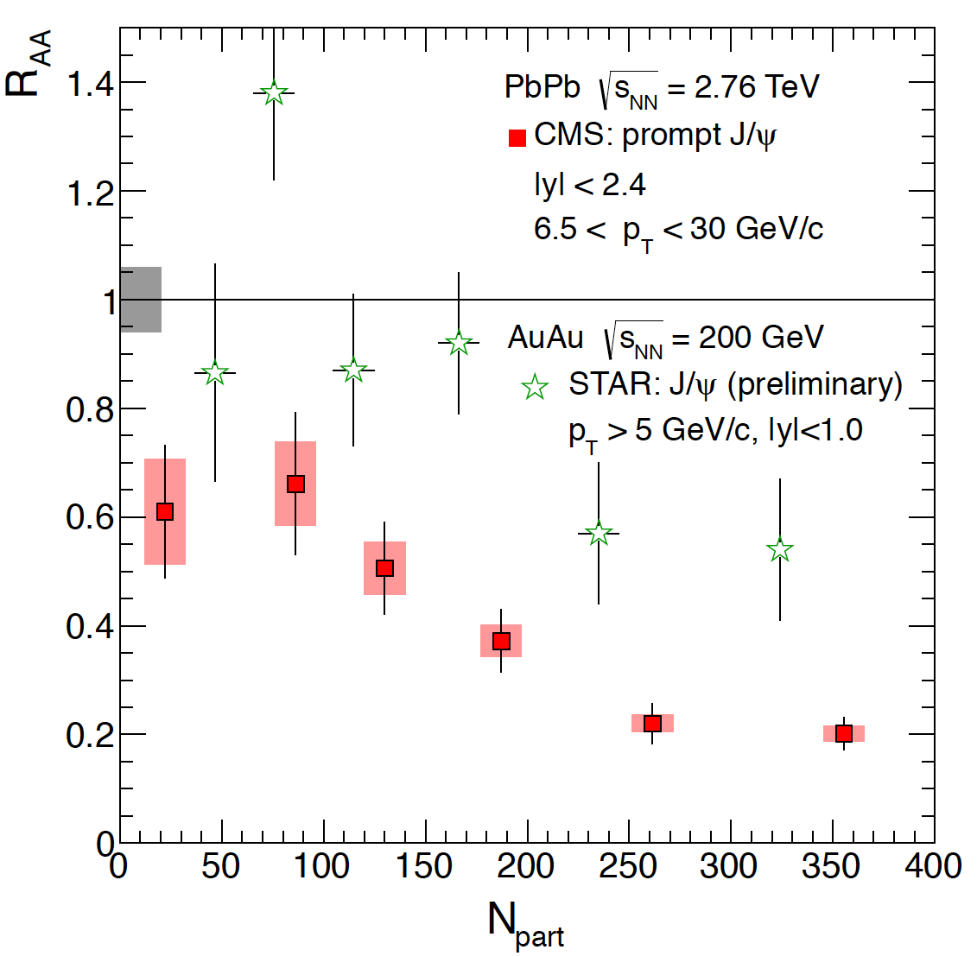
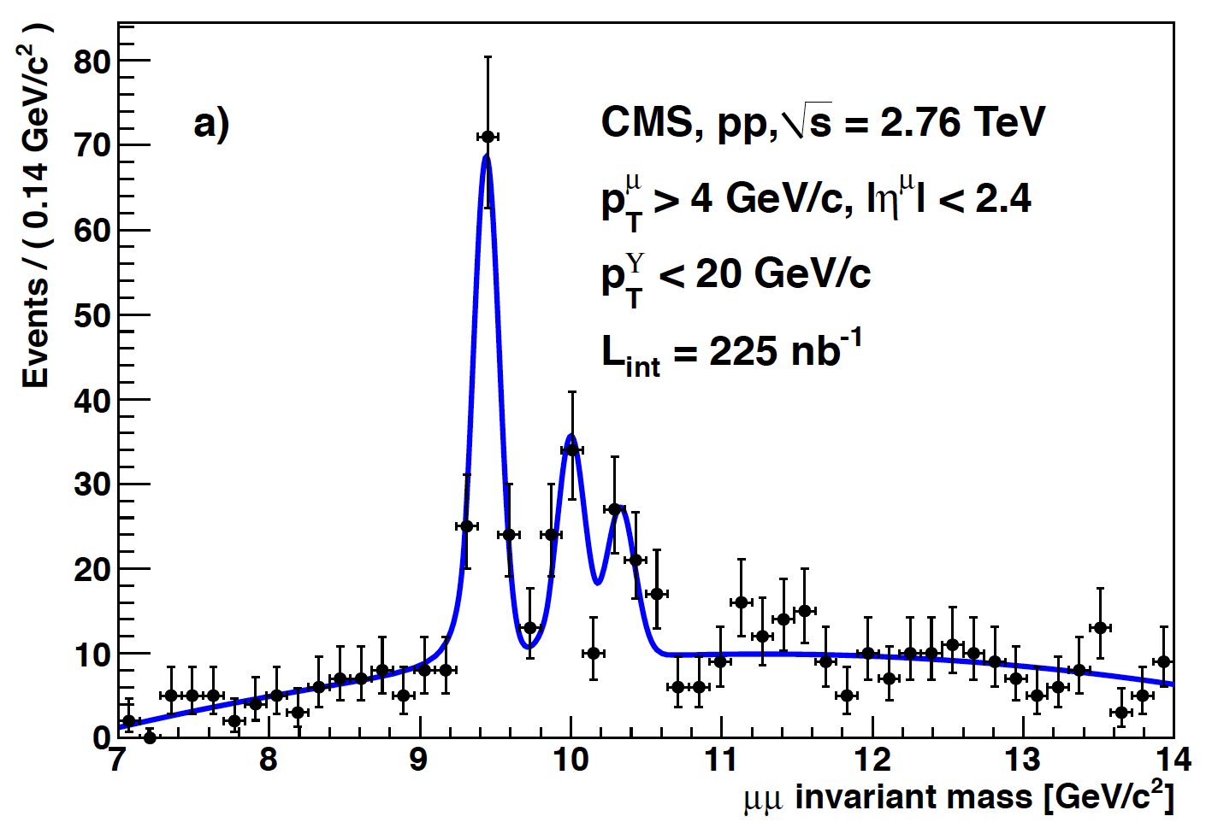
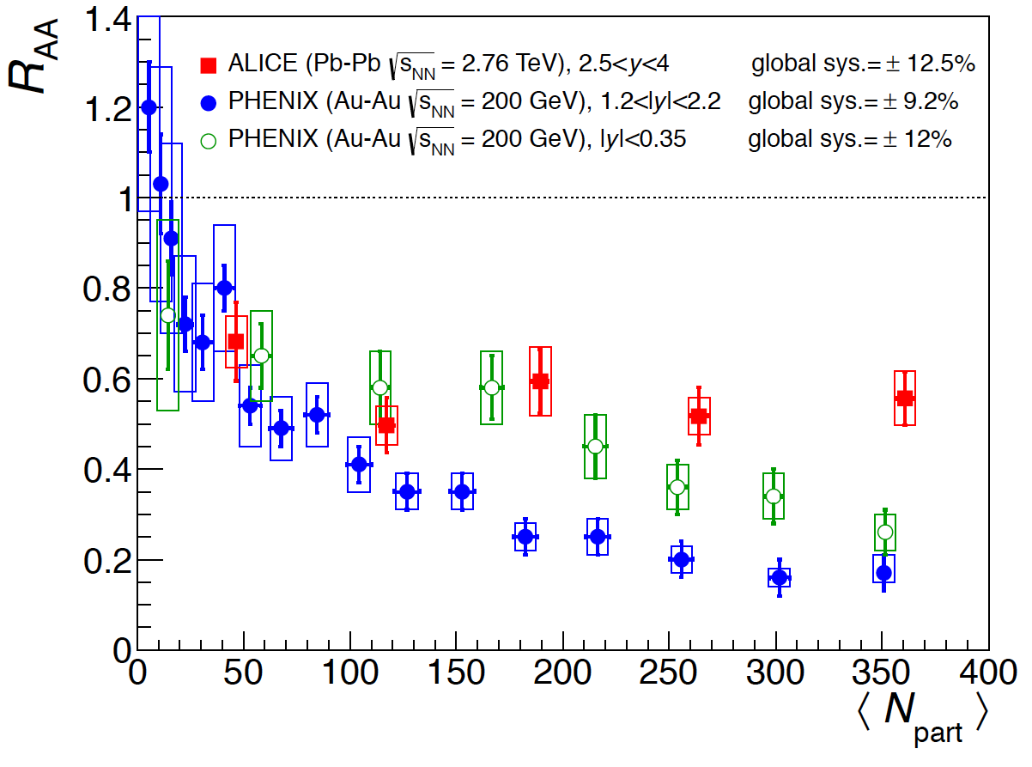
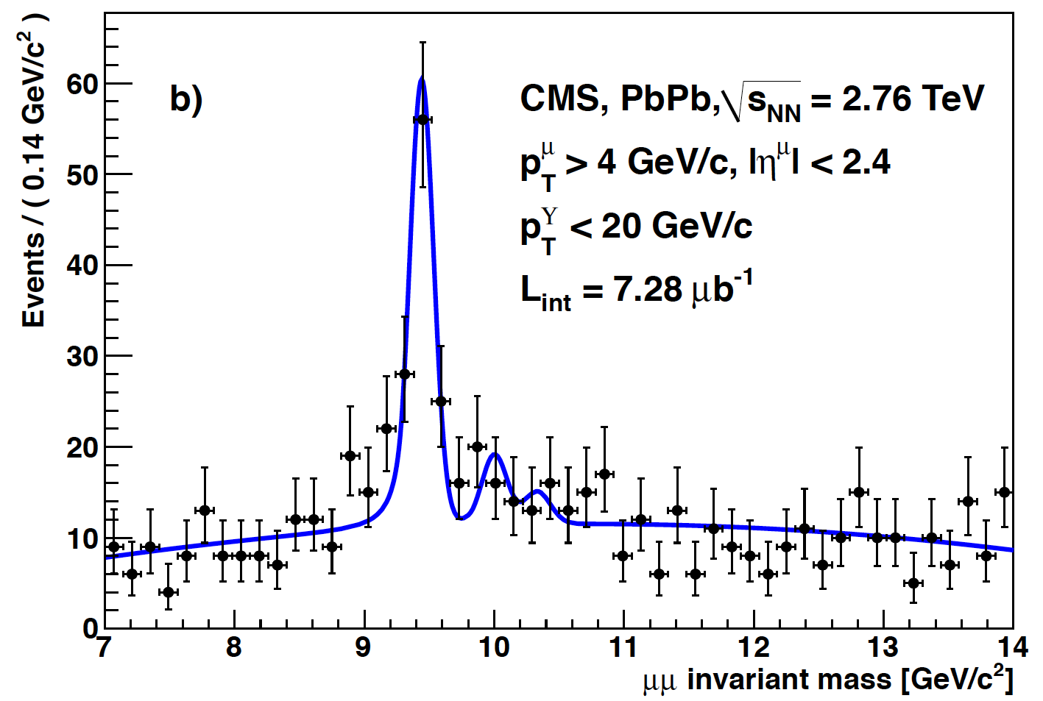
Heavy Quarkonia suppression in the QGP
A decade of QGP related J/Psi
suppression from RHIC / now LHC
Clean results for ϒ spectra at LHC
Bottomonium in p+p collisions
CMS: JHEP 1205 (2012) 063
STAR: arXiv:1107.0532
CMS Collaboration
PRL 107 (2011) 052302
Bottomonium in Pb+Pb collisions
ALICE: arXiv:1202.1383
PHENIX: PRL 98 (2007) 232301
Notes:
It is an exciting time for working on of Heavy Quarkonium phsyics in the QGP, due to the whealth of data now available on one of the most prominent phenomena, namely Qqbar suppression in Heavy Ion collisisons. For J/Psi, the ccbar ground state a decade of QGP related suppression data is now available and since the heavy ion program of the LHC started even higher energy regimes become accessible. What is even more interesting is the availability of clean dimuon spectra of bottomonium at LHC, where now the relative suppression of excited states compared to the ground state has been measured. This will certainly help the theory to benschmark and validate their model descriptions.
Let me start with a promiment apect of Heavy Quarkonium phsyics, i.e the relative suppression in Heavy Ion collisions compared to protpon/proton collisison.

Slide 3

Heavy Quarkonium melting
How does a heavy quark bound state react to the presence of a hot medium?
J/ψ
T=0
T_{C}>T>0
T>T_{C}
Classic argument: Debye screening in the QGP prevents J/Psi formation
Matsui, Satz 1986
Presence of large constituent masses: Non-relativistic description ?
Goal: Derive the potential from first principles QCD
Need to develop fully dynamical potential description of QQ melting
Goal: Treat effects at finite T consistently, e.g. spatial decoherence
Notes:
In vacuum from spectroscoy we know that Jpsi has small intrinsic width, so it is a well defined bound state held together by a color string.
This train of thoughts was made quantitative by the classic paper of Matsui satz:

Slide 4
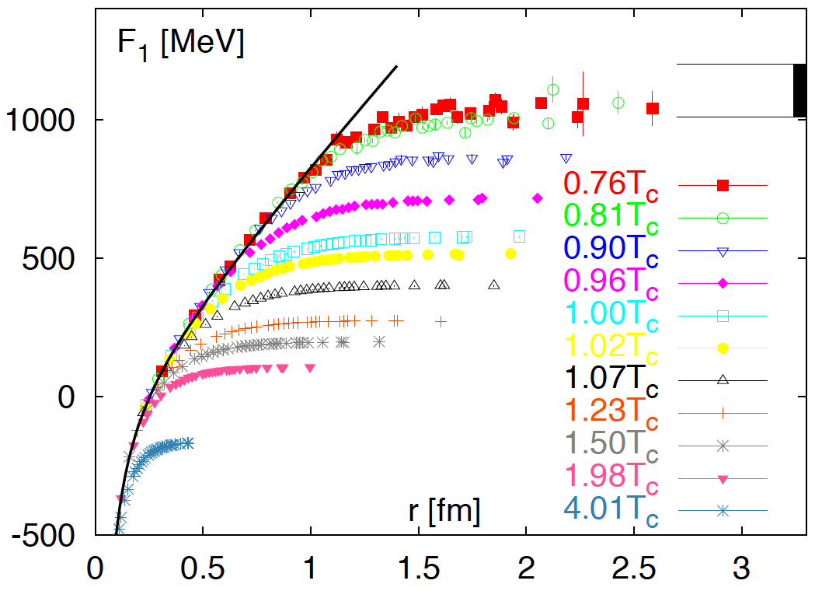
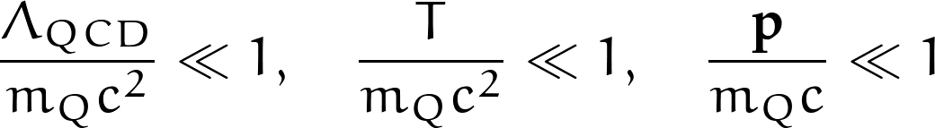
Towards a potential
Model potentials at T>0
LQCD:
Monte Carlo
τ
N_{f}=2
Ad-hoc choice:
Free Energies or
Internal Energies
Δτ
Δx
No Schrödinger equation
available, gauge dependent,
handling of entropy?
Ω
Kaczmarek, Zantow
PoS(LAT2005)192
R
i=x,y,z
Nadkarni, 1986
Systematic approach: Separation of scales
Notes:
W_\square(t,R)\overset{t\to\infty}{\propto} e^{iV( R )}
W_\square(\tau,R)\overset{\tau\to\infty}{\propto} e^{-\tau V( R )}
F^1 ( R ) =-\frac{1}{T}log\Big[\langle Tr[\Omega( R ) \Omega( 0 ) ]\rangle\Big]
W_\square\overset{t\to\infty}{\propto} e^{-itV( R )}
W_\square\overset{\tau\to\infty}{\propto} e^{-\tau V( R )}
F^1 ( R ) =\langle Tr[\Omega( R ) \Omega( 0 ) ]\rangle

Slide 5



The effective field theory (EFT) strategy
Appropriate degrees of freedom: Systematic expansion in 1/m_{Q} and r
Relativistic thermal
field theory
Quantum
mechanics
QCD
Dirac fields
NRQCD
Pauli fields
pNRQCD
Singlet/Octet
Brambilla et. al.
Rev.Mod.Phys. 77 (2005) 1423
PRD 78 (2008) 014017
Connection between QCD and pNRQCD in the static limit
t
R
Q
Q
x,y,z
Notes:
\psi_S(R,t), \psi_O(R,t)
E\sim m_Q
\psi_S(R,t)\equiv W_\square(R,t)=Tr\Big(exp\Big[-i\int_\square dx^\mu A_\mu(x)\Big]\Big)

Slide 6
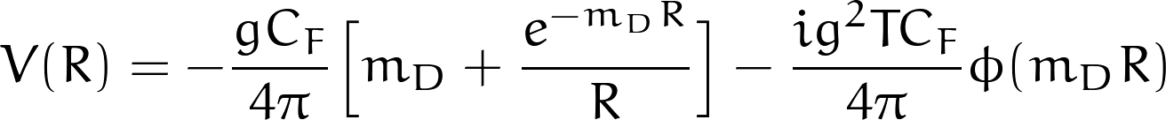
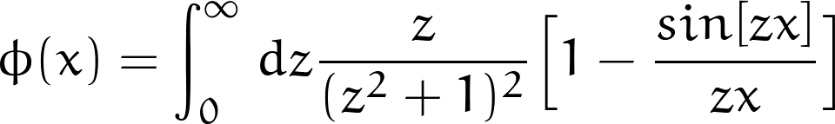
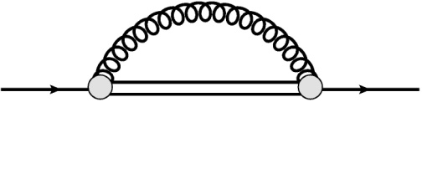
What we know from perturbation theory
At high T>>T_{C}: Resummed perturbation theory “Hard thermal loops”
Im[V(R)]
GeV
fm
Debye screening
Landau damping
Re[V(R)]
Laine, Philipsen, Romatschke,
Tassler JHEP03 (2007) 054;
Beraudo et. al. NPA 806:312,2008
T=0.5- 2.2 GeV
EFT: Systematic improvement possible
Brambilla, Ghiglieri, Vairo
and Petreczky PRD 78 (2008) 014017
E
Corrections to both Re[V] and Im[V]
singlet -> octet -> singlet
Improvement of the small r region
How to go to a non-perturbative setting?

Slide 7
Spectrum of the Wilson Loop
Make time dependence of the Wilson loop explicit (connection to Lattice QCD)
Maximum Entropy Method
see talk by O. Kaczmarek
A.R., T.Hatsuda & S.Sasaki
PRL 108 (2012) 162001
At each R, lowest lying peak determines the potential
Analytically solvable cases: Breit-Wigner shape
ω₀
ρ(ω)
Γ₀
ω
Y.Burnier, A.R in preparation
Notes:
V^0(R)=\lim_{t\to\infty}\frac{ \int_{-\infty}^{\infty} d\omega \,\omega\,e^{-i \omega t}\, \rho_\square(R,\omega) }{\int_{-\infty}^{\infty} d\omega \,e^{-i \omega t}\, \rho_\square(R,\omega)}
W_\square(R,t)=\int_{-\infty}^{\infty} d\omega \,e^{-i \omega t}\, \rho_\square(R,\omega)
\rho_L(\omega)=2\frac{\Gamma cos[\Gamma/2\xi]-(\omega_0-\omega)sin[\Gamma/2\xi]}{\Gamma^2+(\omega_0-\omega)^2}
\rho_L(R,\omega)\propto\frac{\Gamma (R) }{\Gamma^2 (R)+(\omega_0(R)-\omega)^2}
V_L^0 (R)=\omega_0(R)-i\Gamma (R)
\rho_G(R,\omega)\propto Exp \Big[ \frac{(\omega_0(R)-\omega)^2}{2\Gamma^2(R)} \Big]
V_\square( R)=\lim_{t\to\infty}\frac{ \int_{-\infty}^{\infty} d\omega \,\omega\,e^{-i \omega t}\, \rho_\square(R,\omega) }{\int_{-\infty}^{\infty} d\omega \,e^{-i \omega t}\, \rho_\square(R,\omega)}
V_{BW}( R)=\omega_0( R)-i\Gamma( R)

Slide 8
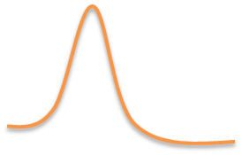
Extracting the Potential from Lattice QCD
Wilson Loop
Lattice QCD
Maximum Entropy
Method
Fit lowest lying
spectral peak
ρ
ω
τ∈ [0,β]
x,y,z
T>0
Re[V⁽⁰⁾](R)
R
Im[V⁽⁰⁾](R)

Slide 9
Lattice Results: Quenched QCD
Below T_{C}: Real Part coincides with Color Singlet Free Energies, Im[V]=0
Around T_{C}: Real part unchanged, imaginary part grows
T>>T_{C}: Both real and imaginary part show same large slope
Scenario: Real part freezes, medium modification through imaginary part
Should we be surprised about the existence of Im[V]?

Slide 10

Heavy Quarkonia as Open Quantum System
Underlying theoretical framework: Open Quantum Systems
see e.g. H.-P. Breuer, F. Petruccione,
Theory of Open Quantum Systems
σ(t) denotes density matrix of states
unitary evolution: H=H†
Interested in the dynamics of the QQbar system only
Interaction with the medium induces a stochastic element into the dynamics
(similar concepts are quantum state diffusion, quantum jumps, etc..)
see also: N.Borghini, C.Gombeaud:
arXiv:1103.2945
Eur.Phys.J. C72 (2012) 2000
Decoherence: Interaction between medium and QQbar select a basis of states
in which σ_{QQ} becomes diagonal over time
Notes:
H = H_{\rm sys} \otimes I_{\rm med} + I_{\rm sys}\otimes H_{\rm med}+H_{\rm int}
\frac{d}{dt} \rho(t)=\frac{1}{i\hbar}\left[H,\rho(t)\right]
\rho_{Q\bar{Q}}(t)=Tr_{med}\Big[ \rho(t)\Big]
\frac{d}{dt} \sigma(t)=\frac{1}{i\hbar}\left[H,\sigma(t)\right]
\rho_{Q\bar{Q}}(t,\mathbf{R},\mathbf{R}')&=Tr_{med}\Big[ \rho(t,\mathbf{R},\mathbf{R}')\Big]\\
&=\langle \Psi_{Q\bar{Q}}(\mathbf{R},t) \Psi^*_{Q\bar{Q}}(\mathbf{R}',t)\rangle_\Theta
\rho_{Q\bar{Q}}(t,\mathbf{R},\mathbf{R}')&=Tr_{med}\Big[ \rho(t,\mathbf{R},\mathbf{R}')\Big]\\
&=\langle \Psi_{Q\bar{Q}}(\mathbf{R},t) \Psi^*_{Q\bar{Q}}(\mathbf{R}',t)\rangle_\Theta

Slide 11
Stochastic evolution in the QGP
How to treat stochastic nature of the dynamics in the potential picture?
A new proposal: width in the Wilson loop spectra uncertainty in Re[V(R)]
Re[V]
V(R)
ρ(ω)
Γ=Im[V]
Γ=δ(V(R))
ω
ω
Notes:
i\hbar\frac{\partial}{\partial t}\Psi_{Q\bar{Q}}(\mathbf{R},t) =\Big\{ -\frac{\nabla^2}{2m_Q}+Re[V(\mathbf{R})]+\Theta(\mathbf{R},t)\Big\}\Psi_{Q\bar{Q}}(\mathbf{R},t)
\Psi_{Q\bar{Q}}(\mathbf{R},t)={\cal T}exp\Big[-\frac{i}{\hbar}\int_0^tdt\,\Big\{ -\frac{\nabla^2}{2m_Q} +V(\mathbf{R}) + \Theta(\mathbf{R},t)\Big\}\Big]\Psi_{Q\bar{Q}}(\mathbf{R},0)
\langle \Theta(\mathbf{ R},t)\rangle=0, \quad \langle \Theta(\mathbf{ R},t)\Theta(\mathbf{ R}',t')\rangle=\hbar\Gamma(\mathbf{ R},\mathbf{ R}')\delta_{tt'}/\Delta t

Slide 12
Stochastic evolution in real-time
Construct unitary stochastic time evolution (neglects back reaction on medium)
Y.Akamatsu, A.R.
PRD 85, 105011 (2012)
Evolution on the level of the wavefunction:
Average wavefunction depends on diagonal noise correlations

Slide 13
Summary
Effective Field Theory allows derivation of QQbar in-medium potential V⁰(R)
Systematic improvements possible (expansion in 1/m_{Q} and r)
Perturbative evaluation of the static potential:
Debye screening and Landau damping (imaginary part)
Next order in HTL?
First correction: Singlet to octet breakup
Lattice Evaluation (quenched) of the static potential:
Below T_{C}: Re[V] coincides with the Color Singlet Free Energies
- Improve fit to spectral peaks
- Use full QCD medium
Real part freezes around phase transition
Im[V] grows with temperature and distance
Stochastic Evolution of Heavy Quarkonia in the QGP : Open Quantum System
Instead of imaginary part: uncertainty in the real part of the potential
Microscopic evolution fully unitary
Im[V] obtained after ensemble average
- Extract Γ (x,x‘) from LQCD?
- Include back reaction

Slide 14
The End
Thank you for your attention

Slide 15
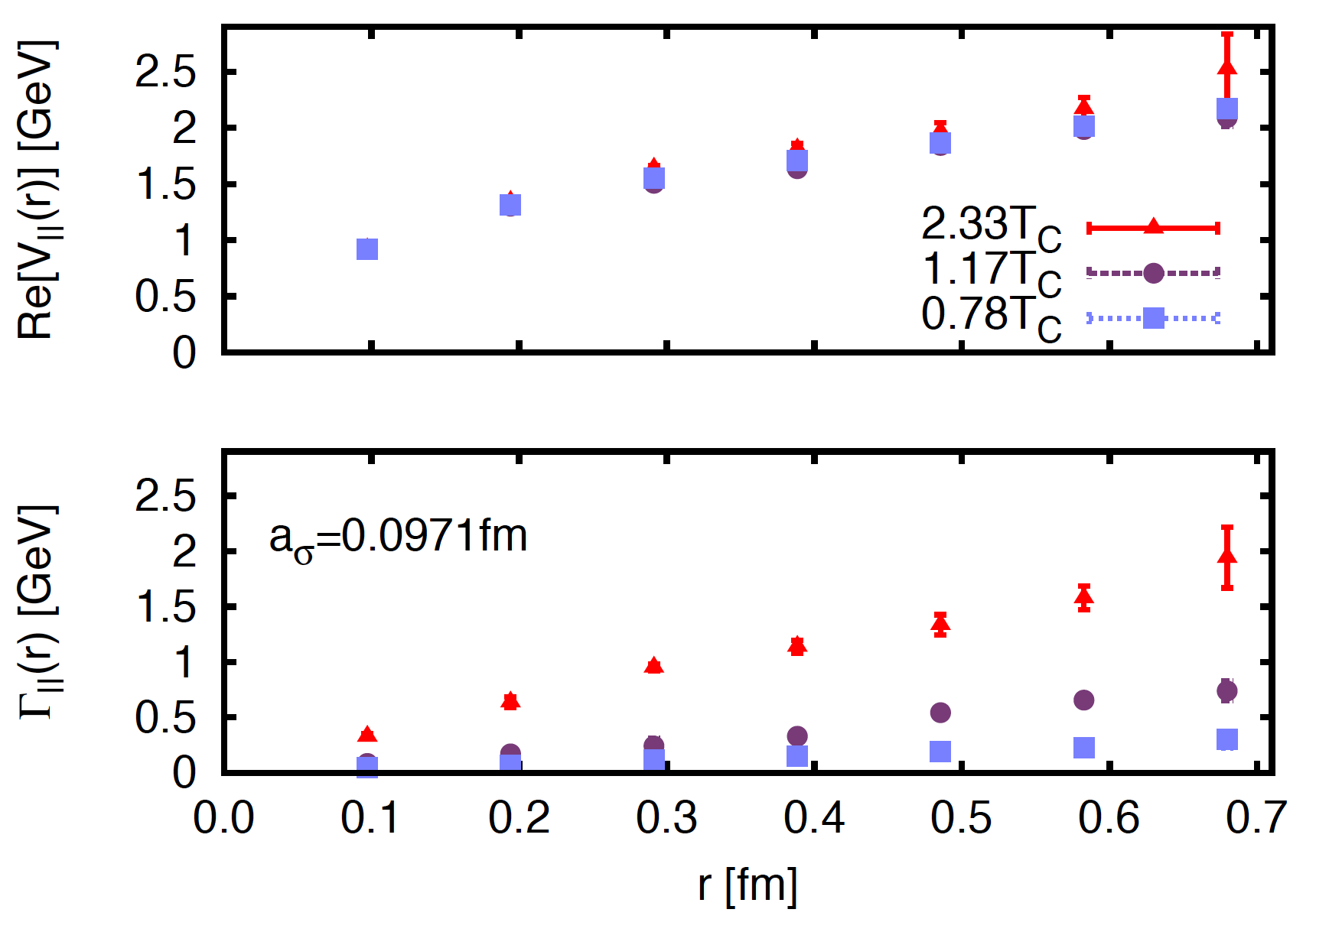
An alternative observable ?
R
R
x
y
x
y
remove Wilson lines
fix Coulomb gauge
W(R,τ)
W||(R, τ)
x
y
x
y
Derivation of V(R) remains the same
Lattice data much less noisy
Real part and width are smaller
Possible tradeoff to ensure
same physics outcome?

Slide 16
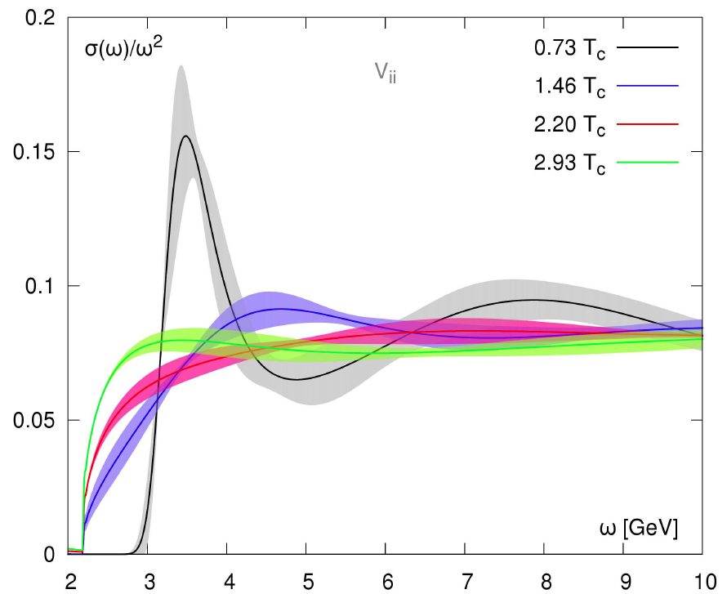
Do we need a potential picture?
Cannot measure
spectral function directly
LQCD: Monte Carlo
τ
J†
Δx
Judging the survival
of J/ψ through an
inspection by eye
Δτ
J
Infer from a measurable
quantity instead:
Maximum Entropy Method
i=x,y,z
Asakawa, Hatsuda, Nakahara
Prog.Part.Nucl.Phys. 46 (2001) 459-508
Ding et. al.
PoS LAT2010 (2010) 180,
arXiv:1204.4945
Spectral function and suppression: Interpretation remains difficult
In the end: Combine the clarity of the potential picture
with non-perturbative capabilities of lattice QCD
Notes:
Heavy qqbar not thermlaized -> cannot directly map to dilepton rates.
Concept of a bound state is not well defined.

Slide 17
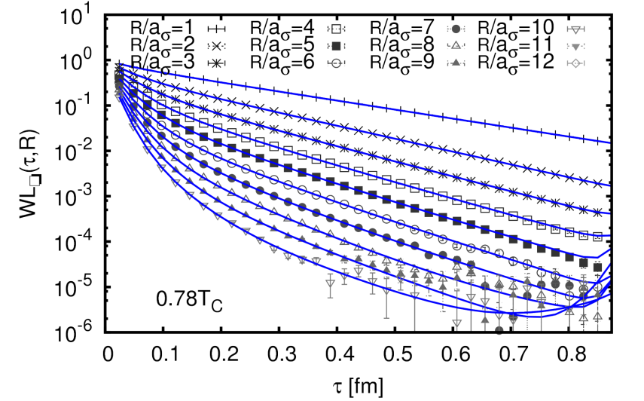
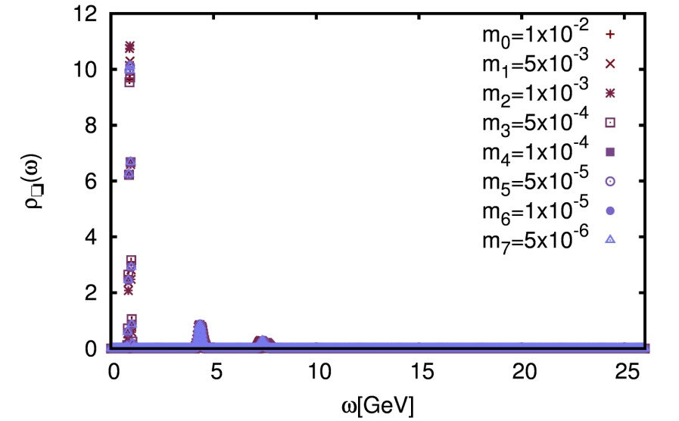
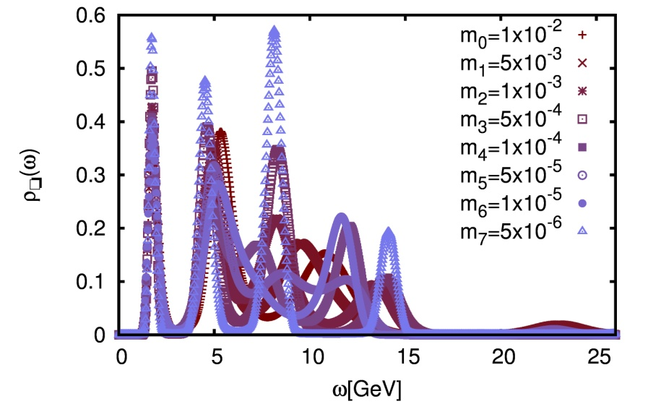
The Potential at T=0.78T_{C}
Prior dependence
MEM
ringing
R=0.1fm
R=0.4fm

Slide 18
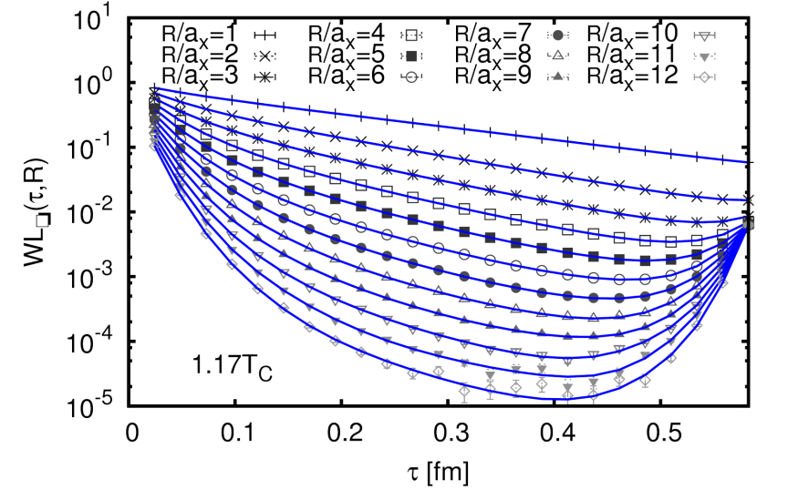
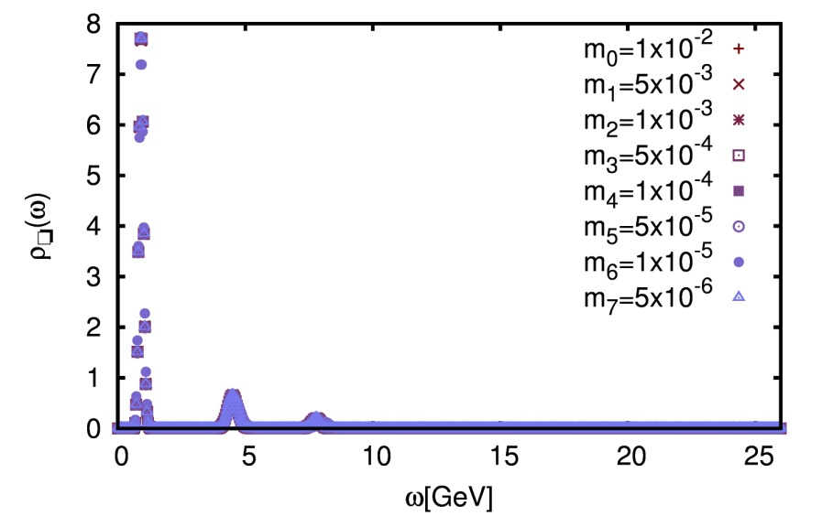
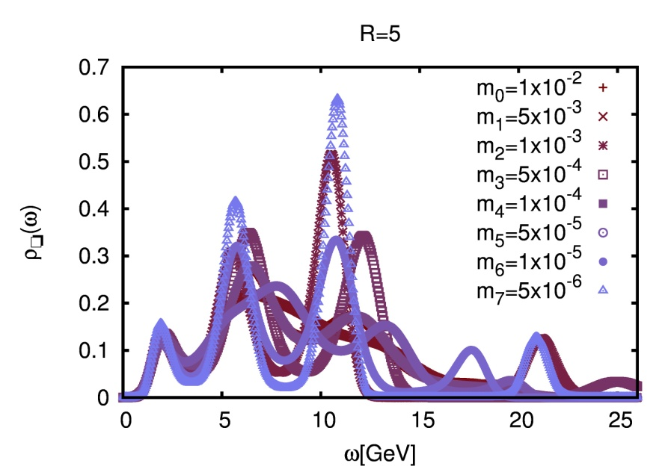
The Potential at T=1.17T_{C}
At T>T_{C}
upward trend
Only lowest peak stable
MEM
ringing
R=0.1fm
R=0.4fm

Slide 19
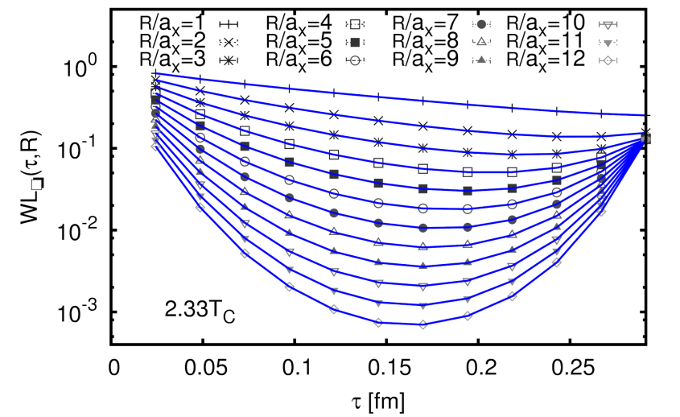
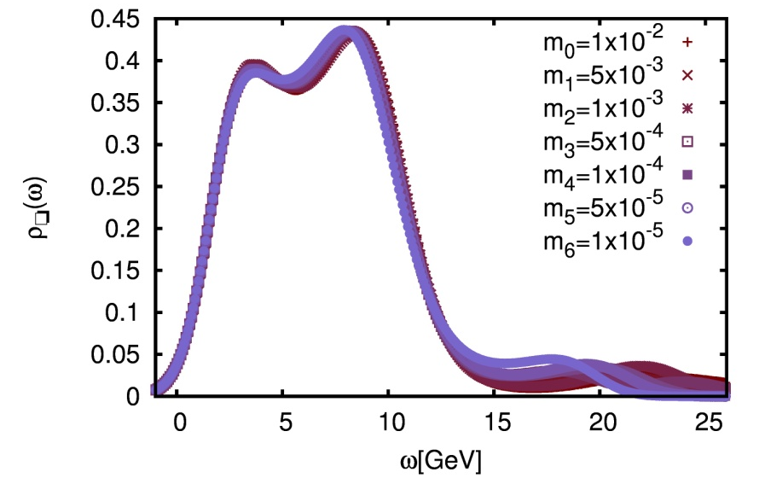
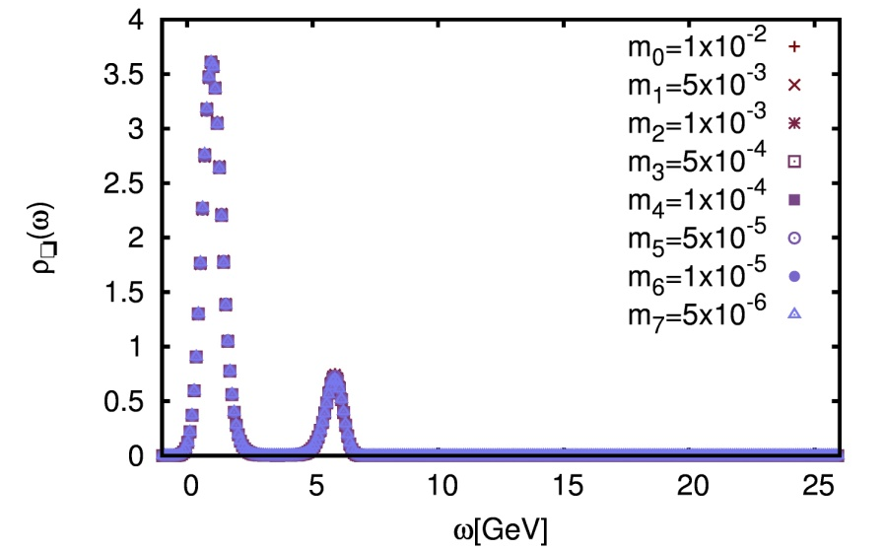
The Potential at T=2.33T_{C}
T=2.33T_{C}
T=2.33T_{C}
MEM stable but individual peaks overlapping
R=0.4fm
R=0.1fm

Slide 20
Generic features of the 1-d simulation
Unitarity is preserved in each member of the stochastic ensemble <|Ψ_{QQ}|>=1
Imaginary part emerges after averaging |<Ψ_{QQ}>|<1
Diagonal noise: Correlation length l_{corr}= dx << 2π/T

Slide 21
Heavy quarkonium in the QGP I
Vacuum potential + linearly rising noise
Debye screening + small noise
Exponential suppression in P^{v}(t): v(x) and Γ(x,x) determine speed
Populating of higher states: Noise vs. mixing through h(x)
Very different parameter sets give similar asymptotic P^{v}(t) -> artificial

Slide 22
Heavy quarkonium in the QGP II
Debye screening without noise
Mixing through h(x) with m_{D}=5GeV
Observed suppression not exponential, not even monotonous
Only parity even eigenstates are excited

