Slide 1
Hard Probes 2012, 27 May 1 June 2012, Cagliari (Sardinia, Italy)
Quarkonium production: theory aspects
Elena G. Ferreiro
Universidade de Santiago de Compostela, Spain
E. G. Ferreiro USC Quarkonium: theory aspects HP2012 27 May 2012

Slide 2
Some definitions…
Charmonium: heavy quark bound states
J/Ψ meson: bound state of a charm quark and its antiquark
ϒ meson: bound state of a bottom quark and its antiquark
QGP: deconfined matter made of quarks and gluons, supposed
to exist in the first instants after Big Bang
The goal: search of a QGP in heavy-ions collisions (high T and density)
Looking for QGP signals:
unambiguous” signature of QGP Onset of quarkonia melting above a certain temperature / energy density threshold
Matsui & Satz, PLB178 (1986) 416
E. G. Ferreiro USC Quarkonium: theory aspects HP2012 27 May 2012
Notes:
the idea to use high energy nuclear collisions to
form small and short-lived bubbles of the quark-gluon plasma in the laboratory,

Slide 3
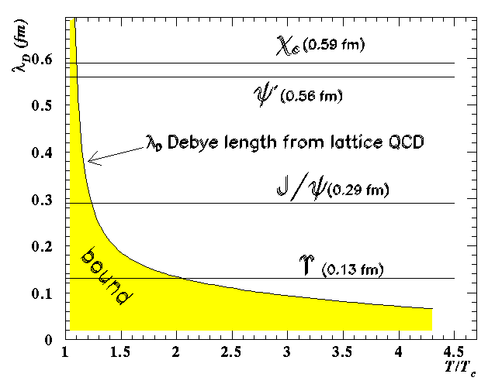
The intringuing story of J/ψ production
Potential between q-anti-q pair
grows linearly at large distances
V(r)
Screening of long range confining potential at high enough temperature or density.
r
What happens when the range of the binding force becomes smaller than the radius of the state?
V(r)
different states “melting” at different temperatures due to different binding energies.
Matsui and Satz:
J/ψ destruction in a QGP by Debye screening
J/Ψ suppression = QGP signature
E. G. Ferreiro USC Quarkonium: theory aspects HP2012 27 May 2012

Slide 4
...but the story is not so simple
• Are there any other effects, not related to colour screening, that may induce
a suppression of quarkonium states ?
• Can the melting temperature(s) be uniquely determined ?
• Are there effects that can induce an enhancement of quarkonium?
• Is it possible to define a “reference”(i.e. unsuppressed) process in order to
properly define quarkonium suppression ?
• Do we understand charmonium production in elementary p+p collisions?
• Do experimental observations fit in a coherent picture ?
Let’s start by the end….
E. G. Ferreiro USC Quarkonium: theory aspects HP2012 27 May 2012

Slide 5
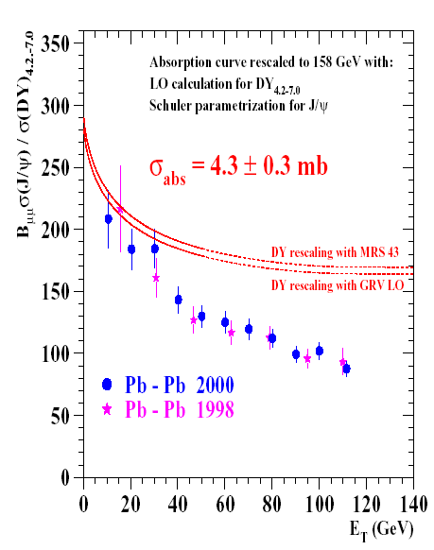
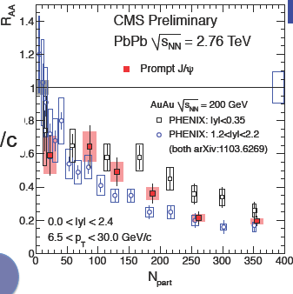
Experimental situation : the strange J/ψ behaviour
• J/Ψ suppression at SPS
Suppression beyond nuclear absorption
observed in central Pb+Pb at √s ~ 17 GeV
CERN communicate: SPS results presented a compelling evidence for the existence of a new state of matter in which quarks, instead of being bound up into more complex particles such as protons and neutrons are liberated to roam freely.
• J/Ψ suppression at RHIC
J/Ψ are suppressed, but not as much as
expected if we have complete color screening
Puzzle at RHIC:
Same amount of suppression at RHIC and SPS
√s≈200 GeV
√s≈20GeV
• At LHC the situation is still not clear but…
amount of suppression similar to RHIC ¿?
E. G. Ferreiro USC Quarkonium: theory aspects HP2012 27 May 2012

Slide 6
Too many effects on J/ψ production …
nuclear absorption
CGC
cronin effect
low x
sequential suppresion
percolation
gluon shadowing
hadronic comovers
J/ψ
c
pomeron shadowing
c-bar
c
recombination
partonic comovers
energy loss
QGP
parton saturation
E. G. Ferreiro USC Quarkonium: theory aspects HP2012 27 May 2012

Slide 7
COLD or HOT effects?
•cold effects:
wo thermalisation NO QGP
gluon shadowing
CGC
partonic comovers
percolation
hadronic comovers
nuclear structure functions
in nuclei ≠ superposition
of constituents nucleons
parton saturation
dissociation of the c-cbar
pair with the dense medium produced in the collision partonic or hadronic
non-lineal effects favoured by the high density of partons become important and lead to eventual saturation of the parton densities
NI@SPS, IMP@RHIC
nuclear absorption
suppression by a dense medium, not thermalized
multiple scattering of a pre-resonance c-cbar pair within
the nucleons of the nucleus
non thermal
colour connection
Others: Cronin effect
energy loss
IMP@SPS, RHIC?
•hot effects:
w thermalisation QGP
QGP
sequential suppression
recombination
E. G. Ferreiro USC Quarkonium: theory aspects HP2012 27 May 2012

Slide 8
COLD or HOT effects?
•cold effects:
wo thermalisation NO QGP
gluon shadowing
CGC
partonic comovers
percolation
hadronic comovers
nuclear structure functions
in nuclei ≠ superposition
of constituents nucleons
parton saturation
dissociation of the c-cbar
pair with the dense medium produced in the collision partonic or hadronic
non-lineal effects favoured by the high density of partons become important and lead to eventual saturation of the parton densities
NI@SPS, IMP@RHIC
nuclear absorption
suppression by a dense medium, not thermalized
multiple scattering of a pre-resonance c-cbar pair within
the nucleons of the nucleus
non thermal
colour connection
Others: Cronin effect
energy loss
IMP@SPS, RHIC?
•hot effects:
w thermalisation QGP
QGP
sequential suppression
recombination
E. G. Ferreiro USC Quarkonium: theory aspects HP2012 27 May 2012

Slide 9
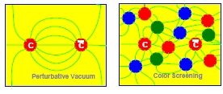

HOT effects: QGP and Debye screening
What happens to a c-cbar pair in a QGP?
• The “confinement” contribution disappears
• The high color density induces a screening
of the coulombian term of the potential
Debye screening radius λ_{D}(T):
maximum distance which allows the formation of a bound qq pair
decreases with the temperature T
vacuum
Temperature T<Td
Temperature T>Td
J/ψ
λ_{D}
λ_{D}
c
c
c
J/ψ
c
c
c
r
r
r
If resonace radius r < λ_{D}(T)
resonance can be formed
If resonace radius r > λ_{D}(T)
resonance cannot be formed
E. G. Ferreiro USC Quarkonium: theory aspects HP2012 27 May 2012

Slide 10
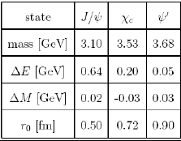
HOT effects: charmonium suppression in a QGP
λ_{D}(T) depends on temperature
The quarkonium states are characterized by
• the binding energy
• radius
Debye screening condition r > λ_{D} will
occur at different T for the different species
T_{c}
T_{c}
T_{c}
T_{c}
ψ(2S)
ψ(2S)
ψ(2S)
ψ(2S)
χ_{c}
χ_{c}
J/ψ
χ_{c}
J/ψ
χ_{c}
J/ψ
J/ψ
T~T_{c}
T~1.1T_{c}
T<T_{c}
T>>T_{c}
J/ψ suppression can be due to
• the melting of the J/ψ itself
• the melting of excited states
which feed down to J/ψ
E. G. Ferreiro USC Quarkonium: theory aspects HP2012 27 May 2012

Slide 11
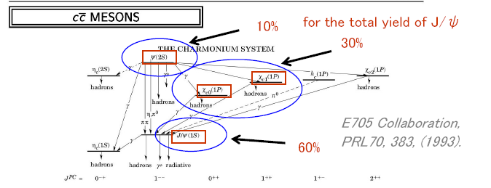
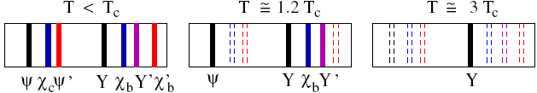
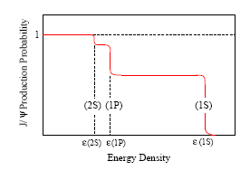
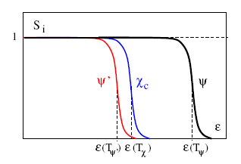
HOT effects: sequential screening in a QGP
• Usually, one assumes that the observed J/ψ production contains:
60% directly produced 1S states
30% decay products from χc(1P)
10% decay products from ψ′(2S)
S_{J/Ψ}= 0.6 S_{Ψ}+0.3 S_{χc}+ 0.1 S_{Ψ×}
• Temperature of dissociation T_{d} for χ_{c} and Ψ’: T_{d} ~ 1.1 T_{c ;} for J/Ψ : T_{d} ~ 1.5 to 2 T_{c}
• Sequential dissociation as the temperature (or the energy density) increases
⇒
Karsch, Kharzeev, Satz
E. G. Ferreiro USC Quarkonium: theory aspects HP2012 27 May 2012

Slide 12
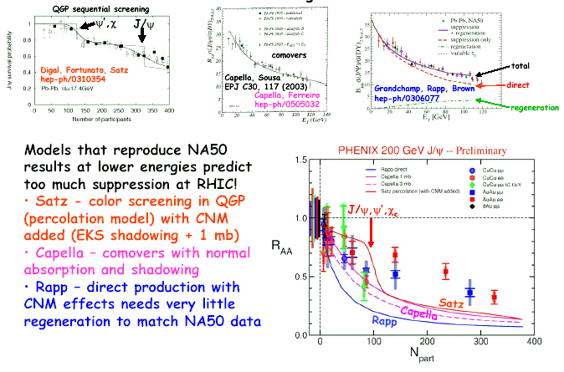
Suppression by a dense medium (models @ SPS & RHIC)
thermalized or not thermalized, this is the question...
no
QGP
QGP
QGP
Experimental suppression @ RHIC smaller than expected!
QGP
no
QGP
QGP
E. G. Ferreiro USC Quarkonium: theory aspects HP2012 27 May 2012

Slide 13

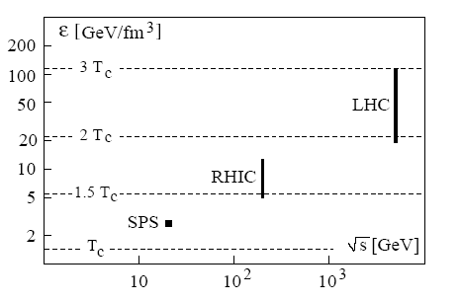
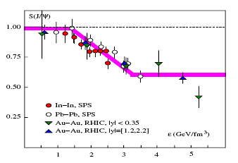
Theoretical interpretation 1: QGP dissociation temperatures
• By determine heavy quark potential V(r,T) in finite T QCD and solving Schrodinger eq:
Dissociation temperatures T_{diss}/T_{c}
Energy densities:
0.5-1.5 GeV/fm³ = 1.0 T_{c}
10 GeV/fm³= 1.5 T_{c}
30 GeV/fm³= 2.0 T_{c}
J/ψ could survive up to T ≥ 2 Tc ⇒ ε_{J/ψ} ≥ 25 GeV/fm³
χ_{c} and ψ′ melt near Tc ⇒ ε _{ψ′,χ} ≃ 0.5 − 2 GeV/fm³
If J/ψ(1S) survives up to 2 Tc ∼ ε ≥ 25 GeV/fm³:
• all anomalous suppression observed at SPS and
RHIC due to dissociation of excited states χc and ψ′
• onset of anomalous suppression at ε(Tc) ≃ 1 GeV/fm³
• J/ψ survival probability for central Au +Au collisions
at RHIC same as for central Pb+Pb collisions at SPS
J/ψ itself not screened after all!
E. G. Ferreiro USC Quarkonium: theory aspects HP2012 27 May 2012
Notes:
Earlier lattice studies had provided only the colour average of the in-medium
Q¯Q free energy; now it is possible to separate out the colour singlet contribution.
• Earlier potential models had used the free energy as potential in the Schr¨odinger
equation; today we can specify the colour singlet internal energy, which is
more realistic as the relevant potential and leads to a stronger binding.
• There now exist direct finite temperature lattice QCD studies of the inmedium
behaviour of charmonia, allowing ab initio conclusions not based
on any potential model, and they support a higher J/ψ dissociation temperature.

Slide 14
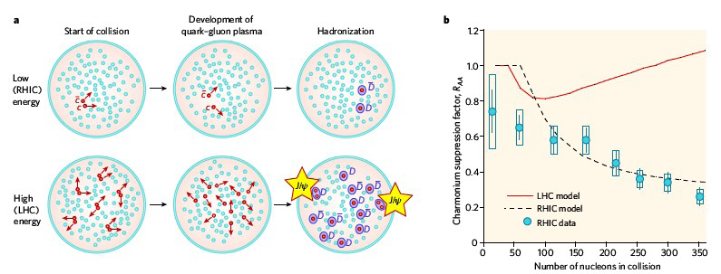
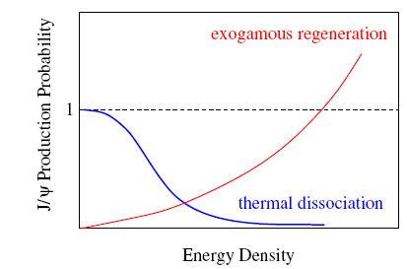
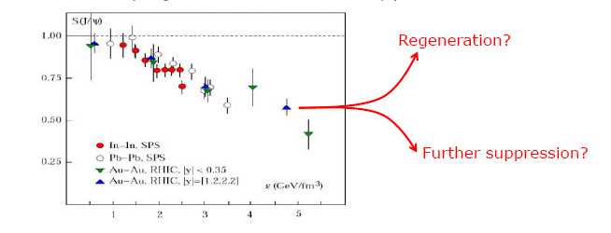
Theoretical interpretation 2: QGP + recombination
• Also direct J/ψ are suppressed at RHIC, but excess of initially produced charm
=> new form of combinatorial charmonium production at hadronization
=> J/ψ regeneration (α Ncc) contributes to the J/ψ yield
The 2 effects may
balance =>
•suppression
at RHIC
similar
to SPS
• LHC?
E. G. Ferreiro USC Quarkonium: theory aspects HP2012 27 May 2012
Notes:
The basic idea here is that nuclear collisions
initially produce more than the thermally expected charm, and that this
excess, if it survives, may lead to a new form of combinatorial charmonium
production at hadronization.
The basic assumption of the regeneration approach [30] - [32] is that the initial
charm excess is maintained throughout the subsequent evolution, i.e., that the
initial chemical non-equilibrium will persist up to the hadronization point. If
that is the case, a c from a given nucleon-nucleon collision can at hadronization
combine with a ¯c from a different collision (“off-diagonal” pairs) to create
a J/ψ. This pairing provides a new exogamous charmonium production mechanism,
in which the c and the ¯c in a charmonium state have different parents,
in contrast to the endogamous production in a pp collision. At sufficiently high
energy, this mechanism will lead to enhanced J/ψ production in AA collisions
in comparison to the scaled pp rates. When should this enhancement set in?

Slide 15
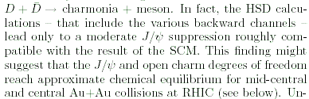
HOT effects: QGP+recombination
•statistical coalescence model
Andronic, Braun-Muzinger,Redlich,
Stachel, nucl-th/0303036
• screening of primary J/ψ & statistical
• recombination of thermalized c-cbar
• travel of c quarks over significant distance
• presence of a deconfined phase
qgp, recom
•recombination model
Grandchamp, Rapp, Brown,
hep-ph/0306077
• screening & in-medium production
• includes effects of chemical equilibrium
• includes effects of thermal equilibrium
qgp, recom
•kinetic model
Thews hep-ph/0504226
• movility of initally produced charm quarks in a
space-time region of color deconfinement
• allows formation of heavy quarkonium states via
off-diagonal combinations of q & qbar
qgp, recom
•transport in a qgp
Yan, Zhuang, Xu, nucl-th/0608010
• transport equations for the Jpsi
• hydrodynamic equation for the qgp
qgp, w and wo
recom
•hadron string dynamics
Bratkovskaya, Kostyuk, Cassing,
Stocker, nucl-th/0402042
• transport approach
• include backward channels for charmonium repro duction
by D channels
•comovers
• full chemical equilibration not achieved
in the transport calculations
no qgp, recom
K. Tywoniuk, I. C. Arsene,
L. Bravina, A. Kaidalov, E. Zabrodin
A. Capella, E. G. Ferreiro
• gain and loss diferential equations for:
dissociation J/Ψ+comovers + recombination D+Dbar
no qgp, recom
E. G. Ferreiro USC Quarkonium: theory aspects HP2012 27 May 2012

Slide 16
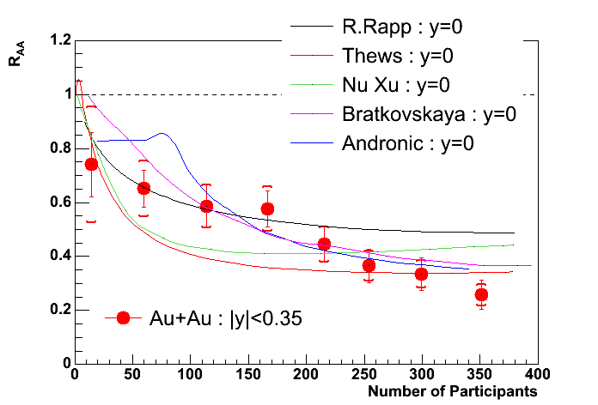
Regeneration (@ RHIC), this can be the answer….
____
Bravina: y=0
R. Rapp et al. PRL 92, 212301 (2004) screening & in-medium production
Thews Eur. Phys. J C43, 97 (2005) statistical and kinetic model, deconfinement & recombination
Nu Xu et al. Phys.Rev.Lett. 97 (2006) 232301 transport equations & hydro & recombination
Bratkovskaya et al. PRC 69, 054903 (2004) HSD, hadron-string dynamics & recombination
Andronic et al. nucl-th/0611023 SCM, screening & statistical recombination of thermalized c-cbar
Bravina, comovers: suppression & regeneration
(no QGP)
(no QGP)
E. G. Ferreiro USC Quarkonium: theory aspects HP2012 27 May 2012

Slide 17
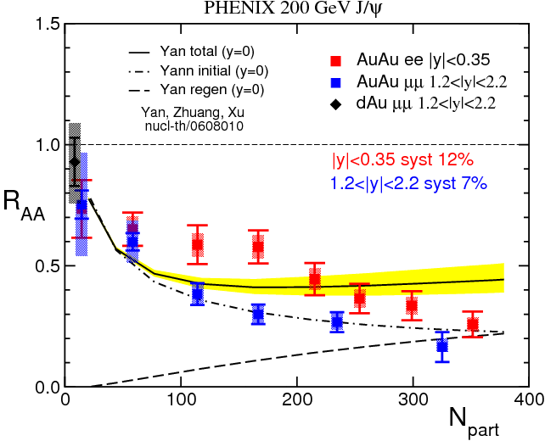


or not?
some inconvenients of recombination
• indetermination of σ_{cc}²
•it can be present w or wo thermalization
-w or wo QGP-
solution: normalization of J/psi to the open charm cross section(J/psi)/D ratio
solution: nevertheless the amount is smaller
wo QGP (when considering recombination as
D Dbar final states interactions) LHC
• the results can be as bad as
without recombination (RHIC):
solution: LHC
wo QGP
hadronic & partonic comovers w
suppression+recombination
w QGP
thermal dissociation+recombination
nucl-ex/0611020
=
*
E. G. Ferreiro USC Quarkonium: theory aspects HP2012 27 May 2012

Slide 18
LHC data can give us some answers, as we will see
but before….

Slide 19
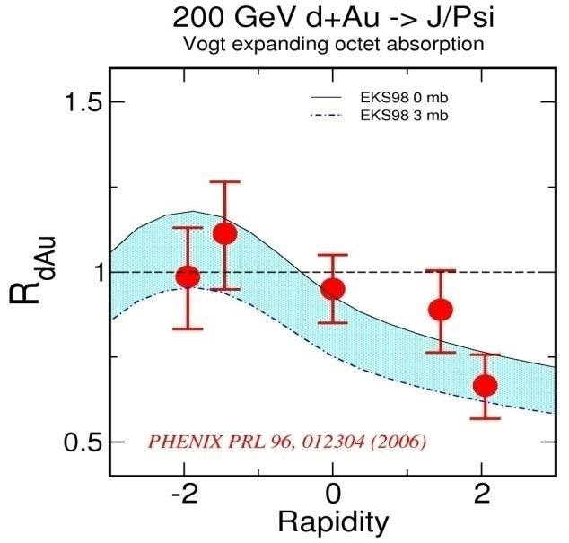
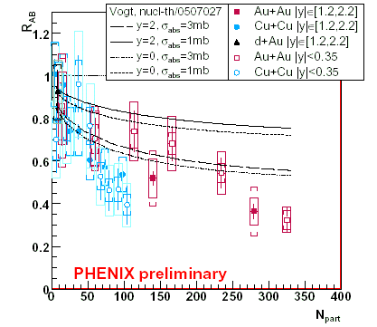
What about other effects? COLD effects
In pA collisions, no QGP formation is expected
in principle, no J/Ψ suppression
• however a reduction
of the yield per
nucleon-nucleon
collisions is observed!
0 mb
Low x₂ ~ 0.003
(shadowing region)
3 mb
NA50, pA 450 GeV
Why CNM are important?
The cold nuclear matter effects present in pA collisions are of course also present in AA and can mask genuine QGP effects
CNM
E. G. Ferreiro USC Quarkonium: theory aspects HP2012 27 May 2012

Slide 20
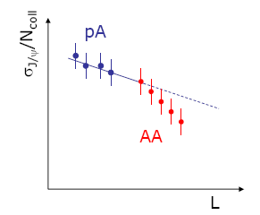
Quarkonium supression in p+A collisions: CNM effects
Quarkonium production is suppressed in nuclear collisions ...but for a variety of reasons
• dissociation by screening (“melting”) and/or collisions in hot QGP
QGP effects
A+A collisions
shadowing,
saturation
intrinsic charm
nuclear absorption
final energy loss
comovers
μ
J/ψ
μ
p
CNM effects
p+A and A+A collisions
Initial state
Final state
To understand quarkonium behaviour in the hot medium, it’s important to know its
behaviour in the cold nuclear matter. This information can be achieved studying pA collisions
The cold nuclear matter effects present in pA collisions are of
course present also in AA and can mask genuine QGP effects
It is very important to measure cold nuclear matter effects (CNM)
before any claim of an “anomalous” (QGP) suppression in AA collisions
CNM, evaluated in pA, are extrapolated to AA, in order to build
a reference for the J/Ψ behaviour in hadronic matter
E. G. Ferreiro USC Quarkonium: theory aspects HP2012 27 May 2012

Slide 21
COLD or HOT effects?
•cold effects:
wo thermalisation NO QGP
gluon shadowing
CGC
partonic comovers
percolation
hadronic comovers
nuclear structure functions
in nuclei ≠ superposition
of constituents nucleons
parton saturation
dissociation of the c-cbar
pair with the dense medium produced in the collision partonic or hadronic
non-lineal effects favoured by the high density of partons become important and lead to eventual saturation of the parton densities
NI@SPS, IMP@RHIC
nuclear absorption
suppression by a dense medium, not thermalized
multiple scattering of a pre-resonance c-cbar pair within
the nucleons of the nucleus
non thermal
colour connection
Others: Cronin effect
energy loss
IMP@SPS, RHIC?
•hot effects:
w thermalisation QGP
QGP
sequential suppression
recombination
E. G. Ferreiro USC Quarkonium: theory aspects HP2012 27 May 2012

Slide 22
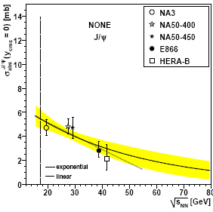
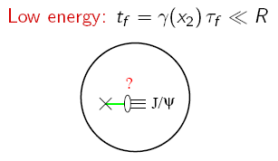
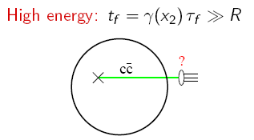
Nuclear absorption: a final cold nuclear matter effect
Particle spectrum altered by interactions with the nuclear matter they traverse
=> J/Ψ suppression due to final state interactions with spectator nucleons
• Usual parameterisation:
(Glauber model)
Sabs = exp(-ρ σabs L )
nuclear matter density
break-up cross section
path length
Energy dependence
• At low energy: the heavy system undergoes successive interactions with nucleons in
its path and has to survive all of them => Strong nuclear absorption
• At high energy: the coherence length is large and the projectile interacts with the
nucleus as a whole => Smaller nuclear absorption
In terms of formation time:
C. Lourenço et al.
σabs @ mid y < σabs @ forward y?
Rapidity dependence of nuclear absorption?
4
E. G. Ferreiro USC Quarkonium: theory aspects HP2012 27 May 2012
Notes:
Energy conservation and relation with rapidity

Slide 23
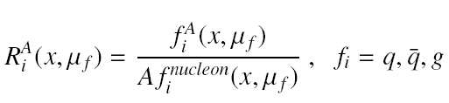
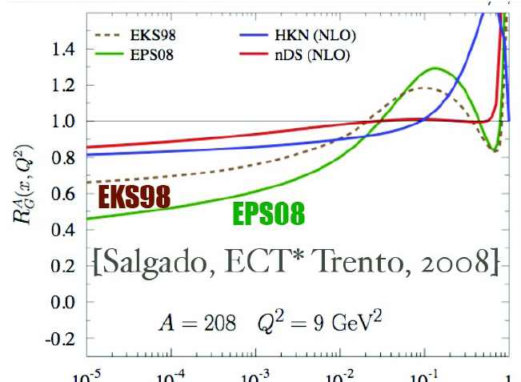
Shadowing: an initial cold nuclear matter effect
• Nuclear shadowing is an initial-state effect on the partons distributions
• Gluon distribution functions are modified by the nuclear environment
• PDFs in nuclei different from the superposition of PDFs of their nucleons
Shadowing effects increases with energy (1/x) and decrease with Q² (m_{T})
antishadowing
The shadowing corrections strongly
depend on the partonic process producing the J/Ψ
since it affects kinematics (x,Q²)
shadowing
E. G. Ferreiro USC Quarkonium: theory aspects HP2012 27 May 2012

Slide 24
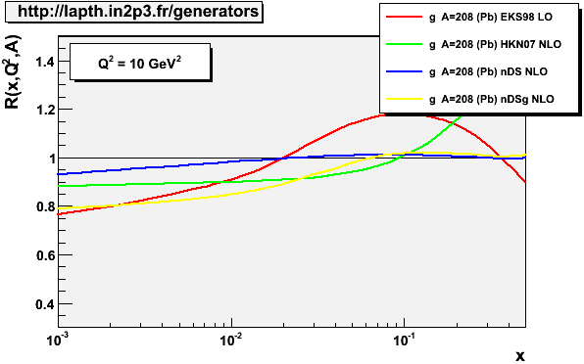
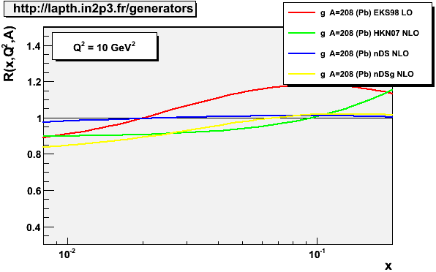
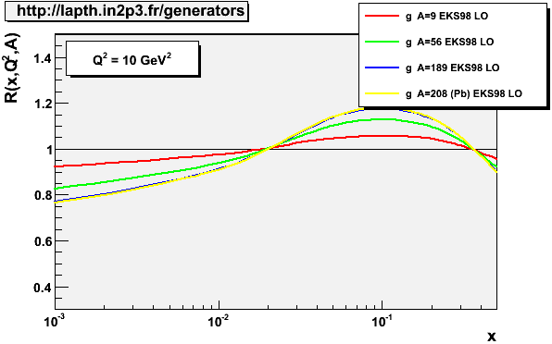
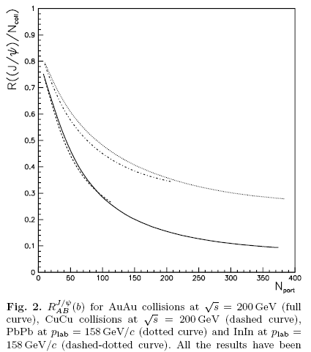


Incertainties: shadowing
depends on the partonic process (p+p) producing the J/Ψ
Model dependent
In+In @ SPS
Pb+Pb @ SPS
Nucleus dependent,
but, for the same energy,
the same at fixed
centrality
Cu+Cu @ RHIC
Au+Au @ RHIC
For J/ψ, ψ’, χ_{c}
independent of
final charmonium
state
E. G. Ferreiro USC Quarkonium: theory aspects HP2012 27 May 2012

Slide 25
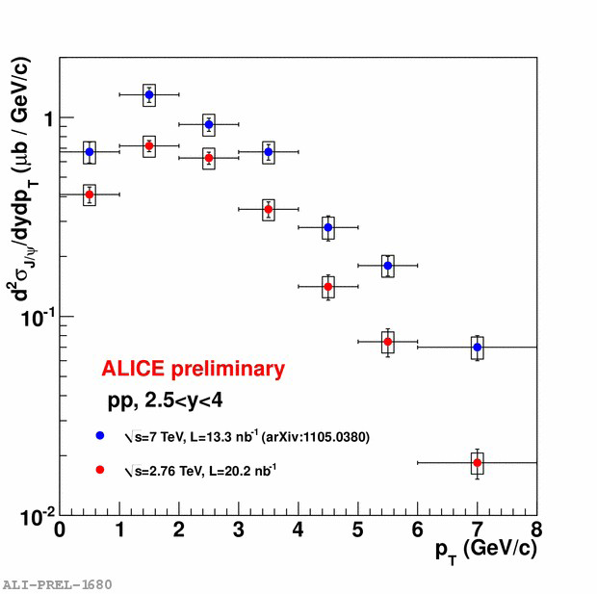
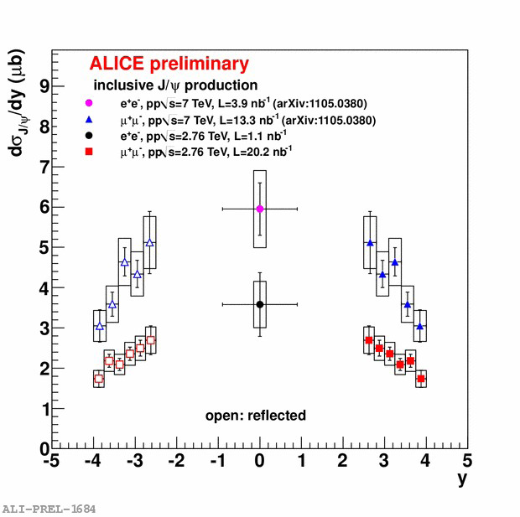
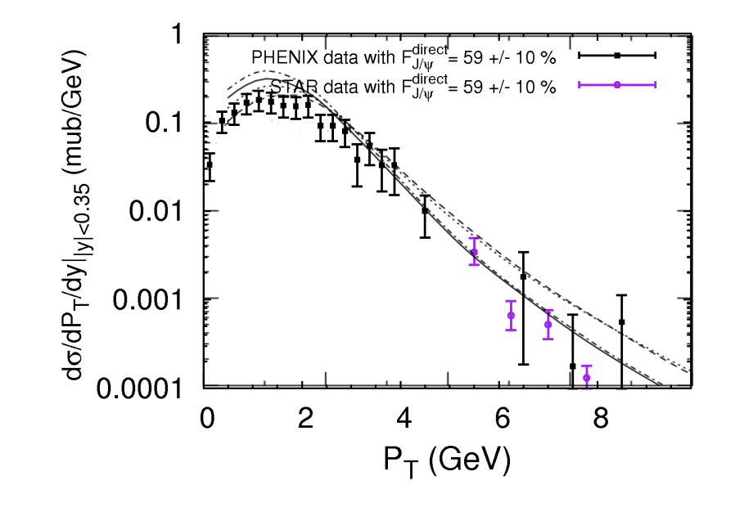
Quarkonium production in p+p collisions
The p+p collisions serve as a baseline for searching for suppression compared to binary scaling predictions, allow one to quantify the amount of feed-down from higher states as well as serve as a tool to distinguish between different theoretical calculations for charmonium production mechanisms.
Of course, extrapolations rely on a model based technique and depend heavily on the assumption of a production mechanism, a fact that reinforces the importance of the p+p measurements.
E. G. Ferreiro USC Quarkonium: theory aspects HP2012 27 May 2012

Slide 26
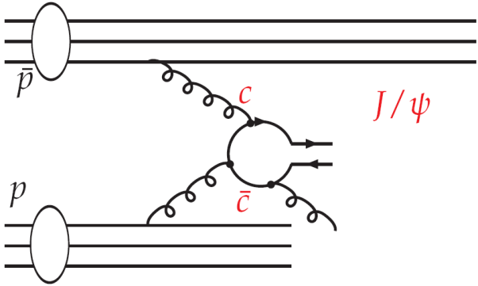
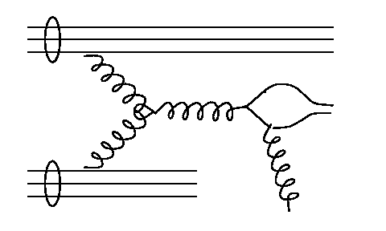
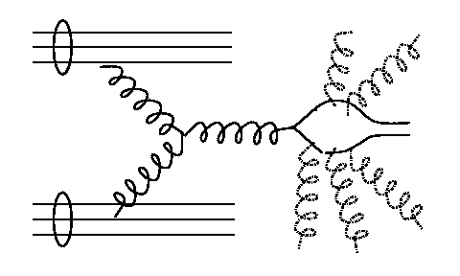
Theory: J/ψ production mechanisms at partonic level
Color Singlet Model:
perturbative creation of the ccbar pair in color singlet state with subsequent binding to J/ψ with same quantum numbers
hard gluon emission
underpredicts J/ψ production cross section
predicts no polarization
p
c
J/ψ
CSM
c
p
hard g
hard g
Color Evaporation Model:
phenomenological approach
perturbative creation of the ccbar pair in the color octet state with subsequent non-perturbative hadronization to color singlet via unsuppressed soft gluon emission
predicts no polarization
soft g
p
c
c
J/ψ
p
COM
NRQCD Color Octet Model:
uses NRQCD formalism to describe the non-perturbative hadronization of the ccbar color octet to the color singlet state via soft gluon emission
factorizes the charmonium production into a short distance hard part and a long distance matrix element which is claimed to be universal
predicts large transverse polarization at high p_{T} (not seen by data)
E. G. Ferreiro USC Quarkonium: theory aspects HP2012 27 May 2012

Slide 27
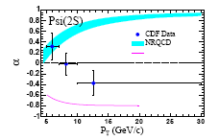
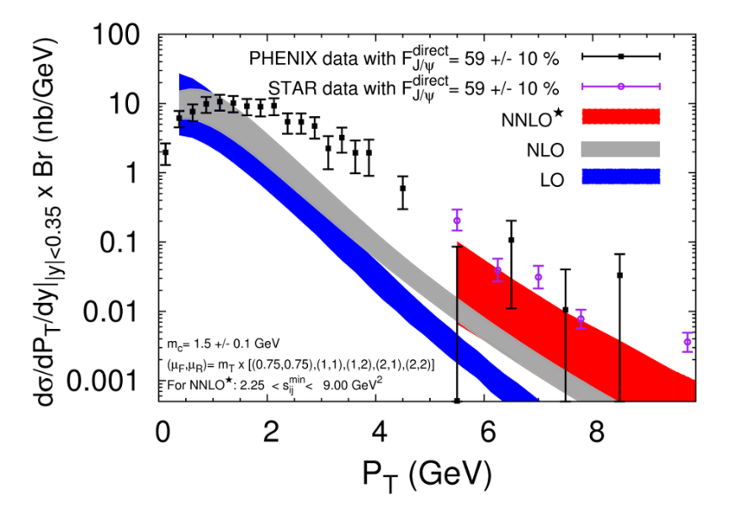
Theory: J/ψ production mechanisms at partonic level
Historically:
• First proposed: CSM @ LO
But CDF results on J/ψ direct
production revealed a striking
discrepancy wrt LO CSM
factor 50!
• Second proposed: COM @ LO
The agreement improves in NRQCD approach but it does not describe polarization
Recently many step forwards (NLO and NNLO corrections…)
Most probably: CS+CO @ NLO
E. G. Ferreiro USC Quarkonium: theory aspects HP2012 27 May 2012

Slide 28


Why this is important: on the kinematics of J/ψ production
• CNM -shadowing- effects depends on J/ψ kinematics (x,Q²)
• J/ψ kinematics depends on the production mechanism =>
Investigating two production mechanisms (including p_{T} for the J/ψ):
g+g → J/ψ
• intrinsic scheme: the p_{T} of the J/ψ comes from initial partons
    Not relevant for, say, p_{T}>3 GeV
    Only applies if COM(LO, α_{s}²) is the relevant production mechanism at lowp_{T}
2→1
2→2, 3, 4
g+g → J/ψ+g, gg,ggg,…
•extrinsic scheme: the p_{T} of the J/ψ is balanced by the outgoing parton(s)
    COM, CSM (NLO, NNLO)
for a given y, larger x in extrinsic scheme =>
modification of shadowing effects
5
E. G. Ferreiro USC Quarkonium: theory aspects HP2012 27 May 2012

Slide 29
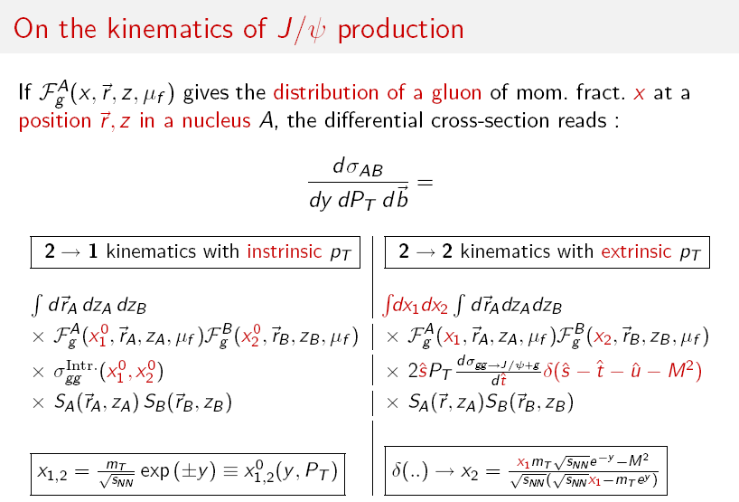
On the kinematics of J/ψ production: equations
shadowing
partonic cross section
nuclear absorption
kinematic variables
E. G. Ferreiro USC Quarkonium: theory aspects HP2012 27 May 2012

Slide 30
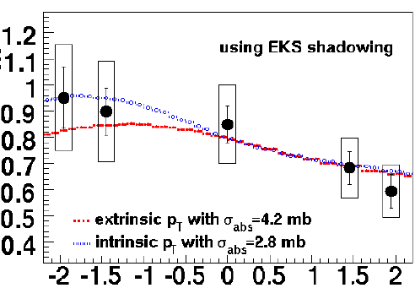
An example: how partonic kinematics affects shadowing
d+Au collisions @ RHIC
• intrinsic scheme: g+g → J/ψ
2→1
soft g
p
c
c
J/ψ
p
• extrinsic scheme: g+g → J/ψ+g, gg, ggg,…
p
c
J/ψ
2→2, 3, 4
c
p
hard g
hard g
E.G. Ferreiro, F. Fleuret, J-P. Lansberg (and A. Rakotozafindrabe,
Eur. Phys. J. C61, 859 (2009), Phys.Lett.B680, 50 (2009) Phys. Rev. C81(2010)
E. G. Ferreiro USC Quarkonium: theory aspects HP2012 27 May 2012

Slide 31
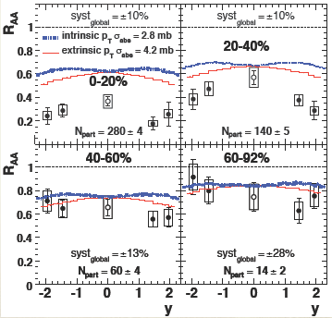
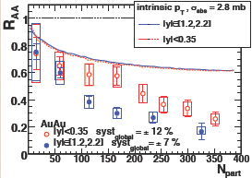
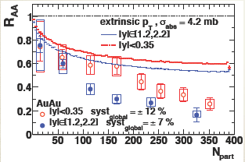
An example: how partonic kinematics affects shadowing
Au+Au @ RHIC: J/ψ centrality and y dependence
mid-y & forward-y
2→1 & 2→2 process
Intrinsic scheme: 2→1
Extrinsic scheme: 2→2
By considering the correct partonic kinematics
(CSM @ LO, CSM@ NLO, COM @ NLO…)
CNM effects can explain the mid/forw @ RHIC
8
E. G. Ferreiro USC Quarkonium: theory aspects HP2012 27 May 2012

Slide 32
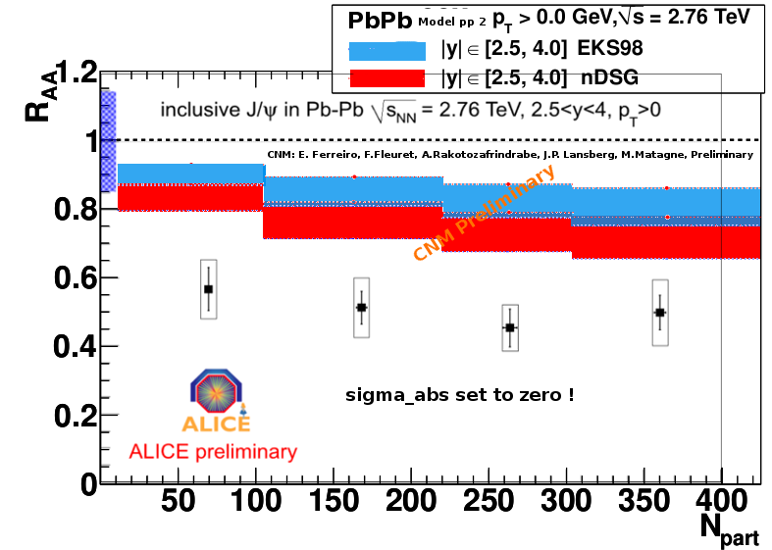
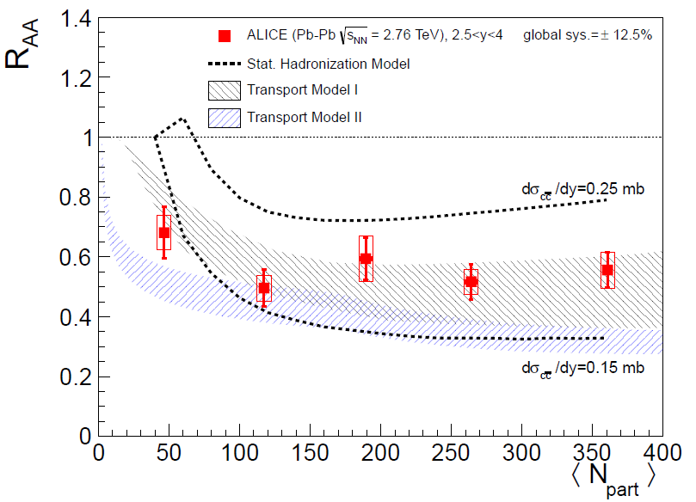
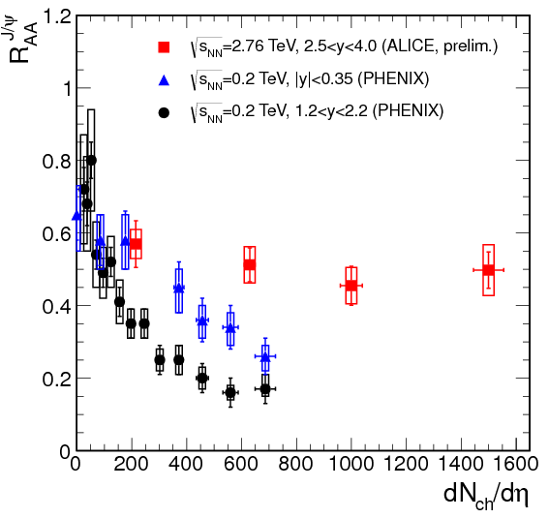
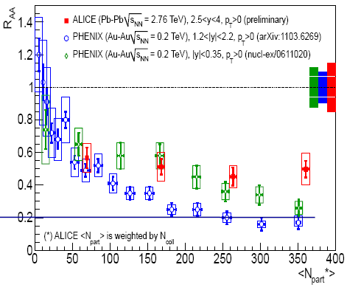
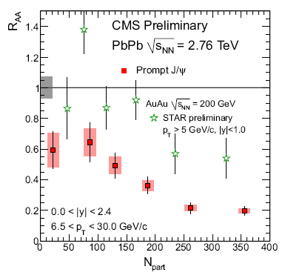
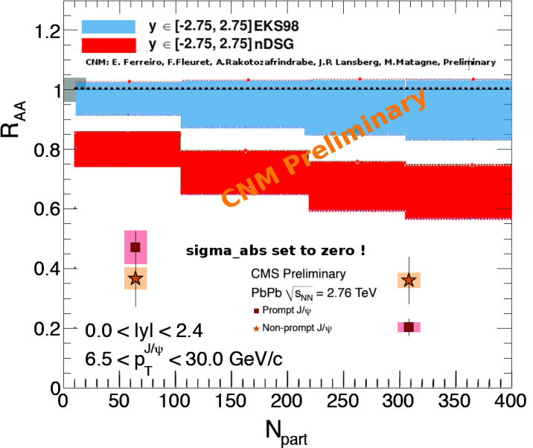
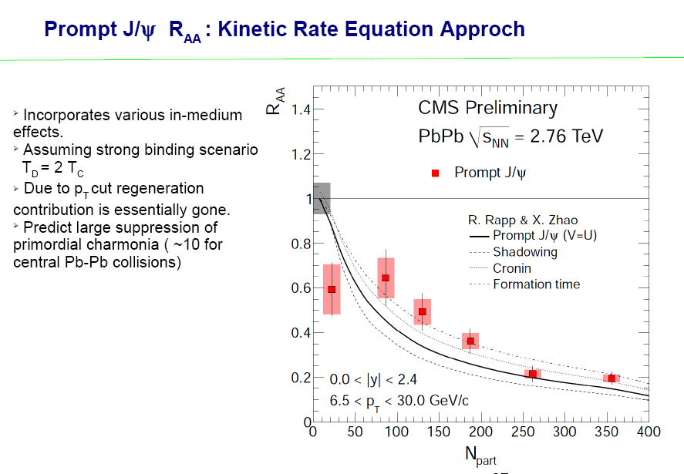


Putting all together: J/ψ @ LHC
COLD effects: shadowing
HOT effects: QGP+ recombination
Andronic, Braun-Munzinger,
Redlich & Stachel
Zhao & Rapp
Liu, Qu, Xu & Zhuang
energy density
Due to pT cut,
recombination
contribution
essentially gone?
Data at mit rapidity
and low pT would
be most useful
E. G. Ferreiro USC Quarkonium: theory aspects HP2012 27 May 2012

Slide 33
Something new… other CNM effects
Gluon EMC effect
Fractional energy loss
E. G. Ferreiro USC Quarkonium: theory aspects HP2012 27 May 2012
Notes:
The EMC Effect
Extensive structure function measurements have been made on nuclear targets. The European
Muon Collaboration used muon scattering to measure nuclear structure functions [1]. The
initial goal of using nuclear targets was to increase luminosity by increasing the target
thickness, but the structure functions measured in scattering from iron and deuterium differed
substantially. When they compared the cross section per nucleon, they saw an enhancement
in iron below and a suppression at larger values of x . Figure 1 shows the ratio
as a function of x for measurements by the EMC collaboration [1], the BCDMS
collaboration [2], and SLAC experiment E139 [3]. This nuclear dependence, termed the EMC
effect, has since been measured for several targets and mapped out over a large kinematical
range. Following these measurements, several models have tried to explain the effect. While it
is now possible to identify some of the necessary ingredients in an explanation of the nuclear
dependence of the structure function, there are still competing models that lead to
significantly different pictures of the effect. An overview of measurements and models of the
EMC effect can be found in ref. [4].
Several approaches have been used to try to explain the observed nuclear dependence of the
cross section. If one expresses the nuclear structure function as a convolution of the proton
and neutron structure functions, the modification can be generated in one of two ways. Either
the nucleon structure is modified when in the nuclear medium, or the nuclear structure
function is modified in the convolution due to multi-nucleon effects (binding, exchange pions,
N-N correlations, etc...). Models using both types of explanation have attempted to explain the
EMC effect. While many of these models have had some success, they typically reproduce only
part of the observed enhancement or suppression, explain a limited x range, or are in
conflict with other measurements. Calculations which simply include the momentum
distribution of the nucleons predicted that the effect would be below the few percent level for
[5] (i.e. away from the quasielastic peak), which is significantly smaller than
is observed. Models which also include the removal energy of the nucleon (Akulinichev
et al. [6], Ciofi degli Atti and Luiti [7]) have been able to reproduce certain
aspects of the data, but have either failed to reproduce the magnitude or the low x behavior
of the effect. The nuclear dependence has also been modeled in terms of a change in the
confinement radius of a nucleon bound in a nucleus. This leads to a `swollen' nucleon, which
will have a softer valence quark distribution. While this picture can reproduce the magnitude
and x -dependence of the EMC effect fairly well, it requires a significant increase in the size
of the nucleon ( 15% for iron). This would have observable effects in other experiments, and
a swelling of this size appears to be ruled out [8,9,10]. The EMC effect has also been modeled
in terms of an enhancement of the pion field within a nucleus. The pion exchange piece of the
nucleon-nucleon interaction leads to a modification of the virtual pion cloud in the nucleus,
producing a shifting of strength in x . However, this requires a pion excess that is too large to
be consistent with a Drell-Yan measurement of the pion modification in nuclei [11]. Ultimately,
the EMC effect may be fully described by one of the mechanisms currently being examined, by
some new approach, or by some combination of these models. In order to determine which
model best describes reality, we need to measure the EMC effect over as broad a range in x ,
Q 2 , and A as possible to separate models by their specific predictions.

Slide 34







Other CNM effects: ϒ rapidity dependence in dAu @ RHIC
Extrinsic scheme: σabs=0 mb, σabs= 0.5mb , σabs= 1 mb in 3 shadowing models
• backward: ok within uncertainties
• central: reasonable job
• forward : clearly too high (for any σabs)
Physical interpretation
• backward: EMC effect
• central: antishadowing
• forward : shadowing≈1
energy loss is needed
16
E. G. Ferreiro USC Quarkonium: theory aspects HP2012 27 May 2012
Notes:
The EMC Effect
Extensive structure function measurements have been made on nuclear targets. The European
Muon Collaboration used muon scattering to measure nuclear structure functions [1]. The
initial goal of using nuclear targets was to increase luminosity by increasing the target
thickness, but the structure functions measured in scattering from iron and deuterium differed
substantially. When they compared the cross section per nucleon, they saw an enhancement
in iron below and a suppression at larger values of x . Figure 1 shows the ratio
as a function of x for measurements by the EMC collaboration [1], the BCDMS
collaboration [2], and SLAC experiment E139 [3]. This nuclear dependence, termed the EMC
effect, has since been measured for several targets and mapped out over a large kinematical
range. Following these measurements, several models have tried to explain the effect. While it
is now possible to identify some of the necessary ingredients in an explanation of the nuclear
dependence of the structure function, there are still competing models that lead to
significantly different pictures of the effect. An overview of measurements and models of the
EMC effect can be found in ref. [4].
Several approaches have been used to try to explain the observed nuclear dependence of the
cross section. If one expresses the nuclear structure function as a convolution of the proton
and neutron structure functions, the modification can be generated in one of two ways. Either
the nucleon structure is modified when in the nuclear medium, or the nuclear structure
function is modified in the convolution due to multi-nucleon effects (binding, exchange pions,
N-N correlations, etc...). Models using both types of explanation have attempted to explain the
EMC effect. While many of these models have had some success, they typically reproduce only
part of the observed enhancement or suppression, explain a limited x range, or are in
conflict with other measurements. Calculations which simply include the momentum
distribution of the nucleons predicted that the effect would be below the few percent level for
[5] (i.e. away from the quasielastic peak), which is significantly smaller than
is observed. Models which also include the removal energy of the nucleon (Akulinichev
et al. [6], Ciofi degli Atti and Luiti [7]) have been able to reproduce certain
aspects of the data, but have either failed to reproduce the magnitude or the low x behavior
of the effect. The nuclear dependence has also been modeled in terms of a change in the
confinement radius of a nucleon bound in a nucleus. This leads to a `swollen' nucleon, which
will have a softer valence quark distribution. While this picture can reproduce the magnitude
and x -dependence of the EMC effect fairly well, it requires a significant increase in the size
of the nucleon ( 15% for iron). This would have observable effects in other experiments, and
a swelling of this size appears to be ruled out [8,9,10]. The EMC effect has also been modeled
in terms of an enhancement of the pion field within a nucleus. The pion exchange piece of the
nucleon-nucleon interaction leads to a modification of the virtual pion cloud in the nucleus,
producing a shifting of strength in x . However, this requires a pion excess that is too large to
be consistent with a Drell-Yan measurement of the pion modification in nuclei [11]. Ultimately,
the EMC effect may be fully described by one of the mechanisms currently being examined, by
some new approach, or by some combination of these models. In order to determine which
model best describes reality, we need to measure the EMC effect over as broad a range in x ,
Q 2 , and A as possible to separate models by their specific predictions.

Slide 35



EMC effect
EMC
antishadowing
Let us try to increase the suppression of g(x) in the EMC region, thr shadow incert.:
we have used three of the EPS09 LO sets: one with a quark-like EMC gluon suppression, and the two limiting curves
Works better for backward region
17
E. G. Ferreiro USC Quarkonium: theory aspects HP2012 27 May 2012

Slide 36
Energy loss effect: Fractional energy loss
• Usual idea: An energetic parton traveling in a large nuclear medium undergoes multiple elastic
scatterings, which induce gluon radiation => radiative energy loss (BDMPS)
• Intuitively: due to parton energy loss, a hard QCD process probes the incoming PDFs at higher x, where they are suppressed, leading to nuclear suppression
• The problem: This energy loss is subject to the LPM bound (Brodsky-Hoyer)
=> Δ E is limited and does not scale with E =>negligible effect at RHIC and LHC
• Recently (Arleo, Peigner, Sami) it has been probed that the notion of radiated energy associated
to a hard process is more general than the notion of parton energy loss.
=> a fractional energy loss: Δ E α E
The medium-induced gluon radiation associated to large-x_{F} quarkonium hadroproduction:
arises from large gluon formation times t_{f} >> L
scales as the incoming parton energy E
cannot be identified with the usual energy loss
qualitatively similar to Bethe-Heitler energy loss
the Brodsky-Hoyer bound does not apply for large formation times
Thus, the Gavin-Milana assumption of an “energy loss” scaling as E turns out to be qualitatively valid for quarkonium production provided this “energy loss” is correctly interpreted as the radiated energy associated to the hard process, and not as the energy loss of independent incoming and outgoing color charges.
19
E. G. Ferreiro USC Quarkonium: theory aspects HP2012 27 May 2012
Notes:
The EMC Effect
Extensive structure function measurements have been made on nuclear targets. The European
Muon Collaboration used muon scattering to measure nuclear structure functions [1]. The
initial goal of using nuclear targets was to increase luminosity by increasing the target
thickness, but the structure functions measured in scattering from iron and deuterium differed
substantially. When they compared the cross section per nucleon, they saw an enhancement
in iron below and a suppression at larger values of x . Figure 1 shows the ratio
as a function of x for measurements by the EMC collaboration [1], the BCDMS
collaboration [2], and SLAC experiment E139 [3]. This nuclear dependence, termed the EMC
effect, has since been measured for several targets and mapped out over a large kinematical
range. Following these measurements, several models have tried to explain the effect. While it
is now possible to identify some of the necessary ingredients in an explanation of the nuclear
dependence of the structure function, there are still competing models that lead to
significantly different pictures of the effect. An overview of measurements and models of the
EMC effect can be found in ref. [4].
Several approaches have been used to try to explain the observed nuclear dependence of the
cross section. If one expresses the nuclear structure function as a convolution of the proton
and neutron structure functions, the modification can be generated in one of two ways. Either
the nucleon structure is modified when in the nuclear medium, or the nuclear structure
function is modified in the convolution due to multi-nucleon effects (binding, exchange pions,
N-N correlations, etc...). Models using both types of explanation have attempted to explain the
EMC effect. While many of these models have had some success, they typically reproduce only
part of the observed enhancement or suppression, explain a limited x range, or are in
conflict with other measurements. Calculations which simply include the momentum
distribution of the nucleons predicted that the effect would be below the few percent level for
[5] (i.e. away from the quasielastic peak), which is significantly smaller than
is observed. Models which also include the removal energy of the nucleon (Akulinichev
et al. [6], Ciofi degli Atti and Luiti [7]) have been able to reproduce certain
aspects of the data, but have either failed to reproduce the magnitude or the low x behavior
of the effect. The nuclear dependence has also been modeled in terms of a change in the
confinement radius of a nucleon bound in a nucleus. This leads to a `swollen' nucleon, which
will have a softer valence quark distribution. While this picture can reproduce the magnitude
and x -dependence of the EMC effect fairly well, it requires a significant increase in the size
of the nucleon ( 15% for iron). This would have observable effects in other experiments, and
a swelling of this size appears to be ruled out [8,9,10]. The EMC effect has also been modeled
in terms of an enhancement of the pion field within a nucleus. The pion exchange piece of the
nucleon-nucleon interaction leads to a modification of the virtual pion cloud in the nucleus,
producing a shifting of strength in x . However, this requires a pion excess that is too large to
be consistent with a Drell-Yan measurement of the pion modification in nuclei [11]. Ultimately,
the EMC effect may be fully described by one of the mechanisms currently being examined, by
some new approach, or by some combination of these models. In order to determine which
model best describes reality, we need to measure the EMC effect over as broad a range in x ,
Q 2 , and A as possible to separate models by their specific predictions.

Slide 37



Energy loss effect
Independently of the gluon PDF parameterization, this energy loss will induce
For ϒ For J/ψ
a suppression of 80% - 90% at mid y a suppression of 80% - 90% at mid y
a suppression of 65% -85%at forward y a suppression of 70% -80%at forward y
Due to t_{f} of the order of nuclear size, this energy loss is not applicable in the backward y
Note that this “loss” is not the loss of an independent parton suddenly produced, but the amount of gluon radiation associated to the quarkonium production process
20
E. G. Ferreiro USC Quarkonium: theory aspects HP2012 27 May 2012

Slide 38

Conclusions…. if any
• A lot of work trying to understand A+A data (since J/ψ ≡ QGP signal)
Quarkonium as a hint of deconfinement
QGP
• If we focalise on p+A data (where no QGP is possible)
only cold nuclear matter (CNM) effects are in play:
shadowing and nuclear absorption
EMC and energy loss
LHC p+Pb run
Quarkonium as a hint of coherence
nPDF
• In fact, the question is even more fundamental: p+p data
we do not know the specific production kinematics at a partonic level: (2→2,3,4) vs (2→1)
Quarkonium as a hint of QCD
QCD
1
E. G. Ferreiro USC Quarkonium: theory aspects HP2012 27 May 2012

