Slide 1


Azimuthal angular correlations between heavy flavour decay electrons and charged hadrons in pp collisions at √s = 2.76 TeV in ALICE
Deepa Thomas
For the ALICE collaboration
Hard ProbeS, Cagliari
31-05-2012

Slide 2
Motivation
Heavy quarks
  Produced in hard scattering processes
  Good test for perturbative QCD calculations in new energy regime
  Sensitive probe of QCD matter produced in heavy ion collisions
Interaction of heavy quarks with the QCD medium can be studied using electron from semi-leptonic decay of heavy flavour hadrons.
Need to separate electrons from D and B decays to study the mass dependence of heavy quark energy loss
2

Slide 3
Motivation (cont’d)
Azimuthal angular correlations of HF decay electrons and charged hadrons
→ relative beauty contribution.
Exploit different decay kinematics of D and B hadrons.
Relative beauty contribution extracted by fitting Monte Carlo (PYTHIA) templates (with detector simulation) to data.
  Complementary to direct measurements (using displaced vertices).
  STAR¹ and PHENIX² measurements with the same technique
MC : PYTHIA (PERUGIA-0)
pp √s = 2.76 TeV
|η^{e}|<0.9
Decay kinematics of heavy flavour hadrons
- D decay
- B decay
Posters by M. Heide and M. Volkl
¹STAR Collaboration, Phys. Rev. Lett. 105, 202301 (2010).
²PHENIX Collaboration, Phys. Rev. Lett. 103, 082002, (2009).
3

Slide 4
Analysis Strategy
Heavy flavour decay electron (HFE) identification
Azimuthal angular correlation between HFE and charged hadrons
  Deconvolute c and b
    Monte Carlo template
    Fit data
4

Slide 5
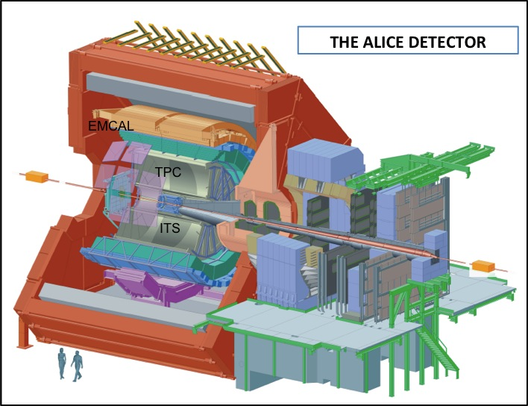
ALICE detector
ALICE - |η| < 0.9 (acceptance of central barrel detectors)
Detectors used for present analysis
  Inner tracking system
  Time projection chamber
  Electromagnetic calorimeter
    |η| < 0.7
    80⁰ < ϕ < 180⁰
EMCAL
TPC
ITS
5

Slide 6
Electron identification
Dataset:
  pp at √ s = 2.76 TeV
  EMCal triggered events
  Statistics : 6.2 x 10⁵ events
Electron Identification
  TPC : -1σ < TPC dE/dx < 3σ
  EMCAL : 0.8 < E/p < 1.2
K+p
π
e
6

Slide 7
Non - heavy flavour electron identification
Non-heavy-flavour electron
  Main sources : γ conversion, π⁰ and η Dalitz decays.
  Identified using e⁺ e⁻ invariant mass method.
Invariant mass cut of 50 MeV/c² applied
Efficiency for Non-heavy flavour electron identification
  - N_{NHFe}^{reco} / N_{NHFe} ~ 50%
  Remaining small contamination (< 10%) corrected.
7

Slide 8
Azimuthal angular correlation of heavy flavour electrons and charged hadrons
Charged hadron selection
  p_{t} > 0.3 GeV/c
  |η| < 0.9, 0<ϕ<360
Fit data with MC template for beauty and charm (PYTHIA + GEANT3)
Fit function : Δϕ_{data} = const + r_{b} Δϕ_{B} + (1-r_{b})Δϕ_{D}
  where r_{b} = e from b / (e from b + e from c)
8

Slide 9
Fraction of beauty decay electrons
Main source of systematics:
  Electron identification using TPC and EMCal.
  Fit range : (-1,1) to (-2.5,2.5).
  Non-HFE identification
  - invariant mass and dE/dx cut .
At ~ 5 GeV/c the beauty contribution has similar magnitude as charm.
¹STAR Collaboration, Phys. Rev. Lett. 105, 202301 (2010).
²PHENIX Collaboration, Phys. Rev. Lett. 103, 082002, (2009).
³M. Cacciari et al., JHEP 0103, 006 (2001) and private communication (2012)
Consistent with FONLL pQCD calculations³ and RHIC measurements^{1,2}.
9

Slide 10
Conclusions
Relative beauty contribution to the heavy flavour decay electron yield is measured in pp collisions at 2.76 TeV with the ALICE detector using an EMCal trigger.
Beauty contribution to heavy flavour electron yield is similar to charm contribution at around 5 GeV/c.
Beauty fraction is well described by FONLL pQCD calculation and it is comparable to results at 200 GeV from RHIC.
Outlook:
  Measurement of the absolute b-decay electron cross section with Heavy Flavour Electron spectra.
  Perform this analysis in Pb-Pb collisions at 2.76 TeV.
10

