Slide 1
Measurement of electrons from Heavy Quarks at PHENIX
Sourav Tarafdar
Banaras Hindu University
For the PHENIX Collaboration
Hard Probes 2012

Slide 2

Heavy flavor hadrons measurement in PHENIX
Measured mainly by semi-leptonic decay of D or B mesons.
(e^{+/-}) from heavy flavor detected in mid rapidity region [ | ɳ | < 0.35 ] in PHENIX
(μ^{+/-}) from heavy flavor detected in forward and backward rapidity region [ 1.4 < | ɳ | < 1.9]
Measurement of e+&e- from open heavy flavor decay has been done by PHENIX in broad range of collision species
p + p : Provides baseline for hot and dense matter studies in Heavy Ion Collisions
PRL 97, 252002 (2006)
Preliminary (2012) NEW
d + Au: Baseline for cold nuclear matter effect in hot and dense matter
NEW
Cu + Cu : Fills the void between d+Au and Au + Au
Preliminary (2012)
Au + Au : Information about hot dense matter produced in RHIC
2
PRL 98, 172301 (2007)
Preliminary 2012 New
Notes:
ICPAQGP-2010, Goa
2

Slide 3
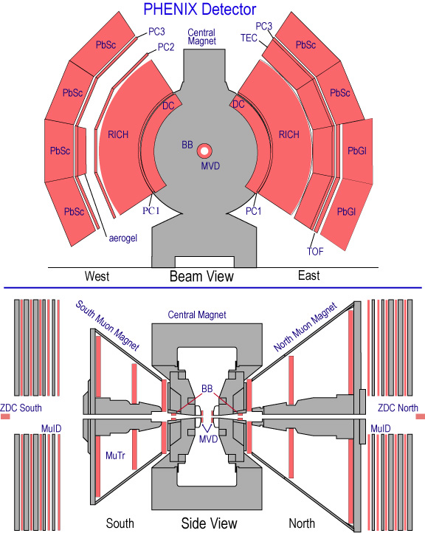
PHENIX tracking and particle detection
BBC and ZDC provide the Min. Bias
triggering and are being used for
Centrality determination.
Tracking of particles are being done by
Drift Chamber (DC) and Pad Chamber
(PC).
Ring Imaging Cherenkov Counter
(RICH) is the primary electron ID
detector.
The energy by electrons is being
deposited on Electromagnetic
calorimeters.
π
γ
e⁻
e⁺
Additional advantage for PHENIX to measure semi-electronic heavy flavor yield
Low material radiation length
3
Notes:
ICPAQGP-2010, Goa
3

Slide 4
Extraction of heavy flavor electron in PHENIX
Identify electrons from data
Determine photonic and non photonic electron background
Cocktail subtraction method
Converter method
Determined by PHENIX
particle generator
Photon converter added to increase the fraction of conversion. Increase in conversion probability estimates the photonic background
Scaling of photonic electron from cocktail is done to match the photonic
electron from converter method
Subtract non photonic and scaled photonic electrons as determined by
cocktail from all the electrons identified in data
Nuclear modification factor
v2 flow measurement
Heavy Flavor electron
4
Notes:
ICPAQGP-2010, Goa
4

Slide 5
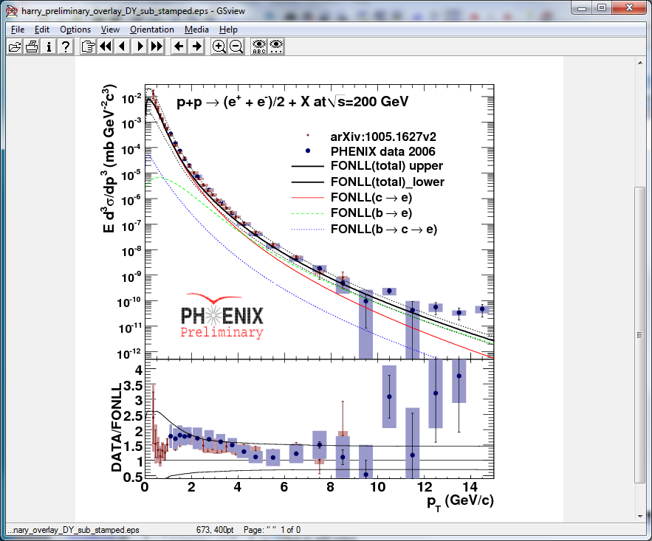
Improved p+p result and better baseline
Provides baseline for studying
the hot and dense matter effects
in heavy Ion reactions.
Recently combined 2005 and 2006
data providing :
Extension upto high pT .
Smaller uncertainties : Better comparison of RAA.
Has good agreement with
FONLL calculations.
5
Notes:
ICPAQGP-2010, Goa
5

Slide 6
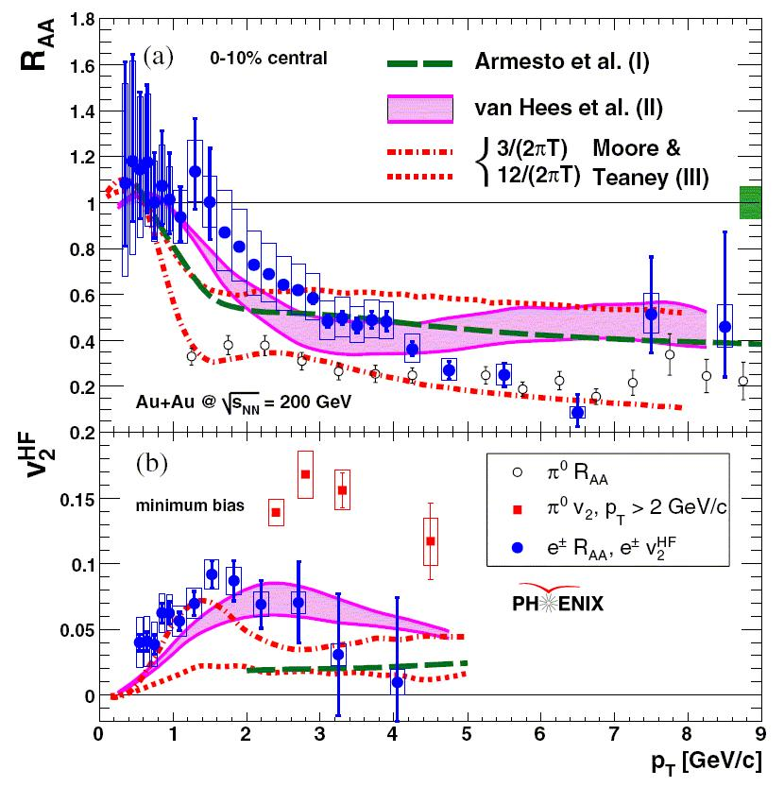
Au+Au Results
Energy loss via gluon radiation
Suppression will reduce from lighter quarks to heavier quarks.
Flow will reduce from lighter quarks to
heavier quark
PRL 98, 172301 (2007)
Observations for R_{AA} in 2.0 < p_{T} < 5.0 GeV and for v₂ in p_{T} < 2.0 GeV
don’t support expected behavior.
Suggests strong coupling of
heavy quarks to the medium
v₂ results in Au+Au at √S_{NN} =200 GeV
raised question about flow of heavy
quarks at lower beam energy.
Measurement of heavy flavor v₂ done
recently by PHENIX in Au+Au at
√S_{NN} = 62.4 GeV
6
Phys. Rv. Lett. 08. 172301(2007)
Notes:
ICPAQGP-2010, Goa
6

Slide 7
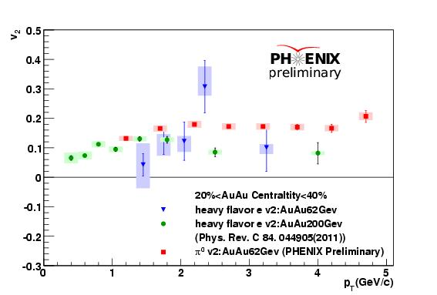
Recent Au+Au at √S_{NN} = 62.4 GeV result

Slide 8
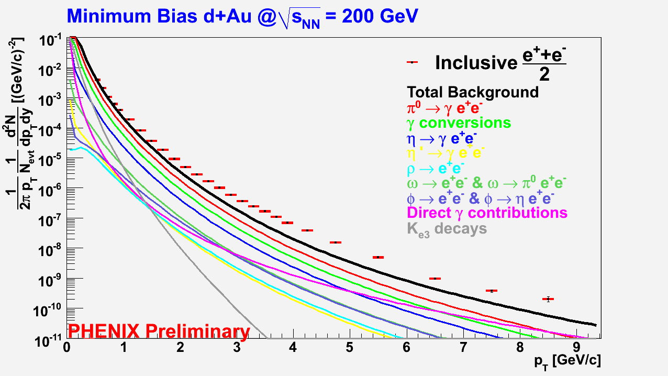
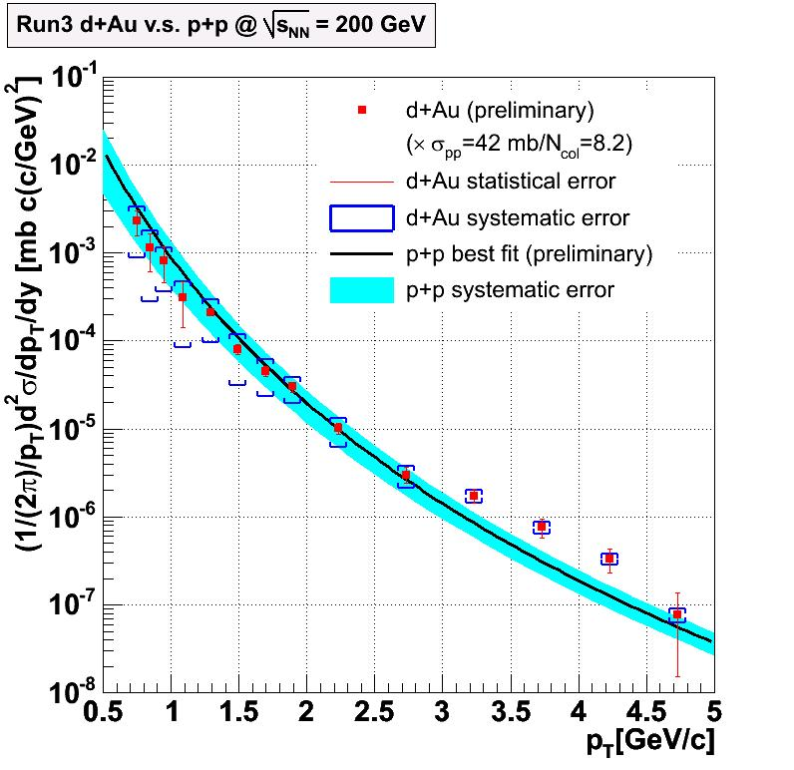
d+Au Results
RHIC run in 2008 provided 30x statistics for d+Au of year 2003 .
Extension upto high pT
Subtract the cocktail
from the inclusive
spectra with photonic
component of cocktail
scaled by the
mismatch in converter
method photonic
electron and cocktail
photonic electron
Heavy flavor single electron invariant yield from 2003 RHIC RUN measured by PHENIX
Heavy flavor single electron
8
Notes:
ICPAQGP-2010, Goa
8

Slide 9
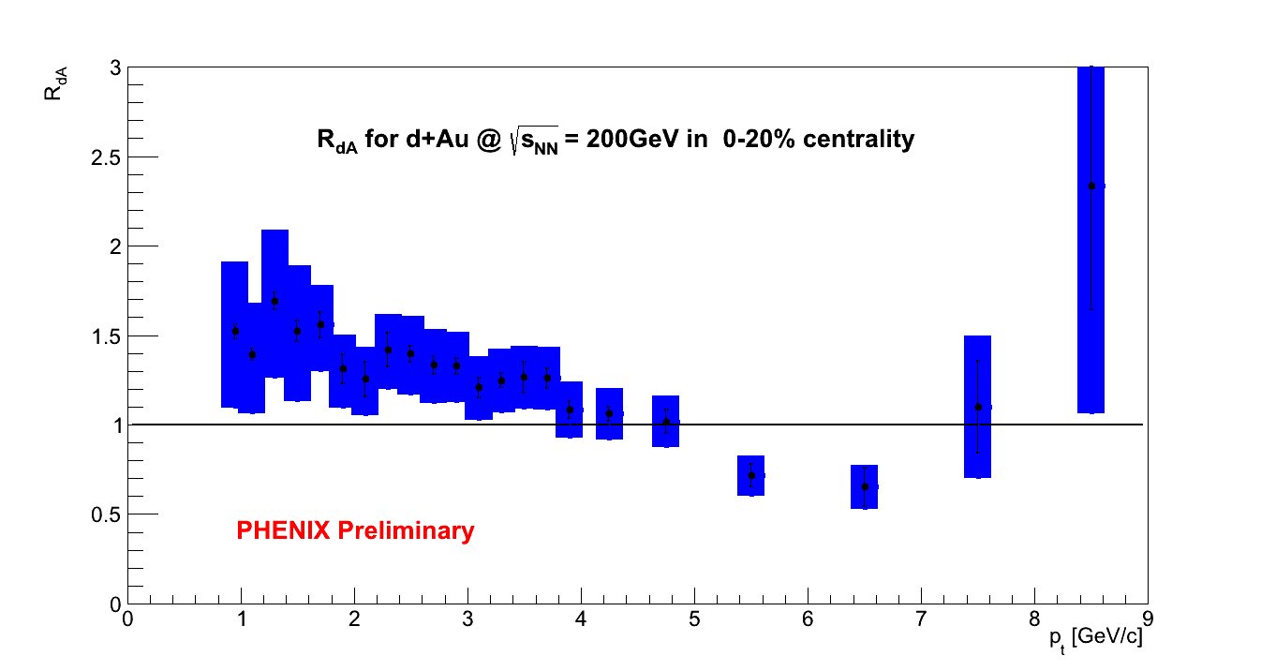
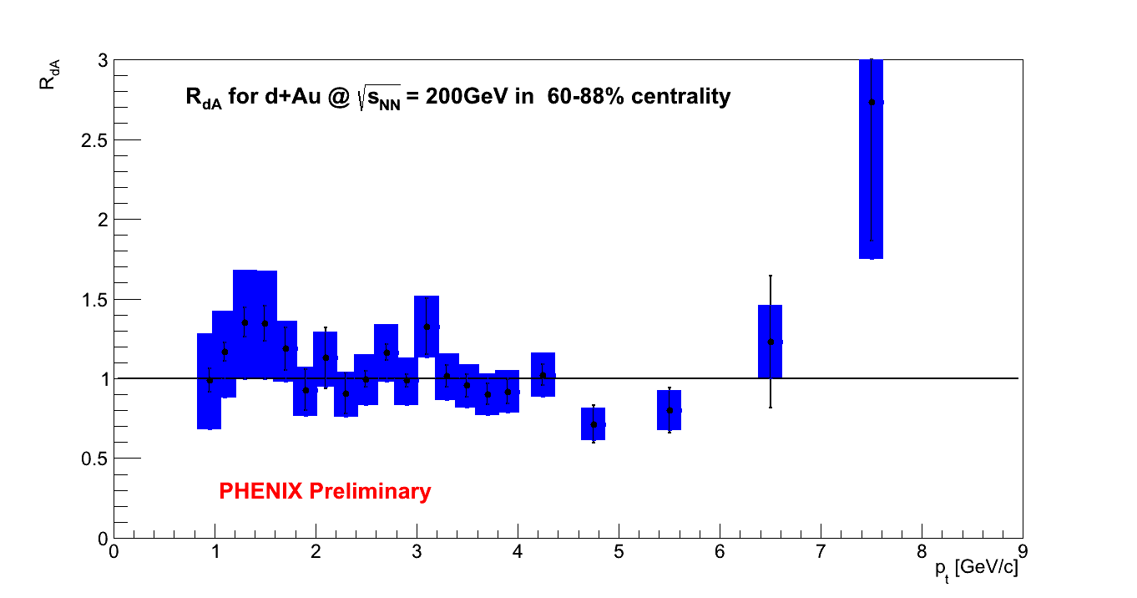
RdA in most central and most peripheral
9
Notes:
ICPAQGP-2010, Goa
9

Slide 10
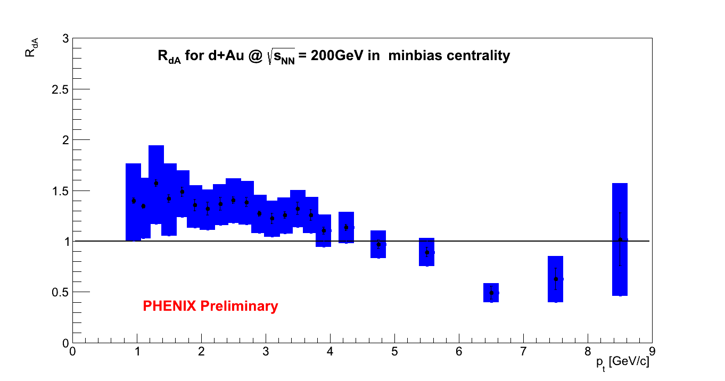
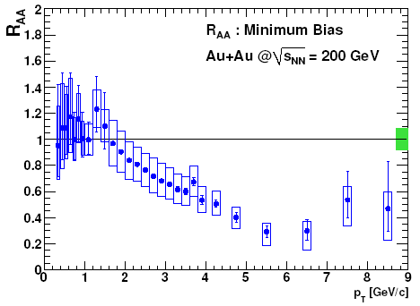
Observations from R_{dA}
No suppression in RdA for the central collision is observed unlike observed in R_{AA}.
CNM effect ???
Suppression in R_{AA} is because of the hot dense medium and not an initial state effect
R_{dA} in peripheral collision is consistent with
p+p
arXiv: 1005.1627
10
Notes:
ICPAQGP-2010, Goa
10

Slide 11
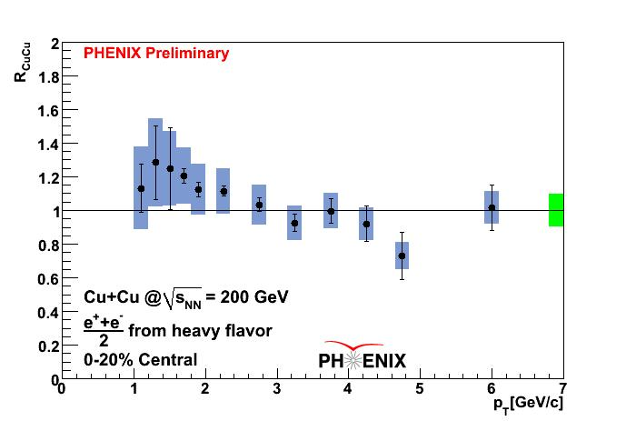
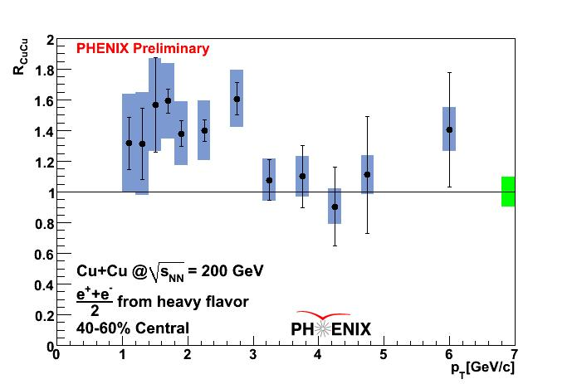
Result for Cu+Cu (e⁺+e⁻ )/2
R_{CuCu} in most central collision
R_{CuCu} in mid peripheral collision
11
Notes:
ICPAQGP-2010, Goa
11

Slide 12
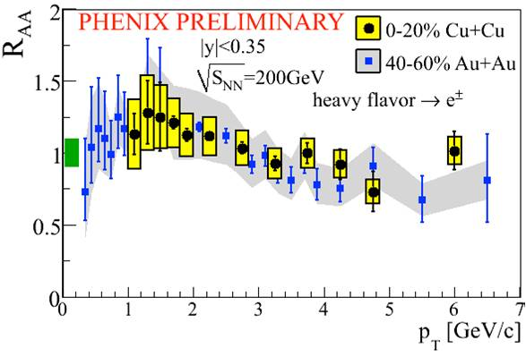
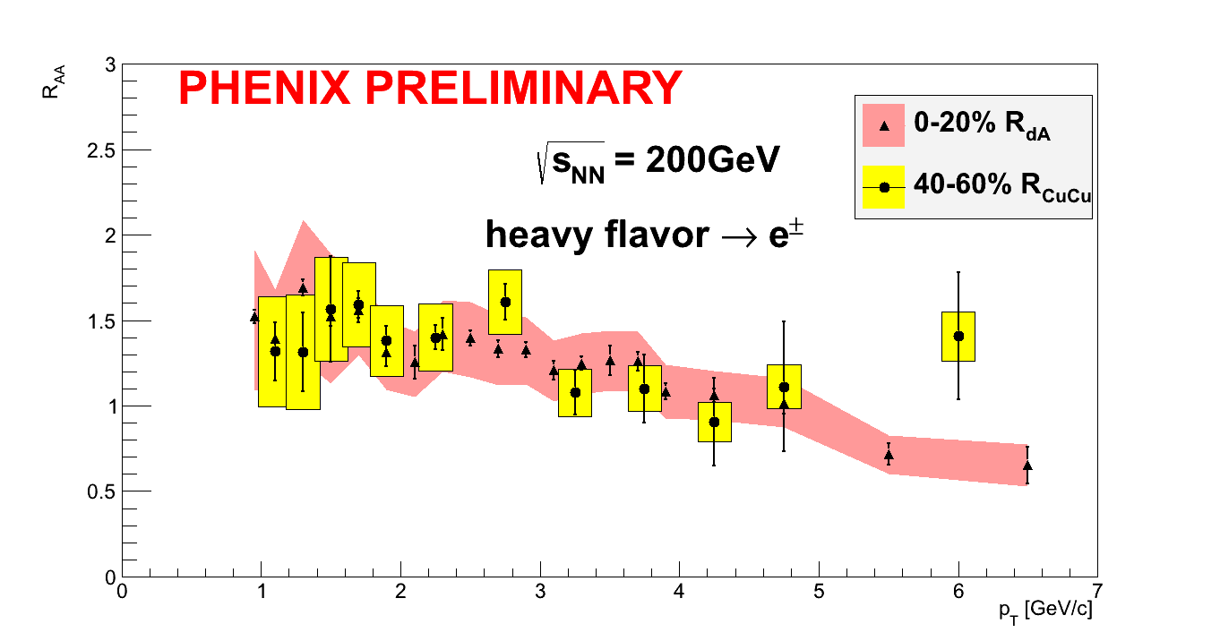
p_{T} dependence of R_{CuCu} , R_{AA} and R_{dA}
R_{CuCu}(0-20% central) ~ R_{AuAu}(40-60% central)
R_{CuCu}(40-60% central) ~ R_{dAu}(0-20% central)
12
Notes:
ICPAQGP-2010, Goa
12

Slide 13
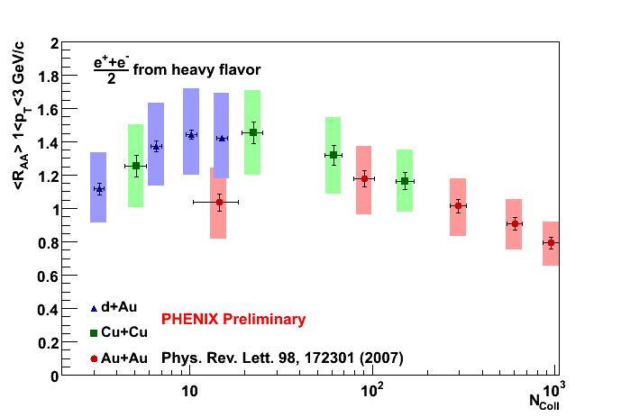
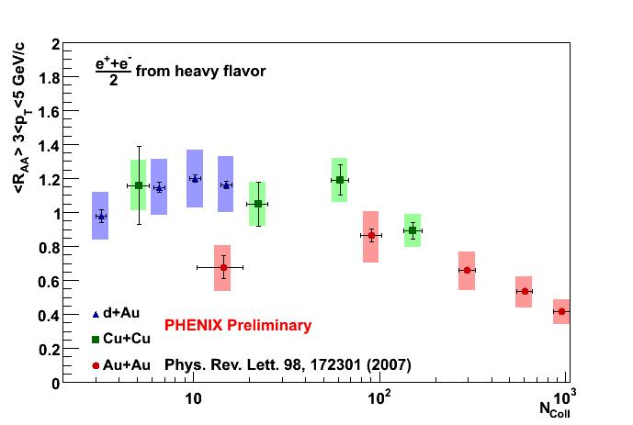
Common trend of R_{CuCu}, R_{dA} and R_{AA} with N_{coll}
1.0 < p_{T} < 3.0 GeV
3.0 < p_{T} < 5.0 GeV

Slide 14
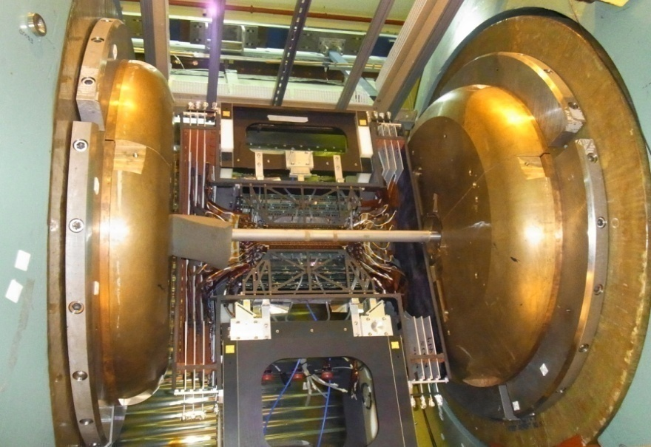
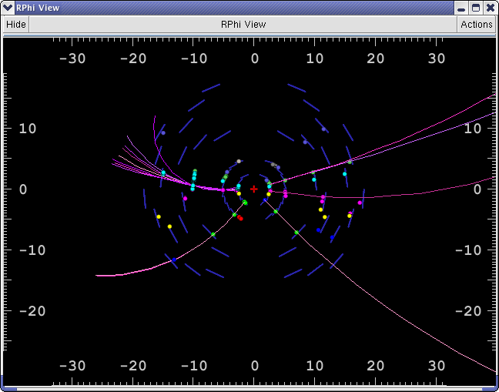
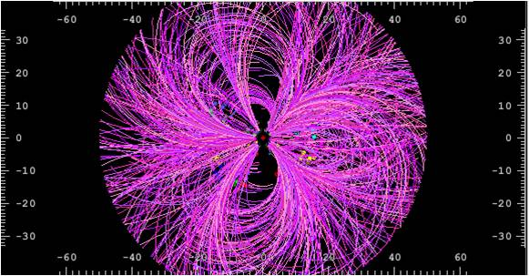
Next stage in Heavy flavor electron measurement in PHENIX
Results shown so far lacks separation of charm and
bottom.
More detailed understanding of energy loss by heavy quarks is possible by studying charm and bottom quarks separately (c e^{HF} and b e^{HF} )
Vertex Tracker was installed in PHENIX for data taking in 2011 and 2012.
VTX RUN-11: p+p at 500 GeV, single event
display
VTX RUN-11: Au+Au at 200 GeV, single event display

Slide 15
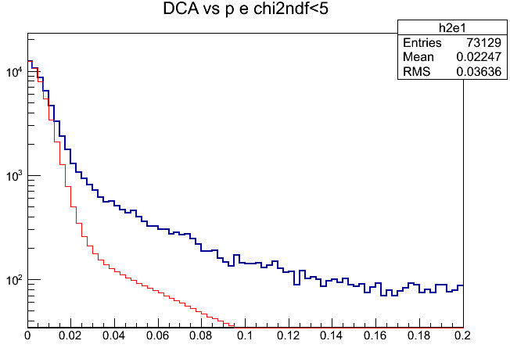
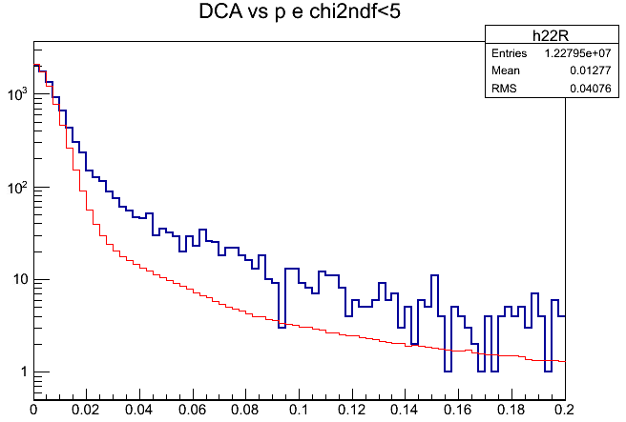
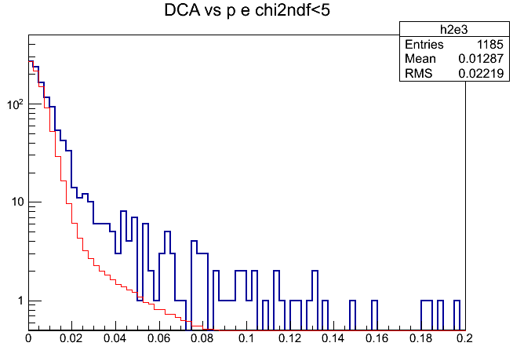
Electron DCA vs Charged Hadron DCA
Silicon Vtx performance for Run 11 : Charm and Bottom separation
P>1 GeV
P>2 GeV
Blue: e
Red: charged (x 0.6x 10⁻³)
Blue: e
Red: charged (x10⁻³ )
DCA distributions of electrons are broader than that of all charged
The difference can be due to heavy flavor signal.
Large DCA tail : Can it be b-signal?
P>3 GeV
Blue: e
Red: charged (x 0.6x 10⁻³)
Needs comparison with expected shape from MC
STAY TUNED !!!

Slide 16
Summary
Improved p+p baseline.
Flow of heavy flavor in Au+Au at 62.4 GeV.
d+Au for CNM effects.
Cu+Cu covered the N_{coll} region between d+Au and Au+Au.
Vertex Tracker will give precise independent measurement
from charm and bottom.
16
Notes:
ICPAQGP-2010, Goa
16

Slide 17
Backup
17
Notes:
ICPAQGP-2010, Goa
17

Slide 18
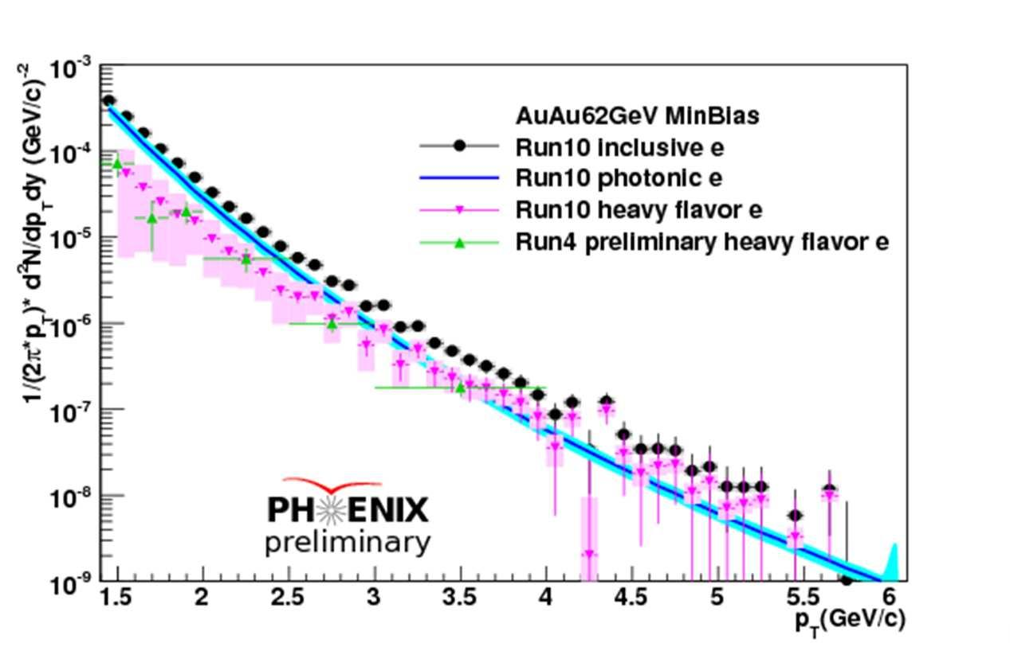
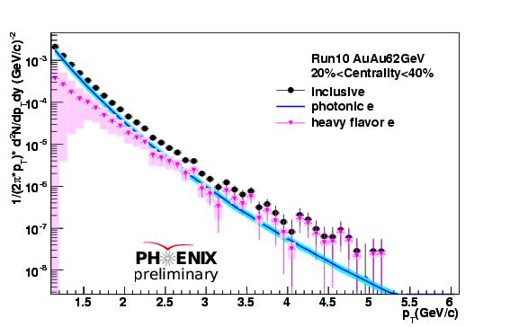
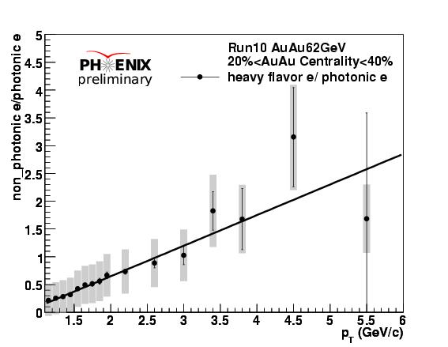
Heavy flavor from Au +Au 62.4 GeV
18
Notes:
ICPAQGP-2010, Goa
18

Slide 19
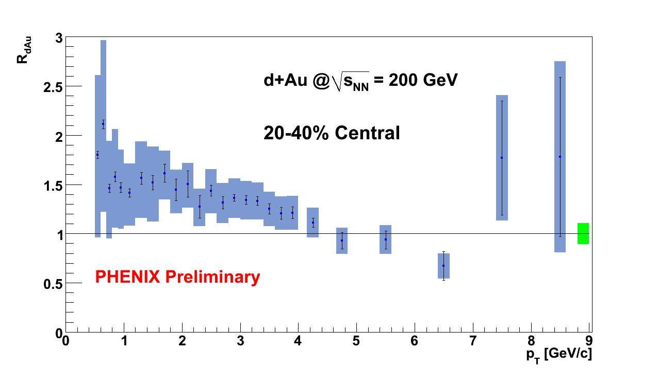
RdA in semi-central
19
Notes:
ICPAQGP-2010, Goa
19

Slide 20
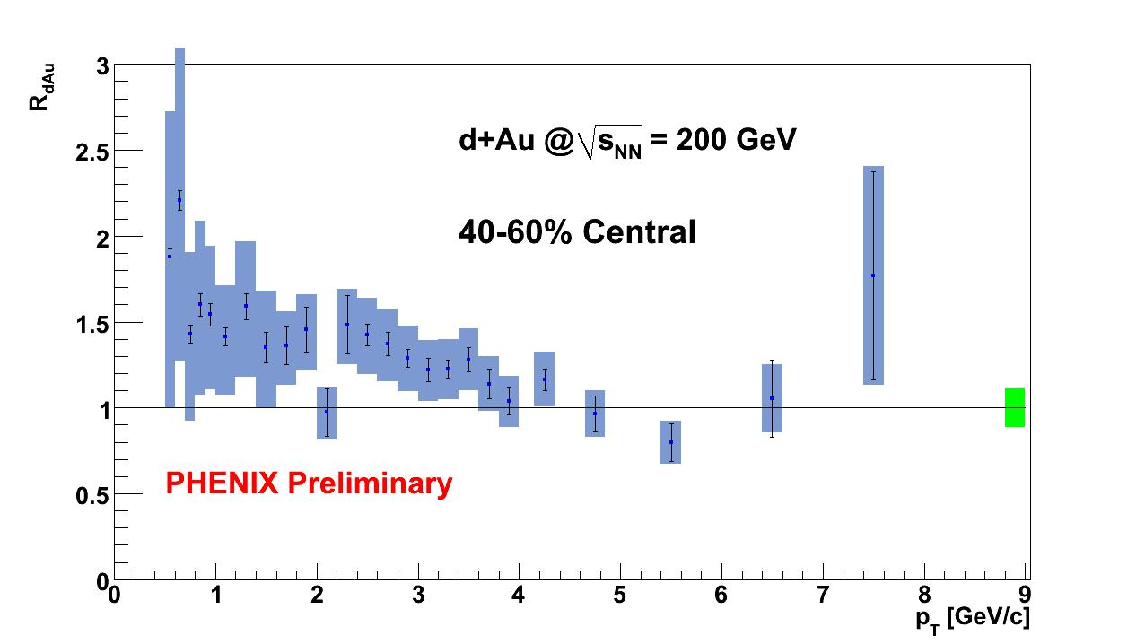
RdA in semi-peripheral
20
Notes:
ICPAQGP-2010, Goa
20

Slide 21
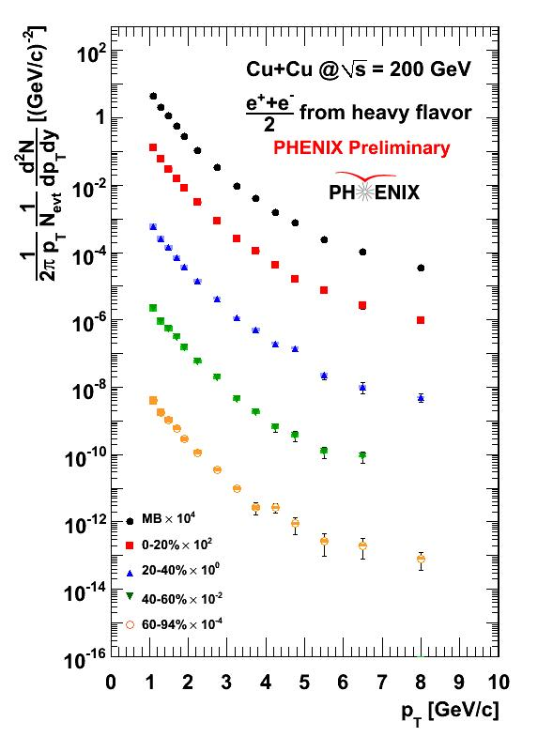
Heavy flavor single electron invariant yield in different centralities in C+Cu
21
Notes:
ICPAQGP-2010, Goa
21

Slide 22
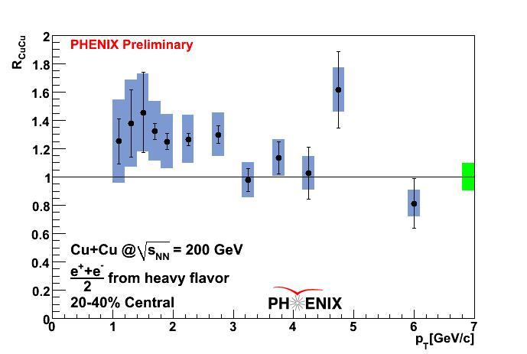
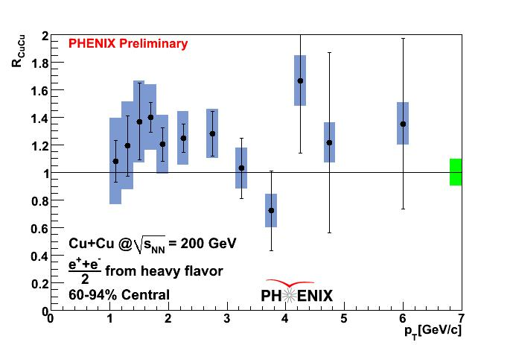
R_{CuCu} in peripheral and semi-central
22
Notes:
ICPAQGP-2010, Goa
22

