Slide 1

Jet-Triggered Back-Scattering Photons for QGP Tomography
With
Somnath De
VECC and Texas A&M
Dinesh K Srivastava
VECC
Rainer J Fries
Texas A&M University
Hard Probes 2012
Cagliari, Italy, May 31, 2012

Slide 2
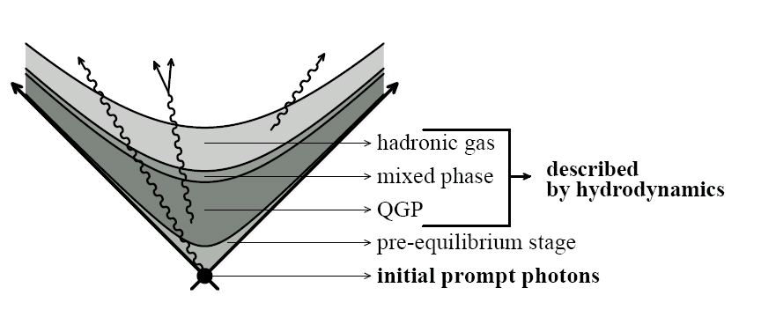
Direct Photons in Heavy Ion Collisions
Sources:
  Initial hard photons + jet fragmentation
  Pre-equilibrium + jet-medium photons
  Thermal radiation from QGP and HRG
  Background: photons from hadronic decays
Goals:
  Separate sources experimentally.
  Use them to constrain QGP properties
Single inclusive spectra
  Hierarchy in momentum ~ hierarchy in
  average momentum transfer/temperature)
Hadron Gas Thermal T_{f}
QGP Thermal T_{i}
“Pre-Equilibrium”?
Jet Re-interaction √(T_{i}x√s)
Hard prompt
E_{γ}

Slide 3
Initial Hard Photons + Fragmentation
Background for our jet-medium photon search.
Prompt photons from initial hard scattering of partons in the nuclei: calculable in collinear factorized pQCD.
Photons fragmenting off jets created in initial collisions
Can be calculated in LO and NLO e.g. by JETPHOX.
Parton
cross
section
PDF
PDF
Parton
cross
section
PDF
PDF
FF

Slide 4
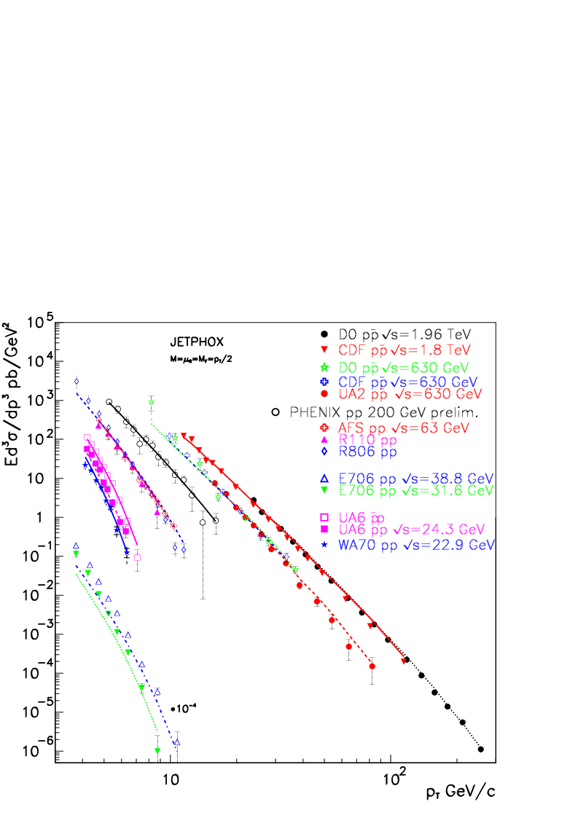
Initial Hard Photons + Fragmentation
Data in p+p well described by JETPHOX NLO calculations.
A safe baseline!
Photon world data @ hadron colliders
[Aurenche et al., PRD 73 (2006)]

Slide 5
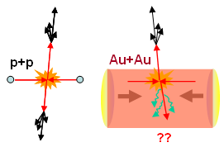

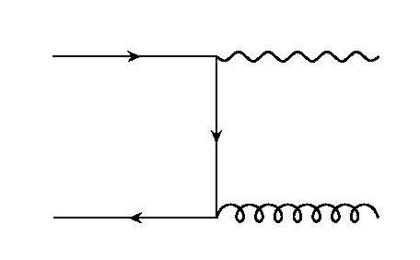
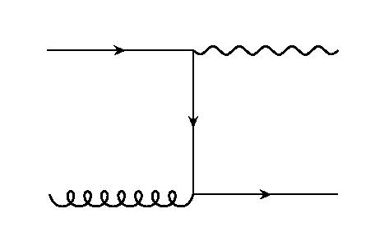
Jet-Medium Photons
Photon radiation induced by hard partons interacting with QGP
Particularly interesting kinematics: back-scattering peak in annihilation and Compton scattering of high momentum quarks
[RJF, Müller & Srivastava, PRL 90 (2003)]
[Zakharov, JETP Lett. (2004)]
⇒
jet
⇒
jet
⊗
⊗

Slide 6
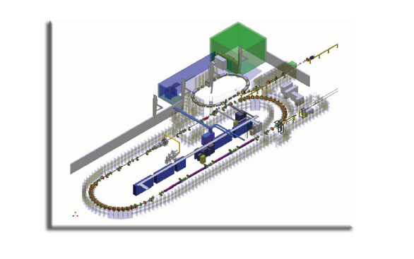
Back-Scattering Photons
Same diagrams and kinematics in QED: widely used to convert high energy electron beams into gamma-ray beams
  E.g. HIGS and ALICE facilities
  (~eV) γ + (~GeV) e → (~GeV) γ + e
Here:
  (~T) g+ (~GeV) q → (~GeV) γ + q
Yield for jet phase space distribution f and QGP with temp. T:
HIGS @ Duke
[RJF, Müller & Srivastava, PRL 90 (2003)]

Slide 7
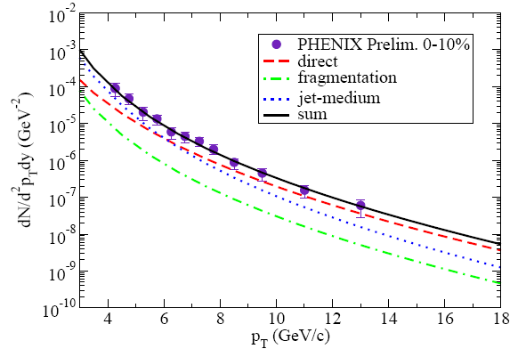
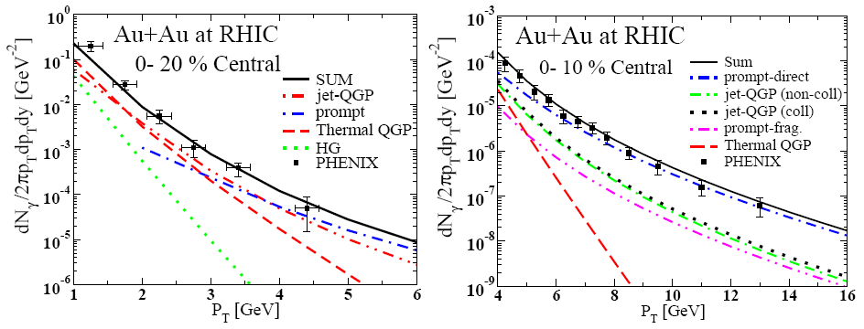
How to Measure Those Photons?
Inclusive yield and R_{AA}: hopeless
Negative v₂ for jet-medium photons!
Expected signal too small for current experimental resolution.
[Qin, Ruppert, Gale, Jeon & Moore, PRC 80 (2009)]
[Turbide, Gale, Frodermann & Heinz, PRC 77 (2007)]
[Turbide, Gale & RJF, PRL 96 (2006)]
[Chatterjee, Frodermann, Heinz, Srivastava, PRL 96 (2006)]

Slide 8
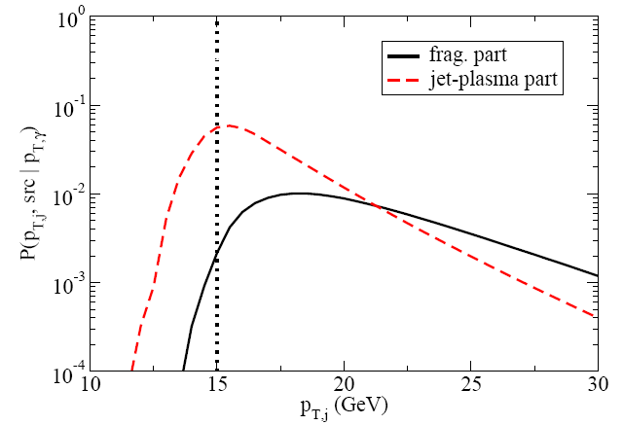
Photon-Jet Correlations
Back-Scattering Photons:
  Strong correlations of photon momentum and original jet momentum.
  Strong correlation with away-side jet momentum.
Already lots of photon triggered jet/hadron measurements
  Note: jet-medium photon dilute the correlation you need for measuring energy loss/modified fragmentation.
Strategy:
  Use away-side jet as trigger
  Compare to p+p to get rid of prompt hard photons
  No contamination by thermal + pre-equilibrium photons
[Qin, Ruppert, Gale, Jeon, Moore, EPJ C61 (2009); PRC 80 (2009)]

Slide 9
Jet-Triggered Photons
Idealized picture: photons opposite a jet of fixed energy E in LO kinematics.
Important information stored in those photons: Scattering off individual gluons? Medium Temperature? Parton energy loss?
Is nature that kind? Have to account for finite trigger windows, kinematics beyond LO, etc.
Prompt hard
T² log 1/T
Photon
fragmentation
Back-Scattering (no energy loss)
Blue: background
Red: back-scattering
Energy loss
Back-Scattering
(with energy loss)
P_{T}^{γ}
E

Slide 10
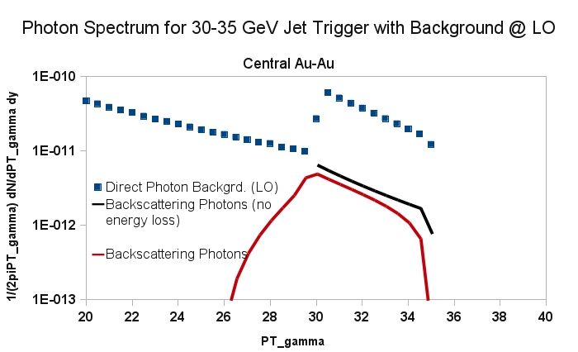
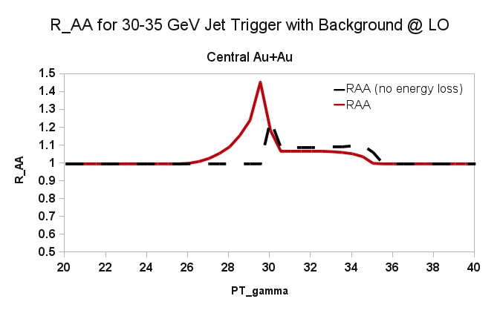
Jet-Triggered Photons: RHIC
Test feasibility with 30-35 GeV trigger jet, central Au+Au @ 200 GeV
Look for photons on away-side ±15°.
LO kinematics; energy loss for quarks/gluon before conversion
Clear backscattering peak despite finite trigger interval.

Slide 11
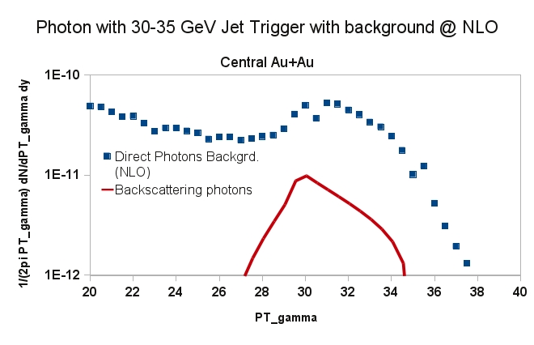
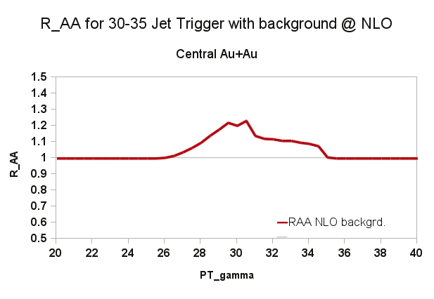
Jet-Triggered Photons: RHIC
Background calculated at NLO:
Signal washed out but surviving.

Slide 12
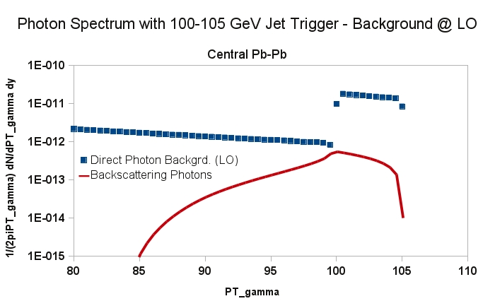
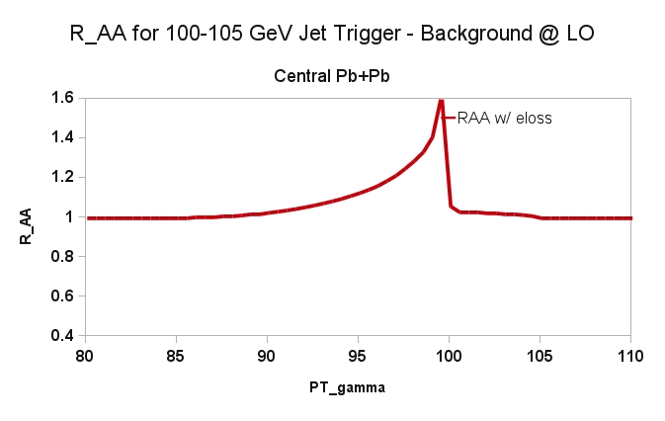
Jet-Triggered Photons: LHC
Test LHC energy with 100-105 GeV trigger jet, central Pb+Pb @ 2.76 TeV
Photons on away-side ±15°.
LO kinematics; energy loss for quarks/gluon before conversion
Visible back-scattering peak as well.

Slide 13
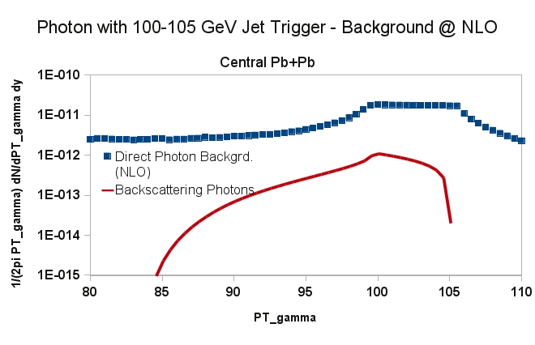
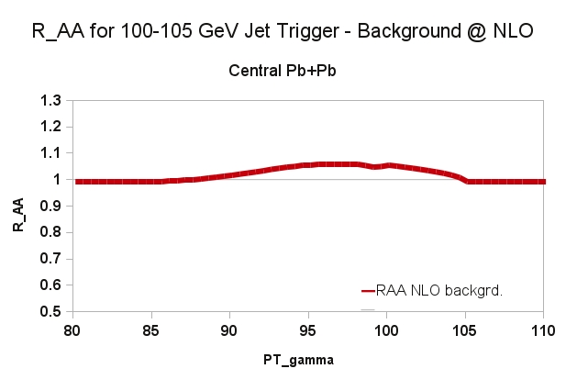
Jet-Triggered Photons: LHC
Background calculated at NLO:
Signal quite a bit smaller ~ 10% enhancement

Slide 14
How To Search
Missing in this estimate:
  Jet energy loss
  NLO kinematics for signal
  Proper accounting for finite jet resolution
Strategies to maximize the signal
  Choose trigger energies as low as possible: enhance signal over background
  Smaller trigger window: sharper peak structure
  Isolation cut for photon: probably not very effective
  Veto for a second large energy jet and tightening of cuts on azimuthal angle. could improve the signal.
  Influence of R?

Slide 15
Conclusions
Jet-medium back-scattering photons contain interesting physics
Tight correlations with jet E_{T} → back-scattering peak in jet-photon correlations
Look for rapid changes in jet-triggered photon R_{AA} below the trigger window.

Slide 16
Backup

Slide 17
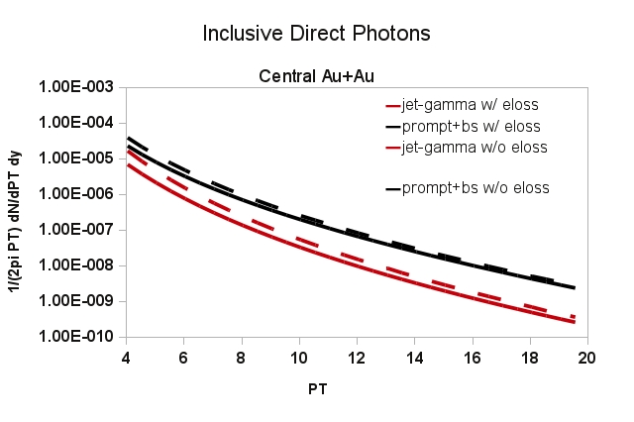
Inclusive Photon
Same energy loss and fireball model as for triggered spectra.

