Slide 1
Update on ITS3 test beam analysis

Slide 2
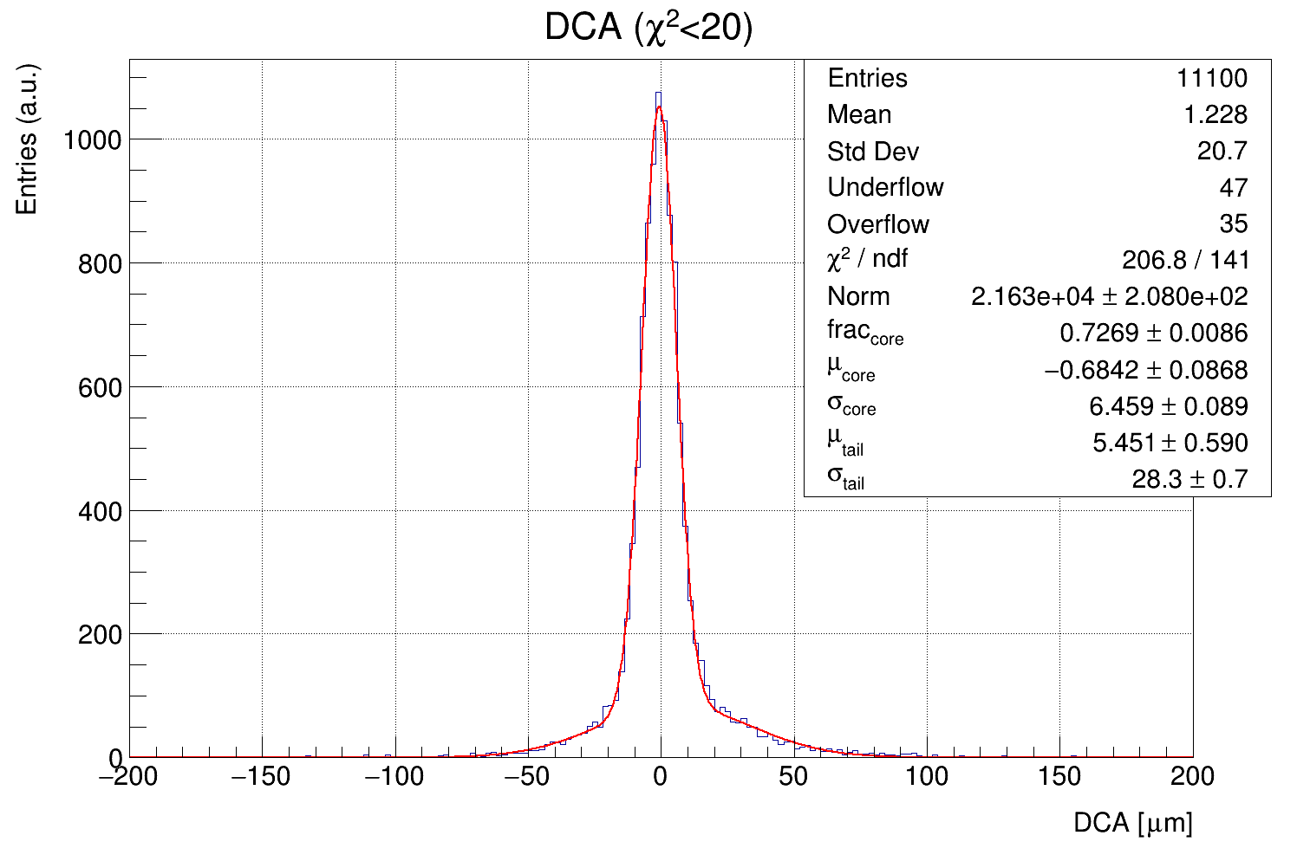
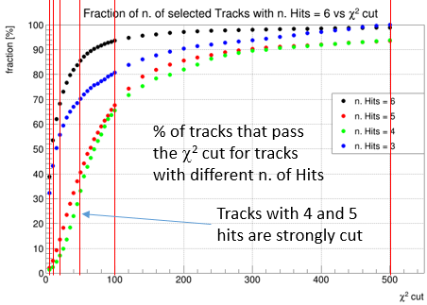
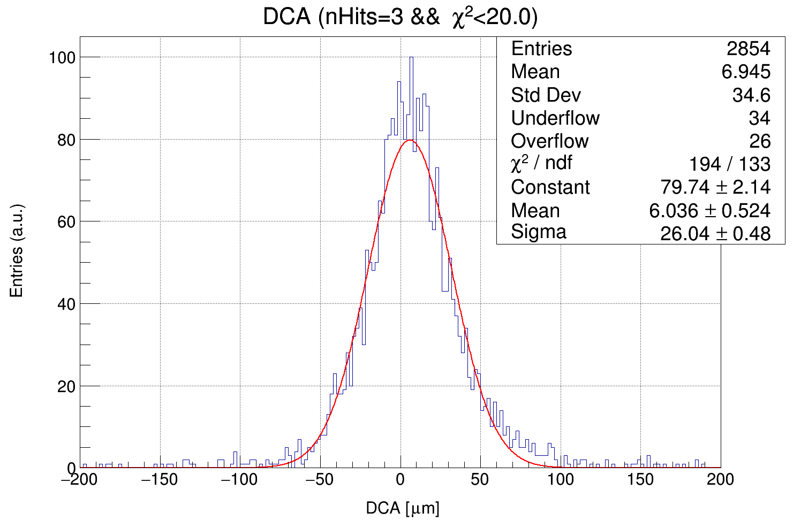
Remainder and Status
Open questions:
why the DCA of tracks with 3 hits is significantly shifted?
why the quality (χ²/p-val) of the tracks with 4 and 5 hits is worst?

Slide 3
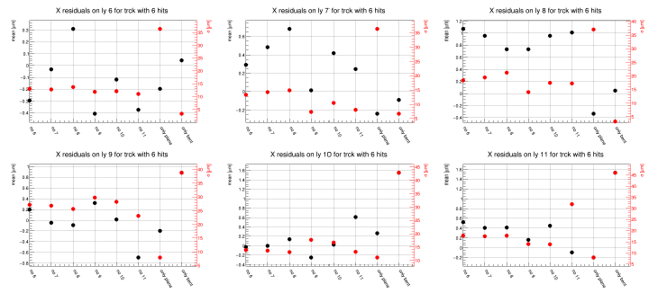
Remainder and Status
It seems that there is a residual misalignment, especially between bent and plane layers.
X Residuals distributions per layers for Tracks with p-val>0 and nHit=6

Slide 4
New additional alignment method
We decided to introduce a new alignment procedure to try to refine the reached alignment.
The method works outside of Corryvreckan as ROOT macro:
Take the reconstructed tracks (eventually applying some quality cuts)
One or more layers can be excluded from the track fitting
One or more layers can be selected to be aligned
The tracks are fitted with the selected layers
The geometrical properties of the layers that have to be aligned are updated
The tracks are re-fitted
The global χ² of the tracks or a global probability is evaluated
Step 4-7 are repeated iteratively up to a minimum/maximum of the χ²/probability is reached (χ² or ML method can be used)

Slide 5
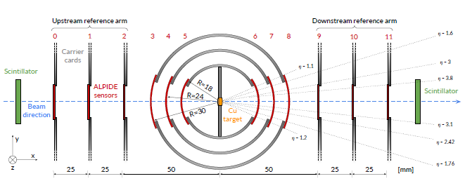
New additional alignment method
Layer geometrical properties:
sensors “general” positioning is assume to be already resolved, the movements are applied starting from their nominal positions
For bent layer their radius can be modified
Layers can rotate respect to their nominal center around X, Y and Z axes
Layers centers offsets (X,Y,Z) can be added
y
x
y
x
y
x
y
x
y
x
y
x
y
x
z
z
z
z
z
z
z
y
x
z

Slide 6
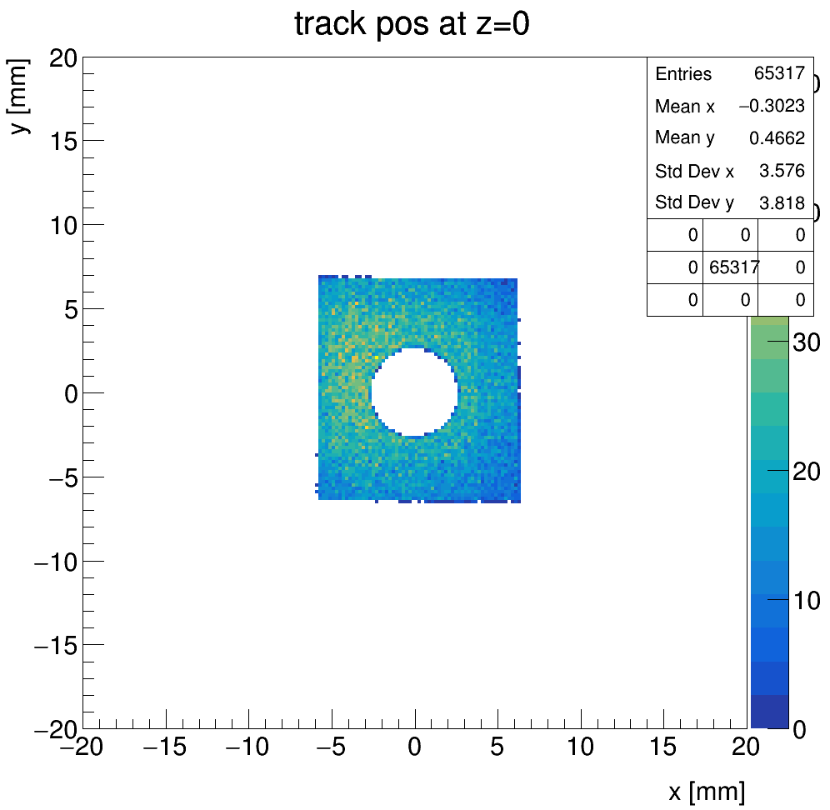
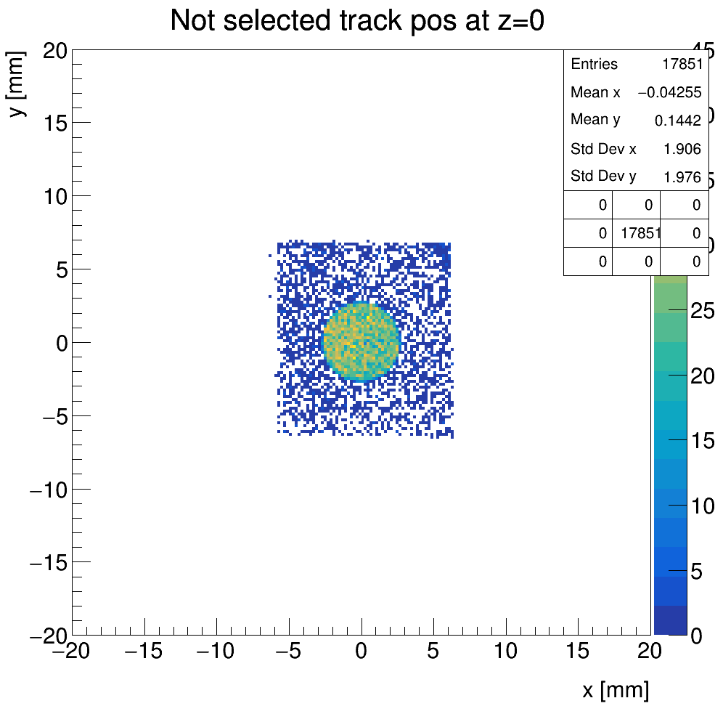
Re-alignment of the alignment data set
To align the system a set of about 92200 single track events were used
Check of the current alignment status:
to don’t bais the residual, the tracks are fitted by using only the flat layers and the following selection criteria are used:
p-val > 5%
η > 8
d(z=0) > 2.7 mm (to avoid the target)
selected
not selected

Slide 7
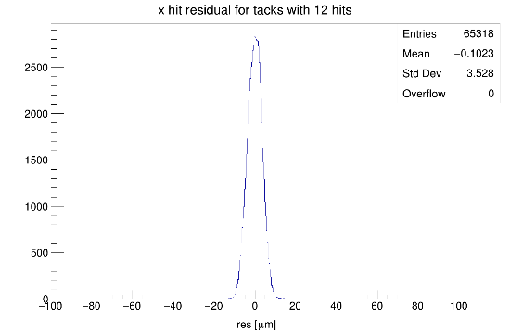
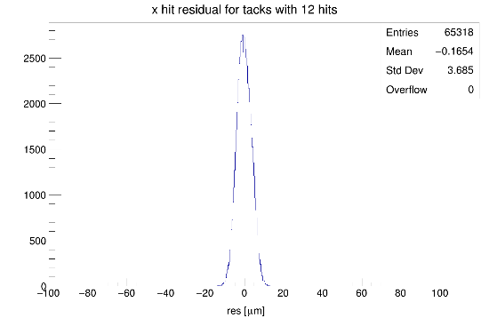
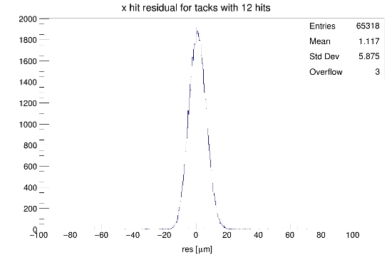
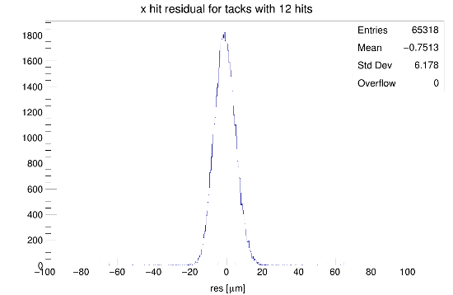
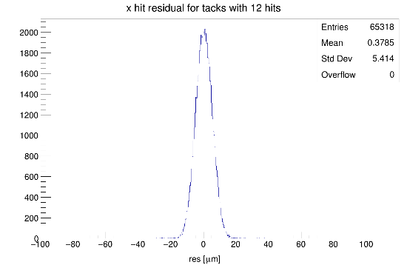
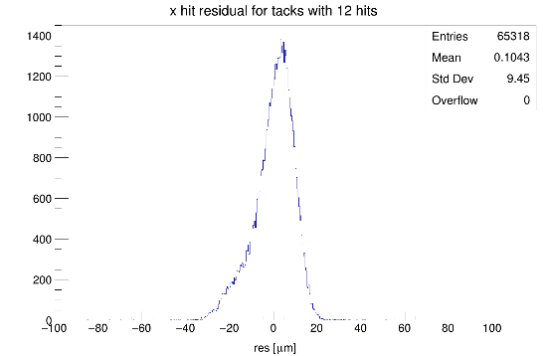
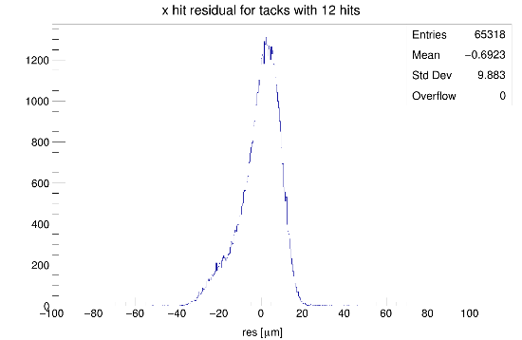
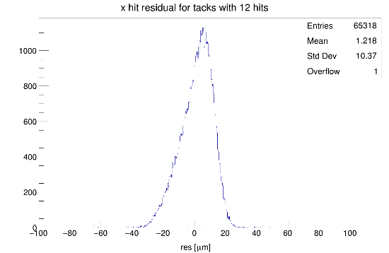
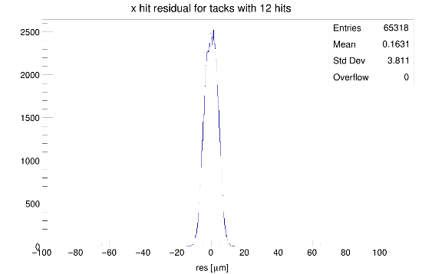
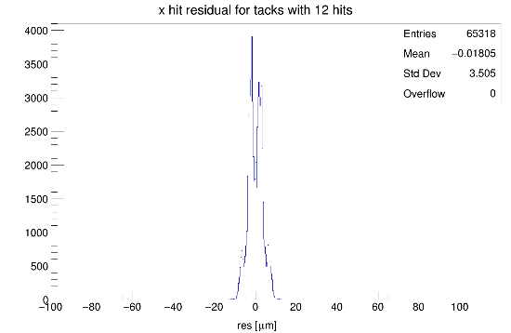
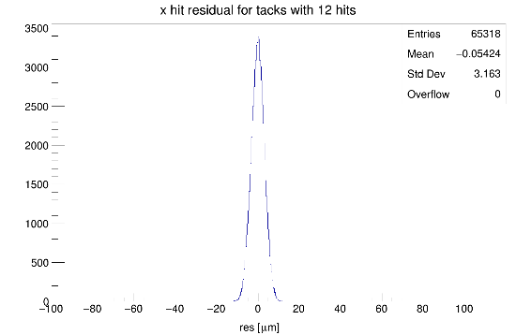
Re-alignment of the alignment data set: check
Residuals on X
1
2
3
4
5
6
7
8
9
10
11
12

Slide 8
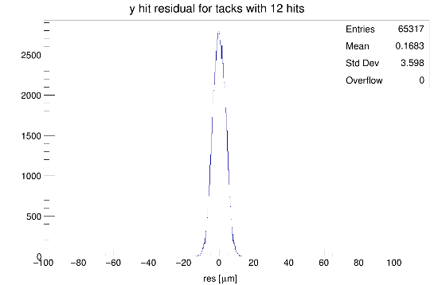
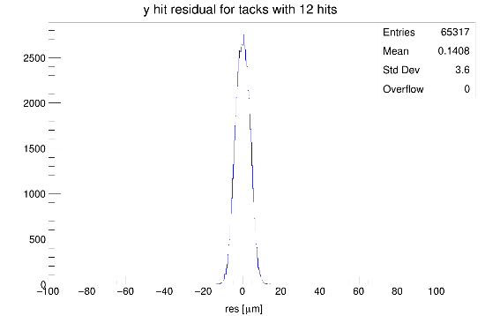
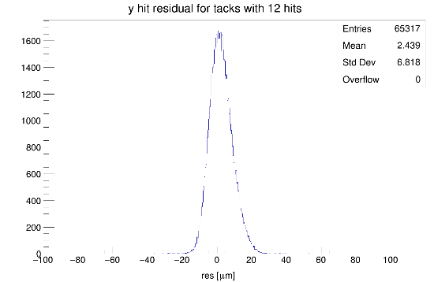
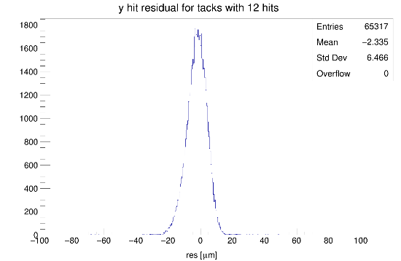
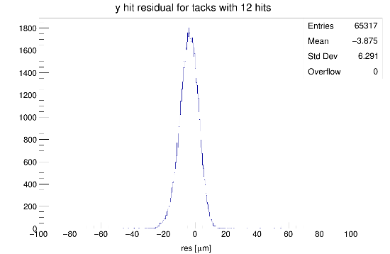
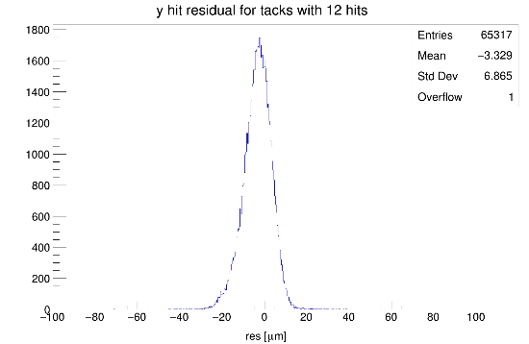
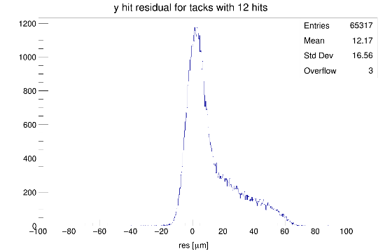
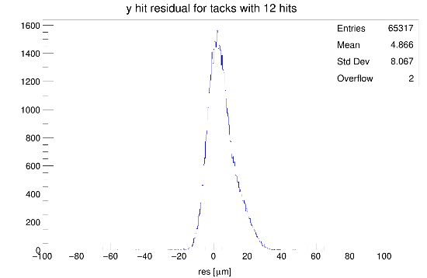
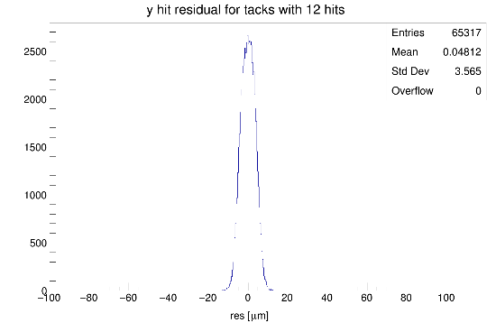
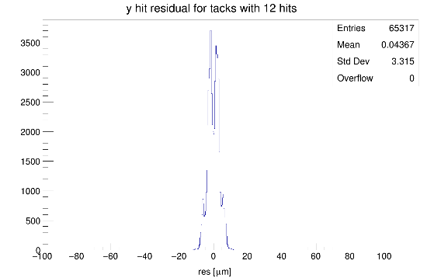
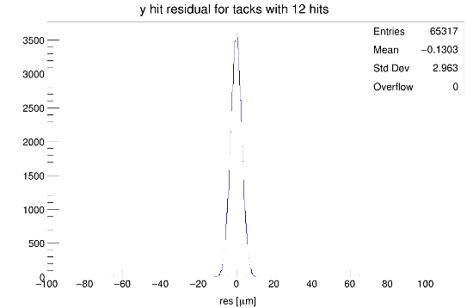
Re-alignment of the alignment data set: check
Residuals on Y
1
2
3
4
5
6
7
8
9
10
11
12

Slide 9
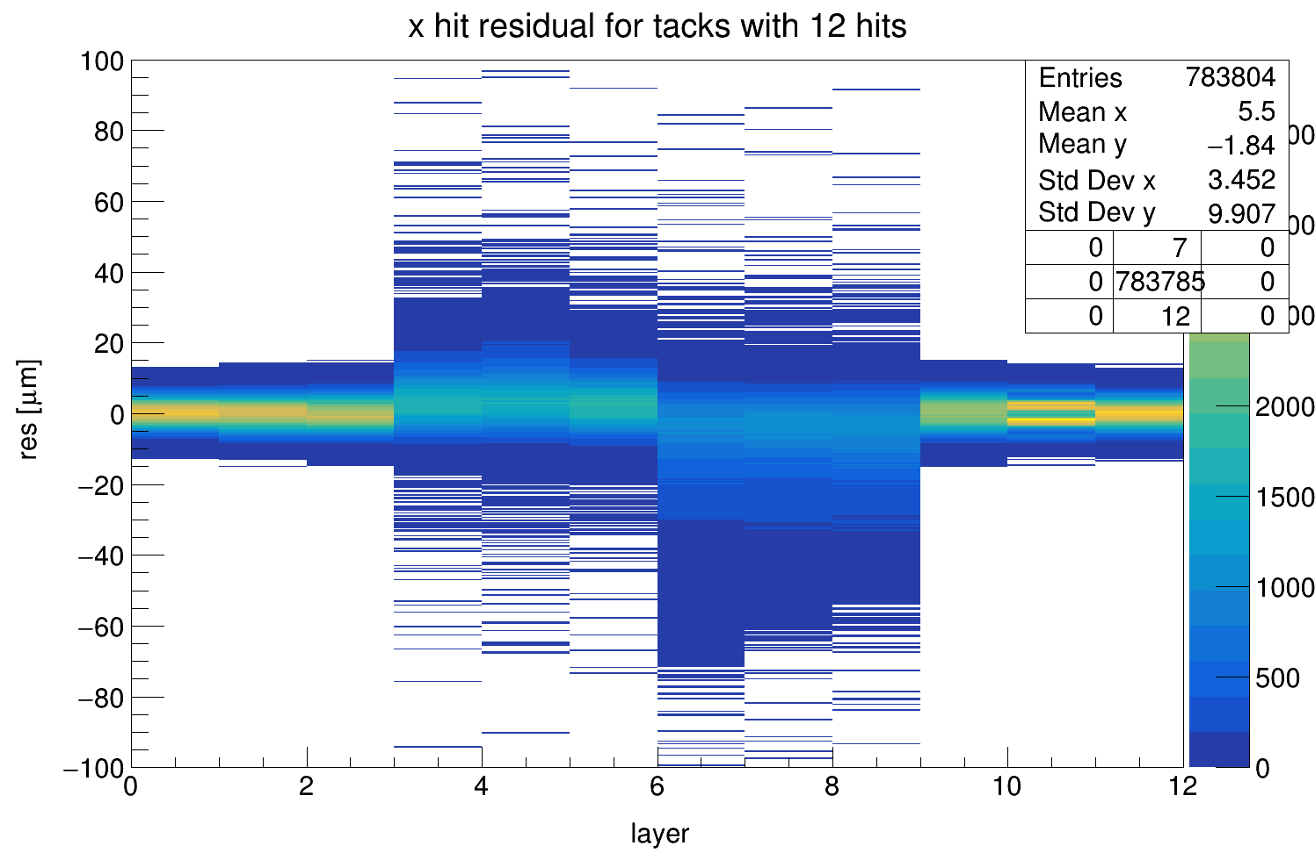
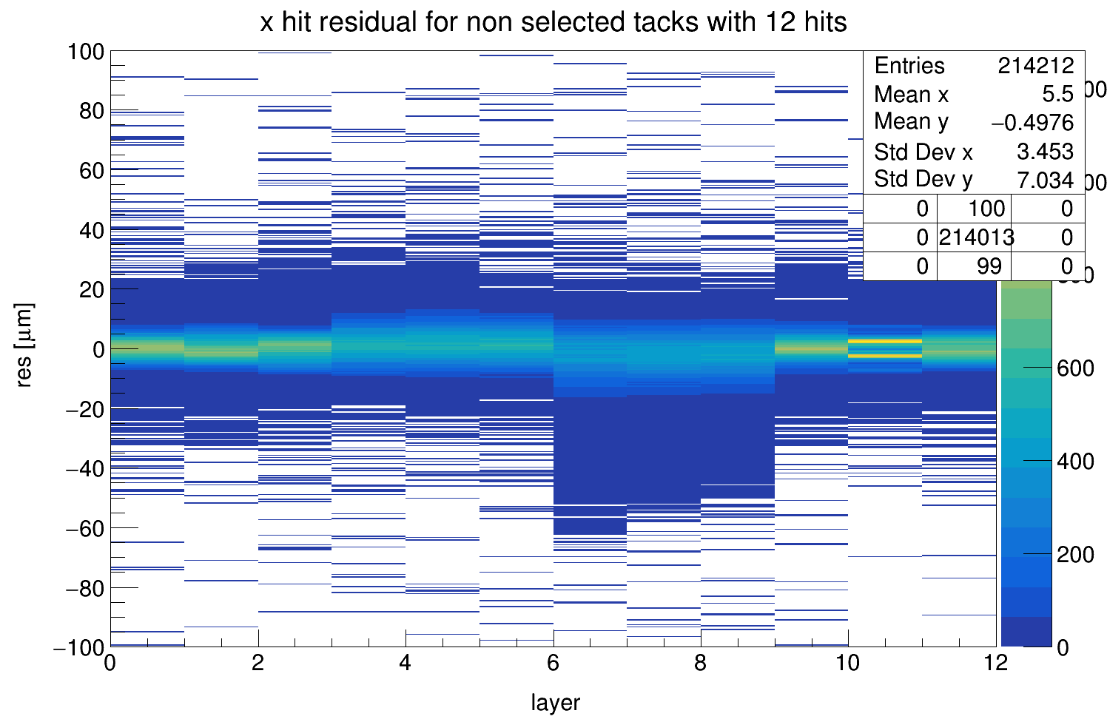
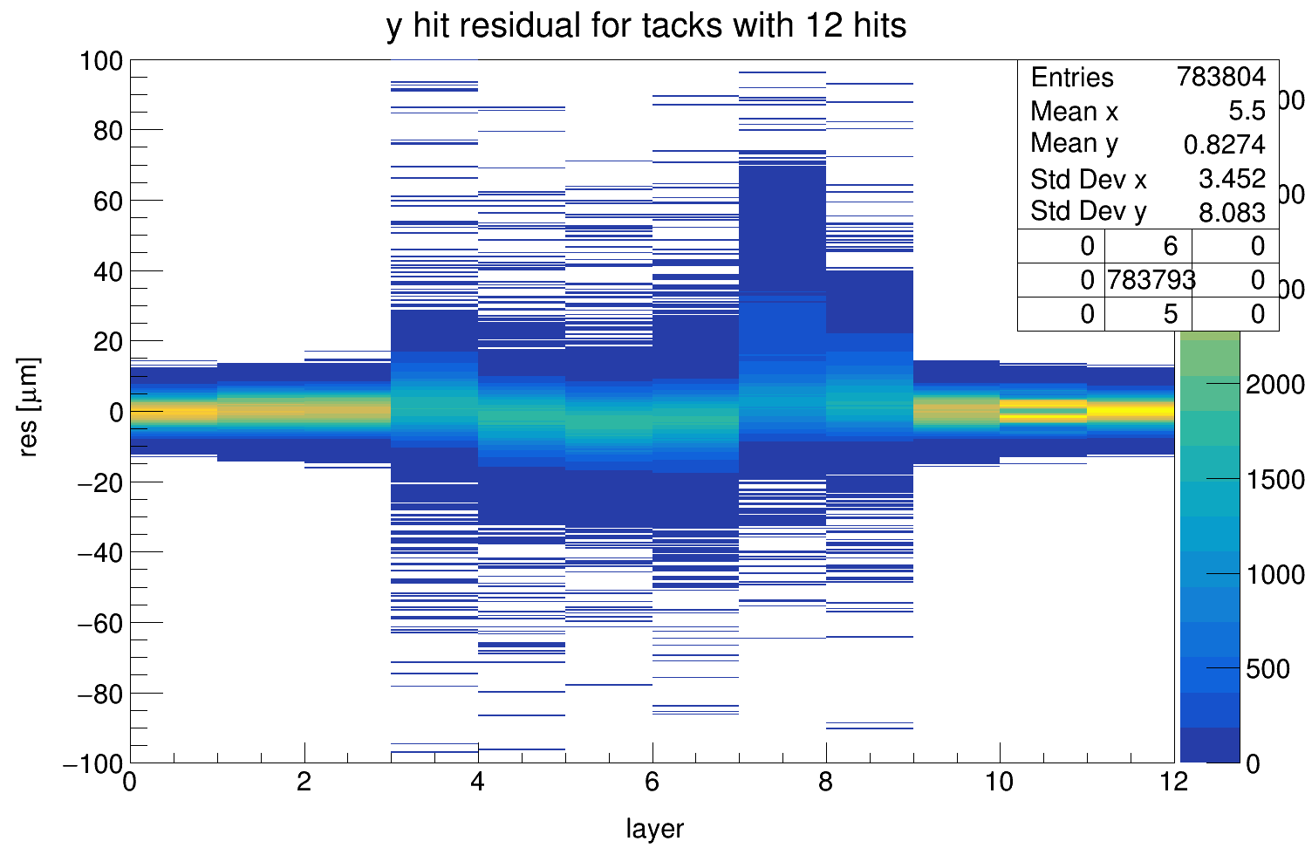
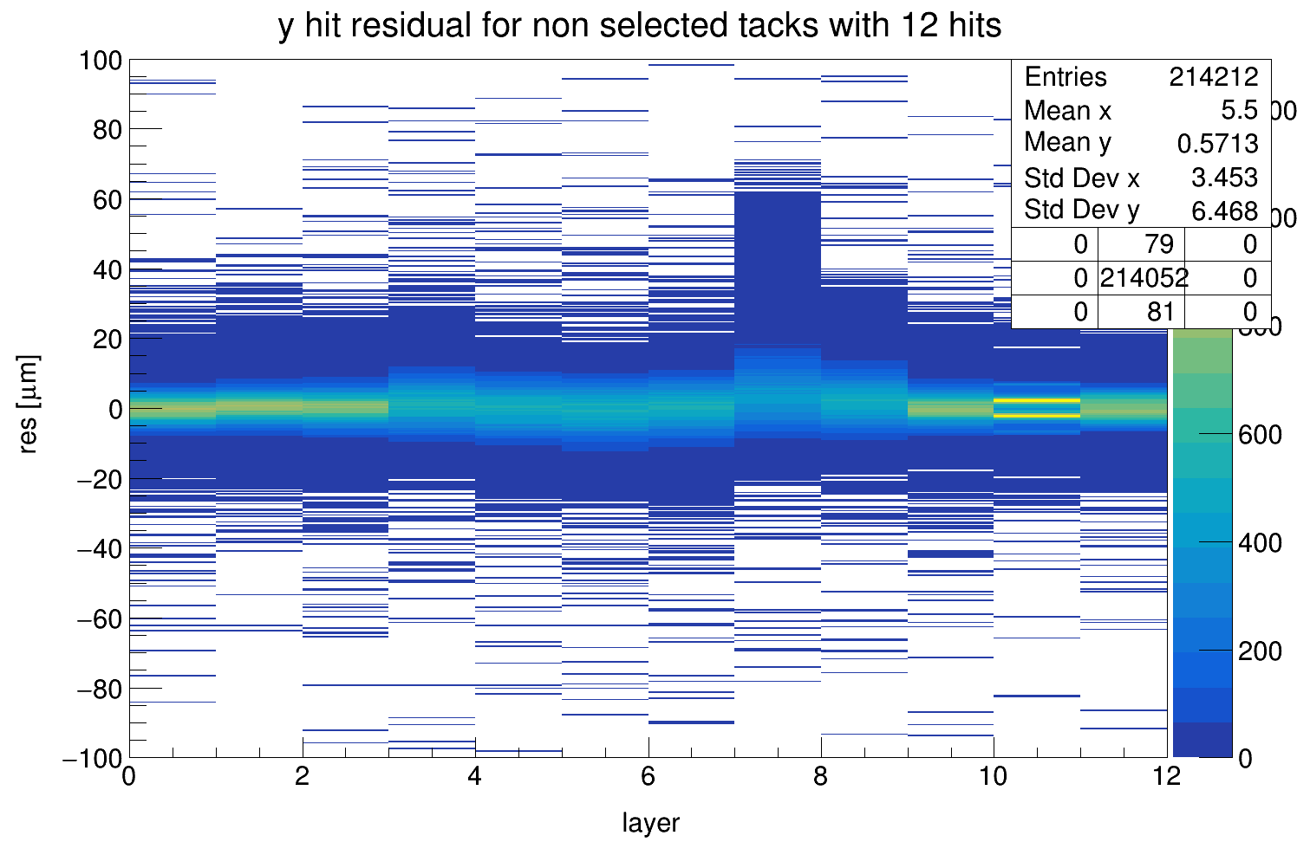
Re-alignment of the alignment data set: check
selected
not selected

Slide 10
Re-alignment of the alignment data set: check
To proceed with the second alignment the first alignment data are needed to be able to transform the hits in their sensor local frame
[ALPIDE_0]
orientation = -0.096658deg,0.0261269deg,0.482201deg
position = 9.331um,6.744um,-100mm
[ALPIDE_1]
orientation = 0.0147823deg,-0.00435448deg,-0.145245deg
position = -952.535um,-93.781um,-75mm
[ALPIDE_2]
orientation = 0.00802141deg,0.00429718deg,-0.294443deg
position = -814.475um,106.285um,-50mm
[ALPIDE_3]
orientation = 0.0148396deg,-0.00836518deg,90.0387deg
position = 910.03um,1.55357mm,-30mm
[ALPIDE_4]
orientation = 0.027903deg,1.48104deg,89.9099deg
position = 1.1072mm,385.58um,-24mm
[ALPIDE_5]
orientation = -0.974659deg,2.48566deg,89.9272deg
position = 826.939um,470.953um,-18mm
[ALPIDE_6]
orientation = 0.0591292deg,180.104deg,90.9439deg
position = -355.875um,1.23141mm,18mm
[ALPIDE_7]
orientation = -0.0609054deg,180.097deg,90.762deg
position = -648.574um,2.26835mm,24mm
[ALPIDE_8]
orientation = -0.00332316deg,180deg,90.0485deg
position = -104.285um,1.83396mm,30mm
[ALPIDE_9]
orientation = -0.0662339deg,0.111841deg,-0.5674deg
position = -2.48536mm,313.481um,50mm
[ALPIDE_10]
orientation = -0.0642286deg,0.120378deg,-0.55617deg
position = -2.89125mm,462.662um,75mm
[ALPIDE_11]
orientation = -0.0636556deg,0.132296deg,-0.510906deg
position = -3.55659mm,202.39um,100mm
The highlight rotations are needed to define the nominal position of the sensors, we don’t need it for the second alignment step

Slide 11
Re-alignment of the alignment data set: check
To proceed with the second alignment the first alignment data are needed to be able to transform the hits in their sensor local frame
A new custom data format has been adopted, it should be equivalent to the previous data positioning apart from the rotation for the nominal positioning. Note:
1e30 default value to flag the flat layers
position step of 1um
Rotation step of 1°/1000
#Id Radi[mm] Cx[mm] Cy[mm] Cz[mm] Rx[deg] Ry[deg] Rz[deg]
0 1e30 0.009 0.007 -100.000 -0.097 0.026 0.482
1 1e30 -0.952 -0.094 -75.000 0.015 -0.004 -0.145
2 1e30 -0.814 0.106 -50.000 0.008 0.004 -0.294
3 -30.0 0.910 1.554 0.000 0.015 -0.008 0.039
4 -24.0 1.107 0.386 0.000 0.028 1.481 -0.090
5 -18.0 0.827 0.471 0.000 -0.975 2.486 -0.073
6 18.0 -0.356 1.231 0.000 0.059 0.104 0.944
7 24.0 -0.649 2.268 0.000 -0.061 0.097 0.762
8 30.0 -0.104 1.834 0.000 -0.003 0.000 0.048
9 1e30 -2.485 0.313 50.000 -0.066 0.112 -0.567
10 1e30 -2.891 0.463 75.000 -0.064 0.120 -0.556
11 1e30 -3.557 0.202 100.000 -0.064 0.132 -0.511

Slide 12
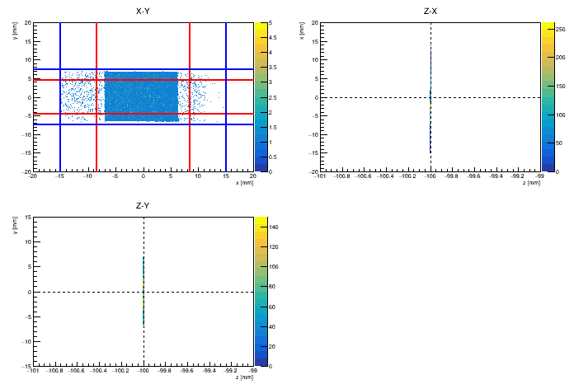
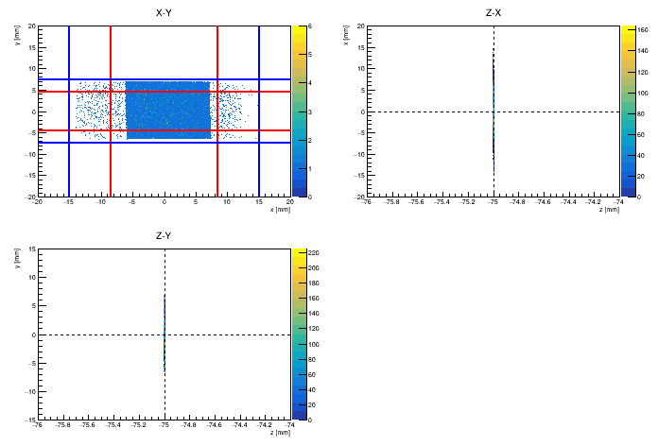
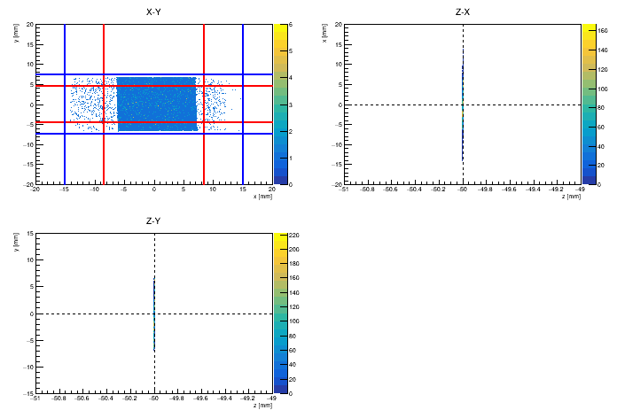
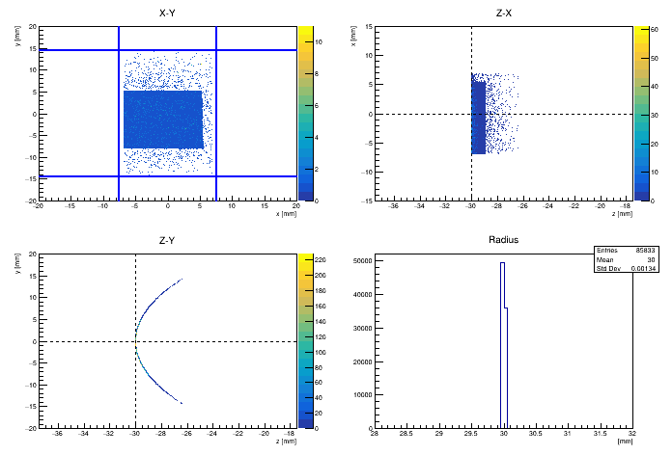
Re-alignment of the alignment data set: check
Check of the invers transformation
Blue: chip nominal limits
Red: flat layers jigs limits

Slide 13
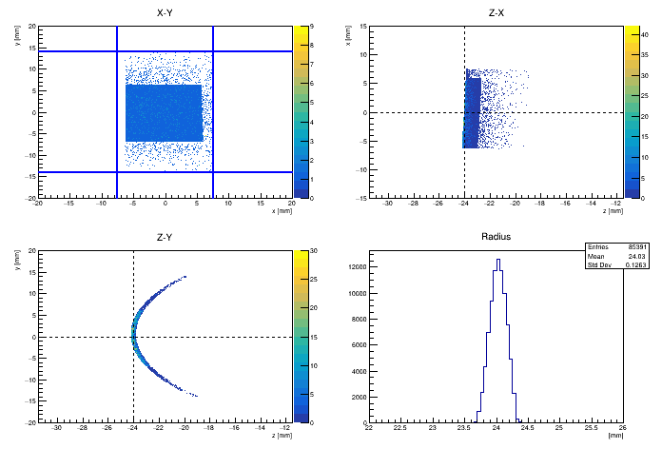
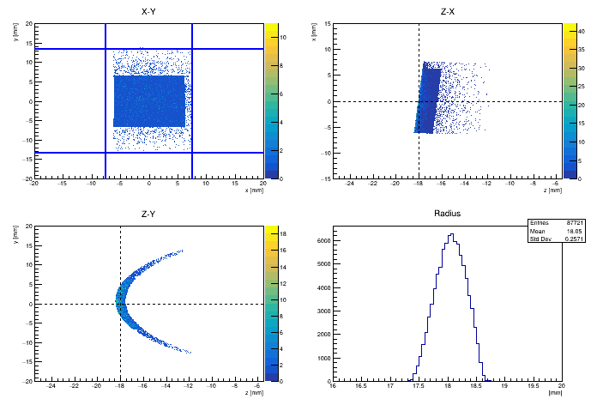
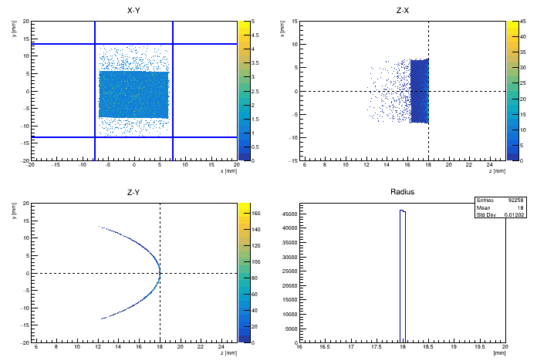
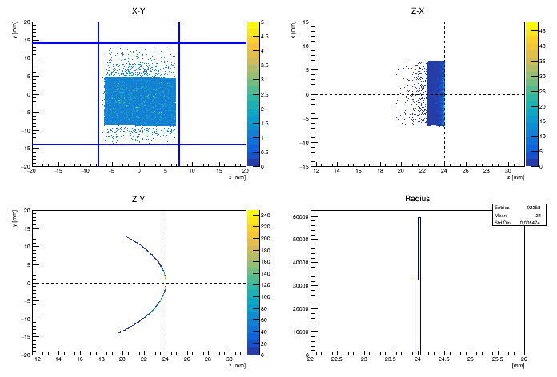
Re-alignment of the alignment data set: check
Check of the invers transformation

Slide 14
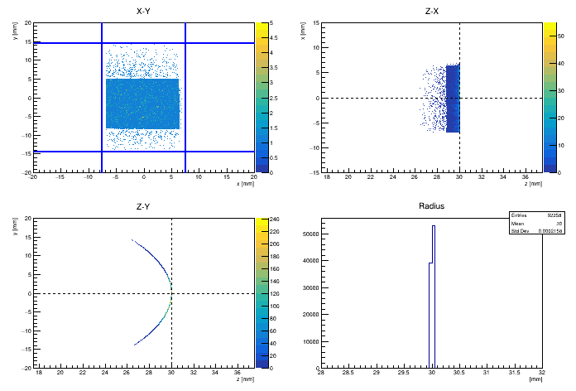
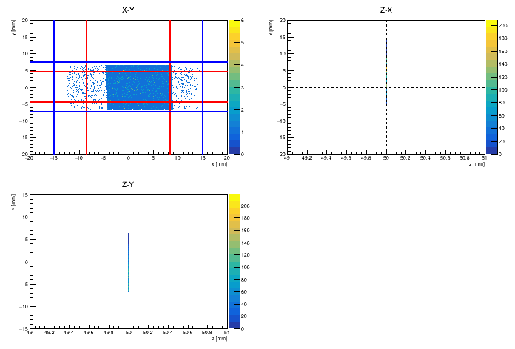
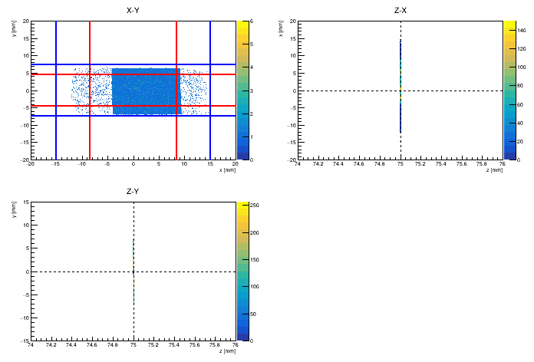
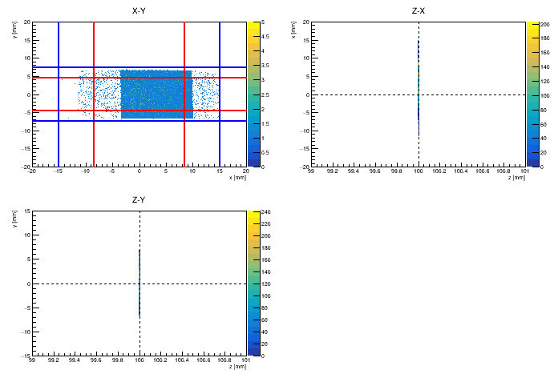
Re-alignment of the alignment data set: check
Check of the invers transformation

Slide 15
Re-alignment of the alignment data set: check
It seems that the inverse transformations are not very well (why? Have the all bent layers been included in the alignment from beginning?):
Some of the bent layer have a residual rotations
Almost all the bent layers have some shift
There are even some problems with the flat layers
The problems with the bent layers have to fixes because the applying rotations starting form a not well centered configuration cause wrong positioning that can be solved by the alignment procedure (The hit radius is calculated by their positon when they are in the sensor frame).
The problems with fat layers can be neglected because they not sensible to the same issue and the alignment can find a solution.
A fixing on the starting transformation is needed:
The fix was done by hand, by correcting the rotation and the position and by checking the hits distributions, e.g. for some bent layers:

Slide 16
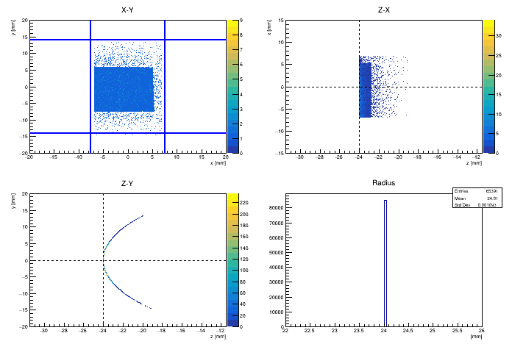
Re-alignment of the alignment data set: check
Check of the invers transformation (layers 5-8 after corrections)

Slide 17
Re-alignment of the alignment data set: check
#Id Radi[mm] Cx[mm] Cy[mm] Cz[mm] Rx[deg] Ry[deg] Rz[deg]
0 1e30 0.009 0.007 -100.000 -0.097 0.026 0.482
1 1e30 -0.952 -0.094 -75.000 0.015 -0.004 -0.145
2 1e30 -0.814 0.106 -50.000 0.008 0.004 -0.294
3 -30.0 0.910 1.554 0.000 0.015 -0.008 0.039
4 -24.0 1.107 0.386 0.000 0.028 1.481 -0.090
5 -18.0 0.827 0.471 0.000 -0.975 2.486 -0.073
6 18.0 -0.356 1.231 0.000 0.059 0.104 0.944
7 24.0 -0.649 2.268 0.000 -0.061 0.097 0.762
8 30.0 -0.104 1.834 0.000 -0.003 0.000 0.048
9 1e30 -2.485 0.313 50.000 -0.066 0.112 -0.567
10 1e30 -2.891 0.463 75.000 -0.064 0.120 -0.556
11 1e30 -3.557 0.202 100.000 -0.064 0.132 -0.511
Form Cory:
#Id Radi[mm] Cx[mm] Cy[mm] Cz[mm] Rx[deg] Ry[deg] Rz[deg]
0 1e30 0.009 0.007 -100.000 -0.097 0.026 0.482
1 1e30 -0.952 -0.094 -75.000 0.015 -0.004 -0.145
2 1e30 -0.814 0.106 -50.000 0.008 0.004 -0.294
3 -30.0 0.910 1.554 0.000 0.015 0.015 0.039
4 -24.0 1.107 1.000 0.000 0.028 0.020 -0.090
5 -18.0 0.827 1.271 0.000 -0.975 -0.970 -0.073
6 18.0 -0.356 1.200 0.000 0.059 -0.045 0.944
7 24.0 -0.649 2.220 0.000 -0.061 0.061 0.762
8 30.0 -0.104 1.834 0.000 -0.003 0.002 0.048
9 1e30 -2.485 0.313 50.000 -0.066 0.112 -0.567
10 1e30 -2.891 0.463 75.000 -0.064 0.120 -0.556
11 1e30 -3.557 0.202 100.000 -0.064 0.132 -0.511
Cory Fixed:

Slide 18
Re-alignment of the alignment data set
The new alignment was performed in steps:
The flat layers are well aligned so they are used as references in the first steps;
The alignment is performed to fit layers rotations and C_{x} and C_{y};
Using only the first 5000 events, each single bent layer are aligned one by one respect to the flat layers. After all the bent layers are aligned all together;
A second iteration of the alignment of the bent layers (as before) is repeated using the second 5000 events starting from the configuration found in step 1;
A third iteration of the alignment of all the layers, one by one, and after all together, are aligned using the second 10000 events starting from the configuration found in step 2.
A final refinement of the layers offsets is performed by hand (not strictly needed)
The residuals are evaluated even respect to the tracks fitted with all the layers after the alignment.

Slide 19
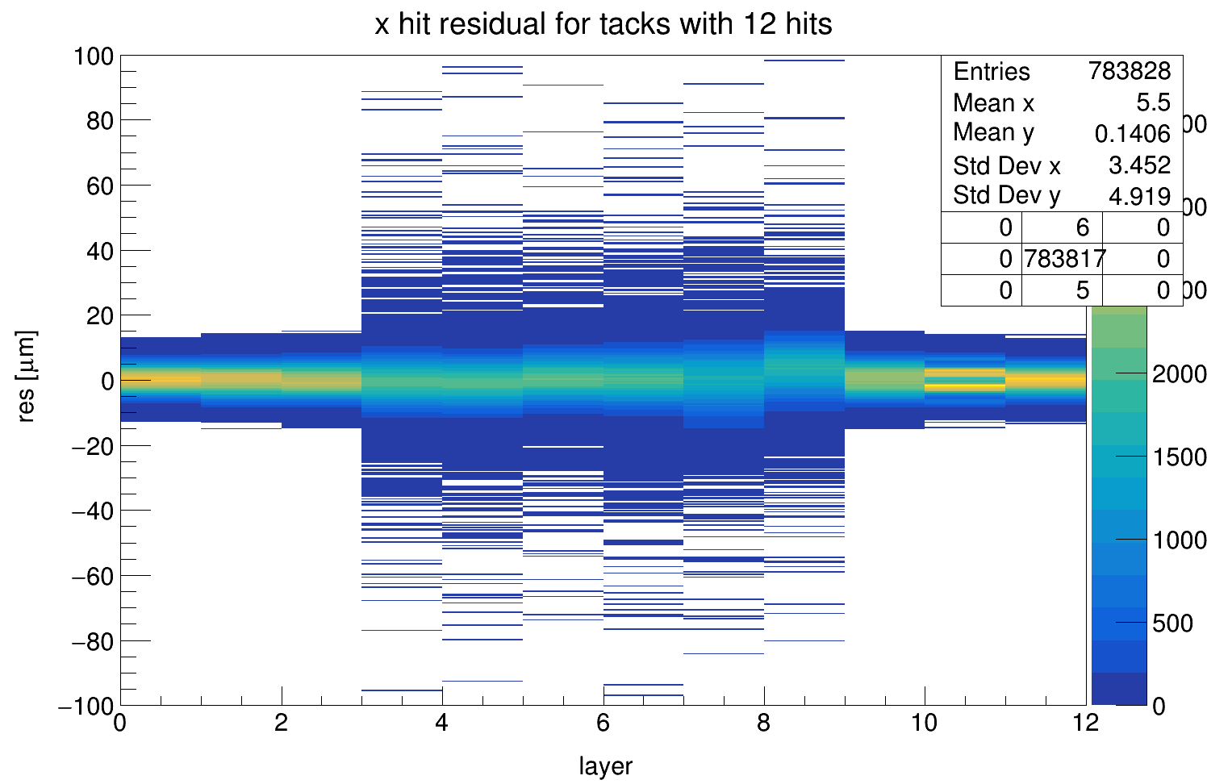
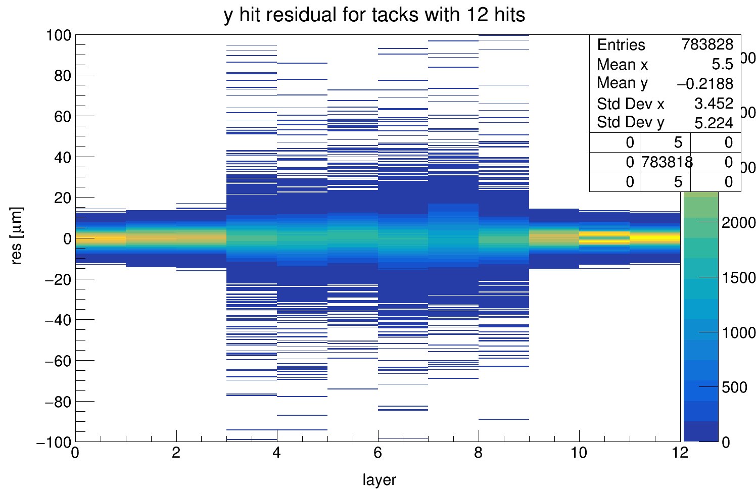
Re-alignment of the alignment data set
Cory
Step 1

Slide 20
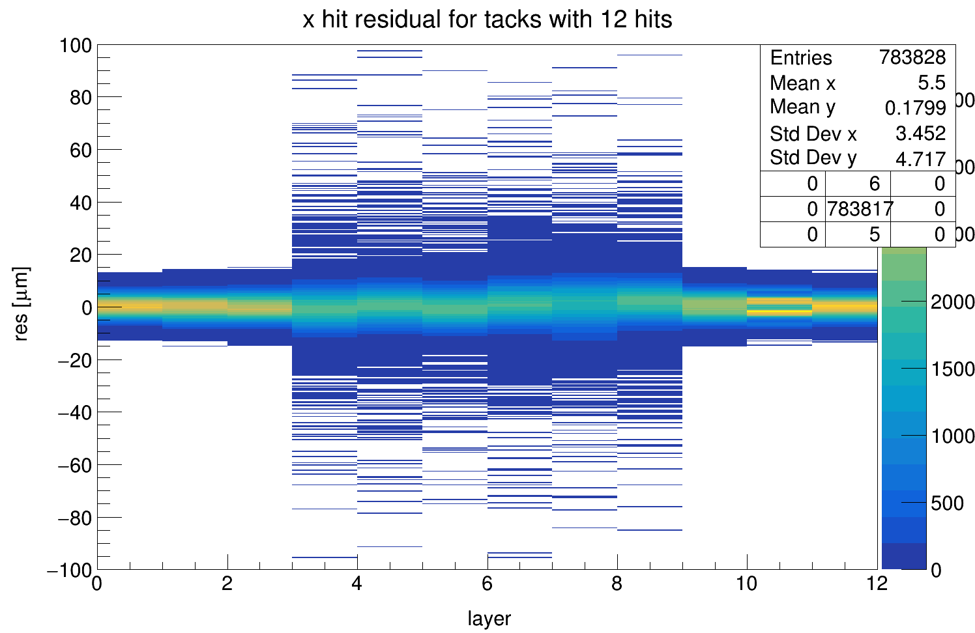
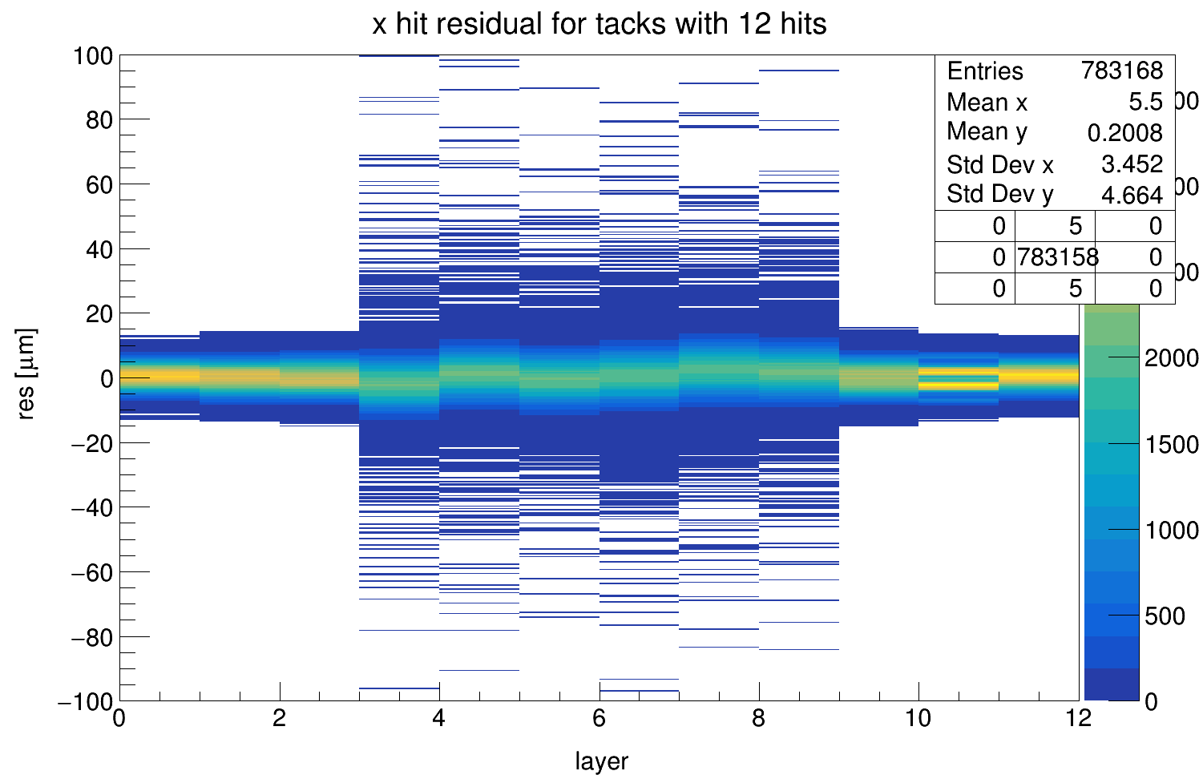
Re-alignment of the alignment data set
Step 2
Step 3

Slide 21
Re-alignment of the alignment data set
Step 4
Step 5

Slide 22
Re-alignment of the alignment data set (Step 4)
Residuals on X
1
2
3
4
5
6
7
8
9
10
11
12

Slide 23
Re-alignment of the alignment data set (Step 4)
Residuals on Y
1
2
3
4
5
6
7
8
9
10
11
12

Slide 24
Re-alignment of the alignment data set
#Id Radi[mm] Cx[mm] Cy[mm] Cz[mm] Rx[deg] Ry[deg] Rz[deg]
0 1e30 0.009 0.007 -100.000 -0.097 0.026 0.482
1 1e30 -0.952 -0.094 -75.000 0.015 -0.004 -0.145
2 1e30 -0.814 0.106 -50.000 0.008 0.004 -0.294
3 -30.0 0.910 1.554 0.000 0.015 0.015 0.039
4 -24.0 1.107 1.000 0.000 0.028 0.020 -0.090
5 -18.0 0.827 1.271 0.000 -0.975 -0.970 -0.073
6 18.0 -0.356 1.200 0.000 0.059 -0.045 0.944
7 24.0 -0.649 2.220 0.000 -0.061 0.061 0.762
8 30.0 -0.104 1.834 0.000 -0.003 0.002 0.048
9 1e30 -2.485 0.313 50.000 -0.066 0.112 -0.567
10 1e30 -2.891 0.463 75.000 -0.064 0.120 -0.556
11 1e30 -3.557 0.202 100.000 -0.064 0.132 -0.511
Cory Fixed:
#Id Radi[mm] Cx[mm] Cy[mm] Cz[mm] Rx[deg] Ry[deg] Rz[deg]
0 1e+30 0.009 0.007 -100.000 -0.097 0.029 0.481
1 1e+30 -0.952 -0.094 -75.000 0.760 -0.766 -0.150
2 1e+30 -0.814 0.106 -50.000 1.476 0.158 -0.288
3 -30.00 0.520 1.123 0.000 0.841 -0.730 0.020
4 -24.00 0.771 1.068 0.000 -0.131 -0.783 -0.112
5 -18.00 0.717 1.363 0.000 -1.262 -1.320 -0.083
6 18.00 0.215 1.322 0.000 0.414 -1.873 0.967
7 24.00 0.036 1.333 0.000 -2.206 -1.542 0.802
8 30.00 1.093 1.242 0.000 -1.143 -2.288 0.070
9 1e+30 -2.485 0.313 50.000 -1.786 -0.789 -0.556
10 1e+30 -2.891 0.462 75.000 -1.885 -0.661 -0.544
11 1e+30 -3.556 0.202 100.000 -2.442 -0.824 -0.489
Step 4:

Slide 25
Re-alignment of the alignment data set
Step 4 - Cory Fixed:
#Id Cx[mm] Cy[mm] Cz[mm] Rx[deg] Ry[deg] Rz[deg]
0 0 0 0 0 0.003 -0.001
1 0 0 0 0.745 -0.762 -0.005
2 0 0 0 1.468 0.154 0.006
3 -0.39 -0.431 0 0.826 -0.745 -0.019
4 -0.336 0.068 0 -0.159 -0.803 -0.022
5 -0.11 0.092 0 -0.287 -0.35 -0.01
6 0.571 0.122 0 0.355 -1.828 0.023
7 0.685 -0.887 0 -2.145 -1.603 0.04
8 1.197 -0.592 0 -1.14 -2.29 0.022
9 0 0 0 -1.72 -0.901 0.011
10 0 -0.001 0 -1.821 -0.781 0.012
11 0.001 0 0 -2.378 -0.956 0.022

Slide 26
Re-alignment of the alignment data set
20000 events over 92200 were used to perform the new alignment;
The residuals of all the layers are all good Gaussian distributions;
The resolutions of the bent layer respect to the tracks defined only with the flat layers is about 5 um;
The resolutions of all the layers respect to the tracks defined with the all layers is about 3 um;
(can we use the 72200 events to measure the single hit resolution?)
the results even in the target region are compatible

Slide 27
New alignment with “interaction” data set
The new alignment is applied to the “interaction” data set
In the “interaction” data set there are events with remnant beam, by tracking the full track (across the 12 layers) it is possible to check the alignment:
X seems quite good, but which is the problem with Y?

Slide 28
New alignment with “interaction” data set: check
Check of the invers transformation (e.g. layers 5-8)

Slide 29
New alignment with “interaction” data set: check
It is quite good but a little refinement can be done
#Id Radi[mm] Cx[mm] Cy[mm] Cz[mm] Rx[deg] Ry[deg] Rz[deg]
0 1e30 0.009 0.007 -100.000 -0.097 0.026 0.482
1 1e30 -0.952 -0.094 -75.000 0.015 -0.004 -0.145
2 1e30 -0.814 0.106 -50.000 0.008 0.004 -0.294
3 -30.0 0.910 1.554 0.000 0.015 0.015 0.039
4 -24.0 1.107 1.000 0.000 0.028 0.020 -0.090
5 -18.0 0.827 1.271 0.000 -0.975 -0.970 -0.073
6 18.0 -0.356 1.200 0.000 0.059 -0.045 0.944
7 24.0 -0.649 2.220 0.000 -0.061 0.061 0.762
8 30.0 -0.104 1.834 0.000 -0.003 0.002 0.048
9 1e30 -2.485 0.313 50.000 -0.066 0.112 -0.567
10 1e30 -2.891 0.463 75.000 -0.064 0.120 -0.556
11 1e30 -3.557 0.202 100.000 -0.064 0.132 -0.511
Cory Fixed:
#Id Radi[mm] Cx[mm] Cy[mm] Cz[mm] Rx[deg] Ry[deg] Rz[deg]
0 1e30 0.009 0.007 -100.000 -0.097 0.026 0.482
1 1e30 -0.952 -0.094 -75.000 0.015 -0.004 -0.145
2 1e30 -0.814 0.106 -50.000 0.008 0.004 -0.294
3 -30.0 0.910 1.444 0.000 0.015 0.013 0.039
4 -24.0 1.107 0.930 0.000 0.028 0.020 -0.090
5 -18.0 0.827 1.136 0.000 -0.975 -0.970 -0.073
6 18.0 -0.356 1.120 0.000 0.059 -0.061 0.944
7 24.0 -0.649 2.165 0.000 -0.061 0.060 0.762
8 30.0 -0.104 1.750 0.000 -0.003 0.001 0.048
9 1e30 -2.485 0.313 50.000 -0.066 0.113 -0.567
10 1e30 -2.891 0.463 75.000 -0.064 0.120 -0.556
11 1e30 -3.557 0.202 100.000 -0.064 0.132 -0.511
Cory Fixed_1:

Slide 30
New alignment with “interaction” data set
The refinement of the Starting Configuration helps a bit but non enough;
By assuming that the rotations for each layers between the alignment and the «interaction» data sets a new alignment procedure is run over the remnant beam to fit only the Cx and Cy positions of the bent layers:

Slide 31
Re-alignment of the alignment data set
#Id Radi[mm] Cx[mm] Cy[mm] Cz[mm] Rx[deg] Ry[deg] Rz[deg]
0 1e+30 0.009 0.007 -100.000 -0.097 0.029 0.481
1 1e+30 -0.952 -0.094 -75.000 0.760 -0.766 -0.150
2 1e+30 -0.814 0.106 -50.000 1.476 0.158 -0.288
3 -30.00 0.520 1.123 0.000 0.841 -0.730 0.020
4 -24.00 0.771 1.068 0.000 -0.131 -0.783 -0.112
5 -18.00 0.717 1.363 0.000 -1.262 -1.320 -0.083
6 18.00 0.215 1.322 0.000 0.414 -1.873 0.967
7 24.00 0.036 1.333 0.000 -2.206 -1.542 0.802
8 30.00 1.093 1.242 0.000 -1.143 -2.288 0.070
9 1e+30 -2.485 0.313 50.000 -1.786 -0.789 -0.556
10 1e+30 -2.891 0.462 75.000 -1.885 -0.661 -0.544
11 1e+30 -3.556 0.202 100.000 -2.442 -0.824 -0.489
Step 4:
#Id Radi[mm] Cx[mm] Cy[mm] Cz[mm] Rx[deg] Ry[deg] Rz[deg]
0 1e+30 0.009 0.007 -100.000 -0.097 0.029 0.481
1 1e+30 -0.952 -0.094 -75.000 0.762 -0.768 -0.149
2 1e+30 -0.814 0.106 -50.000 1.478 0.160 -0.286
3 -30.00 0.523 1.012 0.000 0.842 -0.728 0.017
4 -24.00 0.771 0.998 0.000 -0.132 -0.785 -0.115
5 -18.00 0.718 1.226 0.000 -1.261 -1.318 -0.080
6 18.00 0.210 1.240 0.000 0.413 -1.874 0.968
7 24.00 0.032 1.277 0.000 -2.206 -1.541 0.802
8 30.00 1.092 1.158 0.000 -1.140 -2.286 0.069
9 1e+30 -2.485 0.313 50.000 -1.788 -0.791 -0.556
10 1e+30 -2.891 0.462 75.000 -1.885 -0.659 -0.544
11 1e+30 -3.556 0.202 100.000 -2.441 -0.825 -0.487
Final for interaction data set:

Slide 32
Impact of the new alignment on the analysis
New Alignment
Original Alignment

Slide 33
Impact of the new alignment on the analysis
New Alignment
Original Alignment
Selection criteria (after preselection in PR: d0<50 mm, tracks selected by p-val):
P-val > 0.001 (0.1%)
η < 7.5
Beam-Track DCA < 500 μm

Slide 34
Impact of the new alignment on the analysis
New Alignment
Original Alignment

Slide 35
Impact of the new alignment on the analysis
New Alignment
Original Alignment

Slide 36
Impact of the new alignment on the analysis
New Alignment
Original Alignment

Slide 37
Impact of the new alignment on the analysis
New Alignment
Original Alignment

Slide 38
Impact of the new alignment on the analysis
New Alignment
Original Alignment

Slide 39
Impact of the new alignment on the analysis
New Alignment
Original Alignment

Slide 40
Impact of the new alignment on the analysis
The new alignment (with some luck) works on the «interaction» data set too:
More tracks are well reconstructed
More tracks with 3 hits pass the quality cuts
The DCA distribution is well centered and there is no more shift of the tails and it is in agreement with simulation
The Y residuals for the 3 hits tracks now are well centered
Open question: why are the bent layers shifted (almost along Y) respect to the alignment data set? The system was touched?

Slide 41
More on the analysis
MC

Slide 42
More on the analysis

Slide 43
More on the analysis
Hit distributions over each layer for track with 3 hits that are rejected

Slide 44
More on the analysis
Hit distributions over each layer for track with 3 hits that are selected

Slide 45
More on the analysis
Hit distributions over each layer for track with 4 hits that are rejected

Slide 46
More on the analysis
Hit distributions over each layer for track with 4 hits that are rejected

Slide 47
More on the analysis
Hit distributions over last layer for track with 5 hits that are rejected

Slide 48
More on the analysis
Hit distributions over last layer for track with 5 hits that are selected

Slide 49
More on the analysis
Hit distributions over last layer for track with 6 hits that are rejected

Slide 50
More on the analysis
Hit distributions over last layer for track with 6 hits that are selected

Slide 51
More on the analysis
The hole in the h distribution around 3-4 is due to a strong dependency of the track quality with the track h for each track kinds (with 3, 4, 5 and 6 hits). It is due to tracks that are hitting the jigs of the flat layers.
The Vertex z positions has «negligible» tail:

Slide 52
Single Hit resolution (from alignment data set)
Used the last about 72200 events
Tracks selection criteria:
η > 8
p-val > 0.05
The residuals on a layer are evaluated by fitting the tracks excluding the considered layer
The resolutions on a layer are evaluated by subtracting the extrapolation errors to the residuals

Slide 53
Single Hit resolution (from alignment data set)

Slide 54
Single Hit resolution (from alignment data set)
Residuals on X
1
2
3
4
5
6
7
8
9
10
11
12

Slide 55
Single Hit resolution (from alignment data set)

Slide 56
Single Hit resolution (from alignment data set)
Residuals on Y
1
2
3
4
5
6
7
8
9
10
11
12

