Slide 1

OFFICE OF SCIENCE
US High Energy Physics Program
12th Pisa Meeting on Advanced Detectors
May 22, 2012
Dr. Mike Procario
Office of High Energy Physics
Office of Science, U.S. Department of Energy

Slide 2
Outline
HEP Plans and Priorities
Technology Stewardship
Conclusion

Slide 3
HEP Plans and priorities

Slide 4
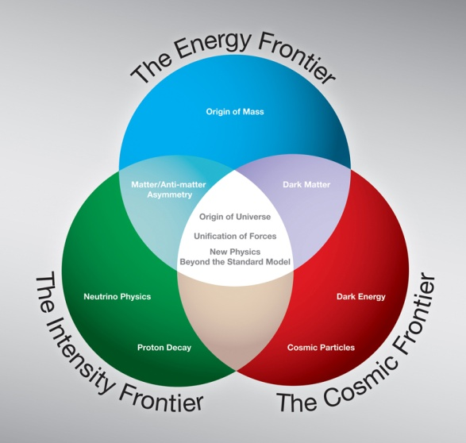
HEP Strategic Plan
Plan is based on High Energy Physics Advisory Panel “P5” report
This is still the plan.
Implementation at the Energy and Cosmic Frontiers is clear
  End of Tevatron
  LHC (+upgrades)
  Dark Matter + Dark Energy
  Implementation at the Intensity
  Frontier has been more challenging
  Funding levels at lower end of P5 Scenarios
  CR uncertainties + “no new starts”
  DUSEL difficulties

Slide 5

Vision for Program Development
Our domestic program is the world leader in ‘Intensity Frontier’ area, and we need to increase investments there, while keeping a balance with the other frontiers
Community is engaged on further developing the science case on all 3 frontiers – we need a healthy portfolio of construction ideas supported by compelling science drivers at achievable budget levels
Our program will deliver science now, in the near term, and in the long term on all 3 frontiers

Slide 6
HEP Priorities for the Next 12 Months
  Develop Mission Need statement for US participation in LHC detector upgrades
  Make critical decisions on Long Baseline Neutrino Experiment
  Issue solicitation for R&D leading to Next Generation Dark Matter Experiments and make selections
  Develop strategic plans for Intensity Frontier and Accelerator R&D programs

Slide 7
Energy Frontier
Near-term Science goal :
  Discover the Higgs or whatever takes its place. Is there just one?
Recent results
  LHC + Tevatron have ruled out most of the interesting Higgs mass range
  Tevatron run is completed, final data analyses are underway
  LHC will run thru 2012, then shutdown to achieve full energy (14 TeV)
No new facilities under construction at this time
  Program is centered in Europe (CERN) for the next 10+ years
Planned program of major projects:
  LHC Upgrades Phase I : (2017-2018) to cope with increased data rates
  LHC Upgrades Phase II: (2021+) factor of 10 increased luminosity
  Future evolution (>2025) will depend on results in the next few years:
    If New Physics can be accessed at ~TeV energy, e+e- or mu+mu- collider (?)
    If not, long program of LHC exploitation (+ LHC energy upgrade?)

Slide 8
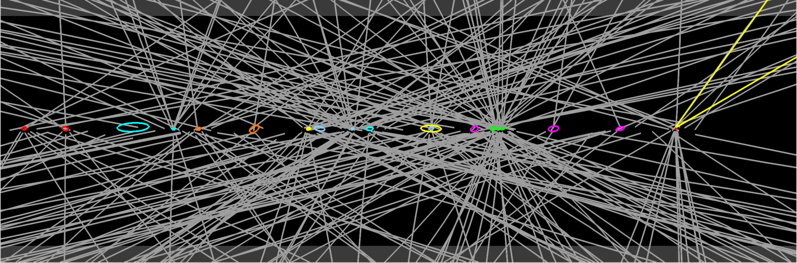
Priorities: Developing a Mission Need Statement
HEP will work with the collaborations and CERN to understand the impact of the CERN LHC upgrades on detectors:
  What are the critical needs for detector upgrades?
  What responsibilities does CERN want the US to take on?
  In what technical areas does the US possess leading or unique capabilities?
Analyze the schedule needed to deliver upgraded detector components.
Develop a cost estimate and plan to have the funding available in the HEP budget.
Goal is to complete a Mission Need Statement in FY 2012 for the near-term upgrades that keep the detectors running smoothly
ATLAS Z→μμ event with 20 reconstructed vertices

Slide 9
Intensity Frontier
Near-term Science goals :
  Implement comprehensive program to understand neutrino mixing
  Deliver much improved limits (measurements?) of charged lepton mixing and hidden sector phenomena
Recent results (see following slide)
  Daya Bay discovers third kind of neutrino mixing (and its large!)
  Various “hints” of additional neutrino species, anomalous interactions?
New facilities under construction:
  NuMI upgrade + NOvA; reactor experiments commissioning
Planned program of major projects:
  Mu2e to explore charged lepton mixing (2018-2022)
  LBNE to make definitive measurements of neutrino properties (2021+)
Must upgrade domestic facilities to maintain US leadership

Slide 10
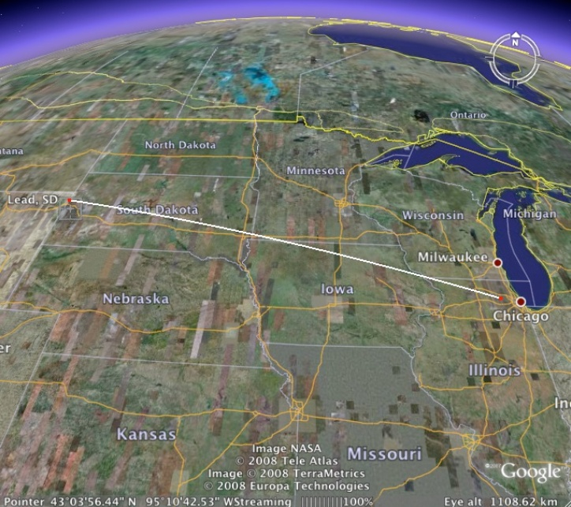
Current Intensity Frontier Facilities
NOvA
(off-axis)
MINOS (on-axis
NSF’s proposed
Underground Lab.
DUSEL
735 km
1300 km
MiniBooNE
SciBooNE
MINERvA

Slide 11
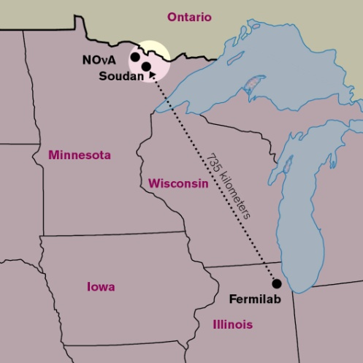
The Neutrino Physics Program
Neutrinos from the Main Injector (NuMI) is the most intense neutrino beamline in the world.
Key future experiments:
NuMI Off-Axis Electron Neutrino Experiment (NOvA) –NOvA will provide precision measurements of neutrino mixing and will determine the relative masses of neutrinos. Operations are planned to begin in 2013.
Long Baseline Neutrino Experiment (LBNE) – Like NOvA, the specific design will be determined by the results of currently active experiments. LBNE should be sensitive to differences between neutrinos and antineutrinos to test our assumptions about the symmetries between matter and antimatter and will deliver more precise measurements of neutrino mixing.
The trajectory of the NuMI beam and far detectors
The NuMI horn, part of the neutrino sources

Slide 12
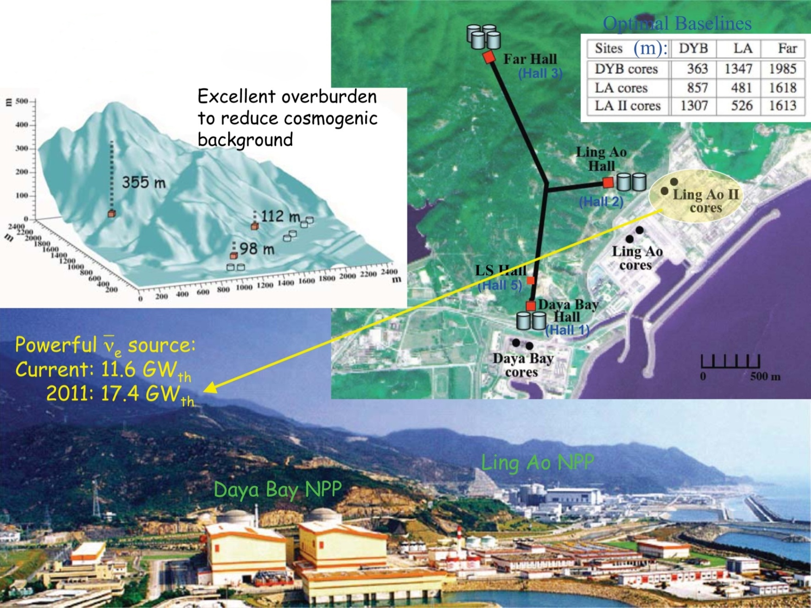
Reactor Neutrino Detector at Daya Bay

Slide 13
Priorities : LBNE Decisions
The Office of Science charged a review to examine cost-effective options to do underground science.
Report was delivered in June 2011. Main findings relative to LBNE:
  Cost estimates need more work.
  Making a technology choice should be done soon to reduce costs of developing two technologies.
Project team was charged to develop a technology choice and refine the cost estimates.
  The project team has recommended a technology.
  Fermilab and DOE concurred with that recommendation.
Currently asking Fermilab to examine phased/staged options
  Explore alternatives to achieve a significant fraction of the science goals of LBNE in a different configuration with significantly reduced cost.
  Workshop on options was held in April at Fermilab.
  Report due from the lab by July 1.

Slide 14
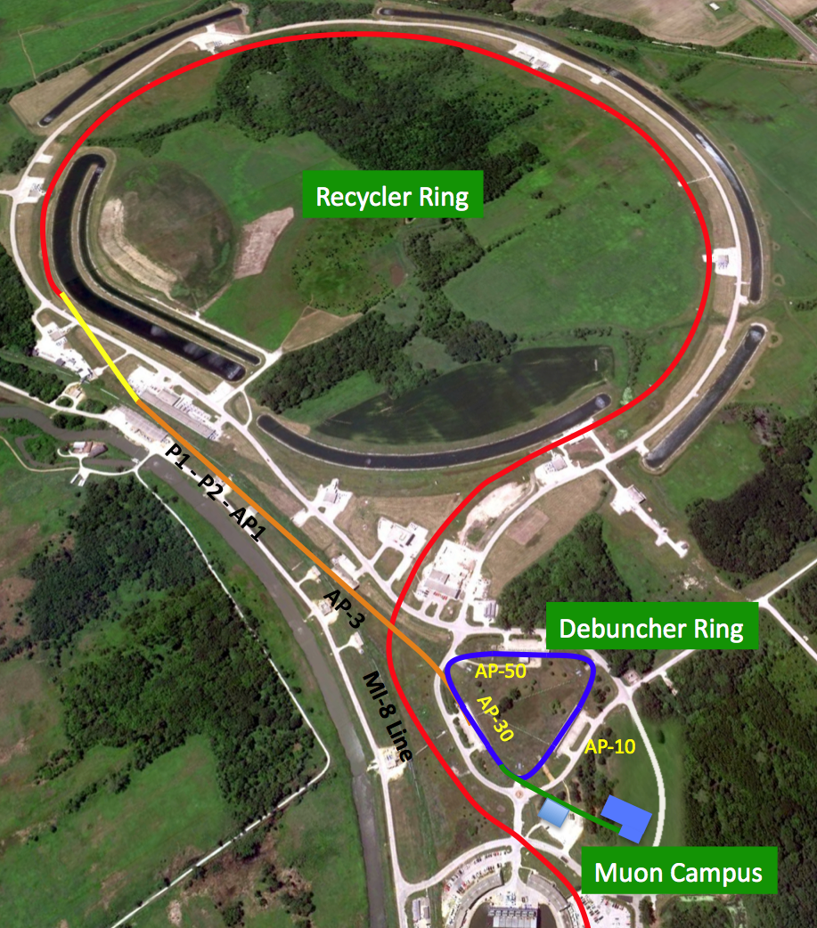
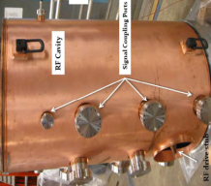
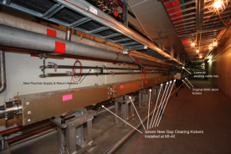
Overview of Common Recycler Upgrades
Extraction kicker required by Mu2e and g-2 – Significantly cheaper due to relaxed requirements associated with fewer Booster Batches.
New 2.5 MHz RF system using recycled MI RF. Required by Mu2e and g-2.
Extension of existing building at MI-52 for extraction kicker power supplies.
Recycler Ring to P1 connection in existing enclosure

Slide 15
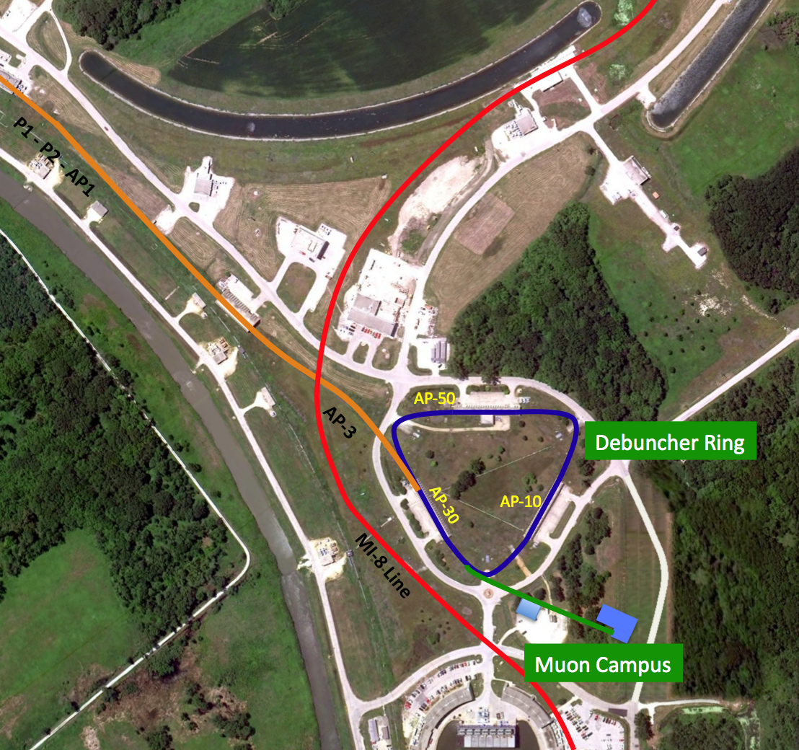
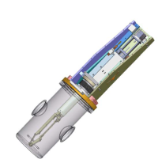
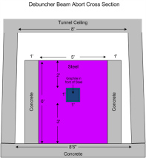
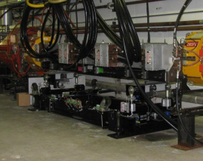
Overview of Common Debuncher Upgrades: Debuncher AIP
Increase magnet apertures to improve beam transfer efficiency and reduce losses.
Abort magnet and dump
Beam line instrumentation
Remove Collider equipment
Debuncher Injection System

Slide 16
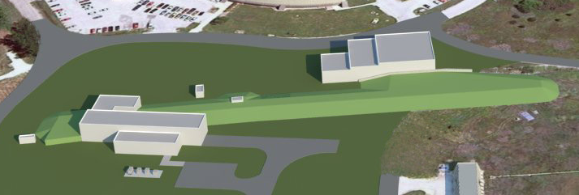
MC-1 design evolved to meet g-2 & Mu2e needs
MC-1
Building
Mu2e Building
  Medium bay area 50’ x 70’
    power supplies for upstream g-2 & Mu2e beamline elements
    power supply for Mu2e AC dipole
  Low bay area 50’ x 50’
    houses cryo plant for both experiments
    saves $ to add onto MC-1 versus stand-alone facility

Slide 17
Cosmic Frontier
Near-term Science goals :
  Discover (or rule out) the particle(s) that make up Dark Matter
  Advance understanding of Dark Energy
Recent results :
  Various controversial evidence for Dark Matter from both direct and indirect searches
  Demonstration and prototyping of several Dark Energy measurements
New facilities under construction:
  Dark Energy Survey commissioning
Planned program of major projects:
  Large Synoptic Survey Telescope (2018-2023+) will make definitive ground-based Dark Energy measurements using “weak lensing”
  3rd-Generation (ton-scale) Dark Matter experiments (2021?) to reach ultimate background limits

Slide 18
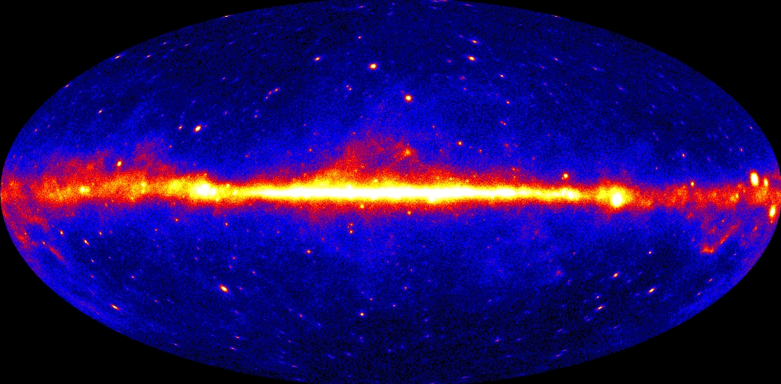
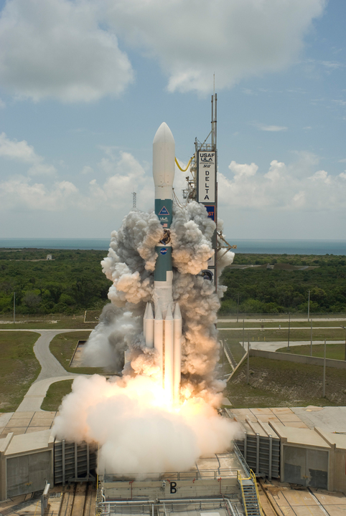
The Cosmic Frontier
Launch: June 11, 2008
70% of the photons in the high-energy γ-ray sky are diffuse radiation from the Milky Way; remainder are localized sources or extragalactic “diffuse” radiation

Slide 19
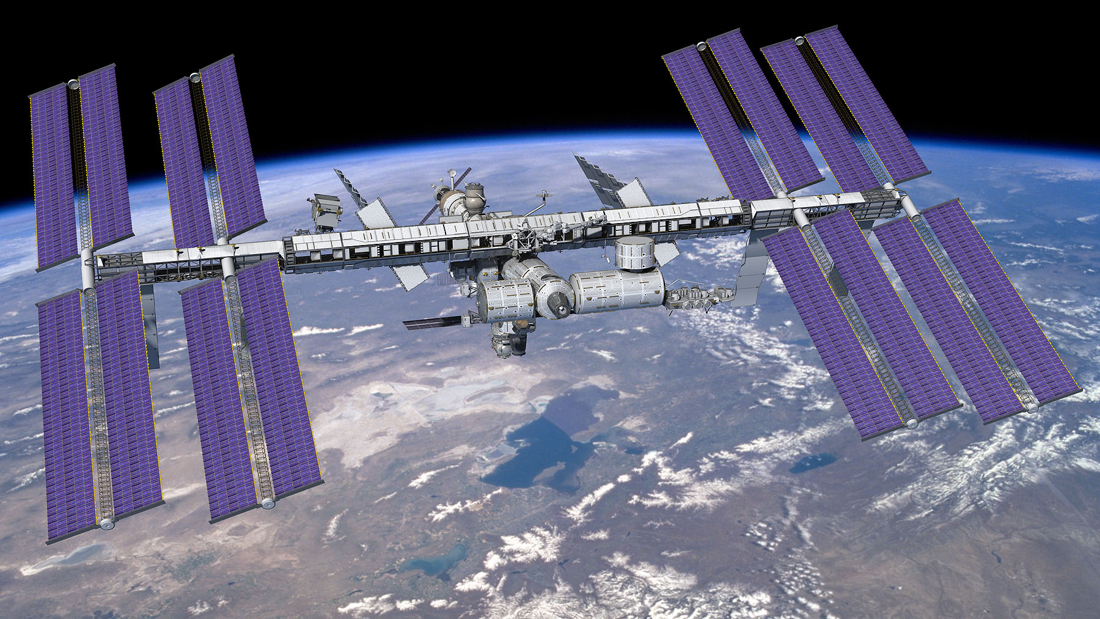

AMS: HEP in Space
AMS
Notes:
19

Slide 20
Priorities: Develop Cosmic Program Plans
Dark Matter:
  Funding Opportunity for R&D on 2nd Generation direct detection experiments: https://www.fedconnect.net/FedConnect/?doc=DE-FOA-0000597&agency=DOE .
  Aug 2012 – community workshop to get input on strategy for dark matter research, particularly coordination and complementarity of different methods (e.g. direct detection vs. indirect gamma-ray searches vs. LHC)
Dark Energy:
  Pro-actively developing a balanced, robust dark energy program in HEP – our own independent plan
    With near term and low cost options
    Using multiple methods
  What facilities are required and how do we obtain access to do our experiments?
  Plan HEP community workshop this summer, then broaden the discussion
Computing
  What do Cosmic Frontier experiments actually need? How well integrated are they with emerging national Computational Cosmology collaboration?
    Planning meeting with all parties this summer

Slide 21
TECHNOLOGY STEWARDSHIP

Slide 22
Accelerator Stewardship
The FY2012 Senate report specifies that
  “The Committee directs the Department to submit a 10-year strategic plan by June 1, 2012 for accelerator technology research and development to advance accelerator applications in energy and the environment, medicine, industry, national security, and discovery science.”
HEP has charged a community task force to provide input on promising R&D areas, pros and cons of current technology transfer models, and potential challenges of implementation
  Report from task force to DOE SC February 13. N. Holtkamp talk at this mtg.
This will be significant effort to implement and is not without risk. We have positive feedback from other SC offices and other agencies. Industry has given many constructive suggestions
  HEP is not expecting any immediate changes associated with this, just some modest redirection and stability for our support to accelerator science
  Community report will form the basis of the strategic plan and inform FY2014 formulation. We are working on a reorganization of our accelerator R&D efforts aligned with the strategic plan

Slide 23
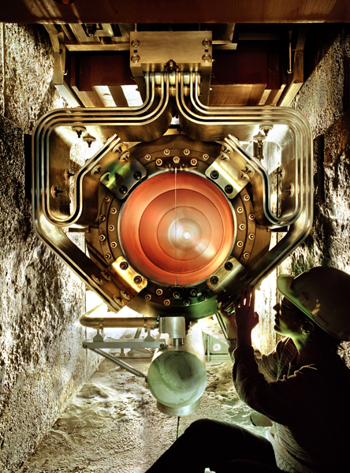
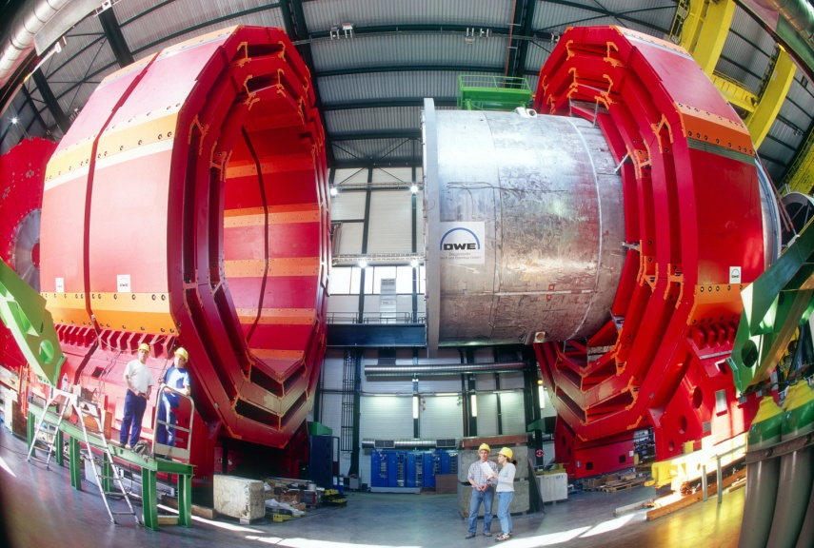
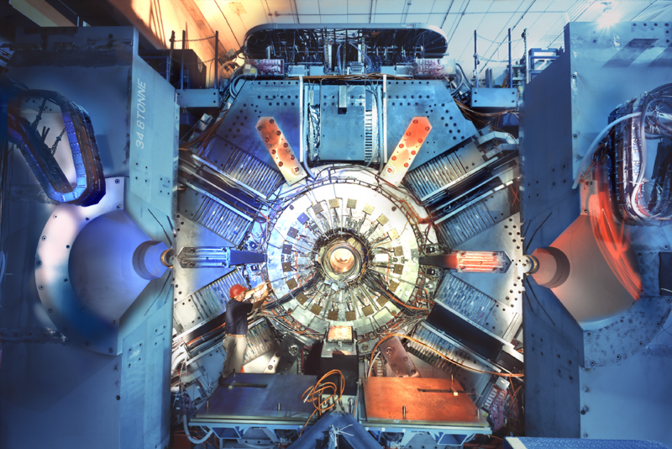
HEP Technology Today

Slide 24
New User Facility for Accelerator R&D
The Facility for Advanced aCcelerator Experimental Tests (FACET) at SLAC received CD-4 in January 2012.
FACET will operate as a national user facility for accelerator R&D with open access based upon peer review.
It will use the front end of the SLAC linac to supply electron beams with high energy (20 GeV) and short length bunch lengths.
Plasma wakefield experiments will be in the first run.
HEP is supporting this facility as part of its accelerator R&D stewardship initiative.

Slide 25
Conclusion
Exciting program pushing ahead all three frontiers
Current focus on transition of FNAL facilities to expanded role on the Intensity Frontier
Cosmic frontier in close collaboration with NSF Astronomy, NASA; regular input from AAAC
US-CERN relation to be ‘regularized’ before 2017 to support Energy Frontier
New role in accelerator stewardship under exploration

