Slide 1



The upgrade of the ATLAS Inner Detector
D. Ferrère, University of Geneva
On behalf of the ATLAS collaboration
12th Pisa Meeting on Advanced Detectors
La Biodola, Isola d'Elba (Italy)
May 20 - 26, 2012

Slide 2
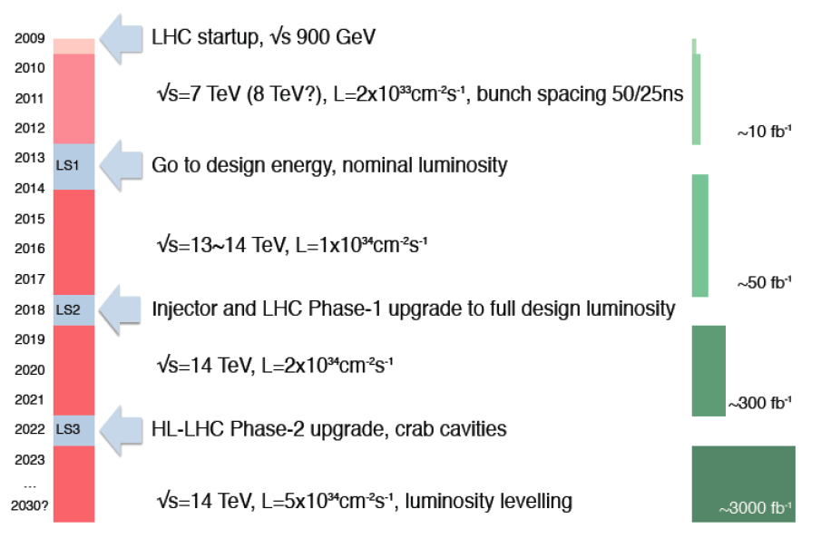
LHC Plans and Upgrade Phases
Introduction
The future observations at LHC should drive physics investigations at HL-LHC
8 TeV since April 5th
Phase-0
ID upgrade: IBL, nSQP, DBM
D. Ferrere – 12th Pisa Meeting on Advanced Detector
ID upgrade: Pixel (option)
ID upgrade: Renew ID – Pixel & Strip
The Machine and the Detectors are working towards the Upgrade Phases to improve the performances as well as the life time
2

Slide 3
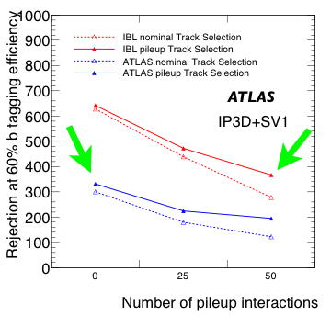
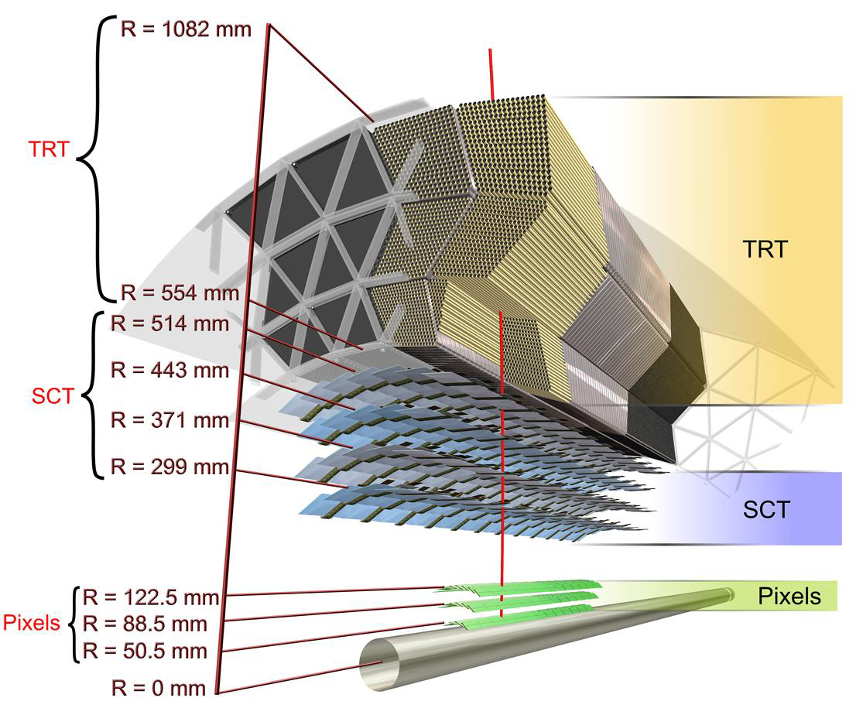
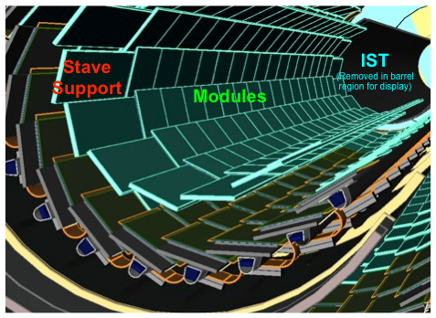
IBL
Phase-0
Insertable B-Layer (IBL)
Features:
4th Pixel layer (instead of b-layer replacement)
Closer interaction point (5.05 → 3.27cm)
Smaller pixels (50 x 250 μm2)
Better sensors, better R/O chip
More robust tracking
Better performance
Reduce beam pipe diameter (47 mm) in Beryllium under production
ATLAS Inner Detector sector
D. Ferrere – 12th Pisa Meeting on Advanced Detector
IBL
3

Slide 4
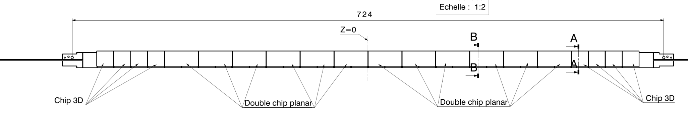
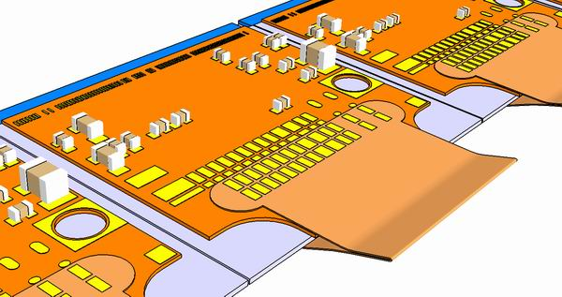
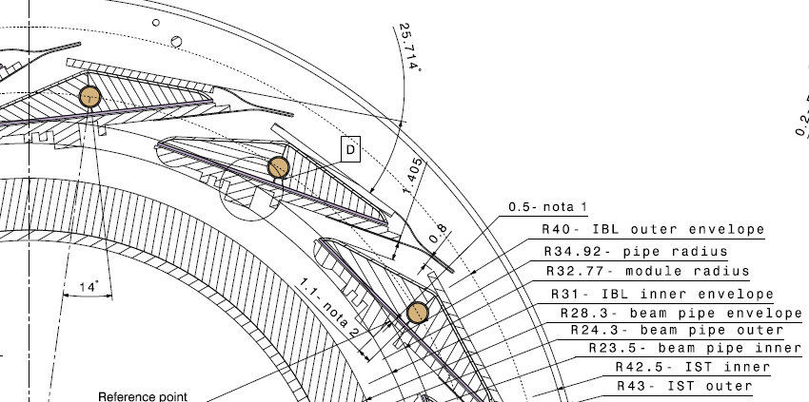
IBL
Phase-0
IBL Layout and Features
IBL features:
14 staves overlapping in Phi and mounted around the beam pipe on support rings
Small clearances between beam pipe - IBL - IST : 2.5 to 2.7mm
Stave to stave gap is only 0.8mm → Integration for the last stave delicate
Instrumented stave made of 12 planar and 8 3D sensor modules along 664mm
IBL Support Tube (IST)
Stave section envelope
3D module layout
D. Ferrere – 12th Pisa Meeting on Advanced Detector
Beam pipe
4

Slide 5
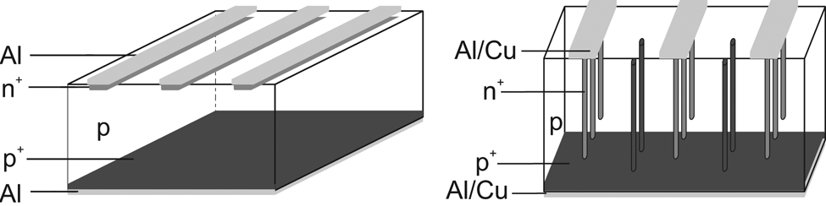
IBL
Phase-0
Sensor Technologies
Planar sensor – n-in-n
Charges are collected at the strip surface
3D sensor
Charges are collected at the bulk implanted electrodes
n
Structure | Planar | 3D
Thickness (nominal) [μm] | 200 | 230
Depletion voltage [V] | ~35 | 10 - 25
Working voltage after LHC fluence (5x10¹⁵ 1MeV n_{eq}/cm²) [V] | ~1000 | ~160
Module width [μm] | 41325 | 20450
Active size WxL [mm²] | 16.8 x 40.9 | 16.8 x 20.0
D. Ferrere – 12th Pisa Meeting on Advanced Detector
Production status:
- Planar sensors from CiS: 424 good double chip (DC) tiles (89.1 % yield) - IBL needs 168 tiles (75% planar).
- 3D sensors from CNM & FBK: 306 good tiles as today (62% yield) – IBL needs 112 tiles (25 %).
1st time 3D sensors will be used on a Si-tracker
5

Slide 6
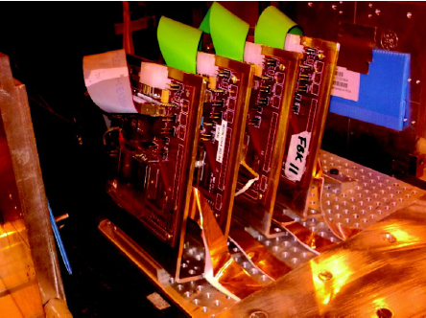
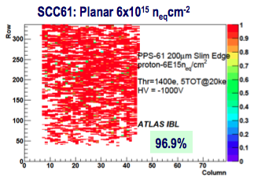
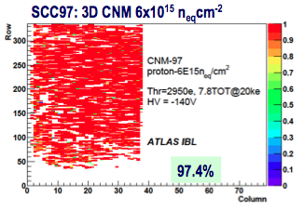
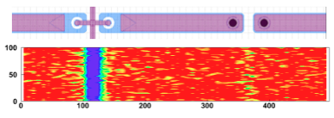
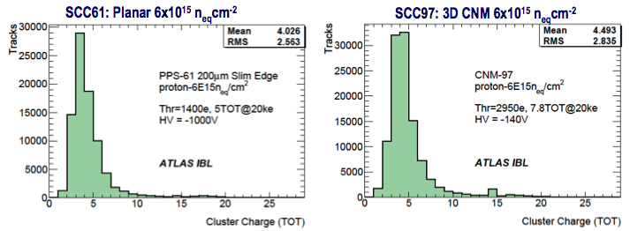
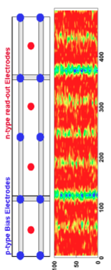
IBL
Phase-0
Test Beam Results
PLANAR
Efficiency
A number of pixels does not work after proton irradiation (TID ~ 3x IBL lifetime)
Same behavior for both sensor types => FE-I4 “feature” (Pixels masked during analysis) will be addressed with FEI4b
3D
Charge collection
D. Ferrere – 12th Pisa Meeting on Advanced Detector
6

Slide 7
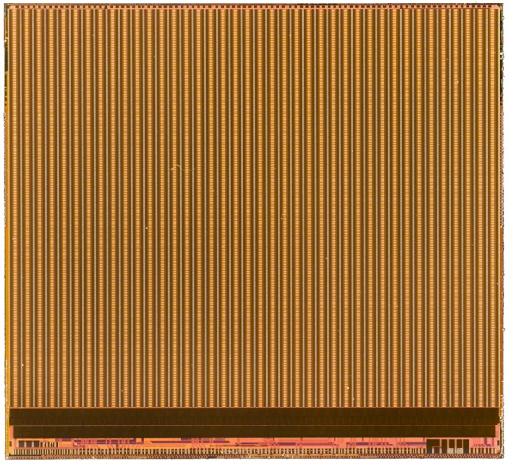
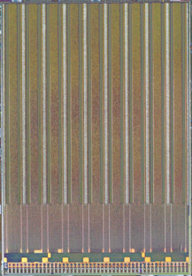
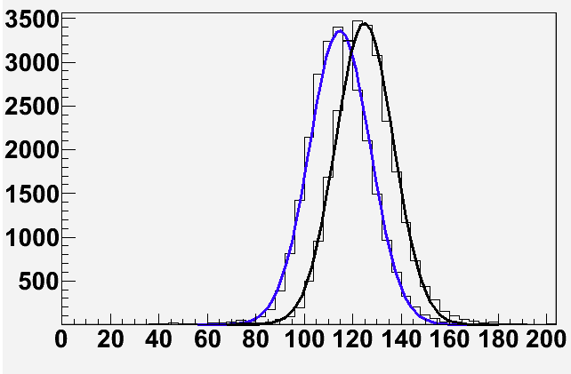
IBL
Phase-0
Front-end Electronics – FEI4
FEI4 main features:
• IBM (130 nm)
• 70 Million transistors
• 26880 pixels (50 x 250 μm2)
• Lower noise than FE-I3 (~150e- with sensor)
• Lower threshold operation
• Higher rate compatibility
• Radiation hard to >250Mrad
• In use for pixel R&D and towards Upgrade phase 2
20.2 mm
FEI4
7.6 mm
FEI3
18.8 mm
11.1 mm
Through the FEI4 progresses:
First version FEI4a for validation and IBL prototypes (32 FE-I4A wafers received in 2010/11)
FEI4b features: minor fixes + r/o functionalities + uniform pixel matrix + Power functionality
First FEI4b delivery in Dec. 2011
FEI4b now in production (30 wafers) and wafer probing is almost completed (yield ~60%)
D. Ferrere – 12th Pisa Meeting on Advanced Detector
FEI4b noise before and after irradiation:
114e → 124e (both tuned)
7
FE-I4A Threshold scan
FE-I4B Threshold scan

Slide 8
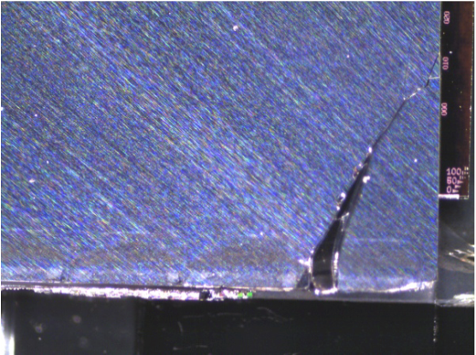
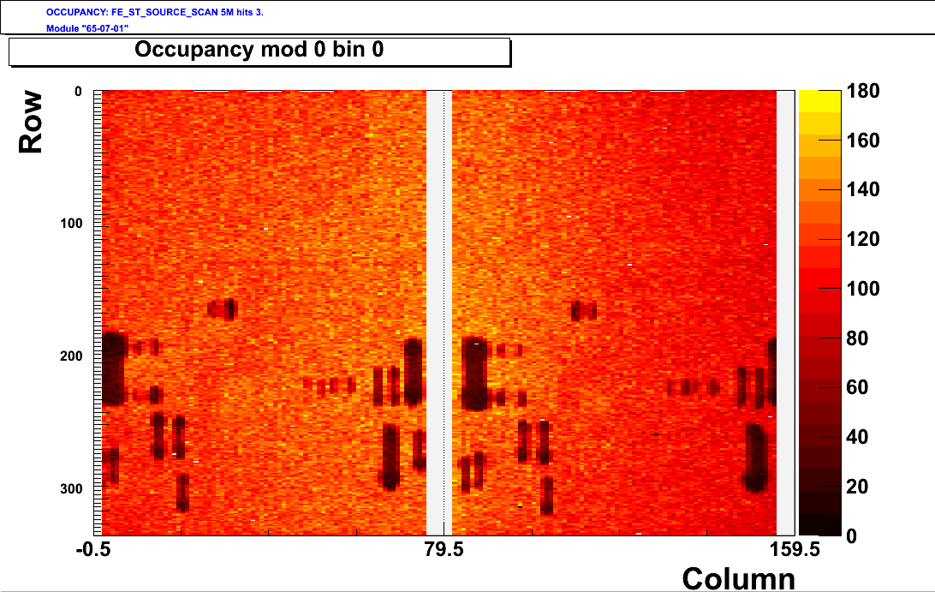
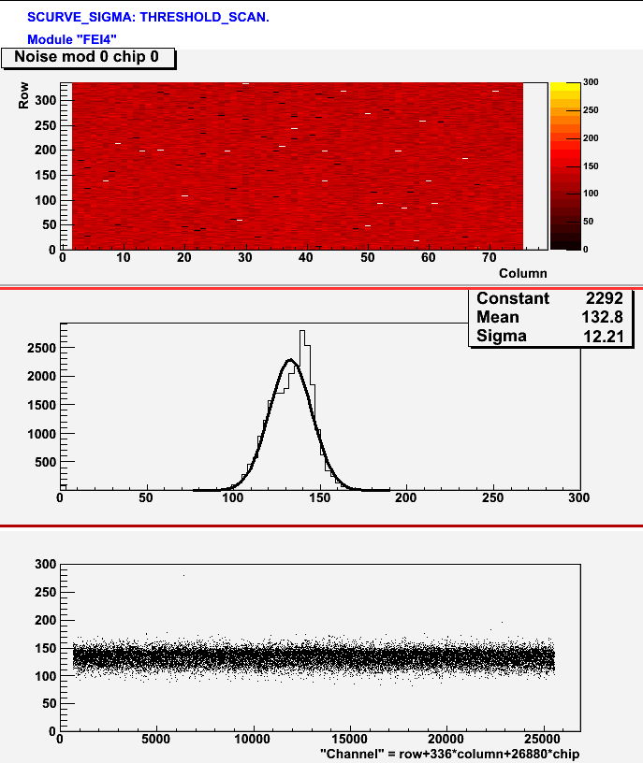
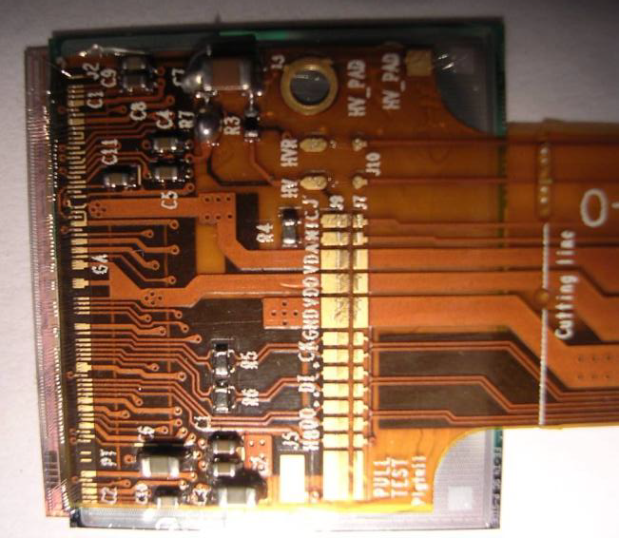
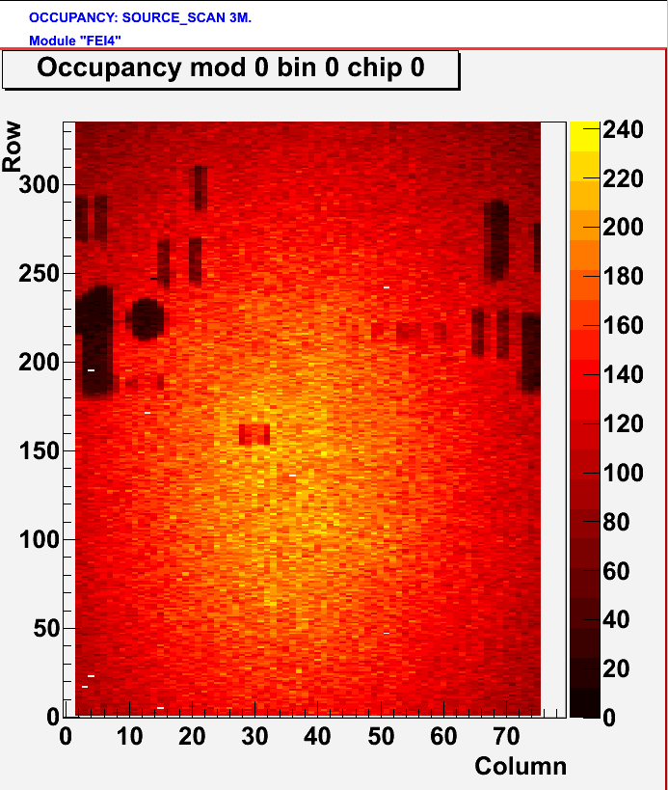
IBL
Phase-0
Module Production Status
Production is in progress in two assembly sites
Started first with FEI4a module production for stave 0
FEI4b modules has just started – PRR is programmed for beginning of June
Thin module process steps (100 and 150μm thick FE):
① FE-I4 wafers thinned
② glued on glass support wafer
③ bump deposition
④ dicing wafer & substrate
flip-chip & reflow
⑥ substrate wafer removal by power laser.
Crack found in the thinnest FE backside
→ IBL will go with 150μm thick
Planar module
Modules with FEI4a
Typical Noise scan
Am241 source scan
D. Ferrere – 12th Pisa Meeting on Advanced Detector
Layout of the SMD components are clearly visible
3D module
8

Slide 9
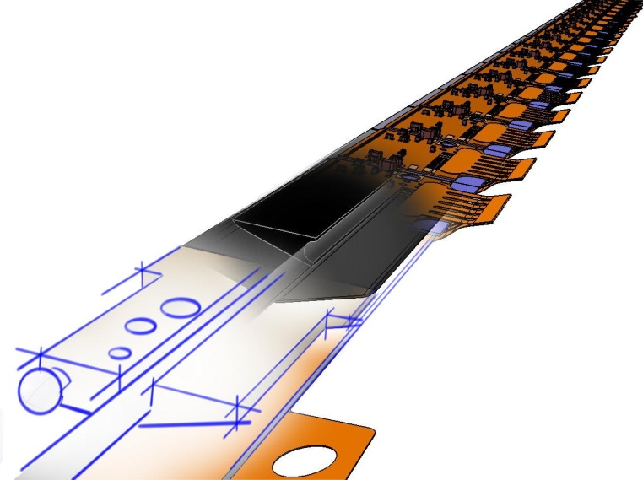
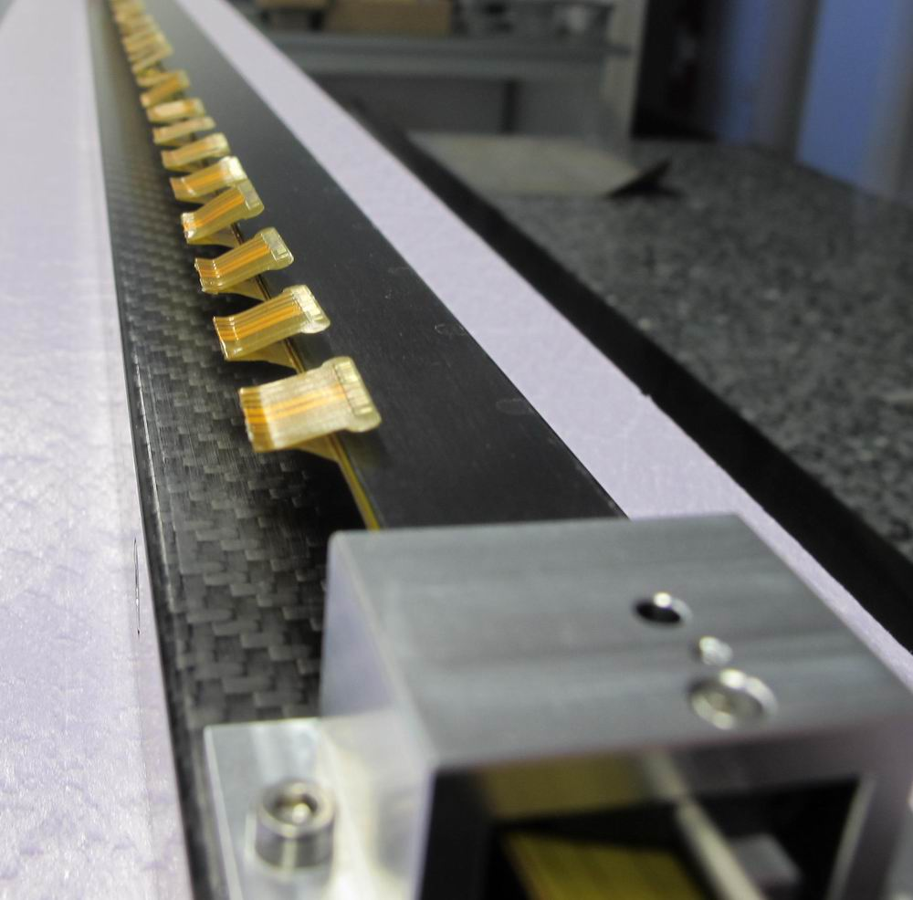
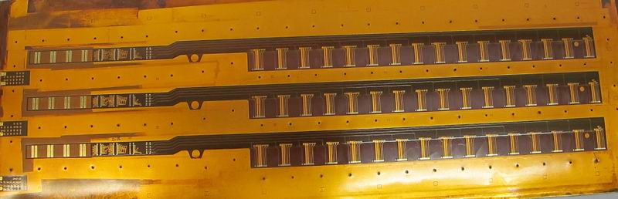
IBL
Phase-0
Stave and Flex Features
Stave features:
Made of light material (K9 carbon foam + CFRP skins for stiffness)
Ti pipe of 1.5mm ID and 0.1mm wall thickness
Face plate (module side) is coated with Parylen for safer electrical break to detector HV
Tight planarity and envelope tolerance: +/- 0.1mm
Stave fixations on 3 points: 2 end-blocks + central support
Stave & flex pre-production started and OK
K9 Foam block
K13C /RS3 parylen coated face plate
Peek end blocks
Flex features:
- Mix of 4 Cu-layers and 2 Al-layers for the LV lines. Total thickness ~450μm
The 2 Al-layers needs to be processed with CVD for Chrome and Copper (vias)
The wings supply through 1 layer the connectivity for every FE. Wing thickness 70μm
Wings are folded and glued for very precise envelope required for the integration
K13C/RS3 Omega
Stiffener
ID 1.5mm Ti boiling pipe
Flex Bus
D. Ferrere – 12th Pisa Meeting on Advanced Detector
1st AlCu flex ever made for tracker in fabrication for IBL
9

Slide 10
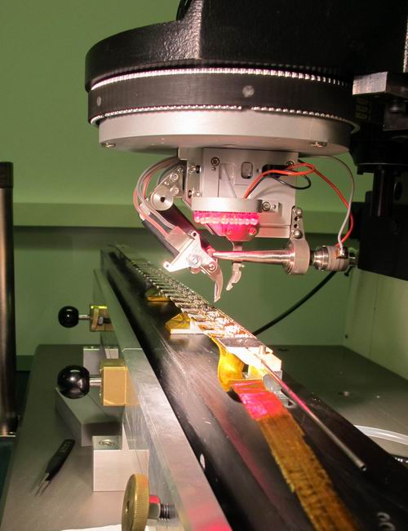
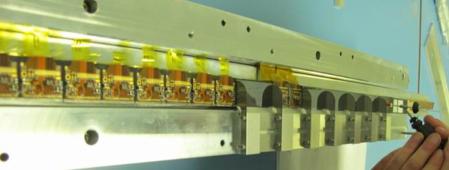
IBL
Phase-0
Module Loading and QA
The module loading and QA consists of 16 working steps
Key features of the loading procedure:
Modules are mounted with a thermal grease interface + epoxy glue drops
Thermal grease was qualified for its good thermal performance and for its radiation hardness
Rework and module replacement is possible but not straight forward
→ Module and flex QA prior to loading is essential
All staves will be thermal cycled with loaded modules for QA – Electrical tests and metrology survey will be made before and after this operation
Electrical insulation between HV groups will be done → Thin polyimide layer in module gaps
Stave handling frame
D. Ferrere – 12th Pisa Meeting on Advanced Detector
The stave will remain on a handling frame for all assembly and QA operations including the pipe extension and the integration around the beam pipe. One per stave with high precision machining.
Stave wire bonding
Loading modules
10

Slide 11
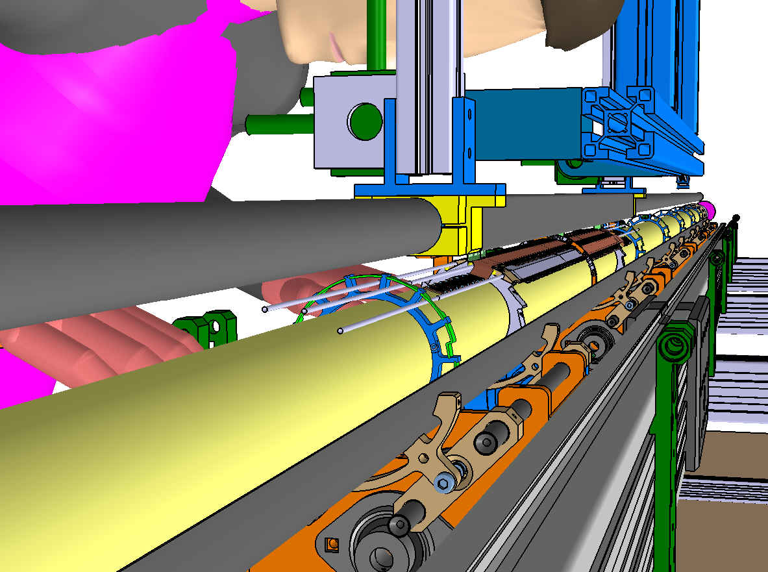
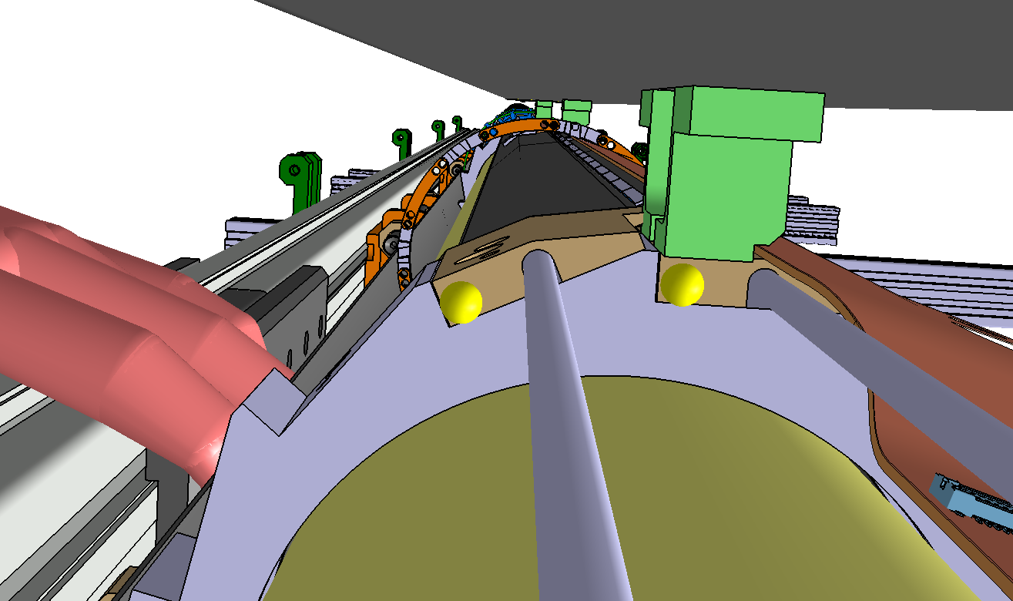
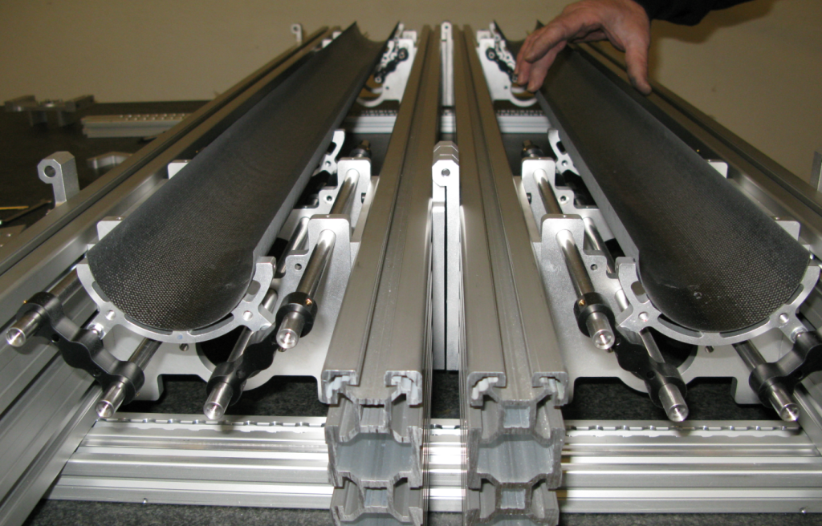
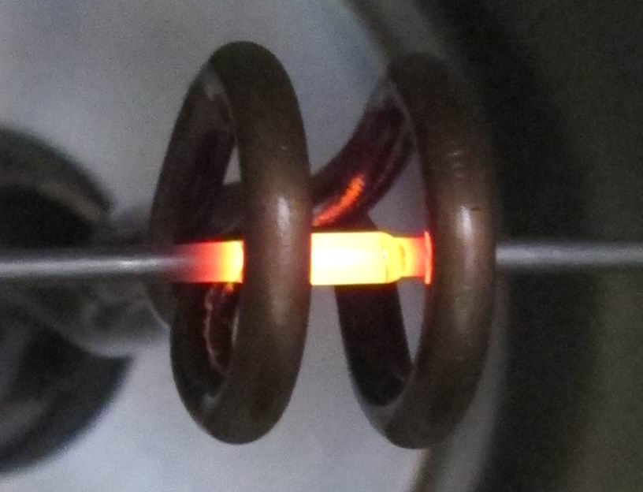
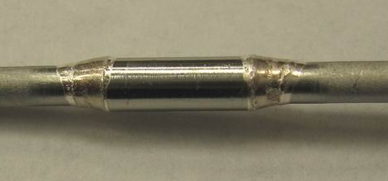
IBL
Phase-0
Stave Integration
Staves Assembly around the New Beam pipe with the
MPC (Multi-Purpose Container)
Stave Handling frame
Stave Handling frame
IBL_MPC (8.9m long)
D. Ferrere – 12th Pisa Meeting on Advanced Detector
Stave pipe extension to 7m - Brazing technique
MPC as a multi purpose object for: BP container, stave loading, IBL Test bench and, IBL container.
Testing has been performed on an IBL_MPC 1.6m long prototype (done in January)
MPC proto to be used for IBL Integration checks, sealing issue, interfaces with integration tables
IBL_MPC prototype @ UNIGE
(1.6m long, cut out successfully)
Pipe brazing for extension
11

Slide 12
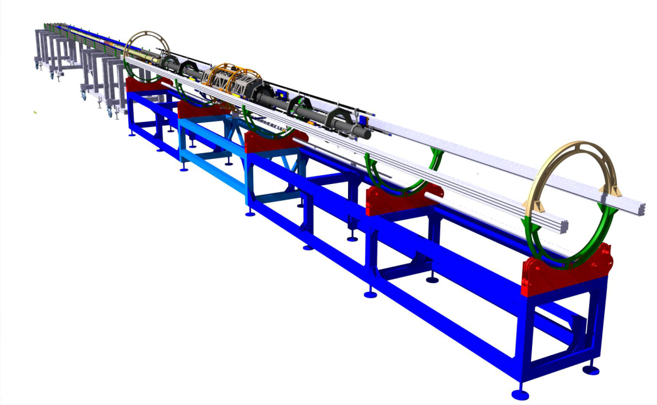
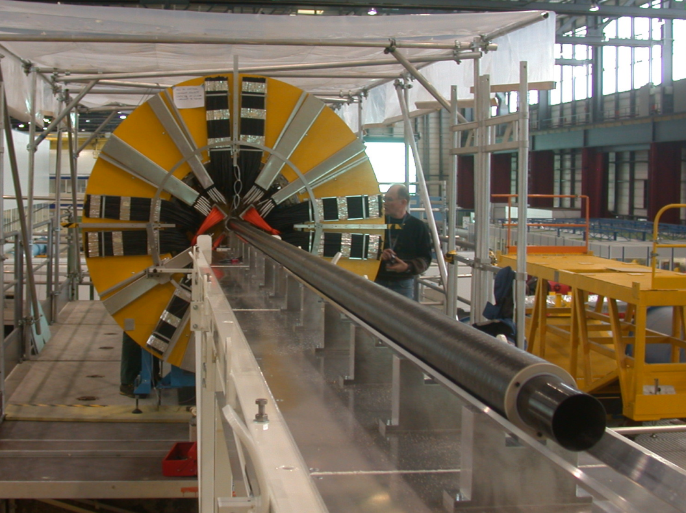
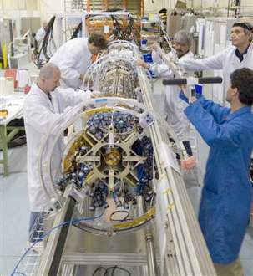
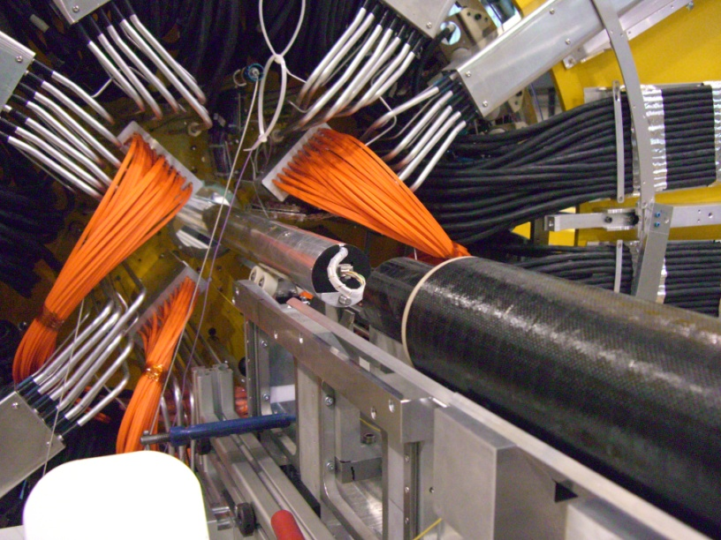
IBL
Phase-0
Integration & Installation
Two viable options are investigated:
IBL to Pixel integration in the surface building associated to nSQP installation
IBL to ATLAS integration in the pit
IBL to ATLAS integration in the pit
IBL to Pixel integration in SR1
“ID” Mock up – Bldg180
Dummy IST
ITT already in SR1
Integration scenario clearly defined
Insertion Table
D. Ferrere – 12th Pisa Meeting on Advanced Detector
Long Guiding Tube (LGT)
12
Pixel Integration & Testing Tool

Slide 13
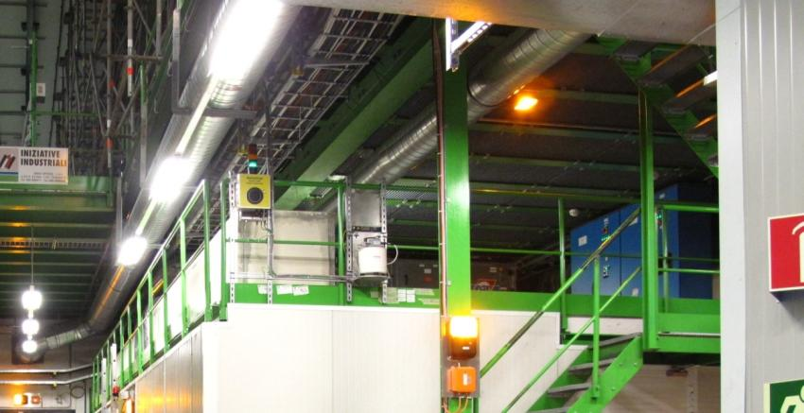
IBL
Phase-0
CO2 Cooling
Test bench allowed to evaluate IBL system (branch + stave):
- Coolant at -39°C → Stave -24.4°C (60% of the DeltaT due to the stave TFoM)
Joint CERN-PHDT & Nikhef responsibilities
Plant construction @ Nikhef (by April 13)
Integration of electronics @ CERN (May-June 13)
Commissioning of cooling plant (July-Sep. 13)
Installation in Cavern: Oct. 13
Vacuum insulated concentric tibe (~13m)
D. Ferrere – 12th Pisa Meeting on Advanced Detector
Free space in USA15
1.9 m
13
Identified place

Slide 14
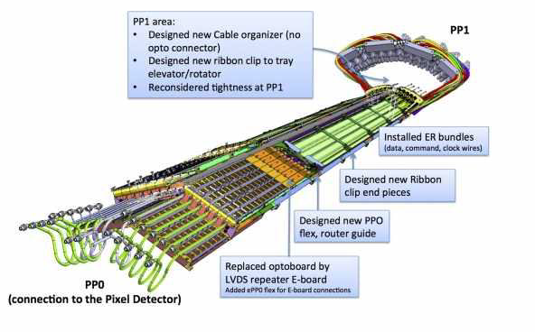
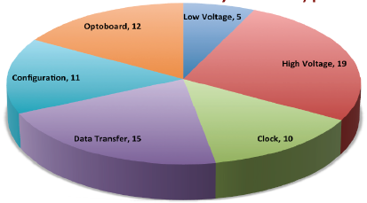
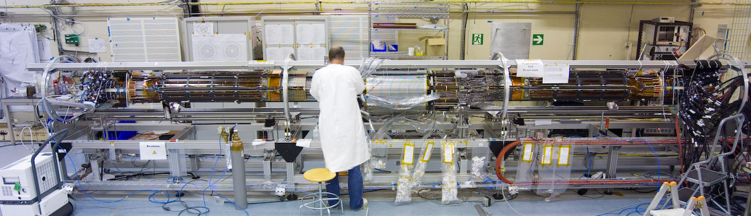
nSQP
Phase-0
Pixel nSQP – new Service Quarter Panels
nSQP features:
No optical transceiver inside the ID region (VCSEL problems on ID triggered the project)
On-detector optoboards replaced by new accessible optoboards located at ID End-Plate
Reproduces the Pixel services with design improvements
Add long-term reliability to the operation of the detector
(→ pending decision in June)
Installation and Integration (2013-2014) in phase with IBL at the surface building
Pixel running experience 2010 + 2011
Data taking efficiency in 2011: 99.8%
95.9% of Pixel modules are active
  2.1% before LHC turn
  2.0% lost in 2010 + 2011
  Problems constantly increase after cooling cycles and ~equally distributed
D. Ferrere – 12th Pisa Meeting on Advanced Detector
nSQP is expected to improve Pixel efficiency & reliability
14
Pixel during integration in SR1

Slide 15
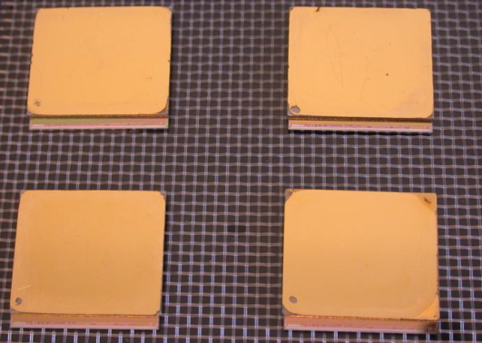
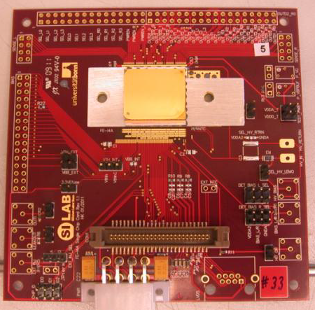
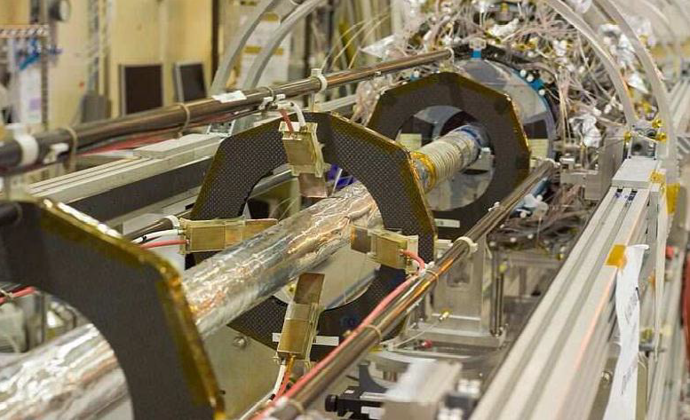
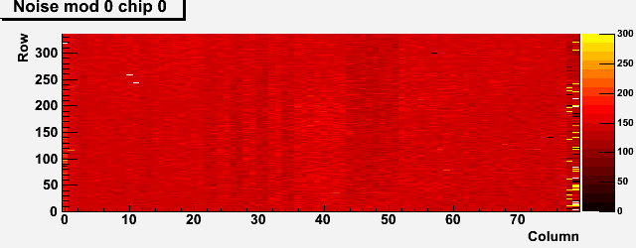
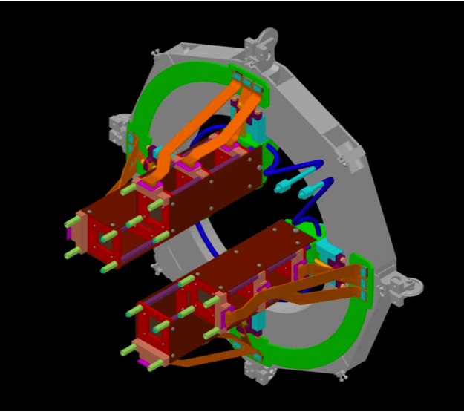
DBM
Phase-0
DBM – Diamond Beam Monitor
The goals of DBM:
Luminosity
  Monitor luminosity delivered to ATLAS for individual BCIDs
  Aim for % level accuracy in lumiblock (1-2 minutes)
Beam Spot
  Unbiased (trigger) beam spot monitoring
  Aim for ~1cm accuracy per event
Background monitoring
  Topology of BG different than IP interactions
Track Trigger test-bed
  Possible test-bed for ideas (pattern reco., tracking,…)
1st DBM modules with FEI4
DBM installation is linked to IBL and nSQP integration and installation
Module on test board
3 successive modules pointing towards the IP
D. Ferrere – 12th Pisa Meeting on Advanced Detector
Pixel
DBM
Noise map of a DBM module
BCM
15

Slide 16
Upgrade
Phase-2
ID Upgrade Phase 2 - Topics
Topics under investigation for the tracker upgrade:
New ID layout: Only silicon pixel and strip detectors → Simulations
Trigger: Si-track trigger for L1 decision is considered using RoI
New detector technology: n-in-p planar for strips and pixel (slim and active edges), 3D-sensors & Diamond (innermost layers), Gossip – Current R&Ds efforts
New ASICs technologies: Deep submicron 250 nm →130nm
- Pixel FEI4b in production + R&D in 65nm
- Strip ABCN130 to be submitted at the end of 2012
Cooling with more headroom: CO2 plant for coolant down to -35°C or lower
New powering scheme: Serial powering or DC-DC for parallel powering
Faster readout: FE asics (160/320 Mbps) and optical link (5Gb/s)
SCT 1.5 kch/link → Upgrade up to123 kch/link
Strip module integration will be grouped on a stave or a super-module structure
DCS is proposed to be partially integrated into the readout architecture
Engineering:
- Assemble and commission the complete ID in a surface building
- Service reuse of cables between counting room and detector
Installation: Limited access time inside the cavern → Need clear and well prepared integration plans
D. Ferrere – 12th Pisa Meeting on Advanced Detector
16

Slide 17
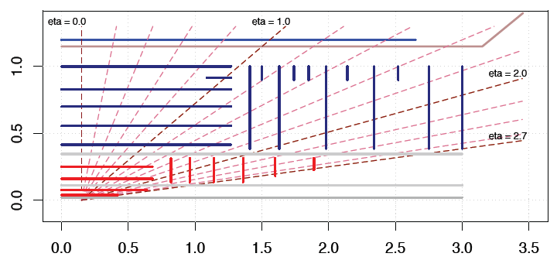
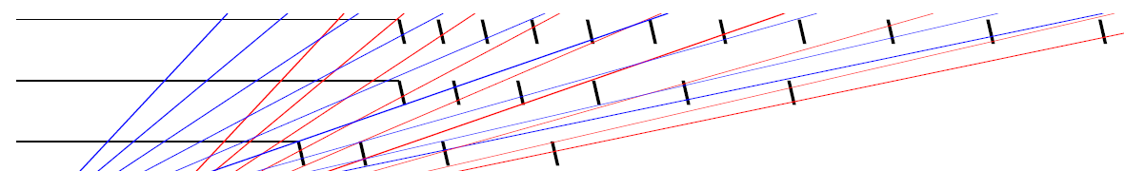
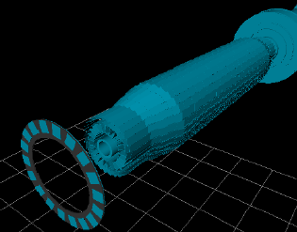
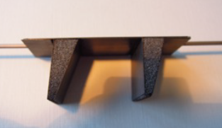
Upgrade
Phase-2
Pixel Layout
Cartigny ID layout
R [m]
Classical layout – Barrel & Disk
• 2 innermost pixel layers should be replaceable (IST R=11cm)
• Full pixel package should be replaceable
• Pixel services should be axial
Z [m]
I-beam stave concept for Innermost 2 layers
Possible options for outer layers
Goal is to reduce or suppress disc → material budget saving
D. Ferrere – 12th Pisa Meeting on Advanced Detector
Conical layout
Alpine stave concept
Bended staves in conical layout
Real prototype for feasability
17

Slide 18
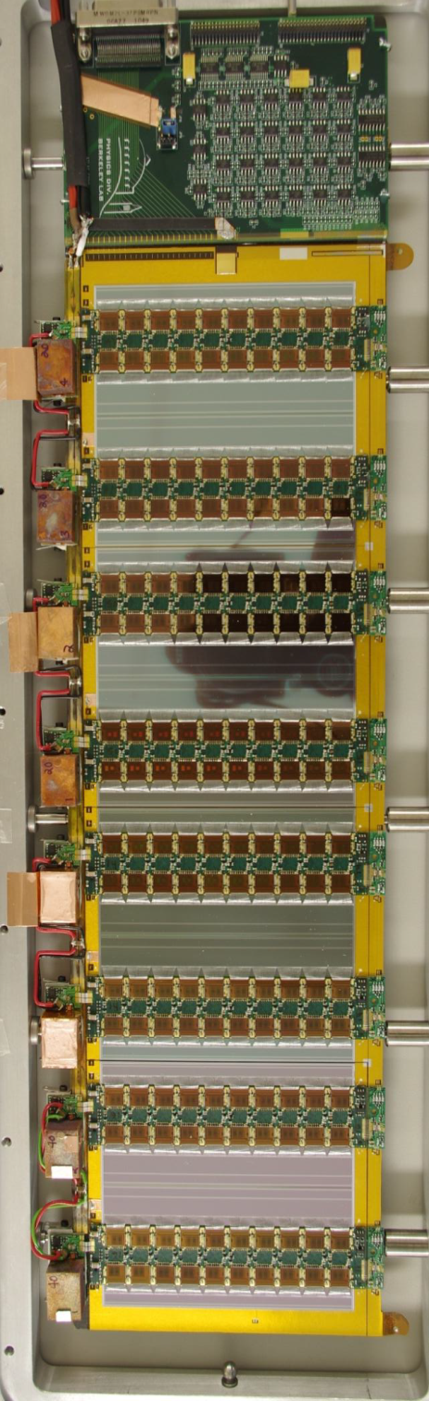


Upgrade
Phase-2
Strip Tracker – Stave & Petal
Stavelet with 4 modules using DC-DC powering
Features:
- Single sided modules mounted on each side of core structure (Carbon foam + CFRP planes)
Cooling pipe embedding into the core structure
Stave service bus is laminated with the core structure and modules are glued on top
Hybrids are directly glued on top of the Si-strips and are serviced at each side of the sensor
Stave design is compact
D. Ferrere – 12th Pisa Meeting on Advanced Detector
Petal layout
Thermo-mechanical stave
Progress so far:
Successful module production in several institutes with ABCN250
Stavelets with 4 module evaluated with success on system tests – Noise performance with Serial and DC-DC powering configurations
Thermo-mechanical measurement of real stave has been studied
Hybrid and sensor designs in progress for matching the new FE in 130nm technology with 256 ro channels
18

Slide 19




Upgrade
Phase-2
Strip Tracker - Super-Module
Features:
Double sided modules allowing for space point reconstruction (back-to-back sensors mounted to few μm)
Module mounting with Z-overlapping for full hermeticity
Module symmetry and bridged hybrids allowed for very low thermo-mechanical deformation (< 2μm out of plane)
12 modules are precisely mounted with grease joint on a local support with cooling pipe and plates on the sides.
Modularity allows for modules and items replacement during production or even late after integration
Module noise inside test box and on local support very similar and uniform
Super-module prototype for 8 modules
5 modules are mounted with DC-DC
D. Ferrere – 12th Pisa Meeting on Advanced Detector
Local support prototype
Light local support CFRP structure for 12 modules + service buses
19

Slide 20
Summary
Summary
Phase 0 long shutdown will allow :
The ATLAS ID to insert in 2013/14 a new innermost Pixel layer namely IBL
IBL is possible thanks to a new reduced beam pipe diameter now in production (delivery in Fall)
IBL layout is a mix of planar and 3D sensor technology integrated on the stave
The FEI4 readout chips is one of the key items which is working fine and the latest version is in production – Also used for future Upgrade development
The IBL parts are in production – Schedule is on a fast track
D. Ferrere – 12th Pisa Meeting on Advanced Detector
Phase 2 long shutdown – R&D:
ATLAS is working on the layout, the module and the integration concepts for pixel and the strip detectors
For the pixel, the focusing is on sensor R&Ds as well as the integration of multi-FE modules
For the strip, multiple modules have been tested with DC-DC and serial powering
Strip ABCN front-end readout in130nm technology is under design and will be submitted by the end of 2012
20

Slide 21
References
Thanks for your attention…
and enjoy this nice conference!
References to related R&Ds:
C. Da Via - 3D silicon detectors (talk)
H. Pernegger - Development of CVD Diamond Beam Monitors at cryogenic and room-temperature for LHC, CNGS and the ATLAS Experiment (talk)
C. Gallrapp - Planar Pixel Sensors for the ATLAS tracker upgrade at HL-LHC (poster)
F. Huegging - Hybrid diamond pixel detectors for the upgrade of ATLAS (poster)
A. La Rosa - Novel Silicon n-in-p Pixel Sensors for the future ATLAS Upgrades (poster)
D. Ferrere – 12th Pisa Meeting on Advanced Detector
21

