Slide 1
Poster Session SUmmary Talk: ApPLications -- Frontier Detector for Frontier Physics
Presenter: Drew Weisenberger
Thomas Jefferson National Accelerator Facility, USA
“Beside the comfort of knowledge, every science is auxiliary to every other."
Thomas Jefferson
August 26, 1786
May 20 – 26, 2012
La Biodola, Isola d’Elba, Italy

Slide 2
Summary of Applications of Particle Physics Technology
5 posters on clinical or pre-clinical applications
1 poster on plant biology application
3 posters on geophysical applications
2 posters on material analysis (homeland security)
4 posters on general technology development w/ multiple applications

Slide 3
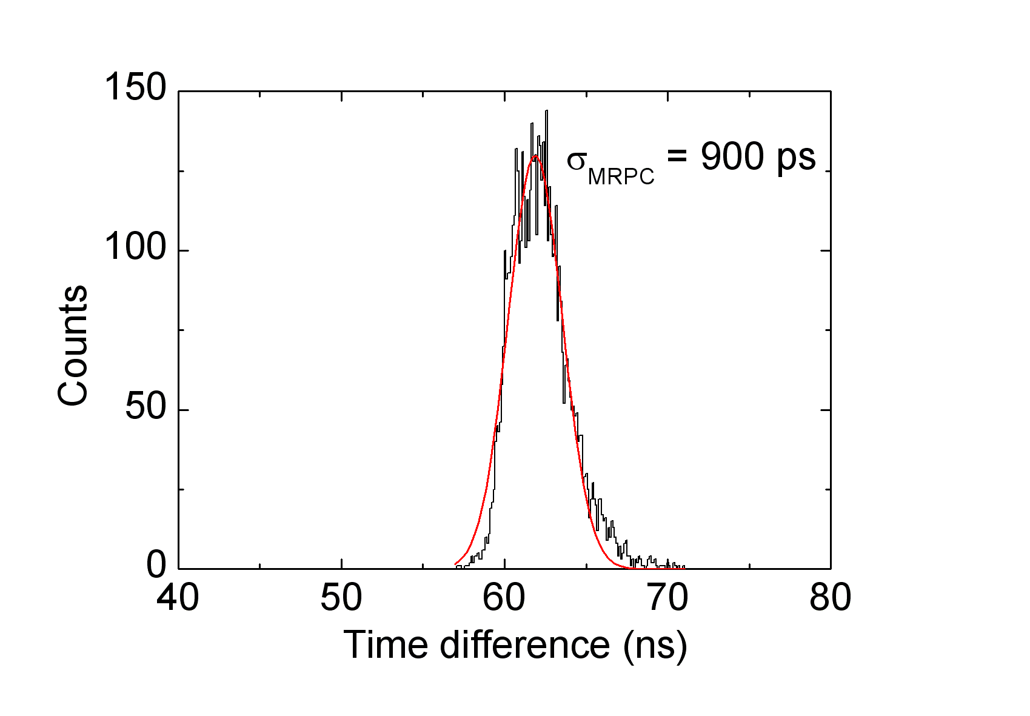
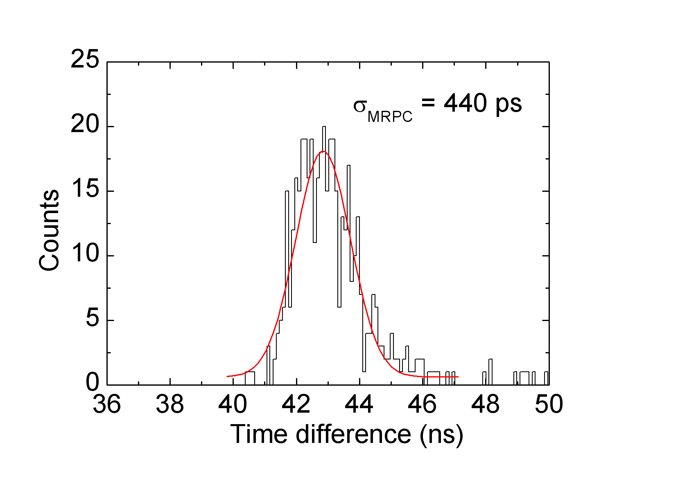
Development of Multi-Gap RPC for Medical Imaging
S. Biswas, et al. GSI - Darmstadt
Timing spectrum 4-gap Bakelite MRPC
Timing spectrum 6-gap glass MRPC
MRPCs are suitable candidates for PET imaging requiring good time and position resolution.
One prototype bakelite MRPC was build with 0.6 mm × 4 gas gap and one prototype glass MRPC was build with 0.2 mm × 6 gas gap.
Time resolution of the MRPCs are measured using a Time to Digital Converter (TDC) (Start signal: from scintillator; stop signal: from MRPC)
Streamer mode operation of the bakelite MRPC gives time resolution (σ) ~ 900 ps
In the avalanche mode operation of the glass MRPC a time resolution (σ) ~ 440 ps has been obtained.
Simulation to optimise the number of gaps and width of individual gap is in progress.

Slide 4
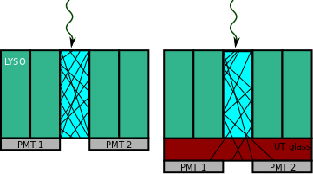
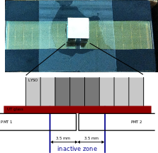
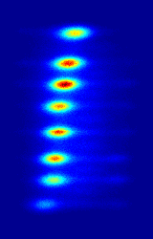
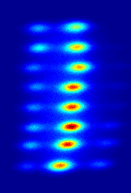
K. Straub, et al. University of Pisa- INFN
Pixels geometrically within the inactive area can be recovered by inserting UT glasses.
Pixel identification efficiency especially at the peripheral area of a detector module can be enhanced by using ultra-transmitting glasses inserted between the scintillating crystal matrix and the photomultiplier.
Three UT glasses of 0.7, 1.0, and 1.35 mm thickness have been tested in comparison to direct coupling.
no UT
1.35 mm UT
no UT

Slide 5
High Resolution Detectors Based on Continuous Crystals and SiPMs for Small Animal PET
G. Liosa, et al. IFIC/CSIC-UVEF Valencia
Continuous crystals can provide high resolution and efficiency in PET scanners.
An accurate determination of the interaction position is essential. A method is applied which provides (x,y) and also z coordinate to reduce the parallax error.
The detectors are tested in a PET prototype, achieving sub- millimeter resolution.

Slide 6
Development of a TOF PET Prostate Probe Readout System
P. Colombetti, et al. INFN - Genova
A compact readout system for a matrix of Silicon PhotoMultipliers (SiPM) has been developed in the framework of the TOPEM (TOf PEt Mri) INFN research program.
The electronic system was designed to completely handle 128 pixels (a SiPM matrix), independently measuring both the arrival time of the incoming photons and the charge of the detected signal.
The design is based on existing ASICs, developed in the framework of high energy physics, achieving a good compromise in compactness, speed and power.
In parallel to this work, a dedicated ASIC is under advanced development, implementing all the needed functions and giving a higher compactness, necessary to build a real detector to be used in clinical practice.

Slide 7
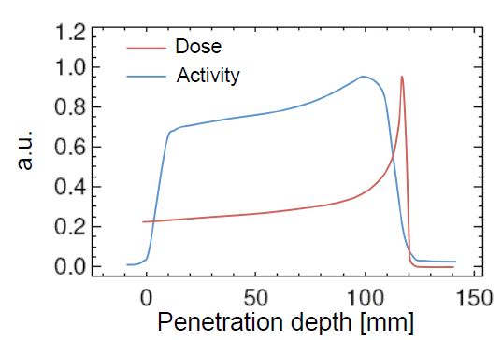
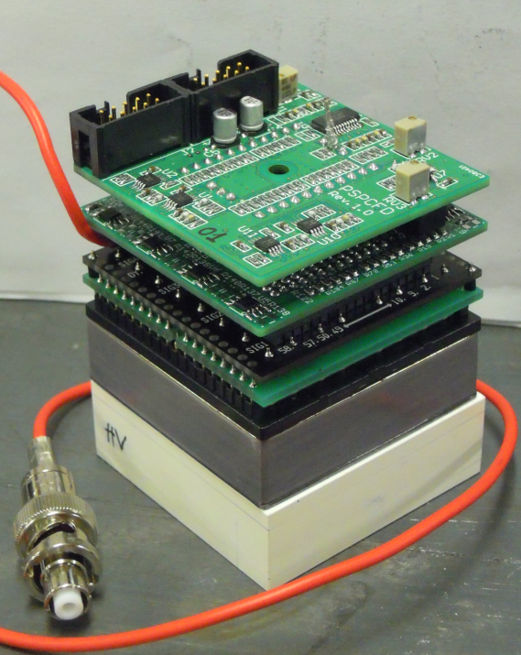
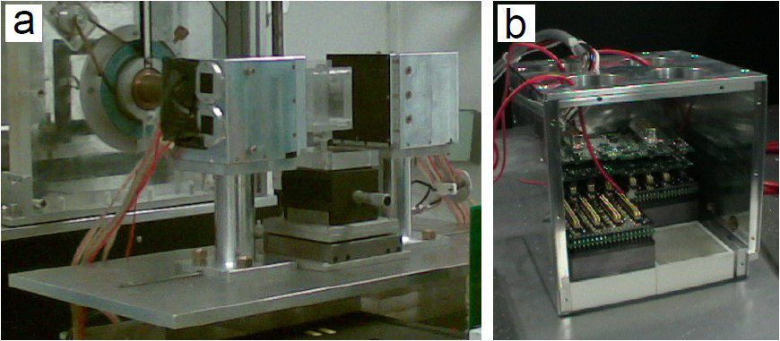
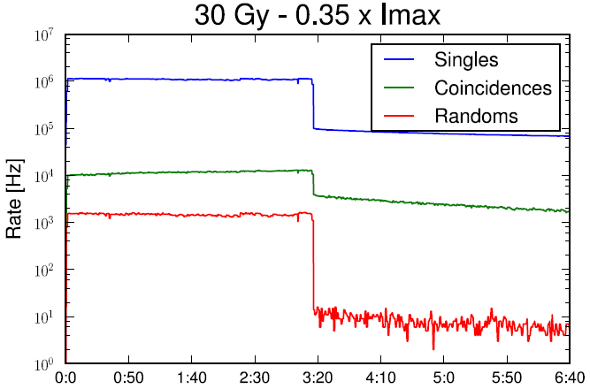
First full in-beam PET measurements of 62 MeV protons onto a PMMA target
G. Sportelli, K. Straub, N. Camarlinghi, S. Ferretti, N. Marino, N. Belcari, A. Arabpour,
M. Aiello, F. Attanasi, G. A. P. Cirrone, G. Cuttone, F. Romano, V. Rosso, A. Del Guerra
University of Pisa / INFN
Positron emission tomography (PET) is a valuable technique to monitor in-situ and non-invasively the delivered dose in ion beam therapy.
The main challenge to be solved is data acquisition also during therapeutic irradiation (full in-beam measurement).
The authors have implemented a dedicated PET system with faster frontend electronics, that halves the dead time of the system.
They have shown that it is possible to reduce the ratio of random counts over the total acquired coincidences to 0.12. Such a ratio is comparable to standard clinical PET cases and it is sufficiently low for successful image reconstructions. Using a fully stripped carbon ion beam of 80 MeV/u impinging on a Poly-methyl methacrylate (PMMA) target.
Notes:
The study of the charged and neutral particles production from the fragmentation of the Carbon Projectiles plays a crucial role in the actual development and delivery of therapeutic beams for hadron therapy.
We will present the measurements performed at the Laboratori Nazionali del Sud (LNS) dellINFN in Catania, Italy using a fully stripped carbon ion beam of 80 MeV/u impinging on a Poly-methyl methacrylate (PMMA) target.
The feasibility of an online dose monitoring has been investigated using dedicated detectors: a Drift Chamber for charged particles detection, a LYSO crystal for prompt photons detection and NaI crystals for beta+ decays measurements.
They also investigated the possibility to reconstruct the Bragg peak position using charged secondary tracks (Drift chamber) and gamma-PET emission form beta+ decays.
The dose monitoring and Bragg peak analysis performed are fundamental to validate MC simulations and confirm expected performances of detectors used for those purposes.

Slide 8
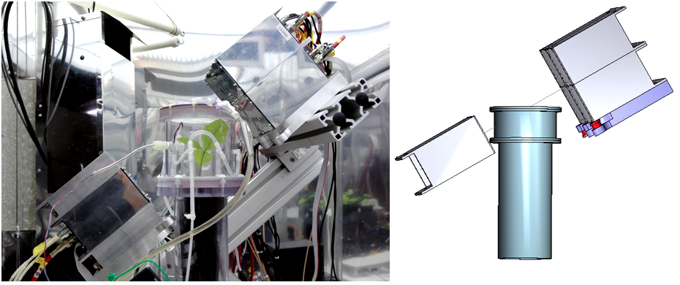
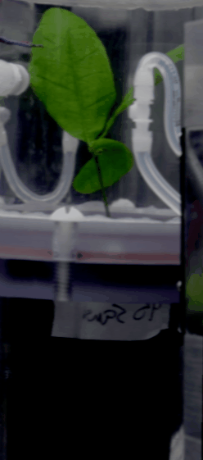
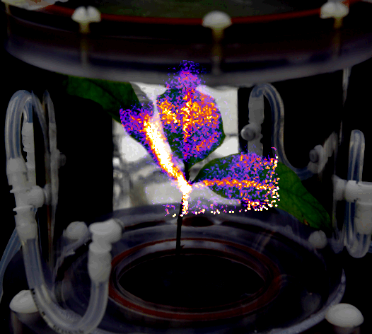
Nuclear Physics Detector Technology Applied to Plant Biology Research
A.G. Weisenberger, et al, Jefferson Lab, USA
Positron Emitter Carbon-11
CO₂ Studies w/five PhytoPET 5 cm x 5 cm modules (LYSO scintillator & PSPMT): oak seedling in whole plant CO₂ induction chamber
detector arrangement
Carbon translocation in oak seedling using whole plant CO₂ induction chamber and PET

Slide 9
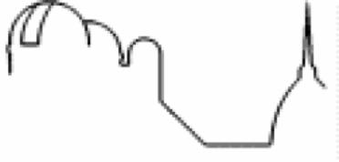
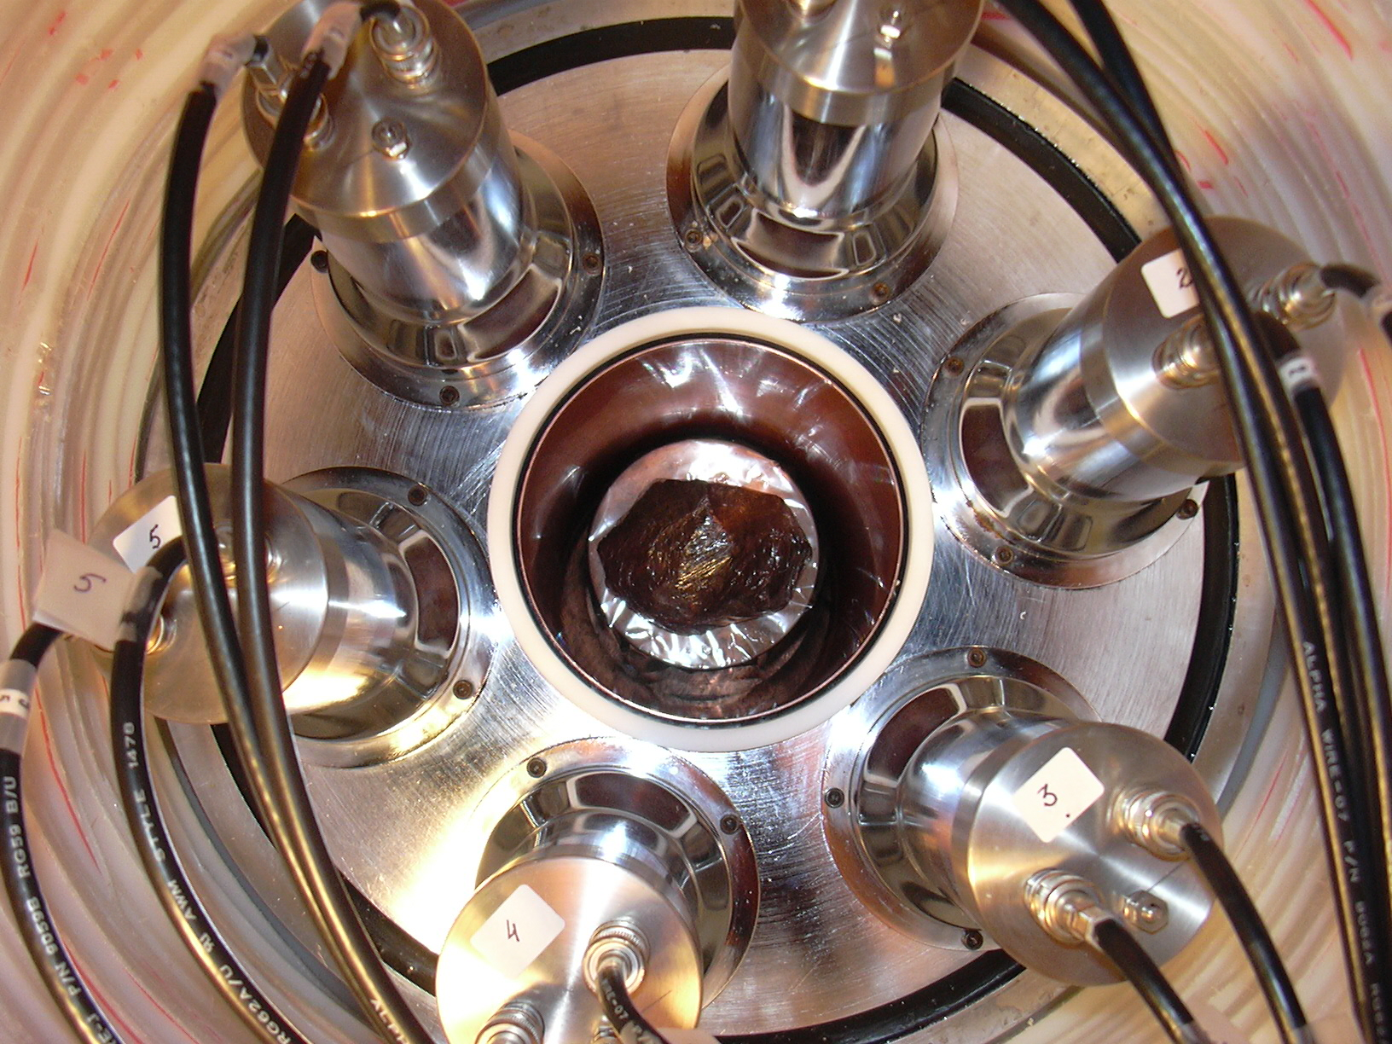
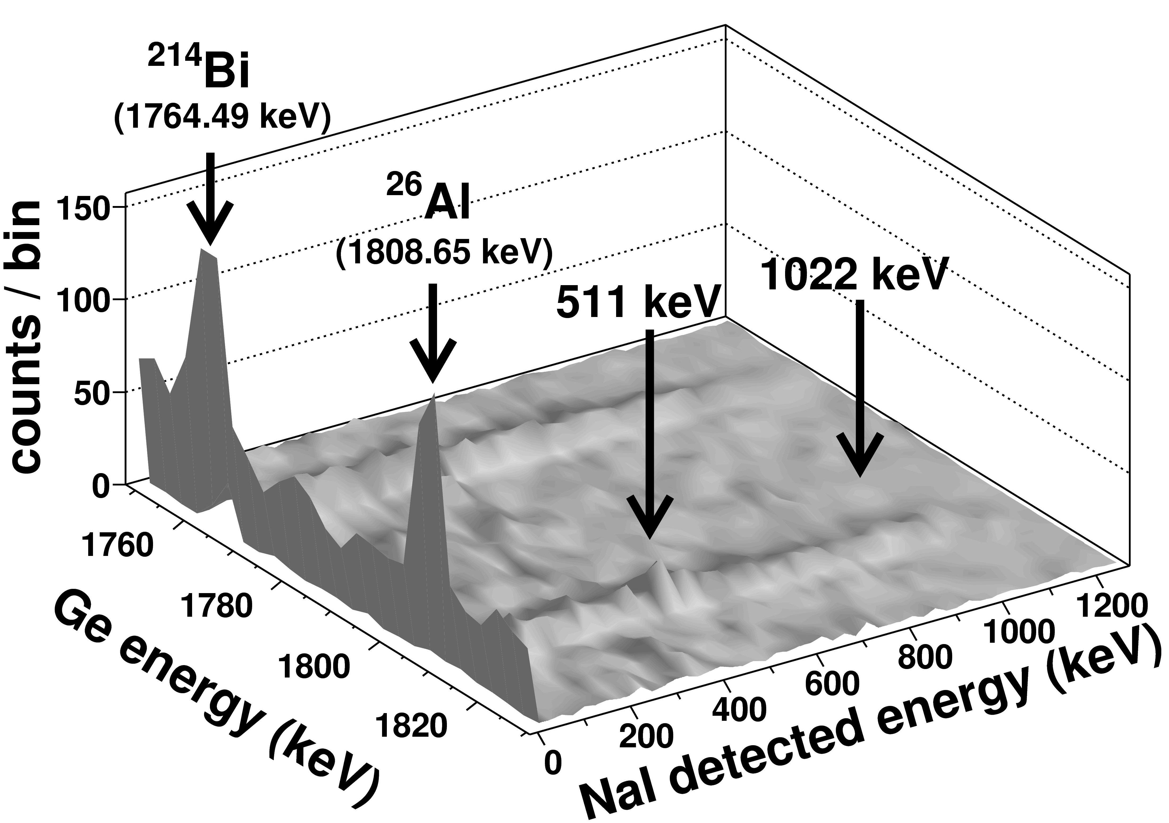
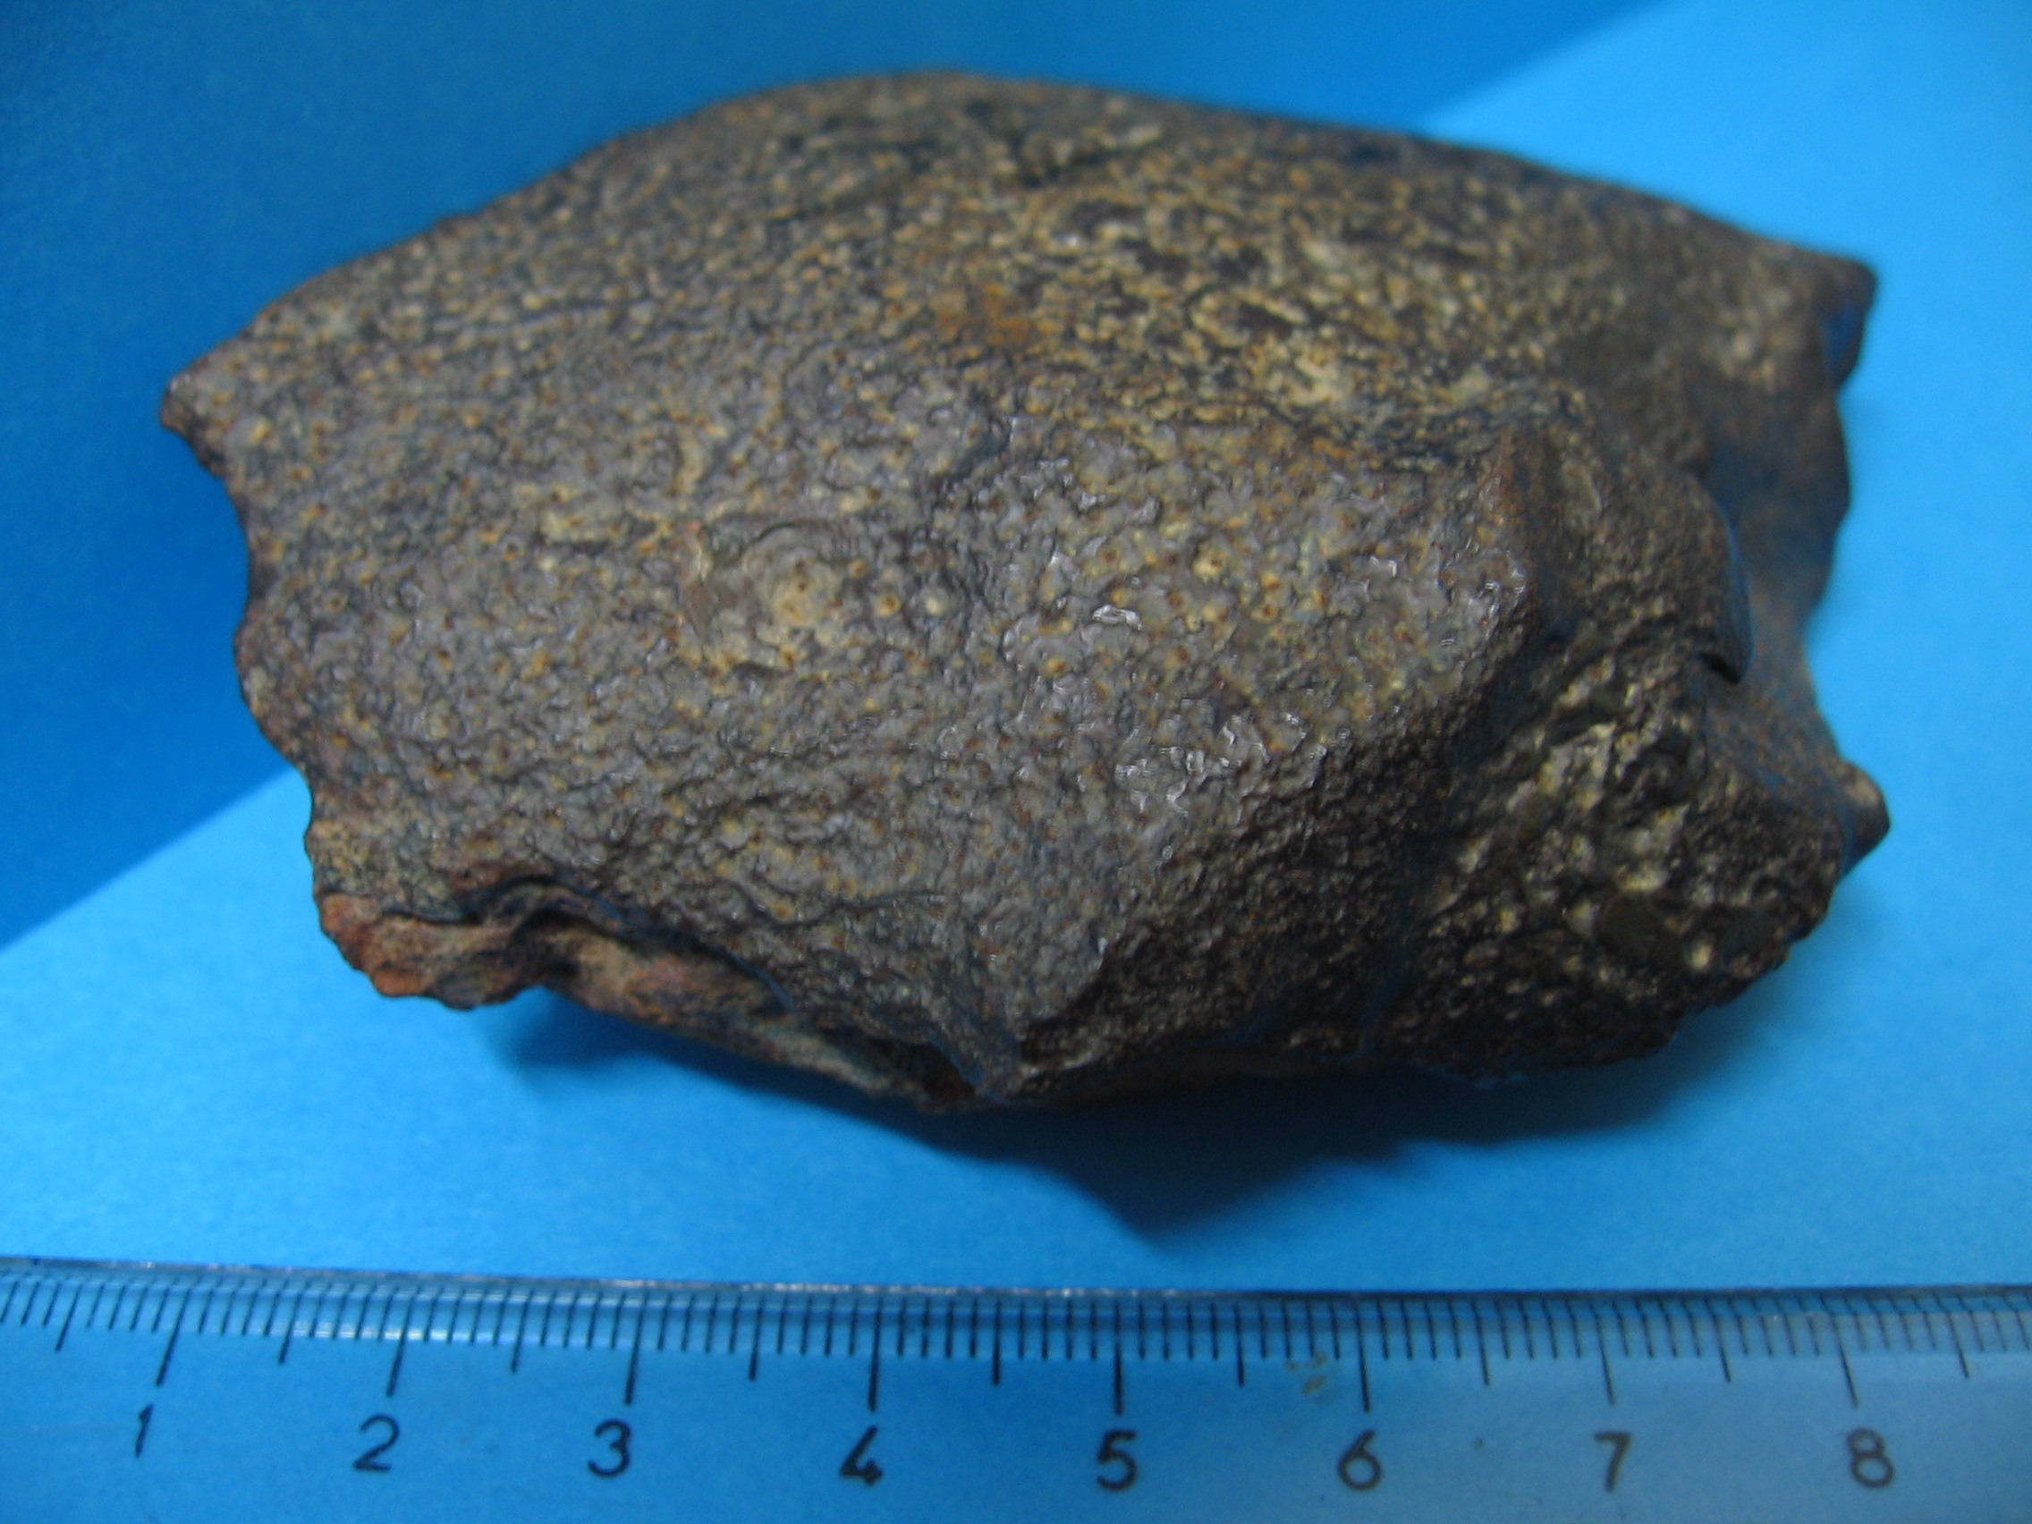
Low gamma activity measurement of meteorites using HPGe-NaI detector system
P. Colombetti ^{a,b}, C. Taricco ^{a,b}, N. Bhandari ^{c}, N. Sinha ^{d}, M. Di Martino^{b}, A. Cora^{b}, G. Vivaldo ª
ª Dipartimento di Fisica dell’Università di Torino — ^{b} Osservatorio Astrofisico di Torino, INAF, Torino, Italy ^{c} Basic Sciences Research Institute, Navrangpura, Ahmedabad ^{d} Department of Science, Wentworth institute of Technology, Boston, USA
The radioactivity in natural samples like cosmogenic isotopes in meteorites is very low, usually below 0.001 dpm/g.
Special techniques are required as
the sample can not be destroyed
large amount of sample must be counted
HPGe inside NaI(Tl) “umbrella”
We have then developed a multiparametric acquisition system → better selectivity
cosmogenic
Gebel Kamil meteorite
2D spectrum
We have developed a highly selective Ge-NaI coincidence spectrometer, operating in the underground Laboratory of Monte dei Cappuccini (INAF) in Torino.
Applications to the study of chondrite, achondrite and iron meteorites are described.
“plug” to complete 4π geometry
iron meteorite

Slide 10
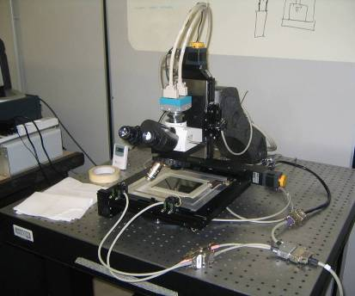
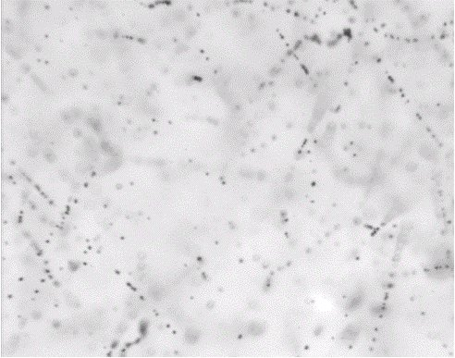
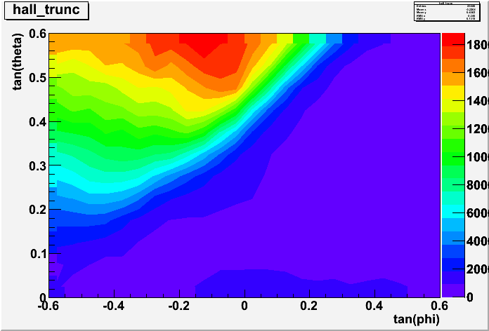
Nuclear Emulsion Detectors: an Application to Volcanoes' Muon Radiography
Lucia Consiglio (consiglio@na.infn.it)
on behalf of:
MU-RAY collaboration
In the poster the application of the nuclear emulsion technique to the muon radiography of Unzen and Stromboli volcanoes is presented. The authors report some preliminary results on a sample of emulsion films exposed in Japan at the Unzen mountain and the description of the emulsion detector exposed at Stromboli. A first overlook of Stromboli data will be reported in the conference proceeding; a good reason to read it when published!
A fast microscope for the emulsion data acquisition and readout
In a nuclear emulsion a sequence of dark silver grains (0.3-1 μm diameter) identifies the path of the ionizing particle
A thin emulsion layer is coated on both sides of a transparent plastic base. Multiplet arrangements increase efficiency and reduce random background.
The Unzen mount profile

Slide 11
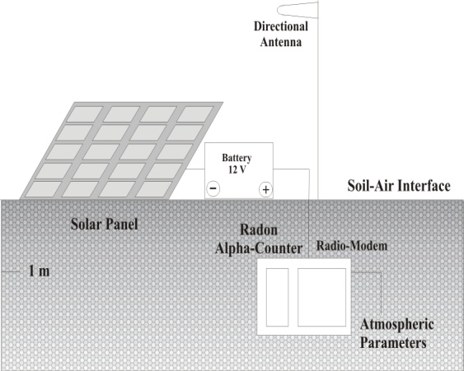
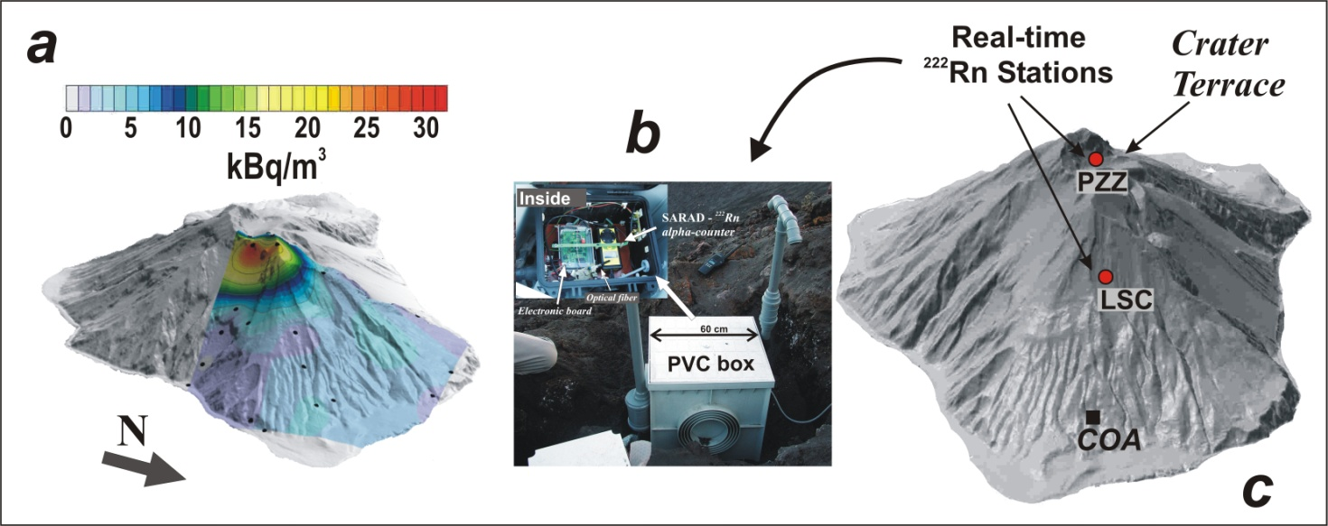
Real time ²²²Rn measurements at Stromboli Island
A. Lavagno et al. Politecnico di Torino
Geophysical surveys are employed for natural hazard and geological risk mitigation in many natural contexts, the real-time monitoring of several physical parameters is a powerful tool in the surveillance of volcanic and seismic areas. Monitoring ²²²Rn emanation from soil allows provides information about volcano activity, fault surveillance as well as the analysis of the hydrothermal systems
Sketch of the ²²²Rn
real-time monitoring
station
average radon concentration on the north side of Stromboli Volcano
measurement box w/ photo of contained radon α-detector & the read-out electronics
position of the two real-time stations (filled red circles)

Slide 12
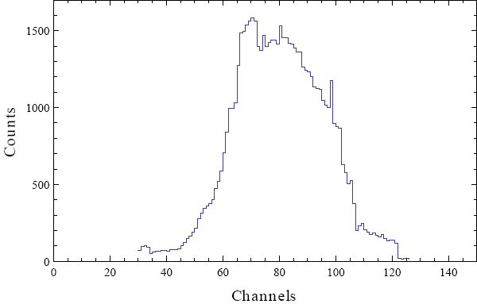
Preliminary Results of a New Boron Coated Neutron Detector
G. Gervino et al., Università di Torino , SELEX Galileo & CAEN Collaboration
Authors present a low cost neutron detector based on a 3 cm diameter, 150 cm long cylindrical metal tube (“straw tube”) coated on the inside with a thin layer of ¹⁰B-enriched (93%) boron carbide (¹⁰B₄C) filled with 1 atm nitrogen for homeland security and portal monitoring applications
Capture cross section for thermal neutrons σ=3850 barns
¹⁰B + n = ⁷Li (0.84 Mev)+α(1.47 MeV)+γ(0.48MeV) 94%
= ⁷Li(1.02MeV)+α(1.47 MeV) 6%
¹⁰B enriched up to 93% material available
as colloidal suspension in mineral oil,
painted inside the tube.
Thickness of painted¹⁰B-enriched
film is ~2.0 – 2.4 μm
Pulse height spectrum from
boron coated straw tube
surrounded by 7 cm thick
polyethylene and irradiated by
20 mCi ²⁵²Cf neutron source

Slide 13
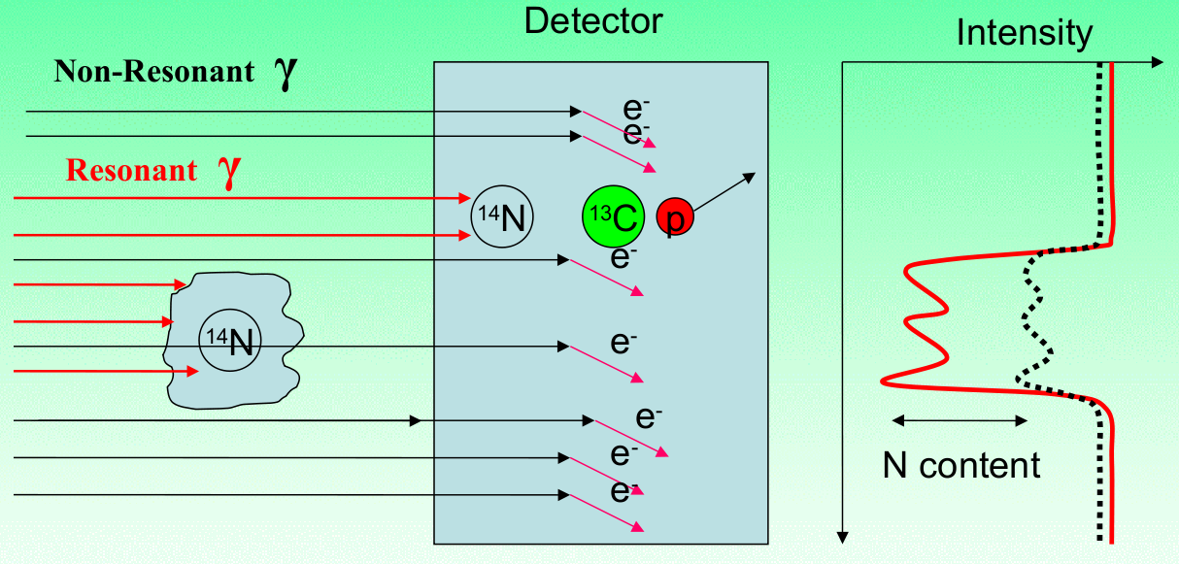
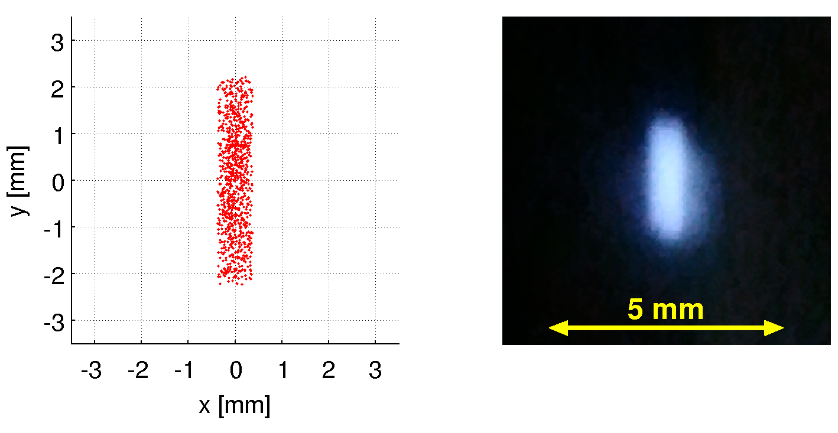
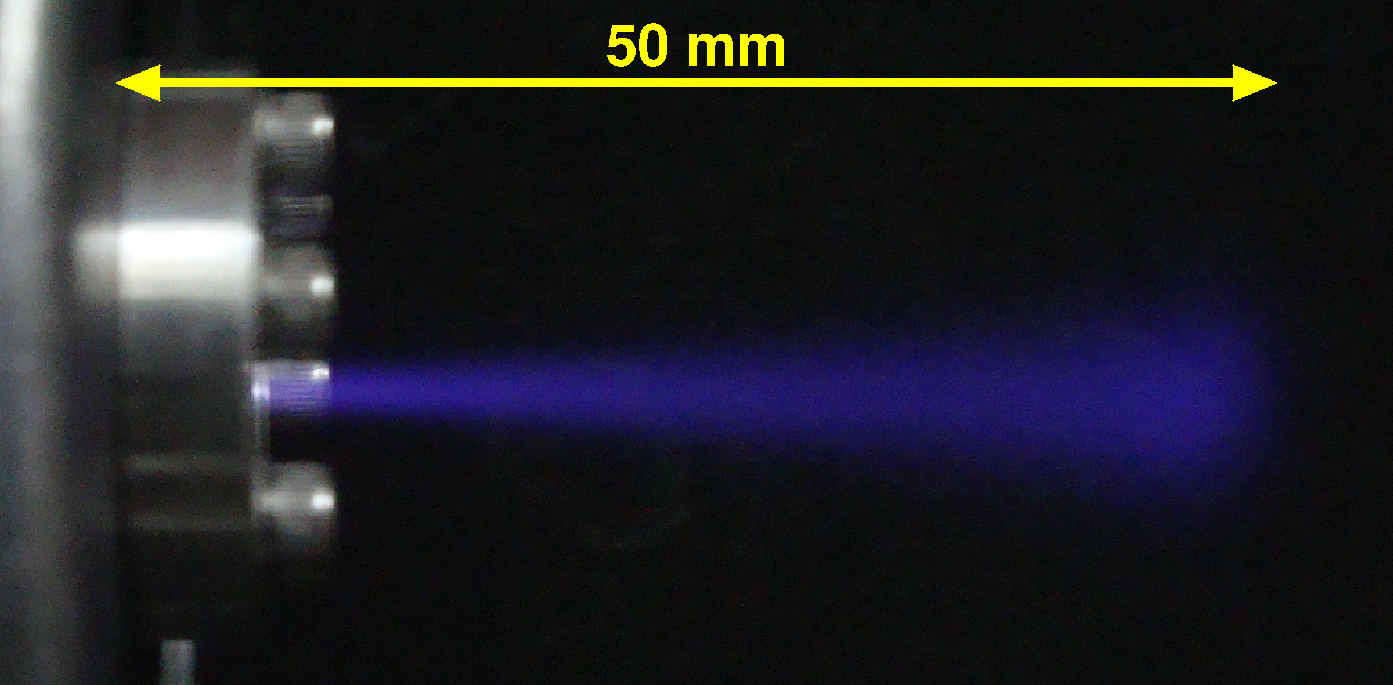
The 2 MeV Proton Linac Facility in Bern
M. Zeller, et al. Albert Einstein Center for Fundamental Physics, LHEP, University of Bern
- We have recommissioned the 2 MeV RFQ linac used at L3 during LEP. It provides an intense H⁻ ion beam.
- The primary physics goals are to enable the elemental analysis of given targets via particle-induced gamma emission (PIGE), and the detection of potentially dangerous materials with high nitrogen content using the gamma-resonant nuclear absorption (GRNA) technique for potential security applications (see figure above).
- Following the RFQ accelerator, the high-energy beam transport (HEBT) consists of an adjustable focusing system with four permanent magnet quadrupoles (PMQs) which reduce the transverse beam sizes to the order of millimetres (see centre figure).
- The end of the beam line is easily exchangeable, two options are currently in use:
→ PIGE: An extraction window with a 5 µm stainless steel foil is used to strip the electrons and extract the beam to air. The resulting proton beam has a range of approx. 50 mm in air, corresponding to energies up to 1.5 MeV after extraction (see figure below).
→ GRNA: A carbon-13 target in vacuum is used to create a 9.17 MeV gamma-source via the ¹³C(p,γ)¹⁴N reaction.
proton beam in air

Slide 14
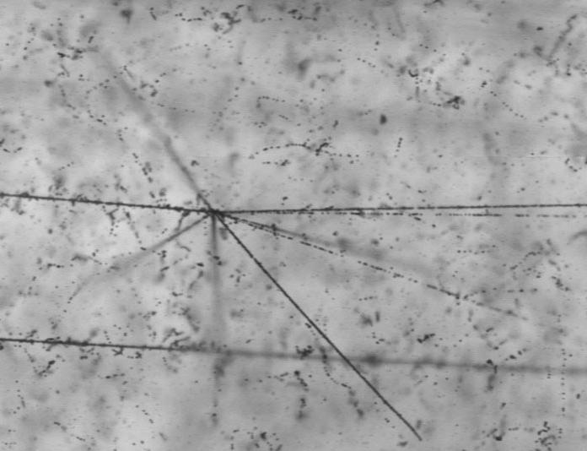
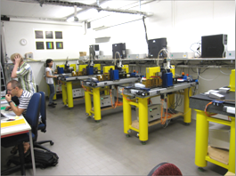
Advances in Nuclear Emulsion Detectors
J. Kawada, et al. Bern University
Nuclear emulsion is a 3D dimensional tracking detector, with sub micron position resolution.
Very old detector, but recently high speed readout system were developed, emulsion has many applications in many fields now.
Interaction of carbon nuclei in emulsion
Application Examples
Particle physics | OPERA(Neutrino Oscillation) AEgIS (Anti-particle gravity measurement)
Radiology | Beam monitor in proton therapy Neutron detection
Nuclear physics | Hyper Nuclei, Exotics search
Astronomy | Cosmic ray (Electron, heavy nuclei, etc)
Geology | Muon radiography
Emulsion scanning lab in Bern Univ.

Slide 15
A New Low Momentum Electrons Tertiary Test Beam Line at Fermilab
G. M. Piacentinoi, et al. INFN Lecce, Fermilab, and Università G. Marconi
The present work describes the design and full simulation of a new low-energy beam and tertiary beamline at Fermi National laboratory
The work has been focused on the study and simulation of all the feasible variations of the beamline taking into account the characteristics of the existing high energy beam, the space constrains within the experimental hall and the requirements
The aim is to deliver a low energy electron beam as a possible test beam for Mu2e experiment aside with the feature of switching to other kind of low energy particles beams in order to test most of the background radiation of the true experiment
A summary of the final design of the tertiary beamline is presented with the expected response of its elements based on complete Monte Carlo simulation
? Poster

Slide 16
UA9, an Experiment to Study Accelerator Crystal Collimation
W. Scandale, et al. INFN –Roma 1 / INAF
UA9 experimental equipment was installed in the CERN-SPS in March ’09 with the aim of investigating crystal assisted collimation in coasting mode.
Based on silicon bent crystals acting as primary collimators mounted inside two vacuum vessels. A movable 60 cm long block of tungsten located downstream with ~90 degrees phase advance intercepts the deflected beam.
Scintillators, Gas Electron Multiplier chambers and other beam loss monitors measure nuclear loss rates induced by the interaction of the beam halo in the crystal.
Two Roman pots installed in the path of the deflected particles are equipped with a Medipix detector to reconstruct the transverse distribution of the impinging beam.
The UA9 takes advantage of an LHC-collimator prototype installed close to the first Roman pot to help in setting the beam conditions and to analyze the efficiency to deflect the beam.
The hardware installed to study the crystal collimation during the various data taking periods in 2009-2011 and the challenges for the upgrade of the system to study crystal collimation on the LHC will be described.

Slide 17
A MAPS Vertex Detector for the Measurement of the Double Differential Cross Section of Ions on Different Targets in the FIRST Experiment
E. Spiriti, et al. INFN – Roma
The FIRST (Fragmentation of Ions Relevant for Space and Therapy) experiment at GSI has been built to study carbon fragmentation, measuring ¹²C double differential cross sections for beam energies between 100 and 1000 MeV/u with an experimental setup that integrates newly designed detectors in an existing setup at GSI laboratory (Darmstadt).
In the interaction region a key role is played by the Vertex detector made of four layers of M26 pixel sensors MAPS type (Monolithich Active Pixel Sensor), provided by the IN2P3 Strasbourg group, spaced 3mm and thinned down to 50 micrometers thickness to minimize secondary fragmentation.
Each layer covers an area of 2 x 2 cm² with an overall angular coverage of +/-40 degrees and the 18.6 micrometers pitch of the sensor allows a final tracking resolution of about 5 micrometers.
The mechanical structure of the detector, the newly built data acquisition system and a outline of the reconstruction software with the preliminary results of the last August data taking will be presented.
? Poster*

