Slide 1
The RD51 Collaboration,
Micro-Pattern Gas Detector Technologies and Applications
Leszek Ropelewski, CERN, Switzerland
on behalf of the RD51 Collaboration
OUTLINE:
RD51 Motivation and Main Objectives
RD51 Collaboration Activities and Results
Large area detectors
Electronics
Software tools
MPGD workshop upgrade & industrialization
Technology Transfer
RD51 test beam facility
Training
Summary and Outlook
12th Pisa Meeting on Advanced Detectors, Isola d’Elba, 20-26 May 2012

Slide 2
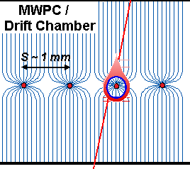
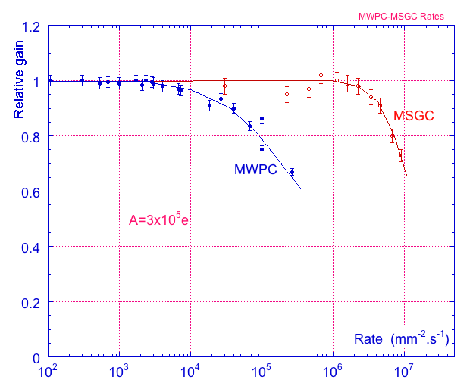
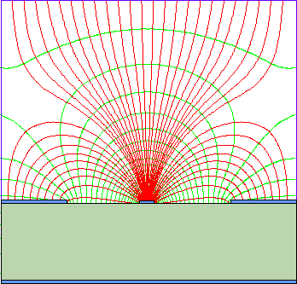
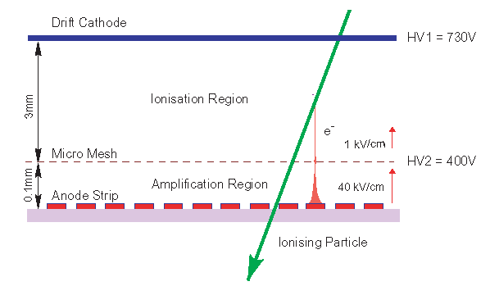
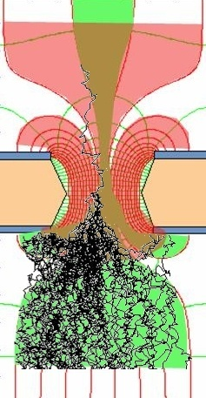
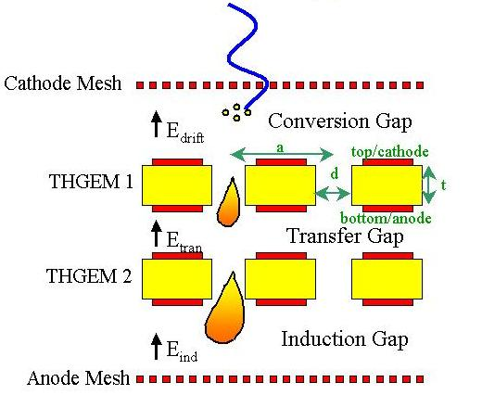
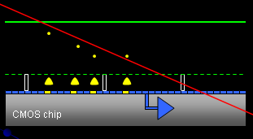
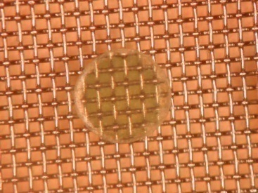
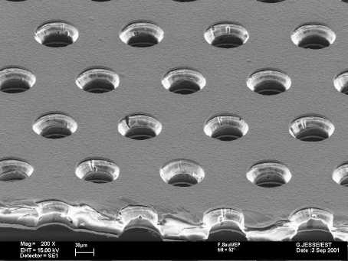
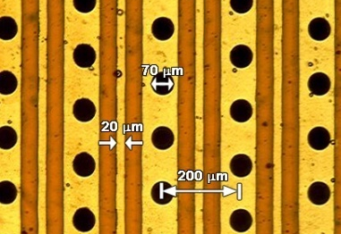
Current Trends in Micro-Pattern Gas Detectors (Technologies)
Semiconductor Industry technology:
Photolithography
Etching
Coating
Doping
Wafer postprocessing
Ions
40 %
60 %
Electrons
Micromegas
GEM
THGEM
MHSP
Ingrid
2

Slide 3
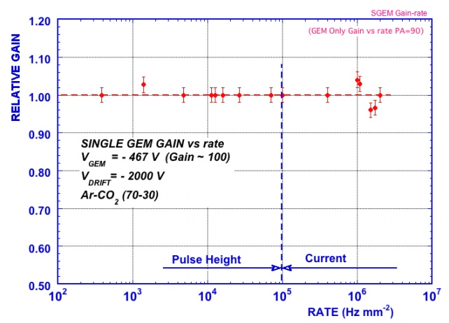
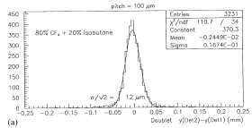
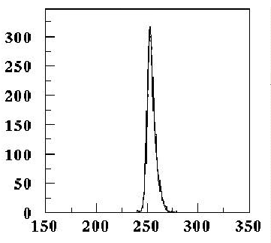
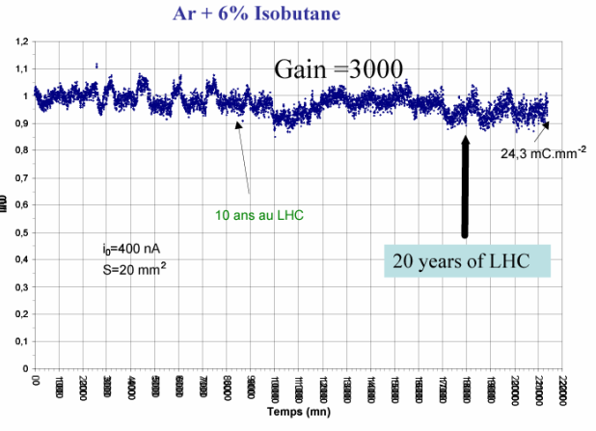
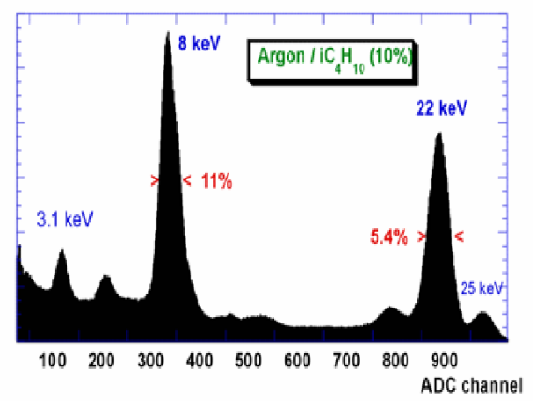
Micro-Pattern Gas Detectors Performance Summary
GEM
THGEM
Rate Capability
High Gain
Space Resolution
Time Resolution
Energy Resolution
Ageing Properties
Ion Backflow Reduction
Photon Feedback Reduction
2x10⁶ p/mm²
Micromegas
GEM
Ar/CO2/CF4
(45/15/40)
rms = 4.5ns
Spatial
resolution
σ ~ 12 μm
MHSP
Micromegas
Micromegas

Slide 4
Demand for the Micro-Pattern Gas Detectors
MPGD are mostly used/proposed for high-rate tracking and photodetectors
COMPASS Upgrade:
Micromegas and GEM detectors for high-rate tracking
Photon Detectors Using THGEM technology for RICH 1
KLOE2 Upgrade:
Large-area cylindrical GEMs for Inner Tracker
RHIC Upgrades:
GEM Tracking for STAR Experiment
GEM Tracking for PHENIX Experiment(+ drift micro-TPC);
development of Ring Imaging version of HBD for particle ID
Future JLAB Projects:
Thin-Curved Micromegas for JLAB/CLAS12
GEM Tracker for JLAB/Hall A High Luminosity (SBS) experiments
Future FAIR Facility:
GEM Tracker and GEM TPC for the PANDA Experiment
GEM/Micromegas tracking in CBM Muon Chamber (MUCH)
Future Electron - Ion Collider Facility:
Tracking and particle ID detectors based on MPGD-technology

Slide 5
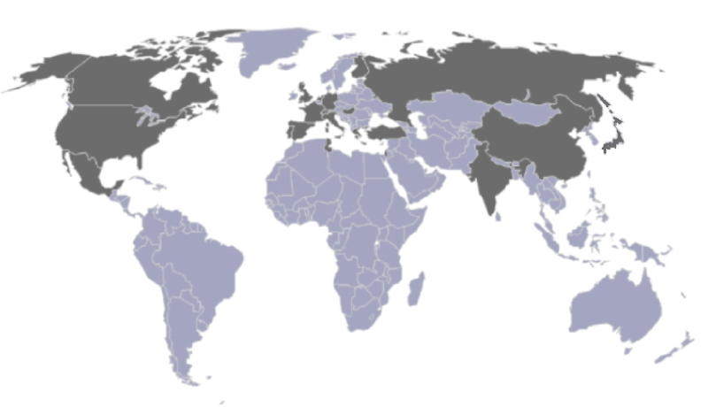
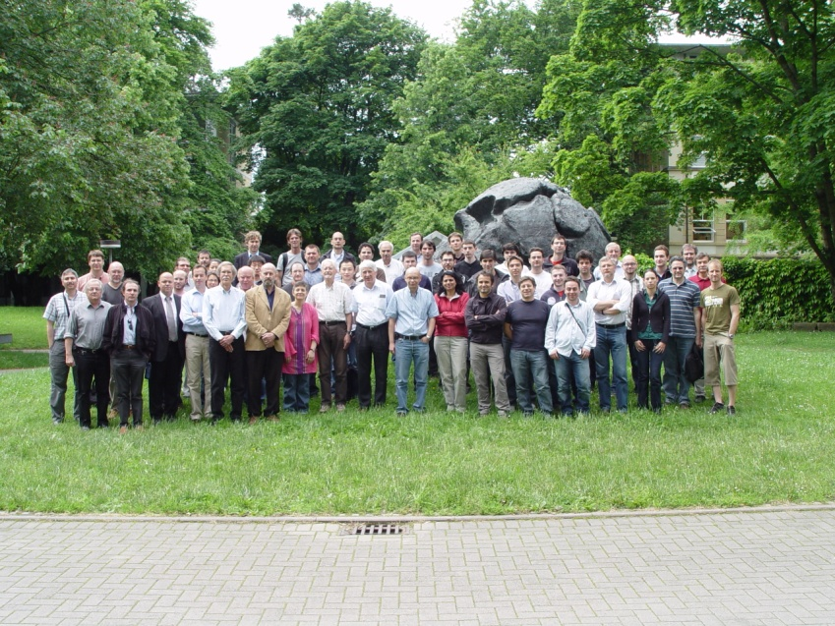
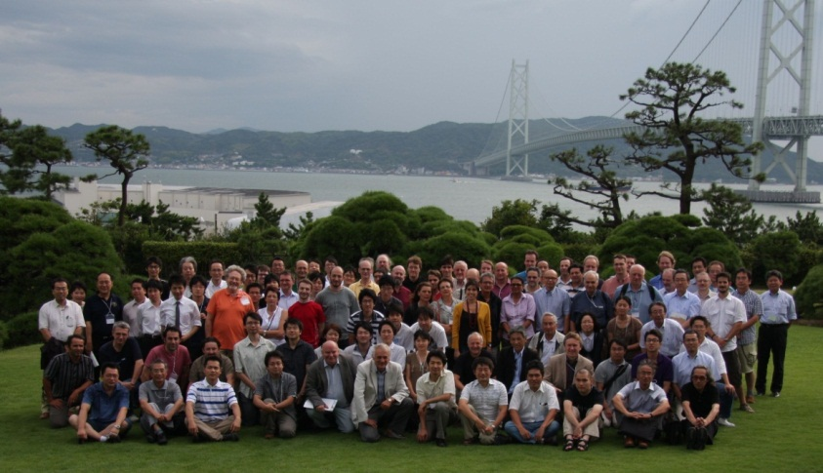
RD51 Collaboration
The main objective of the R&D programme is to advance technological development of Micropattern Gas Detectors
~ 80 institutes
~ 450 people involved
Representation (Europe, North America, Asia, South America, Africa)
“RD51 aims at facilitating the development of advanced gas-avalanche detector technologies and associated electronic-readout systems, for applications in basic and applied research”
Freiburg , Germany, May 2010
Kobe, Japan, September 2011
RD51 contributes to the LHC upgrades, BUT, the most important is:
RD51 serves as an access point to
MPGD “know-how” for the world-wide community
5

Slide 6
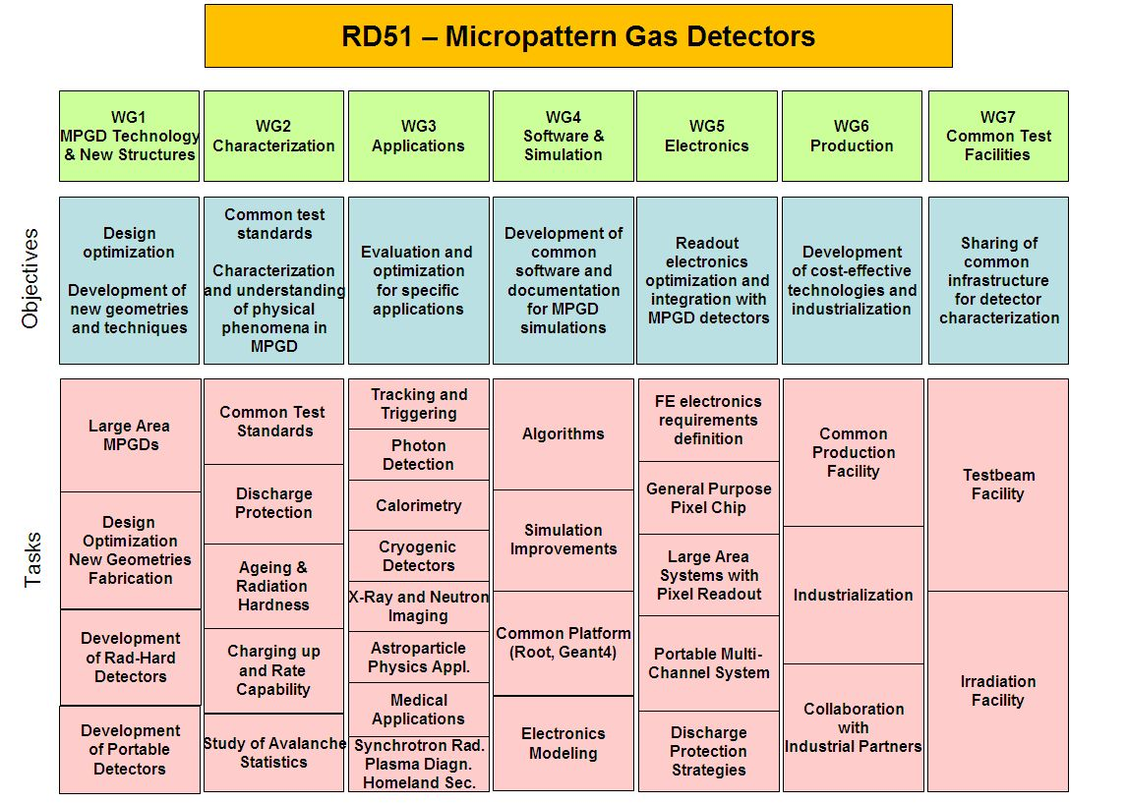
RD51 Collaboration – Working Groups
“Transverse organization” of MPGD activities in 7 Working Groups
6

Slide 7
RD51 Collaboration Organization
RD51 Collaboration Organization
Consolidation around common projects: large area MPGD R&D, CERN/MPGD
production facility, common electronics developments, software tools, beam tests
WG1: large area Micromegas, GEM; THGEM R&D; MM resistive anode readout (discharge protection); design and detector assembly optimization; large area readout electrodes and electronics interface
WG2: double phase operation, radiation tolerance, discharge protection, rate effects, single-electron response, avalanche fluctuations, photo detection with THGEM and GridPix
WG3: applications beyond HEP, industrial applications (X-ray diffraction, homeland security)
WG4: development of the software tools; microtracking; neBEM field solver, electroluminescence simulation tool, Penning transfers, GEM charging up; MM transparency and signal development, MM discharges
WG5: scalable readout system; Timepix multi-chip MPGD readout
WG6: CERN MPGD Production Facility; industrialisation; TT Network
WG7: RD51 test beam facility
7

Slide 8
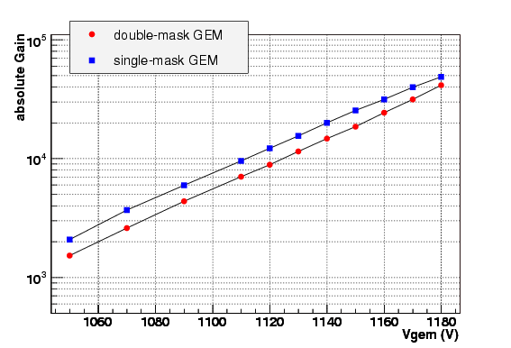
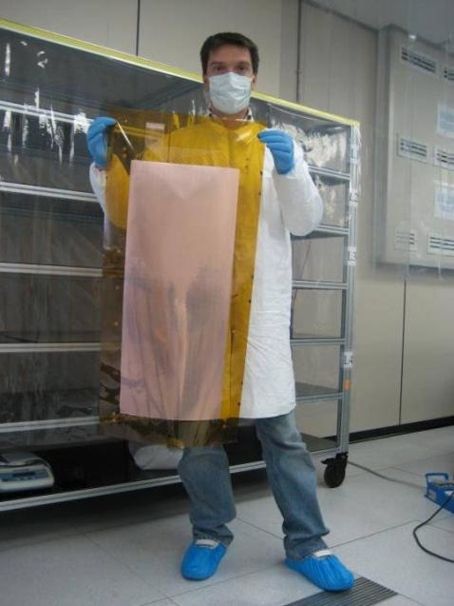
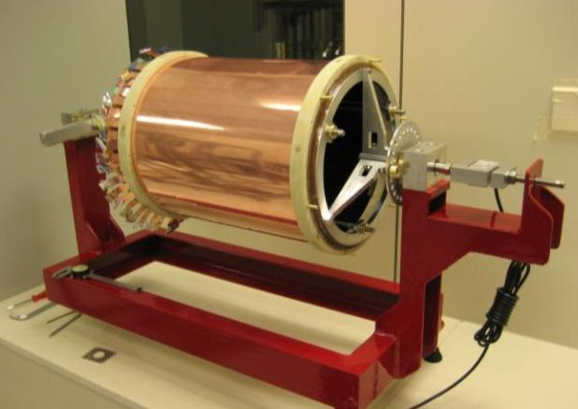
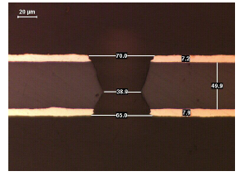
WG1: Large area detectors
Single mask GEM technology
Chemical Polyimide etching
Copper electro etching
Stripping
Second Polyimide etching
Result
Large area GEM detectors for KLOE2 tracker
Frascati
D. Domenici
8

Slide 9
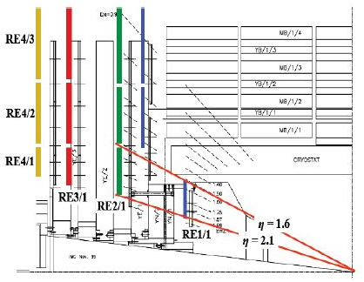
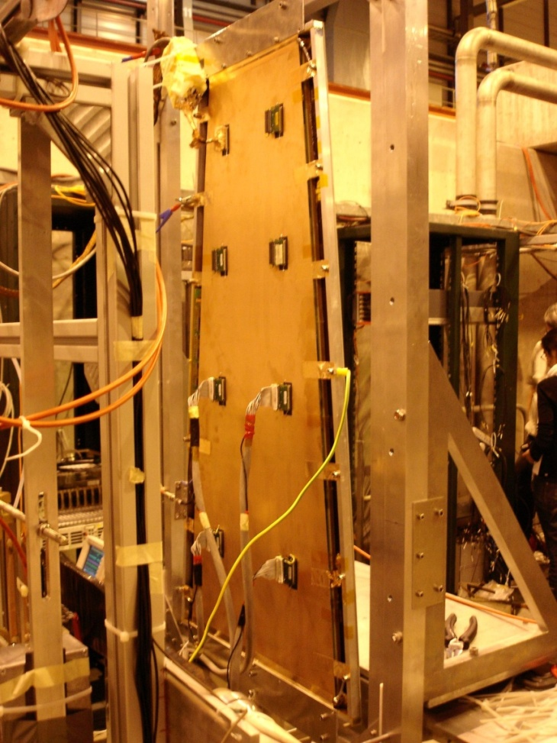
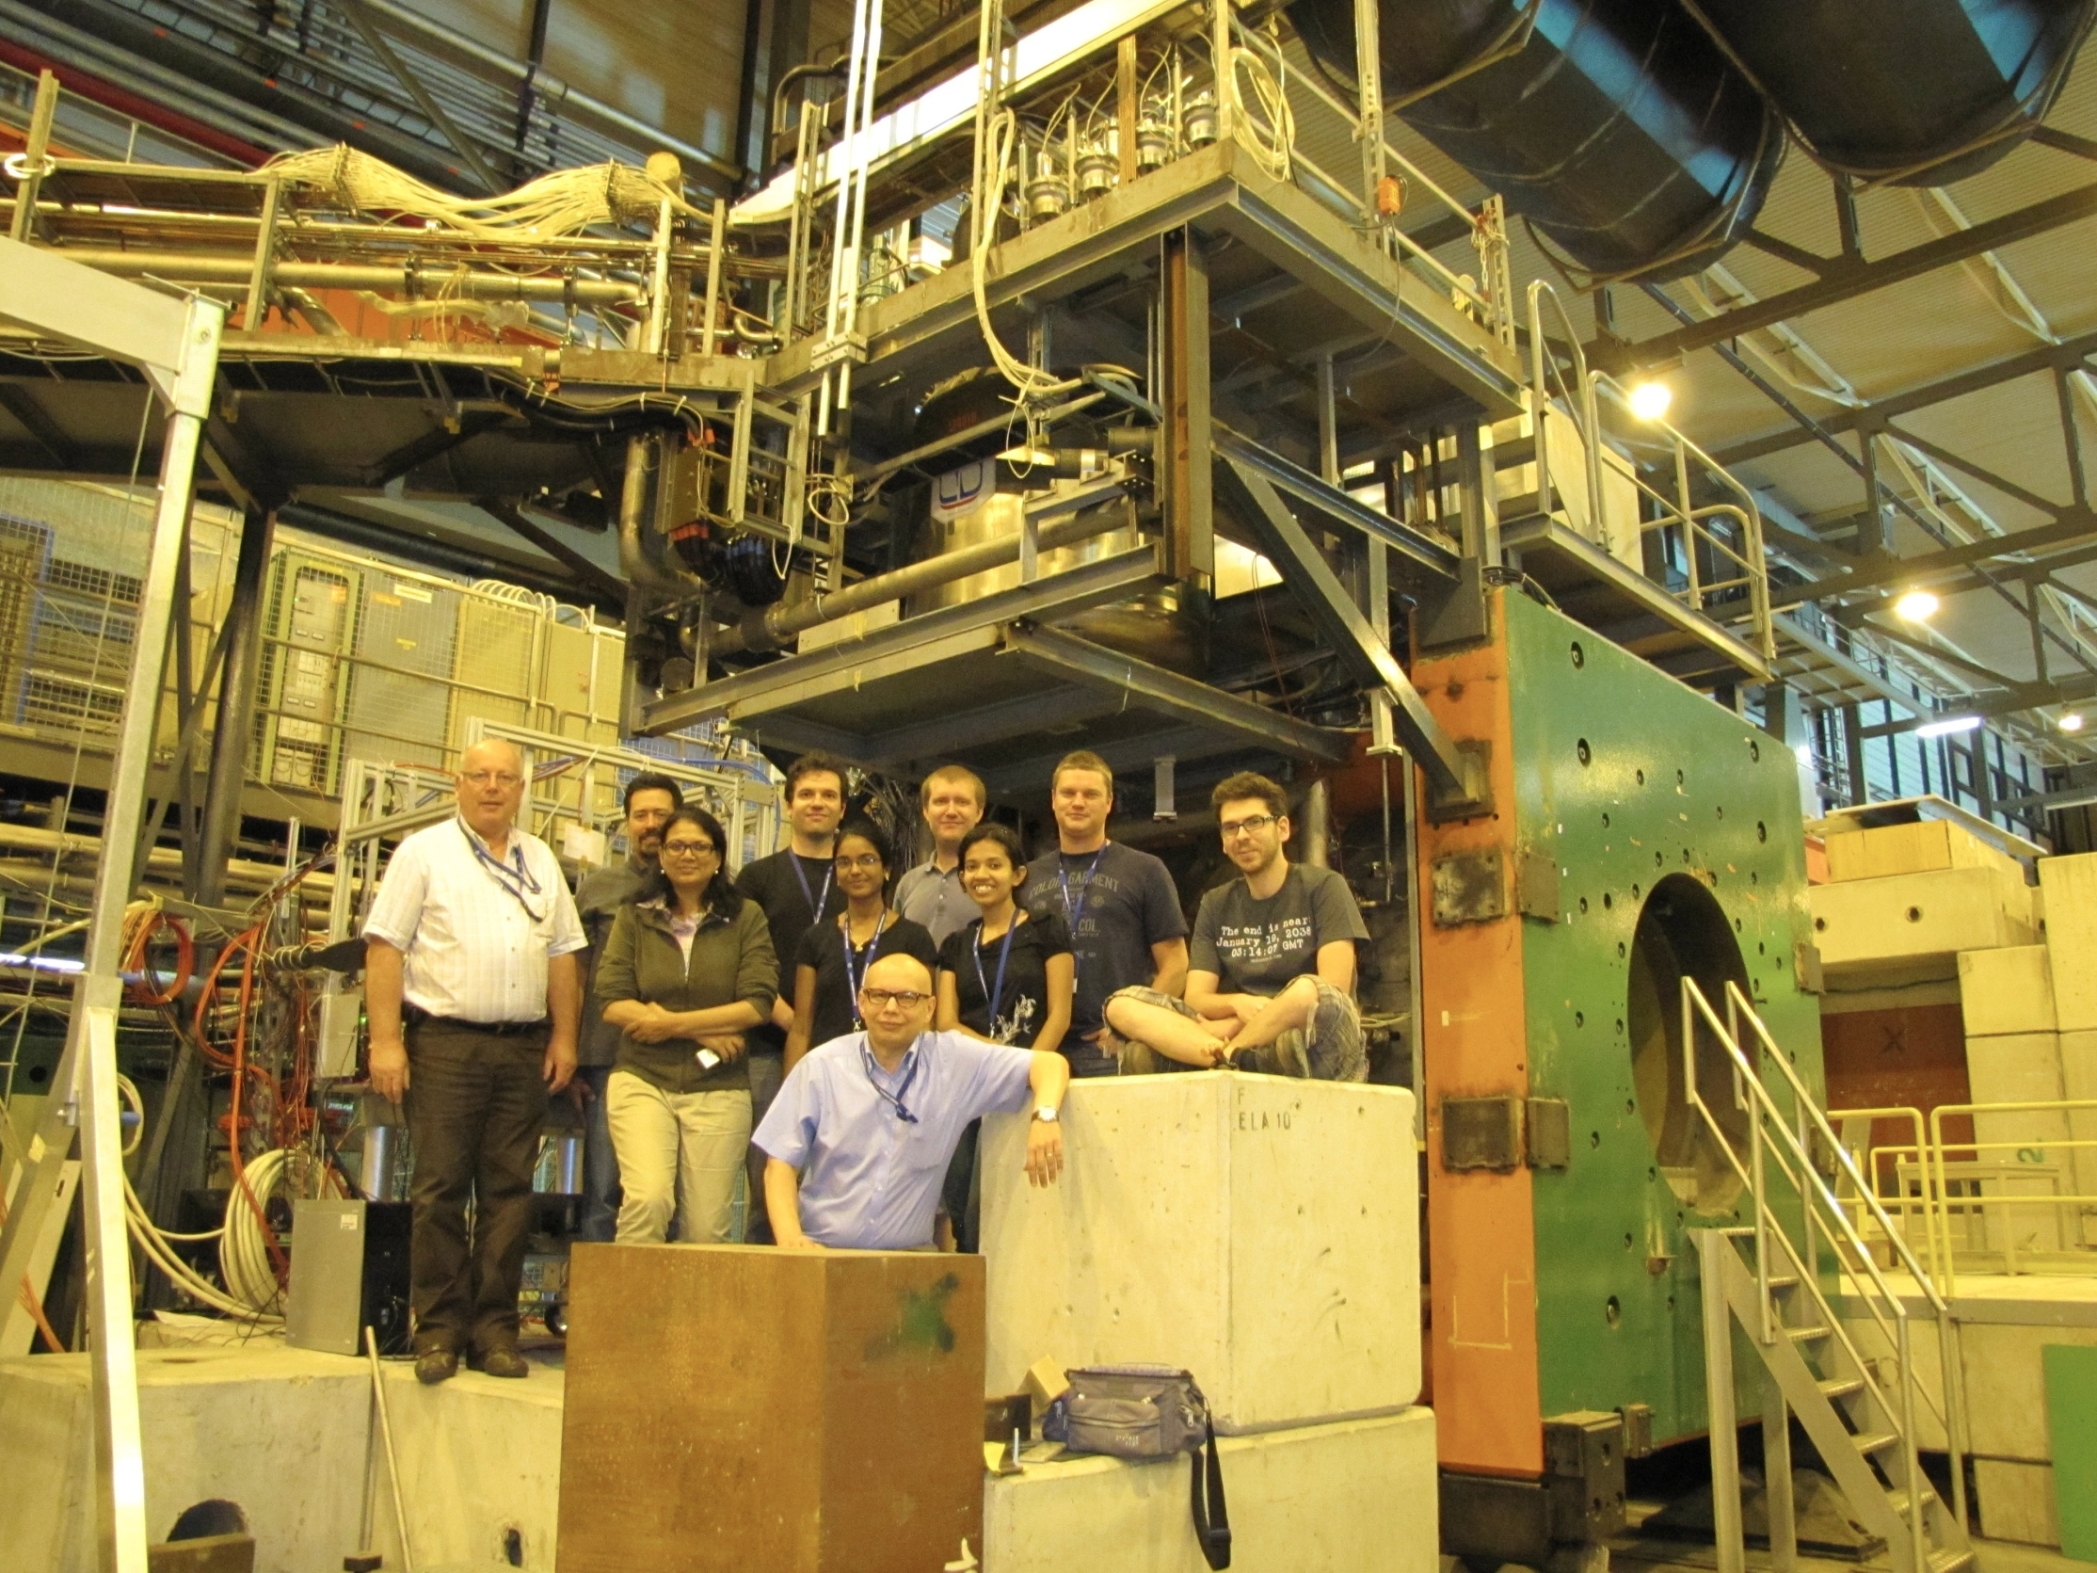
CMS High Eta MPGD Project (GE1/1 1.6>η>2.1)
GEM for CMS Collaboration
S. Colafranceschi
Goals:
Development and evaluation of large size GEM detectors for tracking and triggering.
Assembly optimization for cost reduction
Production transfer to industry
Large Prototype: GE1/1
Beam Test @ RD51 setup
Requirements:
Rate capability : 10⁴/mm²
Space/Time resolution: ~ 100 μm / ~ 4-5 ns
Efficiency > 98% ; Excellent Long Term Operation
Large areas ~ 1m x 2m with industrial processes
9

Slide 10
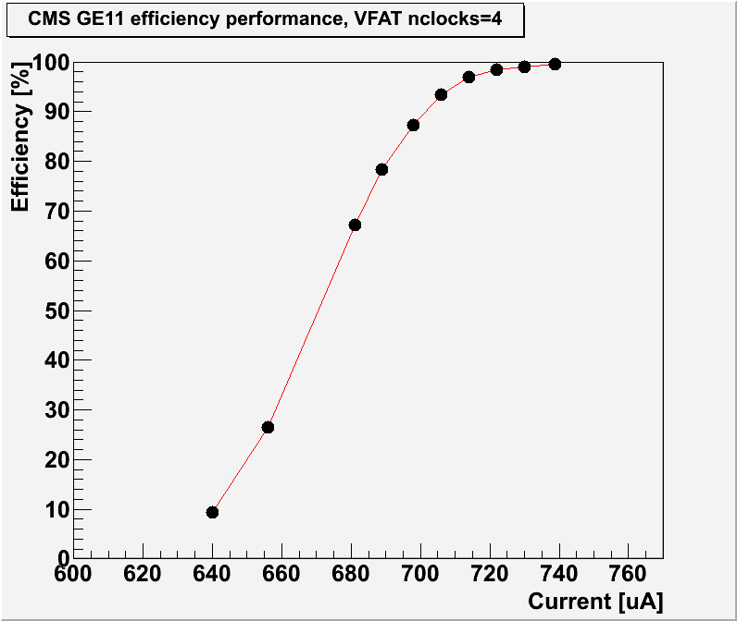
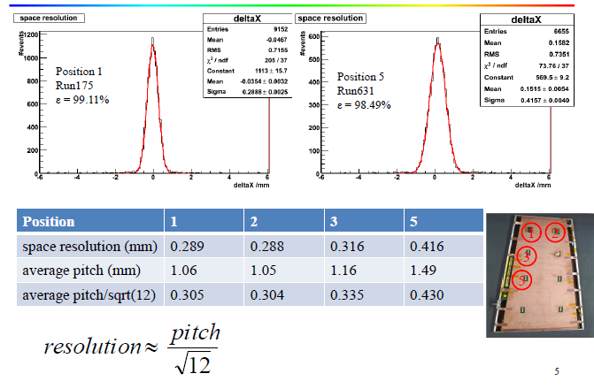
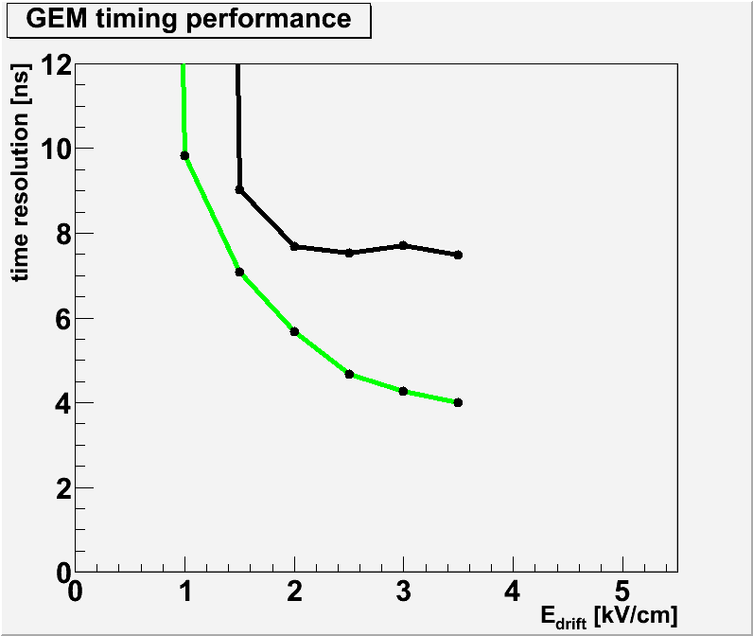
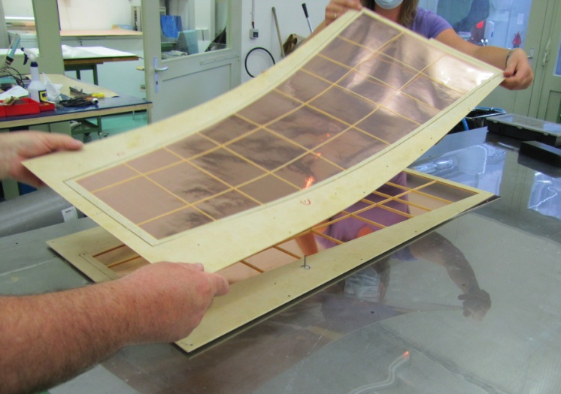
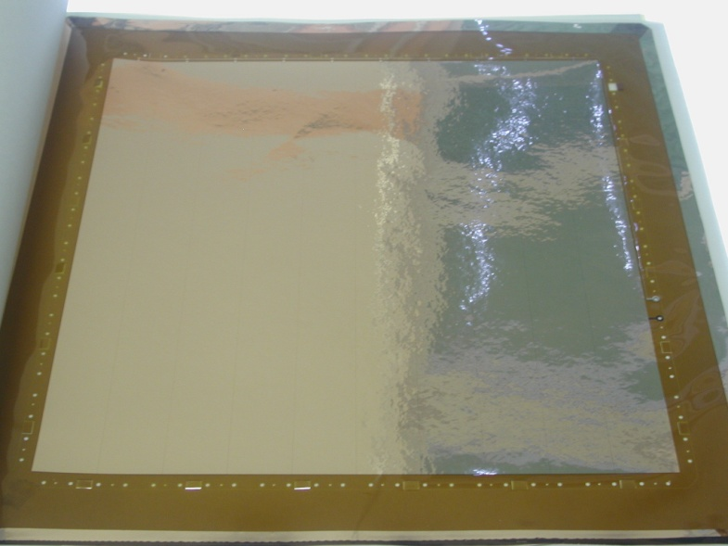
CMS High Eta MPGD Project
  Time resolution for different
  gas mixtures and gap configurations:
  Ar(45):CO₂ (15):CF₄ (40)
  [gaps 3/1/2/1]
  Ar(70):CO₂(30)
  [gaps 3/2/2/2]
Self-stretching technique:
Assembly time reduction: 3 days → 2 hours
S. Colafranceschi
10

Slide 11
ALICE endplates TPC upgrade with GEMs
V. Manzari
Goals and Requirements:
Space-charge effects at 50 kHz Pb-Pb continuous readout too high with wires
  Limit GEM ion back-flow to 0.25% at gain 1500 –R&D required
Maintain excellent dE/dx resolution for particle Id uniformity and time stability
Total area: 32.5 m²
Chamber size 46x50 cm² and 88x112 cm² -> Use single mask GEM technology

Slide 12
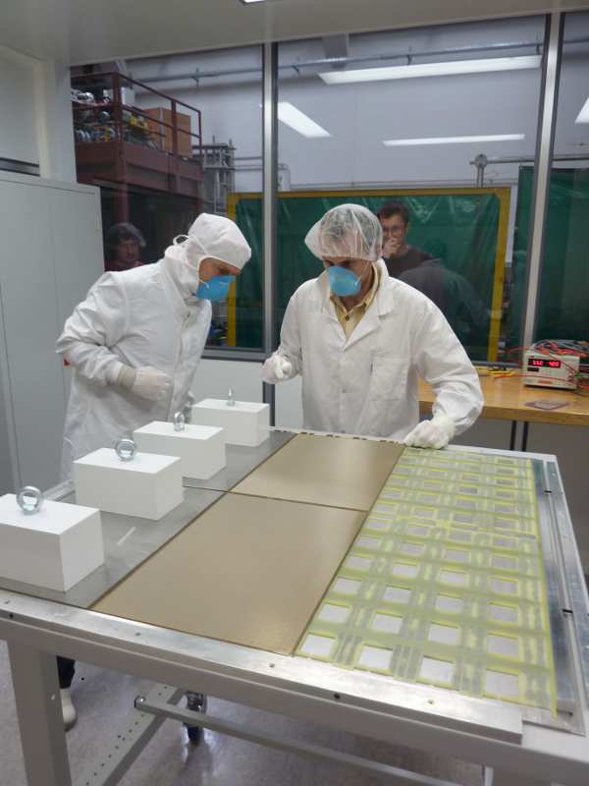
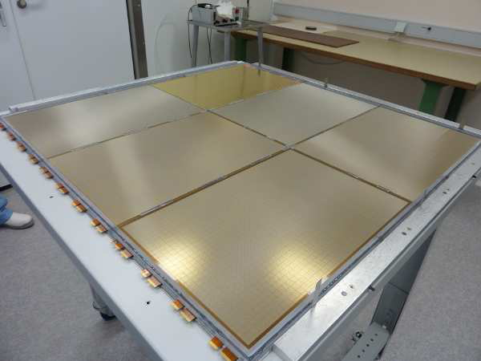
WG1: Large area detectors
Bulk MicroMegas technology
PCB
lamination
Mesh deposit
lamination
Fine segmentation 1cm², thickness 8mm for ILC Hadronic calorimetry
Tested in the RD51 1 kHz beam
development
Bulk Micromegas ILC DHCAL first m²
LAPP Annecy
12

Slide 13
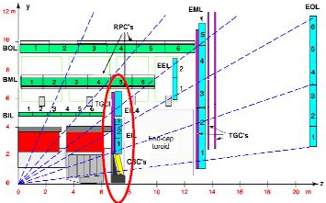
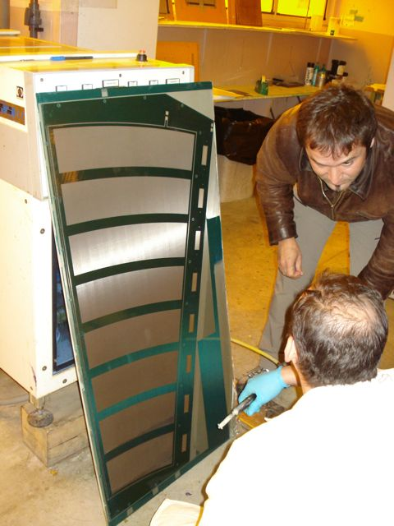
MicroMegas detectors for the upgrade of the ATLAS muon system
Goals:
Development of large-area (≈2 x 1 m²) bulk-MicroMegas chambers for high-rate applications that combine precision measurement and trigger functionality
Spark neutralization and/or suppression
Resistive coating on readout strips
Multi-stage amplification schemes
Transfer of know-how to competent industry
Large-scale production in industry
March 2011
Requirements and Performance:
Spatial resolution ~30μm (Ar:CO₂ 93:7)
Single plane efficiency 98%
Gains above 10⁴
Clean signals up to >1 MHz/cm²,
with some loss of gain
Stable response over duration of
neutron irradiation equivalent
to 20 years LHC (5x10³⁴ cm⁻²s⁻¹)
1.2 x 0.6 m² prototype chamber with 2048 readout strips (0.5 mm strip pitch) during construction in CERN/TE-MPE workshop
M. Byszewski

Slide 14
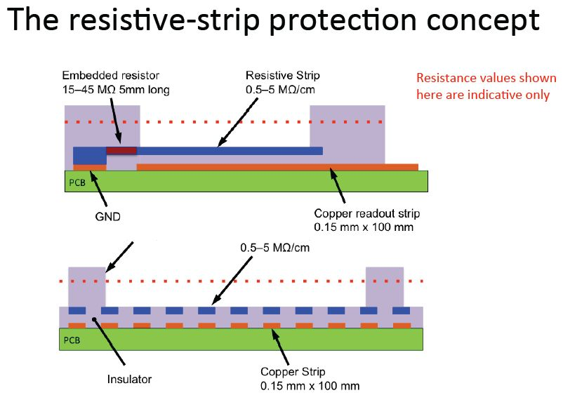
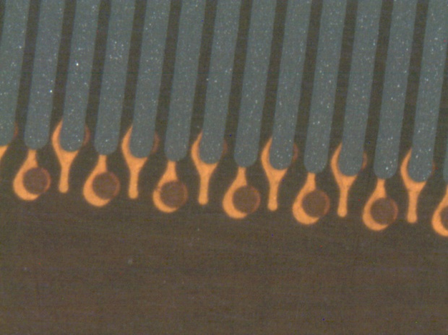
M. Byszewski

Slide 15
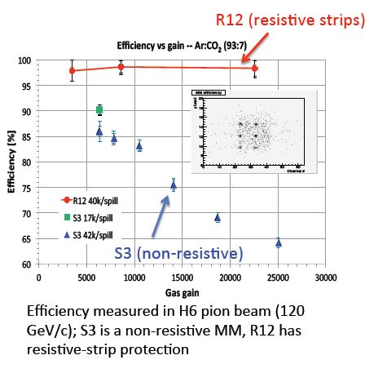
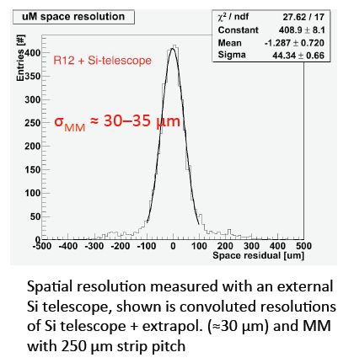
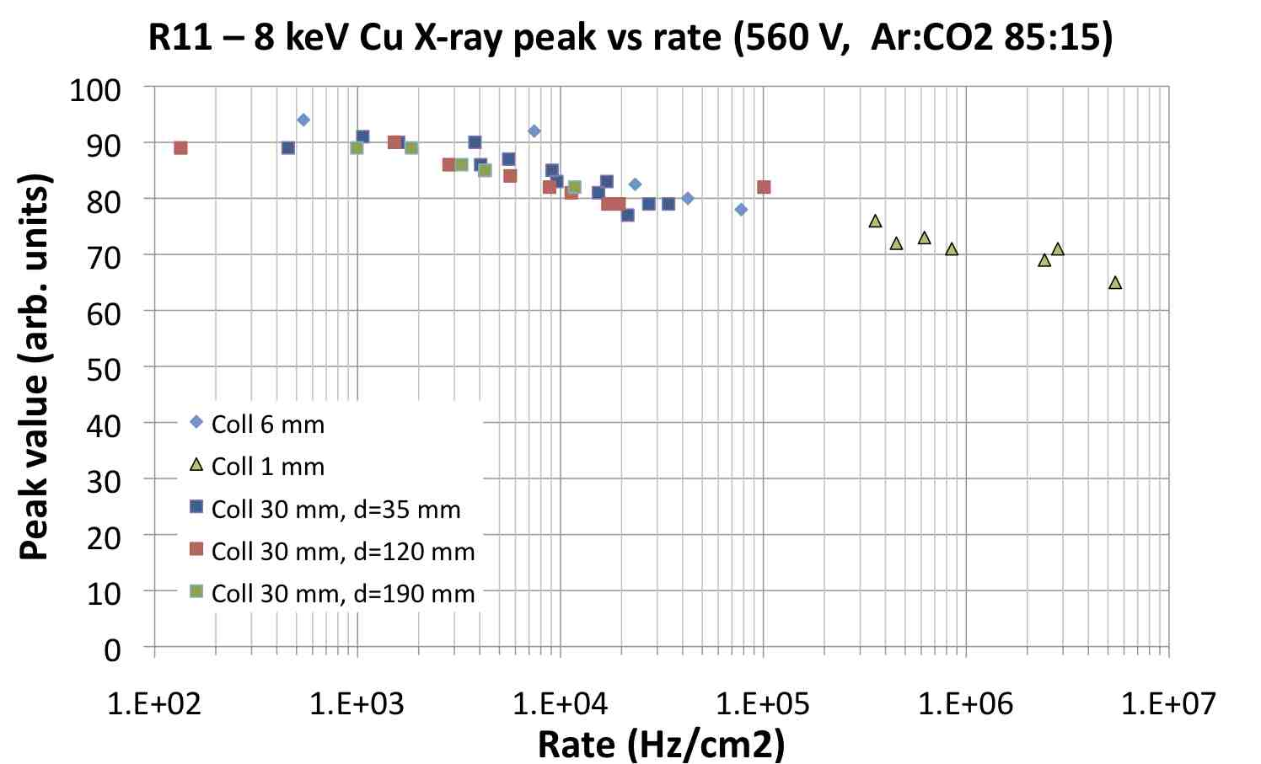
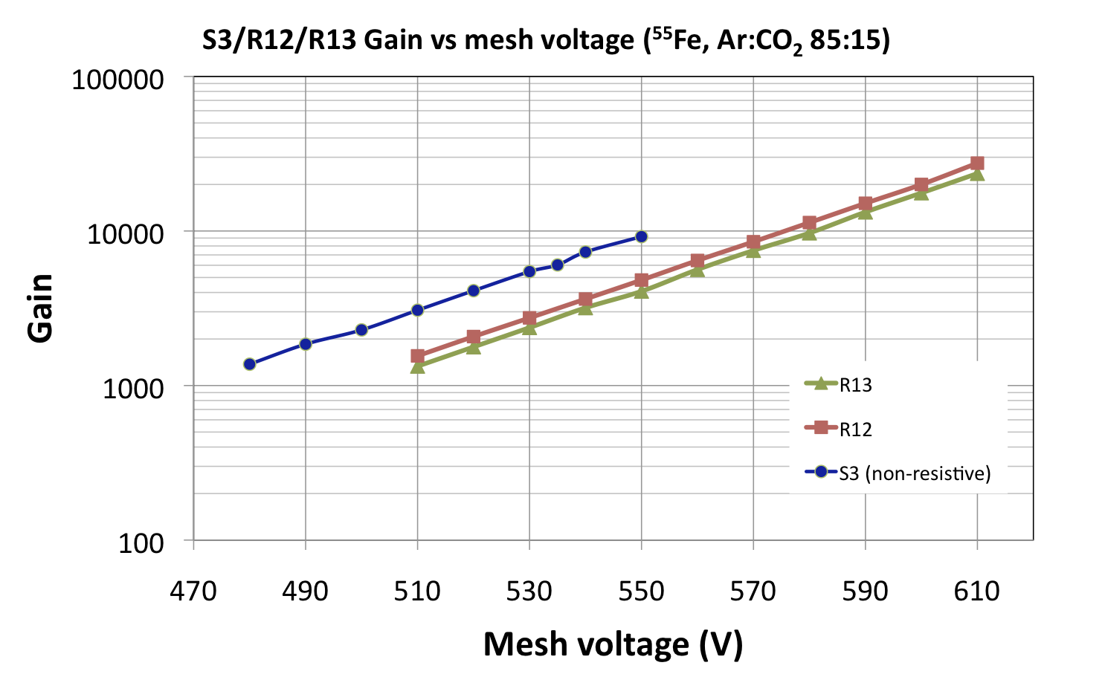
MM Resistive strip protection
Gain ≈ 5000
M. Byszewski

Slide 16
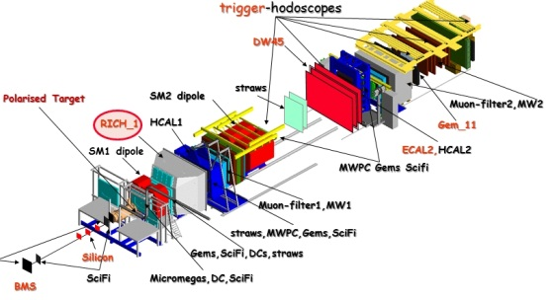
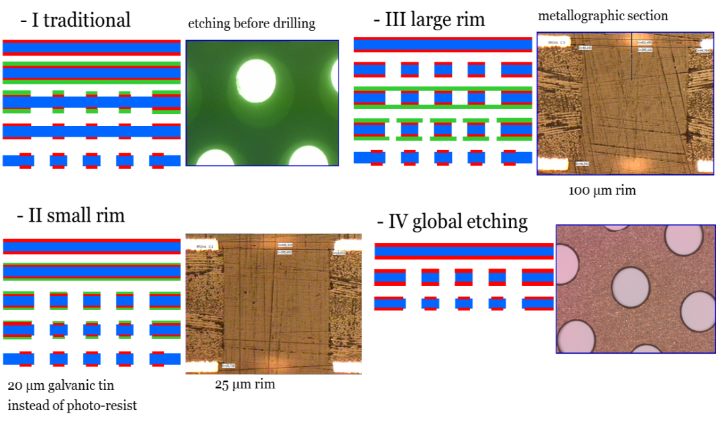
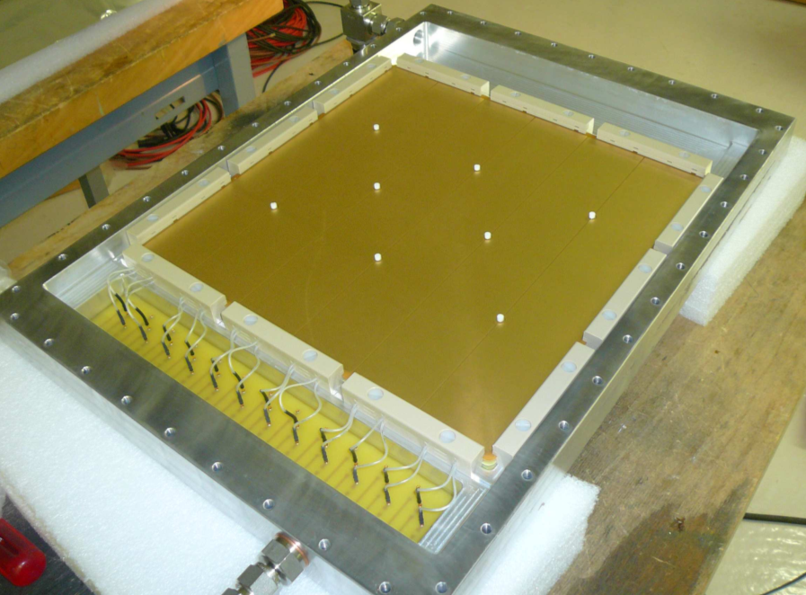
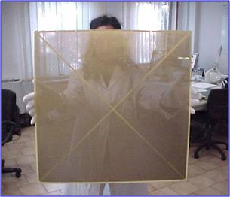
ThickGEM photon detector for COMPASS RICH-1
Requirements:
Reduced photon and Ion BackFlow (IBF)
Reduced aging
High stable gain - high photoelectron detection efficiency
Large area
Short integration time
High rate environments
In collaboration
with industrial PCB company
ELTOS S.p.A. Arezzo Italy
F. Tessarotto

Slide 17
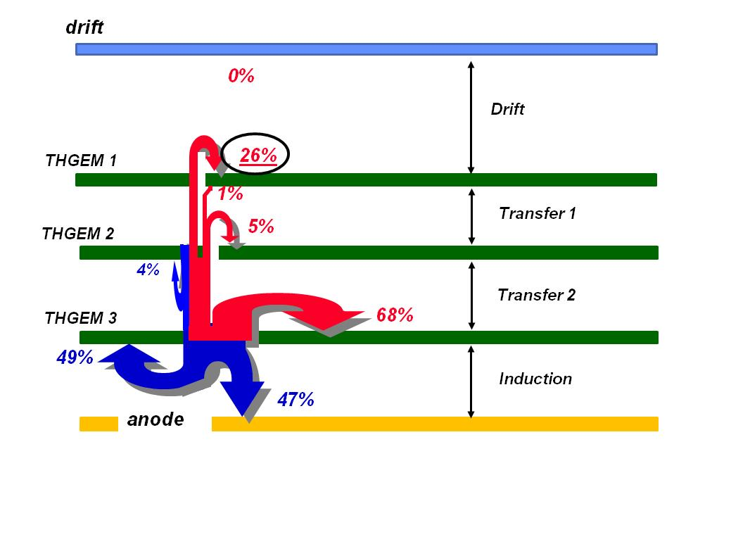

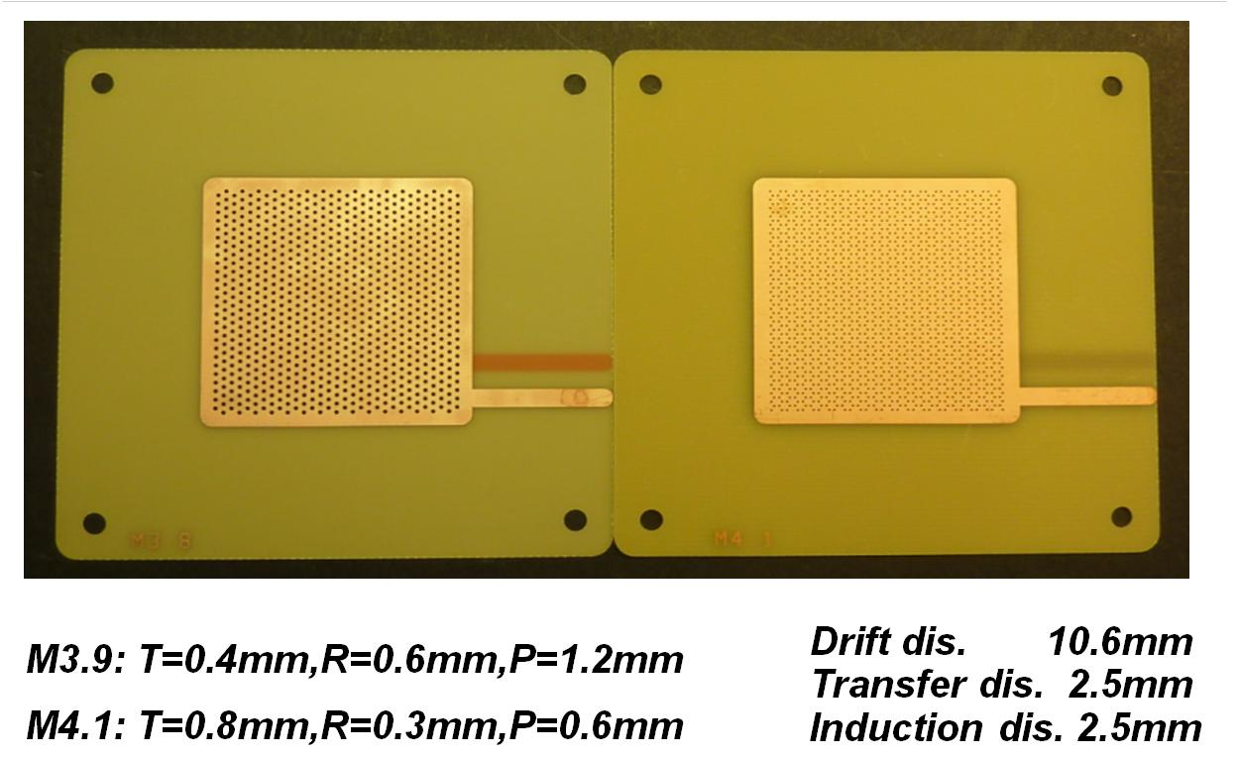
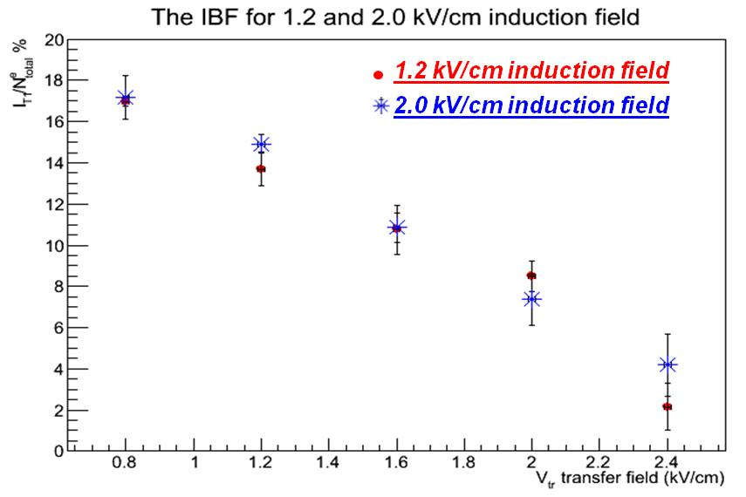
Ion backflow reduction with “Flower THGEMs”
F. Tessarotto
current flow for the standard triple THGEM configuration:
“Flower THGEM” configuration:
THGEM 1 has holes of 0.6 mm diameter, 1.2 mm pitch
THGEM 2 has holes of 0.3 mm diameter, 0.6 mm pitch,
with 1/3 of the holes missing: the ones below the THGEM 1 holes
This configuration
provides charge
splitting and allows
for ion backflow
minimization
current on TOP of THGEM 1 in %
for the “FLOWER” configuration:

Slide 18
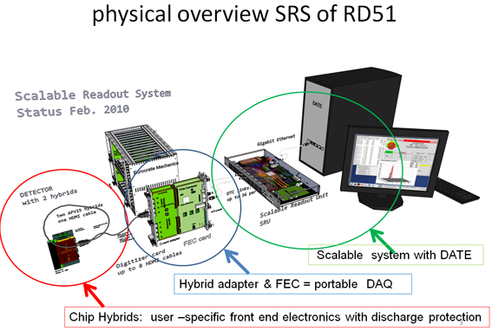
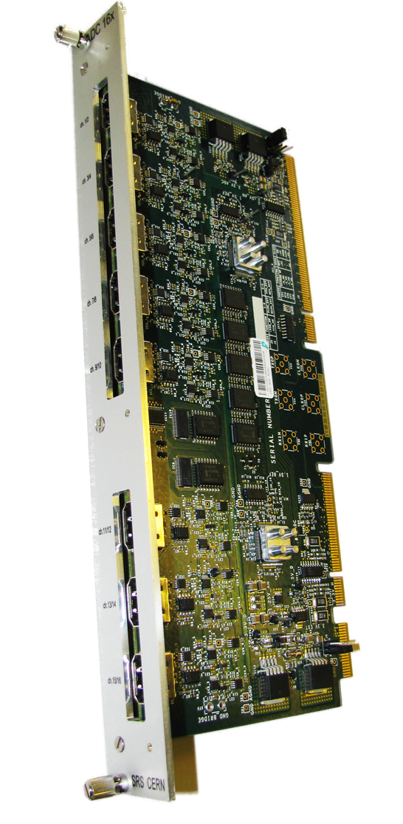





Electronics for MPGD
ADC frontend adapter
for APV and Beetle chips
ADC plugs into FEC to make a 6U readout
unit for up to 2048 channels
H. Muller
Frontend hybrids
so far all based on APV25 chip
VFAT and Beetle being designed
FEC cards
Virtex-5 FPGA, Gb-Ethernet, DDR buffer, NIM and LVDS pulse I/O
High speed Interface connectors to frontend adapter cards
→ Scalable Readout System
Scalability from small to large system
Common interface for replacing the chip
frontend
Integration of proven and commercial
solutions for a minimum of development
Default availability of a very robust and
supported DAQ software package.
More than 10 full systems delivered
SRS Production 2012 (commercial): PRISMA, Alexandoupulis Gr, sales via CERN store, CERN contract KTT
18

Slide 19


RD51 SRS User Status
H. Muller
CERN experiments
ATLAS CSC upgrade MMegas ( 8kch APV-SRS systems, 1st SRS testbeams, MMDAQ developer )
ATLAS CSC upgrade MMegas, (VMM1 readout chip developer, SRS Adapter by Arizona Univ, MMDAQ )
ALICE EMCaL + FOCAL, SRU-based backend ( 50 kHz upgrade via SRS, DATE, new: Focal readout via SRS-Beetle ?)
ALICE TPC upgrade, SRS readout electronics with DATE backend ?
NA62 ref. tracker with Micro-Megas (1kCH-SRS Minicrate, MMDAQ )
CMS high Eta GEM collaboration ( VFAT hybrid and VFAT SRS adapter, in prep. )
Totem upgrade R&D , SRS VFAT readout, DATE ?
HEP experiments
NEXT Coll., dual Beta decay, SiPM, PM ( Collaboration on SRS HW & FW, FEC cards, DATE )
BNL GEM detector readout ( 2kCH. APV Minicrate, PHENIX SRDAQ porting to SRS )
Jeff. Lab Virginia Univ. GEM prototyping, ( Minicrate , Offline Data evaluation via AMORE + DATE)
SRS Minicrate up 4k ch.
Applications with Cosmic Tomography
FIT Florida, Muon Tompography for homeland security, GEMs ( 1st 16K SRS application, DATE )
Geoscienes CRNS- Waterquality in Rocks, MMegas ( 5kCh SRS Crate , DATE , Labview)
R&D with MPGD’s ( small systems )
Bonn/Mainz Univ, Timepix readout ( SRS- Timepix adapter card )
Helsinki HIP, GEM-MMega ( SRS evaluation, Trigger pickup box via CSP )
MEXICO UNAM, THGEM 2x ( SRS Minicrate, DATE )
C.E. Saclay, Micromegas ( 2k Ch SRS Minicrate , MMDAQ)
WIS Israel, THGEM 3x ( Minicrate, Beetle hybrid, SRS- Labview Beta tester
INFN Naples (Minicrate, Labview for SRS developer, CTF card , Zero-supression code
SRS crate 16k ch.
Teams waiting for commercial SRS delivery (orders via CERN store )
RD51 lab, Radcore, WIS, USTC, SAHA, INFN Bari, INFN Napoles, Stony Brook, Freiburg Univ
Yale Univ, J-Parc-RIKEN, East Carol. Univ., Jeff-Lab, Tsinghua Univ, Univ Texas,
* in red: SRS developers in green: to be confirmed in blue: USER

Slide 20
WG4: MPGD Simulation Tools
Focus on providing techniques for calculating electron transport in small-scale detectors.
The main difference with traditional gas-based detectors is that the electrode scale is comparable to
the collision mean free path.
C++ version of Garfield:
C++ class that has the functionality of the Garfield Fortran for gas has been developed. Lots of effort went into benchmarking and validating the new C++ code.
Gas properties (i.e. Magboltz) and primary ionization (i.e. Heed) have been implemented.
Drift path integration algorithms and analytic field calculations had already been translated, and it opens the path to TPC-like calculations.
Microscopic, MC and Runge-Kutta charge transport techniques are in place.
Progress is being made in a second generation and final interface to Geant4 from Garfield C++.
Maintenance:
Ionization processes – Heed and MIP (cluster size distribution, electron range and Fano limit)
Field calculations – BEM method validated for MPGD
Gas properties – Magboltz tables extended and updated (Ar, Xe, He, Ne; GeH₄,SiH₄, C₂H₂F₄ )
(Import ant in view of the next generation electroluminescent detectors for dark matter and double beta decays searches)
Generic studies:
Penning transfers
Avalanche statistics and gain fluctuations
Neutron detection in gases
Photon feedback
Modeling:
MicroMegas transfer properties
GEM charging up
IBF for TPC application
R. Veenhof
20

Slide 21

WG4: MPGD Simulation Tools
R. Veenhof
S. Didlick
H. Schindler
21

Slide 22
RD51– MPGD Production
1) Current: CERN-MPGD workshop is the UNIQUE MPGD production facility
(generic R&D, detector components production, quality control)
Detector Technology | Currently produced | Future Requirements
 | cm * cm | cm * cm
GEM | 40 * 40 | 50 * 50
GEM, single mask | 70 * 40 | 200 * 50
THGEM | 70 * 50 | 200 * 100
RTHGEM, serial graphics | 20 * 10 | 100 * 50
RTHGEM, Kapton | 50 * 50 | 200 * 100
Micromegas, bulk | 150 * 50 | 200 * 100
Micromegas, microbulk | 10 * 10 | 30 * 30
RD51
Collaboration
Survey:
R. De Oliveira
2) Future MPGD R&D: Reinforcement of CERN-MPGD workshop infrastructure to produce 2x1m
Bulk Micromegas and 2x0.5 m GEMs has been approved by CERN Management (Nov. 2009)
Participation the AIDA proposal
3) Technology Industrialization → transfer “know-how” from
CERN workshop to industrial partners for MASS PRODUCTION
22

Slide 23



New TE/MPE/EM Workshop Building 107
Start of the construction : beginning 2012
Completion: October 2013
Water treatment plant
Present location
New location
R. De Oliveira

Slide 24



Technology Industrialization
Potential partners
THGEM Technology – ELTOS S.p.A. (Italy)
GEM Technology
New Flex (Korea, Seoul)
Tech-ETCH (USA, Boston)
Scienergy (Japan, Tokyo)
Keerthi Industries (India)
MicroMETAL GmbH (Germany, Muellheim)
Micromegas Technology
ELTOS S.p.A. (Italy)
TRIANGLE LABS (USA, Nevada)
SOMACIS (Italy, Castelfidarco)
CIREA (France, CHOLET)
Industrial test runs for each technology foreseen in 2012 after selection of the best candidates
New Flex Facilities and the first evaluation GEM foils produced there
24

Slide 25



WG6: Technology Transfer and Spinoff
Example
Cargo container
MPGD Tracking Detector (GEMs)
hidden &
shielded
high-Z
nuclear
material
Θ
Θ
Scalable Readout System
Gas
Electron
Multiplier
Detector
~ 1.5 cm
Homeland Security
Cosmic Muon Tomography
Spherical GEM
For X-Ray Diffraction
M. Hohlmann,
25

Slide 26




WG7: Test Beam Facility at H4 SPS
2012 RD51 beam allocation
4 – 18 June
9 – 23 July
2 – 15 November
2 beam telescopes; services; DAQ, FEE
Y. Tsipolitis
GOSSIP/GridPix
THGEM for HCAL
THGEM for RICH
26

Slide 27


WG7: Test Beam Facility at H4 SPS
THGEM for RICH (upgrade for COMPASS)
GOSSIP/GridPix (NIKHEF) ATLAS inner tracker upgrade
THGEM for HCALs (Aveiro/Coimbra/UTA/Weizmann)
Resistive MicroMegas for JLAB and COMPASS (Saclay)
MicroMegas TPC for nuclear physics (Demokritos Athens)
GEM for CMS High-Eta upgrade
GEM for TOTEM T1 upgrade
Micromegas TPC for ILC (Saclay)
DHCAL Micromegas for CALICE
Y. Tsipolitis
DHCAL Micromegas
CMS High-Eta & TOTEM T1 upgrades
27

Slide 28



RD51 Simulation School
RD51 Simulation School (19-21 January 2011)
Contents:
Introduction to Geant4
Introduction to FEM, COMSOL
Field calculations
Transport of electrons in small-scale devices
Calculation of signals and their processing
25 participants; enthusiastic feedback
28

Slide 29


Excellence in Detectors and Instrumentation Technologies
CERN, Geneva, Switzerland - 31 January - 10 February 2011
“GEM Detectors”
The principles of GEM-based detectors and their applications will be explained. GEM detectors will be
assembled, and afterwards tested in X-ray stands. Concepts such as detection of X-rays will be explained and
pulse height gain, and counting rate measurements will be carried out.
Professors of excellence and Tutors: L.Ropelewski, G.Bencivenni
“GridPix and Micromegas”
The set-up consists of two tests stations:
A complete GridPix/Gossip detector(s): PolaPix, Dice, Gossip including gas system, new miniHV supplies and
readout systems. Students will operate the set-up and take data with various sources and cosmic rays, followed
by data analysis: track fitting, dE/dX, interaction of ionization radiation with gas.
The second set-up consists of a 10x10 cm2 bulk Micromegas read out by a charge preamp, amplifier- shaper and
a Multi-Channel analyzer, and a 1726-channel TPC in a gasbox, read out by T2K electronics. Fundamental
concepts such as X-ray conversion, diffusion, electron collection and gas amplification will be understood via
measurements with a full DAQ and analysis chain.
Professors of excellence and Tutors: H.van der Graaf, P.Colas
29

Slide 30
Summary and Outlook
consolidation of the Collaboration and MPGD community integration
considerable progress in MPGD technologies in particular large area GEM, THGEM, Micromegas; some picked up by experiments (including sLHC upgrades) for feasibility studies and prototyping
secured future of the MPGD technologies development through the TE MPE workshop upgrade and FP7 AIDA contribution (upgrade in progress)
improved MPGD simulation software framework allows for first applications
infrastructure for common RD51 test beam facility (~20 user groups)
development of common, scalable electronics (~20development and user groups)
contacts with industry for large volume production, first runs
30

