Slide 1
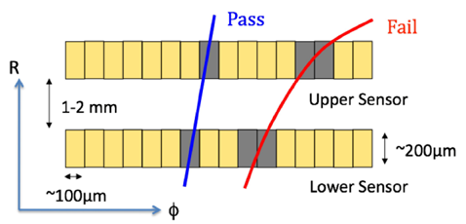
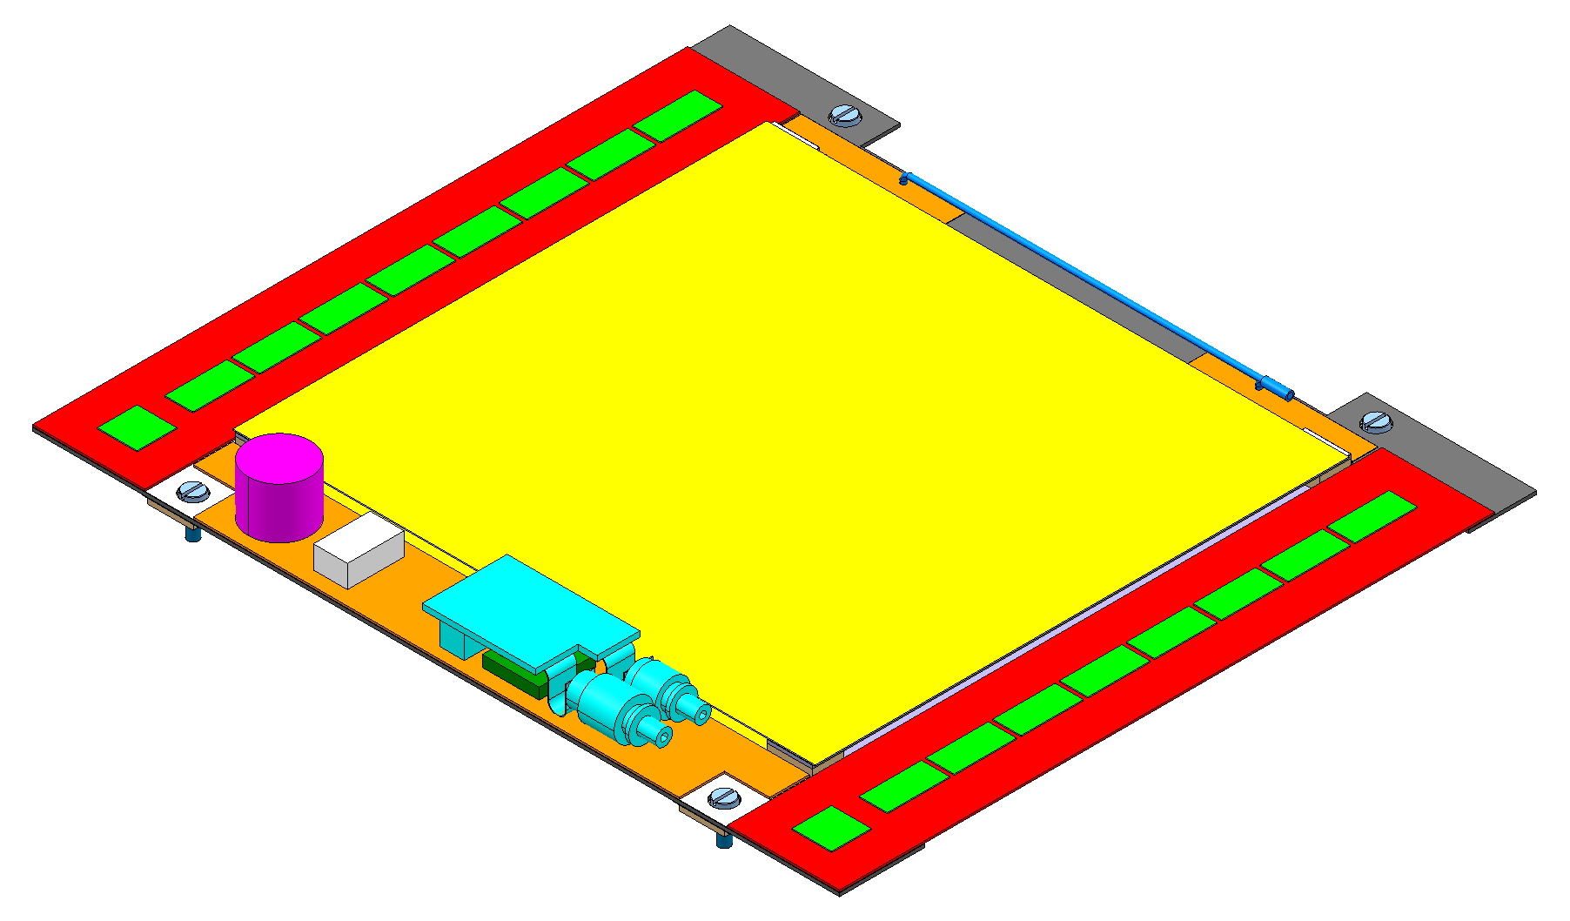
The CBC microstrip readout chip for CMS at LHC Phase II
D Braga, W Ferguson, J Fulcher, G Hall, L Jones, M Prydderch, M Raymond
Imperial College, London & Rutherford Appleton Laboratory
Readout of modules in outer radius of future CMS Tracker
To provide (high p_{T} stub) data for input to L1 trigger, with low latency
Readout of full data at up to 100 kHz
8 TeV !
edge view
127

Slide 2
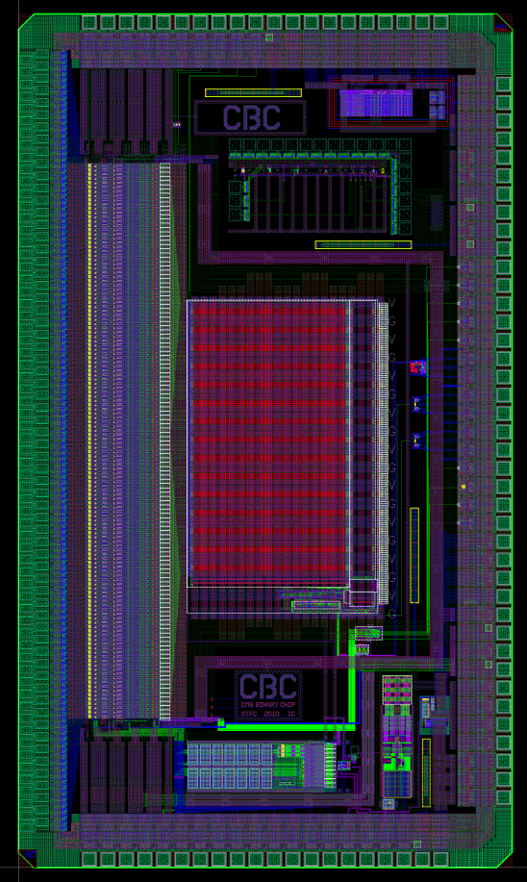
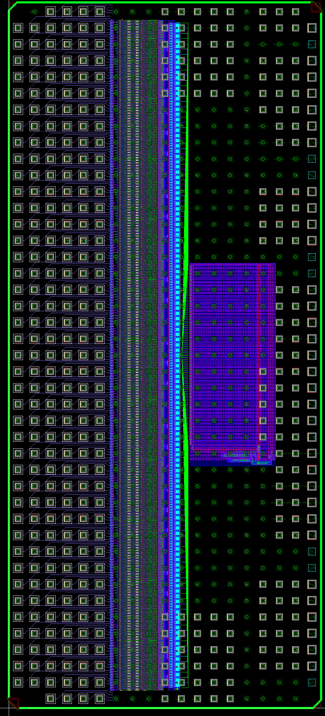
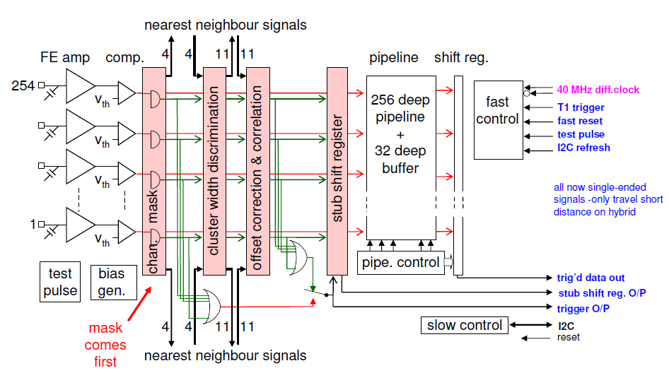
CBC -> CBC2
CBC2
254 channels
C4 bump-bond: 250 µm pitch
10.75mm x 4.75mm
Submit June 2012
CBC
128 channels
wirebond: 50 µm pitch
7mm x 4mm
Fully functional 2011

