Slide 1
DIRECT TRANSFER REACTION STUDIES WITH GRIT AT SPES
F. Galtarossa (INFN PD)
Young GAMMA's meeting
Asiago, June 21st, 2024

Slide 2
Outline
Introduction: direct transfer reactions
Experimental challenges
The GRIT project
Possibilities with SPES

Slide 3
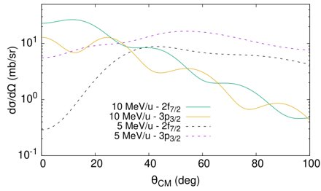
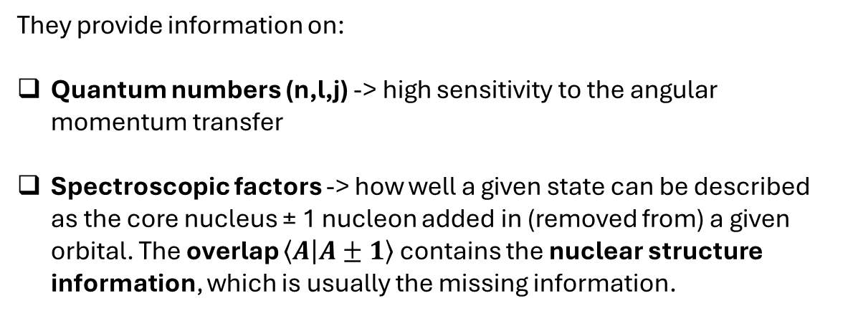

Direct transfer reactions
Direct transfer reactions are reactions where one or two nucleons are exchanged between projectile and target in a peripheral collision. Satchler: «Reactions that go directly from initial to final states without the formation of an intermediate compound system». (G. R. Satchler, Direct Nuclear Reactions, 1983)
They provide information on:
Quantum numbers (n,l,j) -> high sensitivity to the angular momentum transfer
Spectroscopic factors -> how well a given state can be described as the core nucleus ± 1 nucleon added in (removed from) a given orbital. The overlap $\left\langle A | A±1\right\rangle$ contains the nuclear structure information, which is usually the missing information.
$${\left(\frac{dσ}{dΩ}\right)}_{EXP}=C^{2}S{\left(\frac{dσ}{dΩ}\right)}_{DWBA}$$
These «simple» concepts have lots of interesting applications!
Shell evolution and new magic numbers
Effect of diffuse neutron surfaces (halo nuclei, spin-orbit weakening, influence of the continuum, …)
Relative role of tensor and spin-orbit forces
…

Slide 4
Selectivity of direct transfer reactions
How to get a 3/2⁻ in ³⁷S? Easy: adding a neutron on the p_{3/2} shell. But…
p_{1/2}
p_{1/2}
p_{1/2}
p_{1/2}
p_{3/2}
p_{3/2}
p_{3/2}
p_{3/2}
...
α
f_{7/2}
f_{7/2}
+
β
f_{7/2}
f_{7/2}
+
d_{3/2}
d_{3/2}
d_{3/2}
d_{3/2}
s_{1/2}
s_{1/2}
s_{1/2}
s_{1/2}
d_{5/2}
d_{5/2}
d_{5/2}
d_{5/2}
$$\left|\left.ψ_{3/2−}\right\rangle = \right.α\left|\left.νp_{3/2}\right\rangle \right.+β\left|\left.2^{+}⊗{νf}_{7/2}\right\rangle + …\right.$$
A neutron adding reaction will be sensitive only to the first term of the expansion -> SF ~ α²
Unless two-step processes occur…

Slide 5
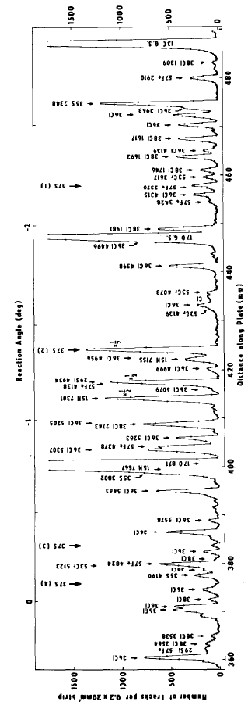
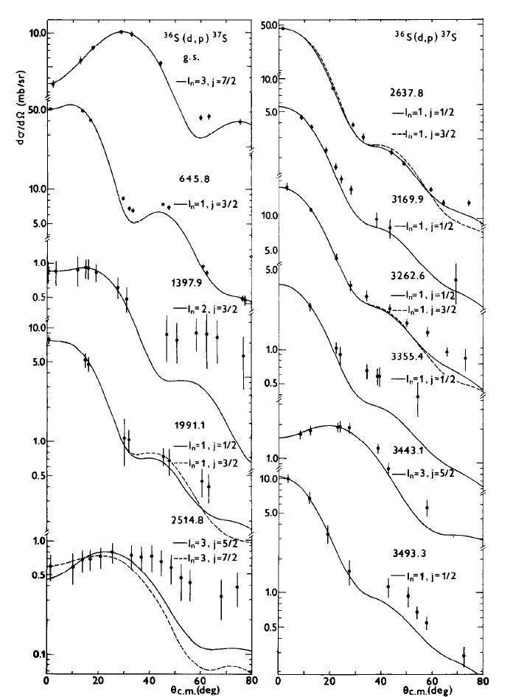
An example: ³⁶S(d,p)³⁷S in direct kinematics
Typical target thickness: 50-100 µg/cm²;
Typical beam intensity: 10⁹-10¹⁰ pps;
Typical resolution in Q value: 10- 30 keV
ΔL=3
Full and detailed spectroscopy achievable.
Almost full single-particle strength exhausted.
Limited to stable targets.
ΔL=1
1.5 MeV in Q value
ΔL=2
S. Piskor et al., Nucl. Phys. A 414 (1984) 219-239

Slide 6
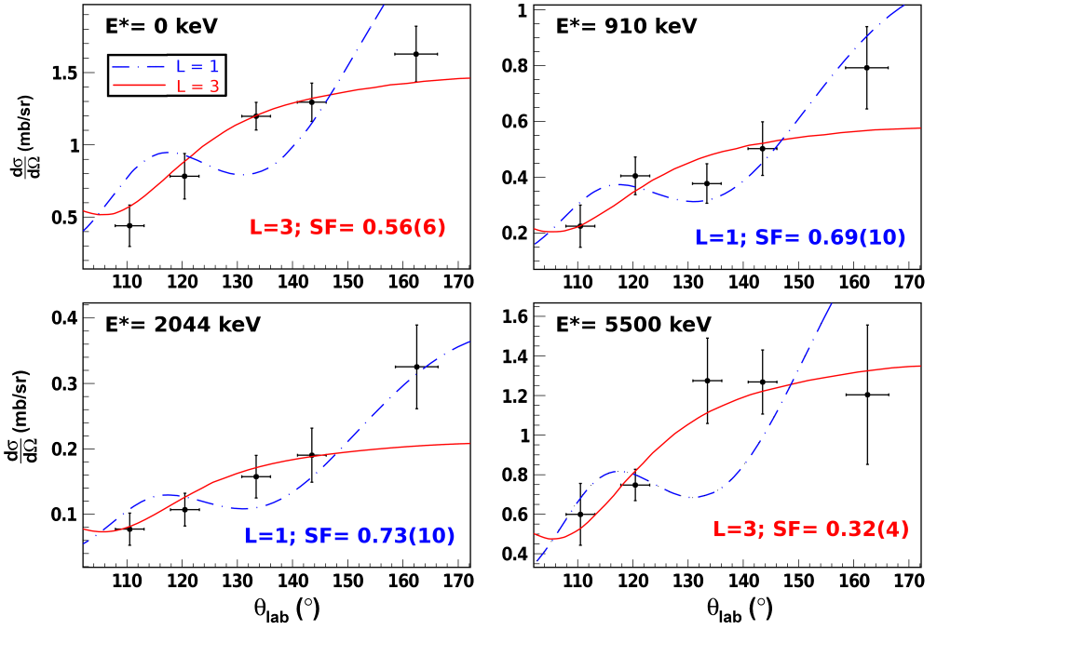
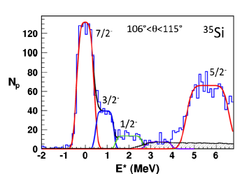
An example: ³⁴Si(d,p)³⁵Si in inverse kinematics
Typical target thickness: 1-5 mg/cm²; (factor of 50-100 more)
Typical beam intensity: 10⁴-10⁵ pps; (5 orders of magnitude less)
Typical resolution in Q value: 100-500 keV
Partial spectroscopy achievable.
Difficult to detect all the single-particle strength.
Possibility to study very exotic nuclei.
How to reduce the gap between direct and inverse kinematics experiments?
Target thickness and purity
Detection efficiency
Granularity
G. Burgunder et al., Phys. Rev. Lett. 112 (2014) 042502

Slide 7
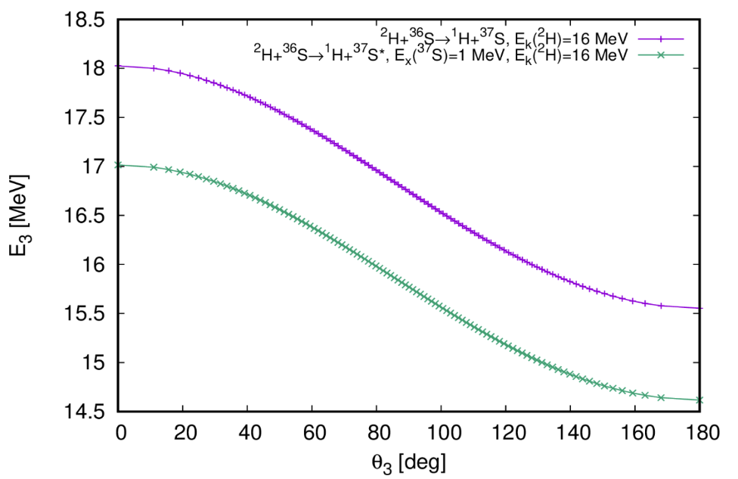
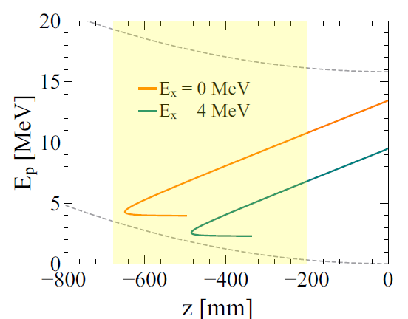
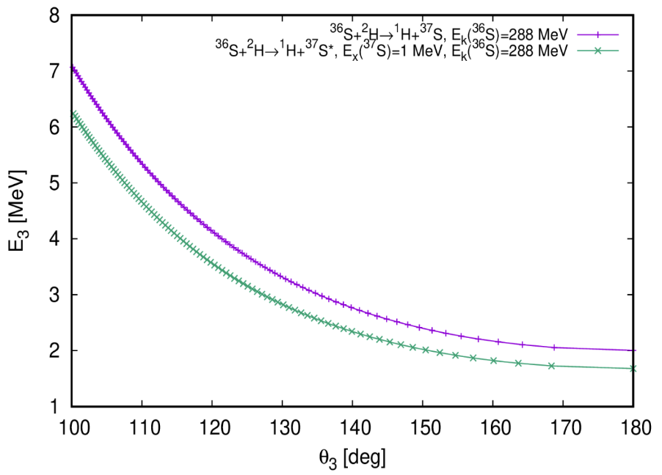


A general issue: the kinematic compression
In inverse kinematics one has to cope with the kinematic compression
SOLENOIDS
(see S. Carollo’s talk)
$$\frac{{dE}^{∗}}{{dE}_{k}}=1$$
But often your resolution is dominated by the target thickness and you may want to have γ rays in coincidence, so…
DIRECT
1 MeV
$$\frac{{dE}^{∗}}{{dE}_{k}}<1$$
HIGHLY SEGMENTED SILICON ARRAYS
INVERSE
300 keV

Slide 8
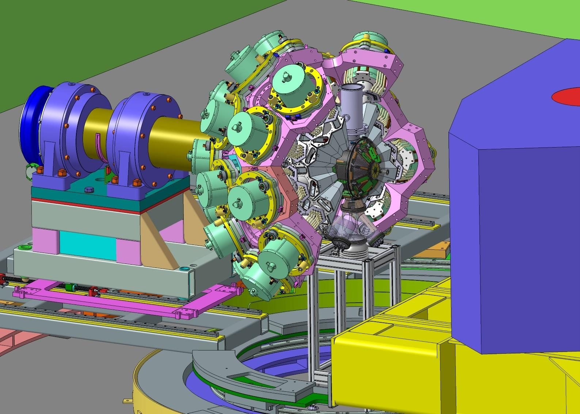

The GRIT array
2020
2022
2025
4π highly segmented silicon array fully integrable in AGATA & PARIS
2021
2023
2024
High efficiency for particles
High granularity (strip pitch < 0.8 mm)
Large dynamical range
PID using Pulse Shape Analysis techniques
New Integrated Digital electronics (LPC Caen, IJCLab, INFN, Valencia)
Integration into AGATA
Transparency to gamma-rays
High compactness
Compatible with special targets (cryogenic, tritium, windowless)
DETECTORS
  500 um DSSD pitch < 0.8 mm
  1.5 mm DSSD pitch ~10mm
Layers of Silicon
ELECTRONICS
MECHANICS
Collaboration: Italy, France, Spain, UK
Notes:
3 axes de developpement

Slide 9
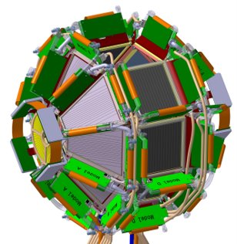
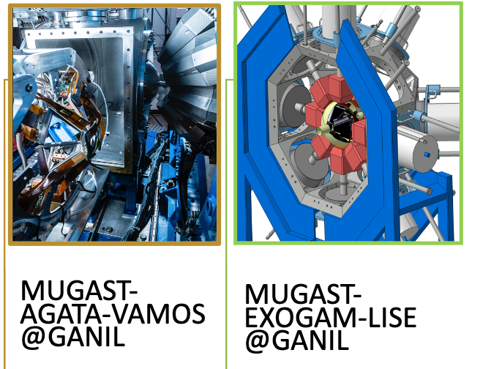
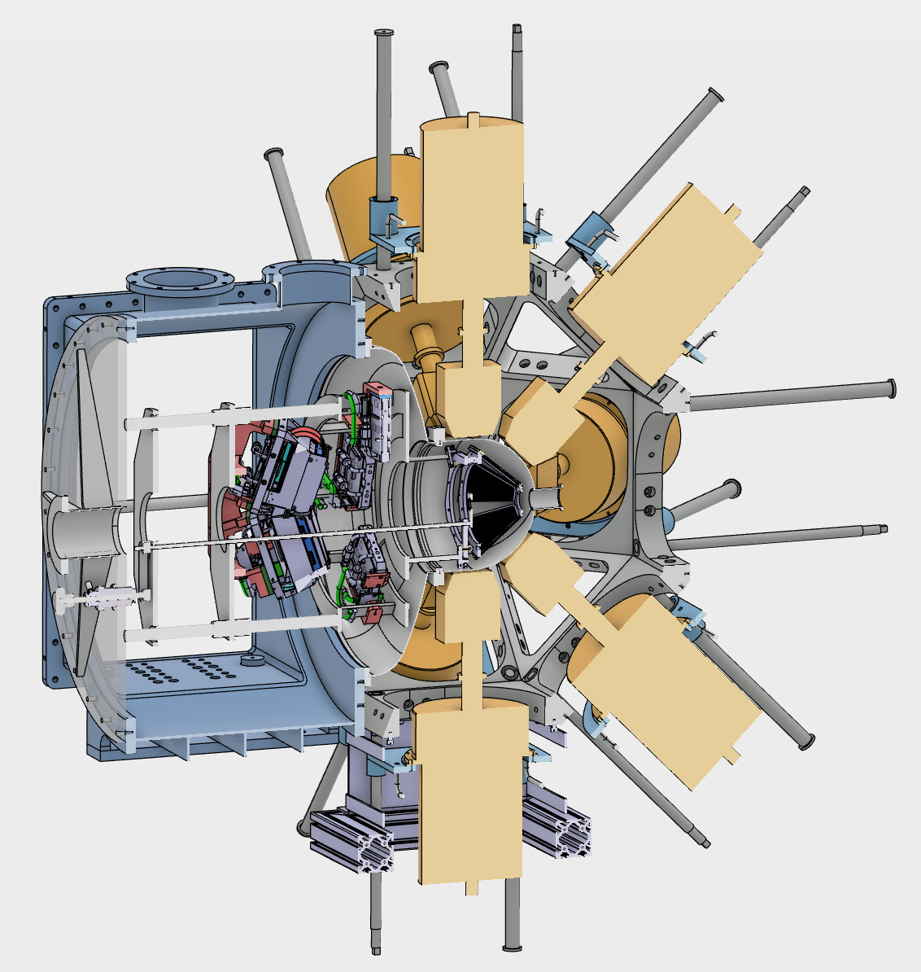
MUGAST / GRIT – Timelines
GRIT Demonstr.
AGATA zero deg
@SPES ?
2019-2021
2023-2025
2026-2027
2028 -
Today
Commissioning
Courtesy D. Beaumel

Slide 10
MUGAST : physics program (as for now…)
Commissioning of the campaign
⁵⁸Ni (p,d) ⁵⁷Ni
@30 MeV/u
PAIRING : How does deformation influence neutron-proton pairing?
Study of ⁴⁸Cr(p,³Heγ)⁴⁶V
⁴⁸Cr beam at 2.5 10⁵ pps
SHELL MODEL
Study of ⁶⁸Ni by neutron adding and removing reactions
⁶⁸Ni(d,pγ) and ⁶⁸Ni(p,dγ)
2023
M. Assié (IJCLab)
S. Koyama, O. Sorlin (GANIL)
M.A. V. G-A (IJCLab)
PhD : H. Jacob
SHELL MODEL
Evolution of the neutron 1d_{3/2}-1d_{5/2} spin-orbit splitting at N = 19 and Fermi surface in ³⁴Si
PhD : R. Nicolás del Álamo
CLUSTERING off stability
Cluster structure of the g.s.of light exotic nuclei beyond alpha-clustering
COMMISSIONING ZDD
You are invited to join!
2024
F. Galtarossa (INFN-LNL)
O. Sorlin (GANIL)
V. Girard-Alcindor,
D. Beaumel (IJCLAB)
PhD : T. Zanatta Martinez
SHELL MODEL
Evolution of the neutron 1d_{3/2}-1d_{5/2} spin-orbit splitting at N = 19 and Fermi surface in ³⁴Si
F. Galtarossa (INFN-LNL)
O. Sorlin (GANIL)
PhD : R. Nicolás del Álamo
TETRANEUTRON
The tetra-neutron Isobaric Analog State in ⁴H : The case for the ⁶He(p,³He) reaction
NUCLEAR ASTROPHYSICS
Determining the thermonuclear ¹⁸Ne(α,p)²¹Na reaction rate by measuring ⁷Li(¹⁸Ne,t)²²Mg(p)²¹Na
2025
A.O. Macchiavelli (ORNL),
M. Assié (IJCLab)
C. Diget (U. York), N. de Séréville (IJCLab), L. Lalanne (CERN)

Slide 11
How are we (as GAMMA group) involved?
Daniele Mengoni (UNIPD) -> co-Spokesperson of the project
Simone Bottoni (UNIMI) -> chair of the WG «Physics Simulations»
Andrea Gottardo (INFN LNL) -> chair of the WG «Special Targets»
Franco Galtarossa (INFN PD) -> chair of the WG «Detectors»
Stefano Capra (UNIMI) -> co-chair of the WG «Front-end Electronics»
Silvia Leoni (UNIMI) -> chair of the Steering Committee
Alberto Pullia (UNIMI) -> member of the Steering Committee
Strong involvement of the PD-LNL-MI sections (and recently also FI)

Slide 12
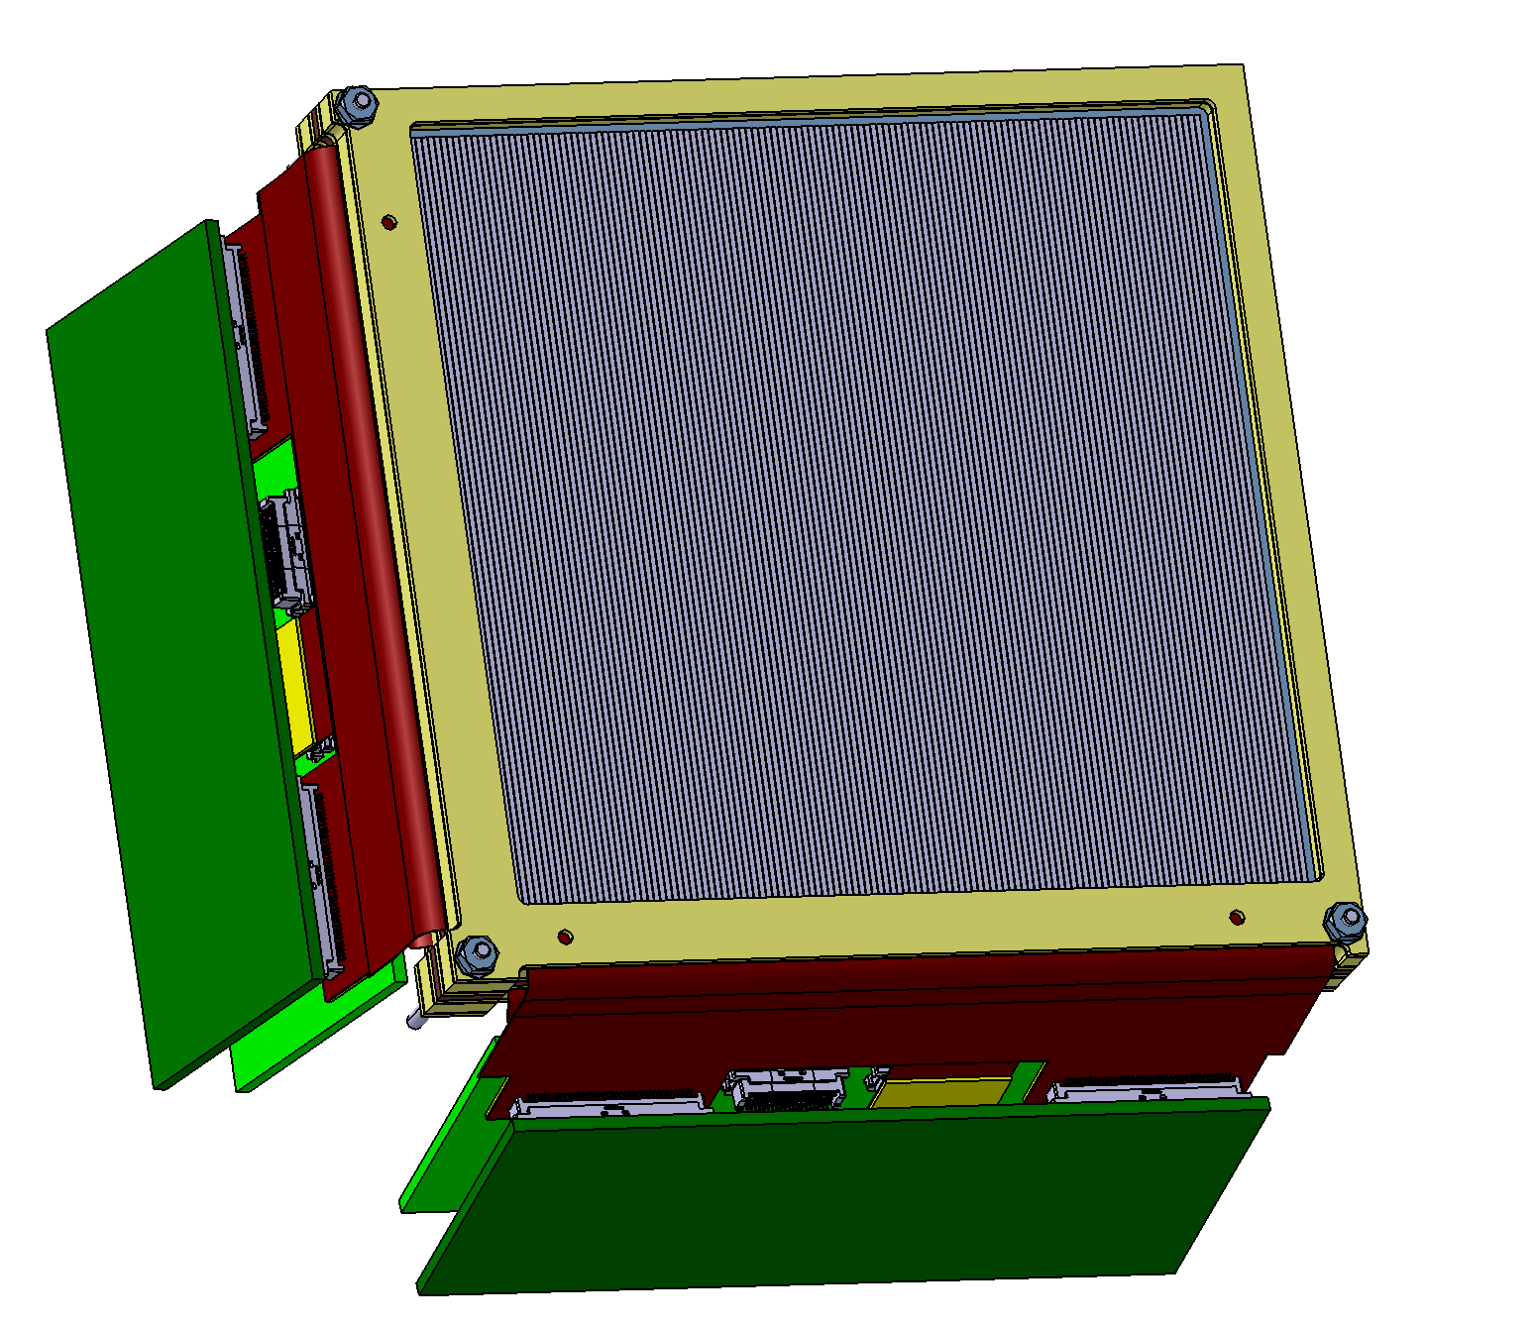
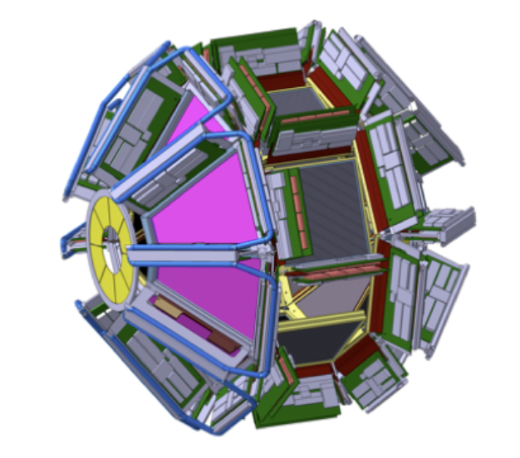
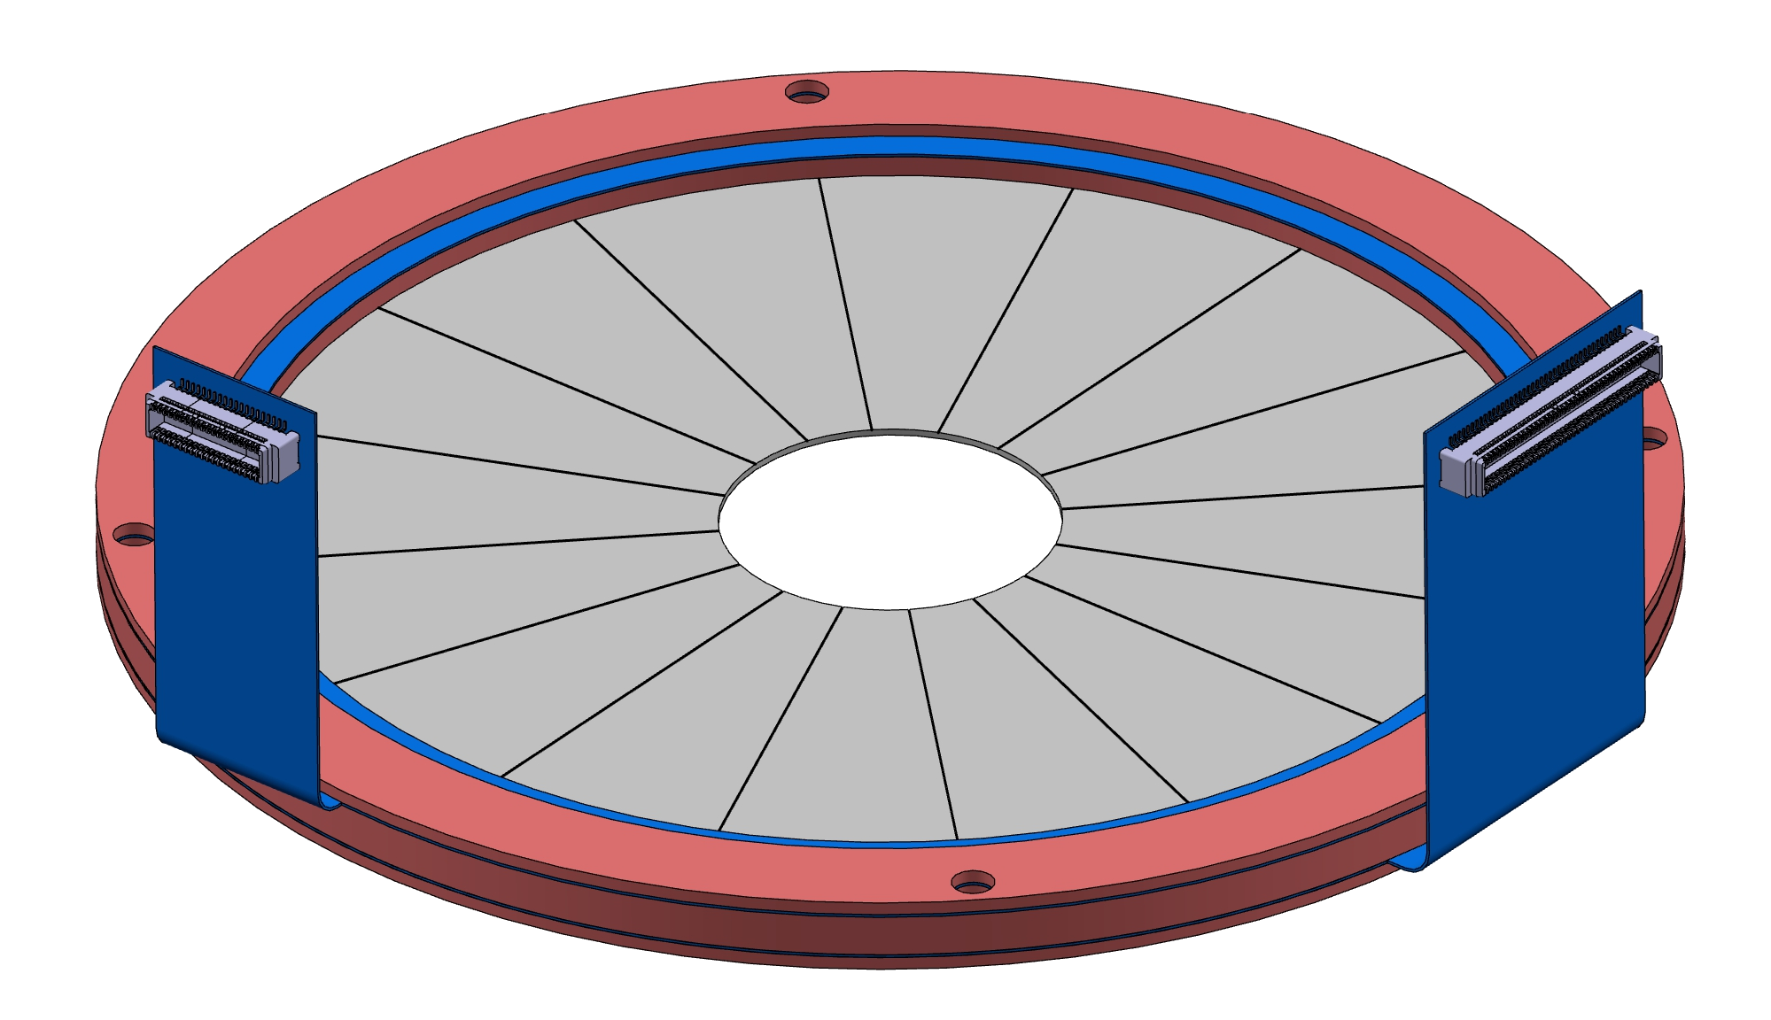
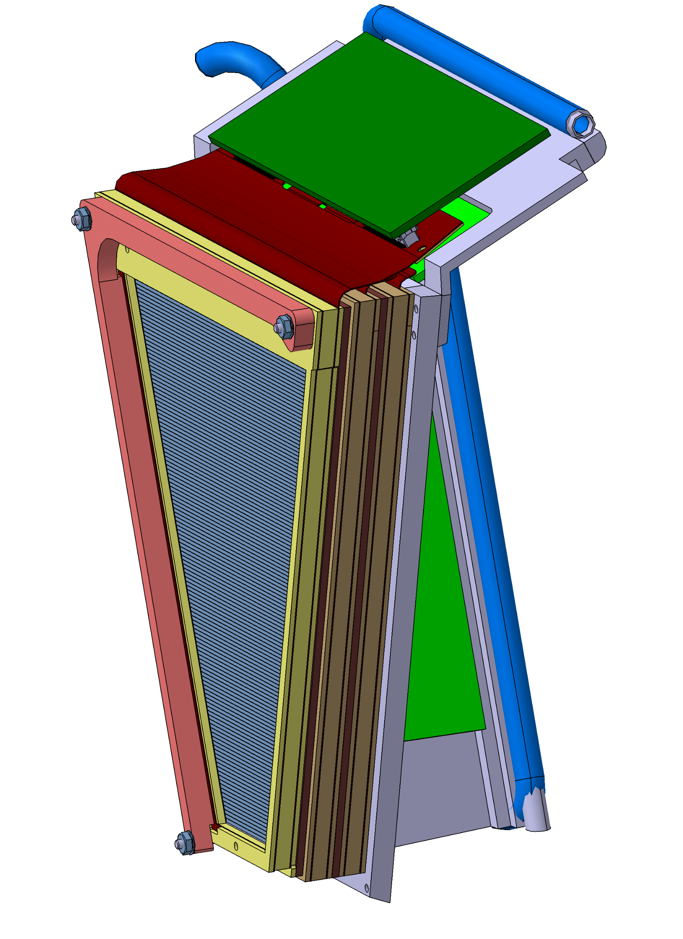
GRIT detectors
1st layer: TTT11, 500 µm, nTD, 128x128
2nd layer: TTT16, 1500 µm, FZ, 16x16
1st layer: 500 µm, nTD, 64 rings x 16 sectors
2nd layer: 1500 µm, FZ, 16 rings x 16 sectors
1st layer: FFF2, 500 µm, nTD, 128x128
2nd layer: MMM4, 1500 µm, FZ, 16x16
Total of about 7000 channels to read!

Slide 13
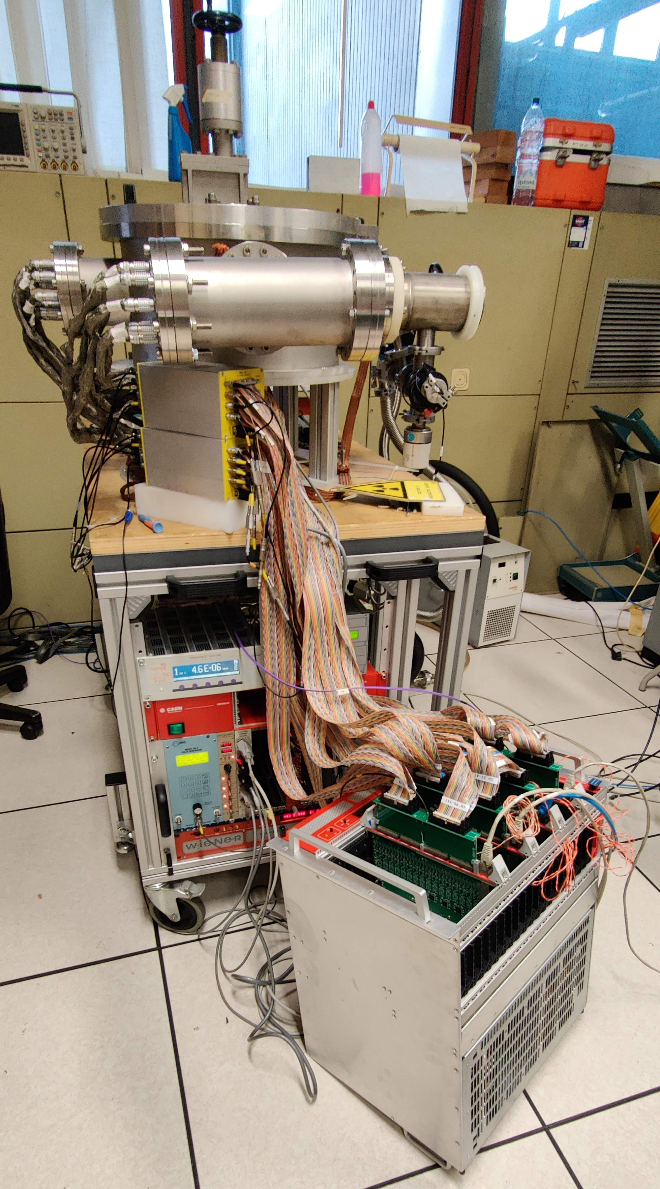
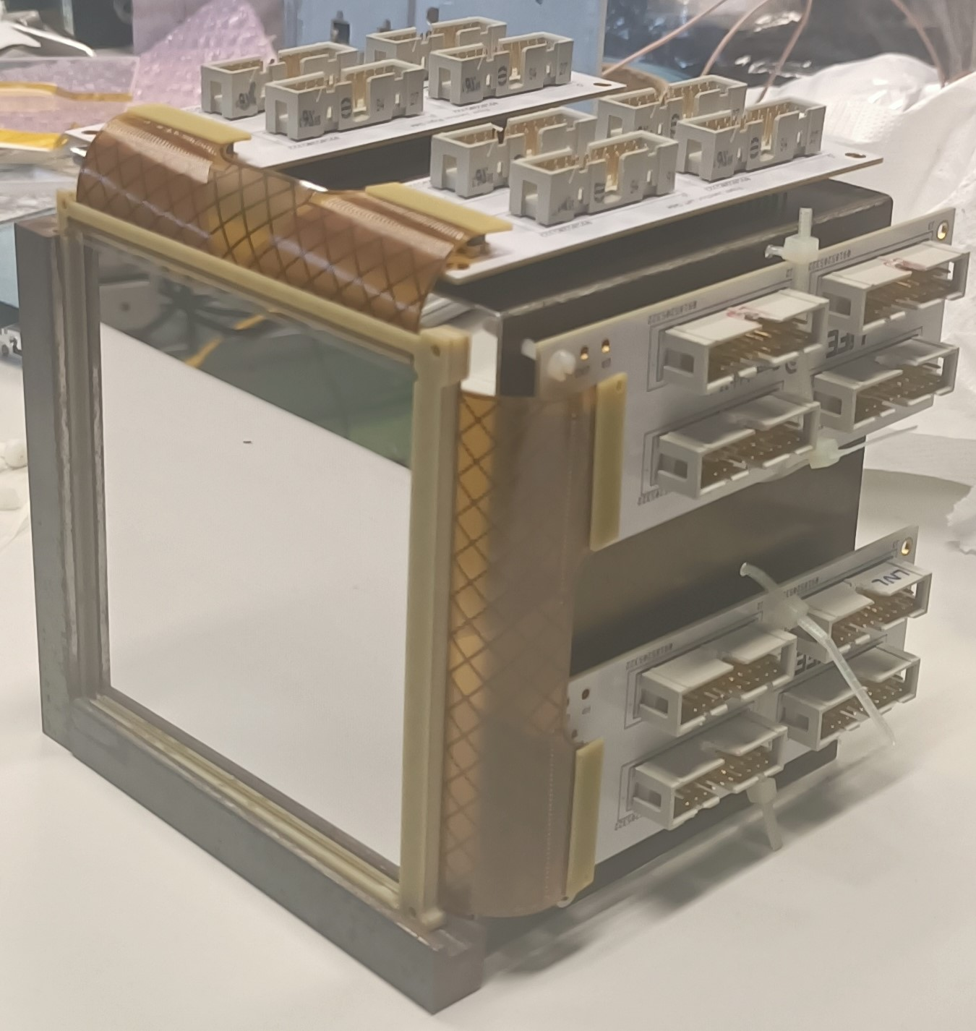
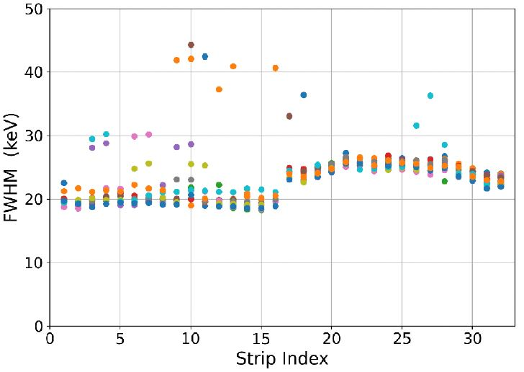
256-channel test bench
GRIT detector tests at LNL
José Dueñas
Alex Cobo
Daniele Mengoni
Alain Goasduff
Franco Galtarossa
Validation of the detectors
I-V curve
Energy resolution
Interstrip events
Charge collection efficiency

Slide 14
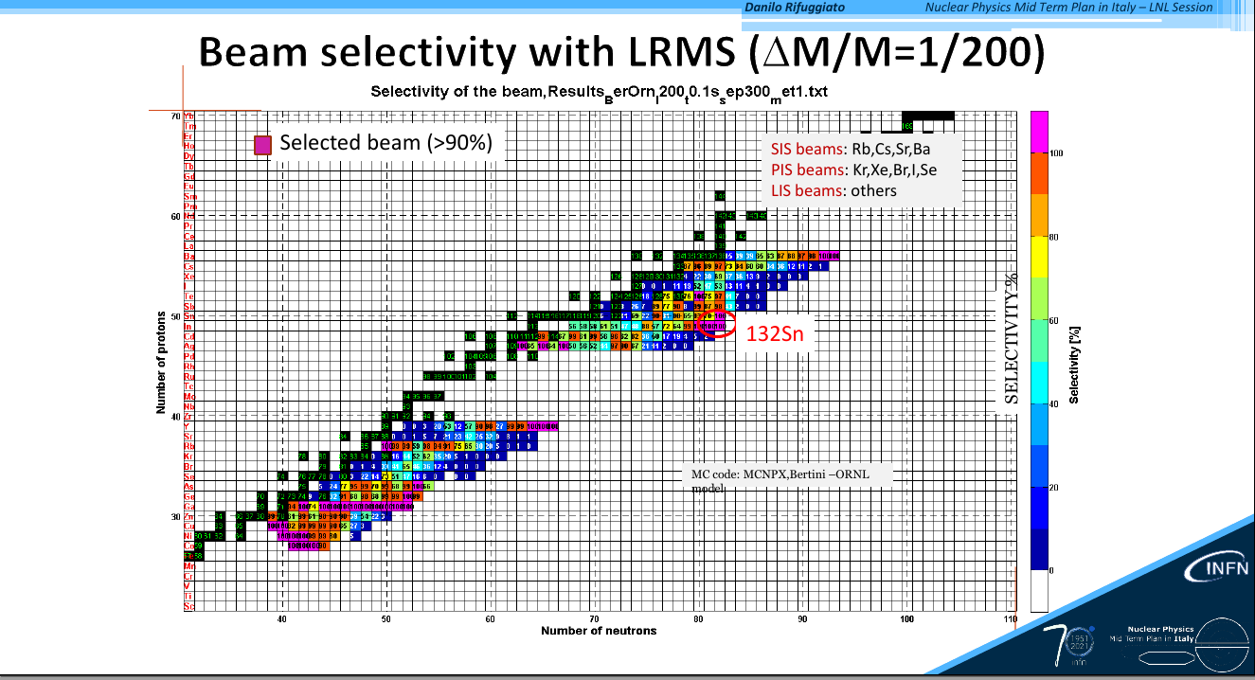

Slide 15
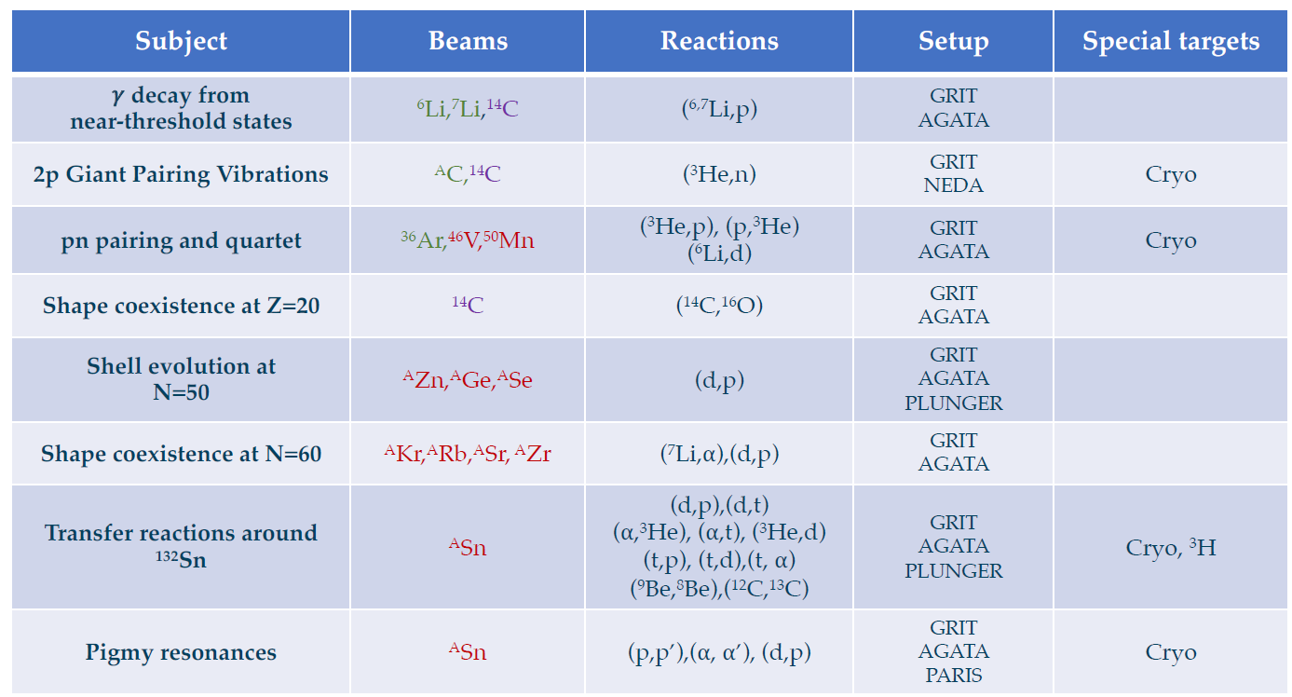
Possible physics cases for GRIT
Taken from S. Bottoni’s presentation at the GRIT Workshop 2023

Slide 16
Transfer reactions around ¹³²Sn
Single-particle structure at N=82
K. L. Jones et al., Nature 09048 (2010) 454
Surrogate reactions
r-process
V. Vaquero et al., PRL 124, 022501 (2020)
Proton shell evolution around ¹³²Sn and proton core breaking at Z=50
(n,𝛾) cross sections via (d,p) reactions
Indirect methods for studying r-process
Courtesy S. Bottoni
D. Rosiak et al., PRL 121, 252501 (2018)
CLAS collaboration., Nature 560 617 (2018)

Slide 17
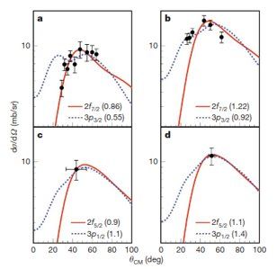
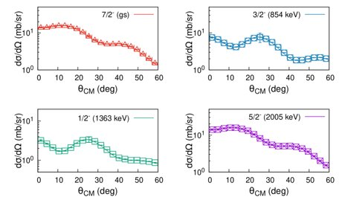
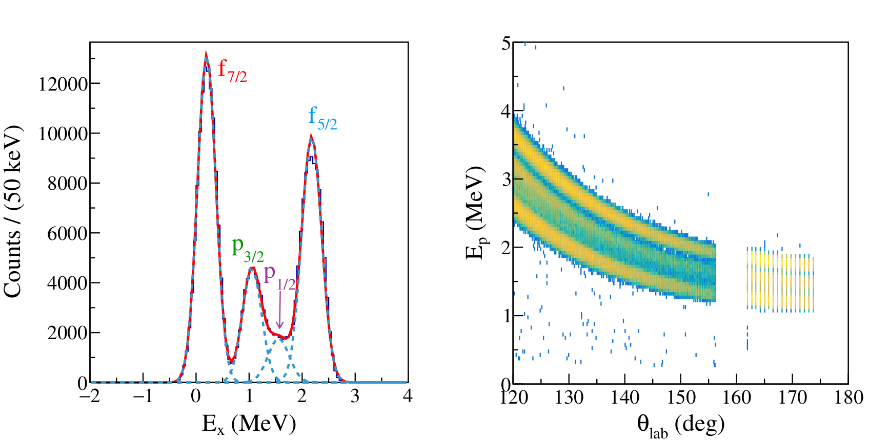
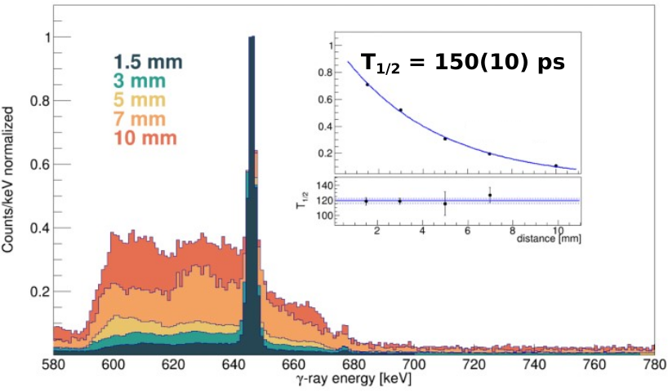
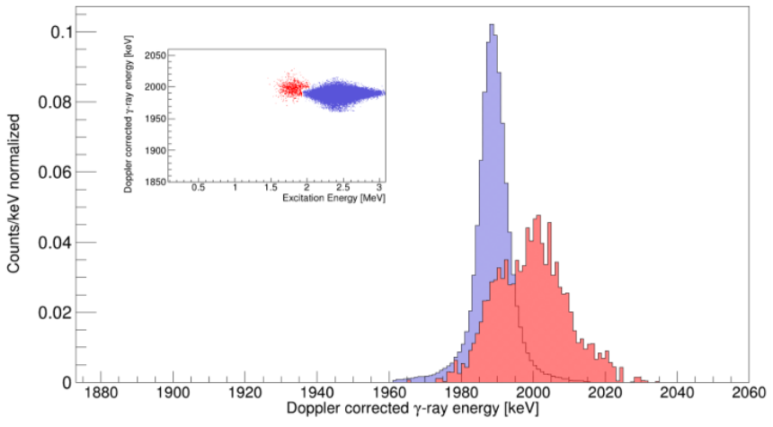
Transfer reactions around ¹³²Sn
Lifetimes measurements around ¹³²Sn
^{130,131,132}Sn(d,p) and (d,t)
^{130,132}Sn(⁴He,³He)
^{130,132}Sn(³He,d) and (t,α)
^{130,131,132}Sn(d,p), (d,t), (⁹Be, ⁸Be), (¹³C,12C)
Population of higher-spin states
PLUNGER
AGATA
GRIT
Cryo target
Combining transfer reactions and lifetime measurements
K. L. Jones et al., Nature 09048 (2010) 454
GRIT@SPES
PLUNGER
DSAM
τ = (165 ± 10) ps
Fast
Slow

Slide 18
Thank you for the attention

Slide 19
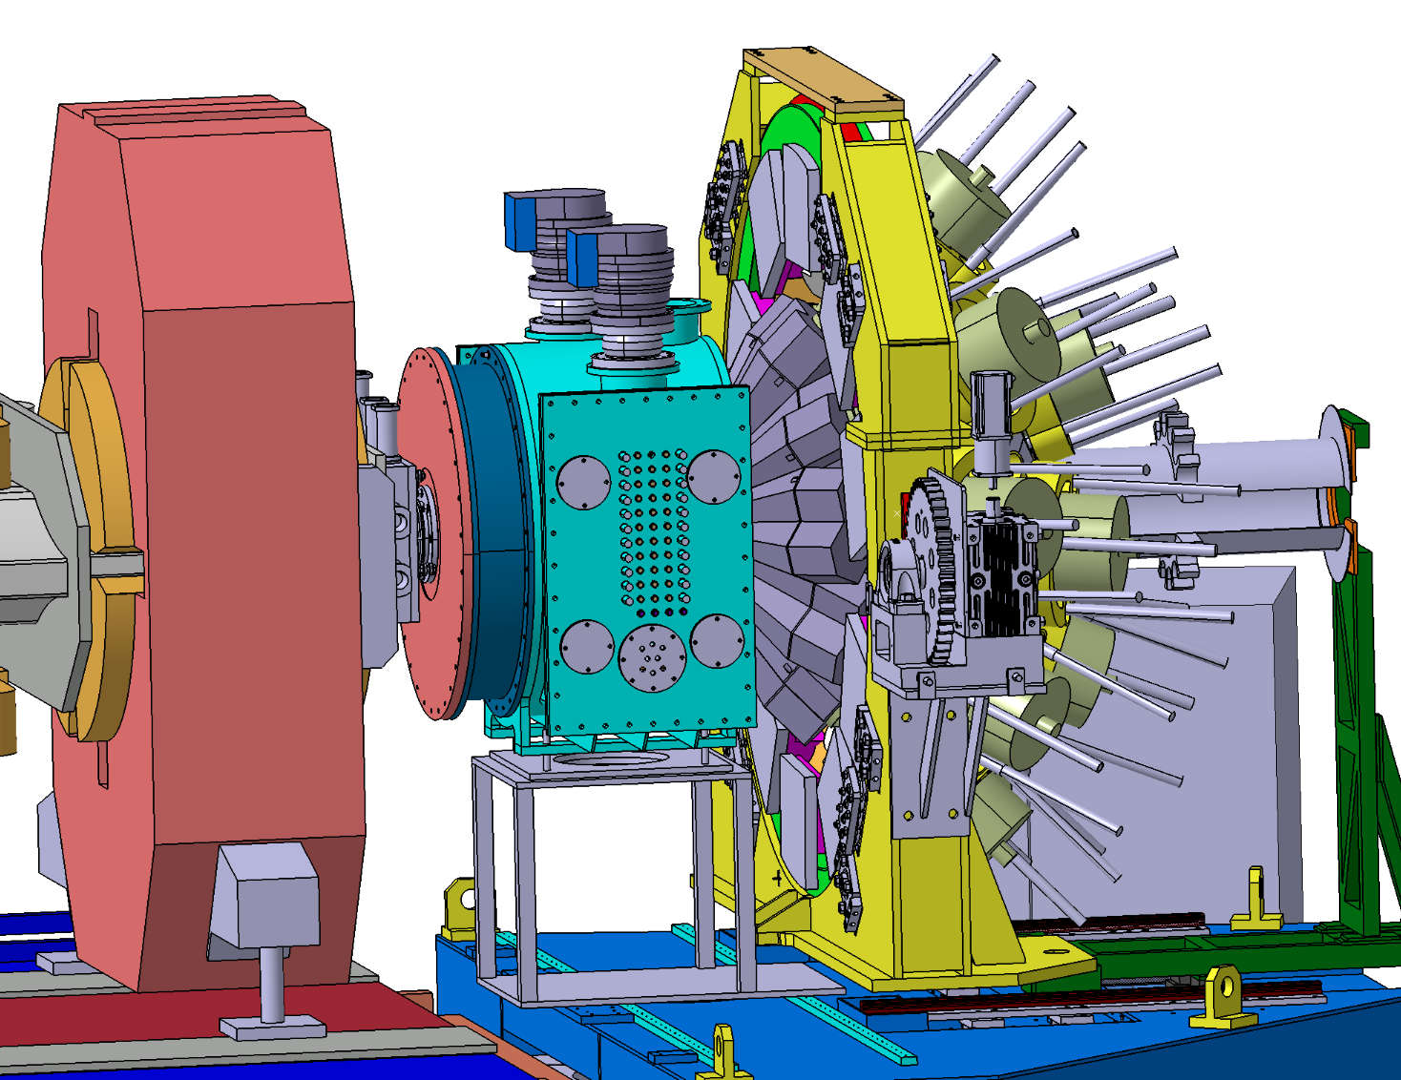
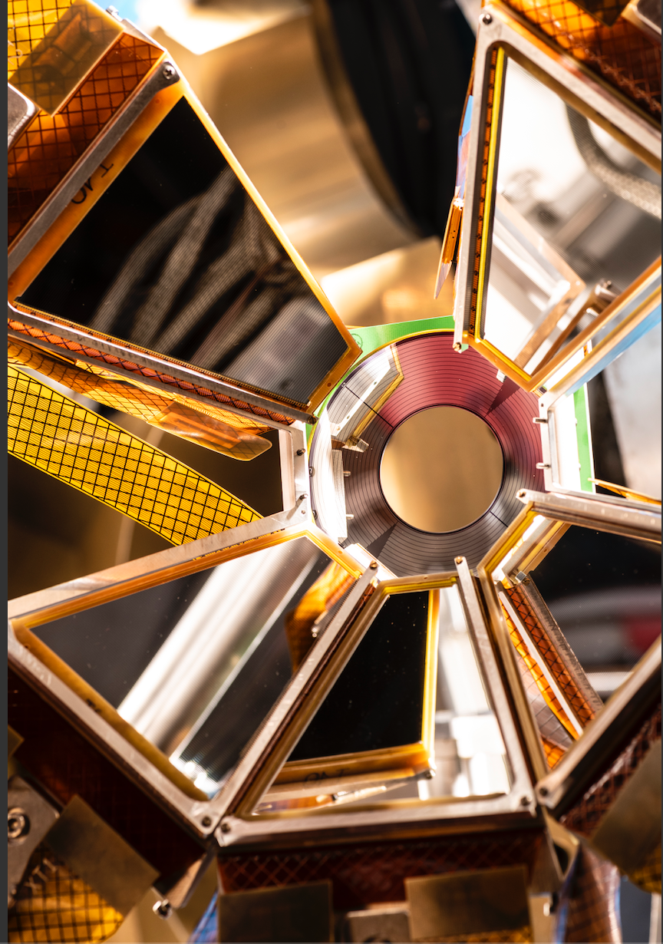
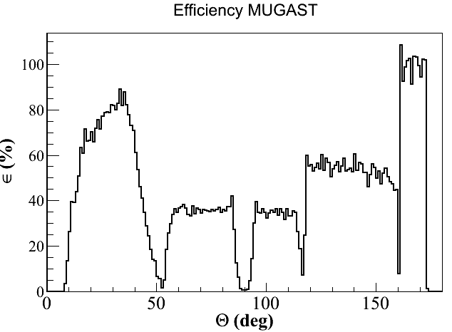
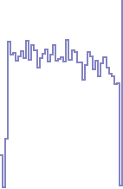
MUGAST–AGATA-VAMOS set-up @ GANIL -- 2019-21 Campaign
VAMOS
Acceptance of VAMOS : +/- 6 deg
VAMOS typical efficiency : ~80%
Digital electronics NUMEXO2
Solid/Cryogenic targets
AGATA efficiency (18cm) at 1 MeV:
  before add-back : 5.5%
  after add-back : ~8%
VAMOS
AGATA
SPIRAL1 RI Beams
2 PPAC
MUGAST
2 DC
BTD
6 Ion. Ch.
MUGAST efficiency
2020
MUGAST
A set of High granularity DSSD (128X+128Y)
  Trapezoid shaped at backward angles – fit in AGATA 1π
  + square detector at 90 deg + annular detector
  MUST2 telescopes (DSSD+CsI) at forward angles
~ 3000 channels all read by MUST2 integrated electronics
2019
Physics results to be discussed at the MUGAST SESSION ON FRIDAY 10th

Slide 20
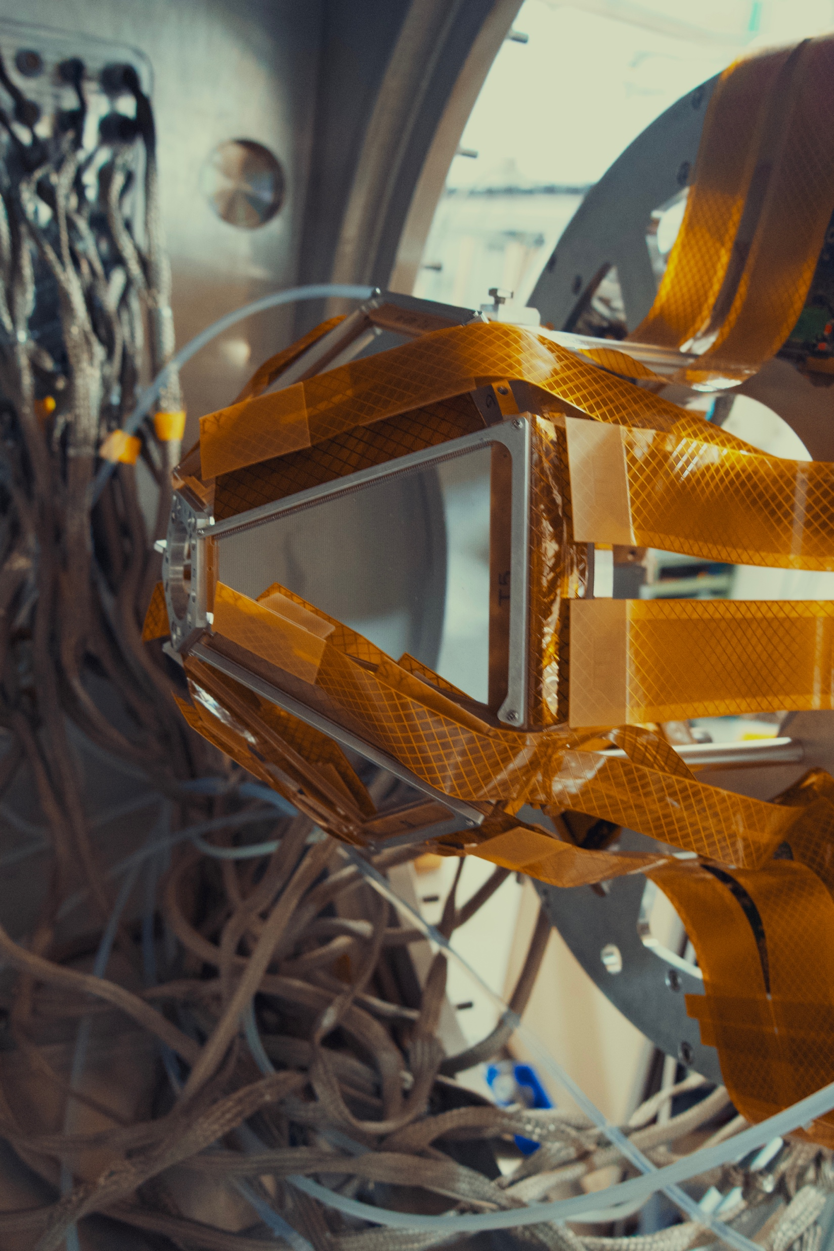
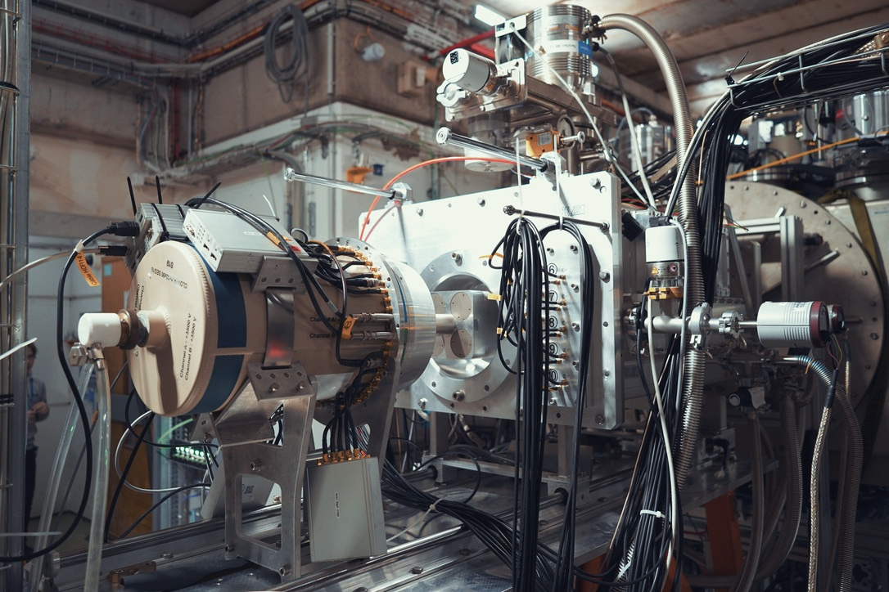
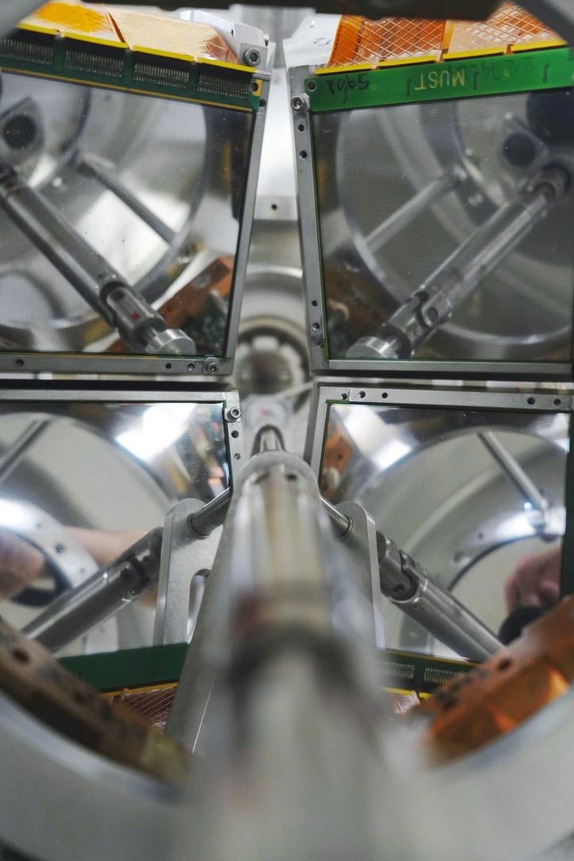
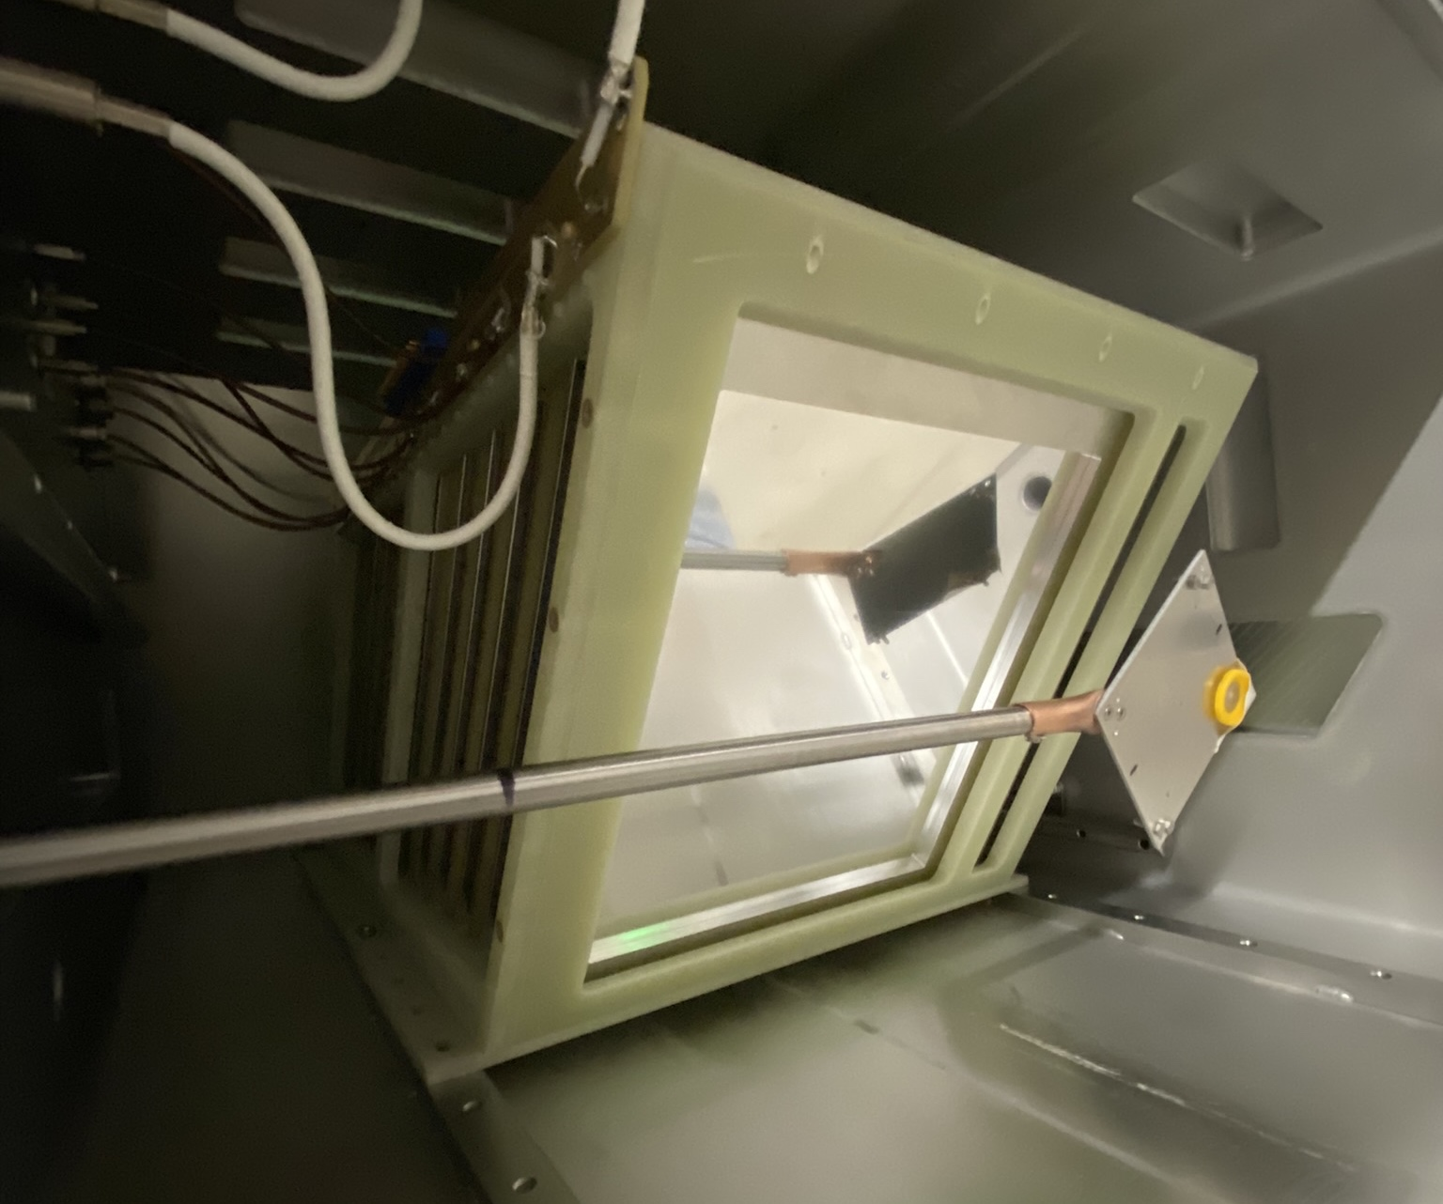
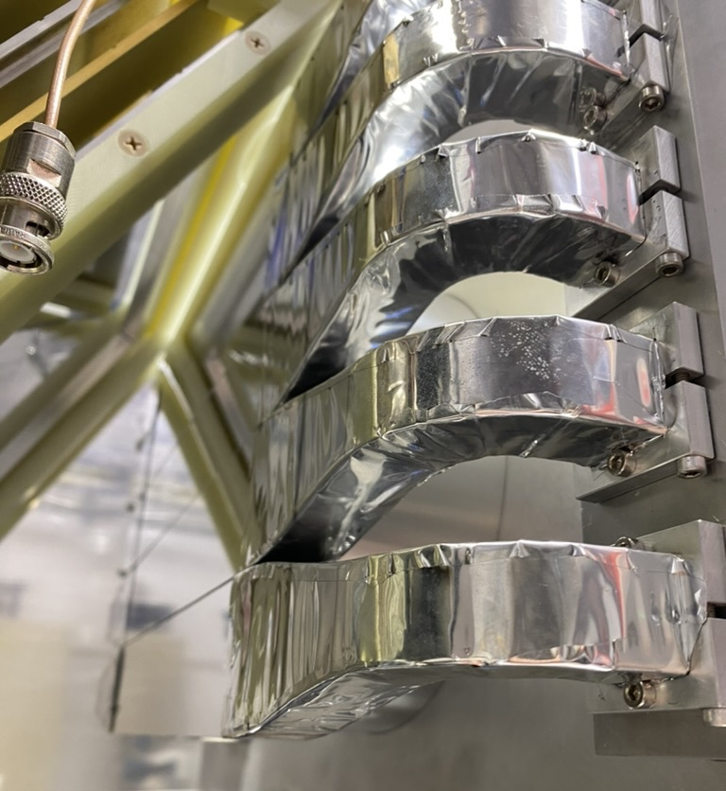
2023: start of MUGAST-EXOGAM@LISE
5 trapezoidal DSSD (backward)
4 MUST2 telescopes (forward)
12 EXOGAM Ge det. @14cm
8% effic. after add-back
0º Detection: ZDD from LISE
Solid Target
DC
IC
EXOGAM
Plastic
EXOGAM
Campaign coordinator: Valerian Girard-Alcindor

