Slide 1
June, 21st 2024
Young GAMMA workshop
Asiago (VI)
L. Zago, F. Galtarossa, A. Gottardo, J. J. Valiente Dobón
and the AGATA collaboration
Mixing between single-particle and intruder states
towards the N=20 island of inversion:
lifetimes in ³⁷S

Slide 2
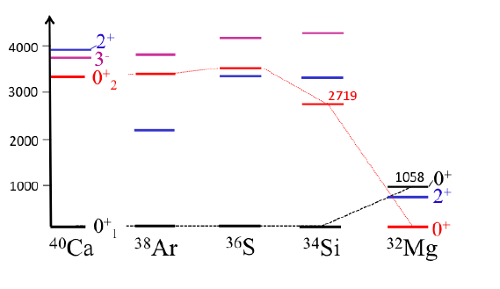
The island of inversion
12
report on exp_001 – l. zago
23rd agata collaboration meeting 2023
12

Slide 3
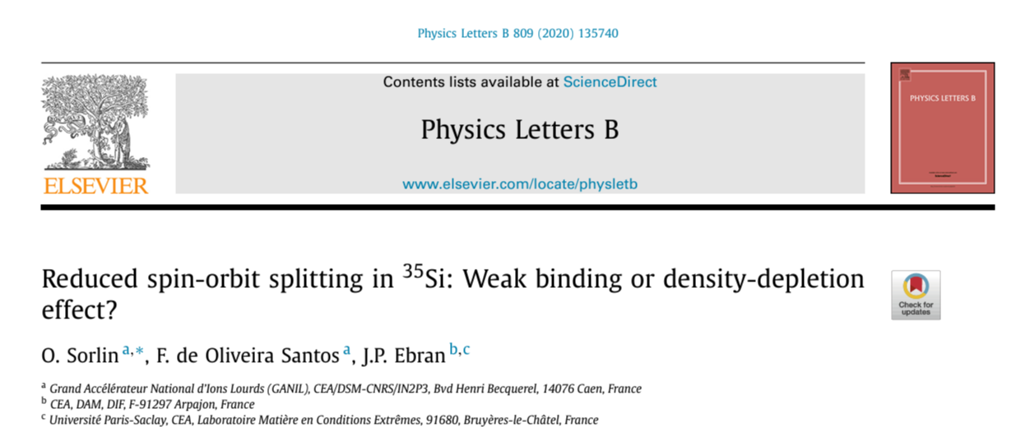
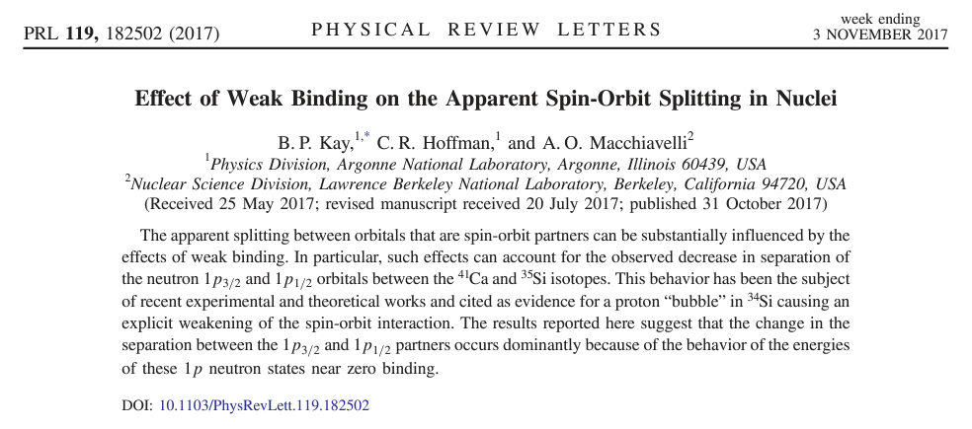
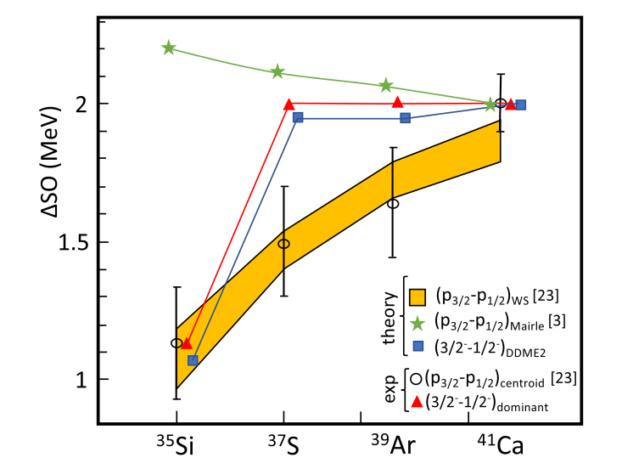
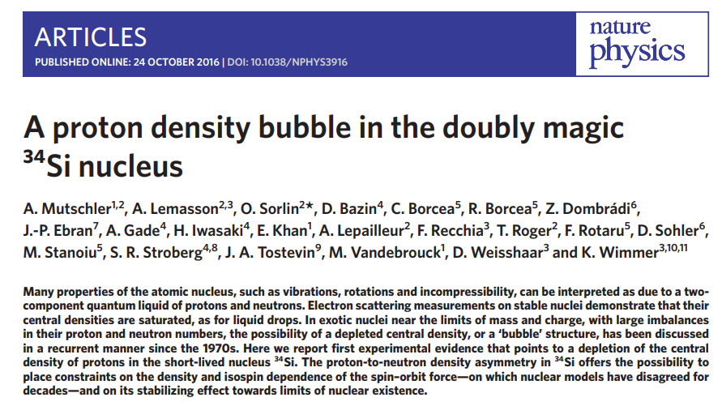
N=21 nuclei
2
lifetimes in ³⁷s– l. zago
Young gammas meeting –asiago 2024
9

Slide 4
³⁷S and the N=20 IoI
³⁷S
³⁹Ar
1/2⁻
2638
7/2⁻
2481
2358
3/2⁻
2433
1/2⁺
5/2⁻
2093
7/2⁻
2023
3/2⁻
1992
3/2⁺
1518
3/2⁻
1267
3/2⁺
1397
3/2⁻
646
7/2⁻
7/2⁻
³⁷S
Wang et al., Phys. Rev. C, 94 044316 (2016)
³⁶S
d
+
168 MeV
500 μg/cm²
p
Chapman et al., Phys. Rev. C, 93
044318 (2016)
3
lifetimes in ³⁷s– l. zago
Young gammas meeting –asiago 2024
9

Slide 5
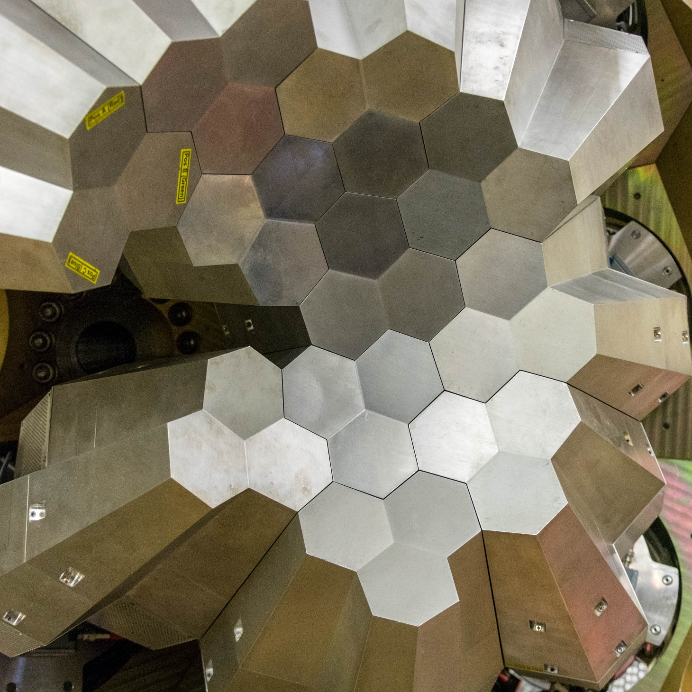
The experiment
AGATA
State-of-the-art γ-ray array. 33 HPGe crystals, with PSA and tracking algorithm to increase efficiency.
FWHM = 2.5 keV @ 1332.5 kev
ε = 3% @ 2 MeV (with tracking)
SPIDER
LNL resident 7x8 segmented Si charged particle array, covering backwards angles from 124° to 161°.
FWHM = 30 keV for α @ 5 MeV (Am-Cm-Pu), 300 keV for p @ 2 MeV
ΔΩ = 17%
PLUNGER
Device built from a collaboration between LNL and Cologne to measure nuclear lifetimes in the range of 10-500 ps via the Differential Decay Curve method.
4
lifetimes in ³⁷s– l. zago
Young gammas meeting –asiago 2024
9

Slide 6
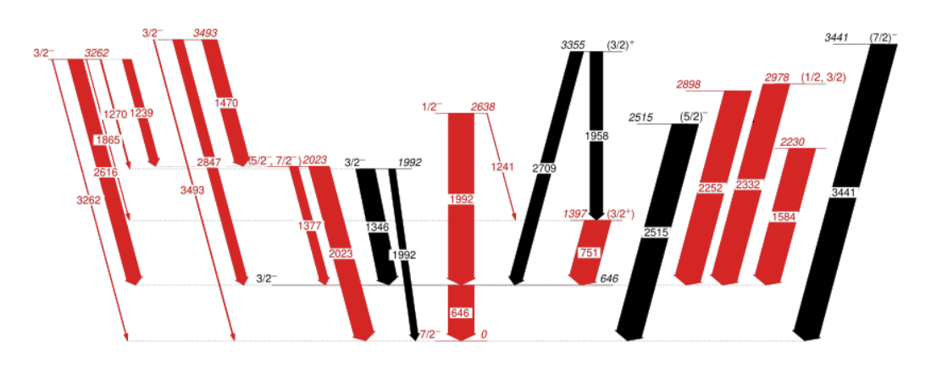
Possible lifetimes
Observed:
3 new states
10 new transitions
with respect to literature results.
9/13 states we can extract lifetime, plus 2 lower limits.
5
lifetimes in ³⁷s– l. zago
Young gammas meeting –asiago 2024
9

Slide 7
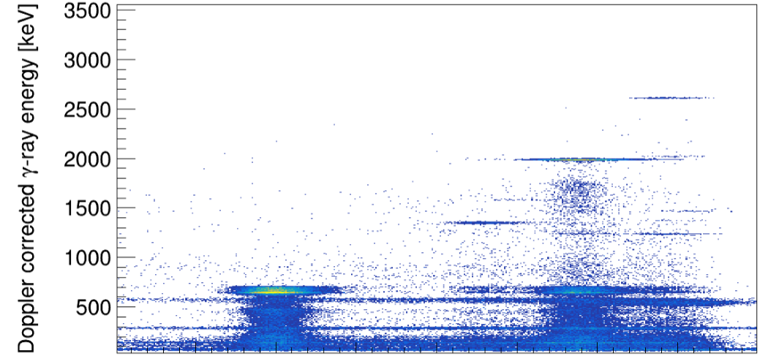
Possible lifetimes
Observed:
3 new states
10 new transitions
with respect to literature results.
9/13 states we can extract lifetime, plus 2 lower limits.
6
lifetimes in ³⁷s– l. zago
Young gammas meeting –asiago 2024
9

Slide 8
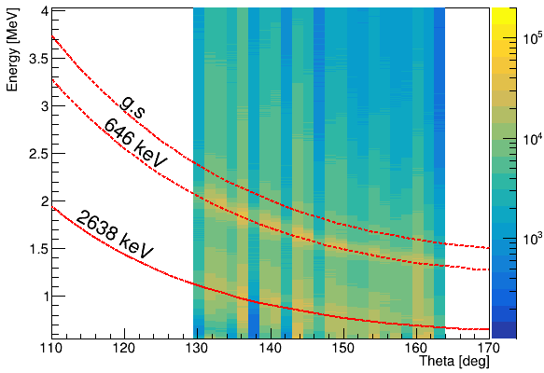
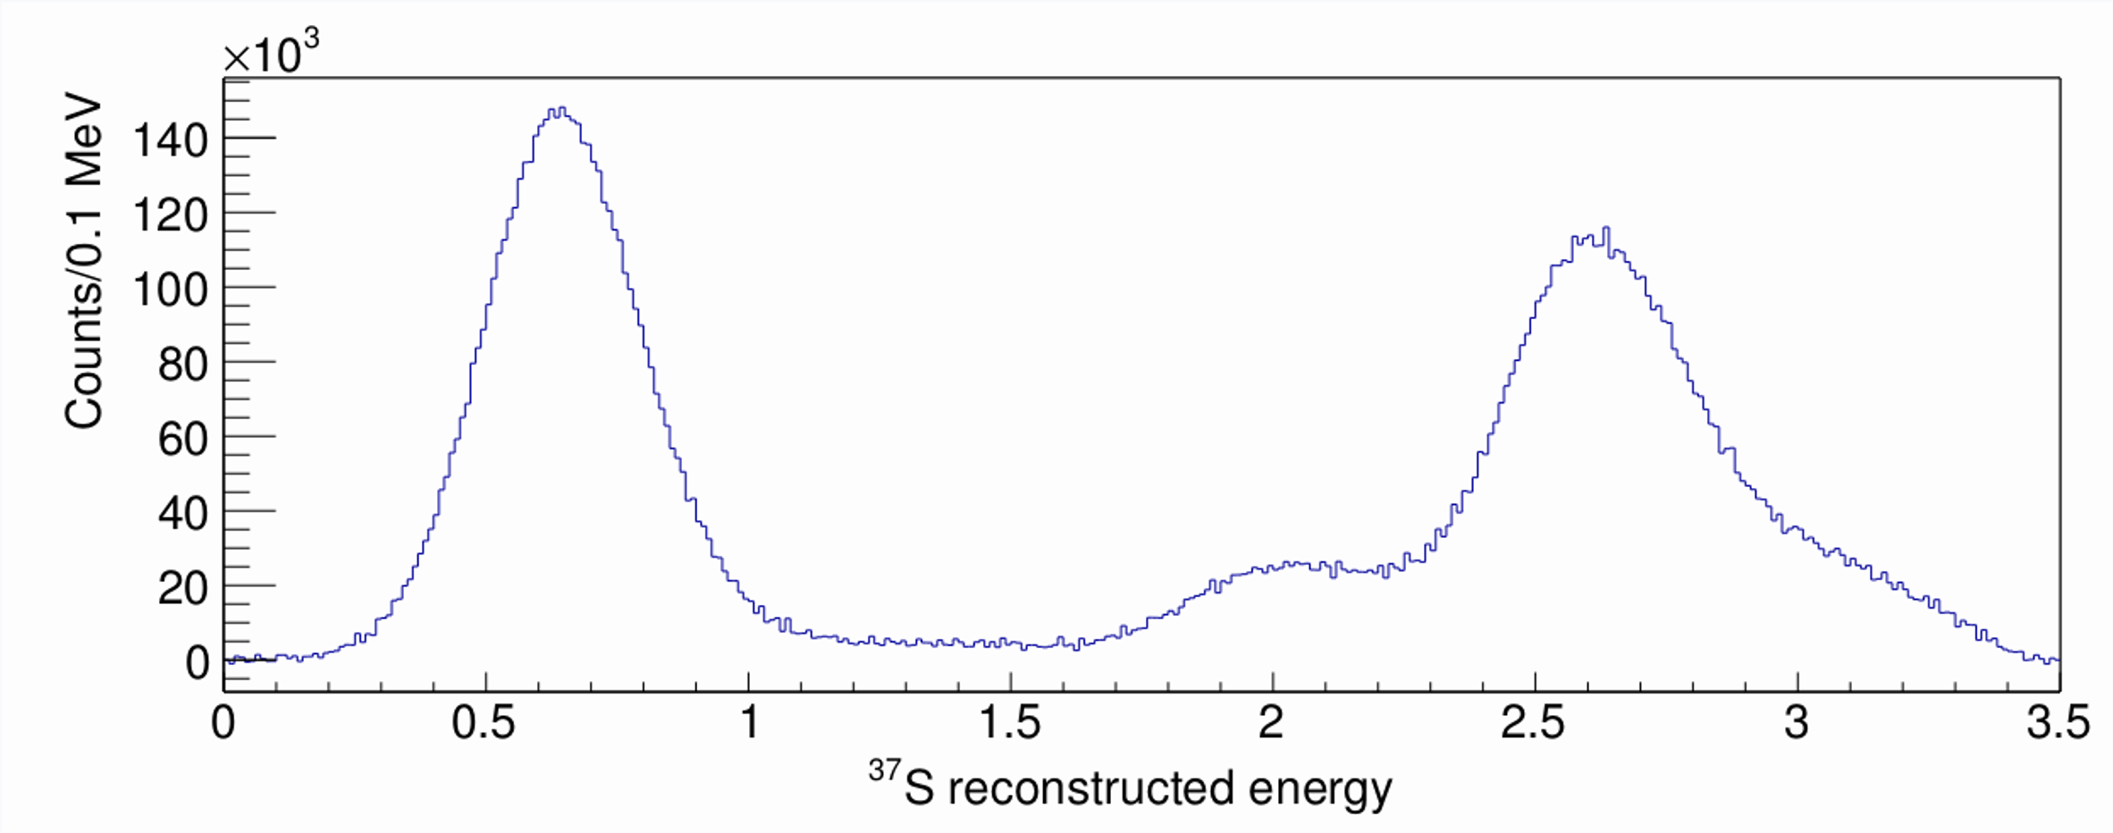
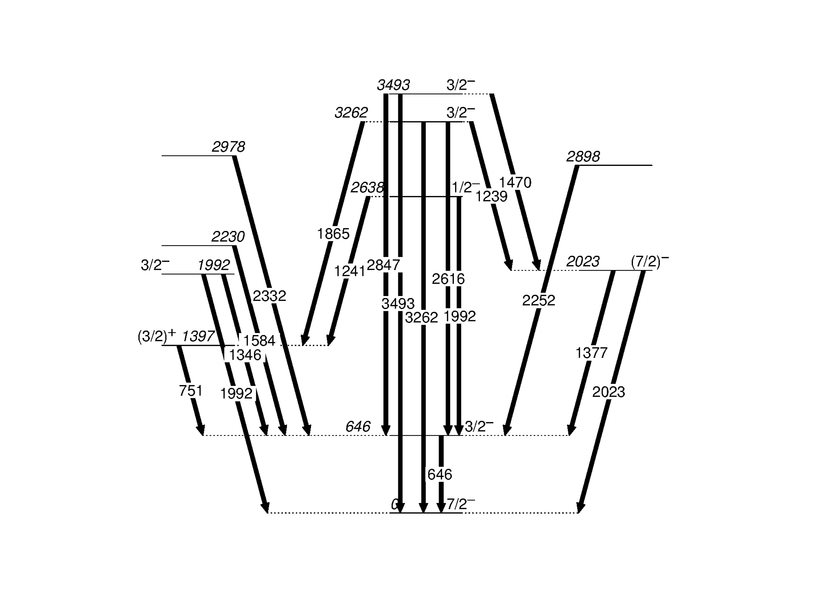
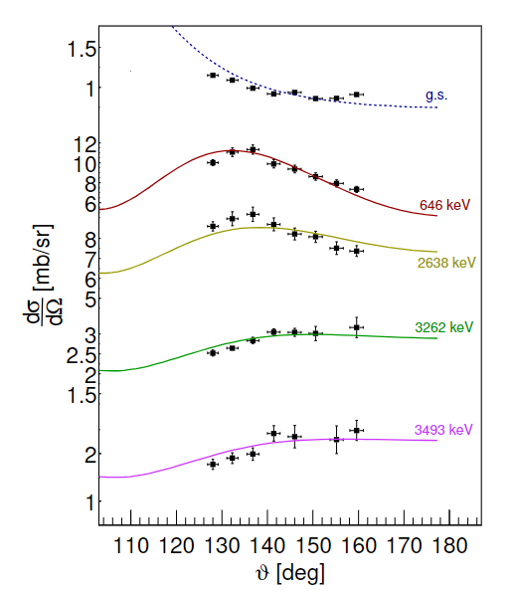
Results snippet
7
lifetimes in ³⁷s– l. zago
Young gammas meeting –asiago 2024
9

Slide 9
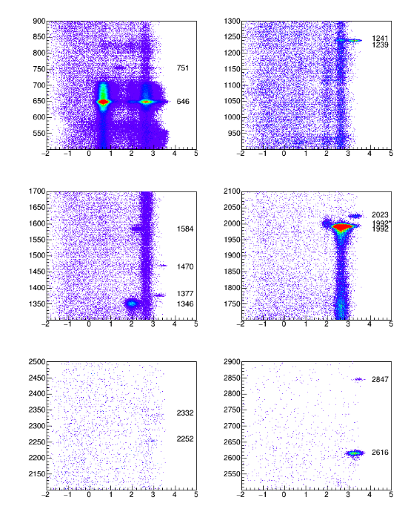
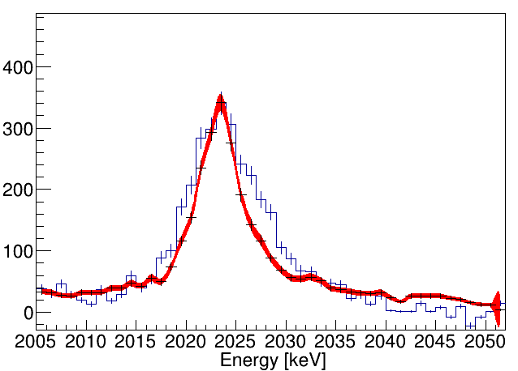
Results snippet
T_{1/2}³⁴⁹³ = 30⁺⁶⁰₋₂₀ fs
PRELIMINARY
T_{1/2}³²⁶² = 20(20) fs
PRELIMINARY
T_{1/2}²⁰²³ = 55(10) fs
Discrepancy due to target thickness change?
8
lifetimes in ³⁷s– l. zago
Young gammas meeting –asiago 2024
9

Slide 10
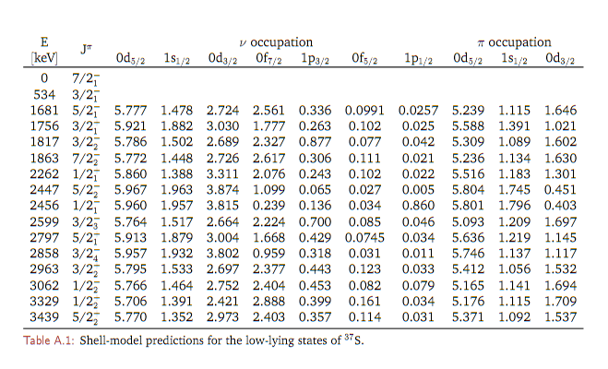
In the next episode…
16 states, 84 gamma-ray branches calculated
only 4 states matched so far to experimental spectrum
9
report on exp_001 – l. zago
23rd agata collaboration meeting 2023
9

Slide 11
Thank you for your attention
:
L. Zago, A. Gottardo, F. Angelini, M. Balogh, D. Brugnara, J. Collado Ruiz, G. de Angelis, A. Ertoprak, A. Goasduff, B. Gongora Servin, A. Gozzelino, T. Marchi, D. R. Napoli, J. Pellumaj, R. M. Perez-Vidal, M. Sedlak , J. J. Valiente-Dobon, I. Zanon
INFN LNL
A. Gadea
IFIC
F. Galtarossa, N. Miani, P.A. Aguilera, D. Bazzacco, J. Benito Garcia, S. Carollo, Z. Huang, S. M. Lenzi, R. Menegazzo, D. Mengoni, S. Pigliapoco, E. Pilotto, M. Polettini, F. Recchia, K. Rezynkina, G. Zhang
UNIPD and INFN PD
G. Benzoni, S. Bottoni, G. Corbari
INFN MI and UniMI Statale
N. Marchini, A. Nannini, M. Rocchini
INFN FI
M. Beckers, F. Dunkel, C. Fransen, L. Kornwebel, C. Lakenbrink, F. von Spee
University of Cologne
J. Diklic
Ruder Boskovic Institute
AGATA collaboration
List of collaborators:

Slide 12
Empty slide, the one to copy
AGATA + SPIDER results
- 2d matrix with bg subtracted
- new line
12
report on exp_001 – l. zago
23rd agata collaboration meeting 2023
12

