Slide 1
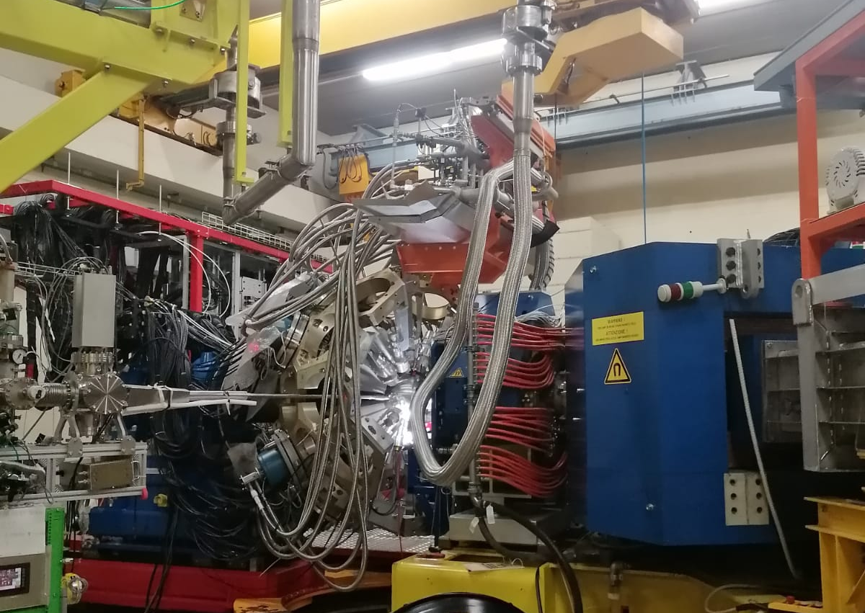
Spectroscopy studies in the A = 18 - 26 Ne-F region using the AGATA-PRISMA spectrometer
Young Gammas Workshop, Asiago, 21 June 2024
Speaker: Davide Genna

Slide 2
The Collaboration
K. Wimmer , S. Bottoni, G. Benzoni, F. Recchia, P. Aguilera, F. Drent, D. Genna, J. Acosta, H. Albers, G. Andreetta, F. Angelini, M. Balogh, J. Bardak, J. Benito, B. Bles, D. Brugnara, S. Carollo, Z. Chen, G. Ciconali, M. Ciemała, N. Cieplicka-Orynczak, L. Corradi, G. Corbari, A. Ertoprak, R. Escudeiro, C. Ferrera, B. Fornal, F. Galtarossa, E.M. Gandolfo, J. Gerl, A. Giaz, A. Goasduff, B. Gongora Servin, M. Gorska, A. Gottardo, A. Gozzelino, Ł.W. Iskra, N. Jovancevic, A. Jungclaus, N. Kitamura, T. Kröll, G. Kosir, M.S.R. Laskar, S. Leoni, M. Luciani, M. Matejska-Minda, R. Menegazzo, D. Mengoni, T. Mijatovic, B. Million, M. Morgante, R. Nicolás del Álamo, J. Pellumaj, S. Pigliapoco, E. Pilotto, W. Poklepa, M. Polettini, K. Rezynkina, M. Rocchini, M. Sedlak, M. Sferrazza, A. Stefanini, J.J. Valiente-Dobon, J. Vesic, A. Yaneva, L. Zago, I. Zanon
GSI Helmholtzzentrum für Schwerionenforschung GmbH, Darmstadt, Germany
INFN sez. Milano and Dipartimento di Fisica, Università degli Studi di Milano, Milano, Italy
INFN sez. di Padova and Dipartimento di Fisica, Università degli Studi di Padova, Padova, Italy
CSIC Madrid, Spain
University of Novi Sad, Serbia
Nuclear Physics Institute, Polish Academy of Sciences, Krakow, Poland
Istituto Nazionale di Fisica Nucleare LNL, Legnaro, Legnaro, Italy
Center for Nuclear Study, University of Tokyo, Tokyo, Japan
TU Darmstadt, Darmstadt, Germany
Ruder Boskovic Institute, Zagreb, Croatia
ULB, Brussel, Belgium

Slide 3
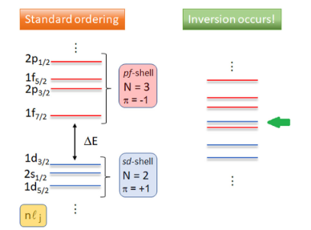
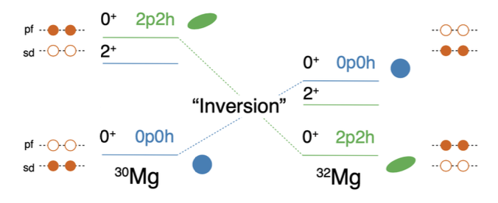
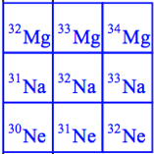
Physics case: Island of Inversion at N = 20
Standard ordering
Intruder configuration
Z = 50
pf shell
Level Energy
Z
Z = 28
sd shell
Z = 20
N = 50
Z = 8
N = 28
N = 20
N = 8
N
K. Wimmer et al., Phys. Rev. Lett. 105, 252501, 2010.
Main goal: understanding microscopic origin of nuclear deformation and improve our knowledge on the nature of the nuclear force

Slide 4
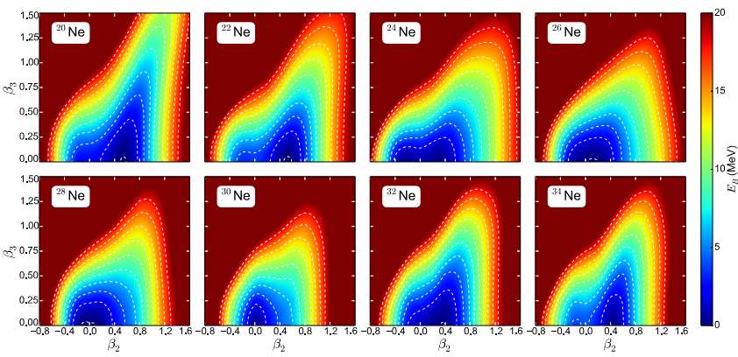
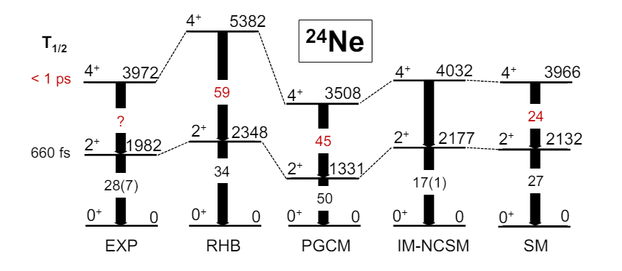
Physics case: Island of Inversion at N = 20
Evolution of negative parity states
Quadrupole and octupole collectivity
7/2⁻
5
7/2⁻
4
3/2⁻
3/2⁻
3
E (MeV)
2
7/2⁻
1
3/2⁻
0
5/2⁺
1/2⁺
3/2⁺
3/2⁻
²³Ne₁₃
²⁵Ne₁₅
²⁷Ne₁₇
²⁹Ne₁₉
23Ne: A.E. Champagne et al., Phys. Rev. C, 42, 6, 1990
25Ne: W.N. Catford et al., Phys. Rev. Letters, 104, 192501, 2010
27Ne: S.M. Brown et al., Phys. Rev. C, 85, 011302, 2012
P. Marević et al., Phys. Rev. C 97, 024334, 2018
29Ne: N. Kobayashi et al., Phys. Rev. C, 93, 014613, 2016
M. Frosini et al., Eur. Phys. J. A, 58:63, 2022
Transition towards N = 20 Island of Inversion for ²³⁻²⁶Ne

Slide 5
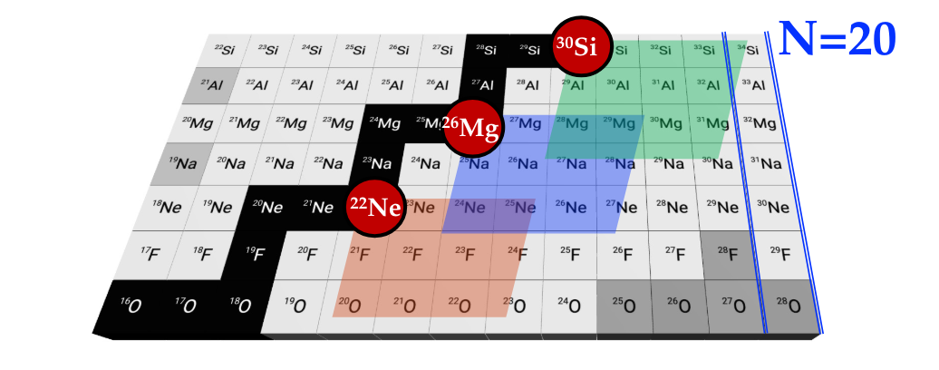
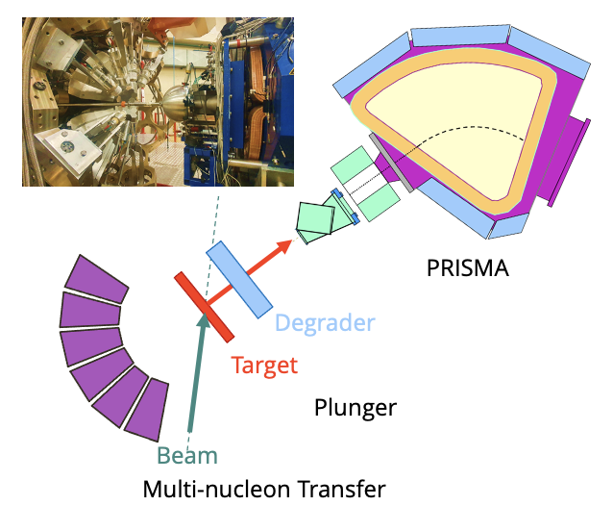
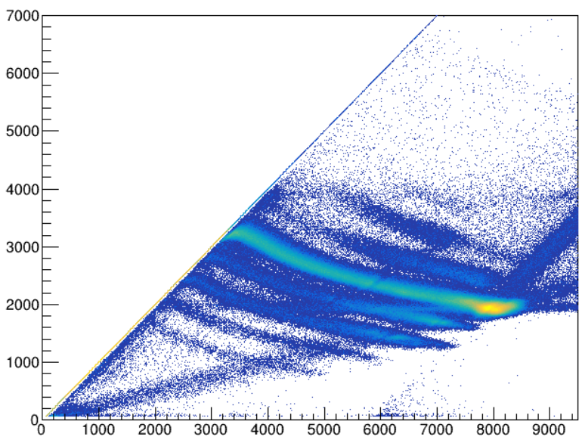
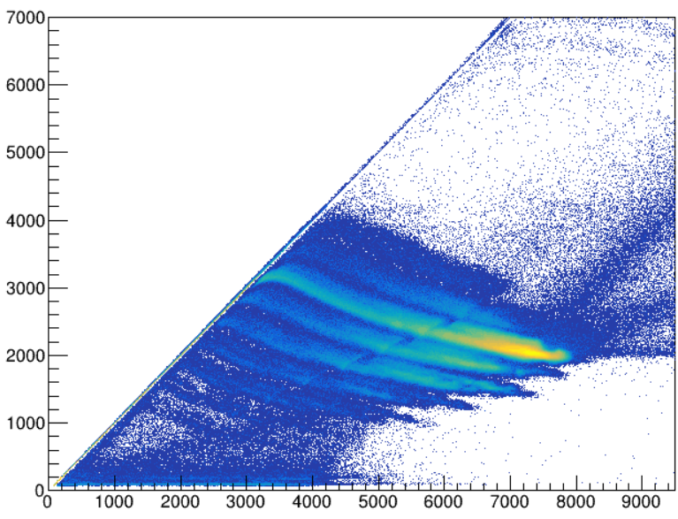
Experimental approach
²²Ne
²³⁸U target
1mg/cm²
²⁶Mg
²³⁸U target
1mg/cm²
⁹³Nb degrader
5mg/cm²
+
160 MeV
54°
200 MeV
50°
PRISMA
PRISMA
$∆$E (A.U.)
PRISMA
Mg
Na
Si
Large acceptance
magnetic spectrometer
Al
Ne
Mg
F
Na
O
Ne
N
F
C
O
N
AGATA
High purity segmented germanium array
Detection efficiency $≈$ 5.5% at 1 MeV
E (A.U.)

Slide 6
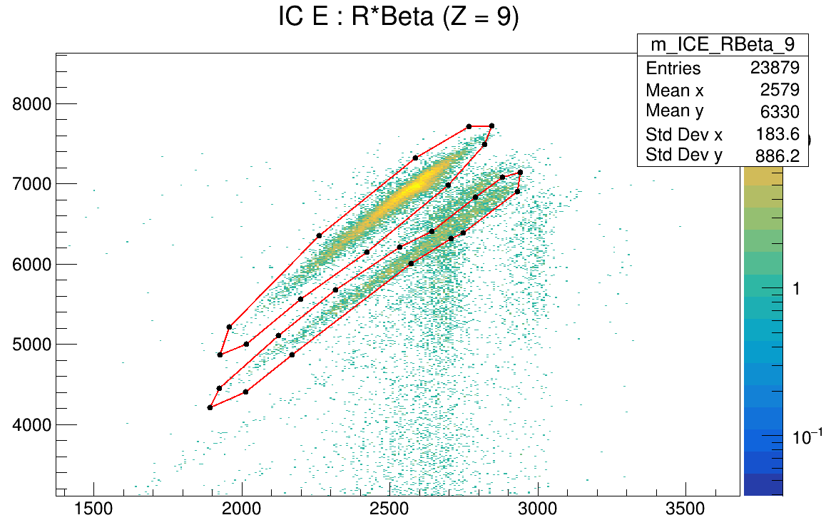
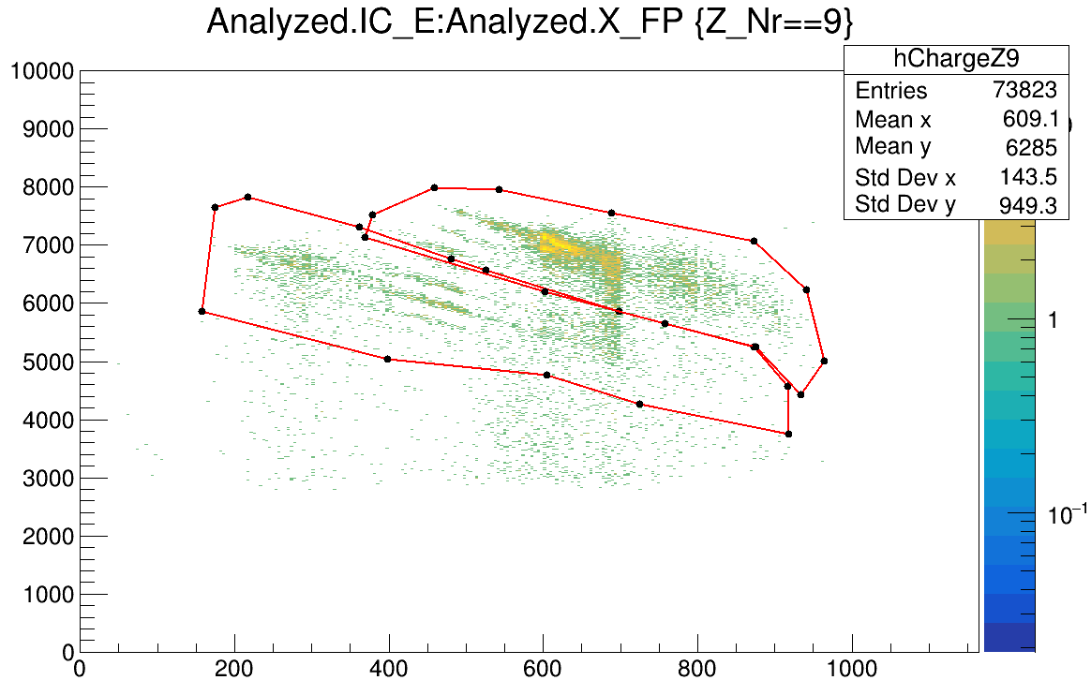
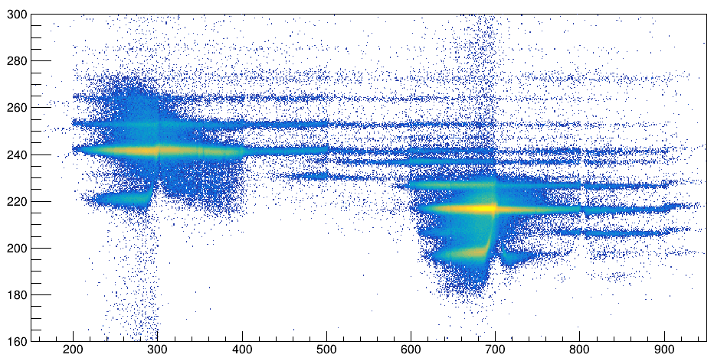
PRISMA analysis ²²Ne + ²³⁸U
Charge states selections
Mass reconstruction
Z = 9
Q = 8,9
Z = 9
Q = 8,9
O
IC_E (a.u.)
&
F
R$β$
X_FP (mm)
Ne
A/Q
Na
X_FP (mm)
16
18
20
22
24
26
28

Slide 7
AGATA data processing and results ²²Ne + ²³⁸U
Energy Resolution (%)
Absolute Efficiency (%)
Energy (keV)
Energy (keV)
Resolution of 0.25% at 1.4 MeV
Absolute efficiency of 5% at 1.4 MeV
Mode | Core | Tracked | Addback
Peak to Total | 17,36% | 26,85% | 27,37%
P/T measured from ⁶⁰Co source run

Slide 8
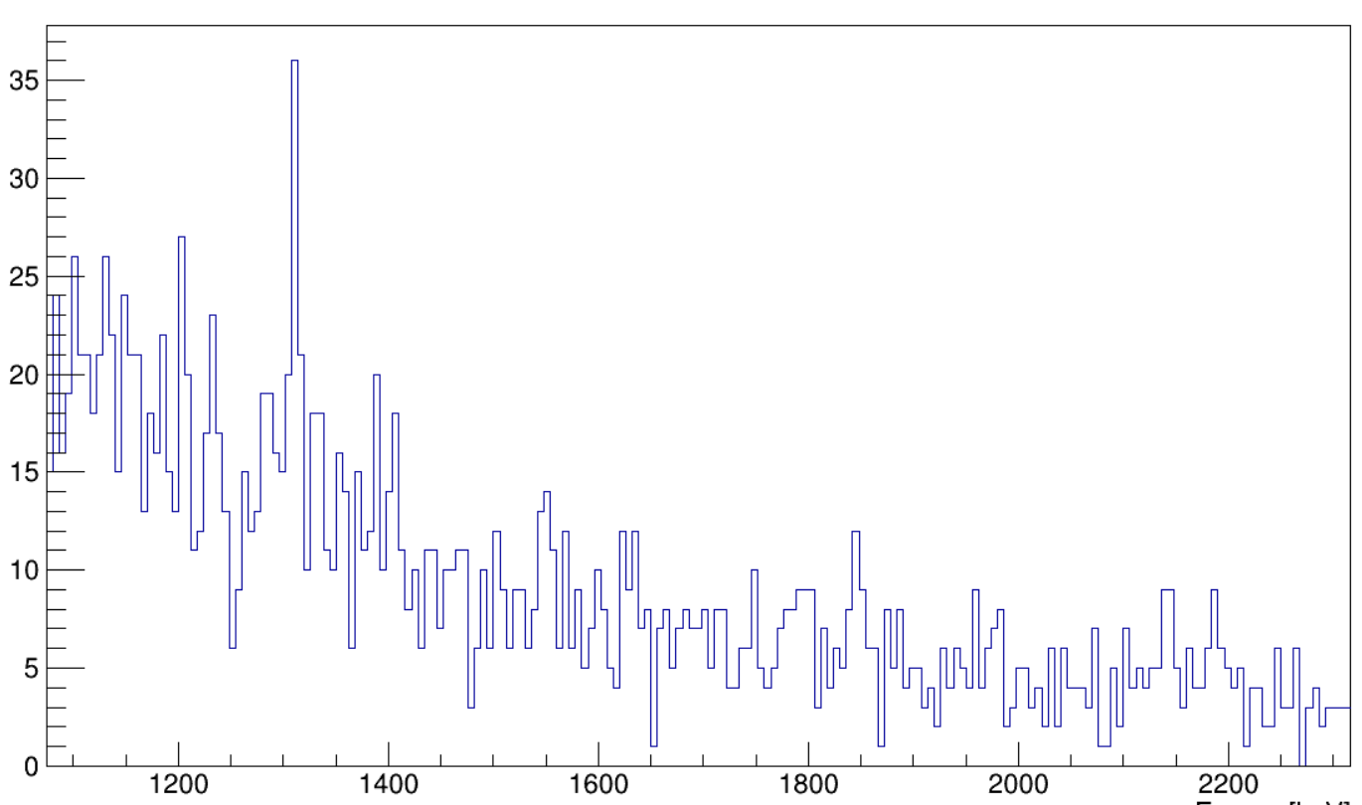
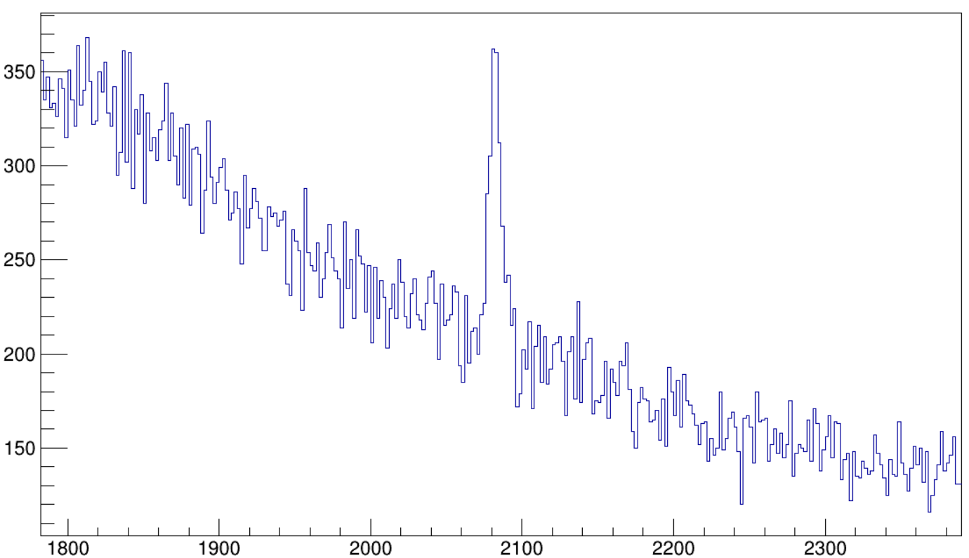
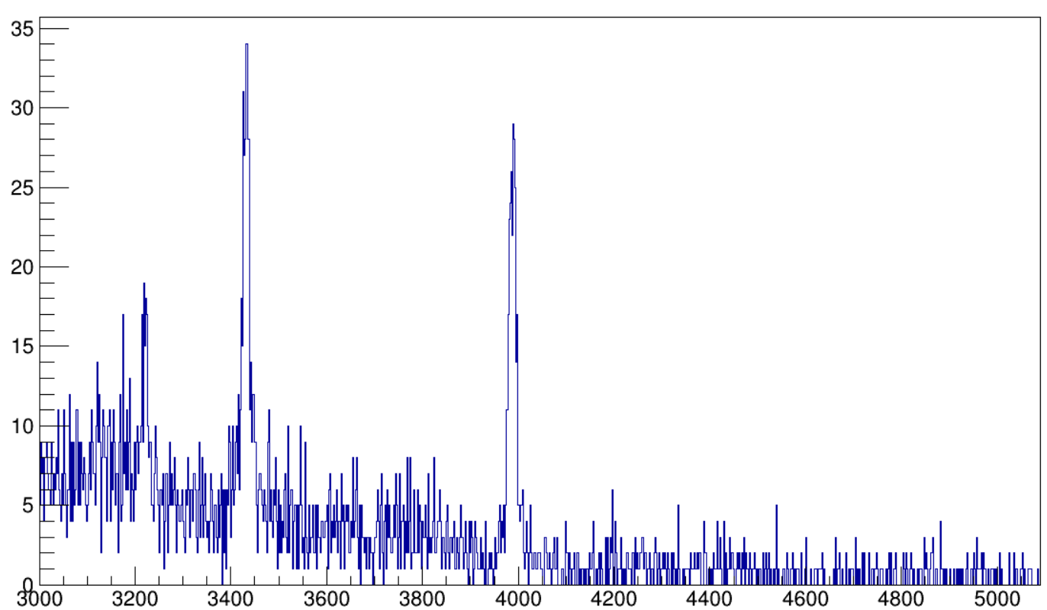
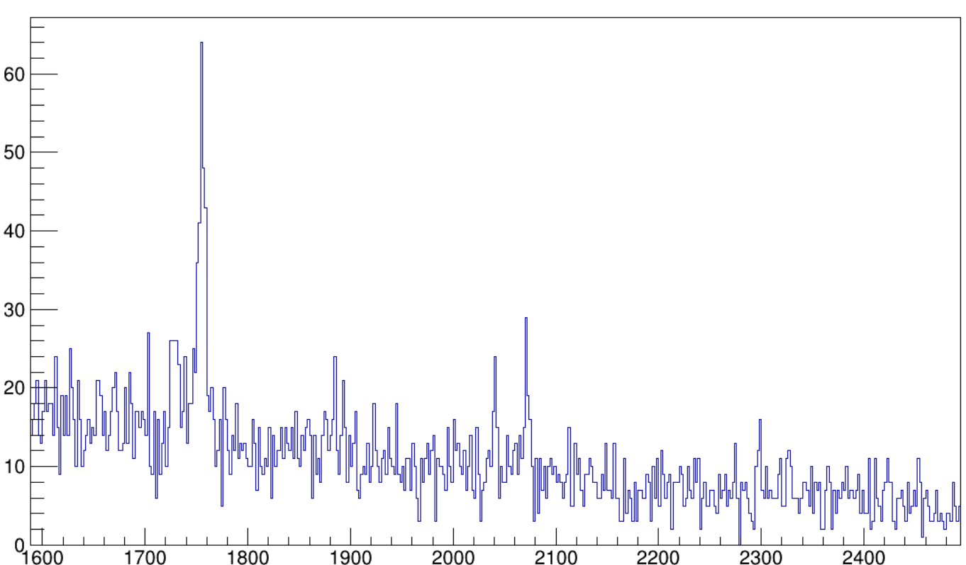
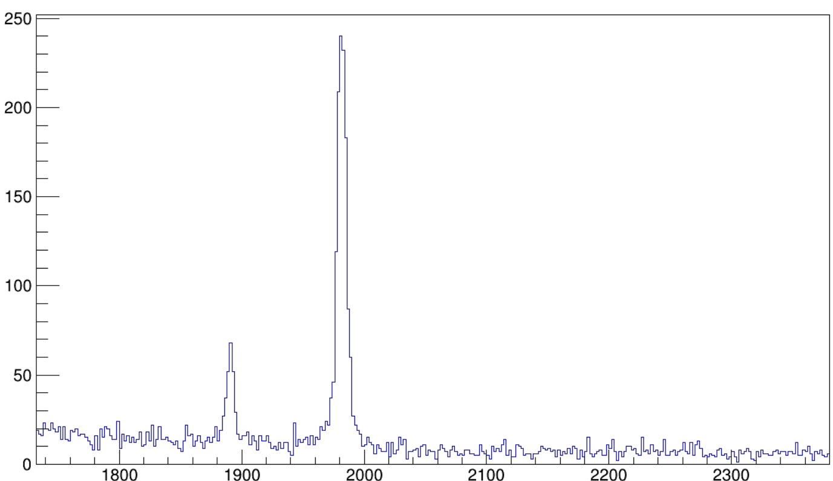
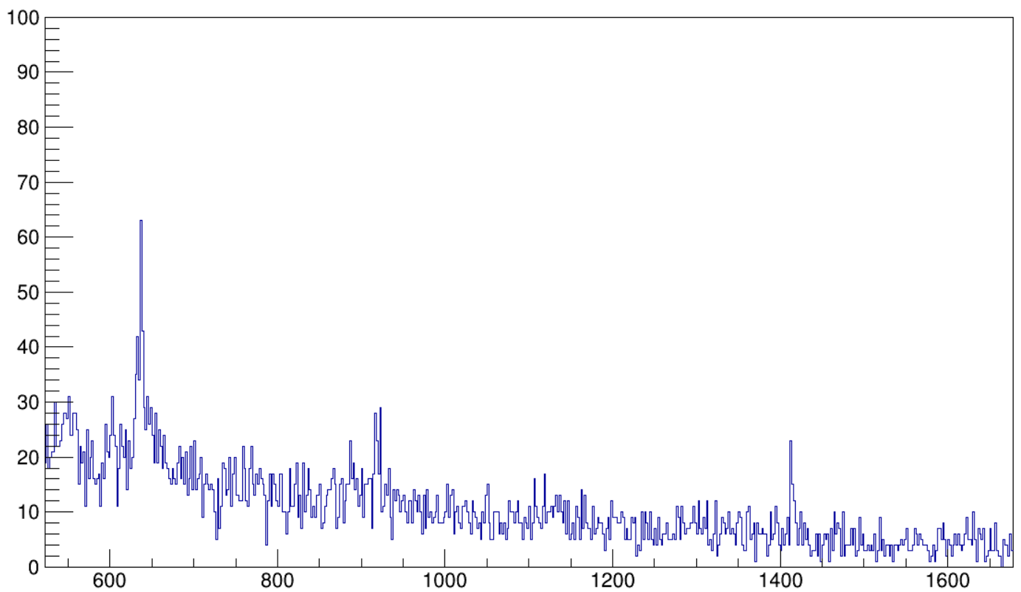
AGATA – PRISMA coincidence ²²Ne + ²³⁸U
Ne
F
21
22
23
24
19
20
21
22
23
4⁺ → 2⁺
3⁺ → 2⁺
2⁻ → 2⁺
²²Ne
²⁰F
2⁺ → 0⁺
²³Ne
(3/2)⁺ → 5/2⁺
²¹F
(7/2⁺,9/2⁺)→ 5/2⁺
1/2⁺ → 5/2⁺
? → 5/2⁺
1/2⁻ → 1/2⁺
3/2⁻ → 5/2⁺
²⁴Ne
2⁺ → 0⁺
²²F
(2⁺) → (3⁺)
1⁺ → (2⁺)
2⁺ → 2⁺
(5⁺) → (4⁺)
1000
2000
3000
4000
Energy (keV)
1000
2000
3000
4000
Energy (keV)

Slide 9
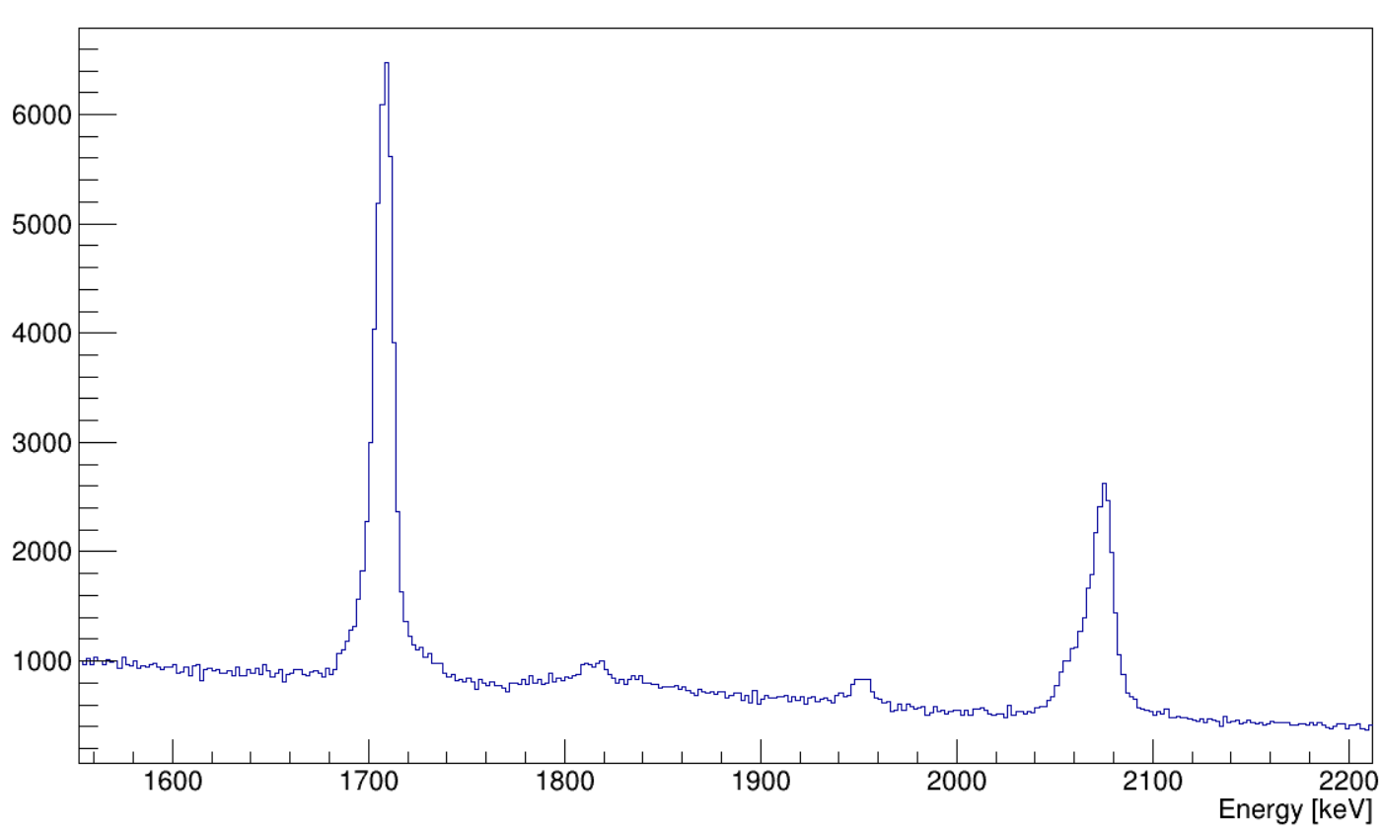
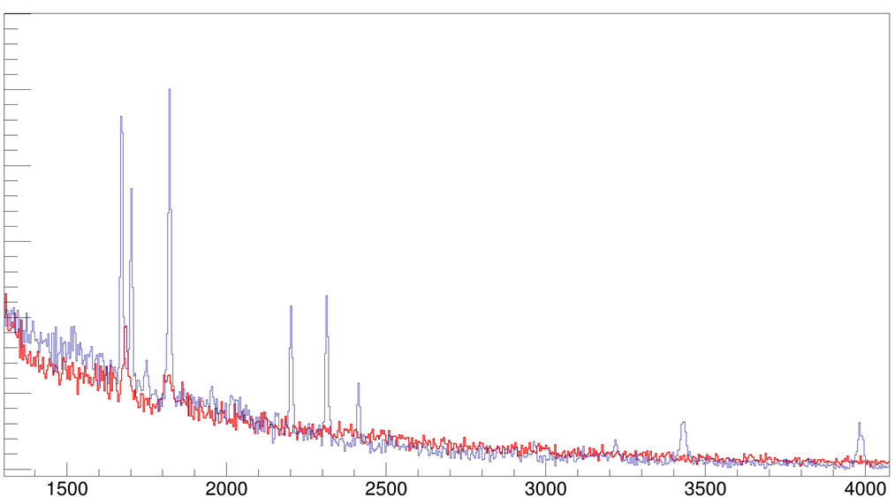
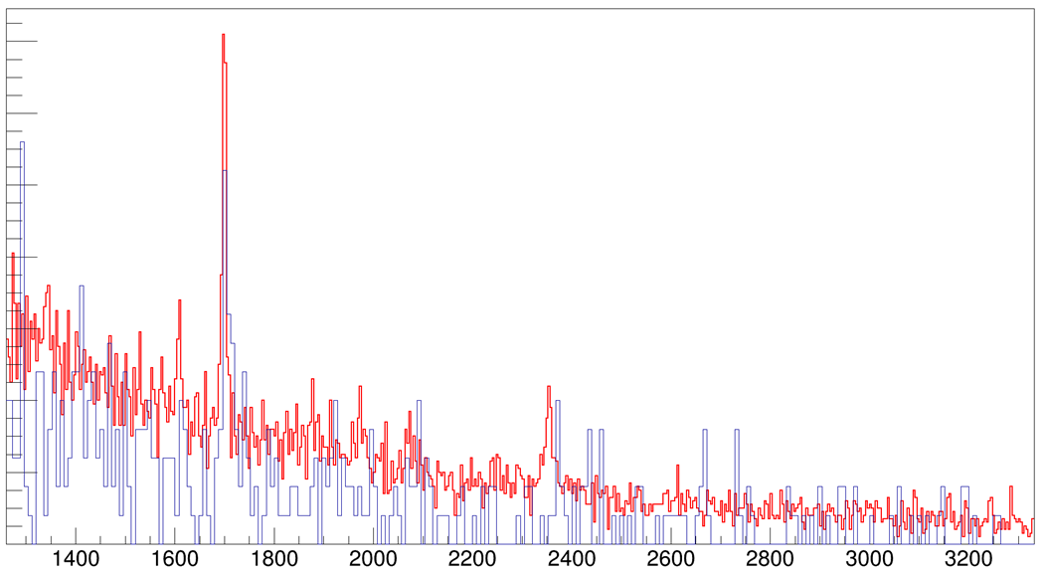
Preliminary results and comparison
5/2⁺ → 1/2⁺
²⁷Mg
$τ$ = 0.81 ps
5/2⁻, 7/2⁻ → 5/2⁺
$τ$ = 0.42 ps
²²Ne + ²³⁸U in blue
²⁶Mg + ²³⁸U in red (online calibrations)
²³Ne
(5/2,3/2)⁺ → 1/2⁺
²⁵Ne
(3/2⁺) → 5/2⁺
3/2⁺ → 5/2⁺
(7/2⁺) → 5/2⁺
5/2⁺ → 5/2⁺
7/2⁻ → 5/2⁺
3/2⁻ → 1/2⁺
Catford et al.
3/2⁺ → 1/2⁺
3/2⁺ → 5/2⁺
(3/2)⁺ → 5/2⁺
Energy (keV)
Energy (keV)

Slide 10
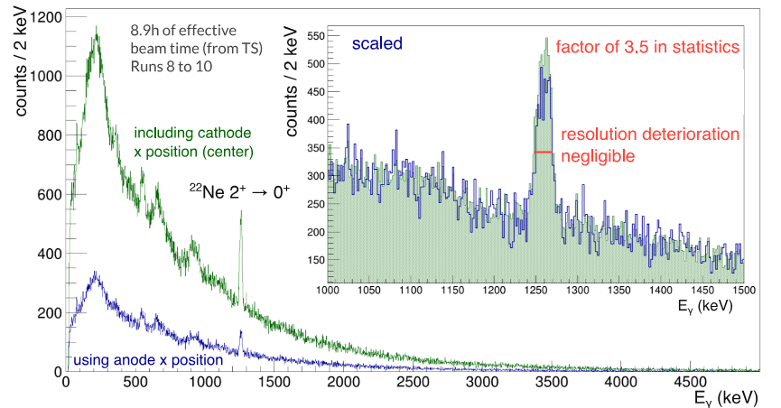
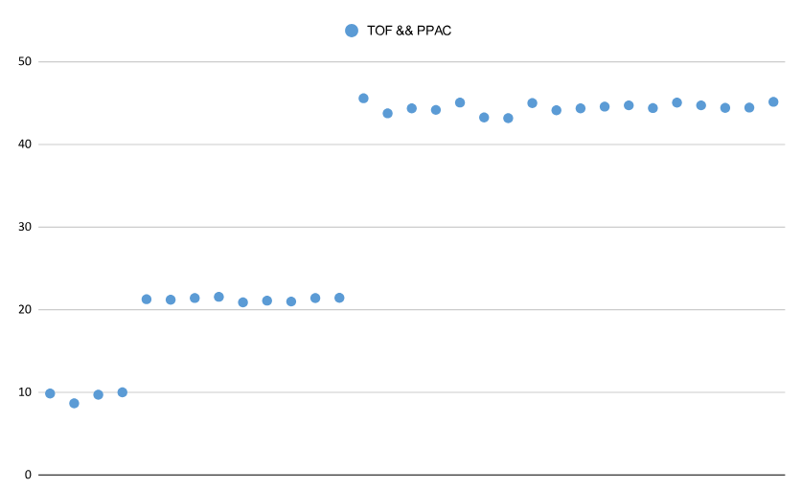
Common issues and solution
MCP and PPAC inefficient for light mass nuclei
New PRISMA analysis without position information by PPAC
PRISMA
AGATA
TOF & PPAC position detection efficiency (%)
50
40
Added timing filter amplifier on MCP
30
Slide courtesy of P. Aguilera
20
Voltage increased on PPAC
10
0
Thank you for your attention
Run number

