Slide 1
NFN
NFN
JuIgen Pellumaj
Lifetime measurements in the N=126 region with the reversed plunger configuration

Slide 2
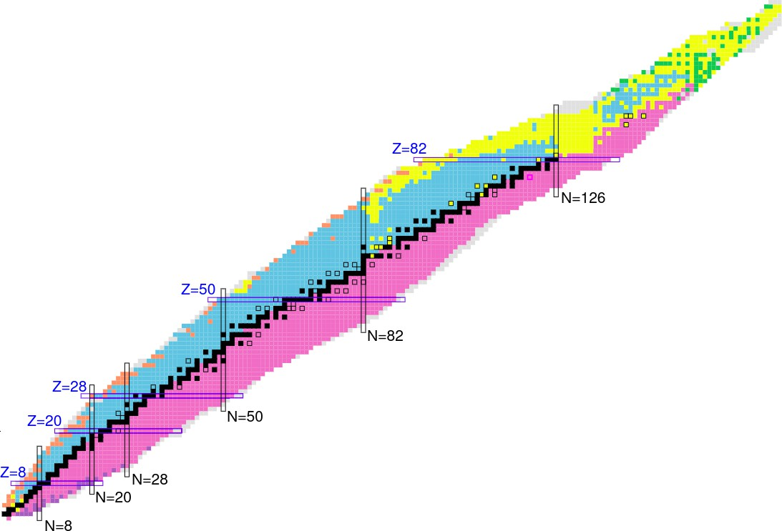
Investigating nuclear structure in the vicinity of N=126
Reversed plunger
1 / 20

Slide 3
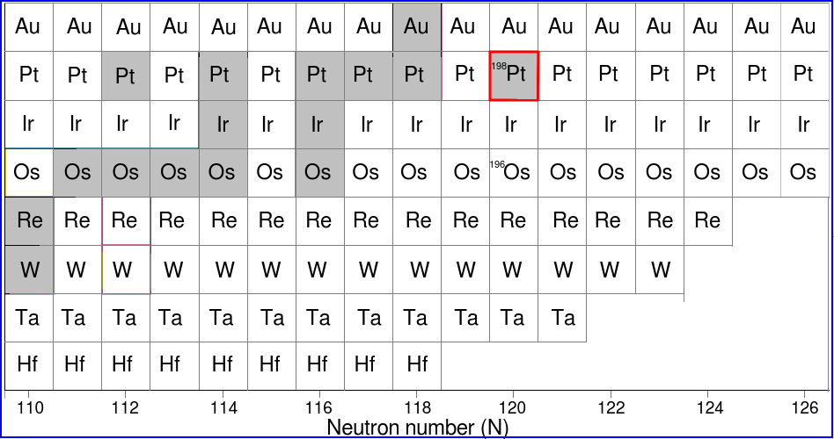
Investigating nuclear structure in the vicinity of N=126
Reversed plunger
1 / 20

Slide 4
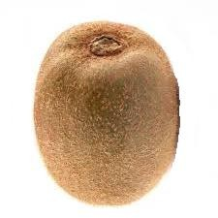
Investigating nuclear structure in the vicinity of N=126
Shape transitions from prolate to oblate and spherical at N=126
Reversed plunger
1 / 20

Slide 5
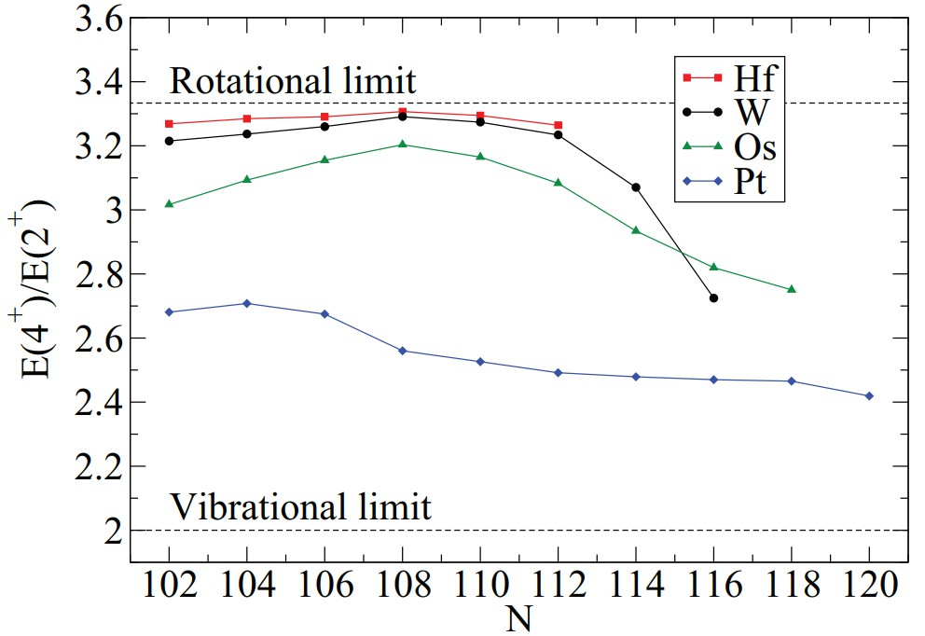
Investigating nuclear structure in the vicinity of N=126
Shape transitions from prolate to oblate and spherical at N=126
P.J.R. Mason et al., Phys. Rev. C 88, 044301 (2013)
Reversed plunger
1 / 20

Slide 6
Investigating nuclear structure in the vicinity of N=126
Shape transitions from prolate to oblate and spherical at N=126
P.R. John et al., Phys. Rev. C 90, 021301 (2014)
Reversed plunger
1 / 20

Slide 7
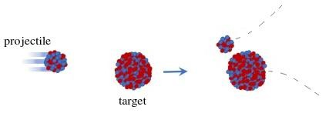
Investigating nuclear structure in the vicinity of N=126
Shape transitions from prolate to oblate and spherical at N=126
✗ To heavy for fission
✗ No fusion evaporation
✔ Fragmentation
✔ Multi-nucleon transfer
Reversed plunger
1 / 20

Slide 8
Investigating nuclear structure in the vicinity of N=126
Shape transitions from prolate to oblate and spherical at N=126
✗ To heavy for fission
✗ No fusion evaporation
✔ Fragmentation
✔ Multi-nucleon transfer
E4/E2 B(E2)
B(E2:4⁺→2⁺)/B(E2:2⁺→0⁺)
Data in the region remain scars.
Reversed plunger
1 / 20

Slide 9
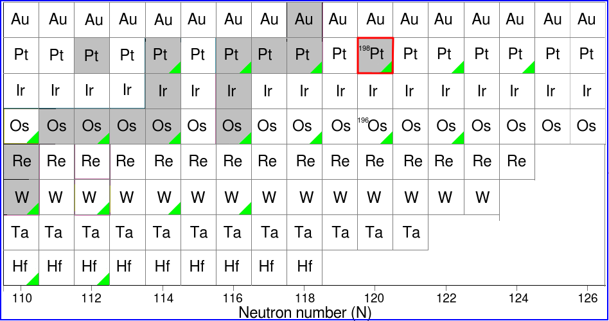
Investigating nuclear structure in the vicinity of N=126
Shape transitions from prolate to oblate and spherical at N=126
Spectroscopy
✗ To heavy for fission
✗ No fusion evaporation
✔ Fragmentation
✔ Multi-nucleon transfer
E4/E2 B(E2)
B(E2:4⁺→2⁺)/B(E2:2⁺→0⁺)
Data in the region remain scars.
Reversed plunger
1 / 20

Slide 10
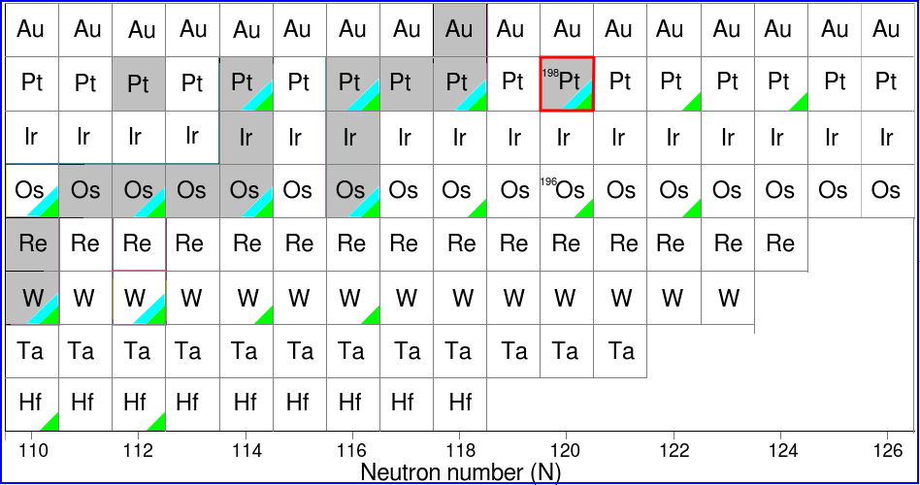
Investigating nuclear structure in the vicinity of N=126
Shape transitions from prolate to oblate and spherical at N=126
Spectroscopy Lifetimes
✗ To heavy for fission
✗ No fusion evaporation
✔ Fragmentation
✔ Multi-nucleon transfer
E4/E2 B(E2)
B(E2:4⁺→2⁺)/B(E2:2⁺→0⁺)
Data in the region remain scars.
Reversed plunger
1 / 20

Slide 11
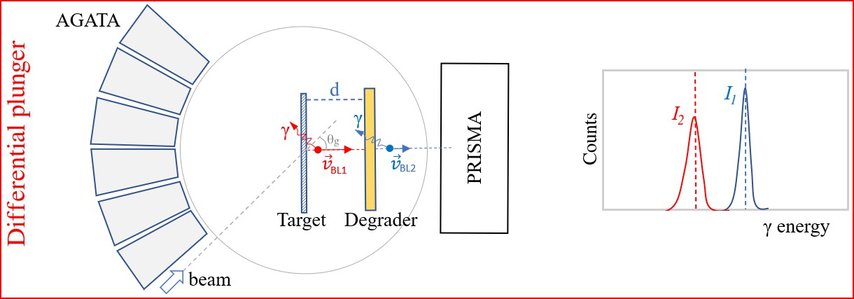
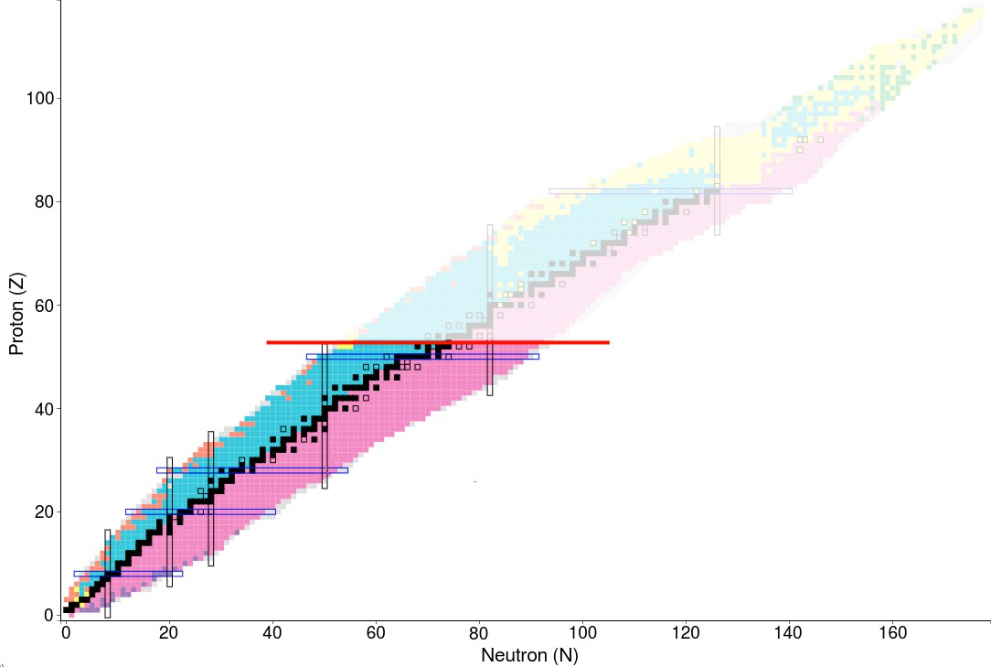
The reversed plunger technique for lifetime measurements
Z=54
Reversed plunger
2 / 20

Slide 12
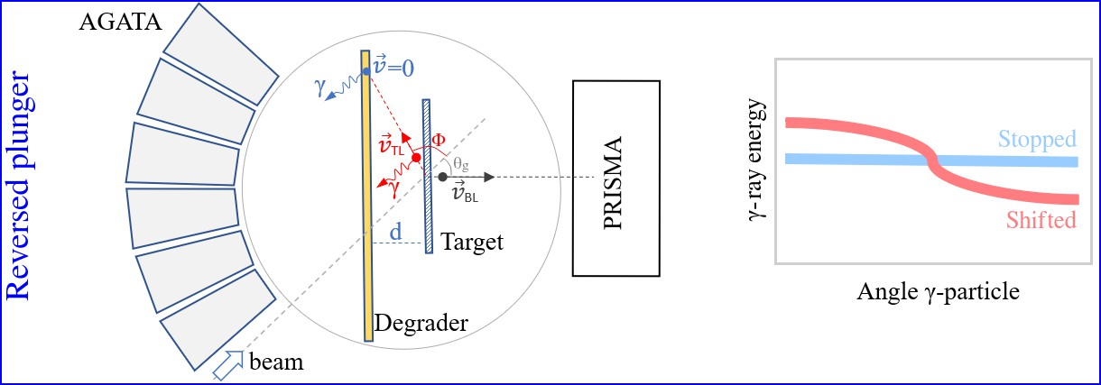
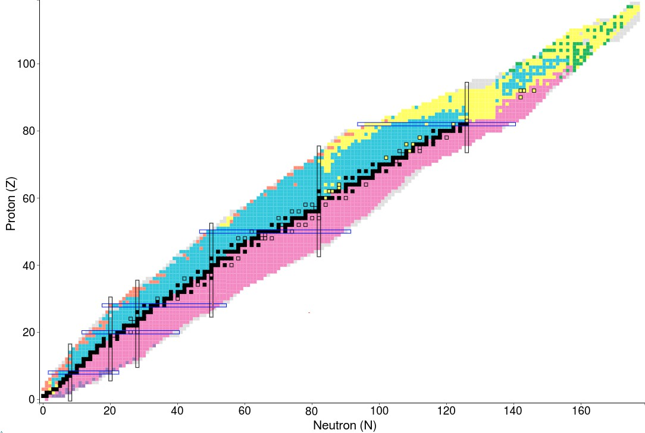
The reversed plunger technique for lifetime measurements
Z=54
Reversed plunger
2 / 20

Slide 13
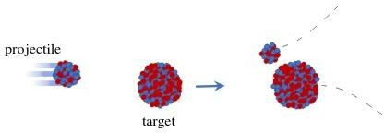
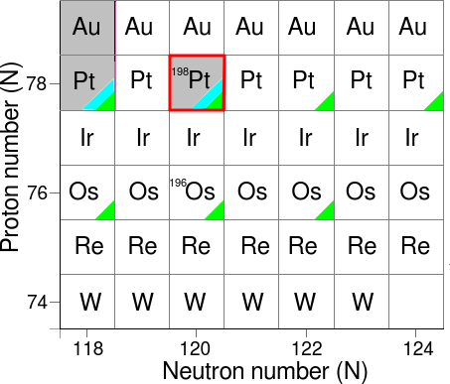
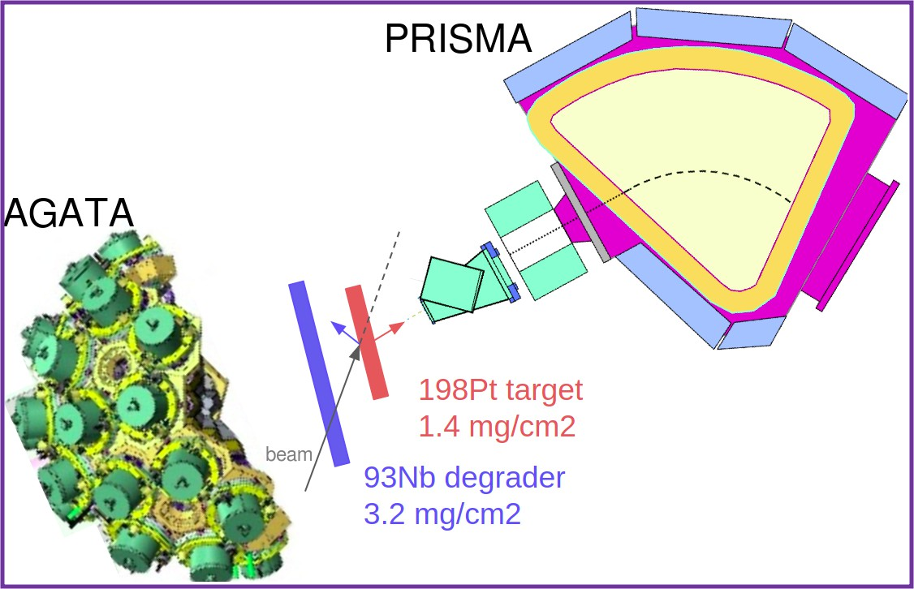
Reaction
Beam ¹³⁶Xe @1134 MeV Target: ¹⁹⁸Pt
Degrader: ⁹³Nb PRISMA set at 39◦
Plunger distances: 30, 40, 50 and 120 µm
Lifetimes of low-lying states are known.
AGATA + PRISMA + Reversed plunger
AGATA: Nuc. Instr. and Meth. A 1049 (2023) 168040
PRISMA: Nucl. Phys. A 701 (2002) 217-221
Experiment performed in May 2023
Reversed plunger
3 / 20

Slide 14
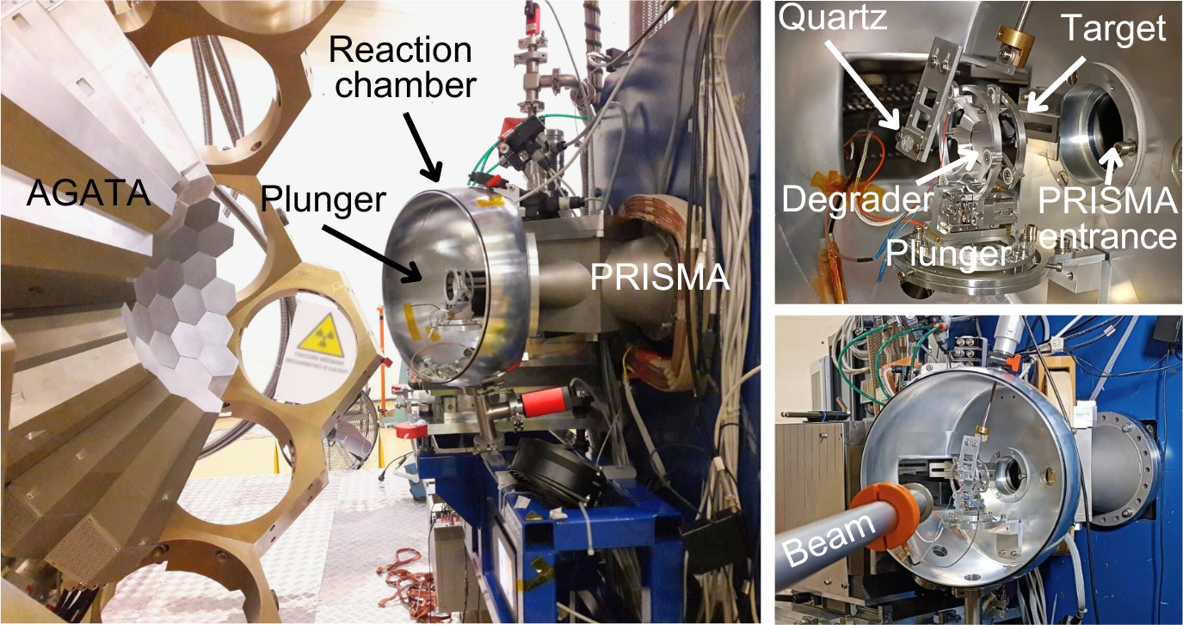
Experimental setup
Reversed plunger
4 / 20

Slide 15
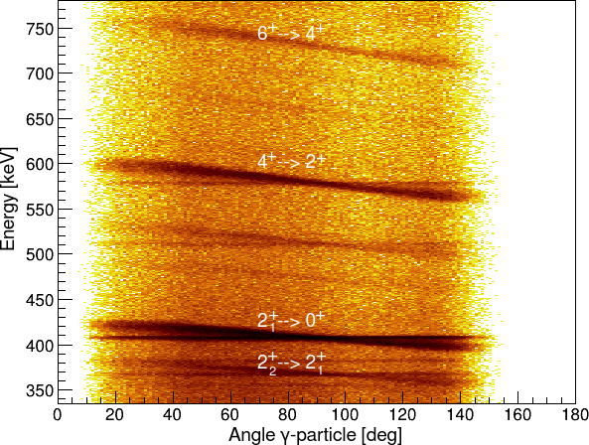
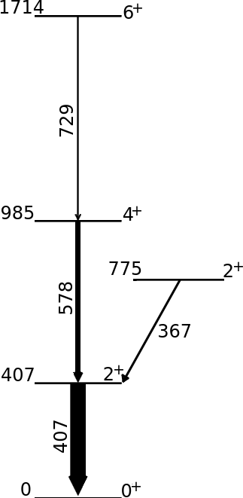
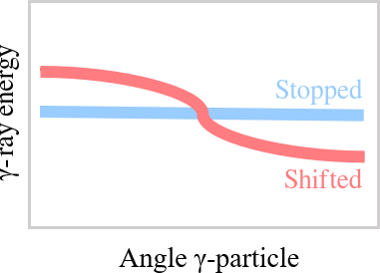
The lineshape matrix for ¹⁹⁸Pt
198_{Pt}
Reversed plunger
5 / 20

Slide 16
The lineshape matrix for ¹⁹⁸Pt
The 407-keV transition (2⁺ →0⁺) (shifted+stopped component)
1
The 578-keV transition (4⁺ →2⁺) (shifted+stopped component)
1
The 367-keV transition (2⁺ →2⁺) (shifted+stopped component)
198_{Pt}
2 1
Reversed plunger
5 / 20

Slide 17
The lineshape matrix for ¹⁹⁸Pt
The 407-keV transition (2⁺ →0⁺) (shifted+stopped component)
1
The 578-keV transition (4⁺ →2⁺) (shifted+stopped component)
1
The 367-keV transition (2⁺ →2⁺) (shifted+stopped component)
198_{Pt}
2 1
The 729-keV transition (6⁺ →4⁺) (shifted component)
Reversed plunger
5 / 20

Slide 18
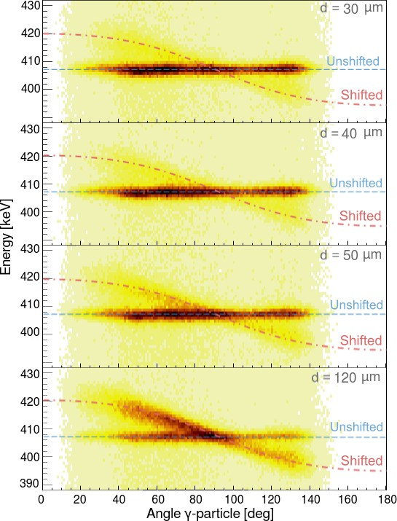
Lifetime measurement of the 2⁺ state
1
Reversed plunger
6 / 20

Slide 19
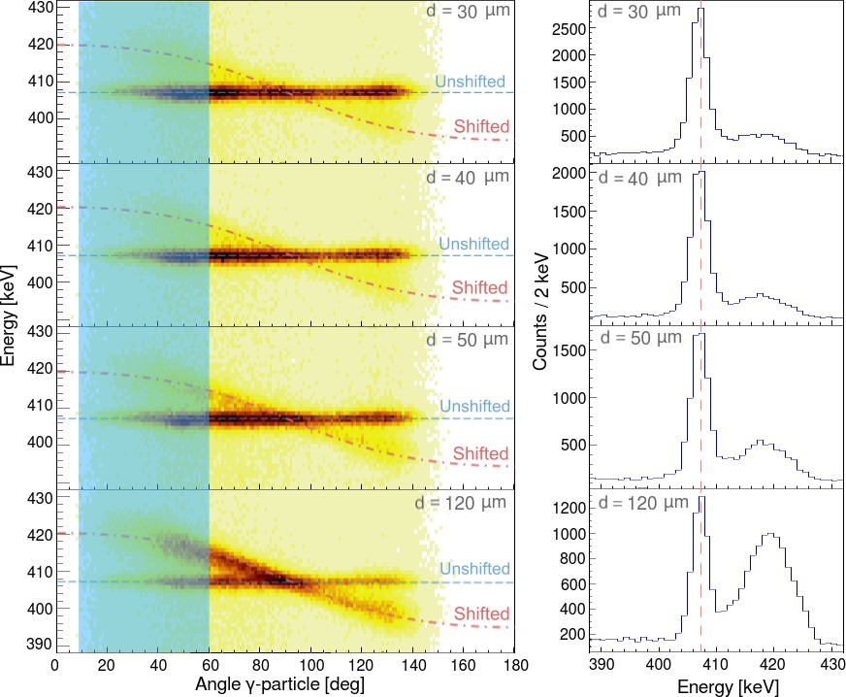
Lifetime measurement of the 2⁺ state
1
Reversed plunger
6 / 20

Slide 20
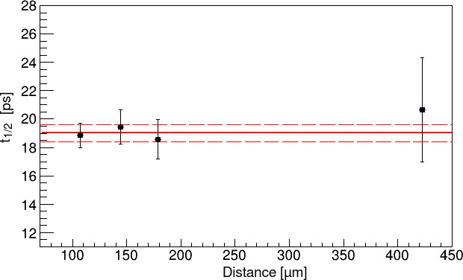
Lifetime measurement of the 2⁺ state
1
^{Σ}
−R_{i} (t) + b_{ki} α_{ki} R_{k} (t)
τ_{i} =
dR_{i} (t) dt
Measured: t_{1/2}=19.3(3) ps Literature: *t_{1/2}=22.25(15) ps
*Adopted value from:
Nucl. Phys. A 370 (1981) 146
Nucl. Phys. A 458 (1986) 165-187
Nucl. Phys. A 266 (1976) 337-345
Nucl. Phys. A 177 (1971) 1-32
Phys. Rev. 188, 1905 (1969)
Reversed plunger
6 / 20

Slide 21
Results from the reversed plunger
*Adopted value from:
Nucl. Phys. A 370 (1981) 146
Nucl. Phys. A 458 (1986) 165-187
Nucl. Phys. A 266 (1976) 337-345
Nucl. Phys. A 177 (1971) 1-32
Phys. Rev. 188, 1905 (1969)
Reversed plunger
7 / 20

Slide 22
Do we need a new analysis procedure for such dataset
In this case the ions travel perpendicular to the degrader foil
Reversed plunger
8 / 20

Slide 23
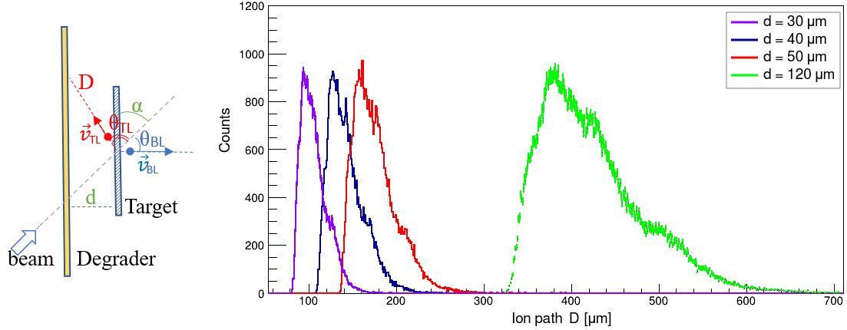
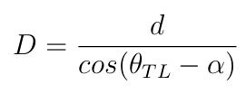
Do we need a new analysis procedure for such dataset
This is not the case with the reversed plunger
configuration
Distance depends on the cos(θ_{TL}- ⍺)
Reversed plunger
9 / 20

Slide 24
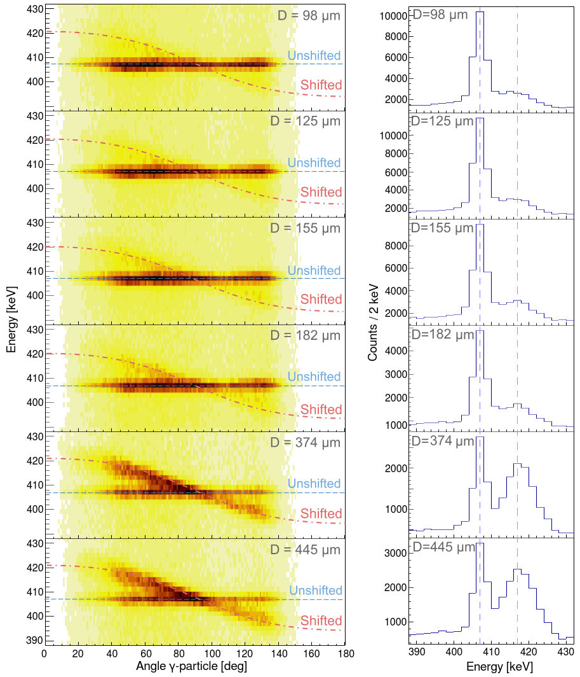
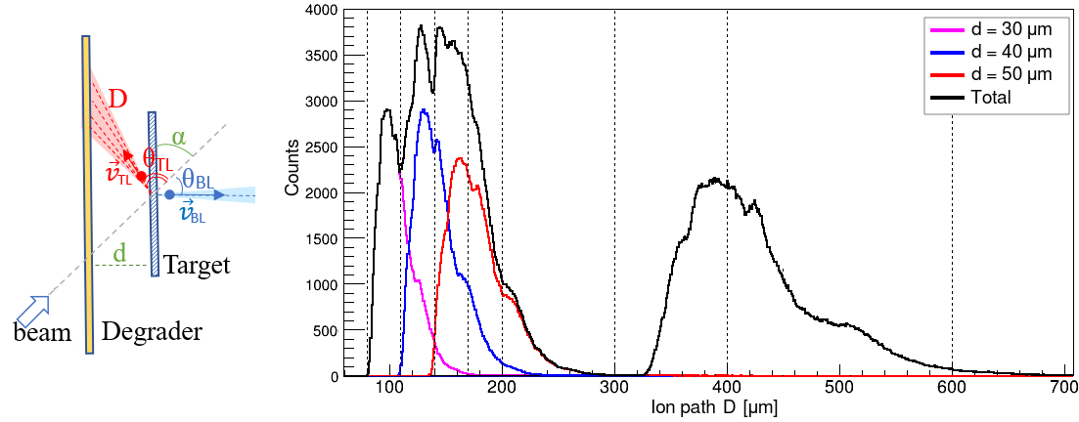
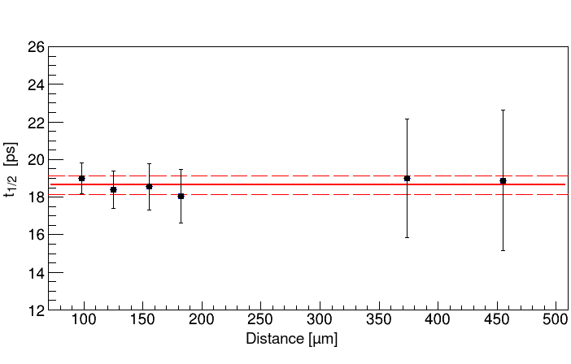
Do we need a new analysis procedure for such dataset
Reversed plunger
10 / 20

Slide 25
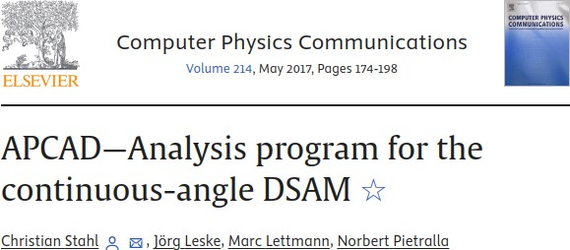
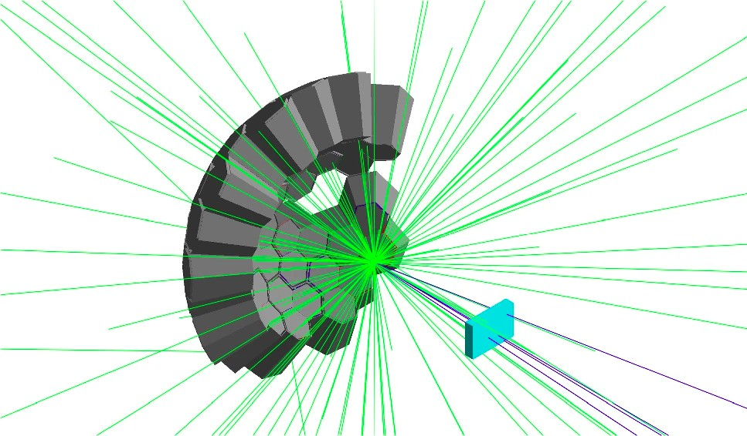
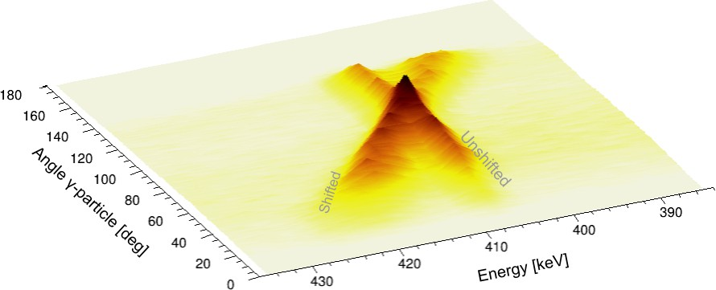
Going towards a 2D fit of the reversed plunger data
AGATA simulation package + Geant4
Take into account the γ decay following complex level schemes.
The lifetime of the energy levels. Reaction mechanism.
Angular distributions of BL or TL ions.
Response function of detectors.
Geometry of the setup.
Reversed plunger
11 / 20

Slide 26
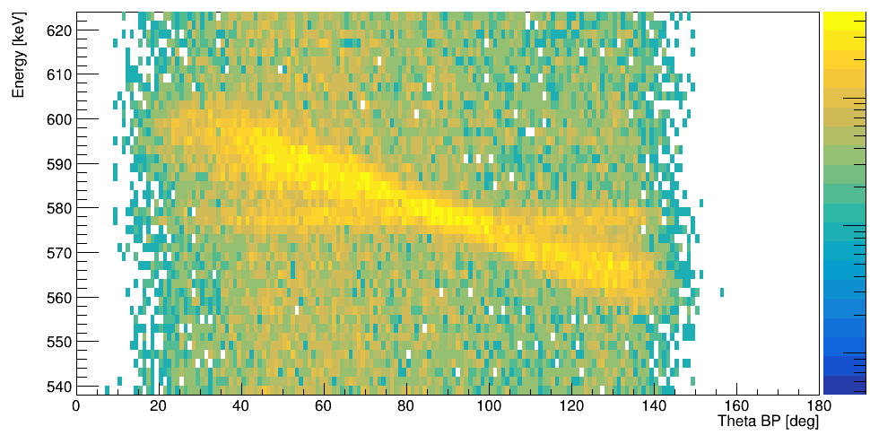
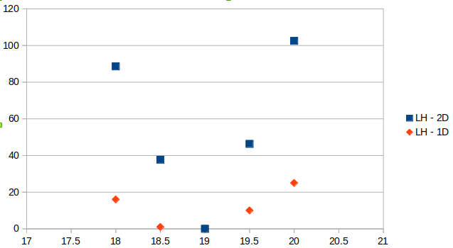
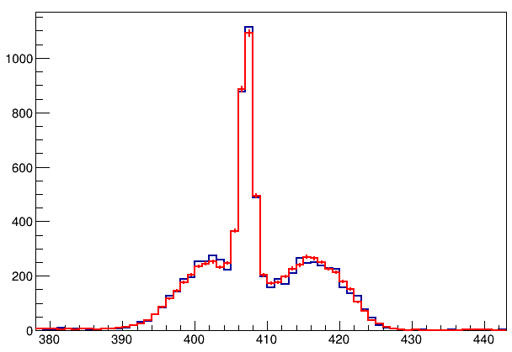
Going towards a 2D fit of the reversed plunger data
Log(L)
Counts
1 sigma -Log(L)_min +- -Log(L) = 0.5
1D
t1/2 = 19.00(5)
2D
t1/2 = 19.00 (1)
Energy [keV]
(Smaller errorbar)
This depends a lot on the number of events in exp data
Reversed plunger
12 / 20

Slide 27
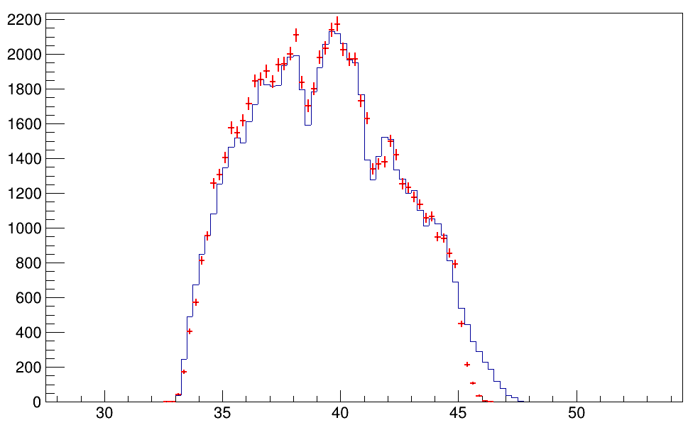
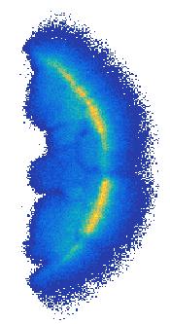
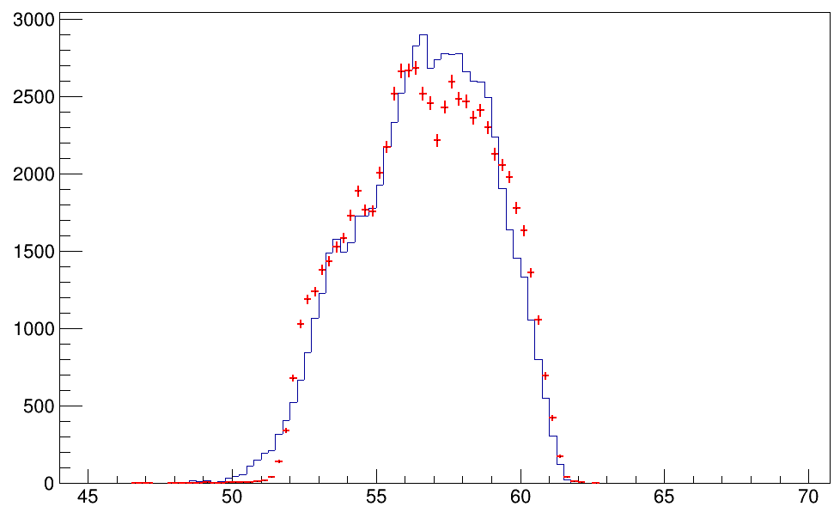
Going towards a 2D fit of the reversed plunger data
BL
Exp
TL
Sim
Phi [deg]
PRISMA
BL
Theta [deg]
beam
TL
Exp
Sim
Distribution of the ions in theta well reproduced by simulations
Phi [deg]
Theta [deg]
Reversed plunger
13 / 20

Slide 28
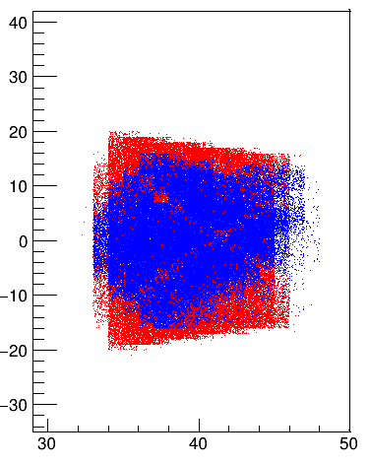
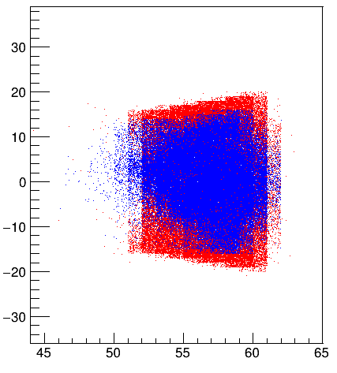
Going towards a 2D fit of the reversed plunger data
BL
Exp
BL
Exp
TL
Sim
Sim
Phi [deg]
PRISMA
BL
Theta [deg]
Theta [deg]
beam
TL
TL
Exp
Sim
Distribution of the ions in theta well reproduced by simulations
That is not the case in theta.
Phi [deg]
Exp
Sim
Theta [deg]
Theta [deg]
Reversed plunger
13 / 20

Slide 29
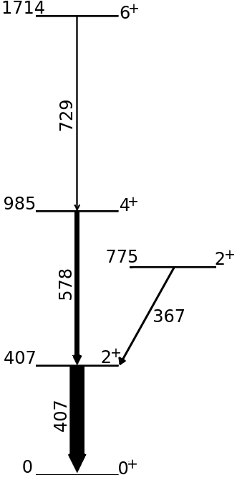
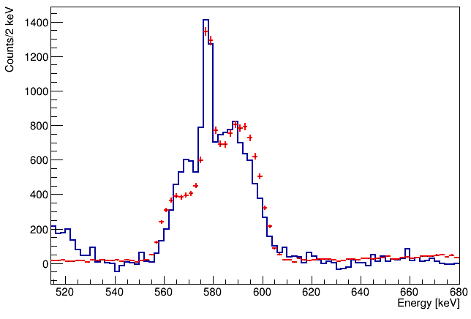
Going towards a 2D fit of the reversed plunger data
Exp
Still to be checked before going to 2D fit
Distribution in phi of the BL and TL ions
Beta distribution of the ions, exp vs sim
The missing counts in the low-energy part of the spectrum
Sim
Comparison of experimental gamma ray spectrum with simulations, for the 4⁺ → 2⁺ transition of ¹⁹⁸Pt
Reversed plunger
14 / 20

Slide 30
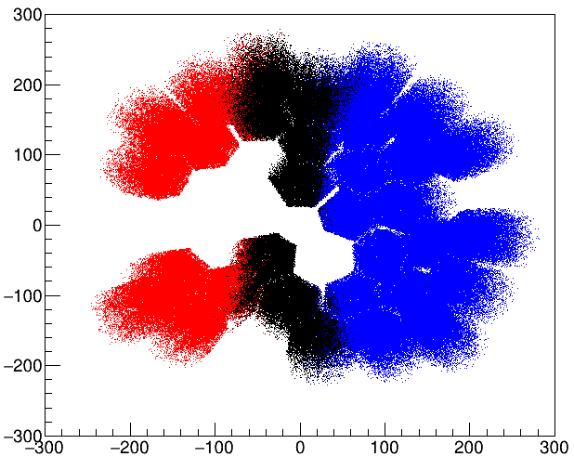
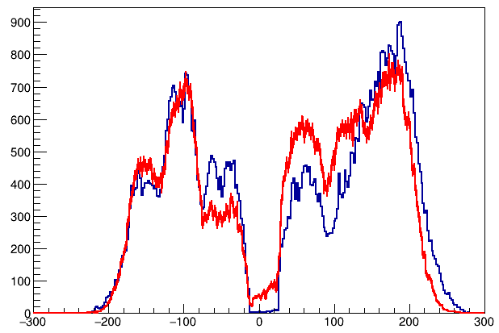
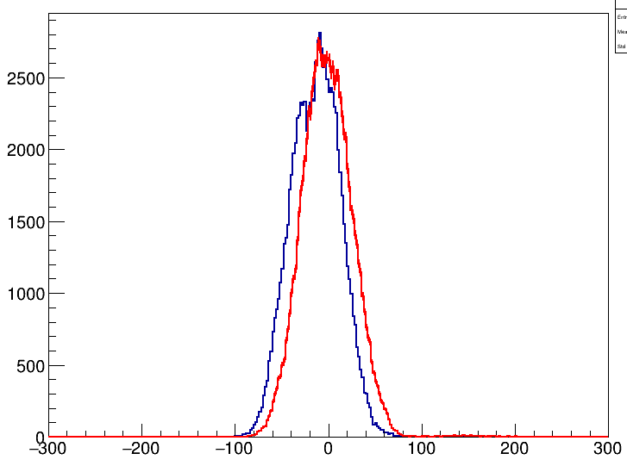
Investigating the lack of counts
Angle ɣ-particle < 90
Angle ɣ-particle = 90
Angle ɣ-particle > 90
Projecting the matrix on the X axis and Y axis (angles ɣ-particle = 90)
Y-projection
X-projection
Reversed plunger
15 / 20

Slide 31
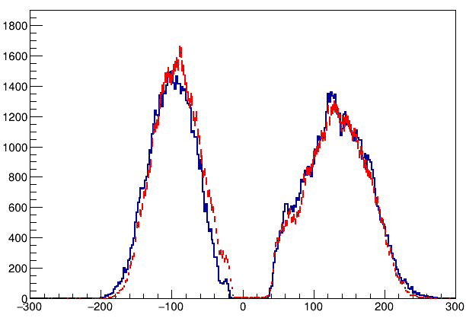
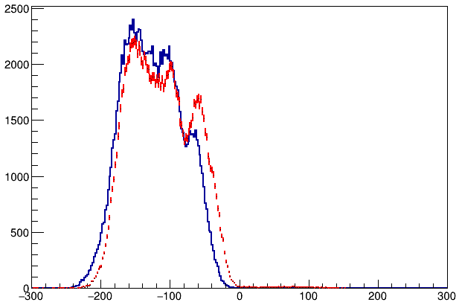
Investigating the lack of counts
Angle ɣ-particle < 90
Angle ɣ-particle = 90
Angle ɣ-particle > 90
Projecting the matrix on the X axis and Y axis (angles ɣ-particle > 90)
Y-projection
X-projection
Reversed plunger
16 / 20

Slide 32
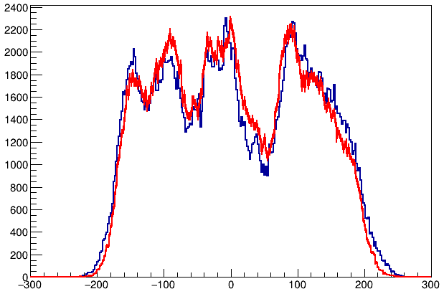
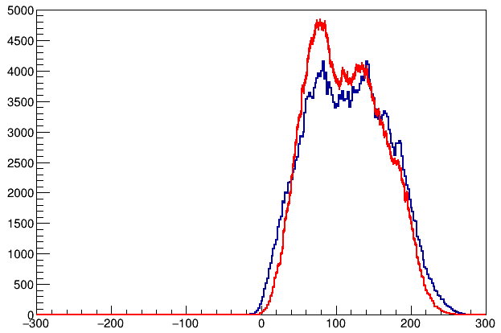
Investigating the lack of counts
Angle ɣ-particle < 90
Angle ɣ-particle = 90
Angle ɣ-particle > 90
Projecting the matrix on the X axis and Y axis (angles ɣ-particle < 90)
Y-projection
X-projection
Reversed plunger
17 / 20

Slide 33
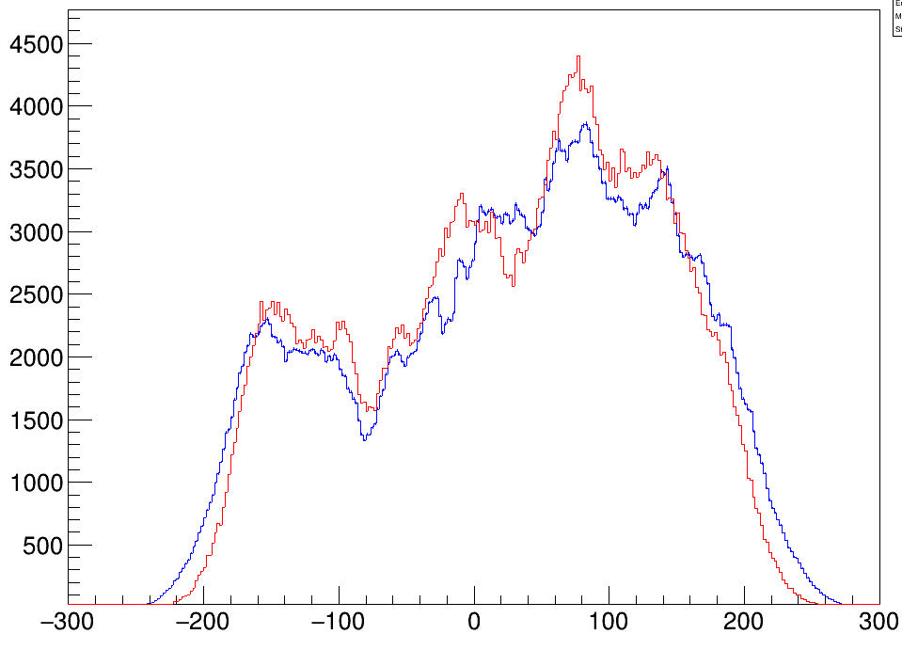
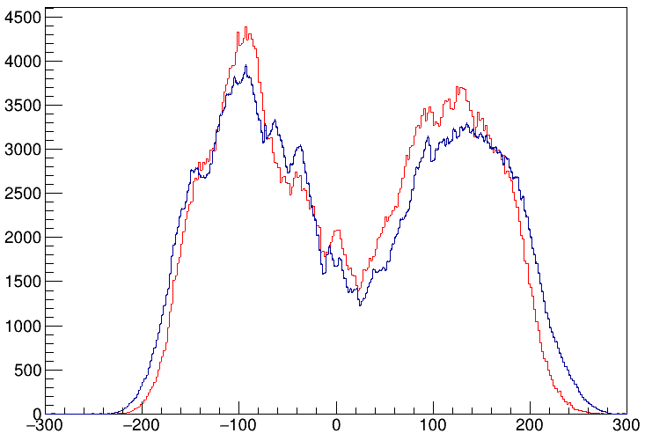
Investigating the lack of counts
Data with 152Eu source
Distribution of the X-coordinate
Distribution of the Y-coordinate
Reversed plunger
18 / 20

Slide 34
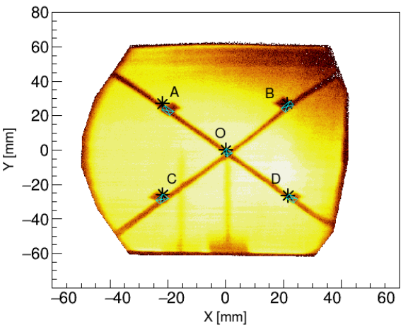
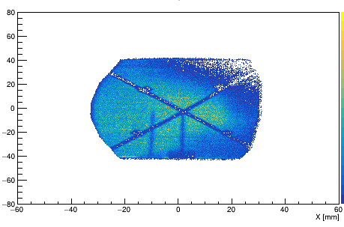
Investigating the lack of counts
before
after
Reversed plunger
19 / 20

Slide 35
Conclusions
Reversed plunger - ¹⁹⁸Pt
Lifetimes measurements in ¹⁹⁸Pt using the reversed plunger configuration:
Being analysed by B. Gongora
407-keV 2⁺ level
1
775-keV 2⁺ level
2
985-keV 4⁺ level
1
The measured lifetimes literature.
are compatible with the
On going...
Performing a 2D fit of the experimental data employing Geant4 simulations.
Lifetime measurements in ¹⁹⁶Os, ²⁰⁰Pt and study shape transitions.
M. Birova & M. Sedlak
Also will analyse this dataset
Reversed plunger
20 / 20

Slide 37
Advanced GAmma-ray Tracking Array
A full sphere of 180 segmented HPGe detectors
Track the path of γ rays inside the detector
Higher sensitivity and large coverage of the solid angle

Slide 38
PRISMA
Used to identify the mass, atomic number, velocity and charge state of heavy ions in binary reactions
PRISMA: Nucl. Phys. A 701 (2002) 217-221
MCP: Nucl. Instr. and Meth. A 547 (2005) 455–463
Focal plane: Nucl. Instr. and Meth. A 551 (2005) 364-374

Slide 39
Differential plunger and its limitations

Slide 40
Differential plunger and its limitations
Limitations due to the identification capabilities of the magnetic spectrometer: ∆Z/Z≈1/60

Slide 41
Differential plunger and its limitations
Limitations due to the identification capabilities of the magnetic spectrometer: ∆Z/Z≈1/60

Slide 42
Differential plunger and its limitations
Limitations due to the identification capabilities of the magnetic spectrometer: ∆Z/Z≈1/60
Z=54

Slide 43
Differential plunger and its limitations
Can we go beyond?
Limitations due to the identification capabilities of the magnetic spectrometer: ∆Z/Z≈1/60
Z=54
Z=54

Slide 44
The reversed plunger technique for lifetime measurements
Z=54

Slide 45
The reversed plunger technique for lifetime measurements
Z=54

Slide 46
Going towards a 2D fit of the reversed plunger data
1 sigma
-Log(L)_min +- -Log(L) = 0.5
1D
t1/2 = 19.00(5)
2D
t1/2 = 19.00 (1)
This depends a lot on the number of events in exp data

Slide 47
Going towards a 2D fit of the reversed plunger data
TL
BL
beam

