Slide 1
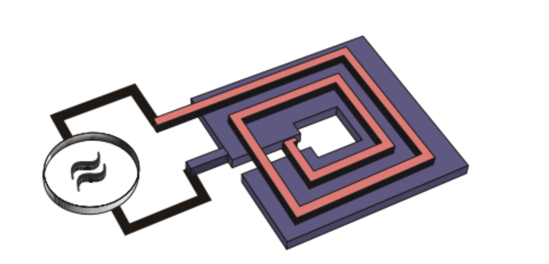
FLASH – Trento Activity
Research Objectives
1) Explore the possibility of using a Microstrip SQUID Amplifier (MSA) in a 300 mK small-size refrigerator inserted in the FLASH cryostat
MSA noise vs T measurements down to 20mK
2) Explore the possibility of simultaneous measurement of multiple cavity modes
Tests at 4.2K of 2-3 MSA and “TBD devices” coupled to a single antenna
Microstrip SQUID Amplifier (MSA)

Slide 2
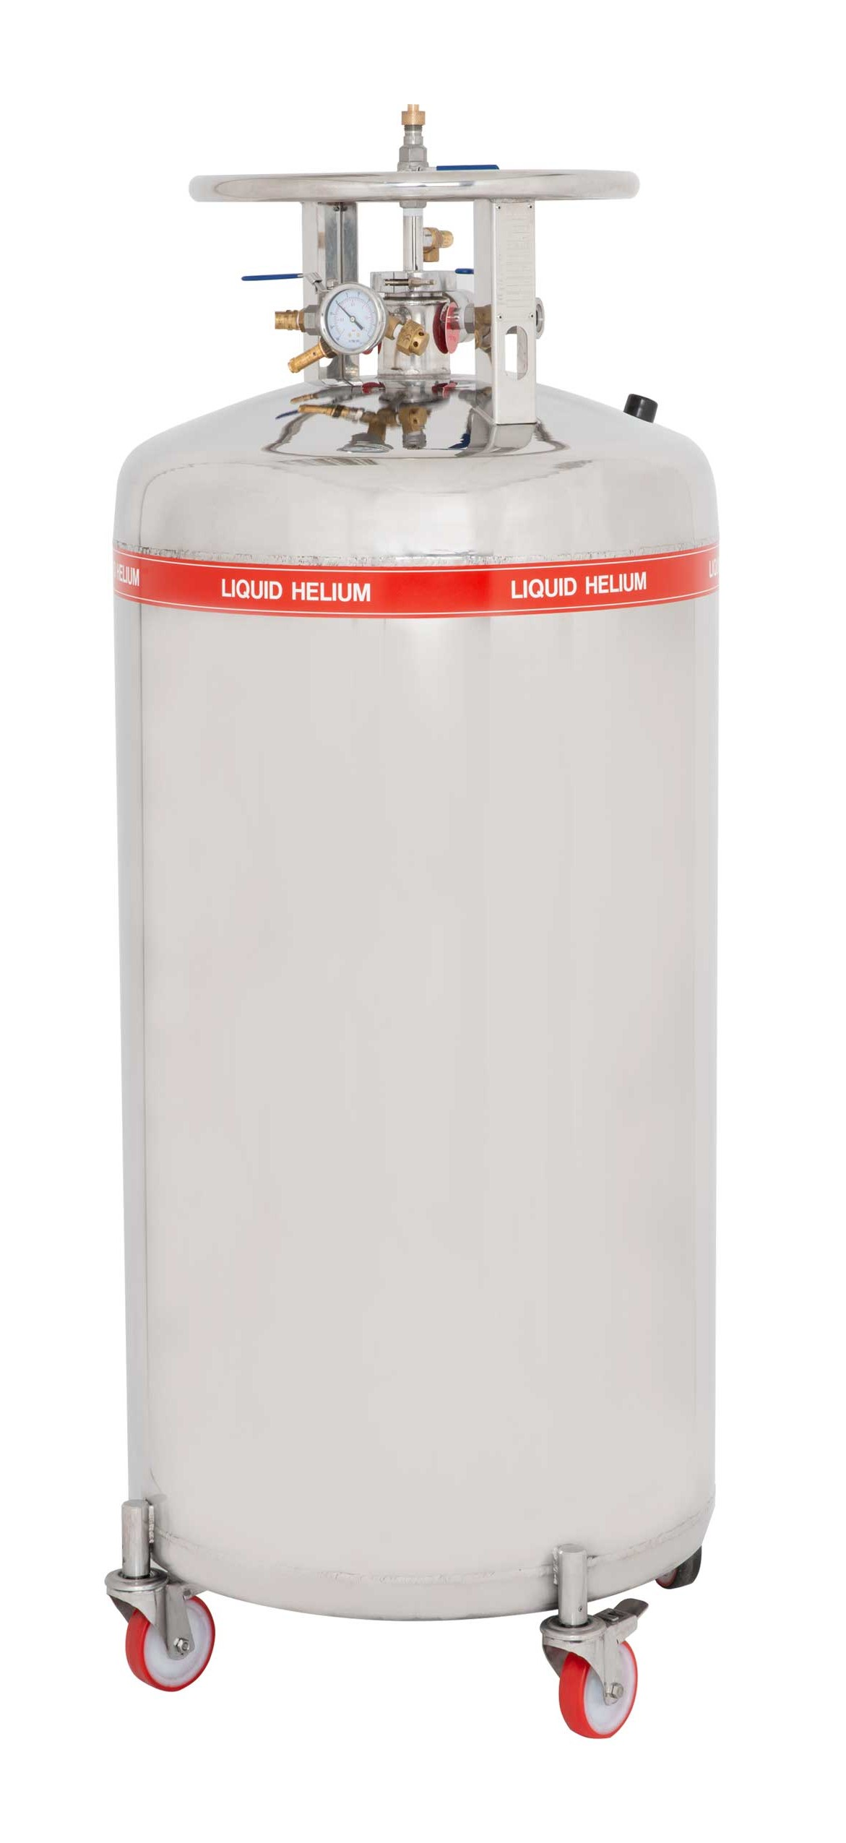
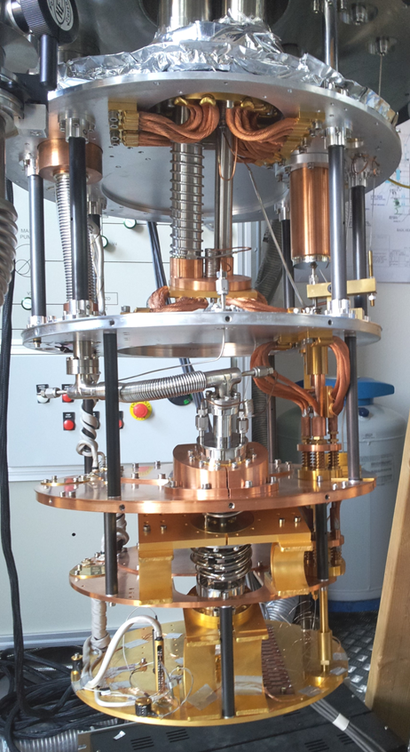
FLASH – Trento Activity
Equipment available
Dilution refrigerator -> MSA tests down to T_{base} = 20 mK
Liquid helium transport and lab dewars -> MSAs-antenna tests at 1-4.2K
Helium liquefier with gas recovery system -> liquid helium at affordable prices
Electronics (Signal generators, VNA, oscilloscope/spectrum analyzer 500 MHz)
FTE: Paolo Falferi 30%, Andrea Vinante 30%
Purchases
MSAs (4 k€ each)
Low noise cryogenic and room temperature RF amplifiers
Microwave-cryo-spares (filters, power splitters, cables, connectors...)
Liquid helium
Dilution Refrigerator
Helium liquifiers with gas recovery system

Slide 3
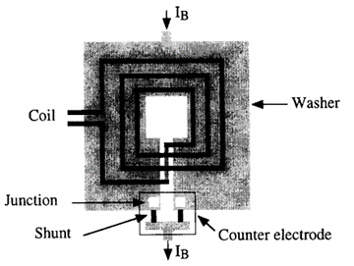
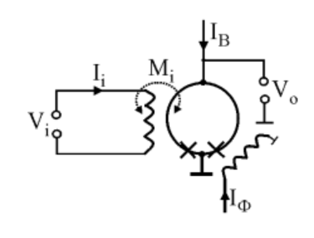
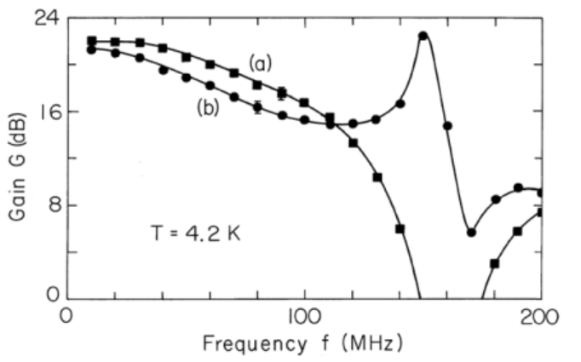
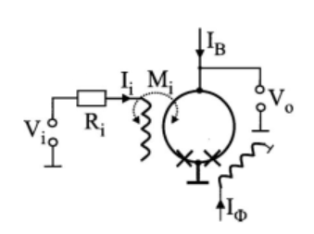
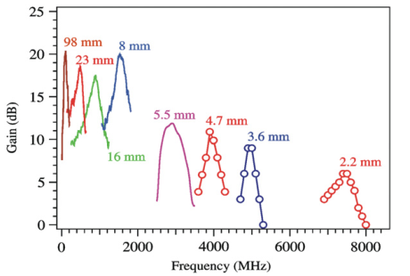
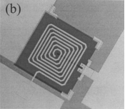
Main differences between dc SQUID and MSA
«Standard» Square Washer SQUID
Input coil and SQUID washer form a capacitor in parallel to the input coil inductance -> Resonant circuit (typically ν₀ ≈ 40 MHz)
Microstrip SQUID Amplifier
The effect of the parasitic capacitance between input coil and SQUID washer can be exploited to operate the input coil as a transmission line resonator
Amplifiers based on this principle have shown gains of 20 dB at frequencies below 1 GHz and up to 10 dB at 5 GHz
Mück and McDermott, Supercond. Sci. Technol. 23 093001 (2010)

Slide 4
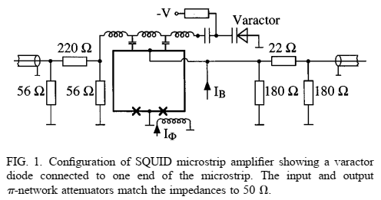
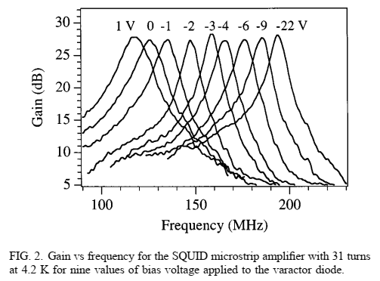
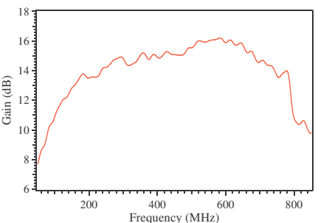
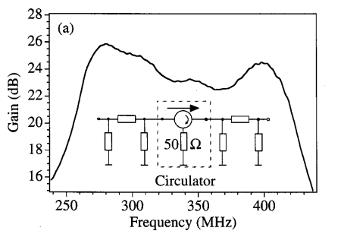
Matching the Flash cavity bandwidth (117–206 and 206-360 MHz)
Tuning the microstrip resonator with a varactor diode
It is possible to tune the resonant frequency of the MSA by terminating the microstrip resonator with a varactor diode.
The varactor doesn’t change the noise temperature of the MSA (here 0.9K @ 200 MHz, 4.2K)
Mück et al. Appl. Phys. Lett., 75, 3545,1999
Lower MSA resonator Q -> wider bandwidth (but lower gain)
Two cascaded MSA tuned to different resonant frequencies
A broad bandwidth can be obtained with a lower quality factor of the resonator but at the expense of a lower gain
A broad bandwidth can be obtained with a second MSA as a postamplifier. Here the resonance frequencies of the first and second amplifiers were about 280 and 400 MHz, respectively.

Slide 5
END

Slide 6
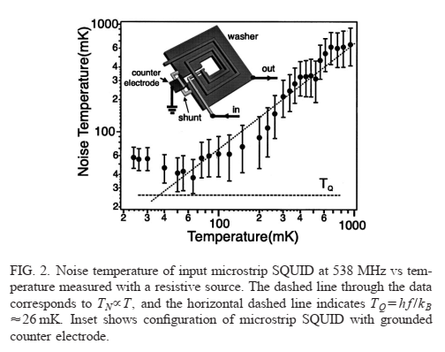
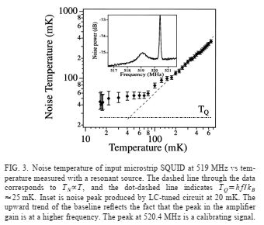
Mück et al., Appl. Phys. Lett. 78, 967 (2001)

Slide 7
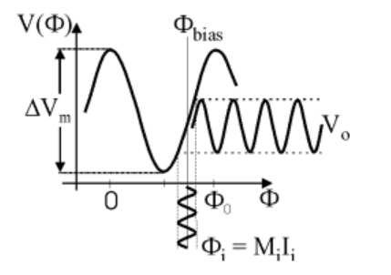
Cryogenic Services Facility with equipment for helium gas recovery: two helium liquefiers (total capacity 12 l/h), storage dewar 500 l, gas storage capacity 250 m
ν₀ = 117–360 MHz Er=1-> λ = 2.56-0.83m
3ν₀ = 351–1080 MHz Er=1-> λ = 0.85-0.28m
Microstrip on Si h=0,65mm, er=11.7, line l=0.5mm h=35um
Z=50 Ohm, Eeff=7.675
ν₀ = 117 MHz Eeff=7.675 -> λ = 924mm
3ν₀ = 1080 MHz Eeff=7.675 -> λ = 100mm

