Slide 1
FLASH @PISA
Few plots from Enrico Teofilo

Slide 2
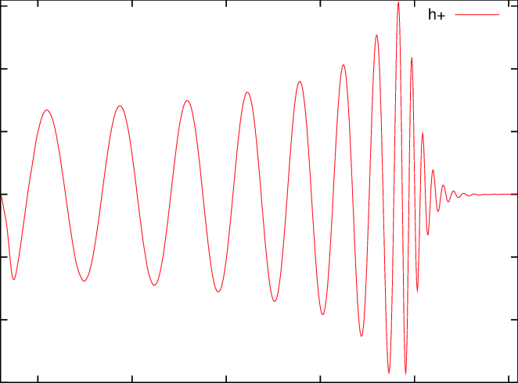
Chirp signal from PBH
Not ideal for a resonant cavity with High Q
In any case the stochastic background is too small
Optimization of cavity, pick-up, readout strategy, interference with standard axions runs,…

Slide 3
HFGW readout strategy consideration
Reach @200 MHz as a function of chirp mass and quality factor

Slide 4
Signal duration in a single readout window

Slide 5
Readout frequency

