Slide 1
DS-20k ID Engineering Forum • April 26th, 2024
ID to UAr vessel connection
Marco Carlini (LNGS – INFN)

Slide 2
OVERVIEW
ID support rods to UAr vessel connection
Concept for ID + UAr vessel support strategy (TDR recap)
ID to UAr vessel connection
ID to UAr vessel connection

Slide 3
Concept for ID + UAr vessel support strategy (TDR recap)

Slide 4
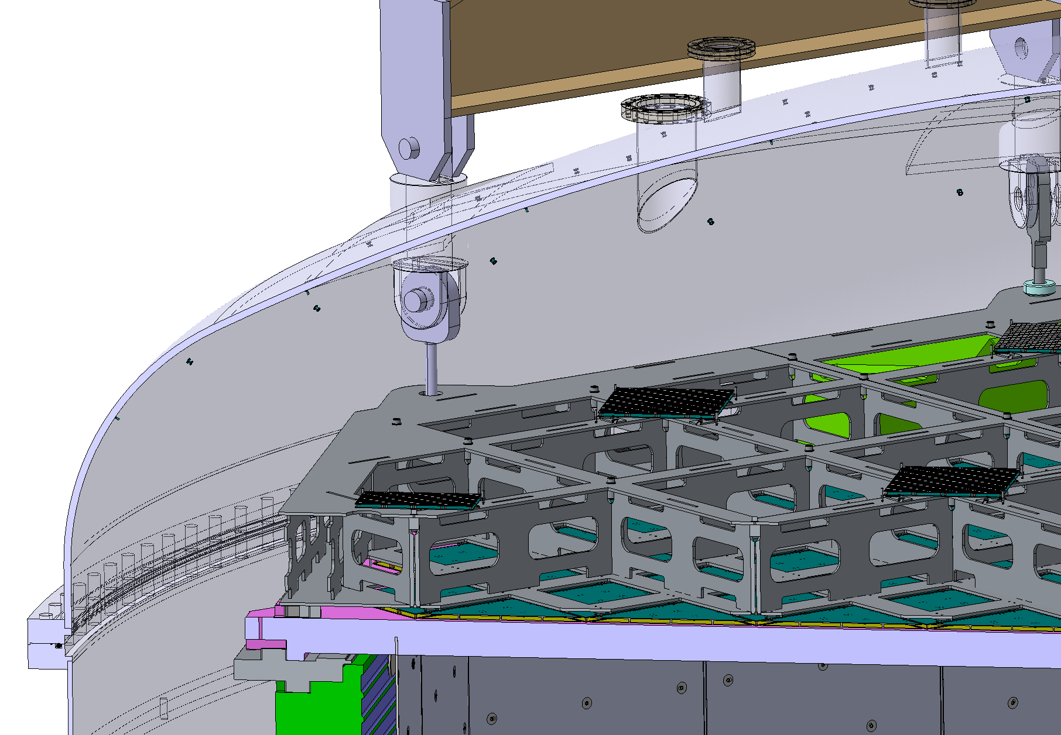
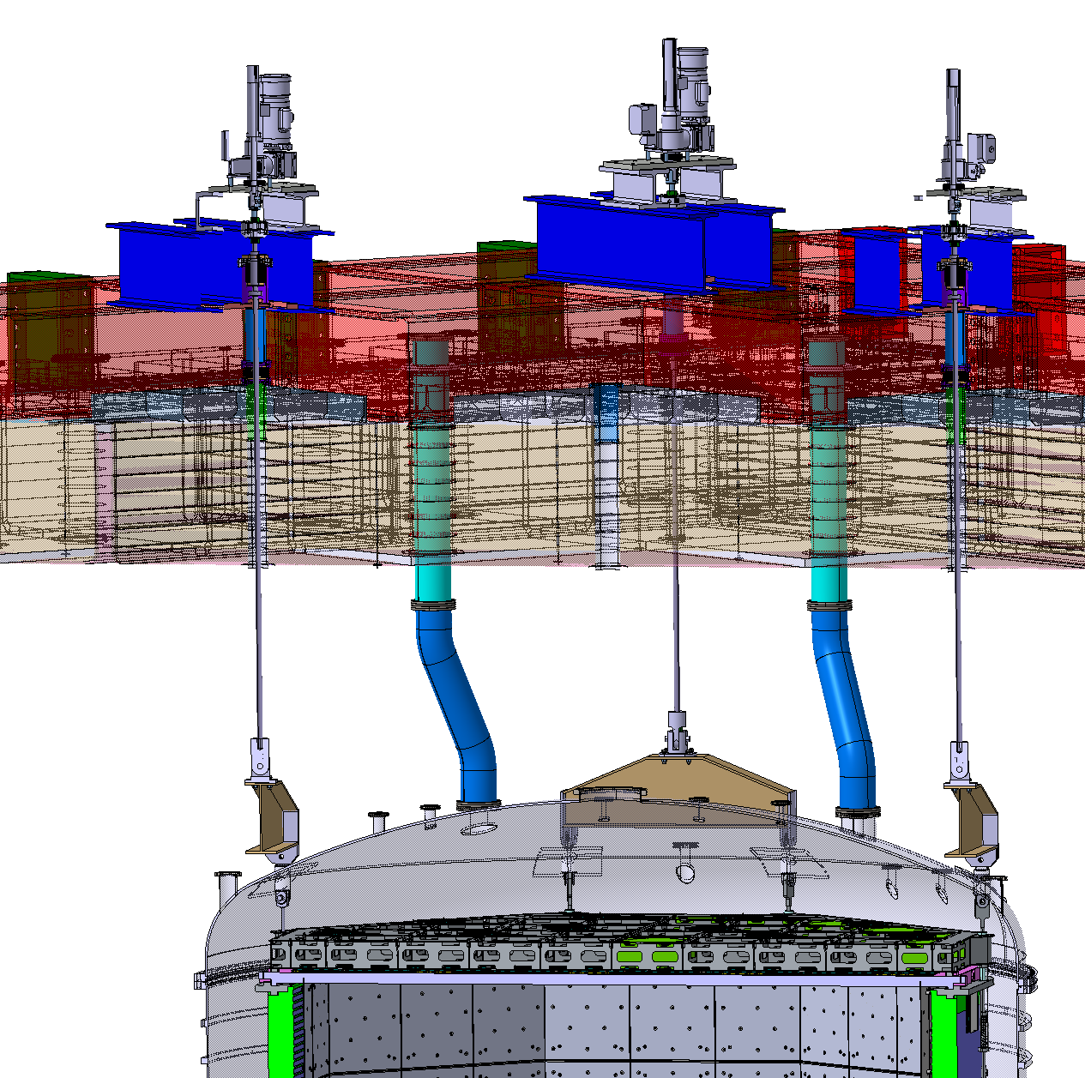
Concept for ID + UAr vessel support strategy (TDR recap)
ID + UAr vessel + HDPE panels (?) weight is transferred though 4 SS beams to the 4 Detector Leveling System (DLS) SS rods
ID hangs on 8 anchor points on the UAr vessel through 8 SS support rods
Pinned connections are planned on these 2 interfaces
4 x DN100CF (ID = 97 mm) penetrations for the DLS rods, included in the cryostat central top cap design. Location matching the ID support rods

Slide 5
ID to UAr vessel connection

Slide 6
Loads summary
DLS beam
UAr vessel to DLS pinned connection (external pin)
ID to UAr vessel pinned connection (internal pin)
ID support rod
Internal pin design load:
Characteristic load (on 8 points) = ID weight = 16845 kg
Characteristic load spread on 2 anchor points
Safety factor 2, chosen in accordance to EN13155 to cover lifting load case
Design load: 16845 kg/2*2*9,81 m/s² = 165,2 kN
External pin design load:
Characteristic load (on 8 points) = ID + UAr vessel + HDPE shield weight = 35205 kg
Suppose that the characteristic load is spread on 2 DLS rods, hence 4 external pins
Safety factor 2, chosen in accordance to EN13155 to cover lifting load case
Design load: 35205/4*2*9,81 m/s² = 172,7 kN
Internal pin |  | External pin
item | weight [kg] | item | weight [kg]
ID | 16845 | ID | 16845
 |  | UAr vessel | 13060
 |  | HDPE shield | 5300
Tot | 16845 | Tot | 35205

Slide 7
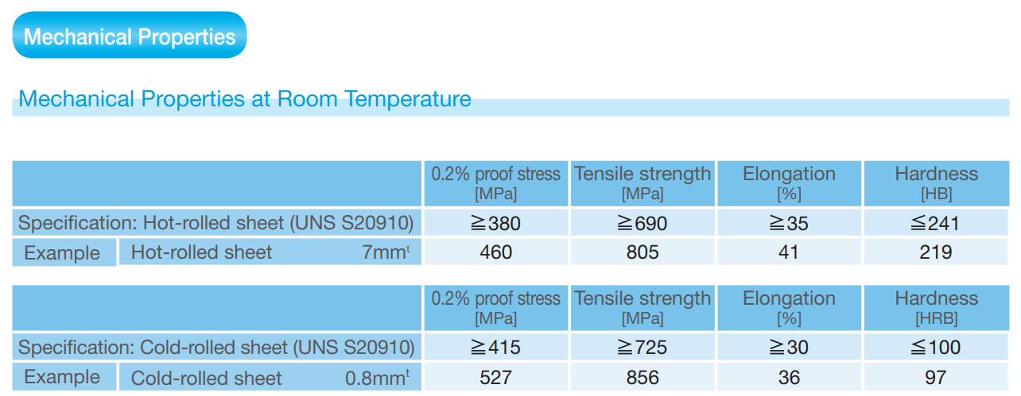
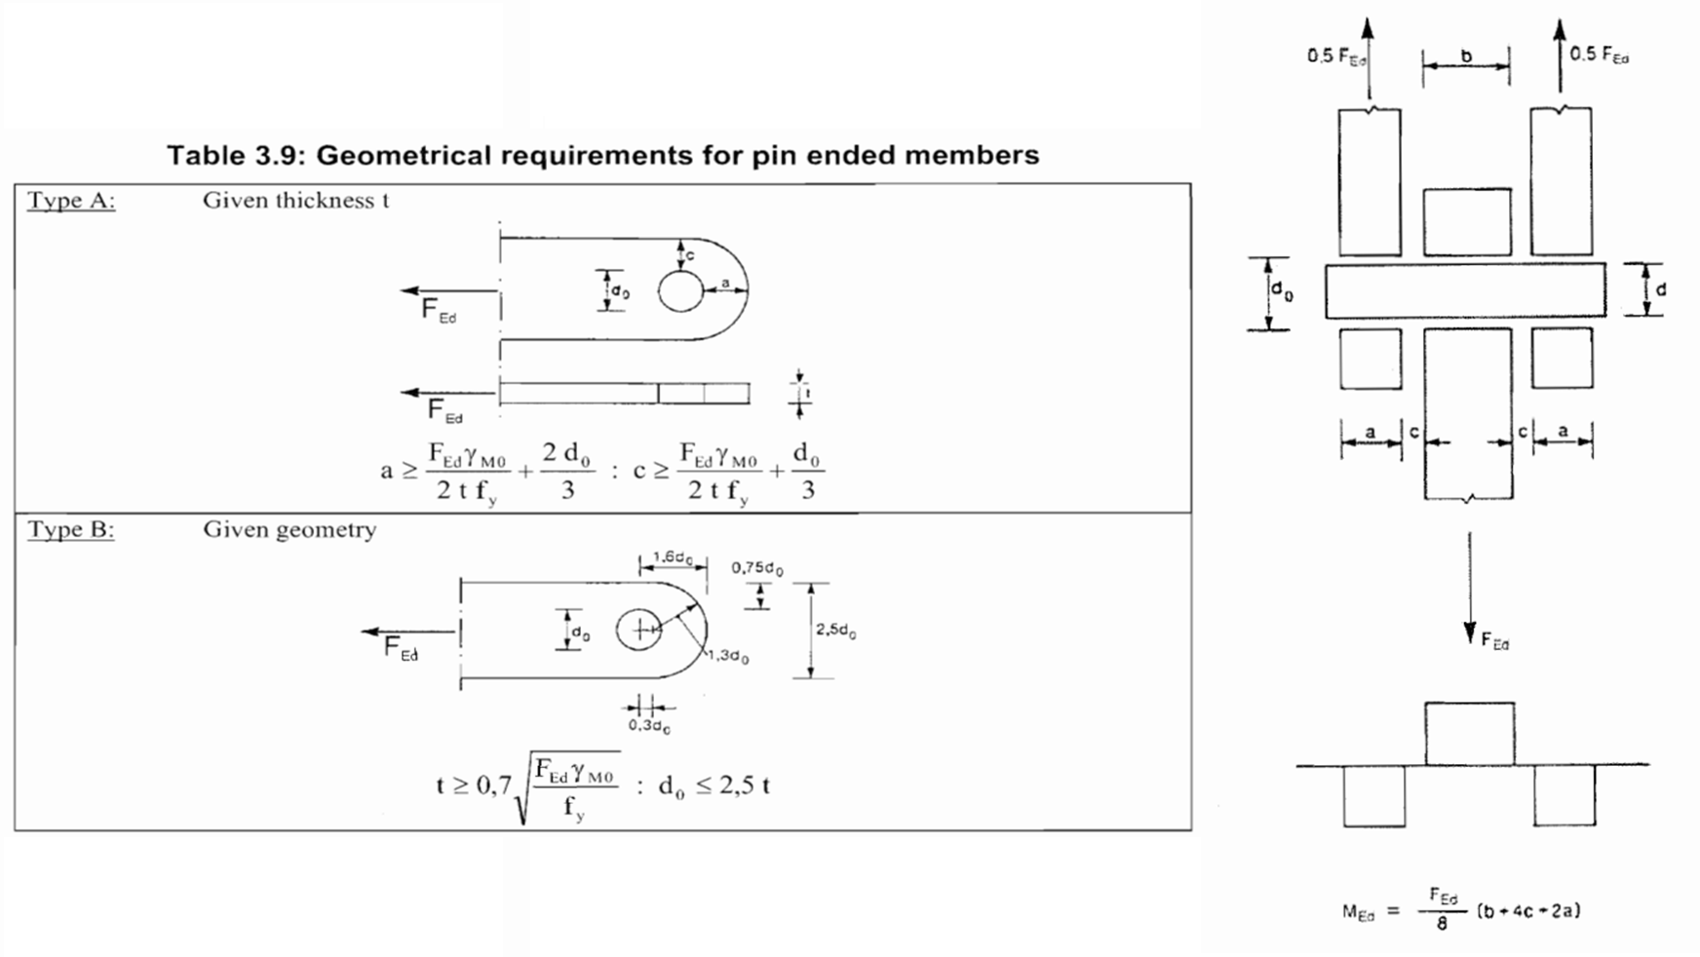
Verification of pinned connections, according to EN1993 - Part 1-8 §3.13
Internal pin verification
Safety factor as per EN13155
phi 35 mm, XM-19 SS pin
XM-19 is a nitrogen-strengthened austenitic stainless steel. In comparison with Type 316L, XM-19 provides higher corrosion resistance and higher strength. Suitable for cryogenic applications.

Slide 8
Verification of pinned connections, according to EN1993 - Part 1-8 §3.13
External pin verification
Safety factor as per EN13155
phi 35 mm, XM-19 SS pin
XM-19 is a nitrogen-strengthened austenitic stainless steel. In comparison with Type 316L, XM-19 provides higher corrosion resistance and higher strength. Suitable for cryogenic applications.

Slide 9
Backup

Slide 10
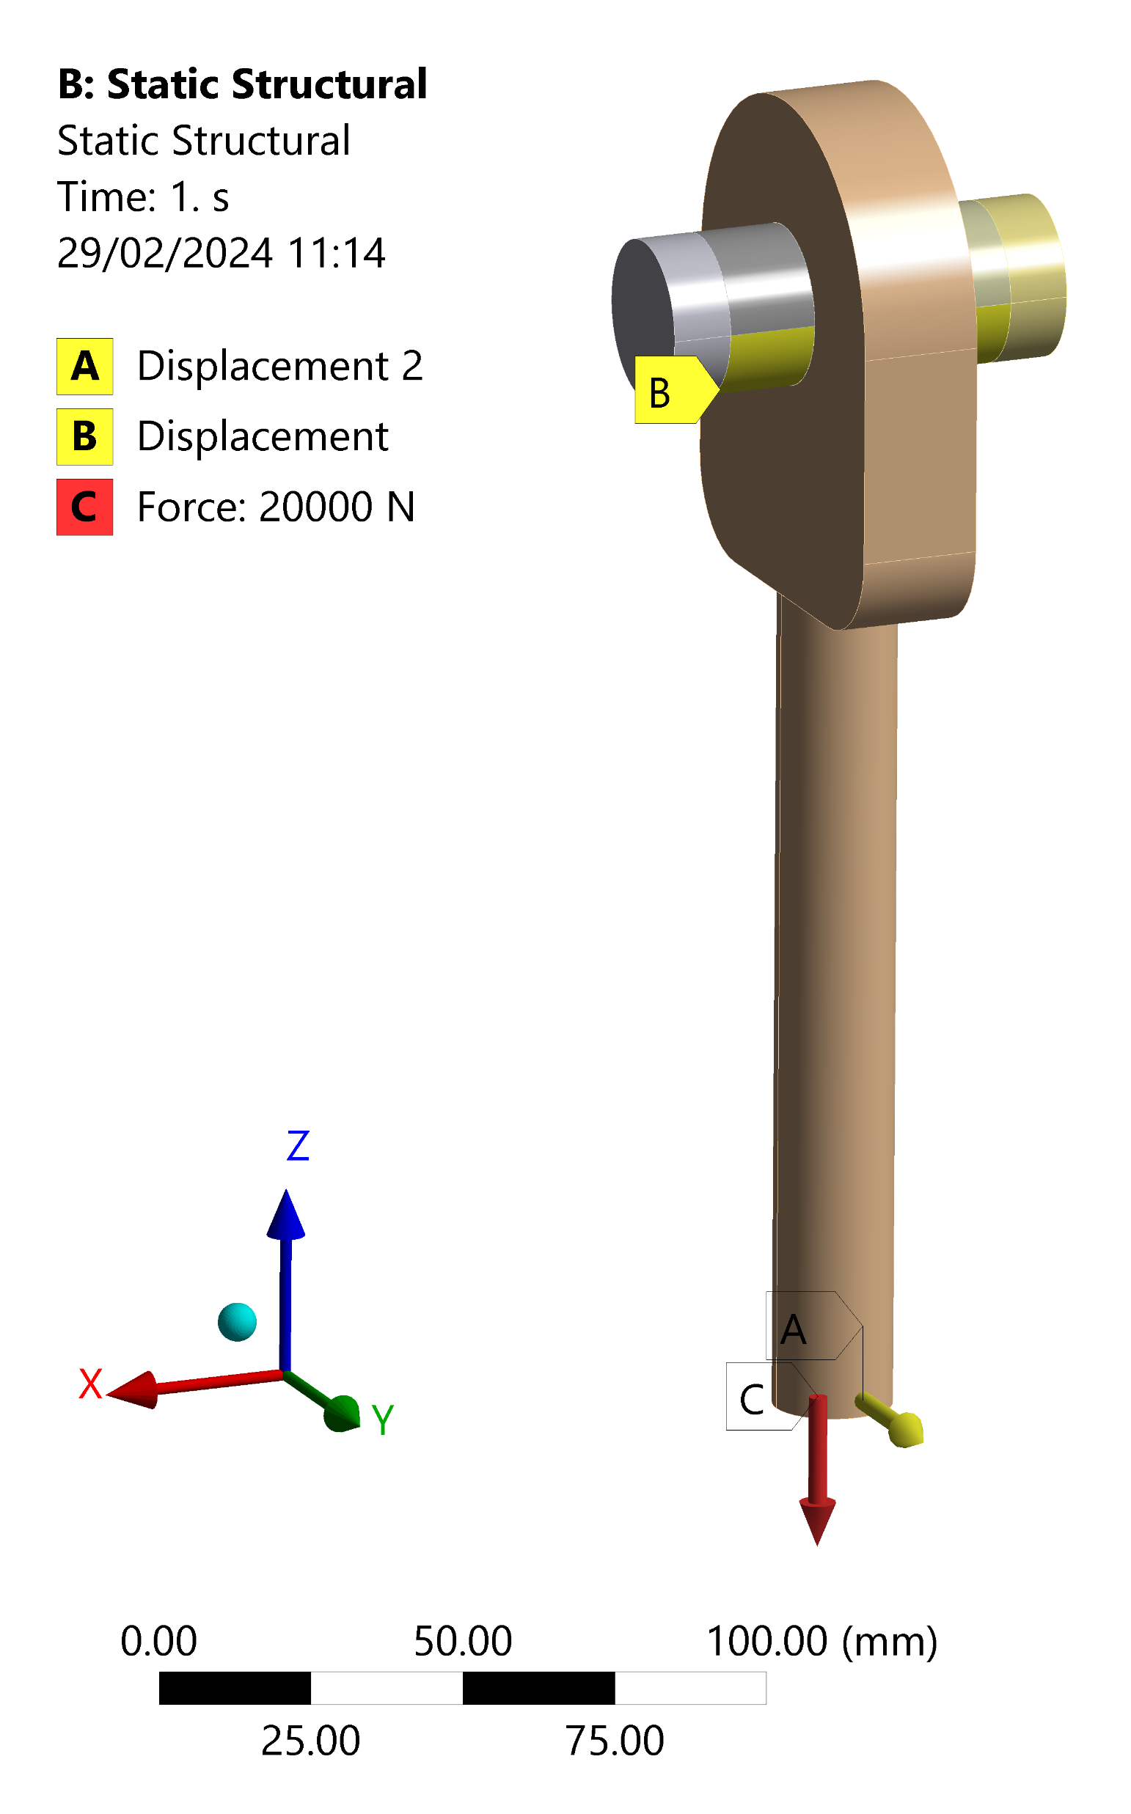
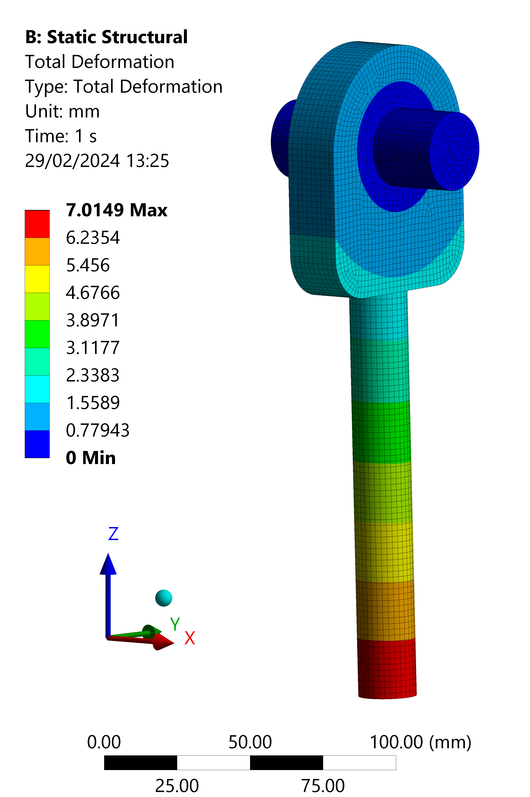
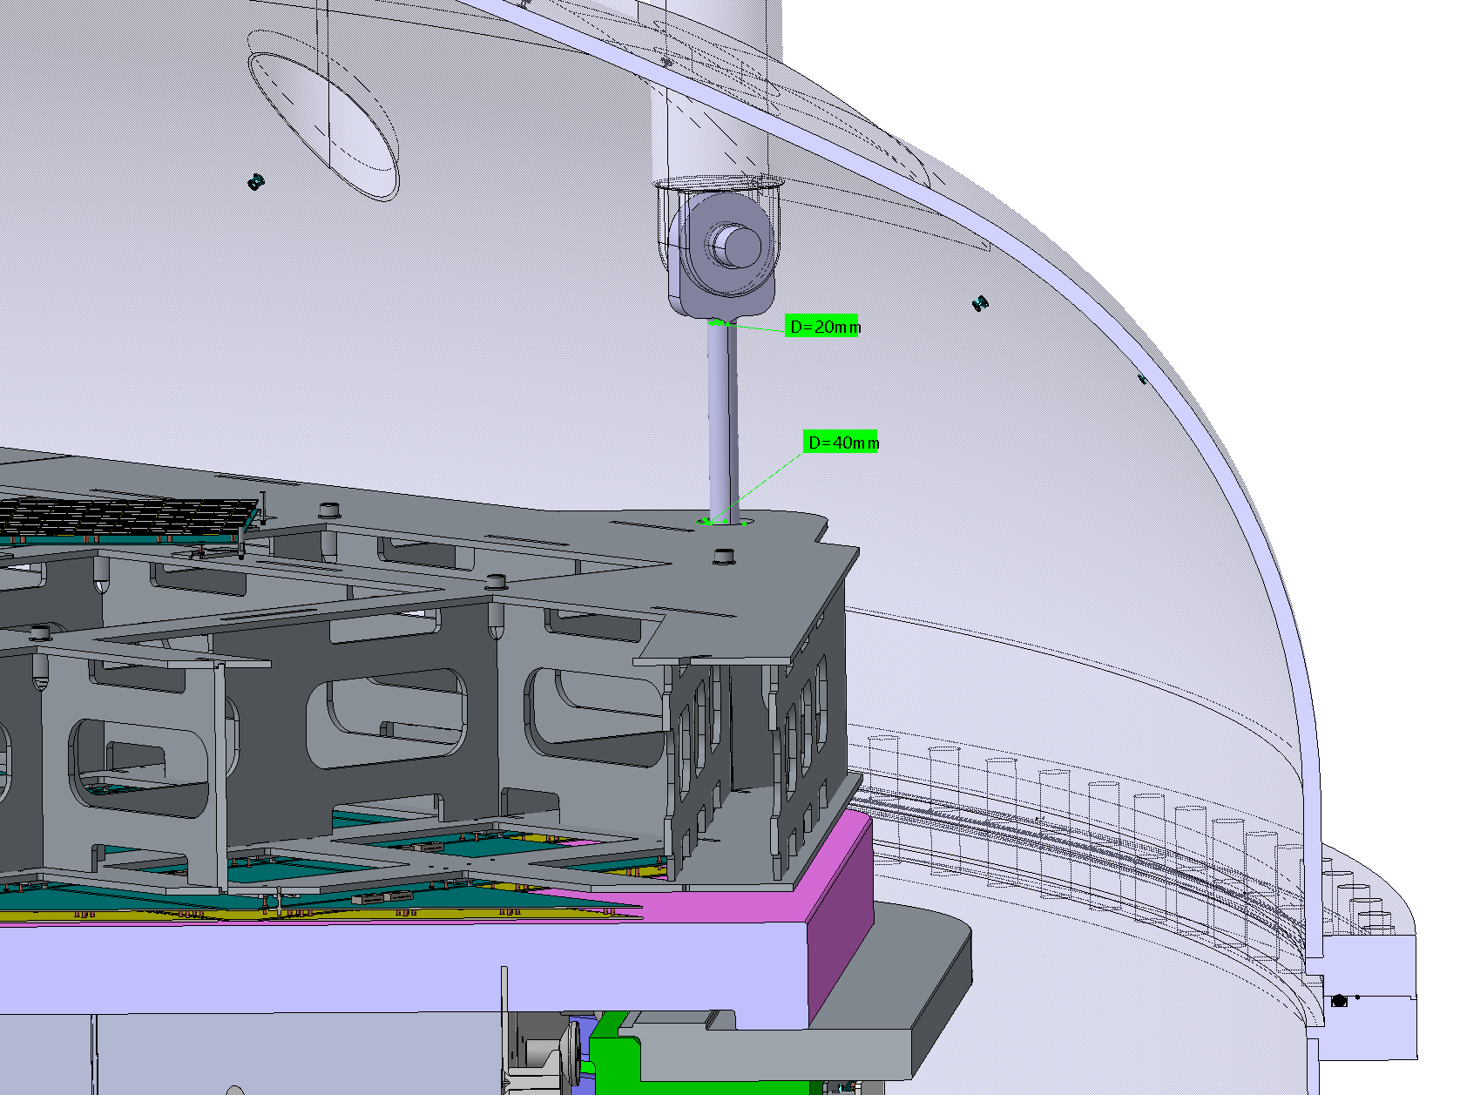
Verification of pinned connections during filling through FEA
FEAs have been run in order to calculate thermal stress arising on the TPC support rods induced by shrinking of the TOP during filling
Boundary conditions:
extreme hp of TOP al LAr temperature and UAr vessel dome at ambient temperature → differential shrinking of 7 mm [A]
contemporaneity of the load of the ID weight acting on the rod [C]
fixed support on the surfaces in contact with the load bearing plates [B]
frictional contact between pin and rod (friction coefficient 0.2; 0.3)

Slide 11
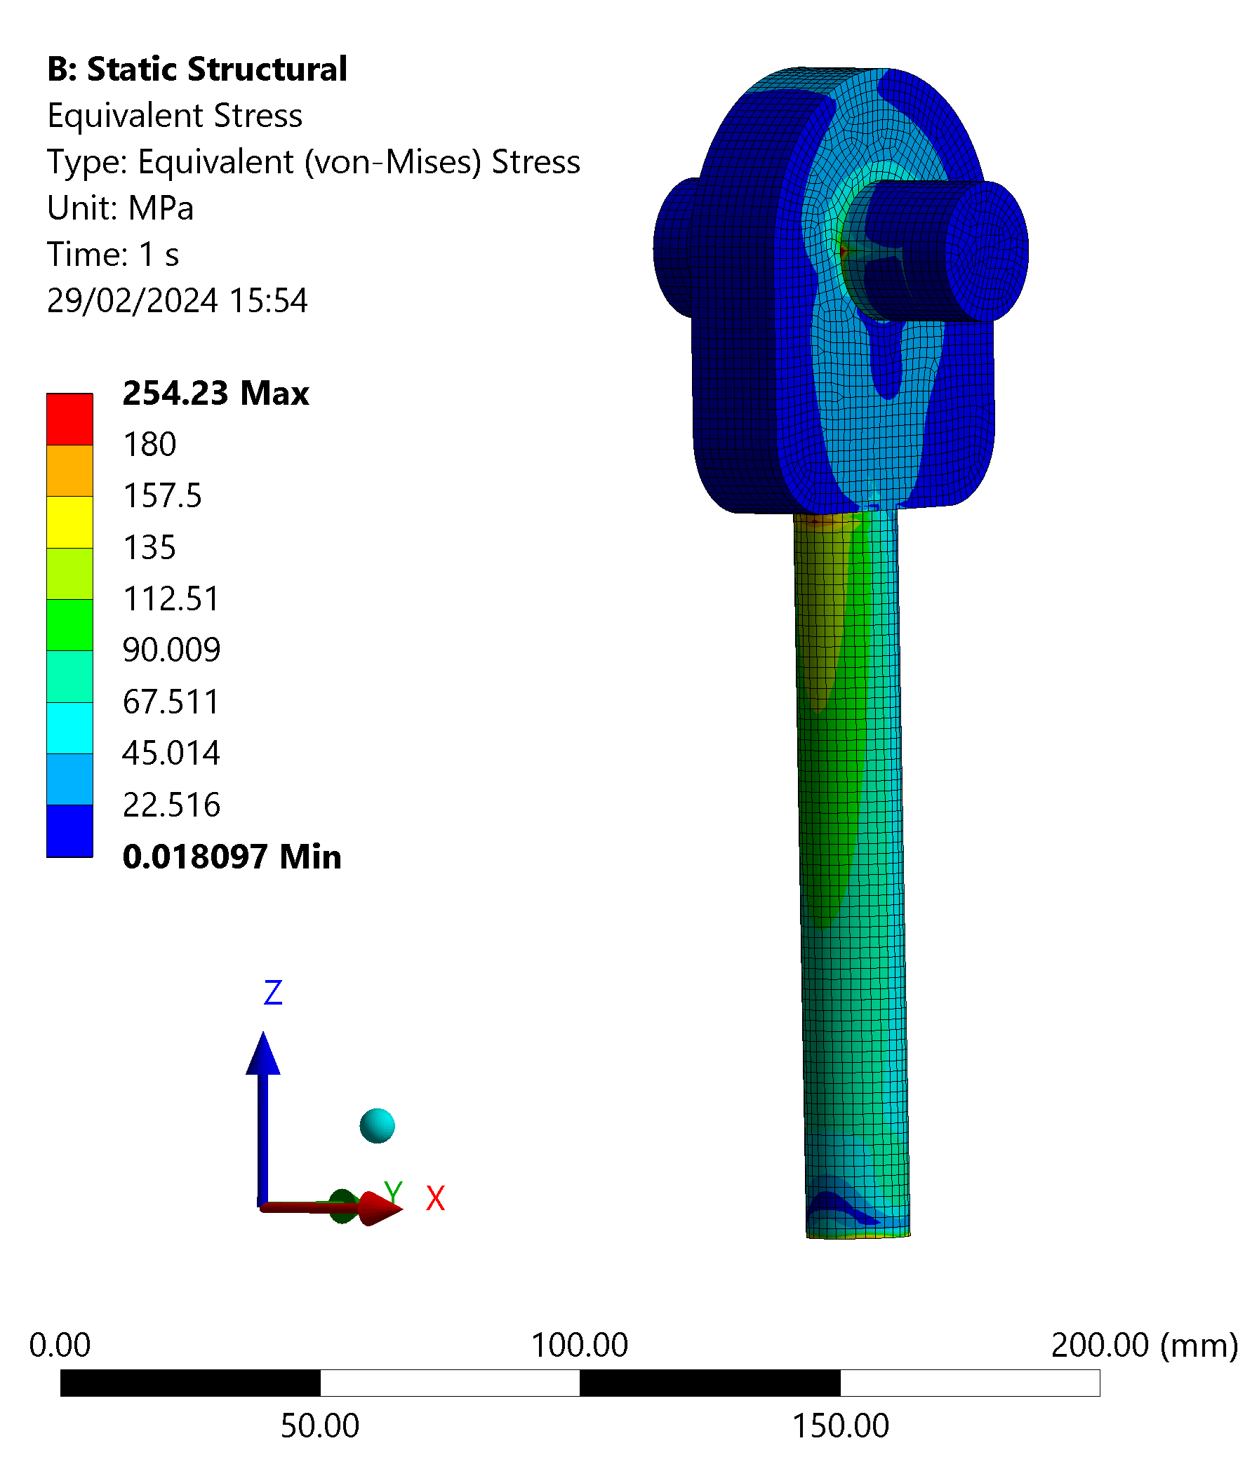
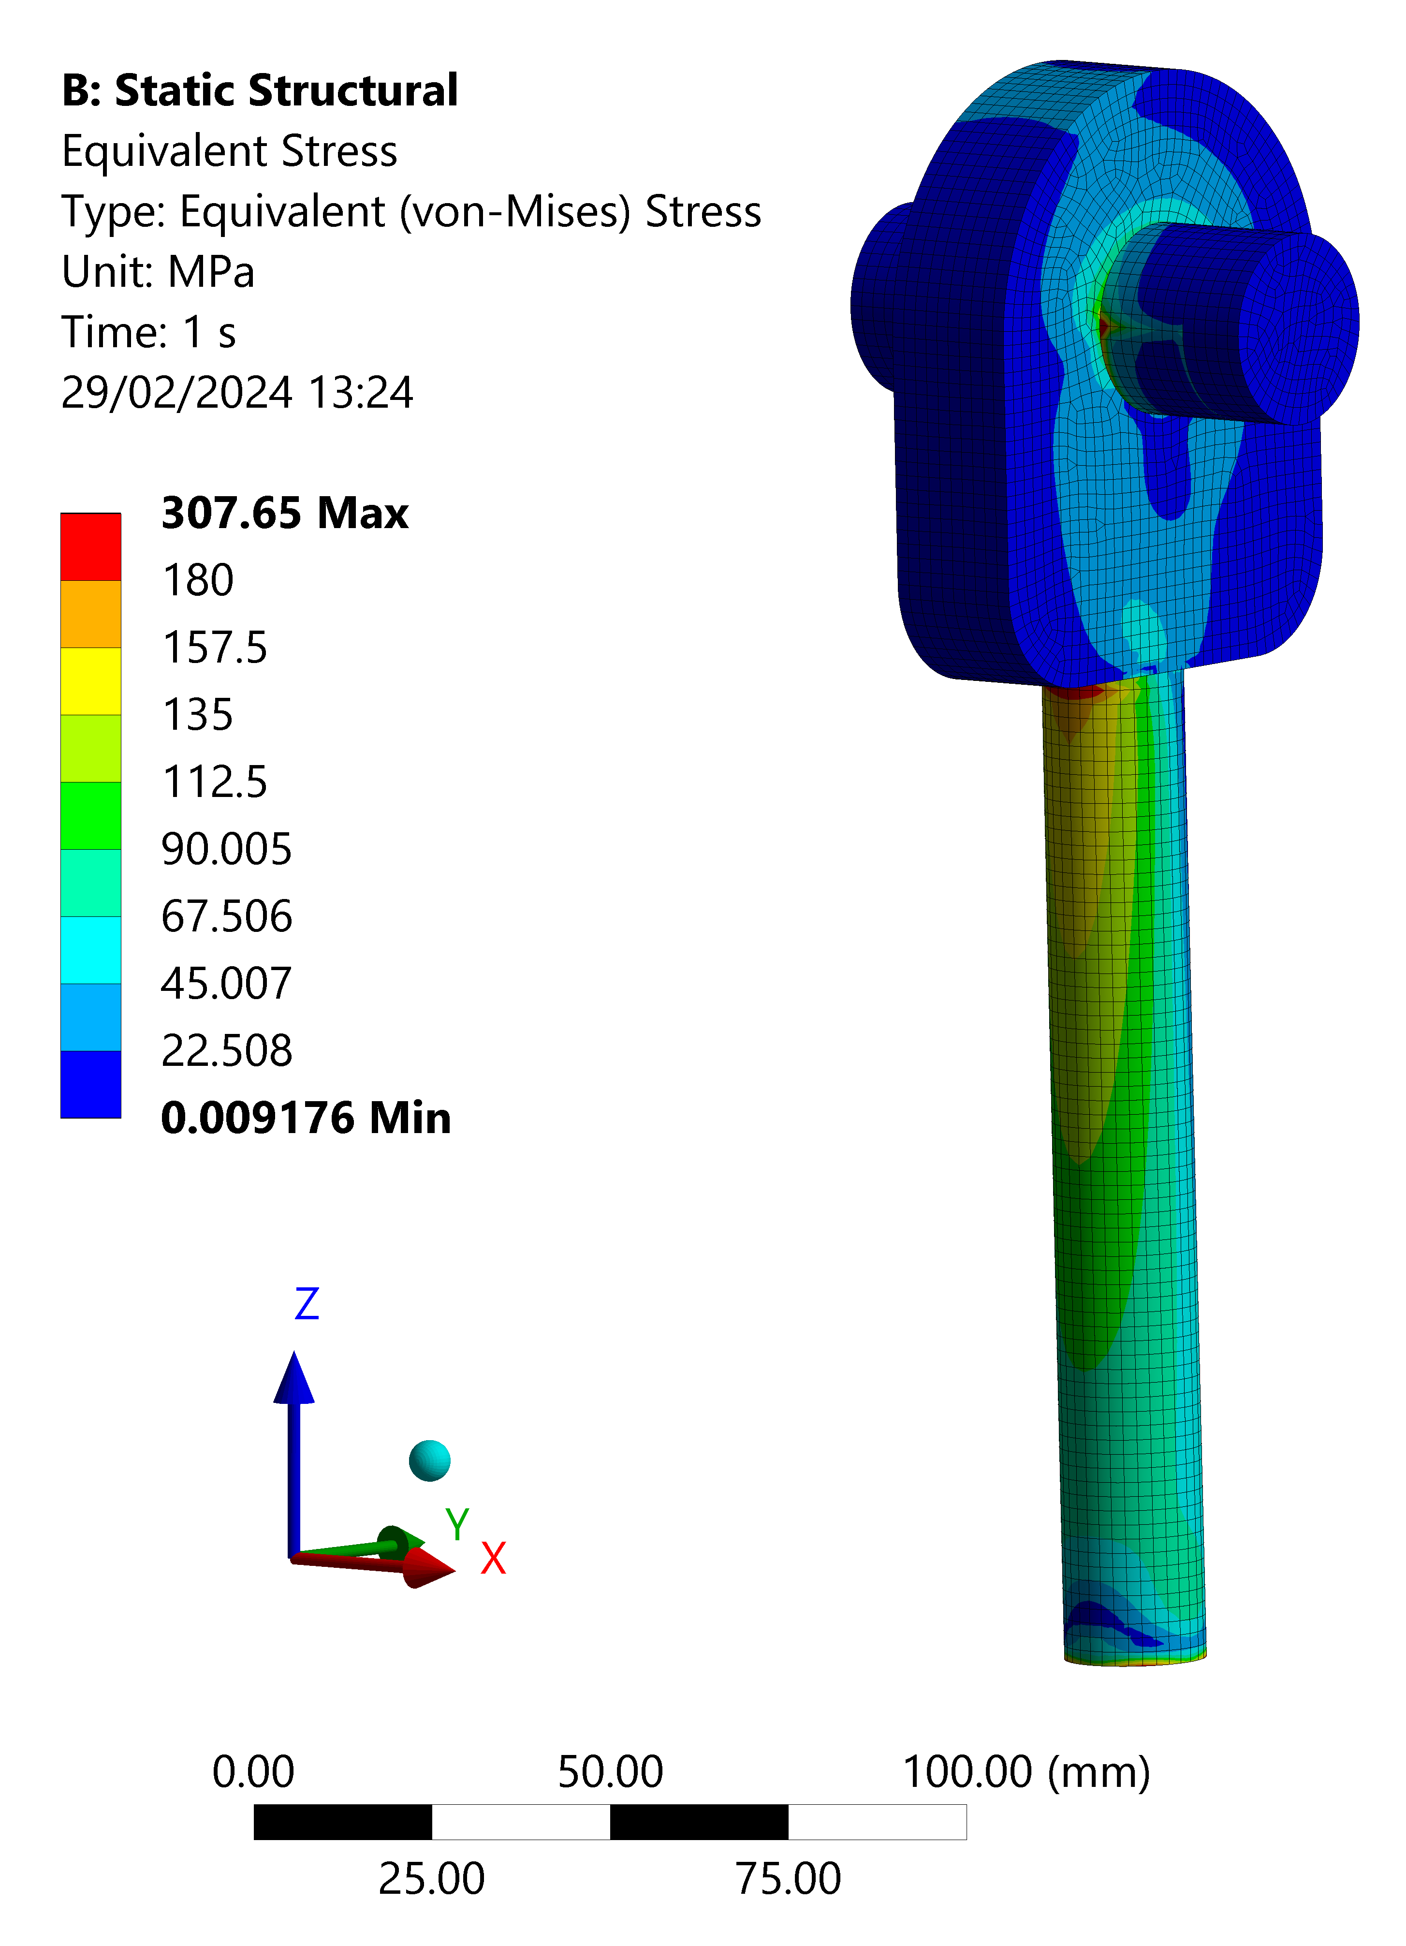
Verification of pinned connections during filling through FEA
FEAs have been run in order to calculate thermal stress arising on the TPC support rods induced by shrinking of the TOP during filling
Friction coefficient: 0.2
Friction coefficient: 0.3

Slide 12
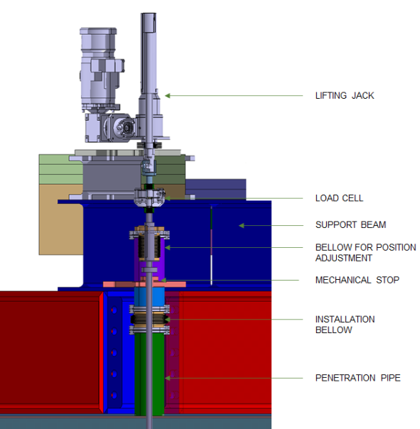
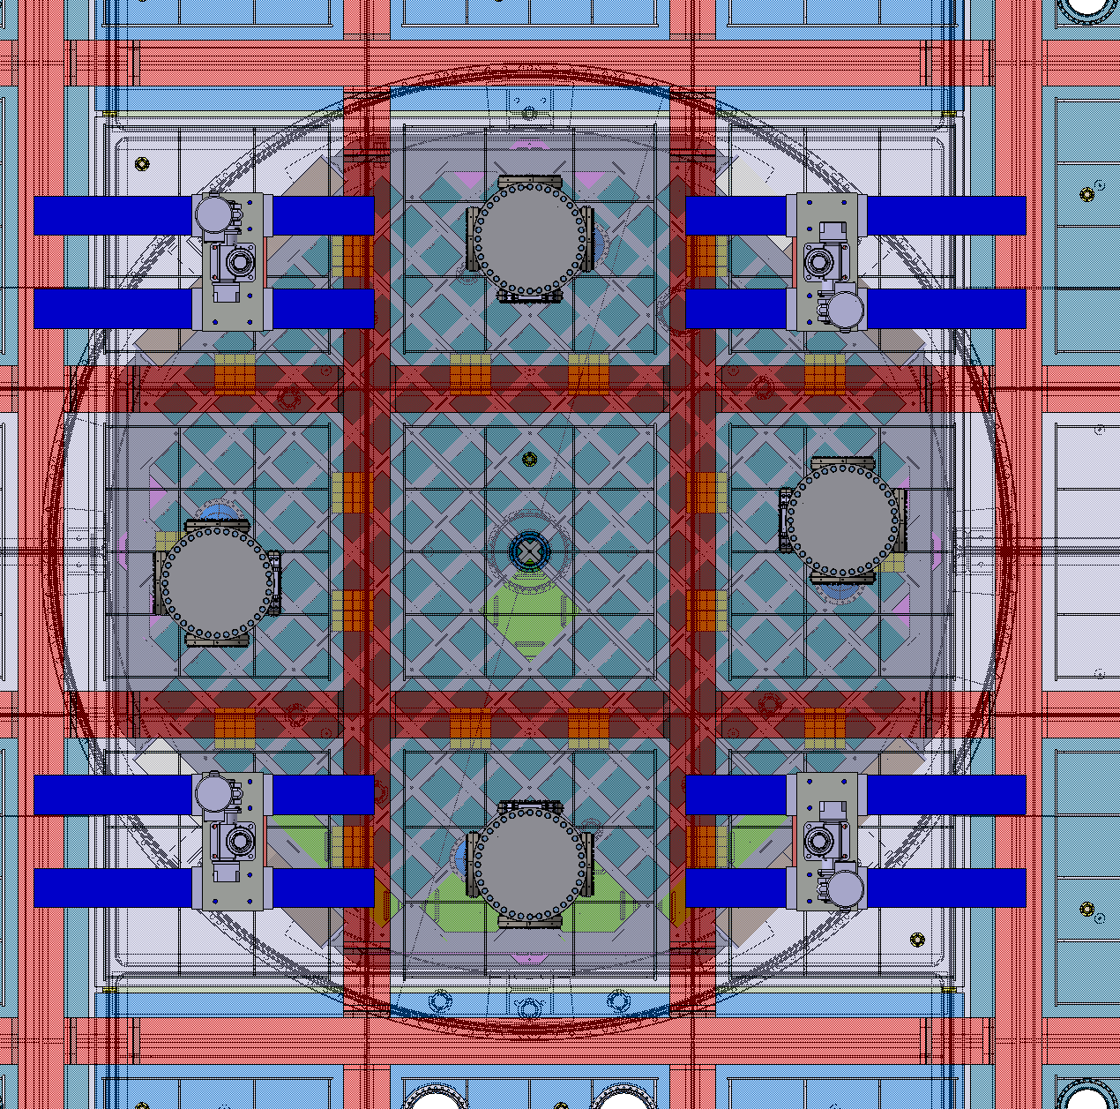
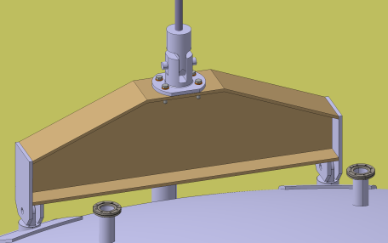
Concept for ID + UAr vessel support strategy (TDR recap) - DLS
WARM ASSEMBLY
COLD ASSEMBLY
Source: DS-20k TDR, Dec 2021
AAr volume
Source: DS-20k TDR, Dec 2021

Slide 13
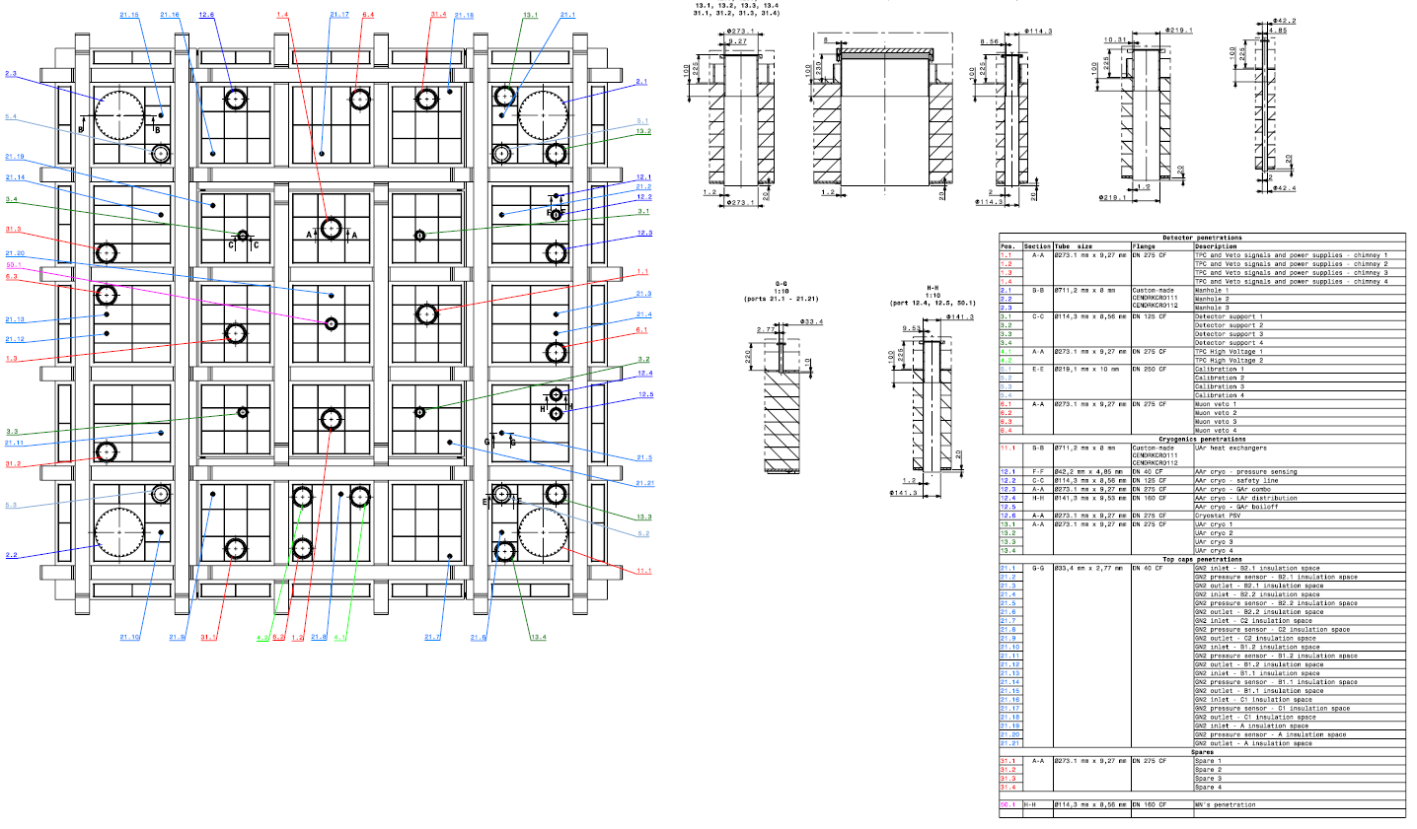

Slide 14
