Slide 1
WP3 “Deliverables 3.1” meeting
Antonella Sciuto
WP 3 Leader & CNR unit coordinator
Catania 24 April 2024

Slide 2
WP3 aim: our focus is the development of a Spectroscopy apparatus for Online Water Quality Monitoring
=> an in-line test system for continuous monitoring of the physical and chemical parameters of the purified water to be re-used for irrigation.
The system consists of compact UV spectroscopy apparatus and visible sensor systems adopting innovative Silicon Carbide and Silicon Photomultipliers detectors
WP3 is organized in 5 tasks

Slide 3
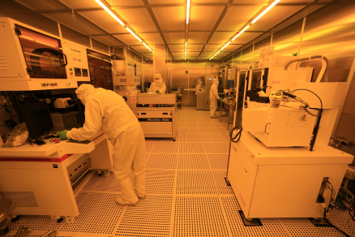
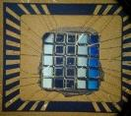

WP3 Task 3.1 Months 3-24
Task 3.1 Development of sensors and electronics (CNR-IT, CSFNSM-IT, UNICT-IT)
Our objectives:
Design and fabrication of innovative SiC sensors operating in deep UV with large area, low noise and high sensitivity
Development of Lecture electronics ensuring biasing of source and detector, low noise, sensing current amplification and digital conversion.
Involved people:
Antonella Sciuto, Domenico Longo, Alessia Tricomi, Nello Abergo, Lucia Calcagno

Slide 4
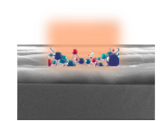
WP3 Task 3.2 Months 12-30
Task 3.2 Optically sensible polymeric substrates for heavy metals and pesticide detection (CNR-IT)
Our objectives:
design and fabrication of Optically sensible polymeric substrates for heavy metals and pesticide detection;
Involved people:
Sabrina Carroccio, Antonella Sciuto, Ivana di Bari and……

Slide 5
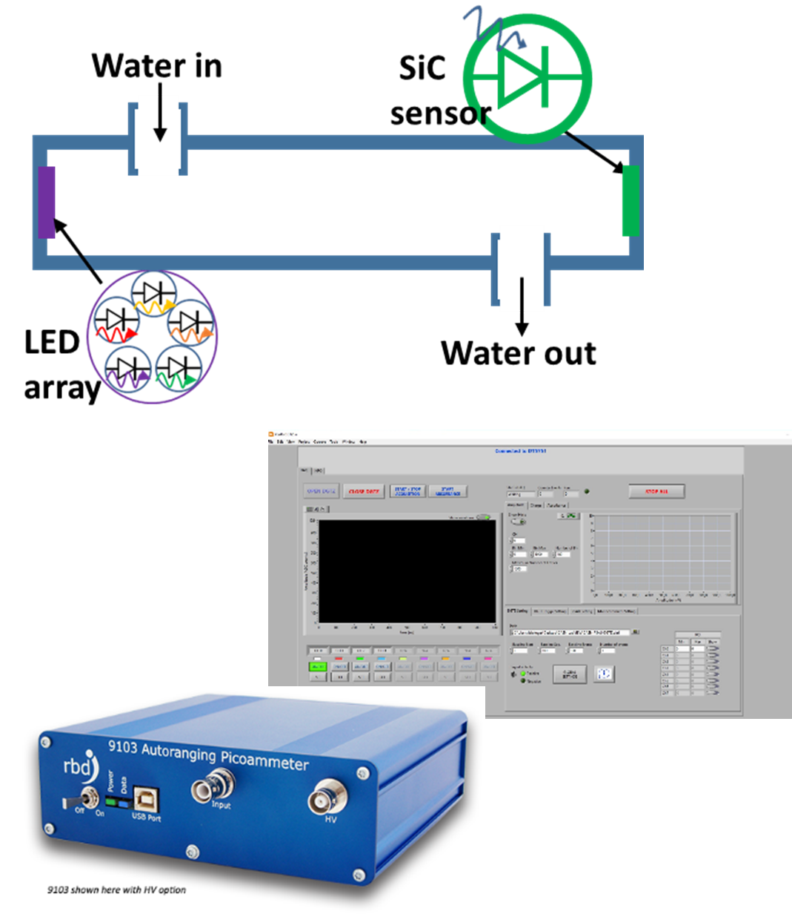
WP3 Task 3.3 Months 12-30
Task 3.3 Detector assembly and readout software development (UNICT-IT, CSFNSM-IT, CNR-IT)
Our objectives:
design and assembly of spectroscopy apparatus operating in the UV range and its complete electro-optical characterization
Involved people:
Domenico Longo, Nello Albergo, Alessia Tricomi, Antonella Sciuto

Slide 6
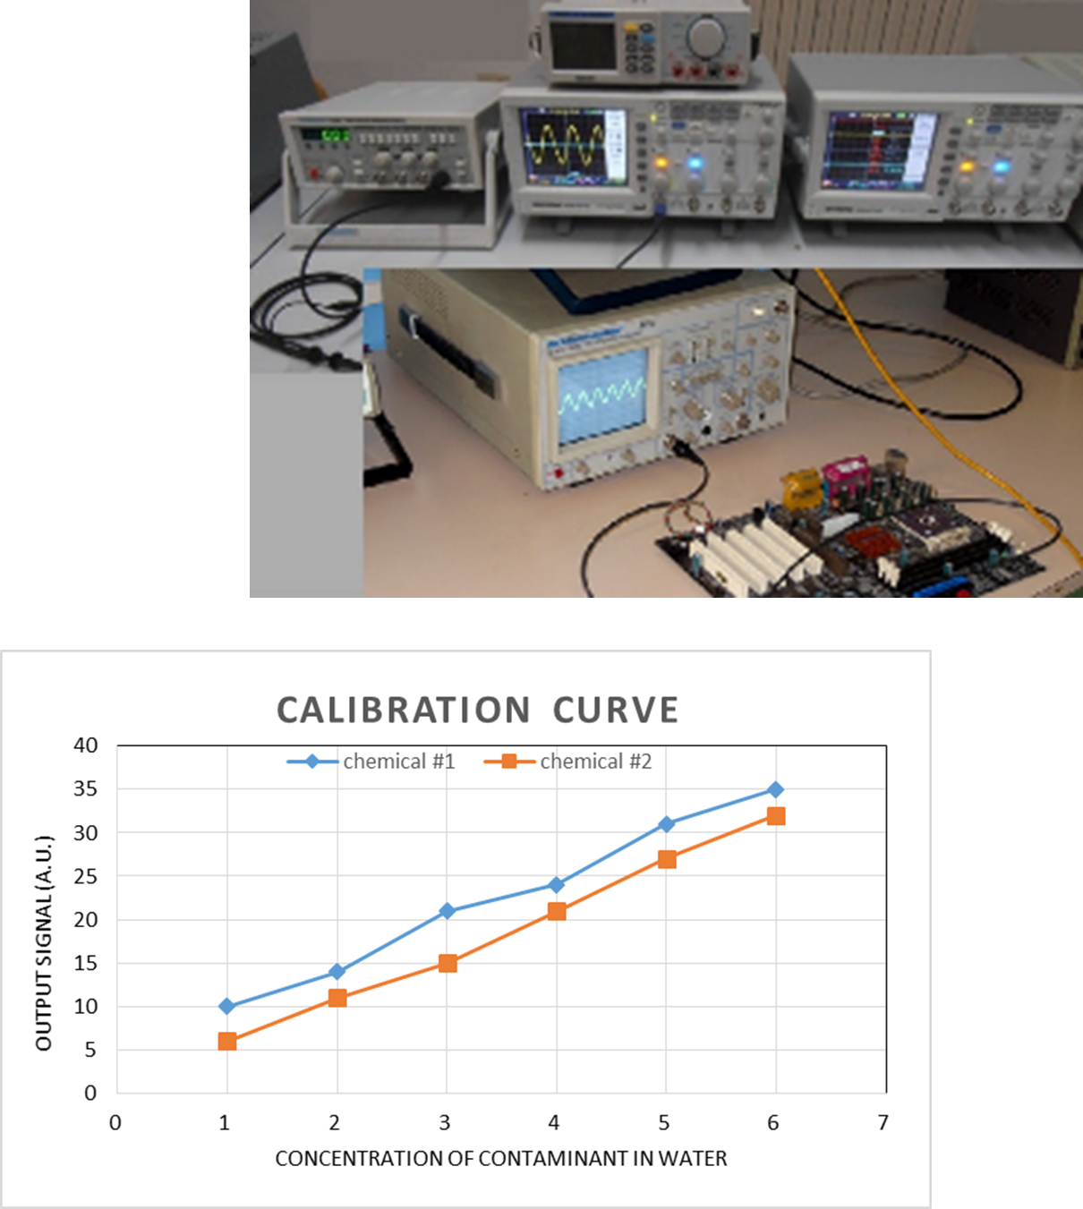
WP3 Task 3.4 Months 12-30
Task 3.4 Detector test and calibration with use cases (CSFNSM-IT, CNR-IT, UNICT-IT, UV-ES)
Our objectives:
Test and calibration of the spectroscopy apparatus
Involved people:
Alessia Tricomi, Antonella Sciuto, Domenico Longo, Nello Albergo, UV-ES

Slide 7
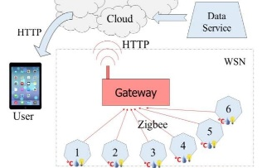
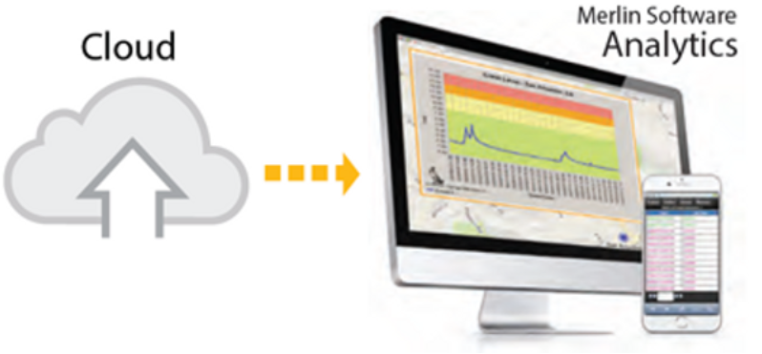
WP3 Task 3.5 Months 6-34
Task 3.5 Development of data network and online monitoring software for remote control (UNICT-IT, CNR-IT, UBOUIRA-DZ, UV-ES)
Our objectives:
Development of data network and of the software for the remote control
Involved people:
Domenico Longo, Antonella Sciuto, UBOUIRA-DZ, UV-ES

Slide 8
WP3 report on performed/running activities in the period February/March
Task 3.1=> Development of sensors and electronics: Design of Silicon Carbide photo-detector is completed. Some test will be performed for the innovative electrode fabrication
Task 3.2=> Optically sensible polymeric substrates for heavy metals and pesticide detection : Activity is temporary stopped due to concomitant activity with higher priority
Task 3.3=> Detector assembly and readout software development: LED sources have been delivered and some test are running
Task 3.4 =>Detector test and calibration: will start in Month 12
Task 3.5 => Development of data network and online monitoring software for remote control: will start in the next weeks (Month 6 of the project)

Slide 9
  WP3 technical and scientific meeting calendar (every ∼3 months )
  coordination meeting 30 January ’24 (Done)
  deliverable meeting 24 April ’24 => D3.1 Design and flow chart preparation for the fabrication of SiC sensors (task 3.1)-M6 (April 2024)
  coordination meeting 21 July ’24
deliverable meeting => D3.2 Report on sensors fabrication and on their electro-optical characterization & D3.3 Large area SiC sensors ready and operating in deep-UV and electro-optical characterised (task 3.1)-M14 (30 November 2024)
deliverable meeting => D3.4 Optically sensible polymeric substrates for pollutant detection made and tested (task 3.2)-M16 (30 January 2025)
deliverable meeting => D3.5 Spectroscopy apparatus assembled and readout software deployed and running (task 3.3) (M18) (30 March 2025)
  coordination meeting July ’25
  deliverable meeting =>D3.6 Report on the tests and calibration curves of the spectroscopy apparatus (task 3.4) (M25) (30 October 2025)
  deliverable meeting => D3.7 Data network and remote control software (task 3.5) (M32) (30 May 2026)
Tasks activity will be discussed and planned during the WP meetings. Further Task meetings will be planned if necessary during the project period.

Slide 10
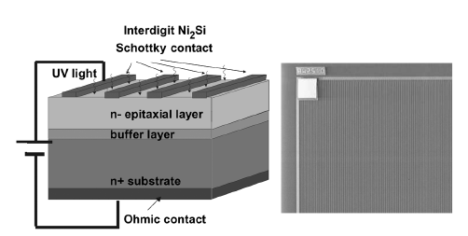
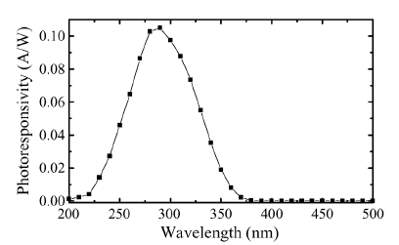
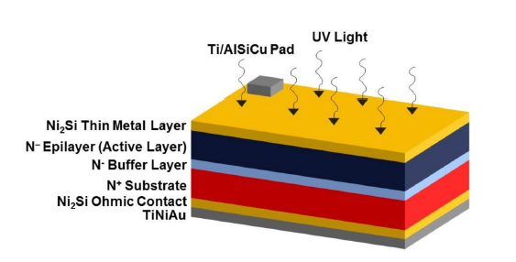
WP3 deliverable 3.1
  Design and flow chart preparation for the fabrication of SiC sensors (task 3.1)-M6 (April 2024)
Involved people:
Antonella Sciuto, Domenico Longo, Alessia Tricomi, Nello Abergo, Lucia Calcagno

Slide 11
WP3 deliverable 3.1
first focus is on large-area devices:
=>high-quality substrates with a low concentration of intrinsic defects
=>processing flow designed to minimize the processing defects
=> sacrificial oxidation
=> Polymeric film deposition on the front side during the back metal deposition process
second focus is to obtain a higher optical response at low wavelengths (deep UV)
=>Integration of an additional layer, e.g. a nanostructured layer, which can enable the Deep UV response to be increased, such as a layer of graphene

Slide 12
Some key points for CNR activities both in the WP2 and WP3:
-list of typical/residual contaminant in the water to be removed by nanostructured filters and to be monitored by sensing systems
(as today shared by Lofti and by Fabio for starting waste water ….) to prepare artificial waste water in lab will be shared from WP1 and WP2 partners for effluent waste water
-water samples to test nanostructured filters on real samples at month 12 and later

Slide 13
Some other questions
Q:Do we have a template for the report delivery?
Answer: Alessia/Livio will share the template in few days
Q:Task activity report will be prepared by the task leader? Or contributions will be collected by the WP leader?
Answer:the Task Leader is responsible for the report delivery
Q:Concerning the Palermo Conference: will be published papers/proceeding or only extended abstract?
Answer: at this moment only abstract but a Special issue will be maybe published

