Slide 1
Using LaBr₃ crystals for measurements of (n,inel) and (n,xn) reactions
Motivations
n_TOF ideal facility for measurements of inelastic and (n,xn) reactions up to high energy.
Main applications: fission reactors, nuclear medicine, fusion reactors. Also important for refining theoretical models.
Technique
Measurements of (n,inel) and (n,xn) reactions typically performed by counting specific γ-rays emitted in the deexcitation of the residue.
Need high efficiency and high resolution detectors -> ideally HPGe
Efforts have been going on at n_TOF since the beginning (2001) to operate HPGe in the EAR1.
However, the presence of the γ-flash and the slow response of HPGe detectors, has hampered the use of these detectors so far, above a few hundred keV.
A fast switch circuit on the detector preamplifier has improved the situation, but the maximum neutron energy is still around a few MeV (too low considering the n_TOF potentialities).
Idea
LaBr₃ crystal have high efficiency, reasonable resolution, and especially have fast signals.
They could allow to go much higher in energy then HPGe.

Slide 2
Some history
To investigate the use of LaBr₃ crystals for measurements of inelastic and (n,xn) reactions, different tests have been performed and a LoI for validation measurement has been approved (INTC-I-261).
First test in 2022: 1x1” crystal with PMT, both in EAR 1 and beam dump
Results
detectors recover fast from γ-flash, but ringing in EAR1 prevented from getting a clear indication of the maximum energy that can be reached
very clean signal in beam dump, indication that hundreds of MeV neutron energy can be reached
resolution of 3% as expected
After investigation in the ENTE (Electronic Noise Testing Environment), setup by Nino Amato, it was concluded that the ringing was due to bad shielding of the Voltage Divider and connectors.
Fixed by wrapping the PMT+VD+connectors in an aluminum foil.
Final tests in 2023 (end of the year campaign, in October) one small (1x1”) and two larger crystals 1.5x1.5” and 1.5x2” with PMT, EAR1 only (capture position). No other detectors tested.
Ringing was much suppressed !!
However: preliminary results presented by Matt in Valencia quite discouraging, showed two peaks and various structures.

Slide 3
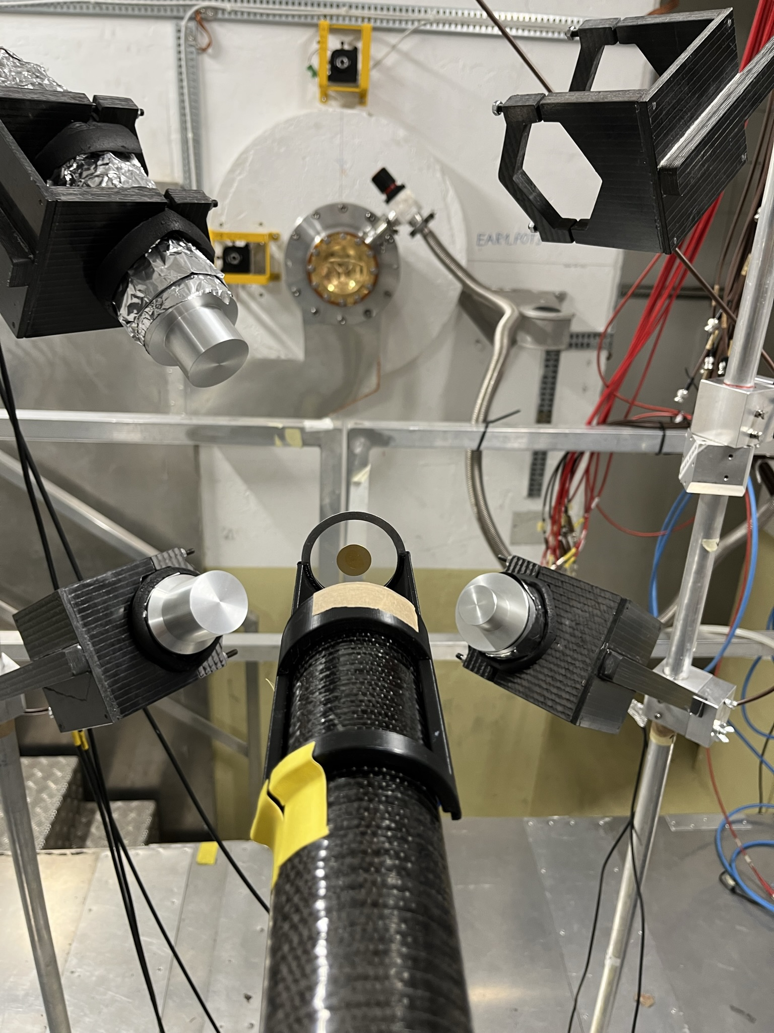
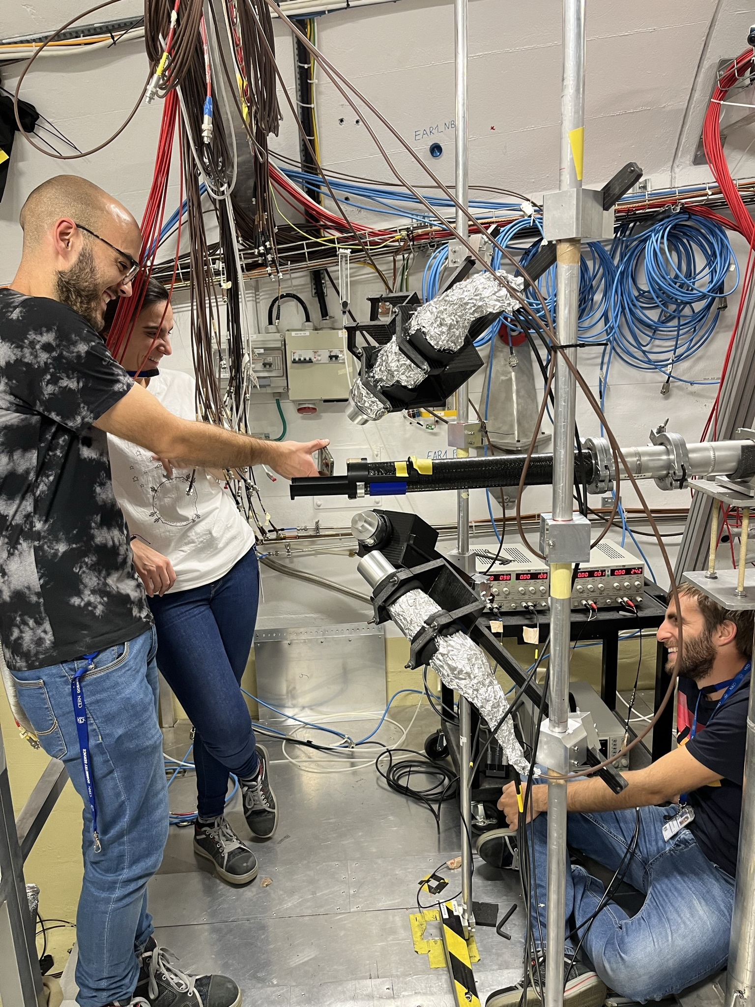
2023 test of LaBr₃ crystals with Fe sample
Different geometries investigated:
3 angular positions (wrt beam): 135, 90, 45 degree
3 distances from the target: 11, 15 and 20 cm
Three LaBr3 detectors looking at an Fe sample.
Capture position and supports.
Samples: Fe, Li, Au and empty
Data collected over 2 days, mostly 20 minutes for each geometrical/sample configuration.

Slide 4
Matt presentation in Valencia
The ringing problem has essentially disappeared !!
However, strange results in the amplitude spectrum. Caused a bit of panic in the audience (especially Cristina).
After discussing over Christmas vacation with Giuseppe, we concluded that the problem was related to the PSA routine.
Problem in recompiling the routine was solved by asking a favour to Michi (should not happen again !!!).

Slide 5
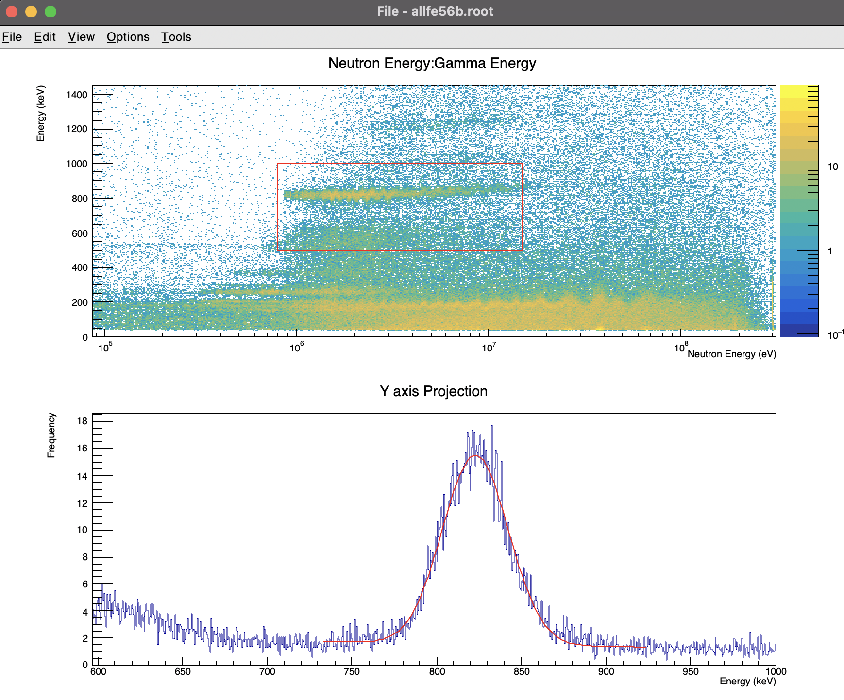
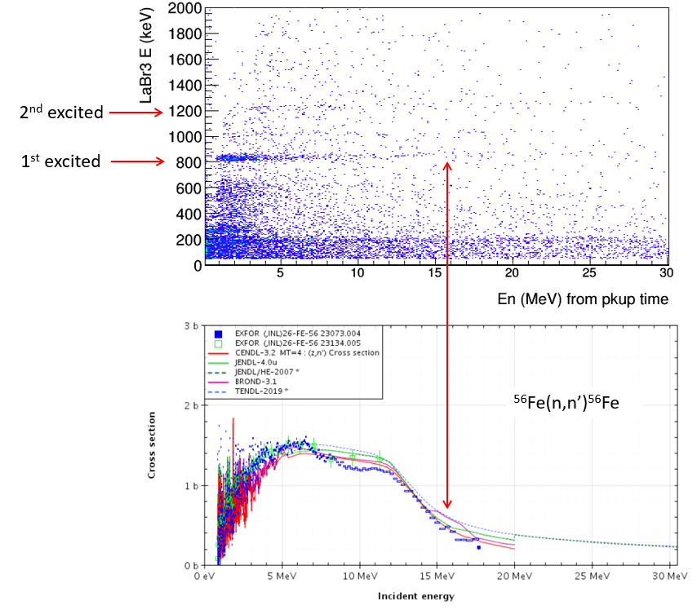
Matt report in February 2024 (still Fe sample)
After solving the PSA problem, Matt made a very detailed analysis and sent a report last February.
Spectrum quite clean and lines where expected (including lines from Br(n,n’) at low energy).
However, a “gain shift” was observed (of the order of a few %). Panic again !!
This time, contrary to my guess, it was not a problem in the PSA routine. The gain shift is REAL.
After lengthy discussion, it was concluded that the problem is at low energy, not at high energy !!
Essentially related to the reaction count-rate, highest around a few MeV because of the flux and cross section.

Slide 6
The validation measurement: 24Mg(n,n’)
Letter of Intent: measure known inelastic cross section at n_TOF: 24Mg(n,n’)
Measurement splitted in two parts:
First one made beginning of May with:
2 INFN LaBr3
2 UoM LaBr3
1 IFIN LaBr3
Dimensions between 1.5” and 2” (diameter and thickness)
All LaBr3 with PMTs, but the IFIN one gated.
Before the measurements, shielding of INFN LaBr3 and one of Manchester improved at LNS (see talk from Paolo F.)

Slide 7
The 24Mg(n,n’) measurement: preliminary results (by Cristina Petrone)
MCNP Simulations
(G. Lorusso)
GEANT4 Simulations
(C. Petrone, in LoI)

Slide 8
The 24Mg(n,n’) measurement: preliminary results (by Cristina Petrone)

Slide 9
The 24Mg(n,n’) measurement: preliminary results (by Cristina Petrone)
Preliminary conclusion:
Clearly visible the 1.3 MeV line
No sign of the 2… and 2.9 MeV line
No sign of the 4 MeV line
Low statistics? Low resolution? Wrong intensities?

