Slide 1

News from CERN
alberto.mengoni@cern.ch

Slide 2
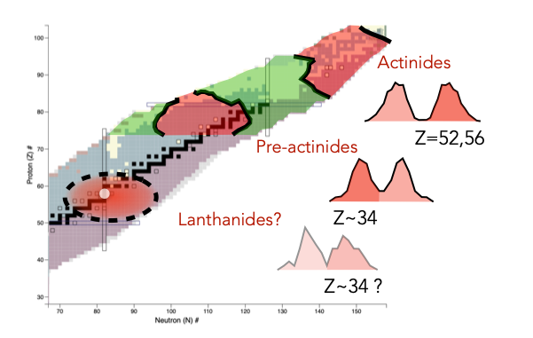
EAR-1
Measurement of fragment distributions of
neutron-induced fission of Cerium with PPACs in EAR1
Search for new fission modes in light systems around Z=60 : The cerium case
CERN-INTC-2023-038; INTC-P-665
Spokespersons : Manuel Caamaño, Diego Tarrío

Slide 3
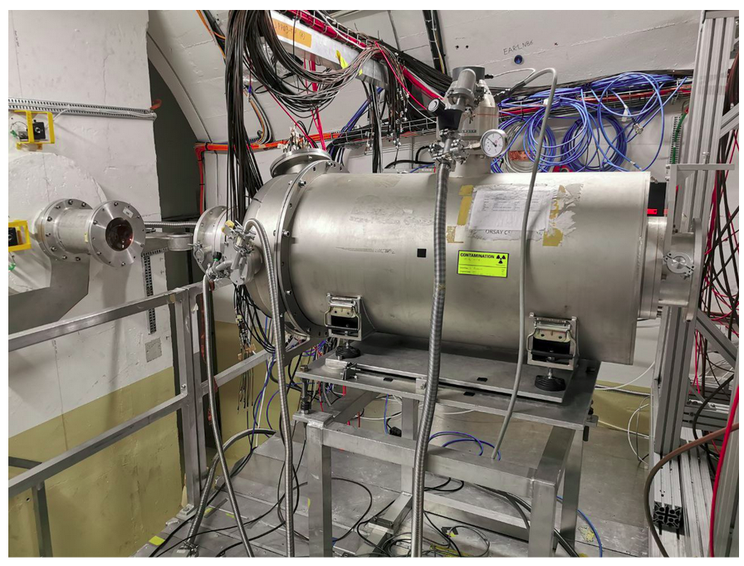
EAR-1
Measurement of fragment distributions of
neutron-induced fission of Cerium with PPACs in EAR1
Search for new fission modes in light systems around Z=60 : The cerium case
CERN-INTC-2023-038; INTC-P-665
Spokespersons : Manuel Caamaño, Diego Tarrío
Key persons:
Laurent Audouin, Alice Manna
(Laurent Tassan-Got)

Slide 4
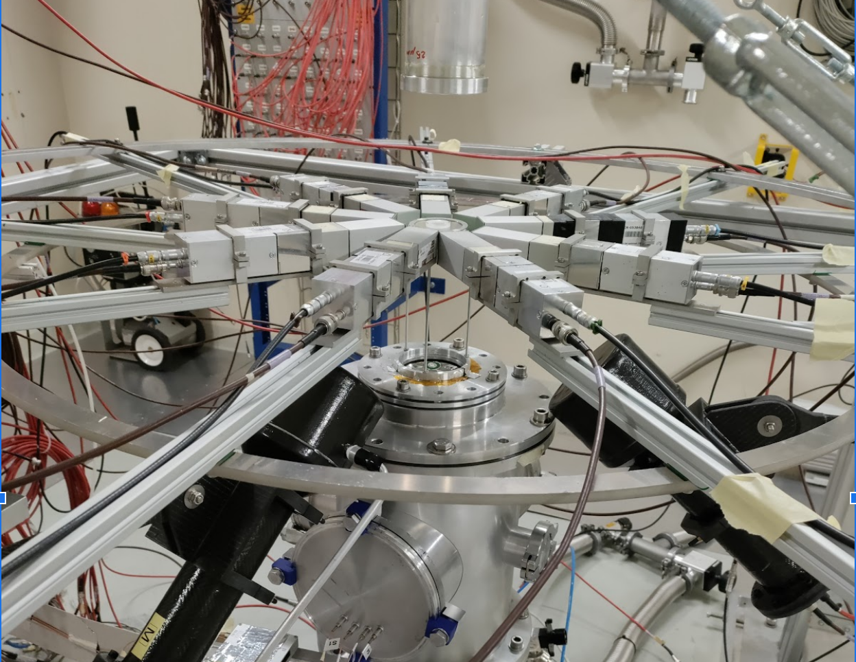
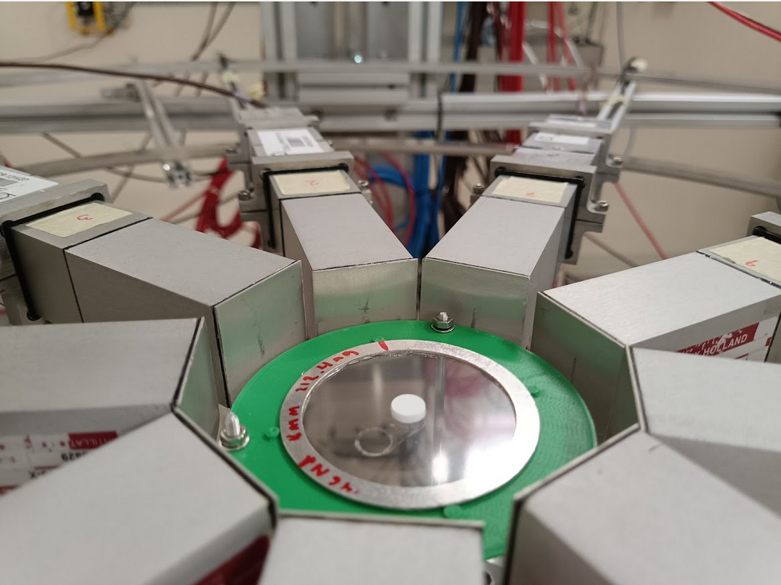
EAR-2
¹⁴⁶Nd(n,𝛾)
97.4% enriched Nd-146 sample
8 mm diameter, 212.4 mg
pressed Nd₂O₃ powder pellet on empty (Al ring + mylar)
Key persons:
Jorge Lerendegui, IFIC-Valencia
Bernardo Gameiro, IFIC-Valencia
Notes:
Inizio con le misure della posizione del fasci (talk di Gerardo)

Slide 5
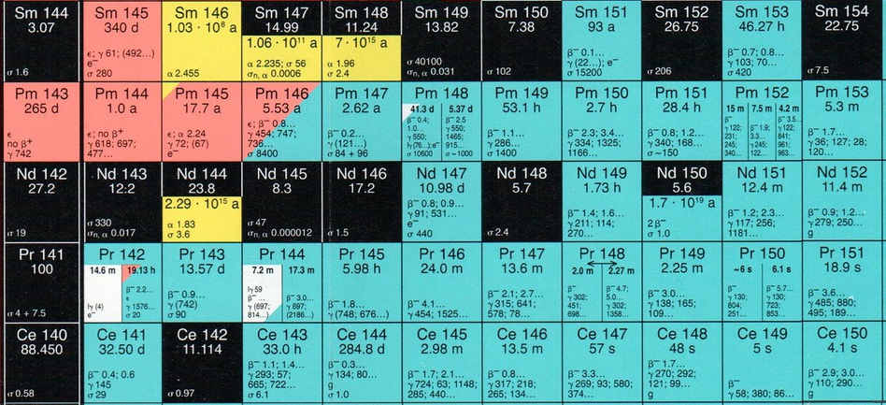
EAR-2
¹⁴⁶Nd(n,𝛾)
Measurement of the Cross Section at n_TOF and Its Astrophysical Implications for the Chemical Evolution of the Universe
Amaducci, S., Colonna, N., Cosentino, L., Cristallo, S., Finocchiaro, P., Krticcka, M., Massimi, C., Mastromarco, M., Mazzone, A., Maugeri, E. A. et al. (The n_TOF Collaboration)
Physical Review Letters 132, 8 (2024) Open Access Editors' Suggestion
DOI: 10.1103/PhysRevLett.132.122701
Neutron Capture Cross Section Measurement of Sm-151 at the CERN Neutron Time of Flight Facility (n_TOF)
U. Abbondanno, G. Aerts, F. Alvarez-Velarde, H. Alvarez-Pol, S. Andriamonje, J. Andrzejewski, G. Badurek, P. Baumann, F. Bečvář, J. Benlliure et al. (The n_TOF Collaboration)
Physical Review Letters 93, 161103 (2004)
DOI: 10.1103/PhysRevLett.93.161103
Time-of-flight and activation experiments on Pm-147 and Tm-171 for astrophysics
C. Guerrero, J. Lerendegui-Marco, C. Domingo-Pardo, A. Casanovas, R. Dressler, S. Halfon, S. Heinitz, N. Kivel, U. Köster, M. Paul et al. (The n_TOF Collaboration)
EPJ Web of Conferences 146, 01007 (2017) Open Access
DOI: 10.1051/epjconf/201714601007
Notes:
Inizio con le misure della posizione del fasci (talk di Gerardo)

Slide 6
2024 run
Start : 18 March 2024
End : 25 November 2024

Slide 7
2024 run
Start : 18 March 2024
End : 25 November 2024

Slide 8
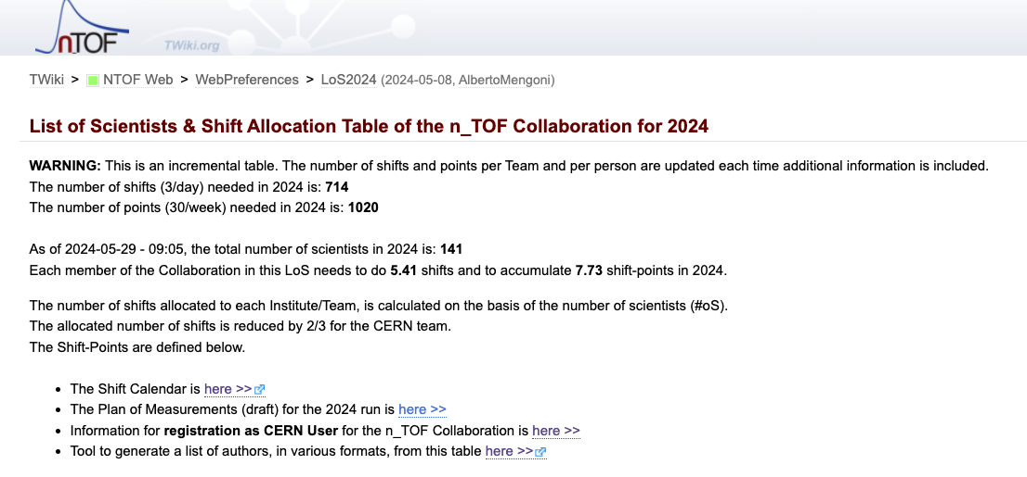
2024 run
Start : 18 March 2024
End : 25 November 2024
https://twiki.cern.ch/twiki/bin/view/NTOF/LoS2024

Slide 9
2025 run
Beam start : 24 March 2025
Physics start : 31 March 2025
End : 17 November 2025
231 days, 33 weeks (35 weeks in 2024)

Slide 10
The n_TOF Futura Working Group activities
Activities at BDF (activation/irradiation activities, clones of NEAR station)
Claudia, Cristian, Alberto, …
New Target (functional specs & options on technology to be adopted)
Michi, Daniel, …
New detection systems development
Nikolas, Jorge, Gigi, Nicola, Pierfrancesco, Catalin, Toby, Giuseppe L, Rosa, …
General physics program for post-LS3 and post-LS4 (highlighted experiments)
Paolo M, Cristian, Cesar, …
LS3
LS4
2024
2025
2026
2027
2028
2029
2030
2031
2032
2033
2034
2035
2036
2037
Notes:
Claudia, Cristian, Emilio

Slide 11
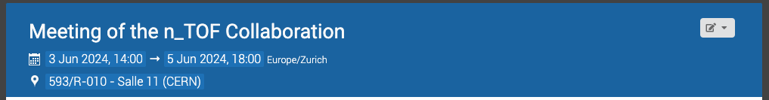
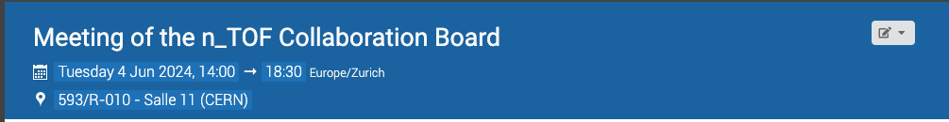
News from CERN
https://indico.cern.ch/event/1403789/
https://indico.cern.ch/event/1419736/

Slide 12
News from CERN
Questions?

Slide 13
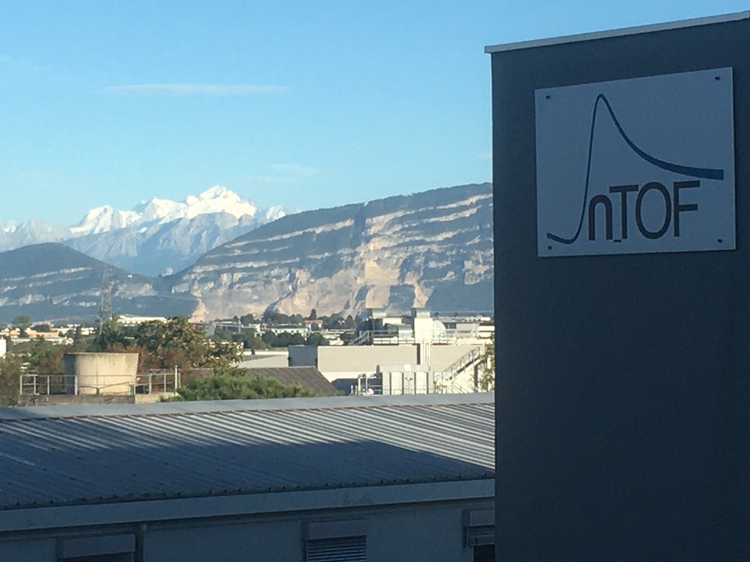
The End

Slide 14
News from CERN

Slide 15
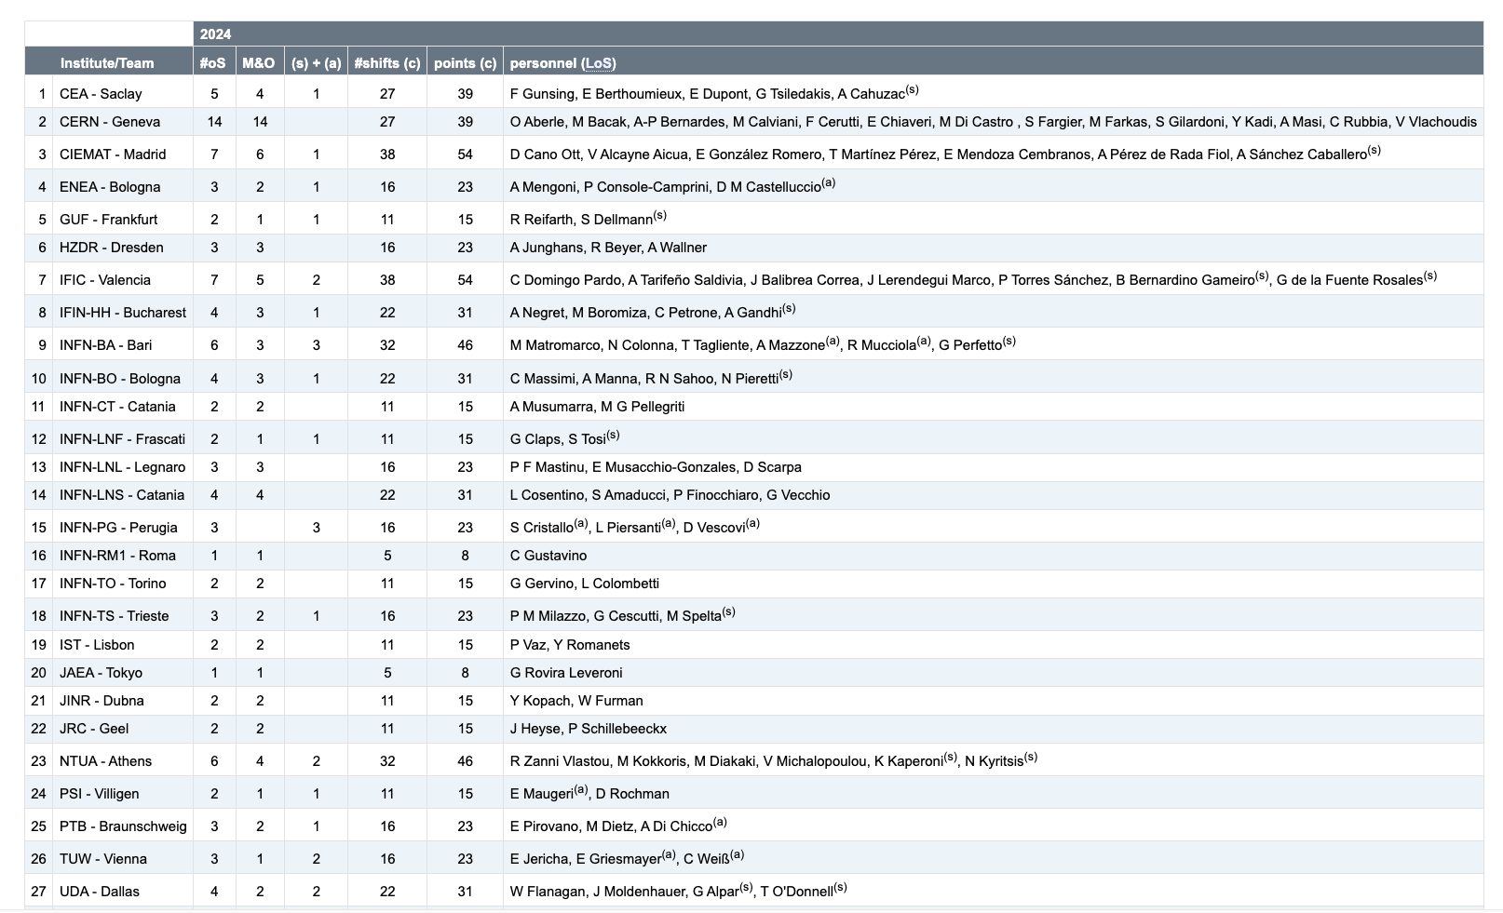
News from CERN

Slide 16
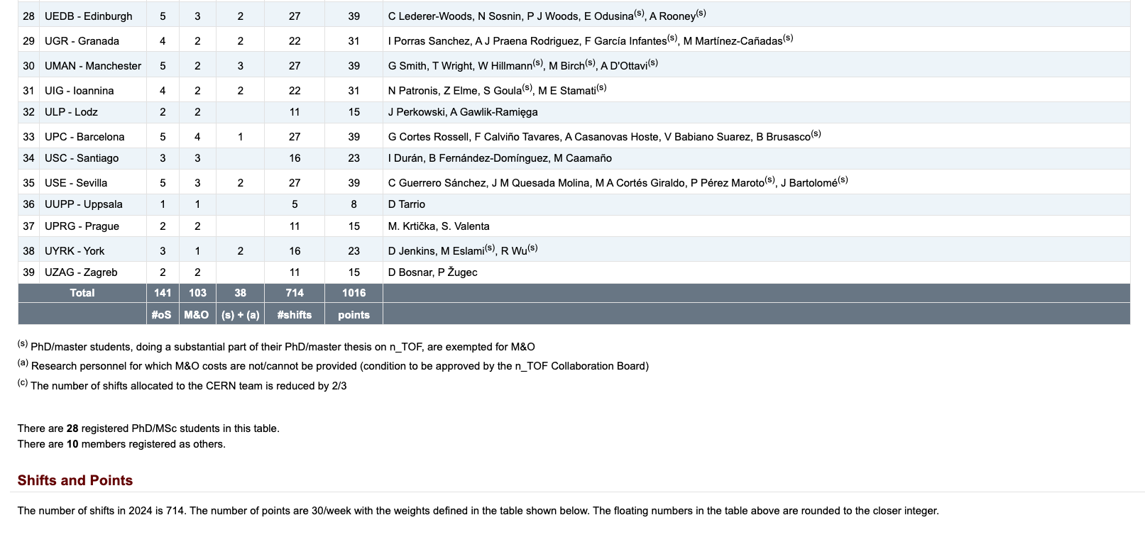
News from CERN

